Slide 1
NCEP-EMC Global Model Verification and Diagnostic Tools
Fanglin Yang
Environmental Modeling Center
National Centers for Environmental Prediction
NEMS FV3GFS Community Modeling System Training and Tutorial: Planning and Preparation Meeting,
19-20 July, 2017, GFDL
1

Slide 2
VSDB-Based NCEP-EMC Global NWP Model Verification Package
The main purpose of this package is 1) to serve as a standard evaluation tool for GFS upgrade and implementation and, 2) to aid model developers in diagnosing forecast errors and in assessing model forecast skills.
It is designed to be portable for different computer platforms, to be easy to set up for evaluating various experiments with minimum input from users, and to have a web interface for quick review of results.
This package is now used by all GFS developers at NCEP. It is also used by other model developers at, for instance, ESRL, NESDIS, KIAPS, CMA, Taiwan CWB, and Indian Meteorological Department etc.
SVN Repository: https://svnemc.ncep.noaa.gov/projects/verif/global/vsdb/
ftp: ftp://ftp.emc.ncep.noaa.gov/gc_wmb/wx24fy/VRFY/ (Version21)

Slide 3
Major Components
It performs the following verifications for NWP forecasts:
AC, RMSE, BIAS etc: model forecast statistics are first computed and saved in VSDB format; verification maps are then made to compare stats among different experiments and/or with operational forecast (up to 10 experiments)
QPF: precipitation threat skill scores over CONUS are first computed , then ETS score maps are made with Monte Carlo significance tests included.
grid-to-Obs: verifying forecasts against surface station observations (e.g. T2m and 10-m wind) and upper-air RAOBS
2D MAPS: make maps of lat-lon distributions and zonal mean vertical cross-sections of forecast s, analyses and certain observations, such as U,V,T,Q,RH,O3, T2m, Precip, etc.
Hurricane track and intensity
Analysis Increments; Ensemble Spreads
Scorecard -- A summary of major verification metrics
The package can be run on-the-fly as a part of the forecast system, and run offline after forecasts complete as well.

Slide 4
grid2grid
vsdbjob_submit.sh
- main driver script for generating forecast performance statistics in VSDB format and makes a variety of graphics to compare AC and RMSE among different experiments
setup_envs_gfs.sh
- script that sets up common directories, utilities, and environmental variables across different platforms, and assigns user specific parameters
MAKEVSDBDATA
verify_exp_step1.sh
- this script computes partial sums and saves the data in a vsdb format. There are two verification types used, anom, which derives anomalies for all models and cycles using the CDAS 30-year climo, and pres, in which forecasts are directly verified against an analysis
mean_anl.exe
- fortran executable for deriving mean analysis from multiple models
cntl_${group}.sh
- (anom, pres, or sfc) generates control files for the 3 types of verification done
prepg2g_exp.sh
- this scripts prepares the data and pulls all of the necessary GRIB variables needed based on two different cases, either one model cycle forecast verified at different times or one verification time used against multiple model cycles
getclimateTime.sh
- simple script that handles the grid2grid control file, but only when running anomaly correlation
run_g2g_wave.sh
grid2grid.x
- this script runs the grid2grid fortran executable and renames/moves the output to it’s proper format/location
MAKEMAPS
verify_exp_step2.sh
- this script computes stats using VSDB database files from multiple cycles and then creates maps using GrADS. This is done by moving various VSDB files to a central location, splitting up the regions for computational efficiency, and then running the three scripts below for AC, RMS, and SFC verification
allcenter_1cyc.sh
gen_wind.sh
gen_scal.sh
- computes stats from anomalies relative to CDAS 30-year mean and makes AC plots that compares scores from different centers
allcenters_rmsmap.sh
gen_wind_pres.sh
gen_scal_pres.sh
- makes plots that compare rmse, bias, pattern correlation, rmse due to mean difference/pattern variation, ratio of standard deviation
sfcfcst_1cyc.sh
gen_sfc.sh
- makes surface plots that compare forecasts and analyses from all centers for the same forecast cycle
MAPS2D
maps2d.sh
- this script makes lat-lon maps and zonal-mean vertical distribution. The script uses grib files for input and they must be on a non-rotated lat-lon grid and isobaric vertical levels
makectl.sh
- script that creates the GrADS control file, including domain dimensions, variable names, and vertical levels
ftp2dmap.sh
- script that sends plots to the dedicated web server

Slide 5
grid2obs
grid2obs_driver.sh
- main driver script from submitting grid2obs jobs to create stas, graphics, and push to the web servers. Uses isobaric lat-lon grib files as model input and aims to compare forecasts against ground and upper air obs (prepbufr data)
grid2obs.sh
- this script creates the verification statistics in vsdb format for both surface and upper air obs. It is aimed to compare the diurnal cycles of area-mean forecasts and ground obs, along with area-mean vertical distributions of bias and RMSE of upper air ADPUPA and AIRCAR obs
get_paragfs_data.sh
gethpss.sh
- script that retrieves experimental (retro?) GFS forecasts and GDAS prepbufr data online or from HPSS archive. If the data doesn’t exist, it grabs the operational GDAS prepbufr
grid2obssfc.fits.sh
get_ndasprepbufr.sh
verf_gridtobs_editbufr
verf_gridtobs_prepfits
grid2obssfc.ctl.sh
verf_gridtobs_gridtobs
- script that retrieves NAM/NDAS prepbufr files and processes fits for surface variables over subregions of the NAM area for all forecast cycles and all verifying hours
grid2obsair.fits.sh
verf_gridtobs_editbufr
verf_gridtobs_prepfits
grid2obssfc.ctl.sh
verf_gridtobs_gridtobs
- script that processes fits for upper air variables using GDAS over subregions of the globe for all forecast cycles and verifying hours
grid2obs_plot.sh
- this script handles the creation of graphics using the grid2obs verification vsdb statistics files generated in the scripts above
g2o_sfcmap.sh
g2o_sfcmap_wind.sh
g2o_sfcmap_scal.sh
- this script generates graphics for the grid2obs surface verification statistics. It compares the diurnal cycle of forecasts and ground obs of T2m, RH2m, and 10m wind speed over CONUS and it’s subregions
g20_airmap.sh
g2o_airmap_wind.sh
g2o_airmap_scal.sh
- this script generates graphics for the grid2obs upper air verification statistics. It compares the vertical distribution of RMSE and bias between forecasts and vertical obs of winds, temperature, RH, and Q over the globe and it’s subregions

Slide 6
Routine GFS Performance Monitoring
Main Verification Web Page http://www.emc.ncep.noaa.gov/gmb/STATS_vsdb/,
including 1) verification statistics of AC, RMSE, Bias etc for major international NWP models and GFS implementation parallels in the past 31 days, 2) real-time weather forecast maps of GFS, ECMWF and GFS implementation parallels, 3) links to other verifications.
Grid-to-Obs Verification http://www.emc.ncep.noaa.gov/gmb/STATS_vsdb/g2o/ and http://www.emc.ncep.noaa.gov/gmb/ssaha/
Including 1) verifications of surface 2-m T, RH, Td, 10-m winds, SLP and total clouds against ground observations over the CONUS and its sub-regions and, 2) verifications of atmospheric T, Q, RH and Winds against rawinsonde and aircraft observations over the globe and its sub-regions.
Precipitation Verification http://www.emc.ncep.noaa.gov/gmb/STATS_vsdb/www/rain2/rain.html
Including precipitation forecast maps verified against CCPA over the CONUS and CPC gauge observations over the globe, and precipitation Equitable Threat Scores for major international models
Objected-Oriented (MODE) Verification http://www.emc.ncep.noaa.gov/gc_wmb/tdorian/
Including MODE verifications of precipitation over CONUS and jet streams over the globe.
Bufr-sunding http://www.emc.ncep.noaa.gov/gc_wmb/tdorian/meg/index.html
Historical Performance http://www.emc.ncep.noaa.gov/gmb/STATS_vsdb/longterm/
Including annual review of GFS forecast skills and historical performances of major international NWP models.
Data Assimilation Monitoring http://www.emc.ncep.noaa.gov/gmb/gdas/
Verification of parallels: http://www.emc.ncep.noaa.gov/gmb/emc.glopara/vsdb/gfs2017/

Slide 7
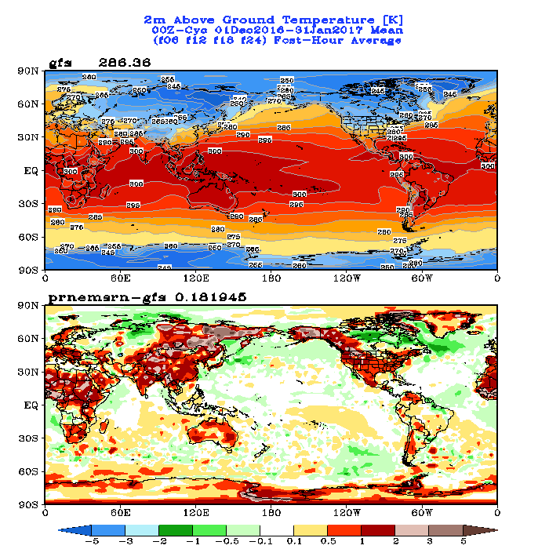
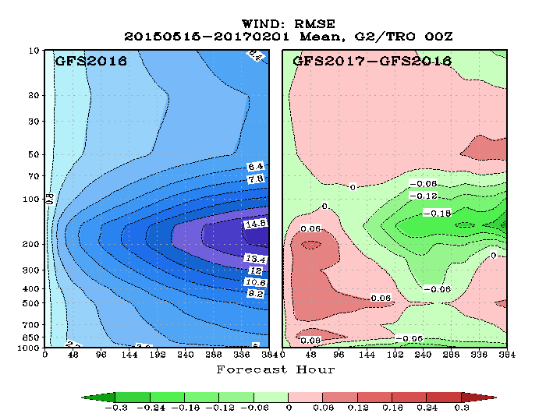
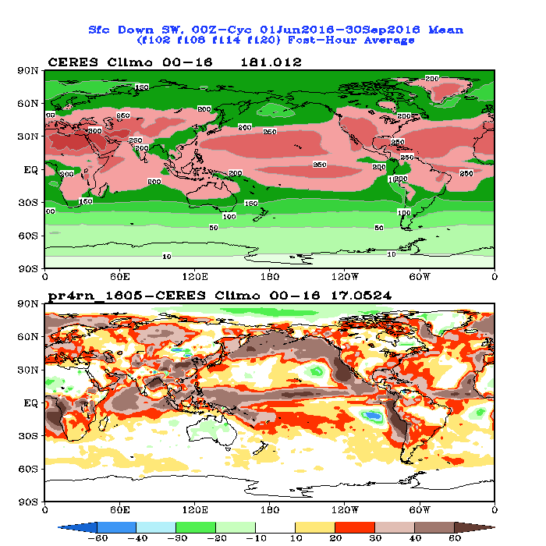
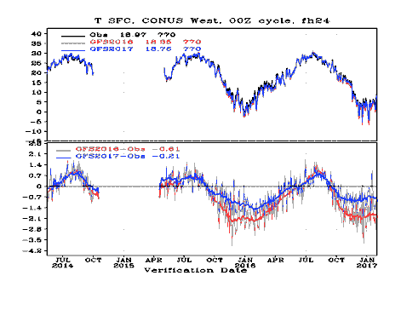
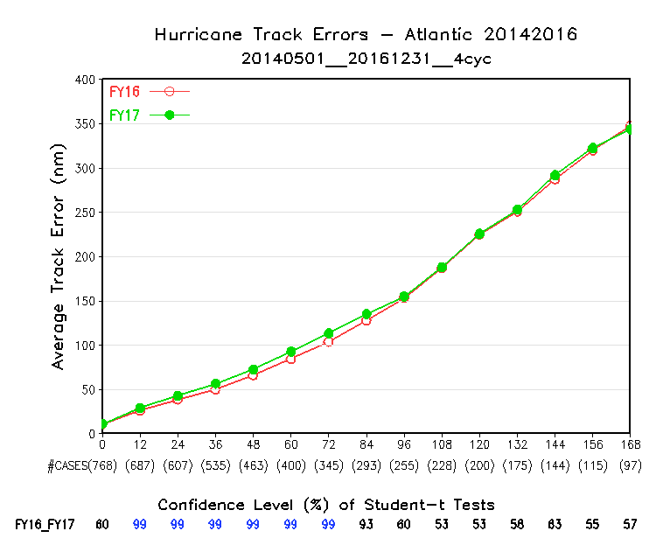
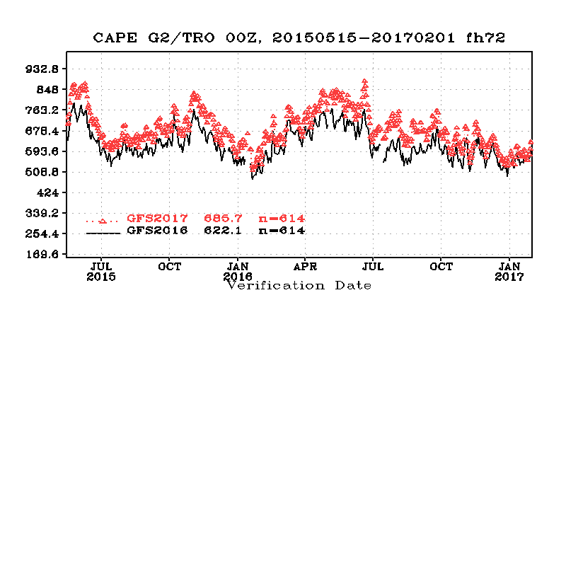
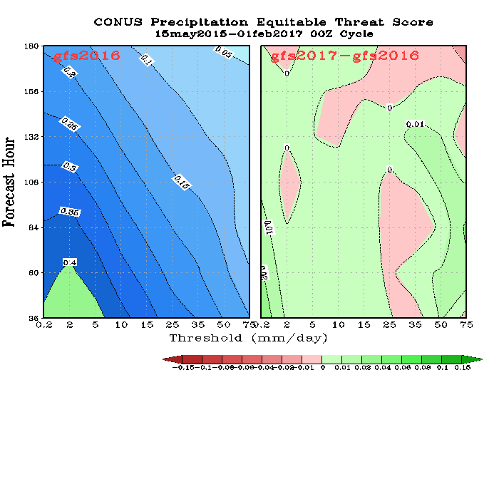
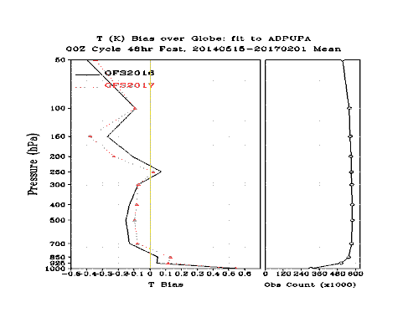
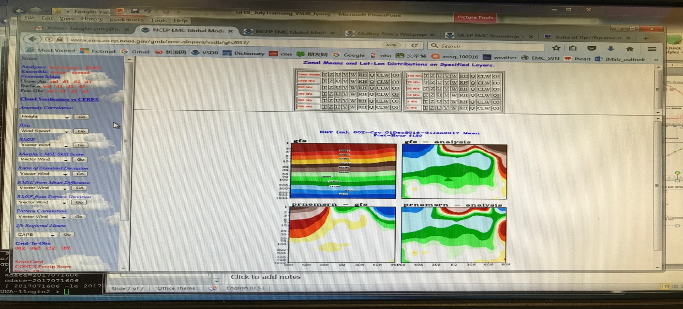
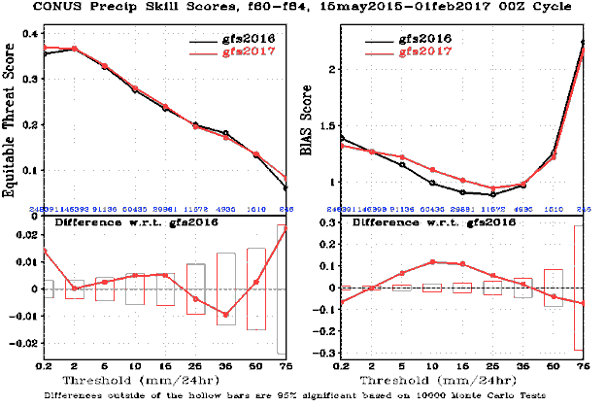
Sample plots:
SfcDwn SW -- CERES

Slide 8
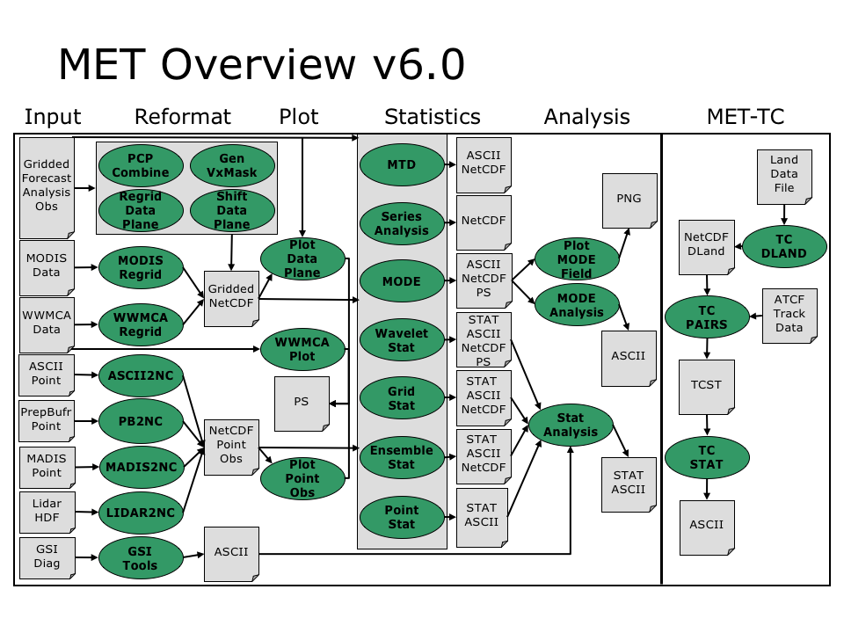
The Future
EMC is transitioning to use MET and MetViewer developed at NCAR DTC for future model diagnostic and verification

