Slide 1
Scientific Verification and Validation of NCEP GFS for Operational Implementation
Fanglin Yang
Environmental Modeling Center
National Centers for Environmental Prediction
NEMS FV3GFS Community Modeling System Training and Tutorial: Planning and Preparation Meeting,
19-20 July, 2017, GFDL
1

Slide 2
Individual Developer: R2O Transition Process and Evaluation
Developers run their own forecast-only sensitivity experiments to prove the science merit of the updates they proposed.
Developers runs cycled experiments with data assimilation to further test the impact on model forecast skills. To a minimum one winter and one summer season must be included in the evaluation.
The same verification package/method is used by all developers to verify their experiments. Results are compared to concurrent operational GFS forecasts, and verified against observations.
If, and only if, each update is proved to be beneficial can it be considered for operational transition.

Slide 3
EMC Official Parallel Experiments: R2O Transition Process and Evaluation
For most of the time only one GFS upgrade/implementation is allowed each year.
At least 6 months before the targeted implementation time, all proposed updates from individual developers are assembled together. Future testing, tuning and evaluation are performed by the implementation group, and a decision is made by managers and developers together to finalize the configuration of next GFS implementation.
Three years of retrospective experiments are then conducted for comprehensive evaluation of the parallel GFS.

Slide 4
G
GDAS/GFS Version 14.0.0
Q4FY17 NEMS GFS Implementation Quard Chart
G
Project Information & Highlights
G
Schedule
Leads: Vijay Tallapragada (EMC), Becky Cosgrove (NCO)
Scope: Transition GDAS/GFS to NEMS infrastructure on Cray, improve deep & shallow convection schemes, and address rapid temp drop & wet bias. GDAS upgrades include Near Surface Sea Temp (NSST) and additional data for GDAS and GLDAS.
Expected benefits: Prepare for unified modeling infrastructure, improve general forecast skill with emphasis on near surface fields
Dependencies: Satisfactory external evaluation
Milestones & Deliverables | Date | Status
Freeze system code; deliver to NCO if applicable | 10/28/16 | completed
Complete full retrospective/real time runs and evaluation | 1/31/17 | completed
EMC CCB Approved | 2/1/17 → 2/17 | completed
Final OD Science Briefing & deliver final codes to NCO | 2/21/17 | complete
Downstream code delivery | 2/21/17 | Scheduled
Issue Technical Information Notice | 2/15/17 → 2/23 | on track
Complete 24-hr parallel production test | 3/17/17 | on track
Complete 30-day evaluation and IT testing | 5/??/17 | on track
Operational Implementation | 7/19/17 | on track
G
Issues/Risks/Concerns
G
Resources
Staff: 4 Fed FTEs + 10 contractor FTEs; including Dev (Physics, DA, and Infrastructure)
Funding Source: STI/Base
Compute: parallels: 1200 nodes for 3 months (devmax/devonprod); 800 nodes for 9 months (devhigh); EMC Dev: ~1200 nodes for 12 months
Archive: 2PB
Risk 1: Upstream/Downstream dependencies of GFS in NEMS; Mitigation: Work with NCO to address upstream/downstream dependencies.
Risk 2: Complex T&E requirements due to Cray availability; Mitigation: Run the parallels on production machine
Management Attention Required | Potential Management Attention Needed | On Target
R
Y
G

Slide 5
GFS Upgrade Test Plan and Evaluation Strategy – Official Parallel Experiments
Example: Q4FY17 Real-Time and Retrospective Parallels:
Three Summers (2014-16) and Two winters (2015-2016) and Real-Time
GCWMB real time (prnemsrn) period: 2016101800 - real time
GCWMB 2015 summer retrospective (pr4rn_1505) period: 2015050100 - 2016010200 (246 days)
GCWMB 2015 winter retrospective (pr4rn_1512) period: 2015121500 - 2016051518 (151 days)
GCWMB 2016 summer retrospective (pr4rn_1605) period: 2016050100 - 2016103018 (184 days)
GCWMB 2014 summer retrospective part1 (pr4rn_1405) → Use ROCOTO Automation period: 2014050100 - 2014073118 (92 days)
GCWMB 2014 summer retrospective part2 (pr4rn_1408) → Use ROCOTO Automation period: 2014073100 - 2014110518 (98 days)
Evaluation Procedures:
Involve field in real-time and retrospective evaluation of science upgrades
Identify case studies and provide data for extended evaluation period beyond last 30-day parallel
NCO 30-day parallel is only for IT evaluation

Slide 6
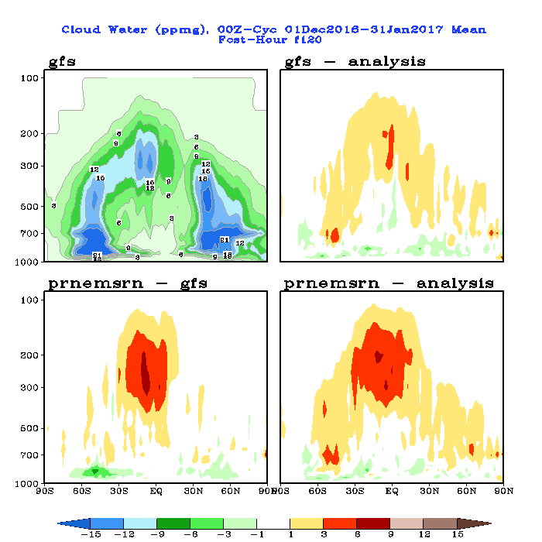
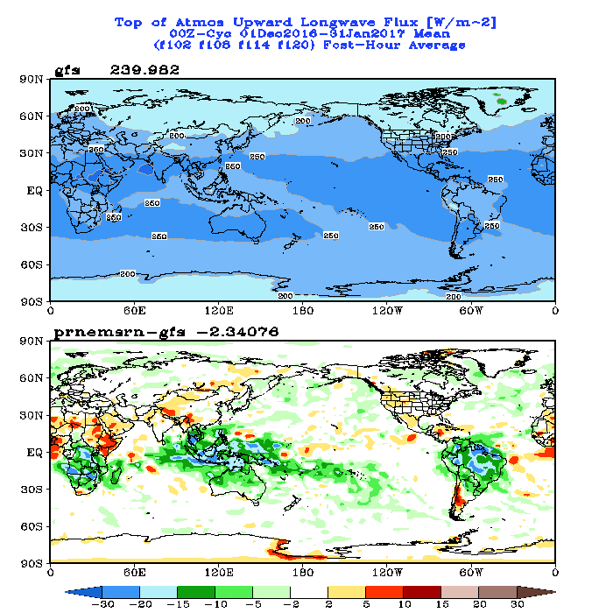
Metrics for evaluation http://www.emc.ncep.noaa.gov/gmb/emc.glopara/vsdb/gfs2017/
Make 2D and zonal-mean maps, compare parallel to operational GFS and analyses, check (almost) forecast variables and products generated by post-processing to make sure there is no surprises.

Slide 7
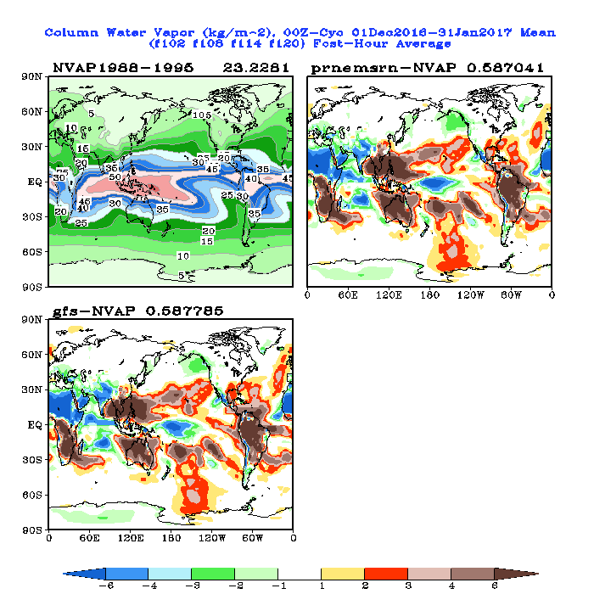
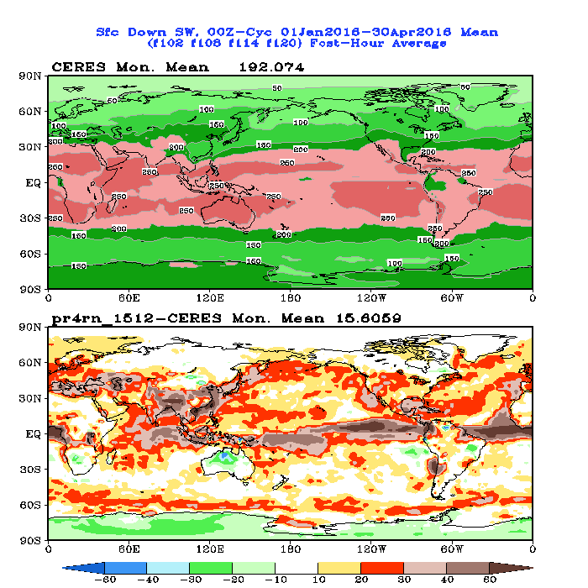
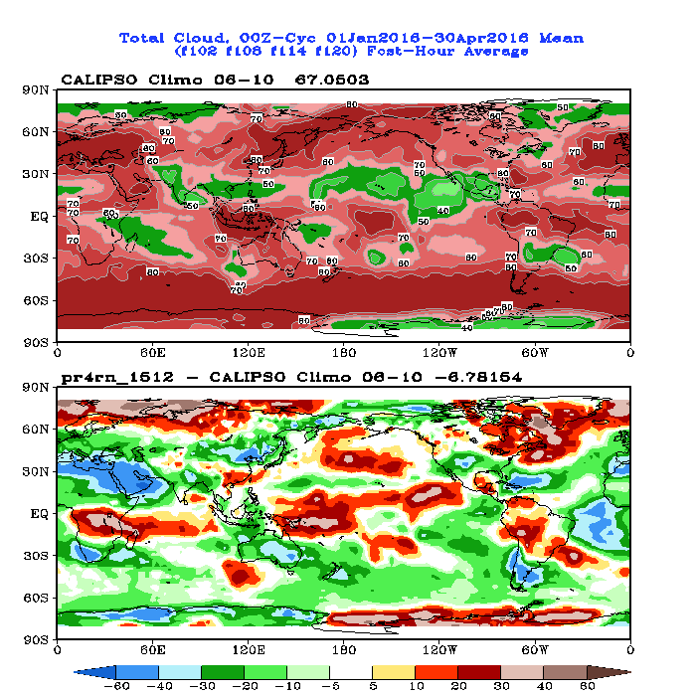
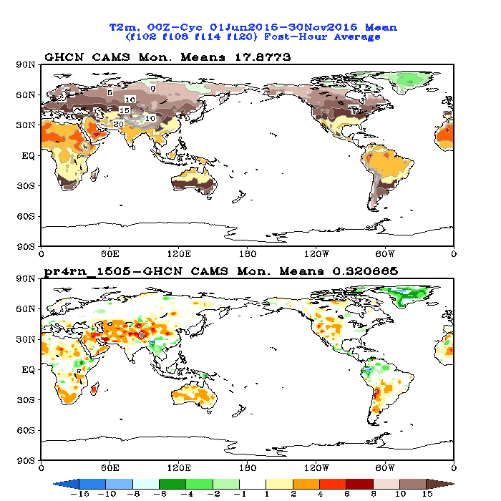
Metrics for evaluation
2. Make 2D maps to compare forecasts to “observations”
NAVP Climo
Real-time CERES SW
CALIPSO Cloud Climo
Real-time CAMS T2m

Slide 8
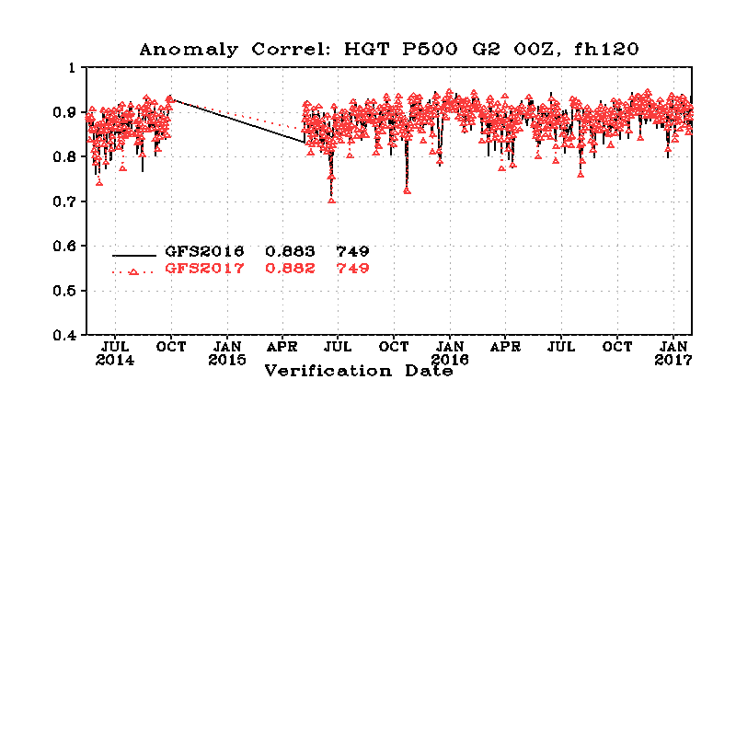
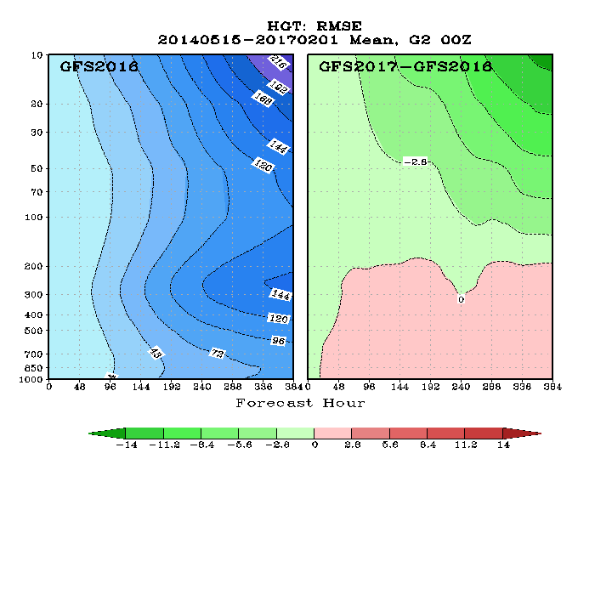
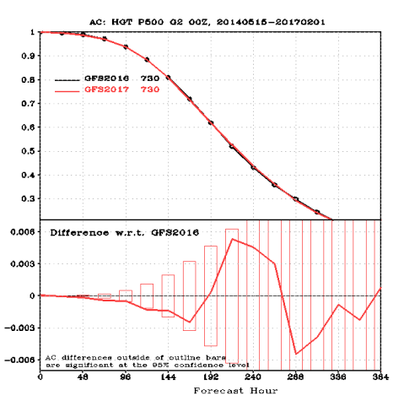
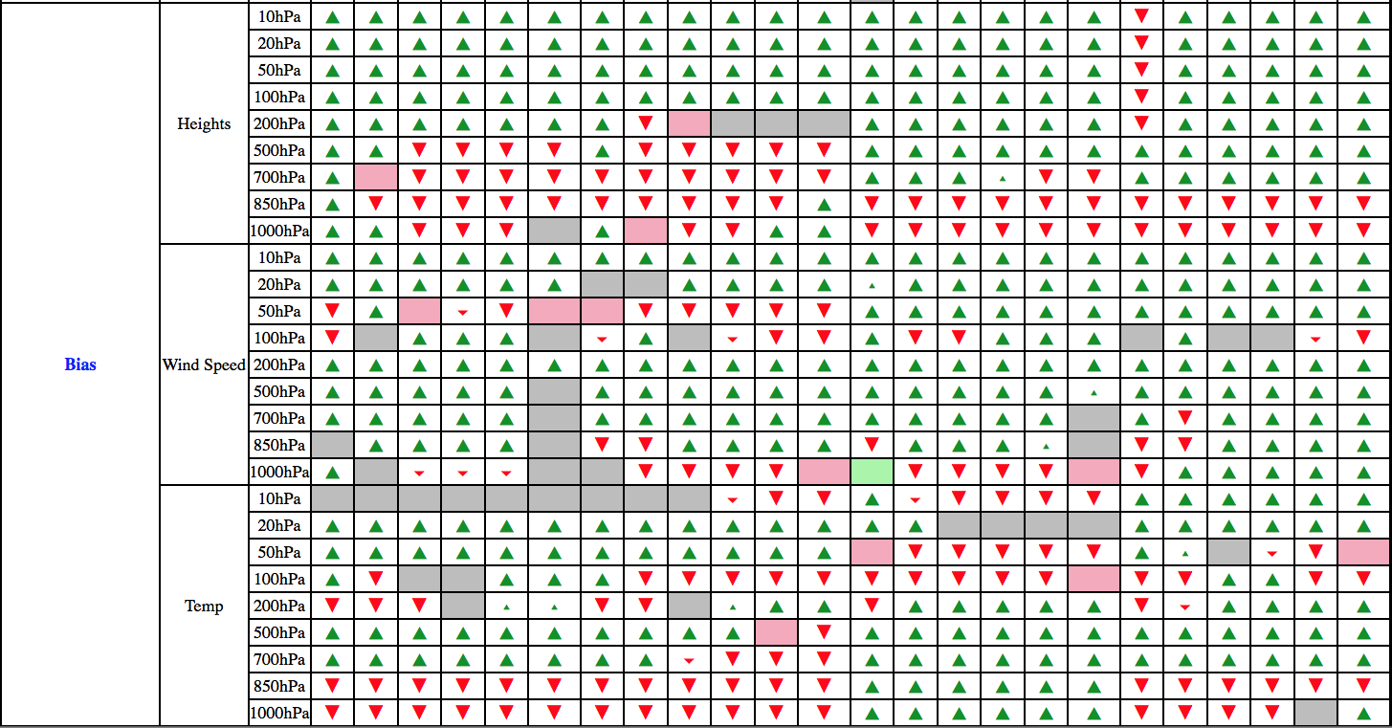
Metrics for evaluation
3. Forecast skill: verified against analysis: AC, RMSE, BIASE
SCORECARD

Slide 9
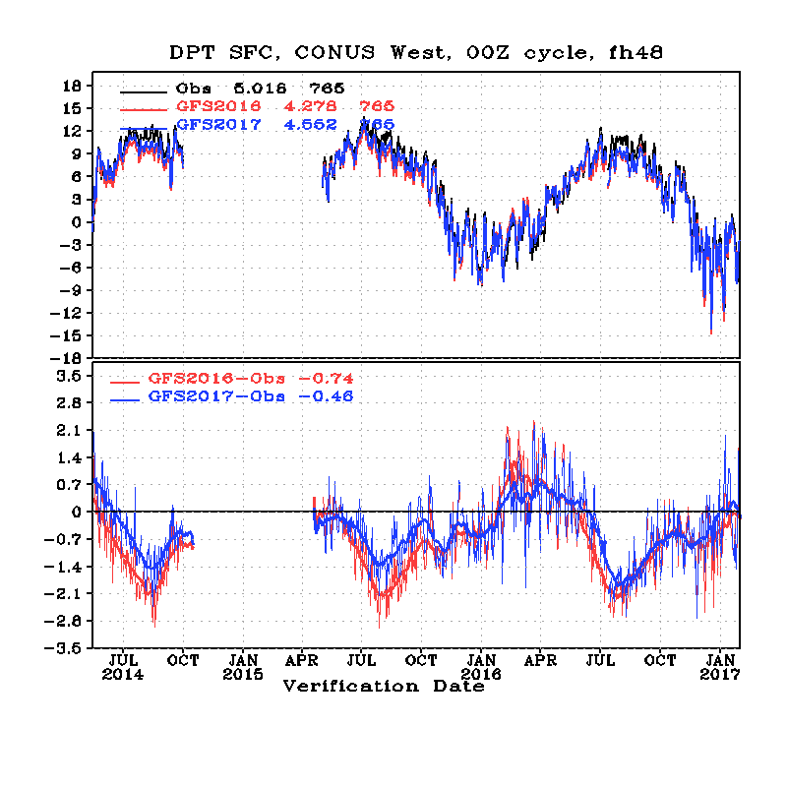
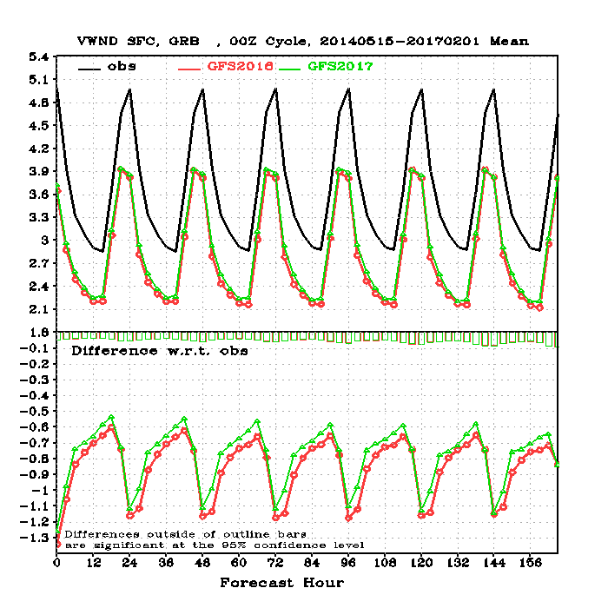
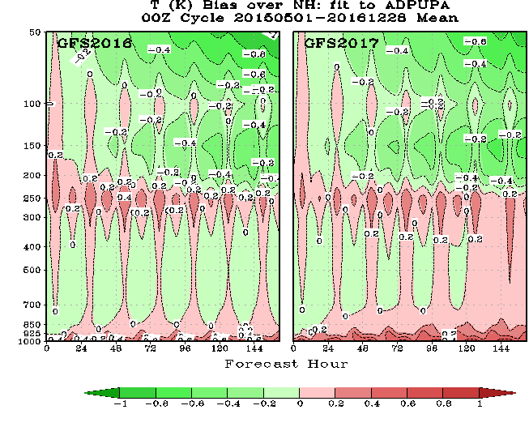
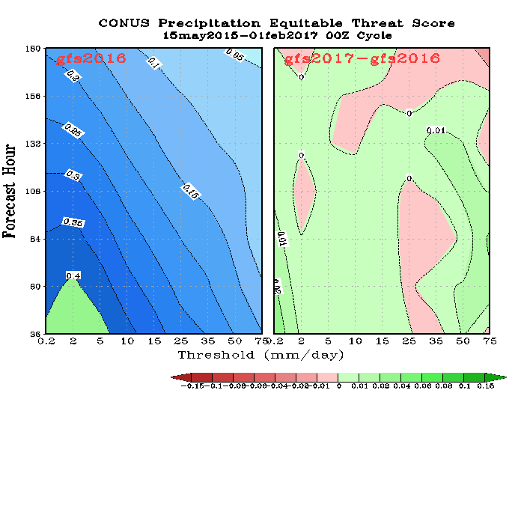
Metrics for evaluation
3. Forecast skill: verified against surface Obs and RAOBS – gridtoobs and fit2obs etc
Sfc Td
10m wind
RAOBS Temp
4. CONUS Precip ETS Scores

Slide 10
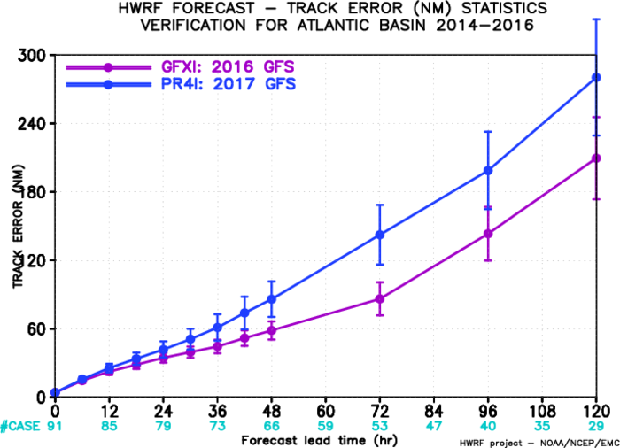
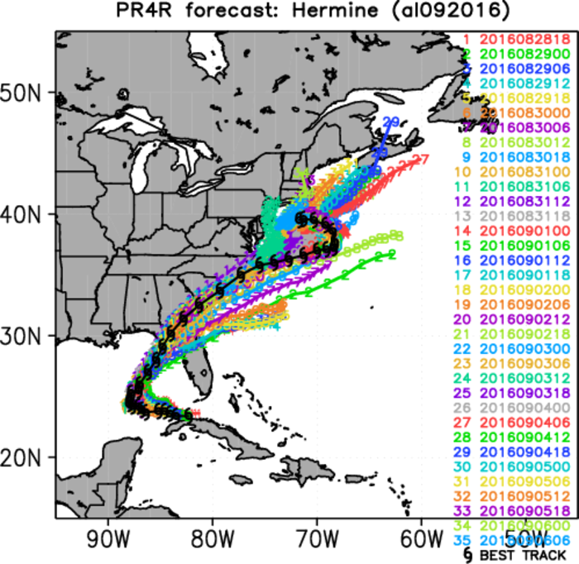
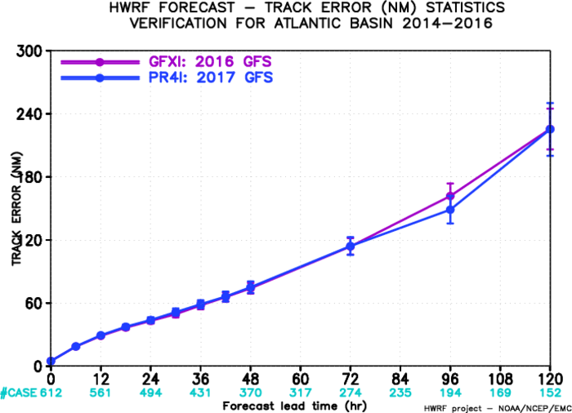
5. Hurricane Track and Intensity The three worst storms from 2016: Gaston, Hermine and Lisa
Track errors for
Gaston, Hermine and Lisa
Track errors for whole three years w/o
Gaston, Hermine and Lisa

Slide 11
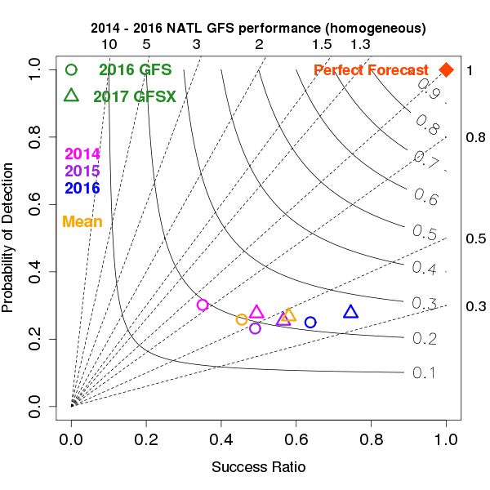
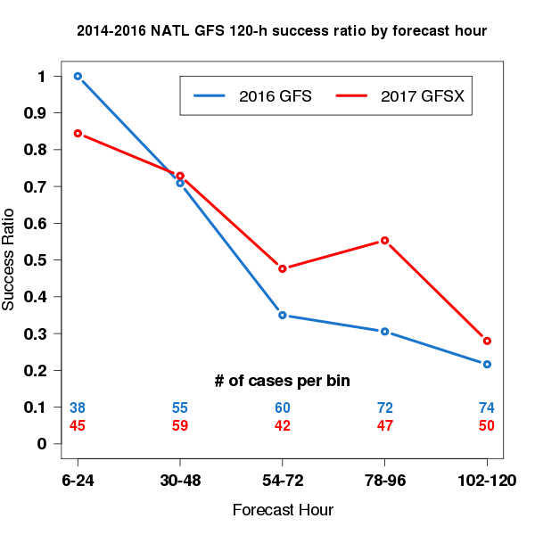
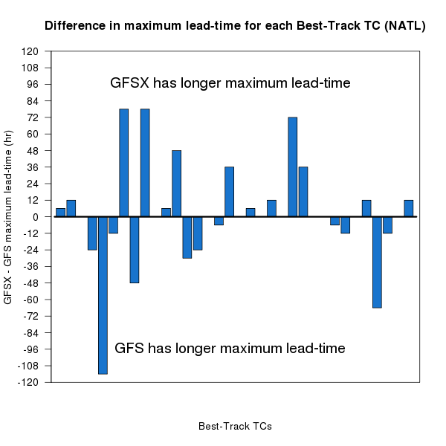
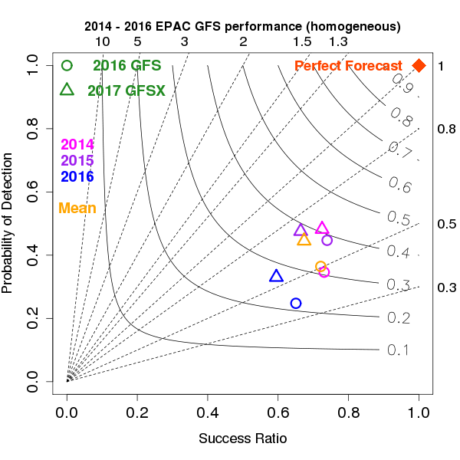
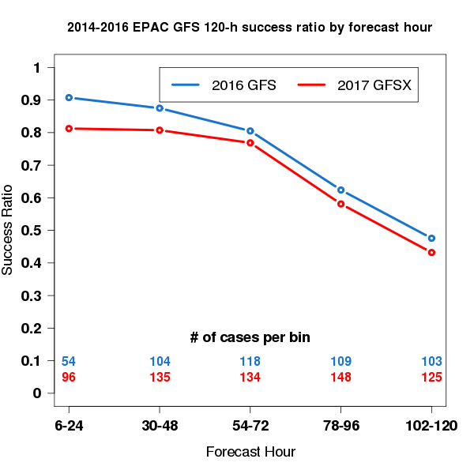
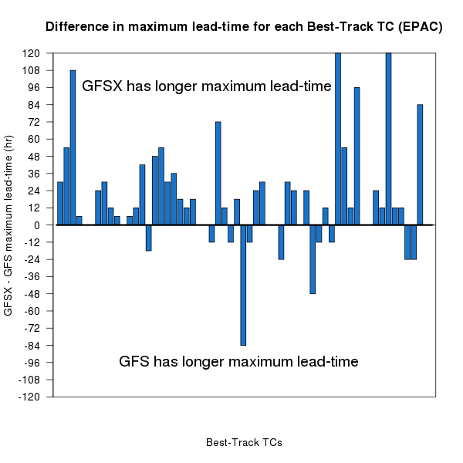
6. Tropical Cyclone Genesis Verification
Improved TC Genesis in the NATL And EPAC for both POD and Success Ratio
Significant gains in lead time for TC Genesis

Slide 12
Metrics for evaluation – and more
MODE verification of CAPE, precipitation, and Jet etc
Bufr sounding verification
Analyses increments
Cases studies (by EMC Model Evaluation Group)
Impact on computing resources, mass storages
……..

Slide 13
Case studies and evaluation/analysis by MEG/EMC
Case Studies | Case Studies
Louisiana flooding case study | Christmas Day 2016 Northern Plains Blizzard
January 23, 2016 East Coast Blizzard | January 22-23, 2017 California precipitation event
Hurricane Matthew | Portland heavy snow Jan. 10-11, 2017
Hurricane Joaquin | Long-range predictability of high-impact west coast atmospheric river
February 7-8, 2016 explosive cyclone | West Virginia flooding case
MODE Jet Verification | MODE Precipitation Verification
Minnesota Blizzard November 18-19, 2016 | MODE CAPE Verification
Weather Prediction Center case studies
Central Region case studies
Hurricane Joaquin precipitation
California precipitation January 9-10, 2017

Slide 14
Downstream Impact and Field Office Evaluation

Slide 15
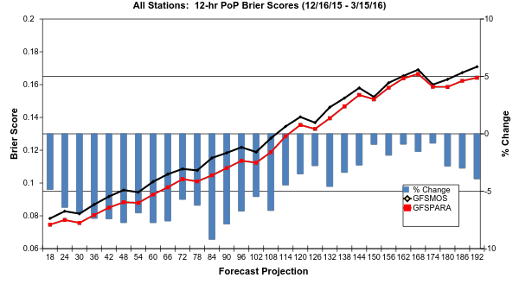
MOS Evaluation from MDL
Brier Scores…remember, smaller is better!

Slide 16
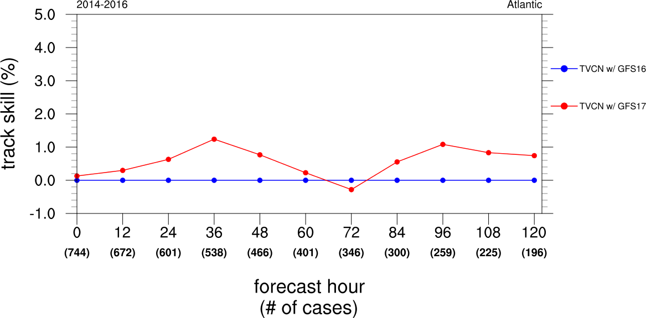
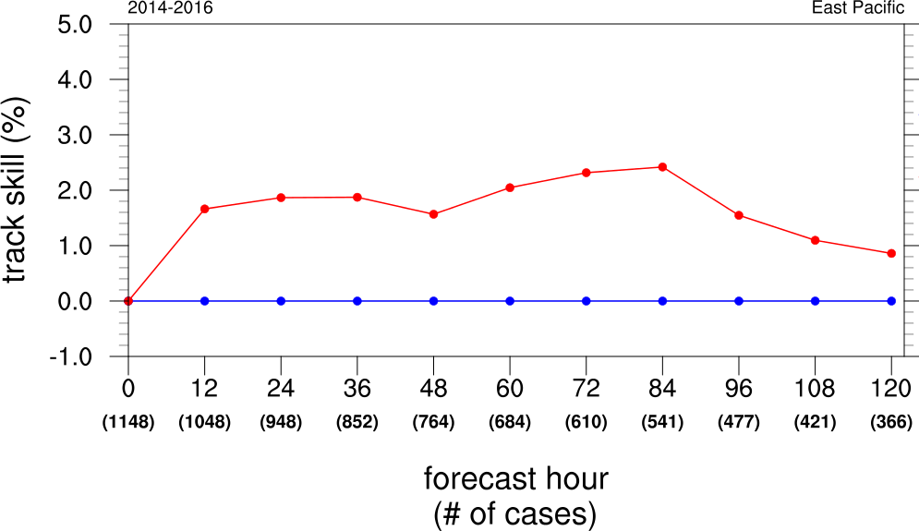
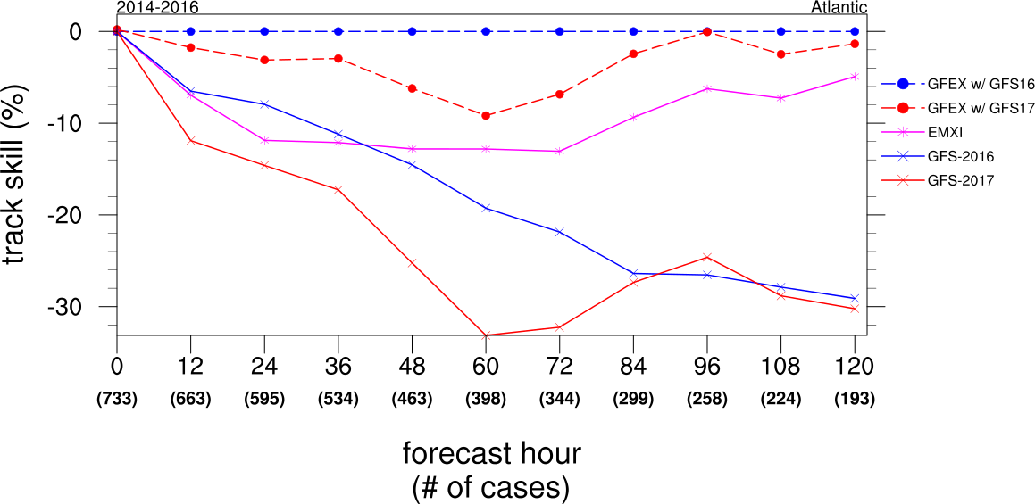
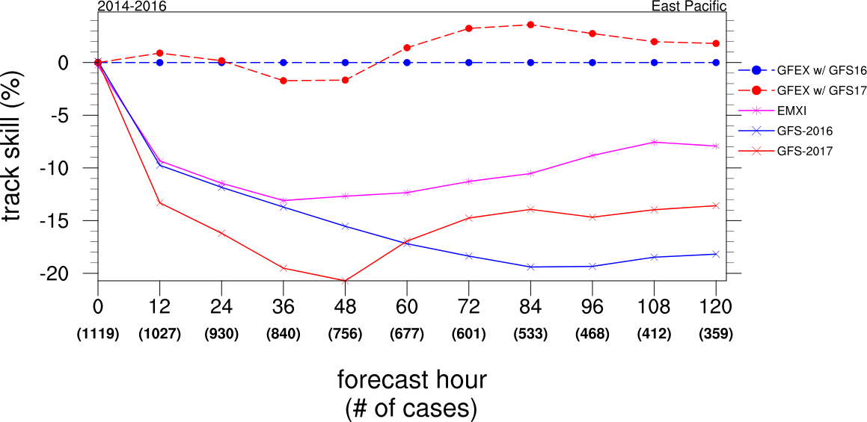
NHC Evaluation of Hurricane Forecasts
Skill relative to TVCN & GFEX
Improved skill w/TVCN, degraded with GFEX in ATL. Improved in EPAC

Slide 17
Summary of various evaluation metrics
Evaluation | Remarks
Fit-to-radiosondes | Small differences, winds have mixed results, temperature slightly better fit in GFSX Winds stronger, temperatures warmer in GFSX
Fit-to-aircraft (global) | Wind and temperature biases mostly decreased in GFSX Fit of winds mixed results, fit of temperatures improved
Fit-to-ACARS | Bias decreased, fit improved
Hurricane Tracks | GFSX slightly worse in short range forecasts
TC Genesis | GFSX improved overall
Hurricane Joaquin | GFSX forecast Joaquin to stay out to sea about 42 hours before the GFS2015 and GFS2016 models
Hurricane Matthew | GFSX did better with track
HWRF | Neutral to improved track forecasts
Multi-Waves | Improved overall
GEFS | Neutral
Downstream | Almost ready to digest NEMSIO related changes

Slide 18
Endorsements from Stakeholders
Region/Center | Recommendation | Remarks
Western Region | Implement | GFSX precip lighter in valleys GFSX more jumps 120-180 h fcsts in December
Central Region | Implement | No significant improvements nor detriments
Southern Region | Implement | GFSX slightly better Matthew, worse on Louisiana flooding
Eastern Region | Implement | Some beneficial improvements and upgrades
Pacific Region | No evaluation
Alaska Region | Implement | Forecast improvements largely neutral
WPC | Implement | Slight improvement, Better tropical convection So. America
NHC genesis | Oppose | 9-10% less skill in track forecast at 48-72h in Atlantic Forecasts of tropical storm genesis improved

Slide 19
Endorsements from Stakeholders
Region/Center | Recommendation | Remarks
AWC | Implement | Significant improvements to tropical convection and ceiling and visibility over CONUS
CPC long range stratosphere | Implement | Stratospheric fields improved, slight improvement D+8, week 2
OPC | Implement | Small scale features improved; large scale features similar
SWPC | No evaluation
MDL | Implement | see little to suggest any dramatic MOS impacts from implementing new GFS
OWP | Implement | Mixed results, extremely limited testing
SPC report | Implement | Slightly improved 2-m dew point and instability bias

Slide 20
Finally
Science briefing to EMC implementation control board
Science briefing to NCEP Director
IT briefing to NCEP Director
NCEP NCO 30-day IT test
Upgrade announcement (TIN)
And …… final implementation

