Slide 1
NEMS and FV3-CAP Building FV3 in common infrastructure
Jun Wang
NEMS architecture development team
ESMF group

Slide 2
Overview
NEMS
Standalone NEMS FV3 architecture
FV3 CAP
Learning from NEMSFV3 to build earth science system:
Object Oriented design
Test system
Challenges in building NEMSFV3

Slide 3
ESMF based NEMS FV3 - object oriented design
NEMS (NOAA Environmental Modeling System) is a common modeling framework. It is based on ESMF (Earth System Modeling Framework) and follows NUOPC (The National NEMS Unified Operational Prediction Capability) convention
A numerical model in NEMS is represented by software and is implemented as an ESMF grid component through a NUOPC CAP wrapped around the model
Each ESMF grid component has import state and export state, they are the interface for inter-grid components communication. ESMF fields with decomposed domain grid information, are elements the import and export state for each component
Each ESMF grid components has its own internal state with internal methods

Slide 4
NEMS atmosphere grid component
The atmosphere component is the first component implemented in NEMS.
In the early version of NEMS, the atmosphere component holds multiple atmosphere models such as GSM, NMMB and FIM. Currently FV3 is an instantiation of atmosphere grid component, this makes the atmosphere grid component consistent with other components in NEMS system.
Besides standalone atmosphere models, many coupled systems that consist of different earth science system components are currently under development in NEMS system.
FV3 is currently running in standalone mode inside NEMS.

Slide 5
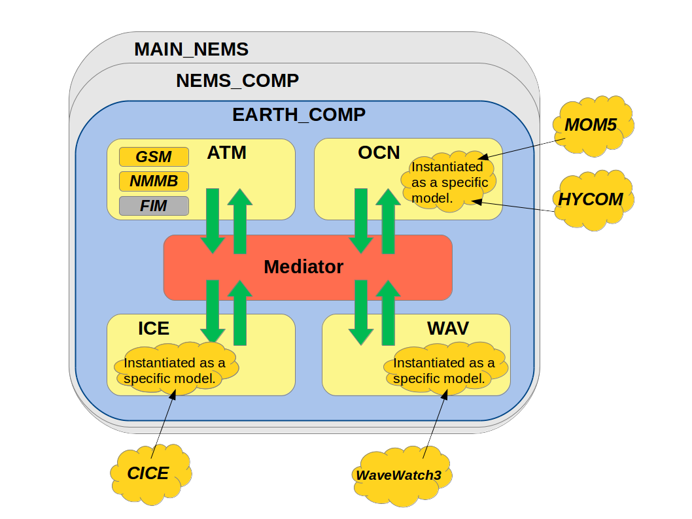
NEMS coupled system
GSM
FV3

Slide 6
NEMS FV3 Standalone System
Program Main
NEMS description
layer
NEMS grid comp
NEMS NUOPC
Layer & mediator
Earth grid comp
(ensemble)
FV3
Mediator
DYN
IPD4
Phys
User’s code
NEMS Infrastructure
ESMF grid component

Slide 7
NEMSFV3 NEMS driver
Program main
-ESMF initialize
-NEMS register (register NEMS initialize, run and finalize with ESMF)
-Register the NEMS component's Initialize, Run and finalize routines
-Create main clock
-Create NEMS grid comp import state, export state
-Execute NEMS comp initialization, run and finalize steps through standard ESMF interface
-ESMF finalize

Slide 8
NEMSFV3 NEMS driver (cont.)
Module NEMS gridded component
-private data
-NEMS register (register NEMS initialize, run and finalize with ESMF)
-NEMS Initialization:
Get internal state
Create earth component and associated import state and export state for each ensemble member (and ensemble coupler for ensemble run)
Register Initialize, Run, and Finalize subroutines for each earth component
Call initialization of each earth component
-NEMS Run:
Call run step of each earth component (ensemble coupler and then earth component)
-NEMS Finalize:
Call finalize of each reach component

Slide 9
NEMSFV3 NEMS driver (cont.)
Module earth gridded component:
* NUOPC layer, and earth subcomponents are selected through nems configure file
-private data
-Earth register (Inherit NUOPC driver, specialization NUOPC set Model services, run sequence, finalize and internal initialization; set up NUOPC field dictionary)
-Set model service: call setservice of selected components or mediator
-SetRunSequence: set run run sequences with selected components
-Finalize: dealloate internal state
-Internal initialization: connector
nems.configure:
EARTH_component_list: ATM
ATM_model: ${atm_model:-fv3}
runSeq::
ATM
::

Slide 10
NEMS fv3gfs_CAP
Set time info for fv3 time manager
Time_init, Time_end, Time_step_atmos,
InitializeAdvertise
diag_manager_init
Atmos_model_init
data_override_init
model_label_Advance
nc = 1, num_cpld_calls
update_atmos_model_dynamics
update_atmos_radiation_physics
update_atmos_model_state
atmos_model_restart
model_label_Finalize
atmos_model_end
diag_manager_end

Slide 11
Features of NEMFV3: ESMF based NEMS GSM- object oriented design
The basic concept of the ESMF is that complicated applications can be broken up into coherent pieces with standard calling interface.
The earth science system subcomponents are implemented as cohesive objects with associated internal state and methods combined hidden inside the grid component.
The encapsulation can provide data protection and reduce system complexity, and thus increase system robustness. This is different from traditional procedural system that model data and procedure separately.
It is also useful design for interoperatable physics driver.

Slide 12
Features of NEMSFV3: test system
NEMSFV3 test system provides evidence for accept new code changes
Regression test
Decomposition, threading, resolution, regional/global
Evolve: add test, update setting for all test after implementation
Parallel test for operational implementation
A unified workflow system is under development, but testing NEMSFV3 as the atmosphere component in many coupled applications remains a big challenge:
Evaluation a certain code updates are done in both weather and climate mode, when improvements are not only shown in all the applications, weather accepting the code change becomes challenging.
How to set up climatology from standalone NEMSFV3 that evolves fast
- Add test cases for special events

Slide 13
Challenges in working with NEMSFV3
Suggestion to work with fast evolving system
Ticket system: document all the code changes
Merge to trunk as frequently as possible
Break big task into small pieces and make several commits
Complexity
Many components, It is impossible to understand all the pieces
Communication is important

Slide 14
Thanks!

