Slide 1
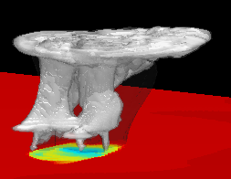
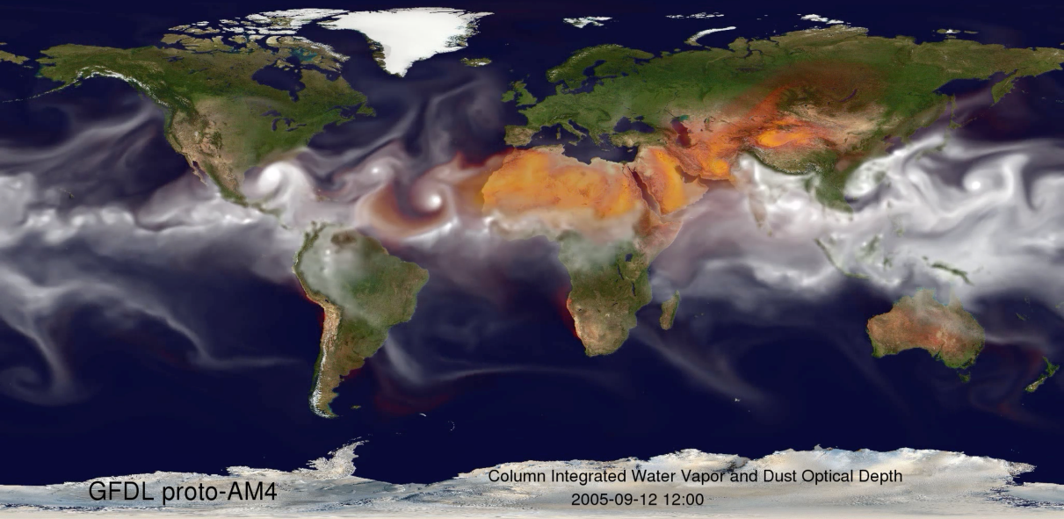

An in-depth look at the FV3 dynamical core:
global
Regional
Shian-Jiann Lin and the GFDL FV3 team
FV3 presentation at NCEP/EMC
Oct 17, 2016

Slide 2
Outline:
What’s “Finite-Volume” about FV3?
A critical review of C & D staggering
Design & tuning of the dynamics:
  top down (FV3) vs. bottom up (MPAS) - the story as told by the KE spectra
On meso-global unification:
  the GFS physics is good enough to be applicable to all scales; except …
Some outstanding issues with fvGFS (FV3 with GFS physics and Land model)
Transplant experiments:
  the insurmountable impact of the IC (GFS vs. IFS) to forecast skill
What we must do to make GFS the best in the world

Slide 3
What’s “Finite-Volume” about FV3? 20-yr of R/D in one slide
Vertically Lagrangian control-volume discretization based on 1st principles (Lin 2004)
  Conservation laws solved for the control-volume bounded by two Lagrangian surfaces
Physically based forward-in-time “horizontal” transport (between two Lagrangian surfaces)
  Conservative analog to the highly efficient trajectory based two-time-level semi-Lagrangian schemes in IFS; locally conservative and (optionally) monotonic via constraints on sub-grid distributions (Lin & Rood 1996; Putman & Lin 2007) – good for aerosols and cloud MP
  Space-time discretization is non-separable -- hallmark of a physically based FV algorithm
Combined use of C & D staggering with optimal FV representation of Potential Vorticity and Helicity
  → important from synoptic-scale down to storm-scale
Finite-volume integration of pressure forces (Lin 1997)
  Analogous to the forces acting upon an aircraft wing (lift & drag forces)
  Horizontal and vertical influences are non-separable (Arakawa-type linear analyses are not applicable to FV’s Lagrangian discretization)
For non-hydrostatic extension, the vertically Lagrangian discretization reduces the sound-wave solver into a 1-D problem (solved by either a Riemann solver or a semi-implicit solver with conservative cubic-spline)

Slide 4

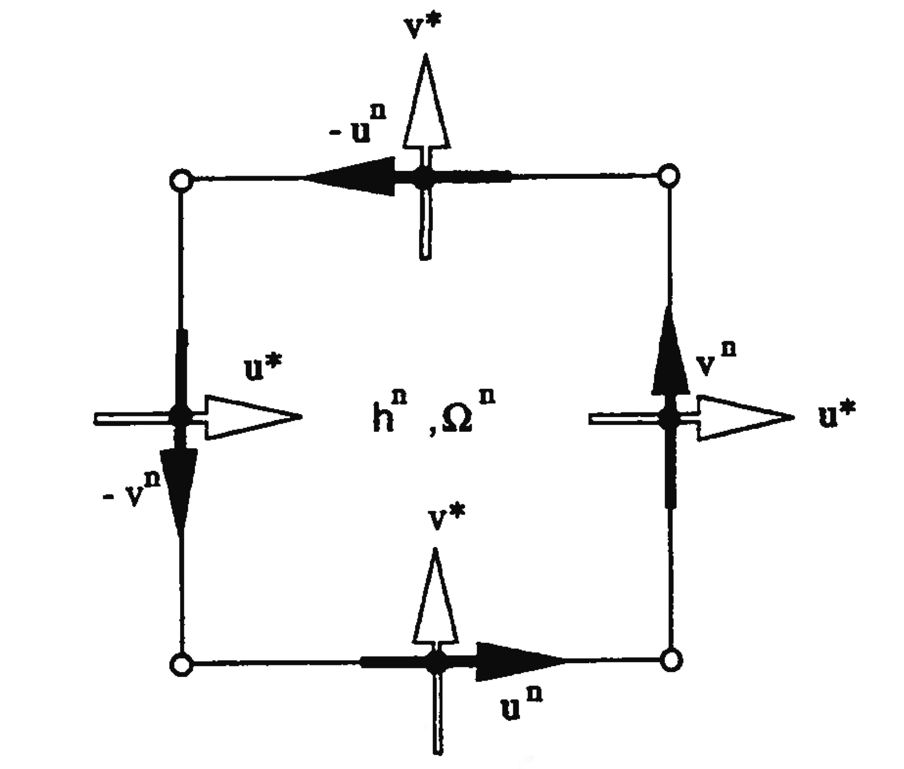
A balanced approach to “horizontal” grid staggering:
Pressure gradient (linear):
C grid requires no averaging (best)
D grid requires averaging in both directions (worst); can be drastically improved with 4th order FV scheme
Geostrophic balance (linear):
C grid requires averaging in both directions (worst)
D grid requires NO averaging (best)
Potential Vorticity & Helicity (nonlinear):
C grid is the worst grid for vorticity & helicity
D grid is the best for vorticity advection and the representation of updraft helicity (severe storms)
A combination of C and D is better than a pure C or a pure D grid
The C+D grid (Lin & Rood 1997)
C & D could work together,
like Yin-Yang

Slide 5
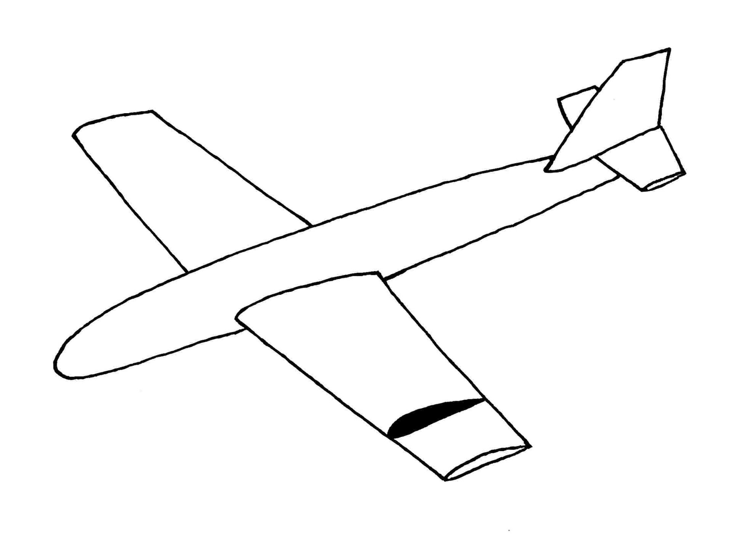
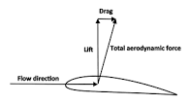
Inspired by the aerodynamics
The forces acting on the wing of an aircraft
Control-volume
The “lift” force is the net force in the vertical direction
  Hydrostatic (cruising): the lift supports the weight (dw/dt = 0)
  Non-hydrostatic: the lift produces the vertical acceleration (dw/dt = F_lift)
The “drag” is the projection of the force in the horizontal direction (du/dt)

Slide 6
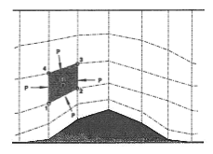


Physically based Finite-Volume integration of Pressure Force
Lin (1997, QJ)
The model top and bottom are Lagrangian surfaces
Physically based finite-volume integration using Newton’s 2nd law and Green’s integral theorem
Vertical-horizontal discretization is therefore non-separable !

Slide 7
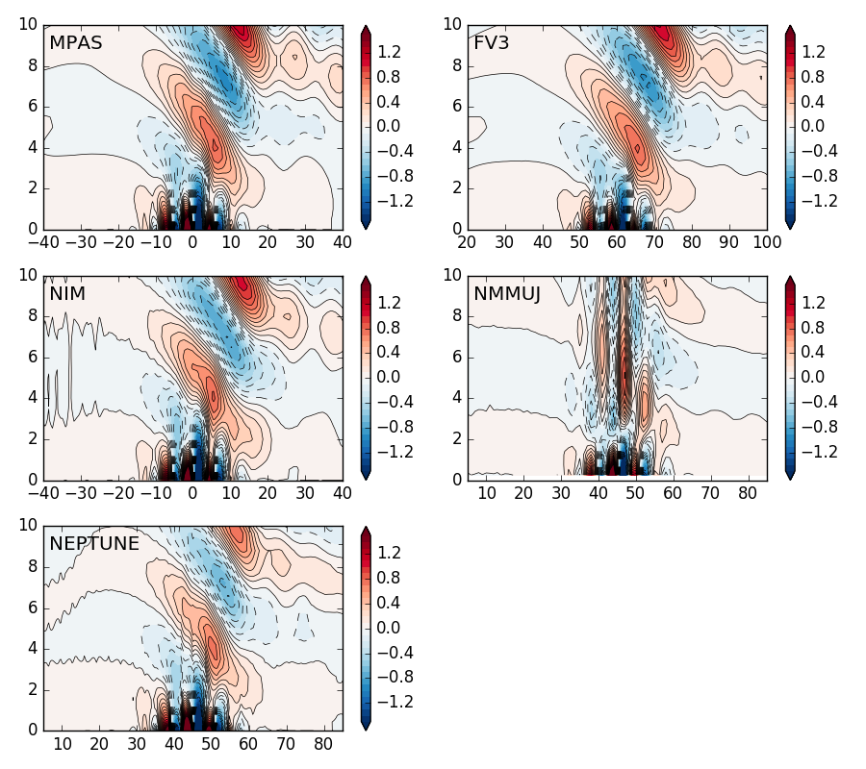
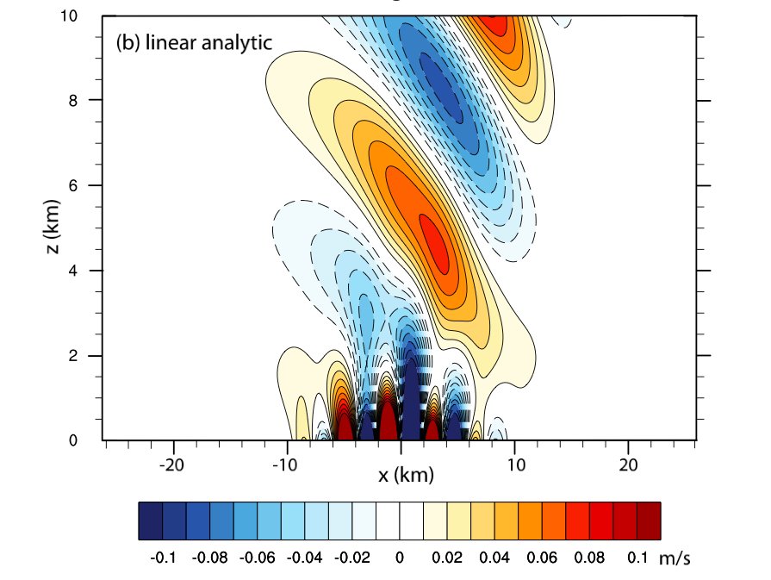
NGGPS phase-1 linear mountain wave test (case: M2) at hour-2
(a constant u-wind blowing from west to east)
linear solution

Slide 8
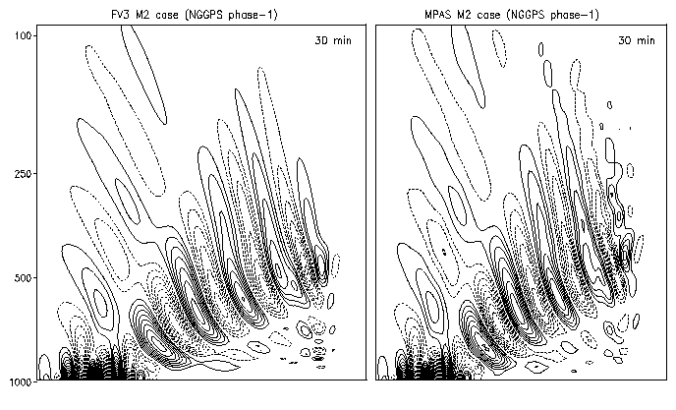
NGGPS phase-1 Mountain wave test at 30-min
MPAS numerical noises propagate out of mountain region
FV3
MPAS

Slide 9
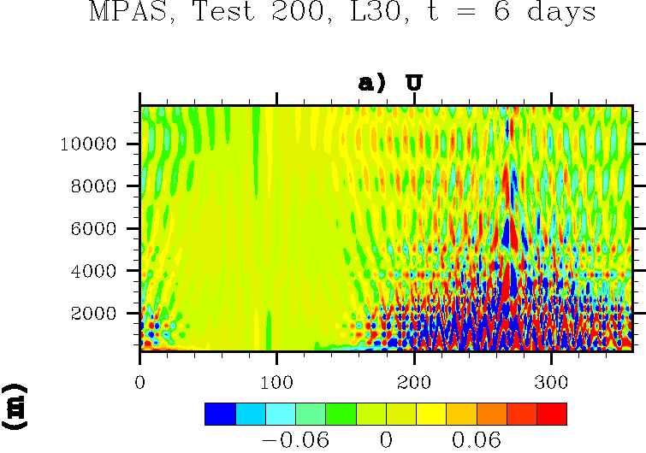
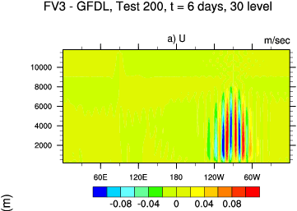
DCMIP-2012 “hydrostatic equilibrium test”
For this “atmosphere-at-rest” test, noises can not propagate out of the source region
(regional-only vs global design)
FV3
MPAS

Slide 10
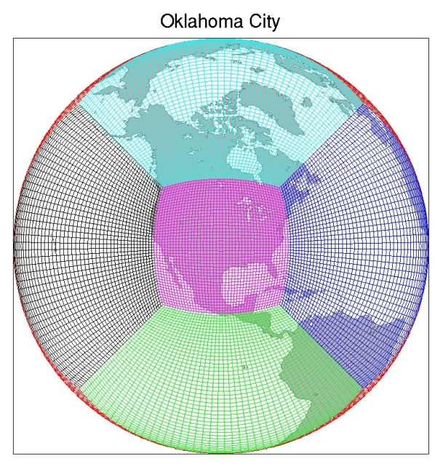
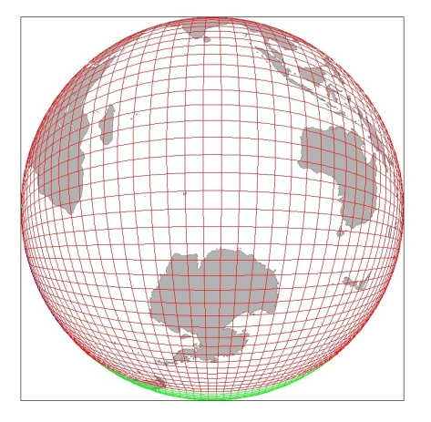
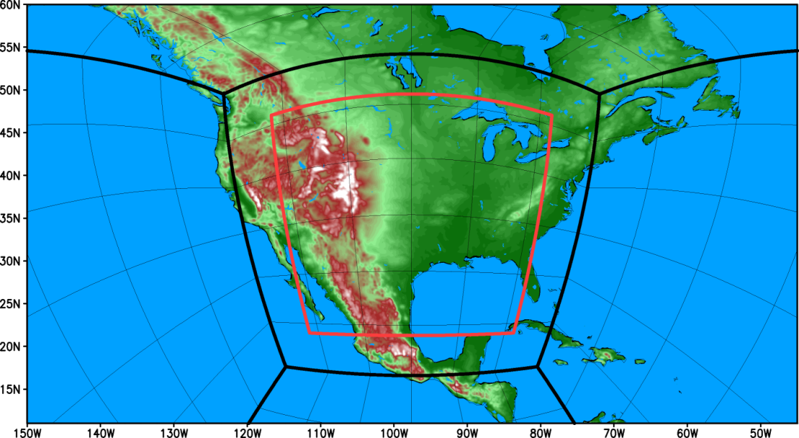
Achieving thunderstorm-resolving resolution “TODAY” in a unified meso-global prediction system
Grid stretching (smooth variation of grid spacing)
2-way nesting (Harris and Lin 2014)
  FV3 is uniquely suitable for 2-way nesting, due to the application of two-time-level Finite-Volume transport scheme
Optimal combination of the “stretching” and “nesting”
Example:
~ 3 km without the nest (black)
~ 1 km with a 2-way nest (red)

Slide 11
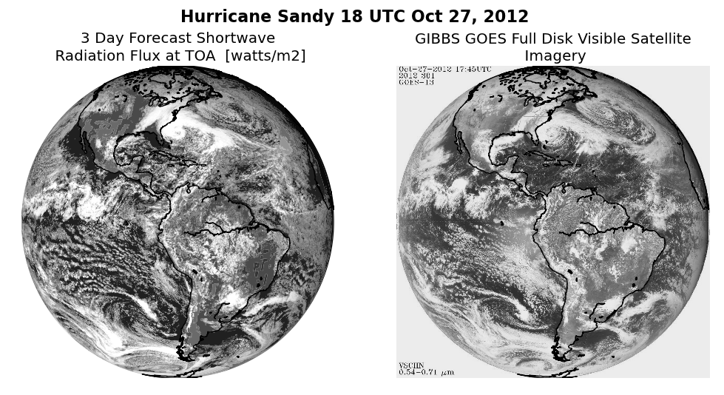
HIWPP global cloud-resolving (3 km resolution) test case:
hurricane Sandy
GFDL FV3 prediction vs. visible Satellite imagery

Slide 12
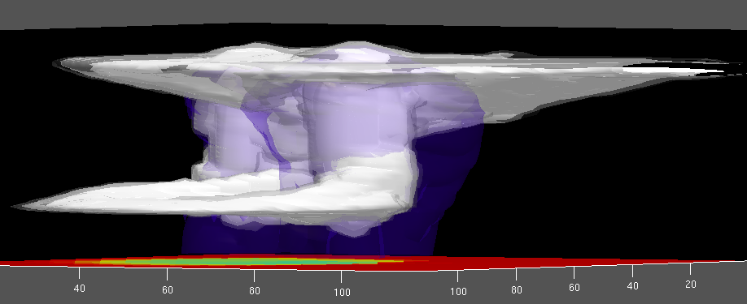
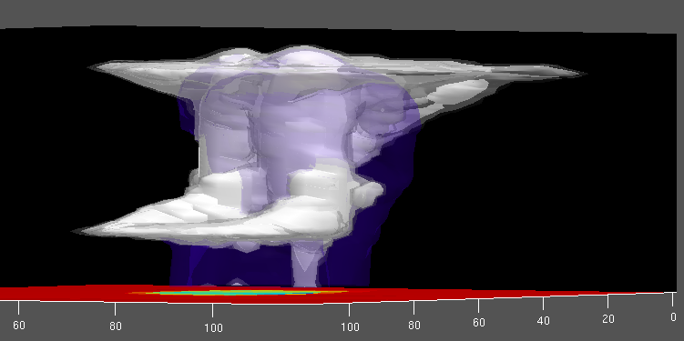
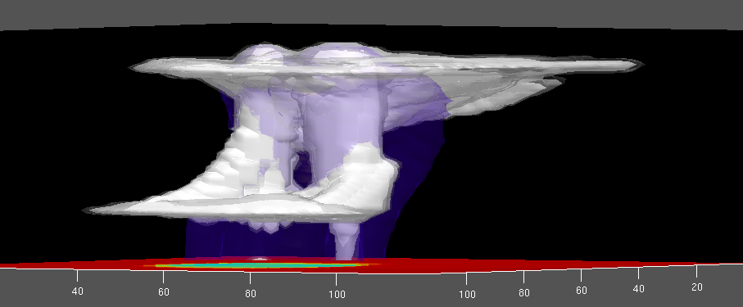
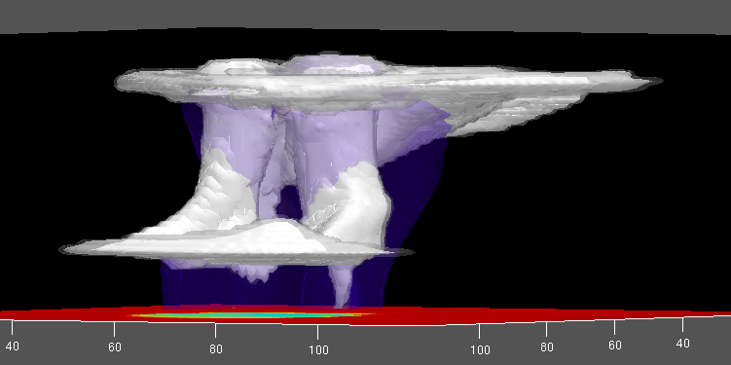
Simulations of tornado-producing super-cell storms with GFDL’s variable-resolution
FV³
4-km
3-km
2-km
1-km
Lin and Harris (manuscript)

Slide 13
KE spectrum from GFDL “Super HiRAM”
(FV3 with modified GFDL AM4 physics at globally uniform ~3.2 km)
-5/3
hour-72
Lindborg 1999
GFS_IC
Hour-1

Slide 14
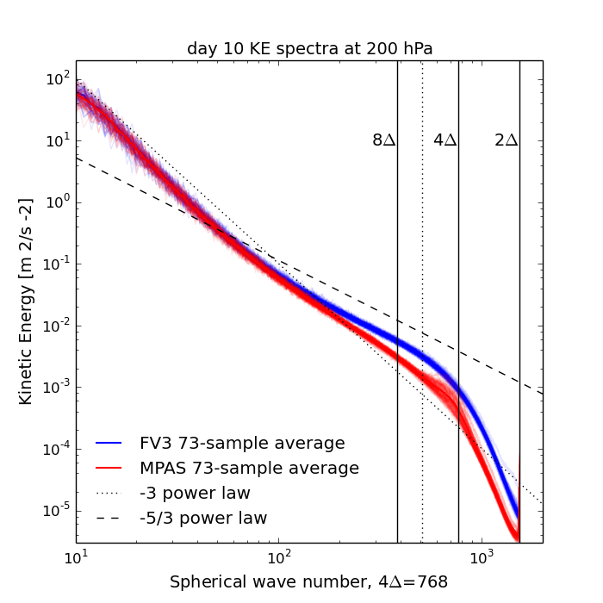
Algorithm design and diffusion tuning: FV3 vs MPAS
The story told by the KE spectra (composite 73 cases, 13-km NGGPS phase-2)
FV3 simulated the -5/3 “meso-scale” spectrum
MPAS has an energy deficit of ~50% in the meso-scale and failed to simulate the -5/3 spectrum
-5/3

Slide 15
Making fvGFS suitable for all-scale predictions:
The 1st step: replacing the GFS’s cloud Micro-Physics (MP)
Options:
Ferrier MP from EMC (work in progress)
Double moment MP from University of Oklahoma (proposal)
GFDL MP (adapted from GFDL HiRAM) – this serves as the base-line
  Designed for seasonal predictions (Chen & Lin 2011) and climate simulations, with “scale-aware” vertical & horizontal sub-grid distribution
  Based on 1st principles: “Ooyama-compliant” and consistent with FV3 (heat & momentum transported by falling condensates)
  Time-implicit fall of precipitating condensates (rain, snow, graupel, and cloud ice)
  Compatible with cloud fields from latest IFS
  Complexity: Double Moment MP > GFDL MP > IFS MP

Slide 16
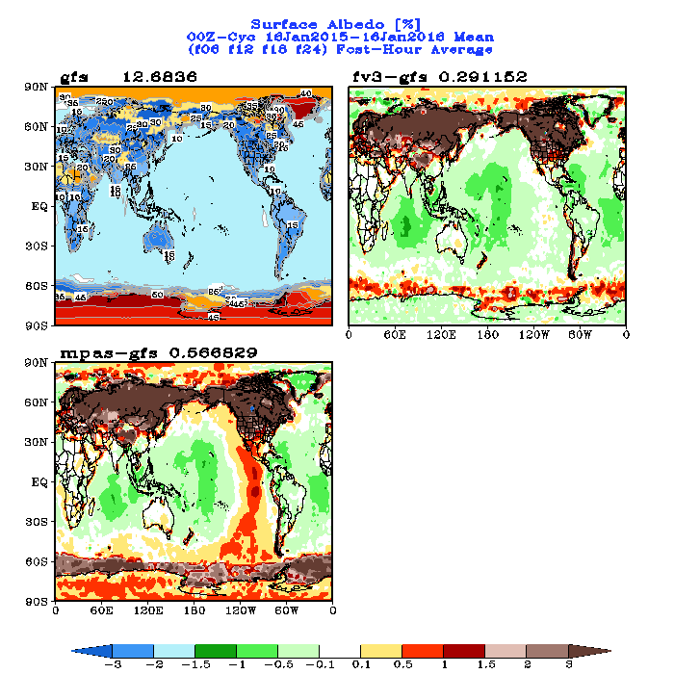
NGGPS phase-2 (13-km hindcasts): Issues with surface Albedo
Both FV3 and MPAS NGGPS implementations exhibited large errors over NH land area
Sea ice are likely incorrectly specified

Slide 17
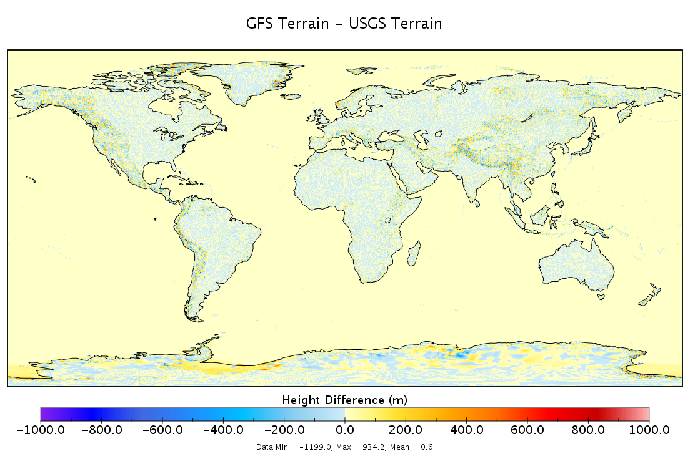
Issues with raw terrain data

Slide 18
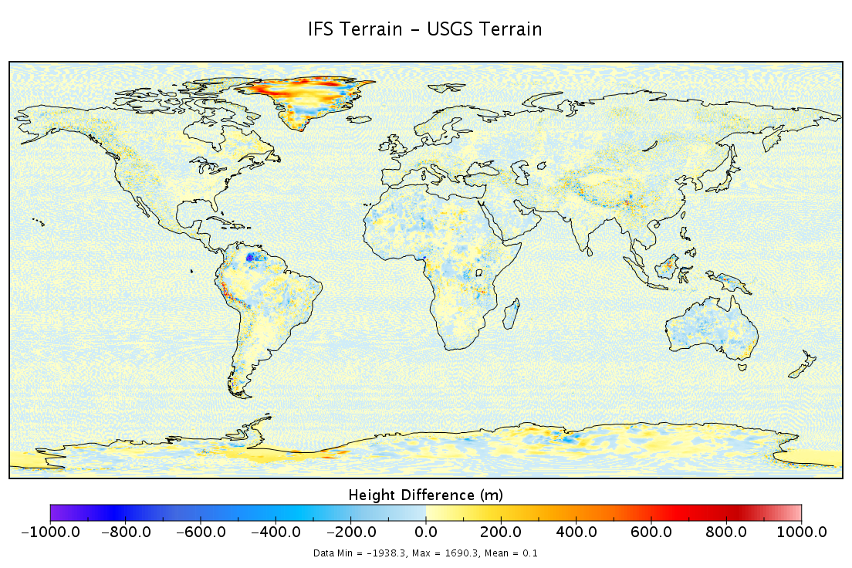

Slide 19
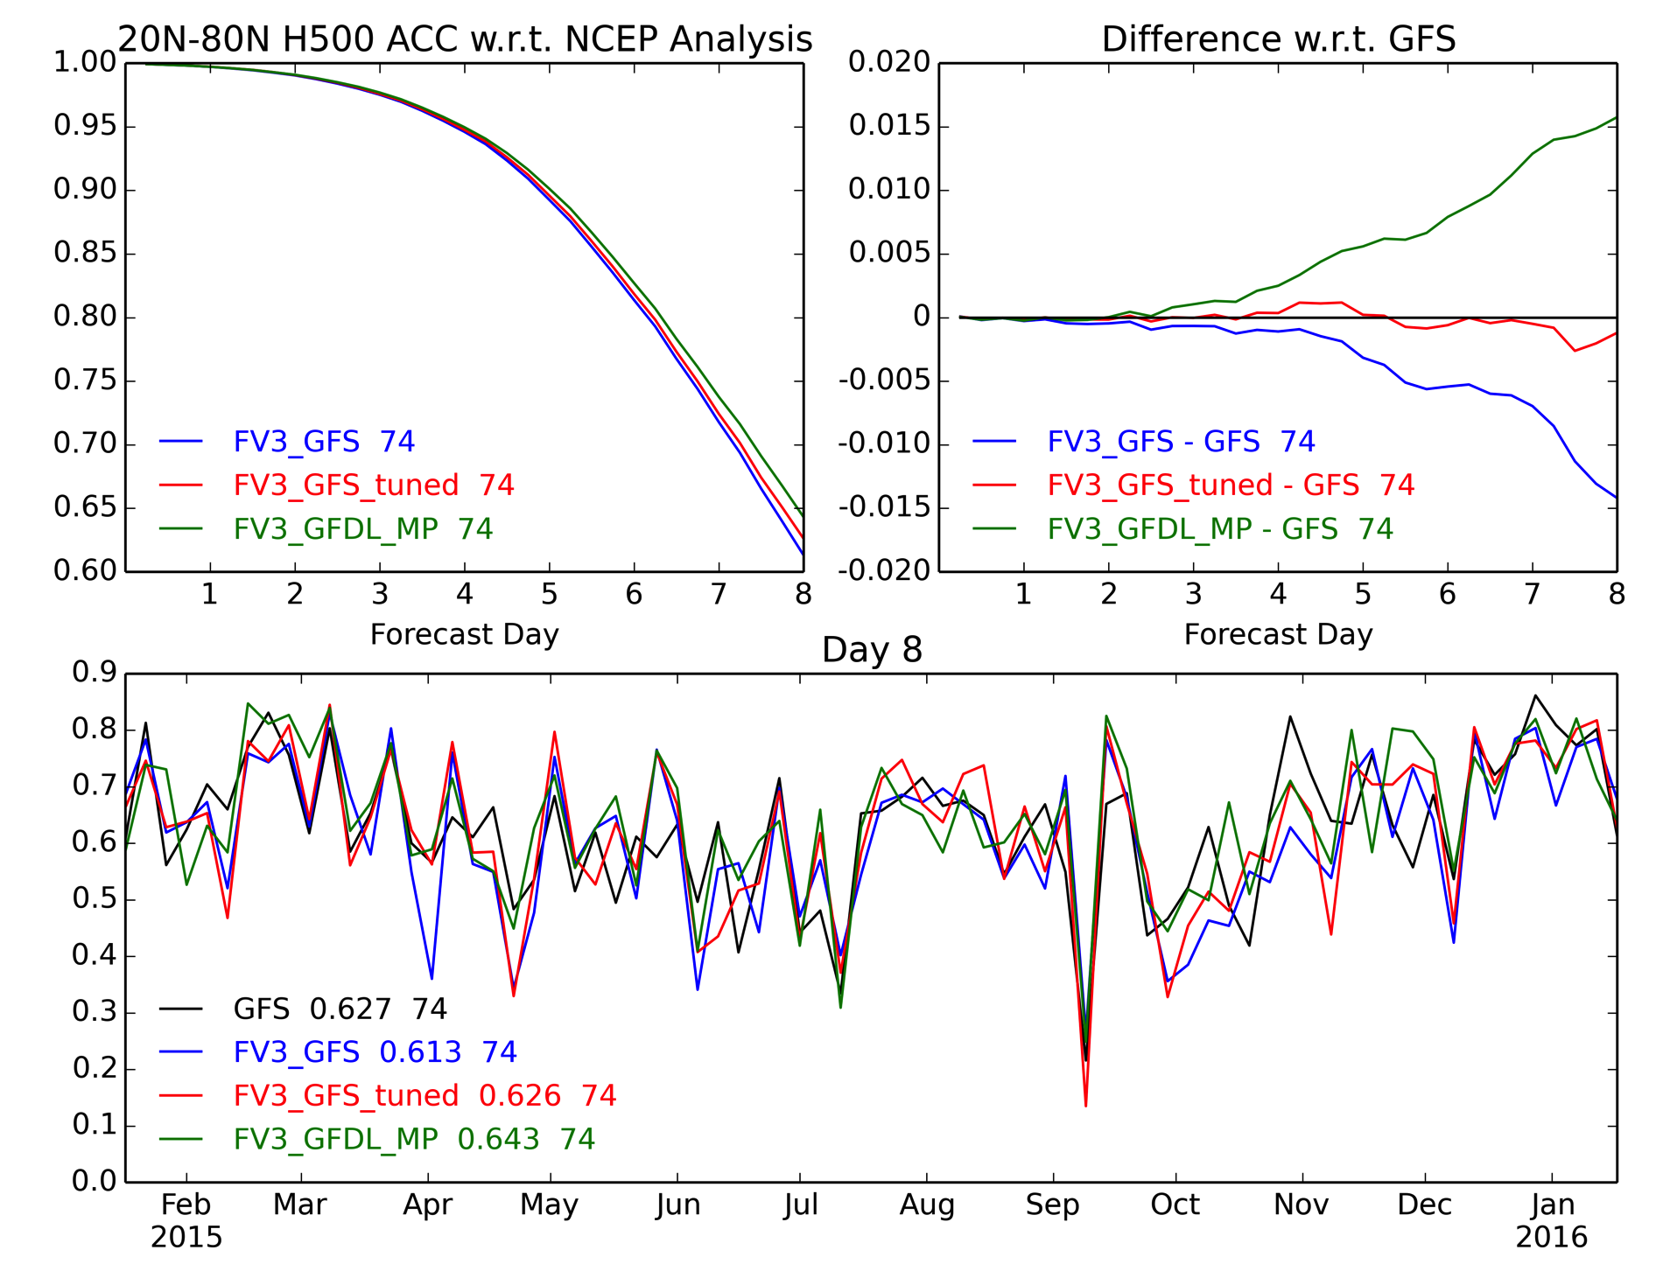
The 1st step towards meso-global unification:
Do no harm to global skill while enabling convection-scale with an advanced cloud microphysics
Relative Skill to Operational GFS
13-km fvGFS with GFDL_MP
ACC: H500
13-km fvGFS with tuned GFS
13-km fvGFS (no tuning)
(as submitted to NGGPS)

Slide 20
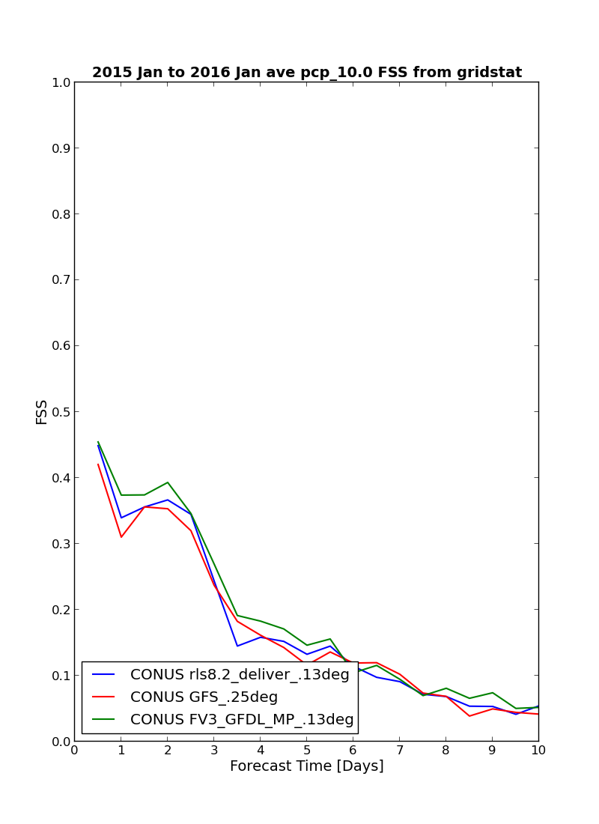
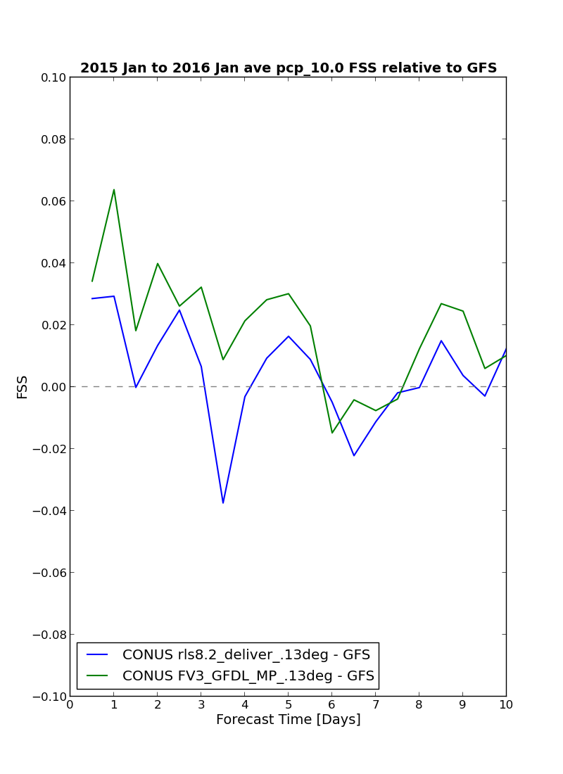
Fractions Skill Score over CONUS
(based on NGGPS 74 cases)
GFDL_MP made a significant improvement
Precipitation Events >= 10.0mm/6hr
13-km fvGFS with GFDL_MP
13-km fvGFS
(as submitted to NGGPS)
FSS by MET tool, using Stage IV data

Slide 21
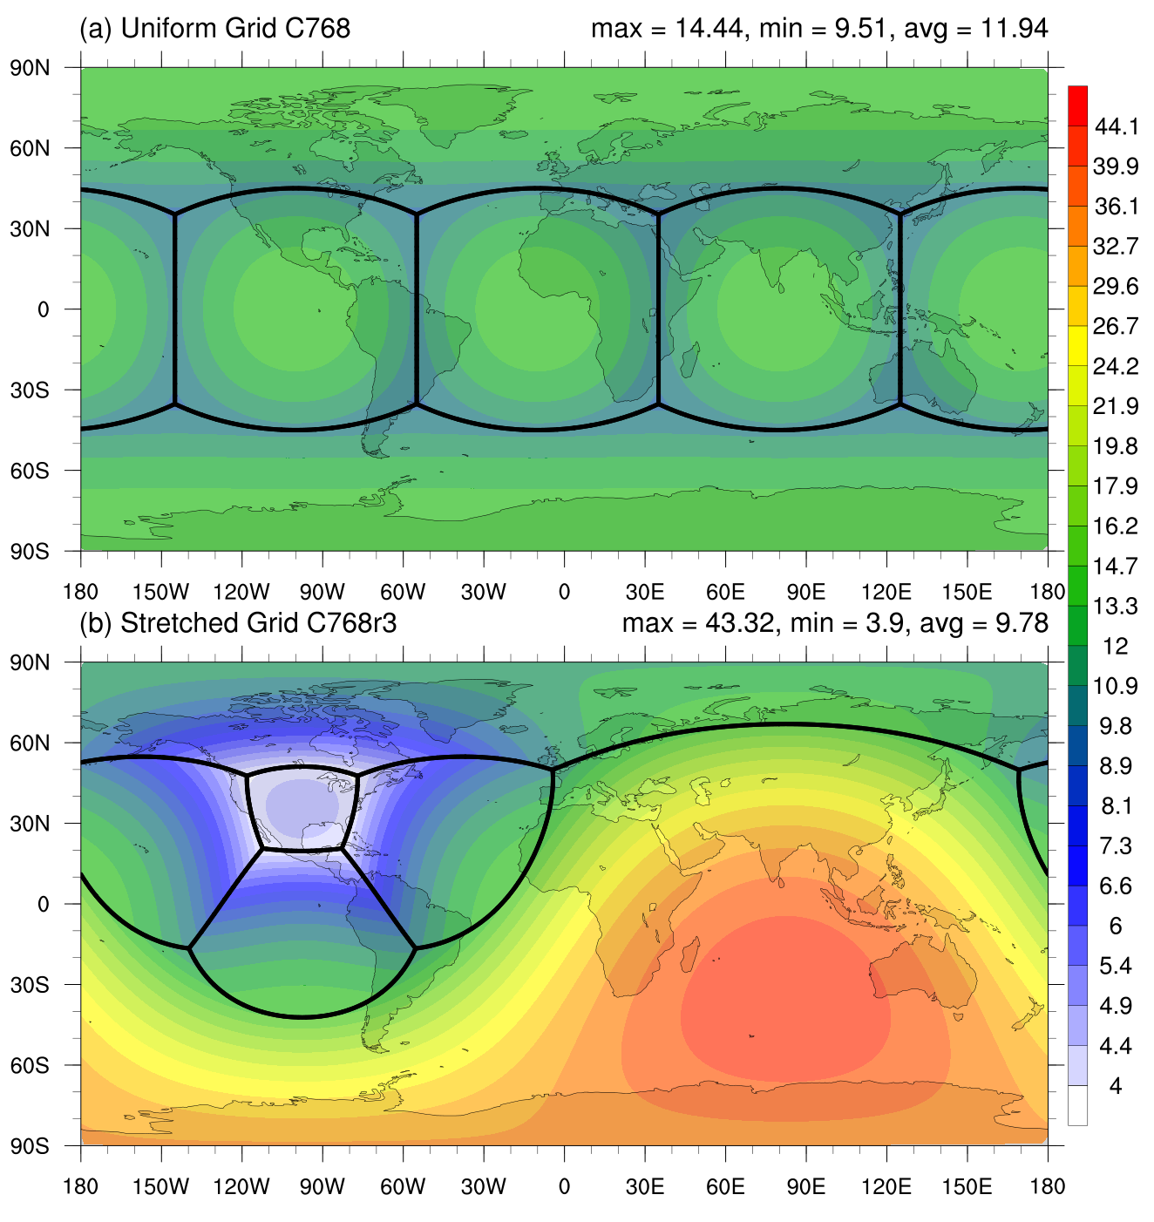
Does the variable-resolution grid degrade the ACC?
Uniform C768 (~13-km)
Stretched C768_r3 (4-30 km)

Slide 22
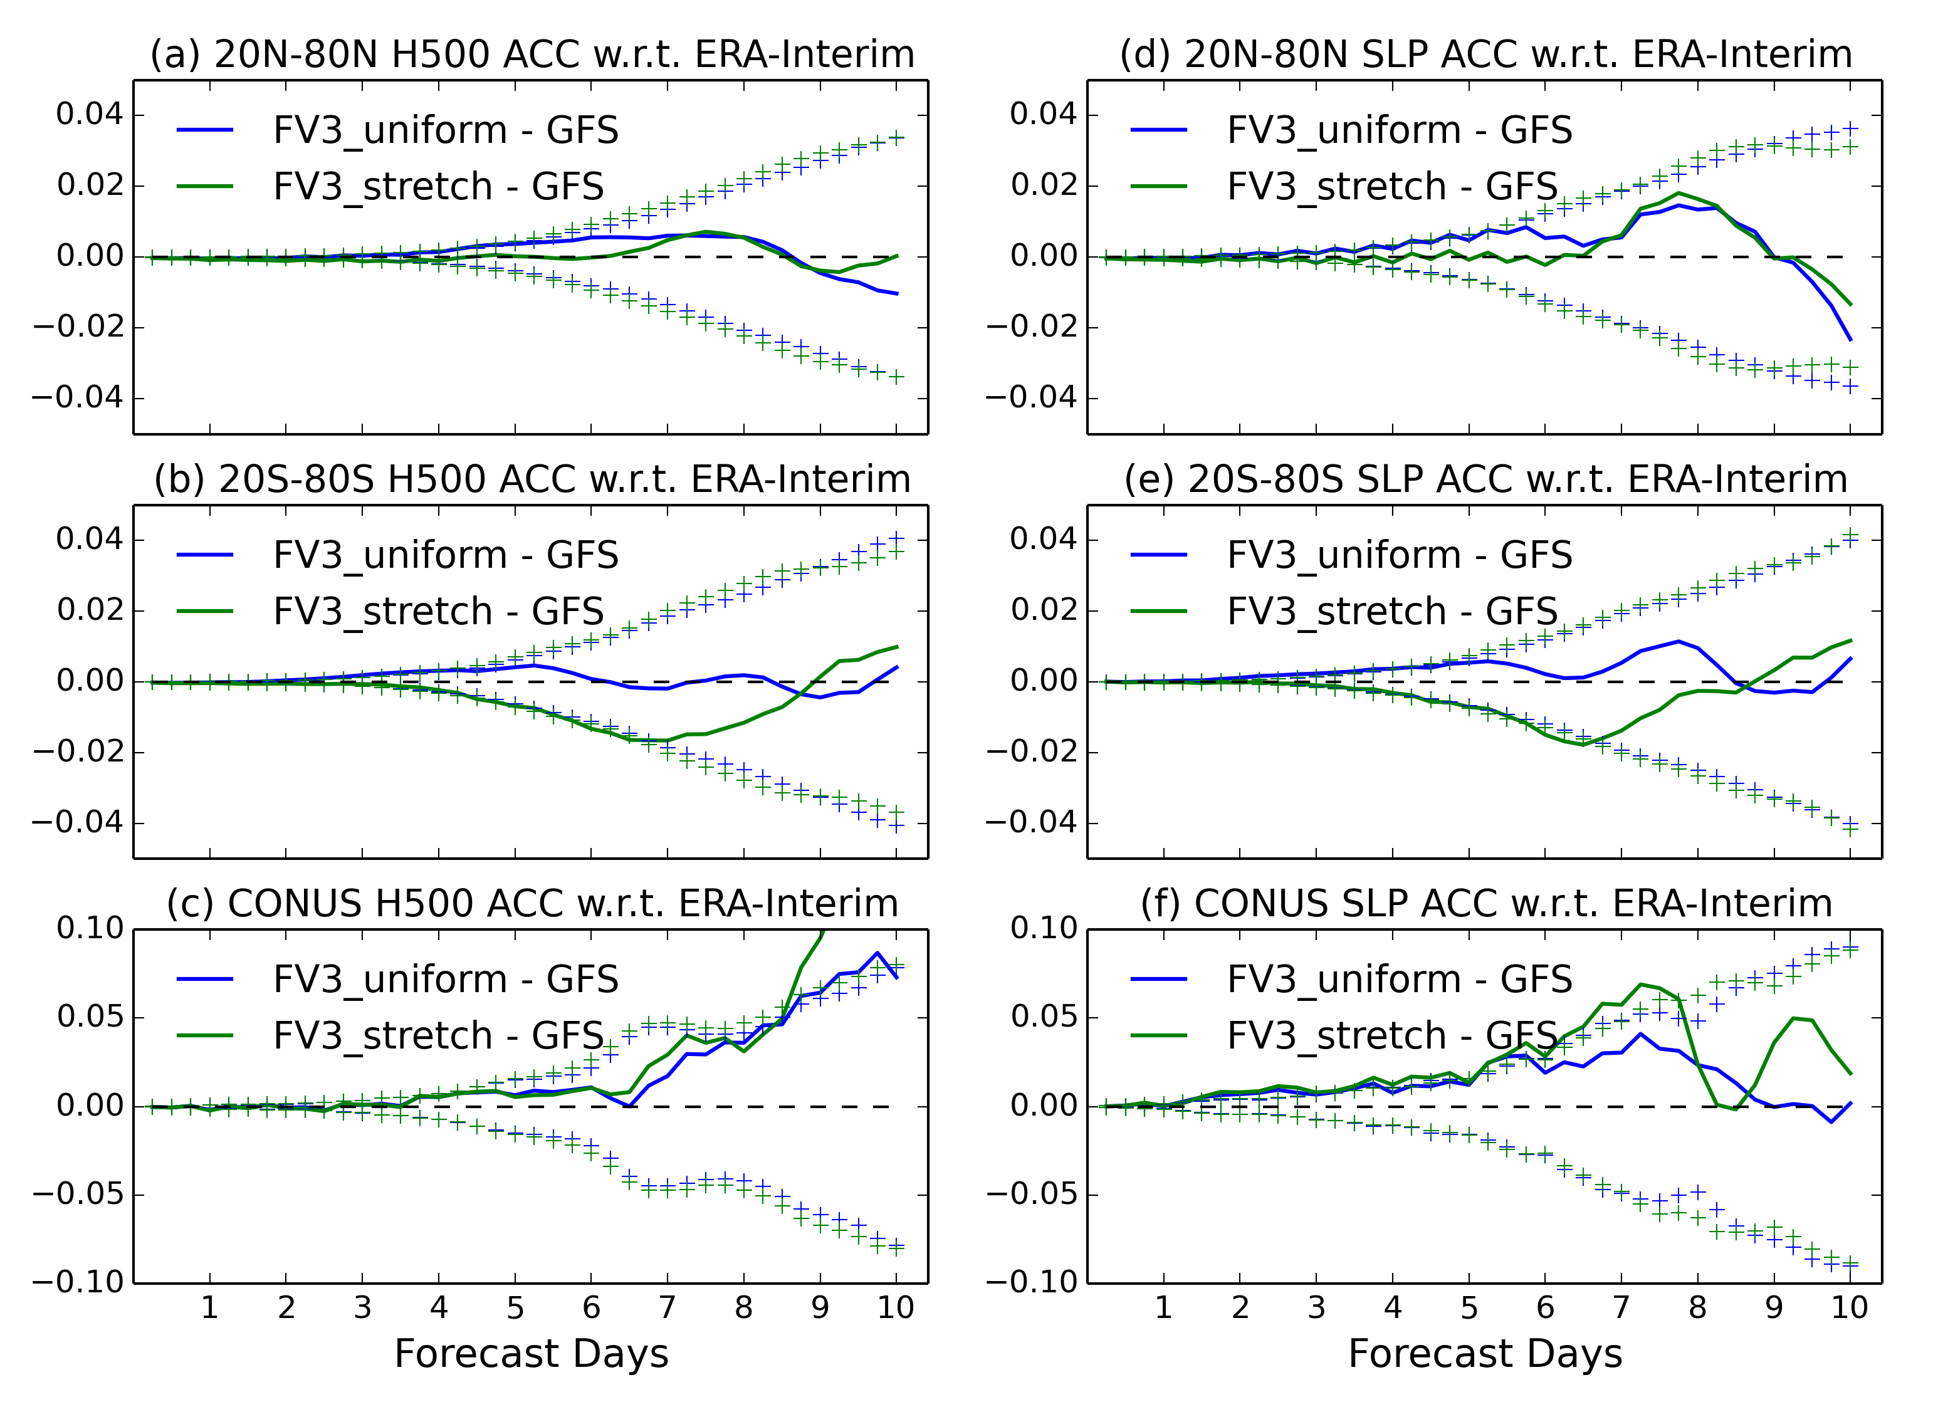
Impact of variable-resolution (4-km over CONUS) on H500 ACC
NH, particular CONUS, skill equal or better
SH skill degraded
10X faster than global uniform grid
C768L63_r3 with GFDL_MP
Non scale-aware SAS (is that a problem?)
All 74 NGGPS cases

Slide 23
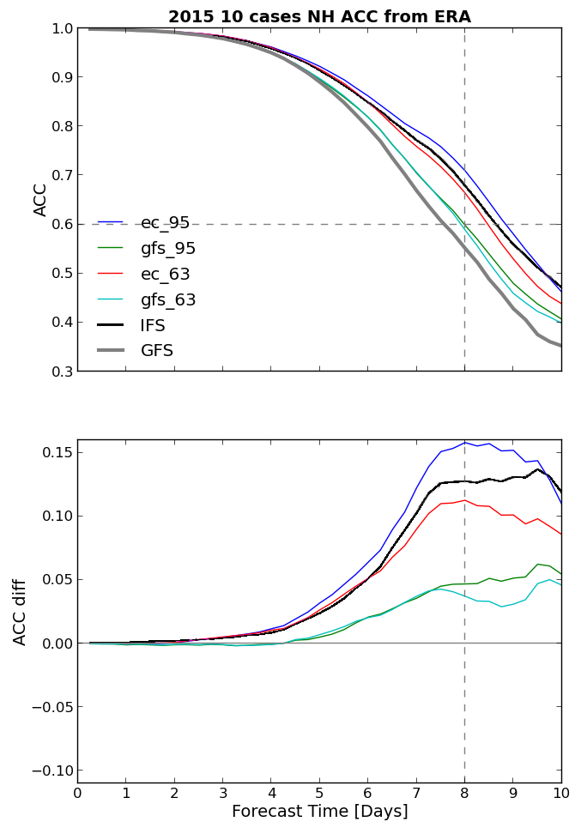
IFS vs. GFS
Transplant Experiments
(10 cases):
20150814
20150819
20150824
20150829
20150903
20150908
20150913
20150918
20150923
20150928
Based on limited cases:
Using ICs from ECMWF IFS, the GFDL modified GFS with sufficient vertical resolution (95 layers) outperforms the 2015-operational IFS and the GFS
Using ICs from GFS, it is extremely difficult to beat IFS
Skill (H500 ACC) relative to GFS
fvGFS_L95
IFS_L137
IFS IC
fvGFS_L63
fvGFS_L95
GFS IC
fvGFS_L63
IFS ICs courtesy of
Linus Magnusson,
ECMWF

Slide 24
DA cycle with FV3 and MPAS: NGGPS phase-2 (J. Whitaker)

Slide 25
Final notes:
The hydrostatic model for medium-range NWP is near its useful limit
  It’s time to go non-hydrostatic for all NWP models & DA
R-2-O-2-R transition
  Today’s NWP model at NWS could be tomorrow’s “high-resolution” climate model at OAR
To be the best in NWP:
  Take advantage of what we already have. Boldly step into the NWP gray-zone (5-10 km) where non-hydro dynamics-microphysics interaction is increasingly more important
  Transplant experiments should be routinely done, for calibration, and for independent evaluation of the model and the DA
  The dynamics must not be treated as a black box. “DA”, “dynamics”, and “physics” must be tuned together by their main developers in a 3-way process
  Fast-pace development cycle (faster than the “competition”)
    the R/D side needs far more HPC resources than we currently have

Slide 26
Supplemental Slides

Slide 27
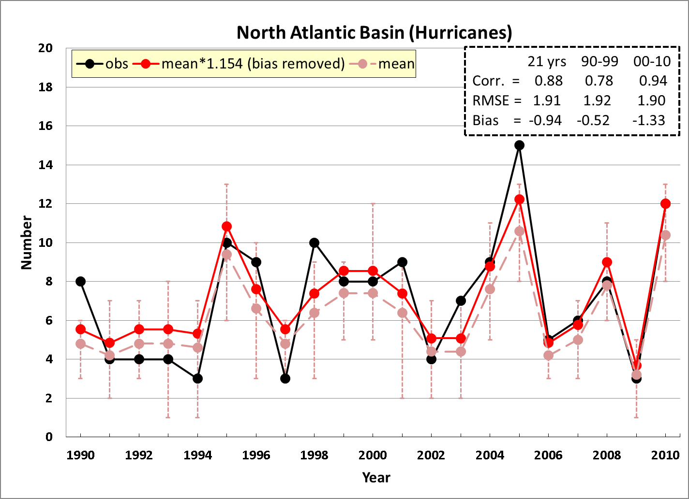
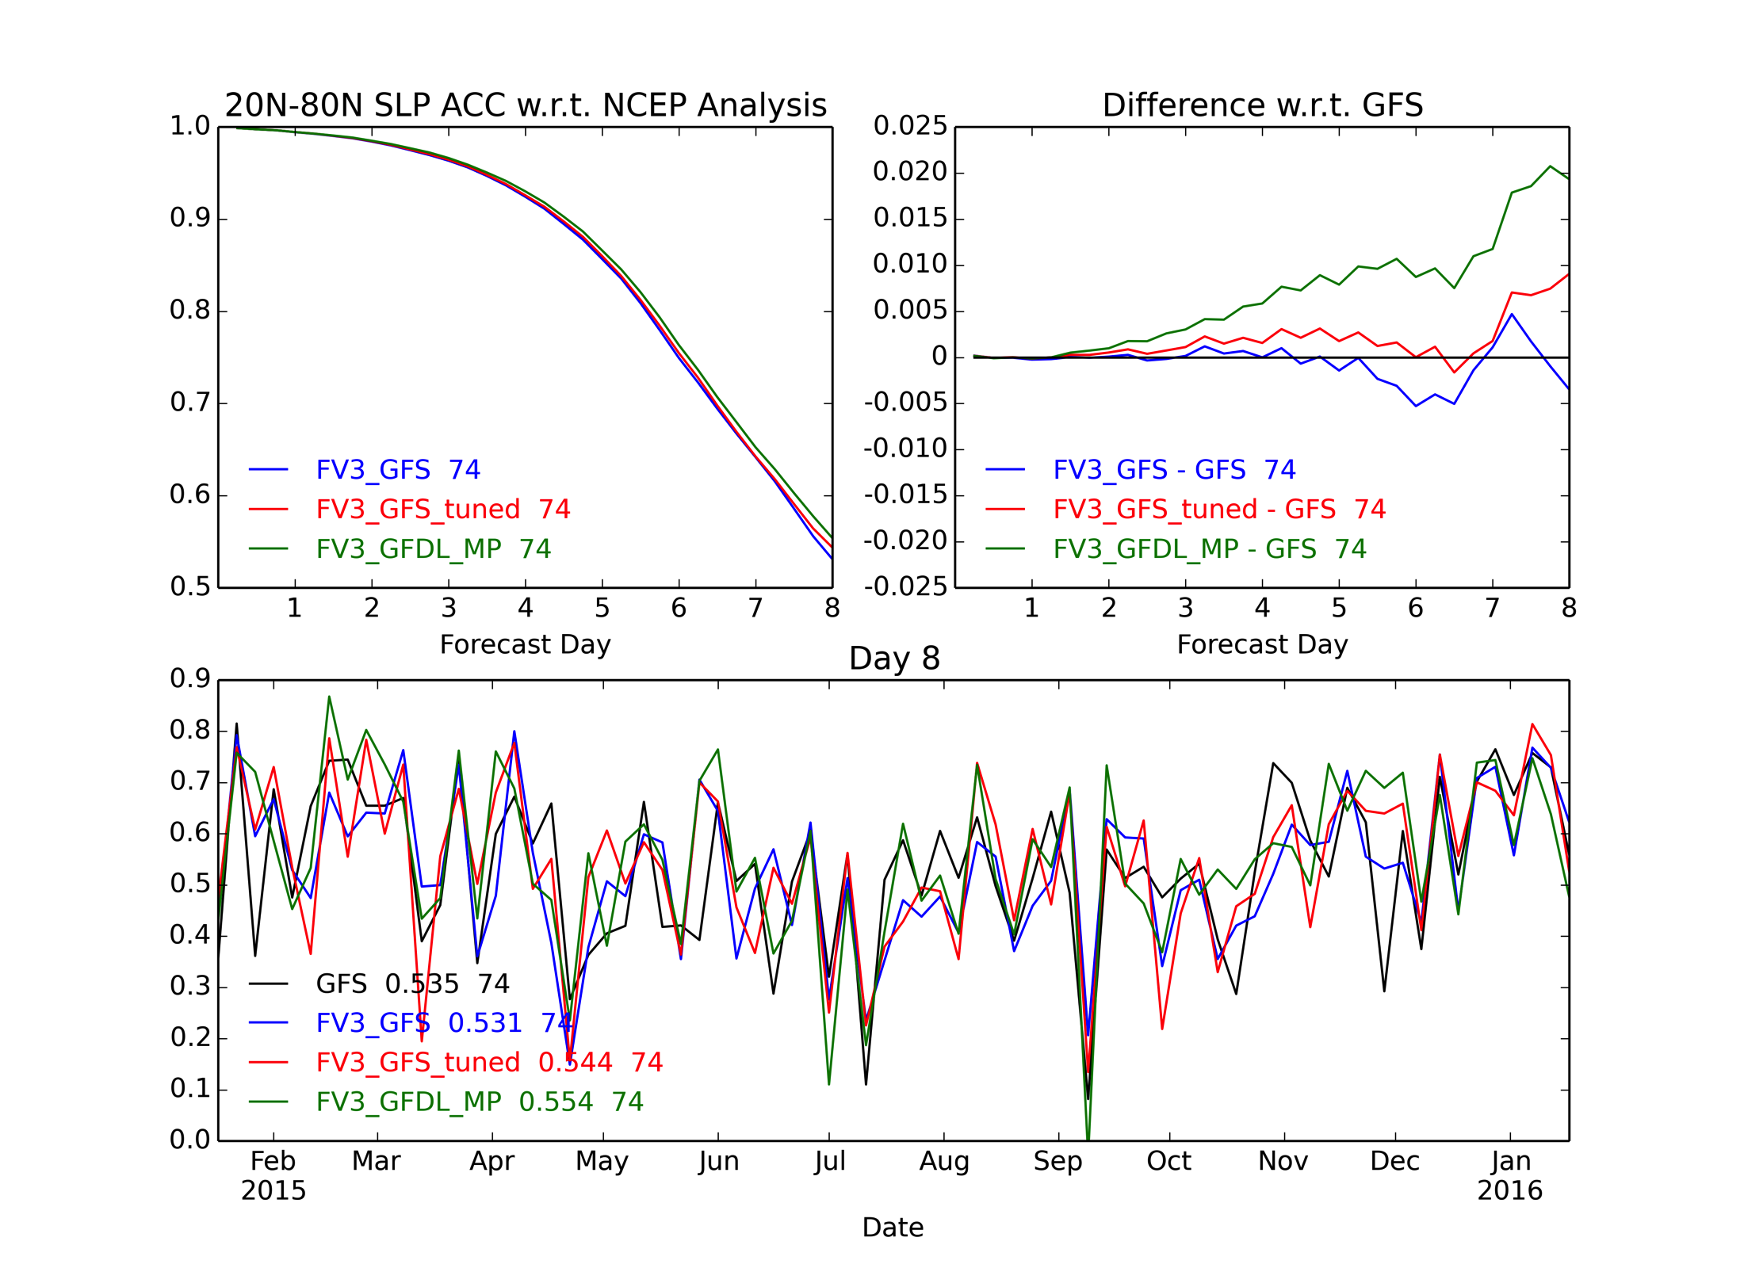
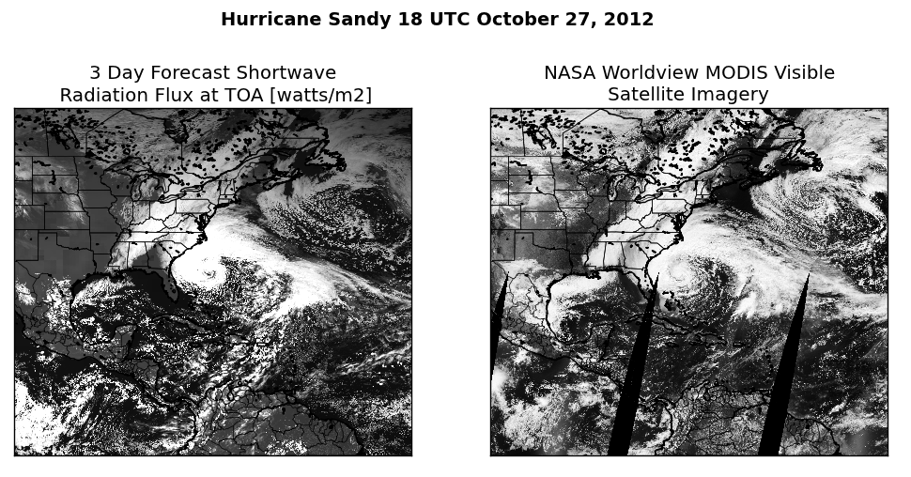
GFDL’s research on Predictions for all-scale
Dust (orange) and water vapor (white)
GFDL 50-km AM4 for IPCC
Seasonal Hurricane Prediction (25-km HiRAM)
1990-2010
Correlation = 0.88
Medium-range NWP (13-km, phase-2 NGGPS)
Global cloud-permitting Predictions
(3-km, phase-1 NGGPS)
Severe Storm prediction
(1 km, Super HiRAM)
ACC: SLP

Slide 28
NGGPS phase-2 benchmarks: FV3 vs MPAS
http://www.weather.gov/media/sti/nggps/Phase%202%20Dycore%20Evaluation%20Briefing%2022%20June%202016%20UMAC%20%234%20v1_0.pdf
Base configuration (13-km): 3.04 X
With 30 more tracers (MP + aerosols): 1.63 X
Variable resolution efficiency: 1.53 X
Net (multiplicative) result: 7.5 X
FV3 can afford to have 7X more ensemble members at the same cost
The difference likely to be more dramatic with higher vertical resolution
Notes:
The tracer speed ratio is 2.5/1.53 = 1.63 X; the variable rosolution ratio is 96.9/63.5 = 1.53

Slide 29
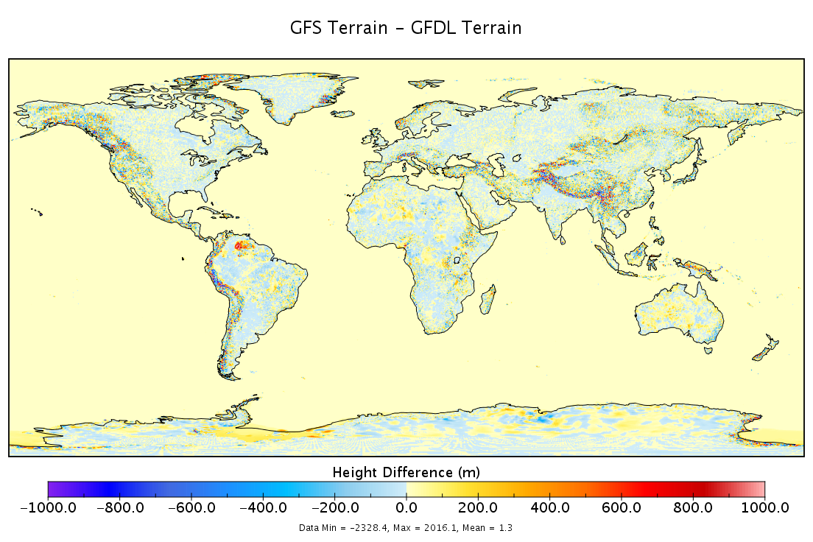

Slide 30
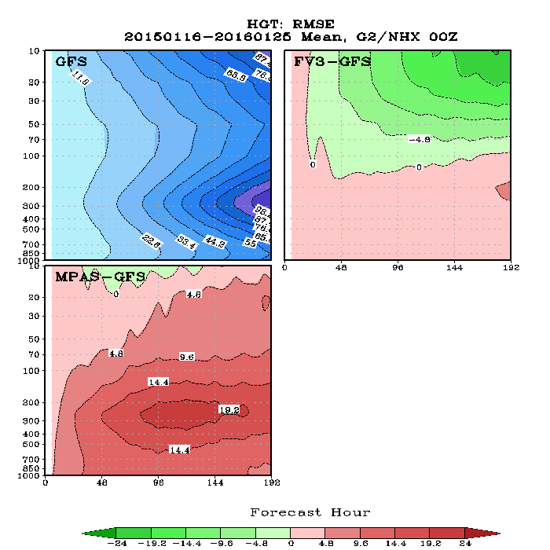
Retrospective forecasts at 13-km:
zonal mean RMSE of Height: FV3 and MPAS vs. GFS
No tuning of the physics was performed
Green: better than GFS
Red: worse than GFS
FV3 RMSE in the stratosphere is much smaller than GFS (and IFS) – source of extended-range predictability
MPAS produced anomalously large error in the troposphere

Slide 32
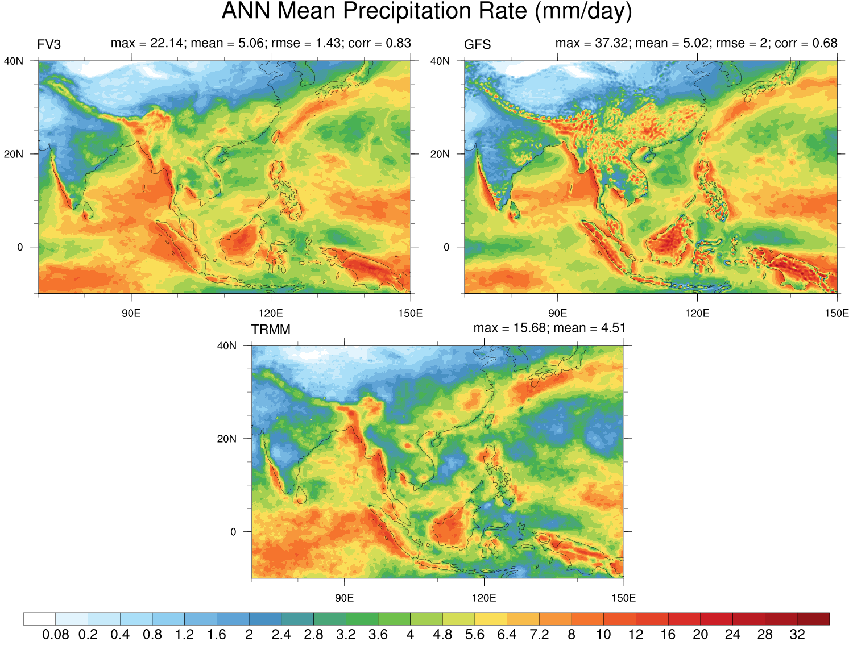
South Asia

Slide 33
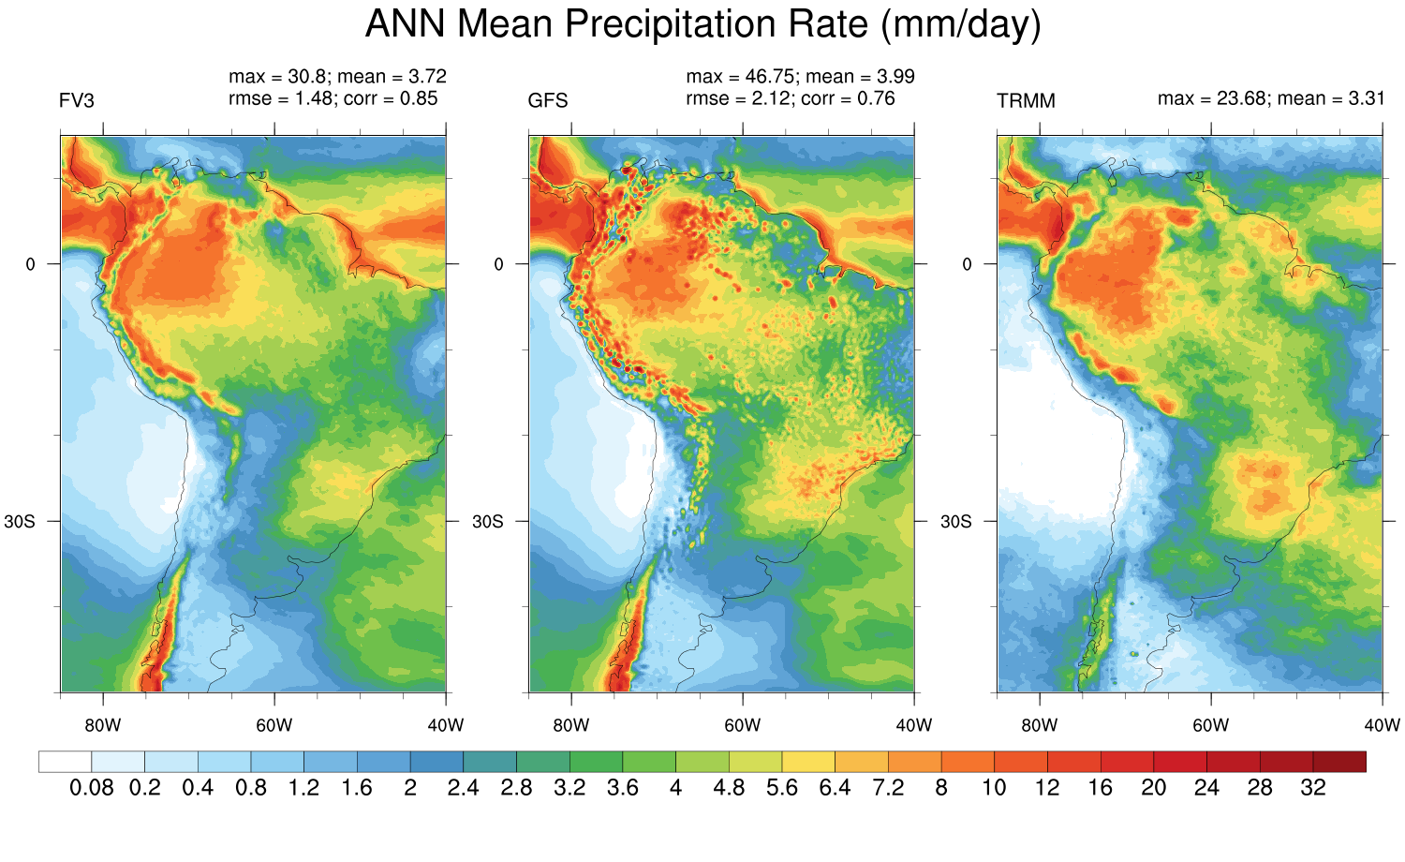
South America

Slide 34
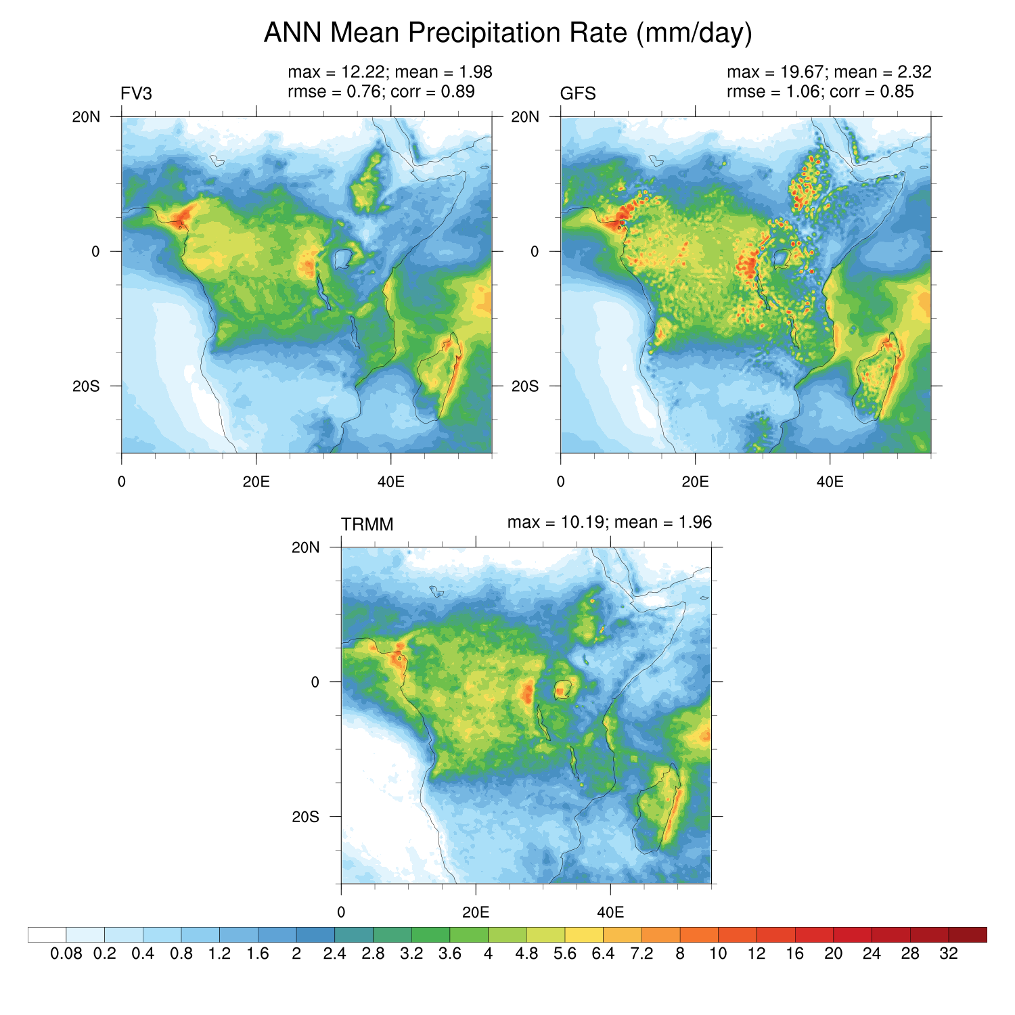
Central Africa
Notes:
GFS’s land model may have a problem over lakes. It seems to precip very litle over all lakes.

