Slide 1
The 2 July 2020 Anomalous Severe Weather Event across eastern New York
Thomas A. Wasula and Daniel B. Thompson
NOAA/NWS Albany, NY
NROW XXII
November 9-10, 2021

Slide 2
Virtual World: Me and my Kids
AUG 2019: Steps of the Jefferson Memorial looking towards the White House

Slide 3
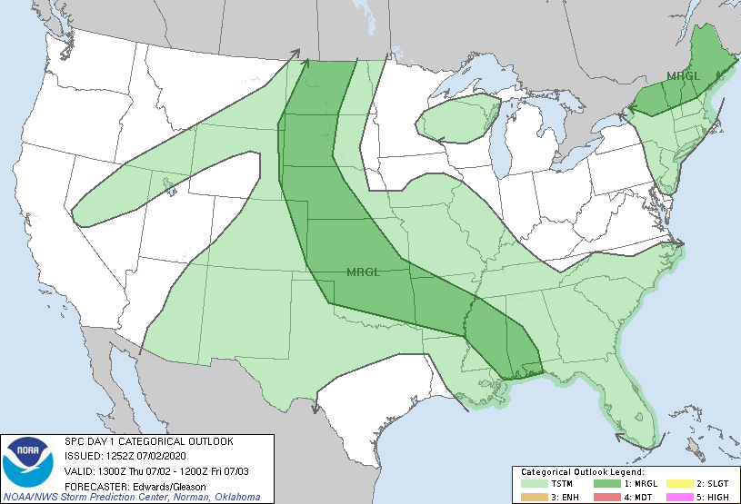
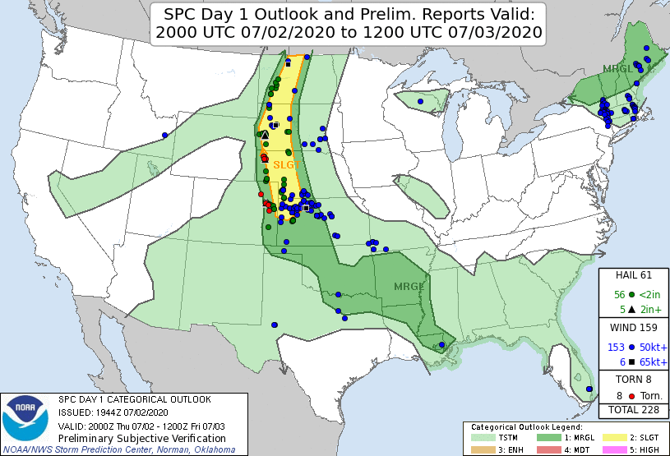
2 JUL 2020: 1300 and 2000 UTC SPC Day 1 Convective Outlooks
1300 UTC Day 1 Outlook
30 wind damage reports in the ALY forecast area
2000 UTC Day 1 Outlook

Slide 4
Motivation
What caused the severe weather in a concentrated area down the Hudson River Valley?
This was an anomalous, low predictability (General Thunderstorm forecast most of the area), localized high impact event
CSTAR VII Project (2019-2022) with SUNY at Albany continues examining a variety of severe weather topics and cases including: the use of the NYS Mesonet, role of complex terrain, improving tornado warning guidance & using new advances with dual polarization data
CSTAR Grant #: NA19NWS4680006

Slide 5
Outline
Brief Synoptic Overview
SPC RAP Mesoanalysis
NYS Mesonet analysis
KENX storm-scale radar analysis with application of Dual-Pol K_{DP} descending columns (wet microbursts/wind damage)
HREF CAMS performance (12Z runs)

Slide 6
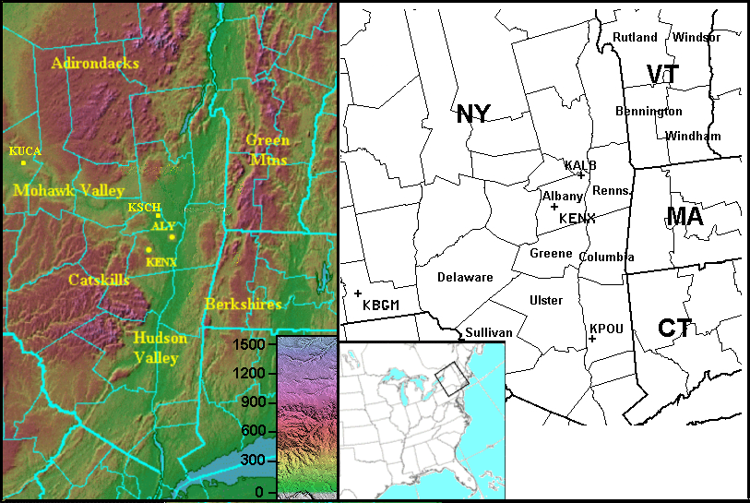
NWS at Albany Forecast Area
KGFL

Slide 7
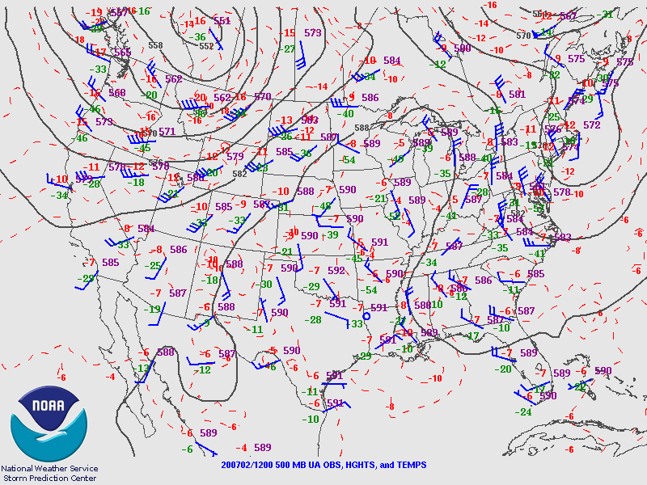
1200 UTC 2 JUL 2020 500 hPa Heights, Isotachs, and Temps
500 hPa trough axis down stream of the Albany forecast area over eastern New England
www.spc.noaa.gov

Slide 8
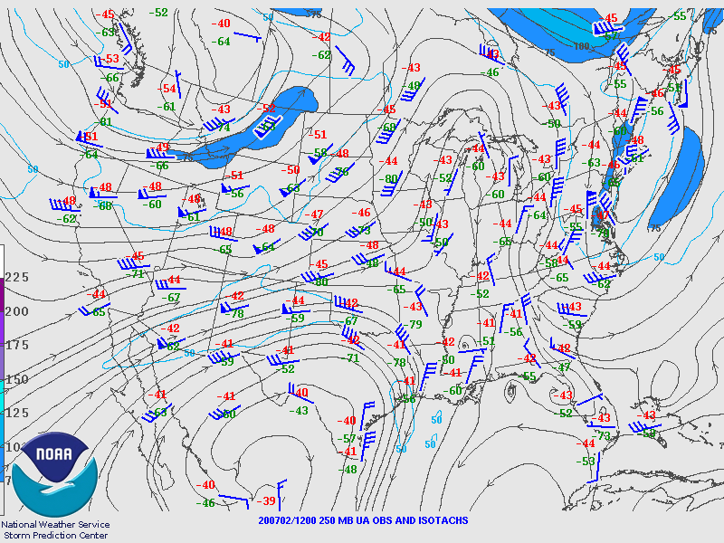
1200 UTC 2 JUL 2020 250 hPa Upper Air Obs & Isotachs (kts)
Modest jet streak of 75-80 kts over southern NY and New England.
www.spc.noaa.gov

Slide 9
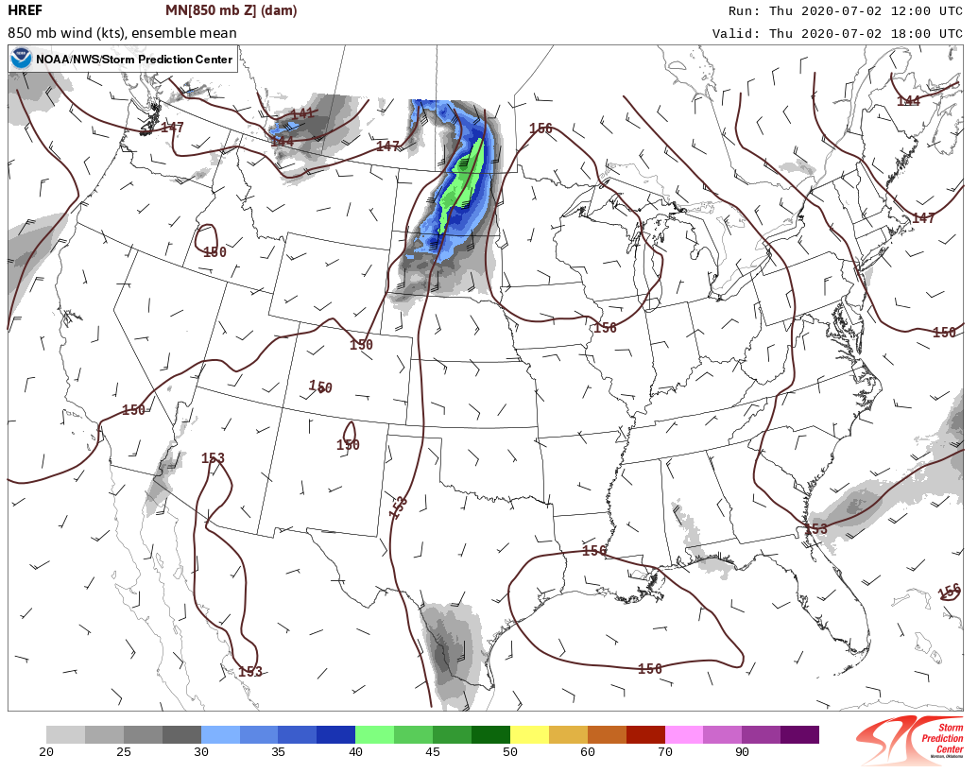
1200 UTC: 2 JUL 2020 HREF’s Forecast 1800 UTC 850 hPa Mean Winds (kts)& Heights (dam)

Slide 10
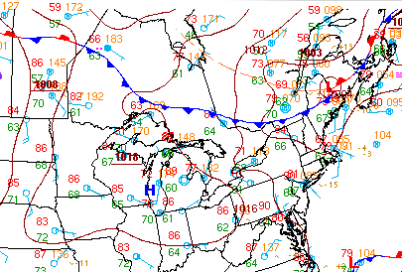
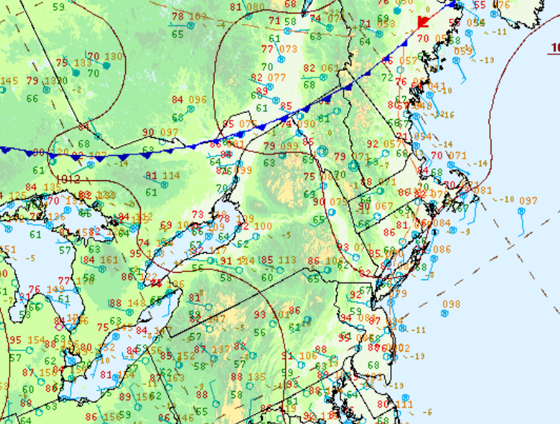
1800 & 2100 UTC 2 JUL 2020 WPC Surface Maps
Sfc dewpoints in the mid to upper 60’s with cold front to north. Temps warmed into the lower 90s.
1800 UTC
2100 UTC

Slide 11
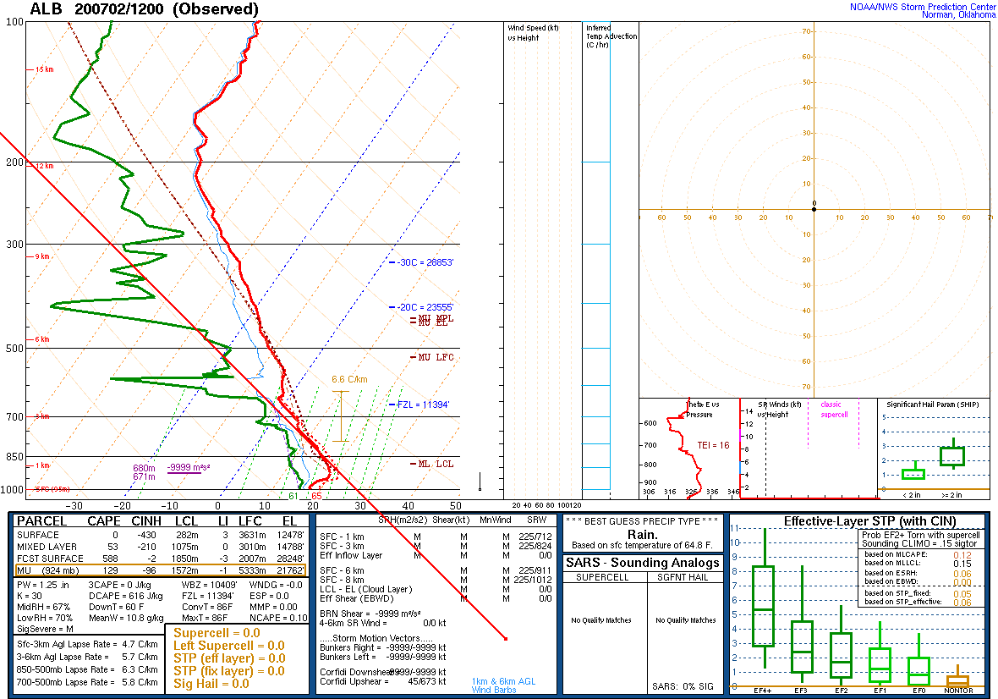
1200 UTC 2 JUL 2020 KALB Sounding
FCST CAPE = 583 J kg ⁻¹
700-500 hPa lapse rate: 5.8°C km⁻¹
0-6 km bulk shear = MSG
DCAPE = 616 J kg ⁻¹
Wet Bulb-Zero Height = 10.4 kft AGL
Freezing Level Height = 11.4 kft AGL
Precipitable Water = 1.25”
Convective Temp = 86°F
Boo!!! No winds on sounding! Maybe a bad sign of what was to come…

Slide 12
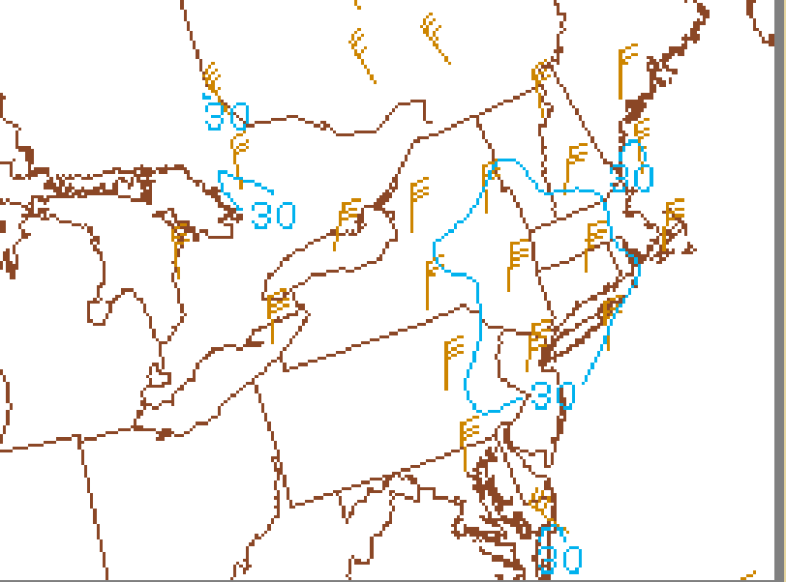
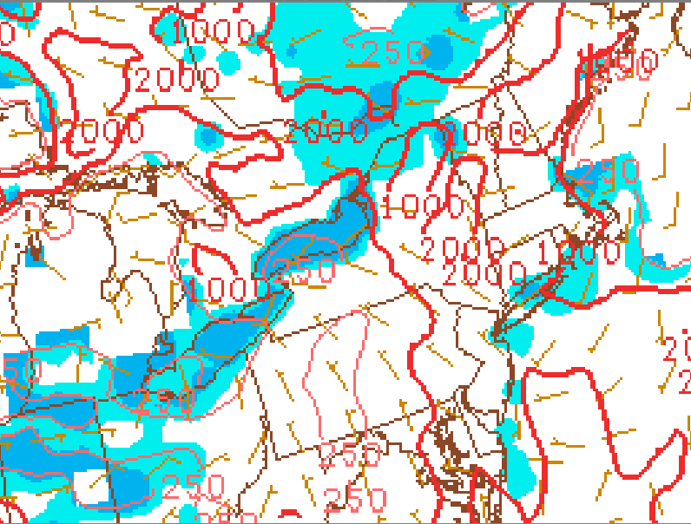
1800 UTC 2 JUL 2020 SPC RAP Mesoanalysis: Effective Bulk Shear (kts) and SBCAPE/SBCIN (J kg⁻¹)
0-6 km Effective Bulk Shear (knots)
SBCAPE/SBCIN (J kg⁻¹)
Notable deep shear 30-35 knots, and SBCAPE’s 1000-2000 J kg⁻¹

Slide 13
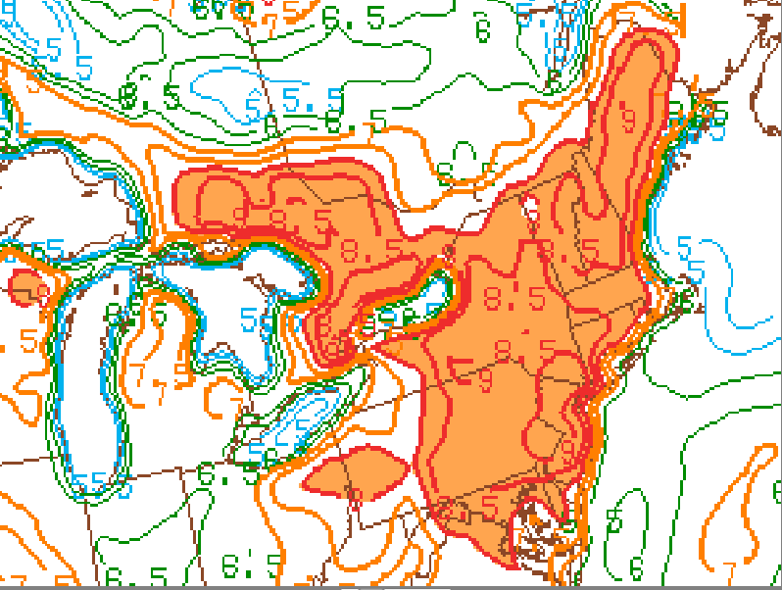
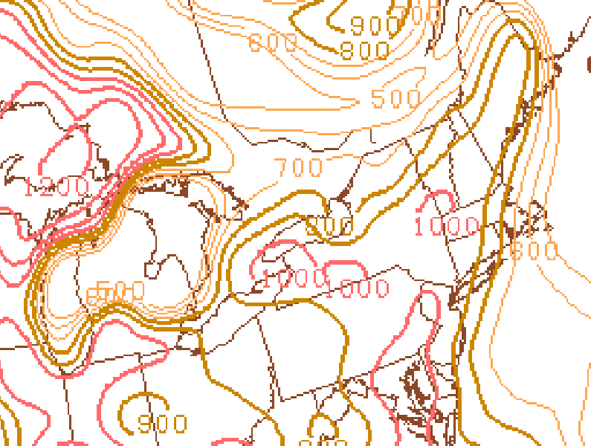
1800 UTC 2 JUL 2020 SPC RAP Mesoanalysis: 1000-700 hPa Lapse Rates (⁰C km⁻¹) & DCAPE (J kg⁻¹)
1000-700 hPa Lapse Rates (⁰C km⁻¹)
DBCAPE (J kg⁻¹)
The low-level lapse rates steepened, as the DCAPE is increasing to 800-1000+ J kg⁻¹

Slide 14
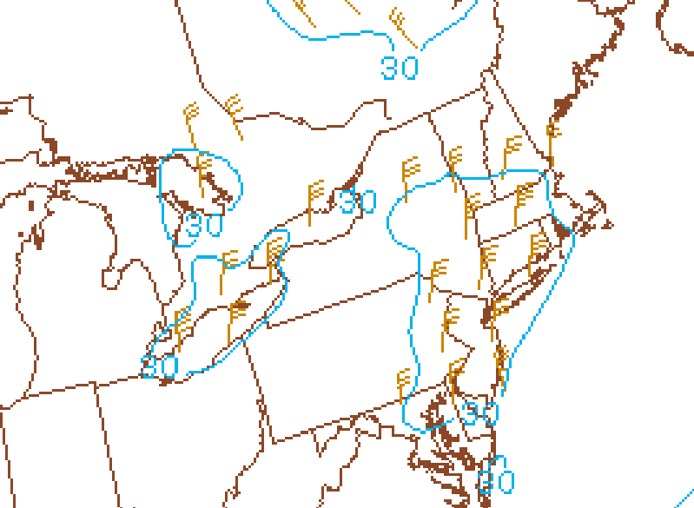
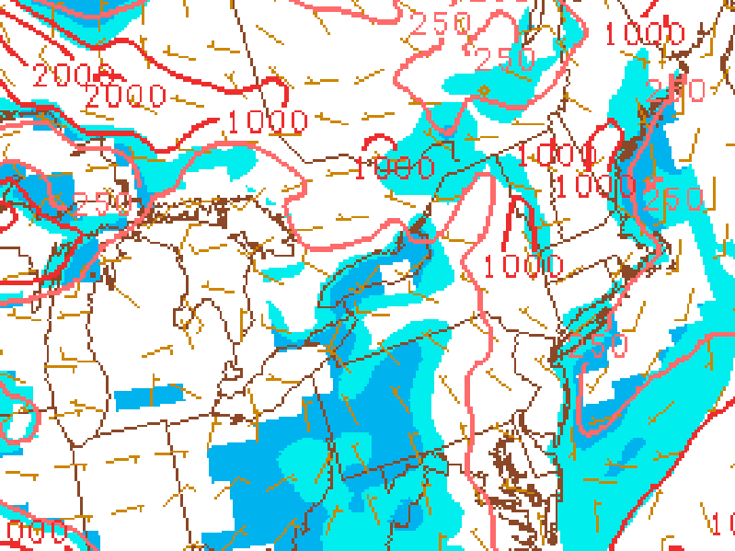
1800 UTC 2 JUL 2020 SPC RAP Mesoanalysis: 0-6 km Bulk Shear (kts) and MLCAPE/MLCIN (J kg⁻¹)
0-6 km Bulk Shear (knots)
MLCAPE/MLCIN (J kg⁻¹)
Deep shear 30-35 kts for possible multi-cells, but MLCAPE’s ~ 1000 J kg⁻¹

Slide 15
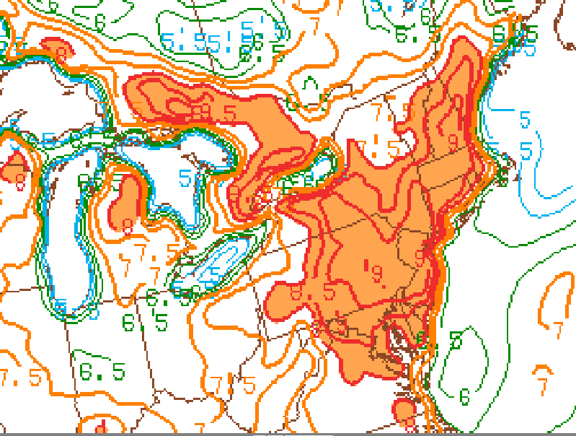
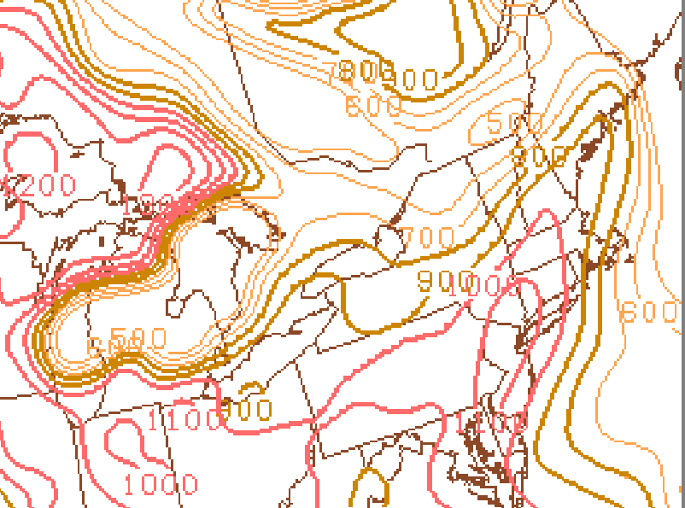
2100 UTC 2 JUL 2020 SPC RAP Meso-analysis: 1000-700 hPa Lapse Rates (⁰C km⁻¹) & DCAPE (J kg⁻¹)
1000-700 hPa Lapse Rates (⁰C km⁻¹)
DCAPE (J kg⁻¹)
Steep low-level lapse rates and DCAPE in the 700-1100+ J kg⁻¹ range, so concern for wet microbursts with convection that forms (strong downdrafts)

Slide 16
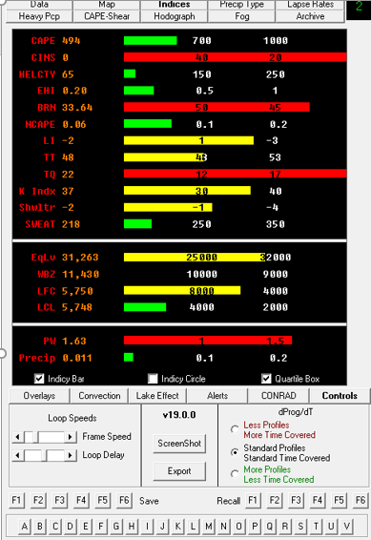
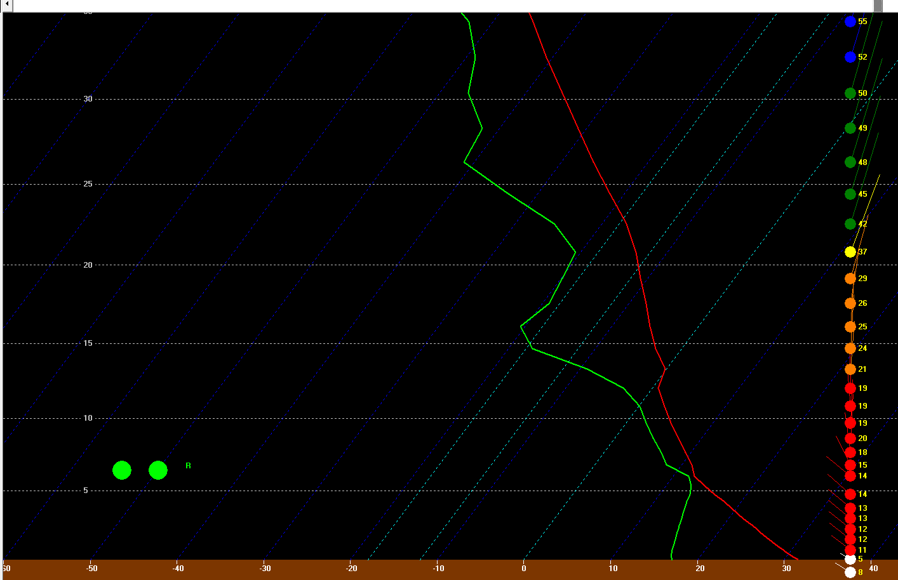
1800 UTC NAM KALB 20Z Forecast
SBCAPE = 494 J kg⁻¹
(18ZF00 = 1978 J kg⁻¹ with a dew point about 68°F)
0-6 km bulk shear = ~35 knots
WBZ Height= 11.4 kft AGL

Slide 17
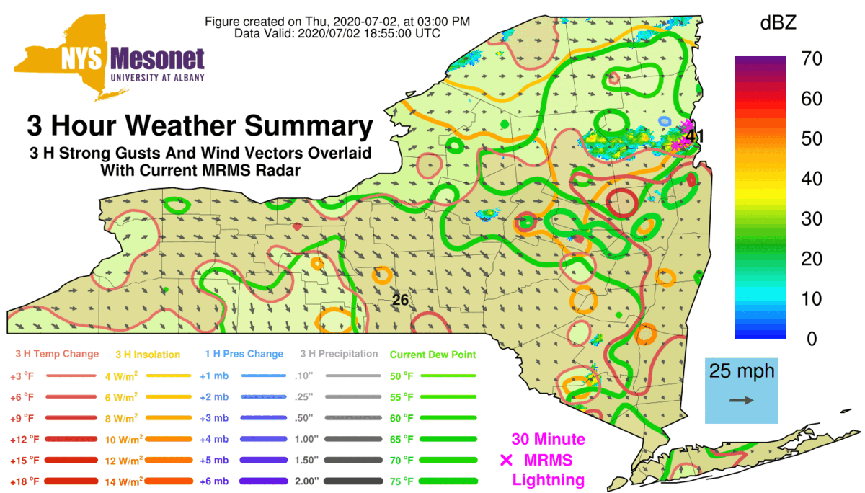
1900-2330 UTC NYS Mesonet 3-hr Strongest Gusts(mph), with current Radar Overlaid (dBZ), and Wind Vectors
Note: Other 3-hr variables contoured and shaded listed on lower left
Credit: NYS Mesonet at UAlbany

Slide 18
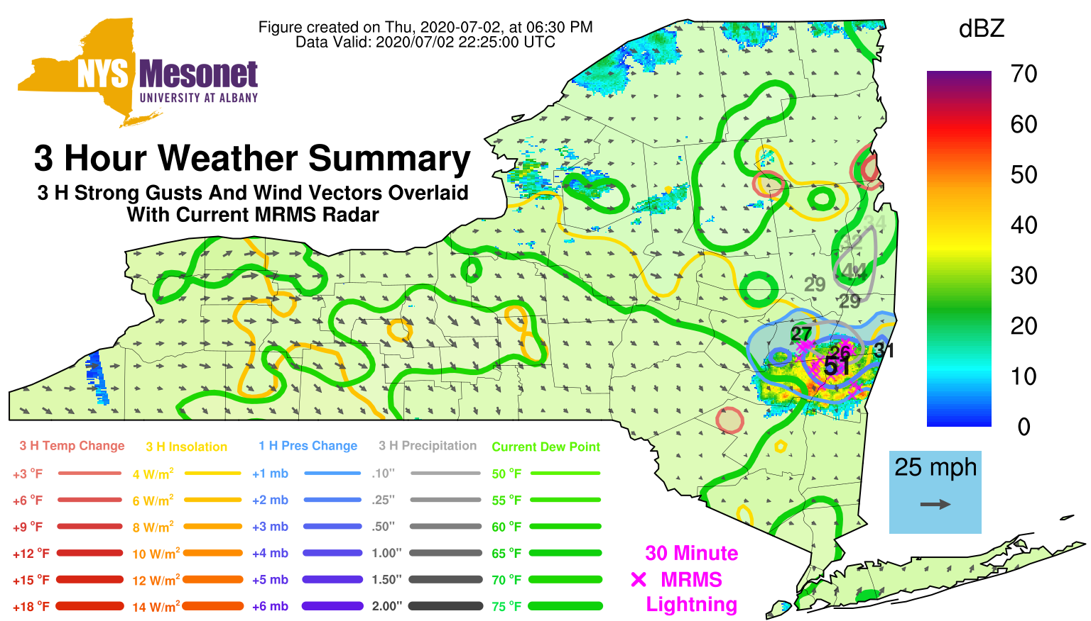
2230 UTC NYS Mesonet 3-hr Strongest Gusts(mph), with current Radar Overlaid (dBZ), and Wind Vectors
Note: Other 3-hr variables contoured and shaded list on lower left
Credit: NYS Mesonet at UAlbany

Slide 19
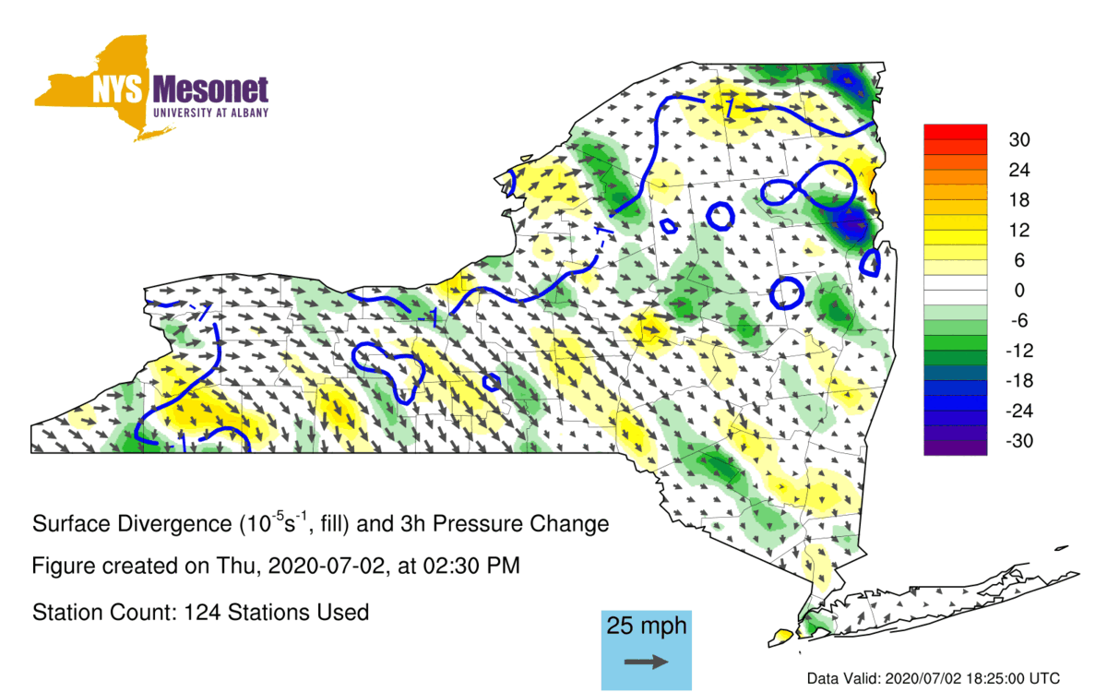
1900-2300 UTC NYS Mesonet Surface Divergence/Convergence (10⁻⁵ S⁻¹) & 3-hr Pressure Change (hPa)
Credit: NYS Mesonet at UAlbany

Slide 20
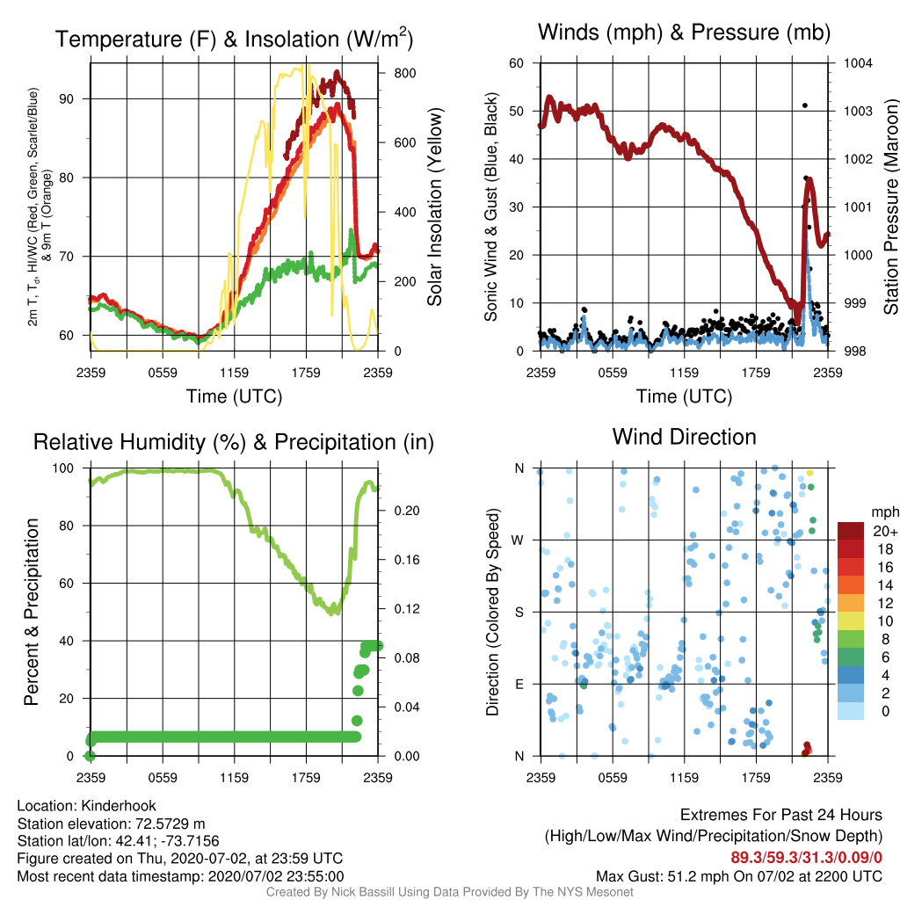
2 JUL 2020 Kinderhook Meteogram

Slide 21
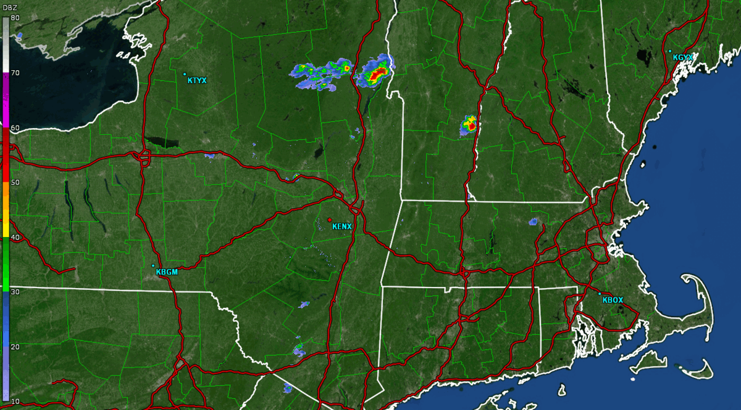
1901 UTC – 2301 UTC 2 JUL 2020 0.5⁰ KENX Base Reflectivity (dBZ) Loop

Slide 22
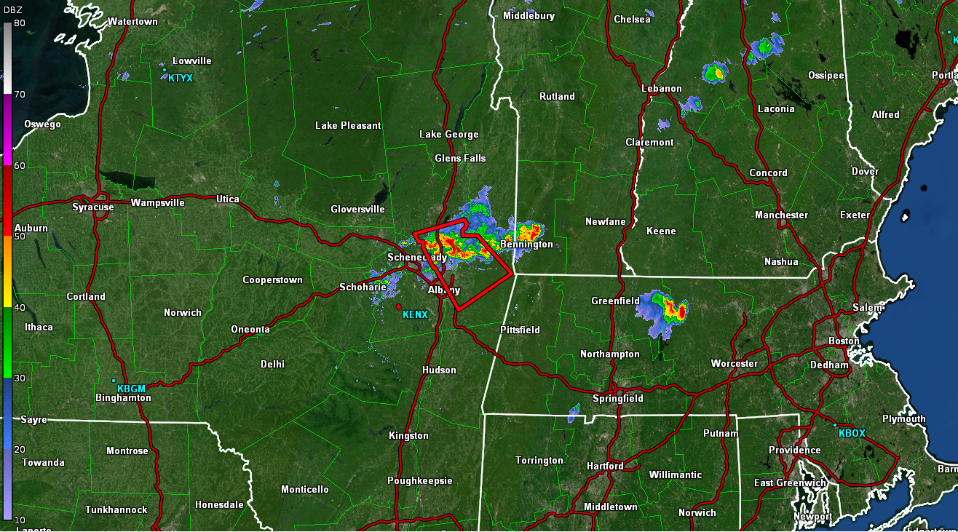
2109 UTC 0.5⁰ KENX Base REF (dBZ)
This was the first of 5 warnings issued due to a cluster of multi-cells orienting into a mini line over the Capital Region and eastern Mohawk Valley. Some wind damage was occurring to the north.

Slide 23
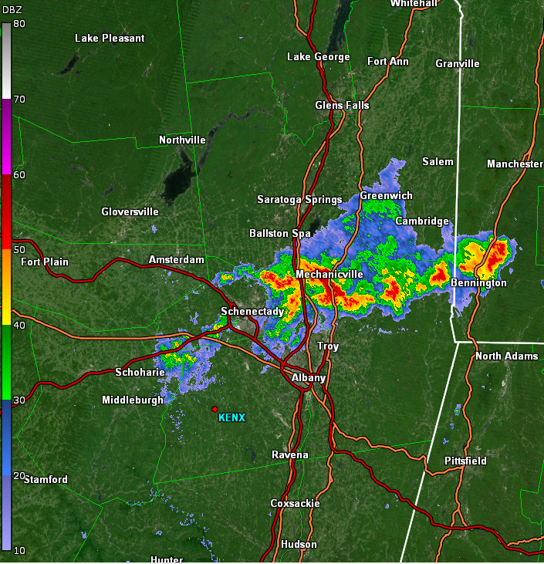
2111 UTC 0.5⁰ KENX Base Ref (dBZ) & Reflectivity Cross-section (dBZ)
Tall updraft with thunderstorm allowed 50 dBZ reflectivity core to reach 32 kft AGL (no hail reported). There were multiple reports with tree/trees reported down in the next 15-30 minutes east/southeast of Troy.

Slide 24
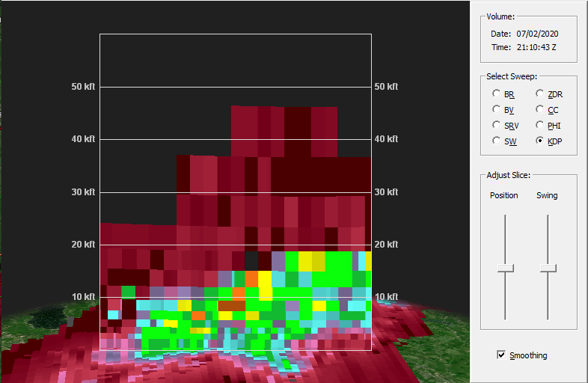
2111 UTC 0.5⁰ KENX K_{DP} (⁰/km) & Cross-section
K_{DP} values 5-7°/km
K_{DP} (Specific differential phase) indicates the liquid water content based on the size and/or concentration of the hydrometeors, and elevated values above the FZL (~11.4 kft AGL), such as a column of K_{DP} potentially indicates a wet microburst (Frugis 2020). Wind damage came in 10 minutes later.

Slide 25
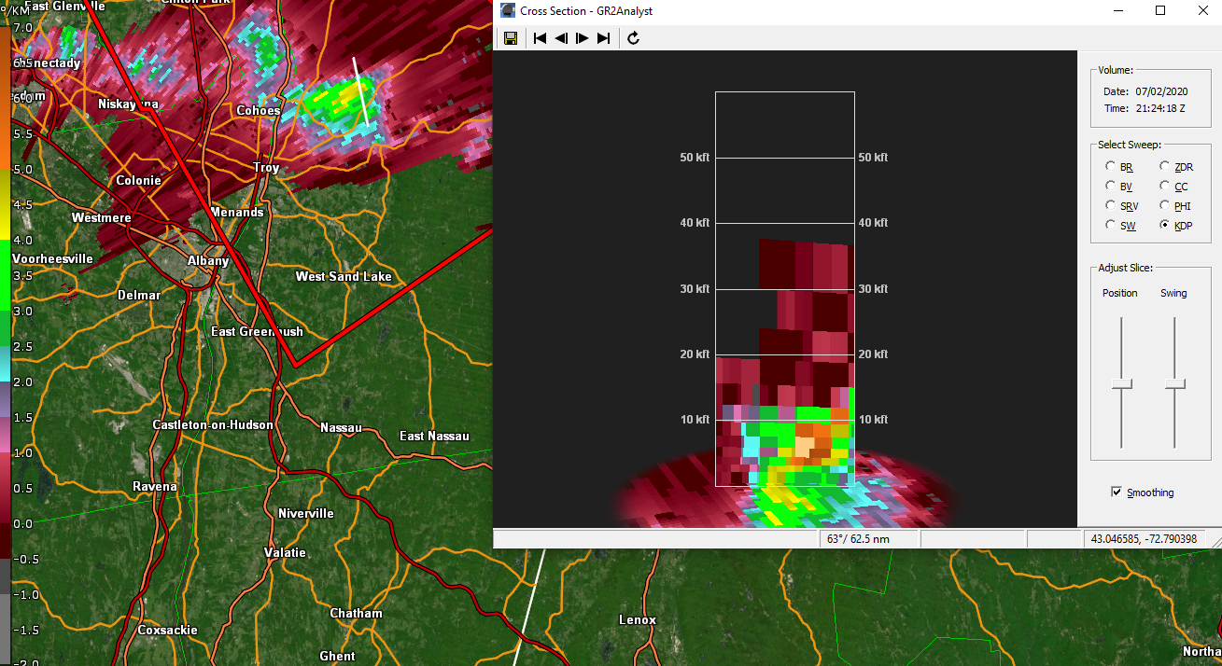
2124 UTC 0.5°KENX REF (dBZ)& K_{DP}(°/km) Cross-section
This severe thunderstorm was just northeast of Troy and the K_{DP} column continued to reach 11.5 kft (FZL ~ 11 kft AGL) and then descends with trees reported down in Brunswick & Poestenkill

Slide 26
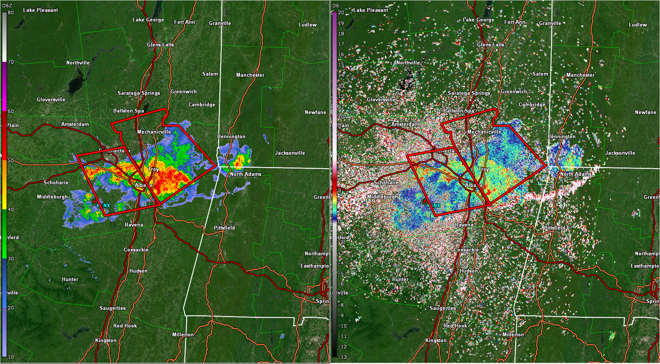
2137 UTC 0.5⁰ KENX Base Ref (dBZ) and ZDR (dB)

Slide 27
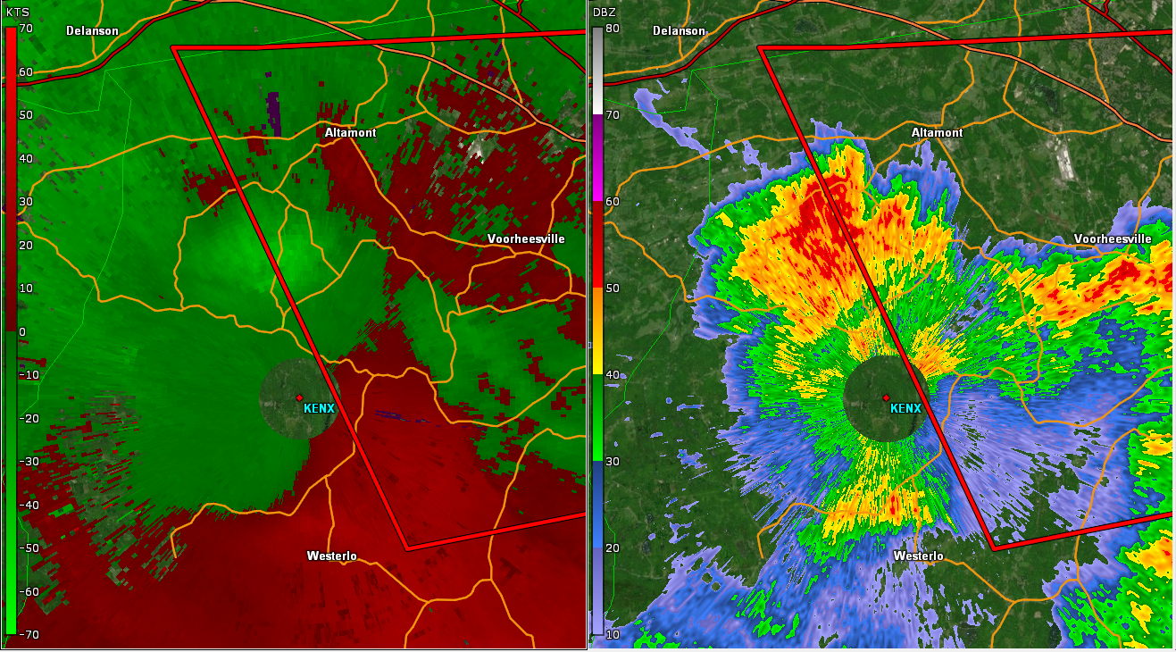
2154 UTC 0.5° KENX Velocity (kts) and Base Ref (dBZ)
Severe convection expanded westward along the outflow boundary with a distinct velocity and reflectivity max west of the Capital District. Max velocity 47 knots at ~ 2000 ft AGL west of Voorheesville
A few wind damage reports would come in a few minutes later near Berne, NY close to the KENX RDA

Slide 28
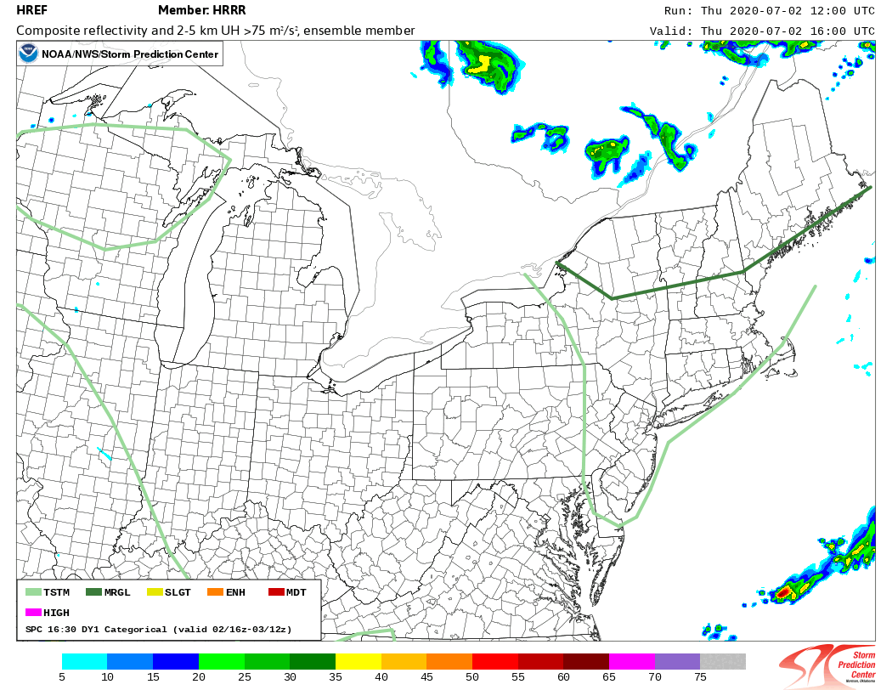
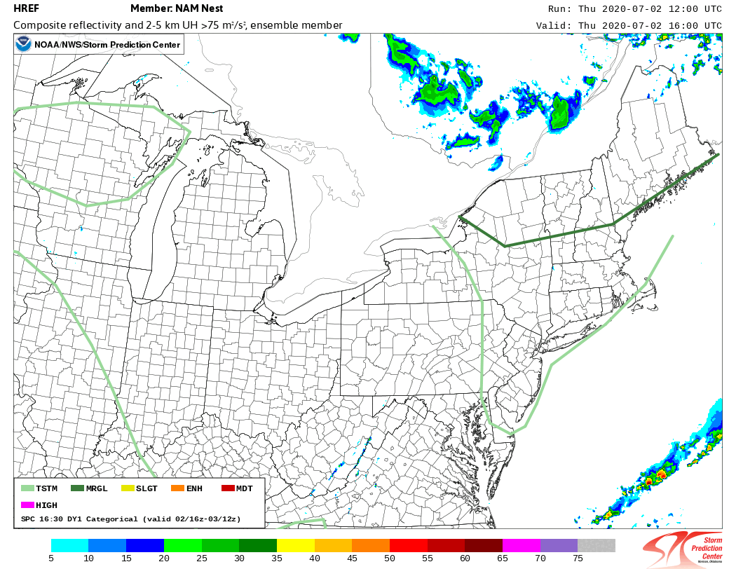
1200 UTC 2 Jul 2020 HREF HRRR vs NAM Nest 16-00 UTC Composite Reflectivity (dBZ)
HRRR
NAM Nest
1630 UTC SPC Day 1 Outlook overlaid

Slide 29
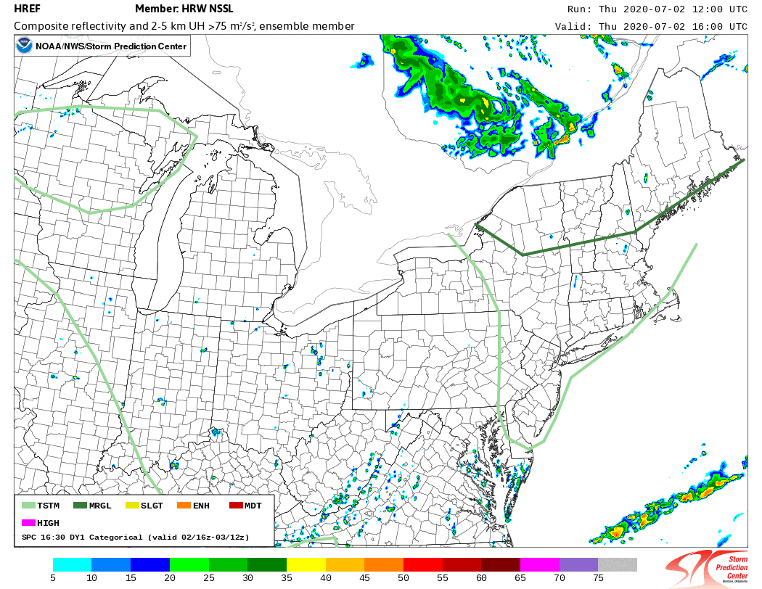
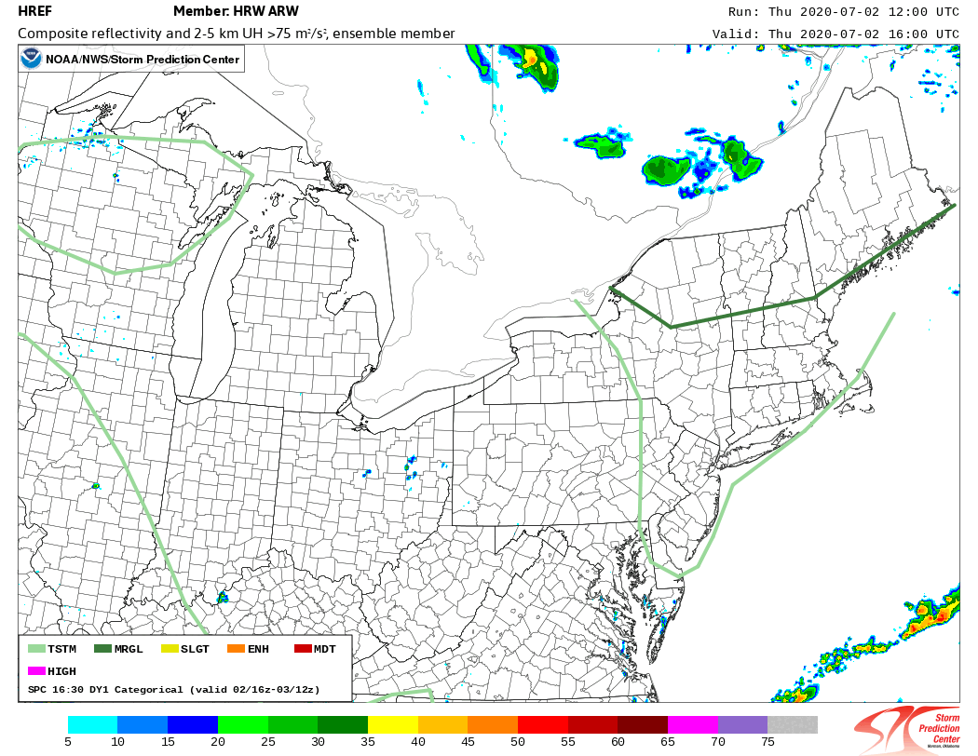
1200 UTC 2 Jul 2020 HRW NSSL vs HRW ARW 16-00 UTC Composite Reflectivity (dBZ)
HRW NSSL
HRW ARW
1630 UTC SPC Day 1 Outlook overlaid

Slide 30
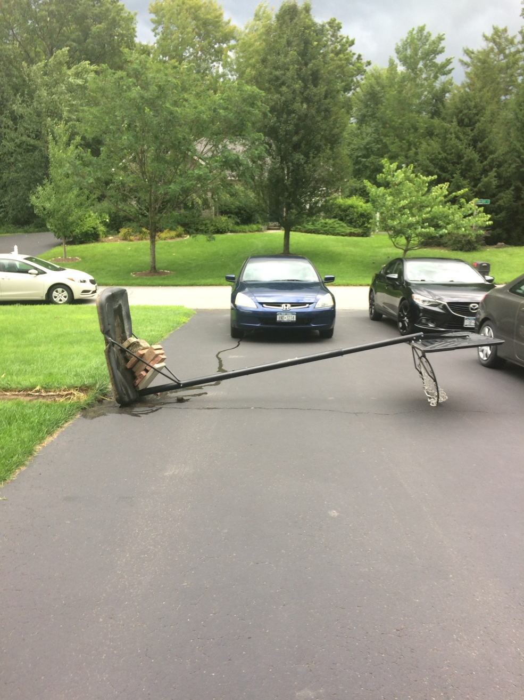
Strong Wind Gust at my Home…Again
The Emperor did not do this with a force push

Slide 31
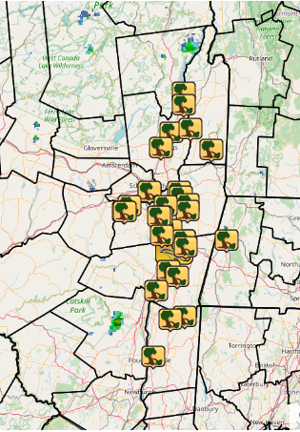
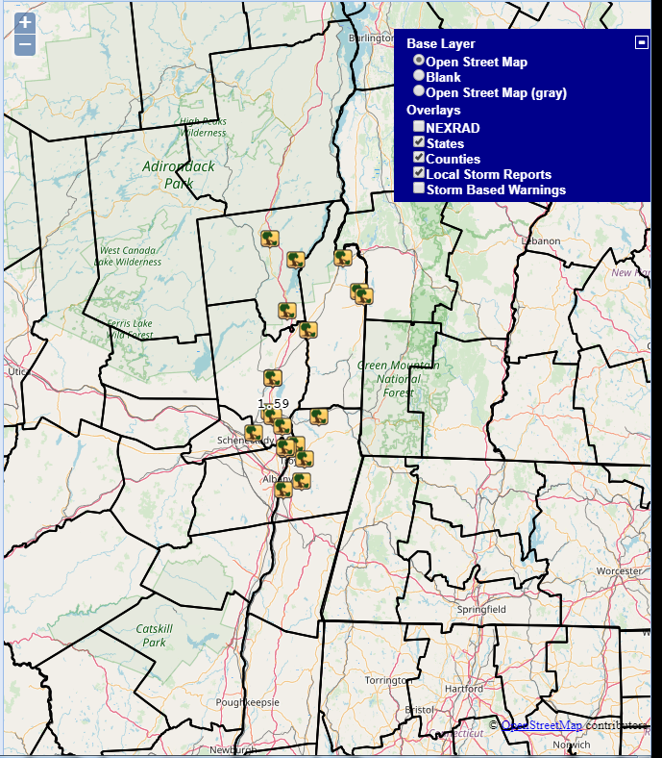
2 JUL 2020 vs 4 AUG 2018 1800 UTC – 0000 UTC Damage Reports
2 JUL 2020
4 AUG 2018

Slide 32
Summary
Low predictability and localized high impact severe weather event (30 wind damage reports in ALY area)
Moderate shear (30-35 kts) and moderate instability pre-convective environment with north/northwest flow aloft
DCAPE values were impressive in the 800-1100+ J kg⁻¹ range with very steep low-level lapse rates (inverted-V signature)
Dual Pol K_{DP} descending columns helped assess damaging winds
Impressive outflow boundary/gust front moved through Capital Region with damage (51 mph gust at Kinderhook in NYS Mesonet). Cold pool helped sustain convection down Hudson River Valley.
1200 UTC 3-km HRRR run did poorly with convection with the 3-km HRW NSSL and NAM Nest doing somewhat better

Slide 33
Future Work
Examine more north/northwest flow severe weather cases ( 4 AUG 2018 and 2 JUL 2020 are two examples) and stratify convective parameters and understand pre-convective environment
Continue to study role of outflows boundaries in local complex terrain
Possible CSTAR VIII project

