Slide 1
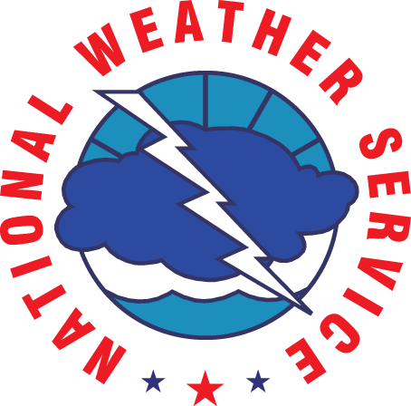
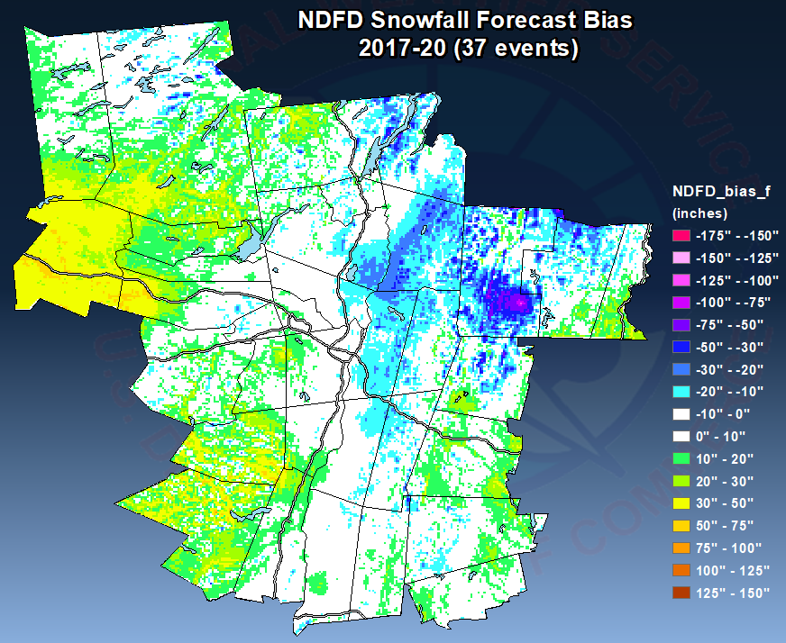
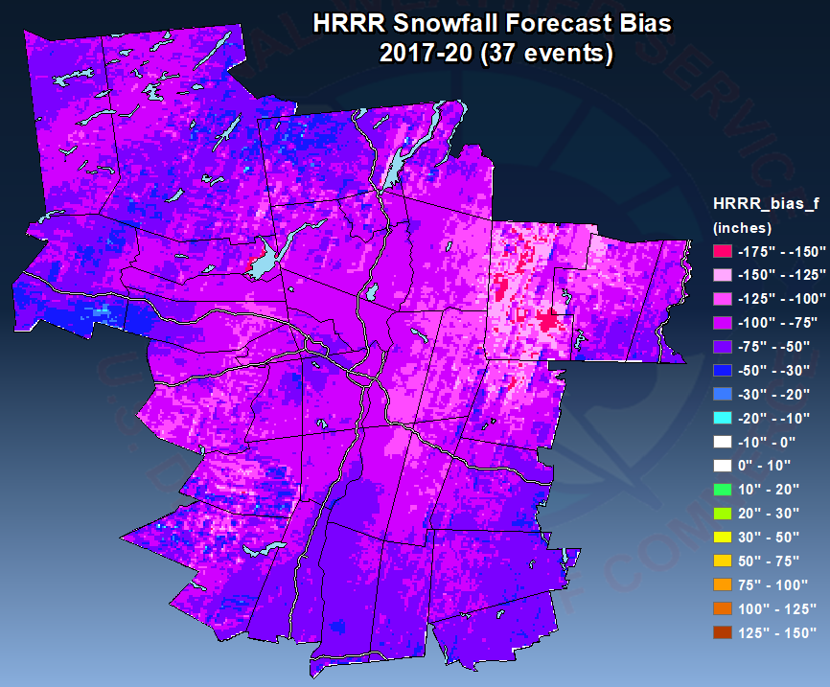
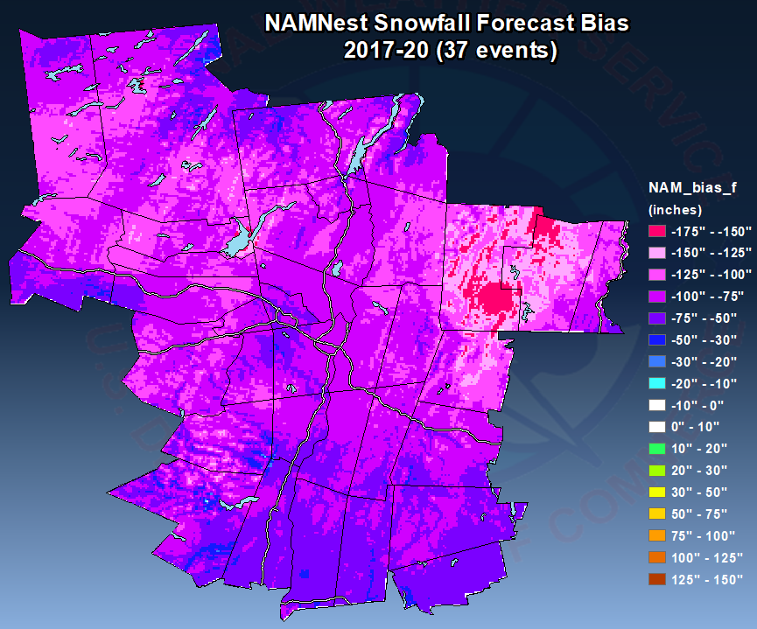
Final Appraisal: Evaluating the accuracy of forecaster and model predictions of snowfall in eastern New York and western New England using a GIS application
Joe Villani, Mike Evans & Vasil Koleci
NOAA/NWS Weather Forecast Office, Albany, NY
Charles (Danny) Gant
NOAA/NWS Weather Forecast Office, Morristown, TN

Slide 2
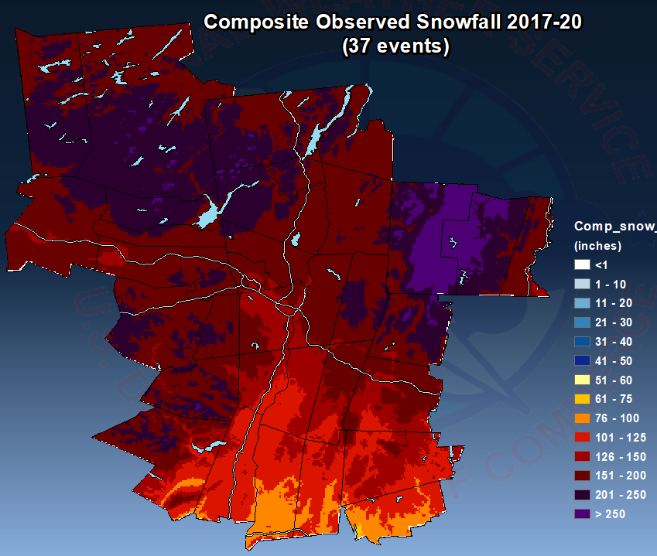
Motivation
NWS Forecasts and high-resolution models reflect lots of detail on the impact of terrain on snowfall; but how good are these detailed forecasts?
Determine relationships between environmental parameters and the impact of topography on snowfall.
Assess accuracy of the impact of terrain on snowfall forecasts from NWS Albany, high-resolution (3 km) models HRRR and NAMNest across eastern New York and western New England.
Stratify observed snowfall analyses and forecast error maps by environmental parameters such as low-level wind direction & speed, surface temperature, flow blocking, 950-850mb lapse rate, and elevation ratio (snowfall > 1000 feet divided by snowfall < 1000 feet).

Slide 3
Froude Number
Froude Number is an estimation of whether the flow can make it over a mountain barrier and is a ratio of the wind perpendicular to the barrier vs. the atmospheric stability.
If the Froude Number is low (< 1), it is subcritical and blocked. Air will not make it over the mountain and precipitation will back up behind the barrier.
If the Froude Number is high (> 1), it is supercritical and unblocked. The air will flow freely over the mountains and deposit the heaviest precipitation on the leeward side.
A Froude Number near 1 is considered critical, and the heaviest precipitation will likely fall along the barrier.
Image courtesy of NWS Burlington, VT

Slide 4
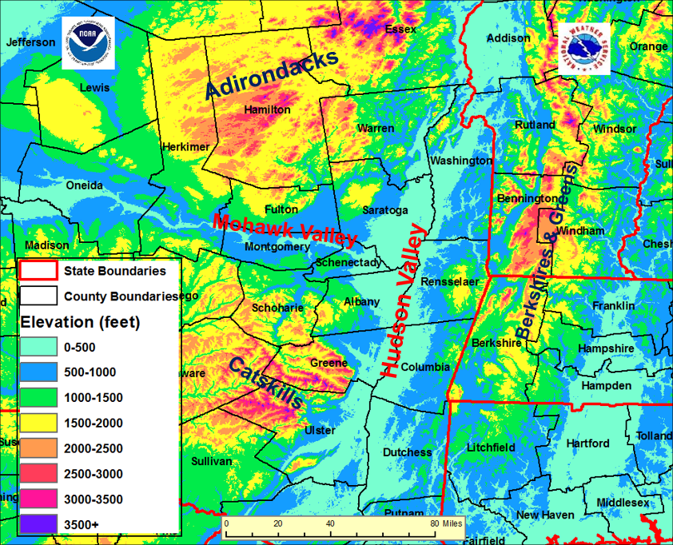
Geography/Topography

Slide 5
Methodology
Model snowfall forecasts were determined from Positive Snow Depth Change from the HRRR and NAMNest.
Archived NDFD (National Digital Forecast Database) used for NWS Albany forecast snowfall.
GAZPACHO (Gridded Automated Zonal Precipitation & Compete Hi-Res Output) utilized for snowfall analyses and forecast error plots:
https://vlab.ncep.noaa.gov/redmine/projects/nwsscp/wiki/Gazpacho
37 events were strategically selected from the 2017-2020 winters.
Environmental parameters were calculated from 00 hour RAP soundings using BUFKIT every 3 hours through the duration of each event.
Parameters were then time-averaged and entered into a spreadsheet:

Slide 6
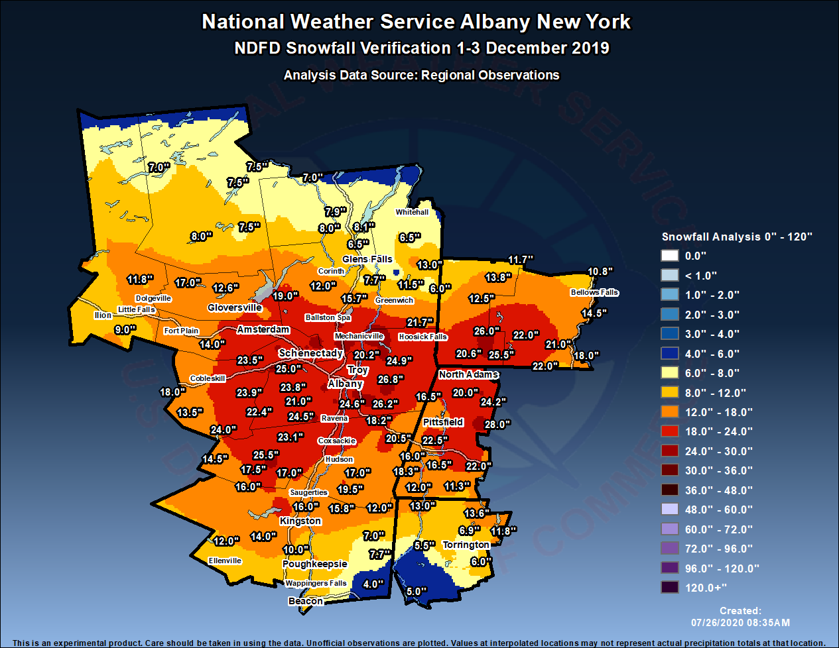
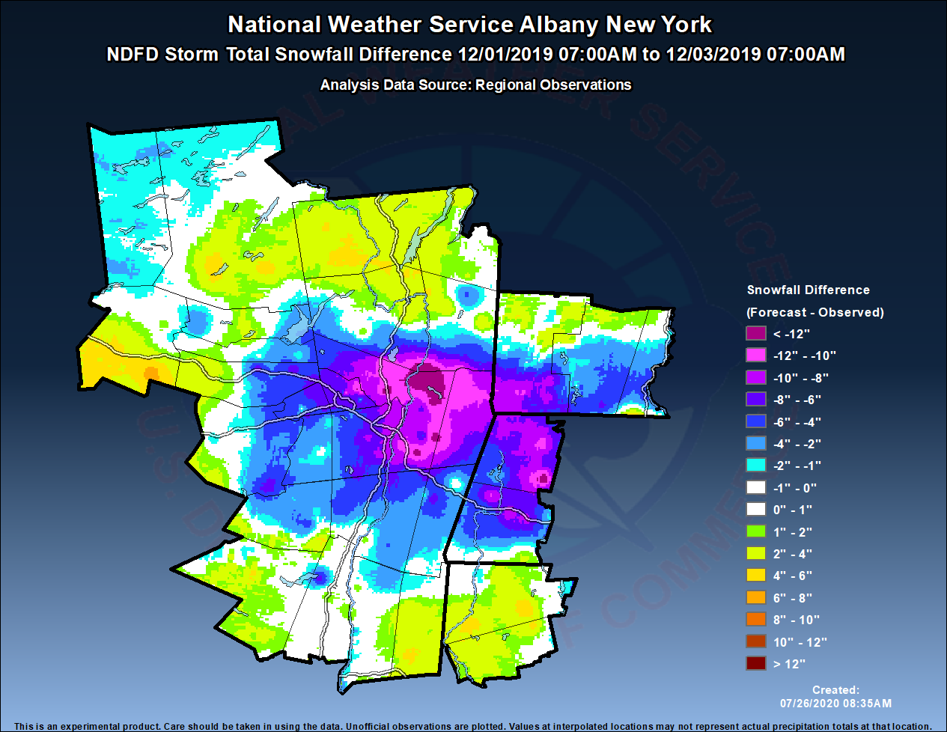
Methodology
Median values for each parameter were determined, then each event was binned into values > or < the median.
Maps of Observed Snowfall and Forecast Error from NDFD(below), HRRR & NAMNest(next slide) were created for each parameter.
Observed Snowfall 1-3 December 2019
NDFD Forecast Error 1-3 December 2019

Slide 7
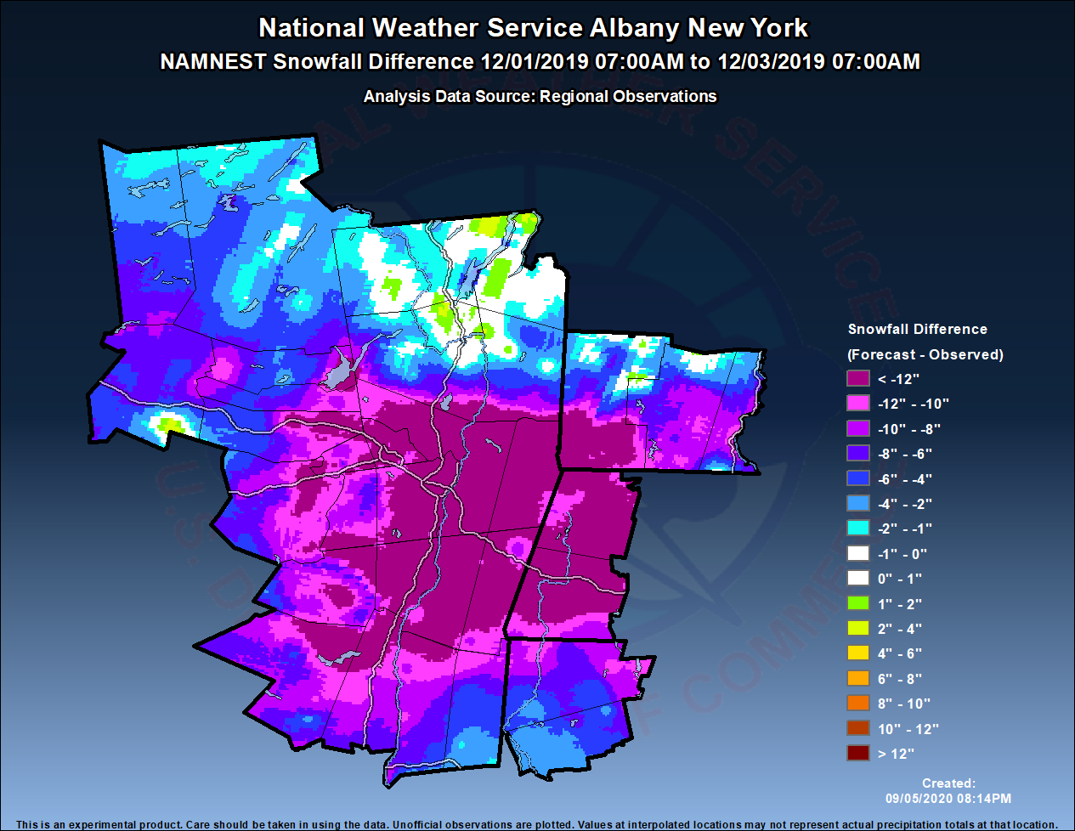
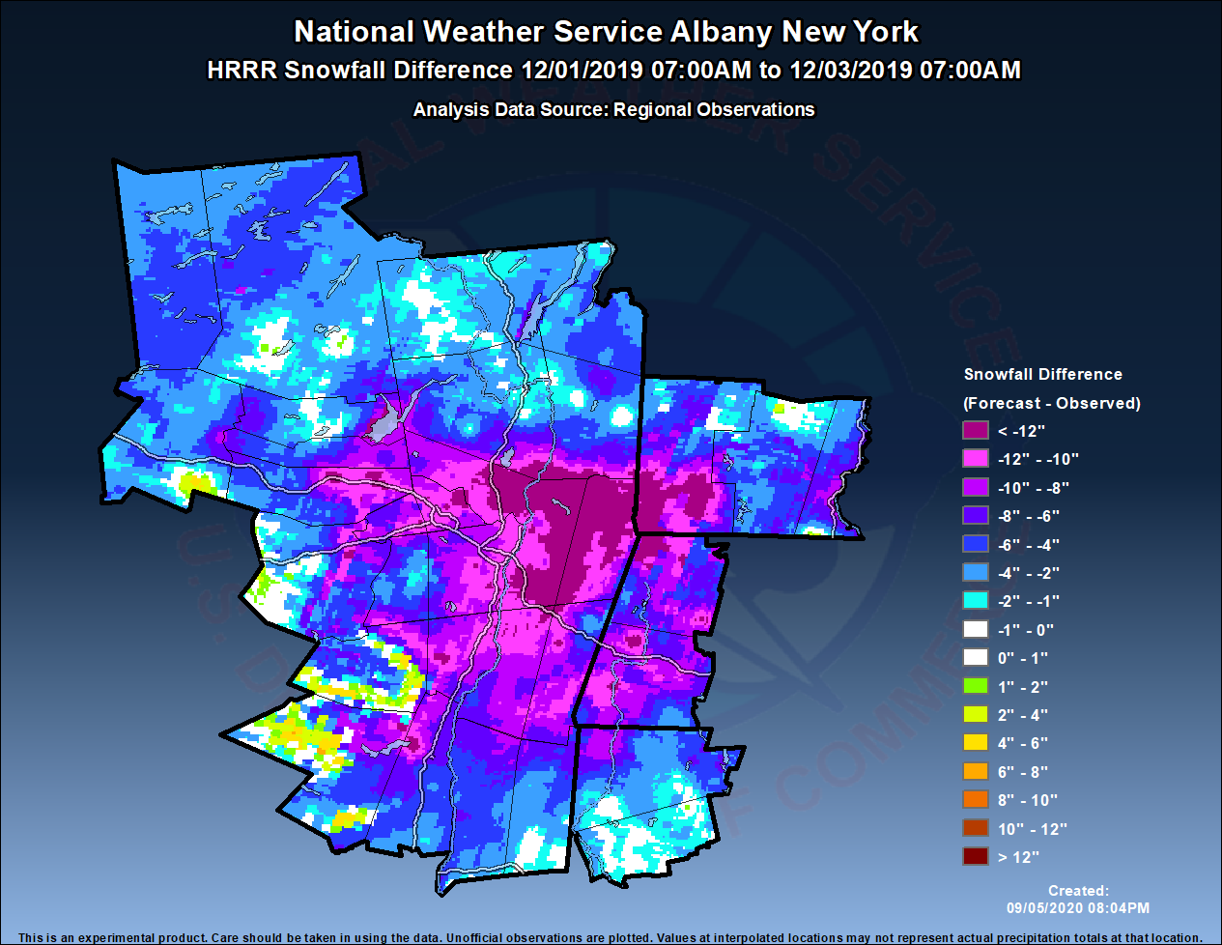
Methodology
NAMNest Forecast Error 1-3 December 2019
HRRR Forecast Error 1-3 December 2019

Slide 8
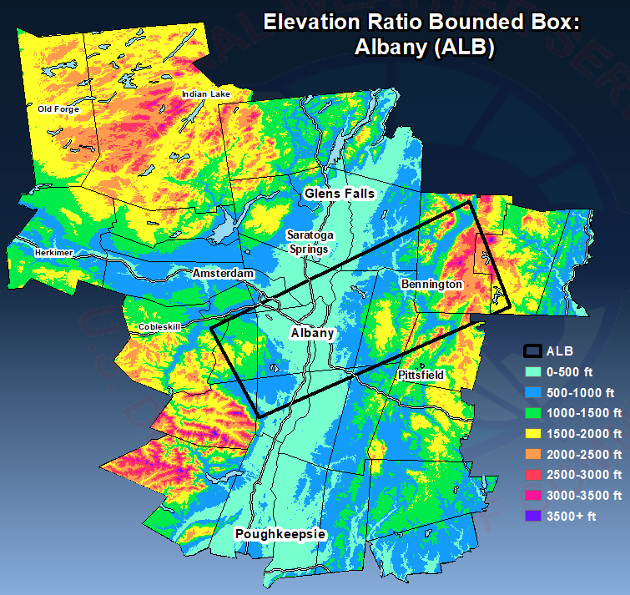
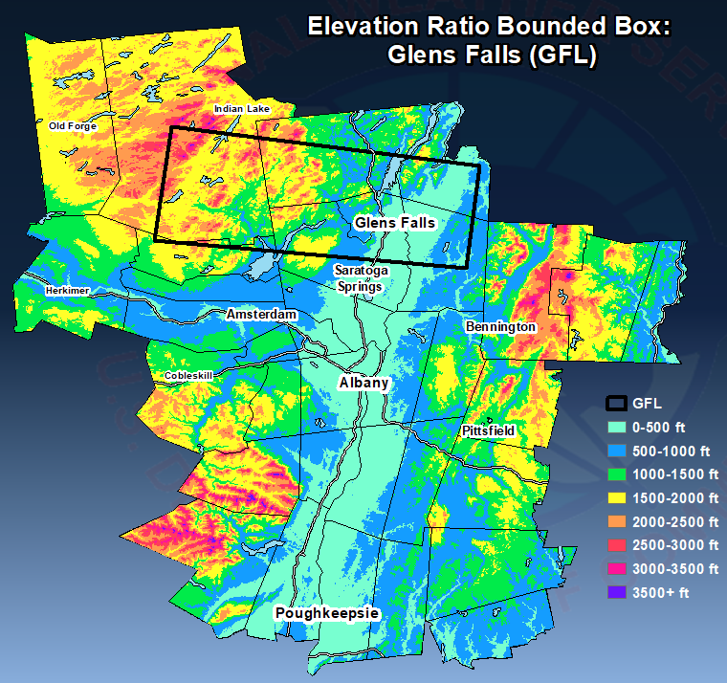
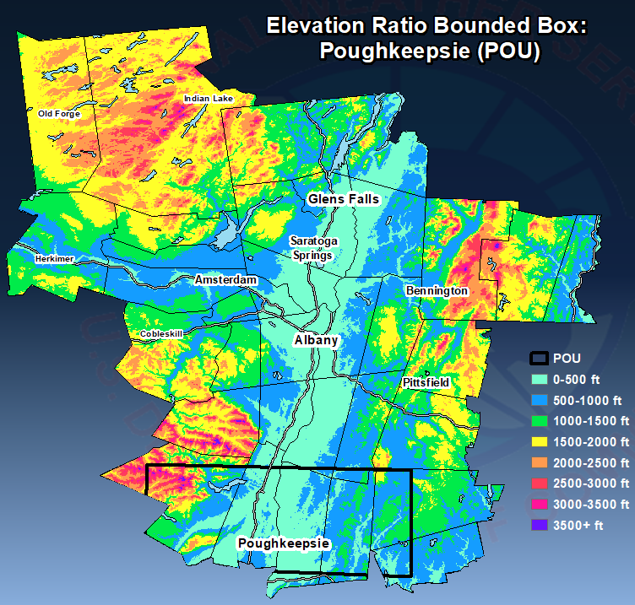
Methodology
Elevation ratio computed within predetermined areas centered over the location of an Automated Surface Observing System (ASOS) location that received the most snowfall from each event [either Albany, NY (ALB), Glens Falls, NY (GFL) or Poughkeepsie, NY (POU)].

Slide 9
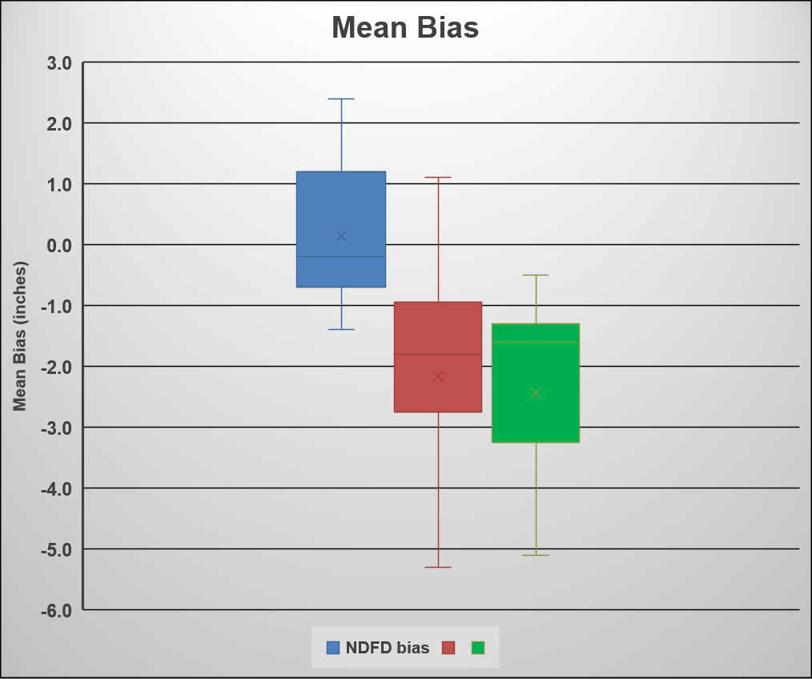
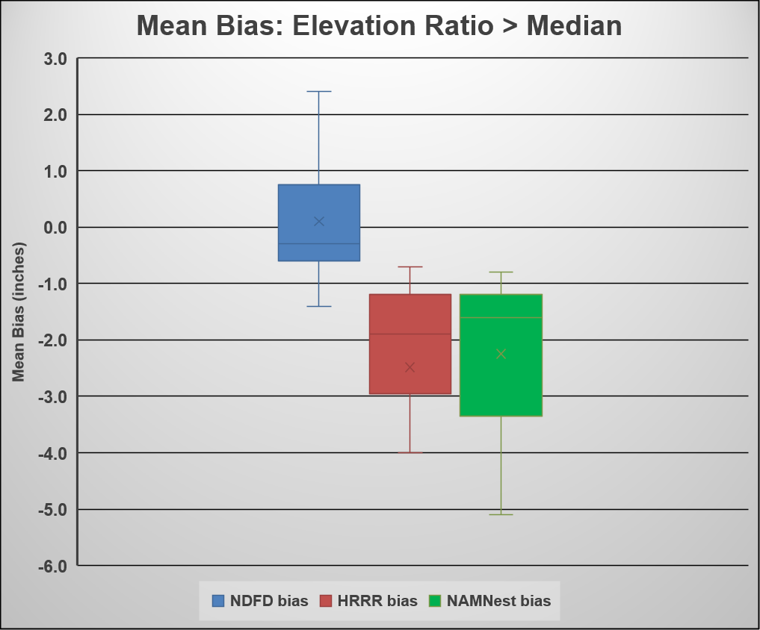
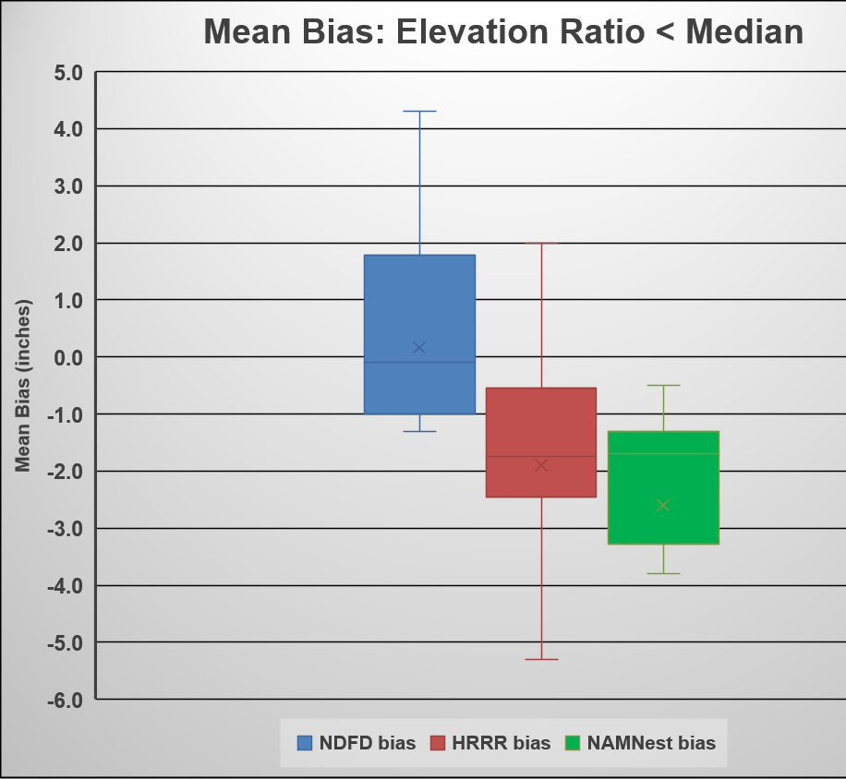
Results
Mean forecast bias from NDFD, HRRR and NAMNest bias varied from event to event.
HRRR and NAMNest biases were consistently negative.
Likely partially due to using Positive Snow Depth Change instead of Snowfall (which assumes 10:1 snow to liquid ratio). Correspondence with Environmental Modeling Center, suggested to use Positive Snow Depth for better model snowfall representation.
Mean bias did not vary much with elevation ratios > or < the median

Slide 10
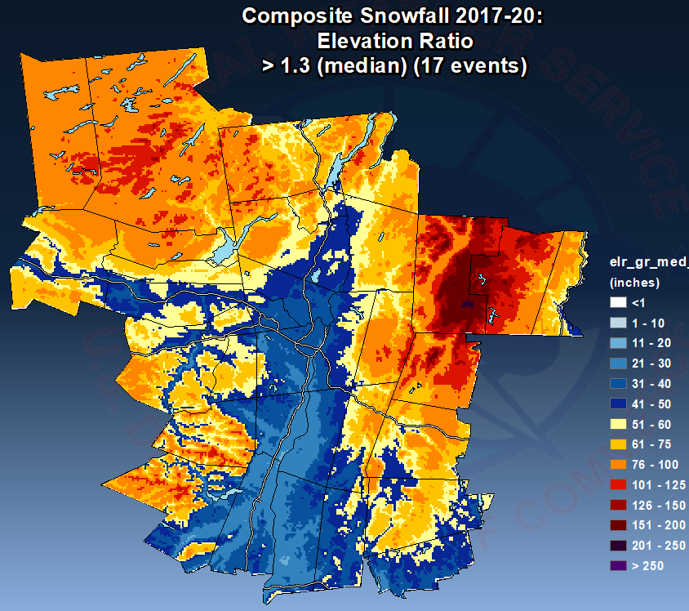
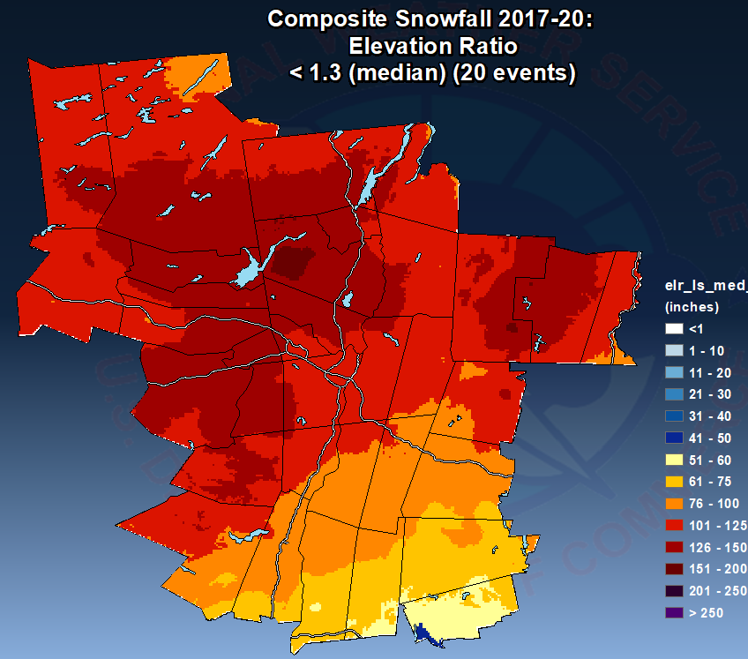
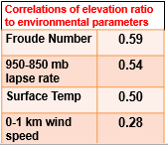
Results
Observed snowfall composites show greater disparity in snowfall at higher vs. low elevations for events > median.
Snowfall more uniform across elevations for events < median.
Observed snowfall composite > median
Observed snowfall composite < median
Substantial correlation values were found between elevation ratio and several environmental parameters

Slide 11
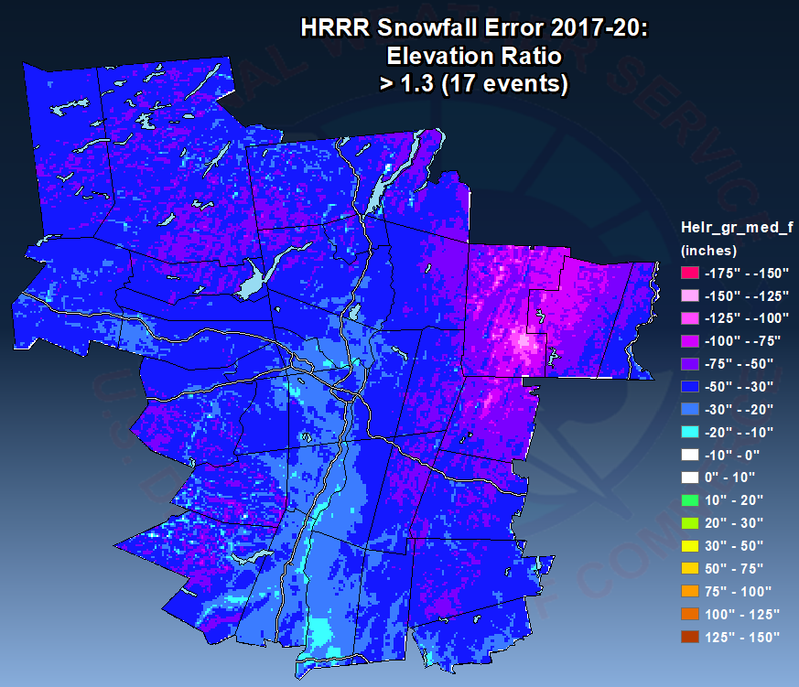
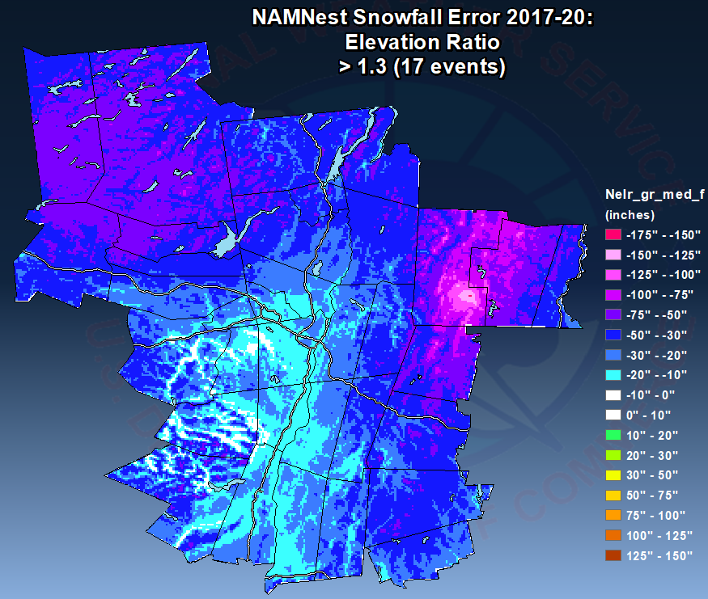
Results
The HRRR and NAMNest exhibited similar spatial patterns of snowfall forecast error.
Example shown for Elevation Ratio.
A snowfall under-forecast bias was most pronounced at higher elevations, especially over southern Vermont, in environments characterized by large elevation ratios, instability and stronger winds.
HRRR snowfall forecast error > median
NAMNest snowfall forecast error > median

Slide 12
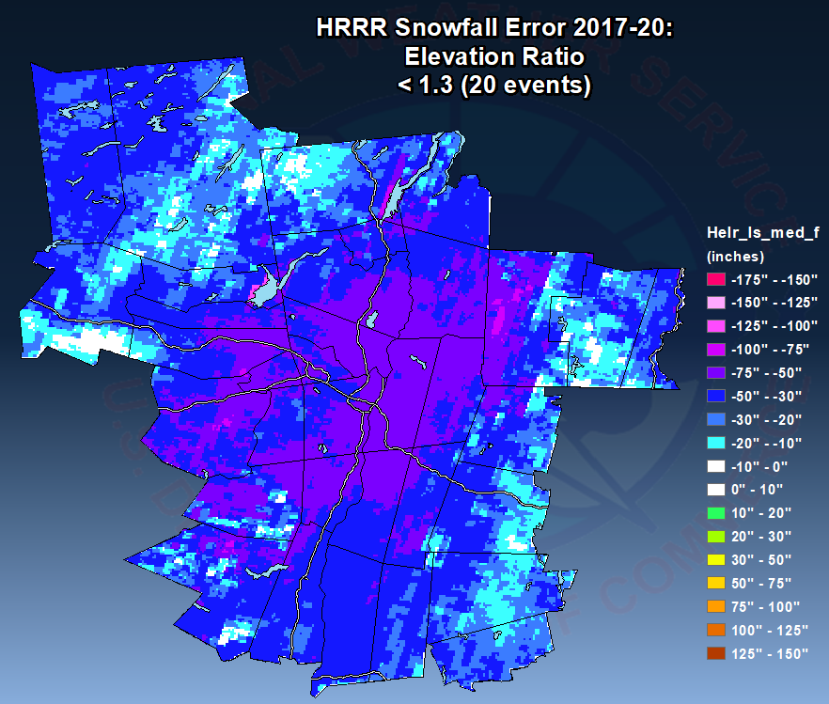
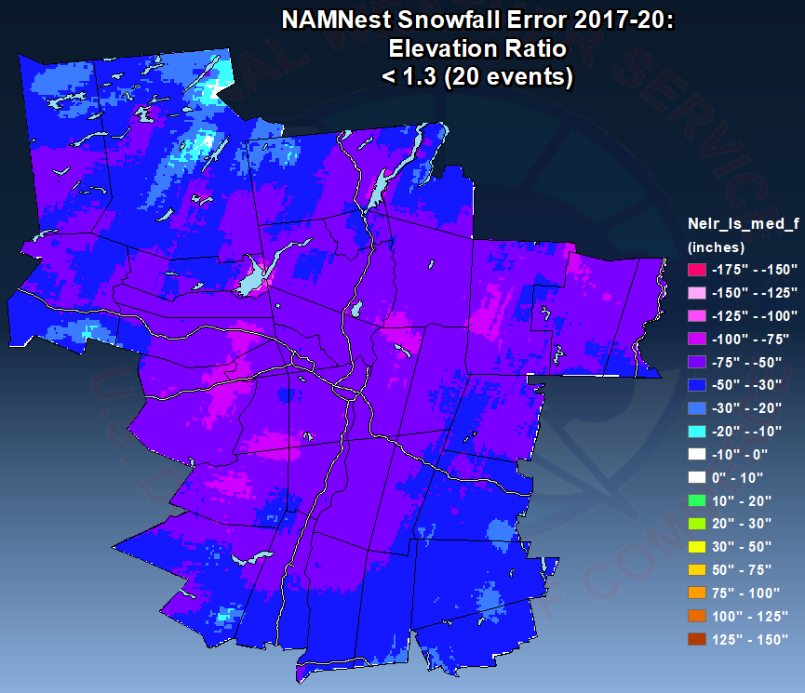
Results
The HRRR and NAMNest exhibited similar spatial patterns of snowfall forecast error.
Example shown for Elevation Ratio.
A snowfall under-forecast bias was more uniform in coverage and magnitude, in environments characterized by small elevation ratios, more stable conditions and lighter winds.
HRRR snowfall forecast error < median
NAMNest snowfall forecast error < median

Slide 13
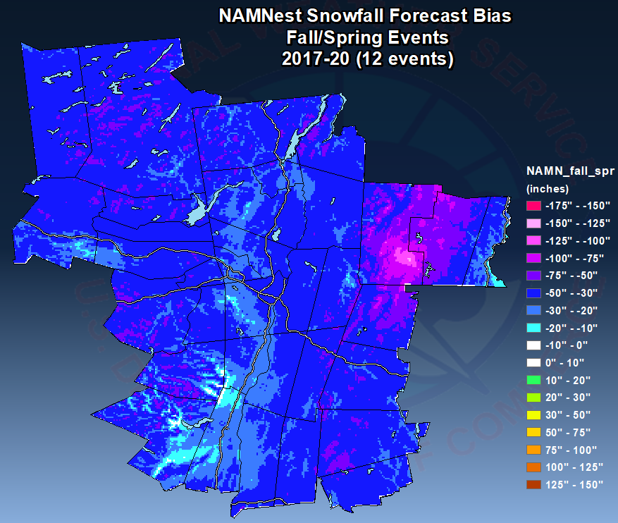
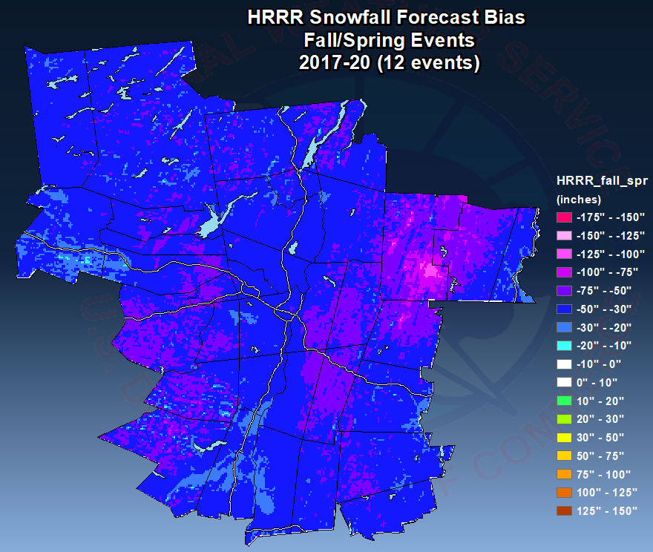
Results: Seasonal
A more pronounced orographic signal evident for spring/fall events, particularly over the southern Green mountains of Vermont and also the eastern Catskills.
Both NAMNest and HRRR displayed similar results, with lowest forecast bias over the southern Green Mountains.
NAMNest snowfall bias (Oct/Nov/Mar/Apr)
HRRR snowfall bias (Oct/Nov/Mar/Apr)

Slide 14
Results: Bias Composites (all events)
NDFD forecasts had some positive and negative forecast bias generally going from west to east across the area
NAMNest and HRRR forecasts had a decidedly negative composite forecast bias

Slide 15
Conclusions
Primary finding: little evidence for difference in forecast snowfall bias for high elevation ratio cases vs. low elevation ratio cases.
However, tendency for HRRR and NAMNest to under-forecast snowfall can be seen in the composite maps.
Greatest snowfall under-forecast area over southern Vermont (Green Mountains):
Especially in NW flow and when the environment was warmer and more unstable, and the flow was less blocked, than the median for the storms in this study.
This tendency for under-forecasting was more noticeable for southern Vermont than in other similarly mountainous areas such as the Catskills and southern Adirondacks.
GAZPACHO is a useful research tool. NWS offices can download via VLAB:
https://vlab.ncep.noaa.gov/redmine/projects/nwsscp/wiki/Gazpacho

Slide 16
Questions/Comments?
Acknowledgements
University at Albany students Chris Genz, Jamin Marino and Luke LeBel for helping to collect and analyze data for this study.
Joe.Villani@noaa.gov

