Slide 1
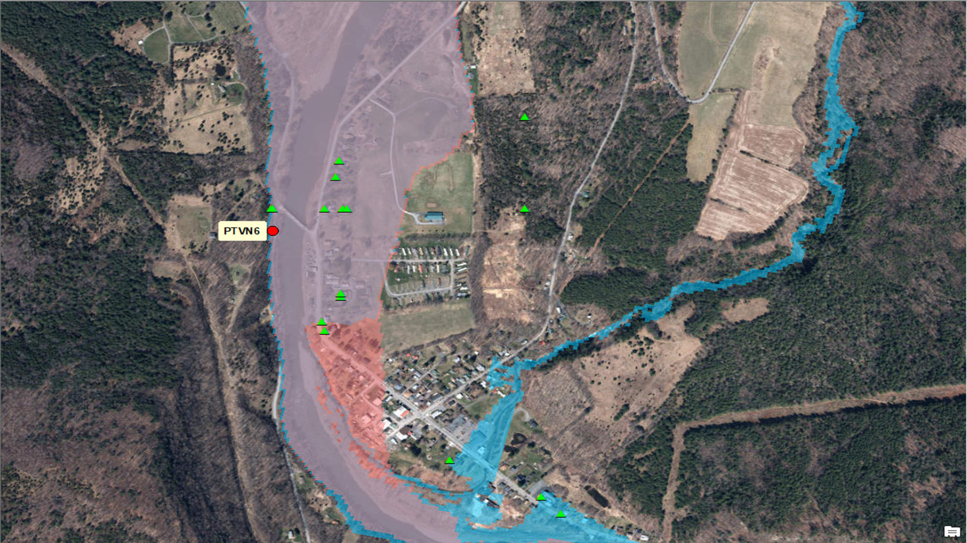
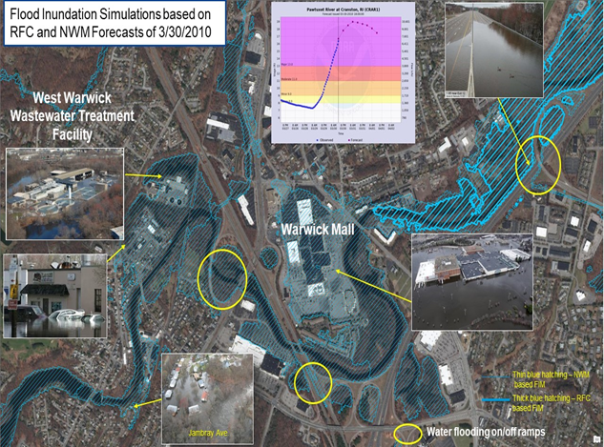
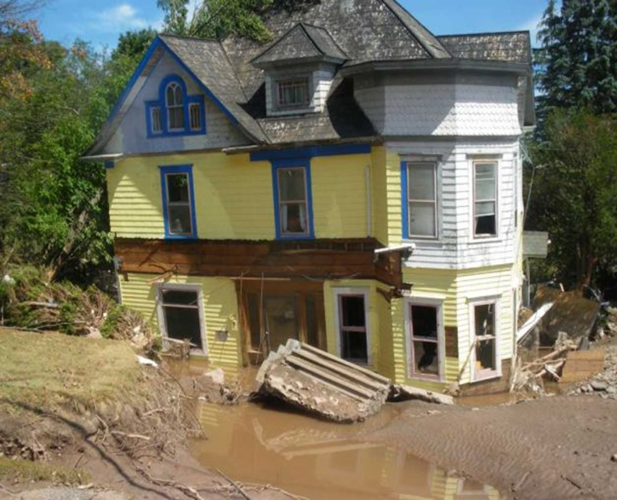
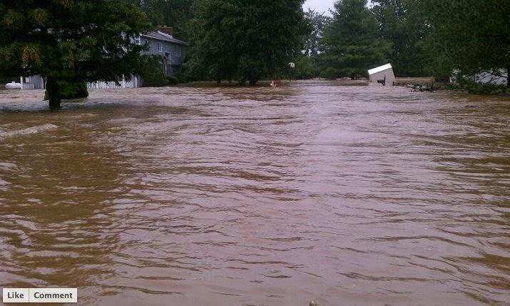
Findings and Recommendations from Two Tabletop Exercises in Support of the Implementation of Near Real-Time Forecast Flood Inundation Mapping Services in the Northeast U.S.
David R. Vallee Hydrologist-in-Charge NOAA/NWS Northeast River Forecast Center
Example of our new experimental flood inundation forecast service, based on NERFC and National Water Model streamflow forecasts for August 27th, 2011
Example of our new experimental flood inundation forecast service, based on NERFC and National Water Model streamflow forecasts for March 30th, 2010

Slide 2
Outline
NERFC’s efforts leading the DOC Agency Priority Goal
Findings and Recommendations from our Partners
The pathway toward operational implementation

Slide 3
Agency Priority Goal Action Plan
Mitigate Flood Impacts by Demonstrating Improved Decision Support Services to Emergency Managers
Achievement Statement: By September 30, 2021, NOAA National Weather Service will improve its flood related decision support services by expanding the demonstration of a new flood inundation mapping capability to at least an additional 10% of the U.S. continental population residing in flood-vulnerable freshwater basins.
Additional coverage includes population served with National Water Model hydrography downstream from a subset of NWS official forecast locations throughout the continental U.S., plus populations in the NWS Northeast River Forecast Center National Water Model domain.
- Including two tabletop exercises:
1. Rhode Island – rerunning the late March 2010 Floods (February 23, 2021)
2. New York – rerunning Tropical Storm Irene in the Schoharie Valley (June 2021)
A huge thank you to WFOs Norton and Albany for their tremendous support!

Slide 4
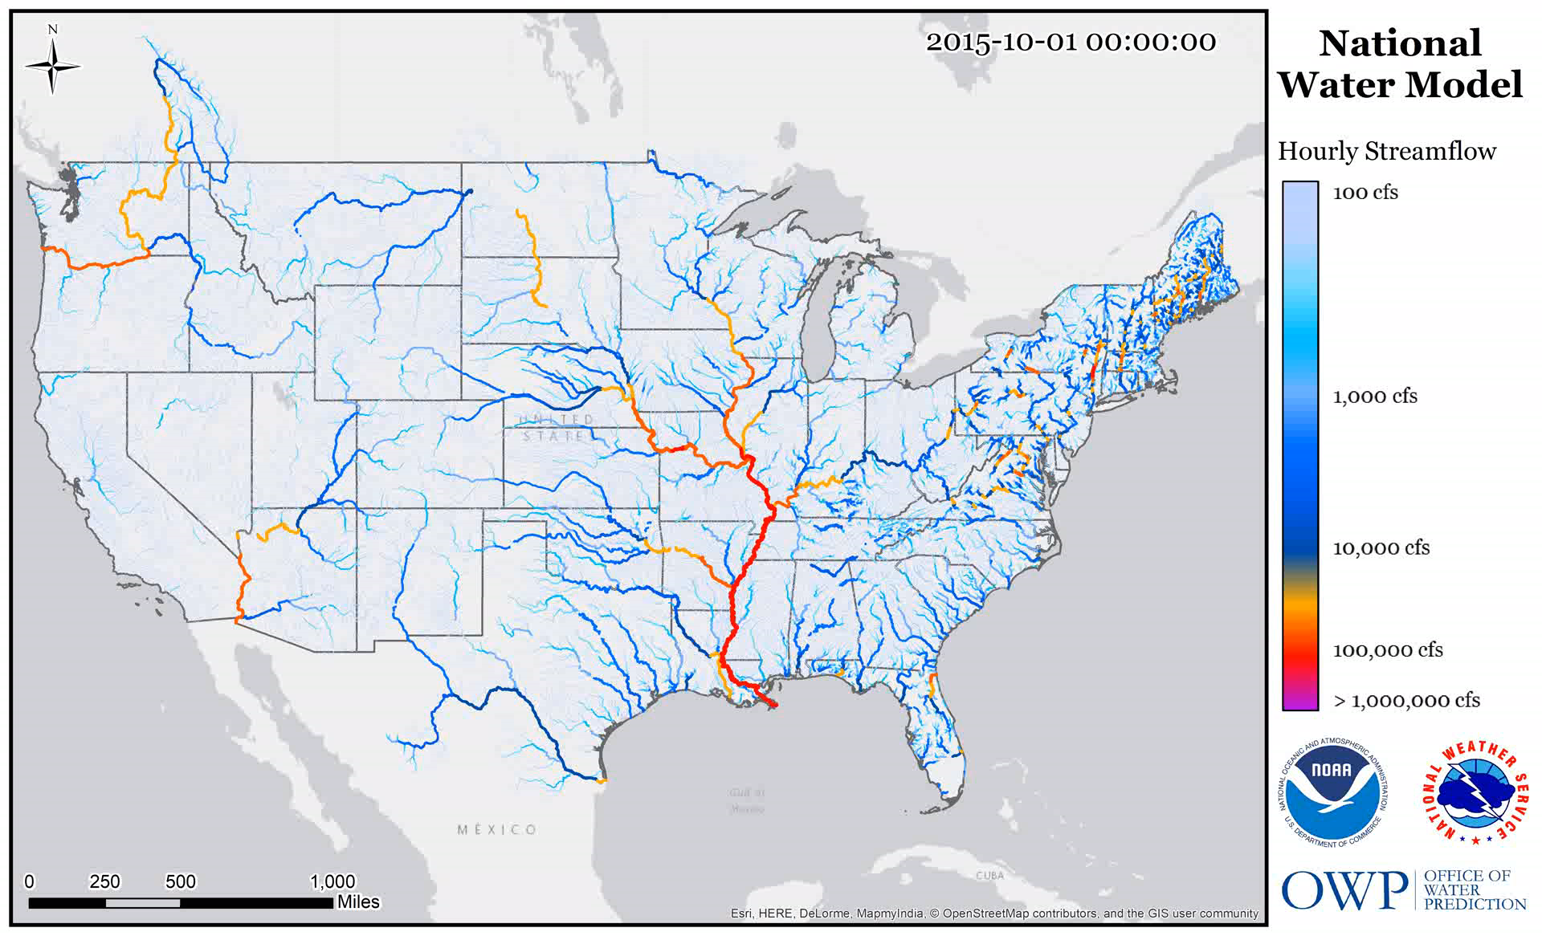
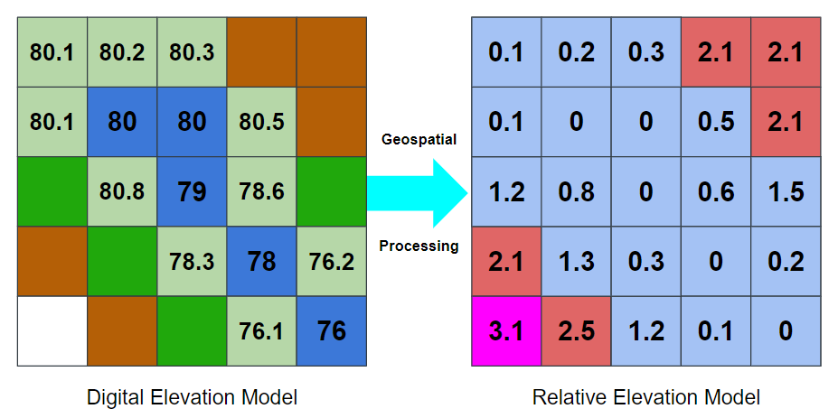
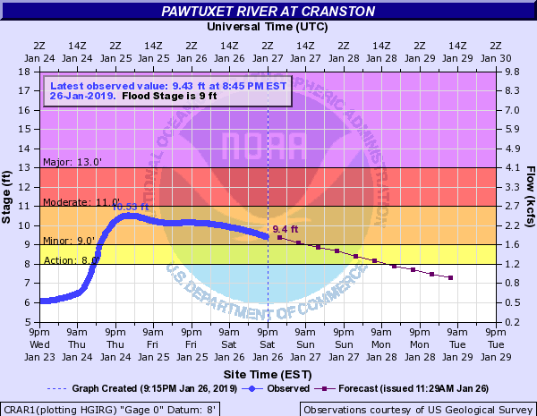
Key Investment to Becoming a Water-Ready Nation: Deliver Forecast Driven Inundation Services!
National Water Model NWM FIM
Completely automated process with no forecaster engagement
Provides complimentary guidance on ~2.7 million stream reaches nationwide!
- 10 day run 4x a day (GFS)
- 18 hour run every hour (HRRR)
Height Above Nearest Drainage (HAND)
NERFC Forecasts (RFC FIM)
Forecasters heavily engaged in the forecast production
Updated as necessary
Replace
Route
Pawtuxet River Valley – West Warwick/Warwick
Height Above Nearest Drainage (HAND)
Flood Inundation Mapping Services

Slide 5
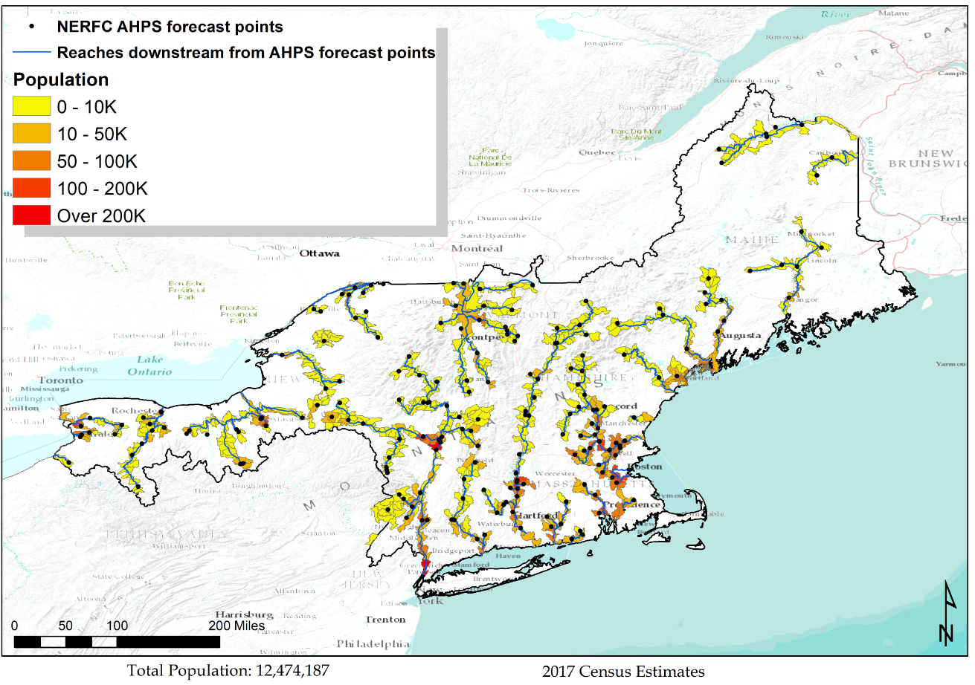
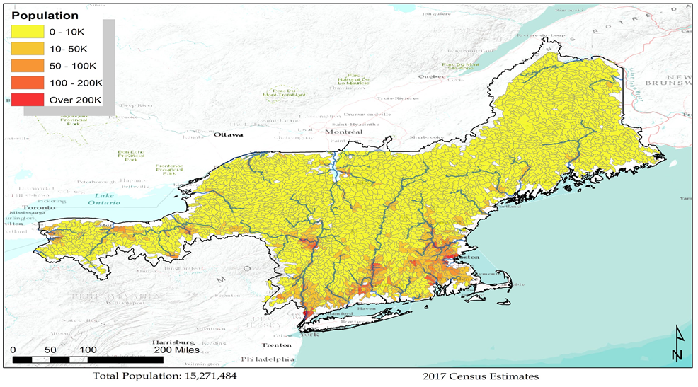
Two Sources for Inundation Guidance: RFC Forecasts & the NWM
River Forecast Center based FIM (RFC FIM)
National Water Model FIM (NWM FIM)
Higher confidence – as it is based off our official forecasts
Lower confidence – based off one of the HRRR or GFS rainfall forecasts which may not represent our official forecast
*Population totals based on 2017 population (327M) in adjacent hydrologic areas, defined by Hydrologic Unit Code (HUC) 12 delineations. Tidal areas will not be included at this time.

Slide 6
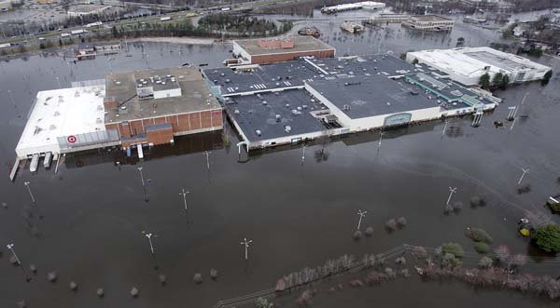
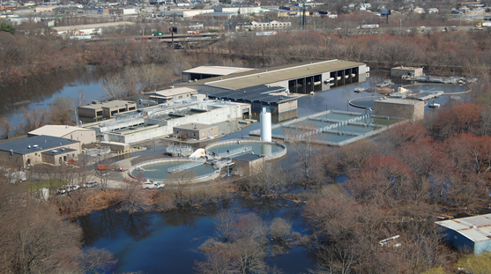
The Rhode Island Tabletop
Conducted February 23, 2021 - Entirely in a virtual environment - 35 participants
Representation from state and local EMA, floodplain managers, Federal partners (FEMA, USACE, USGS), and SERFC
Record March Floods of 2010 – focused on the Pawtuxet, Pawcatuck and Wood River basins
Longer lead time type of event – marking the end of a record wet month for the state ending with record flooding
State communication is directly to the local cities and towns (39 total)
Warwick Mall severely flooding at the crest of the event, March 31st, 2010. Photo: RI ANG
West Warwick Wastewater Treatment Facility under siege, morning of April 1st, 2010 as the Pawtuxet River began to recede. Photo: RI ANG

Slide 7
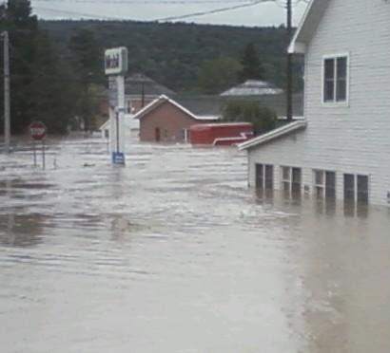
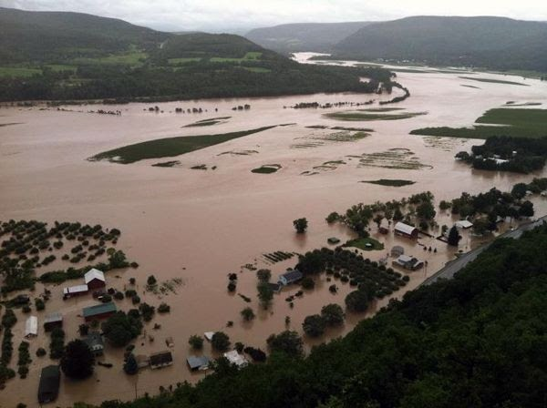
The New York Tabletop
Conducted June 29, 2021 - Entirely in a virtual environment - Maxed out at 79 participants
Reps from State OEM, Green and Schoharie County OEM, local EM/Fire/Police, State DOT NYPA/NYCC, State Police, NYCDEP, FEMA regions 1 and 2, and MARFC
T.S. Irene – rapid onset type of event - Record flooding on the Schoharie and many creeks and kills feeding into the mainstem Schoharie - Initially state was focused on storm surge evacuations of western LI and NYC – before recognizing the massive flood potential for parts of the state
Home rule form of state governance - State communicates to counties > counties communicate to the local communities
Record flooding along Schoharie Creek in the village of Schoharie on the morning of Sunday, August 28th, 2011
Widespread record flooding along the mid portion of the Schoharie Creek through the town of Middleburgh, NY from Tropical Storm Irene

Slide 8
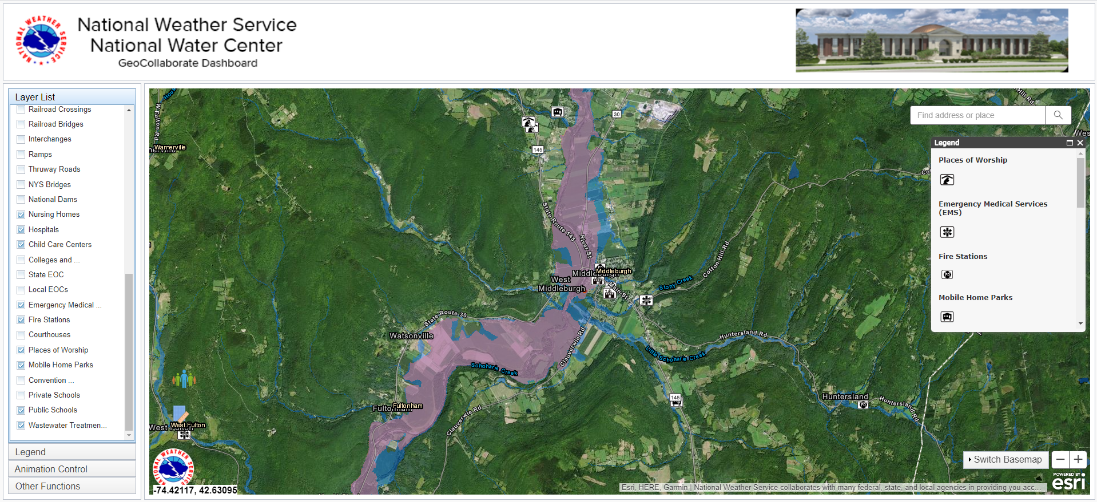
GeoCollaborate https://nwc.geocollaborate.com/dashboard

Slide 9
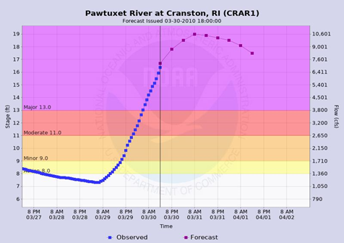
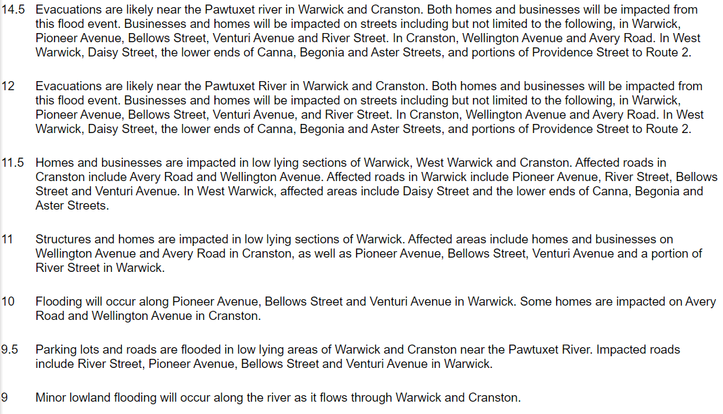
An Example: In 2010 for the Pawtuxet Basin: Cranston, Warwick, West Warwick
County based generic flood warnings which provided timing information but lacked any specifics on impacts
Conference calls with the state & local communities where we tried to leverage the FEMA Flood Insurance Rate Maps as our Guide for potential impacts

Slide 10
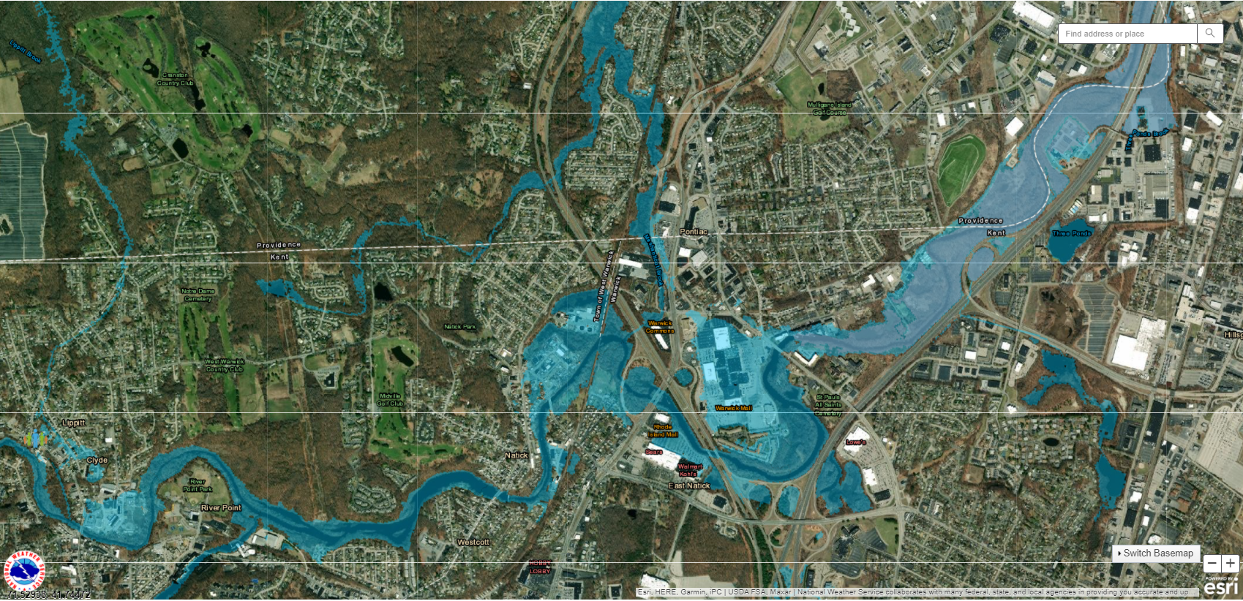
THIS IS WHAT WE ARE GOING TO PROVIDE TODAY!
PAWTUXET RIVER BASIN

Slide 11
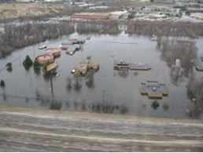
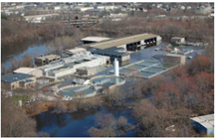
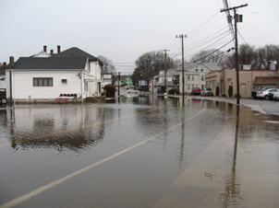
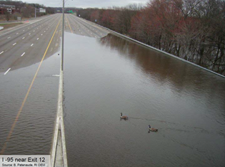
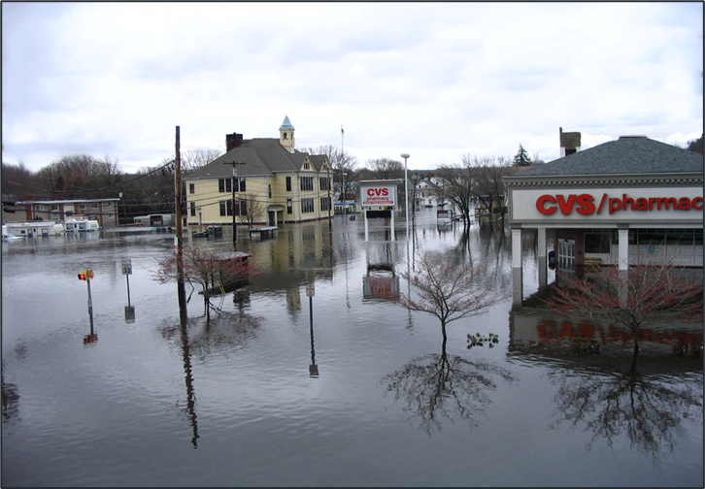
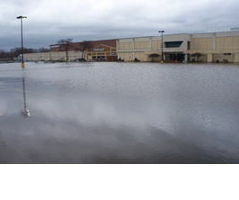
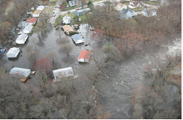
How will you use our forecasts of inundation to prepare?

Slide 12
Tabletop Exercises: Key Findings & Recommendations
1. Traditional NWS methods for communicating flood information (e.g. WFO and RFC briefings) were successfully exercised, augmented with the disclosure of Flood Inundation Mapping services - Partners found this to be a powerful combination to help them understand the magnitude of the impending situation and to properly interpret the FIM services - The majority of participants indicated that the best way to receive these inundation services was through web based services briefed by a professional forecaster
2. The capabilities provided by these FIM services would be a “game changer” to the emergency management community
3. GeoCollaborate demonstrated capabilities necessary for NWS forecasters to effectively deliver IDSS to core partners during flood events.
4. Partners indicated that the capabilities presented by the GeoCollaborate application allow for the creation of a common operating picture across organizations - By having such services available on a mobile device, it increases the ability of local EMA to effectively warn their constituents of potential severity of the impending flood
5. Many participants indicated that these services would be most useful in staging and planning activities in the 1 to 3 day timeframe - Improve their ability to preposition resources, secure critical infrastructure, and for recommending evacuations and proper evacuation routes - NY County EM: “Had I had this tool in 2011, we would have had a larger evacuation area established earlier, would have moved emergency assets out of the flood zone, pre-positioned support resources and been able to provide better information to the residents of the affected area.”
- RI Local EM: “The forecast inundation would make the primary shelters (Middle and High School) unreachable, so alternate shelters would need to be arranged”

Slide 13
Tabletop Exercises: Key Findings & Recommendations
6. Partners stated the need for additional supporting FIM services including: - Depth and velocity - Confidence and reliability information - Time to return to within bank - Descriptive metadata associated with each layer - Rate of rise information - A means to distinguish differences between FIM and current conditions and between forecasts - The addition of recent or historical reference FIMs - The addition of an annotation for direction of flow along river reaches - Training and reference information on the services
7. Participants had generally positive comments regarding the accuracy of the inundation services
- Some discrepancies were noted between forecast inundation extents and those areas that were actually inundated during both the 2010 and 2011 events - These are being investigated for future refinement of the techniques * Some are a function of the underlying DEM * Some are related to the use of synthetic rating curves * Missing areas of inundation are a function of the reach definition (river segment vs. water body)

Slide 14
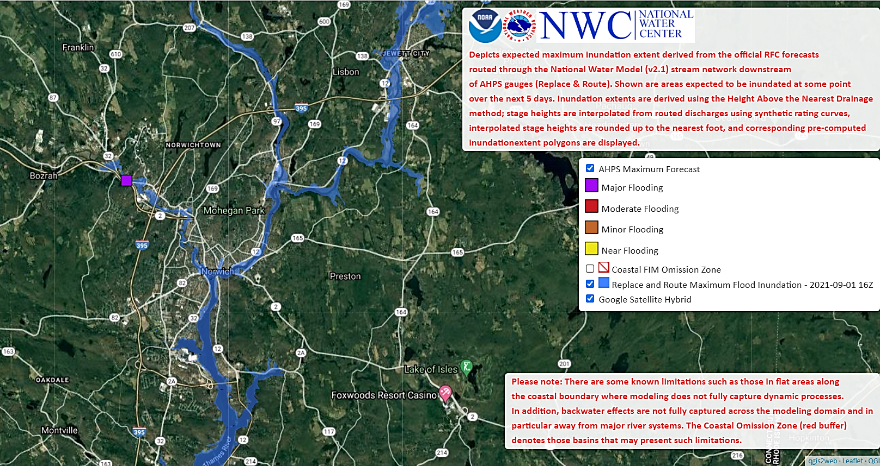
Prototype Example from Ida:
The Yantic River at Yantic, CT

Slide 15
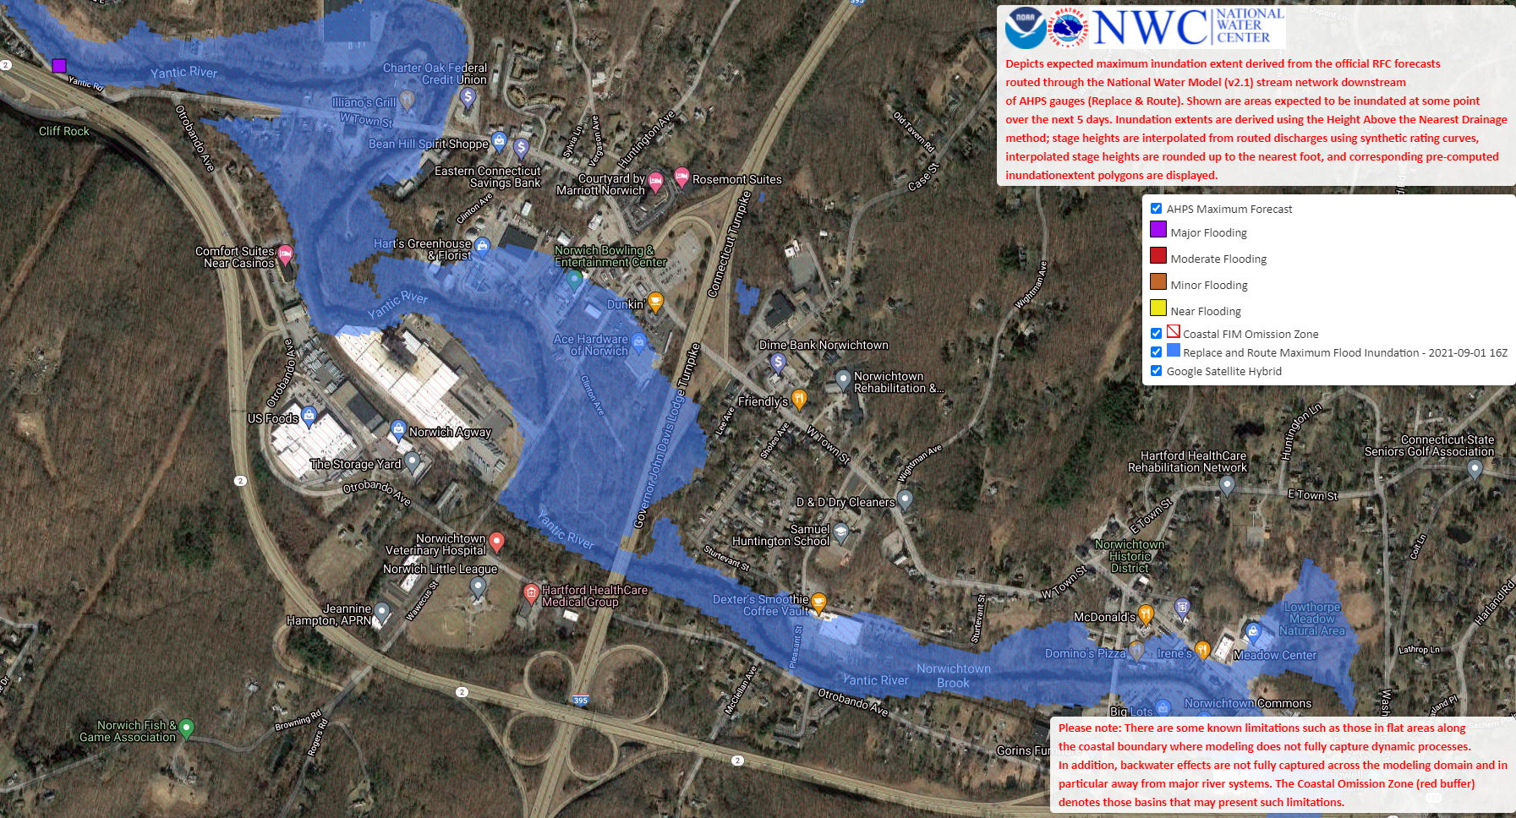
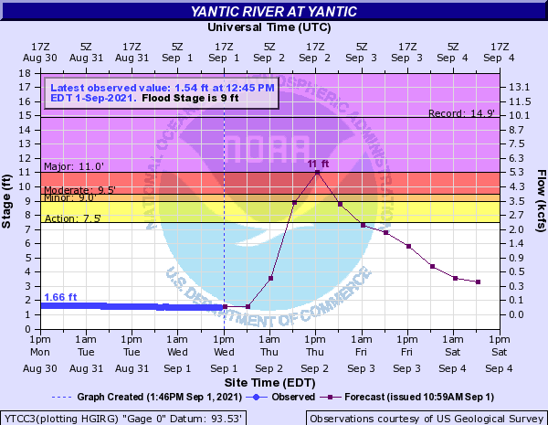
Prototype Example from Ida:
Gives a picture to the forecasts produced by the River Forecast Center
A picture really is worth a thousand words!
Image at left is the RFC FIM from Ida on the Yantic River (noon, September 1st, 2021) -- note the inundation extent
Gage Location

Slide 16
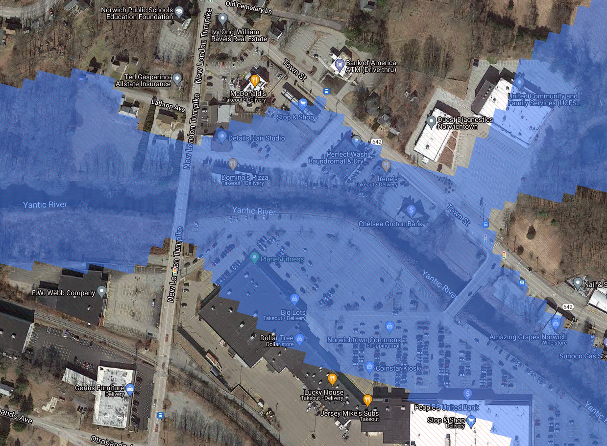
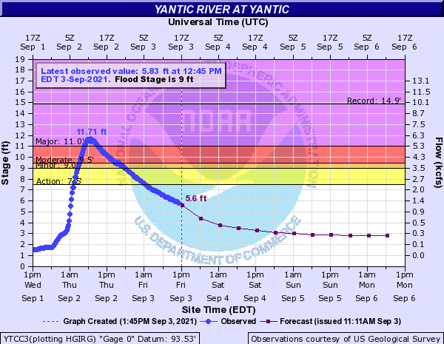
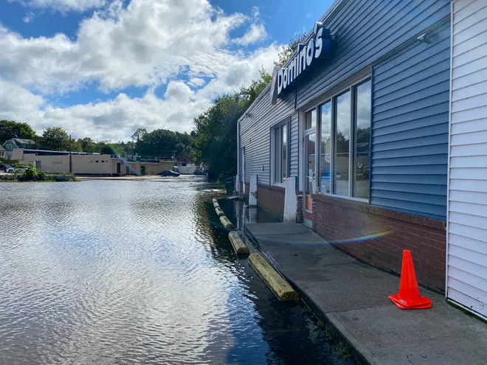
Prototype Example from Ida:
How accurate were the forecast and maps?
Domino’s Parking Lot
River ended up ~¾ foot higher than forecast
Maps look a little overdone, at least based on this picture, but not too bad! The hair salon across the parking lot from Domino’s had water inside it
Photo credit: Trevor Ballantyne / Norwich Bulletin

Slide 17
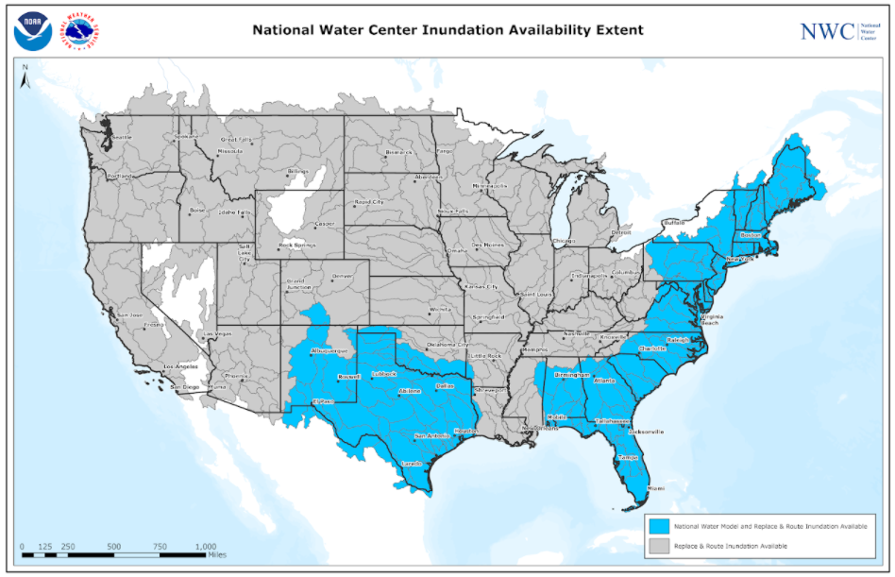
Our pathway forward…
Over the next year - NWS will be working on several efforts:
Developing a Concept of Operations for the delivery of services
Improving QA/QC of FIM through real-time and post event validation
Continuing to refine the HAND methodology (version 4 soon)
Develop robust validation tools and techniques
Real-time and post-event
Provide training our forecasters and our partners
Formulate the pathway to dissemination as a full suite of services
*All of this is contingent upon the passage of the Presidential budget
Replace and Route: CONUS
National Water Model: Texas and Atlantic Coast
Infrastructure: NWC
Forecast Configurations
5-Day Maximum (RnR)
Nowcast (NWM)
3, 5 and 10-Day Maximum (NWM)

Slide 18
Findings and Recommendations from Two Tabletop Exercises in Support of the Implementation of Near Real-Time Forecast Flood Inundation Mapping Services in the Northeast U.S.
David R. Vallee Hydrologist-in-Charge NOAA/NWS Northeast River Forecast Center
Example of our new experimental flood inundation forecast service, based on NERFC and National Water Model streamflow forecasts for August 27th, 2011
Example of our new experimental flood inundation forecast service, based on NERFC and National Water Model streamflow forecasts for March 30th, 2010

