Slide 1
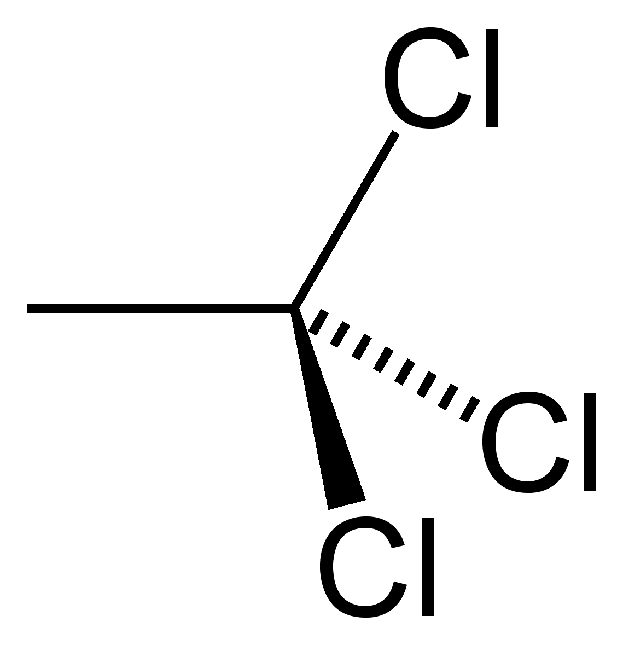
A COVID Conundrum: An Investigation into Enhanced Methyl Chloroform Concentrations
Megan Schiede¹, Dr. Don Blake², Alex Jarnot²
¹University at Albany
²University of California, Irvine

Slide 2
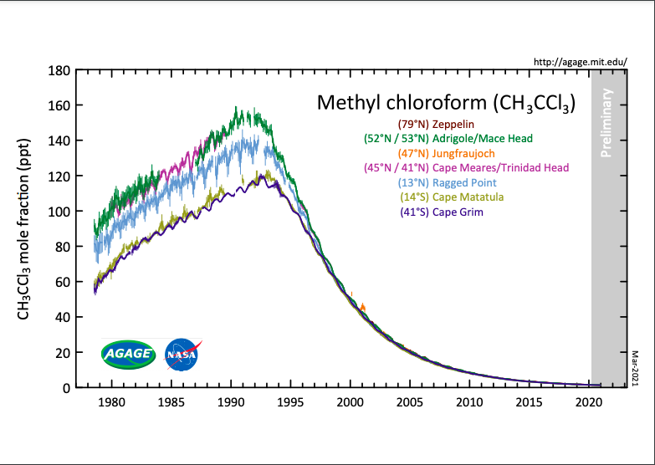
Methyl Chloroform & The Montreal Protocol
1
(Amendments to the Montreal Protocol on Substances that Deplete the Ozone Layer 2002)
Notes:
-Methyl Chloroform was a commonly used solvent and degreasing agent with a lifetime of 5-6 years
- MC is classified as an ozone depleting substance with an ozone depletion potential of 0.16 which is significantly lower than other known ozone depleting substances
-This chart shows MC measurements at different locations across the Earth over the past 40 years
- We can see than the concentration of MC has dropped drastically over the past 30 years, and this can be attributed to effective policy
- Wanted to provide a timeline of the policies surrounding MC use

Slide 3
Methyl Chloroform & The Montreal Protocol
Montreal Protocol (1987)
1
(Amendments to the Montreal Protocol on Substances that Deplete the Ozone Layer 2002)
Notes:
Restrictions began with the 1987 Montreal Protocol which officially classified MC as an Ozone depleting substance

Slide 4
Methyl Chloroform & The Montreal Protocol
Montreal Protocol (1987)
Copenhagen Amendment (1992)
1
(Amendments to the Montreal Protocol on Substances that Deplete the Ozone Layer 2002)
Notes:
Copenhagen Amendment of 1992 accelerated phase out to 1996

Slide 5
Methyl Chloroform & The Montreal Protocol
Methyl chloroform phased out (1996)
Montreal Protocol (1987)
Copenhagen Amendment (1992)
1
(Amendments to the Montreal Protocol on Substances that Deplete the Ozone Layer 2002)
Notes:
Decreasing curve demonstrates success of the Montreal Protocol

Slide 6
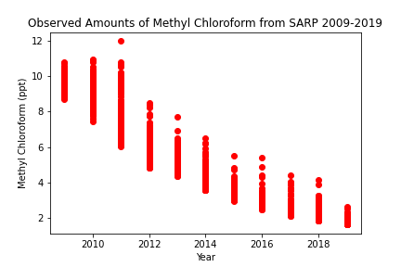
History of SARP Methyl Chloroform Measurements
2
Notes:
- This plot demonstrates a similar decreasing curve to the previous MC plot
- Steady decline with peak values around 12 ppt seen in 2011
- Now if we look more currently, no value from 2019 greater than 4 ppt
- Now moving forward, just as no one expected 2020 to be strange as it was, the same goes for the SARP MC data

Slide 7
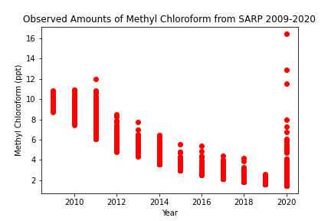
History of SARP Methyl Chloroform Measurements
2
Notes:
- Far wider distribution of measurements
- Most enhanced value at 16.4 ppt
- Record value for MC for all of SARP
- 2020 was a slightly different than 2009-2019 as 2020 samples were taken across the country, to visualize it I have made the following map

Slide 8
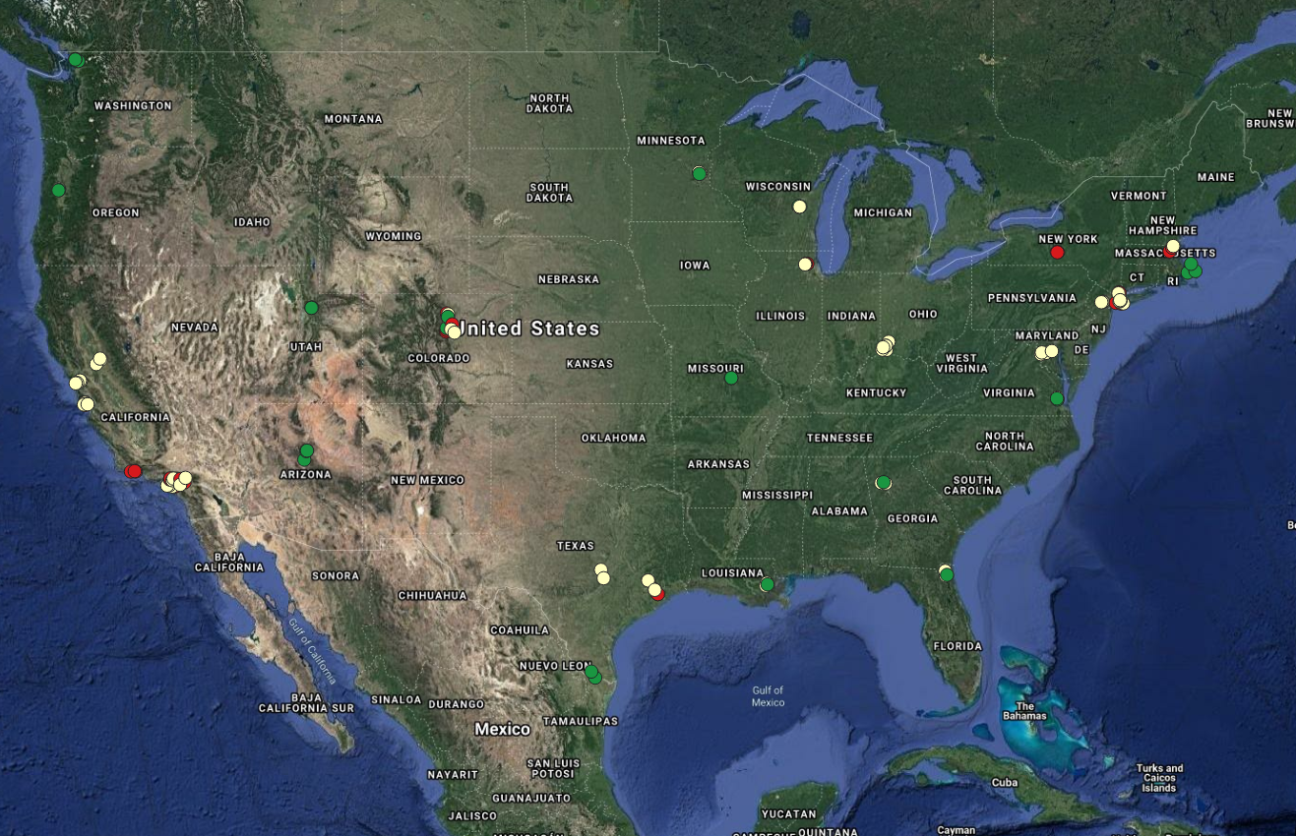
3
Notes:
This is a map of all SARP 2020 whole air sampling locations
Where we can see that these enhanced concentrations are not limited to once region but are more widespread.
I now want to highlight the locations where the most enhanced samples were observed

Slide 9
Queens, NY
6.1 ppt
3

Slide 10
Chicago, IL
7.3 ppt
Queens, NY
6.1 ppt
3

Slide 11
Chicago, IL
7.3 ppt
Queens, NY
6.1 ppt
Isla Vista, CA
12.9 ppt
3

Slide 12
Ithaca, NY
16.4 ppt
Chicago, IL
7.3 ppt
Queens, NY
6.1 ppt
Isla Vista, CA
12.9 ppt
3

Slide 13
How has environmental policy changed in response to COVID-19 lockdowns?
4
Notes:
Wanted to see how environmental policy changed in response to COVID-19

Slide 14
“The EPA does not expect to seek penalties for violations of routine compliance monitoring, integrity testing, sampling, laboratory analysis, training and reporting or certification obligations in situations where the EPA agrees that COVID-19 was the cause of the noncompliance.”
(COVID-19 Implications for EPA’s Enforcement and Compliance Assurance Program, 2020)
4
Notes:
Found EPA Memo released in March 26th 2020
Discussed how COVID will Impact EPA’s Enforcement and Compliance Assurance Program
Placed responsibility of monitoring in the hands of organizations

Slide 15
If the EPA is away, will the polluters play?
4
Notes:
Led me to ask…

Slide 16
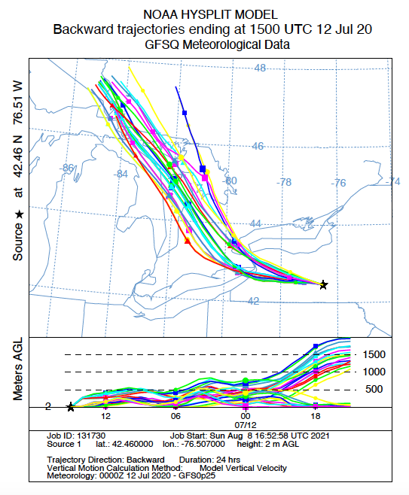
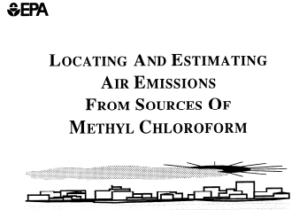
“Missed” Approaches
Past Sources Approach
HYSPLIT Approach
(Locating and Estimating Air Emissions From Sources of Methyl Chloroform 1994)
5
Notes:
First examine vast amounts of literature to find possible sources and or uses for MC in a current context
Proved to be difficult as most of the literature published is relatively older given that MC concentrations were expected to be under control therefore it is difficult to determine how it is used today
Then I tried a different approach using information from my past sources approach to then examine HYSPLIT to see if potential emission sites lie with in a trajectory
Did this using NOAA HYSPLIT backwards trajectories
Lots of speculation and difficult to confirm

Slide 17
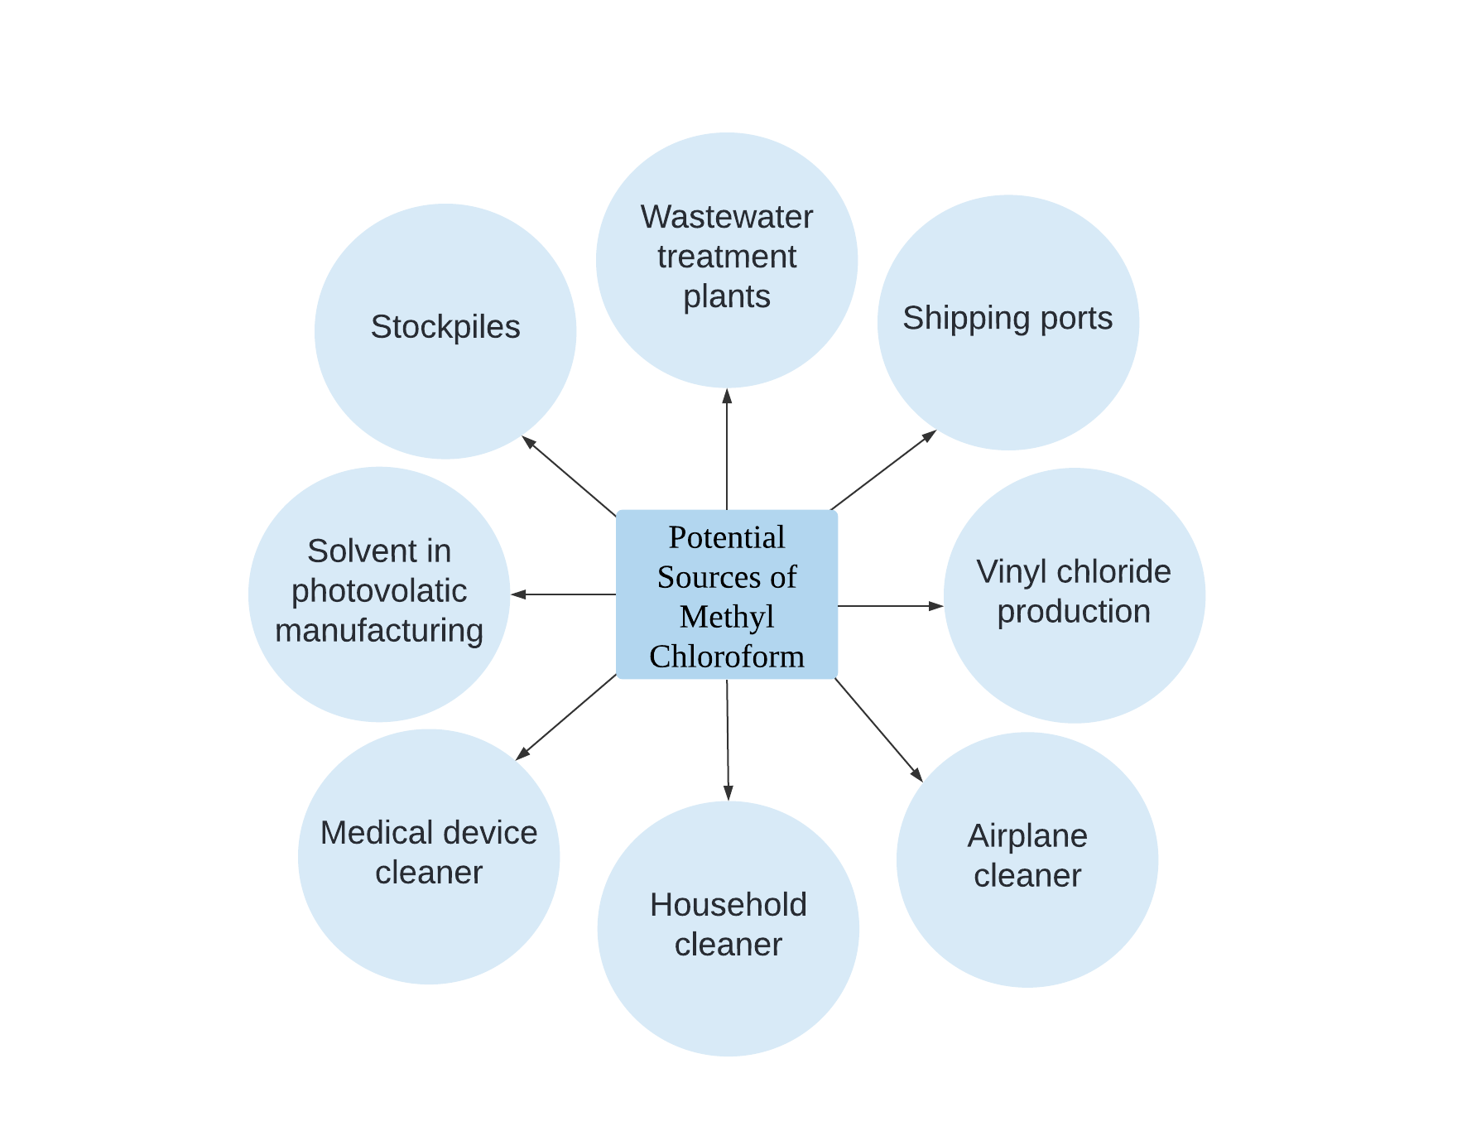
6
Notes:
-Complied list of potential sources
-One by one able to eliminate sources
- I did not feel confident with any of these sources based on the literature I had read or the HYSPLITS I had ran.

Slide 18
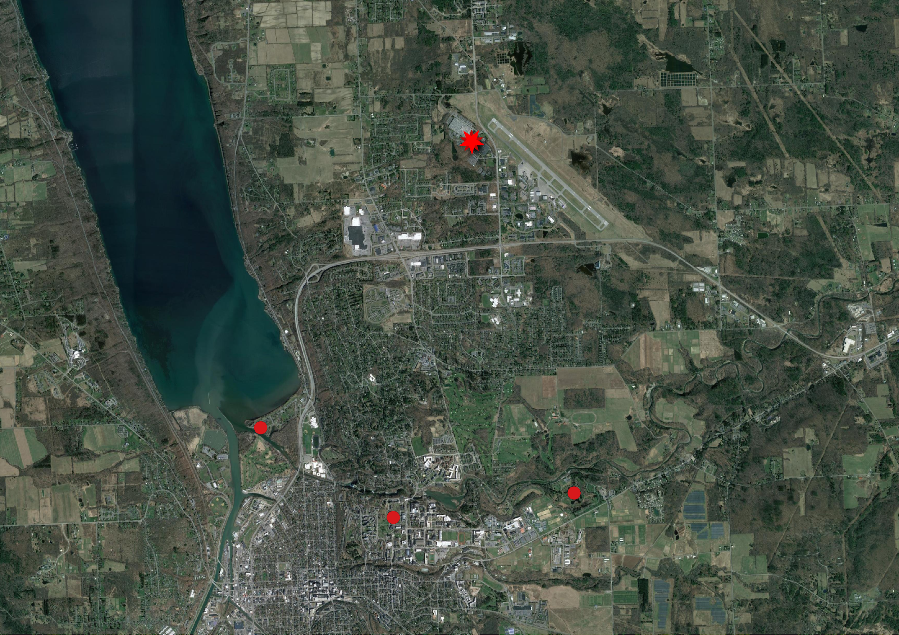
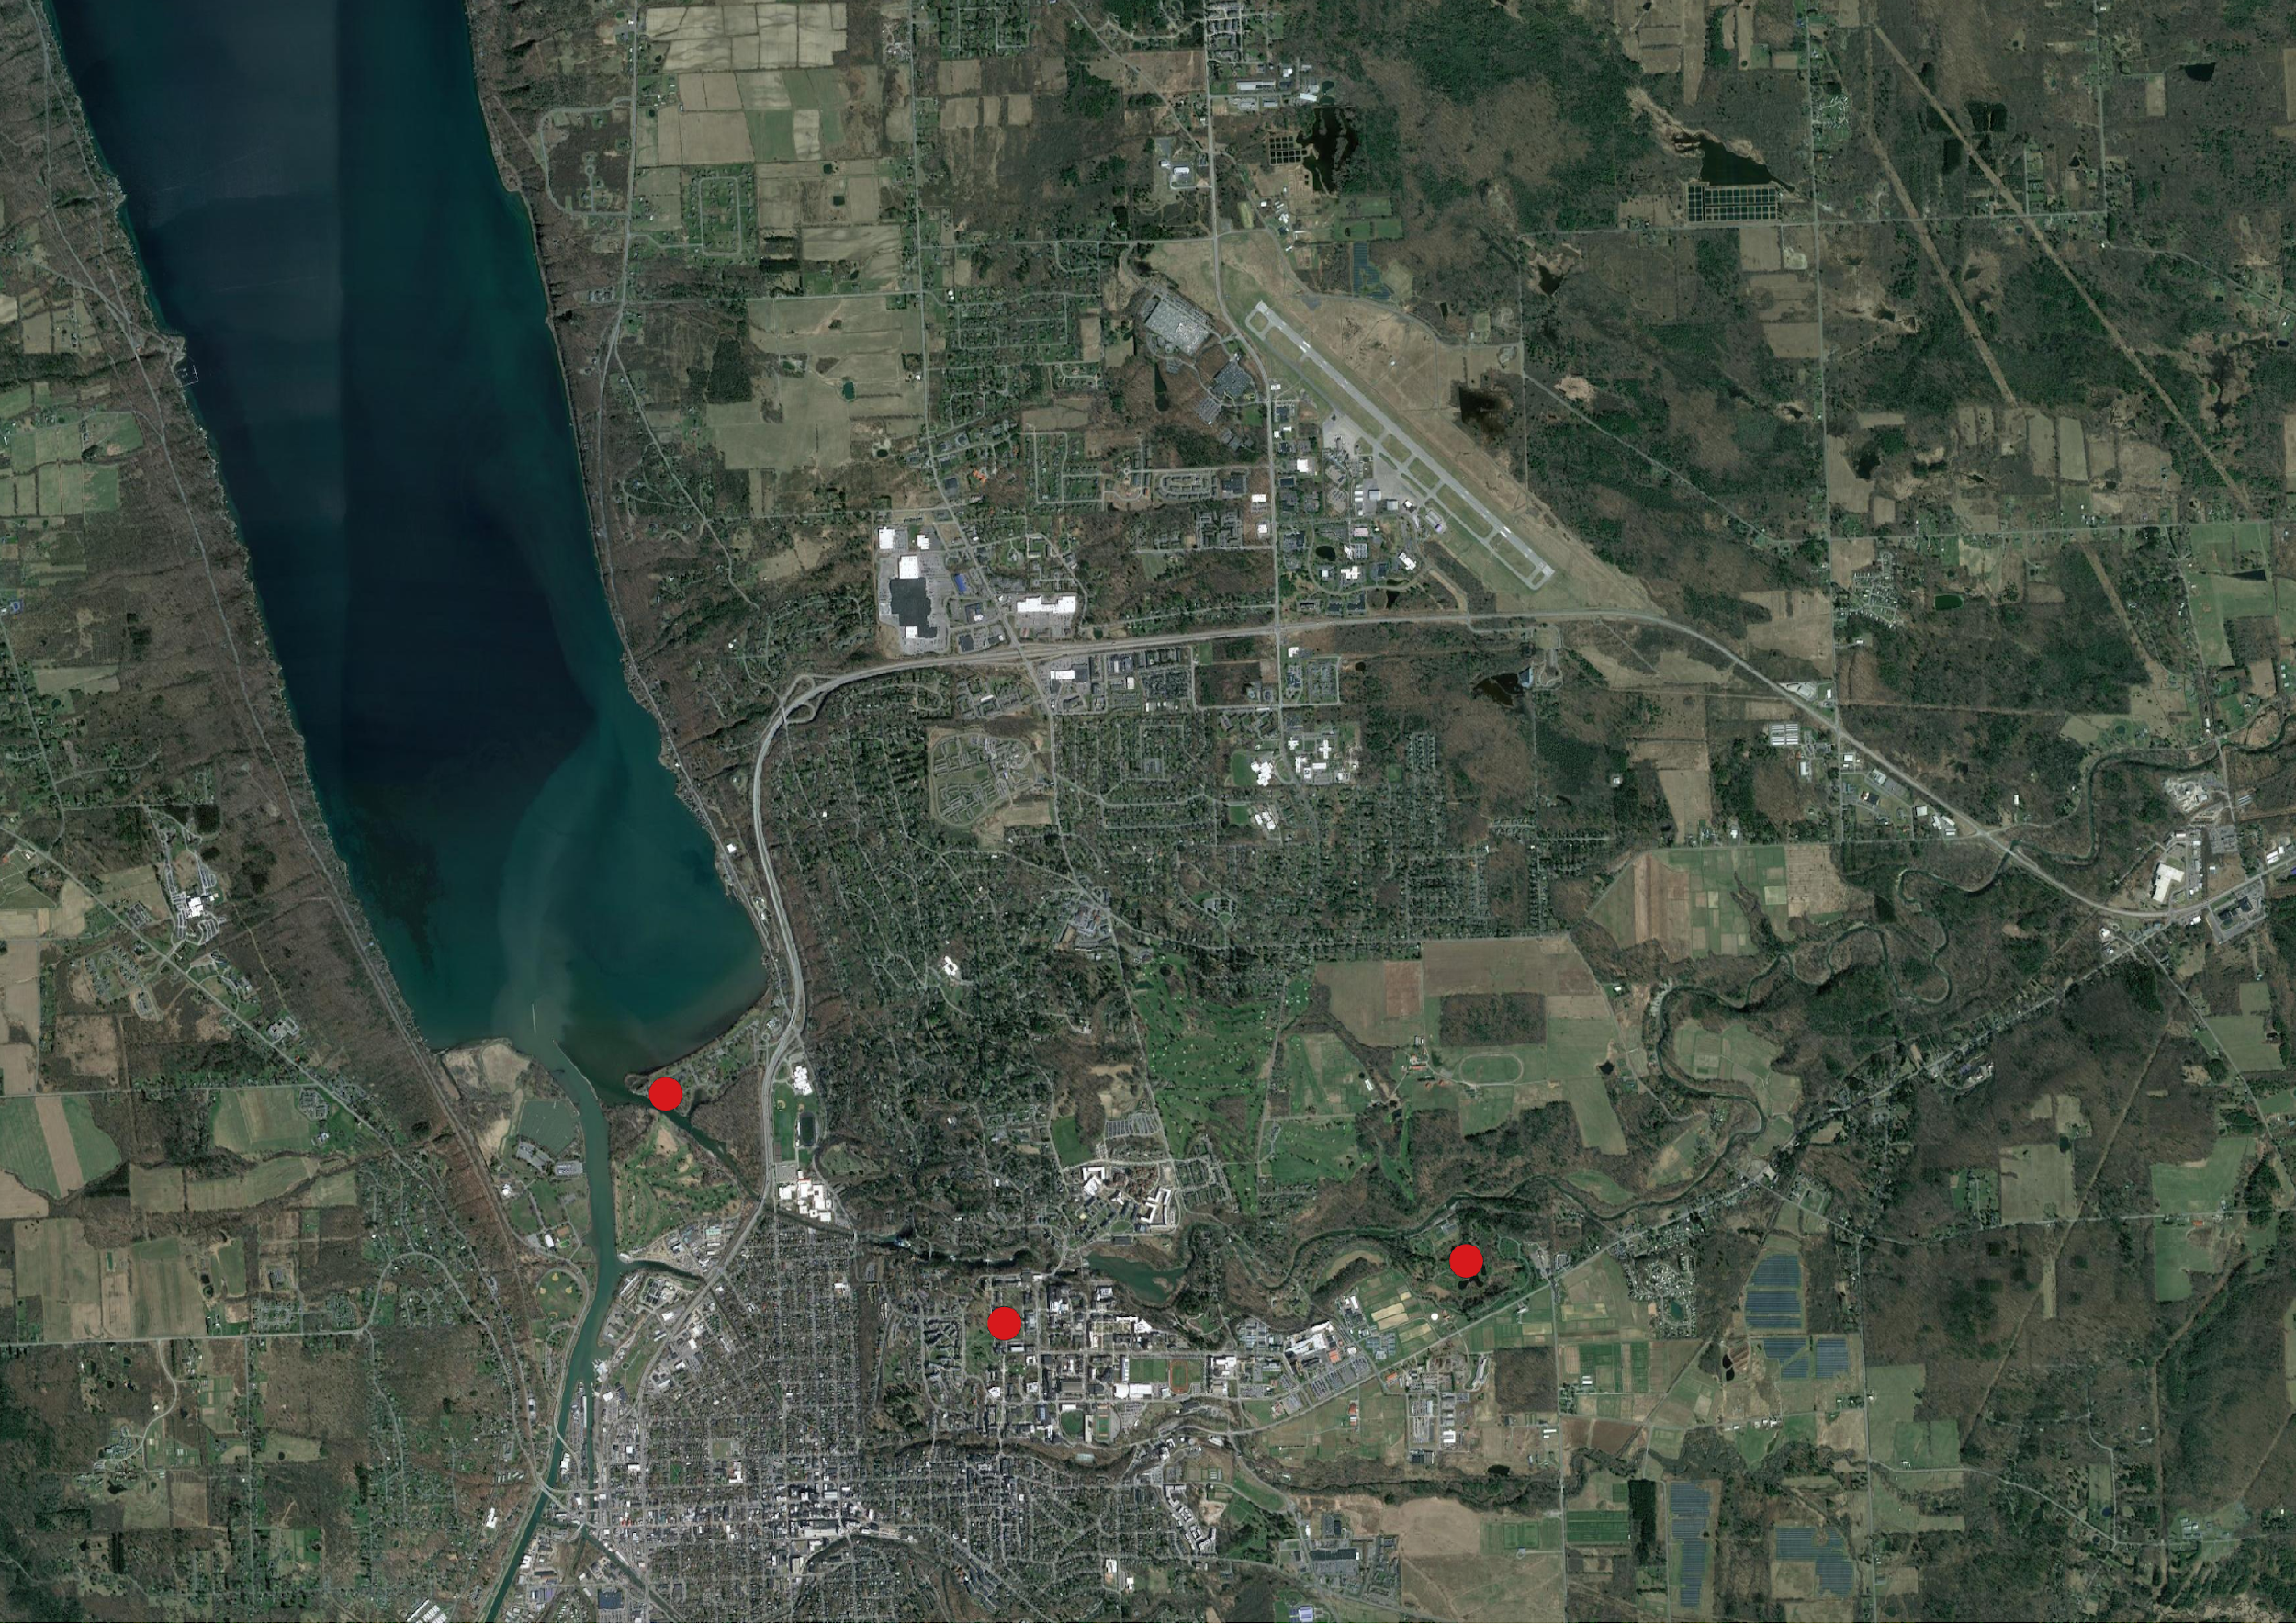
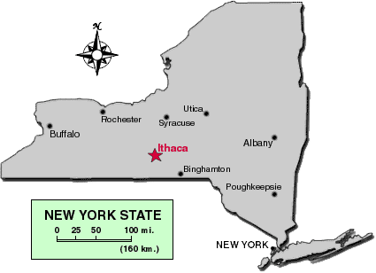
The “Most Enhanced” Approach
BorgWarner Inc.
7
(Cornell University College of Veterinary Medicine)
Notes:
-Focus on Ithaca as it had most enhanced concentration
Found borgwarner in Ithaca
An automotive parts supplier that is highly involved in automotive electronics
Methyl Chloroform has a known connection with electronics

Slide 19
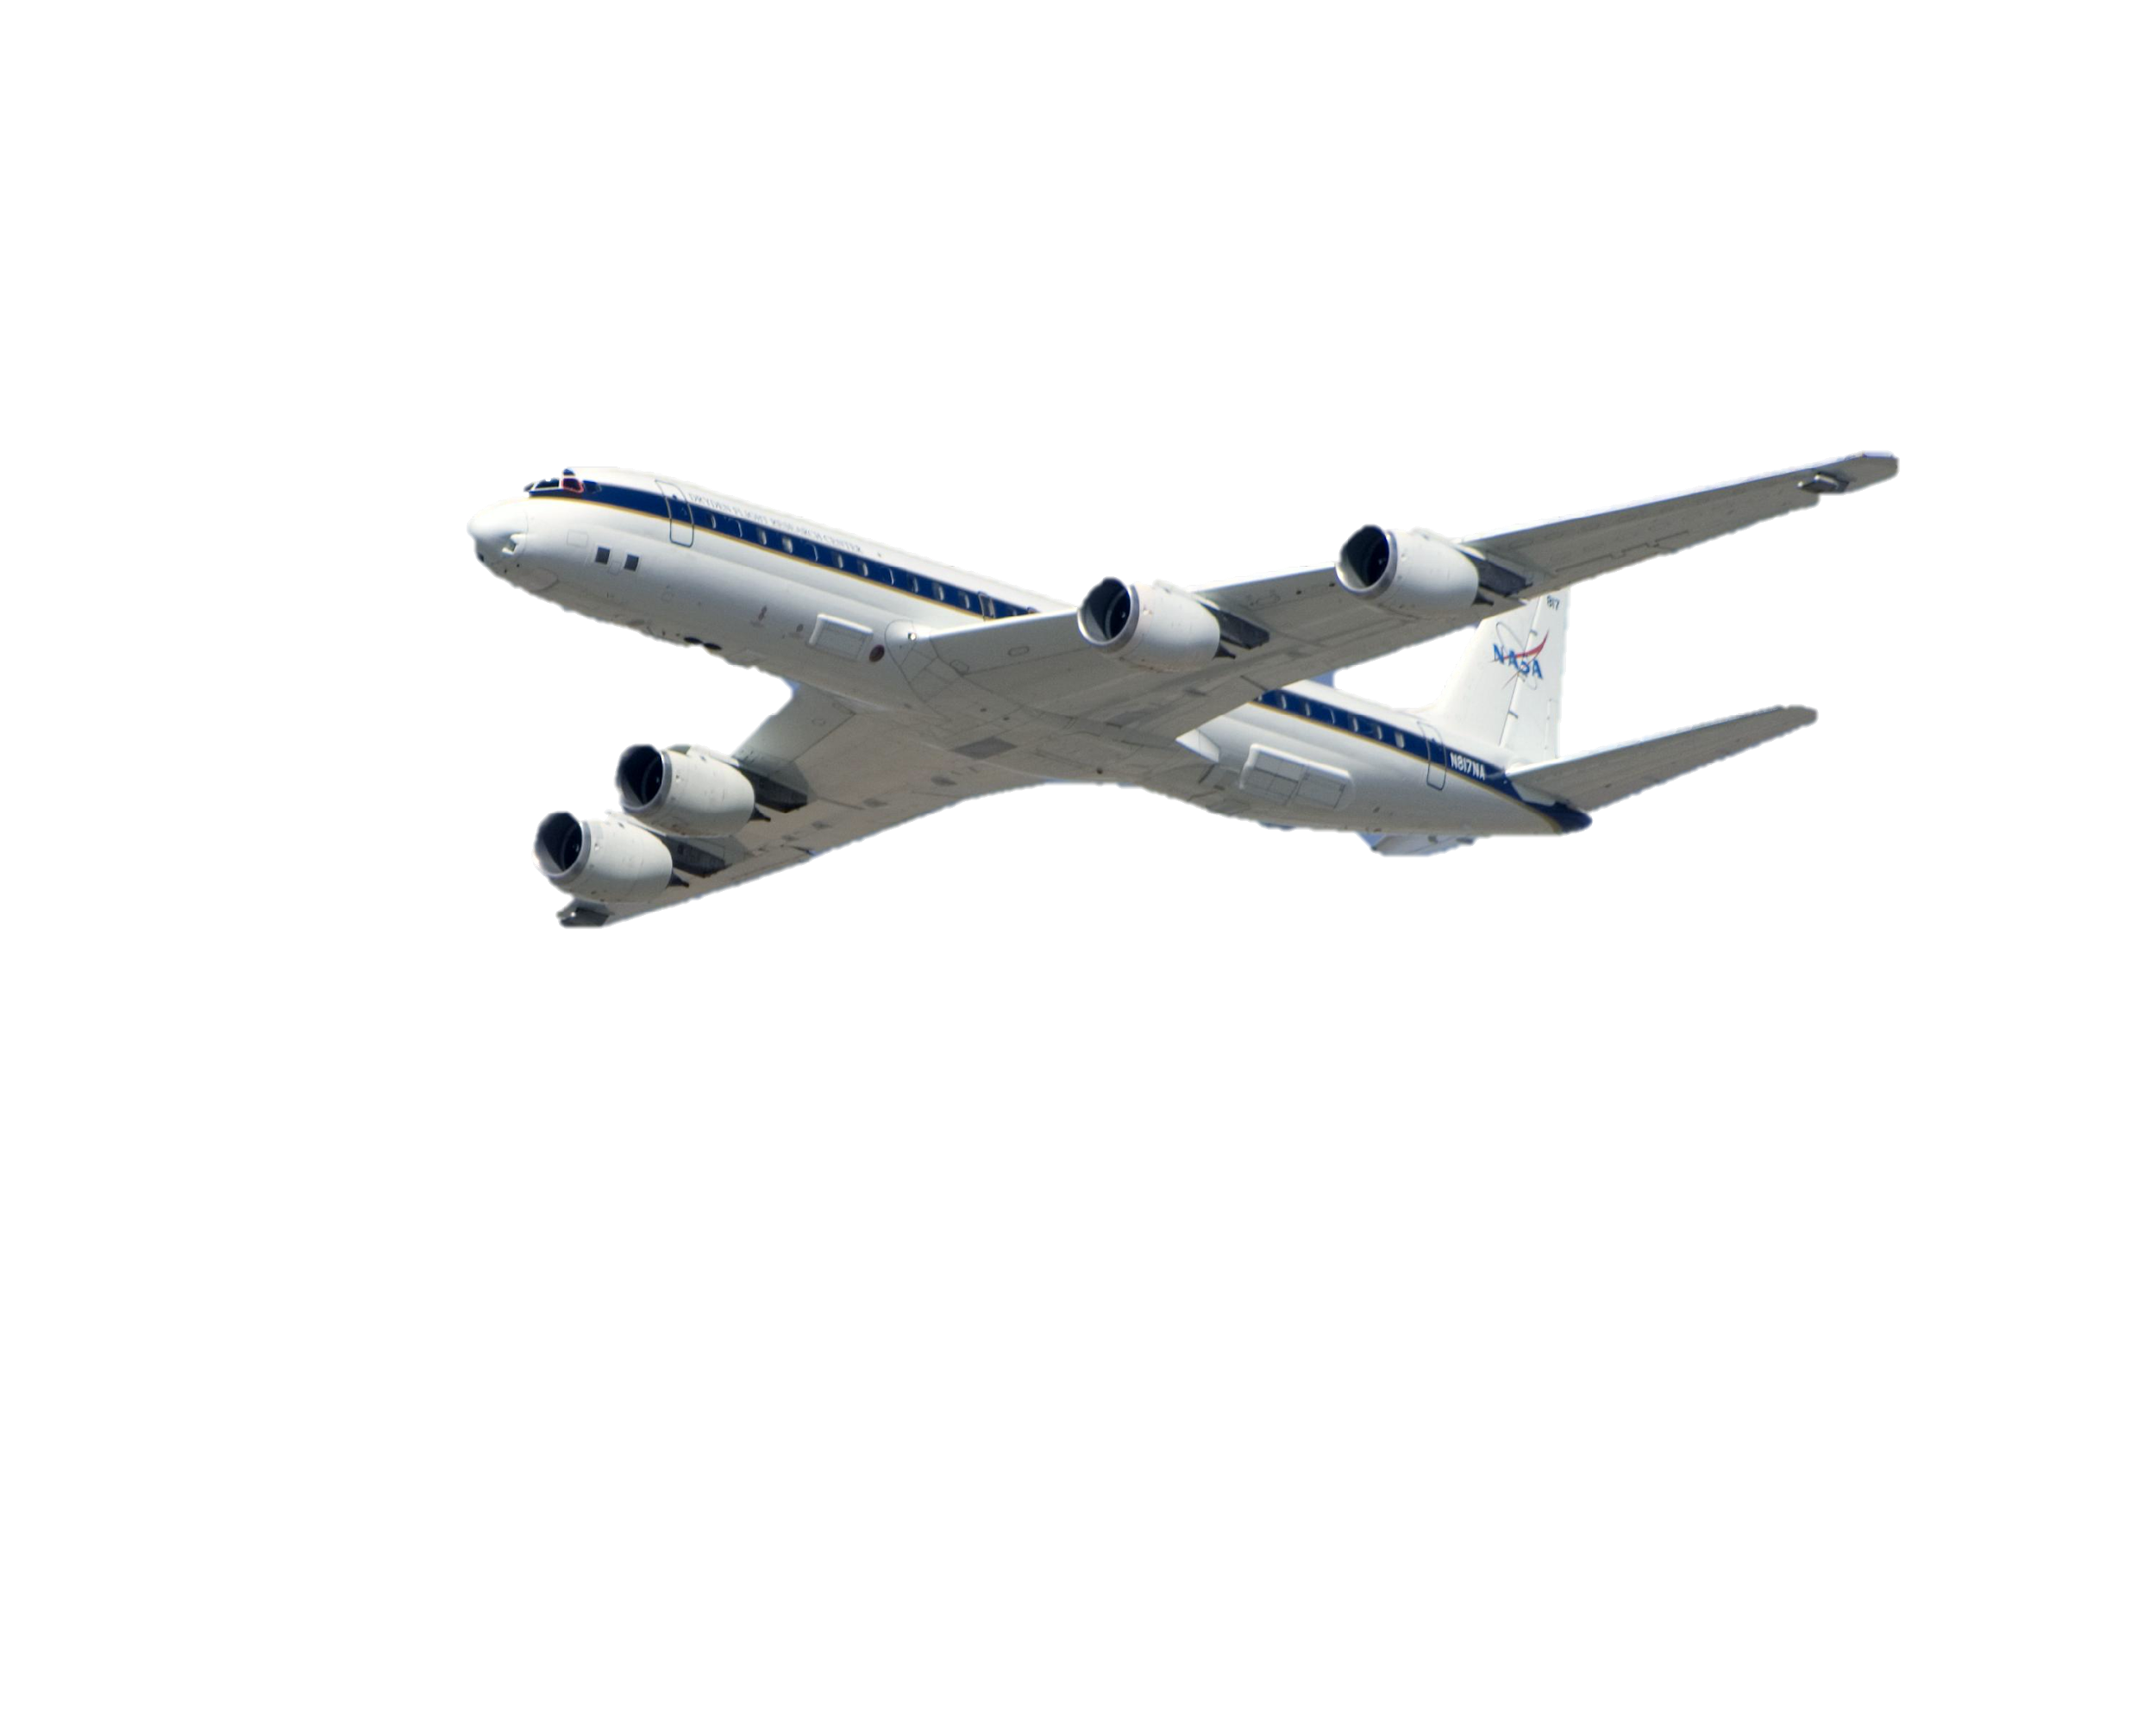
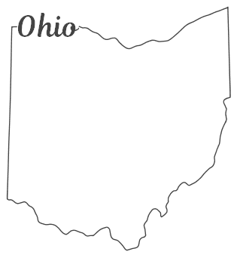
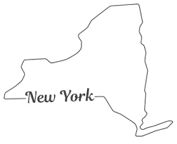
8
(SunCatcherStudio, NASA)
Notes:
- Travel from New York to Ohio

Slide 20
BorgWarner has locations in both Ithaca, NY & Ohio
Why are we shifting focus from New York to Ohio?
Information from Ohio EPA is more accessible than that of New York EPA
8

Slide 21
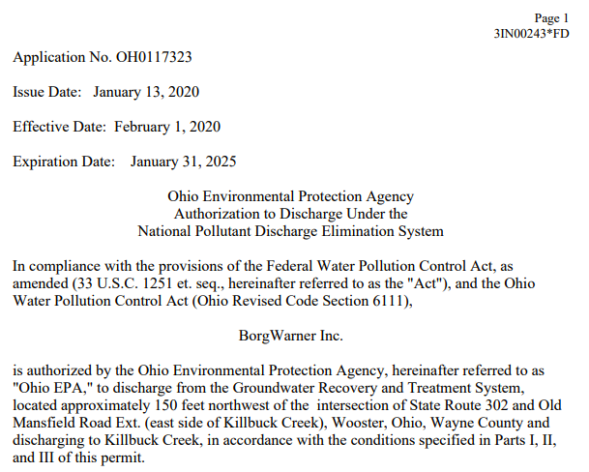
BorgWarner Permit
9
(Ohio EPA Permit No 3IN00243*FD)
Notes:
Found permit in Ohio that allows them to dump water into creek
Read permit

Slide 22
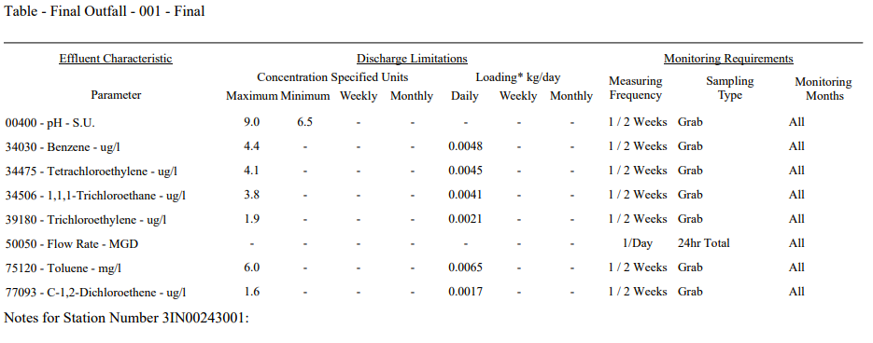
BorgWarner Permit
9
(Ohio EPA Permit No 3IN00243*FD)
Notes:
Next page of permit includes MC
This table shows that this company is legally allow to dump a specified amount of MC into this creek legally.

Slide 23
Now we have established connection between this company located in Ithaca, NY and methyl chloroform
9
Notes:
- Link between this company in Ithaca and MC

Slide 24
BorgWarner Report-August 2020
10
(Annual Indoor Air Sampling Results 1700 Old Mansfield Road Site (OEPA ID 285001381-007) Bosch Rexroth Corporation and BorgWarner Inc., Wooster, Ohio 2020)
Notes:
-Values from report in Ohio for 2020
-Zoom into past 2 years

Slide 25
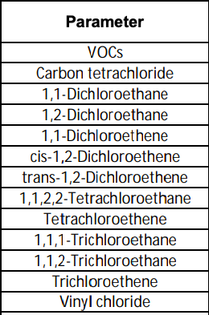
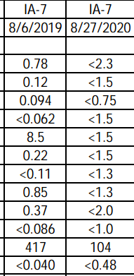
BorgWarner Report-August 2020
Why has the Limit of Detection (LOD) increased from 2019 to 2020?
10
(Annual Indoor Air Sampling Results 1700 Old Mansfield Road Site (OEPA ID 285001381-007) Bosch Rexroth Corporation and BorgWarner Inc., Wooster, Ohio 2020)
Notes:
-Inconsistencies in limit of detection
-Raises suspicion

Slide 26
Conclusions
Ease of EPA restrictions presented companies the opportunity for enhanced methyl chloroform measurements to occur due to the self-regulation of these companies
Difficult to pinpoint exact source of these emissions
Permit shows that organizations can legally discharge methyl chloroform prior to COVID lockdowns
Inconsistencies were observed in limit of detection for 2020 compared to past years
11

Slide 27
Future Work
Explore other companies that have been issued such permits
Compare frequency of NPDES permits issued
Has it increased…
throughout COVID lockdowns?
Over the past few years?
Investigate if trends exist for additional ozone depleting substances
Conduct additional whole air sampling near suspected sites
12

Slide 28
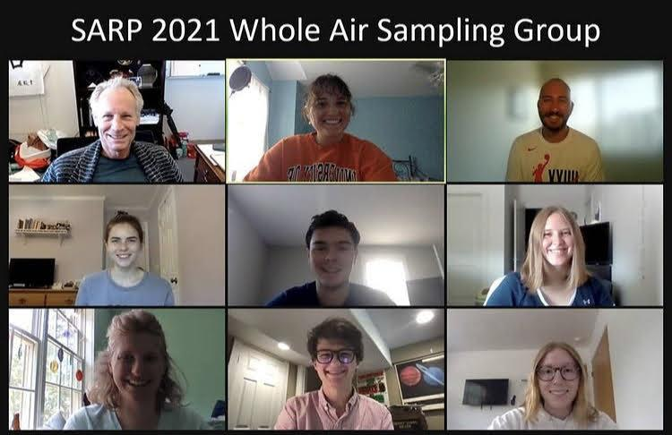
Acknowledgements
Dr. Don Blake
Alex Jarnot
Dr. Emily Schaller
Dr. Brenna Biggs
NASA Airborne Science Program
NASA Earth Sciences Division
The Rowland-Blake Lab
Ryan Bennett
Rachel Wegener
WAS Group
My fellow SARP Students
13
Notes:
Lastly, I would like to thank all those who have made this project possible

