Slide 1
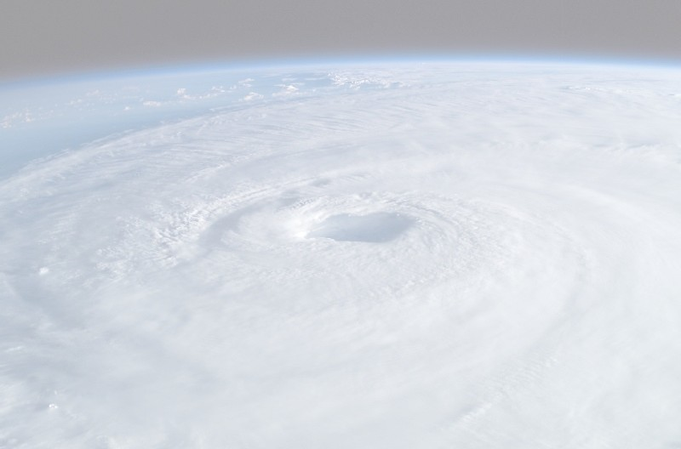
The Evolving Role of the Human in Weather Prediction and Communication
Neil A. Stuart¹,
¹ NOAA/National Weather Service, Albany, New York
Gail Hartfield², David M. Schultz^{3,4}, Katie Wilson⁵, Gregory West⁶, Robert Hoffman⁷, Gary Lackmann⁸, Harold Brooks⁹, Paul Roebber¹⁰, Teresa Bals-Elsholz¹¹, Holly Obermeier¹², Falko Judt¹³, Patrick Market¹⁴, Daniel Nietfeld¹⁵, Bruce Telfeyan¹⁶, Dan DePodwin¹⁷, Jeffrey Fries¹⁸, Elliot Abrams¹⁹, Jerry Shields²⁰
² NOAA/National Weather Service, Raleigh, North Carolina
³ Centre for Atmospheric Science, Department of Earth and Environmental Sciences, University of Manchester, Manchester, United Kingdom
⁴ Centre for Crisis Studies and Mitigation, University of Manchester, Manchester, United Kingdom
⁵ CIMMS/Univ. of Oklahoma and NOAA/OAR/NSSL, Norman, Oklahoma
⁶ BC Hydro, Burnaby, Canada
⁷ Florida Institute of Human and Machine Cognition, Pensacola, Florida
⁸ North Carolina State University, Raleigh, North Carolina
⁹ National Severe Storms Laboratory and University of Oklahoma, Norman, Oklahoma
¹⁰ University of Wisconsin-Milwaukee, Milwaukee, Wisconsin
¹¹ Dept. of Geography and Meteorology, Valparaiso Univ., Valparaiso, Indiana
¹² CIMMS/Univ. of Oklahoma, Norman, Oklahoma
¹³ Mesoscale and Microscale Meteorology Laboratory, NCAR, Boulder, Colorado
¹⁴ Univ. of Missouri, Columbia, Missouri
¹⁵ NOAA/OAR/ESRL/GSL, Boulder, Colorado
¹⁶ 557th Weather Wing (retired), Offutt AFB, Nebraska
¹⁷ AccuWeather, State College, Pennsylvania
¹⁸ Chief, Operations Standards and Tactics, 1st Weather Group (ACC), Offutt AFB, Nebraska
¹⁹ AccuWeather (retired), State College, Pennsylvania
²⁰ Ontario Ministry of Natural Resources and Forestry, Peterborough, Canada
22nd Northeast Regional Operational Workshop – 9 November 2021

Slide 2
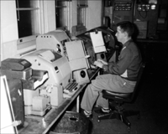
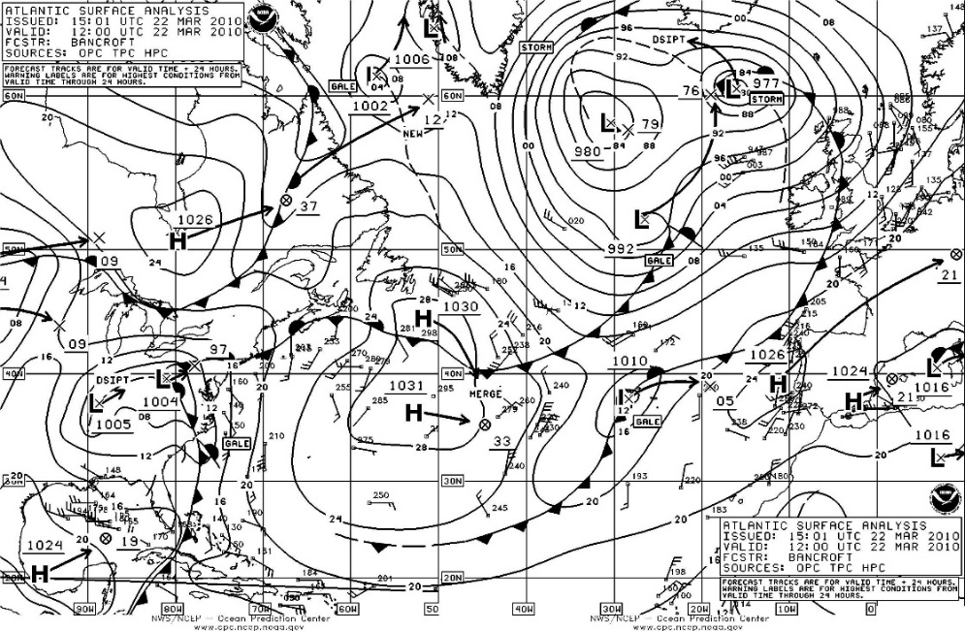
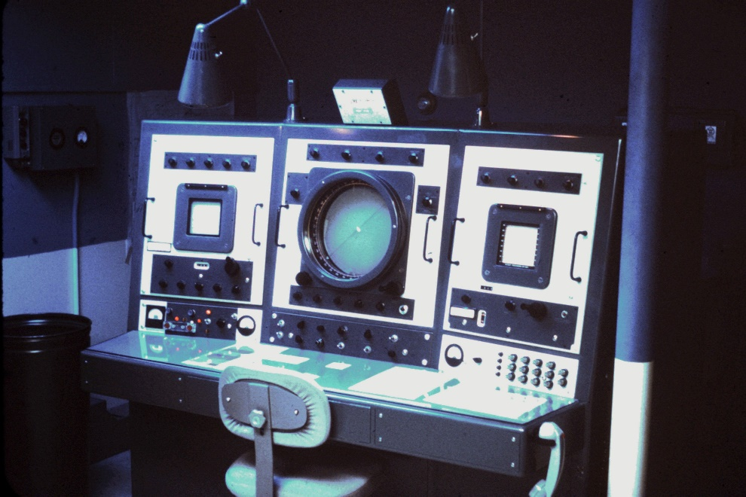
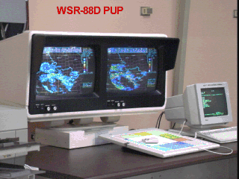
We have come a long way so far…

Slide 3
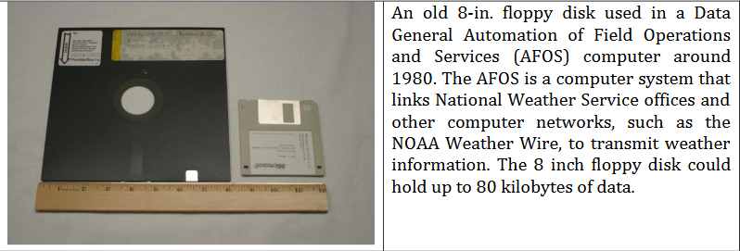
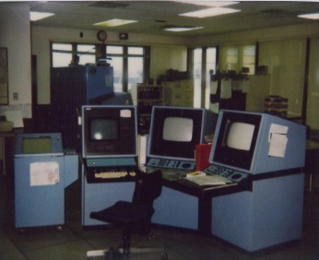
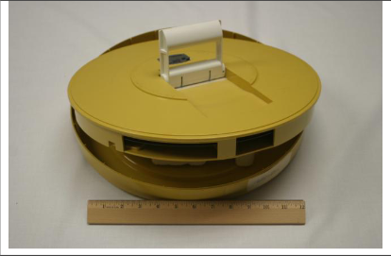
We have come a long way so far…

Slide 4
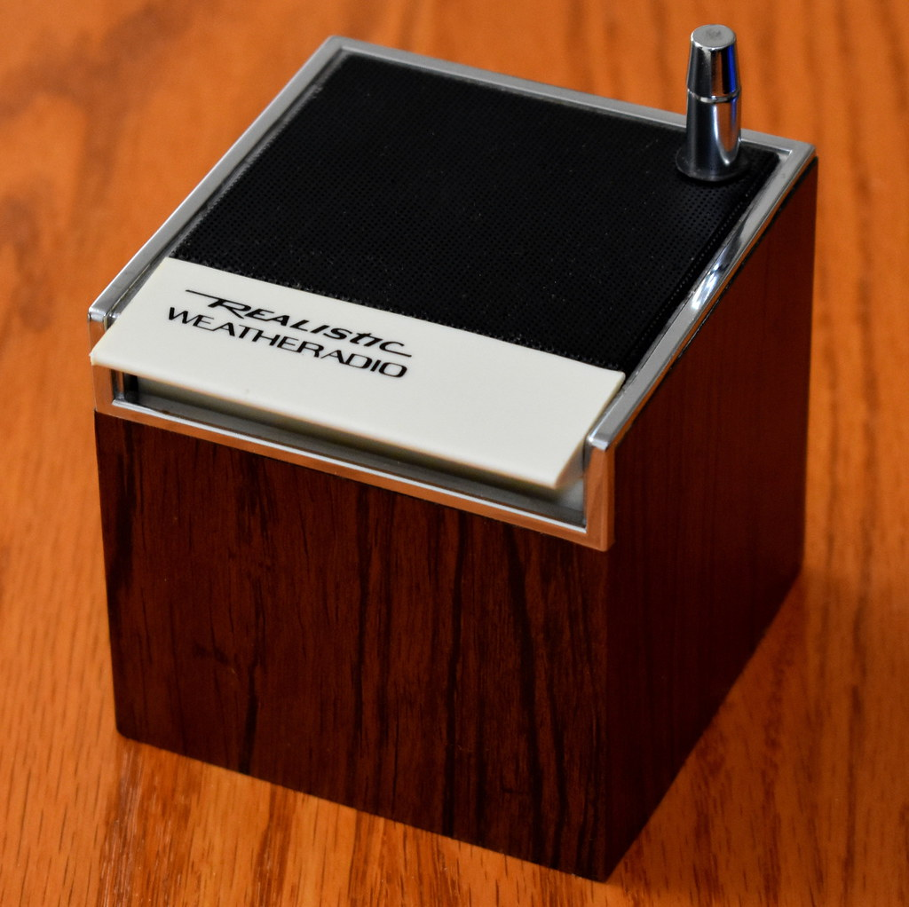
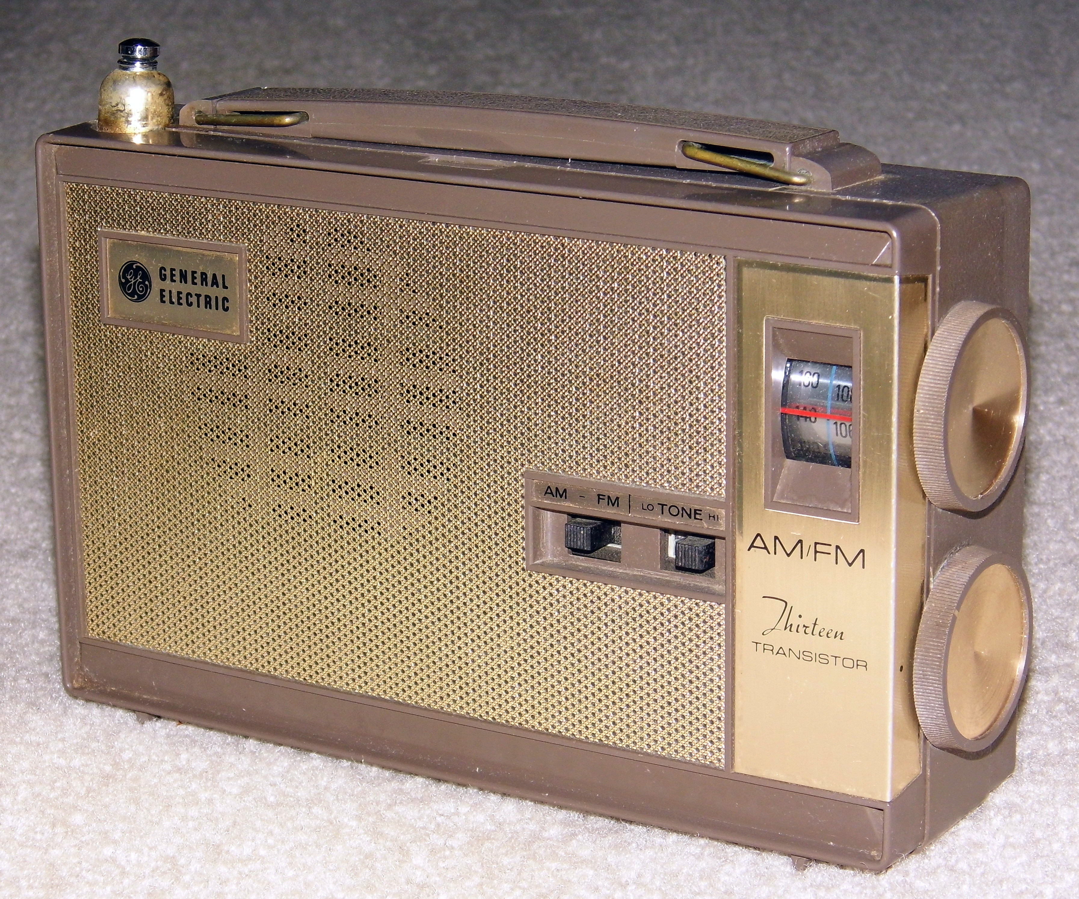
We have come a long way so far…

Slide 5
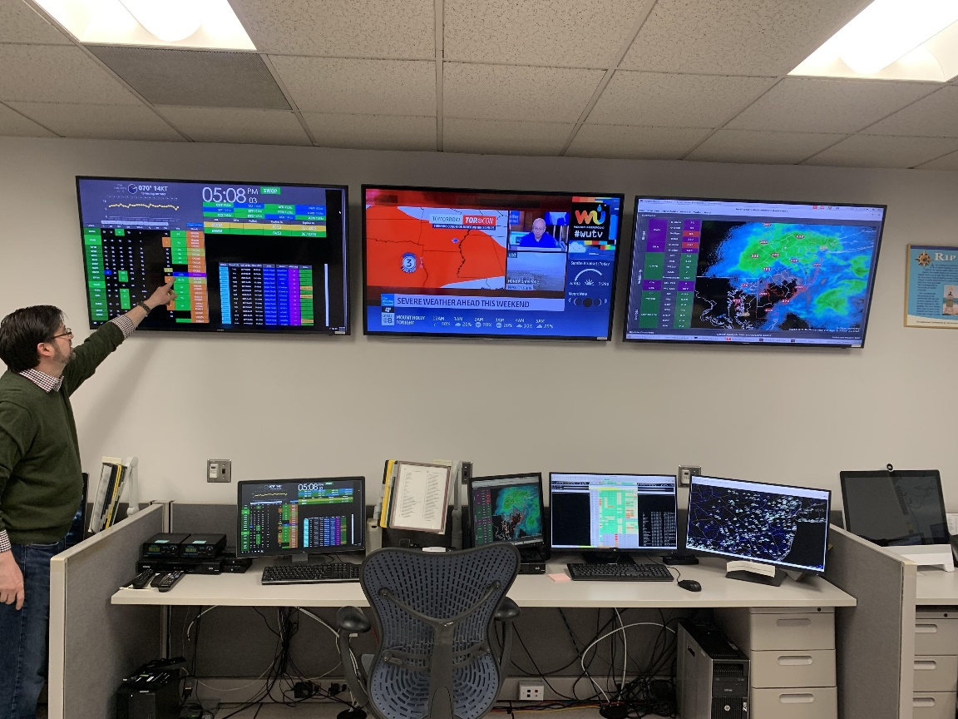
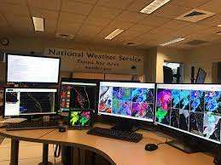
We have come a long way so far…

Slide 6
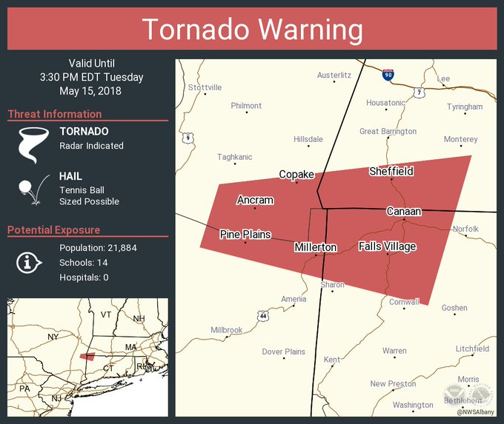
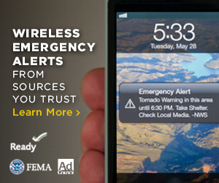
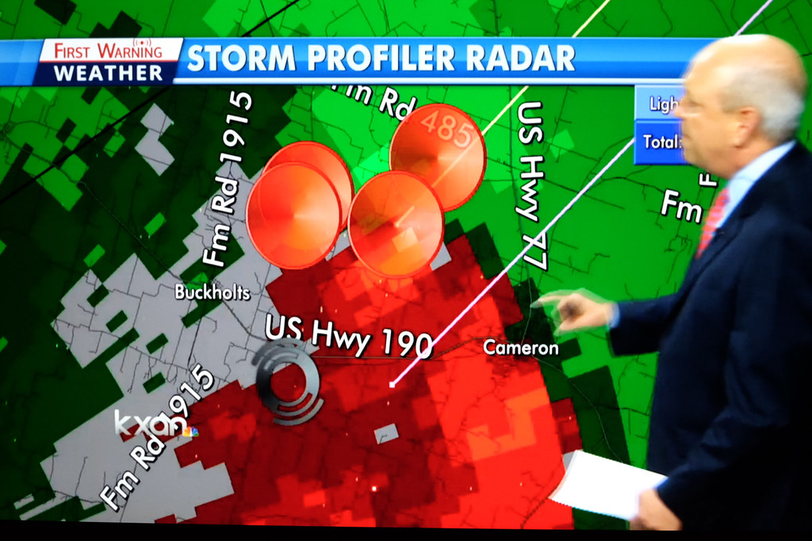
We have come a long way so far…

Slide 7
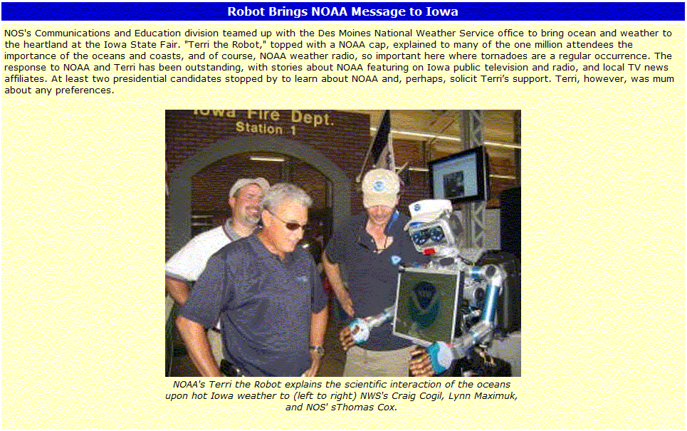
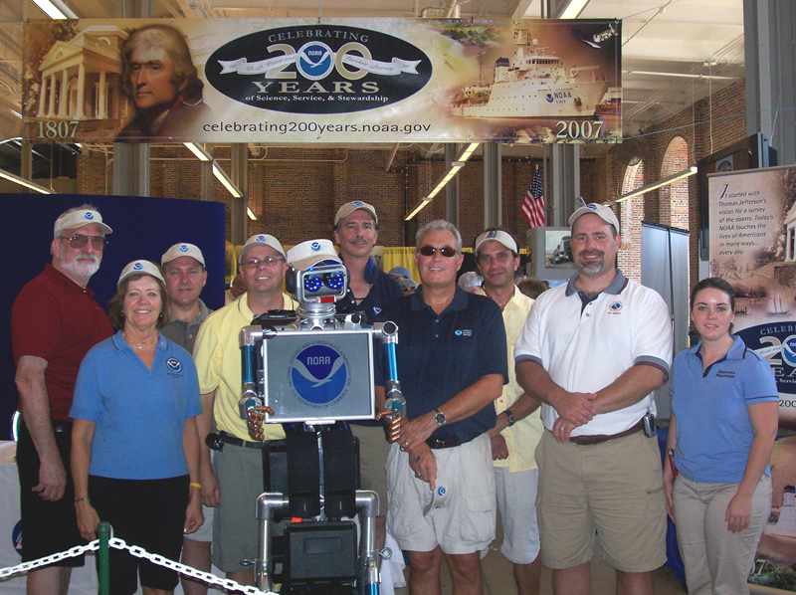
Is this the future or are we there already?

Slide 8
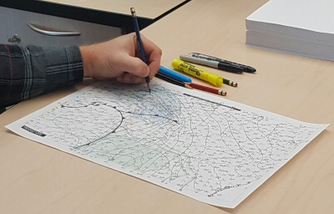
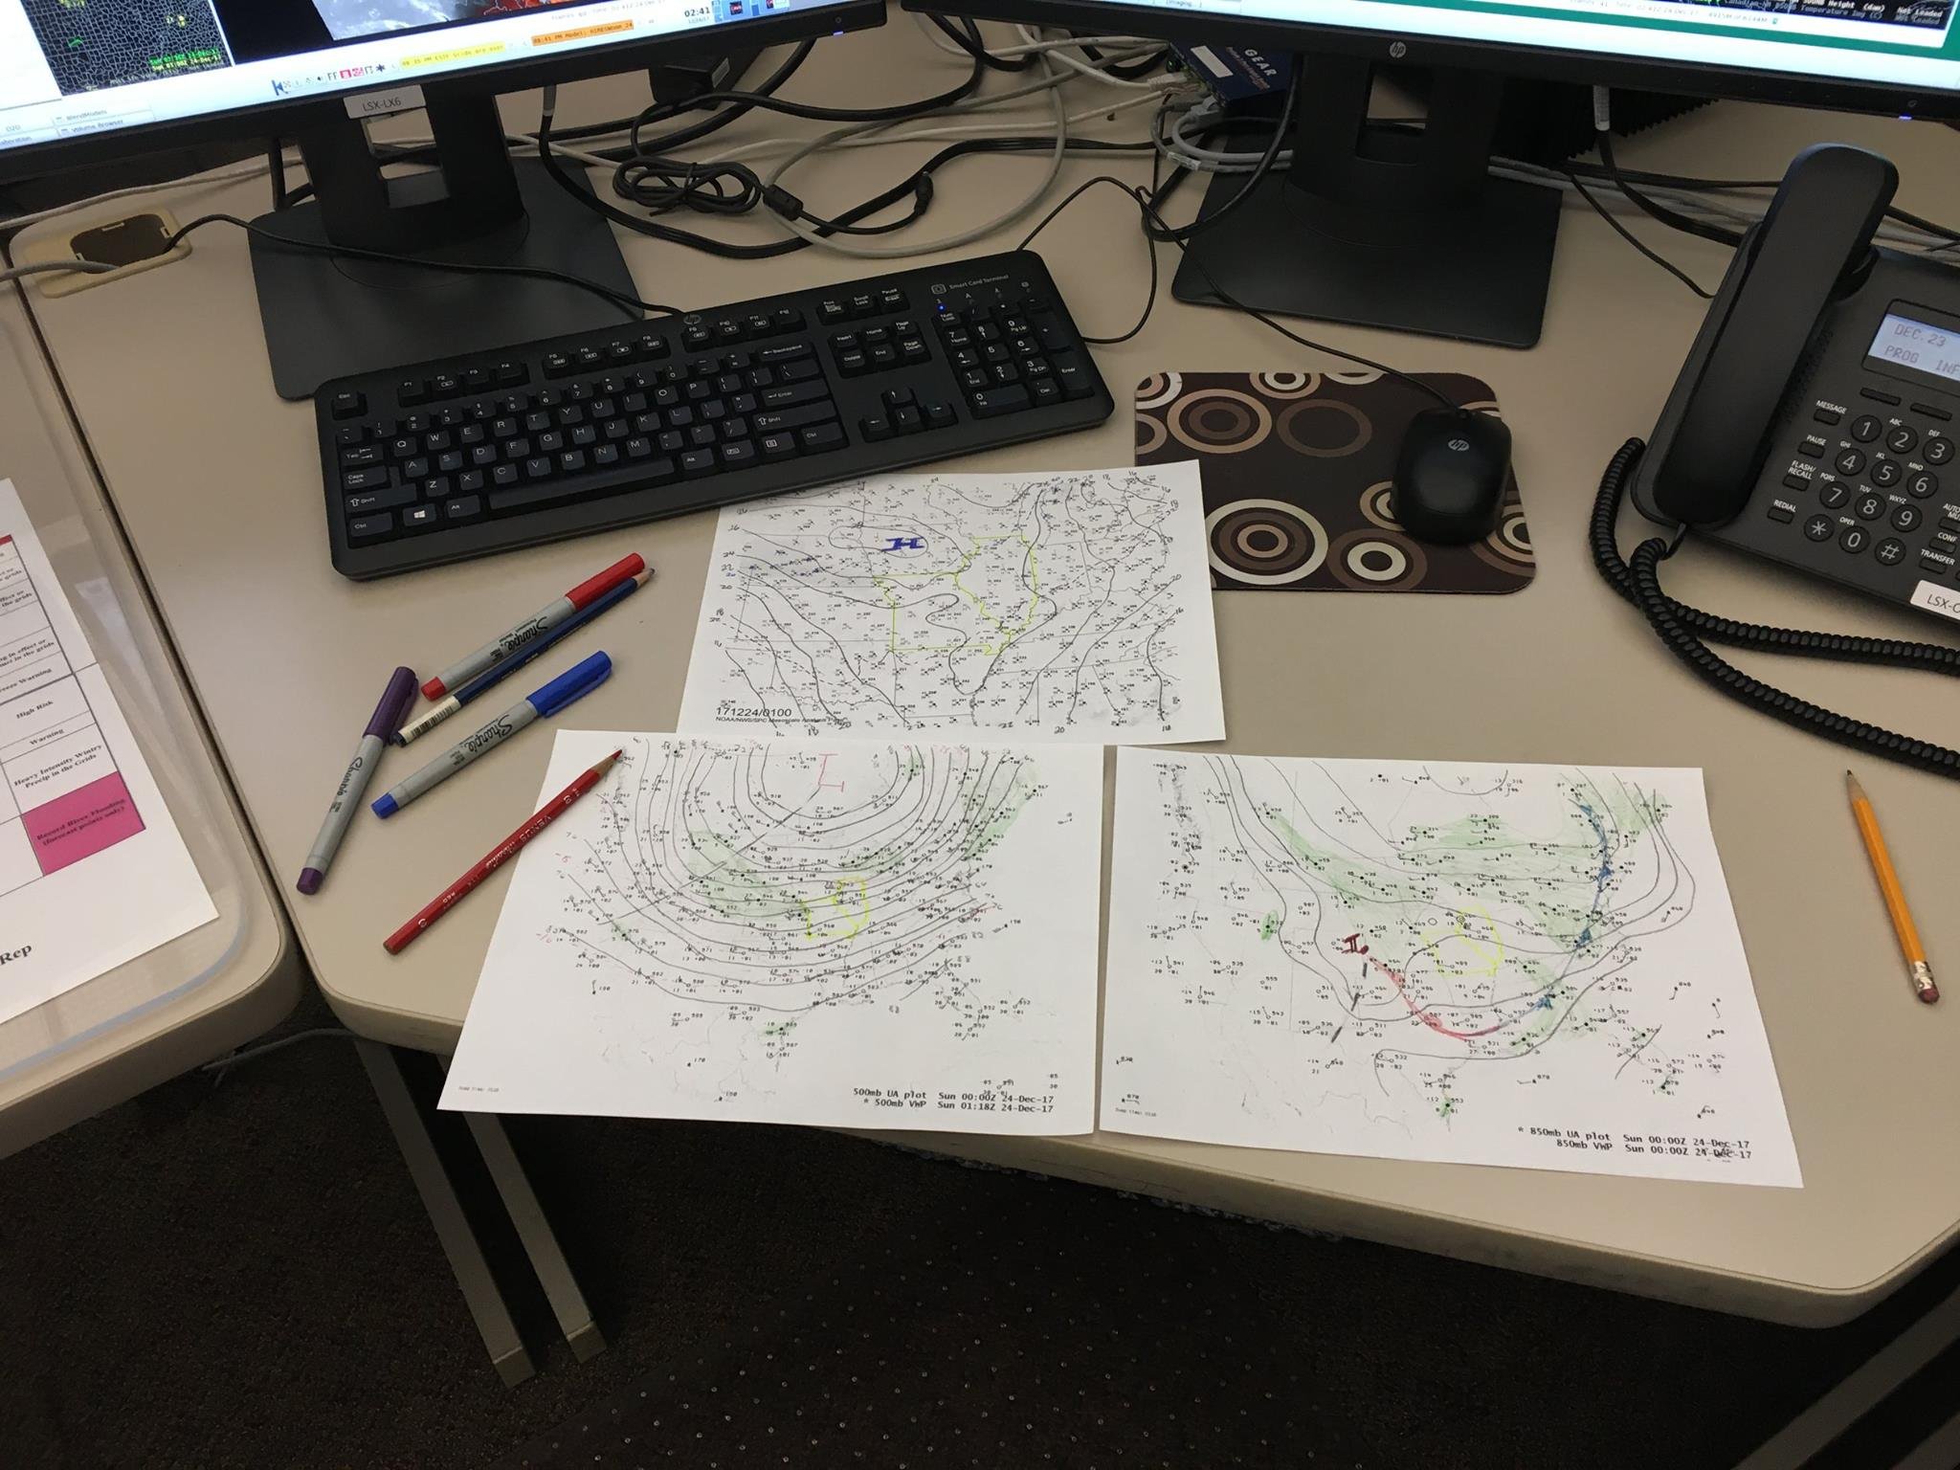
Is this the last of the old guard holding onto the past? Is this an exercise best left to computers? Or will these skills always be critical?

Slide 9
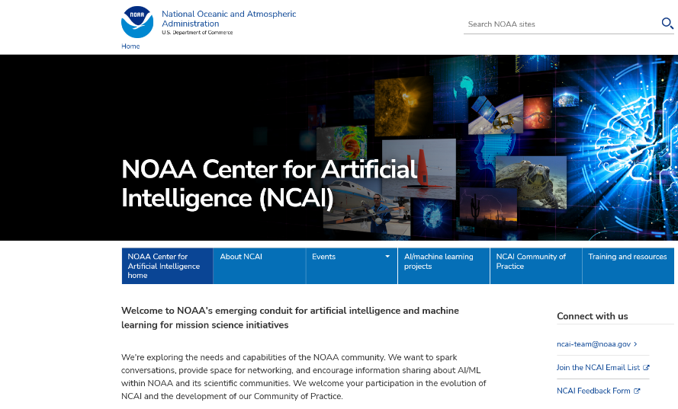
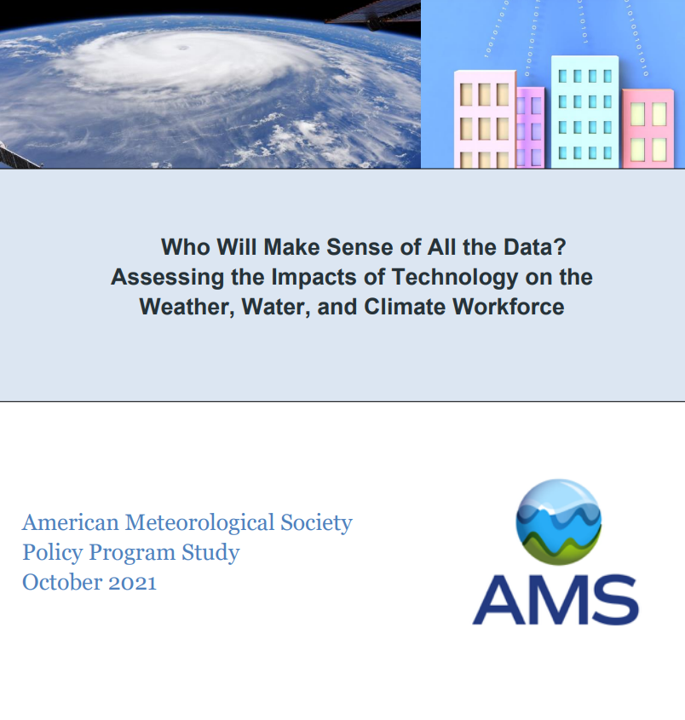
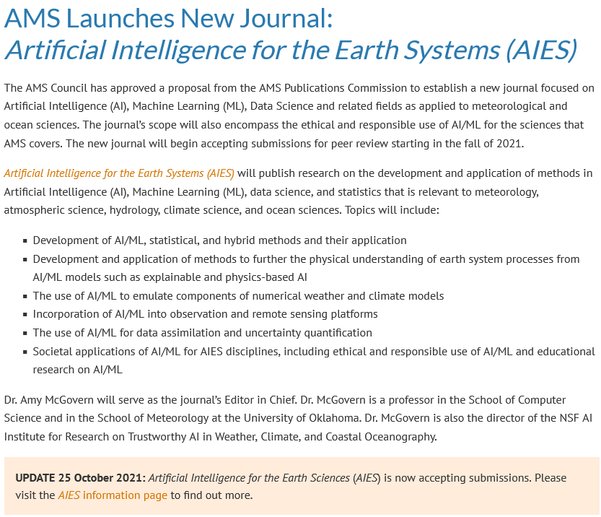
What will be an important factor guiding the evolving role of humans in weather and prediction? Artificial Intelligence?

Slide 10
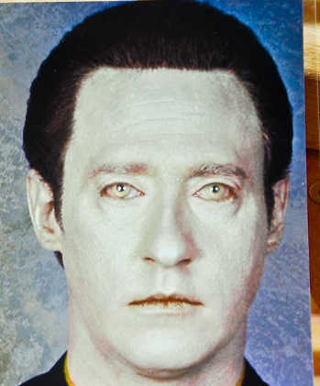
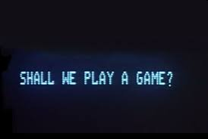
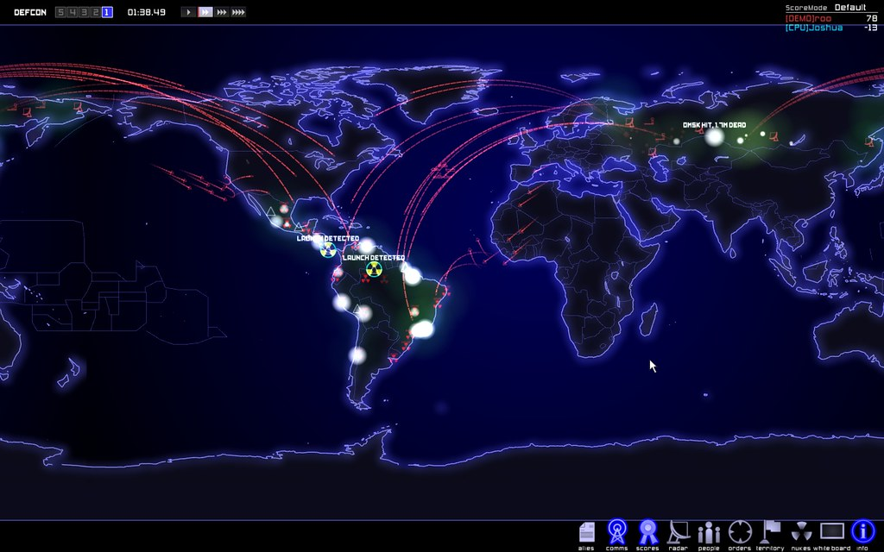
Will Technology/Artificial Intelligence reduce the need for humans in the future?
The role of Technology/AI has been debated at least since the 1960s – and we humans are still around!
Entertainment industry brings AI dilemma to the public masses – often dystopian view suggesting AI learns how to rule over humans – makes calculated objective decisions
What is the ideal balance of AI and human decision making?
AI replacing humans in decisions under constant stress and uncertainty – where humans have never gone before
AI in life and death or morality situations – Global Thermonuclear War
AI in law enforcement

Slide 11
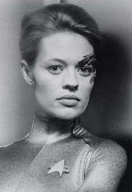
Will Technology/Artificial Intelligence reduce the need for humans in the future?
The role of Technology/AI has been debated at least since the 1960s – and we humans are still around!
Entertainment industry brings AI dilemma to the public masses – often dystopian view suggesting AI learns how to rule over humans – makes calculated objective decisions
What is the ideal balance of AI and human decision making?
What about the interdependence between humans and technology/AI in weather forecasting?
AI replaces or enhances humans - physical and mental abilities

Slide 12
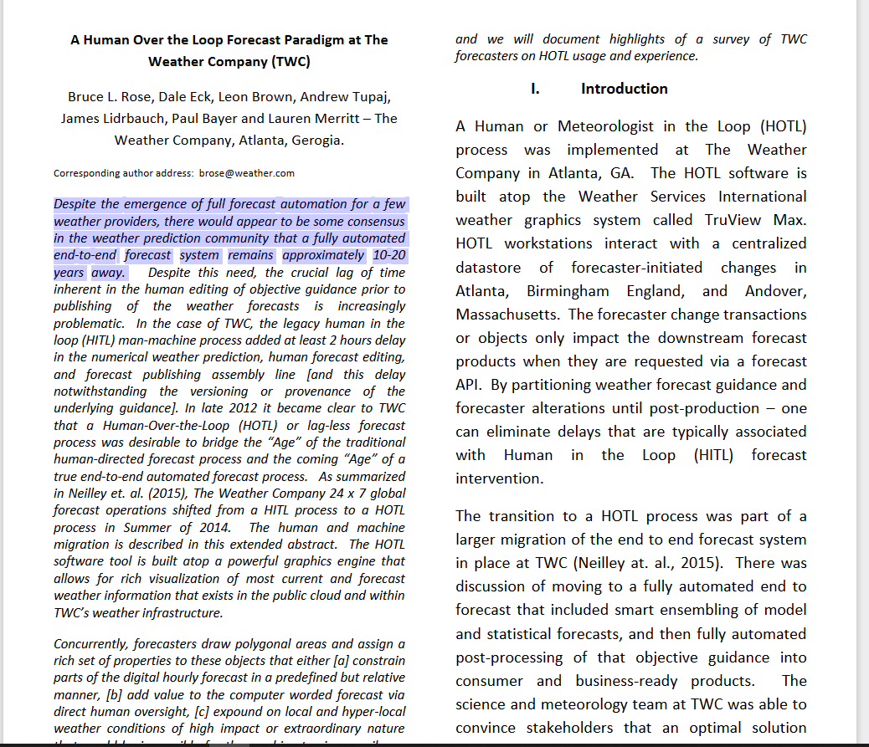
Pressure to adjust and in some cases reduce staffing profiles in operational settings

Slide 13
3 year project 2019-present
Conclusions from 2004-2007 studies on future role of humans needed updating
19 meteorologists and one cognitive science engineer (social scientist)
Webinars conducted in late 2019 to January 2020 through the AMS (Available on AMS website)
Panel discussions at 2020 AMS meeting (not recorded but detailed notes taken)
Other input through E-mail and personal communications
4 overarching topics
development of automated forecasting tools,
use of automated forecasting tools,
training and proficiency for future forecasting
envisioning the future of weather prediction and communication
Near the finish line: BAMS article in final stages of review – Expected to be published 2022

Slide 14
Development of automated forecasting tools in hydrometeorology
Follow the current typical forecast process
Improving data quality, analysis and assimilation
Improving forecasts and warnings
Improving communication
The definition and duties describing the operational forecast process will likely change with time
Humans must be nimble and be ready to adjust to new operational forecasting and warning paradigms as we head into the future
BUT until then ----------------------------------------------→

Slide 15
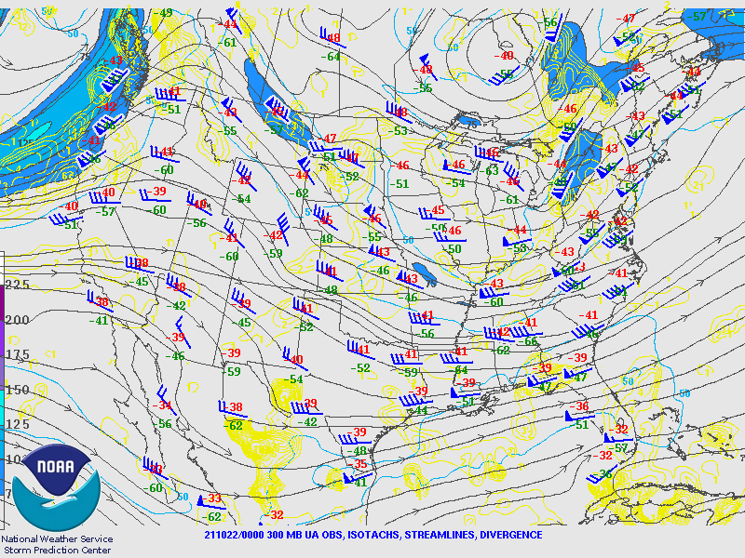
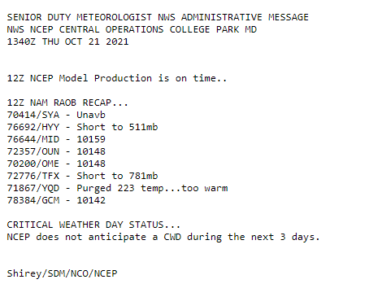
Development of automated forecasting tools in hydrometeorology
Detailed quality control of data already being done and technology/AI will likely increasingly assist in QC of data to optimize model/ensemble initializations
Upper air data – but what about aircraft and satellite data?

Slide 16
Development of automated forecasting tools in hydrometeorology – Lots of data to QC – AI can assist
Real Time Mesoscale Analysis
NWS Mesoscale Analysis
Metar Obs
NY State Mesonet and Weathernet Obs

Slide 17
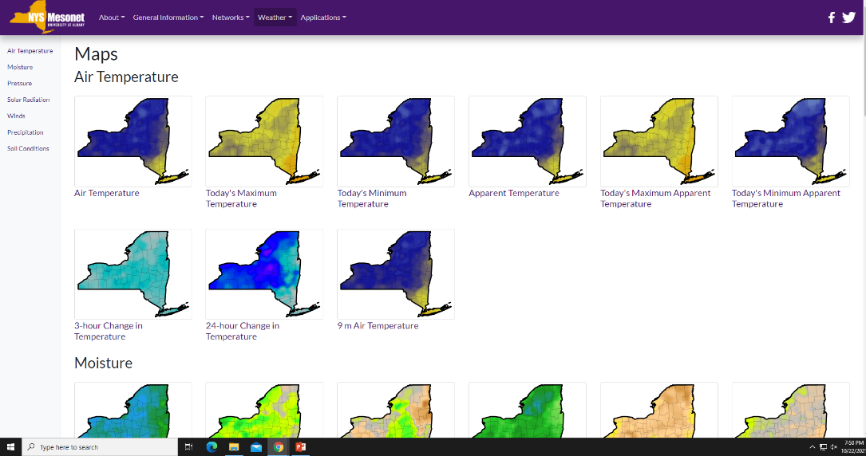
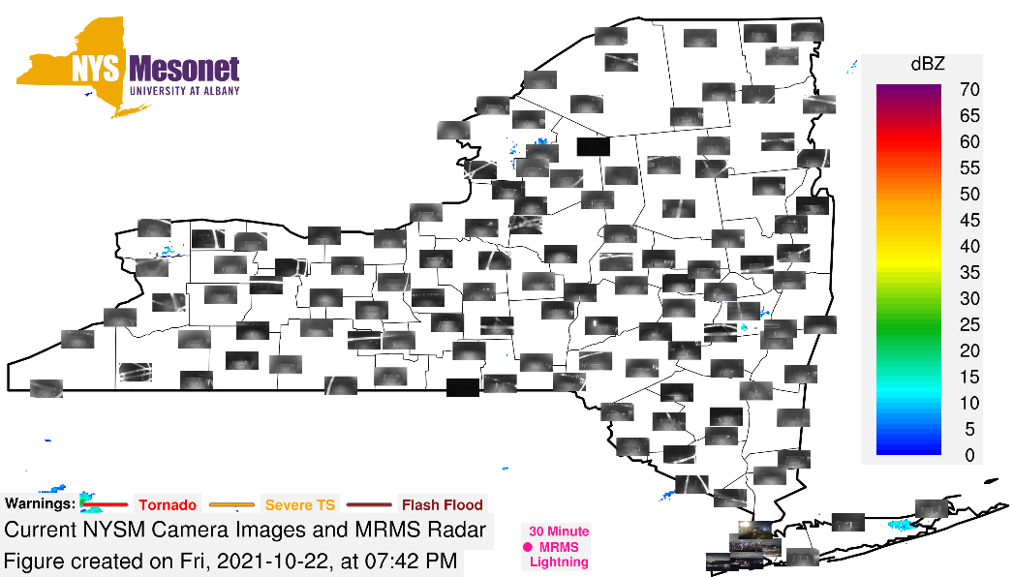
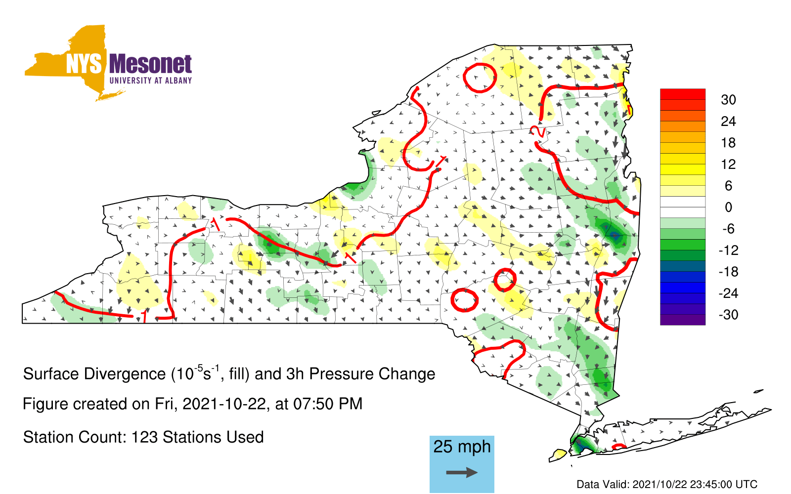
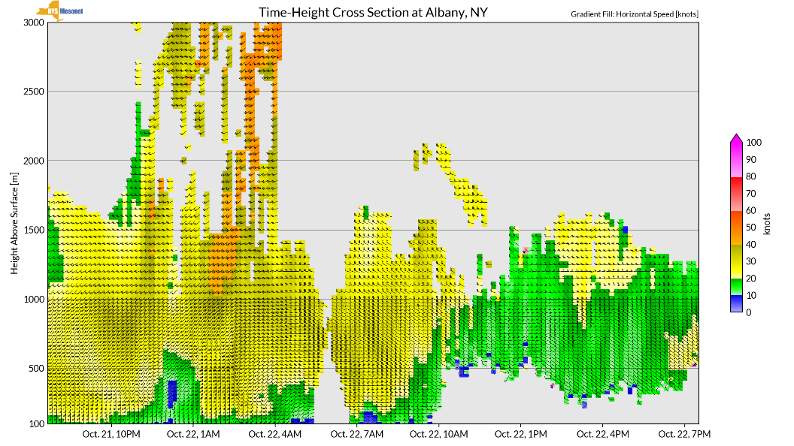
Development of automated forecasting tools in hydrometeorology – Lots of data to QC – AI can assist
More NY State Mesonet analyses to QC initial conditions

Slide 18
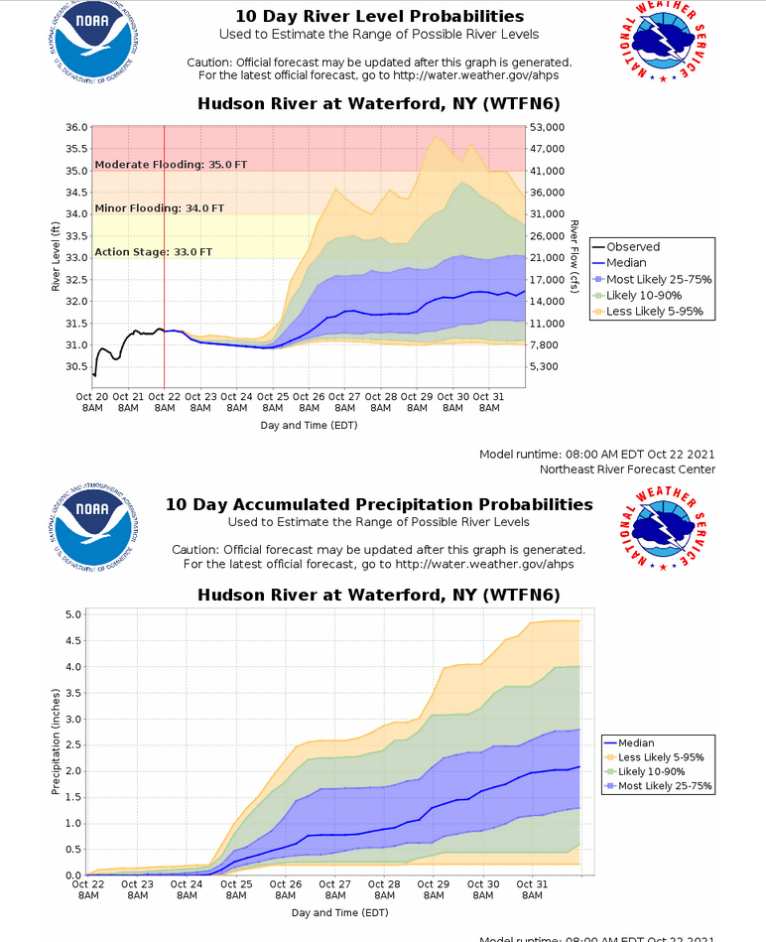
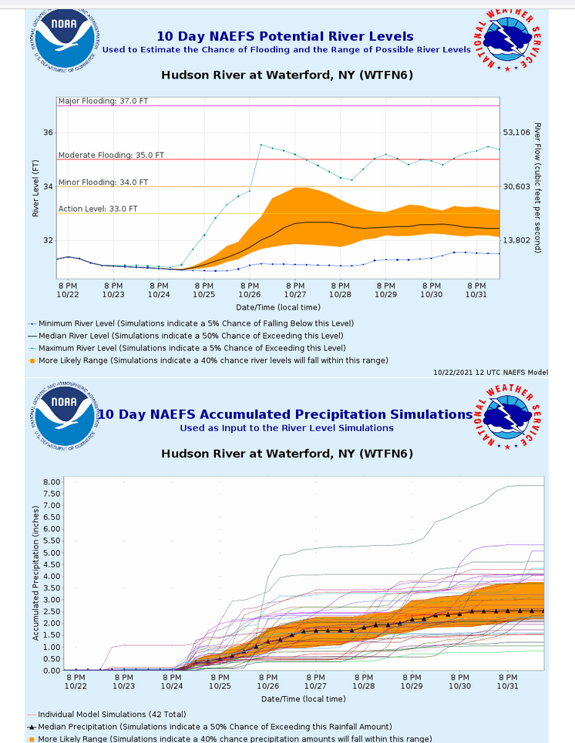
Development of automated forecasting tools in hydrometeorology – Lots of data to QC – AI can assist
Hydrology – North American Ensemble Forecast System
- Hydrological Ensemble Forecasting System
- Real time data and ranges of predictions

Slide 19
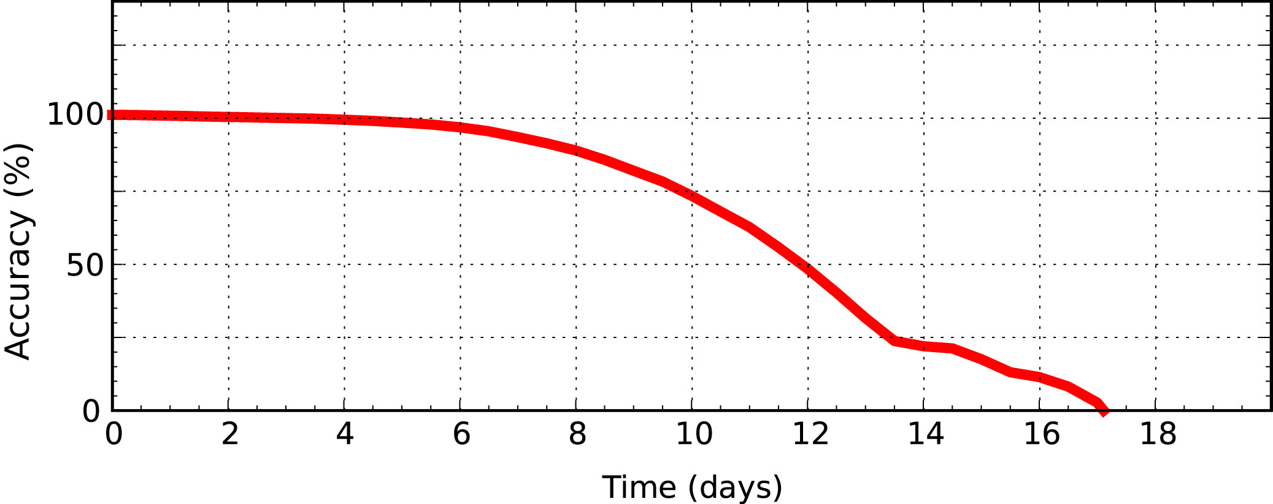
Tools for forecasting and warnings – First we must consider atmospheric predictability
What accuracy could we theoretically expect for day-to-day weather forecasts if we had a perfect model and nearly perfect observations?
theoretical
current ECMWF
adapted from Judt (2018, J. Atmos Sci.) and Zhang et al. (2019, J. Atmos Sci.)
Notes:
theoretical, or intrinsic predictability, is a measure of how far out we could make deterministic forecasts if we had a perfect model and nearly-perfect initial conditions (of course, if we had a perfect model and perfect initial conditions, we could make perfect forecasts)
accuracy here is the “inverse” of wind error, measured with respect to climatology….0% accuracy means 0% skill
the accuracy metric is the squared difference in the wind field, and is heavily influenced by jet streams, so the figure gives you essentially the forecast accuracy of synoptic-scale weather systems in the middle latitudes (day-to-day weather, so it’s not applicable to hyper-local forecasts of thunderstorms)

Slide 20
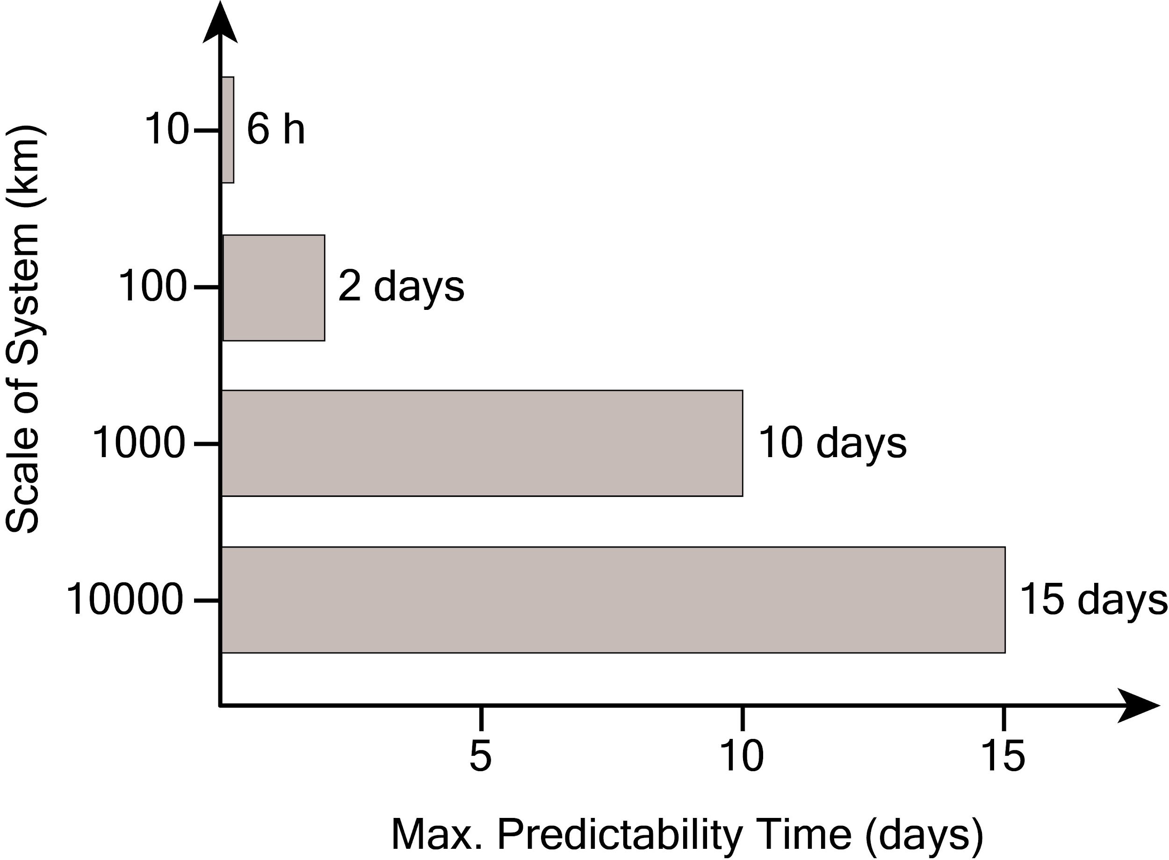
First we must consider atmospheric predictability
Predictability is
scale-dependent
adapted from Judt (2018, J. Atmos Sci.)
Notes:
predictability is scale dependent because error growth is faster on smaller scales….that’s why thunderstorm forecasts more than a few hours in advance are futile, even in a hypothetical future scenario
typical scales:
10 km --- thunderstorm
100 km --- squall lines
1000 km --- cyclones
10000 km --- Rossby waves

Slide 21
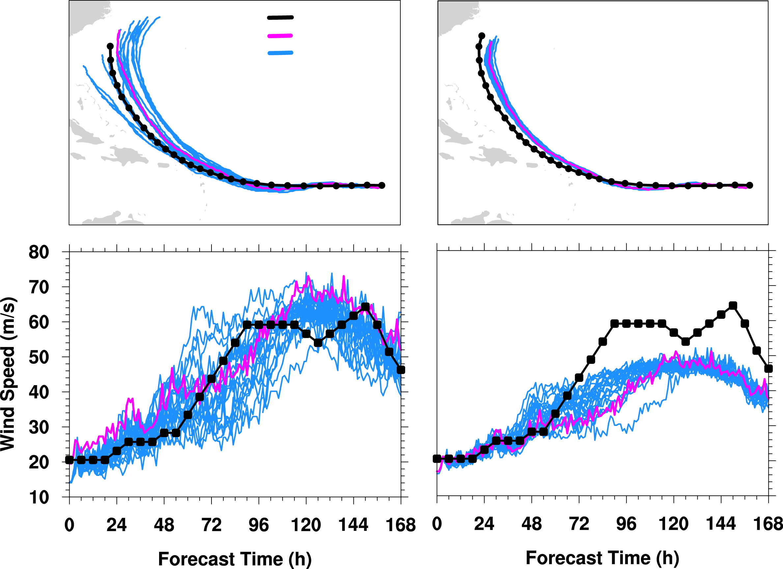
First we must consider atmospheric predictability
Hurricane Earl of 2010
well-calibrated ensemble
biased & underdispersed ensemble
Observation
Deterministic run
Ensemble
adapted from Judt et al. (2016, Q. J. R. Met. Soc.)
Notes:
examples of calibrated/uncalibrated ensembles
(left) A useful ensemble which has been calibrated. There’s no bias and the “truth” is always contained within the ensemble envelop
(right) This ensemble has not been calibrated. It has an intensity bias (too low) and the spread is too narrow. Forecasts based on this ensemble would be overly confident, in a very wrong way.

Slide 22
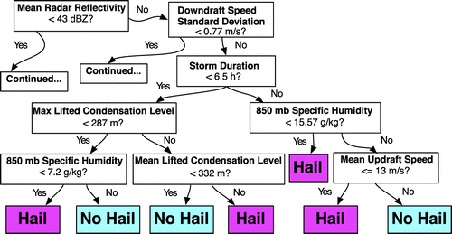
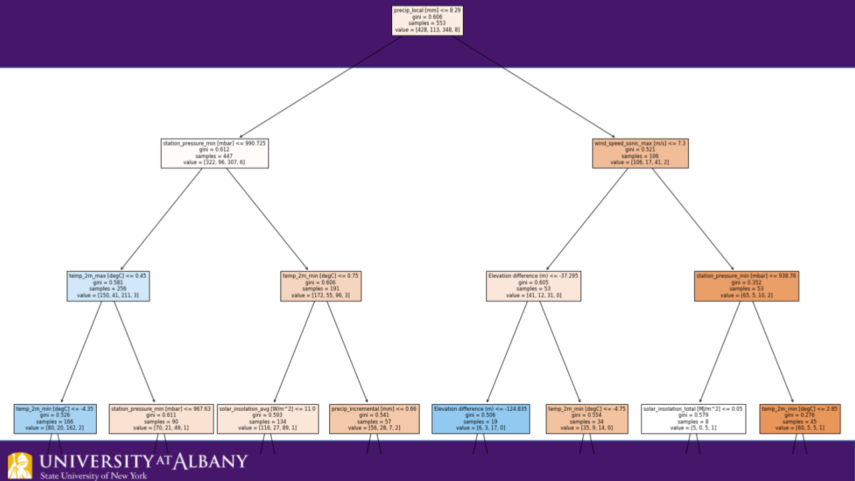
Humans employing AI Random Forests (RF), Gradient Boosted Regression Trees (GBRT), Convolutional Neural Networks (CNN) and other self-learning applications
Gagne (2016)
Cloud computing environment will allow for the entire enterprise to experiment with and share new model code, including AI/ML-based methods - Earth Prediction Innovation Center (EPIC) and Unified Forecast System (UFS)
Filipiak (2021-present)

Slide 23
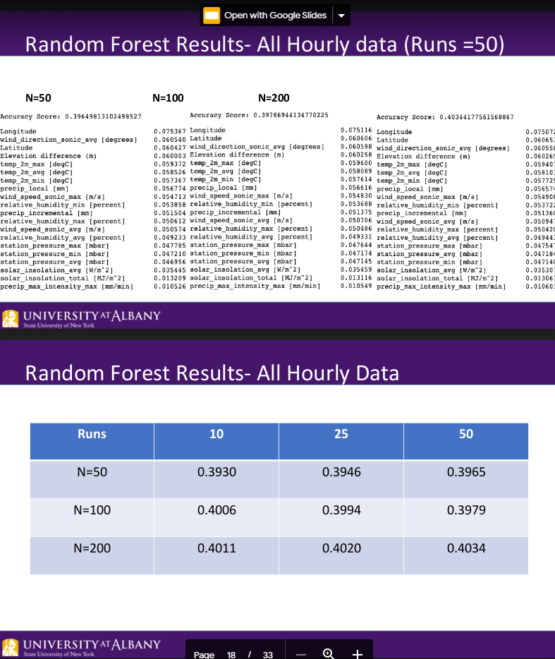
Humans employing AI Random Forests (RF), Gradient Boosted Regression Trees (GBRT), Convolutional Neural Networks (CNN) and other self-learning applications
CSTAR project – Brian Filipiak
Random Forest Machine Learning application to optimize precipitation type predictions
Important aspect of AI we must utilize – showing the weight of different parameters that were used for a successful prediction
Humans can learn how to recognize when an upcoming event is not being represented well in guidance

Slide 24
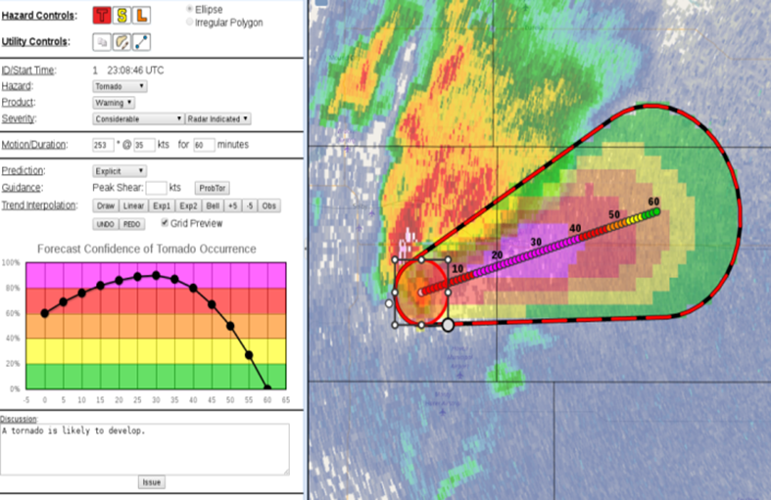
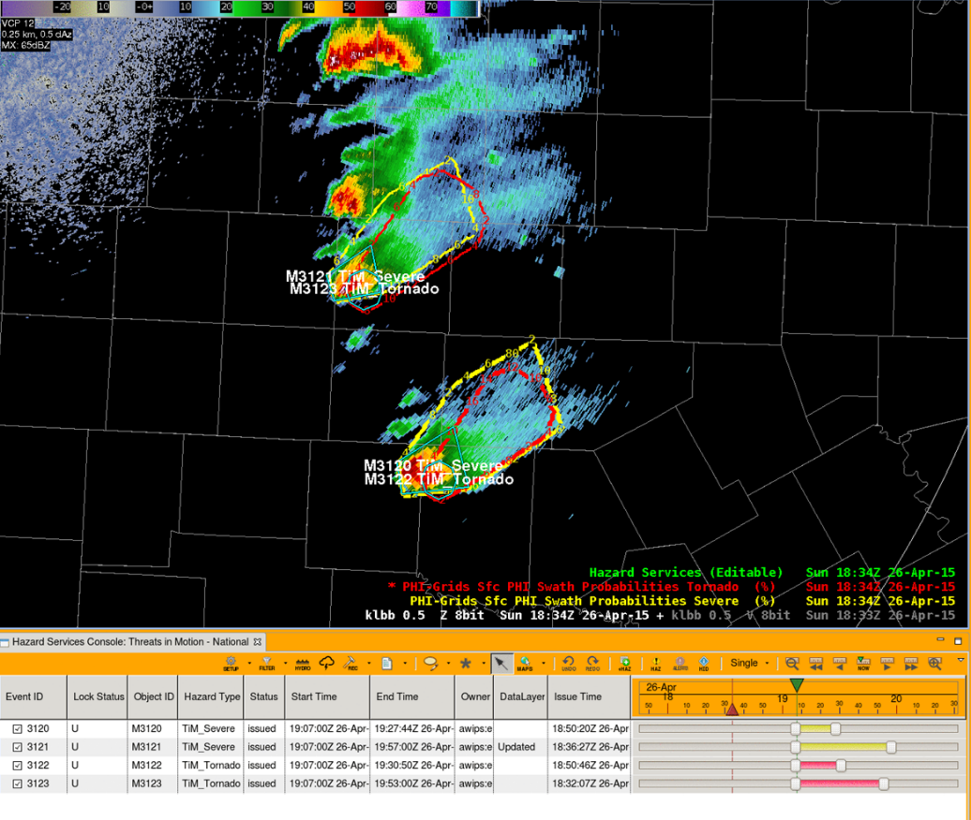
Development of automated forecasting tools: types, the human role in their design
Forecasting a Continuum of Environmental Threats (FACETS) guiding future severe weather operations
Probabilistic Hazard Information (PHI)
We will return to these displays with a more detailed description of them a little later

Slide 25
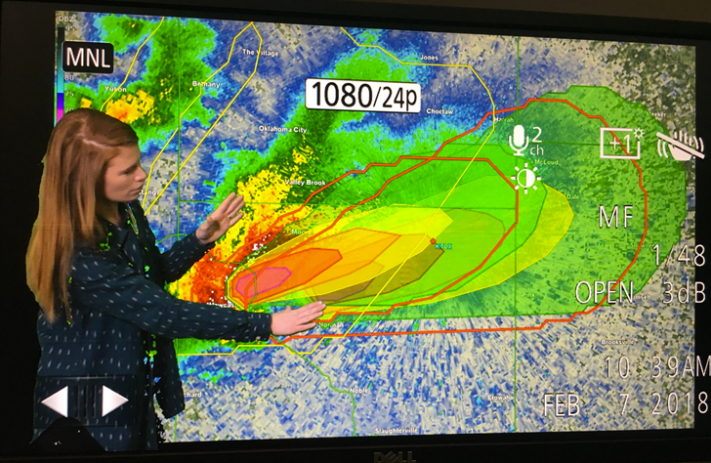
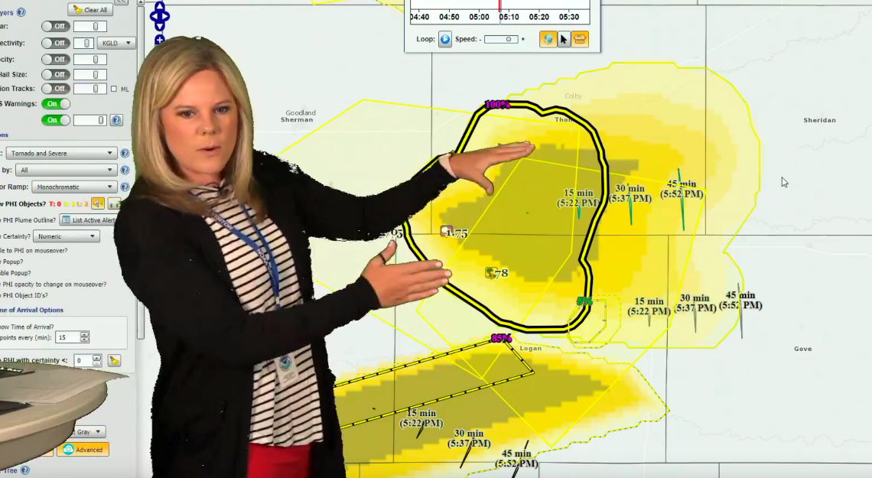
Development of automated forecasting tools: types, the human role in their design
Forecasting a Continuum of Environmental Threats (FACETS) guiding future severe weather operations
All sectors of the profession work together at Hazardous Weather Testbeds - Public, Private, Broadcast, Research
Optimize tools for prediction, communication, visualization

Slide 26
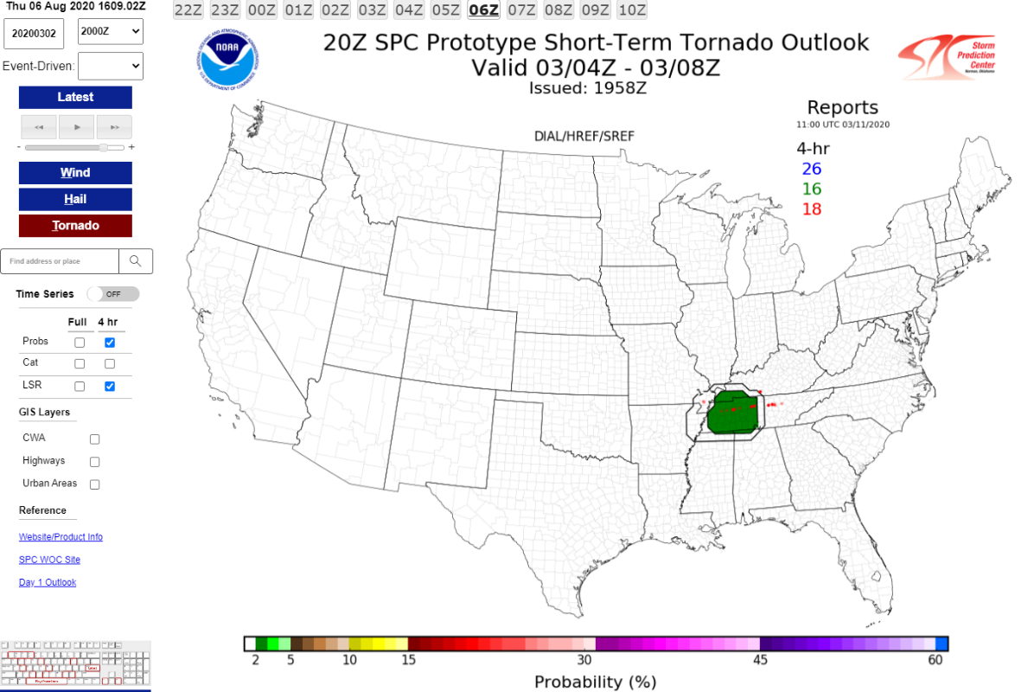
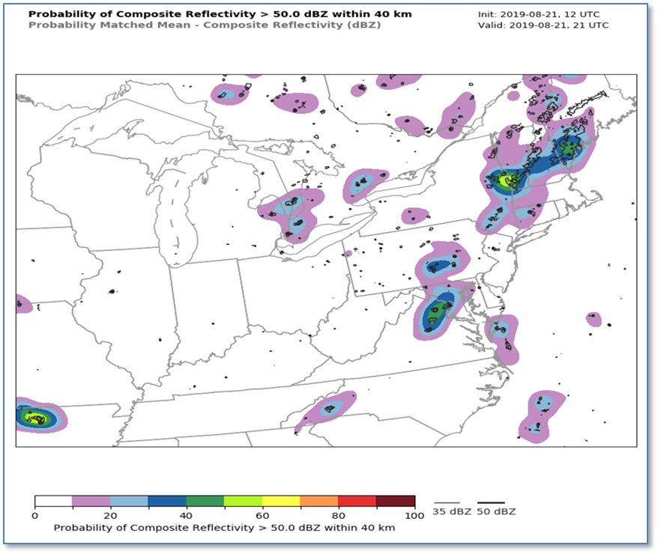
Development of automated forecasting tools: types, the human role in their design
AI/ML being used to improve mesoscale model/ensemble output – not all models but increasing use
We will need to understand rapidly advancing ensemble/probability concepts due to changes/improvement over time

Slide 27
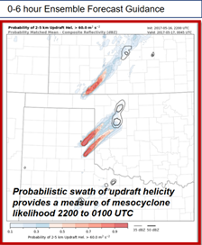
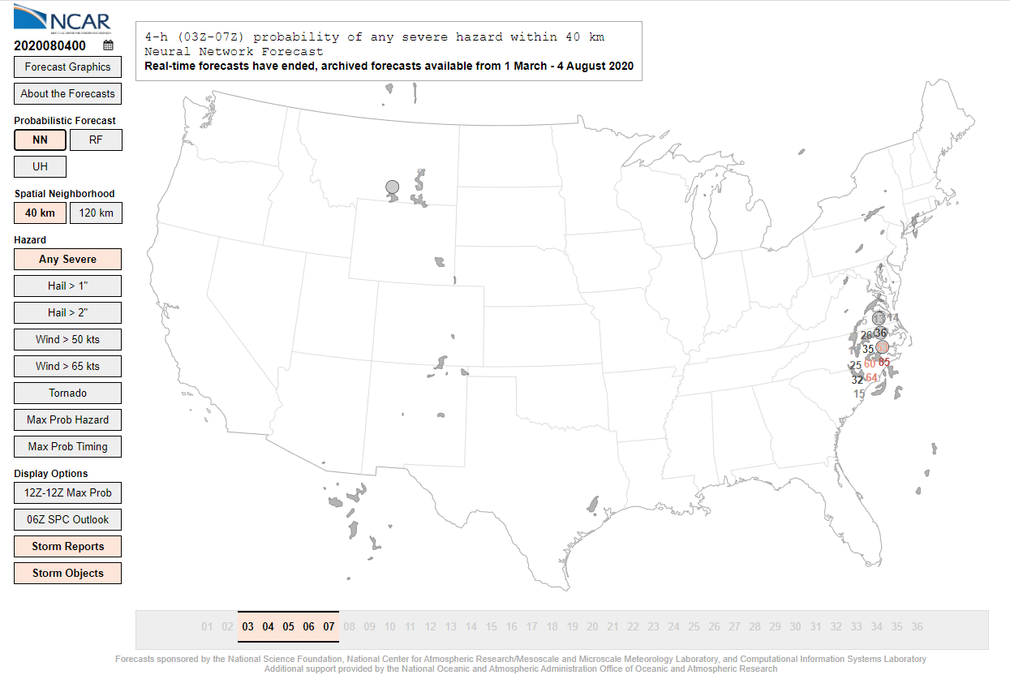
Development of automated forecasting tools: types, the human role in their design
AI/ML being used to improve mesoscale model/ensemble output – not all models but increasing use
We will need to understand rapidly advancing ensemble/probability concepts due to changes/improvement over time

Slide 28
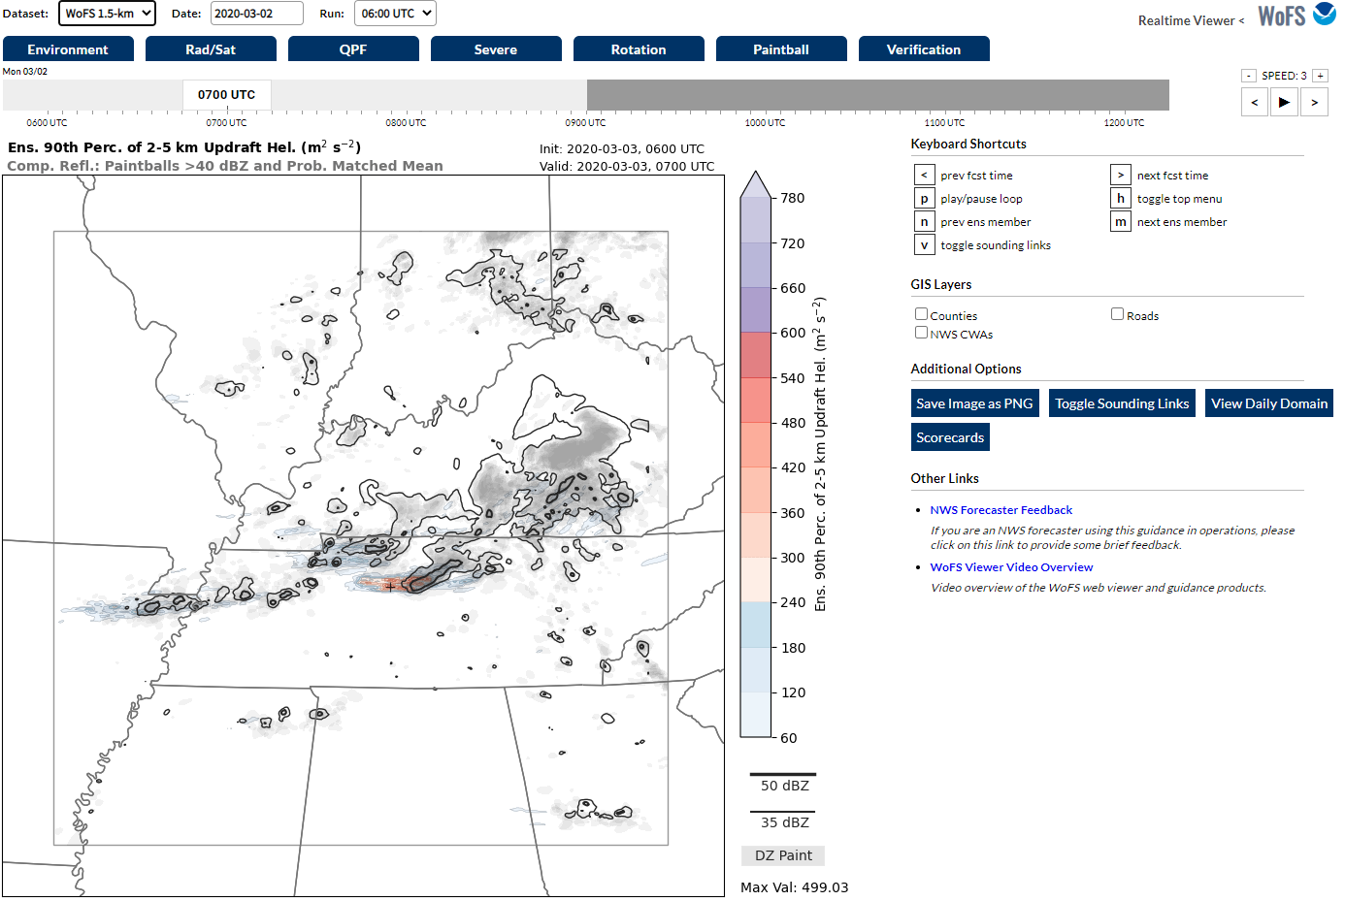
Development of automated forecasting tools: types, the human role in their design
AI/ML being used to improve mesoscale model/ensemble output – not all models but increasing use
We will need to understand rapidly advancing ensemble/probability concepts due to changes/improvements over time
Warn on Forecast System (WoFS) and Multi-radar Multi-Sensor System (MRMS) – 0-6 hour probabilistic forecasts for severe weather

Slide 29
Development of automated forecasting tools: types, the human role in their design
AI/ML being used to improve mesoscale model/ensemble output – not all models but increasing use
We will need to understand rapidly advancing ensemble/probability concepts due to changes/improvement over time
Cannot forget winter weather – HREF and WPC probabilities, again increased reliance on ensemble output

Slide 30
Development of automated forecasting tools: types, the human role in their design
AI/ML being used to improve mesoscale model/ensemble output – not all models but increasing use
We will need to understand rapidly advancing ensemble/probability concepts due to changes/improvement over time
Cannot forget hydrology either – National Water Model

Slide 31
Development of automated forecasting tools: types, the human role in their design
Before we move on – important to address ensemble calibration
Rapidly improving ensemble output and probabilities, some guided by AI, must still be used with caution
Frequent changes and upgrades to ensemble systems limit effective calibration
Calibration is only as good as the data that is used, the greater number of events over the greatest period of time produces the best calibration
Well calibrated ensemble systems provide the most reliable probabilities

Slide 32
Development of automated forecasting tools: types, the human role in their design
AI can help with improving communication to users
Can track people’s choices for weather information on social media – text, graphical, color preferences
Has been used to track human preferences in other research studies but not used in weather prediction or communication, yet
Sutton and Fischer 2021 studied human preferences in severe thunderstorm and tornado products but could be expanded to winter weather, heat and all other hazards and could employ AI

Slide 33
Development of automated forecasting tools: types, the human role in their design
AI can help with improving communication to users
Immersed mixed reality and virtual reality places a person right in the hazard
Virtual Reality games teach people how to prepare and respond to hazardous weather and water events (Bernhardt et al. 2019 and 2020)
Meteorologist Chris Warren – The Weather Channel
Category 3 hurricane from Bernhardt et al. (2019)
https://www.youtube.com/watch?v=XWZCXdkVPZQ

Slide 34
Development of automated forecasting tools: types, the human role in their design
Example – Probabilistic Winter Precipitation Forecast (PWPF)
Ensemble and deterministic guidance – aided by AI – produces probabilities for snow and ice
WFOs produce graphics of 10th and 90th percentile snow and ice amounts, including most likely scenario within the 10th and 90th percentile “goal posts”
Important disclaimer to further communicate uncertainty

Slide 35
Detour – What type of education and training are needed at various stages of ones career?
College – Those in college now will finish their careers around 2060 – Do we know what skills will be needed that far into the future?
Faculty and students make sure everyone is aware of education, internship and job shadow opportunities, including underserved and marginalized groups
Make sure students have the resources to be placed in the career enhancing opportunities
Based on student’s strengths, provide specialized coursework and outside experiences to guide them into their job placement to begin their career

Slide 36
Detour – What type of education and training are needed at various stages of ones career?
College – Those in college now will finish their careers around 2060 – Do we know what skills will be needed that far into the future?
GS-1340 and AMS meteorologist standards updated at different frequencies but need to reflect increasingly changing skill sets

Slide 37
Detour – What type of education and training are needed at various stages of ones career?
College – Those in college now will finish their careers around 2060 – Do we know what skills will be needed that far into the future?
Some universal skills that will be needed
Some baseline computing and programming skills
Understanding probabilistic and ensemble forecasting
Basic understanding of what AI can and cannot do
IDSS and the ever changing ways we communicate
Research skills and independent, critical thinking skills
Group/Team dynamics to optimize forecasting and task delegation through the scientific process
Graphic design, GIS and other visualization methods
Work/life balance working non-standard hours
More telework/remote work? – lessons from COVID era

Slide 38
Detour – What type of education and training are needed at various stages of ones career?
Balance between determining what meteorologists/forecasters understand and what they should understand
Surveys take time (see Demuth et al. 2020)
Surveys can easily be biased depending on who responds
AI can help determine what we learn, what we should learn and how we best can learn it by tracking forecaster successes and failures
AI can guide to improve each step of the forecast process - data/guidance analysis, mechanical forecast production, communication to users, meeting deadlines

Slide 39
Detour – What type of education and training are needed at various stages of ones career?
Characteristics of expert forecasters –
Length of career ≠ Expertise all the time
Active and engaged lifelong learning
including past event analyses = Expertise
Tetlock and Gardener 2016
Hoffman et al. 2017

Slide 40
Which brings up another important subject - Verification
Without a robust and detailed verification system, how do we know what tools, methods and techniques result in the most improvement to predictions and communication?
No universally accepted verification system exists
NWS – National centers and local forecast offices use different methods – deterministic and probabilistic
National Forecasting Game – University/College student forecasts scored using other methods
Model Evaluation Tools (MET) verification package developed by DTC/NCAR may become the standard

Slide 41
Just a few selected types of current verification methods
* Statistical significance

Slide 42
Just a few selected types of current verification methods
Ultimately, different verification systems exist that manipulate data and statistics in different ways for different time periods, areas and points, producing different results
Results could change with different statistical approaches

Slide 43
So, what will the forecast process look like in the future?
Not likely to see this technology in NWS field offices until after 2030

Slide 44
So, what will the forecast process look like in the future?
NWS – Continuous flow if information – Threats in Motion (TIM)
Near-term: Move to this paradigm perhaps within 5-10 years?
Frequently updating polygons – must determine the balance of automation and human intervention in decisions for updated polygons

Slide 45
So, what will the forecast process look like in the future?
NWS – Continuous flow if information – Threats in Motion (TIM)
Farther into the future: Perhaps beyond 5-10 years?
Instead of polygons, updating severe weather probability plumes and resultant graphics/trends/text for locations within the plume
Must determine what probability warrants EAS/WEA severe weather warning to warn locations that reach that probability

Slide 46
So, what will the forecast process look like in the future?
National Weather Service – How will model suite evolve?
Is the NBM and will the NBM serve as the best initialization for the gridded database?
What about GFS, NAM, SREF, GFS Ensemble, Super Ensemble, NAEFS, HEFS, HRRR, HREF etc.?
Is the Forecast Builder and Graphical Forecast Editor the best interface to populate and edit grids?
Will NWS forecasters transition from deterministic to probabilistic gridded forecasts?
How will NWS forecasters collaborate, national centers and WFOs?

Slide 47
So, what will the forecast process look like in the future?
Private Sector – One possible scenario that could become the standard for most operational forecasting
Automated initial database updates every time there is an updated QC’d (through AI?) observation or model/ensemble data
Draw polygons and run tools to edit gridded database where and when needed
Thanks to Dr. Peter Neilley and Joe Koval from The Weather Company/Channel for providing these graphics

Slide 48
So, what will the forecast process look like in the future?
Private Sector – One possible scenario that could become the standard for most operational forecasting
Thanks to Dr. Peter Neilley and Joe Koval from The Weather Company/Channel for providing these graphics

Slide 49
So, what will the forecast process look like in the future?
Please read Rose et al. 2015 for the plans for the future forecast process at The Weather Company/Channel and the example of the proposed future day in the life of a forecaster
Private Sector – One possible scenario that could become the standard for most operational forecasting
Thanks to Dr. Peter Neilley and Joe Koval from The Weather Company/Channel for providing these graphics

Slide 50
So, what will the forecast process look like in the future?
Tools called:
Filters
Qualifiers
Blurbs
Private Sector – One possible scenario that could become the standard for most operational forecasting
Thanks to Dr. Peter Neilley and Joe Koval from The Weather Company/Channel for providing these graphics

Slide 51
So, what will the forecast process look like in the future?
Community Hydrologic Prediction System (CHiPS), National Water Model and Hazard Services provide foundation for Hydrologic predictions and communication – future capabilities will be built off this foundation

Slide 52
In summary
All sectors of the weather, water and climate enterprise must work together to determine how technology/AI guides us to an improved forecast, warning and communication process
– cloud computing environment (EPIC) and (UFS)
Any new guidance and tools must be calibrated for maximum accuracy
Social science is essential throughout the research to operations to research (R2O2R) process
Will increased remote/telework need to be included as a factor? – Lessons from COVID

Slide 53
In summary
Cost/benefit analyses and verification studies will likely be used to also determine what tasks humans will retain in the forecast, warning and communication process
Testbeds will help determine what tools and methods humans prefer and understand the most
Managers and policy makers should shadow operational forecasters at field offices for more informed decision making as well
Money, resources and budget management will greatly affect priorities in the evolution and rate of change in the forecast and communication process

Slide 54
In summary
Fundamental understanding of the atmosphere and pattern recognition will always be necessary.
Training and post-event analyses will help humans to recognize model errors so humans can continue to add value to guidance
Must ensure we know the weights of parameters used in the predictions so we can recognize anomalies and add value to model/ensemble output
AI will make errors when extreme events are not within the learning database, this is when we can add value
Where, when and how we add the most value is what will determine how the forecast process evolves

Slide 55
In summary
Virtual reality and mixed immersed reality will likely become more common to help people better visualize hazardous weather-related threats – calls to action with image or icon in addition to text/WEA?
Smart devices will become more common, including new capabilities and applications for phones, streaming services and other media
How do we reach people using streaming services? How do we reach, teach and guide the underserved and marginalized populations?
The user community needs to be routinely consulted to improve communication and understanding of weather and hazard information – expansion of GIS applications?
Electronic signs on roadways like NY State? –
What about geolocators for WEA on phones
and more pinpointed warnings for all media?
WEA error – yesterday 11/09/21

Slide 56
In closing
Healthy interdependent relationship where we let technology/AI guide and help us, never letting it replace us
Cannot become complacent, dependent and/or lazy and let technology/AI control too much of what we do
Must make sure there aren’t unhealthy power struggles at the manager/leadership level to control technology/AI at the expense of everyone and everything else. Also, can’t let AI overpower us and rule over us!

Slide 57
Ultimately…
Difficult to see, always in motion is the future!
Thank you for your time!
Questions? Comments? Editorial opinions?
Neil.Stuart@noaa.gov

