Slide 1
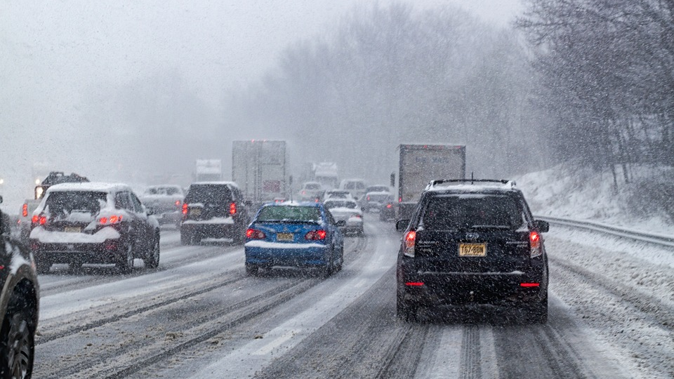

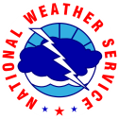

WPC Winter Operations Updates
Bryan Jackson
Winter Weather Desk Forecaster
NOAA/NWS Weather Prediction Center
2021 NROW
Nov. 9, 2021 | Virtual Presentation
Notes:
Hi everyone, my name is Alex Lamers, and I am the Warning Coordination Meteorologist at the Weather Prediction Center. My roots are actually there in Central Region -- I grew up in the Milwaukee suburbs, came into the NWS as a SCEP employee at the Milwaukee/Sullivan office, and also worked as a Met Intern at the Duluth office. So I’m very happy to be here today to talk to you about WPC winter weather operations and some interesting things we’re working on. Thank you to Randy and Alli for the invite to speak!

Slide 2
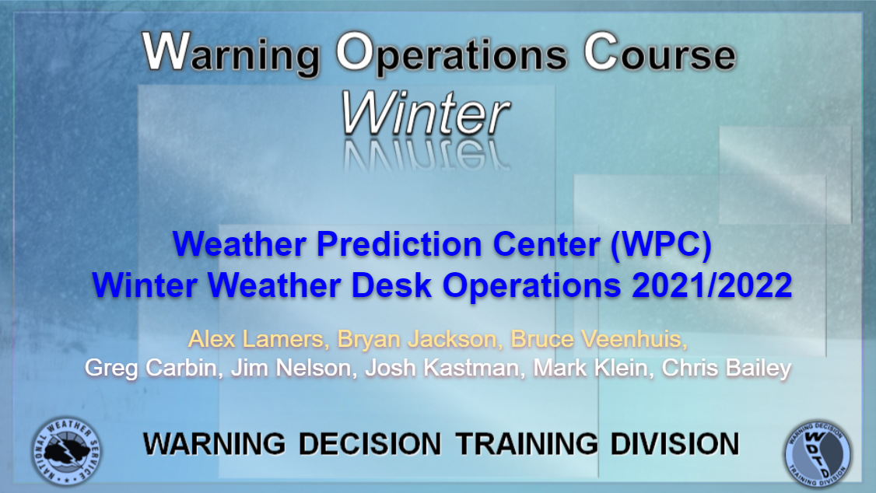
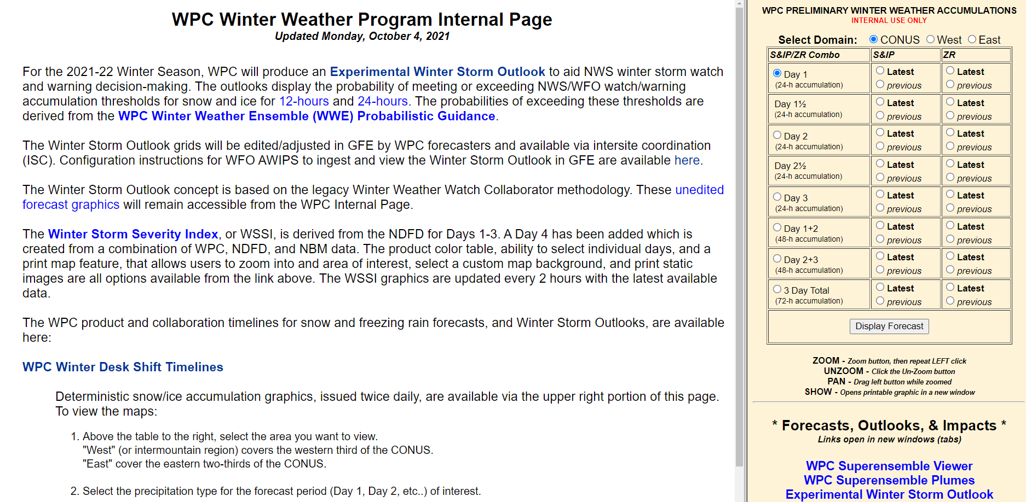


Presentation Roadmap
I’ll be focusing on the following items:
Probabilistic tools and messaging
Experimental Winter Storm Outlook (WSO)
Winter Storm Severity Index (WSSI)
Winter Key Messages
For additional information and detail:
WDTD WWD Operations Course (CLC)
Review links on WWD Internal Page
www.wpc.ncep.noaa.gov/wwd/internal
WEATHER PREDICTION CENTER
NATIONAL OCEANIC AND ATMOSPHERIC ADMINISTRATION
WPC Winter Operations Updates
Nov. 9, 2021 | NROW XXII
Notes:
In this presentation I’ll be focusing on probabilistic tools and messaging, the Winter Storm Outlook (or W-S-O), the Winter Storm Severity Index (or W-S-S-I), and Winter Storm Key Messages. We do have additional information on WPC winter weather services that you can find in our annual WWD Operations Course, which should be available on the Commerce Learning Center soon, and the Winter Weather Desk (or W-W-D) internal page. I won’t be covering everything today, so please do check out those resources.

Slide 3
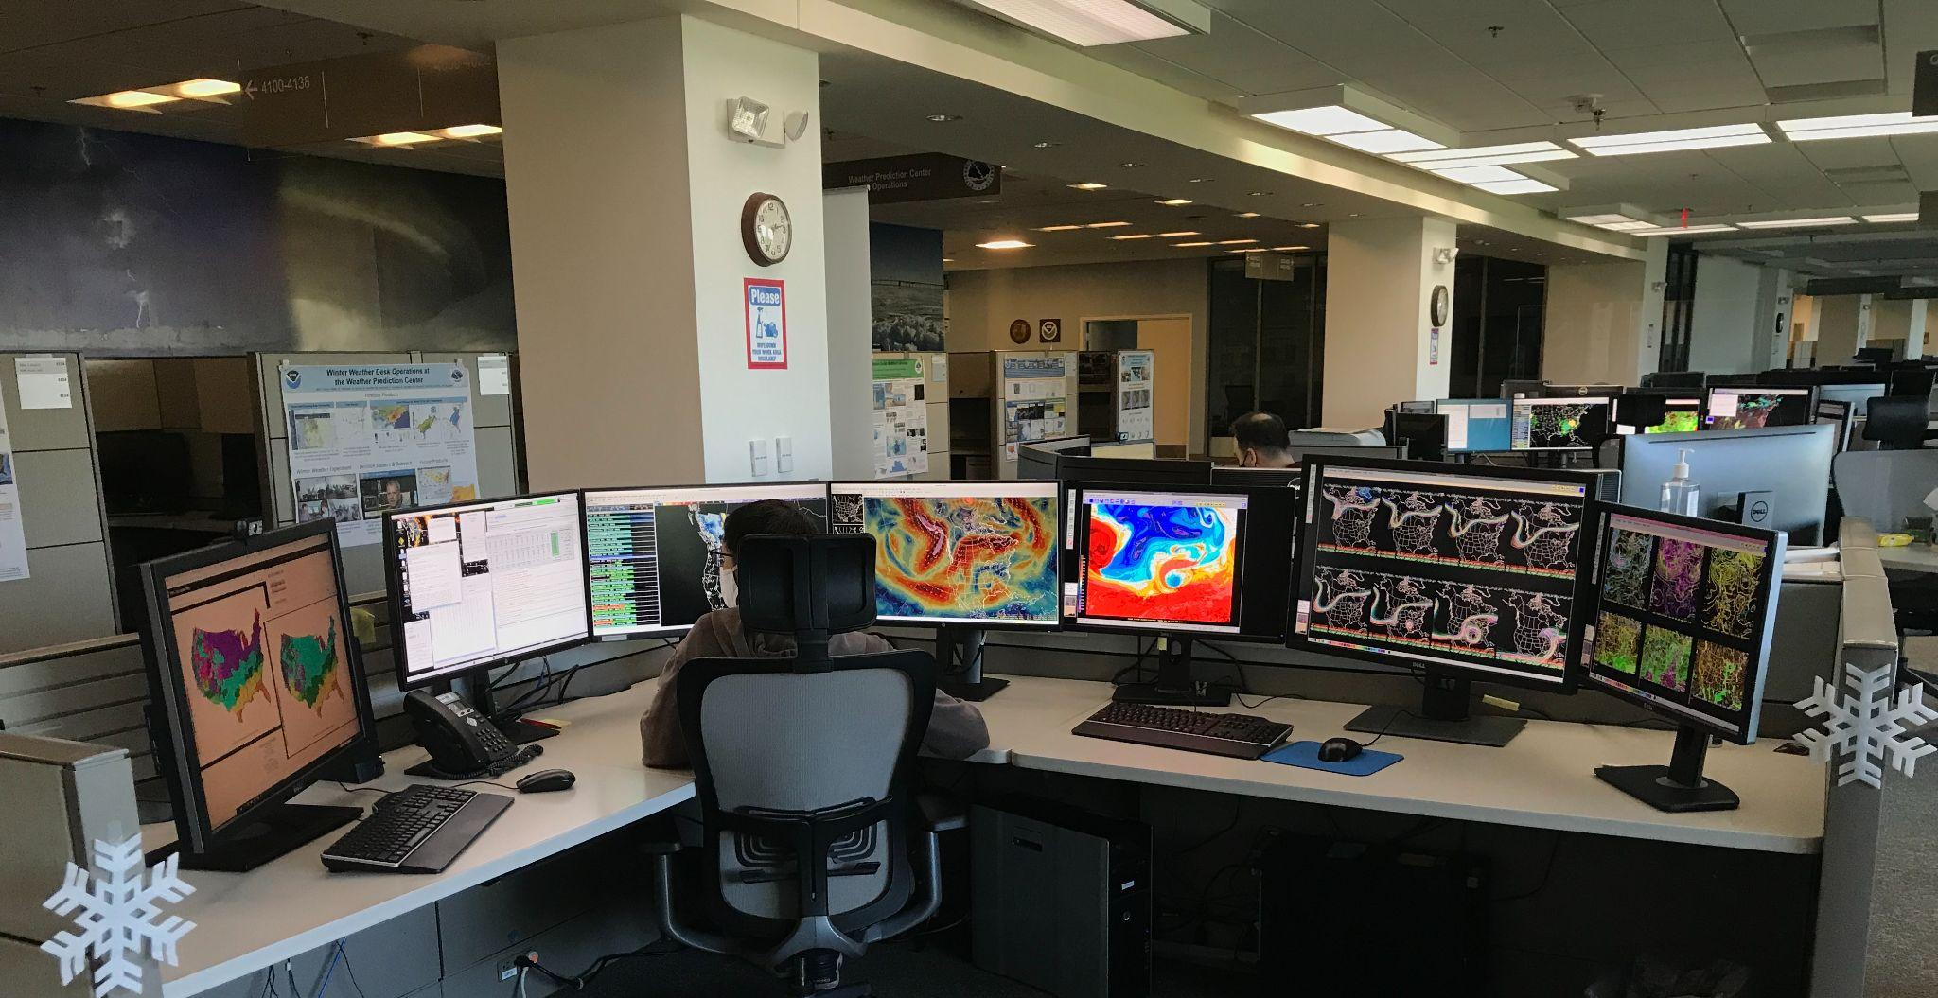
WPC Winter Weather Desk
Now a rotation of 5 forecasters (+1)
Allows for near around-the-clock (23x7) coverage
Overlap in the afternoon to aid with coordination
Call at 301-683-1525
WEATHER PREDICTION CENTER
NATIONAL OCEANIC AND ATMOSPHERIC ADMINISTRATION
WPC Winter Operations Updates
Nov. 9, 2021 | NROW XXII
Notes:
First -- a real quick refresher on the Winter Weather Desk. We’ve increased the number of forecasters in the rotation to 5 for this winter season, and so the desk now supports nearly around-the-clock coverage. This should also provide significant overlap with two winter forecasters from around midday into the afternoon, to aid with coordination. I would strongly encourage you to reach out to the WWD forecasters via chat or the number you see here with any collaboration thoughts or questions. Earlier in the shift can be better!

Slide 4
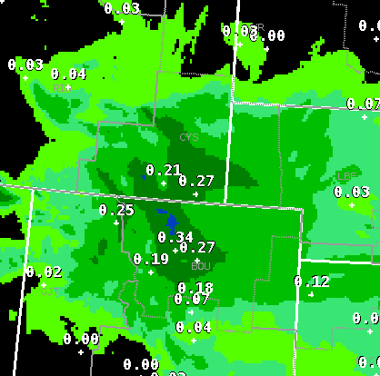
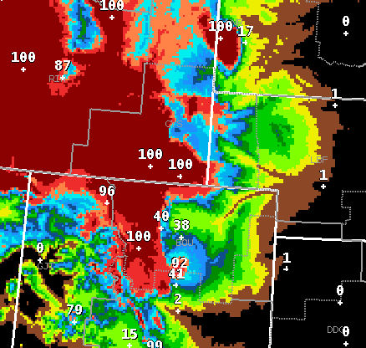
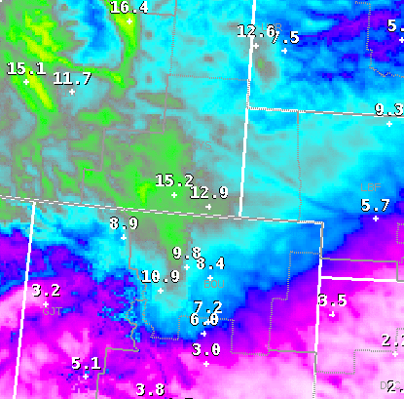
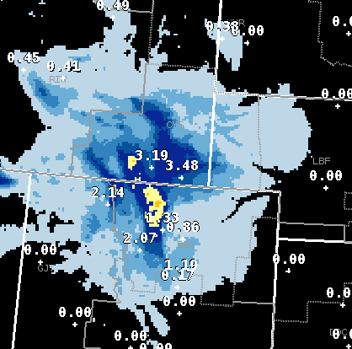

Winter Weather Forecast Process
QPF
Prob. of Snow
Snow:Liquid Ratio
Snow Forecast
x
x
=
“Precipitation Magnitude”
“Temperature profile”
(a similar process exists for ice accumulations as well)
We dial the snow and ice forecast up and down with these components
LESS
MORE
LESS
MORE
WEATHER PREDICTION CENTER
NATIONAL OCEANIC AND ATMOSPHERIC ADMINISTRATION
WPC Winter Operations Updates
Nov. 9, 2021 | NROW XXII
Notes:
The forecast process that WWD uses is outlined in greater detail in the operations course on the Commerce Learning Center. However, I’ll give you a short overview here. Rather than edit the snow and ice forecasts directly, our forecasters use a couple “control knobs” to dial the forecast up or down. These control knobs are generally related to precipitation magnitude, or the QPF, and the temperature profiles, via the probability of weather types and snow-or-ice to liquid ratios. Edits are made to these components, and the snow and ice forecasts are calculated from there.

Slide 5

Who Do I Collaborate With?
QPF
Prob. of Snow
Snow:Liquid Ratio
Snow Forecast
x
x
=
All our precipitation forecasters work as a team and are in constant communication. Generally speaking, collaboration concerns for winter areas should include the WWD.
1 QPF forecaster
per shift
1 WWD forecaster
per shift
WEATHER PREDICTION CENTER
NATIONAL OCEANIC AND ATMOSPHERIC ADMINISTRATION
WPC Winter Operations Updates
Nov. 9, 2021 | NROW XXII
Notes:
The responsibility for these edits is shared among two forecasters in WPC operations -- one QPF forecaster, who edits QPF for all areas of the CONUS for Days 1-3, including non-wintry areas, and one WWD forecaster, who iteratively edits the probability of weather type and ratio grids to produce a reasonable snow and ice forecast. One common question we get is, “who am I supposed to collaborate with?” We would encourage you to not think of the forecasters individually with silo-ed responsibilities, but rather as a team in constant communication. Therefore, it shouldn’t matter whether you reach out to the QPF or WWD forecaster, or WPC more generally. However, I would recommend that for winter weather concerns -- even if you expect the edits to be QPF related -- to always include the WWD forecaster as they will at least need to be aware.

Slide 6
Deterministic Influences Probabilistic
WPC deterministic forecast becomes the mode, or “most likely” value in the distribution
Collaboration is crucial!
Many downstream products are affected, so coming to a consensus is very helpful
Probabilistic Winter Precipitation Forecasts (PWPF)
Winter Storm Outlook
Probability
Snow or Ice Accumulation
Variance is that of the overall ensemble, and the skew is based on the position of the WPC forecast
WEATHER PREDICTION CENTER
NATIONAL OCEANIC AND ATMOSPHERIC ADMINISTRATION
WPC Winter Operations Updates
Nov. 9, 2021 | NROW XXII
Notes:
One final note on the WWD forecast process is that collaboration is crucial. Even though we don’t publish the WPC deterministic snow and ice forecasts publicly, they are acting as a bit more than just “guidance” in the whole forecast process. The WPC deterministic forecast becomes the mode of the probabilistic winter precipitation forecast (or P-W-P-F) distribution. While the variance comes from the overall ensemble, the skew is based on the position of the WPC forecast. This affects a lot of downstream products including the snow and ice probabilities, the Winter Storm Outlook, and a new probabilistic version of the WSSI. Therefore, coming to a consensus on the deterministic amounts is important to make sure these products generally match WFO expectations.

Slide 7
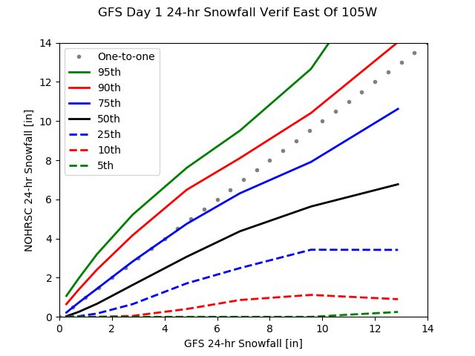
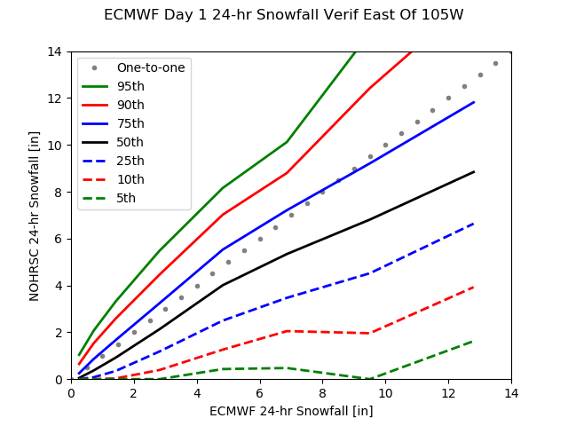
The Case for a Probabilistic Approach
GFS (left) and ECMWF (right) verification for 1 October 2020 to 10 March 2021
GFS Predicts 10“
Observed 10th-90th = 1” to 11”
ECMWF Predicts 10“
Observed 10th-90th = 2” to 13”
WEATHER PREDICTION CENTER
NATIONAL OCEANIC AND ATMOSPHERIC ADMINISTRATION
WPC Winter Operations Updates
Nov. 9, 2021 | NROW XXII
Notes:
This is a simple, but eye-opening, bit of verification that was run by Bruce Veenhuis in our Development and Training Branch. This is five and a half months of data from last winter for areas east of the Rockies. The GFS is depicted on the left, and the ECMWF is depicted on the right. If you look at the X, or horizontal, axis you can see forecast amounts from that particular weather model. If you go vertically and use the different colored lines, you can see how often NOHRSC snowfall occurred relative to that particular model forecast snowfall. For example, if you look at when the GFS forecasted 10 inches of snow, the observed values were between 1 and 11 inches 80 percent of the time. And it was basically less than half the forecast amount, or less than 5 inches, 50 percent of the time. This is an ENORMOUS variation from a deterministic forecast, and that’s to be expected. Even if a model (or forecaster, for that matter) generally gets the structure of a winter storm correct, small errors in the placement of heavy bands and the track of the storm can create HUGE deviations from the deterministic snow forecast. Keep in mind that this is for DAY ONE FORECASTS too! I think this powerfully illustrates the case for probabilistic forecasts -- every deterministic forecast is going to be wrong, it’s just a matter of “degrees of wrong”.

Slide 8
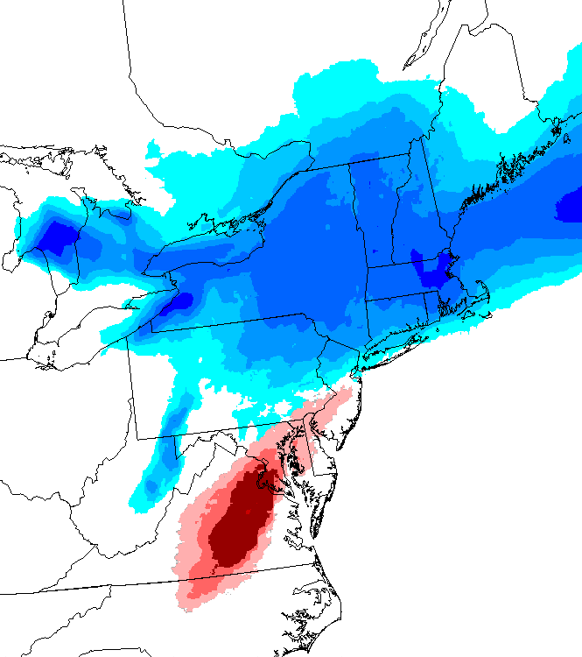


A Few Probabilistic Takeaways
Probability of 2” snowfall
Overall, WPC probability products fairly reliable
Reliability makes them useful for forecast understanding and communication
Many people will still want our “best guess,” but don’t let the probabilities get lost!
Offers an anchor for consistency even if different offices or forecasters disagree somewhat on the deterministic forecast
All things considered, communicating a forecast in probabilistic terms is still relatively new -- we can all learn from each other!
Probability of 0.1” ice
WEATHER PREDICTION CENTER
NATIONAL OCEANIC AND ATMOSPHERIC ADMINISTRATION
WPC Winter Operations Updates
Nov. 9, 2021 | NROW XXII
Notes:
Before we get into the rest of the presentation, I did want to pause with a few quick takeaways on probabilistic winter forecasts. Overall, the probabilities are fairly reliable, and this should make them quite useful for both understanding the forecast and communicating it to partners and the public. I know that you still get asked for the deterministic forecast a lot, and I think this will still be the instinct for a lot of people for awhile -- “tell me how much snow I’m going to get.” However, when you think back to the slide with all the snow maps on it, I do think we can do a better job of making sure probabilistic information doesn’t get lost in the shuffle. And I think the probabilities offer an anchor for consistency and to be honest about the state of the science. Different offices and forecasters will always have some level of disagreement on the “best guess” forecast, but probabilistic information can give us a more stable platform to build a message on. Communicating with probabilistic information is still relatively new in meteorology, so I can’t pretend like we have all the answers. Let’s stay in touch and learn from each other. Please reach out to me if you have any success stories locally!

Slide 9
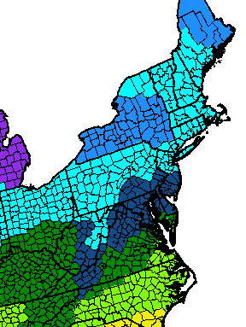
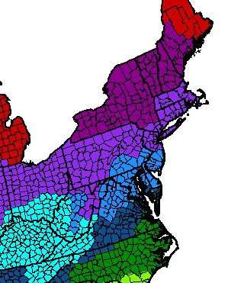
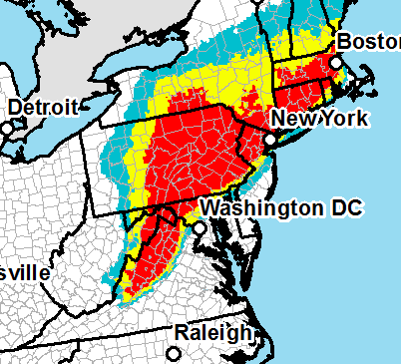
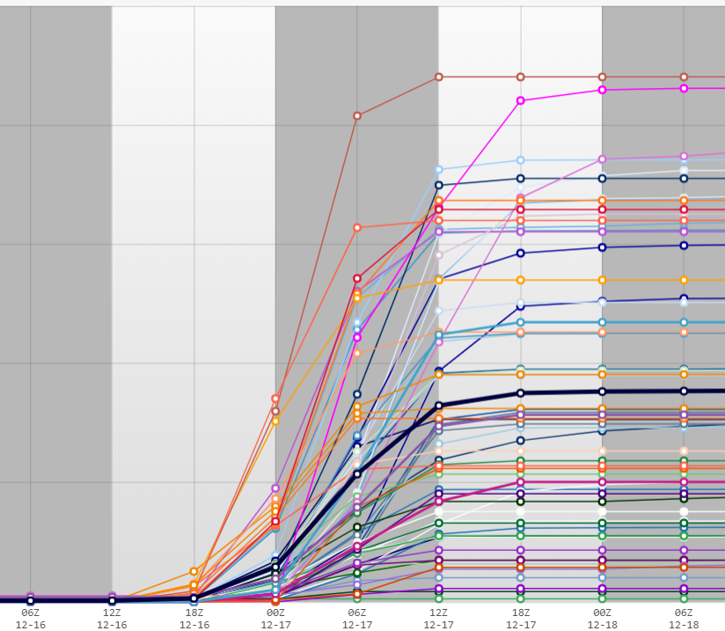

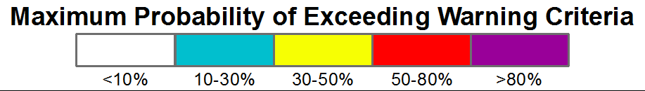
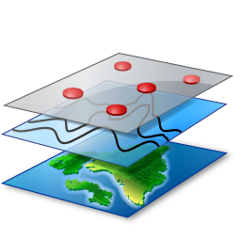
Winter Storm Outlook, WSO (Day 1-4)
61-member ensemble...
...is checked against local warning criteria...
...to create the WSO
12hr WSW snow crit
24hr WSW snow crit
We are taking a slice through the probabilistic data at the “warning threshold”
If you or your partners are interested, this product is available in GIS formats...
File formats: shapefile, KML
WEATHER PREDICTION CENTER
NATIONAL OCEANIC AND ATMOSPHERIC ADMINISTRATION
WPC Winter Operations Updates
Nov. 9, 2021 | NROW XXII
Notes:
One application of WPC probabilistic information is the Winter Storm Outlook, which basically takes a slice through the probabilistic data at the watch/warning threshold at individual grid points across the CONUS. This then creates a probabilistic map like you see on the right side here. Given that it uses the watch/warning threshold, it is both potentially useful for watch collaboration and as an early alert to potentially significant winter storm threats out to Day 4. Of course, it is merely for snow and ice accumulation, so complicating factors such as wind and mixed precipitation would not be reflected.

Slide 10
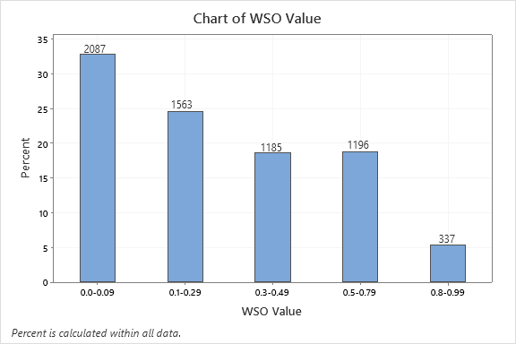
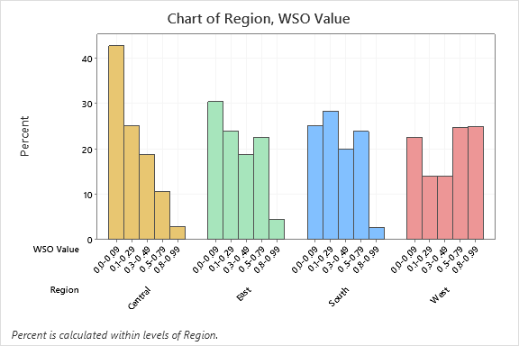
WSO Verification (2020-2021)
What was the WSO value when a watch was issued for individual forecast zones across the country?
Average WSO Value: 0.217
Total WZE’s: 6368
WEATHER PREDICTION CENTER
NATIONAL OCEANIC AND ATMOSPHERIC ADMINISTRATION
WPC Winter Operations Updates
Nov. 9, 2021 | NROW XXII
Notes:
We did have a summer student run some verification data on the WSO, and specifically what the WSO values were in individual forecast zones when a watch decision was made. As you can see the average WSO value in a forecast zone when a watch was issued was just over 0.2, and the sample size was over 6,000 zone events. The most common scenario was actually for a watch to be issued with a WSO value of less than 10 percent. That was true across the CONUS, but the trend was especially common in Central Region -- the first grouping on the chart on the right side of this slide. 30 percent of Eastern Region watches were issued with a minor or zero WSO probability. I’ll get into some possible explanations in a moment.

Slide 11
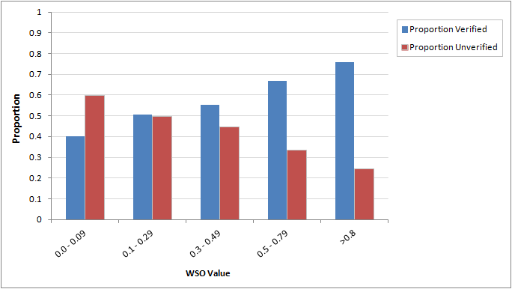
WSO Verification (2020-2021)
Verified in blue
Unverified in red
Overall Stats
Verified: 52.3%
Unverified: 47.7%
Verification Methods
Used NCEI Storm Events Database.
Verified events marked as “Blizzard”, “Lake-Effect”, “Heavy Snow”, “Winter Storm”, or “Ice Storm”
WSO Avg. by Type
Ice Storm: 0.32
Heavy Snow: 0.29
Winter Storm: 0.25
Blizzard: 0.18
Lake-Effect: 0.07
Generally, watches issued with a higher WSO verified at a higher rate, which should be somewhat expected given the reliability of WPC PWPF.
WEATHER PREDICTION CENTER
NATIONAL OCEANIC AND ATMOSPHERIC ADMINISTRATION
WPC Winter Operations Updates
Nov. 9, 2021 | NROW XXII
Notes:
We also evaluated how many of the zone events in each WSO bin verified, and verification was based on the event types you see here in official NWS Storm Data. Generally speaking, watches issued with a higher WSO value verified at a higher rate (verified in blue, unverified in red), which is what you would expect, and is an encouraging result. Also, about half of the watches verified overall, which is also close to what is prescribed in directives as a 50% confidence threshold. The distribution you see in the chart here is similar for all NWS regions. You can also see the average WSO value was highest for watches issued for events driven primarily by accumulations -- ice storms, heavy snow, and winter storms. The WSO values were lower for blizzards, with a combination of wind and snow, and for lake effect events, which can be difficult to resolve in some of the global models that comprise the winter ensemble.

Slide 12
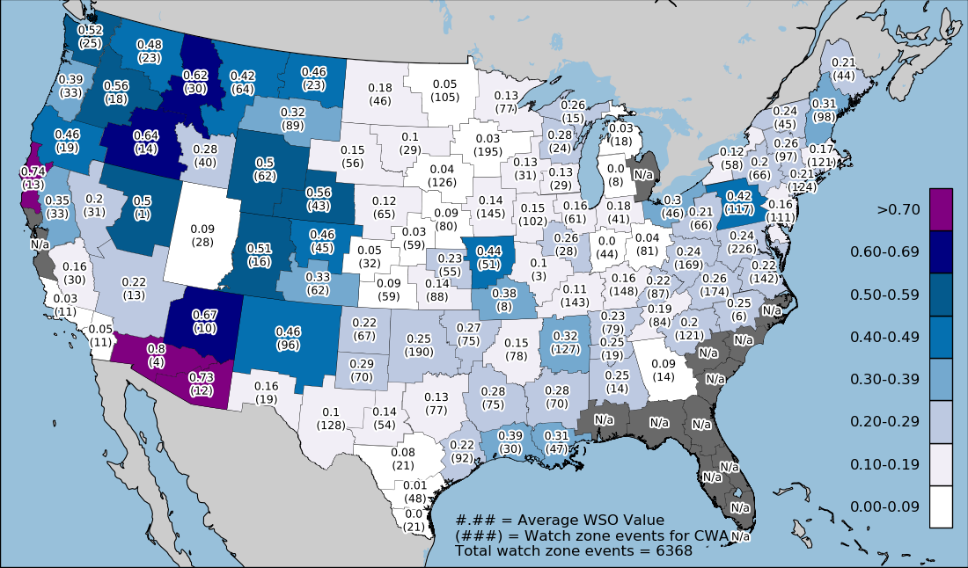
Average Watch Decision WSO by WFO
Average WSO value when a watch was issued in an individual forecast zone, parsed by NWS WFO
Higher values in Eastern Region vs Central Region offices
Given reliability of PWPF, possible hypotheses:
shift to impact-based WWA decisions
wind and mixed precip types lowering thresholds
point vs. zone probabilities
WEATHER PREDICTION CENTER
NATIONAL OCEANIC AND ATMOSPHERIC ADMINISTRATION
WPC Winter Operations Updates
Nov. 9, 2021 | NROW XXII
Notes:
We created a variety of maps showing variations in the data from WFO to WFO, but I will show you just two today. Here is the average WSO value at watch decision points, and you can see that most Eastern Region offices have an average between 0.2 and 0.3. Remember that the WSO is simply a combination of PWPF and local criteria thresholds, and we know that PWPF is fairly reliable -- if anything OVERCONFIDENT! We had a few possible hypotheses that included: (1) that forecasters may be shifting to a more impact-based decision framework even though the criteria written on paper may be higher in some cases, (2) wind and mixed precipitation types were lowering decision thresholds in some cases, and (3) the difference between point and zone probabilities. Remember that WSO is calculated at individual grid points and this study looked at the highest grid value in each zone. However, a watch is issued for an entire forecast zone, which is a bigger target to hit and the probability of a zone being impacted will always be higher than the probability of a specific location in that same zone being impacted. I think it’s probably some combination of all three, but we’re going to focus on number one for now.

Slide 13
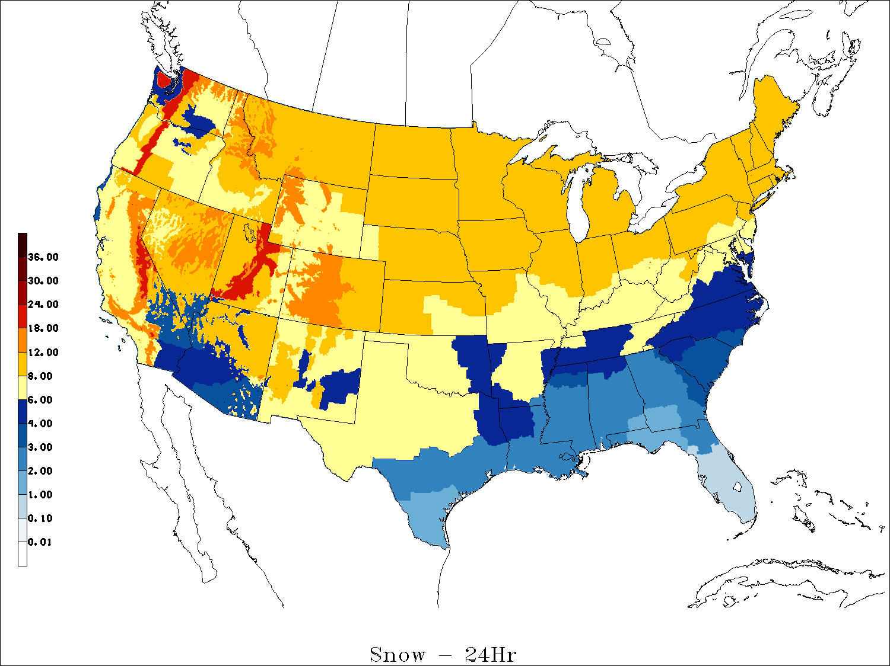
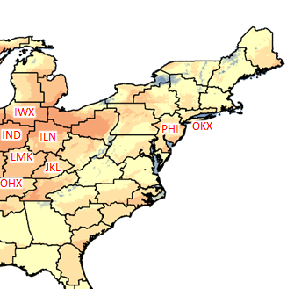
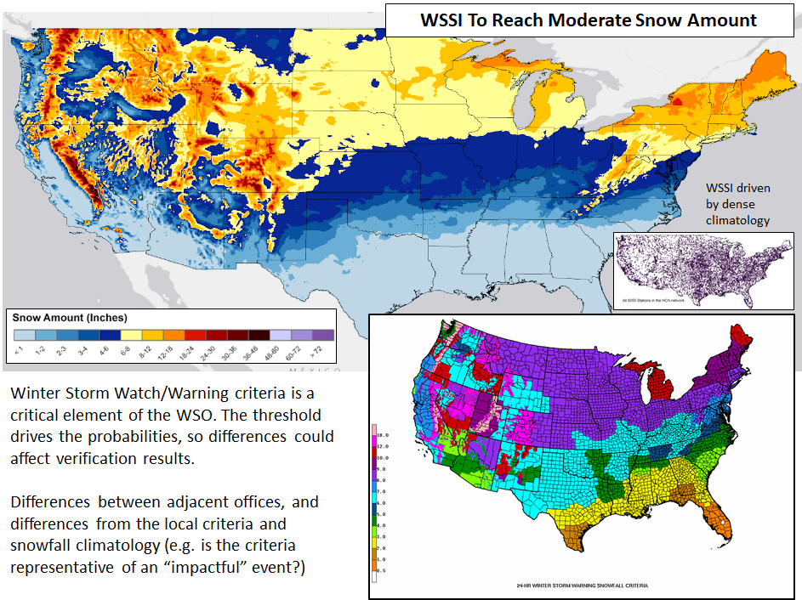


The WSO is solely based on local Winter Storm Watch/Warning criteria
WSSI Moderate Snow Amount
24hr WSW Snow Criteria
24hr WSW Snow Criteria minus
WSSI Moderate Snow Amount
Thresholds Are Important!
Accurately matching the criteria with forecaster decision thresholds is key to utility of the WSO. Are forecasters calibrated to the posted criteria, or perceived impact thresholds?
WEATHER PREDICTION CENTER
NATIONAL OCEANIC AND ATMOSPHERIC ADMINISTRATION
WPC Winter Operations Updates
Nov. 9, 2021 | NROW XXII
Notes:
I kept coming back to the two components of the WSO -- the underlying PWPF, and the threshold set by local criteria. And the thresholds are a CRITICAL element of the WSO -- they really drive the probabilities, so any difference between what’s written on paper and how forecasters are calibrated would tend to show up in the verification dataset. So I decided to do a simple comparison of the WSSI Moderate Snow Amount thresholds -- something we generally message as roughly equal to a warning-level impact -- and the legacy criteria used in the WSO. It is, of course, not perfect, but WSSI Snow Amount thresholds are based on a detailed snow climatology across the country, so big differences between that and watch/warning thresholds may be instructive. By the way, I want to emphasize that forecasters being calibrated to impacts is a GOOD thing, in my opinion -- that is a valuable service to partners and their communities! However, it does limit the WSO if impacts tend to occur at lower thresholds than legacy criteria would indicate. And that’s the narrow issue we’re evaluating here.
The map on this right visually shows where the difference between 24-hour watch/warning criteria and WSSI Moderate Snow Amount thresholds are largest. The beige or yellow shading is close to zero, and the orange and red shadings indicate larger differences, with the legacy criteria being set several inches higher. You can see I have the three letter WFO IDs plotted in red text on a variety of offices where the threshold differences are larger, and I’m about to show you the scatter plot again with these specific WFOs highlighted. I do want to emphasize again that this is not necessarily a critique of the watch strategy at these offices -- I DO think being calibrated to impacts is a very good thing. However, we are trying to identify whether something systematic is happening in the way that quite a lot of offices seem to frequently verify watches issued at low WSO values. And this suggests they do have something in common -- the legacy watch/warning criteria is set at a level that is more rare in the local climatology than offices in other parts of the country.

Slide 14
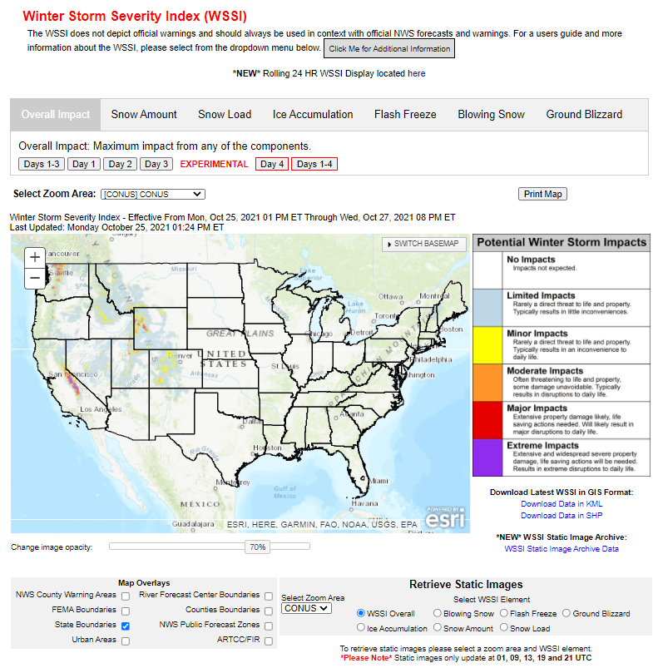
Winter Storm Severity Index, WSSI
WSSI is a tool that forecasts the general level of potential impacts from winter storms
Social science work continues on colors, descriptions
Day 1-3 driven by NDFD forecasts
Experimental extension to Day 4!
  Snow and ice data comes from WPC, SLR from NBM, and wind gusts from NDFD.
Rolling 24-hour WSSI Display also available now
Information dropdown menu which includes a variety of materials that can be used in outreach
File formats: shapefile, KML, static images
WEATHER PREDICTION CENTER
NATIONAL OCEANIC AND ATMOSPHERIC ADMINISTRATION
WPC Winter Operations Updates
Nov. 9, 2021 | NROW XXII
Notes:
Let’s move on to one of the other “tools in the toolbox” - WSSI. Many of you are probably at least somewhat familiar with this, but if you haven’t spent much time evaluating it, I’d encourage you to use the WSSI webpage this winter during live events and provide us any feedback you may have. One thing we emphasize often is that WSSI is merely attempting to forecast a general level of potential impact from a winter storm, not forecast specific impacts such as schools closing at a Moderate impact level. It is designed to capture an overall potential impact to society, which can, of course, be mitigated through protective measures from individuals, organizations, and governments. Therefore, I think it’s key that we frame WSSI as a POTENTIAL impact level. For example, if highways are shut down, the impacts may be considerably less than if traffic was allowed to proceed normally. We have had feedback on the impact category descriptions, and how they sound especially severe at the high end of the scale. There is ongoing, funded social science work evaluating the colors and descriptions, so hopefully we will have more news on that in the future. In the meantime, if you don’t think the impact descriptions necessarily apply in a certain case, I would recommend just using the category names instead. WSSI is experimentally extended to Day 4 this year, using some extra data from WPC and the NBM. Days 1 to 3 are driven by the NDFD forecasts. We also have a new rolling 24-hour display. Finally, there is an information dropdown menu on the page with a lot of resources that contain more detailed information.

Slide 15
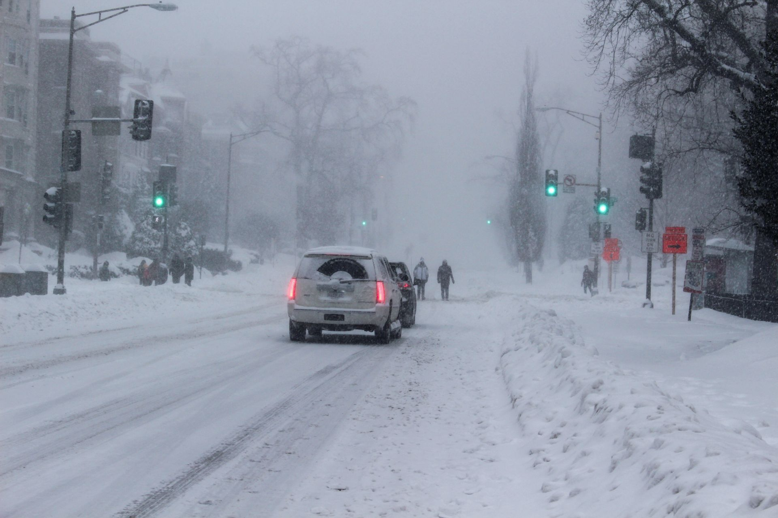
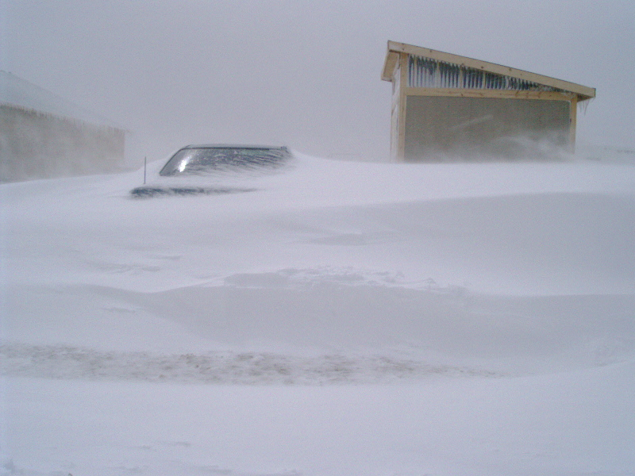
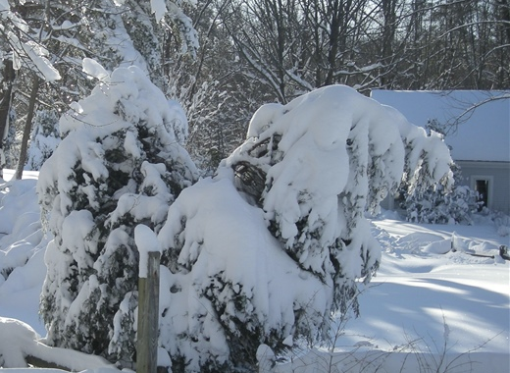
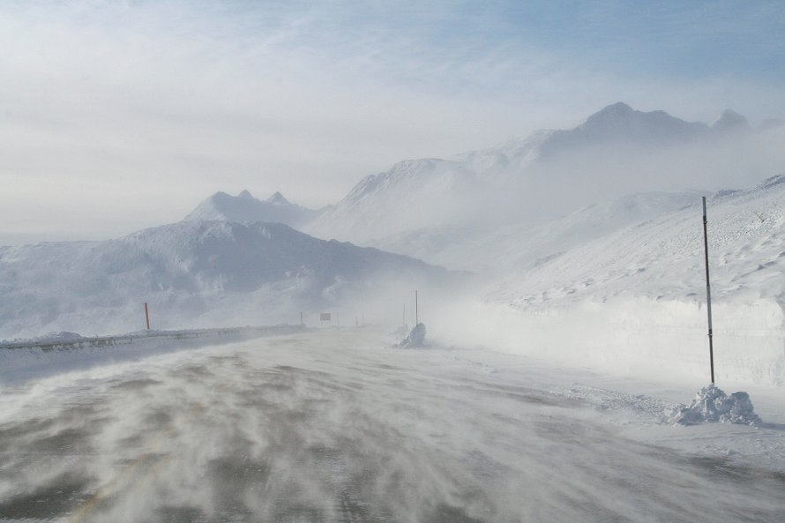
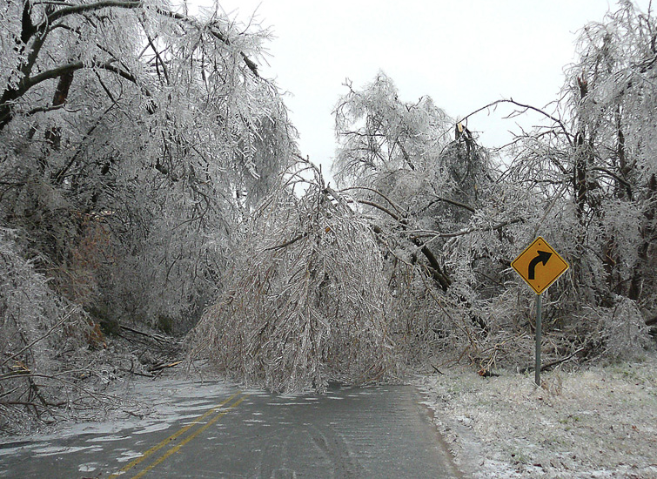

WSSI Components
The overall WSSI level is built from six different winter weather hazard components shown here
Snow Amount
Impacts due to the total amount of snow or the accumulation rate
Blowing Snow
Disruption due to blowing and drifting of snow while the snow is falling
Snow Load
Infrastructure impacts due to the weight of the snow
Ground Blizzard
Travel-related impacts of strong winds interacting with pre-existing snow
Ice Accumulation
Impacts due to the effects and severity of ice and wind
Flash Freeze
Potential for quick-forming ice from rapid temperature drops during or after precipitation
WEATHER PREDICTION CENTER
NATIONAL OCEANIC AND ATMOSPHERIC ADMINISTRATION
WPC Winter Operations Updates
Nov. 9, 2021 | NROW XXII
Notes:
The overall WSSI level is composed of 6 different winter weather hazards shown on this slide. The maximum WSSI value from the individual components is the overall impact level. Snow Amount and Ice Accumulation are relatively straightforward, and are more closely related to the standard snow and ice forecasts you see. Snow Load is meant to describe the potential weight of the snow, and potential impacts to trees and infrastructure. Blowing Snow and Ground Blizzard are more closely related to blizzard conditions or a combination of snow and wind. And finally, flash freeze describes the potential for quick-forming ice from rapid temperature drops.

Slide 16
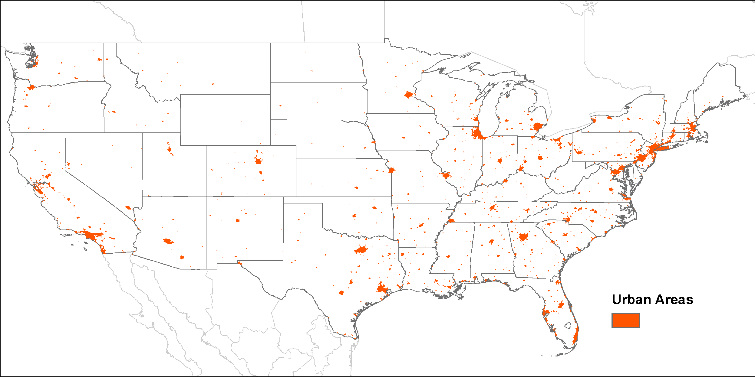
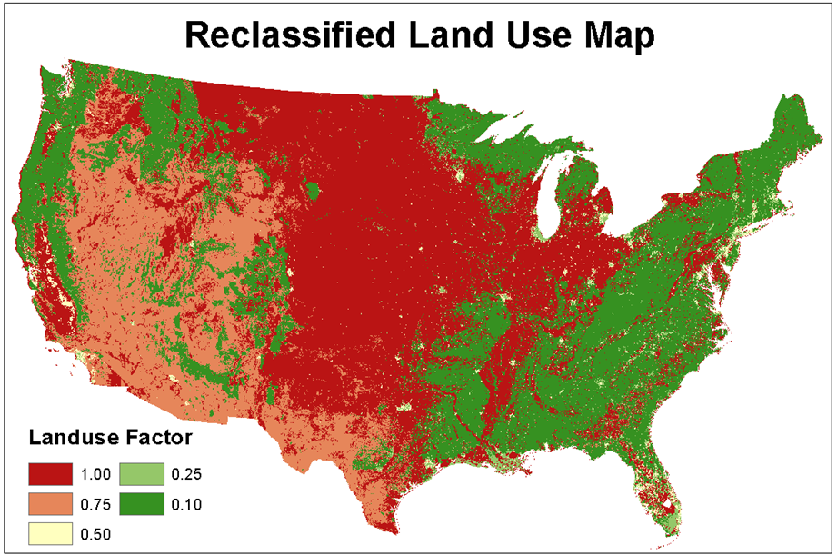
WSSI Non-Meteorological Datasets
Urban areas are used in Ice Accumulation and Snow Amount components to give a 25% increase in the raw impact values (may not necessarily lead to an increase in the category depicted)
Land use is evaluated for the Blowing Snow and Ground Blizzard components to decrease impacts for areas of reduced wind (e.g. forests, high density buildings).
Forest type is used in the Snow Load component. Conifer trees can handle more snow than deciduous trees.
WEATHER PREDICTION CENTER
NATIONAL OCEANIC AND ATMOSPHERIC ADMINISTRATION
WPC Winter Operations Updates
Nov. 9, 2021 | NROW XXII
Notes:
WSSI does also account for some non-meteorological factors in the impact level calculations. Urban areas are used for the Ice Accumulation and Snow Amount components to give a 25% boost to the raw impact values. This does not automatically bump up WSSI to the next impact category. However, a raw value of 1000 would be increased to 1250, for example, over Baltimore and Washington DC. Those raw values are then fit into the appropriate categories before displaying the WSSI impact level. Land use is incorporated into the Blowing Snow and Ground Blizzard components to decrease impacts for areas with reduced wind through friction such as dense forests and areas with high density of buildings. And finally, forest type is used in the Snow Load component, because conifer trees can handle more snow than deciduous trees. Overall, the meteorology will drive the impact levels, but these are important “nudgers” that are accounted for. We have received comments and feedback on other non-meteorological elements, such as rush hours or days of the week, that are being evaluated but are not currently incorporated into WSSI.

Slide 17
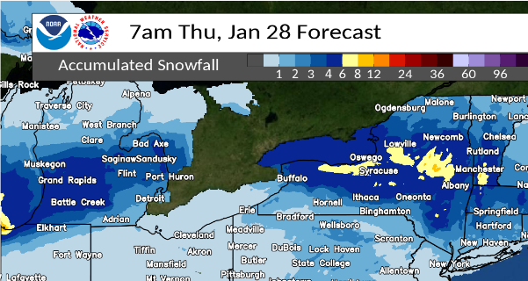
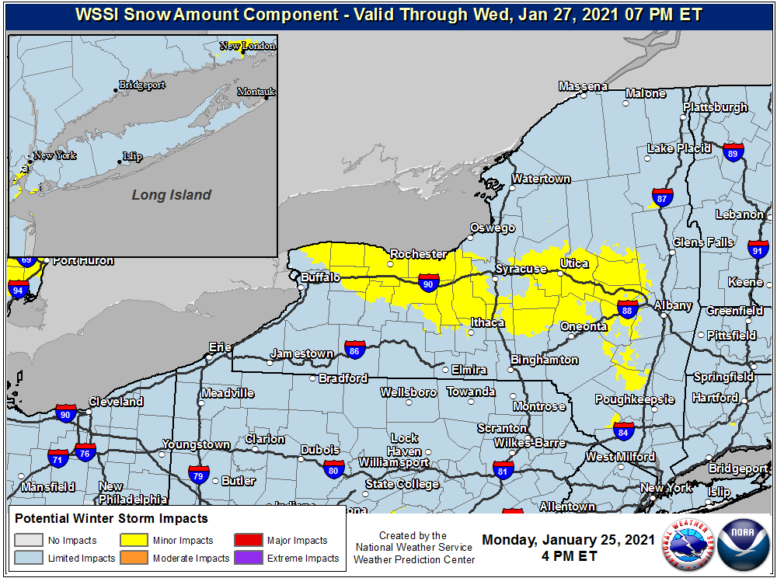

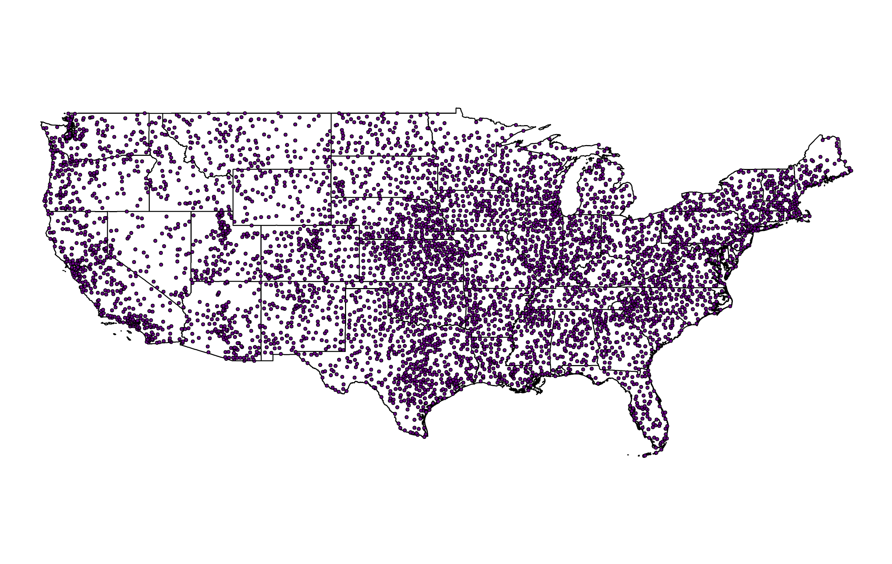
Example: WSSI Snow Amount
How unusual?
Example: 4-8 inches of snow in Upstate NY in late January is a Minor Impact
WSSI leverages a dense network of historical snowfall data over approximately 50 years to help answer “how unusual is this amount of snow in this part of the country?”
Historical Climate Network,
with thousands of stations
WEATHER PREDICTION CENTER
NATIONAL OCEANIC AND ATMOSPHERIC ADMINISTRATION
WPC Winter Operations Updates
Nov. 9, 2021 | NROW XXII
Notes:
Here is a quick example of WSSI in action. Unfortunately the NDFD forecast was not available when the newer WSSI archive occurred, so this is an approximate example from January 25. On the left is the final WWD snow forecast that shows 1-2 inches over central Maryland. Assuming the NDFD forecast was similar, this converts to a swath of minor impact for the WSSI Snow Amount. This is a good time to mention that WSSI does not include time of day or day of the week. Should most of this 1-2” of snow occur on a weekday during rush hour, the actual impacts would be greater. WSSI leverages a dense network of snowfall data over the past several decades to help answer the question, “how unusual is this amount of snow in this part of the country?” So it is essentially “aware” of facts like that. This is likely the reason for the impact drop off north of the Mason-Dixon line in Pennsylvania where only the 2” area warrants minor impacts, otherwise the forecast is for Limited impacts.Therefore, WSSI is more precise than the Winter Storm Outlook.

Slide 18
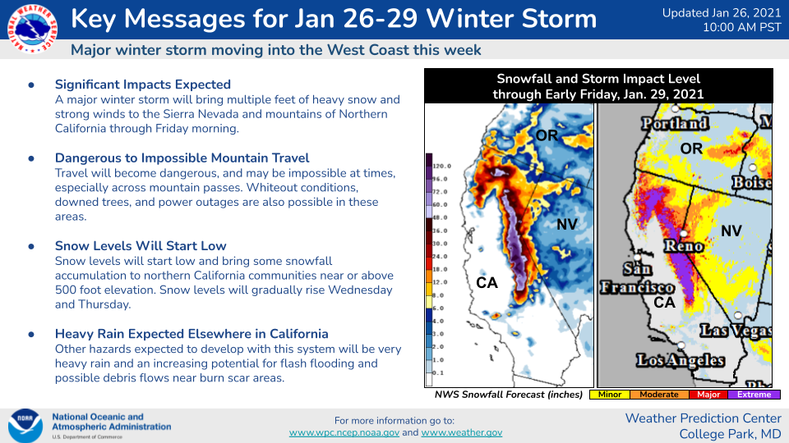
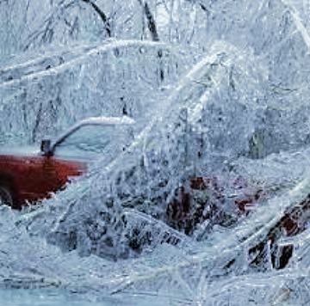
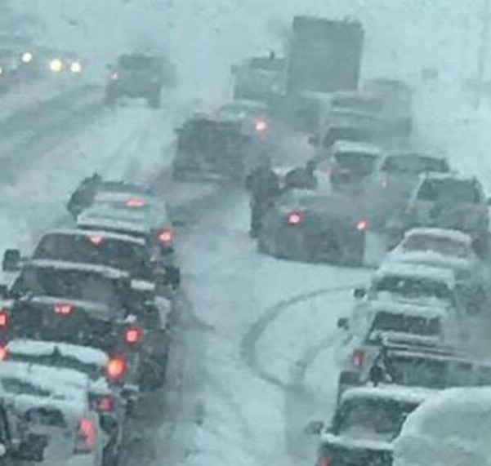
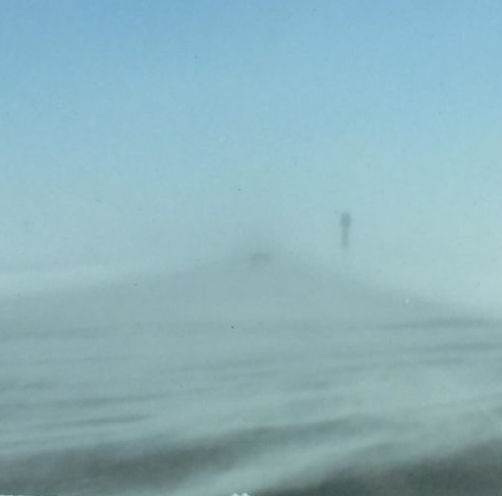
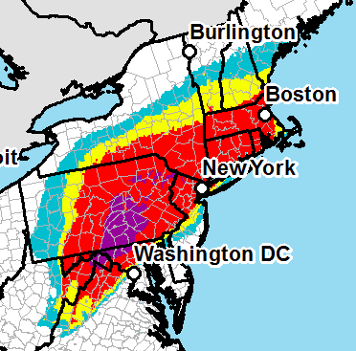
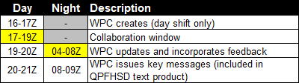
Winter Storm Key Messages
The Concept
Criteria
Collaboration
500 mile long swath of WSO probabilities 30+% with a major metro area (500k+), otherwise 50%
NEW for 2021-22: special cases for ground blizzards and larger snow squall events
Flexibility allowed in high- impact circumstances that may not be captured by strict criteria
Key Messages are only initiated on the day shift through collaboration primarily with ROCs and National Centers
For night shift updates, WPC will collaborate directly with affected WFOs
Key Message text will be added to the Heavy Snow/Ice Discussion (QPFHSD)
Key messages will highlight the agency’s most essential information for upcoming major winter storms.
WEATHER PREDICTION CENTER
NATIONAL OCEANIC AND ATMOSPHERIC ADMINISTRATION
WPC Winter Operations Updates
Nov. 9, 2021 | NROW XXII
Notes:
Before we wrap up, I wanted to briefly mention our Winter Storm Key Messages. We have been doing these for a few years in experimental fashion, mostly sharing them through social media graphics. The intent is similar to NHC’s key messages for hurricanes -- they should highlight the AGENCY’S most essential information for upcoming major winter storms. It provides a brief summary that can be useful to users on the state, regional, and national level who may not have time to evaluate information from numerous WFOs across the country. We have some guidelines on what constitutes a large scale storm listed here, but we do allow for some forecaster discretion. The idea is to capture events that stretch across many WFOs. For this winter, we also plan to initiate key messages for larger, regional-scale ground blizzards and snow squall events that stretch about a couple hundred miles in at least one direction. We hope this elevates awareness of those events. Of course, the idea is that these should be in sync with, and complement, local messaging. So we do have collaboration protocols. On the day shift, we tend to work this through the ROCs, but if they are unavailable, WPC will coordinate directly with WFOs. This year, we will be including the key messages in the Heavy Snow Discussion text product, as well.

Slide 19
Takeaways and Contact Info
Winter probabilities are fairly reliable and can provide a better foundation for consistency and useful information than traditional deterministic forecasts
WPC continues to seek ways to improve probabilistic winter forecasts and communication of those forecasts to a broad audience
WPC is here to help -- please reach out with ideas, thoughts, best practices, etc.
The goal is to eventually have a more consistent suite of probabilistic products from Day 1 to 7. We’re not all the way there yet, but that’s what we’re working toward.
Glad to participate in “blue sky” engagements with your offices
Points of contact include Greg Carbin (Operations Branch Chief; gregory.carbin@noaa.gov), Alex Lamers (WCM; alex.lamers@noaa.gov), and Tony Fracasso (Winter Team Lead; anthony.fracasso@noaa.gov)
WEATHER PREDICTION CENTER
NATIONAL OCEANIC AND ATMOSPHERIC ADMINISTRATION
WPC Winter Operations Updates
Nov. 9, 2021 | NROW XXII
Notes:
Here are a few takeaways. I do want to underline that we welcome thoughts and collaboration. Please reach out with ideas, questions, and best practices. And we are glad to participate in “blue sky” engagements with your offices, from workshops and seminars, to post-event reviews, to exercises. If we have any time left, I can take some questions, otherwise, please reach out via email to any of the points of contact you see here, including myself. Thank you!

Slide 20
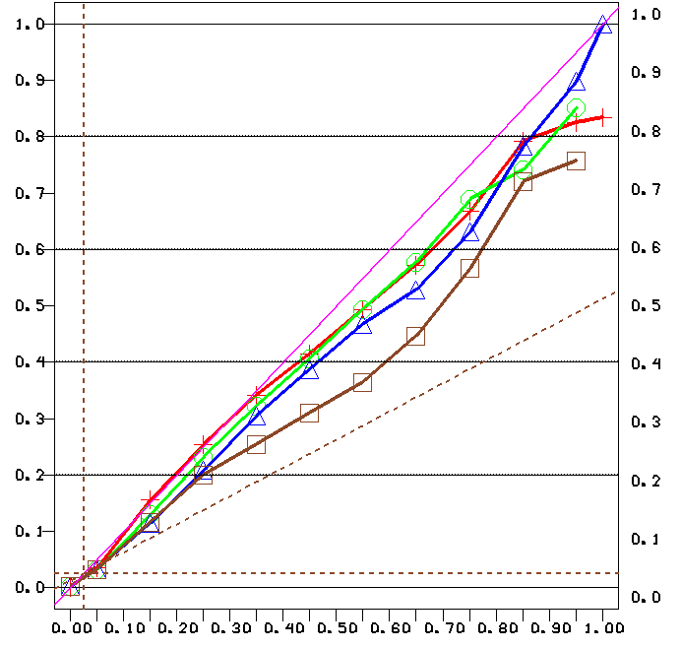
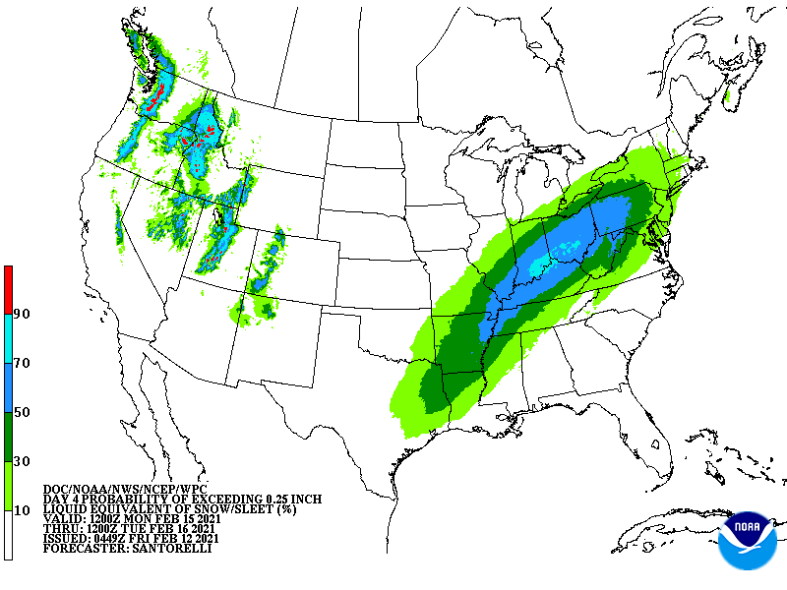
Winter Weather Outlook Verification
WWO
Depicts the probability of 0.25” liquid equivalent snow and sleet, but verification is run against 2.5” accumulations on NOHRSC for simplicity
Day 4
Day 5
Day 6
Day 7
underconfident
line of perfect reliability
overconfident
WEATHER PREDICTION CENTER
NATIONAL OCEANIC AND ATMOSPHERIC ADMINISTRATION
WPC Winter Operations Updates
Nov. 9, 2021 | NROW XXII
Notes:
Finally, all the verification data you’ve seen has been mostly from our short term forecasts, but I did want to also show the verification for our medium range winter probabilities. The Winter Weather Outlook (or W-W-O) is technically the probability of 0.25 inch liquid equivalent snow and sleet, but we ran verification against 2.5 inch accumulations on NOHRSC for simplicity. Overall, you can see that these probabilities are quite reliable as well. One thing to note is that the WWO is not necessarily the same ensemble each shift -- the medium range forecaster can choose which ensemble systems to blend, so the membership is not static.

Slide 21
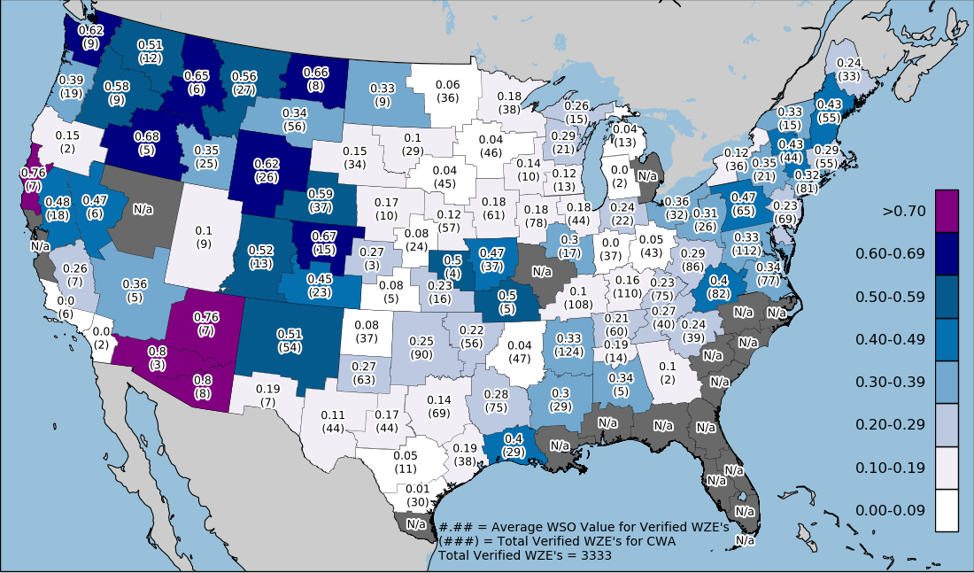
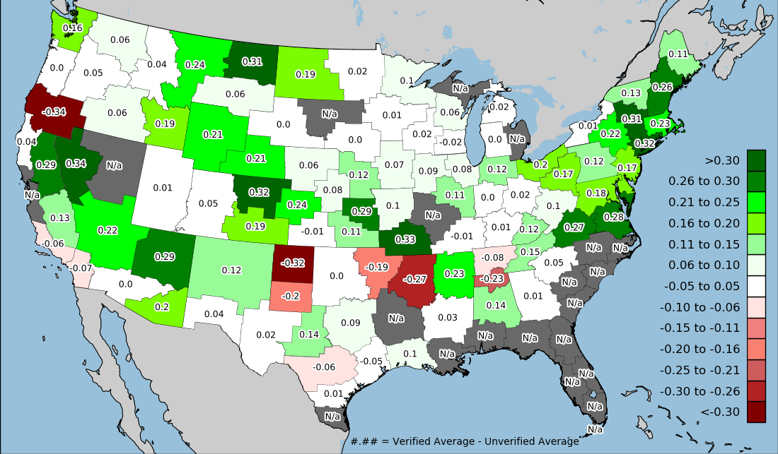
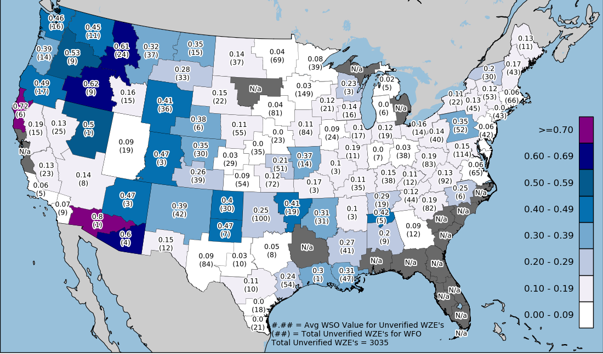
Comparing Average WSO in Verified vs. Unverified
Verified
Difference
Unverified
WEATHER PREDICTION CENTER
NATIONAL OCEANIC AND ATMOSPHERIC ADMINISTRATION
WPC Winter Operations Updates
Nov. 9, 2021 | NROW XXII
Notes:
Remember, showing when watch issued! Breaking down verified events for WFO’s as done for CONUS and regions. Overall, most areas in the green, strong support for WSO! Especially in the east. Some areas in the red, Could be an issue of a couple overall events skewing data.

