Slide 1
Relating Surface Wind Observations to the Local Environment Using Airborne Lidar
NROW XXII
Alex R. Gallagher
11/10/2021
9:00am

Slide 2
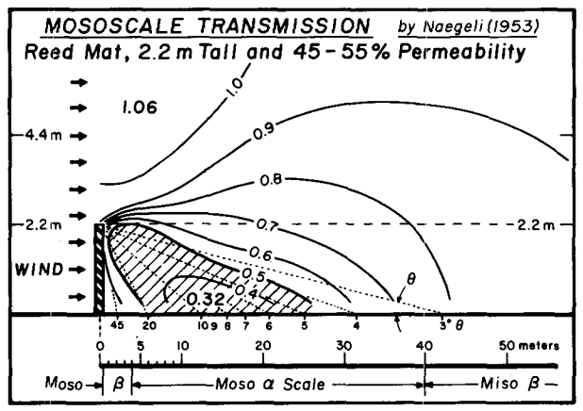
History and Motivation

Slide 3
History and Motivation
Cao and Fovell 2018
Verification of WRF forecasts for Santa Ana downslope windstorm events.
Network average bias is near zero, but large errors persist at individual locations.
Varies rapidly over short distances

Slide 4
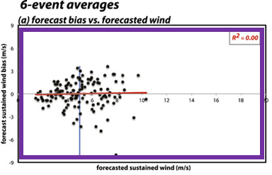
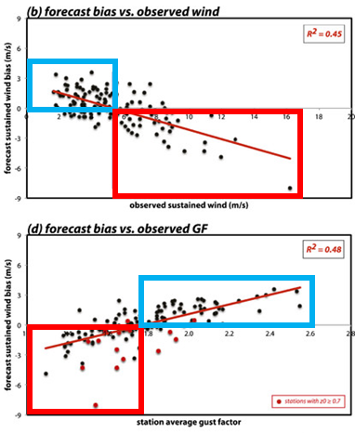
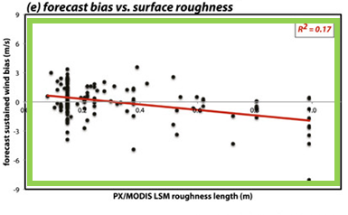
History and Motivation
Station average quantities (over 6 events)
Bias = Forecast - Observation
Bias is unrelated to forecasted wind speeds
Forecasts overpredict slower observed wind speeds and underpredict the fastest winds.
Relationship between bias and surface roughness is very weak.

Slide 5
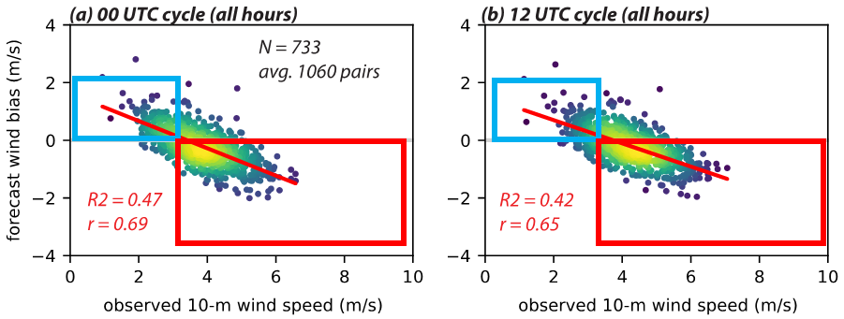
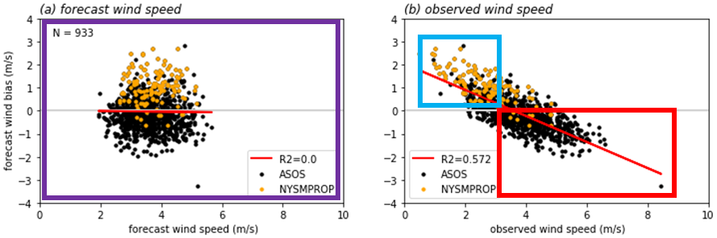
History and Motivation
Fovell and Gallagher 2020, 2021 (in review)
HRRRv3 Verification of ASOS and NYSM wind speed observations.
Continual overprediction of slow wind speeds and underprediction of faster winds.
Result of unresolved sheltering/channeling?
Fovell and Gallagher 2020, HRRR+ASOS
Fovell and Gallagher 2021, HRRR+ASOS+NYSM

Slide 6
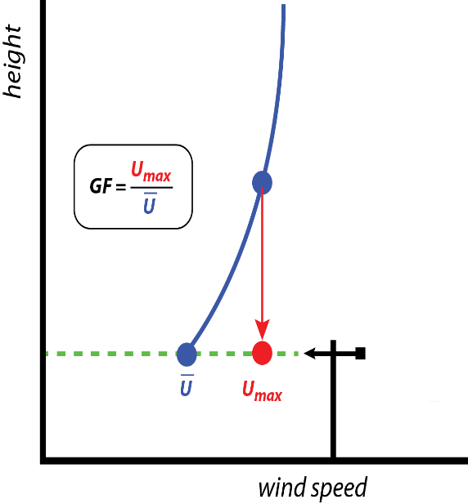
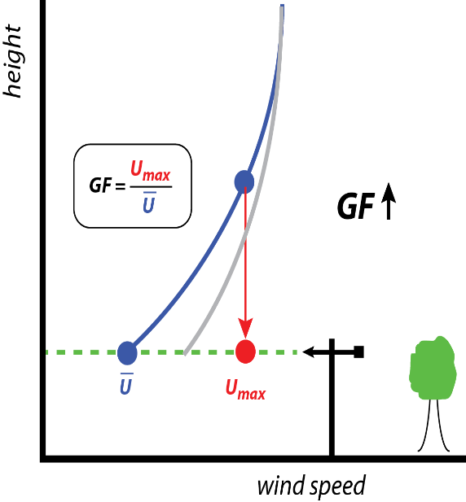

History and Motivation
Fovell and Cao 2014
Theory: Local features can be represented through differences in Gust Factor,
  $GF=\frac{gust}{mean wind}$.
Departures of station GF from network average GF reveal site exposure issues:
  ↑GF = ↑ obstruction
  ↓GF = ↓obstruction

Slide 7
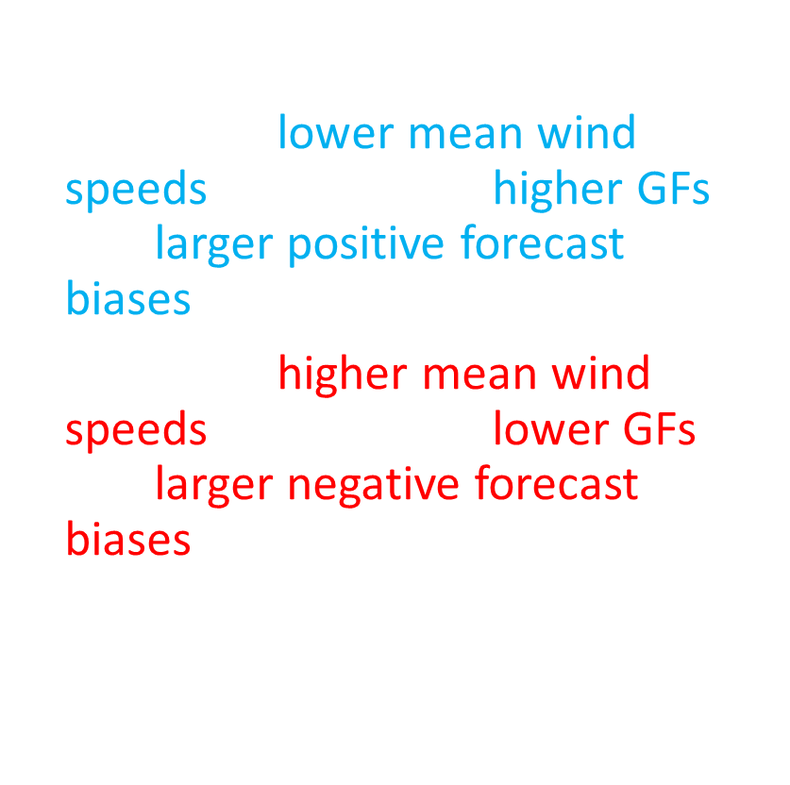
History and Motivation
$GF=\frac{gust}{mean wind}$.
Sites with lower mean wind speeds tend to have higher GFs and larger positive forecast biases.
Sites with higher mean wind speeds tend to have lower GFs and larger negative forecast biases.
This is suspected to be the result of unresolved sub-grid sheltering and channeling effects.

Slide 8
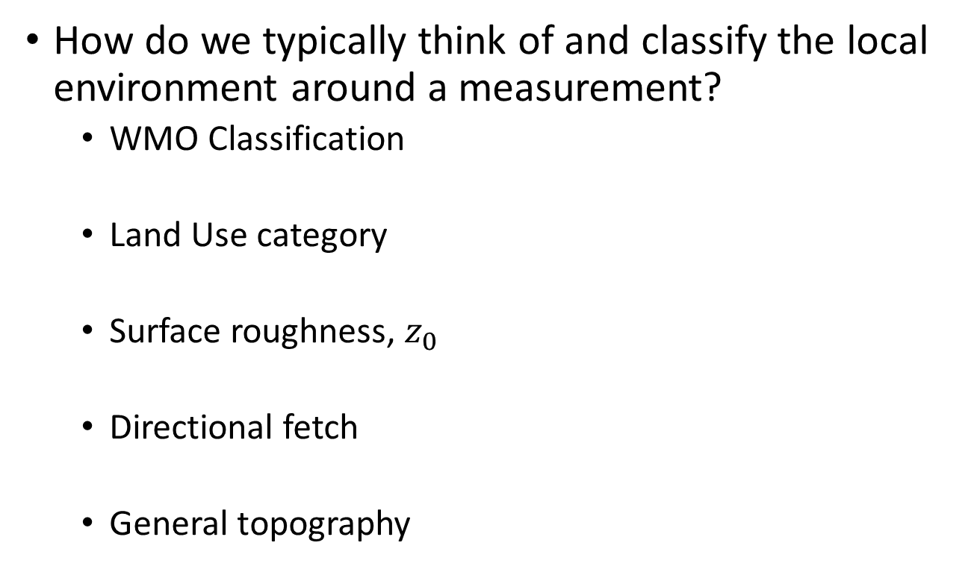
Characterizing the Environment
How do we typically think of and classify the local environment around a measurement?
  WMO Classification
  Land Use category
  Surface roughness, $z_{0}$
  Directional fetch
  General topography

Slide 9
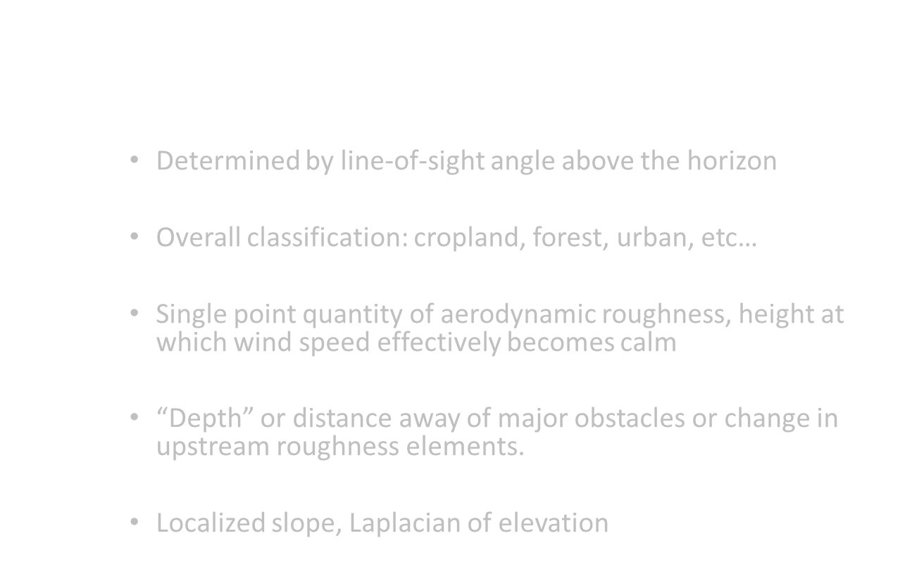
Characterizing the Environment
How do we typically think of and classify the local environment around a measurement?
  WMO Classification
    Determined by line-of-sight angle above the horizon
  Land Use category
    Overall classification: cropland, forest, urban, etc…
  Surface roughness, $z_{0}$
    Single point quantity of aerodynamic roughness, height at which wind speed effectively becomes calm
  Directional fetch
    “Depth” or distance away of major obstacles or change in upstream roughness elements.
  General topography
    Localized slope, Laplacian of elevation

Slide 10
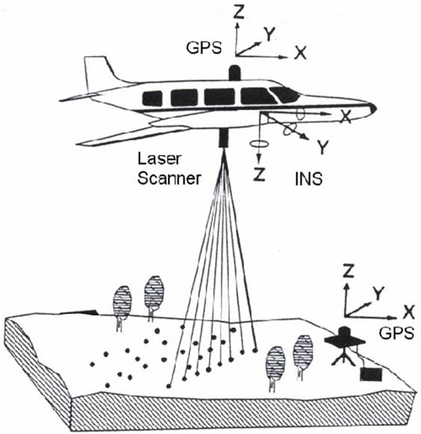
Airborne Lidar
Sweeping or wide beam lidar
units mounted on the
underside of low flying
aircraft gather high resolution
3D “point clouds”
Benefits:
  High resolution, 0.4-1.4m
  spacing
  High accuracy, ±0.1-0.2m
  horizontal and vertical
  Returns position, RGB color,
  intensity, and classification
Drawbacks:
  Limited spatial area (individual project areas)
  Not updated regularly for land cover changes
  Specifications are highly heterogenous and dependent on project area

Slide 11
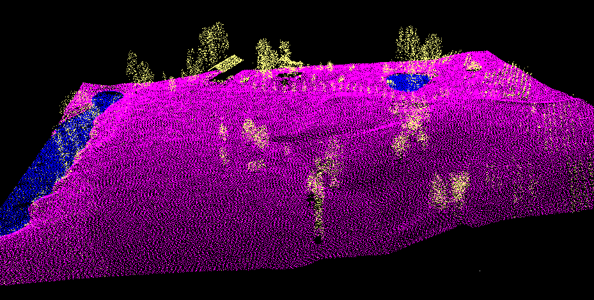
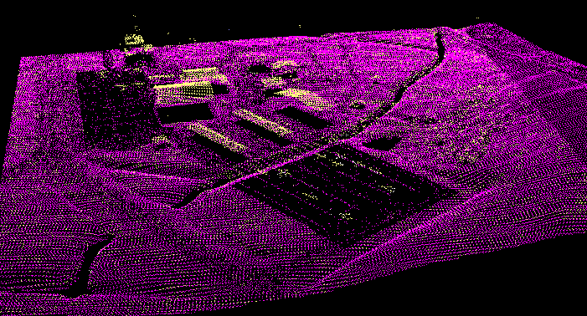
COPA
GFAL
Three dimensional point clouds from airborne lidar at NYSM stations COPA (top) and GFAL (bottom) viewed from the south. Points are color coded according to their classification in post processing: ground (purple), unclassified (i.e. vegetation, buildings, etc.) (yellow), and water (blue).

Slide 12
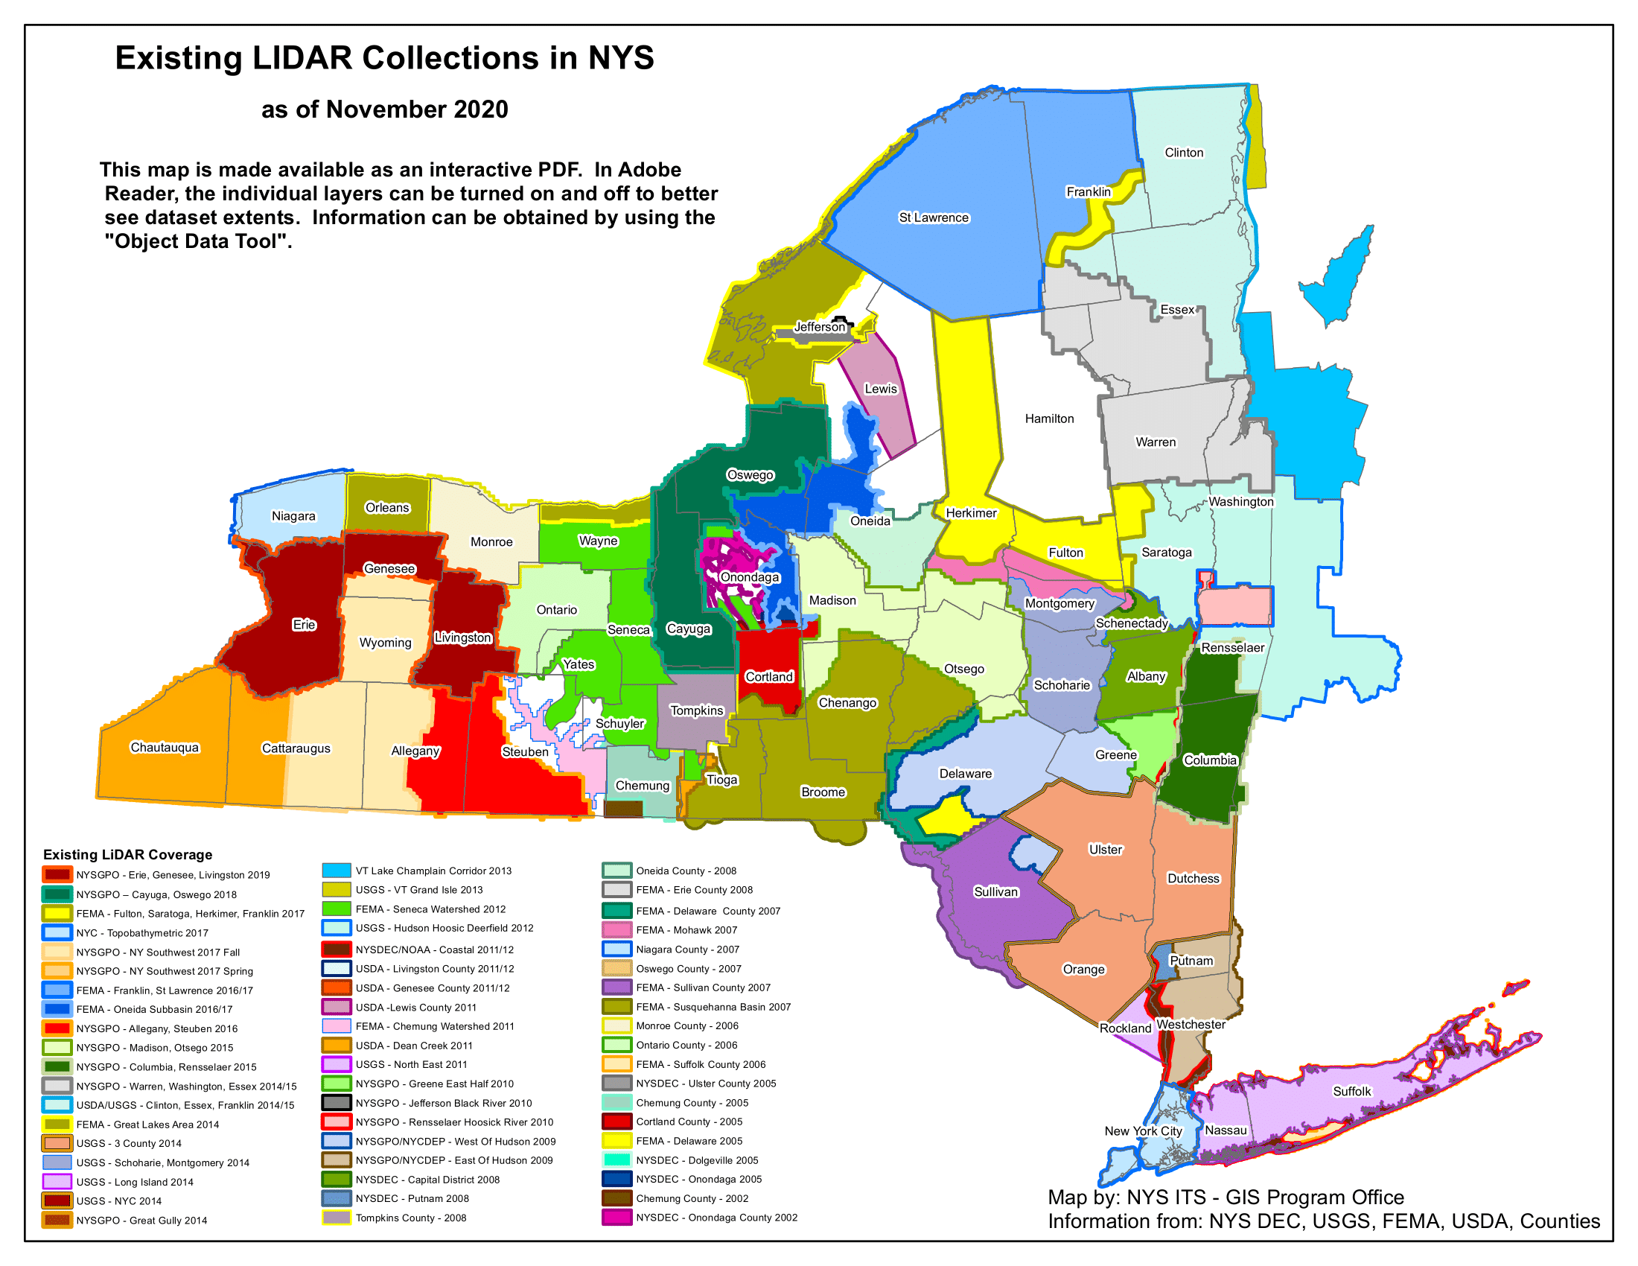
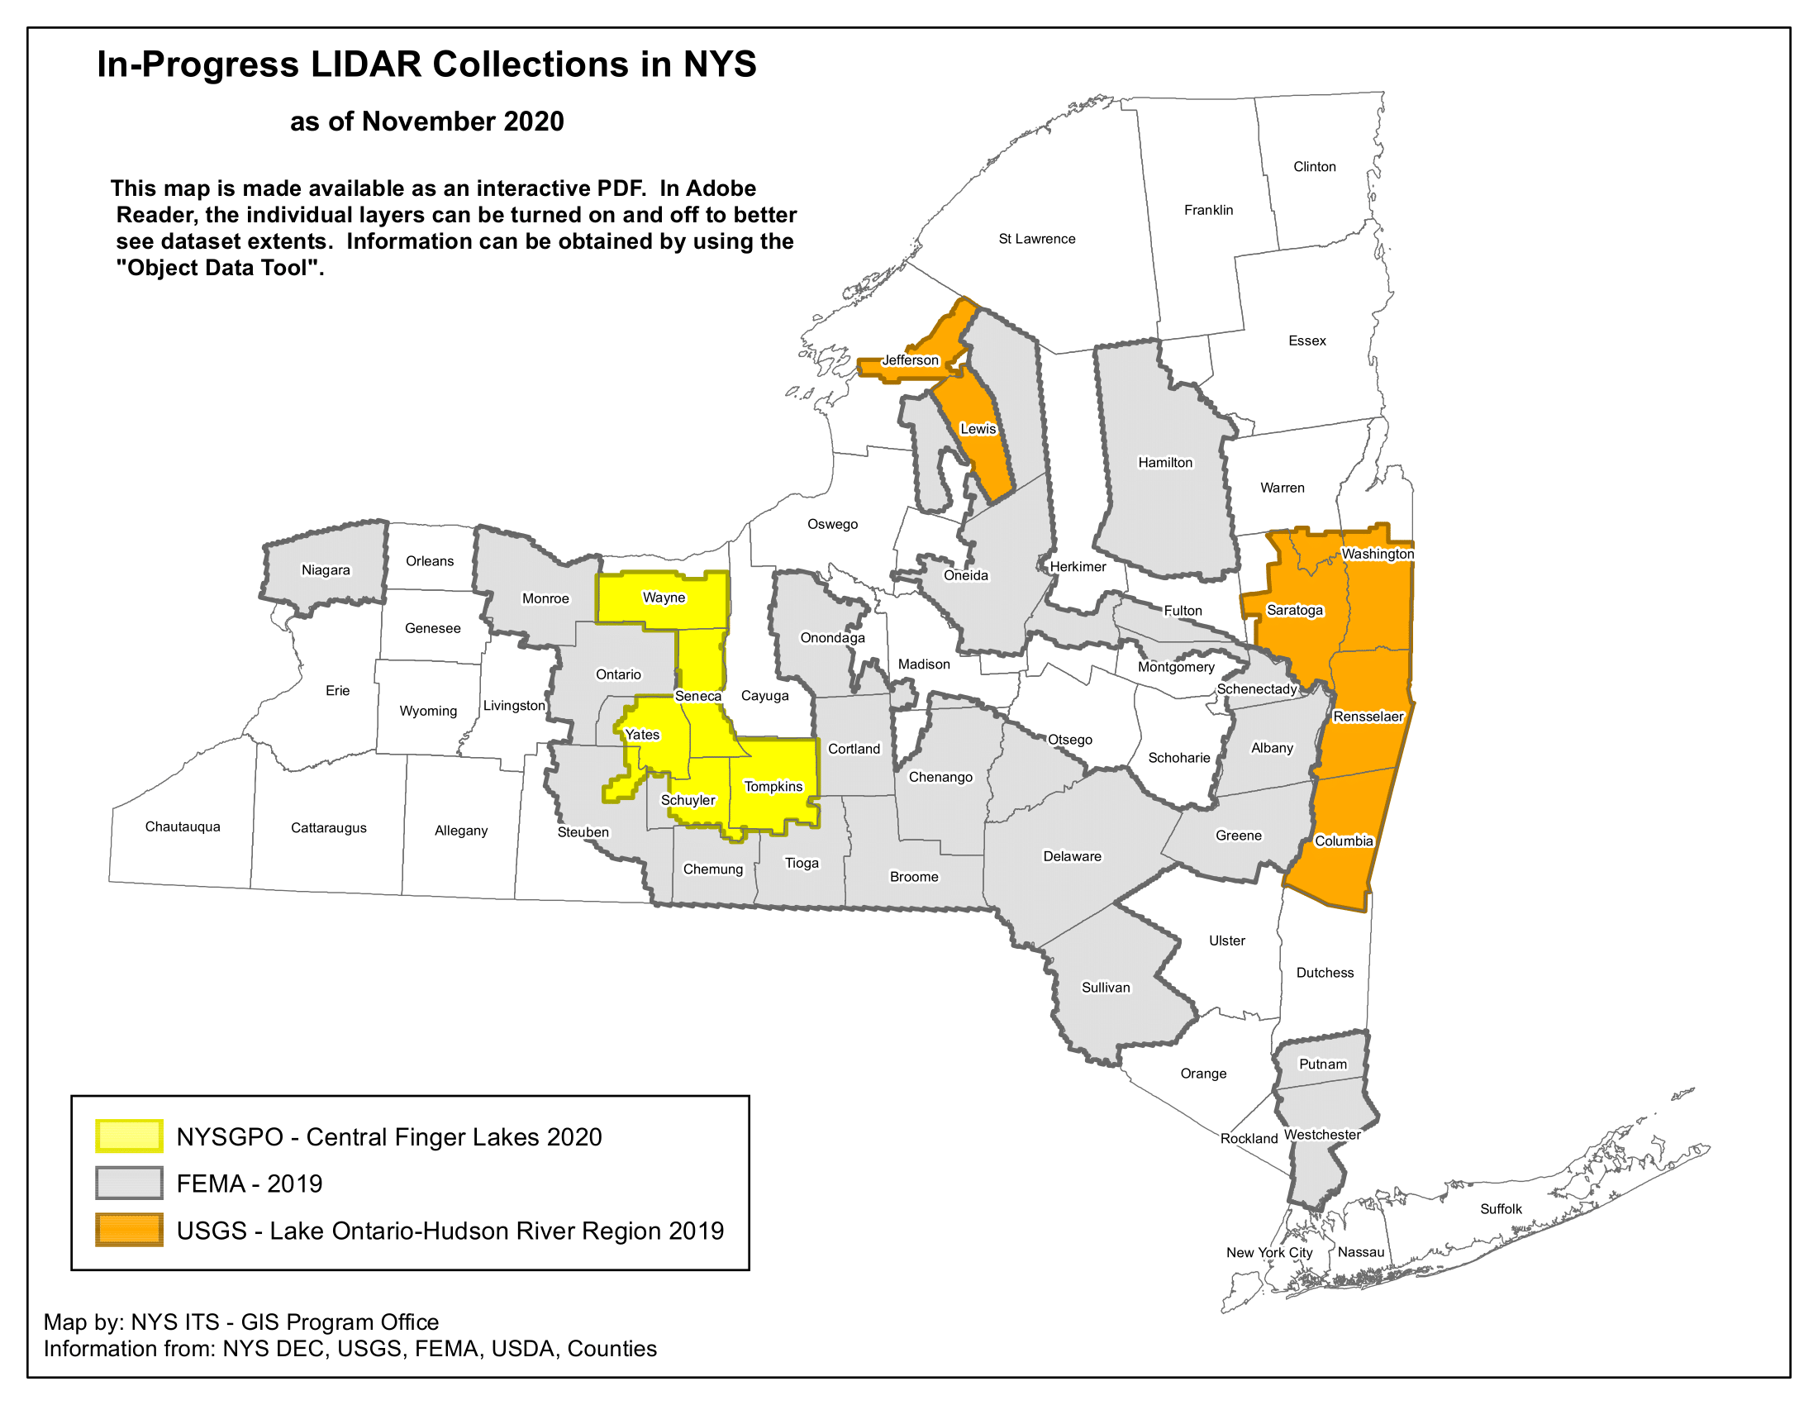
3D Elevation Program (3DEP)
Guarantees threshold resolution, accuracy, and quality.
Extensive NYS coverage, with complete coverage by Fall 2021.

Slide 13
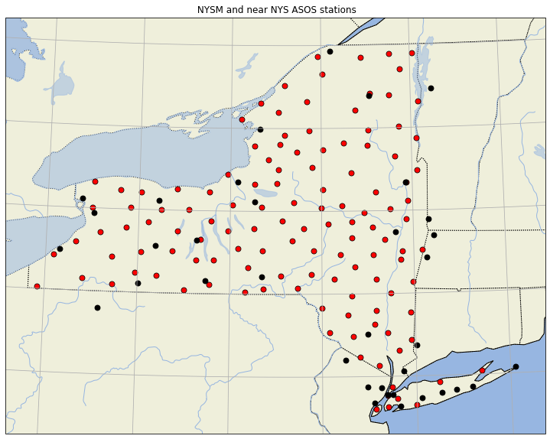
Surface Wind Data, NYSM & ASOS
NYSM is a much denser regional network than ASOS.
Provides data in previously empty/sparse regions like the Catskills and Adirondacks.
ASOS
NYSM

Slide 14
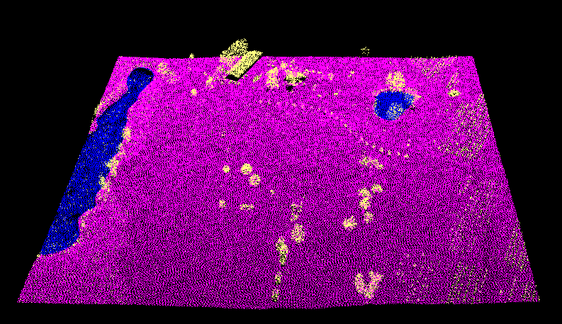
Processing Lidar Data
Compressing 3D lidar data
for analysis:

Slide 15
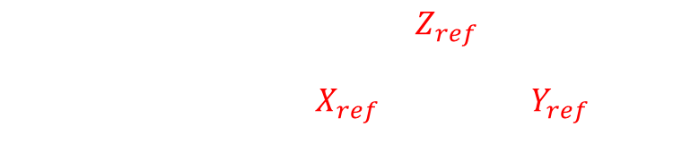
Processing Lidar Data
Compressing 3D lidar data
for analysis:
$$θ_{i}=\tan^{−1}\left(\frac{Z_{i}−Z_{ref}}{\sqrt{{\left(X_{i}−X_{ref}\right)}^{2}+{\left(Y_{i}−Y_{ref}\right)}^{2}}}\right)$$

Slide 16
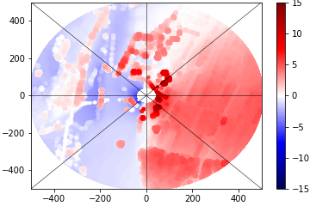

Processing Lidar Data
Compressing 3D lidar data
for analysis:
← S Meters from Station N →
← W Meters from Station E →
$$θ_{i}=\tan^{−1}\left(\frac{Z_{i}−Z_{ref}}{\sqrt{{\left(X_{i}−X_{ref}\right)}^{2}+{\left(Y_{i}−Y_{ref}\right)}^{2}}}\right)$$

Slide 17
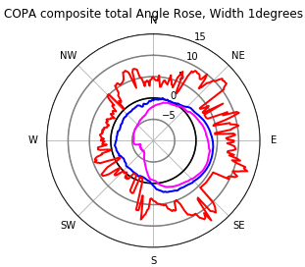
Processing Lidar Data
Fujita and Wakimoto 1982, Wolfson and Fujita 1989
Compressing 3D lidar data
for analysis:
← S Meters from Station N →
← W Meters from Station E →
$$θ_{i}=\tan^{−1}\left(\frac{Z_{i}−Z_{ref}}{\sqrt{{\left(X_{i}−X_{ref}\right)}^{2}+{\left(Y_{i}−Y_{ref}\right)}^{2}}}\right)$$

Slide 18
Processing Lidar Data
Stations were discarded:
  Locations without lidar coverage
  Areas with projection issues
  Locations with no viable reference point
  Rooftop stations
  Stations with nonstandard anemometer mounting heights (KMTP)
Final count:
  NYSM 107/126 stations
  ASOS 19/36 (near NYS) stations

Slide 19
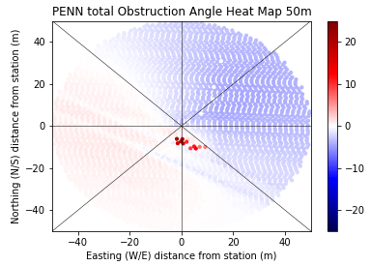
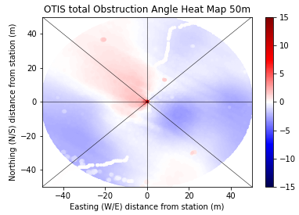
PENN/OTIS
PENN GF = 1.38
OTIS GF = 1.94
Both are NYSM WMO Class 1 stations.
0-50m
No real notable obstructions and gently varying terrain.

Slide 20
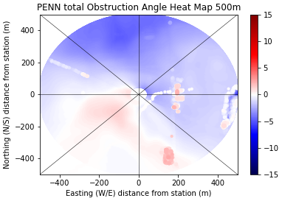
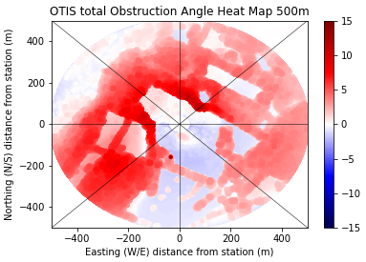
PENN/OTIS
PENN GF = 1.38
OTIS GF = 1.94
Both are NYSM WMO Class 1 stations.
50-500m
PENN is still very open within 500m.
OTIS has trees within 85m of the station.

Slide 21
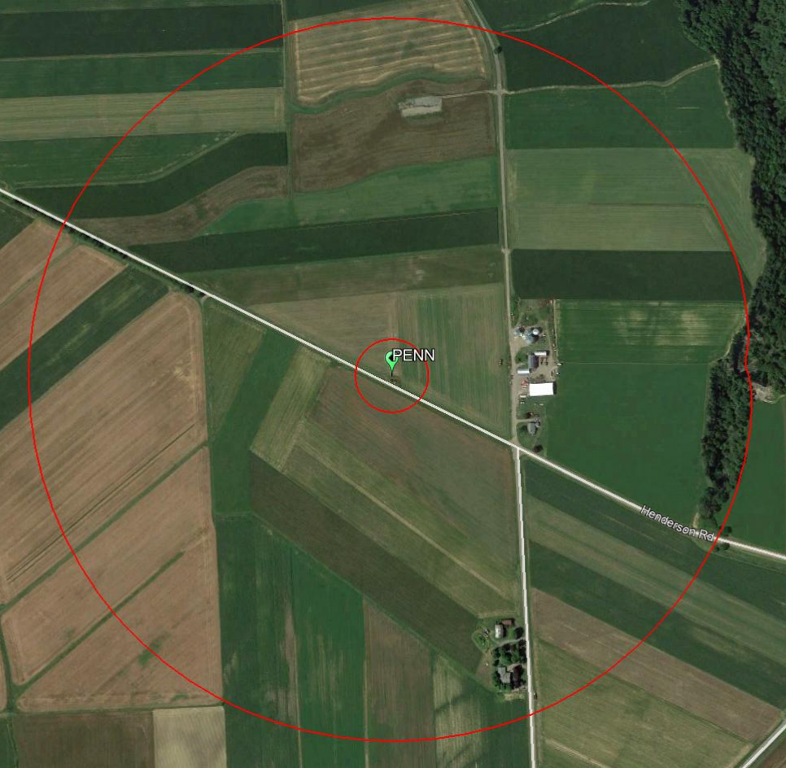
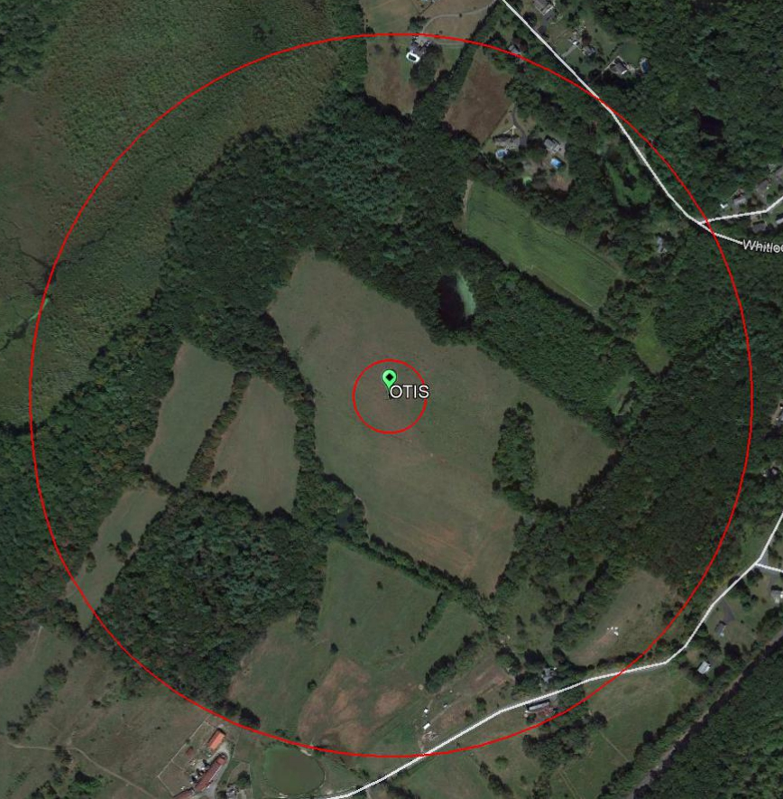
PENN/OTIS
PENN GF = 1.38
OTIS GF = 1.94
Both are NYSM WMO Class 1 stations.
Misoscale
50-500m

Slide 22
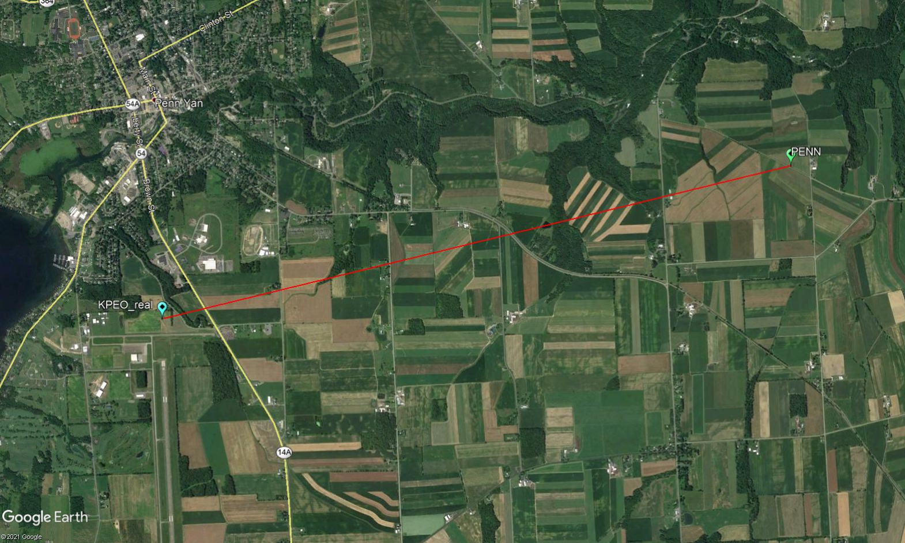
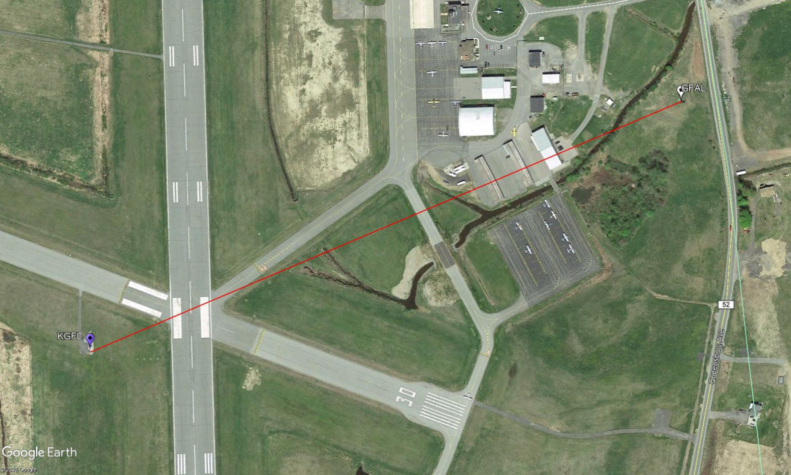
ASOS/NYSM
Pairs
5.5km
Pairs may be subjected to the same large-scale wind, but local environments can vary over short distances.
PENN and KPEO, 5.5km apart.
GFAL and KGFL, 720m apart.
720m

Slide 23
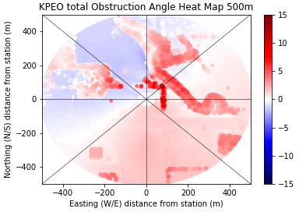
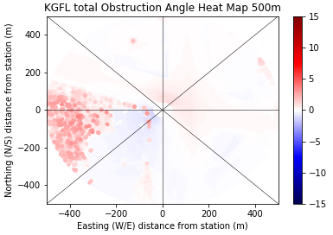
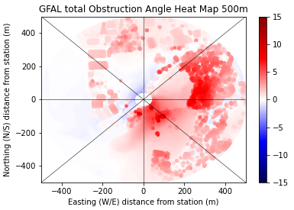
KPEO/PENN and KGFL/GFAL
KPEO
KGFL
Not all ASOS locations are far removed from nearby obstacles (KPEO).
Both the local environment and obstruction angles can change drastically over short distances.
PENN
GFAL

Slide 24
Surface Wind Data (07/01/16-06/30/17)
ASOS and NYSM (and subsequently all observations) are valid but not necessarily equal.
Differ in terms of: Averaging interval, Gust duration (sample averaging interval), Precision, Anemometer model, Siting philosophy
ASOS
  36 “near” NYS locations
  Data every 1-min, 2-min mean wind, maximum 3s average gust
  Sonic anemometers
  Nominally at 10m
  Sited largely at airports with large unobstructed fetches
NYSM
  126 stations across NYS
  5minute data, 5minute mean wind, maximum 3s average gust*
  Sonic and propeller anemometers
  Mounting height of 10m
  Sited in a variety of environments

Slide 25
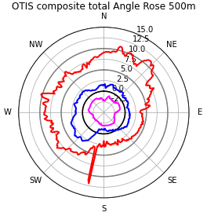
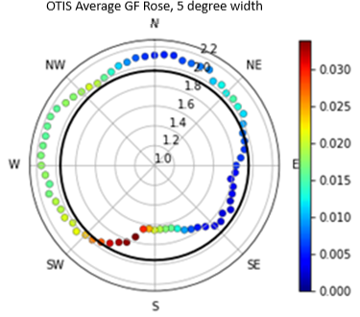
Azimuthal Analysis (OTIS)
Average, minimum, and maximum obstruction angles (within 500m) for every 1° azimuth around stations.
Average GF every 5° azimuth color coded by wind direction frequency.

Slide 26
Azimuthal Analysis (OTIS)
Average, minimum, and maximum obstruction angles (within 500m) for every 1° azimuth around stations.
Average GF every 5° azimuth color coded by wind direction frequency.

Slide 27
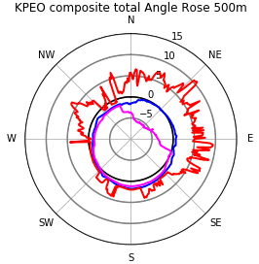
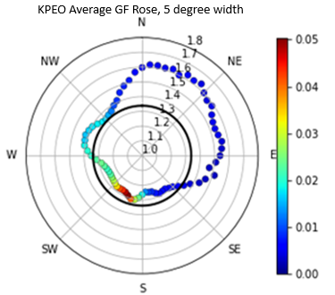
Azimuthal Analysis (KPEO)

Slide 28
Azimuthal Analysis (KPEO)

Slide 29
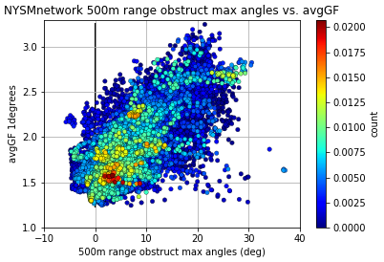
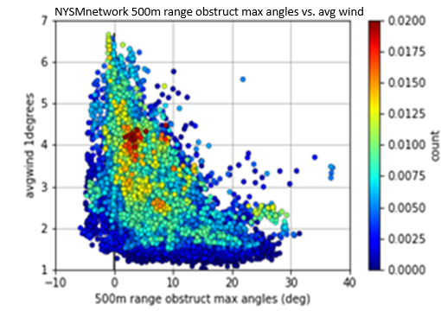
NYSM Network GF and Wind vs. Obstruction Correlation
N=38520

Slide 30
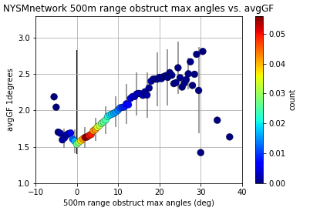
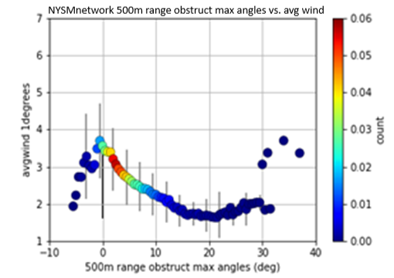
NYSM Network GF and Wind vs. Obstruction Correlation
-6 ≤ θ ≤ 30

Slide 31
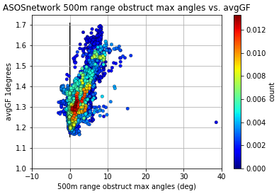
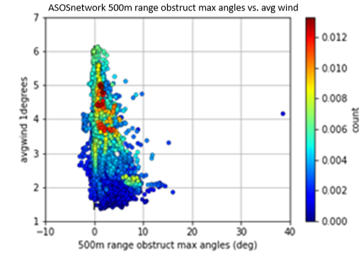
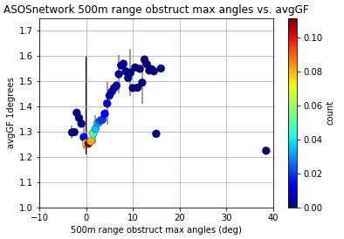
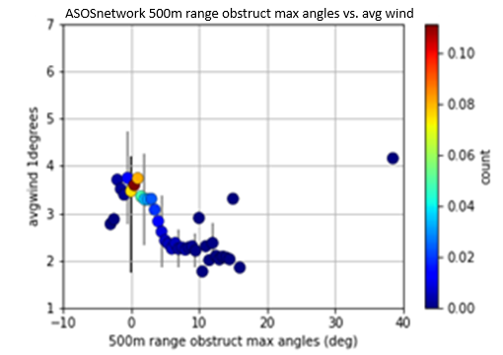
ASOS Network GF and Wind vs. Obstruction Correlation
N=6840, -4 ≤ θ ≤ 16

Slide 32
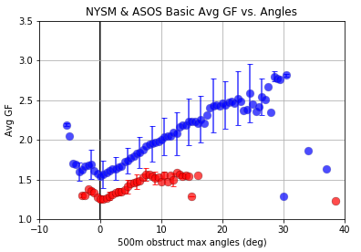
Network GF vs. Obstruction Correlation
Both NYSM and ASOS have notable correlations of GF and wind speed with maximum obstruction angle.
Directly comparing the networks highlights the gap between them.
They have identical patterns of GF with maximum obstruction angle but for differing ranges:
  NYSM: -6-30°
  ASOS: -4-16°
  (93.18% of NYSM locations/direction obstruction angles fall within the ASOS range)

Slide 33
Network GF vs.
Obstruction Correlation
NYSM and ASOS average quantities differ:
  NYSM wind speeds are on average 27.8% slower than ASOS
  NYSM GFnet = 1.72, ASOS GFnet = 1.3
This is in part due to differences in observation methodology:
  Averaging interval, gust duration
Normalizing both datasets to a 10min averaging interval and 3s average gust (propeller anemometer) bring the network quantities much closer together for similar values of maximum obstruction angle.

Slide 34
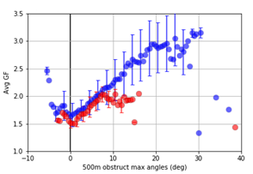
Network GF vs.
Obstruction Correlation
NYSM and ASOS average quantities differ:
  NYSM wind speeds are on average 27.8% slower than ASOS
  NYSM GFnet = 1.72, ASOS GFnet = 1.3
This is in part due to differences in observation methodology:
  Averaging interval, gust duration
Normalizing both datasets to a 10min averaging interval and 3s average gust (propeller anemometer) bring the network quantities much closer together for similar values of maximum obstruction angle.

Slide 35
Airborne Lidar Takeaways
Airborne lidar provides high quality data that can be used to precisely visualize and quantify local environments.
Both NYSM and ASOS demonstrate a strong correlation between average GF and mean wind speed with maximum obstruction angle. As obstacles in the environment deviate from the horizon wind speeds are slowed and GFs increase.
Differences between the NYSM and ASOS networks with respect to obstruction angle can be minimized by unifying averaging interval and gust duration.
For the locations and directions with common obstruction angles ASOS and NYSM are nearly identical.
Average observed GF is a good proxy for site exposure.

Slide 36
Future Work
Expansion of lidar analysis to other networks and relating of other surface variables to degree of obstruction. Re-evaluation of WMO classifications.
Expand analysis to other networks and geographic areas.
Potentially relate site obstruction to other observed meteorological variables.
Re-evaluate WMO classifications
Test seasonal and diurnal efficacy of obstructions

Slide 37
Airborne Lidar Takeaways
Airborne lidar provides high quality data that can be used to precisely visualize and quantify local environments.
Both NYSM and ASOS demonstrate a strong correlation between average GF and mean wind speed with maximum obstruction angle. As obstacles in the environment deviate from the horizon wind speeds are slowed and GFs increase.
Differences between the NYSM and ASOS networks with respect to obstruction angle can be minimized by unifying averaging interval and gust duration.
For the locations and directions with common obstruction angles ASOS and NYSM are nearly identical.
Average observed GF is a good proxy for site exposure.

