Slide 1
High-impact model biased right of track winter storms in the northeast United States
Mike Evans – NOAA / NWS Albany, NY
Tomer Burg – University of Oklahoma

Slide 2
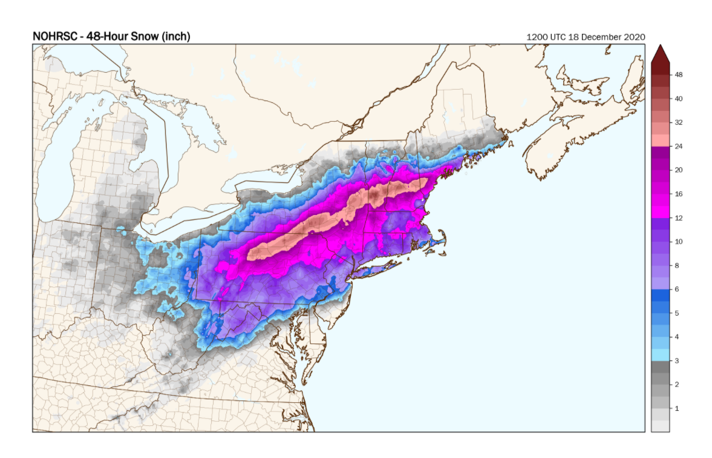
Motivation – December 16-17, 2020

Slide 3
GEFS QPF initialized 00z December 14, 2020
Heaviest Observed Snowfall

Slide 4
GEFS initialized 00z December 16

Slide 5
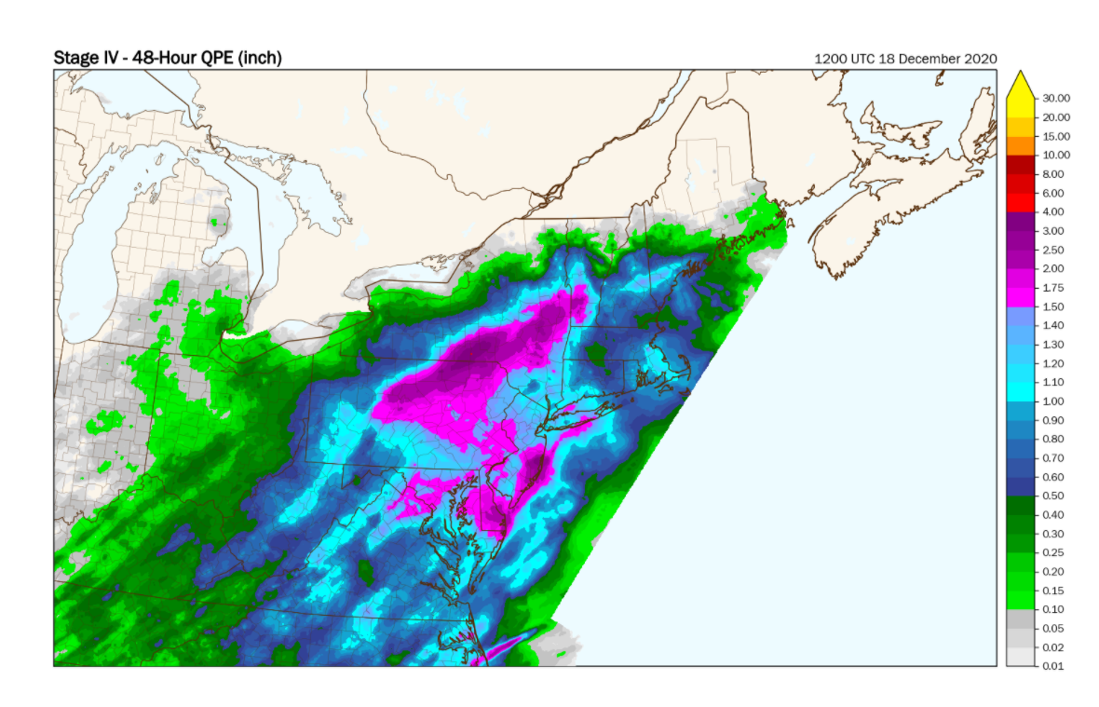
GEFS initialized at 00z December 17 / observed precipitation

Slide 6
CSTAR research – GEFS track biases for 0, 24, 48 and 72 hour forecasts

Slide 7
Forecast errors at 72 hours
Storms in this part of the graph are “right of track” biased (like December 16-17, 2020).
Annotated storms were historical high-impact right of track storms.

Slide 8
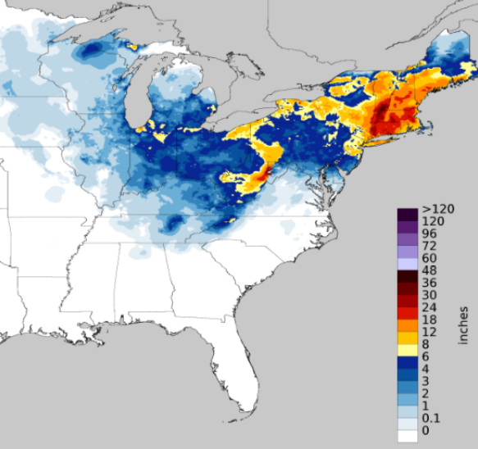
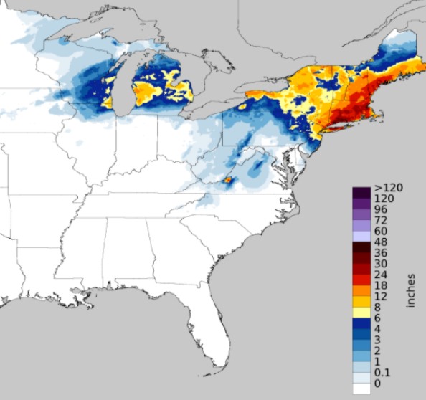
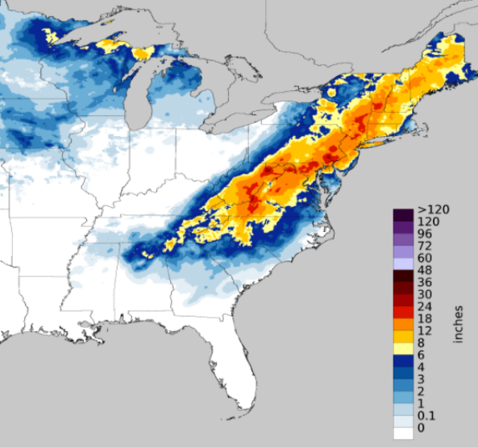
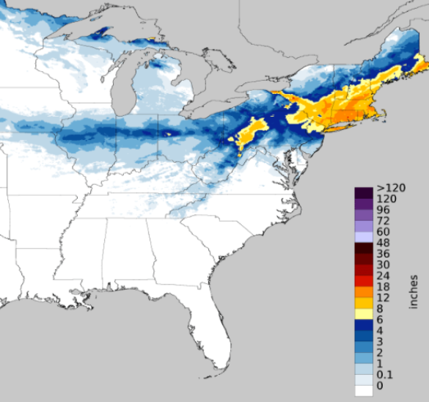
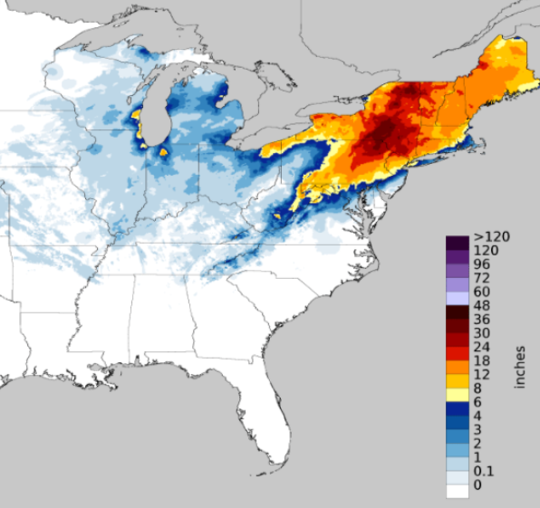
Some historical right of track storms
December 27, 2010
Jan 12, 2011
February 9, 2013
February 14, 2014
February 10, 2017
March 14, 2017

Slide 9
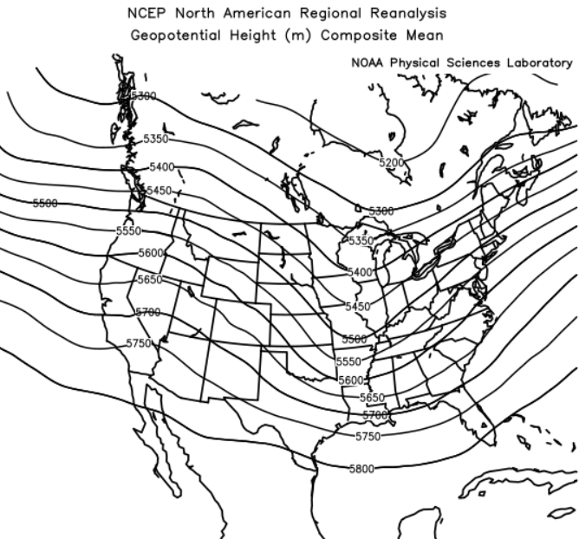
Composites – 500 mb heights for high-impact ROT storms
T36
T0

Slide 10
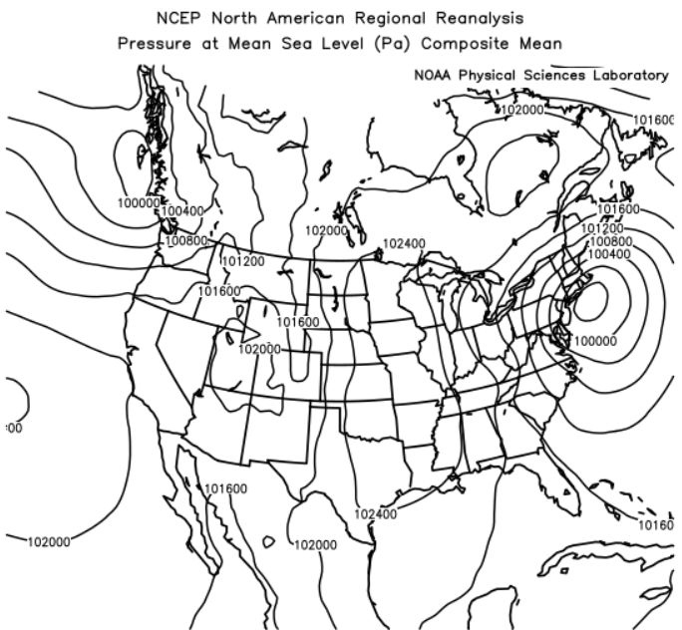
Composites – PMSL for high-impact ROT storms
T36
T0

Slide 11
Convective precipitation at T-36 hours

Slide 12
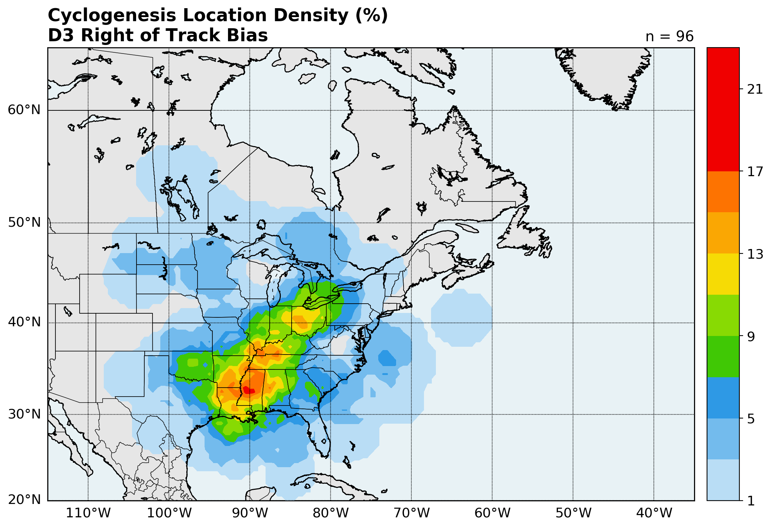
LOT vs ROT location cyclone 1st identified
LOT storms – dominated by Midwest tracks (Miller B)
ROT storms – large number of southern tracks (Miller A)

Slide 13
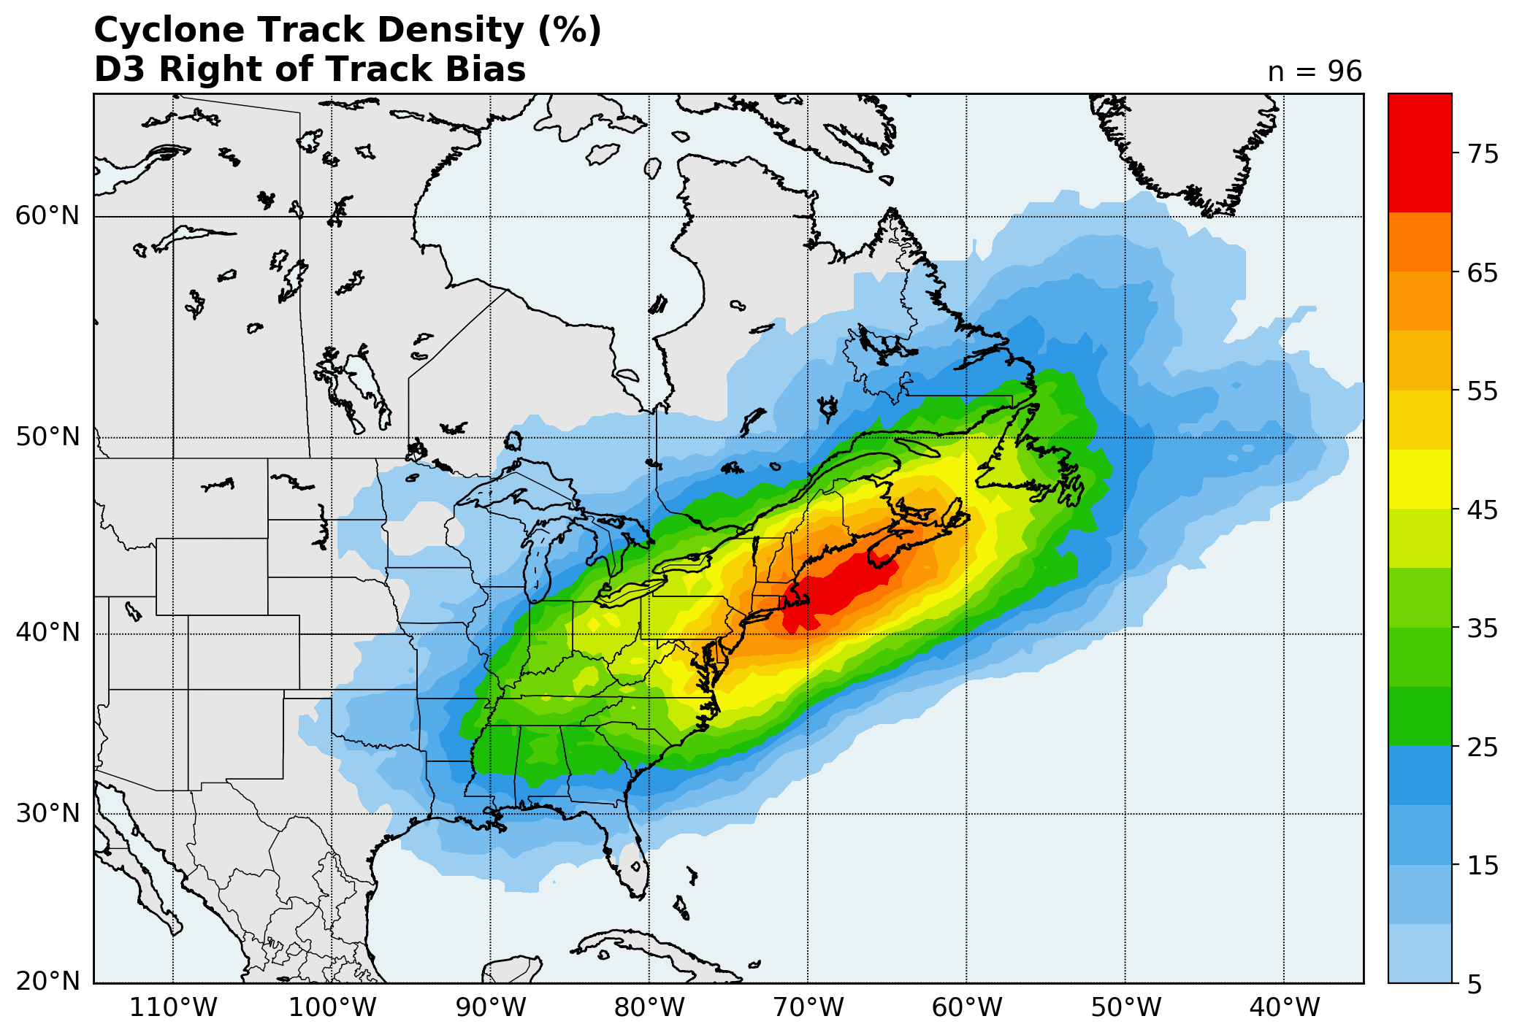
Storm tracks LOT vs ROT

Slide 14
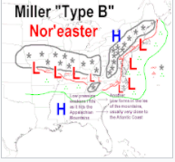
Miller A vs Miller B Nor’easters

Slide 15
Summary and Conclusion
GEFS storm track errors appear to be random for all storms over the eastern U.S.
Right of track biased storms occur with major impacts
There is some evidence that ROT biased storms are more likely to be Miller A storms, LOT storms more likely Miller B
Southeastern CONUS convection may be playing a role effecting the accuracy of the forecast for ROT storms.

