Slide 1
Collaborations between the NWS
and the University at Albany
before and after moving to ETEC
Mike Evans – NWS Albany
Ross Lazear – UAlbany Atmospheric and Env. Sciences

Slide 2
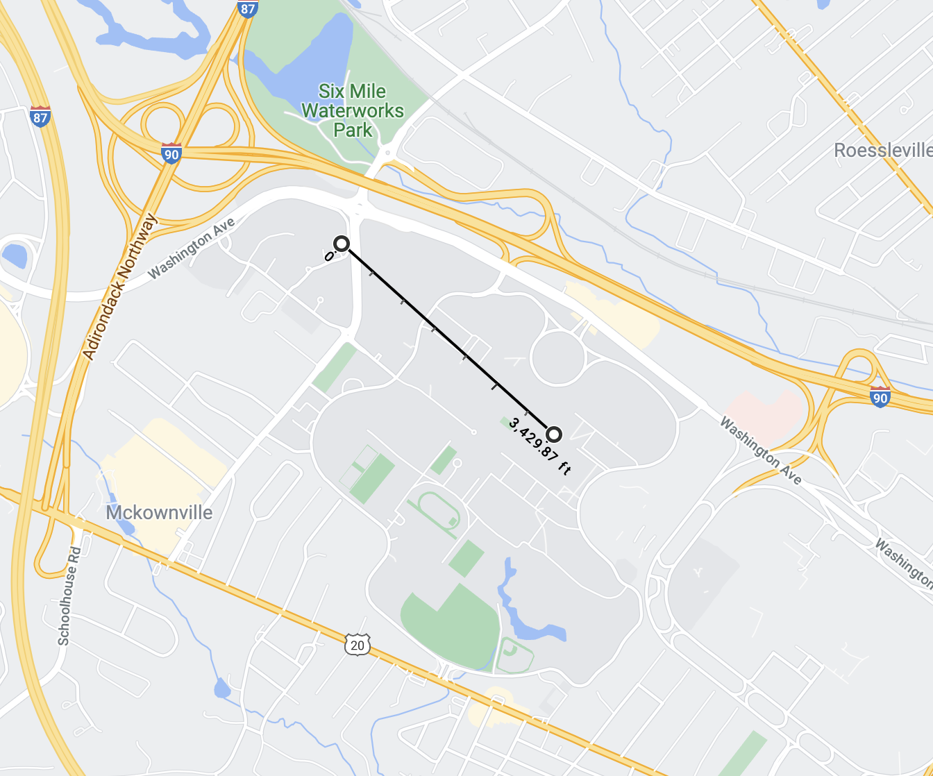
Before…
National Weather Service
UAlbany DAES

Slide 3
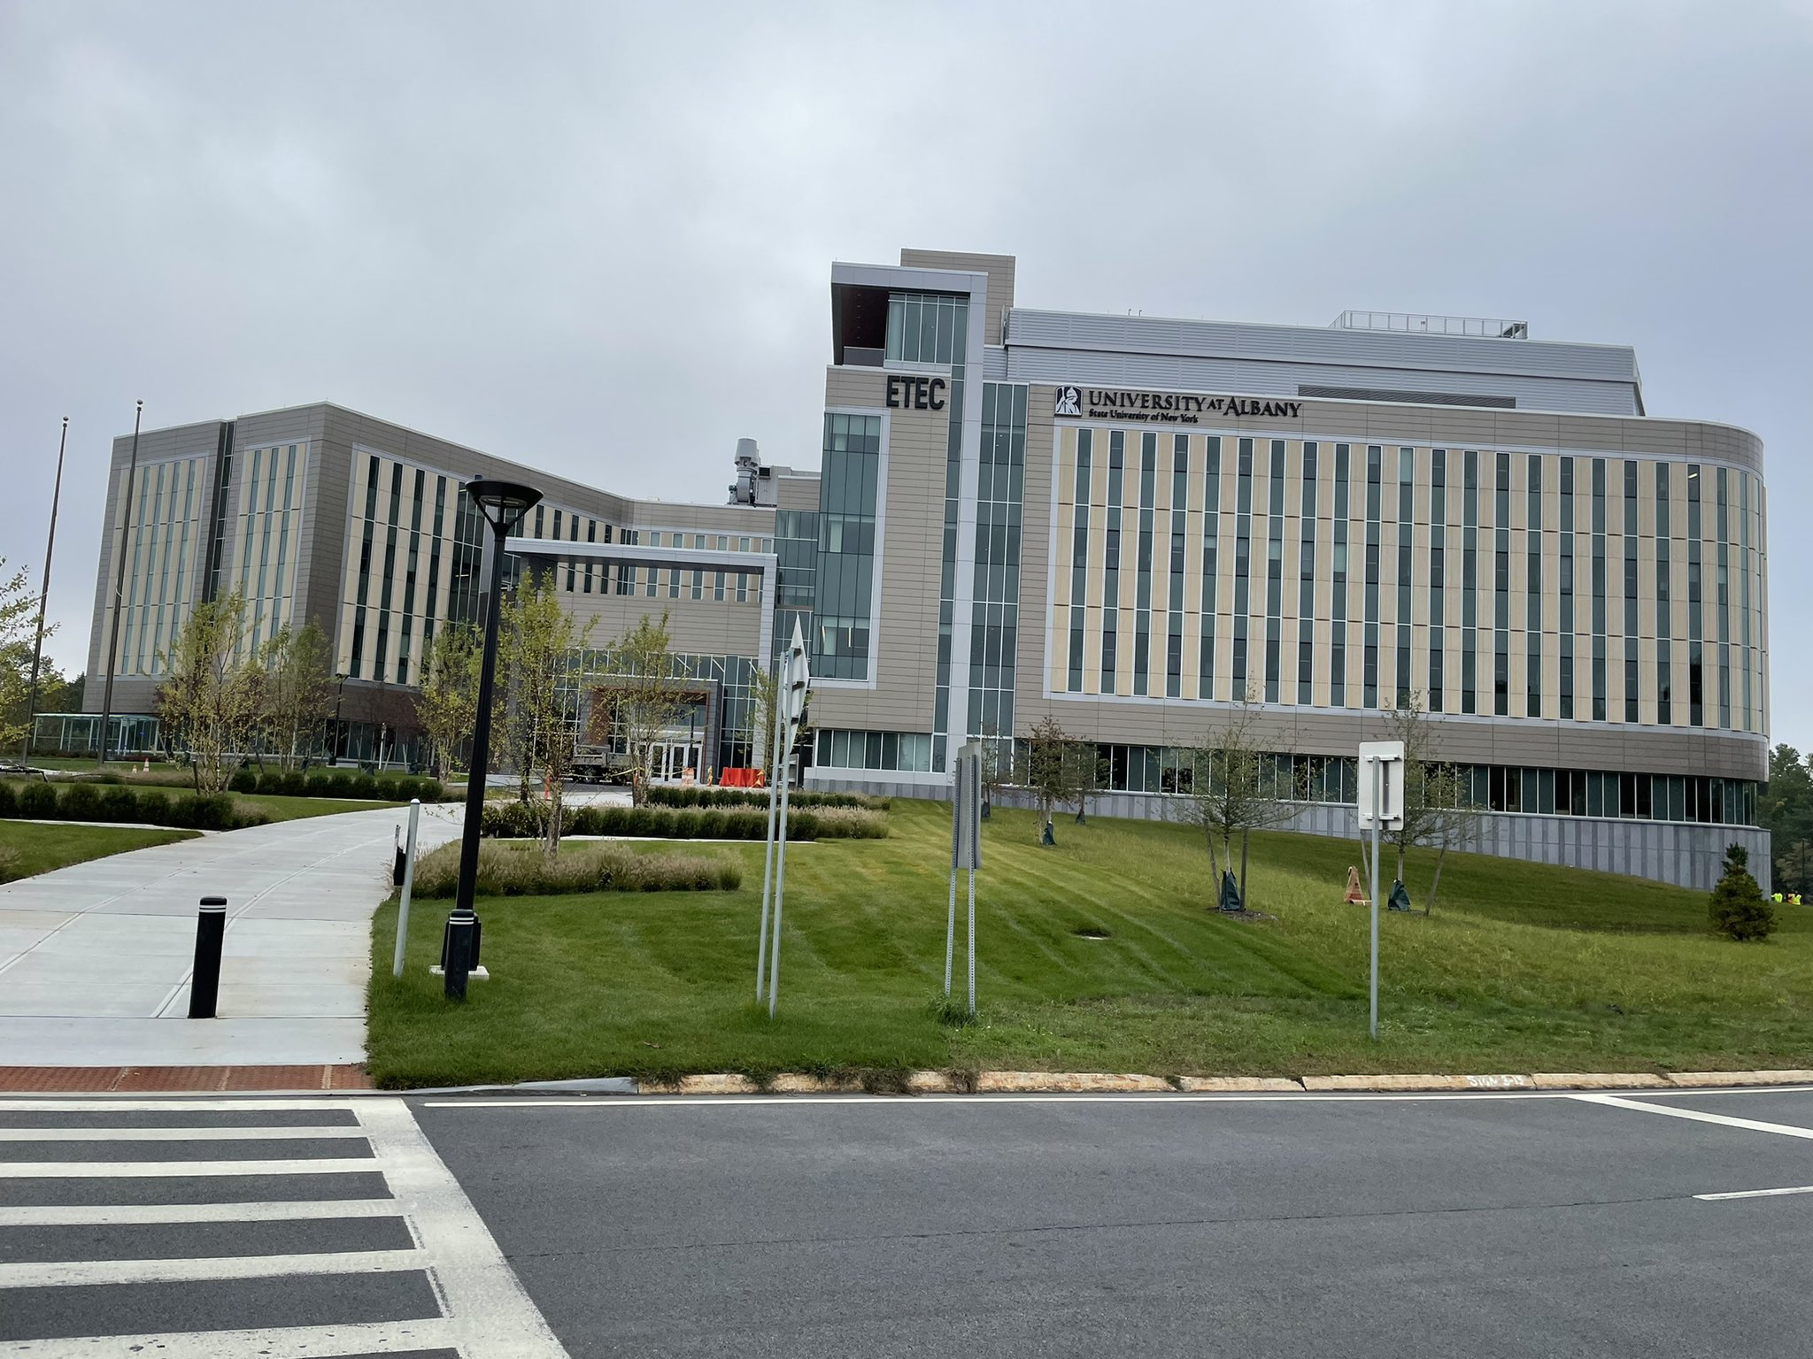
Now…
@HavidanUAlbany

Slide 4
Now…
UAlbany DAES
National Weather Service
@HavidanUAlbany

Slide 5
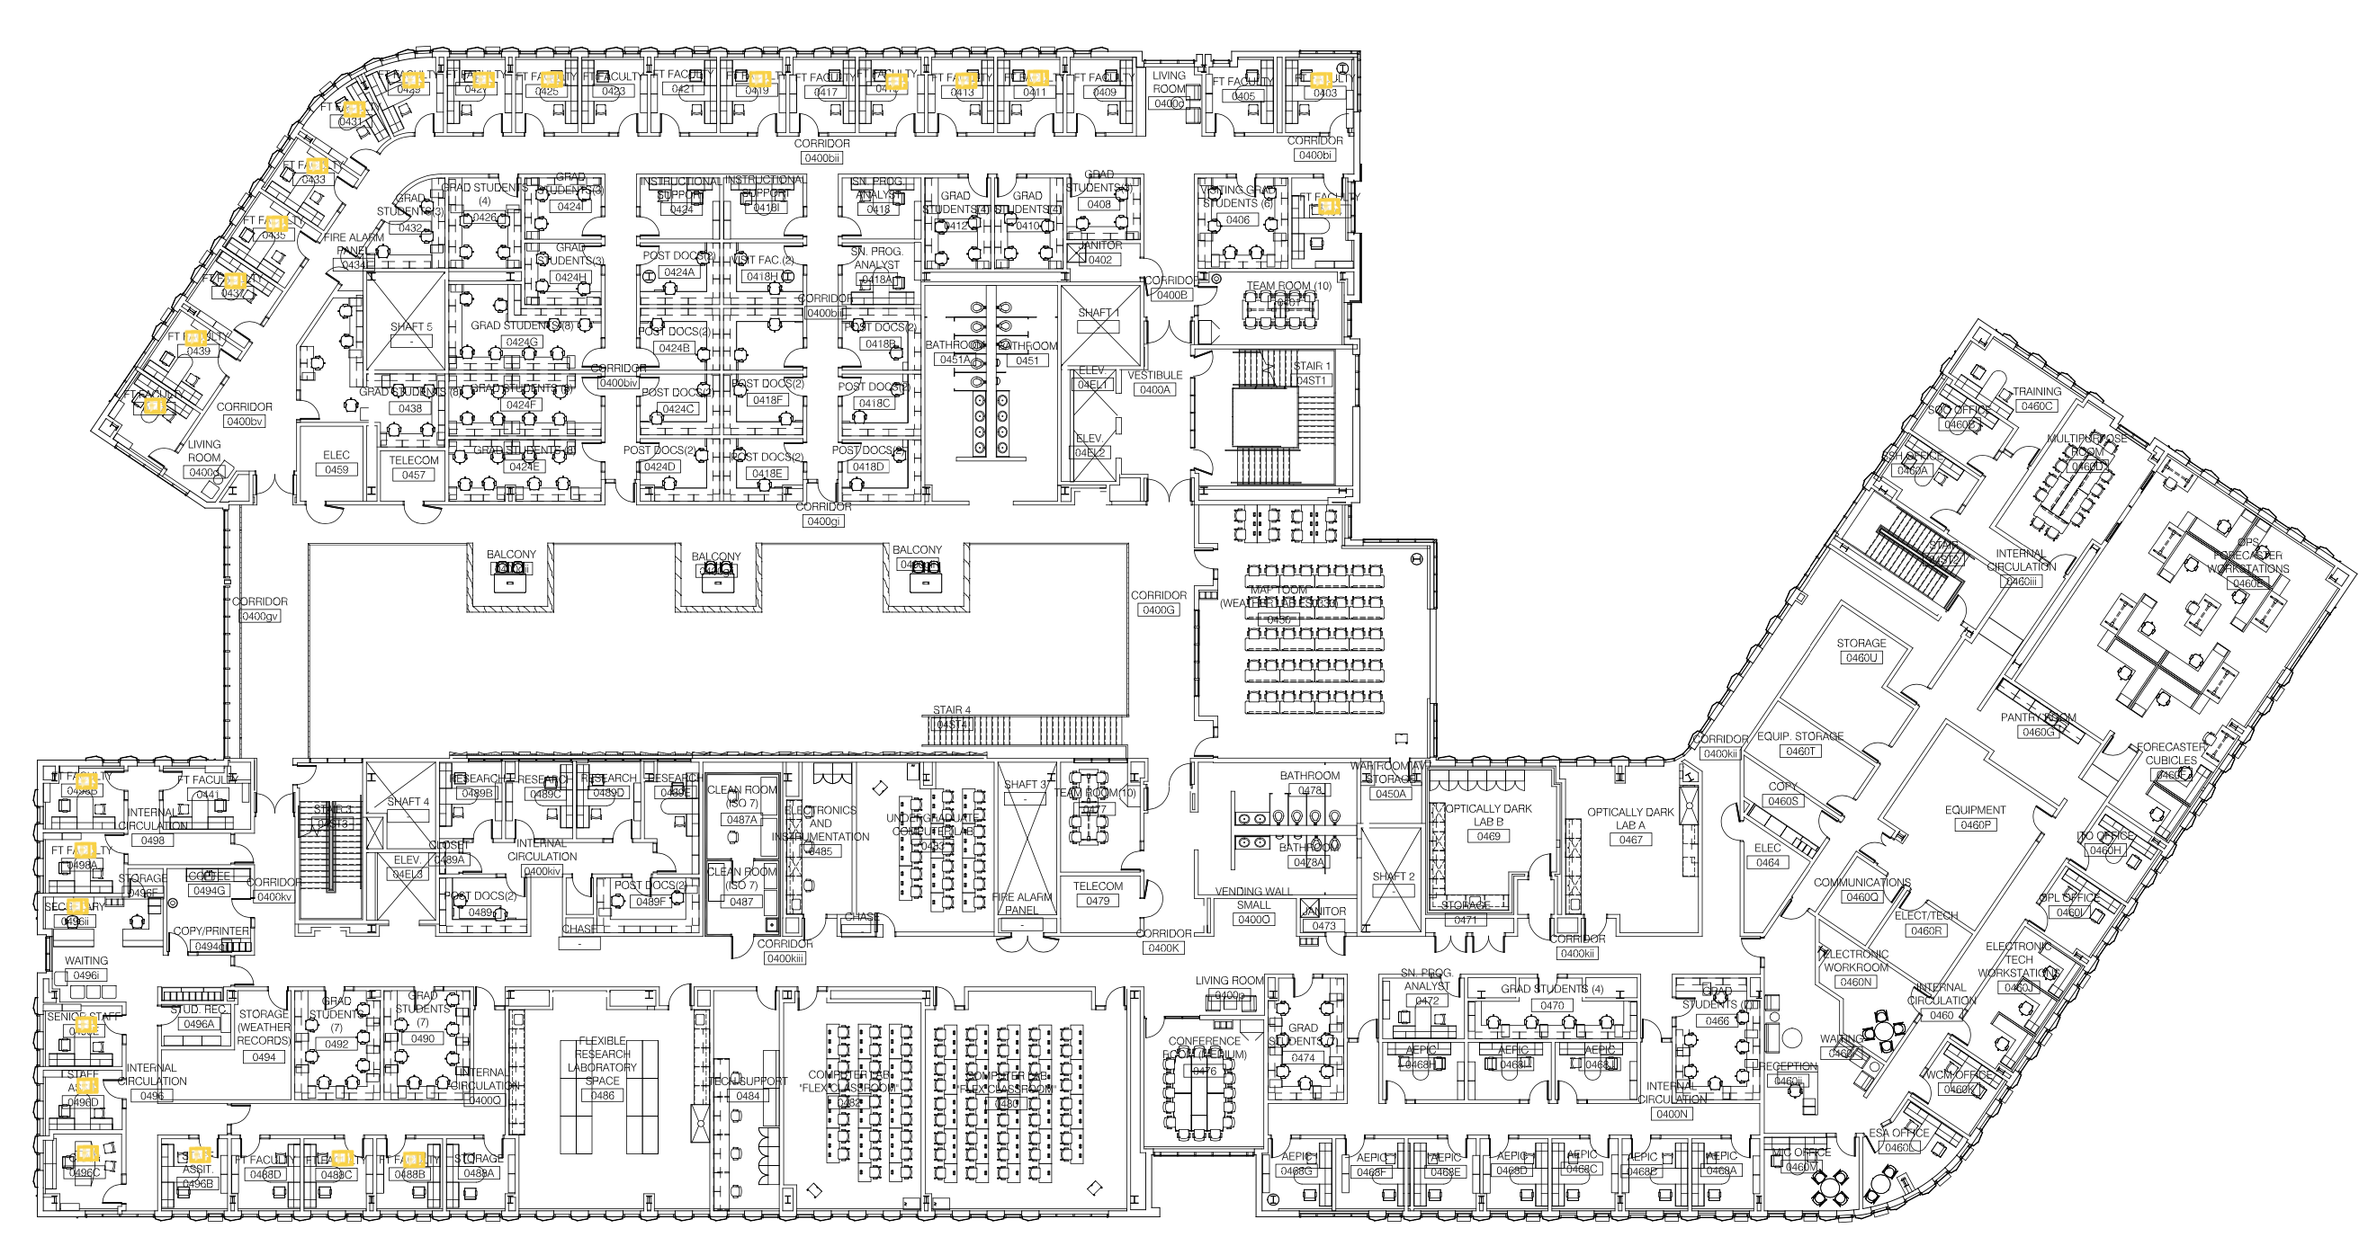
Now…
National Weather Service

Slide 6
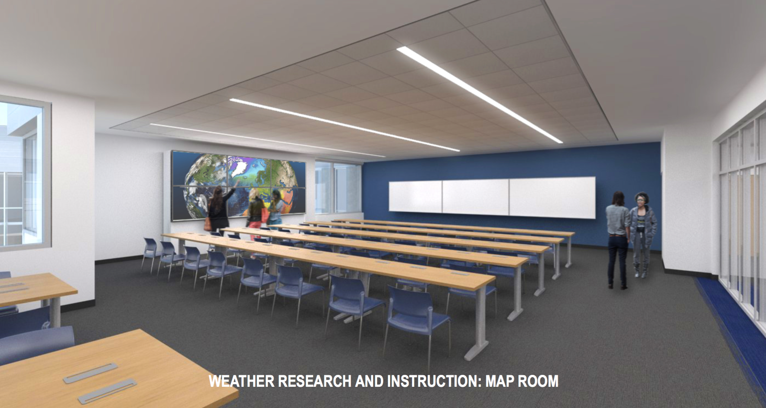
Now…

Slide 7
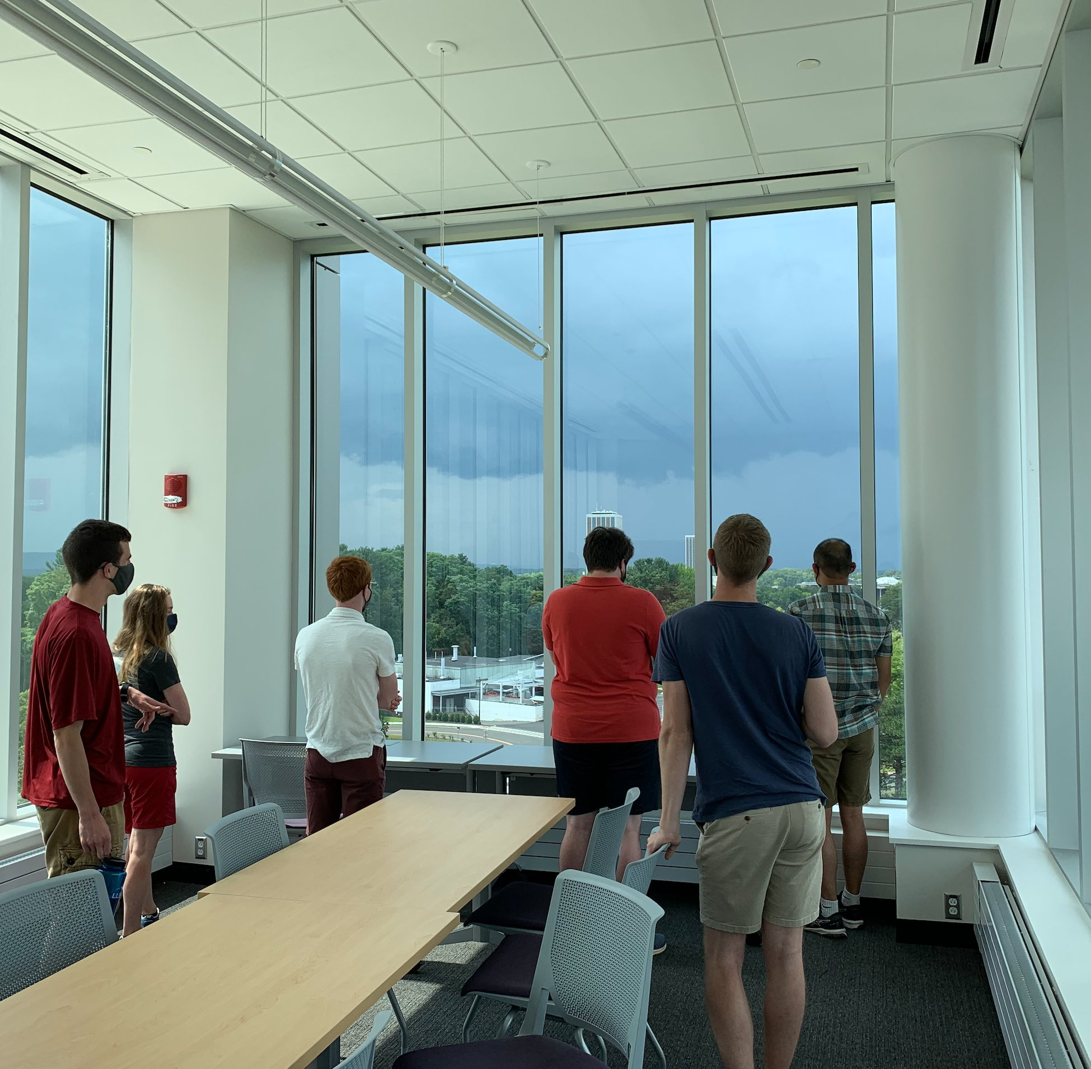
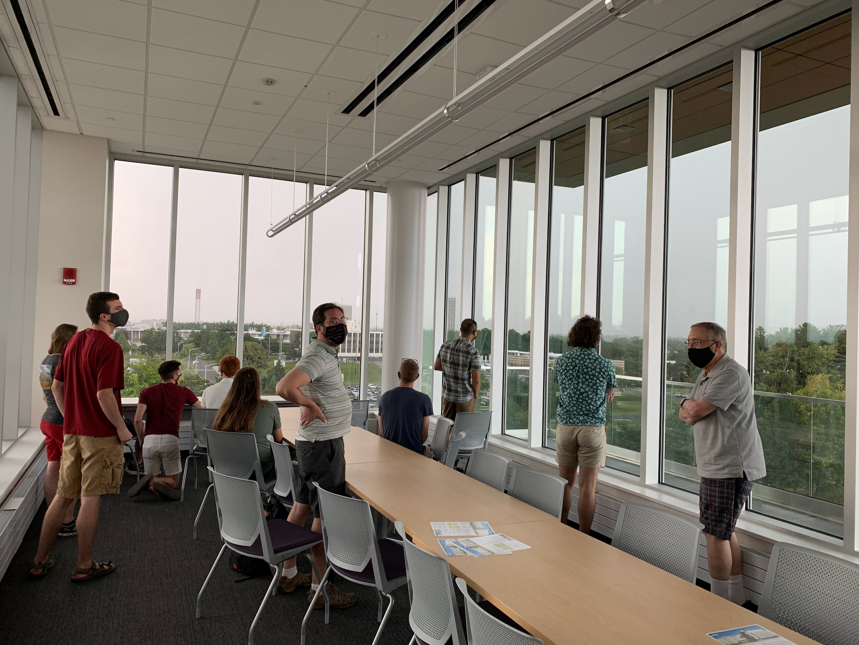
Now…

Slide 8
Topics covered
Current
• UAlbany course: NWS Operations
• CSTAR research to operations
• Conceptual model database
• NWS Volunteer Program (student internship)
• Case studies for independent study credit
Future
• Collaborative map discussions
• Post-event analyses
• Improvements to NWS Operations course
Conclusions

Slide 9
UAlbany ATM 362: National Weather Service Operations
Different NWS staff member lectures every week
- Wide range of topics covered
Hydrology, aviation, decision support, observational networks and ground truth, ensemble forecasting techniques, media, etc…
- There’s a lot more to the NWS than just forecasting the weather!
Complements NWS Volunteer Program (internship)
Small group labs
More on this later…

Slide 10
CSTAR Research to Operations
CSTAR-funded graduate students
• UAlbany DAES advisors
• NWS focal points
Operationally relevant results turned into concise “quick references”
Conceptual diagrams
Decision trees
Tables
Vlab page
vlab.noaa.gov/web/albany-cstar

Slide 11
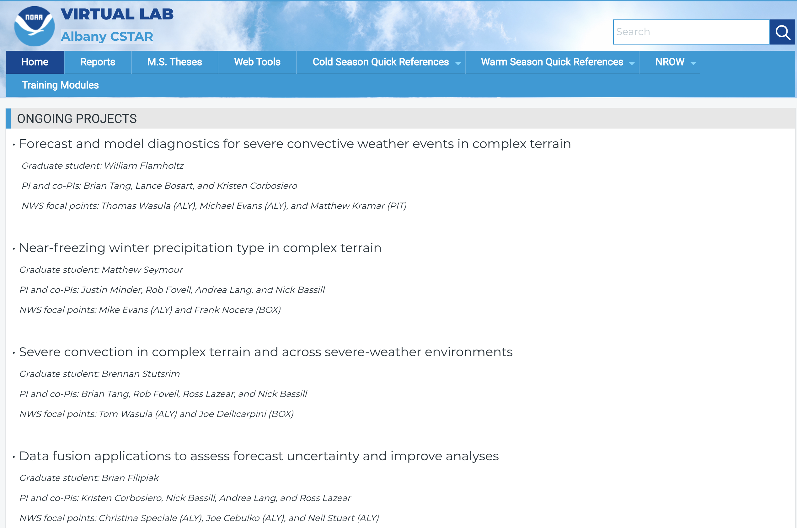
CSTAR Research to Operations

Slide 12
CSTAR Research to Operations

Slide 13
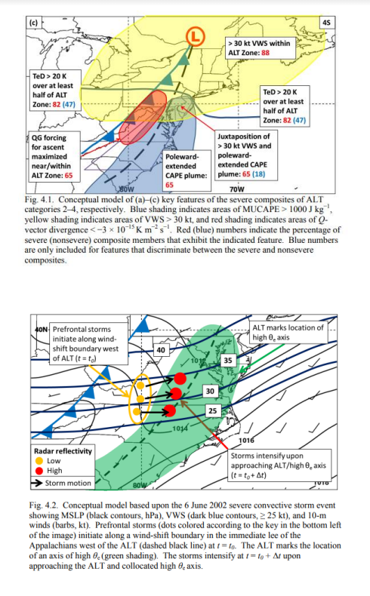
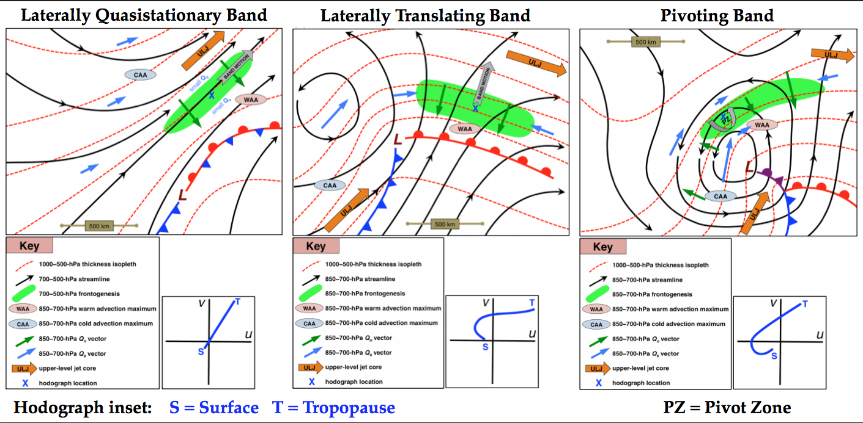
Development of a conceptual model database
Many of our CSTAR projects have resulted in development of conceptual model useful for forecasters
These have been organized into a catalog for quick access by forecasters

Slide 14
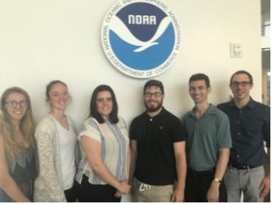
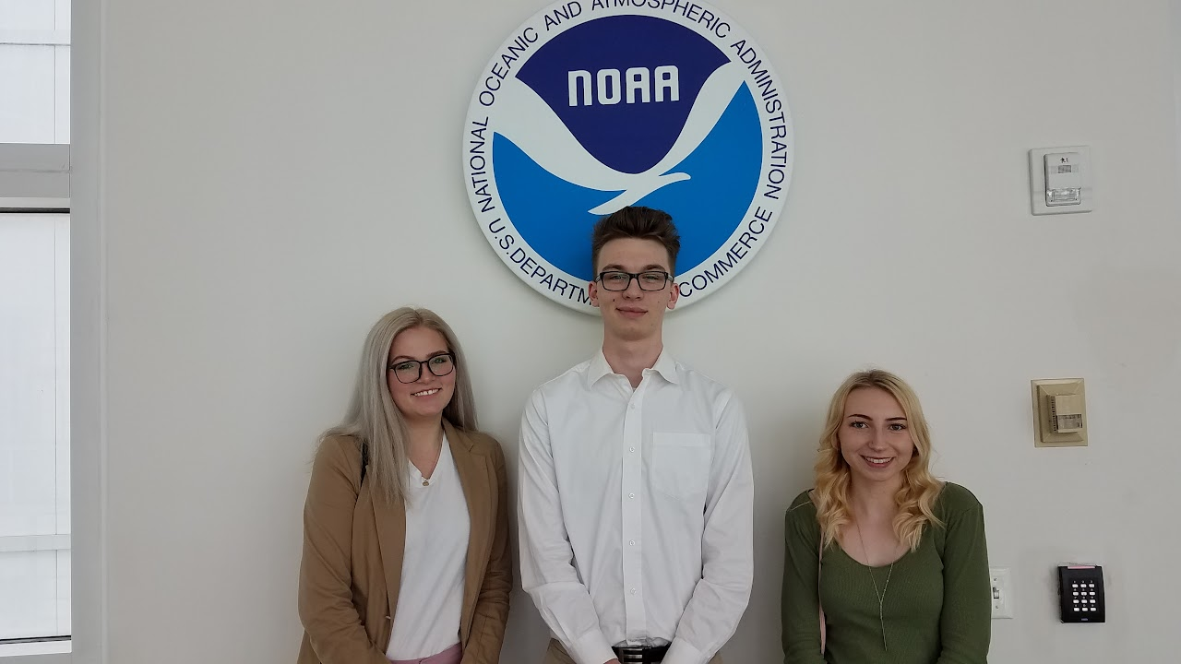
NWS ALY / UAlbany Volunteer Program
Ongoing for two decades

Slide 15
Program prior to March 2020
At least 3 students per semester
Students worked approximately 3 rotating “shifts” per week
Helped with upper-air releases and data collection
Wrote practice discussions and TAFs
Worked on a research project
Emphasis on interaction with forecasters, learning what it’s like to work at the NWS

Slide 16
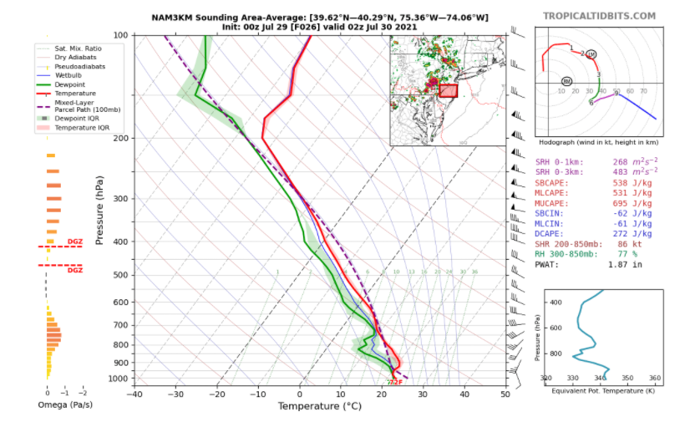
Since 2020
Program had to switch to “virtual”, now going back to “in-person”
Students met our staff with scheduled google meets
CLC training – a necessary evil
Students forecast significant weather, give briefings on Fridays
Students write TAFs, present them on Fridays
Students assigned a case study
Students are beginning studies for upper-air certification

Slide 17
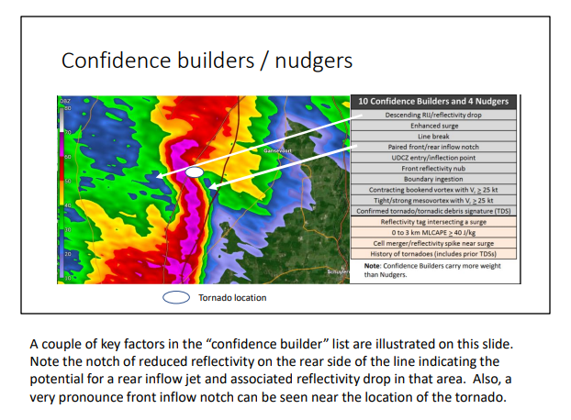
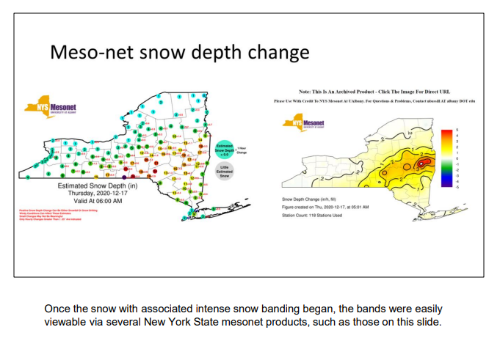
Case studies
Each volunteer is completing a case study for a significant event
Other non-volunteers doing a case study for one credit

Slide 18
The future …

Slide 19
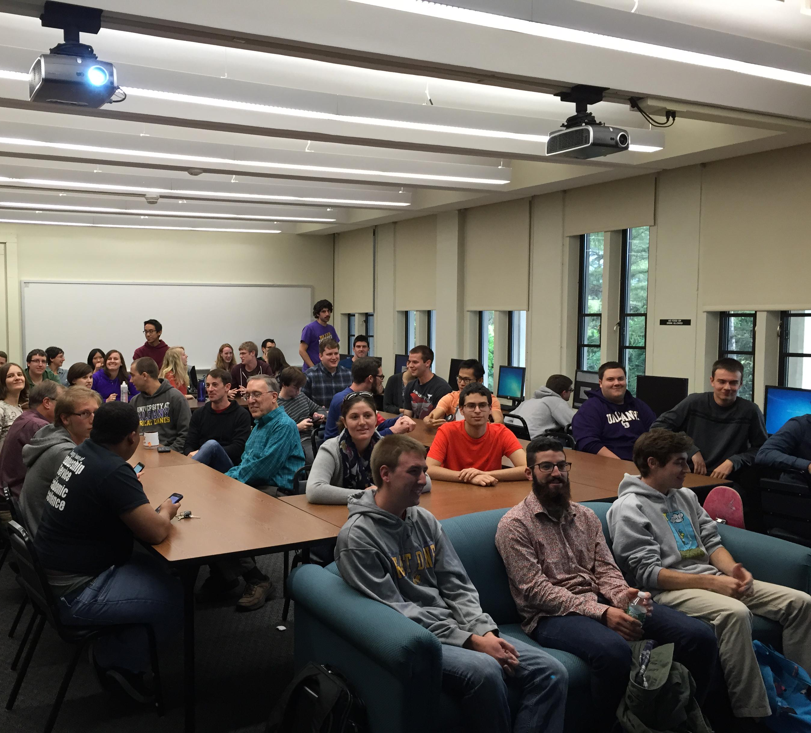
Map Discussions
Recent events
• Deep dive into a recent event
• New research ideas
Major events
• Recent examples
Henri, Ida, Albany snow
Current weather/forecast
• Synoptic/mesoscale
• Focus on Northeast U.S.
• Input from NYS Mesonet, Center of Excellence, CEHC, etc.
• Can be student-led
Teleconferencing capabilities
Hurricane Joaquin discussion

Slide 20
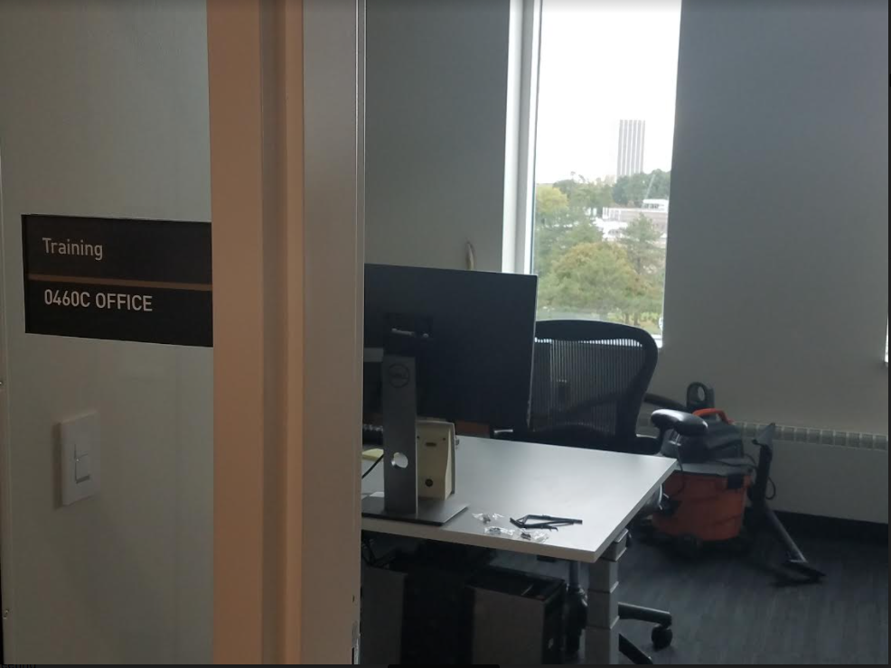
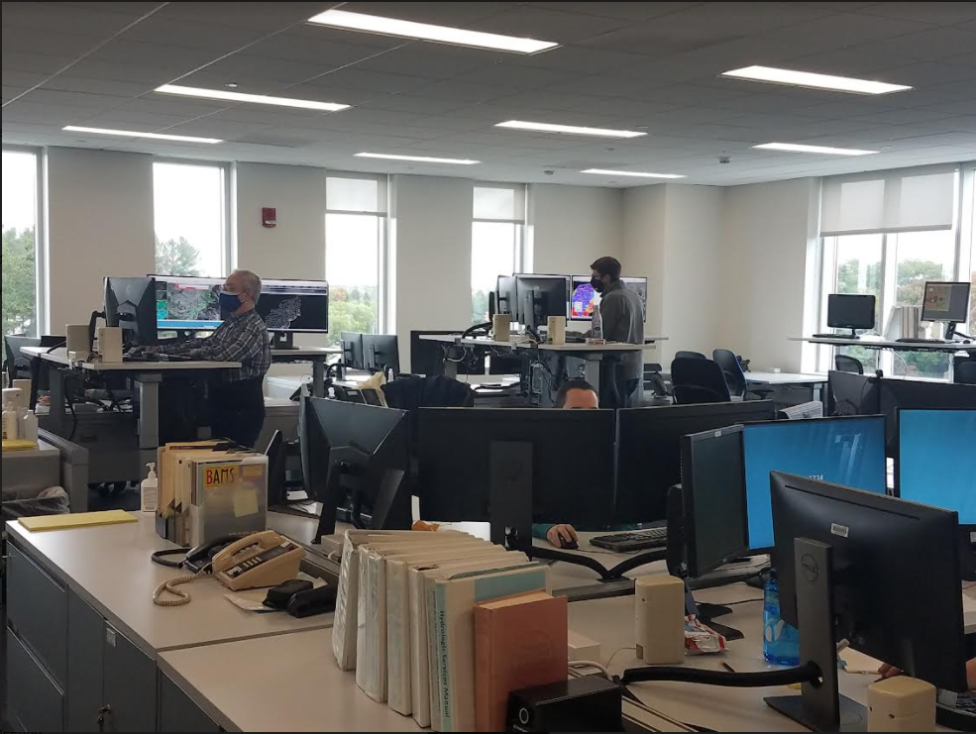
Future of the NWS forecasting class: More “hands-on” activities, enhanced labs

Slide 21
Summary / Conclusions... Benefits of the move to ETEC
Students gain more operational experience for a more well-rounded education.
Faculty can more directly observe operations, interact with forecasters and gain insight into potential research and teaching activities.
Development of a pipeline of “job-ready” new employees for the NWS.
WFO Albany enhances it’s “culture of science” which will continue to be the foundation for forecasts and warnings.

