Slide 1
Characteristics of Enhanced Spectrum Width Layers Within Northeast United States Coastal Winter Storms
Erin Leghart^{1*}, Brian Colle¹, Mariko Oue¹, Edward Luke², Pavlos Kollias^{1,2}
¹ School of Marine and Atmospheric Sciences, Stony Brook University, Stony Brook, NY
² Brookhaven National Laboratory, Upton, NY
*erin.leghart@stonybrook.edu

Slide 2
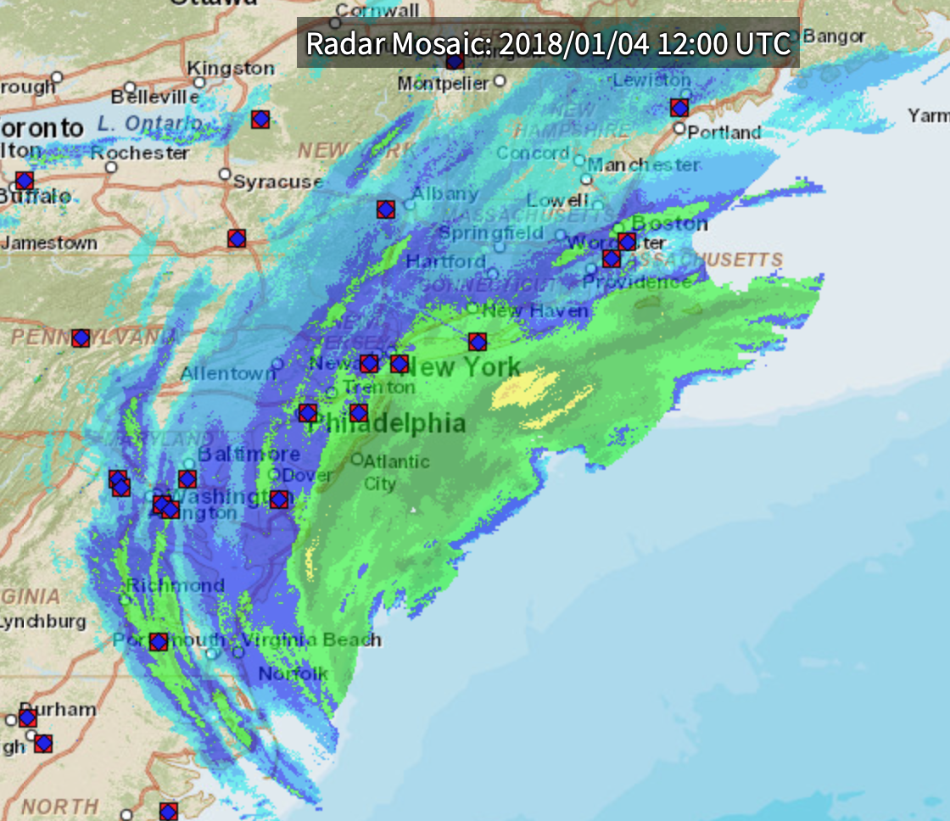
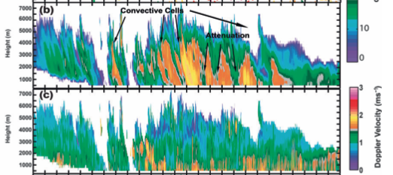
Mesoscale Features within Coastal Winter Storms
https://www.ncei.noaa.gov/maps/radar/
Stark et al. 2013
Observed by KASPR 20180130 - 053845
Notes:
Mesoscale features such as banding, convective cells, and gravity waves have been observed in east coast winter storms
Many of these features have been studied using conventional radars, yet higher resolution radars provide more detail

Slide 3
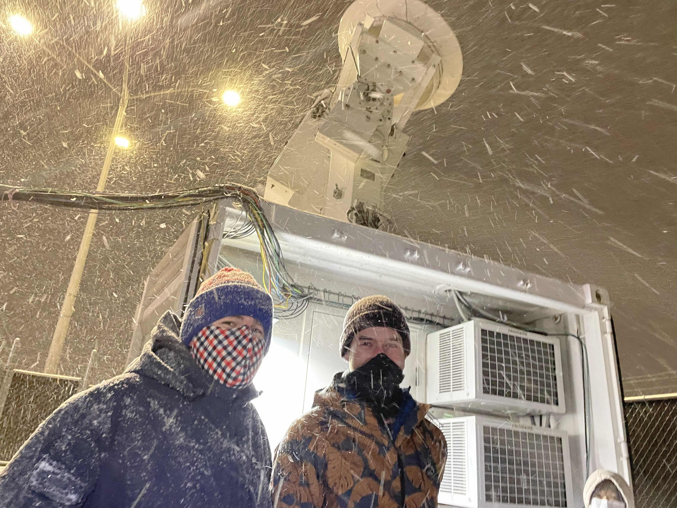
KASPR at Stony Brook Radar Observatory
Ka-band Scanning Polarimetric Radar (KASPR)
Vertical Profiles
15m vertical resolution
1s sampling
RHIs
45m range gate
< 1s sampling
PPIs
35m range gate
< 1s sampling
https://you.stonybrook.edu/radar/
Pavlos Kollias - Twitter https://twitter.com/doppler_fan/status/1356246629649698817
Notes:
As mentioned in my abstract – radars with higher spatial & time resolution allow us to observe these mesoscale structures with greater detail
the radar observatory has a suite of instruments intended for studying winter weather.

Slide 4
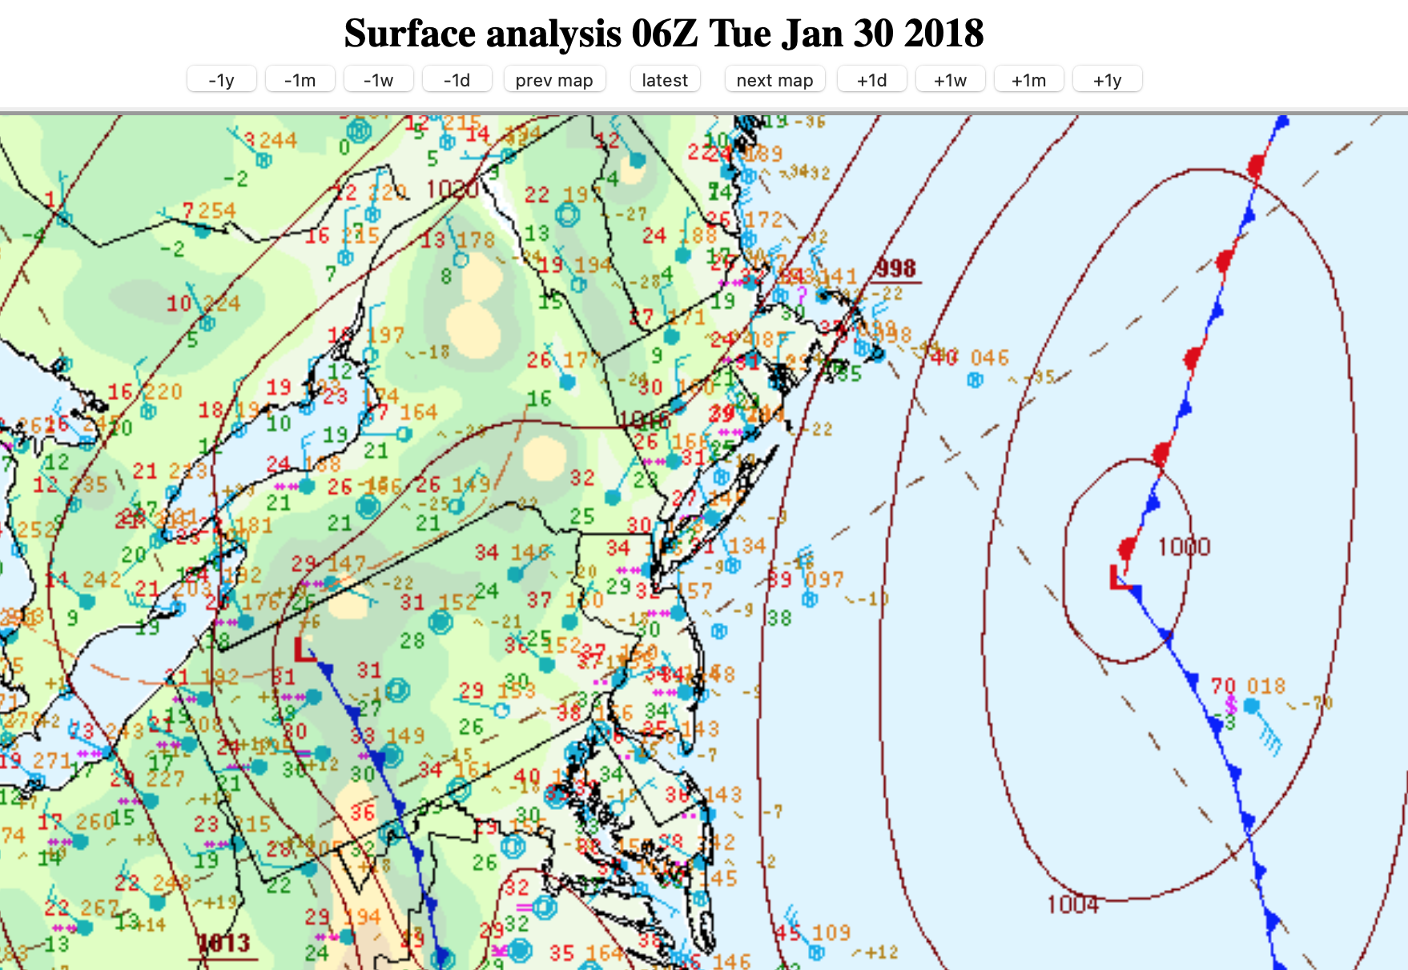
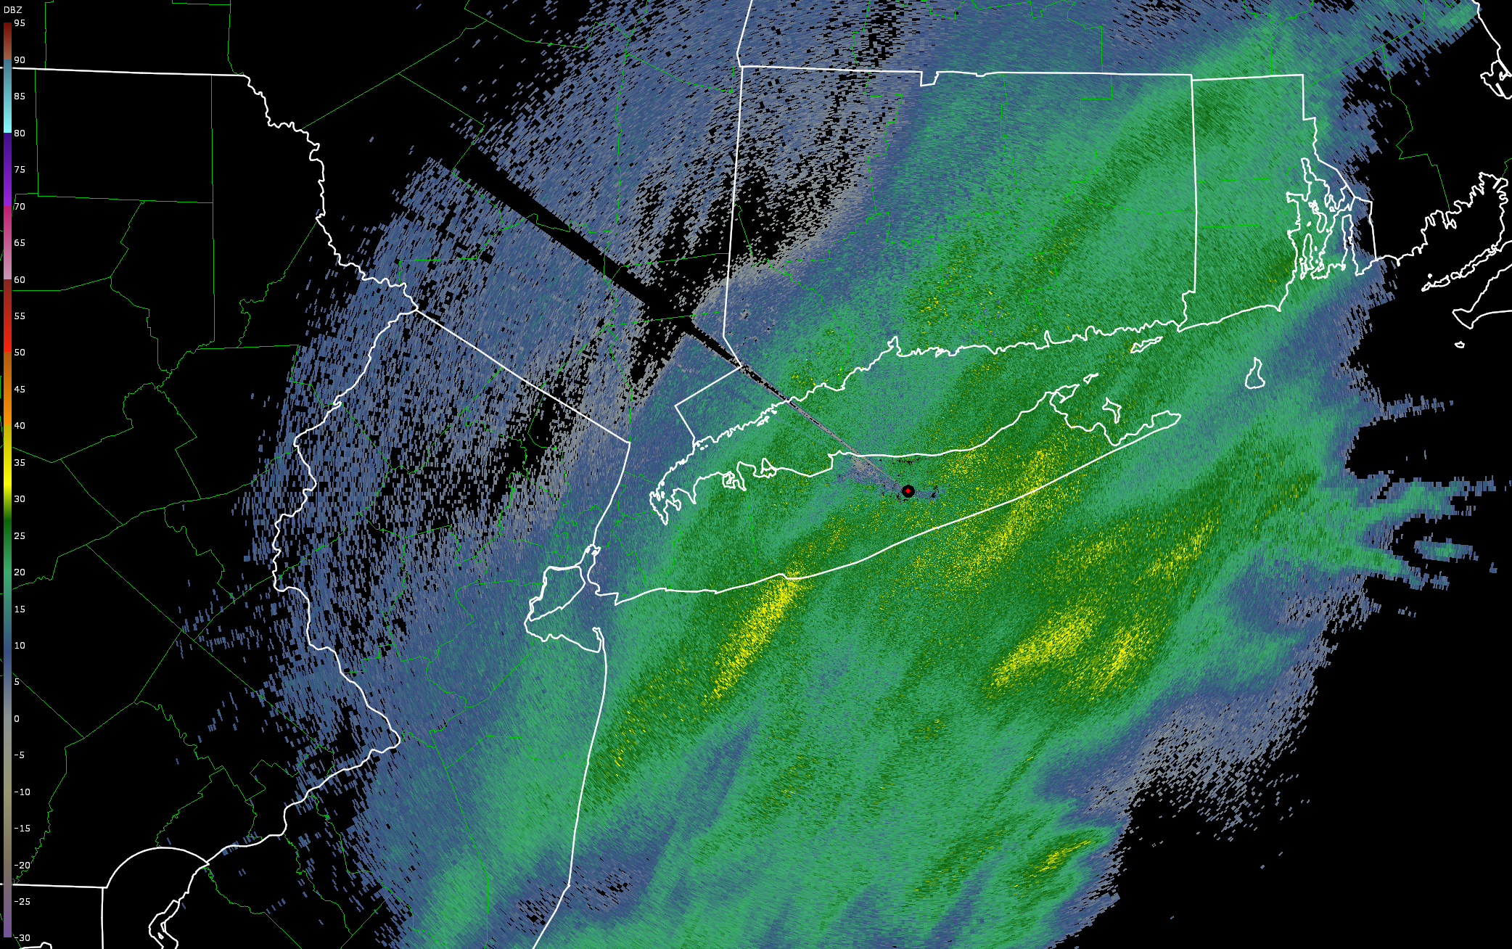
Example Case – January 30, 2018
20180130 – 0559 KOKX 0.5 degree
Courtesy of Kristopher Tuftedal
Notes:
Today I will be showing some output from KASPR, so I want to give a brief synoptic background on a case from Jan 30 2018.
Example figures to follow are ~5:30Z, so I took the 6Z WPC surface analysis
Weakening low pressure center off the mid Atlantic states
Northerly surface flow with subfreezing temperatures
Snow transect through the mid Atlantic into Massachusetts, from South Jersey through Boston

Slide 5
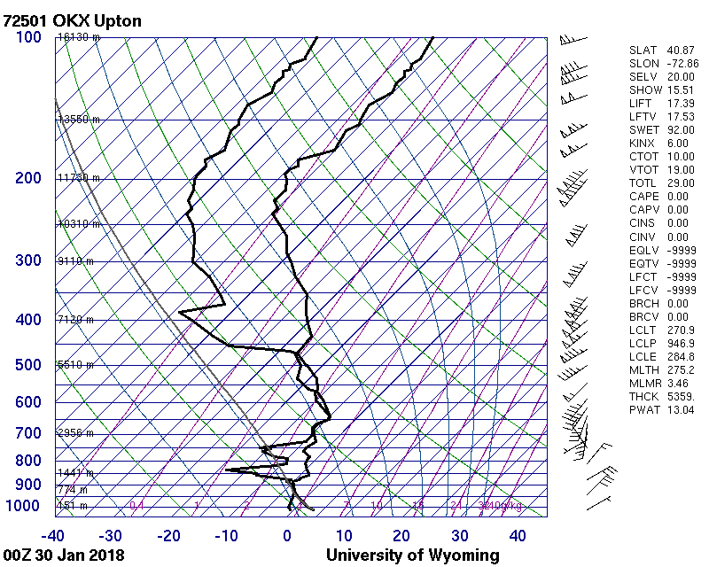
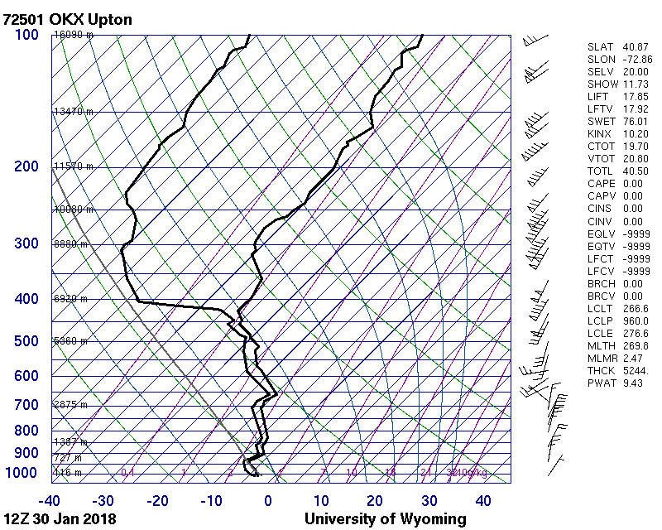
Example Case – January 30, 2018
Notes:
Turbulent mid-levels from 00-12Z
Layering of stable and conditionally unstable layers
The highlighted region is one of of conditional instability throughout the time period, and is a region of interest as I will point out soon

Slide 6
Motivation – Enhanced Spectrum Width (SW) Layers
Notes:
Horizontal nature & wave-like patterns
Varying thicknesses and magnitudes
These layers are interesting – what are producing them?
The origin of these layers are hypothesized to originate from turbulence and microphysical processes, such as riming, aggregation, and secondary ice production.
Combined, these hypothesized origins make these SW layers an important feature for aviation forecasters as both shear and icing pose risks for aircraft

Slide 7
Research Goals
How often are these layers observed?
In which environments are these layers observed?
What are their “basic” characteristics - such as height, thickness, and duration?
What is their relationship to other radar observables, such as reflectivity and mean doppler velocity (MDV)?

Slide 8
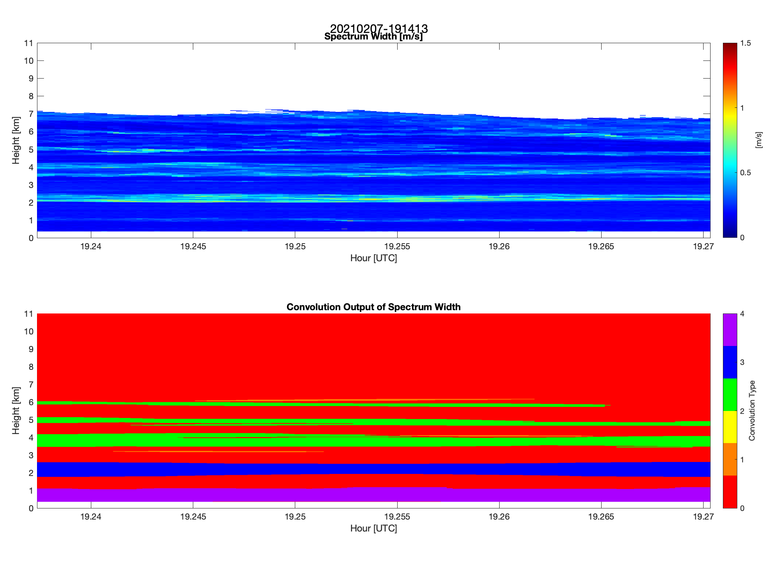
SW Layers
Convolution-based feature recognition applied to SW field
2017-2021 KASPR winter storm dataset:
178+ hours of KASPR vertical profiles
53 individual storms
39,000+ individual SW layers identified
Variables computed:
Layer height, thickness, duration
Layer-mean values
Across-layer differences
Notes:
To study the layers we first need to identify them
Using a convolution-based feature recognitions

Slide 9
Environments of SW Layers – 3 Examples
Within a Wave
Within Reflectivity Gradients
Within a Snow Band

Slide 10
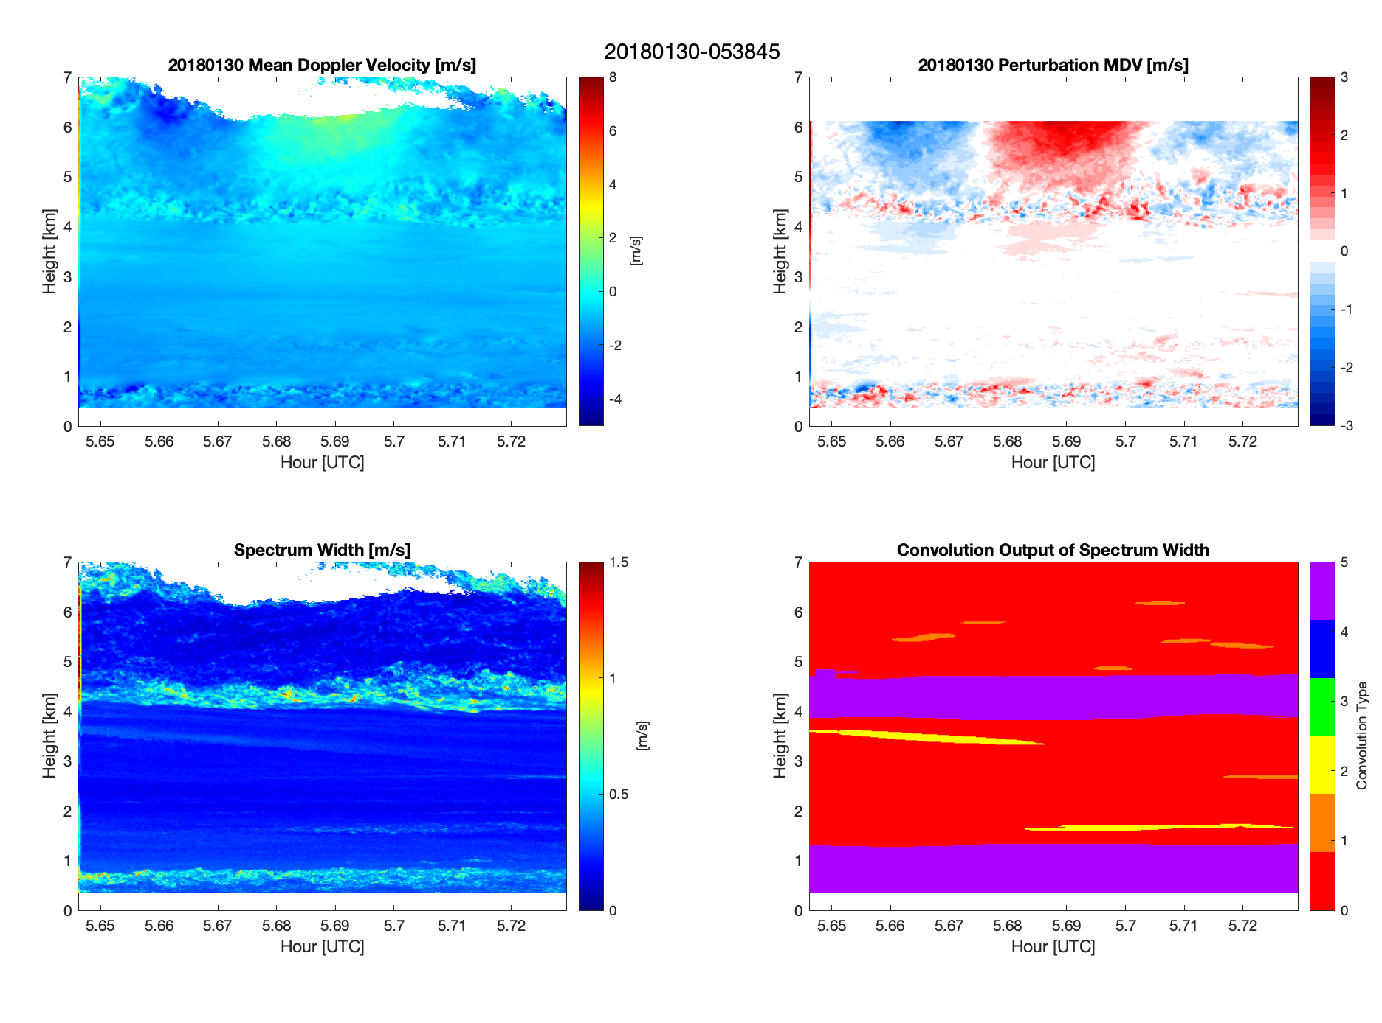
1. SW Layer Within Wave
Gravity wave observed above 4.5km
SW Layer is not influenced by wave motions
Perturbation MDV is produced by removing the average MDV of each (range gate)
To isolate horizontal tendencies
Notes:
Important to note this is vertically pointing – all velocity measurements and thus SW are strictly vertical motions
Left hand side are observed fields – MDV and Spectrum width
RHS is computed properties
See a thick and high magnitude SW layer from 4-5km
Convolution identifies it, as well as a few other weaker layers
This SW layer exists below a gravity wave, seen in the MDV & perturbed velocity
In the Perturbed MDV we see a wave-like structure emerge which penetrates the SW layer without warping its shape

Slide 11
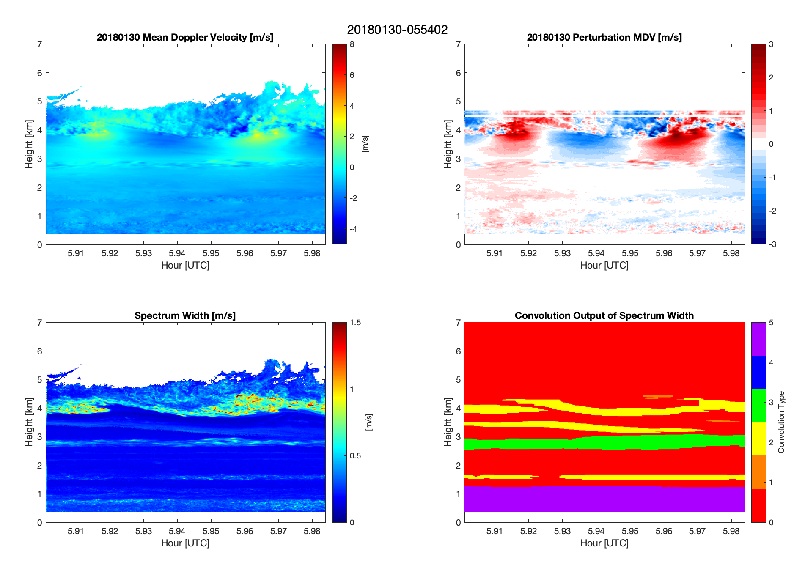
1. SW Layer Within Wave
20 mins after previous figure
Gravity wave descends, and is influenced by secondary wave
SW Layer is influenced by wave motions
Why is this SW layer influenced by the wave motions?
Notes:
Same parameters are the previous figure, but 20 minutes layer
SW layer is not influenced by the wave motions
We see another wave like structure along an interface in the MDV and perturbation velocity. Second wave is of a different wavelength
Is this SW layer being influenced by the original gravity wave, or is it being influenced by the new wave?
A new SW Layer emerges ~3km

Slide 12
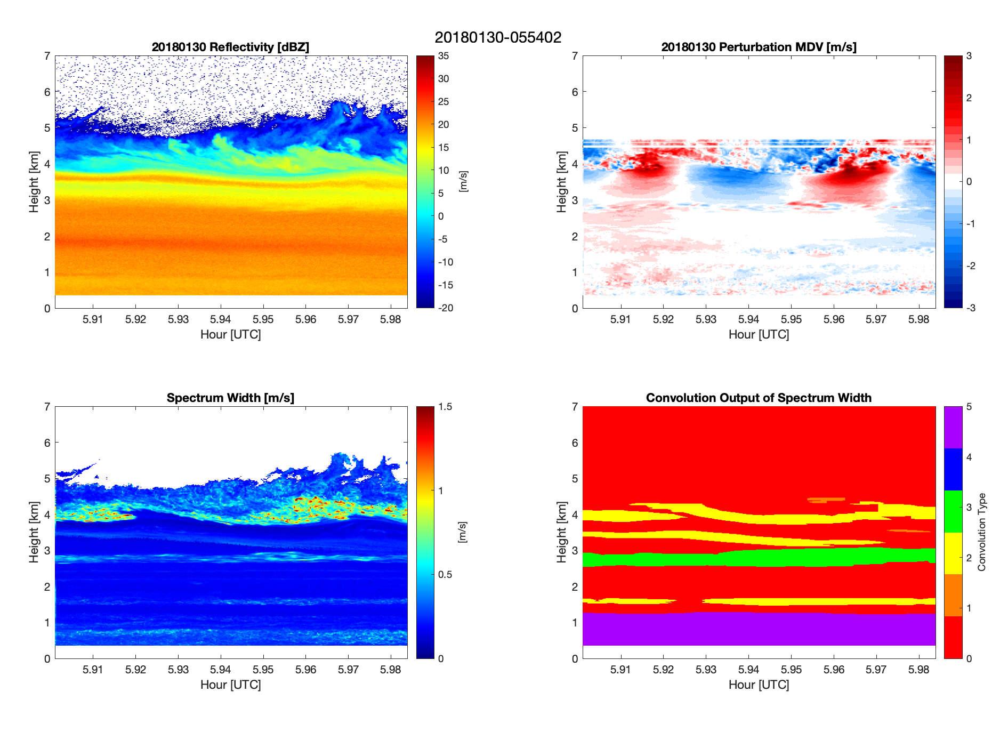
2. SW Layer Within Gradients
Same time as previous figure
SW Layer present in region of reflectivity gradient
~3.7 km
~1.7 km
SW Layers can be indicators of crystal growth/decay processes
Notes:
The second environment type where SW Layers are observed are in regions of reflectivity gradients
See an elevated reflectivity region just below 4km, and a weak SW layer is observed in the same region (thin yellow DESCENDING one)
indicates crystal growth & decay in small vertical region

Slide 13
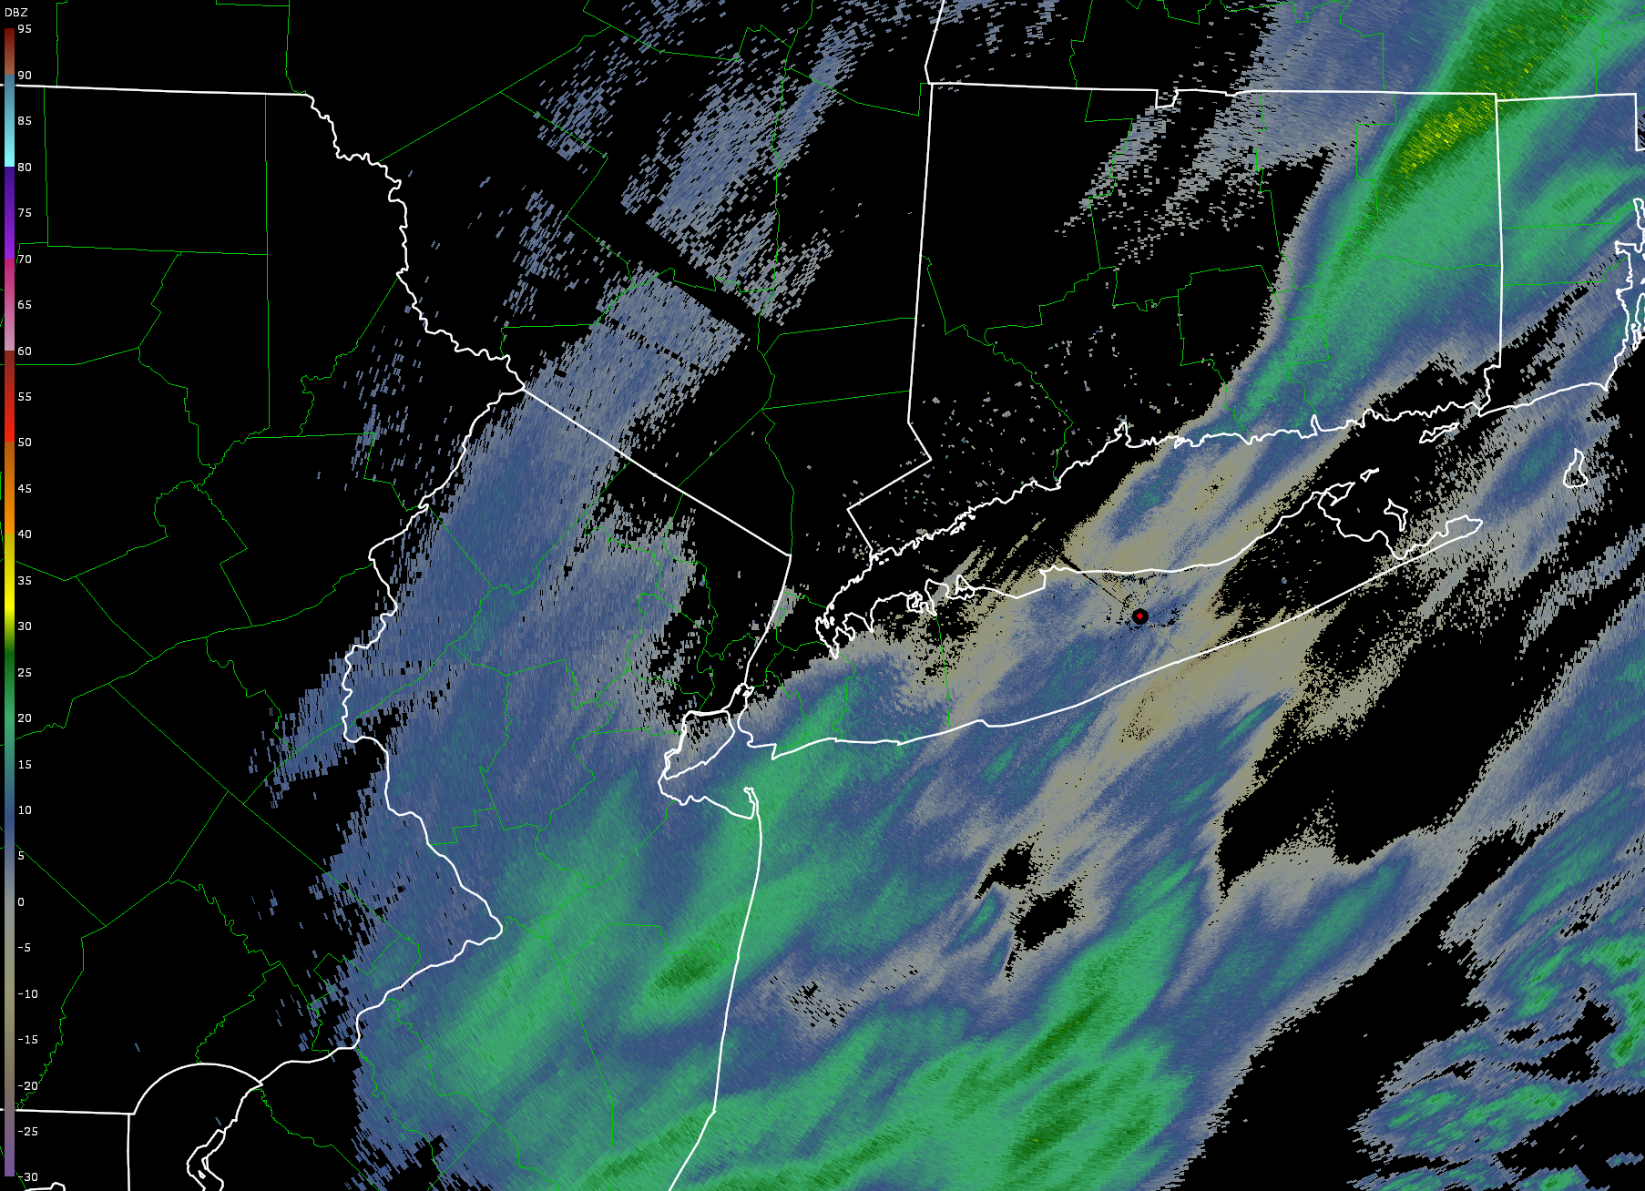
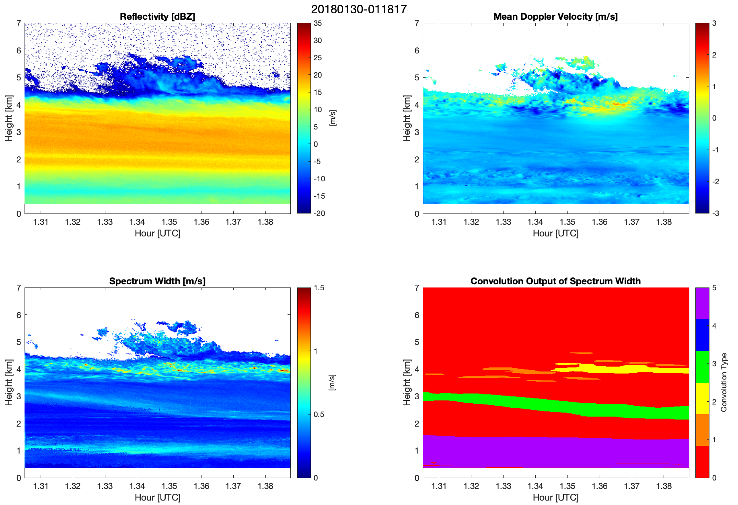
20180130 – 0120 KOKX 0.5 degree
3. SW Layer Within Snow Band
SW layer rapidly descending with time - possible fall streak
Not resolved in the MDV field
No sharp reflectivity gradient (like previous example)
SW field can be used to identify regions of falling crystals
Notes:
This example is from about 4 hours prior to my previous examples
KOKX 0.5 degree PPI - low ref values because of beam being too low near SBU
We see a thick horizontal layer of elevated reflectivity, produced by a band passing over SBU

Slide 14
SW Layer “Climatology”
Remember:
39,000+ individual layers
53 individual storms

Slide 15
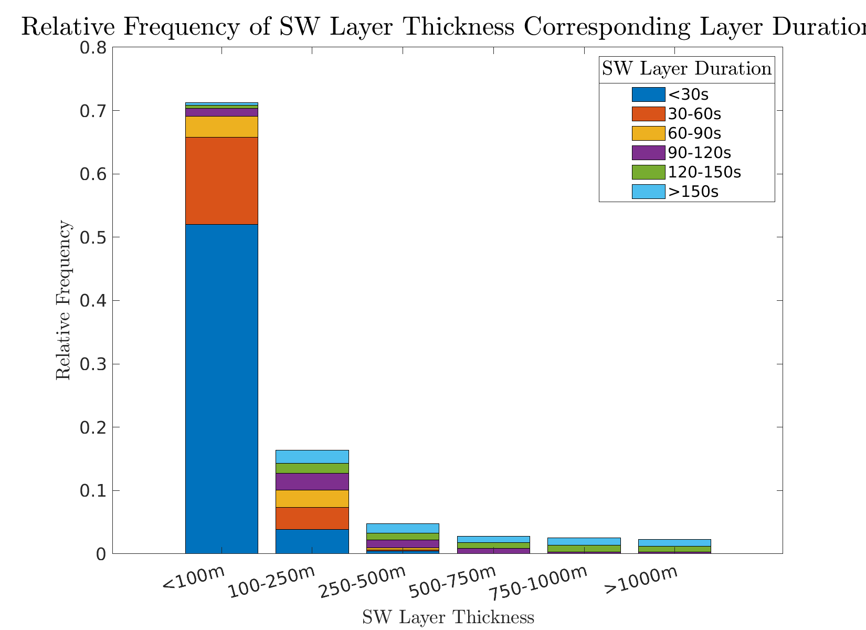
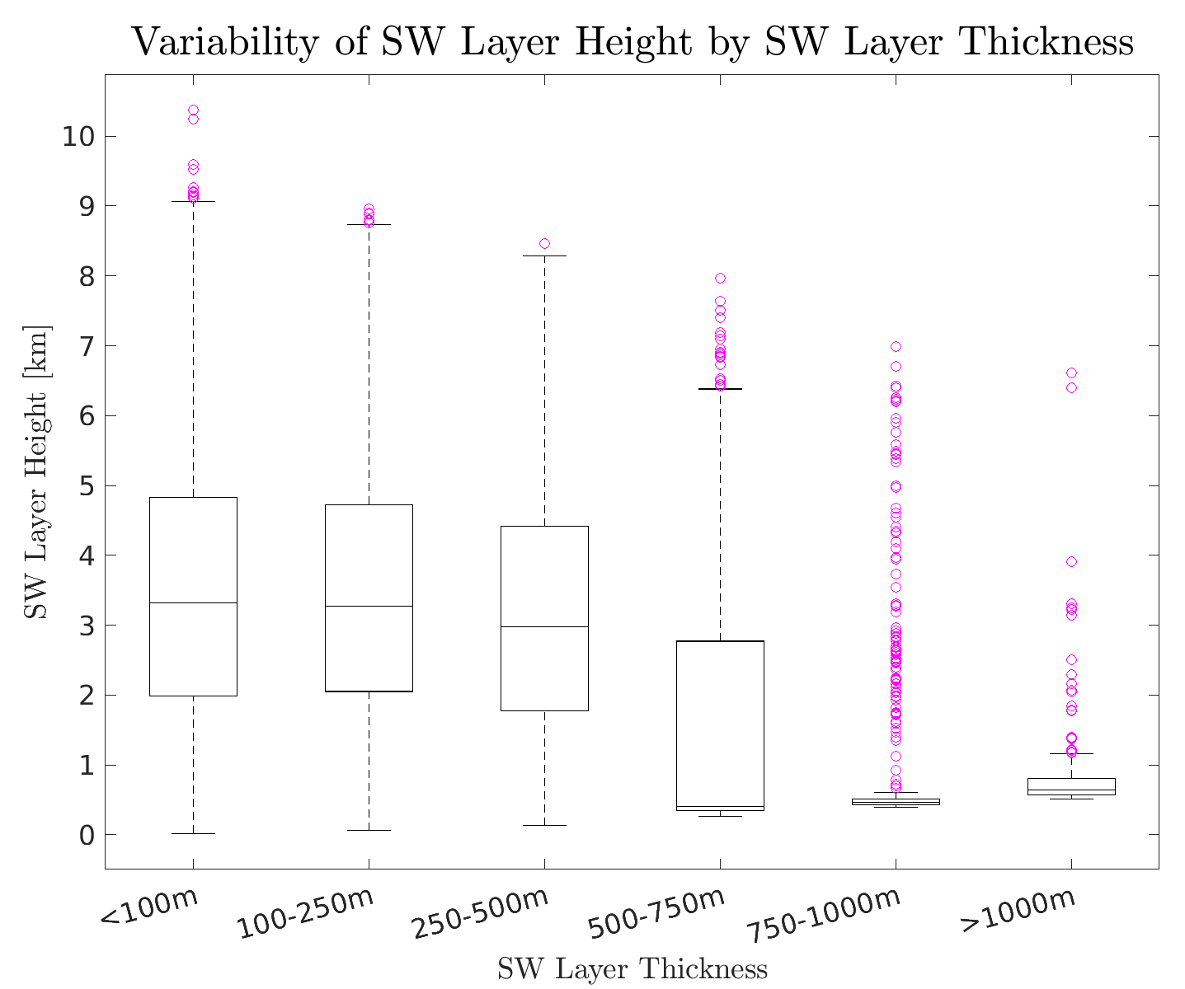
SW Layer Thickness, Duration, and Height
Clear connection between layer thickness and layer duration
70% of all layers are <100m thick
78% of all layers persist for < 60s
Layers are present at all altitudes observed by KASPR
~ 3.25km is median layer height for layers < 500m thick
Thickest layers exist close to the surface
Notes:
Transition from case study to climatology
Just a reminder, this is from our dataset of 39,000 layers
89% of layers > 90s in duration are >250m thick
Thin layers are extremely transient
Thickest layers are very influenced by the surface

Slide 16
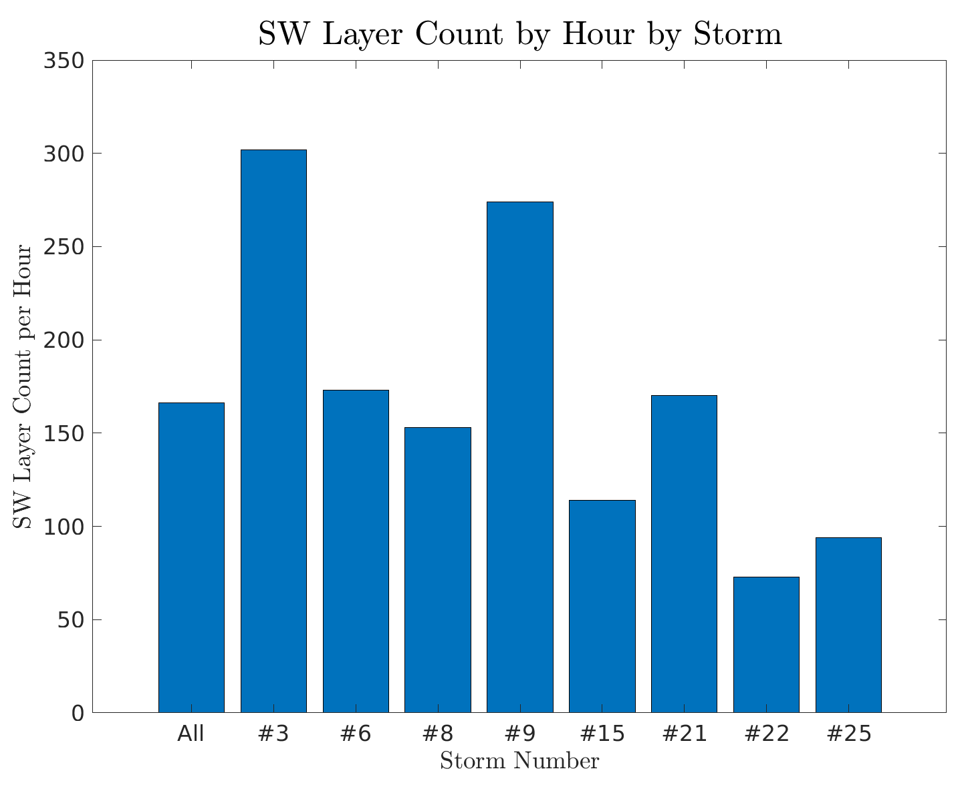
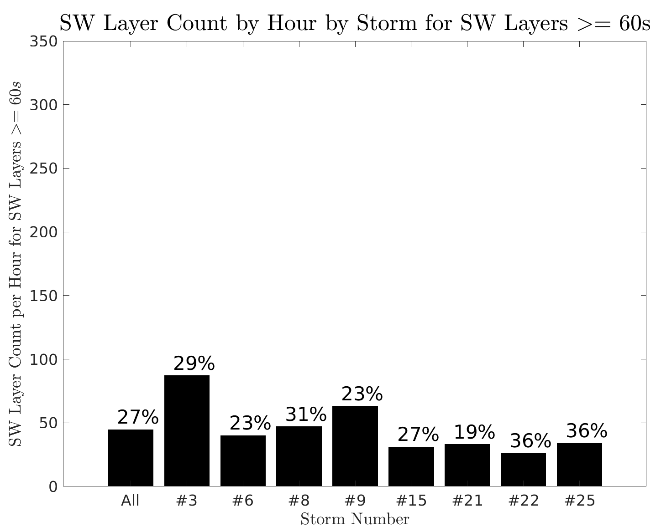
Frequency of SW Layers
The normalized number of layers per hour is variable
The percentage of longer-lived layers (>= 60s) varies for each storm
What processes produce these longer-lived layers, and what microphysical implications do they have?
Notes:
Chose a random sample of 8 storms of the 53 total storms to give an idea of how the lumber of layers varies per storm
RHS is data from the same storm, but shows the percentage of layers which persist for greater than 60s
These layers are transient! In the vertical...

Slide 17
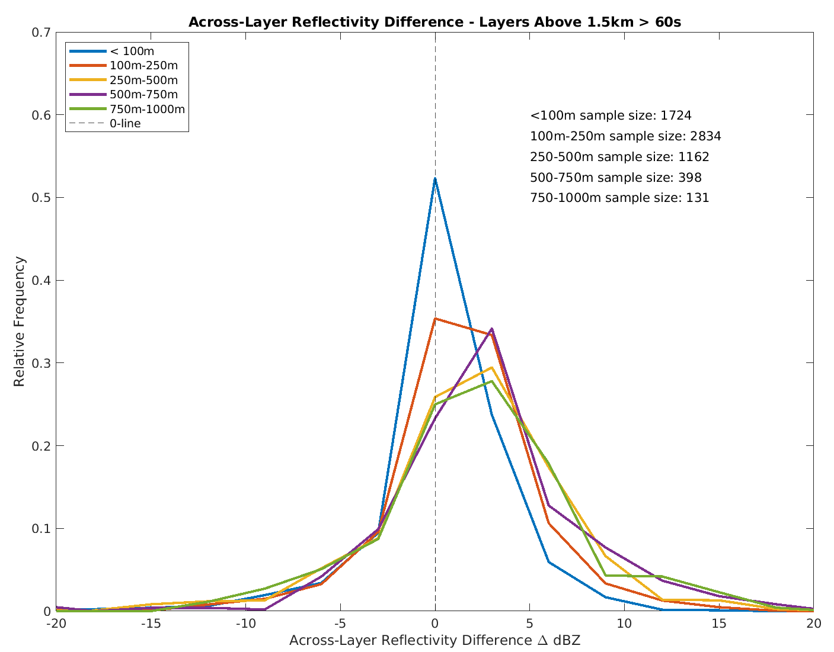
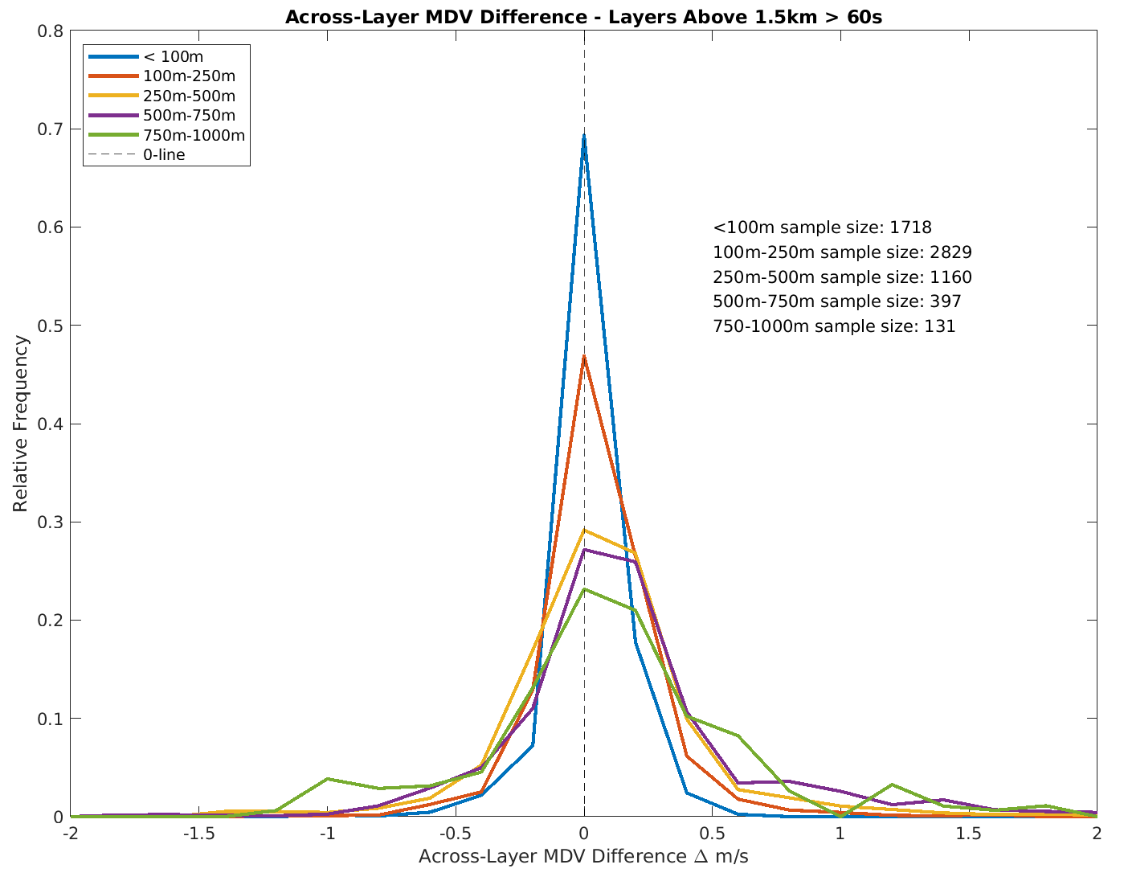
Across-Layer Differences in Reflectivity and MDV
* Positive difference = increasing dBZ towards the surface
* Positive difference = increasing fall speed towards the surface
Thicker layers tend to be found in regions of larger reflectivity differences – particle growth!
Thicker layers tend to be found in regions of larger MDV differences
Notes:
Layers inclined to have positive across-layer reflectivity differences
Layers are also found in regions of decreasing particle size – what processes lead to this?

Slide 18
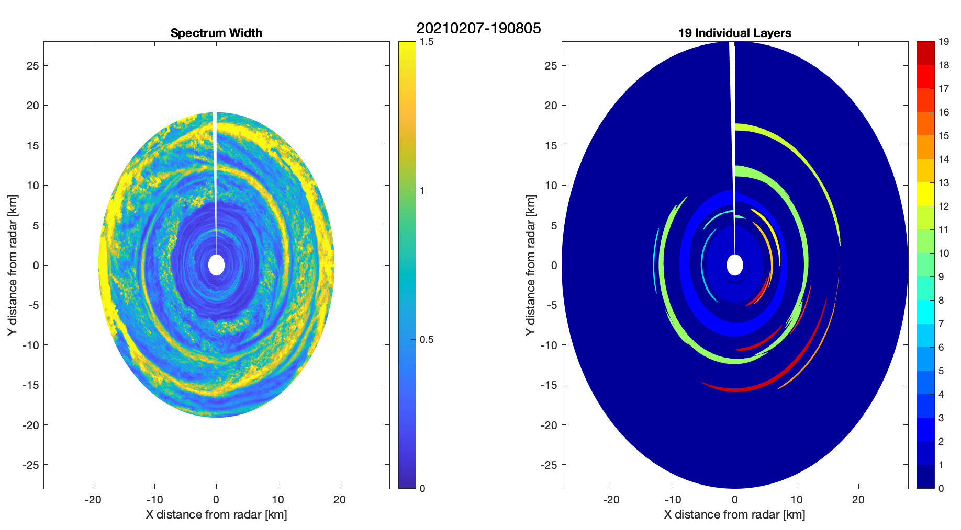
Ongoing Work - SW Layers via PPI
PPI Advantages:
Better understanding of spatial distribution
Non-vertical wind component
Greater SW values
Notes:
In the vertical we are only looking at a tiny fraction of the atmosphere in the column directly above kaspr
In the PPI, we gain much more information on the spatial structure of the layers, as we are able compute each layer’s ‘effective volume’.
This will hopefully yield us more information about the relationships between the layer’s size and the environment it is in and the ice processes it may be representing

Slide 19
Summary
SW layers are frequently observed in east coast winter storms
Hypothesized origins:
Turbulent layers
Regions of ice crystal growth/decay
* SW layers can be a good tool for forecasters – hints at turbulent layers or possible icing!
SW layers are observed in a multitude of environments, and can exist in the presence of other mesoscale features
Majority of SW layers are very thin – less than 100m!
Most of the thickest layers exist close to the surface

Slide 20
Future Work
Investigate prevalence of SW Layers in different regions of ET Cyclones (banding regions, comma head, prefrontal, etc.)
Incorporate sounding data from NWS at Upton, NY and SBU-launched soundings, as well as reanalysis data to investigate temperature, stability, and shear dependencies
DGZ & -15 C region
Sensitivity analysis of the feature-detection algorithm in the PPI space
With IMPACTS 2022 scheduled to be underway in January, we hope to be able to sample these SW Layers with the P3 aircraft

Slide 21
References
Stark, D., Colle, B. A., & Yuter, S. E. (2013). Observed Microphysical Evolution for Two East Coast Winter Storms and the Associated Snow Bands, Monthly Weather Review, 141(6), 2037-2057.

