Slide 1
Ensemble Clustering: Transition to Operations
and Comparison of Clustering Approaches
Brian A. Colle¹, Bill Lamberson^{2,3}, Benjamin Kiel¹, James Nelson²
¹Stony Brook University School of Marine and Atmospheric Sciences
² Weather Prediction Center
³Cooperative Institute for Research in Environmental Sciences (CIRES)
NROW22: 9 November 2021
Funding: NOAA-JTTI and NWS-CSTAR

Slide 2
Fuzzy Clustering Overview
Fuzzy clustering is a way to partition the members of an ensemble into groups of members that have similar forecasts.
Helps forecasters distill ensemble information to help with situational awareness and decision support services.
Clusters based on 100-member GEFS, CMC, and EC ensembles by (1) Determining PCs of the SLP or 500-hPa spread; (2) put all members on PC1 vs PC2 space. Cluster members using fuzzy clustering or K-Means. Calculate other fields using those clusters.
As part of a NOAA-JTTI, the Weather Prediction Center (WPC) is running clustering operationally using the 500 hPa height spread to generate PC1 and 2 phase space at both 00 and 12 UTC.

Slide 3
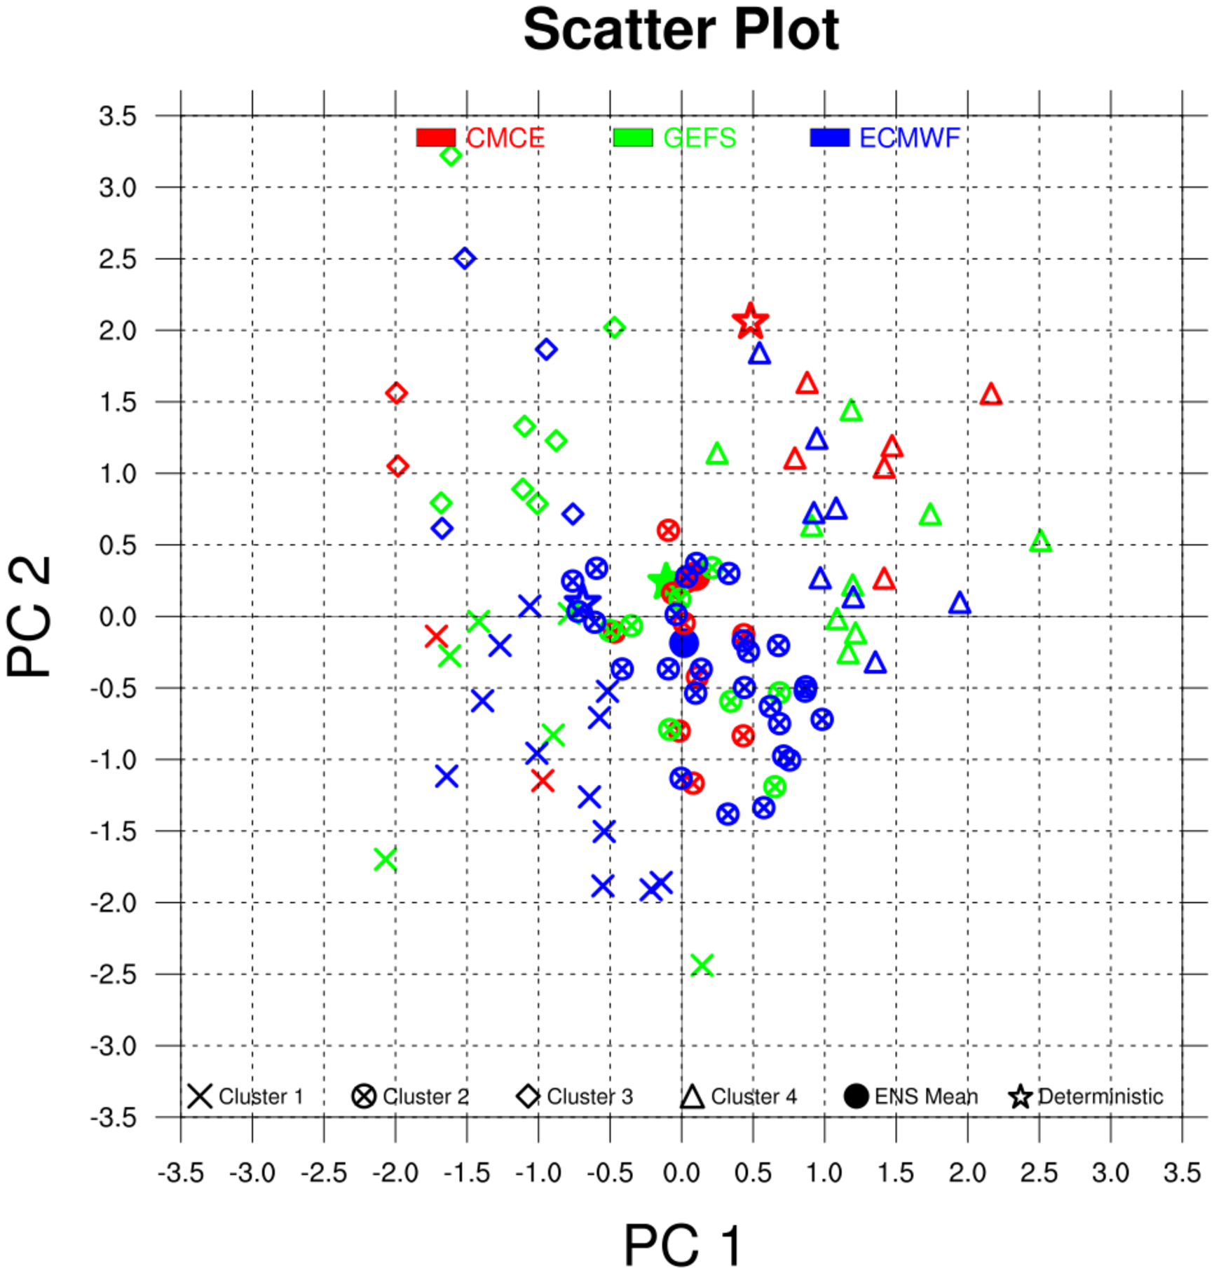
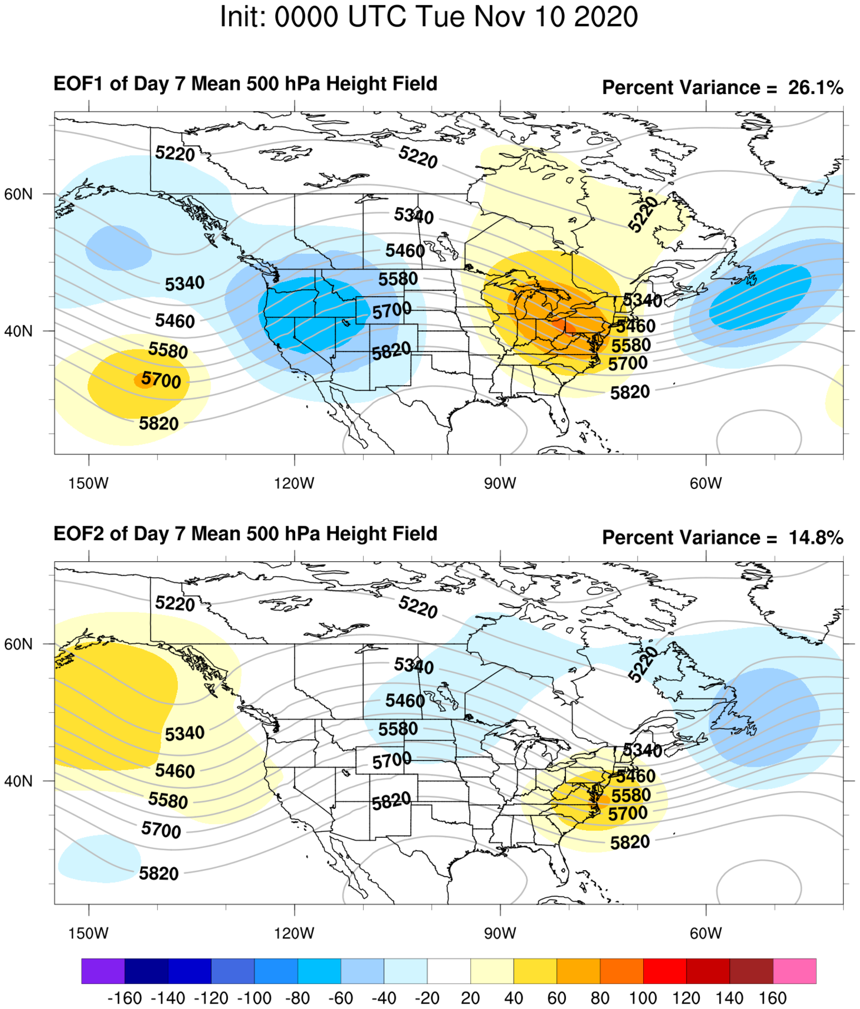
Example Day 7 Clusters: Phase Space
EOF1: East-west differences in location of pattern.
EOF2: Differences in amplitude of pattern.
Less Amplified Pattern
Pattern Shifted West
Pattern Shifted East
More Amplified Pattern

Slide 4
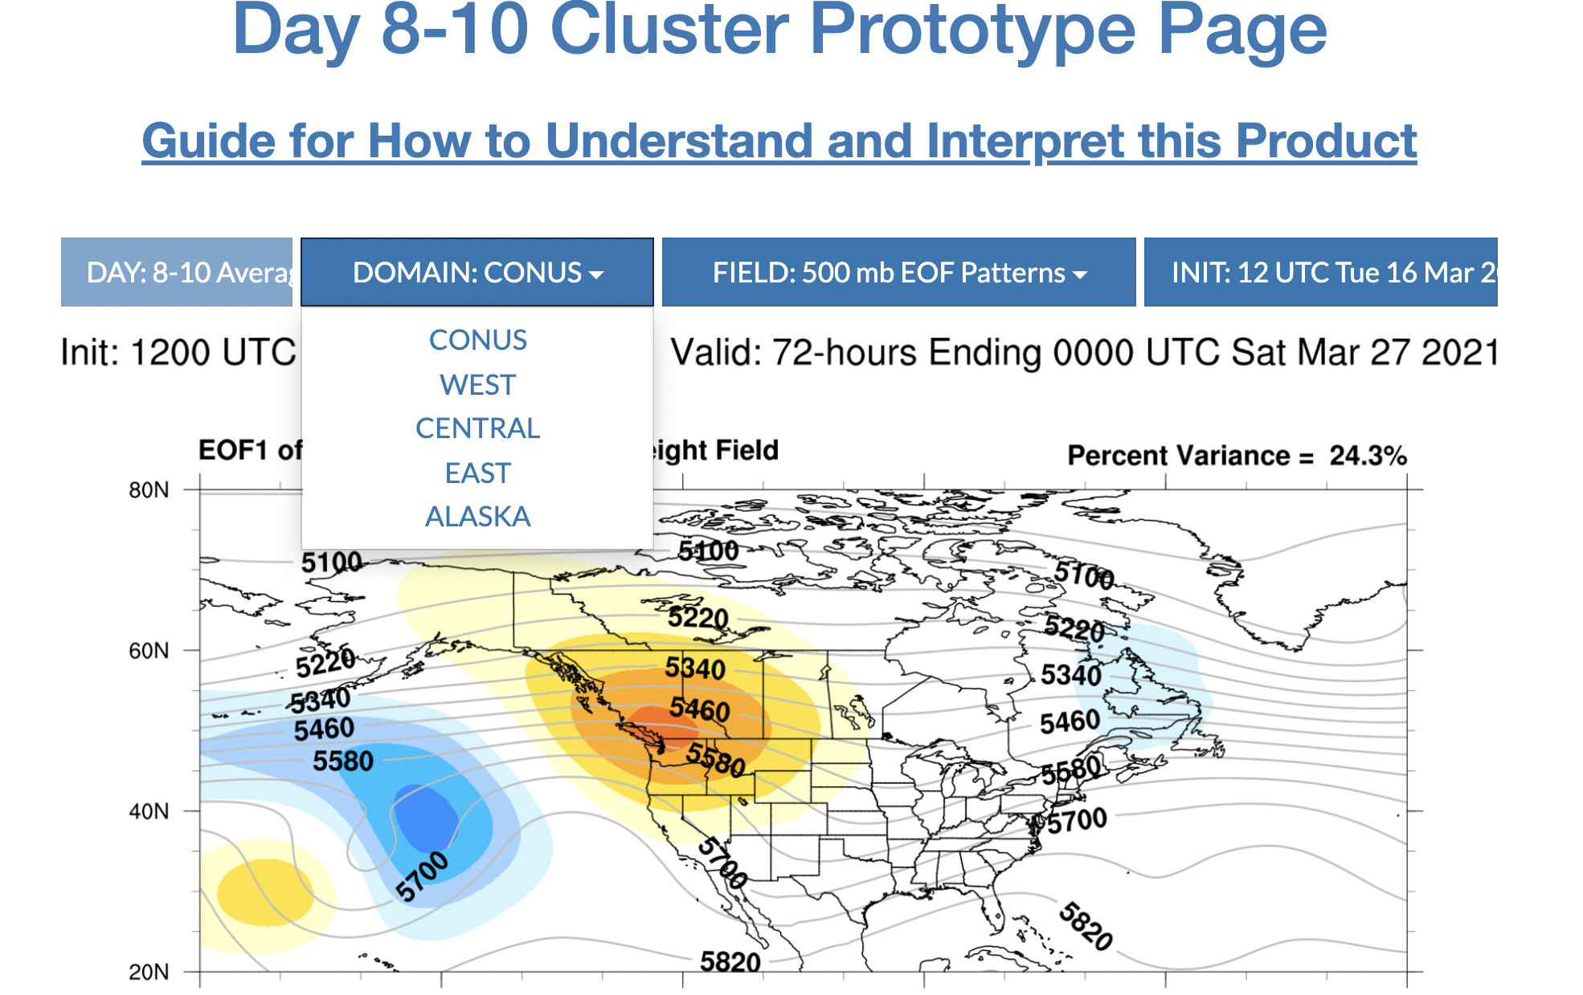
WPC Clustering Web Page
Day 3-7: Cluster Prototype Page (Max temp, Min Temp, QPF;
→ and currently testing SLP, 500Z, 10-m max wind):
https://origin.wpc.ncep.noaa.gov/wpc_ensemble_clusters/day_3_7/view.php
Day 8-10 Cluster Prototype Page (Max temp, Min temp, QPF):
https://origin.wpc.ncep.noaa.gov/wpc_ensemble_clusters/day_8_10/view.php

Slide 5
WPC’s Fuzzy Clustering and SBU Research
* Clusters support WPC’s Extended Range Forecast Experiment (ERFE)
* WPC Hydrometeorological Developers are training staff on use of Fuzzy Cluster
Weekly sessions with forecasters
Special Briefings on Impact Events
* One example case is highlighted below.
* Exploration of different clustering approaches and impact of using SLP clusters on other fields and using day 7 clusters on day 3. (MS Thesis work)

Slide 6
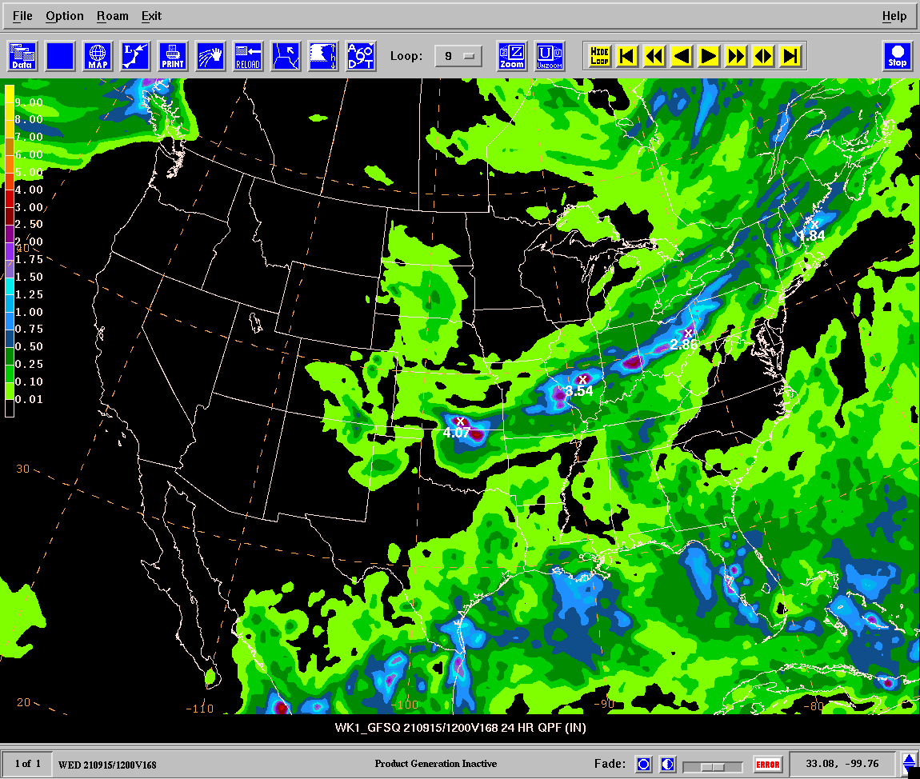
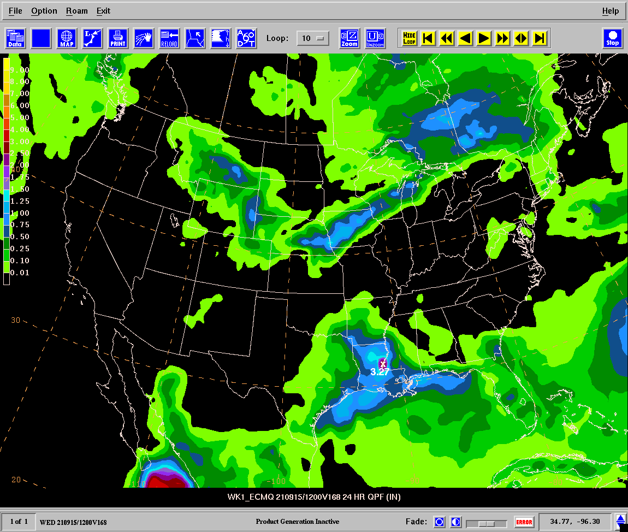
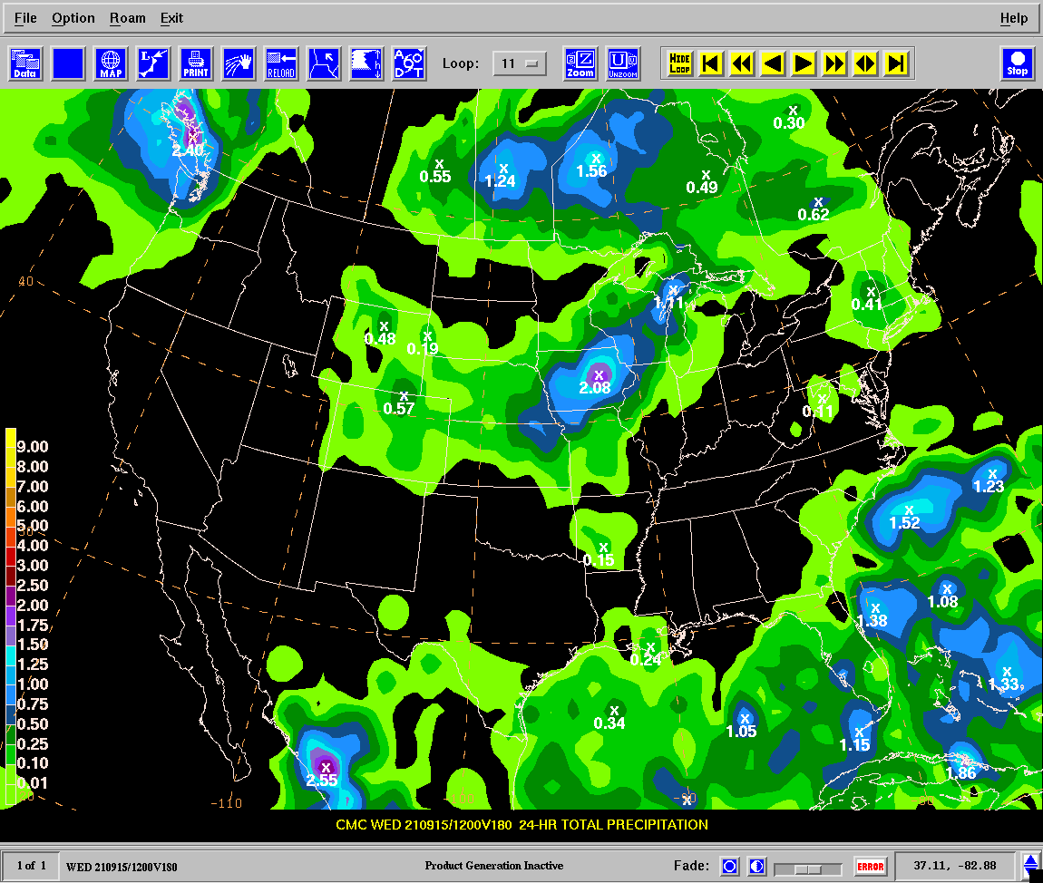
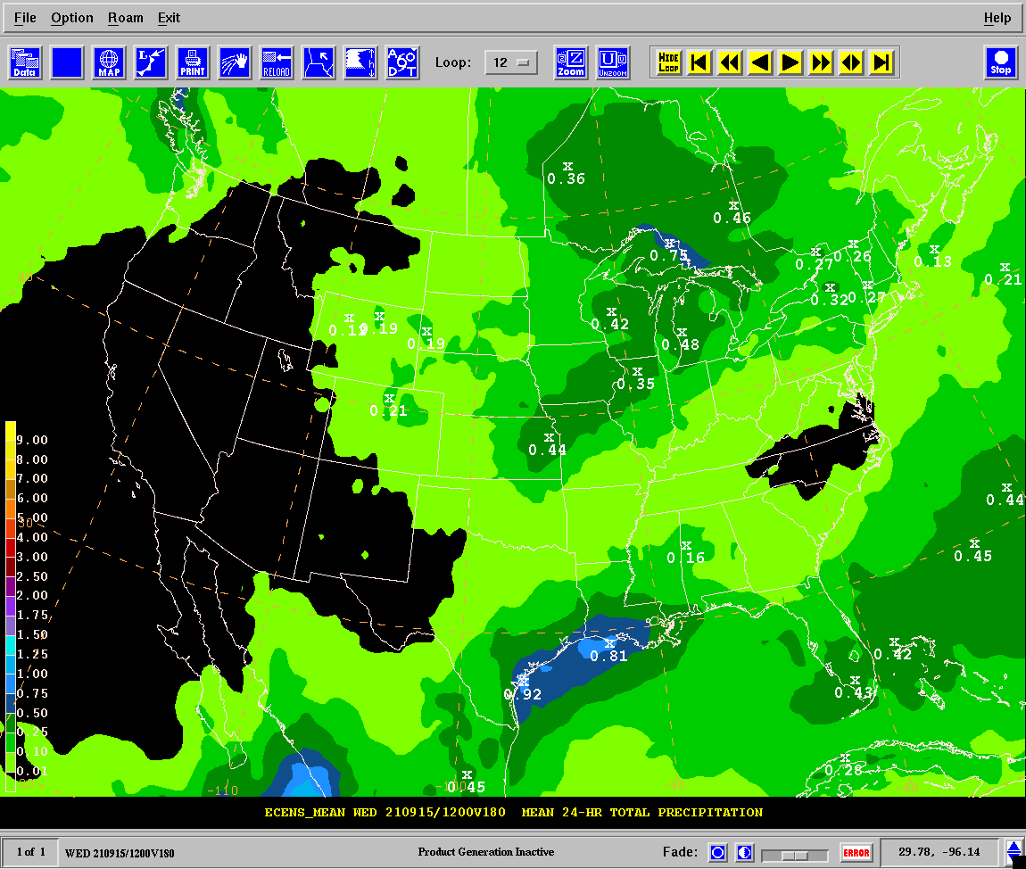
ERFE Hazards Guidance
Wednesday, September 8, 2021
Day 7 Model QPF
GFS shows a signal near Florida coast
Subtle differences over Midwest
GFS Day 7
24-hr QPF
12Z September 8, 2021
ECMWF Day 7
24-hr QPF
12Z September 8, 2021
CMC Day 7
24-hr QPF
12Z September 8, 2021
ECENS Day 7
24-hr QPF
12Z September 8, 2021

Slide 7
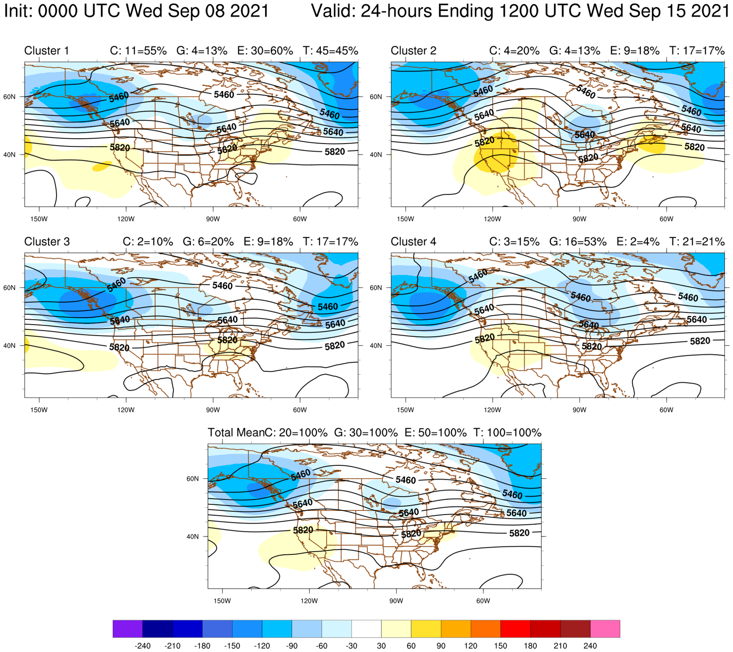
Day 7 Clusters 500 hPa Heights
Diverse solutions in the northern stream will influence convection over central U.S. and QPF along the Gulf Coast
Cluster 500 hPa heights (contours) and anomaly from CFSR climo (shaded in meters)

Slide 8
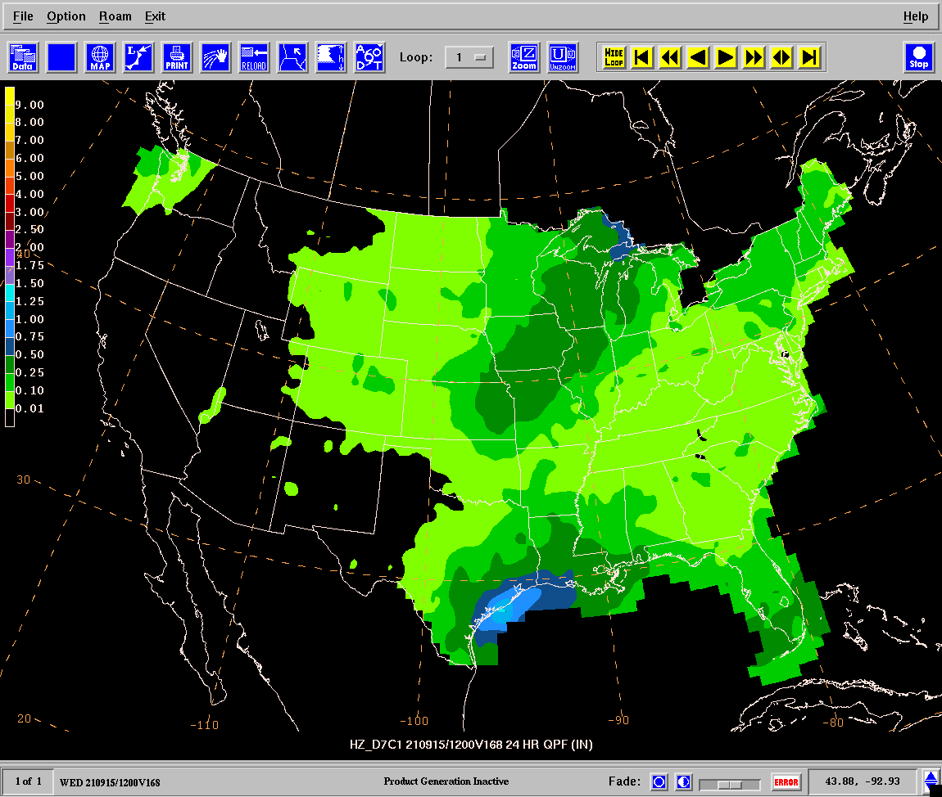
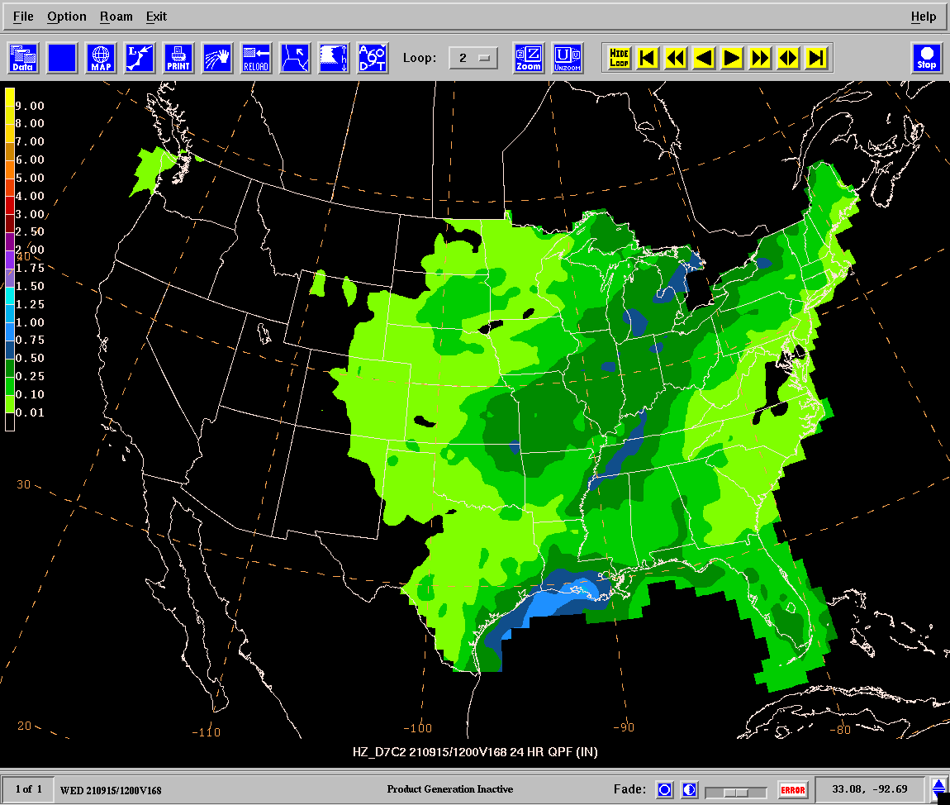
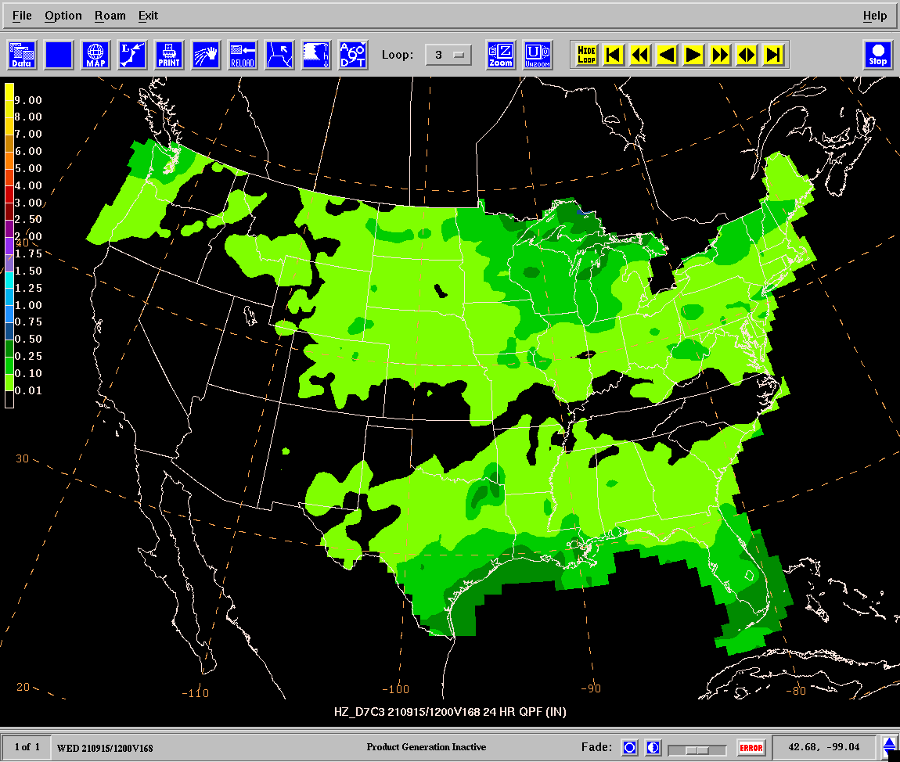
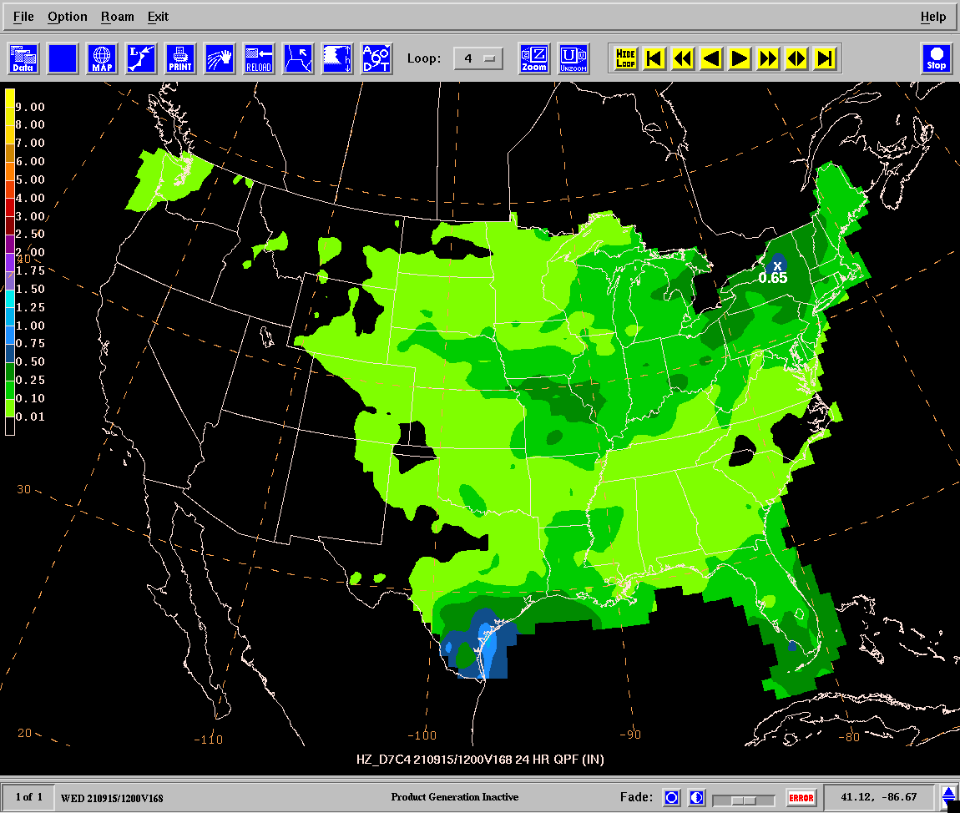
Cluster 1 Day 7
24-hr QPF
12Z September 8, 2021
Cluster 2 Day 7
24-hr QPF
12Z September 8, 2021
Day 7 QPF Clusters
Cluster 3 Day 7
24-hr QPF
12Z September 8, 2021
Cluster 4 Day 7
24-hr QPF
12Z September 8, 2021

Slide 9
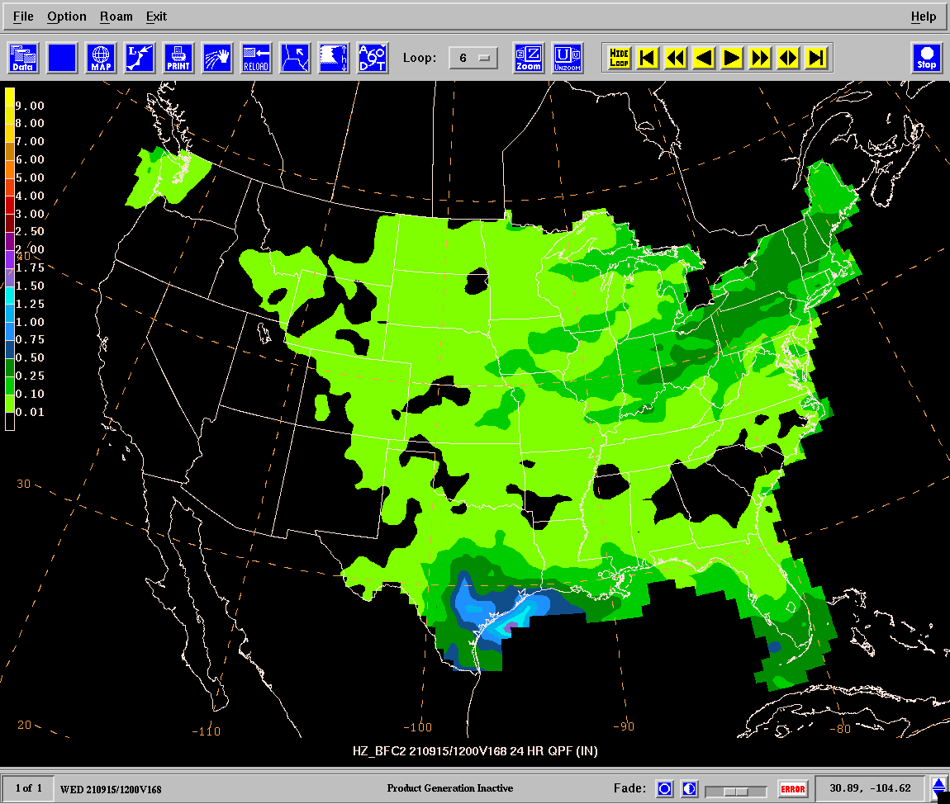
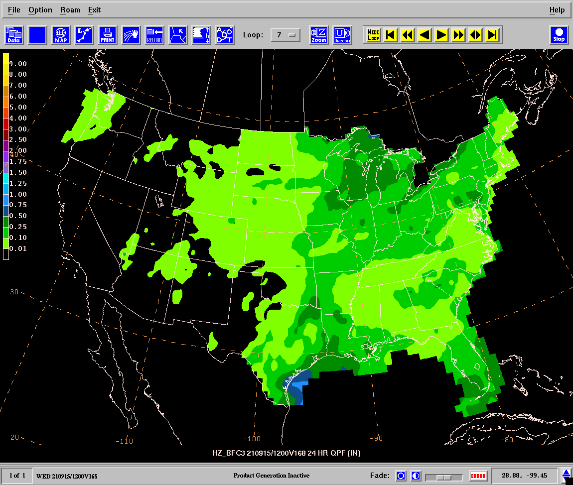
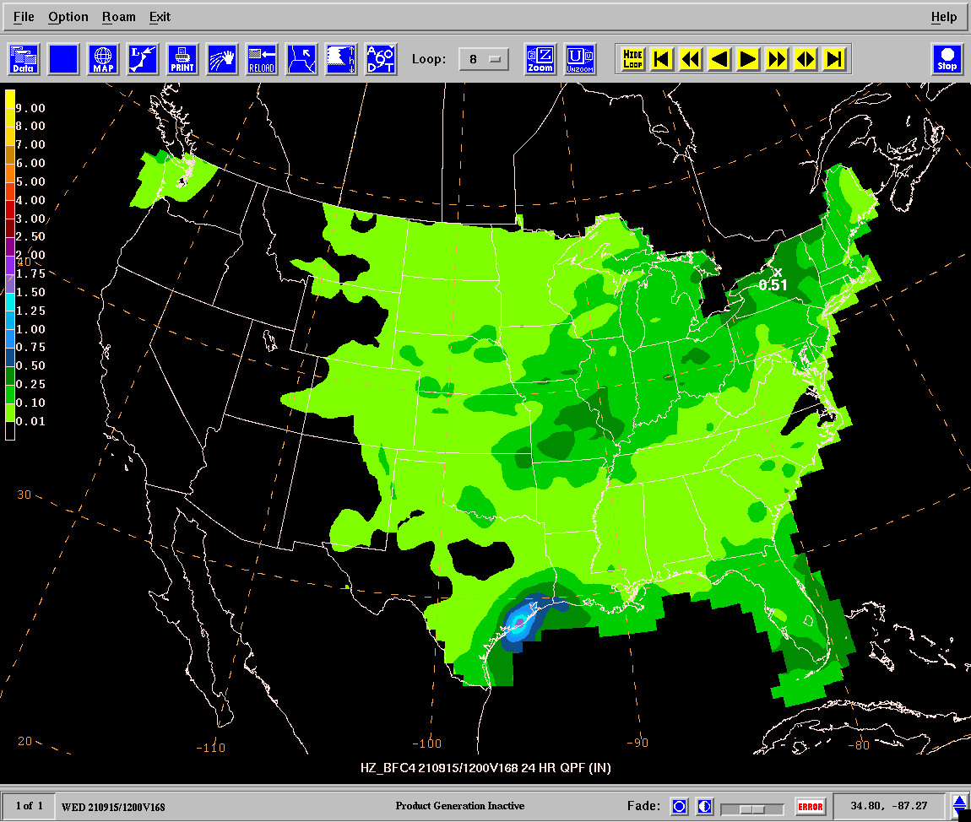
Day 4 Cluster Membership Propagated Through Day 5-7 to Make “Butterfly” Clusters
Butterfly 1 Day 7
24-hr QPF
12Z September 8, 2021
Butterfly 2 Day 7
24-hr QPF
12Z September 8, 2021
More northern tier diversity than standard clusters
Cluster 1 heavily ECENS loaded
Butterfly 3 Day 7
24-hr QPF
12Z September 8, 2021
Butterfly 4 Day 7
24-hr QPF
12Z September 8, 2021

Slide 10
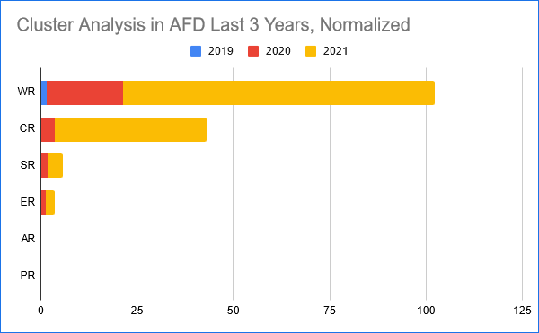
Cluster Analysis in WFO AFDs and Comments
* ”I agree with many on the call that this tool provides some really useful insight into our 100+ ensemble model simulations in the long range. And, it's a great complementary tool to the NBM that allows us to be able to think dynamically while also forecasting statistically." - John Ten Hoeve, Deputy Director Office of Organizational Excellence
* “Thank you for all you have done with developing the clusters. They have been the catalyst to really get Western Region forecasters to think more probabilistically” - Matt Jeglum, Deputy Chief Science and Technology Infusion Division Western Region
* "So many people are using clusters. In the NWA conference Weather Analysis and Forecasting Master Class yesterday, it was the main focus (like I already told you) and many of the participants said they knew about them and had been using them. And just now another talk brought them up and how useful they are in the probabilistic world for forecasting."- Sarah Trojniak on the ubiquity of the clusters at this year's NWA
Number of Mentions of “cluster analysis” in AFDs normalized by Number Offices for each Region
Plot Courtesy: Eric Allen and Jeff W at ER

Slide 11
Testing Other Clustering Phase Spaces
Two Principal Component (2PC): Each grid point is defined as a dimension. Each ensemble member is defined as a variable. The dataset is realigned along the axis of greatest variance, and the coordinates of the first two dimensions of this new axis (PC1, PC2) are extracted for each model member.
Weighted Principal Component (WPC): Same as 2PC but use the number of PCs deemed significant by the North et. al. rule of thumb.
Euclidean: Ensemble member parameter data converted to vectors and plugged into clustering algorithms directly. – ** Least skillful approach (not shown)
Intensity Displacement (IDISP): We define one intensity dimension and two location dimensions for each ensemble member.
For MSLP, the cluster space is defined by pressure minimum, N/S location of pressure minimum, E/W location of pressure minimum.
For APCP, the cluster space is defined by the average of all nonzero precipitation points, N/S location of precipitation center of mass, and E/W location of center of mass.

Slide 12
“Case Example” VT: 0000 UTC 30 December 2012 IT: 0000 UTC 27 December 2012. (72-h or Three-Day Lead Time) (90 Member Ensemble, ECMWF (50) GEFS (20) CMC (20)
NCEP Analysis/ 500 hPa Heights
72 h Ensemble Mean /Spread
NE Cyclone
SW Cyclone
L
L
500 hPa Heights
Spread:

Slide 13
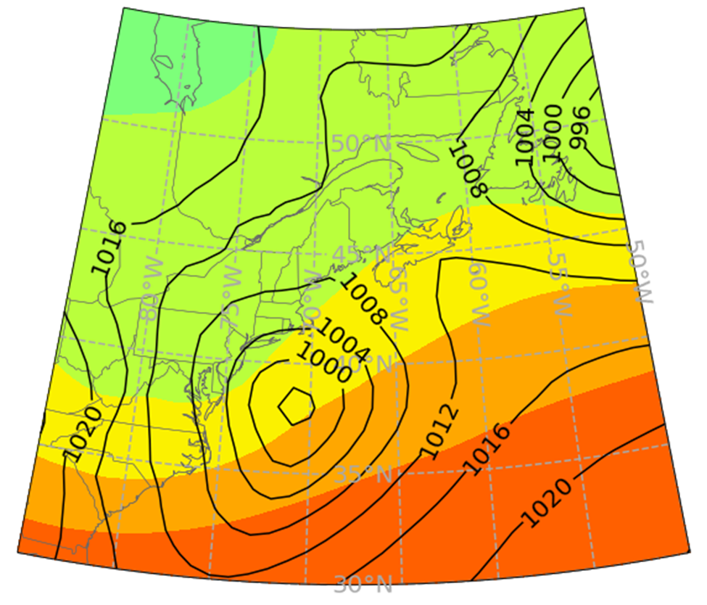
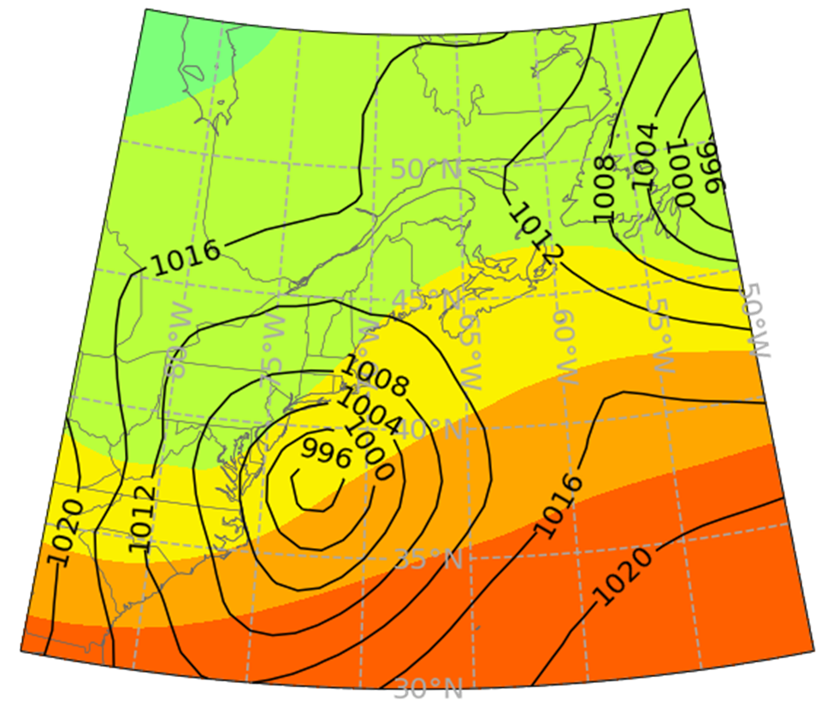
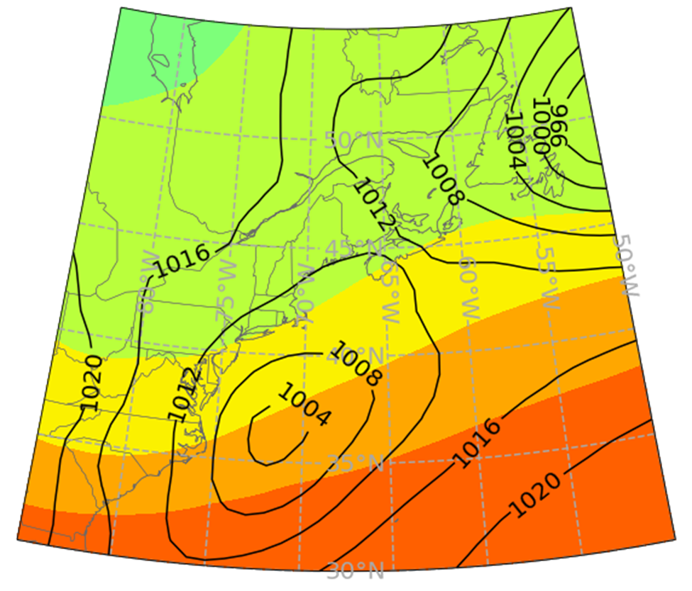
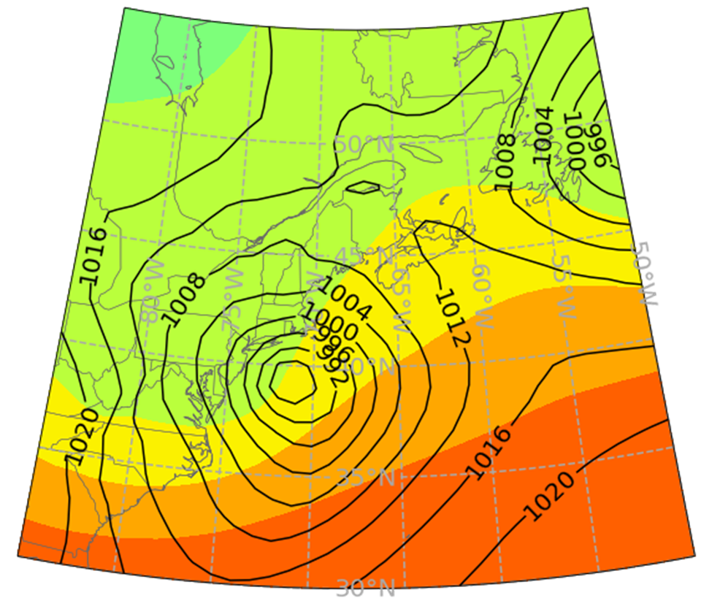
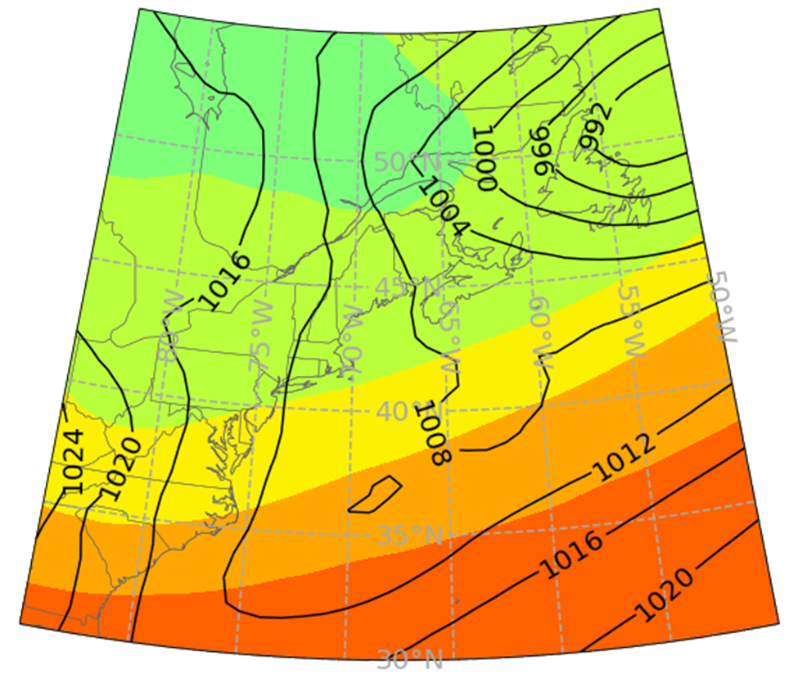
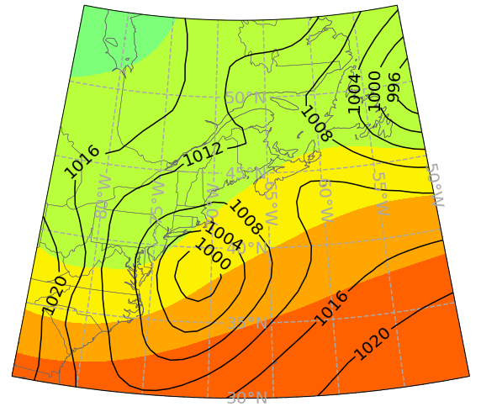
Scenario 1:
Scenario 2:
Scenario 3:
Resulting MSLP scenarios of fuzzy clustering of 2PC space and ensemble mean. (in hPa)
Scenario 4:
Scenario 5:
Ensemble Mean:
Notes:
fzc

Slide 14
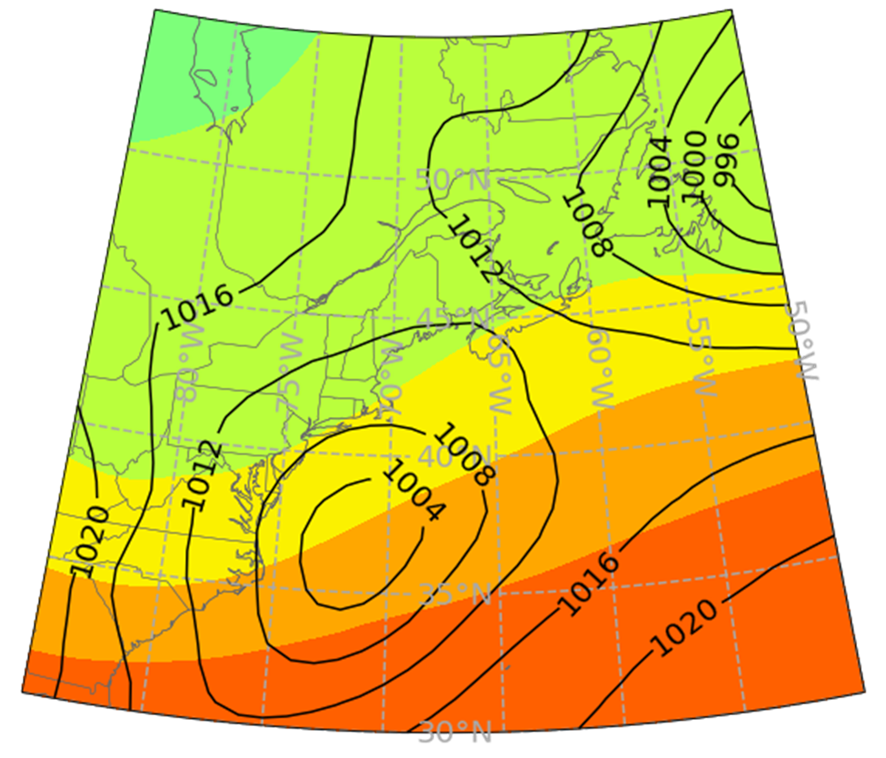
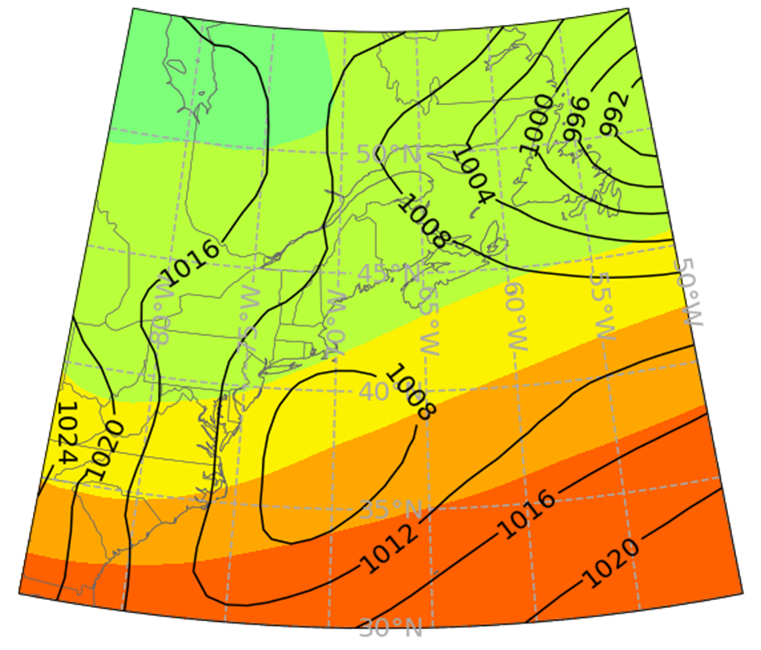
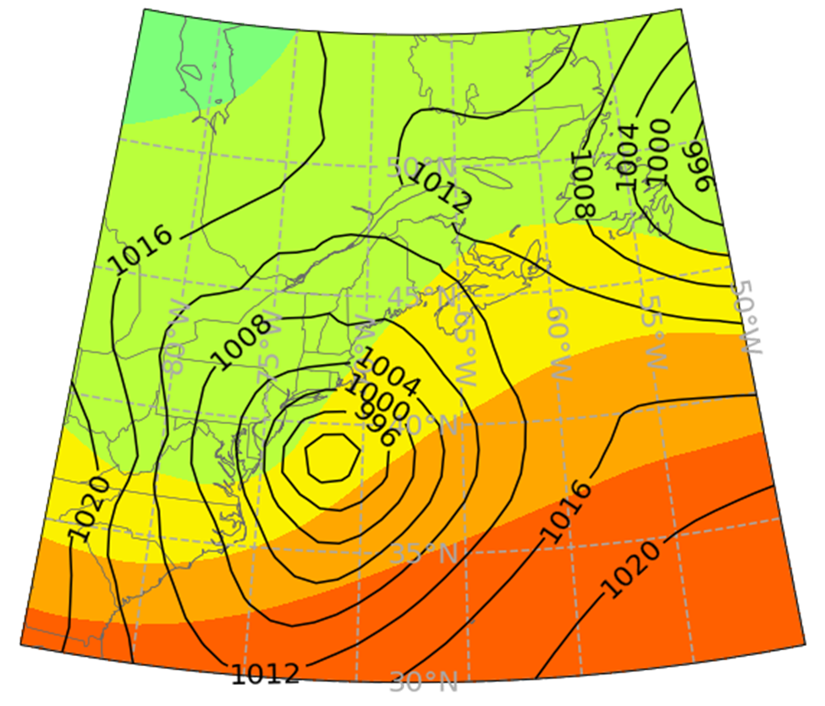
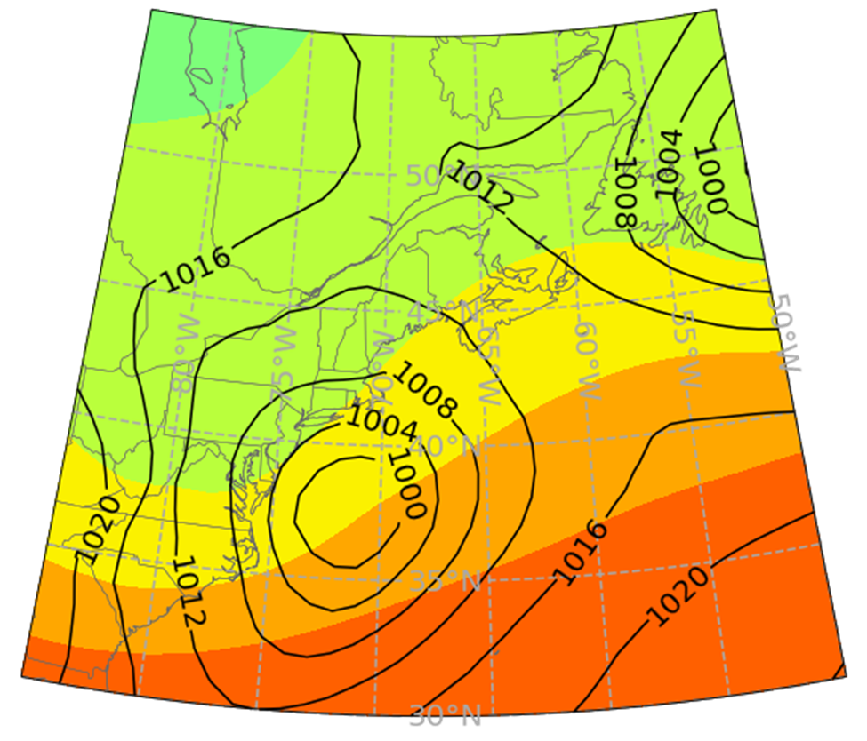
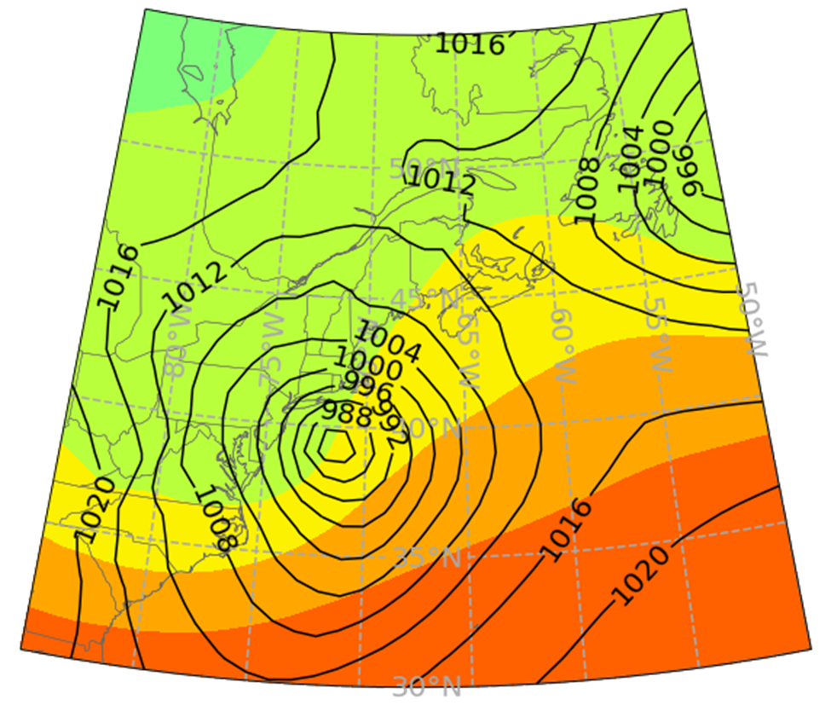
Scenario 1:
Scenario 2:
Scenario 3:
Resulting MSLP scenarios of fuzzy clustering of IDISP space and ensemble mean. (in hPa)
Scenario 4:
Scenario 5:
Ensemble Mean:
Notes:
fzc

Slide 15
2PC k-means Clusters:
IDISP “Scenario Nearest Analysis” members most likely to have lowest displacement/intensity errors….
For every ensemble run for days 7-9:
Calculate intensity, displacement errors for every ensemble member.
Divide each by standard deviation
Label the ensemble members that contribute to scenario nearest analysis in red, otherwise label black.
IDISP scenario nearest analysis is more consistently selecting the individual members with lowest errors.
MSLP Intensity Error vs. Displacement Error Scatterplot at Long Lead Time:
IDISP k-means Clusters:
Notes:
For every ensemble run, separated by lead time groups:
Calculate MSLP intensity and displacement errors for every ensemble member.
Divide the intensity and displacement errors by their standard deviation.
Label the ensemble members that contribute to the scenario nearest analysis.
Plot Intensity x Displacement error of every ensemble member. Plot ensemble members that contribute to the scenario nearest analysis in red, otherwise plot other points as black.

Slide 16
Tested Different Clustering Algorithms
K-means: Clusters obtained through finding local minimum of within cluster sum of squares.
Fuzzy: Like k-means but weights each point by a probability of belonging to a cluster instead of exact assignment.
Agglomerative Hierarchical Clustering (AHC): Each member starts out as its own cluster. On each iteration, until the desired number of clusters is reached:
Ward’s Linkage: The two clusters whose intra-cluster sum of squares increases the least are merged.
Full Linkage: The two clusters whose furthest pair of points away from each other have the smallest Euclidean distance are merged.
Average Linkage: the Two clusters whose average inter-cluster Euclidean distance are smallest are merged.
Self Organizing Map (SOM):
(1) Randomly initialize cluster centers.
(2) Take one random ensemble member. The cluster center closest by Euclidean distance to the ensemble member is called the best matching unit (BMU).
(3) The BMU and other cluster centers are adjusted towards the ensemble member as an inverse function of distance from the BMU.
(4) Repeat steps 2 and 3 for 1000 randomly selected points (with replacement).
* But found no significant differences (ACH slightly worse)

Slide 17
12 H APCP clustering using APCP based (left) and MSLP based (right) clusters, projected onto 12 h APCP 2PC Space: 2PC Fuzzy
Impact of Clustering 12-h QPF (APCP)
vs Using MSLP Clusters to obtain the APCP

Slide 18
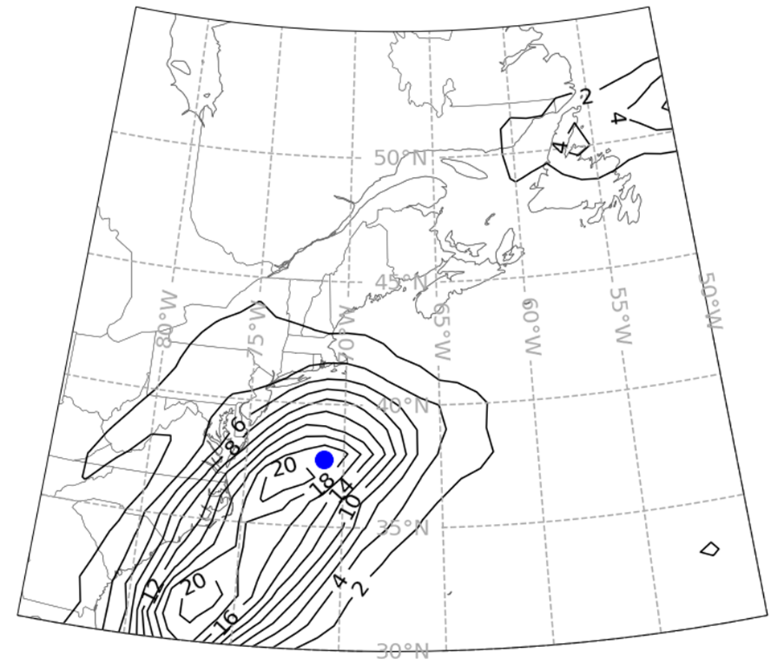
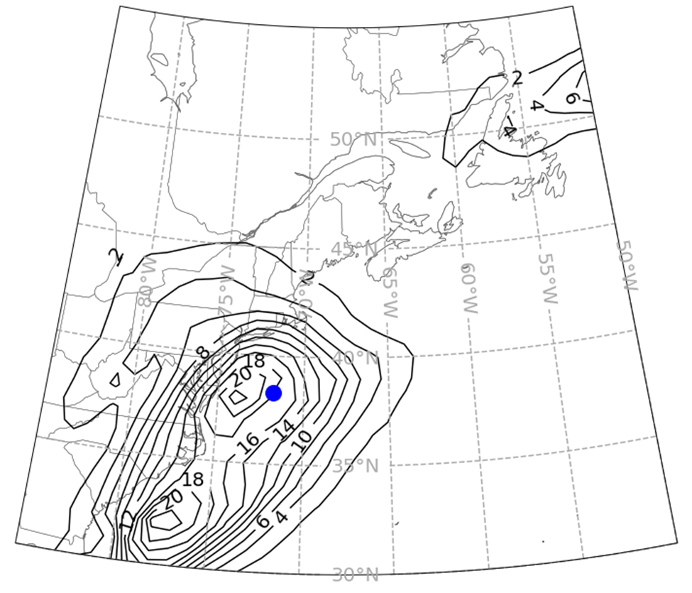
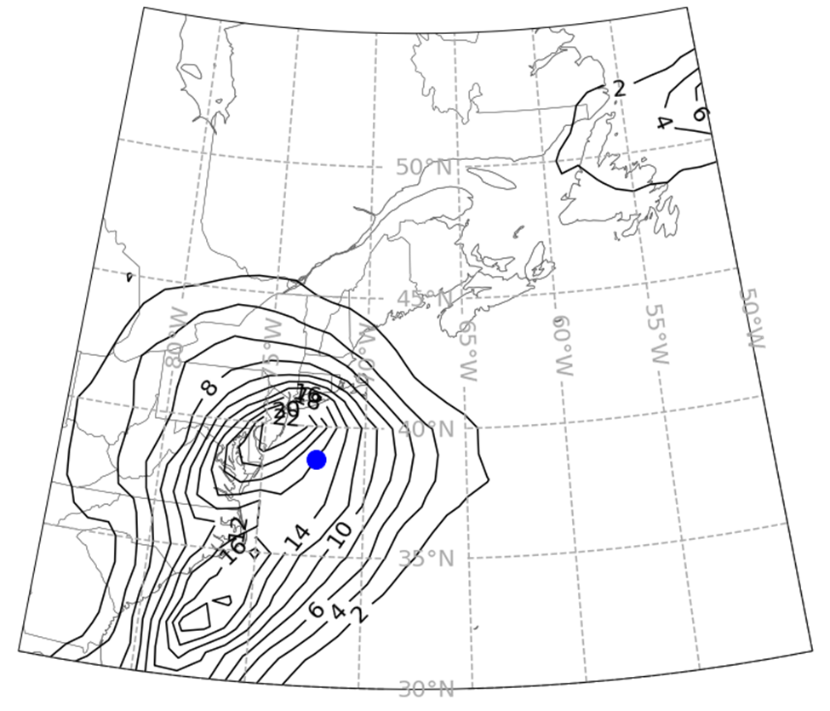
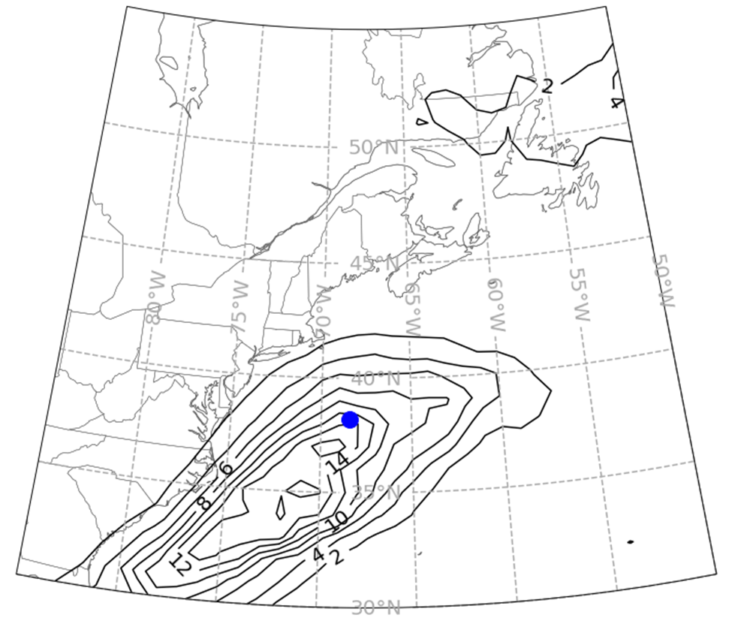
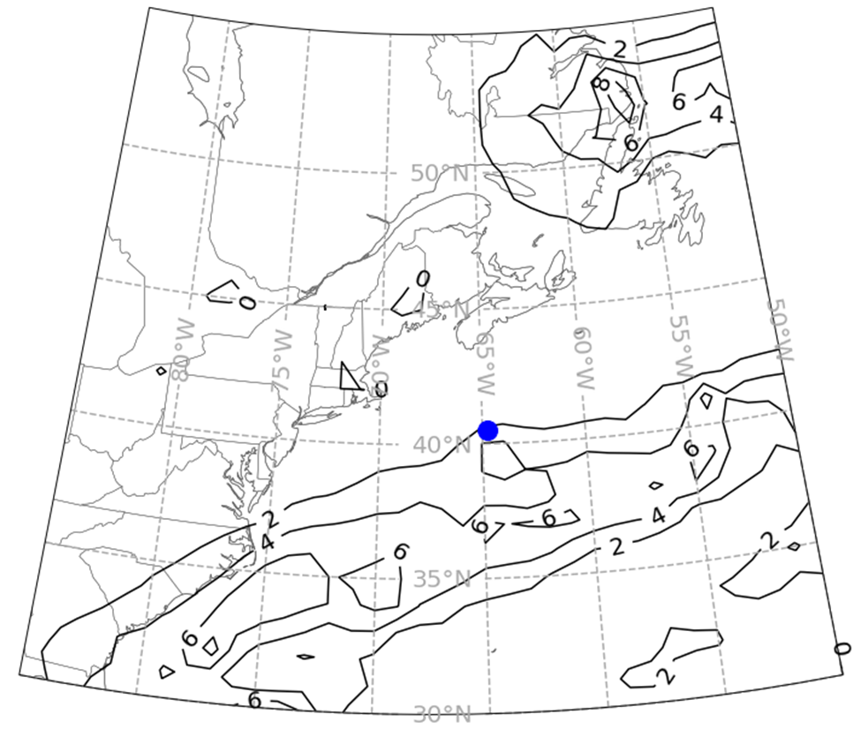
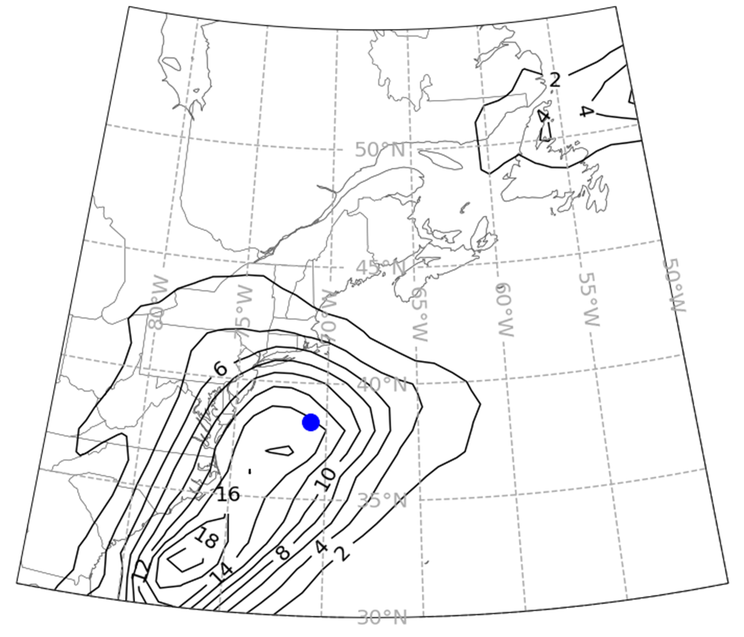
Scenario 1:
Scenario 2:
Scenario 3:
Resulting 12 h APCP scenarios of fuzzy clustering of 2PC space of 12 h APCP and ensemble mean.
Blue dots are center of mass points of precip in domain
Scenario 4:
Scenario 5:
Ensemble Mean:
Notes:
fzc

Slide 19
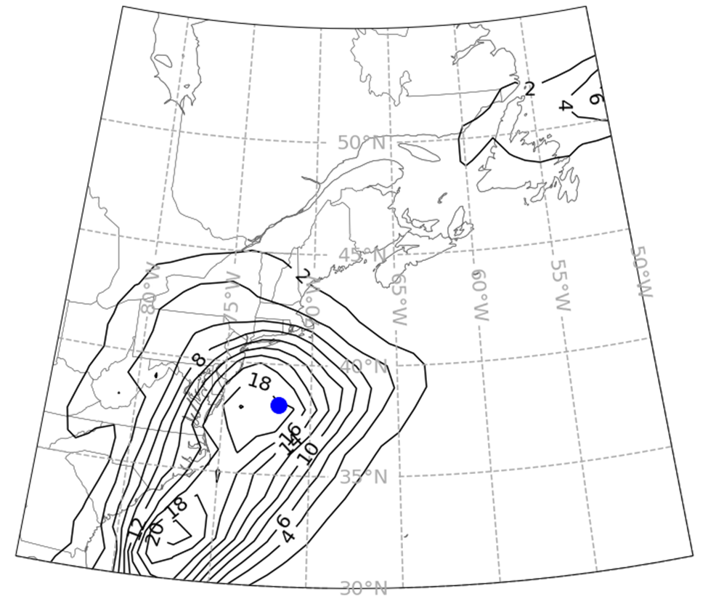
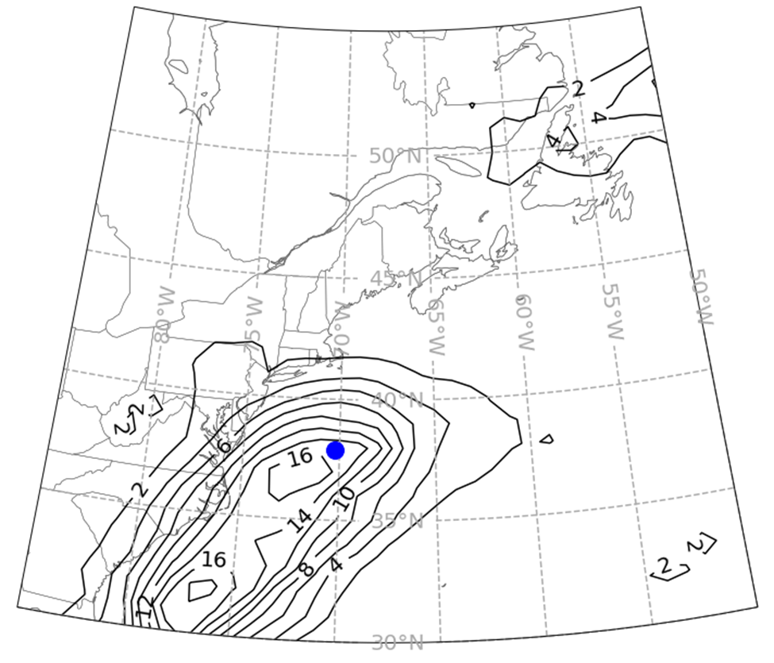
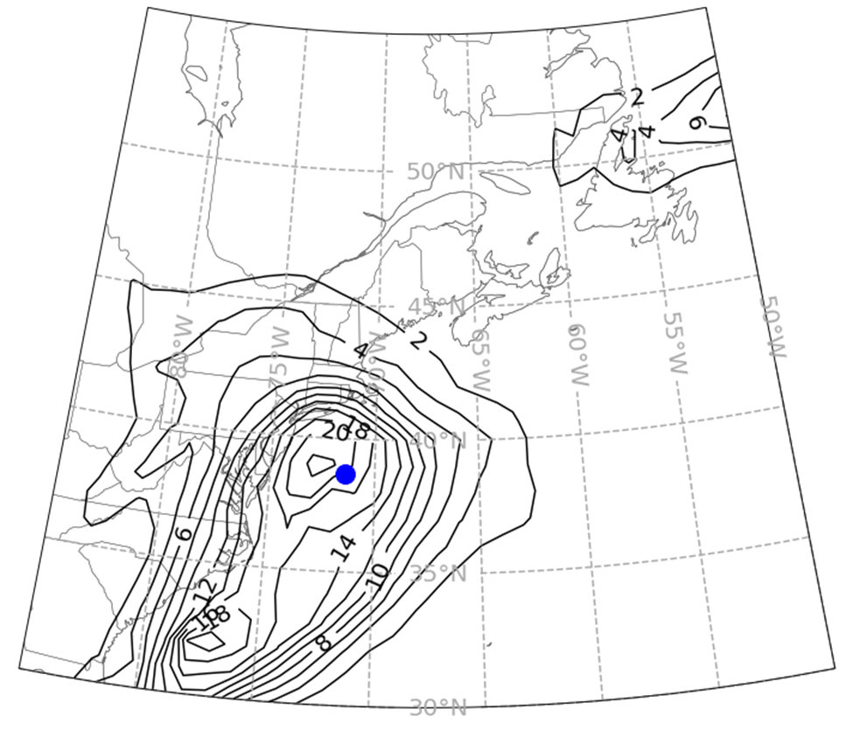
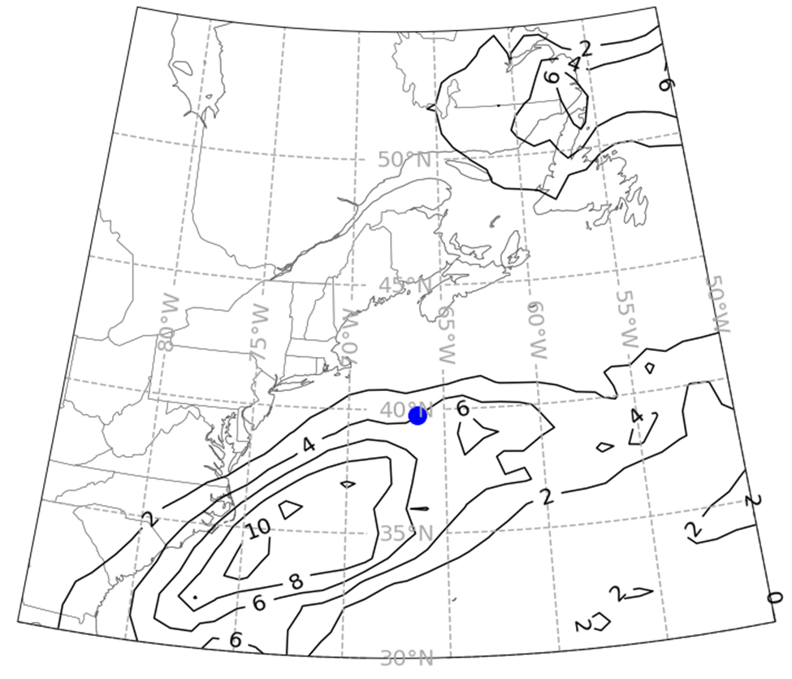
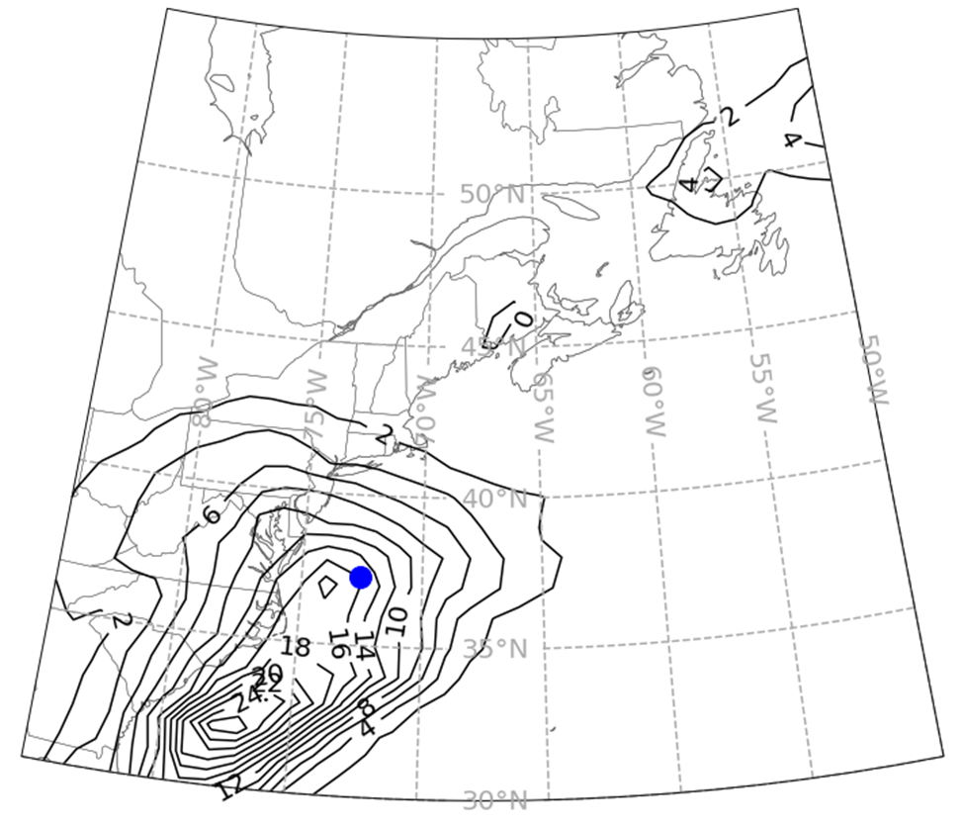
Scenario 1:
Scenario 2:
Scenario 3:
Resulting 12 h APCP scenarios of fuzzy clustering of 2PC space of MSLP and ensemble mean. (in mm)
Scenario 4:
Scenario 5:
Ensemble Mean:
Notes:
fzc

Slide 20
Percentage of times MSLP Based or APCP Based Clusters Produced a Lower Displacement or Intensity Error (mean value across techniques):
Term: | APCP Based Clusters | APCP Clusters by MSLP
a.) Magnitude of Displacement Error:
Short: | 62% ± 6% | 38% ± 6%
Medium: | 59% ± 6% | 41% ± 6%
Long: | 57% ± 6% | 43% ± 6%
b.) Magnitude of Intensity Error:
Short: | 57% ± 6% | 43% ± 6%
Medium: | 64% ± 6% | 36% ± 6%
Long: | 62% ± 6% | 38% ± 6%
Displacement Errors were distance between centers of mass (lat/lon weighted mean, with precipitation amount at each lat/lon being used as the weight).
Intensity error is calculated by averaging the 10 most intense precipitation points together and taking the difference between the scenario and analysis values.

Slide 21
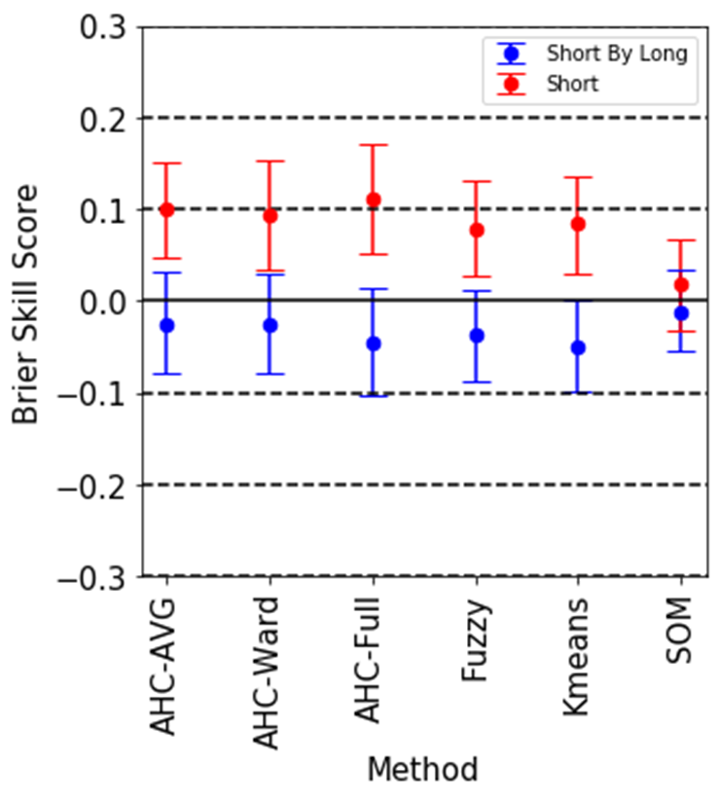
12h APCP Day 3 Clusters: Use Day3 Clusters vs the same Clusters as Day 7 (“Short by Long”)
Probability Largest Cluster Closest to Analysis.
* Motivation: Can we use the same cluster members for all lead times – would result in smoother animations and save some computational time.
* There is a loss in probabilistic skill using the same clusters calculated at day for day 3.

Slide 22
Summary
Ensemble clustering is now running operationally at WPC. Feedback always welcome.
2PC and IDISP are both viable spaces to cluster by. Euclidean is not.
Clustering algorithms do not show many differences in resulting clusters, although AHC has least skill.
Clustering APCP using MSLP results in a slightly less skillful (Prob largest cluster closest to analysis) but could be a viable option. More work needed.
There may be some loss in skill using one lead time to populate the same cluster members for other lead times, but more work needed.

