Slide 1
Evaluate NAQFC with Other Observations: A Study in Summer 2023
NOAA/ARL-George Mason University, NOAA/CSL, and NOAA/NCEP

Slide 2
Background
The existing NAQFC is mainly verified with AIRNow/AQS data for its surface ozone and PM2.5 prediction. During summer 2023, the field experiment of Atmospheric Emissions and Reactions Observed from Megacities to Marine Areas (AEROMMA) took place, and provided comprehensive airborne measurements to evaluate the 3-D full-chemistry performance of NAQFC.
Besides the in-situ measurements, some newly available satellite data could also be used to evaluate the NAQFC’s emission etc.

Slide 3
NAQFC Configuration
Full-chemistry CMAQ mechanism: currently CMAQ 5.2 and will move to CMAQ 5.4
Currently 13km horizontal resolution over North America.
4-cycles-per-day forecast up to 72 hours
Aerosol Lateral Boundary conditions: GEFS-Aerosol
Anthropogenic Emission: National Emission Inventory (NEI) for CONUS, CEDS etc for other regions.
Biogenic Emission: MEGAN scheme
Dust Emission: FENGSHA scheme
Fire Emission: Regional ABI and VIIRS fire Emissions (RAVE) emission. Will be upgraded to RAVE2

Slide 4
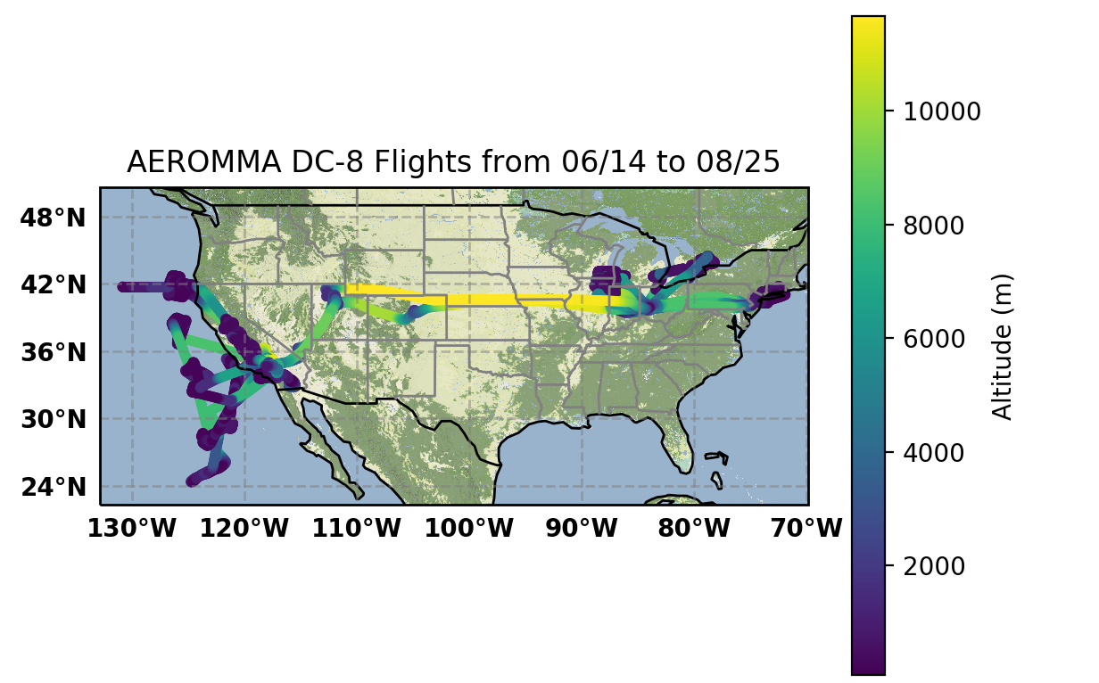
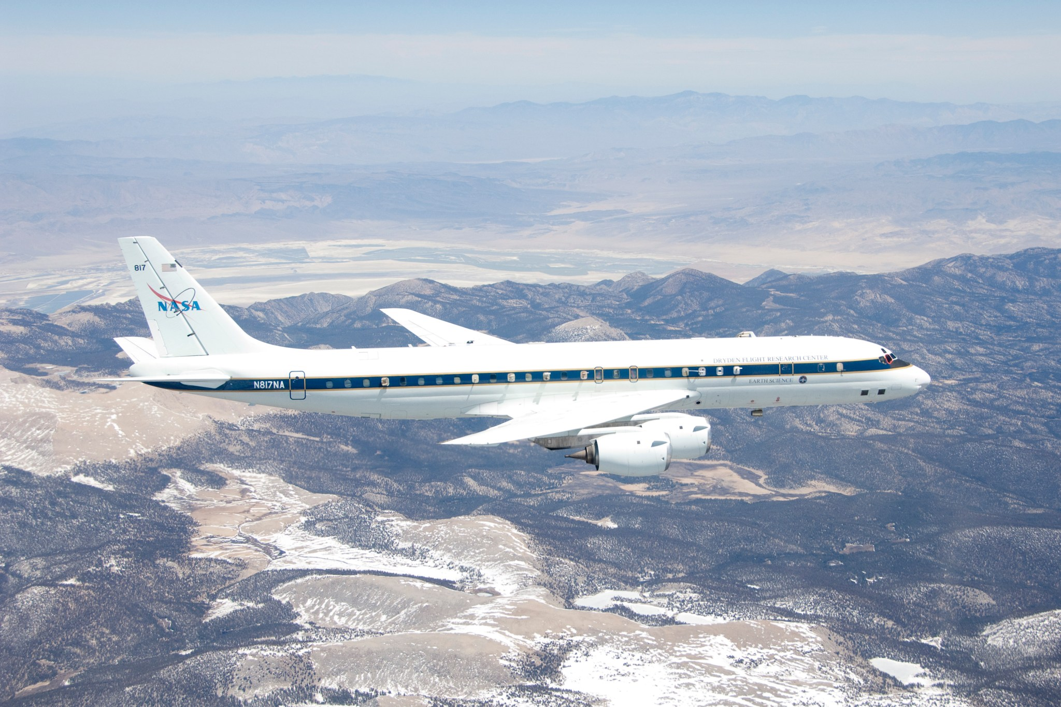
Most AEROMMA flights flew around megacities

Slide 5
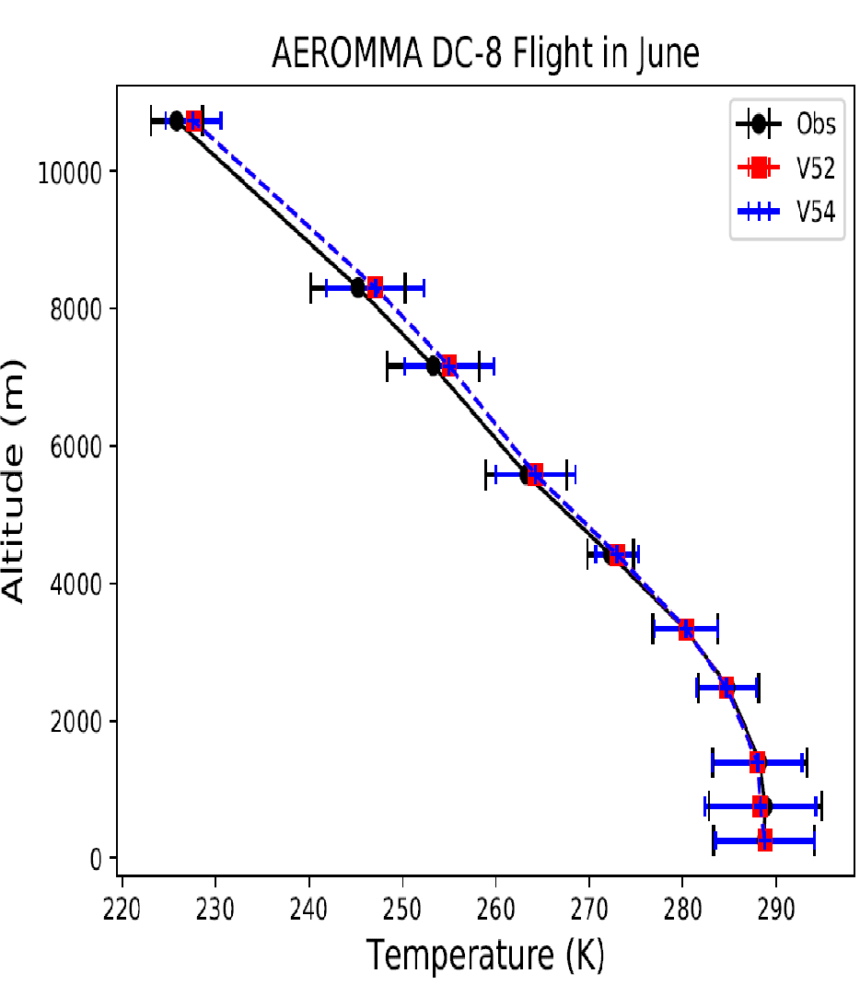
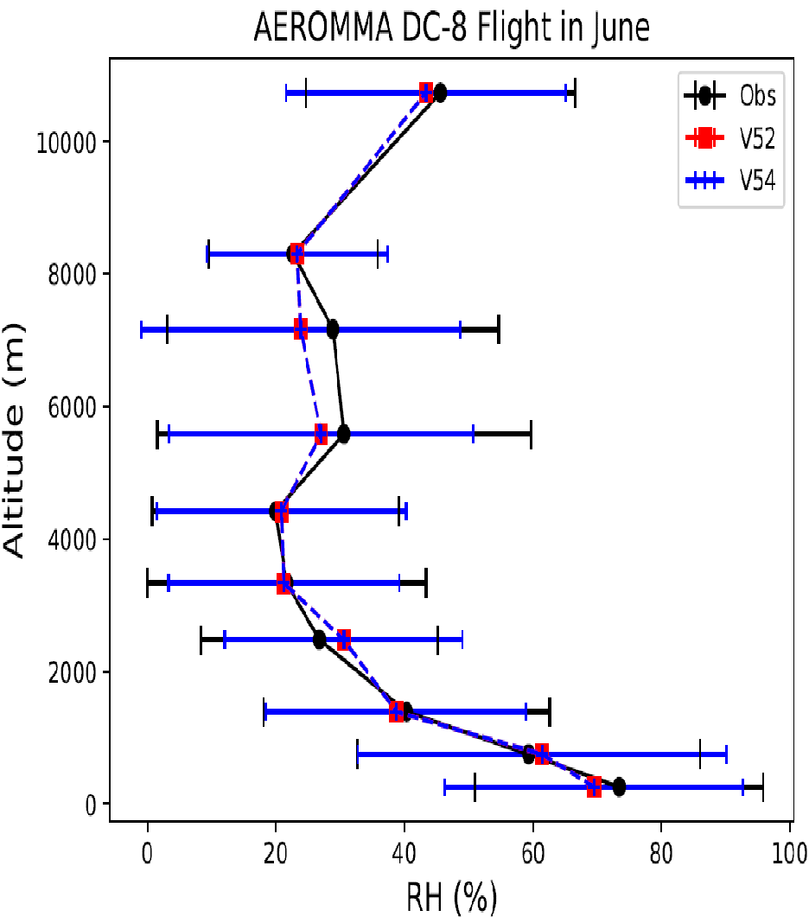
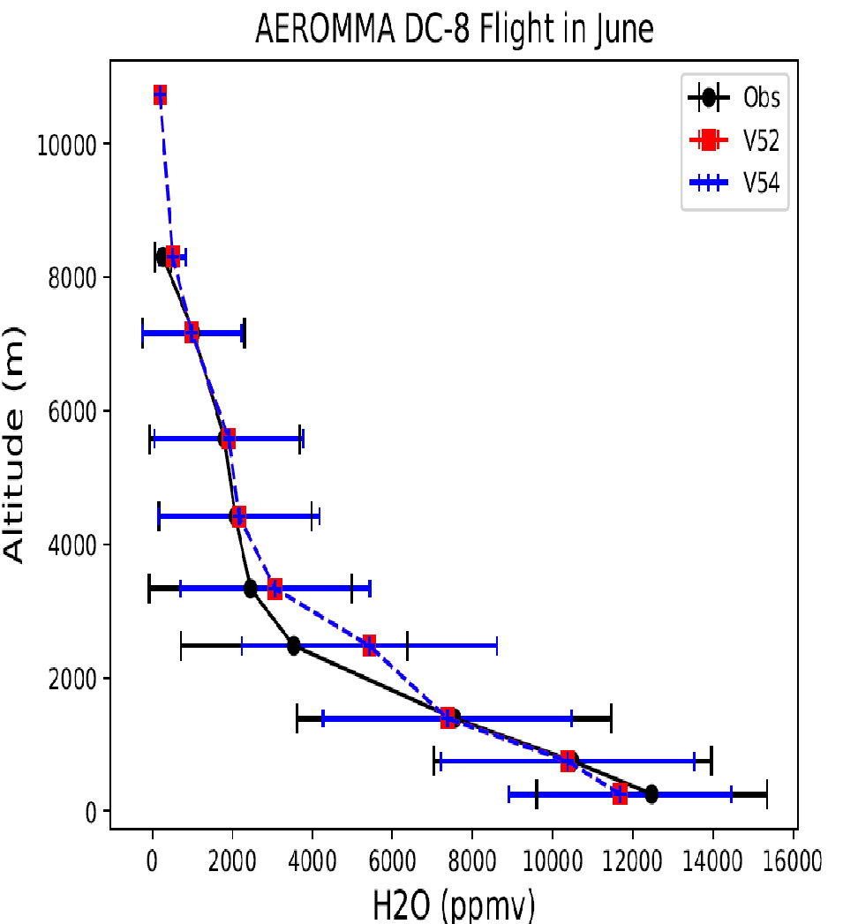
Meteorology over the U.S. West
Dry bias near surface , wet bias near the PBL top

Slide 6
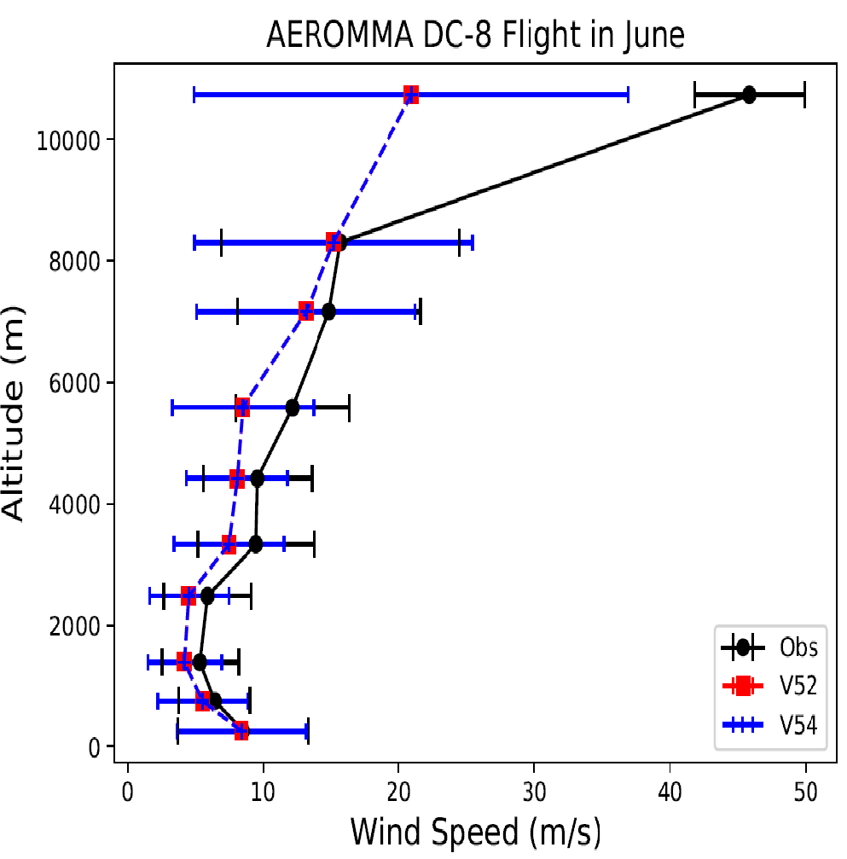
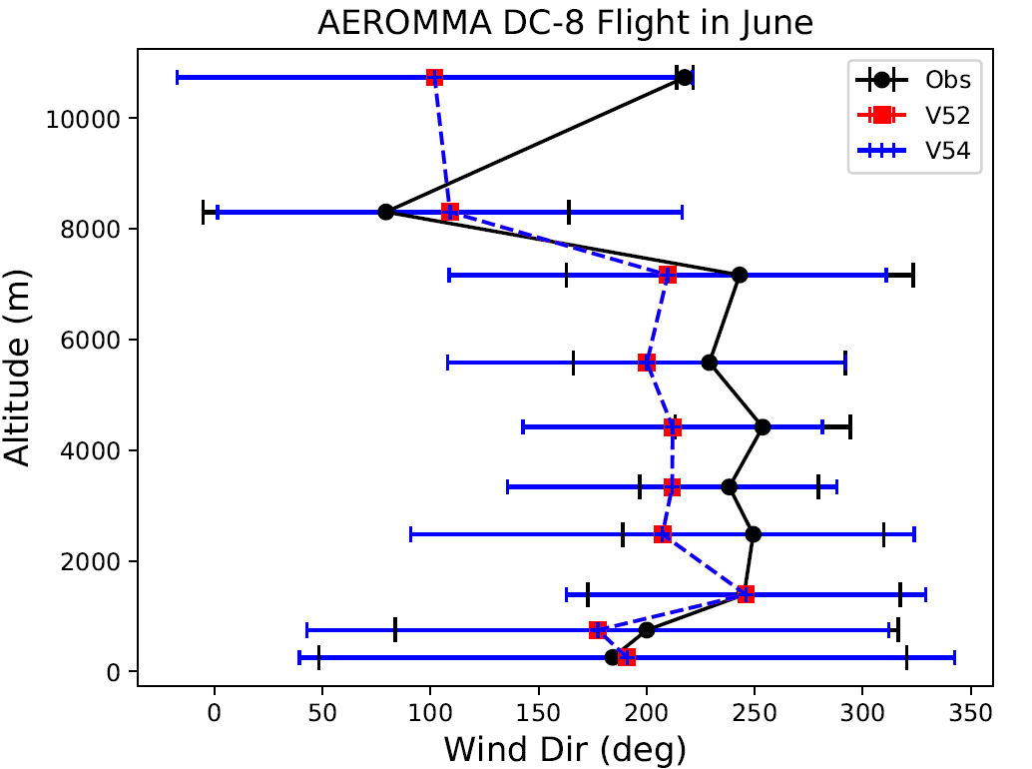
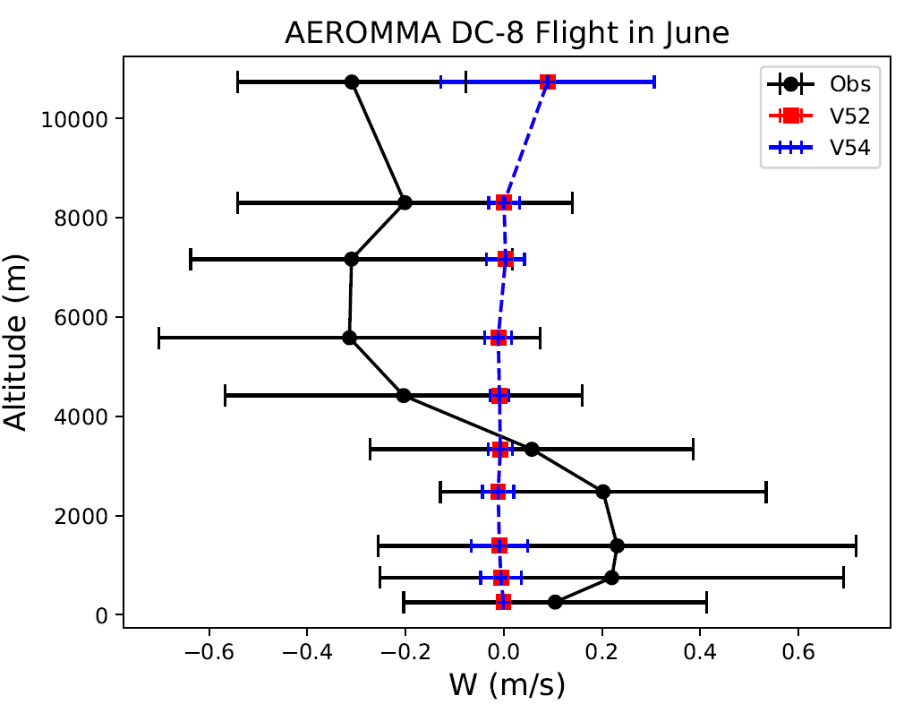
The vertical gradient of modeled winds are too smooth near the tropopause. The model tends to underpredict W by one or two orders of magnitude.

Slide 7
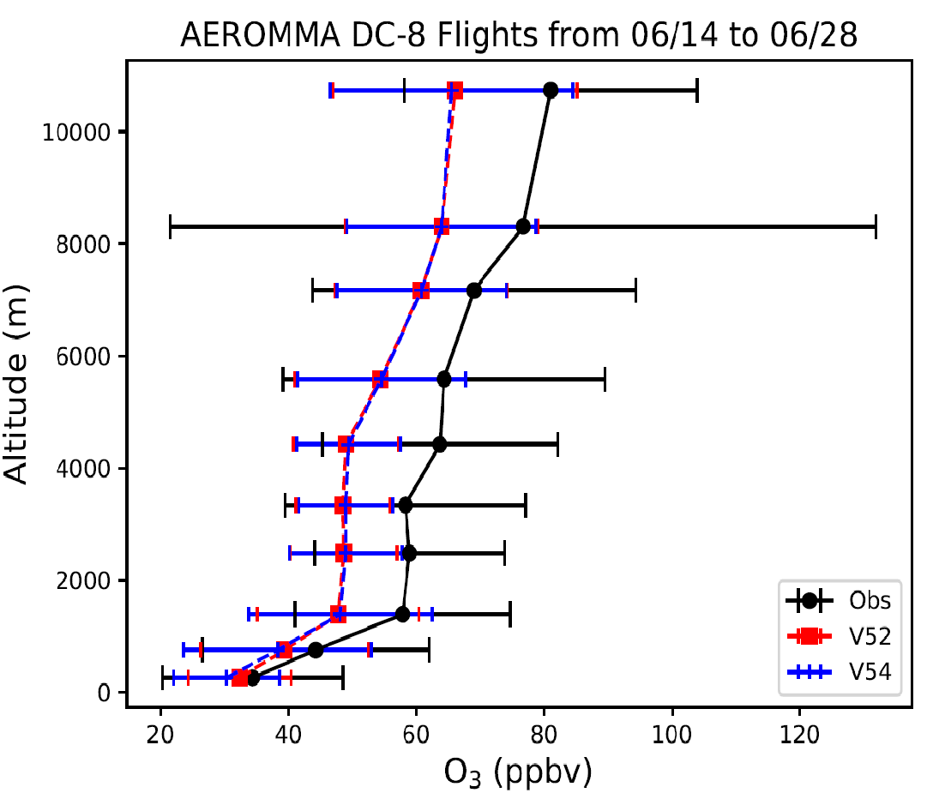
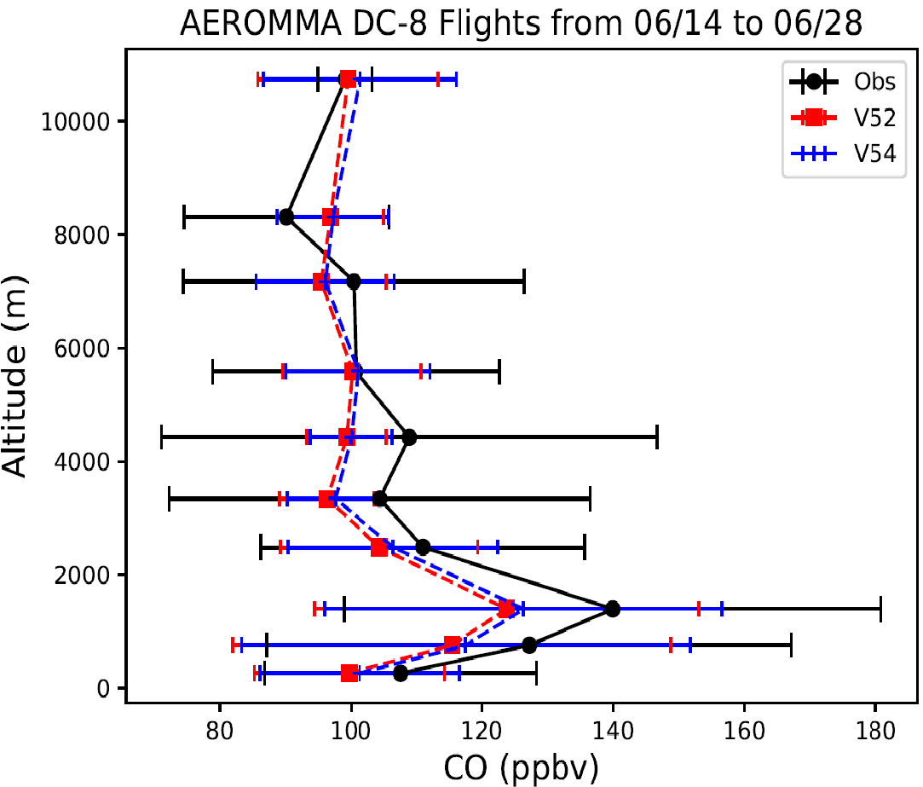
The background ozone and tropospheric CO are underestimated over U.S. West Coast, which is related to the AM4 monthly lateral boundary condition.

Slide 8
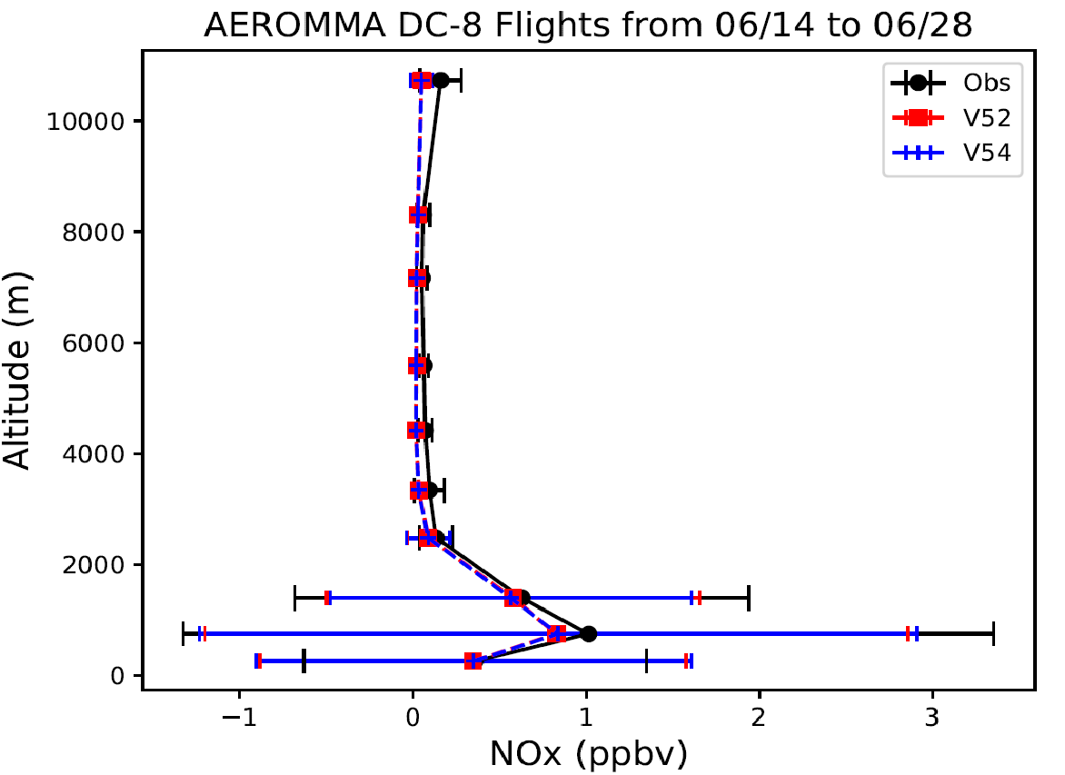
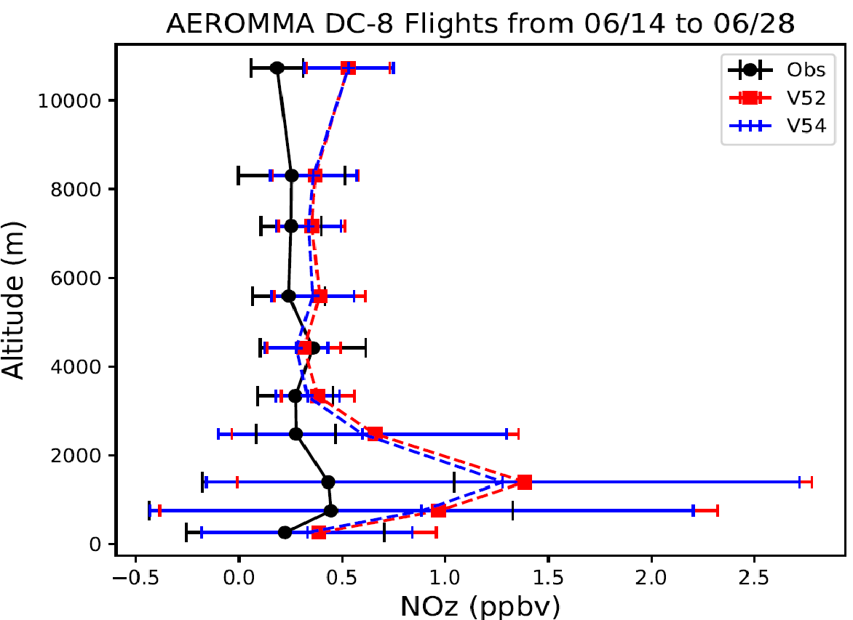
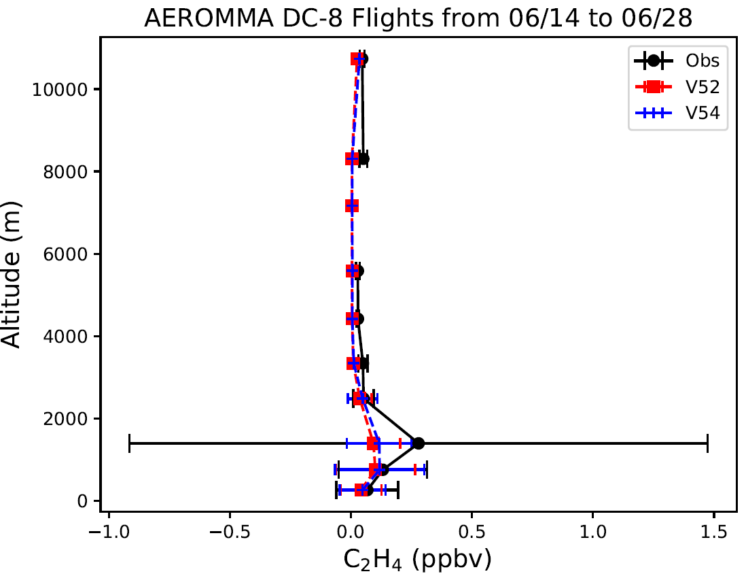
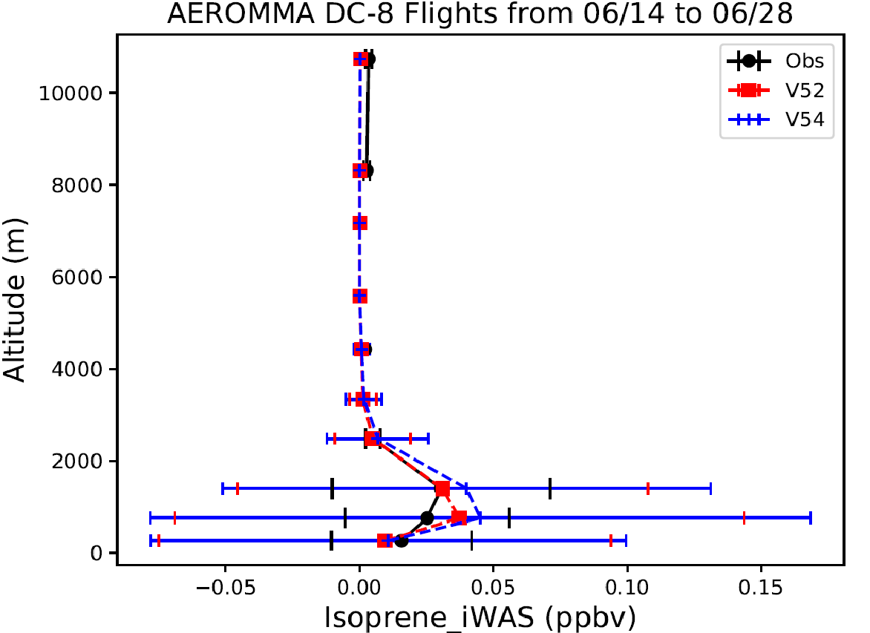
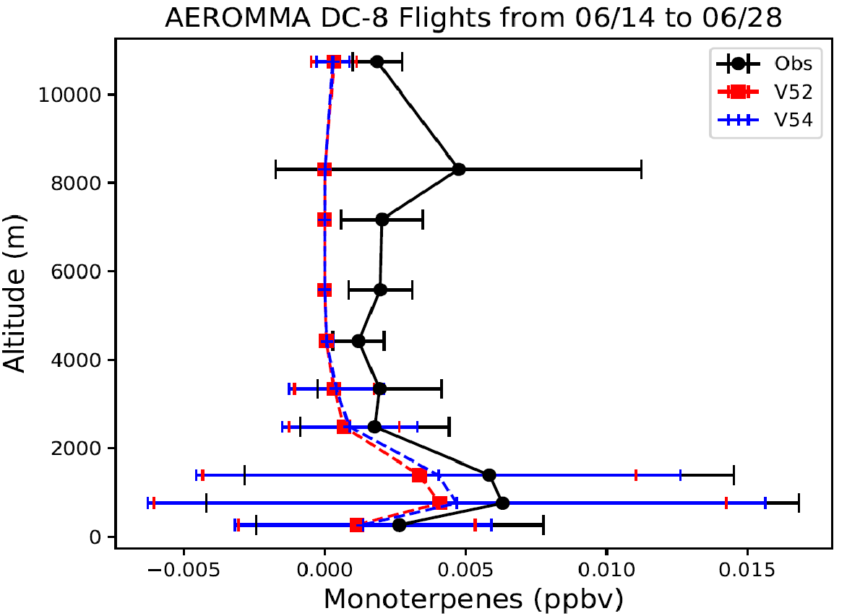
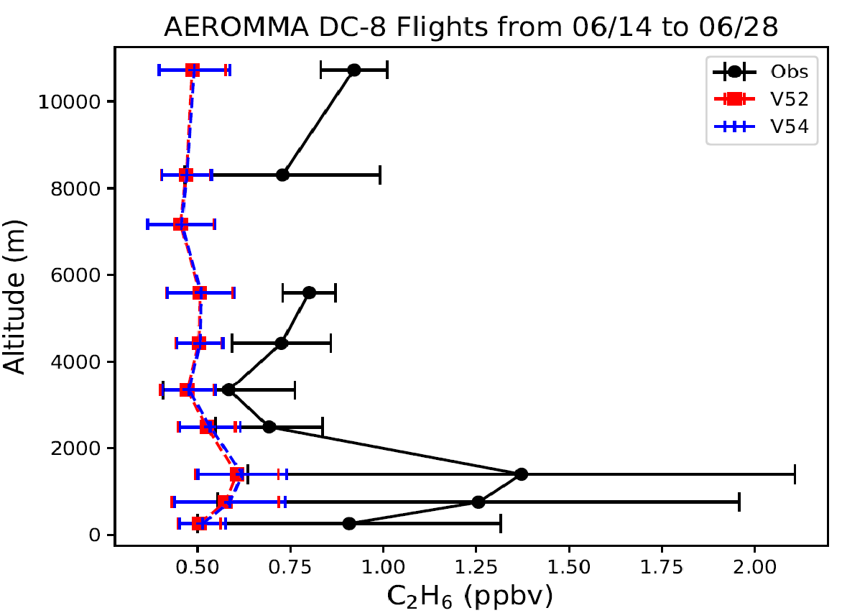
Over the U.S. West Coast, NOz is overpredicted or modeled NOx-to-NOz conversion is too fast.
Models tend to underpredict both background and emission of ethane

Slide 9
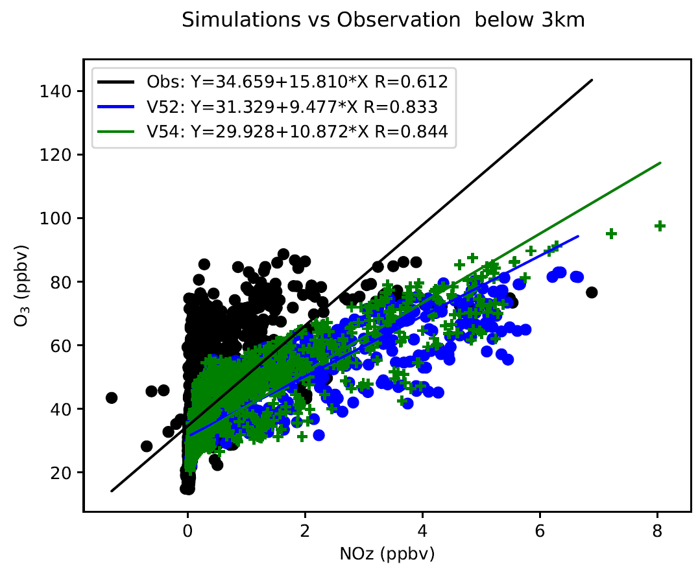
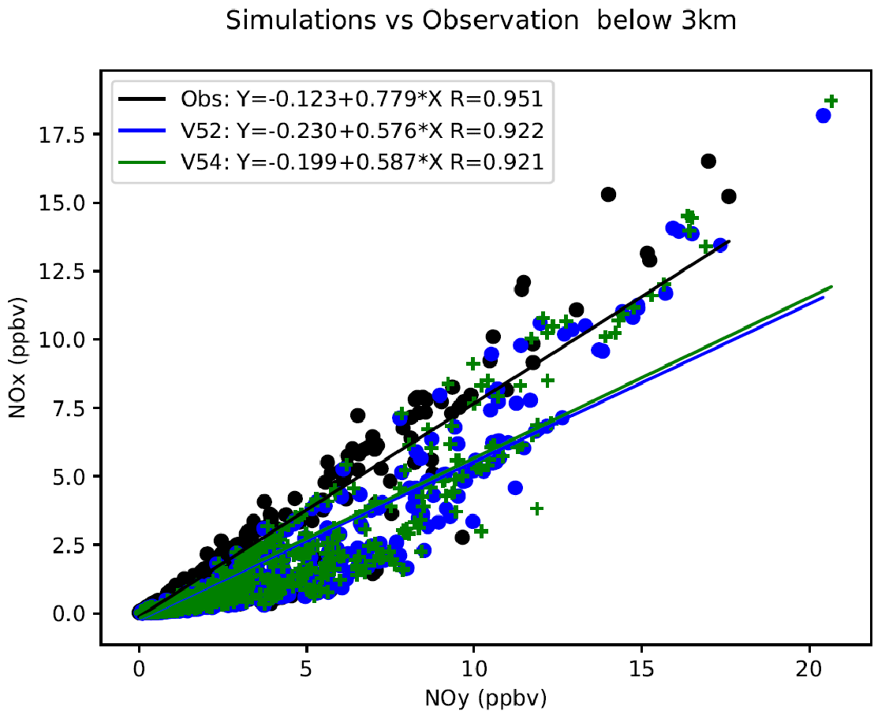
The overpredicted NOx-to-NOz conversion leads to underpredictions of ozone production efficiency, represented by the O3-to-NOz ratio, and NOx age and NOx/NOy ratio. It is caused by the model’s well-mixing assumption in each grid cell or insufficient spatial resolution.

Slide 10
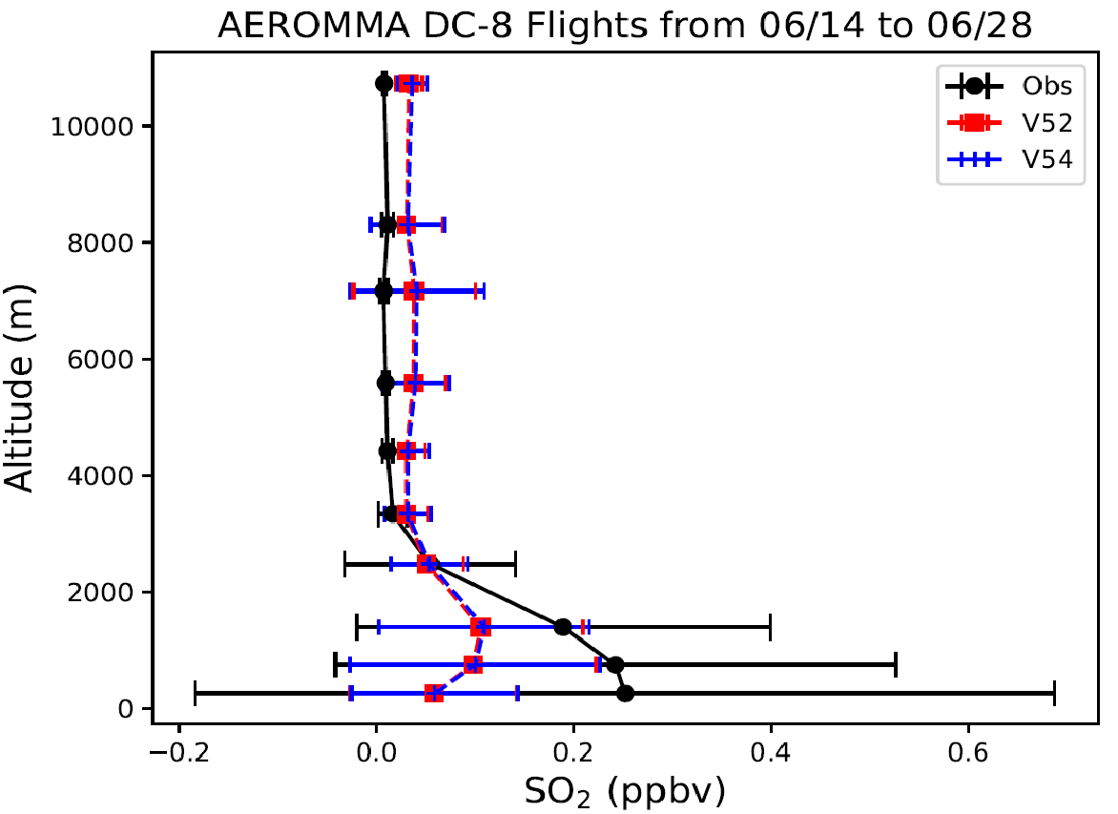
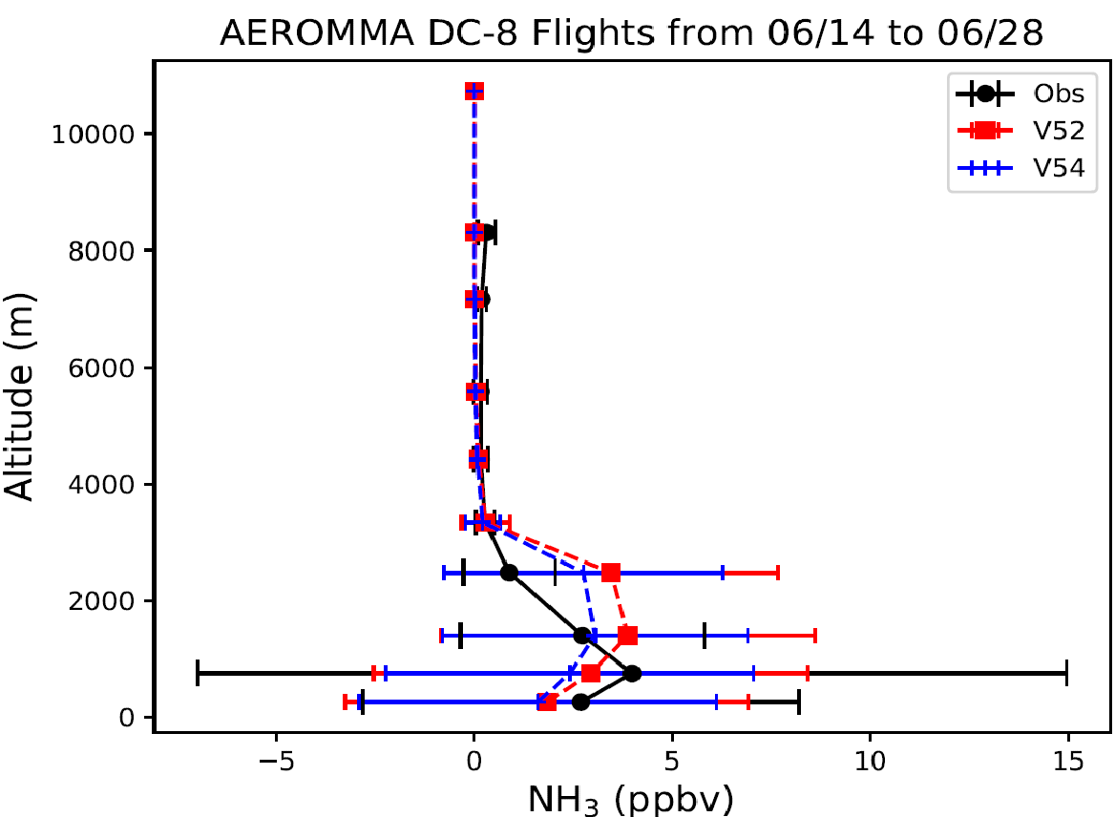
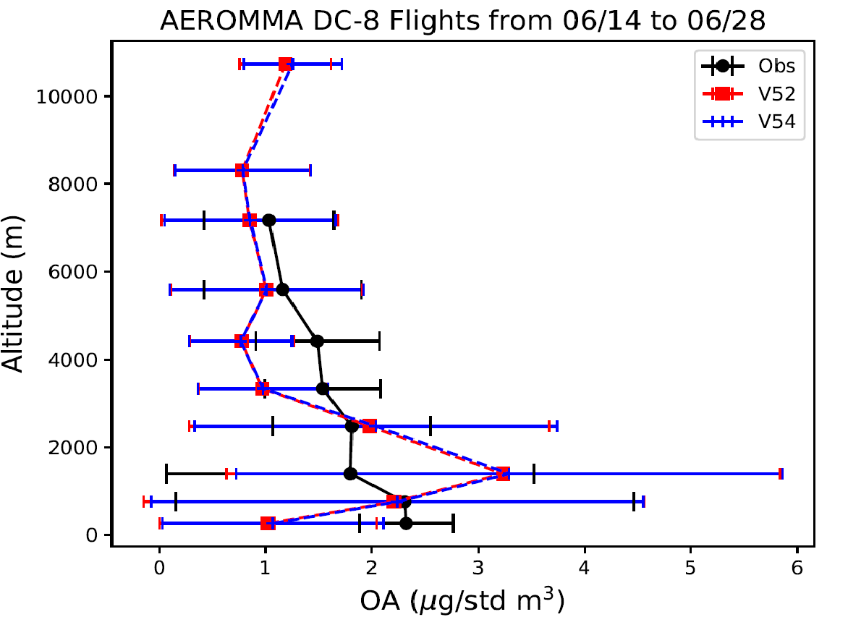
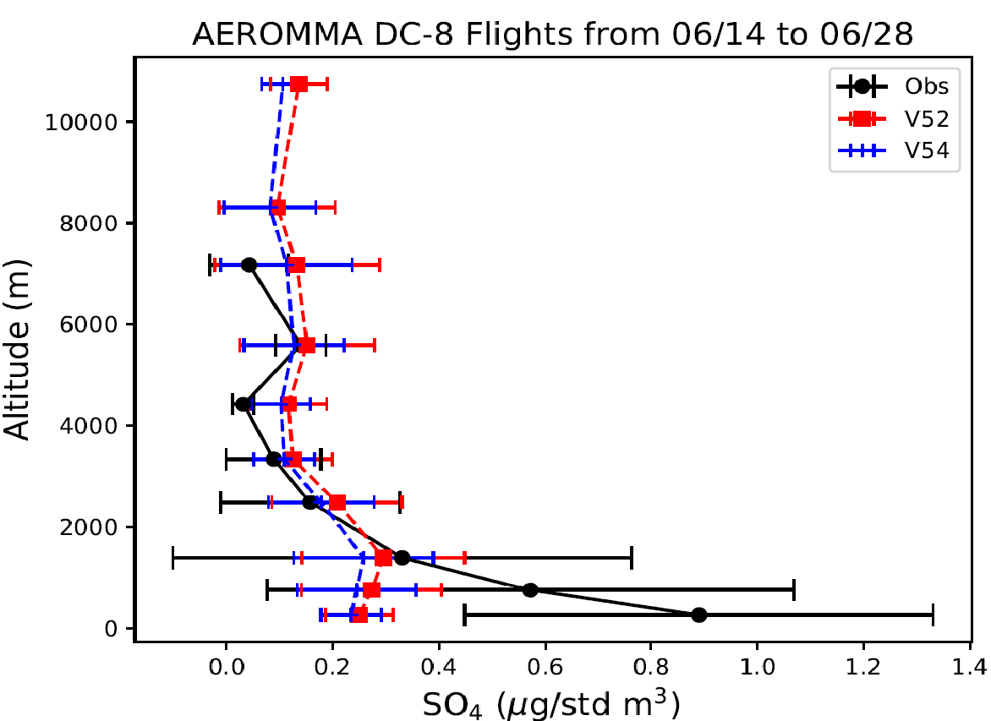
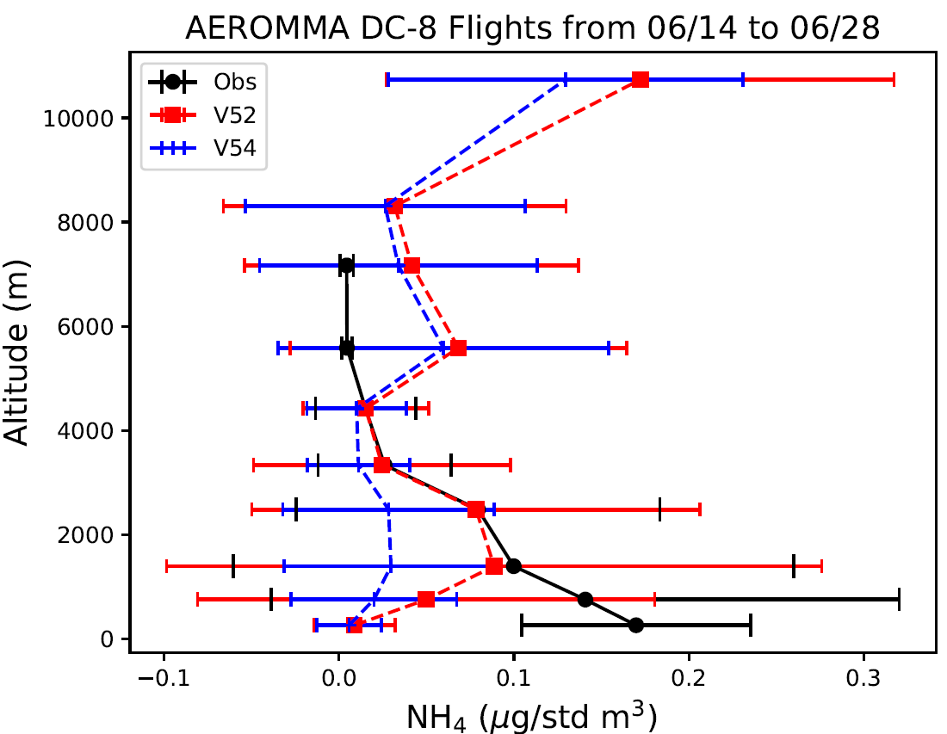
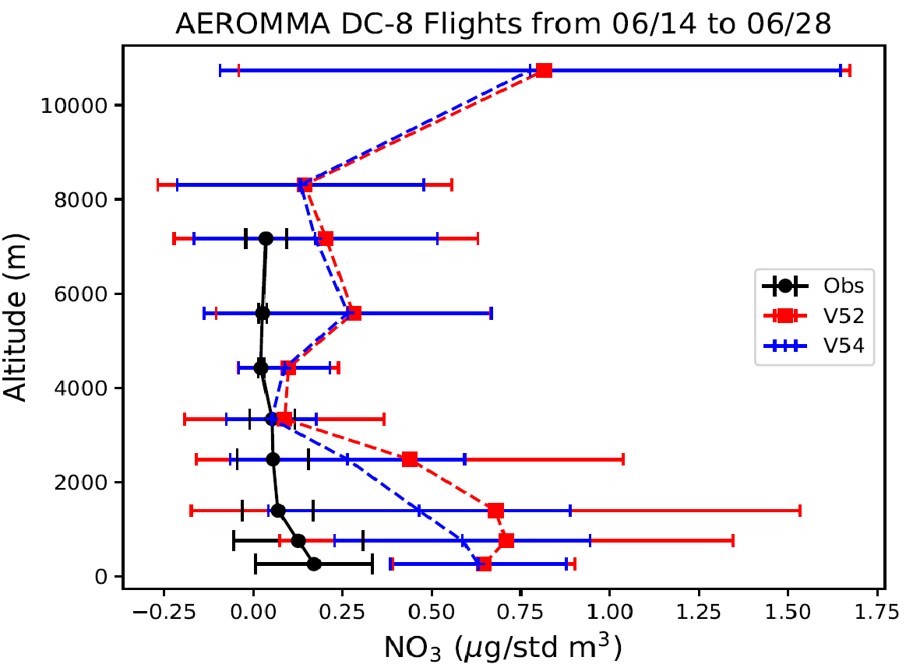
SO₂ undeprediction over U.S. West leads to underprediction of sulfate and ammonium, and overprediction of nitrate. This bias on aerosol compositions could also affect the downstream PM2.5 prediction.
Anions: SO₄²⁻, NO₃⁻, Cl⁻
Cations: Ca²⁺, Mg²⁺, Na⁺, K⁺, NH₄⁺
SO₂ underprediction causes Sulfate and ammonium underpredictions and nitrate overprediction

Slide 11
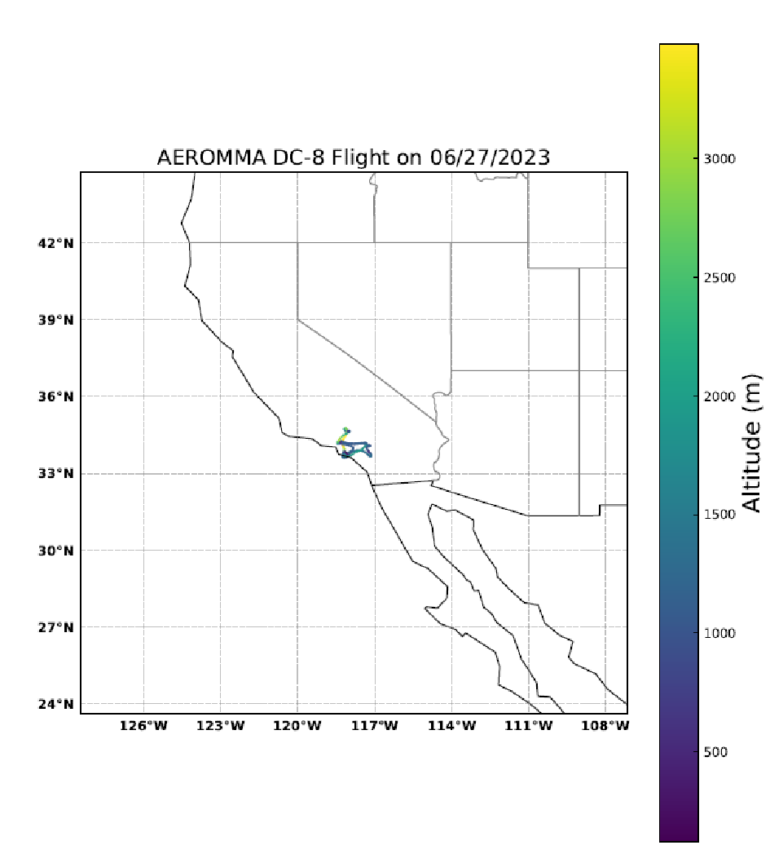
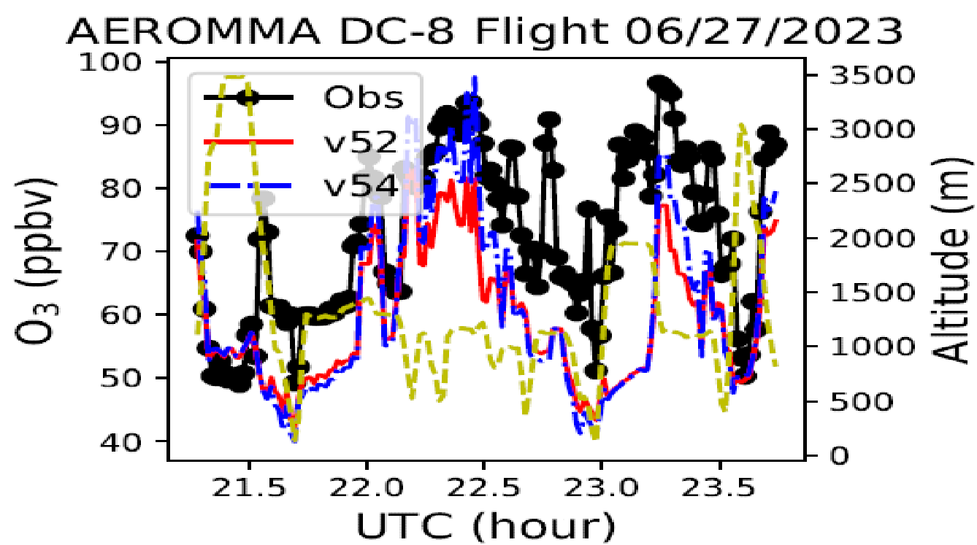
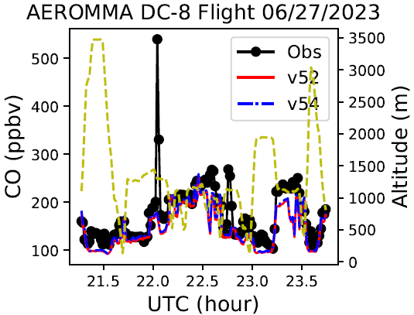
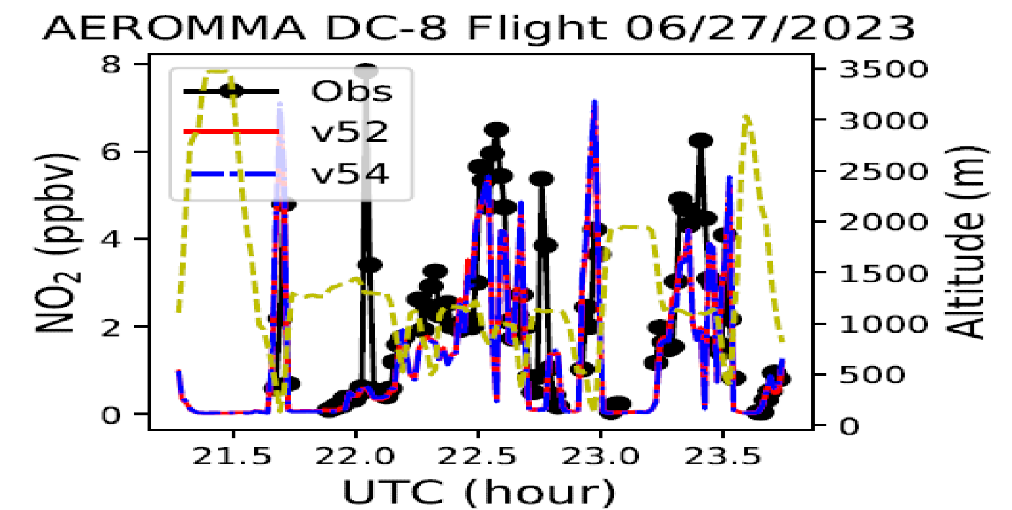
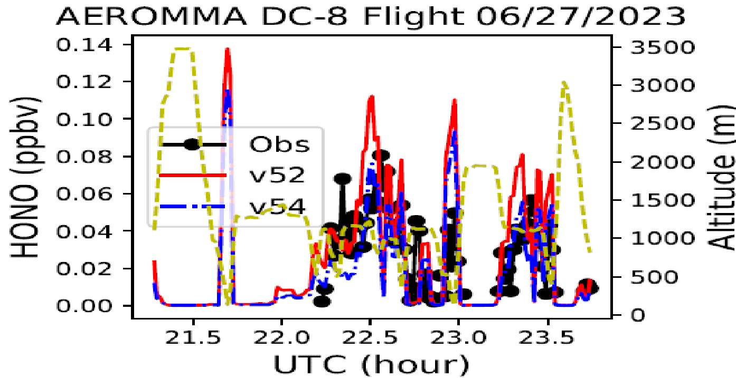
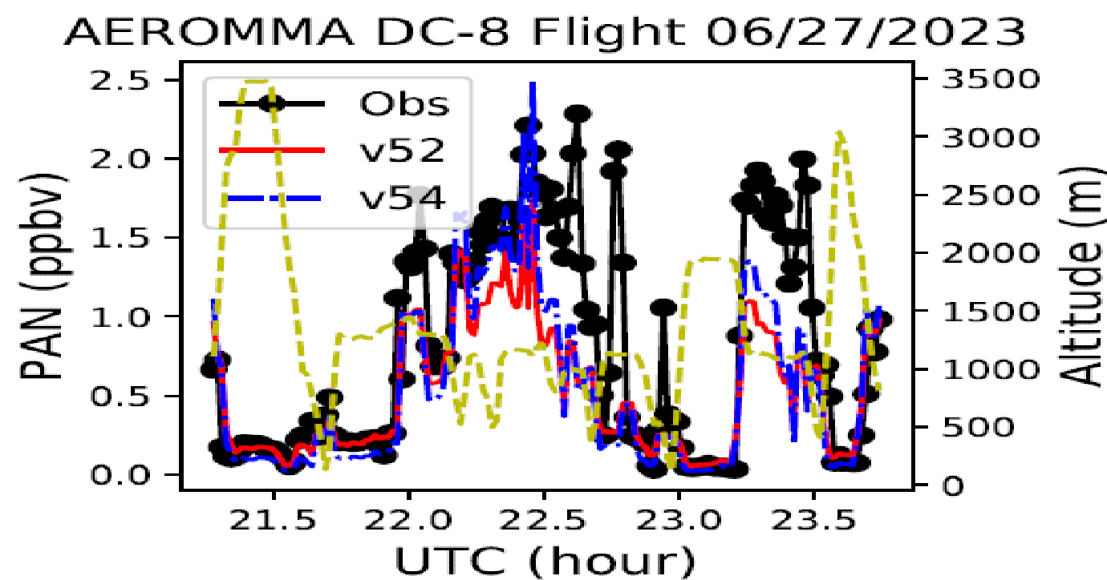
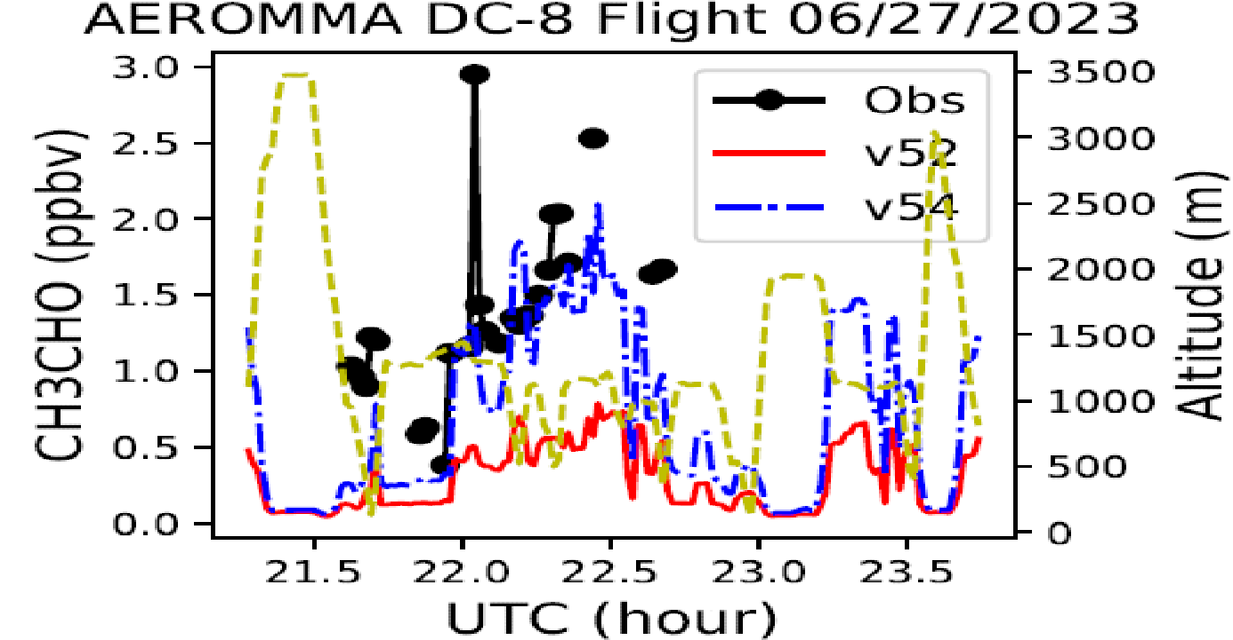
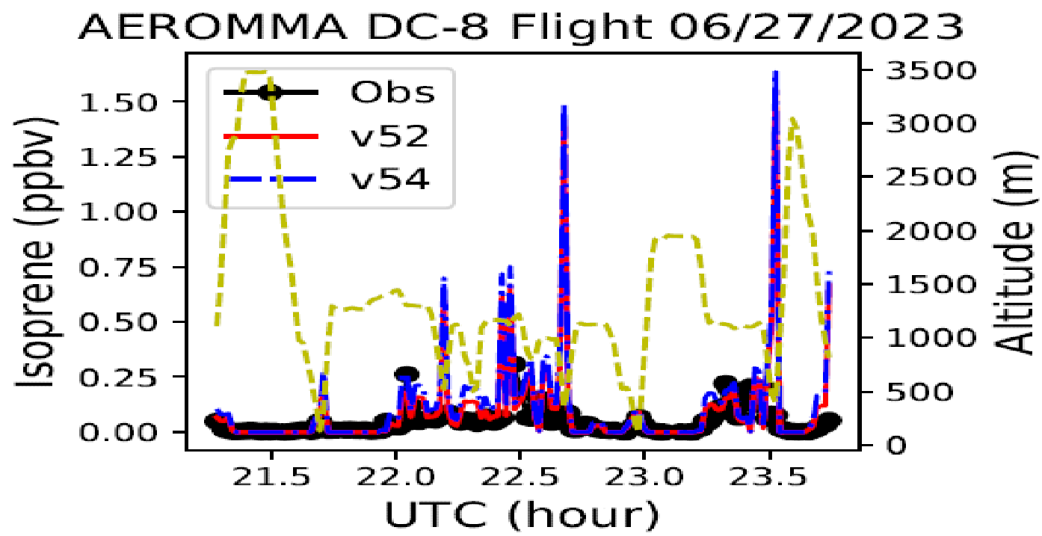
V54 showed better chemical behavior over the LA flight

Slide 12
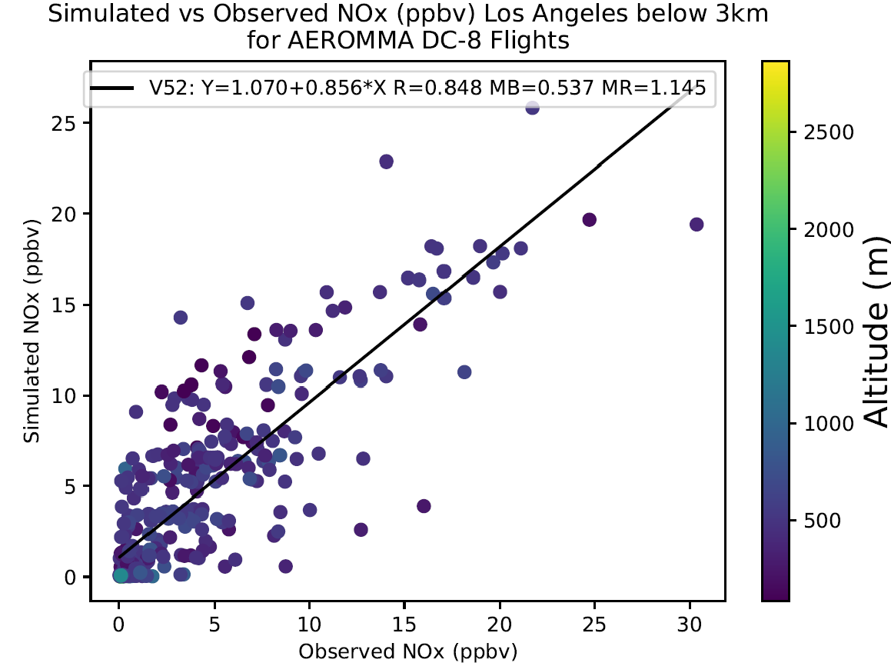
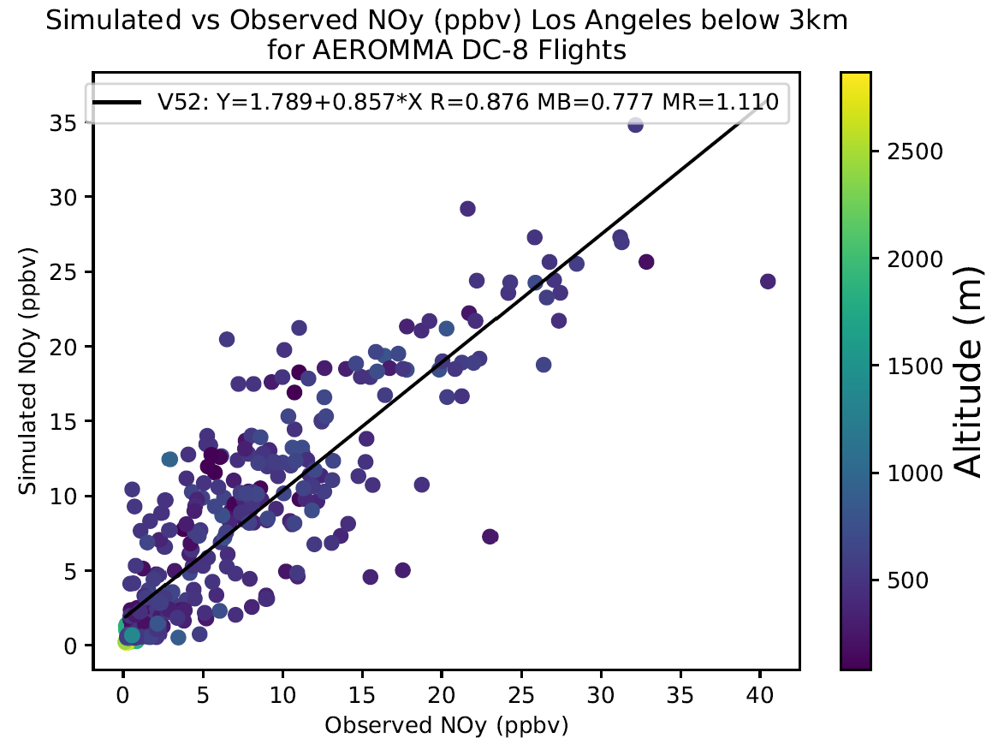
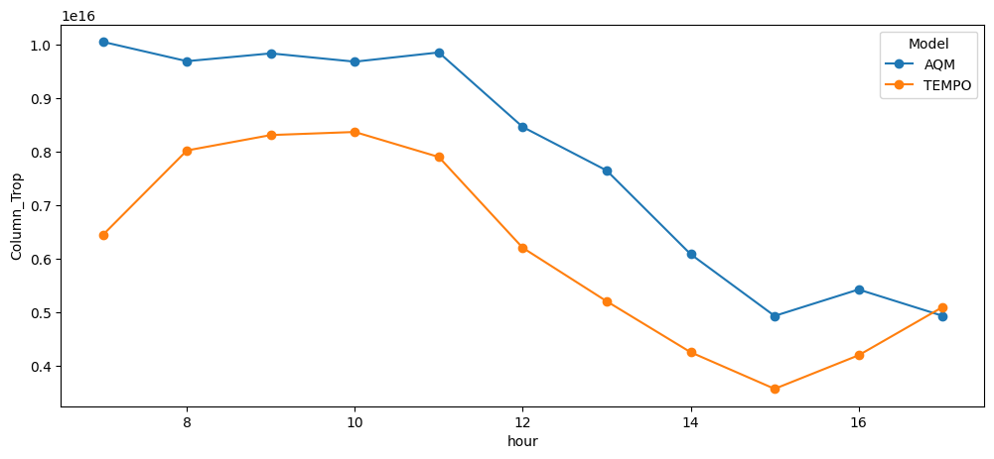
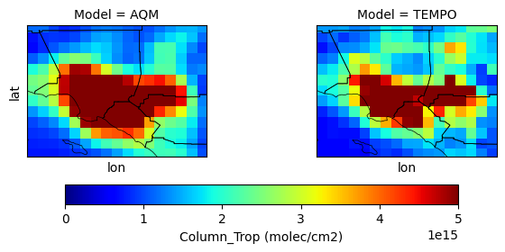
This Cross-Comparison try to address the bias of the NOx emissions over Megacities, reflected by in-situ comparison (slope, mean bias, mean ratio) and TEMPO tropospheric vertical column
Mean bias: 1.72 x 10¹⁵ (+28%)
Los Angeles
Courtesy of Wei Li

Slide 13
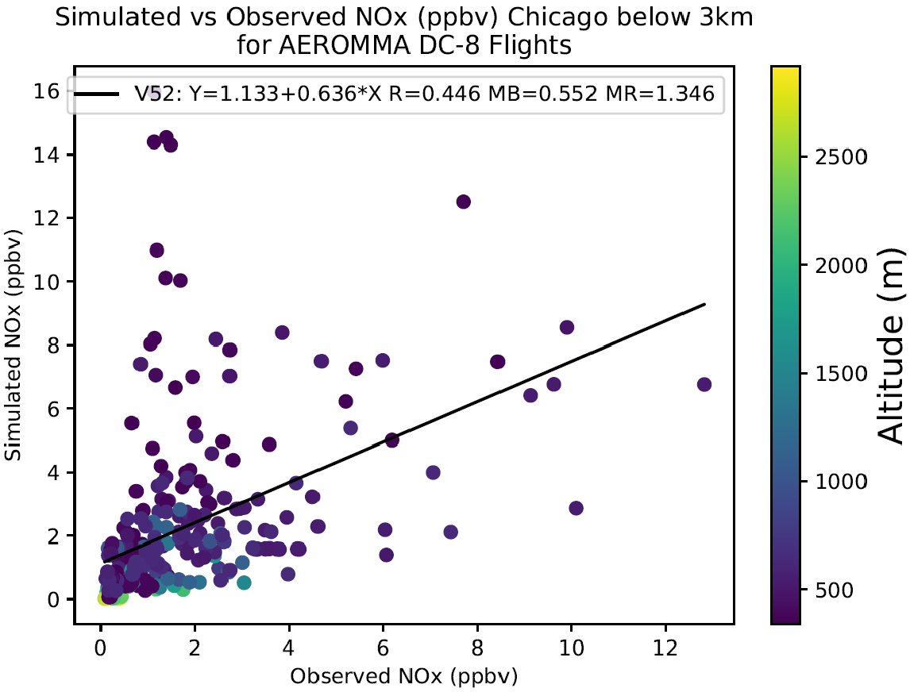
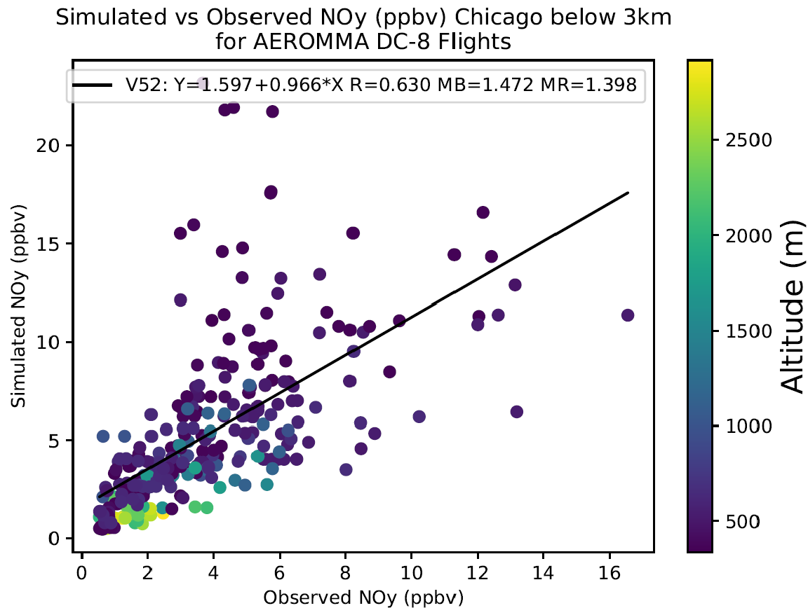
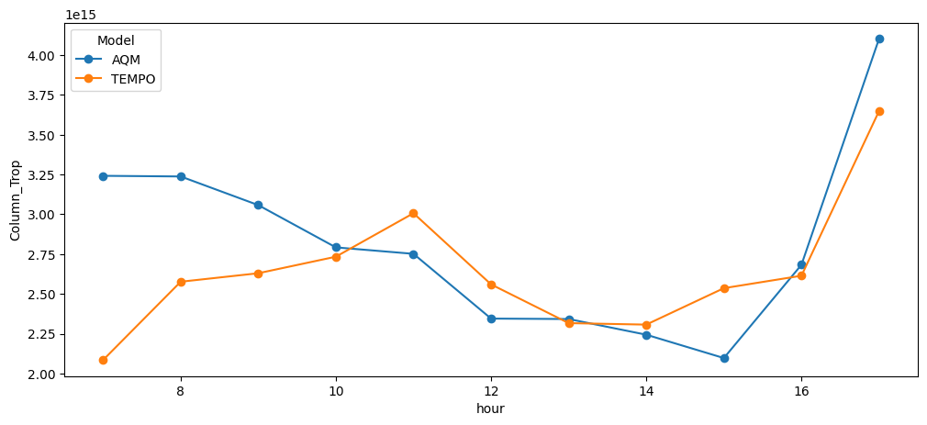
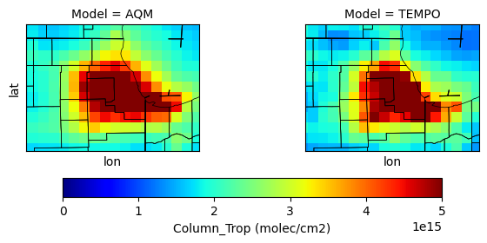
Same but for Chicago
Mean bias: 1.71 x 10¹⁴ (+6%)
Chicago
Courtesy of Wei Li

Slide 14
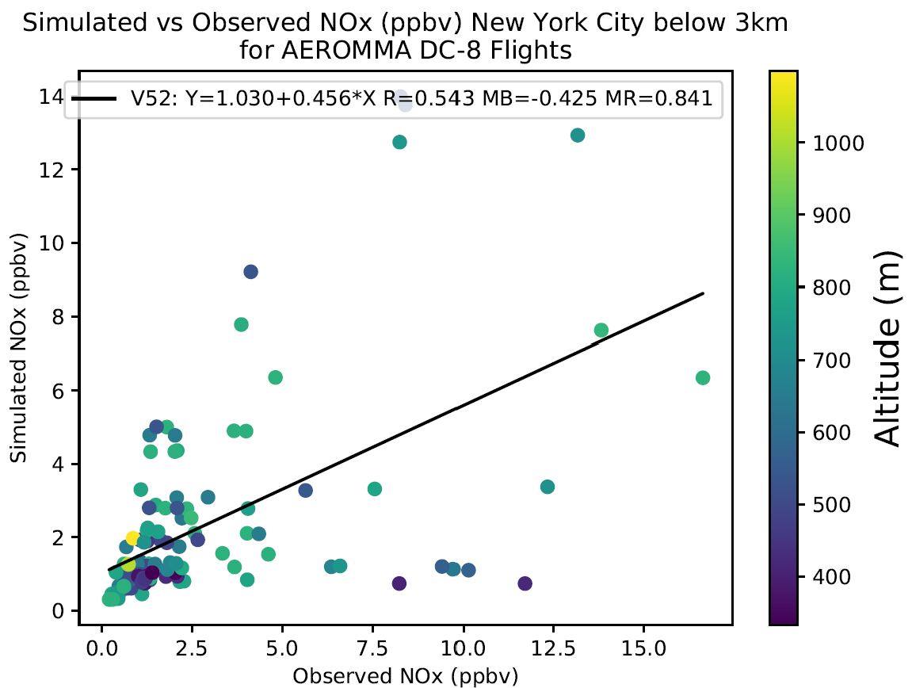
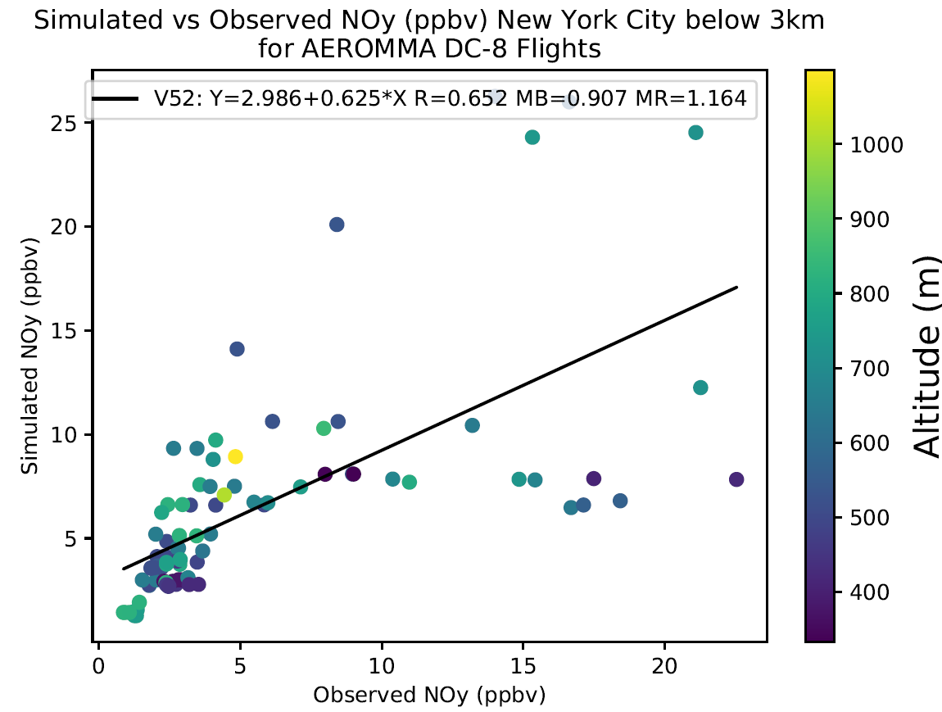
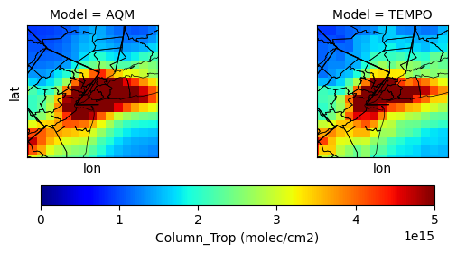
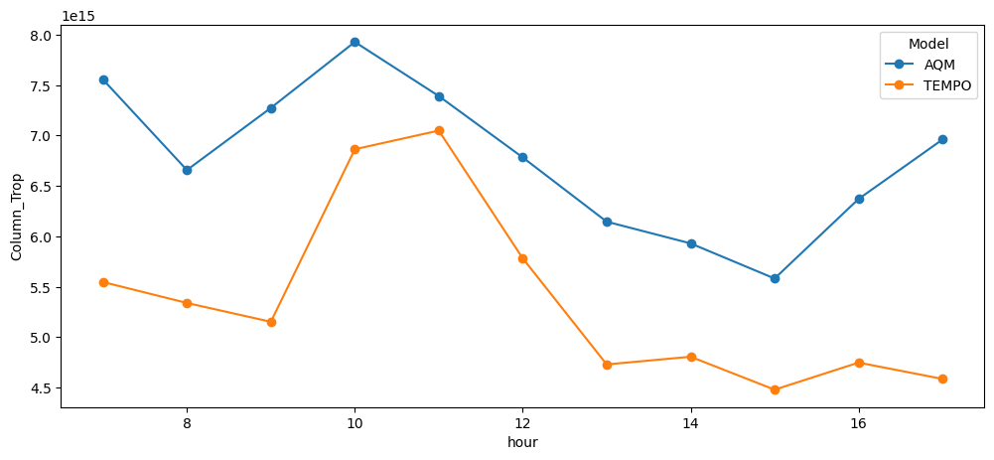
Same but for New York. The discrepancies exist among different species (NOx vs NOy) , as well as in-situ vs TEMPO comparison
Mean bias: 1.41 x 1015 (+26%)
New York City
Courtesy of Wei Li

Slide 15
Summary
The CMAQ5.4 chemistry has stronger photochemical variation than CMAQ 5.2, reflected by its higher ozone product efficiency and lower nighttime ozone.
The model’s well-mixing assumption and insufficient spatial resolution lead to overpredicted NOx consumption and NOz production, and shorter NOx age. CMAQ 5.4 shows slightly better chemical behavior over some areas.
The lateral or top boundary conditions for some species need adjustments.
SO2 is underpredicted over U.S. West and lead to aerosol speciation shift.
The consistency between Satellite and in-situ data could be an issue, and we need to be caution for making emission adjustment based on them.

