Slide 1
2024 Air Quality Forecasters Focus Group Workshop
October 9, 2024

Slide 2
CMAQ
2024 Forecasting March 1 – September 30
Ozone |  | Observation
 |  | Good | Mod | USG
Model | Good | 3301 | 223 | 0
 | Mod | 246 | 115 | 2
 | USG | 2 | 8 | 1
Fifteen forecast cities are included in summary
The largest MSA has 797,616 people
Verification for Good forecasts: 3,301
Verification for Moderate: 115
Verification for USG: 1
Ozone |  | Observation
 |  | Good | Mod | USG
Model | Good | 1080 | 103 | 2
 | Mod | 175 | 75 | 2
 | USG | 2 | 1 | 3
Seven forecast cities are included in summary
All forecast counties have >1,000,000 people
Verification for Good forecasts: 1080
Verification for Moderate: 75
Verification for USG: 3
Notes:
Paste Local into spreadsheet and add totals

Slide 3
CMAQ
USG Over-forecast
May 29: 2 USG Forecast
May 30: 8 USG Forecast, 3 Verified
May 31: 6 USG Forecast, 1 Verified
Notes:
Pensacola, Panama City, Holiday

Slide 4
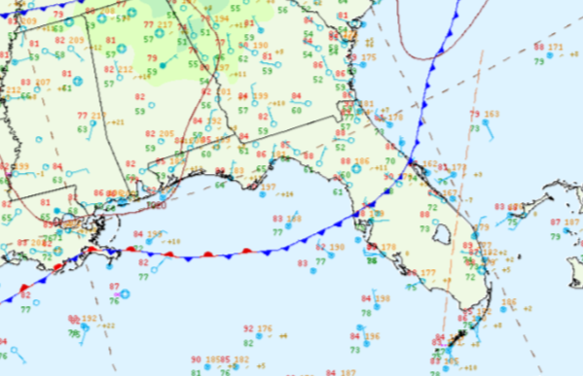
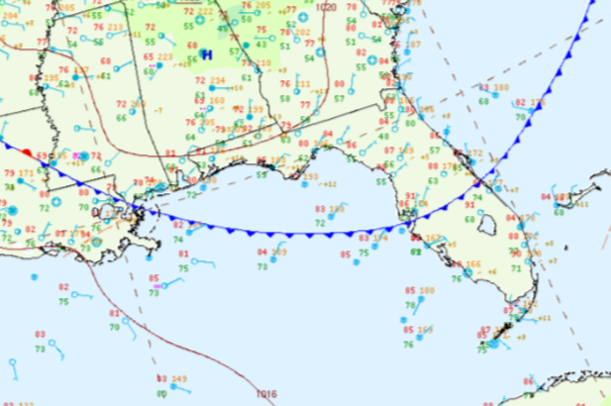
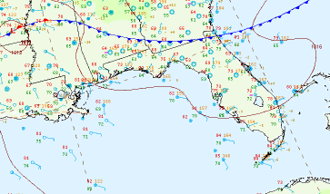
CMAQ
USG Over-forecast
18Z May 29
15Z May 30
In May, there were still cold fronts crossing into Florida.
09Z May 31
Notes:
May 29: 1 USG Forecast, Stationary Manatee line and gone 0Z May 30; May 30: 6 USG Forecast, 1 Verified, stopped Tampa, retreated to OCA and gone 6Z May31; May 31: 4 USG Forecast, Only to JAX and washed out.

Slide 5
THANK YOU
Tammy Eagan
Division of Air Resource Management / Office of Business Planning
Florida Department of Environmental Protection
Contact Information:
850-717-9022
Tammy.Eagan@FloridaDEP.gov

