Slide 1
Air Quality Forecasting in Canada – Program update
NOAA Air Quality Forecaster Focus Group Workshop
Sherry Williams – Health and Air Quality Forecast Services
Céline Audette – Health and Air Quality Forecast Services
Sylvain Ménard – National Prediction Development
Meteorological Service of Canada
October 9, 2024

Slide 2
Overview
AQHI/AQHI+ Review
AQ Advisory Program
WeatherCAN Mobile App Redesign
Small Sensor Update
New maps on Weather Office website
Introduction to Animet
MSC Transformation
Canadian Air Quality Models

Slide 3
The AQHI scale:
Based on rolling 3hr average of pollutant concentrations (NO₂, O₃ and PM_{2.5/10})
Higher index = greater health risk
AQHI forecasts available to 80% of Canadian Population in:
123 Communities across Canada
11 additional local station forecasts in larger cities
Special focus on sensitive population and health impacts
Continue to support the Info-Smog (AQI) program in Quebec
Stieb D, Burnett R, Smith-Doiron M, Brion O, Hwashin H, Economou V Journal of the Air and Waste Management Association, 2008 vol: 58 (3) pp: 435-450
Notes:
AQHI Health based communication tool. 3 pollutant ‘classic’ formula

Slide 4
AQHI-Plus – Alternate formulas for Regional flexibility
Alternate formula based on single pollutants for calculating AQHI
Pollutant threshold often linked to high risk AQHI category, based on provincial regulations
Generally based on 1-hr average to be more responsive to rapidly changing conditions, but also more vulnerable to errors
Health Based AQHI using only PM_{2.5} Wildfire and Residential Wood Smoke
Ceiling([PM_{2.5}]/10) -> calculated in parallel with AQHI, highest is reported as observation
Applies to all values of PM_{2.5} (no thresholds)
1-hour PM2.5 AQHI+ exhibits best-fit for respiratory outcomes for smoke events (Yao et al) ¹
Also effective during cold season for communities impacted by residential wood smoke. (Trieu et al) ²
Currently implemented all seasons for all provinces and territories, except Quebec which uses AQHI+ PM2.5 only for Wildfire smoke.
¹Yao, J., Stieb, D. M., Taylor, E., & Henderson, S. B. (2019). Assessment of the Air Quality Health Index (AQHI) and four alternate AQHI-Plus amendments for wildfire seasons in British Columbia. Canadian Journal of Public Health. https://doi.org/10.17269/s41997-019-00237-w
²Jeffrey Trieu, Jiayun Yao, Kathleen E. McLean, Dave M. Stieb & Sarah B. Henderson (2020) Evaluating an Air Quality Health Index (AQHI) amendment for communities impacted by residential woodsmoke in British Columbia, Canada, Journal of the Air & Waste Management Association, 70:10, 1009-1021, DOI: 10.1080/10962247.2020.1797927
Notes:
Each Storm Prediction Centre issues advisories based on specific thresholds set by the province or territory. Some provinces like BC and QC have a more robust provincial program. BC issues alerts at the provincial level and then sent out by the ECCC forecasters in our system.

Slide 5
AQ Alerting SAQS and AQA
2 tier system for AQ Alerts
SAQS (Special Air Quality Statement)
AQHI 7-10
AQA (Air Quality Advisory)
AQHI 10+ due to wildfire smoke only
Weather office Air Quality alert layer

Slide 6
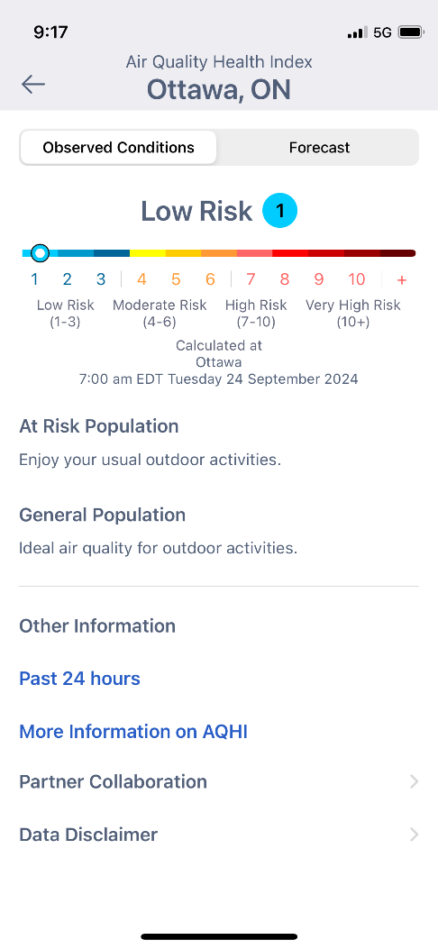
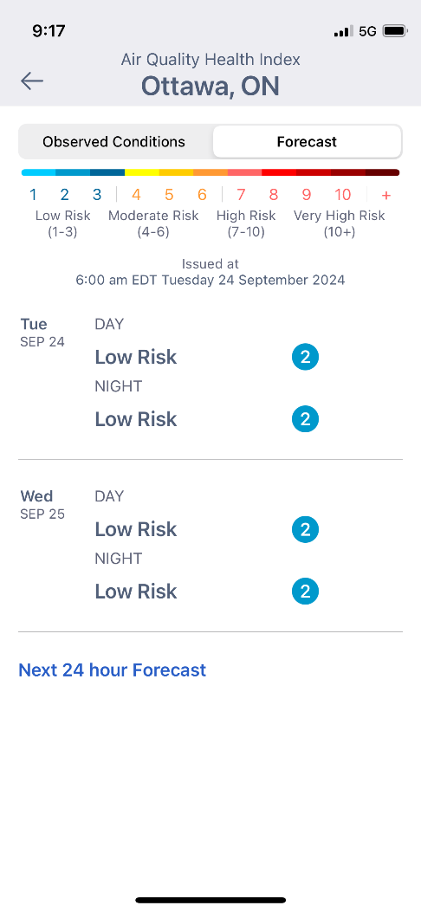
WeatherCAN APP Redesign
The AQ observations are visible on the main ‘now’ page
Users set notifications for their AQHI number, and soon Temperature, Humidex and Wind chill
Notes:
This is a key innovation product which will also include notifications for temperatures in the next upgrade.

Slide 7
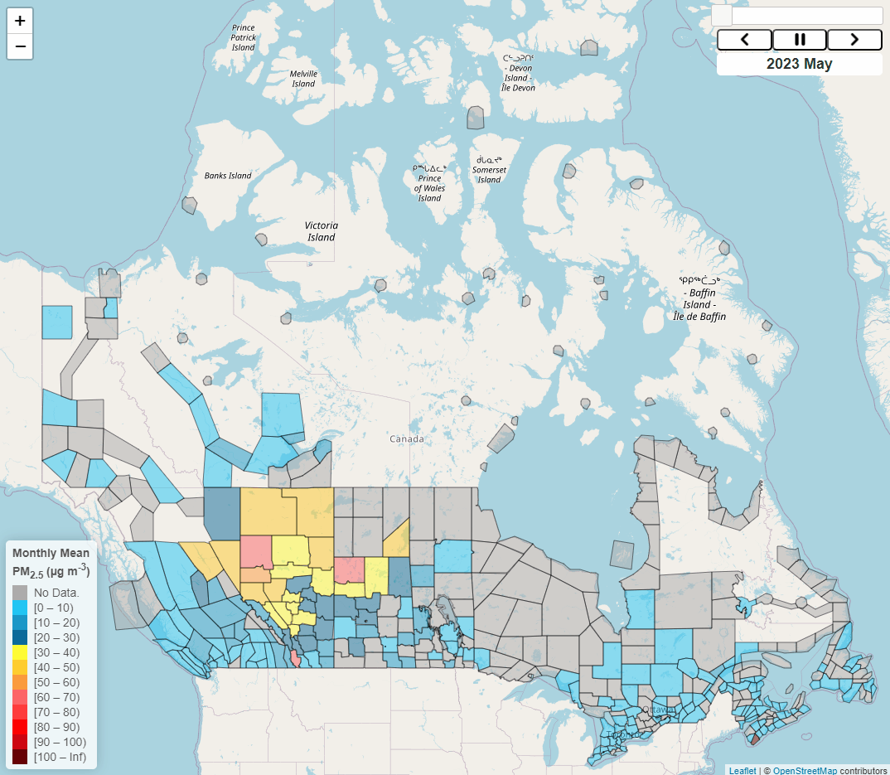
National Small Sensor Pilot Project
After the 5-year pilot, plans for transitioning to a program
Hourly, near real-time PM_{2.5} data is available on the AQmap in partnership with UNBC with additional layers.
Spatial data to verify models and analysis
Future -> Fill gaps in observation network to improve gridded products
EPA including Canadian Small sensors on fire and smoke map.

Slide 8
PM2.5 Peak Events (May 1 – Sept 4)
Notes:
Shows daily max concentrations by forecast zone. Y-axis Daily % of forecast zones, and colour code of AQHI+ category. This is looking at the PM2.5. Is from AQmap.
Can see different events where the AQHI+ spiked. Mostly in July and Aug. AB had a spike in mid May, but then received rain so the fires were kept under control.

Slide 9
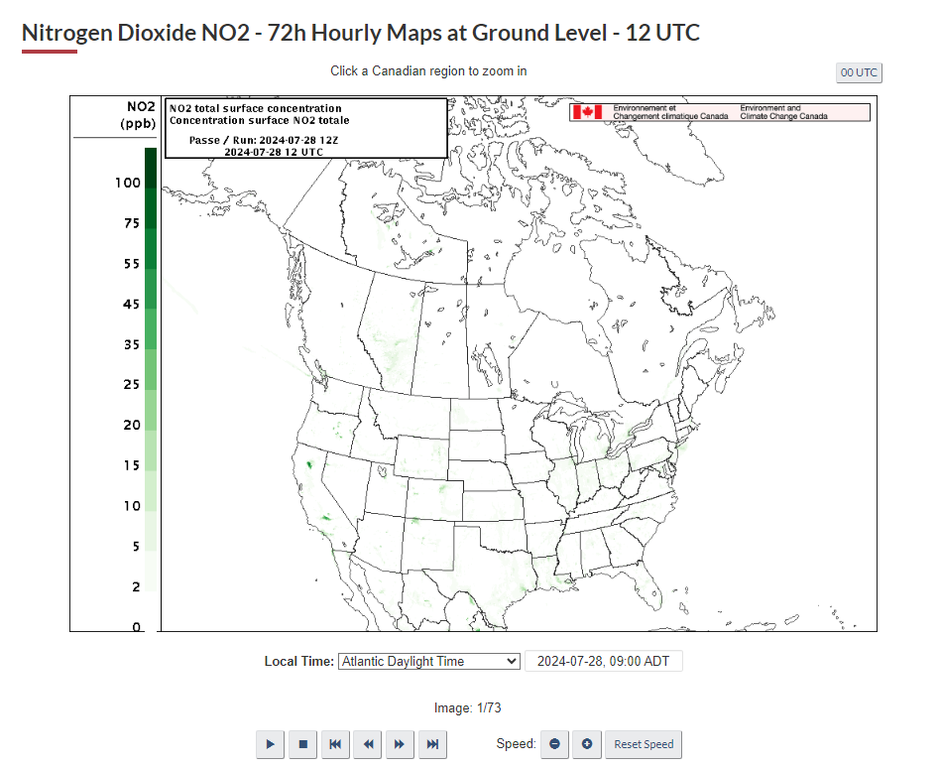
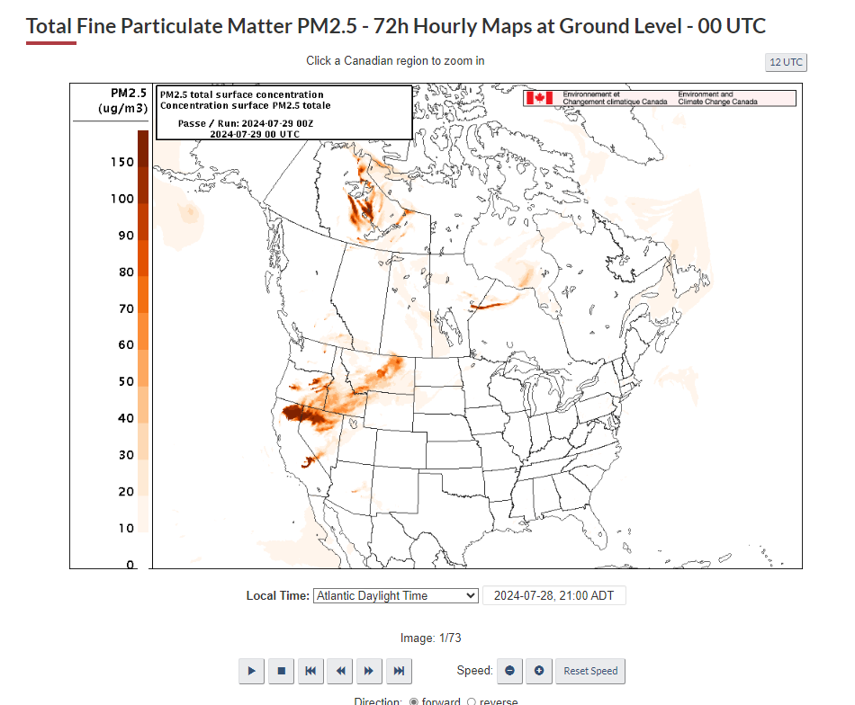
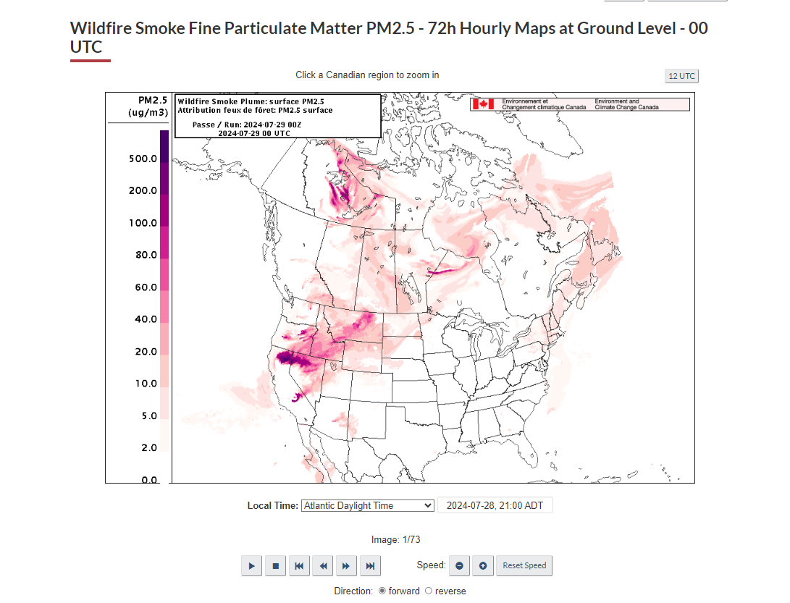
New RAQDPS Maps
Notes:
On weather office, colour are still subject to change. Working with partners to find the best colour scheme. We may add more maps like Max PM2.5

Slide 10
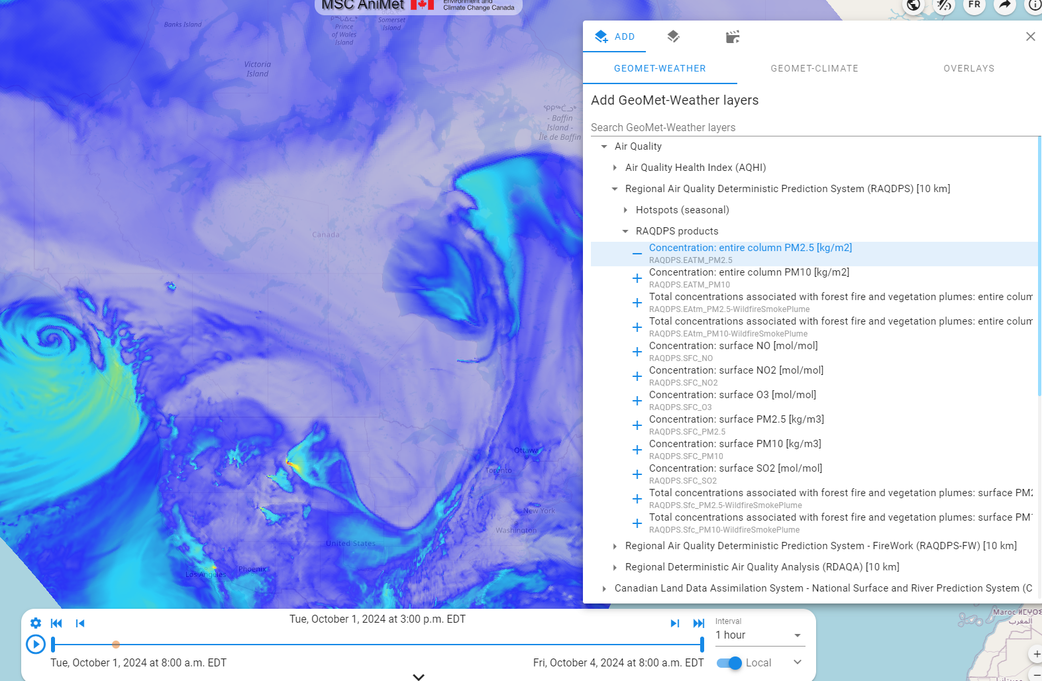
MSC AniMet /AniMet du SMC - MSC Open Data / Données ouvertes du SMC (eccc-msc.github.io)
Notes:
Where to go for info that is no longer on the website. This will be the go to.

Slide 11
MSC TRANSFORMATION
AQ on Grid
Part of a larger initiative to create gridded products for public weather observations and forecasts
Transition from point observations and fixed regional forecasts to a uniform 10x10 km grid
Increase consistency at provincial/territorial borders
RiTA – Risk Tiered Alerting
For all weather alerts types
Evolve from what the weather will be to include what the weather will do
WINGS
Visualization for routine forecasts
To include a weather story, point forecast and meteograms
Notes:
AQ on Grid : Process mainly automated with minimal forecaster intervention, forecast summer 2025, observations (synthetic obs) 2026
Preparation for implementation for 2025-2026

Slide 12
Canadian Air Quality Model(s) Sylvain Ménard – National Prediction Development (ECCC) with contribution from Rodrigo Munoz-Alpizar (ECCC)
Notes:
AQ on Grid : Process mainly automated with minimal forecaster intervention

Slide 13
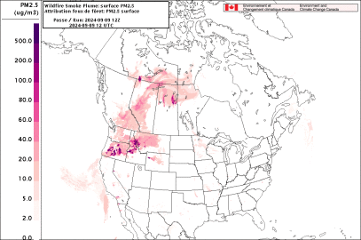
ECCC’s operational AQ systems COMPONENTS Regional Air Quality Deterministic Prediction System (RAQDPS)
RAQDPS main components:
https://collaboration.cmc.ec.gc.ca/cmc/cmoi/product_guide/docs/tech_specifications/tech_specifications_RAQDPS_025_e.pdf
Meteorology: Based on GEM 5.2.1 (NWP)
Chemistry: On-line Chemistry library 3.1.0 (detail gas/aerosol chemistry/physics)
Emissions (CO, NOx, VOCs, PM etc.) :
Anthropogenic: Can-US-Mex gridded hourly emissions of pollutants over North America (set 5.0).
Biogenic based on BEIS 3.7
Wildfire :
Canadian Forest Fire Emissions Prediction System (CFFEPSv4.1)
Detail forest fuel parameters (@250m, e.g., crown/surface fuel loads, elevation, slope, stand density…)
Diurnal fuel consumption based on heat for plume-rise parameterization
Modelled fire rate of spread
Technical specifications:
Limited Area Model over North America (LAM)
10 km horizontal resolution
84 Hybrid Levels up to 0.1 hPa (~65 km)
Run twice a day (00, 12 UTC)
Provides 72-hour AQ forecast mainly for O3, NO2, PM2.5 (AQHI)
Air Quality products available to public:
https://weather.gc.ca/firework/
RAQDPS is an essential tool to forecast the regional distribution of wildfire smoke

Slide 14
RAQDPS innovations IC4 (implemented Operationally in JUNE 2024)
https://collaboration.cmc.ec.gc.ca/cmc/cmoi/product_guide/docs/tech_notes/technote_raqdps-v25_e.pdf
Innovation | Description | Description | Gains & Benefits
Meteorology
I#1 | Upgrade of the Meteorological system GEM5.1.2 to GEM5.2.1 |  | Leverage from NWP GEM improvements
I#2 | Use of IC and LBC from Global (GDPS-G0 10km) instead of the regional (RDPS 10 km) system |  | Phasing out RDPS (open the door to > 3 days air quality forecast in the future)
Chemistry
I#3 | Keeping only one AQ modelling system RAQDPS (Phasing out Firework) |  | Facilitate maintenance & better usage of resources
I#4 | Update to lateral chemical boundary conditions |  | improve ozone concentration along the southeastern border
I#5 | Added impact of Vehicle Induced Turbulence (VIT) on pollutant dispersion from on-road mobile emissions |  | important sub-grid scale vertical mixing processes, can enhance the vertical mixing of on-road vehicle emissions
I#6 | Below-cloud particle scavenging by mixed phase precipitation |  | Non-linearly interacts with the changes in the precipitation
I#7 | Update to Gas-phase dry deposition – Robichaud version 3 and Aerodynamic resistance bug fix |  | Better representation of Gas-phase dry deposition process
I#8 | Update to more accurate gas-phase chemistry solver method (KPP) |  | Improves nitrogen chemistry in gas phase and has a secondary effect on PM concentration.
I#9 | Adding Sea-salt to total PM_{2.5} output |  | Total concentration increases PM2.5 concentration in the coastal regions
Emissions
I#10 | Update to Projected 2023 Canadian Air Pollutant Emission Inventory and Spatial Allocation Emissions Surrogates |  | Improvement of winter PM2.5 forecasts in Canadian cities
I#11 | Update of Biogenic Emissions based on BEIS 3.7 and Satellite-derived Leaf Area Index (vegetation/landuse database) |  | Result in ozone increases over Boreal forest and Rockies
14

Slide 15
RAQDPS Innovations impact on Ozone, NO2 and PM2.5 (Test - Control) --- Spatial differences in average seasonal surface concentrations
Summer 2019 (July – Aug.)
x
x
x
x
ΔPM_{2.5}
ΔNO₂
ΔO₃
Seasalt
Below Cloud
Scavenging
VIT
Biogenic
Biogenic/LAI
Biogenic
Anthro Emis
Decrease
CLBCs
Anthro Emis
Decrease
WildFires (x on the map)

Slide 16
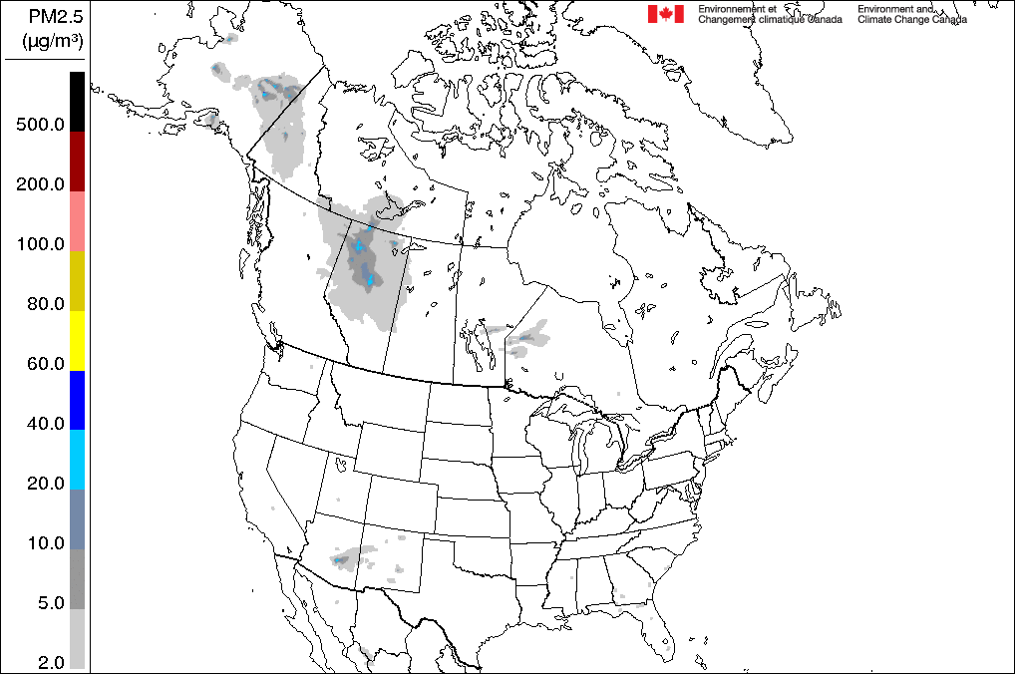
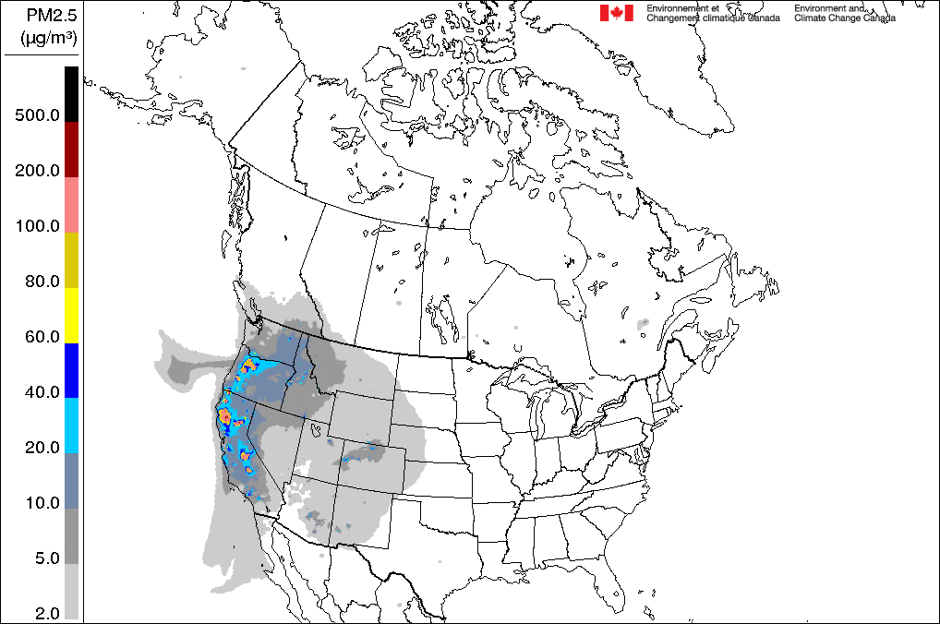
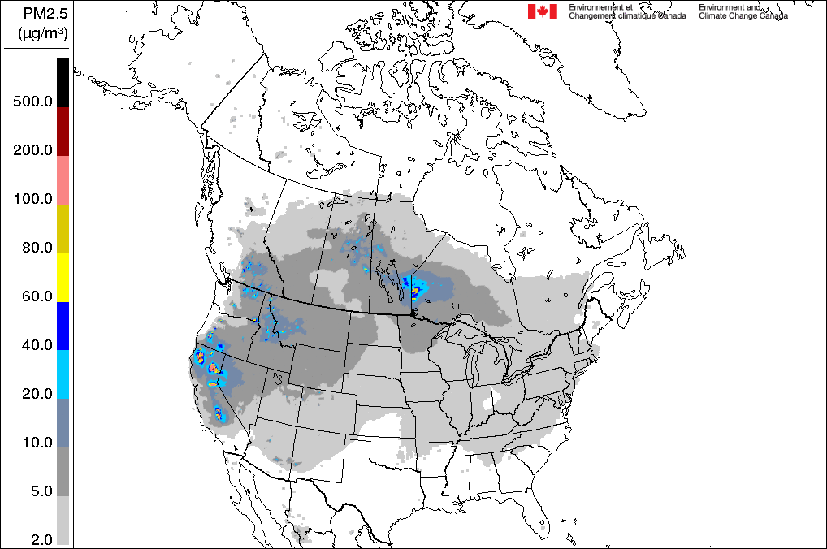
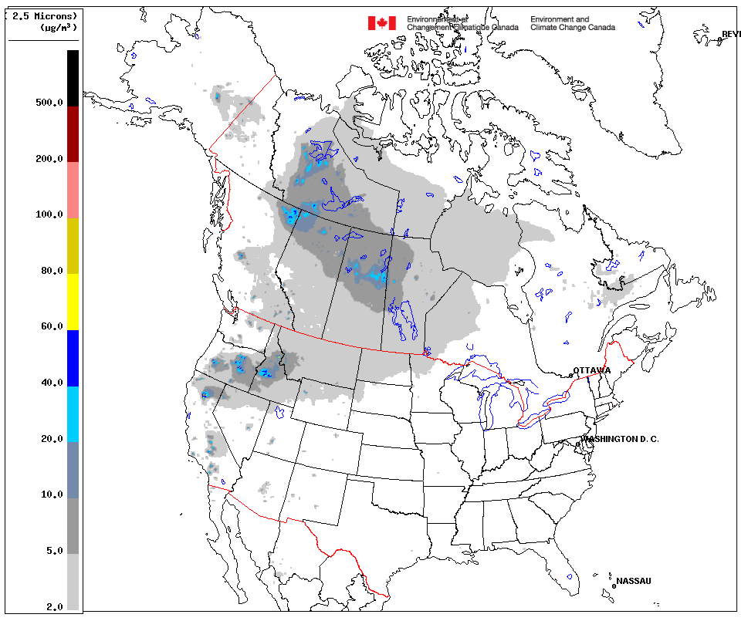
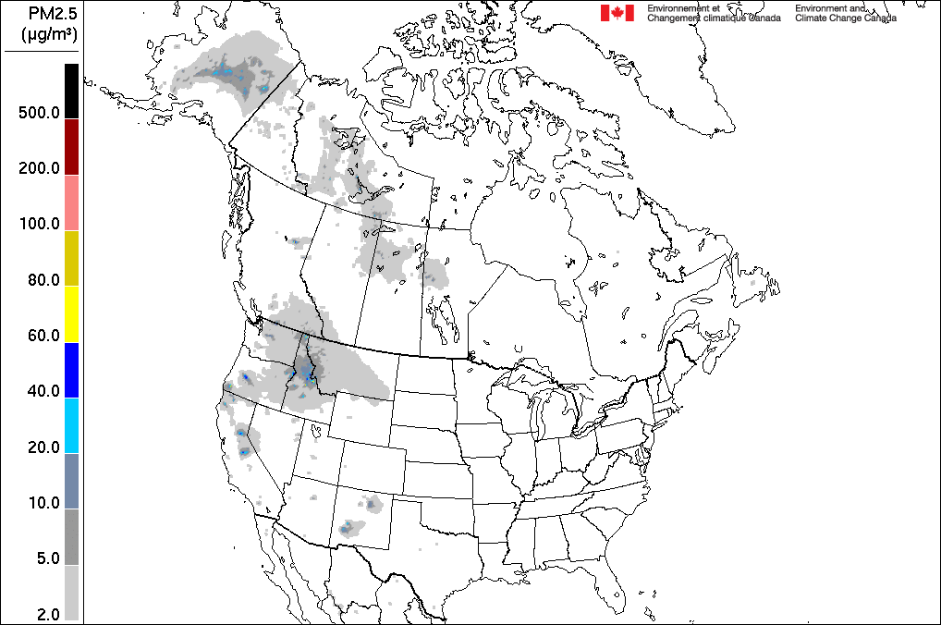
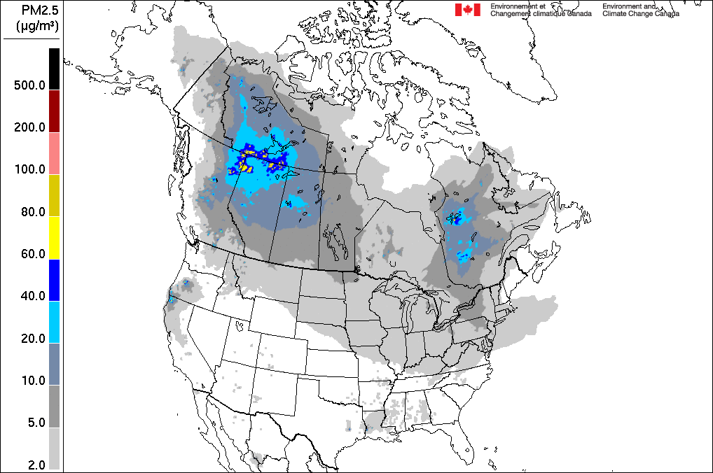
Wildfire-related pollution: seasonal wildfire contributions to PM2.5 surface concentrations fire-PM_{2.5} mean (May-SEP) surface concentrations
2019
2020
2021
2022
2023
2024
Wildfires are episodic and have a high spatial variably

Slide 17
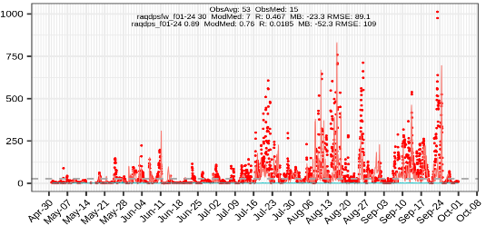
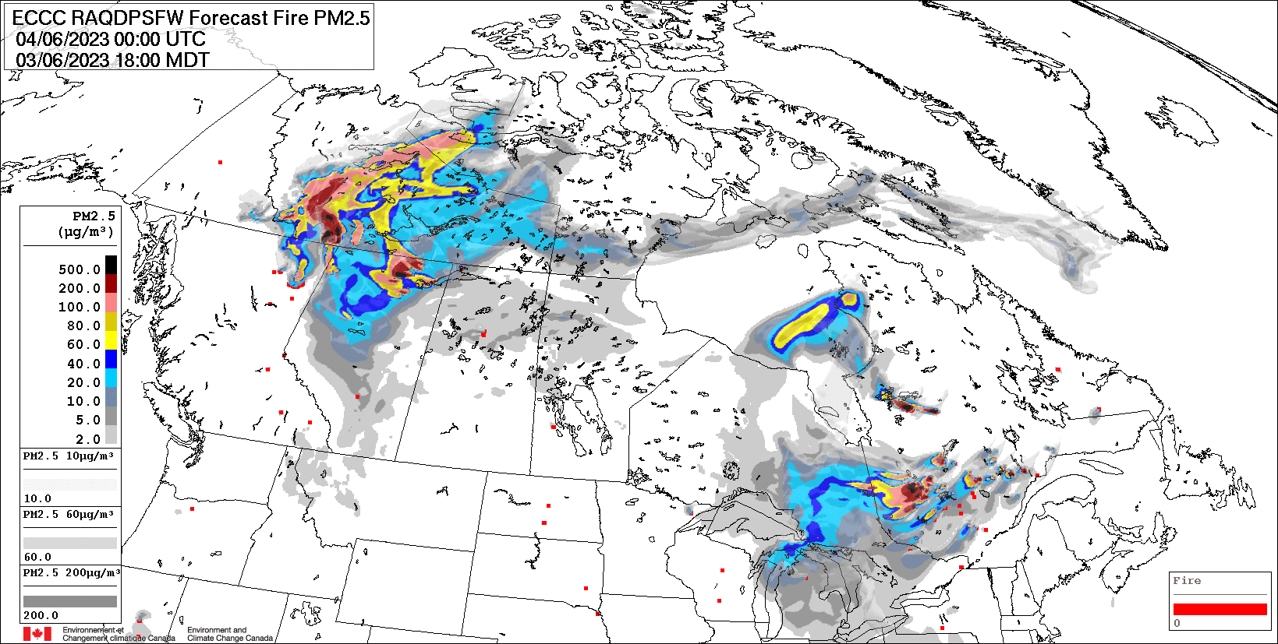
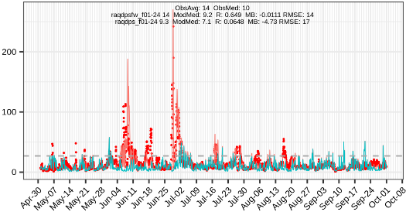
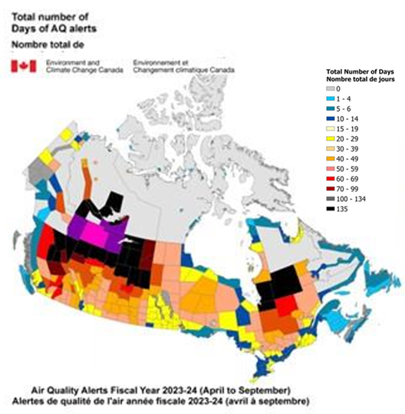
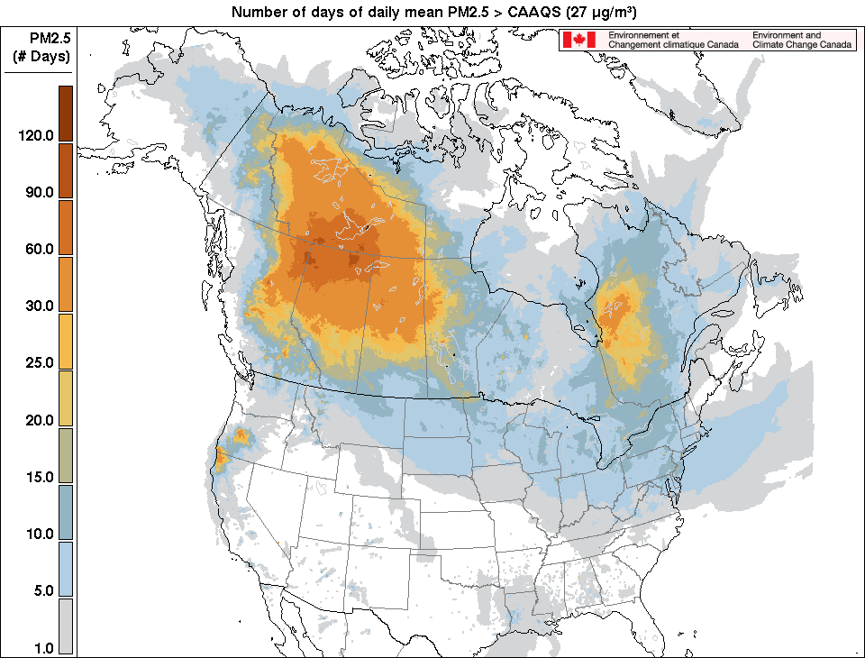
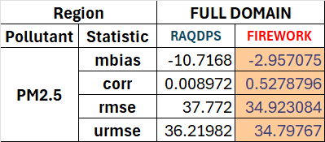
2023 Canadian WILDFIRES IMPACTS
ECCC RAQDPSFW surface PM2.5 72-hr forecast Jun. 4 00z
Yellowknife, NT
Canadian Ambient Air Quality Standard (CAAQS) PM_{2.5} : 24-hr avg. 27 µg/m³
Toronto, ON
Thanks to: Rodrigo Munoz-Alpizar (ECCC)
#Days of Daily Mean PM2.5 > CAAQS (May-Sep 2024)
Firework and RAQDPS statistics for daily Max. PM_{2.5} (May – September 2023)

Slide 18
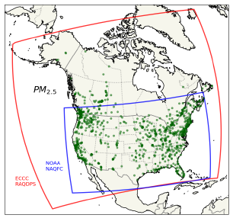
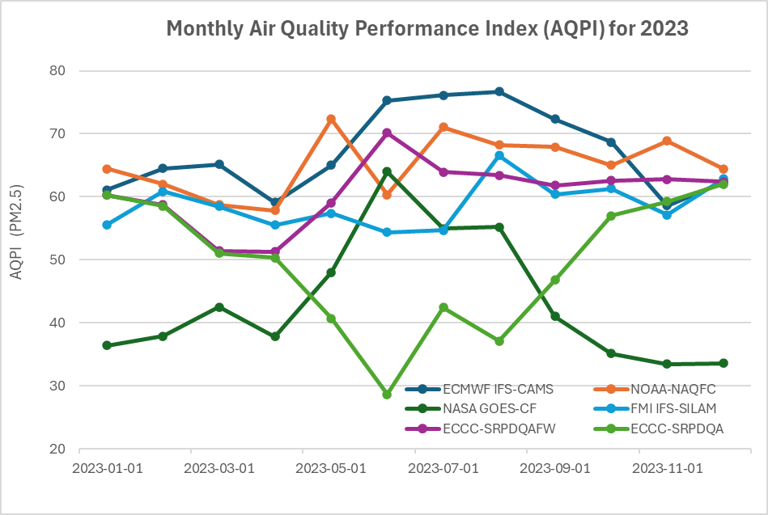
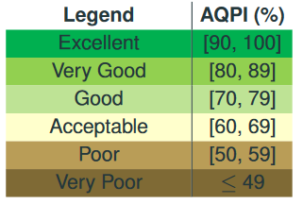
Collaborative initiatives
North American AQ Multi Model Forecast Evaluation
Domain: NAQFC–RAQDPS intersection
AQPI[O₃,NO₂,PM_{2.5}] = 100*AVG( FAC2, R , 1-ABS(MFB/2) )
Pollutant-Specific
AQPI is calculated from the daily max of the first 24h forecasts
Provide values ranging from -33 to 0 (no skill) to 100 (perfect model)
FAC2 : Factor-of-2 Fraction (measure of error, scatter or dispersion)
Fraction (0-1) of modelled (P_{i}) & observed (O_{i}) pairs satisfying the criterion 0.5 ≤ 𝑃_{𝑖} / 𝑂_{𝑖} ≤ 2.0
Dimensionless statistic, not sensitive to outliers
R : Correlation Coefficient
Measure of linearity of relationship
Dimensionless, values between -1 and 1.
MFB : Mean Fractional Bias
Measure of bias or offset
Where $MFB=2\sum{(P_{i} −O_{i})}/\sum{(P_{i}+O_{i})}$ and $1−\left|MFB/2\right|$ provides values in range 0-1.
Dimensionless, symmetric and bounded statistic.
AQPI[PM2.5] = 100 · avg[ FAC2, R, 1 − |MFB/2|

Slide 19
Future plan Innovation cycle 5 (IC-5)
Improve DYN/PHY/CHEM algorithms
Updates of anthropogenic and biogenic emissions
Target date for operational implementation: 2027
Thank you!

