Slide 1
Minnesota Heavy Wildfire smoke events 2014-2023
Ryan Lueck
Minnesota Pollution Control Agency

Slide 2
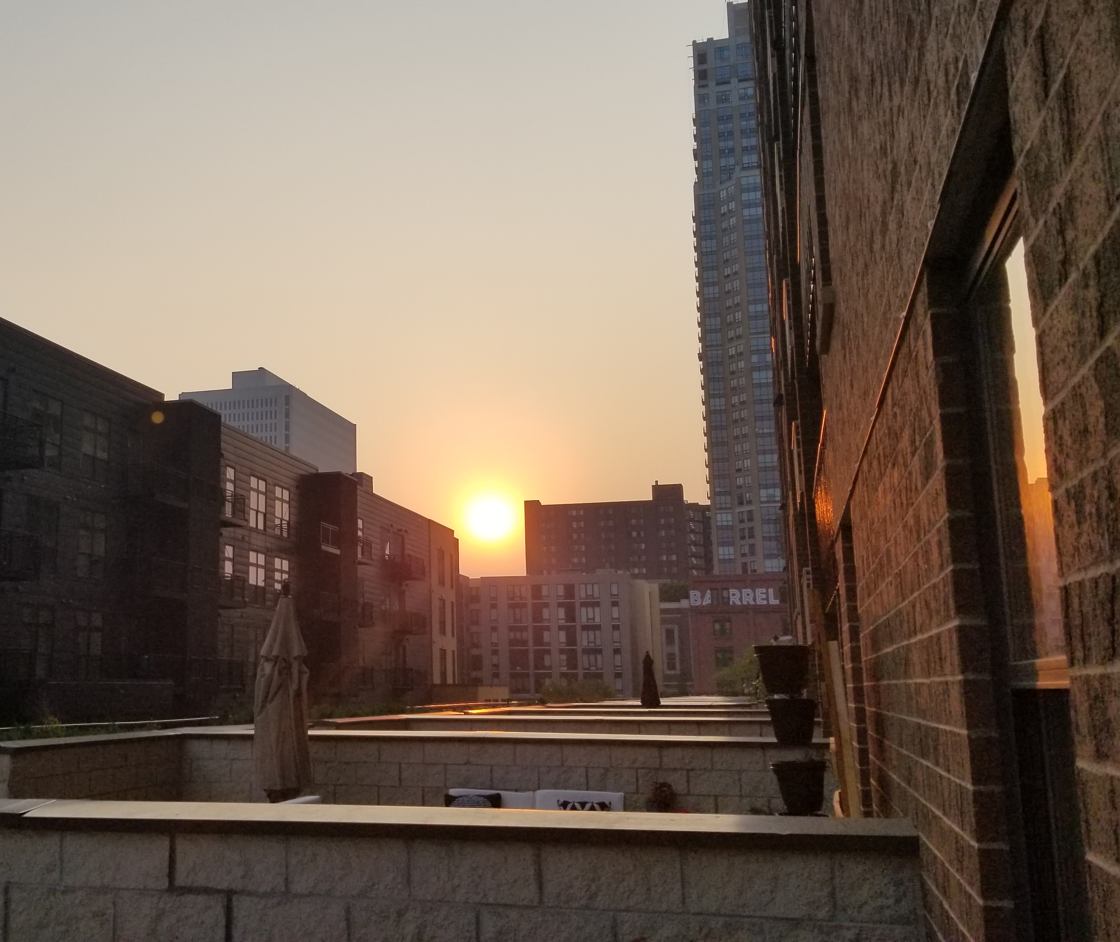
Motivation
Better understand past wildfire smoke events to help forecast future events by establishing a climatology/goal posts
Silver lining to the 2021 & 2023 season
Solidify conceptual models
Synoptic, surface, other weather patterns & parameters
Fire weather conditions
Create another angle from which to approach the forecast, apart from models alone
Variety of tools available for context in weather forecasting such as analogs
Help inform a potential future “outlook” for partners to increase lead time and awareness of potential smoke intrusions
Notes:
*Weekly MNICS briefings – we try to provide a daily “probability of alert” through the next 7 days

Slide 3
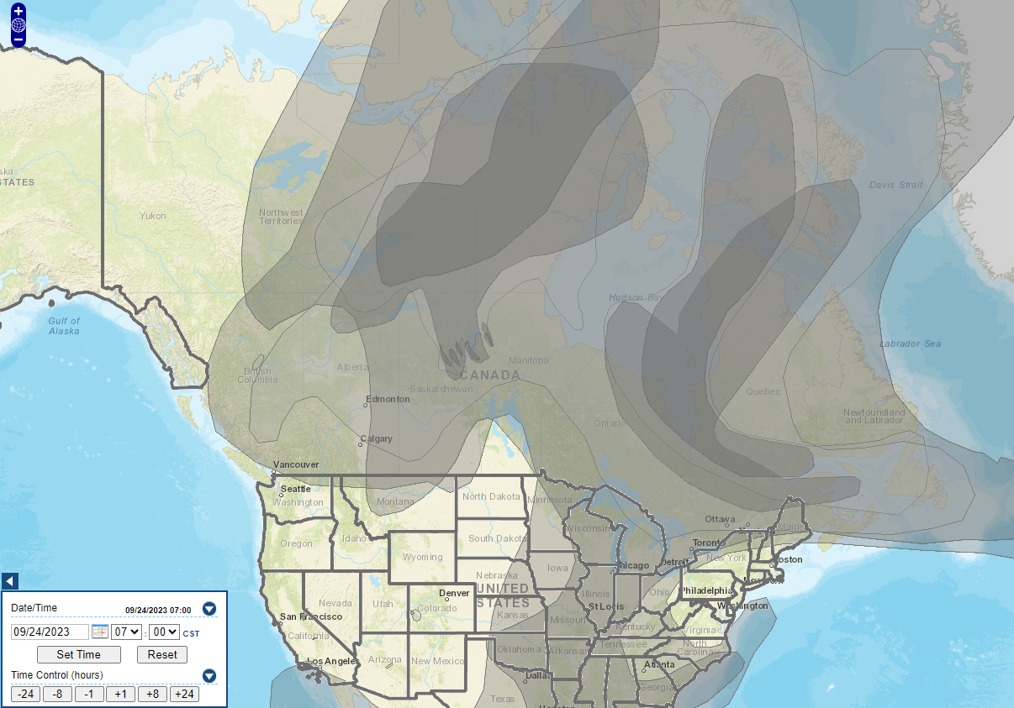
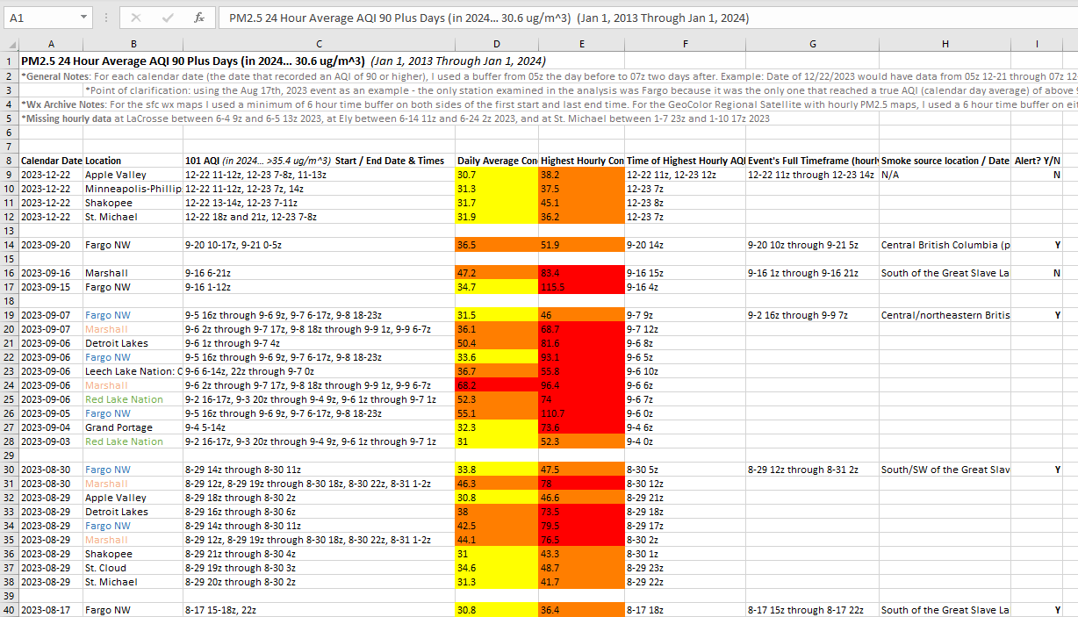
Overview
Identified all Minnesota monitors that had AQI of 90 or greater for PM2.5
Focused on daily NAAQS exceedance criteria, despite the limitations (bulk of smoke not likely to fall neatly within the midnight to midnight timeframe, etc.)
Added a 10 AQI buffer to capture some of the events that may have exceeded via a rolling 24 hour average
Filtered out all non-wildfire events by reviewing archived NOAA Hazard Mapping System smoke plume analysis and polar-orbiting satellite data
Notes:
*I believe there are 25 total PM2.5 “Minnesota monitors” which includes one in Fargo, ND and La Crosse, WI
*MN centric, but hopefully of use or interesting to others

Slide 4
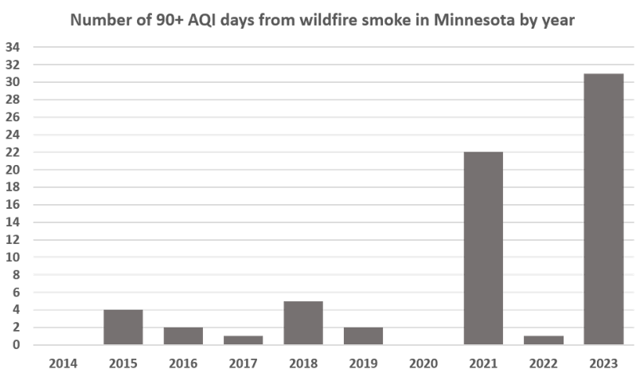
Overview
Years examined: 2014 - 2023
Number of days at least one MN monitor reached an AQI of 90+: 68
Number of events: 25
Defined as an episode of heavy smoke with hourly concentrations of 35.5 ug/m^3 at minimum somewhere in Minnesota within a +/-24 hour buffer of an AQI 90+ day, to simulate how we’d handle Air Quality Alerts (continuation vs new alert)
Each event lasts 2.7 days on average
Notes:
*Still small, but workable sample size thanks to the 2021 and 2023 wildfire seasons.
*These are the worst events. There are many more that involved 6-12 hours of alert-level concentrations but didn't average out high enough.

Slide 5
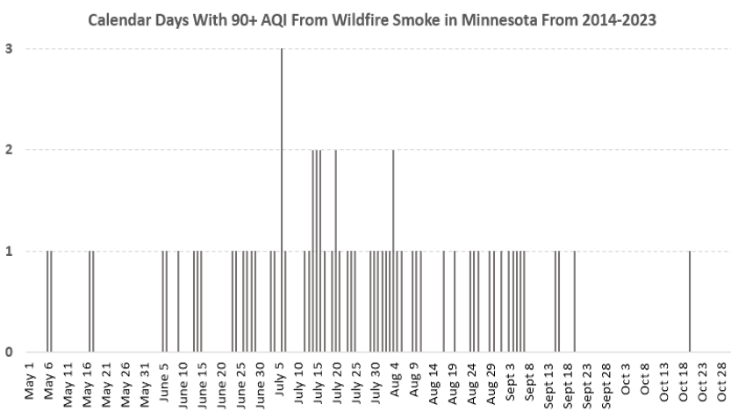
Overview
Years examined: 2014 - 2023
Number of days at least one MN monitor reached an AQI of 90+: 68
Number of events: 25
Defined as an episode of heavy smoke with hourly concentrations of 35.5 ug/m^3 at minimum somewhere in Minnesota within a +/-24 hour buffer of an AQI 90+ day, to simulate how we’d handle Air Quality Alerts (continuation vs new alert)
Each event lasts 2.7 days on average
Notes:
*78% of these days were in 2021 and 2023, which has definitely put a damper on our precious warm season as of late. Many Minnesotans have begun routinely checking the air quality forecast like they do the weather forecast.

Slide 6
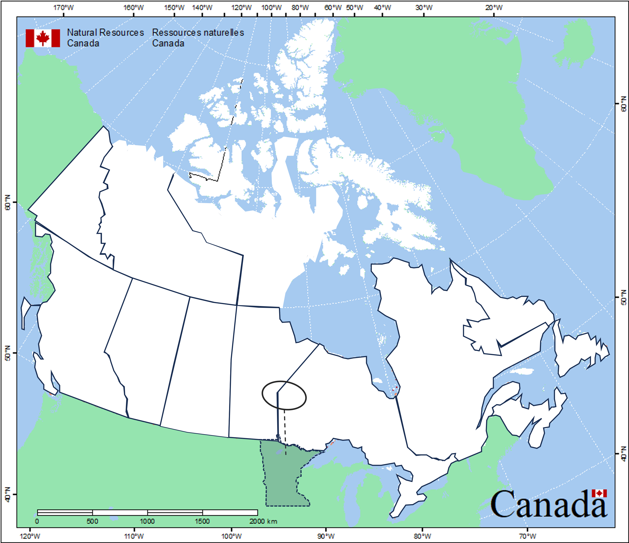
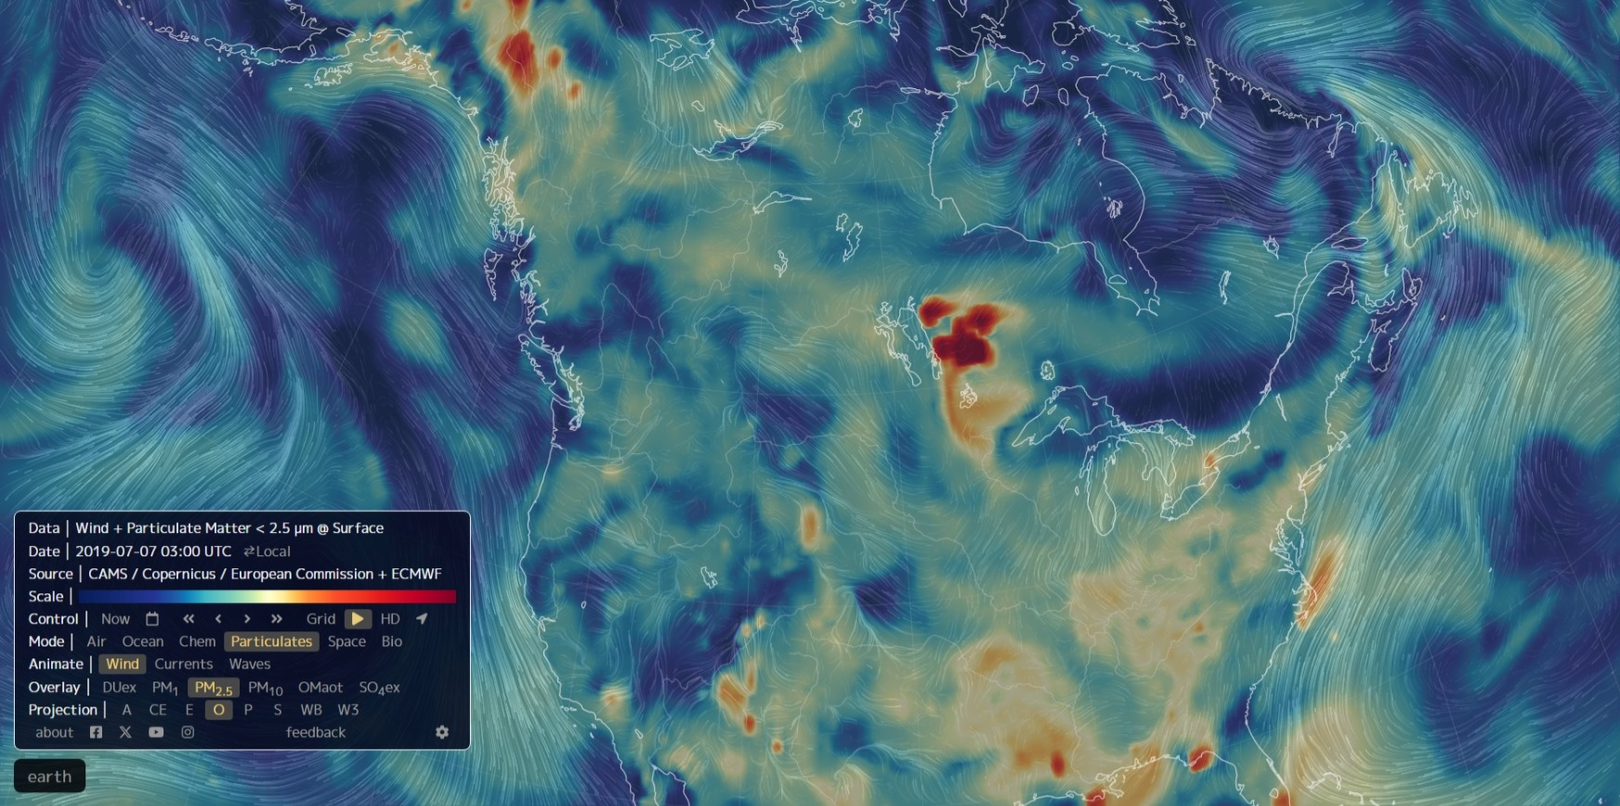
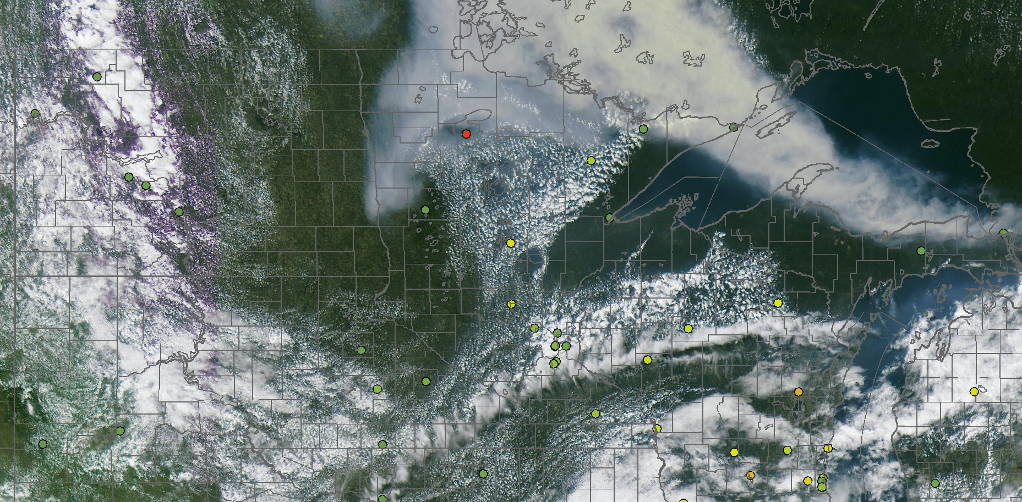
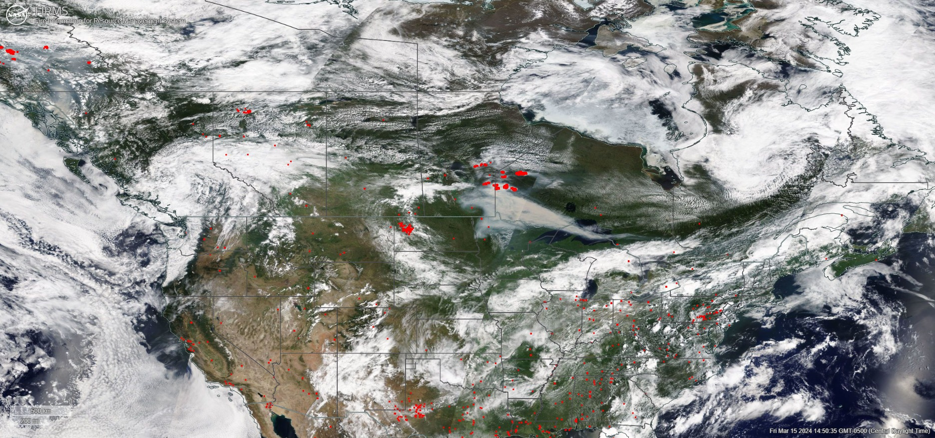
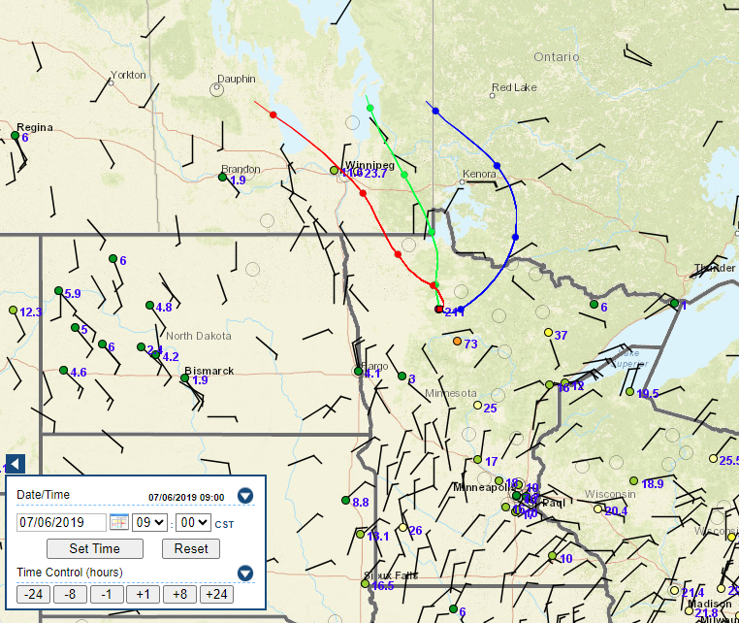
PROCESS
Reviewed polar-orbiting satellite hotspot, aerosol optical depth, and visible imagery, geostationary satellite data when available, smoke model forecasts, air quality observations, and Hysplit back-trajectories as needed
Assigned approximate wildfire areas for each event and their approximate smoke path to Minnesota
July 6, 2019
Map adapted from NRC

Slide 7
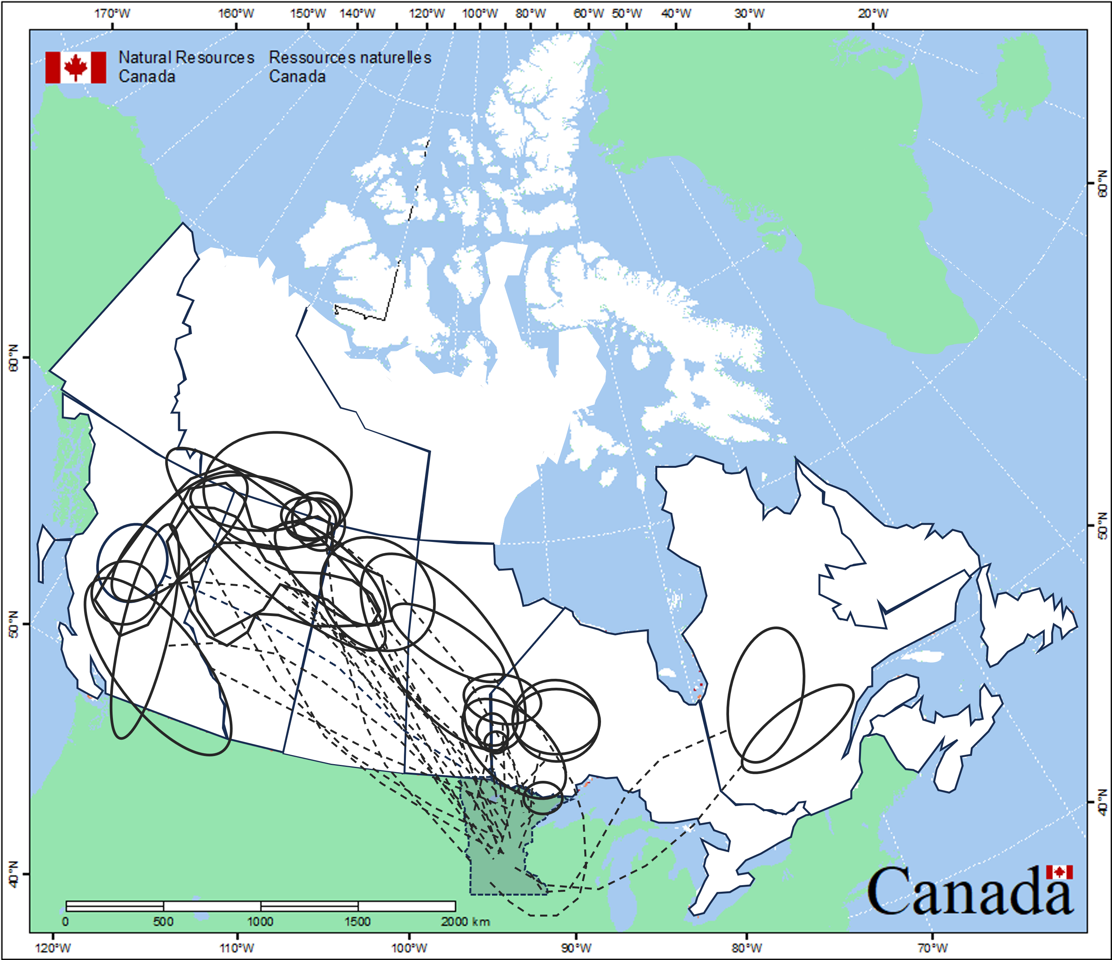
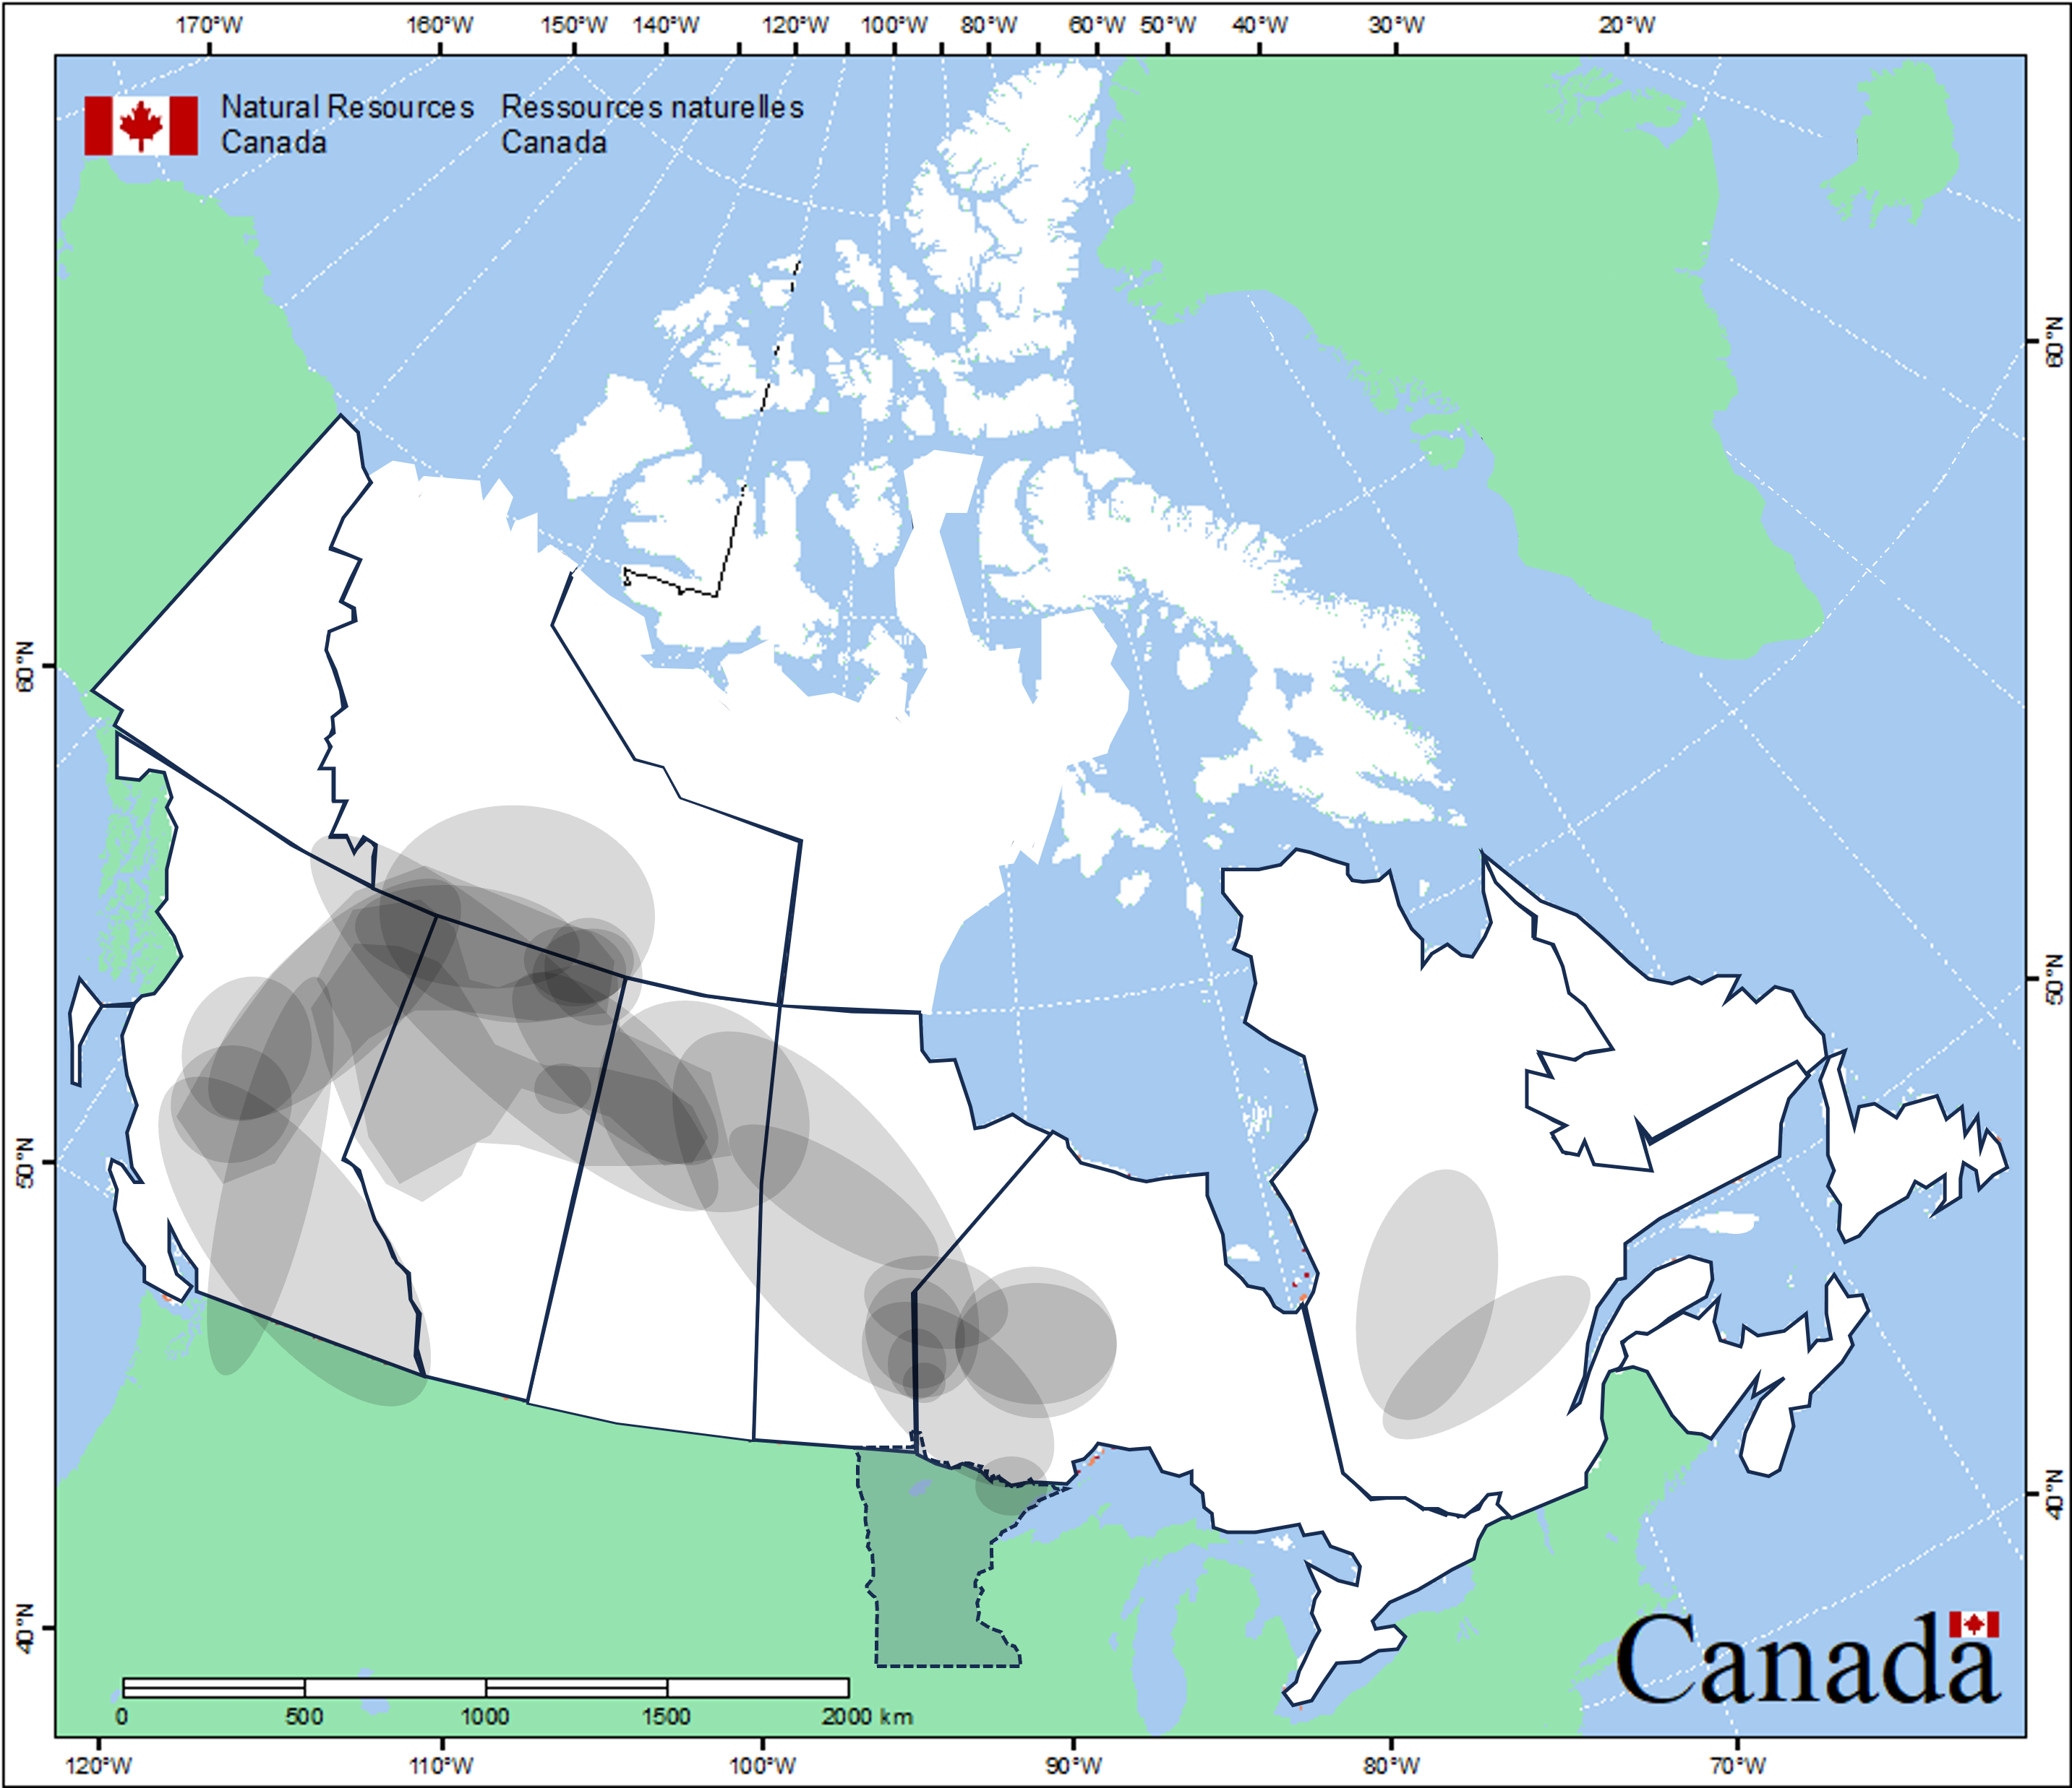
Minnesota’s PM2.5 Exceedance-Causing Wildfires 2014-2023
25 event composite
Takeaways:
Apart from a couple events partially in northern WA/ID/MT, no exceedance events from western US wildfires
An event from 2024 featured mix of Idaho and Saskatchewan smoke
Distances range from near to far
Map adapted from NRC
Notes:
*(”Exceedance-Causing” including the 10 AQI buffer (really 90+ AQI))
*Possible explanation is, oftentimes need a cold front. First, low pressure typically develops on the leeward side of the Rockies. Second, cold fronts typically don’t travel from south to north. Storm track climatology: https://www.cpc.ncep.noaa.gov/products/precip/CWlink/MJO/strack.shtml

Slide 8
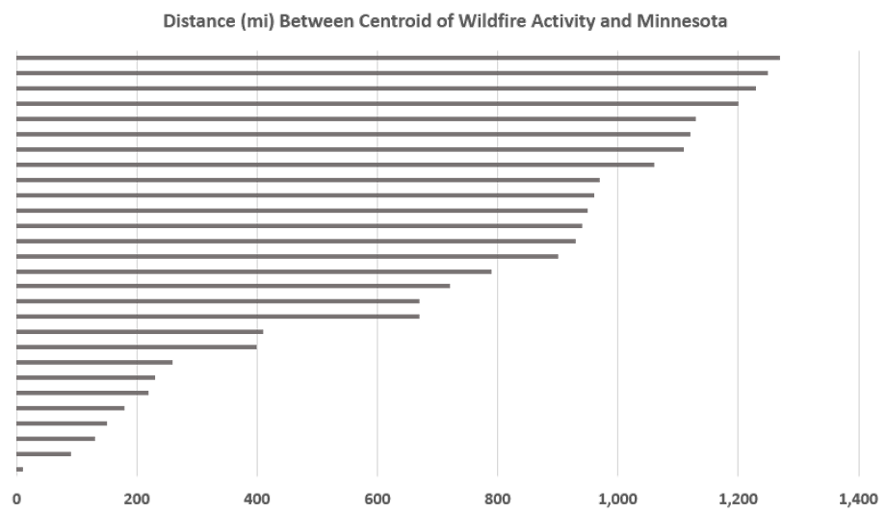
Minnesota’s PM2.5 Exceedance-Causing Wildfires 2014-2023
Notes:
*The 10 mile wildfire event was partly inside Minnesota as well

Slide 9
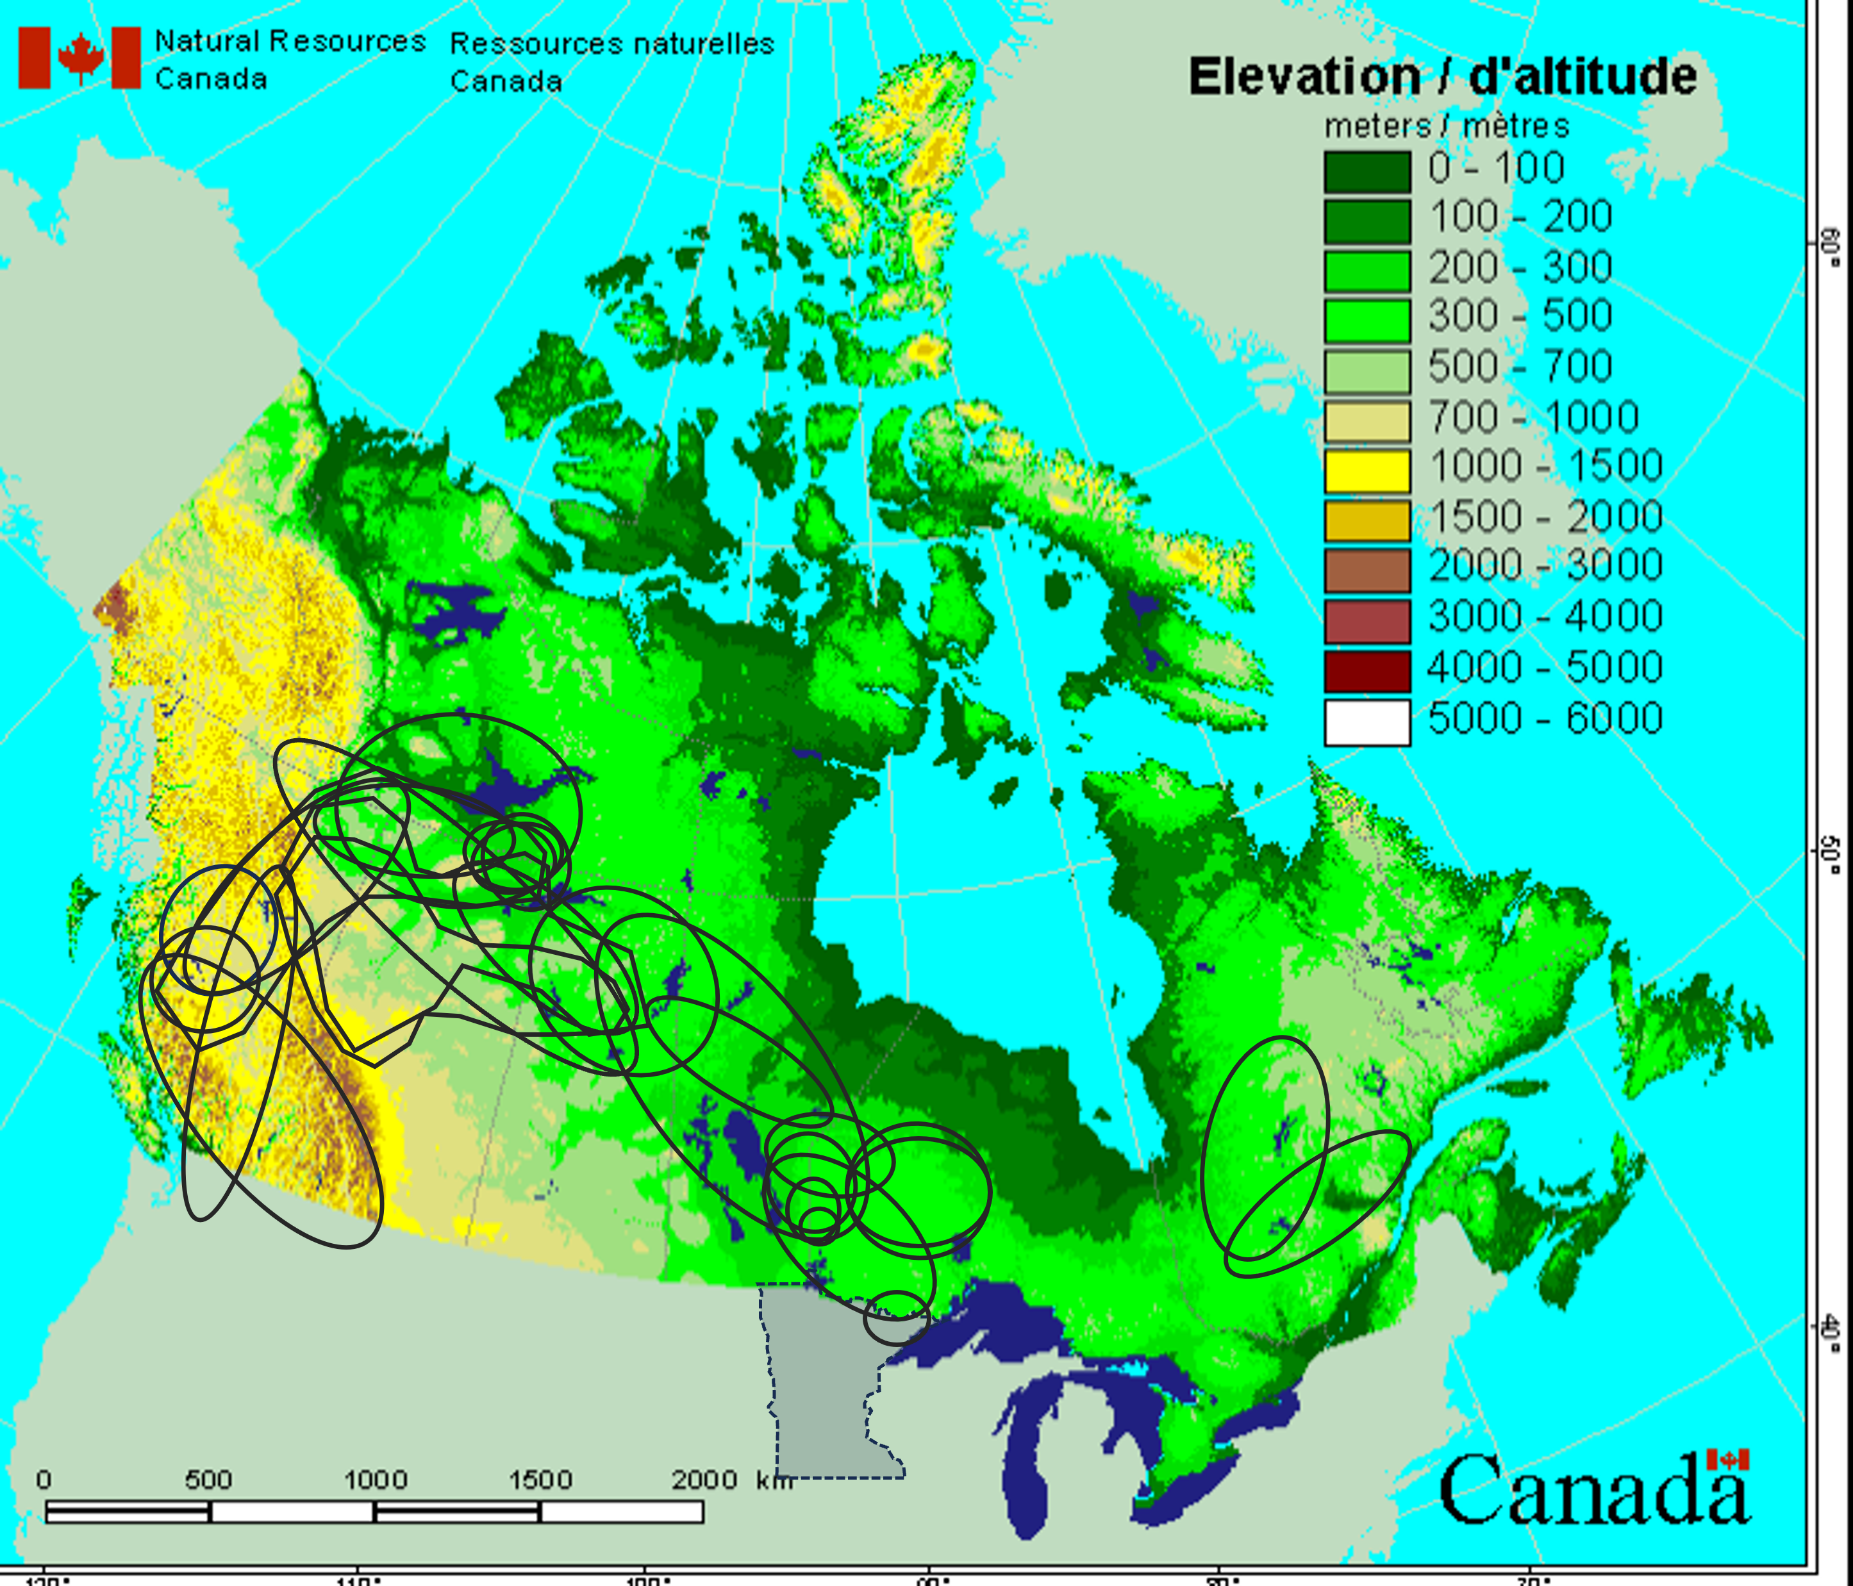
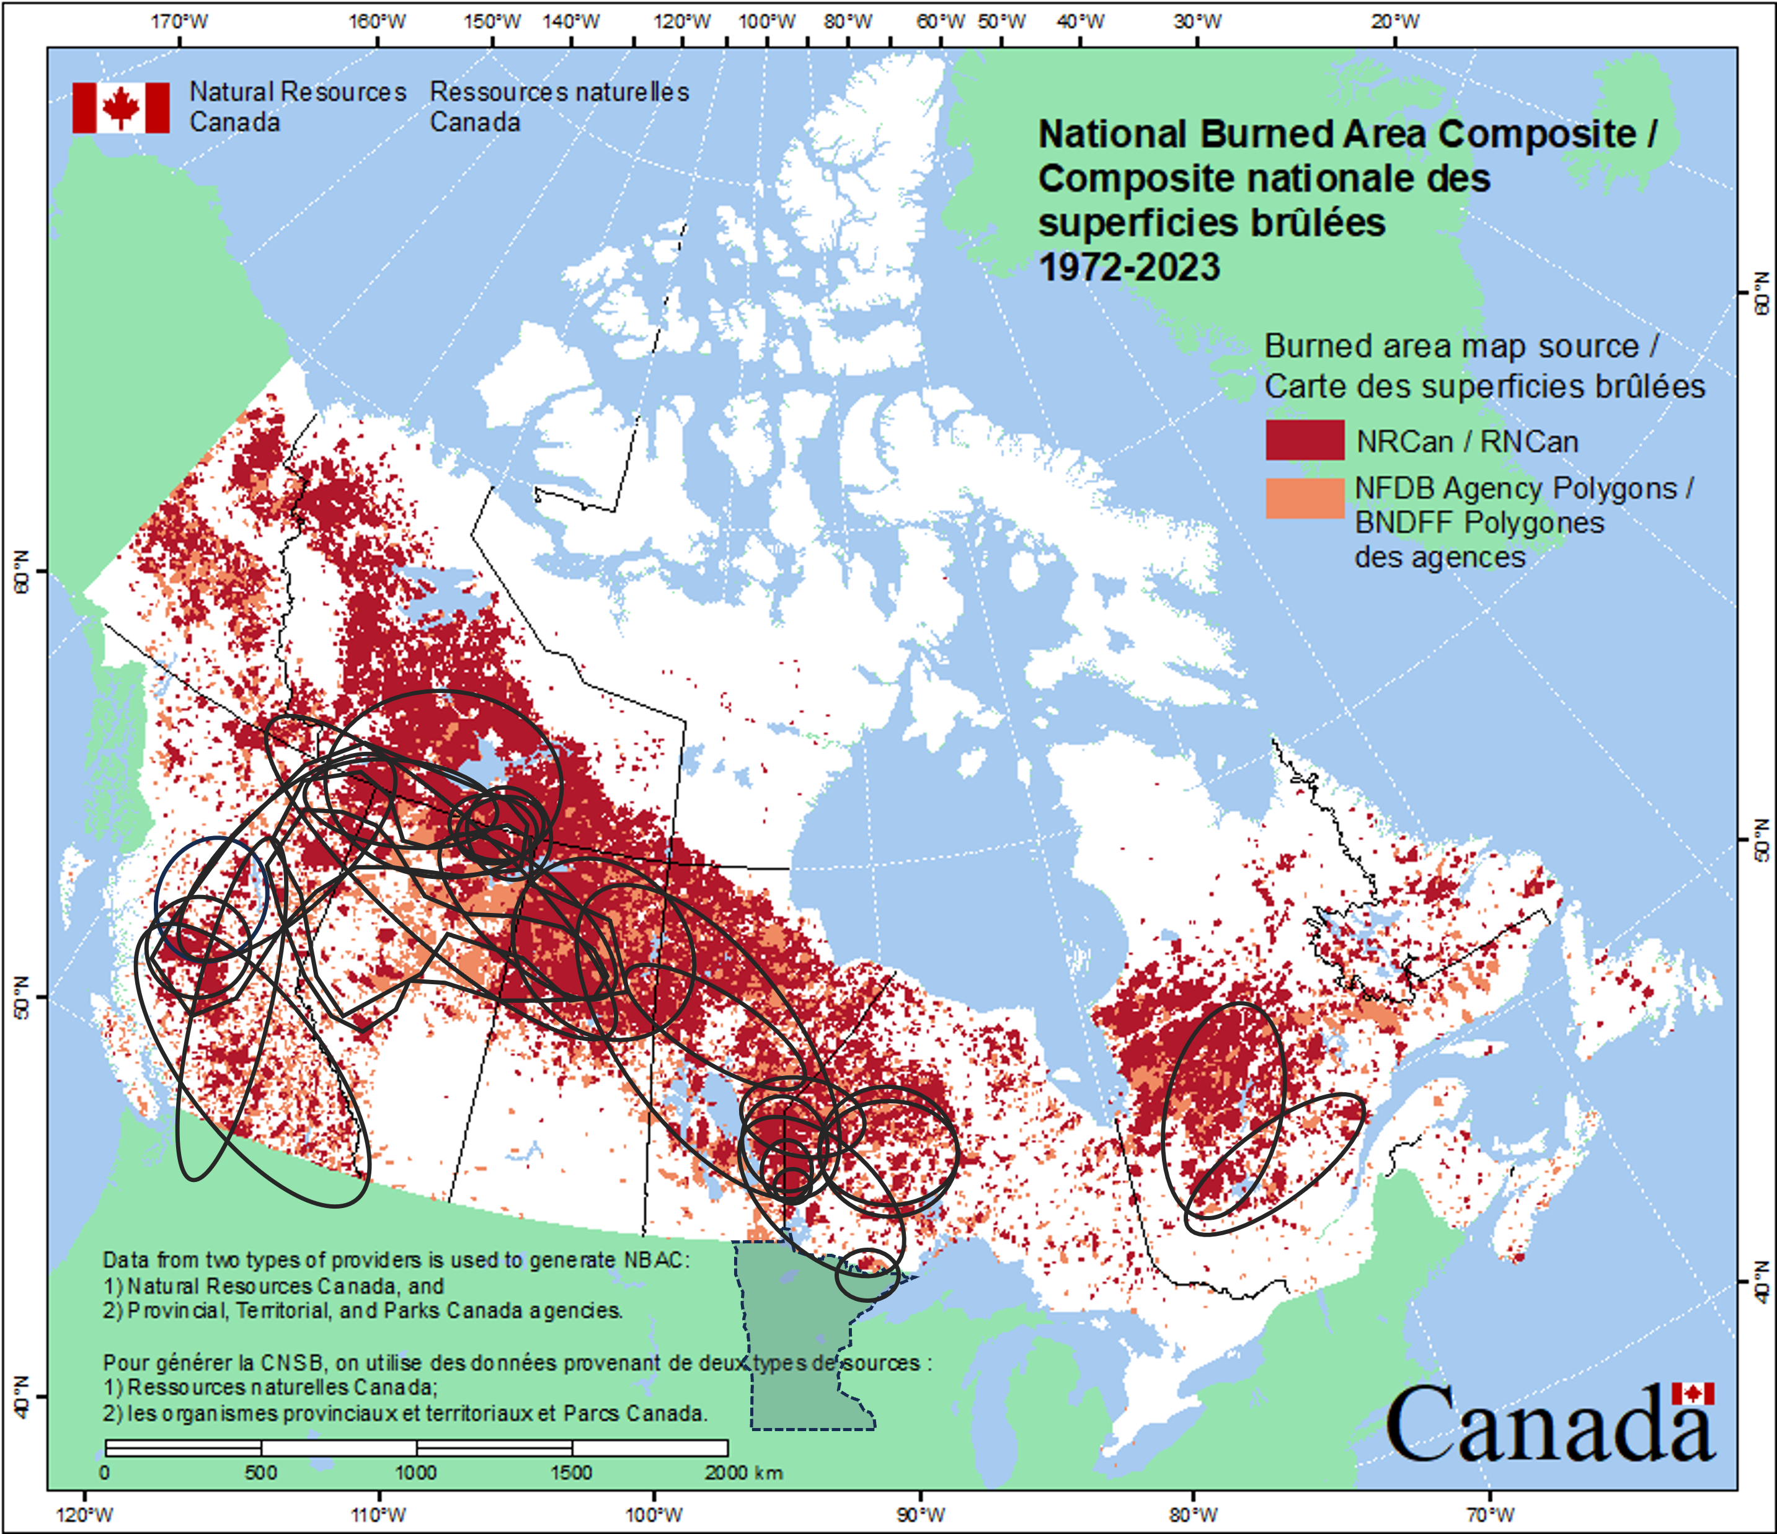
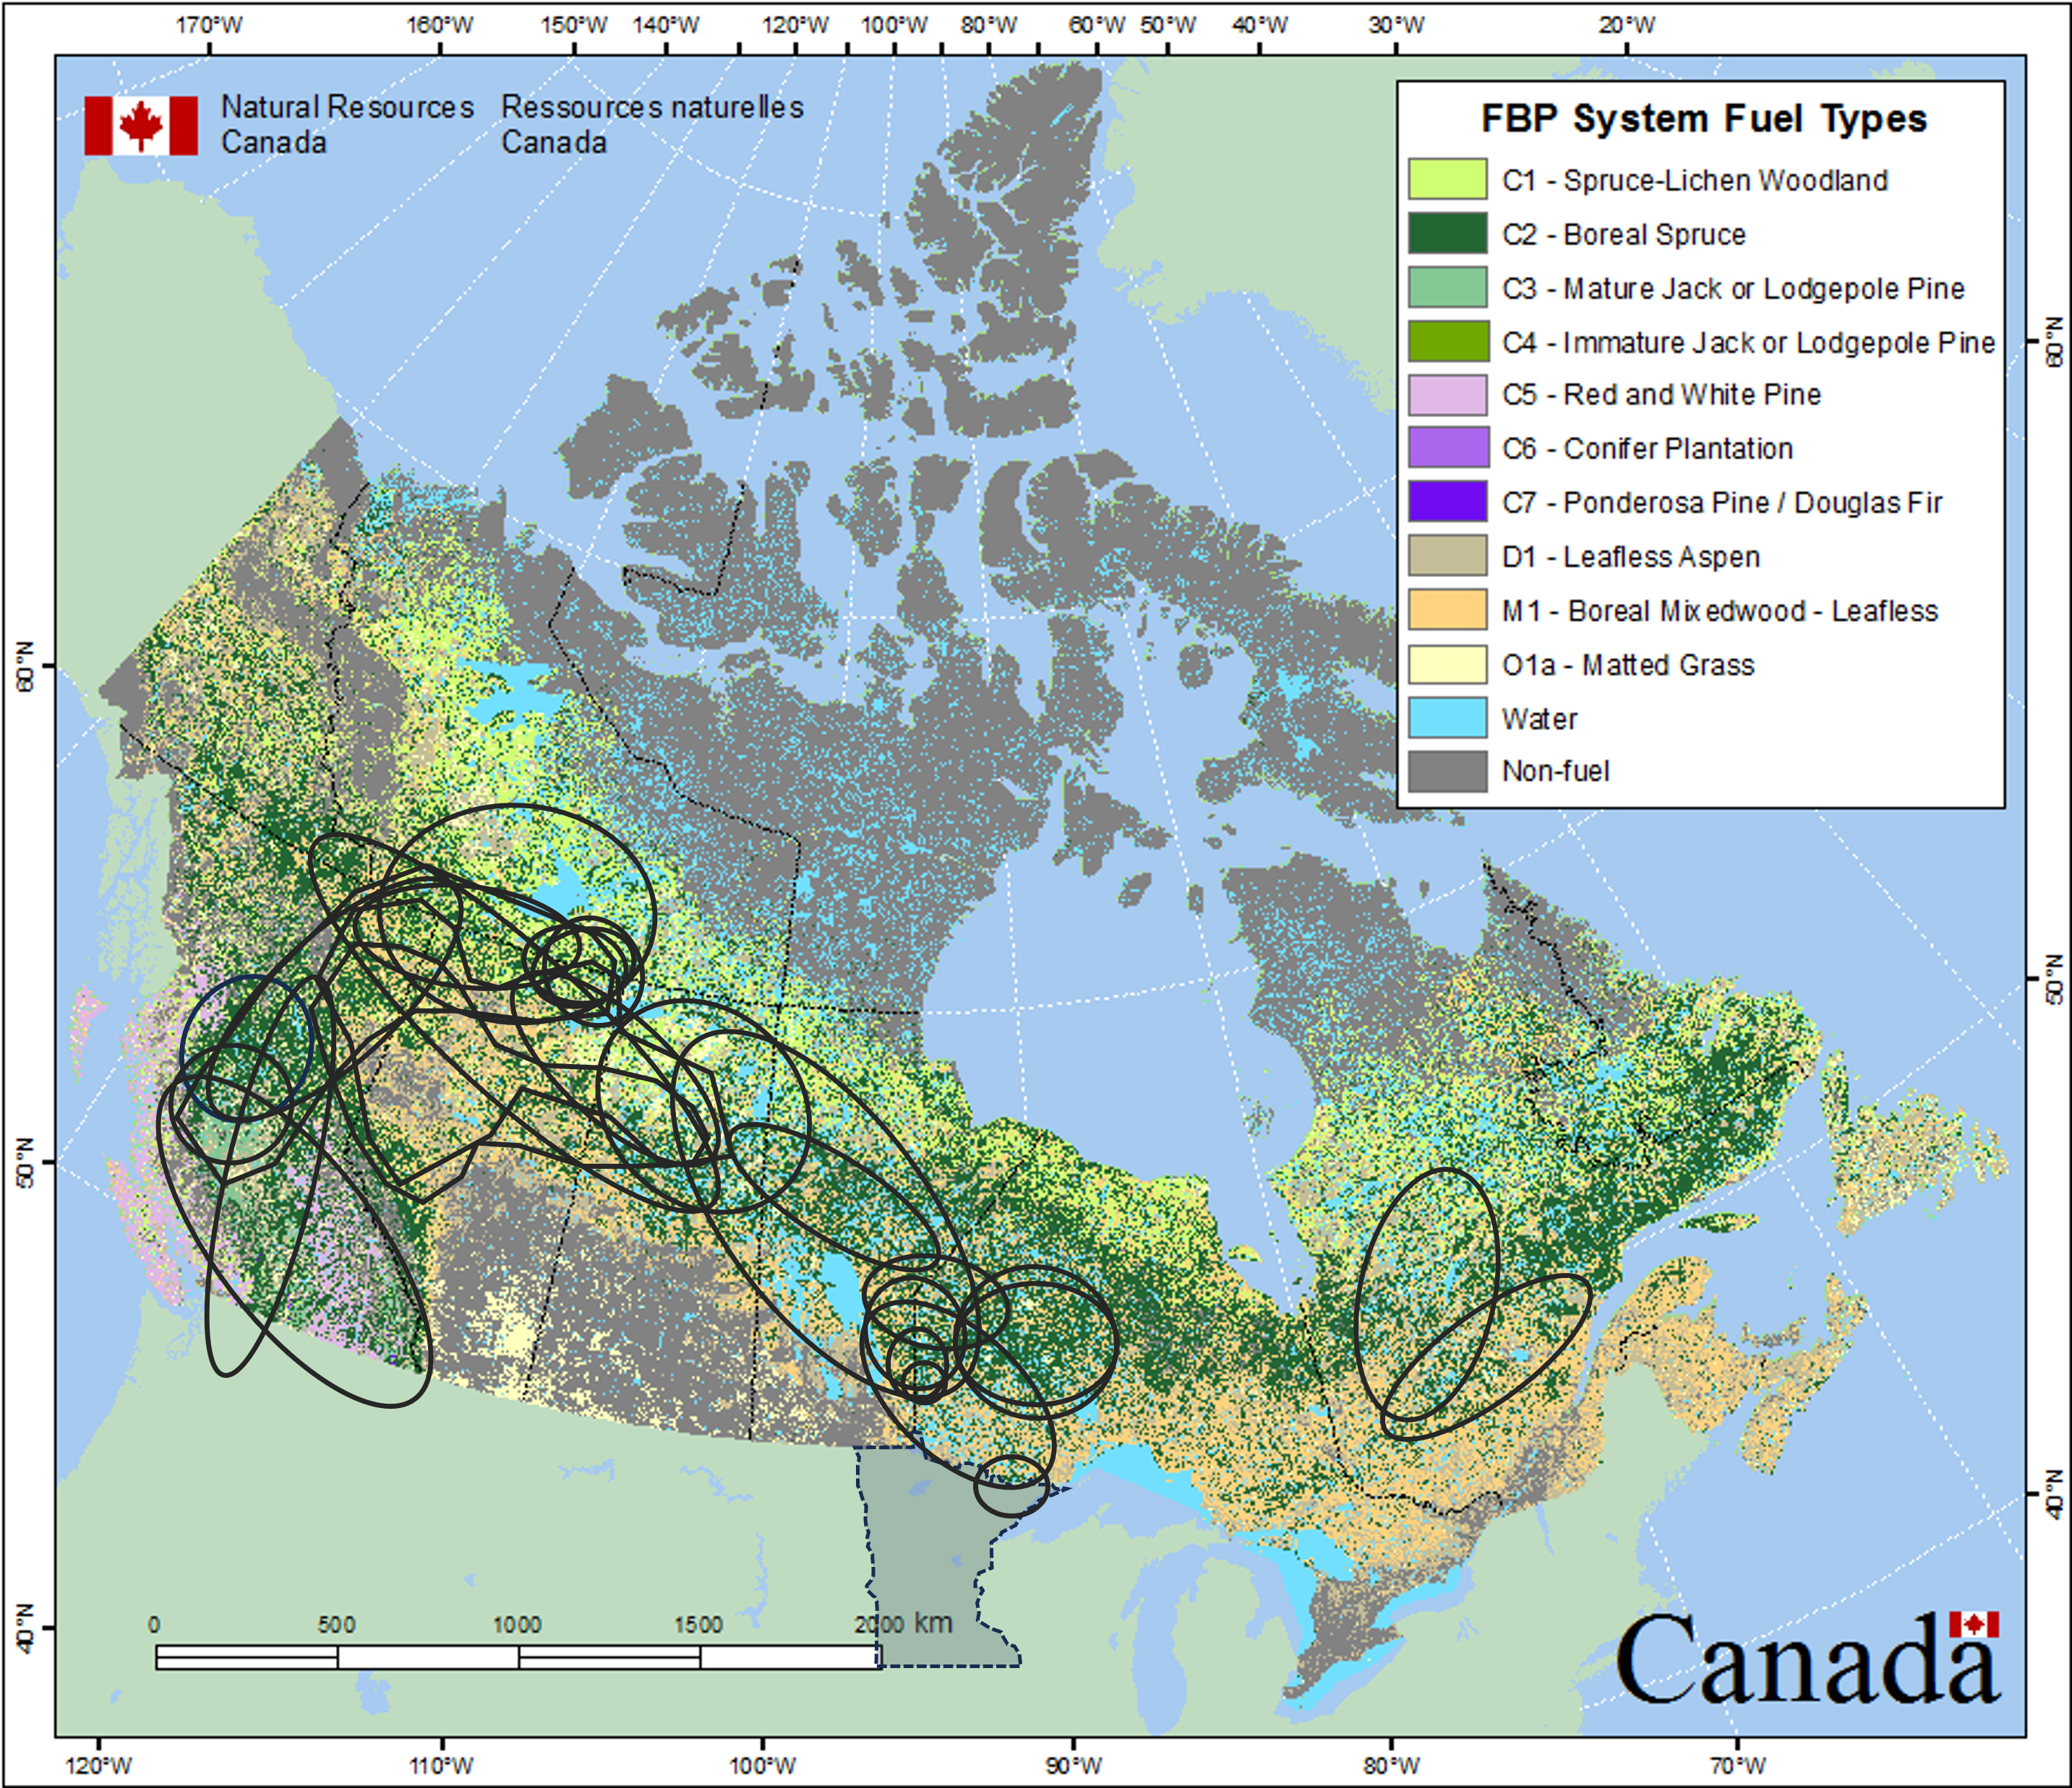
Minnesota Exceedance-Causing Wildfires 2014-2023
Takeaways:
Events have originated from wildfires in high and low elevations
Events correspond well to Canada’s National Burned Area Composite from 1972-2023
Events correspond well to areas of spruce, pine and mixed-wood trees
Main focus areas when forecasting
Maps adapted from NRC

Slide 10
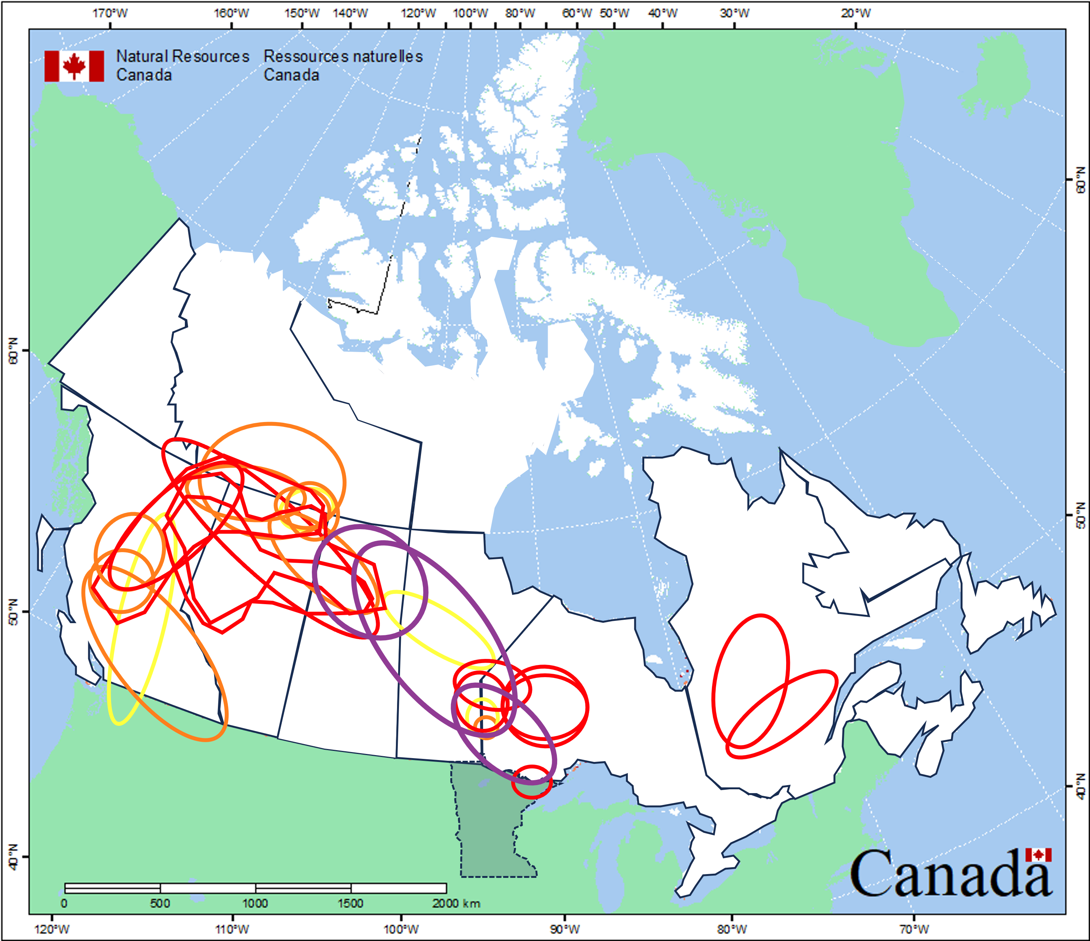
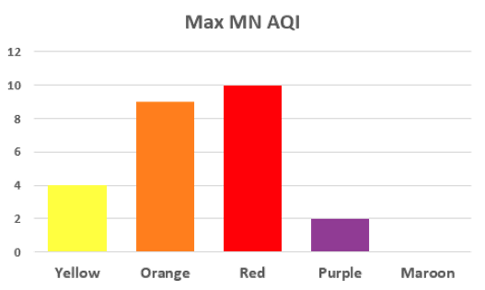
Minnesota Exceedance-Causing Wildfires 2014-2023: MAGNITUDE
90-100 AQI
101-150 AQI
151-200 AQI
Max AQI recorded by a Minnesota regulatory monitor color coded by event
201-300 AQI
Map adapted from NRC
Notes:
*Note, a few events have more than one oval
*Coincidence that all purple AQI wildfire areas were in a group? Too small of a sample size perhaps to say…

Slide 11
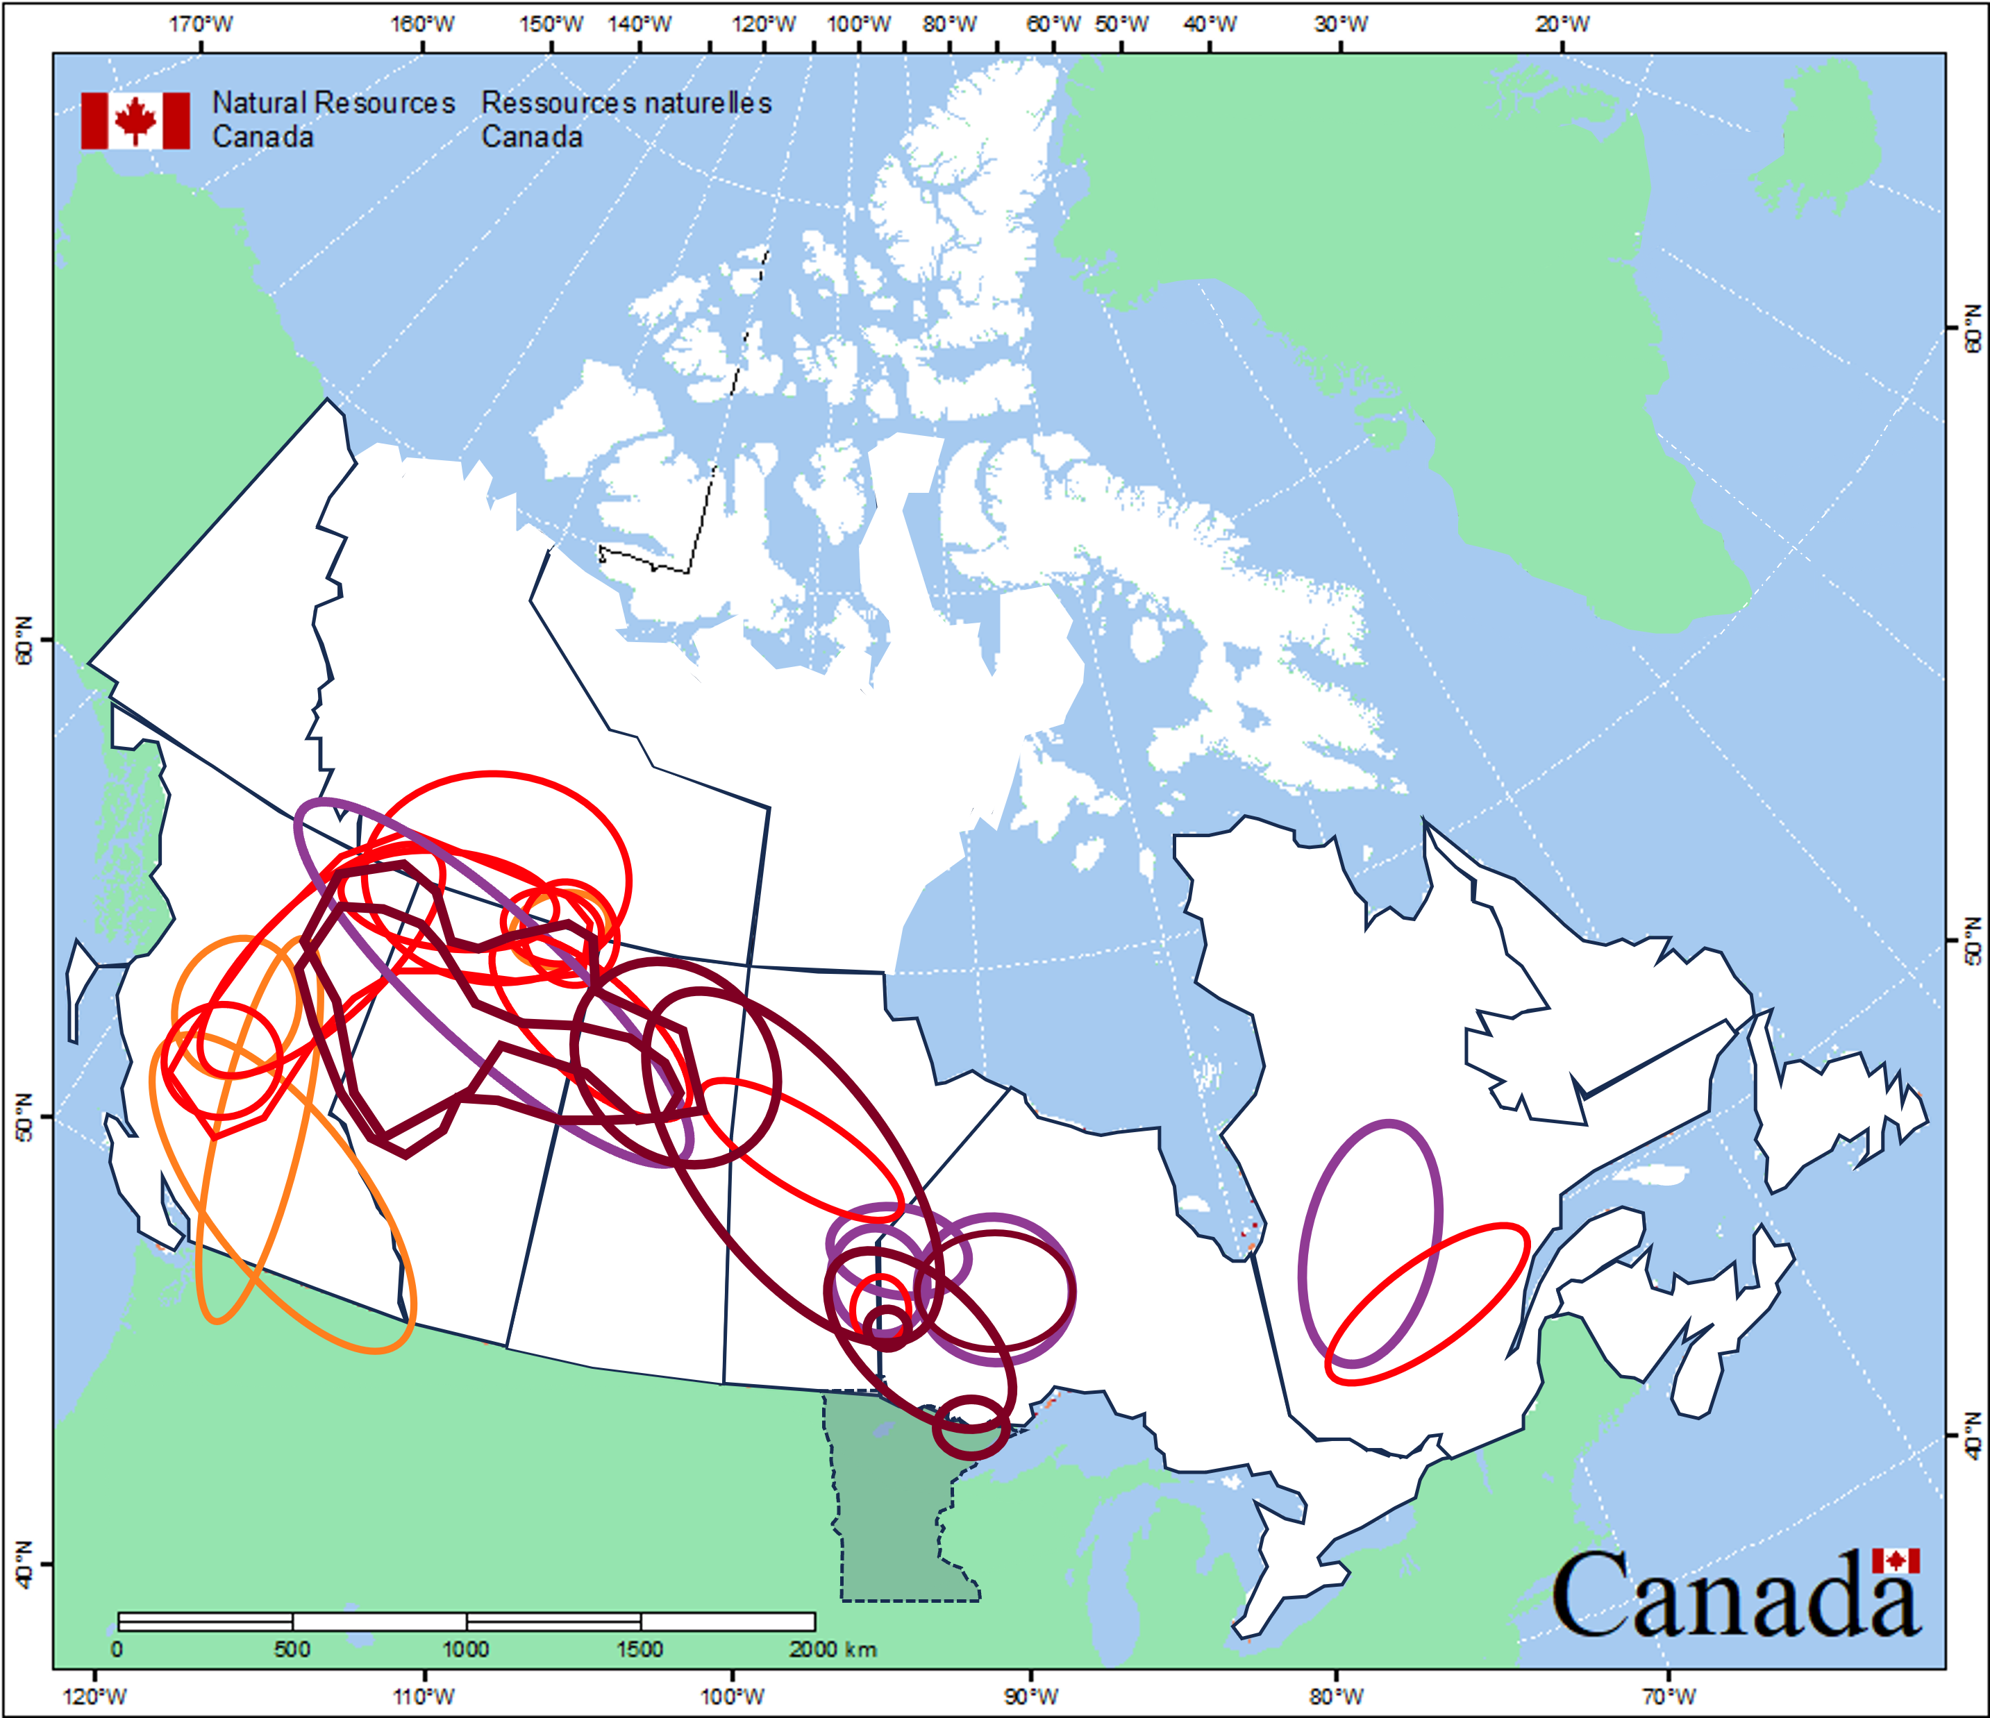
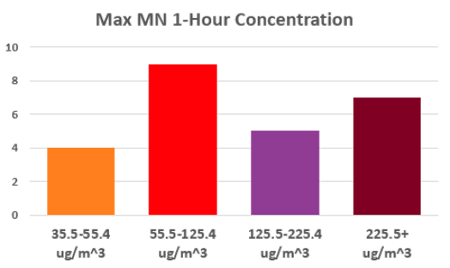
Minnesota Exceedance-Causing Wildfires 2014-2023: MAGNITUDE
35.5-55.4 ug/m^3
55.5-125.4 ug/m^3
125.5-225.4 ug/m^3
Max one hour concentration recorded by a Minnesota regulatory monitor color coded by event
225.5+ ug/m^3
Map adapted from NRC

Slide 12
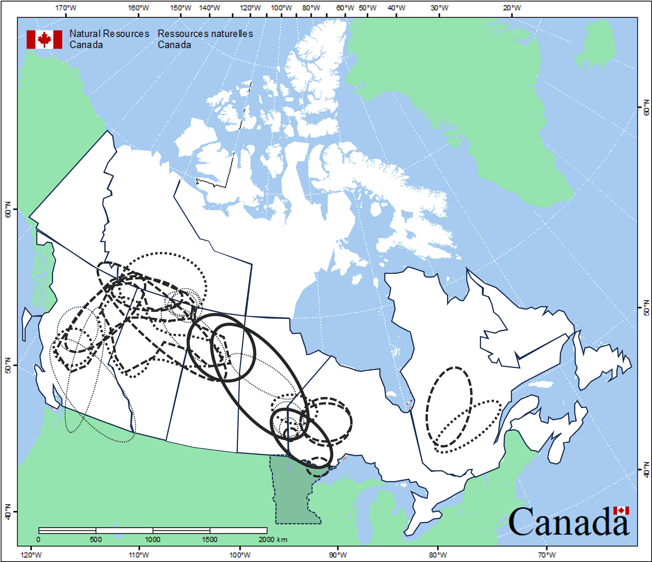
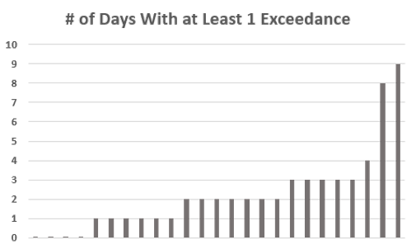
Minnesota Exceedance-Causing Wildfires 2014-2023: DURATION
0-1 Days
2 Days
3-6 Days
All events are impactful, some much more than others
7+ Days
Map adapted from NRC

Slide 13
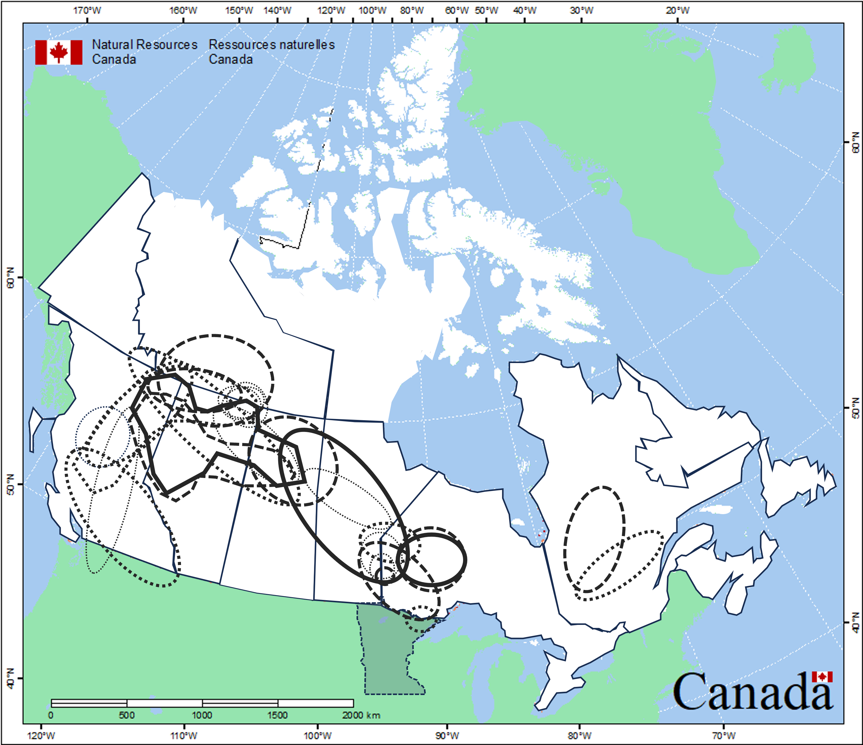
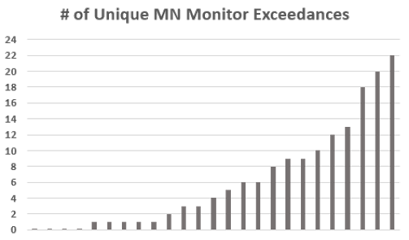
Minnesota Exceedance-Causing Wildfires 2014-2023: COVERAGE
0-1 Monitors
2-9 Monitors
10-19 Monitors
All events are impactful, some much more than others
20+ Monitors
Map adapted from NRC

Slide 14
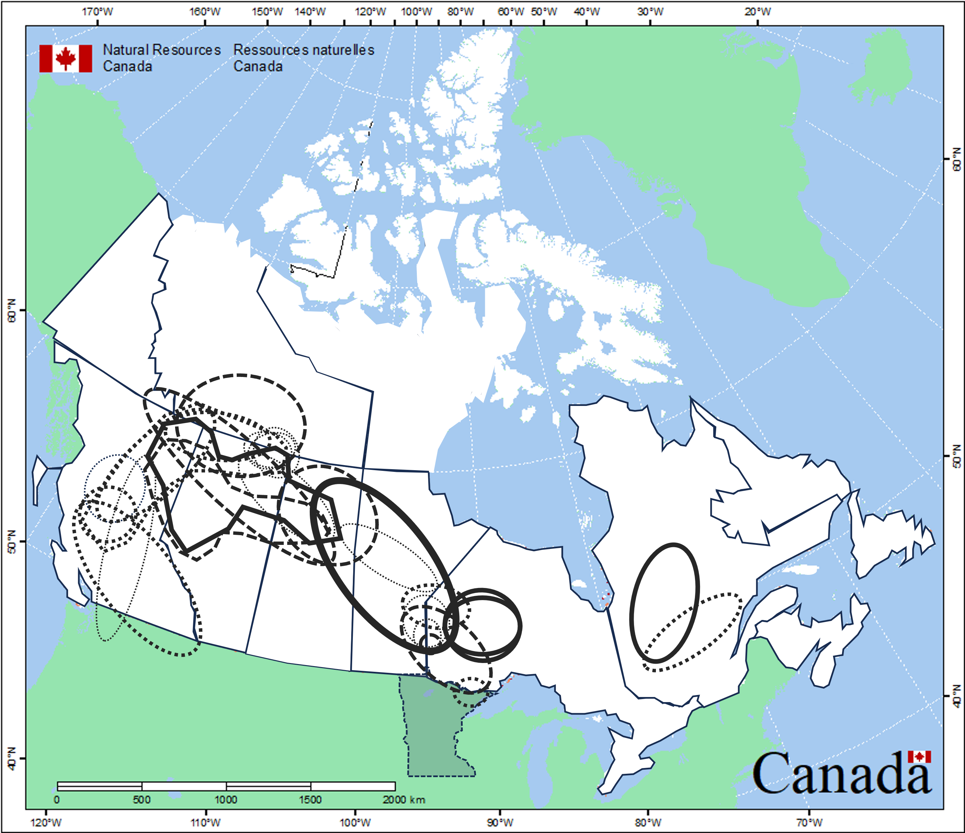
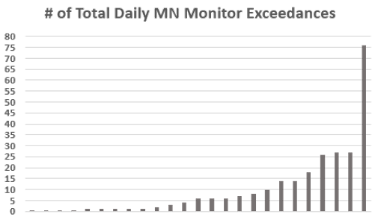
Minnesota Exceedance-Causing Wildfires 2014-2023: TOTAL
0-1 Total Exceedances
2-10 Total Exceedances
11-24 Total Exceedances
All events are impactful, some much more than others
25-49 Total Exceedances
50+ Total Exceedances
Map adapted from NRC

Slide 15
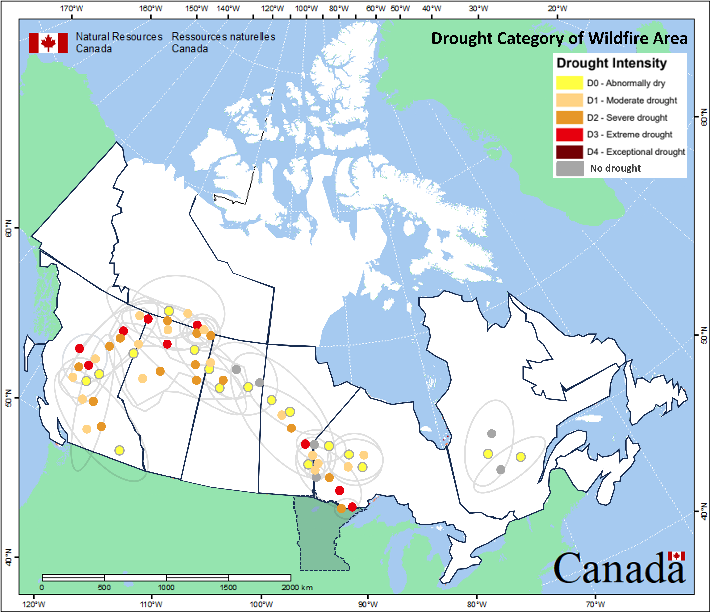
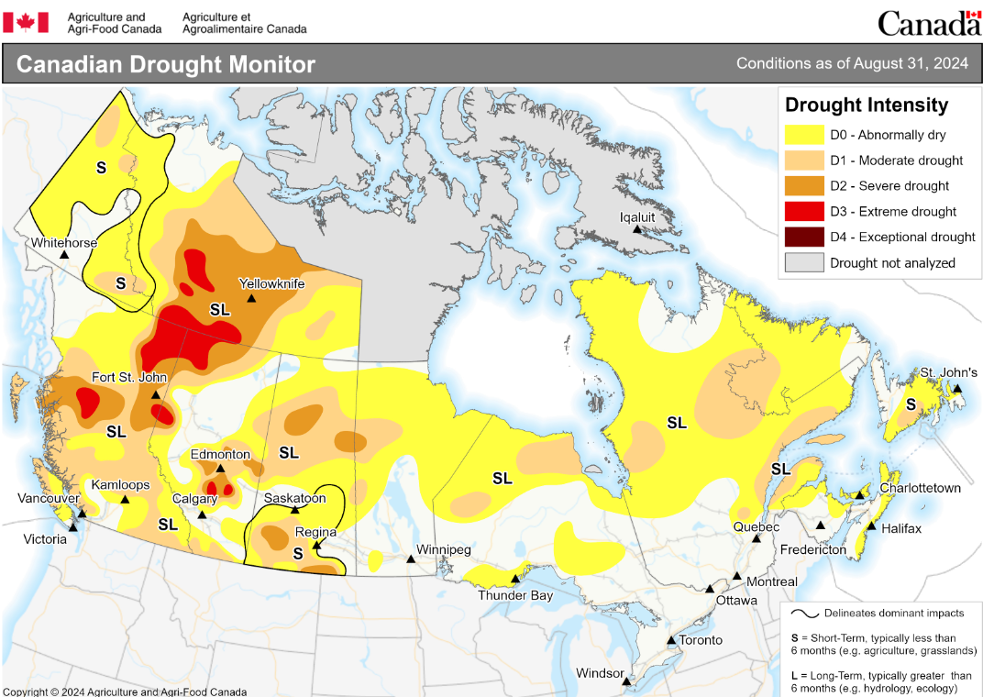
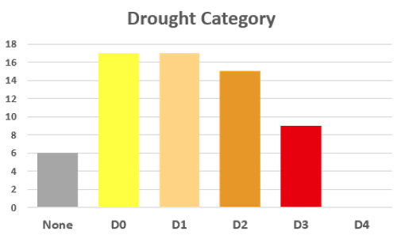
Minnesota Exceedance-Causing Wildfires 2014-2023
Canadian Drought Monitor
All drought classifications within each events’ wildfire areas were included
https://agriculture.canada.ca/en/agricultural-production/weather/canadian-drought-monitor
Map adapted from NRC
Notes:
*Drought is often cited as a risk for wildfires
*Best guess which involved interpolation on occasion, as Canadian drought maps update once a month as opposed to weekly in the US

Slide 16
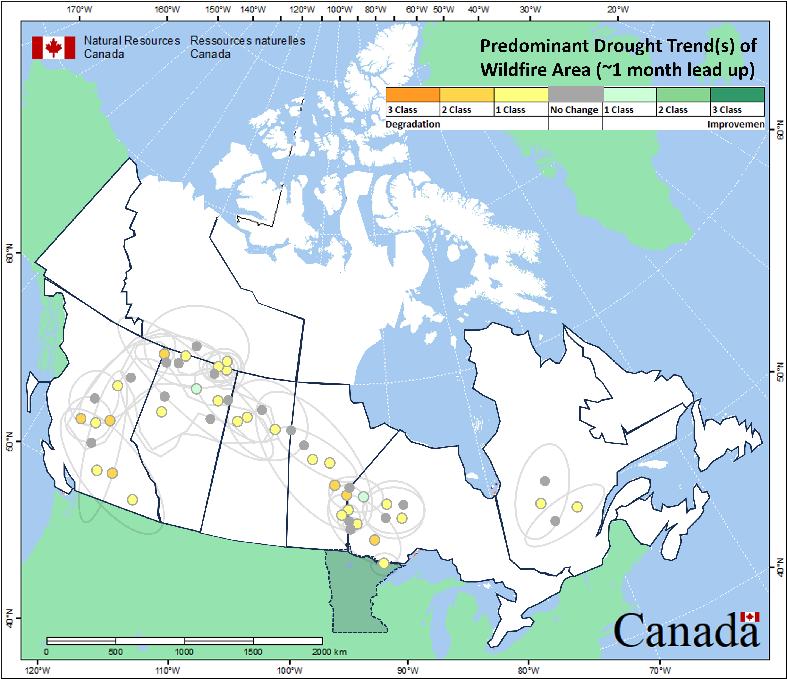
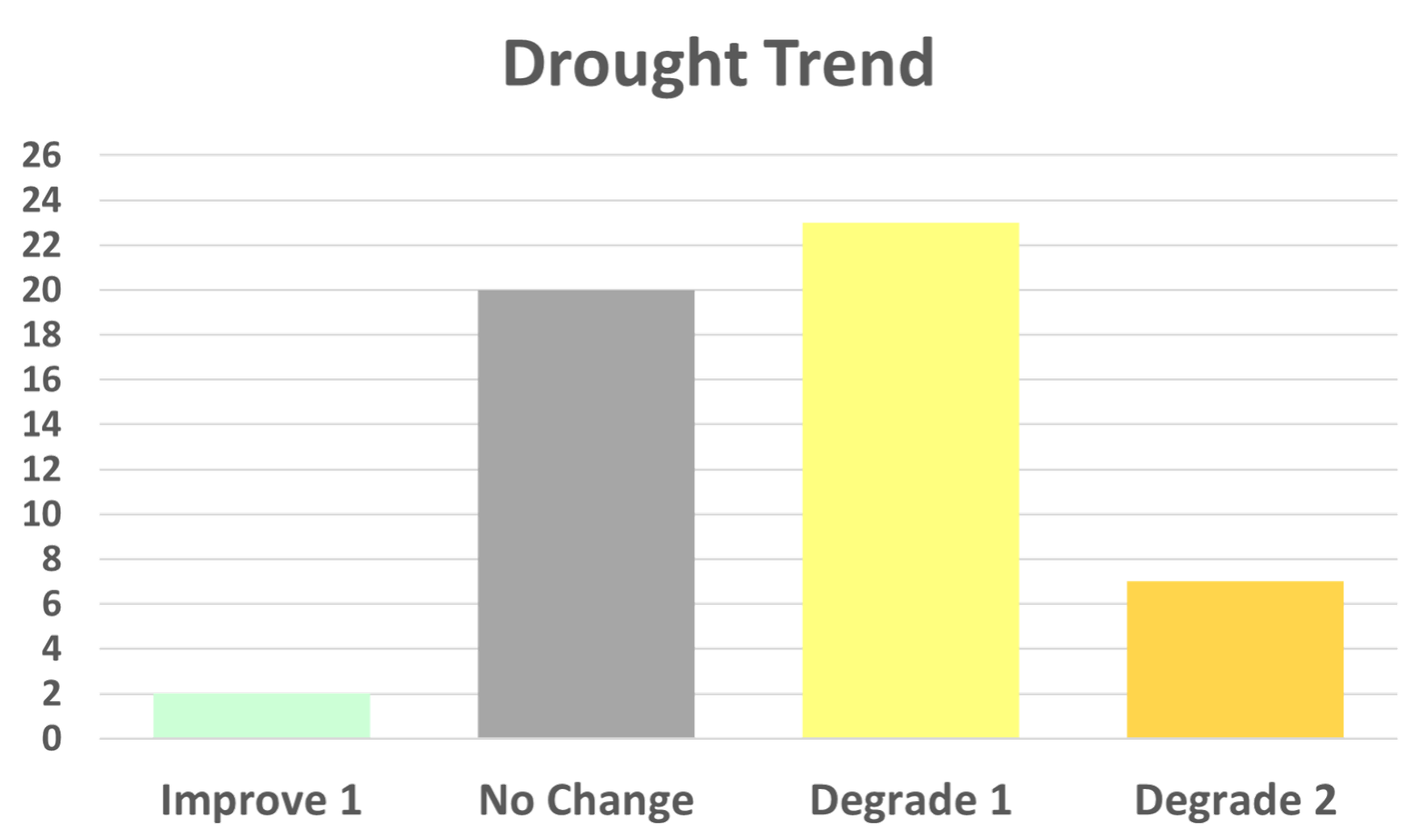
Minnesota Exceedance-Causing Wildfires 2014-2023
Sometimes difficult to determine since information is updated once a monthly
https://agriculture.canada.ca/en/agricultural-production/weather/canadian-drought-monitor
Map adapted from NRC

Slide 17
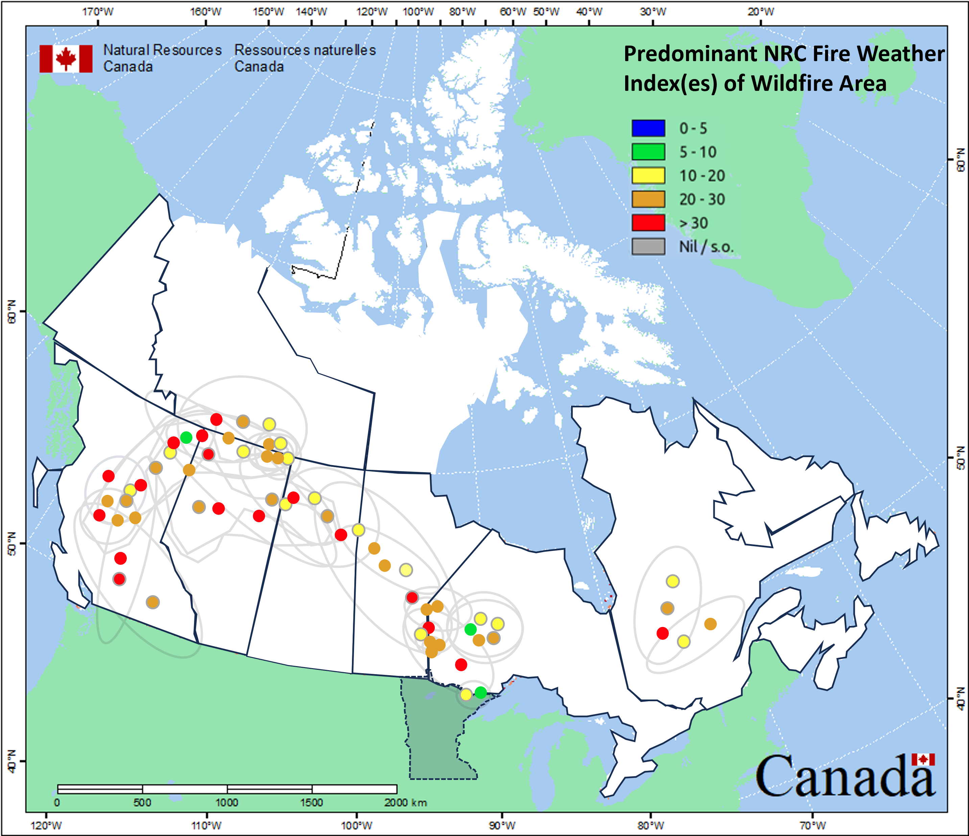
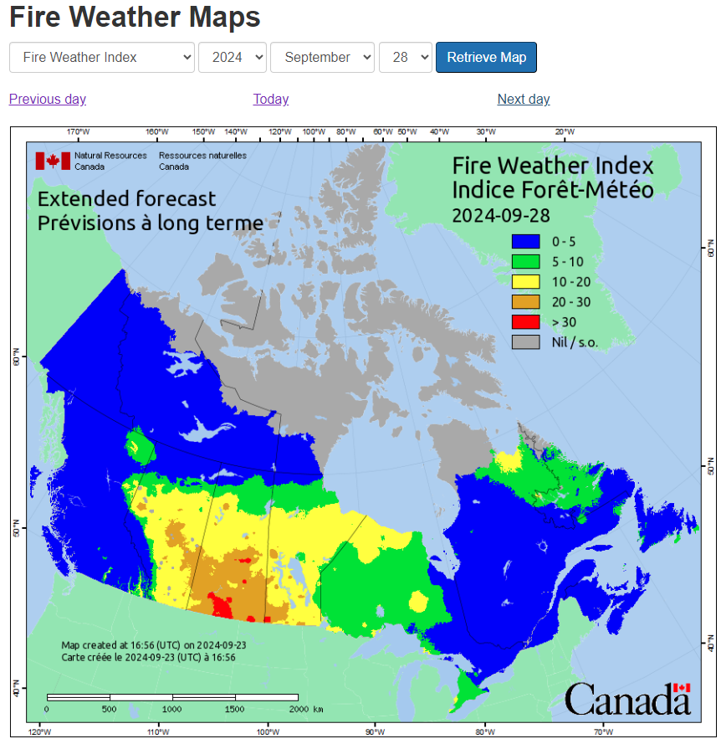
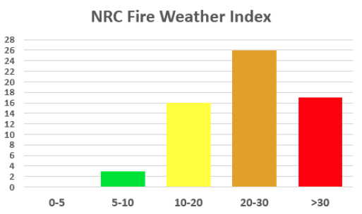
Minnesota Exceedance-Causing Wildfires 2014-2023
Predominant Natural Resource Canada’s Fire Weather Index forecast categories on the day(s) of exceedance-causing wildfire activity
Like drought, sometimes had multiple categories per event
https://cwfis.cfs.nrcan.gc.ca/maps/fw?type=fwi
Map adapted from NRC
Notes:
*Used as a general index of fire danger throughout the forested areas of Canada, which takes into account the dryness of fuels, temperature, humidity, level of precipitation and wind speed

Slide 18
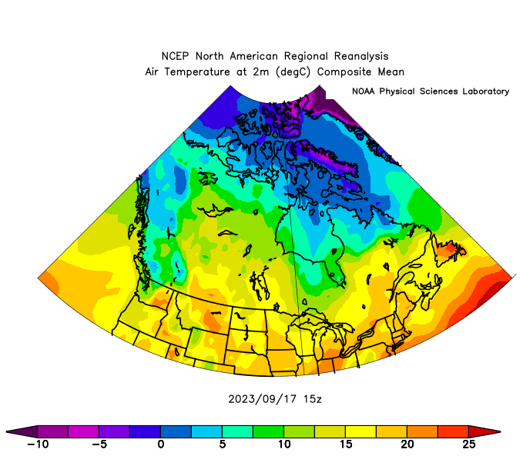
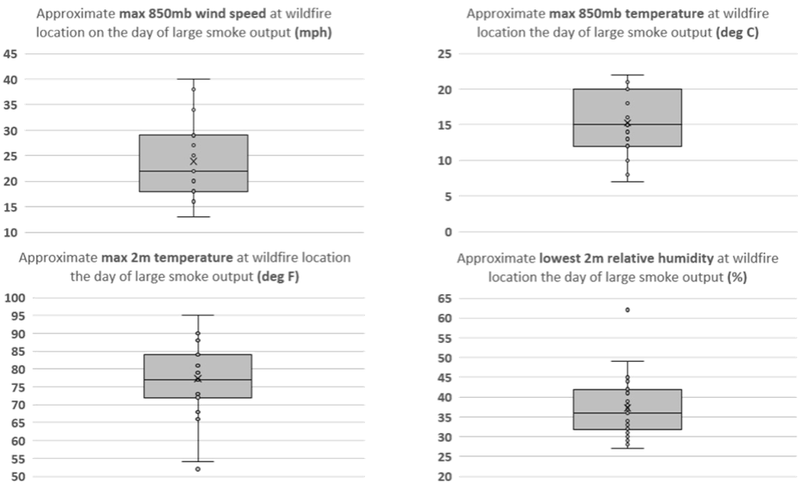
Weather Parameters At Wildfires
3 hourly NCEP North American Regional Reanalysis (NARR) composites
Max values at any time or fraction of the wildfire activity
Most areas had lower values for most of the “day”
“Day” extends from 12z to 03z
Notes:
*Again, small sample size, but can at least start to glean some information about the wildfire environment
(*) Data distributed into quartiles, and I believe the whiskers extend to 1.5* the Interquartile Range (the box) to set a boundary beyond which would be considered outliers
*https://psl.noaa.gov/cgi-bin/data/narr/plothour.pl

Slide 19
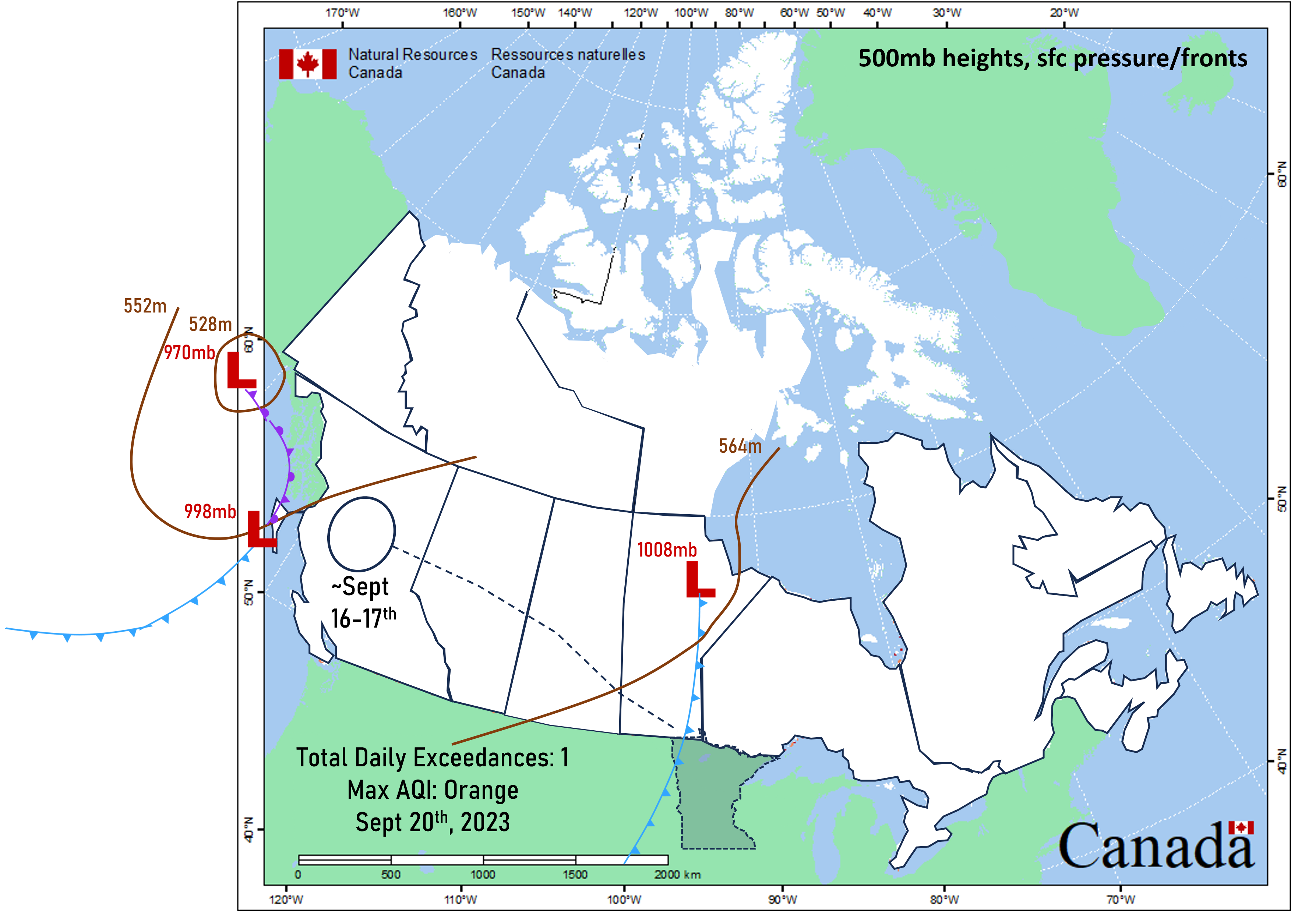
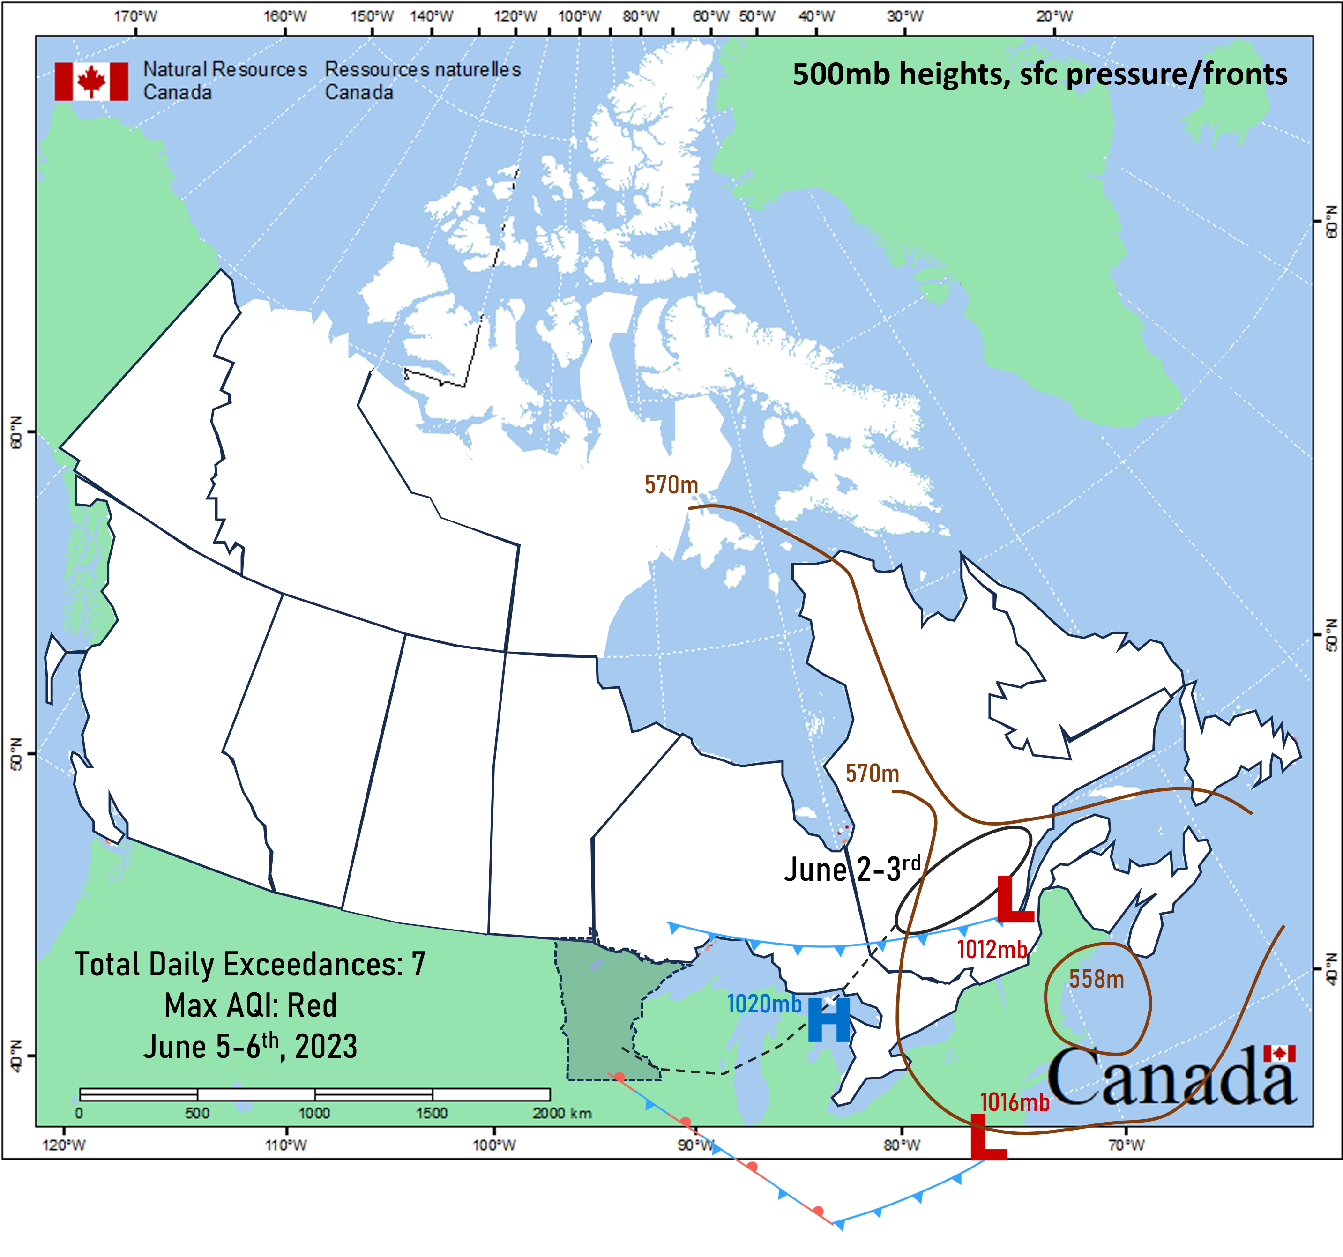
Mechanisms for Smoke Transport
Focus on the upper and lower levels of the atmosphere
500mb height contour(s)
Surface features
Both on the day of large wildfire smoke output and the approximate hour of heavy smoke intrusion into Minnesota
7am Sept 20th
Since the wildfire location changes from event to event, had to normalize when creating the composite map
7pm June 4
Map adapted from NRC

Slide 20
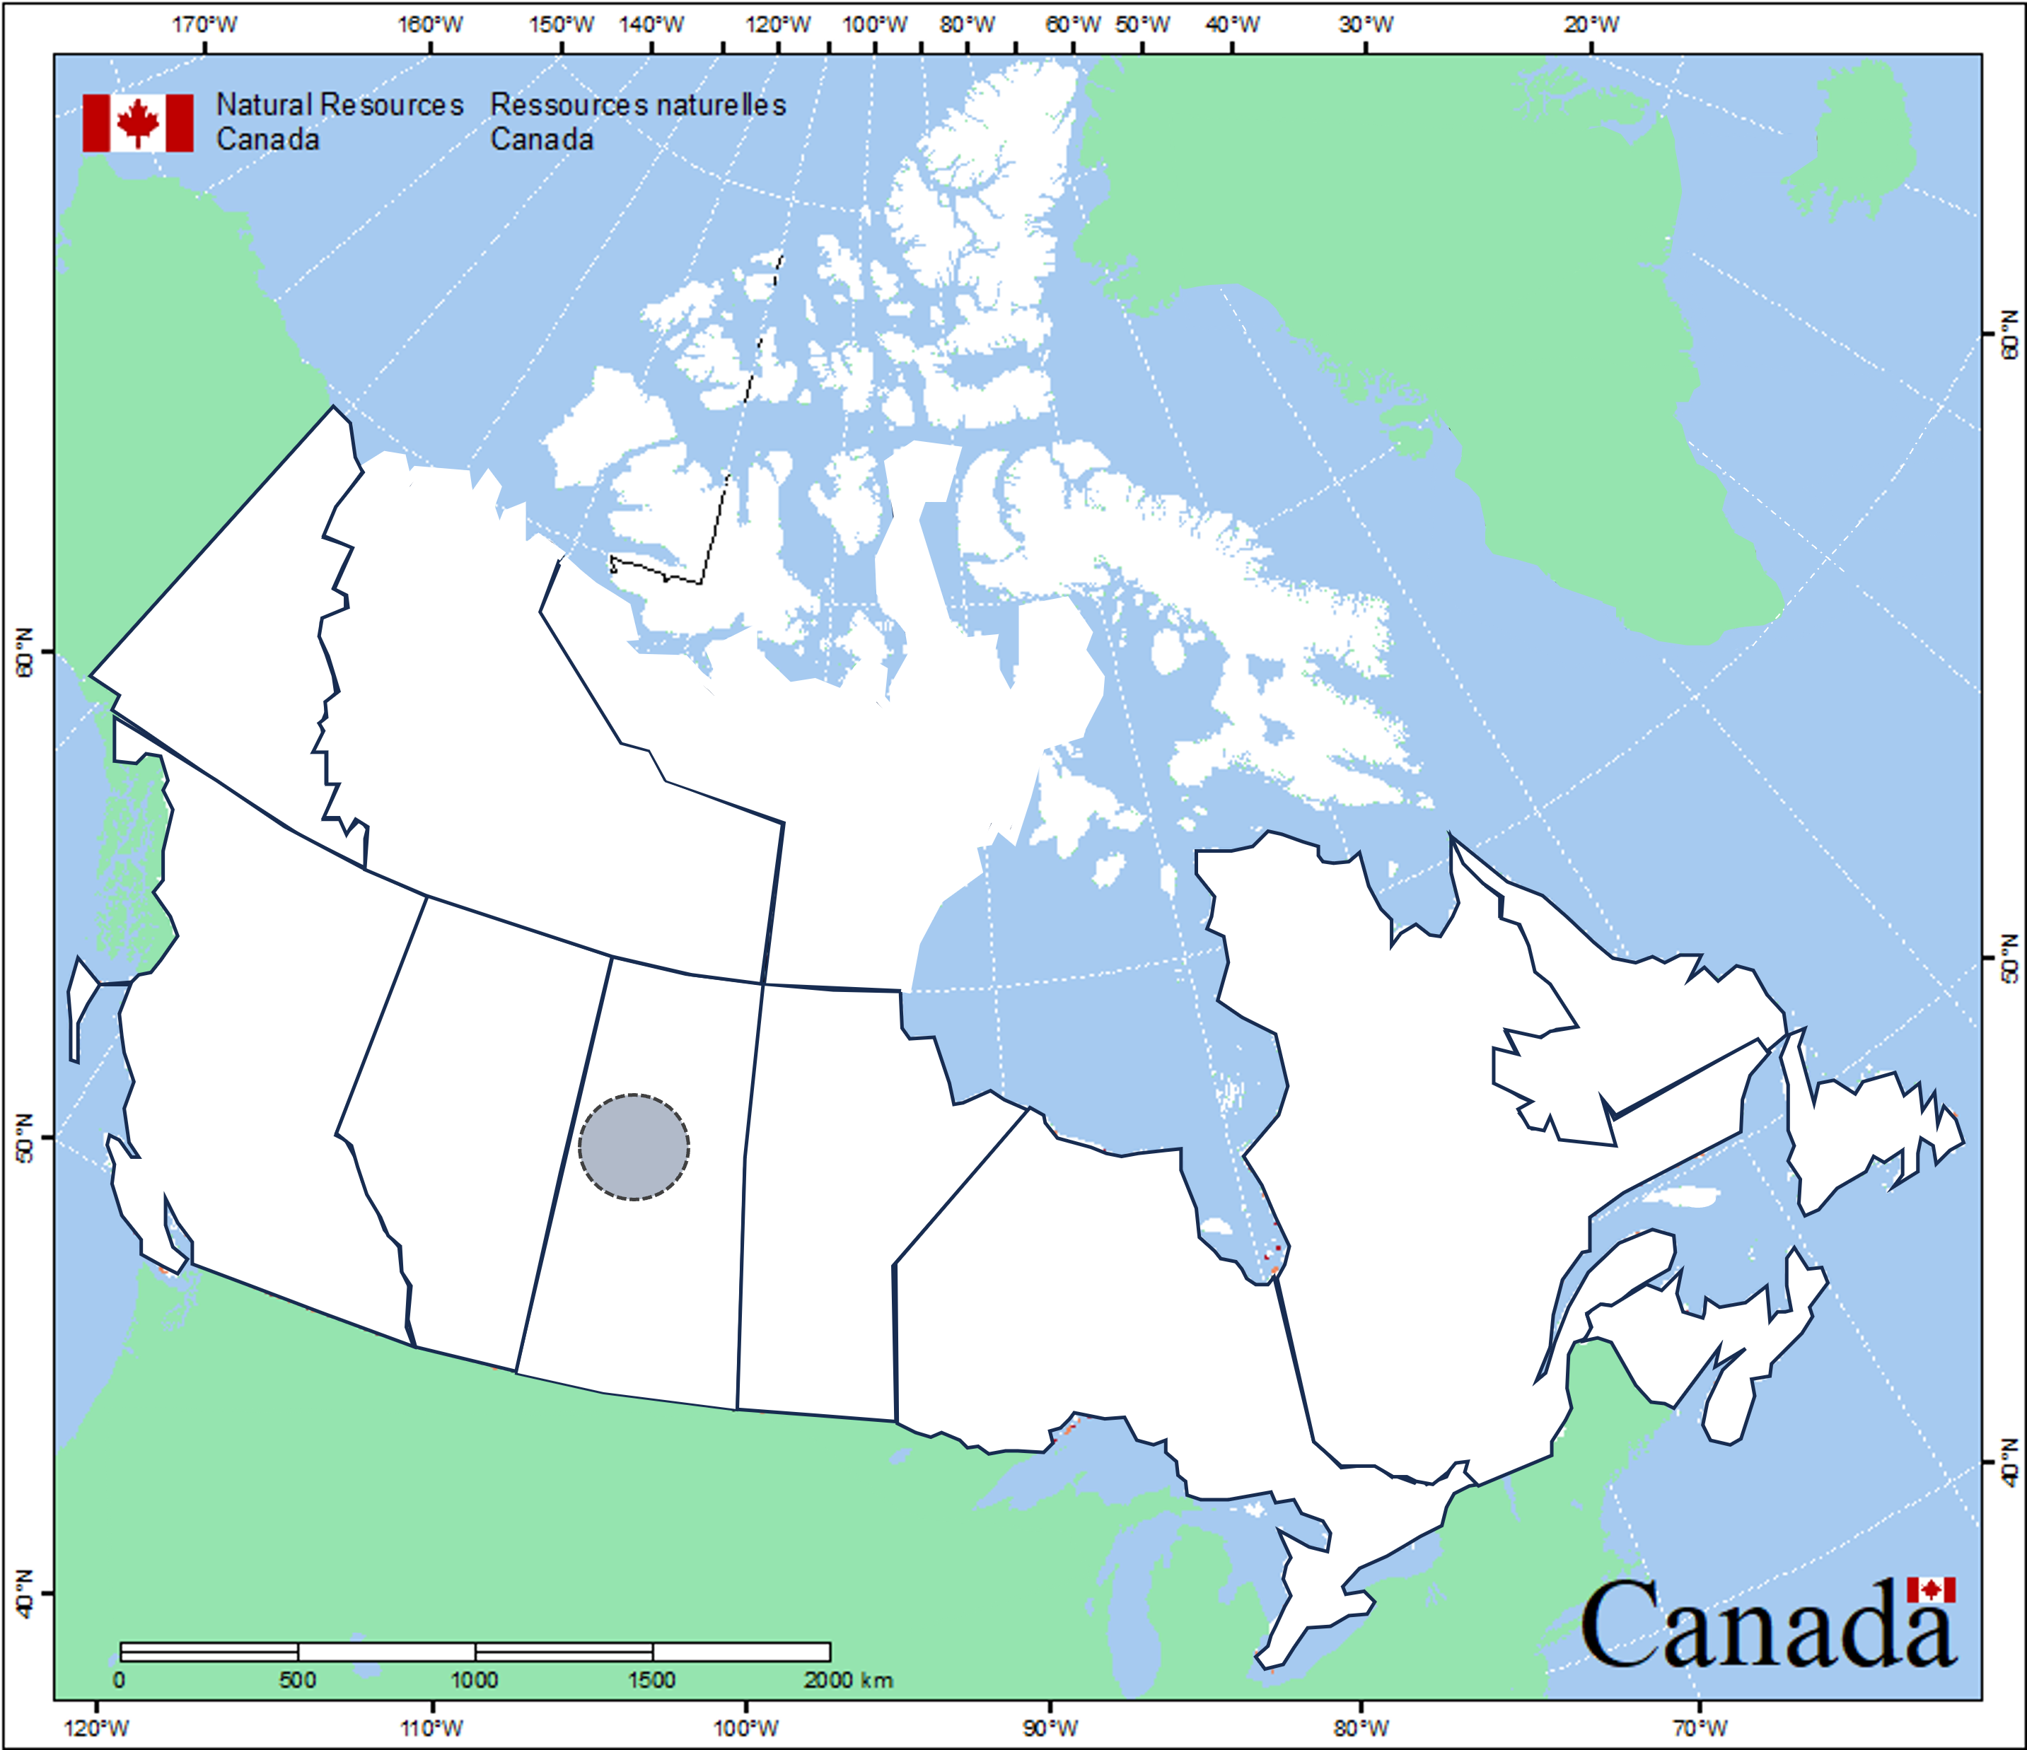
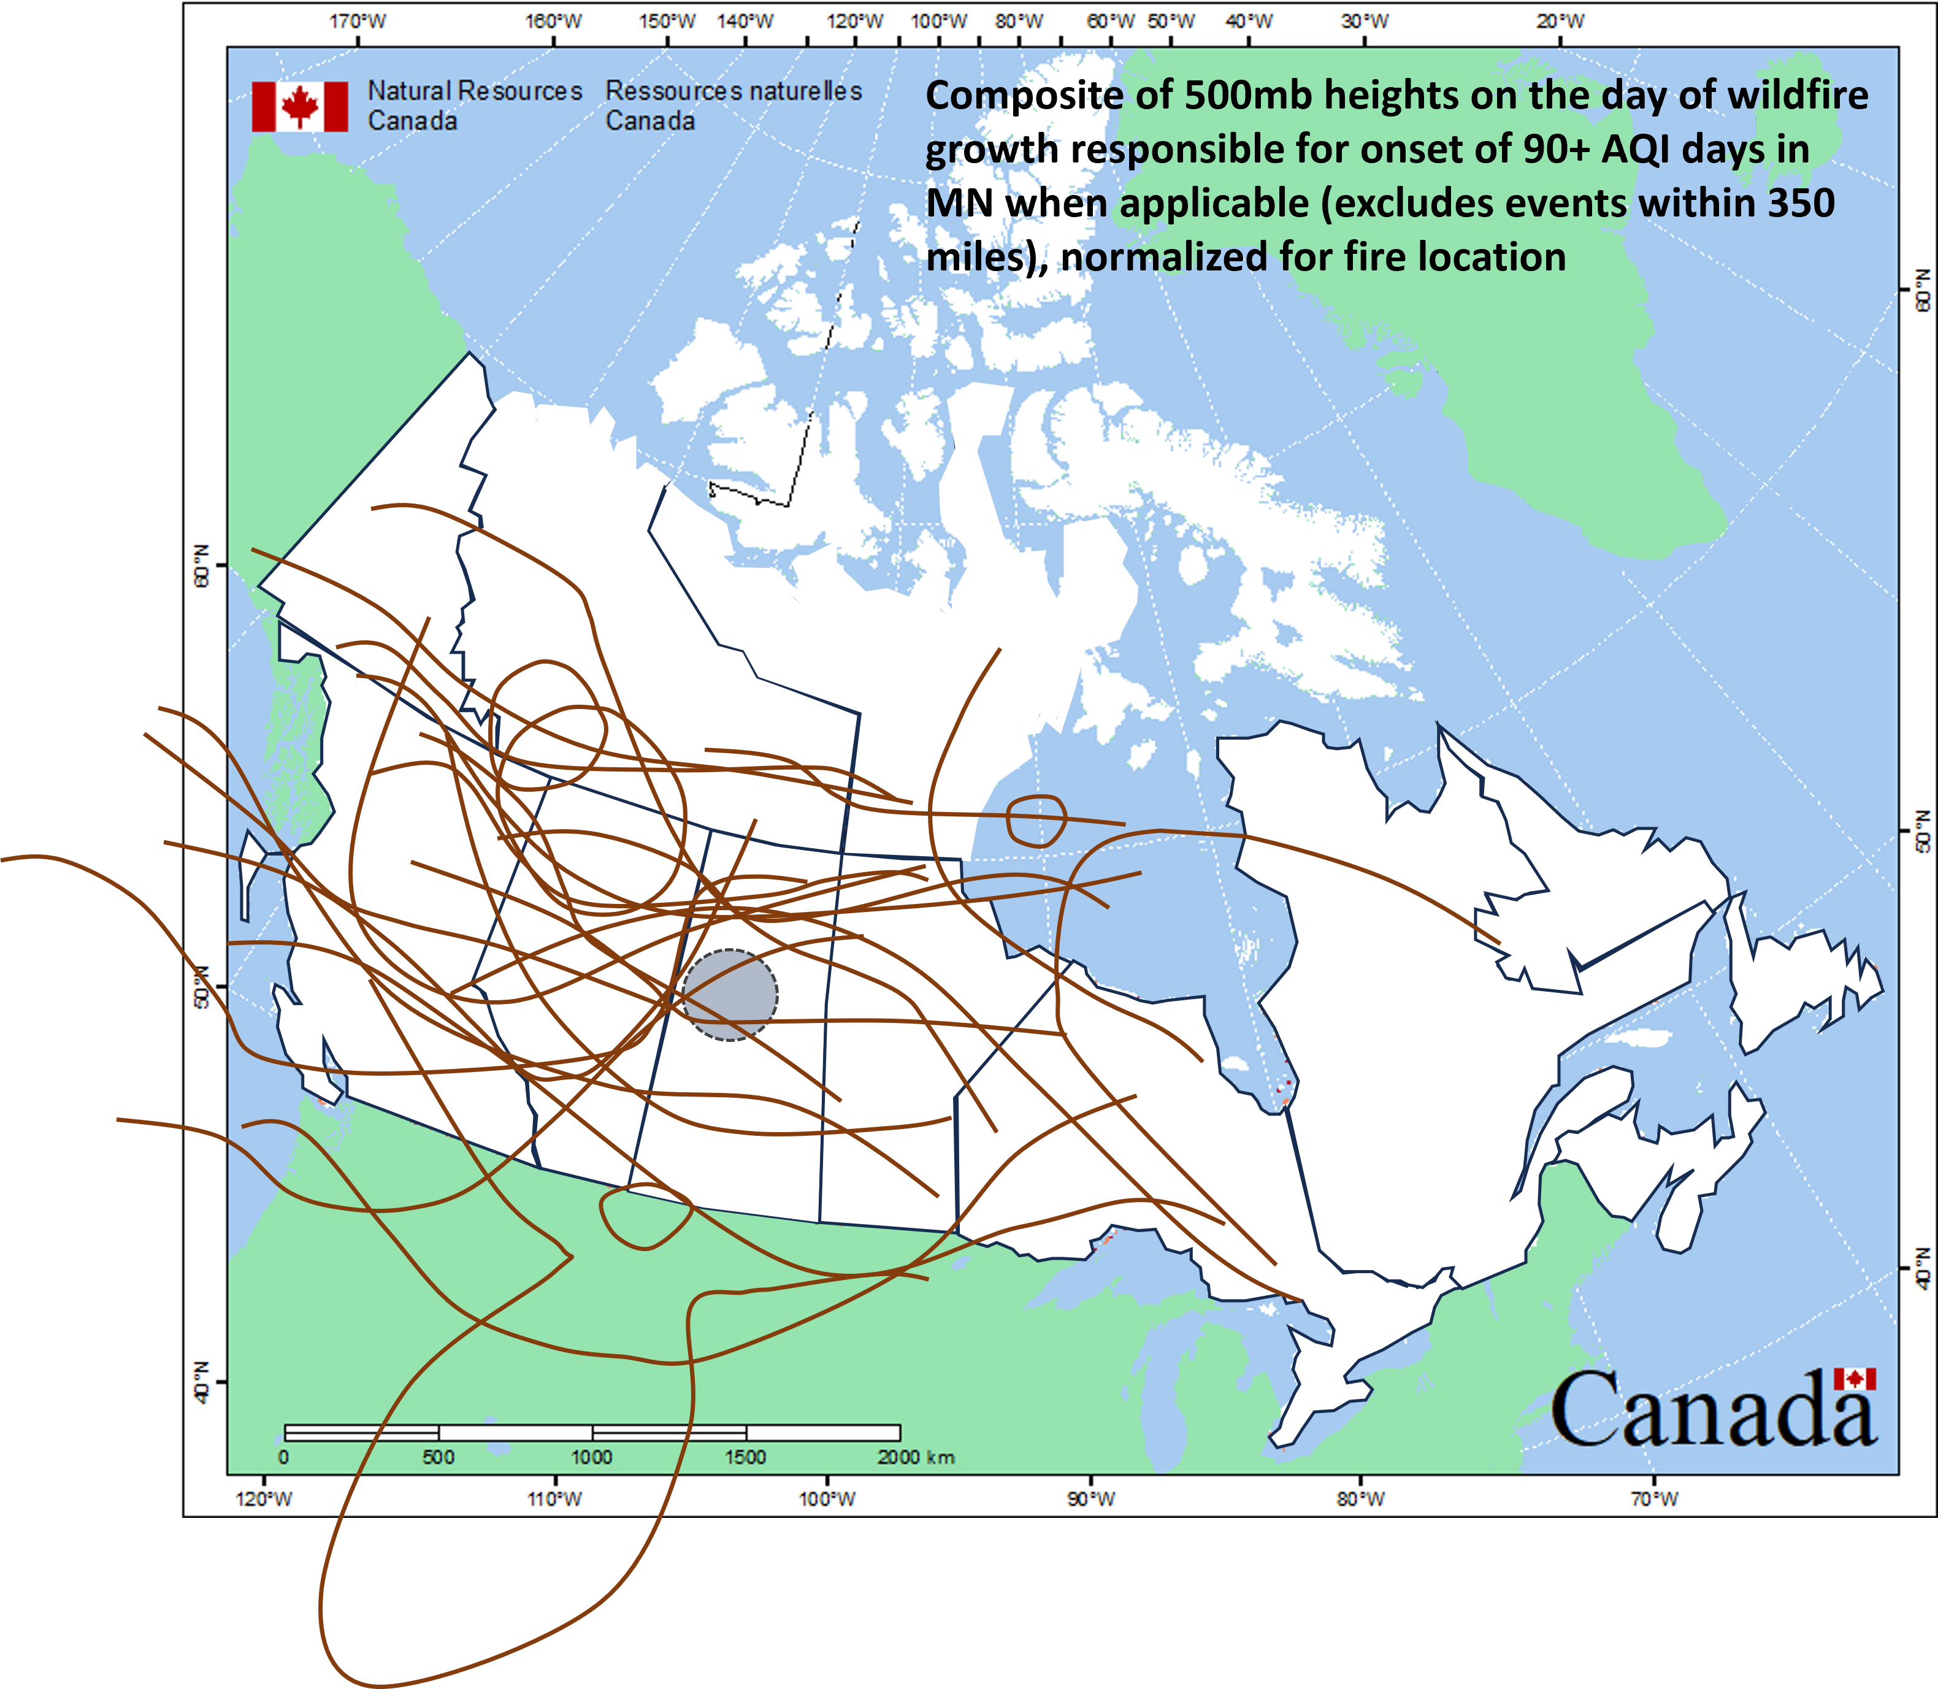
Mechanisms for Smoke Transport
Composite of 500mb height contour(s) on the day of wildfire growth responsible for heavy smoke intrusion for events who’s wildfires were >350 miles from Minnesota
<350 mile events often featured heavy wildfire smoke that was produced on the same day/night as it entered Minnesota - wanted to focus on state of atmosphere prior to this time
Map adapted from NRC
Notes:
*A couple odd-balls, but by and large, seems to be a common theme involving an upper-level trough in the vicinity or just west of the wildfire location.

Slide 21
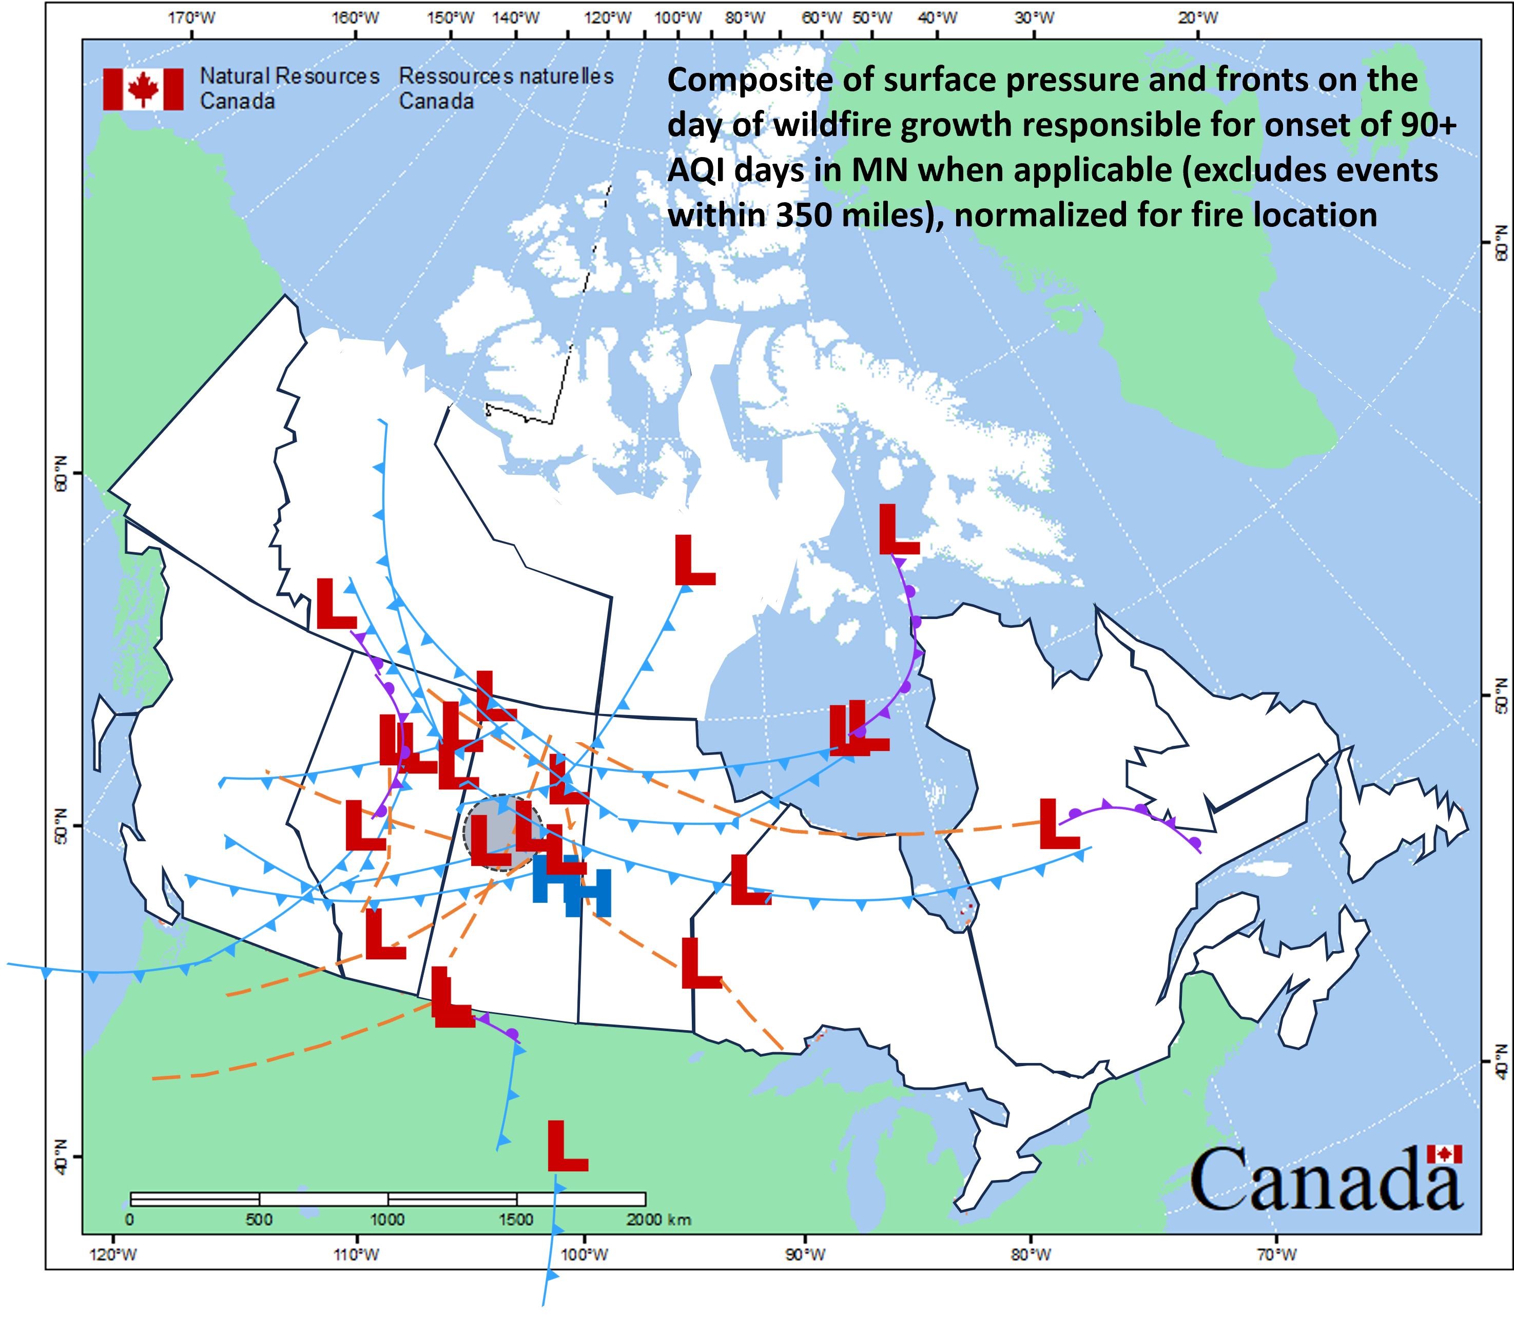
Mechanisms for Smoke Transport
Composite of surface features on the day of wildfire growth responsible for heavy smoke intrusion for events who’s wildfires were >350 miles from Minnesota
<350 mile events often featured heavy wildfire smoke that was produced on the same day/night as it entered Minnesota - wanted to focus on state of atmosphere prior to this time
Map adapted from NRC
Notes:
*A couple odd-balls, but by and large, seems to be a common theme involving a boundary in the vicinity or just west of the wildfire location.

Slide 22
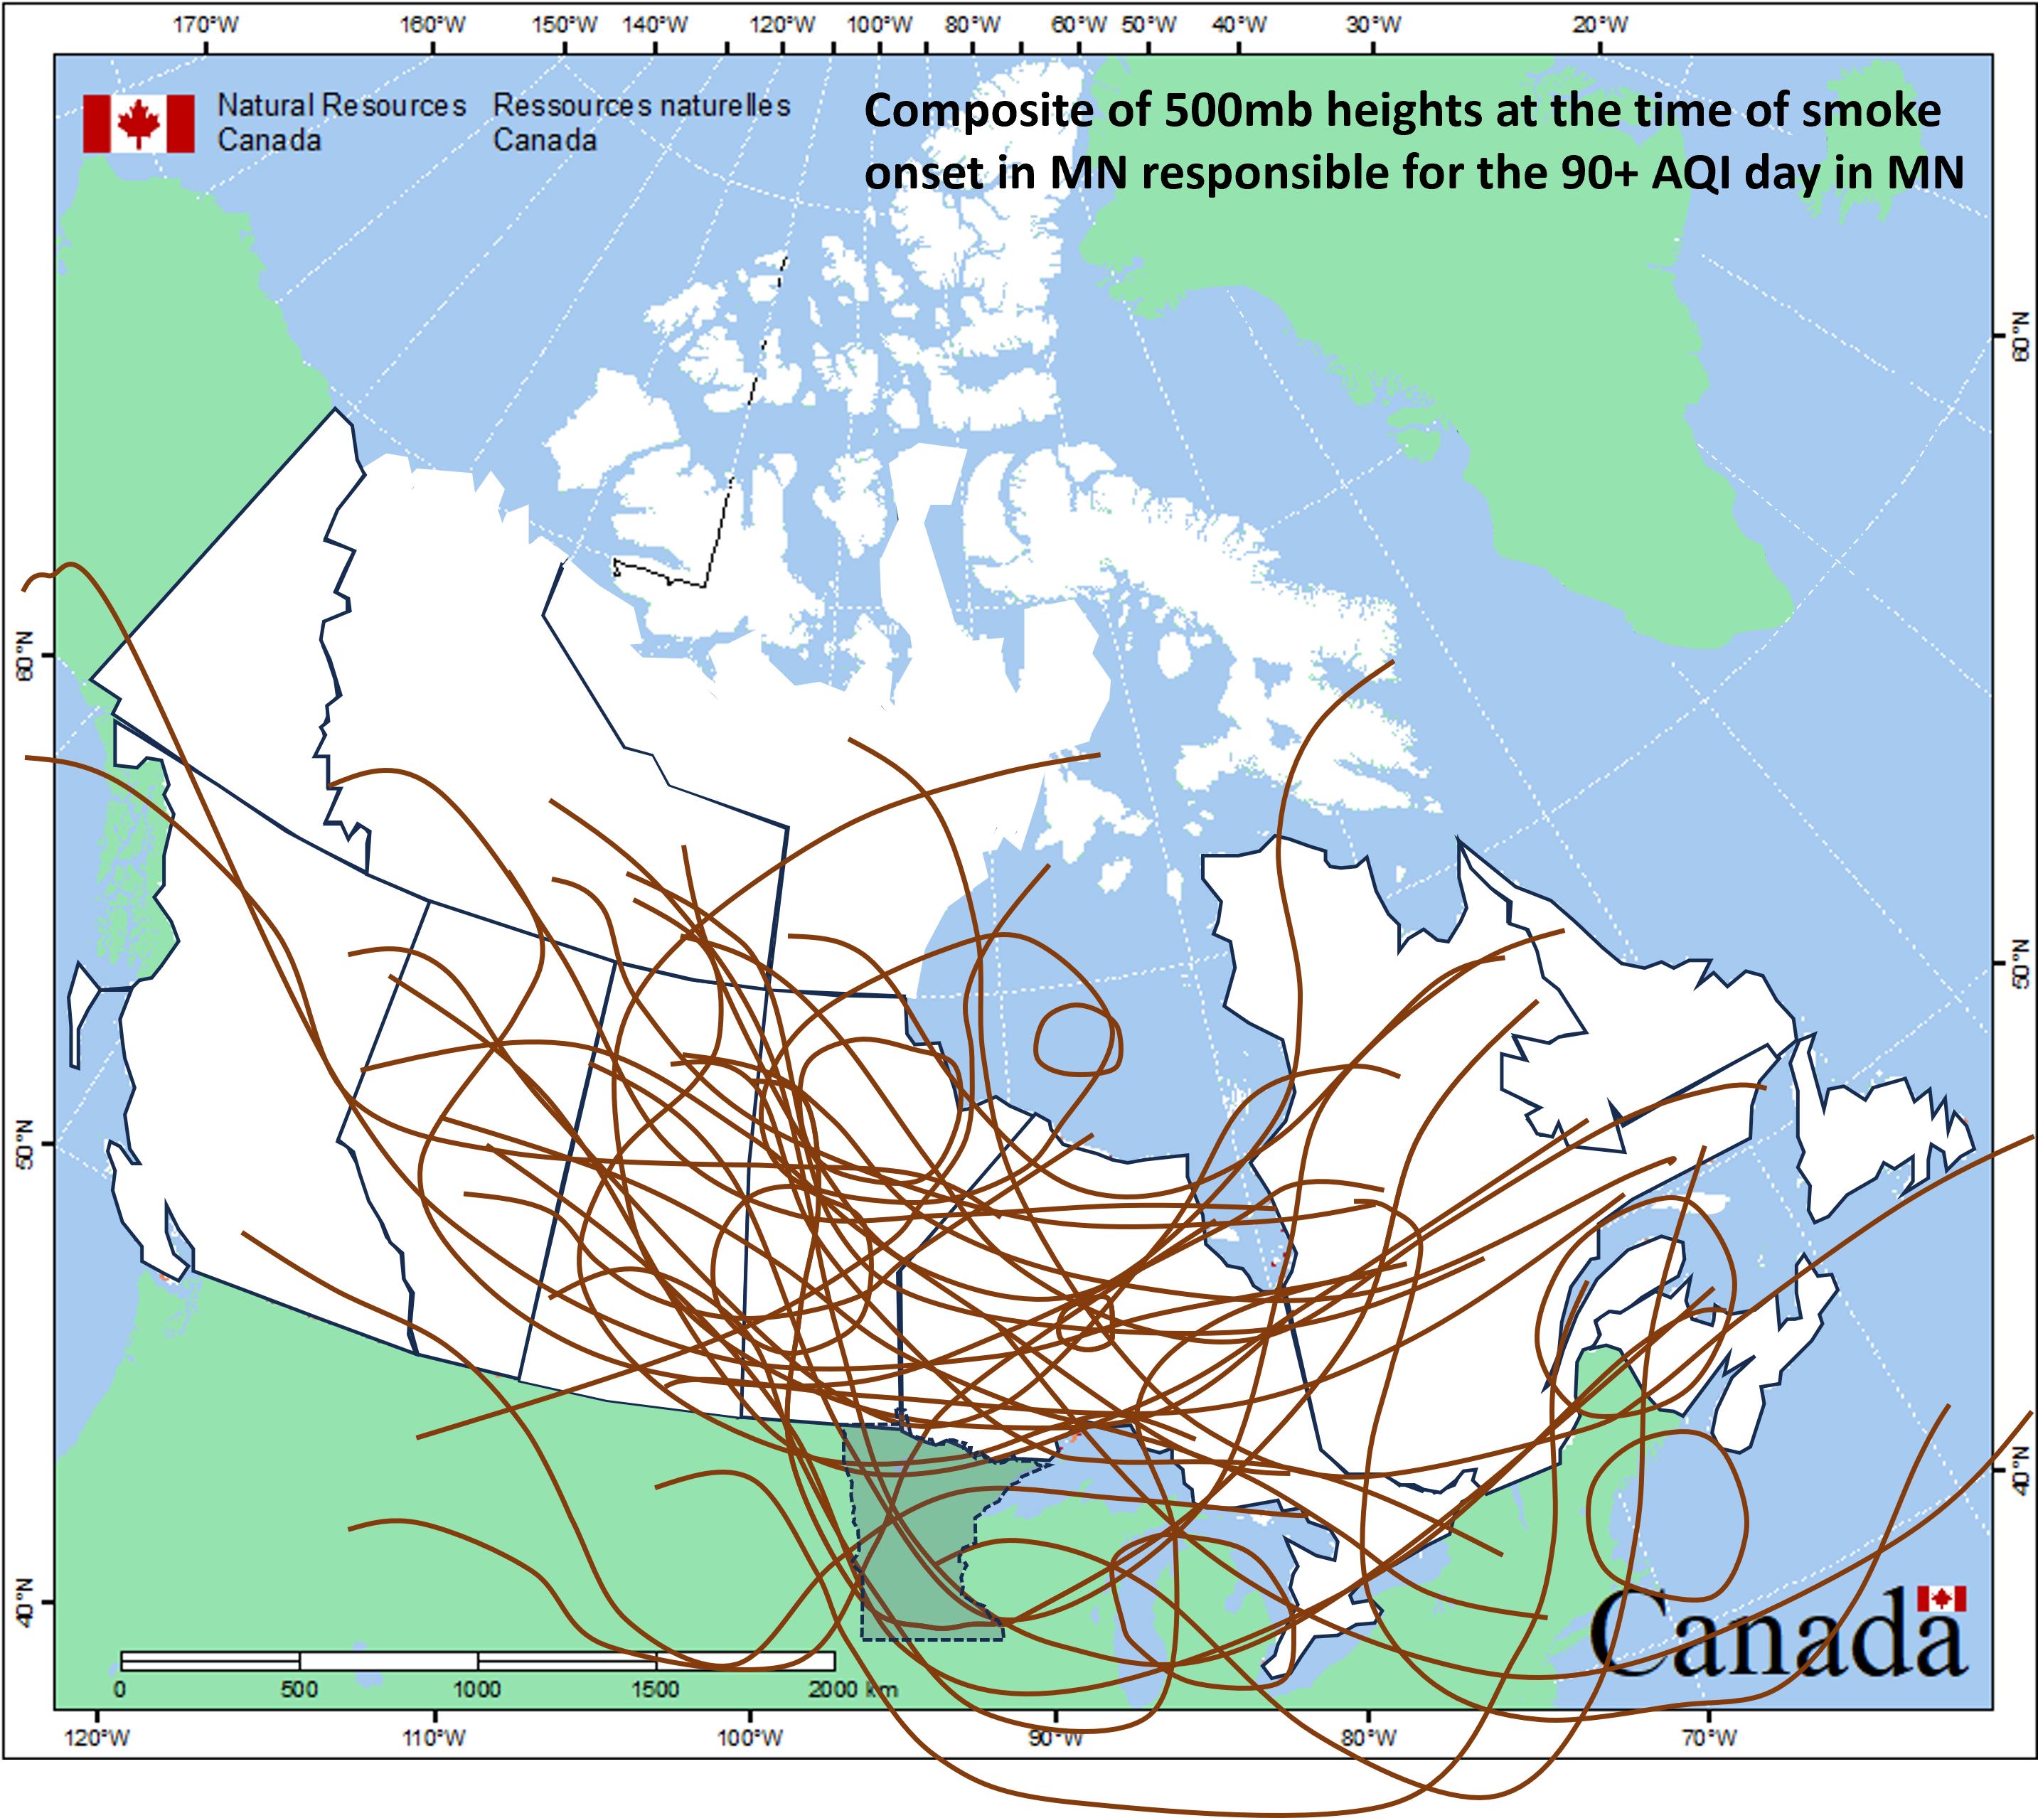
Mechanisms for Smoke Transport
Composite of 500mb heights at the time of heavy smoke onset in Minnesota
Map adapted from NRC
Notes:
*Sometimes the heavy smoke would move in the evening before a 90+ AQI day – wanted to capture the timing of initial onset as close to reality as possible

Slide 23
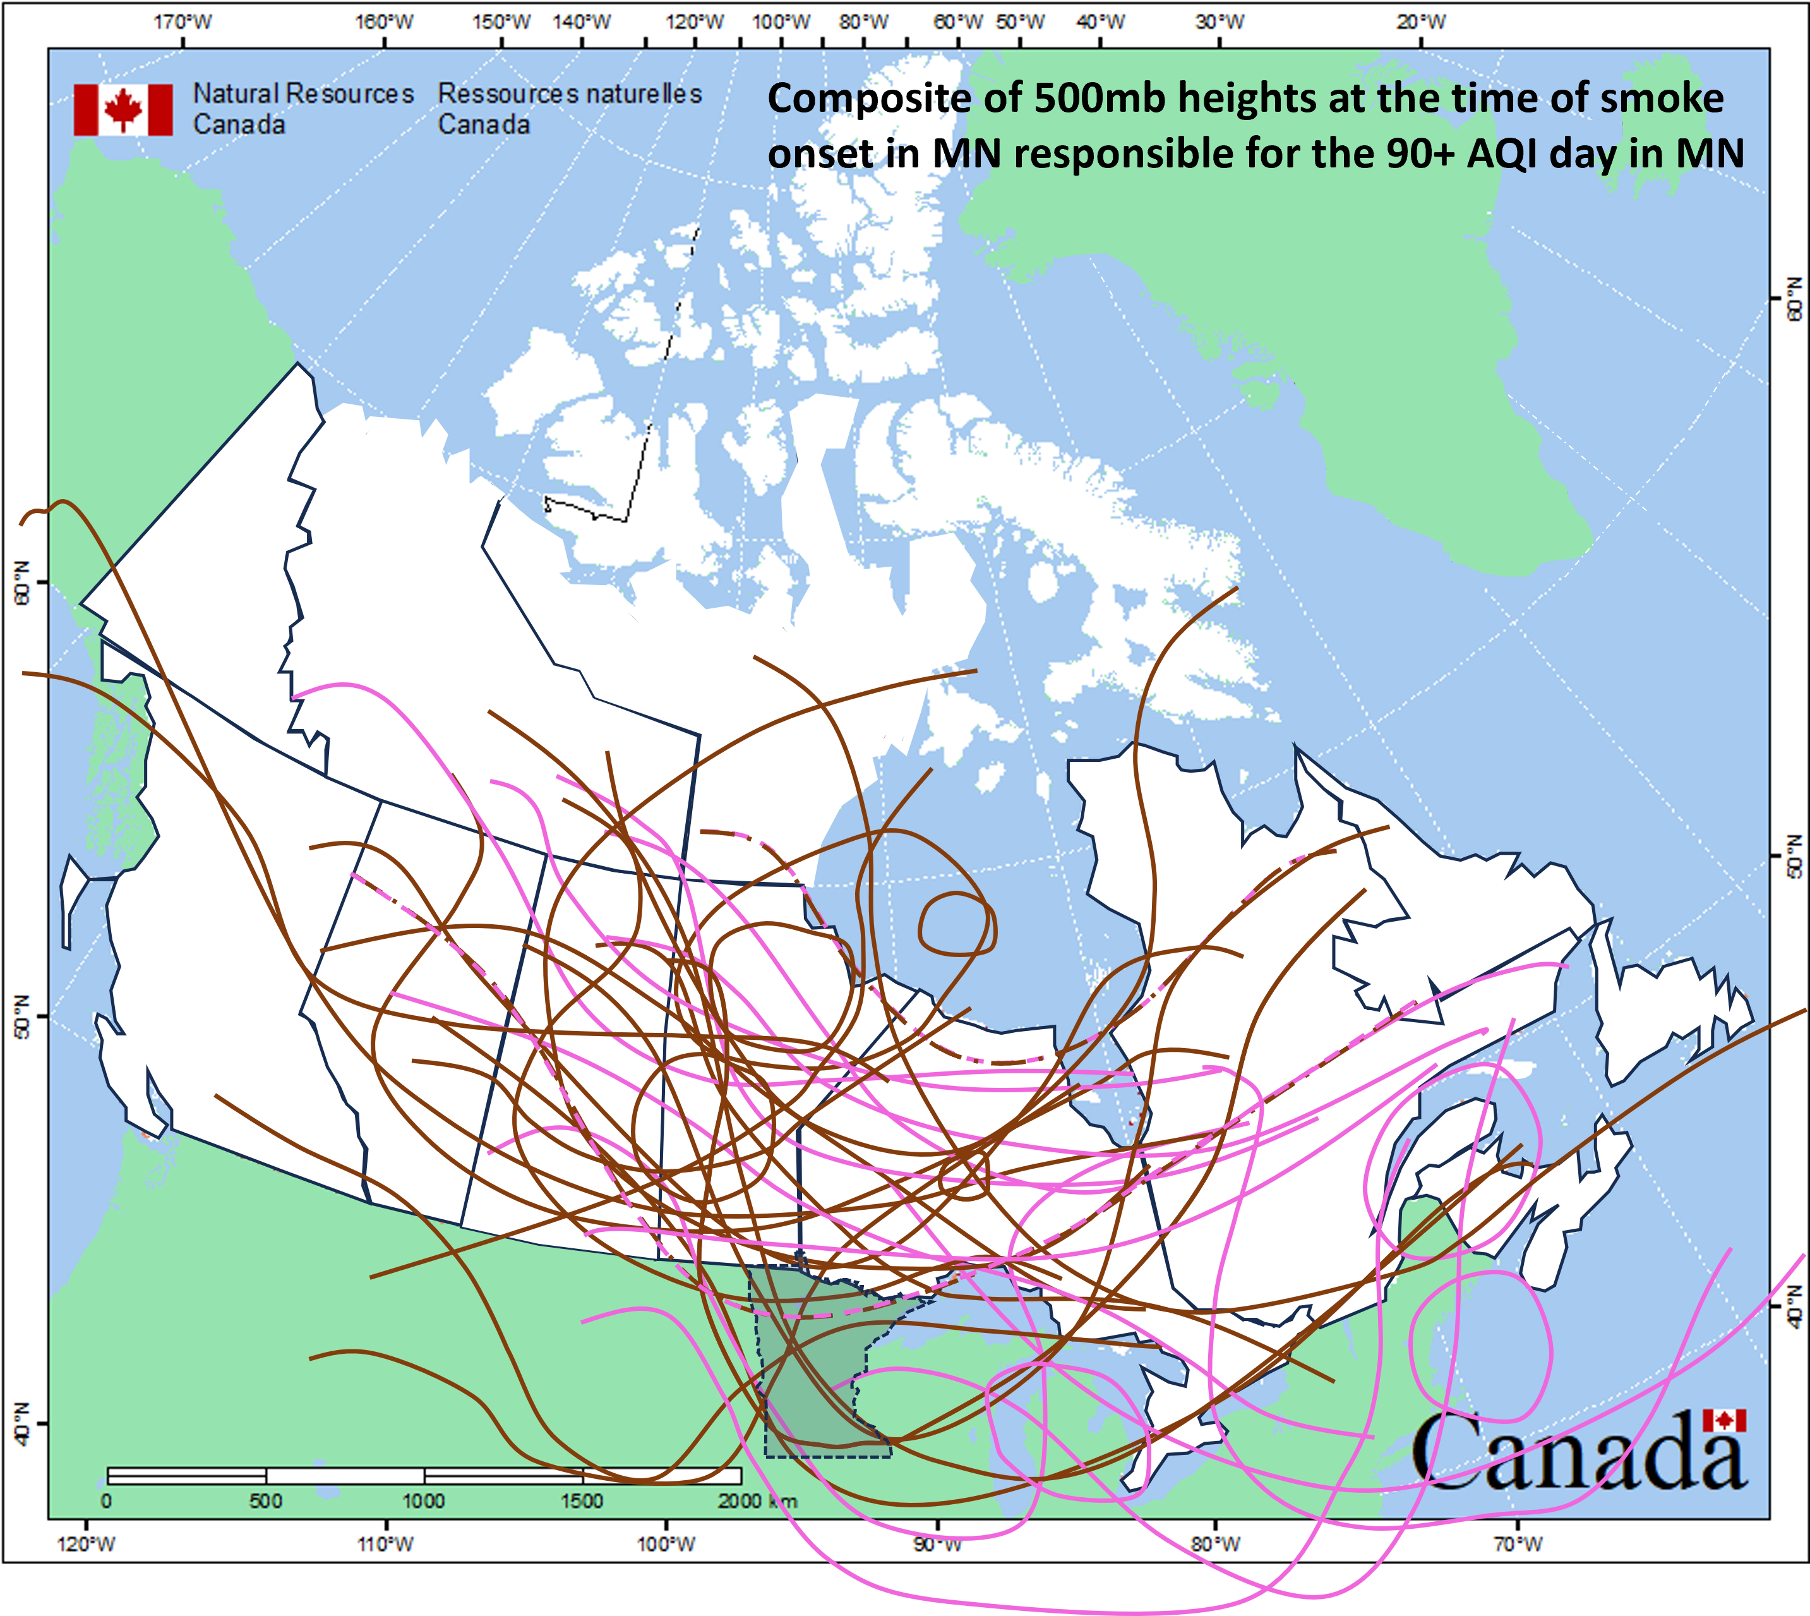
Mechanisms for Smoke Transport
Composite of 500mb heights at the time of heavy smoke onset in Minnesota
Takeaway: The presence of upper-level troughs is a very common theme
Responsible wildfires greater than 350 miles from Minnesota
Responsible wildfires in Quebec or less than 350 miles from Minnesota
Both
Map adapted from NRC
Notes:
*Try to tease out some additional information - for the most part for wildfires >350 miles away, the upper level trough was to the north or west of Minnesota.

Slide 24
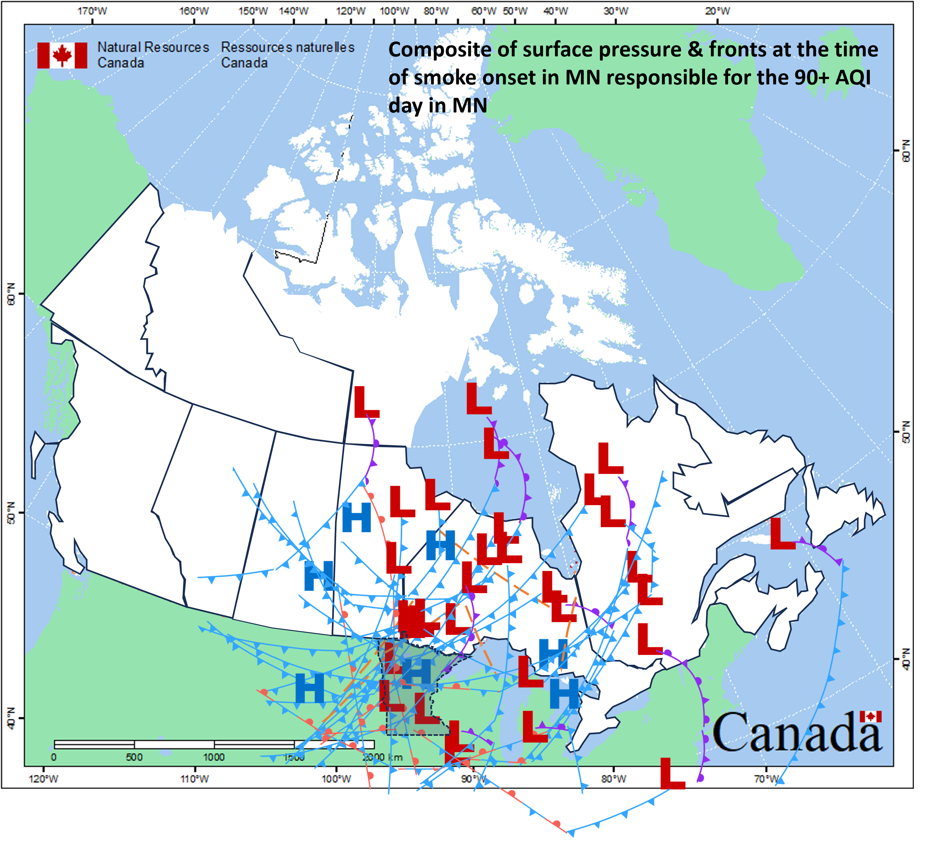
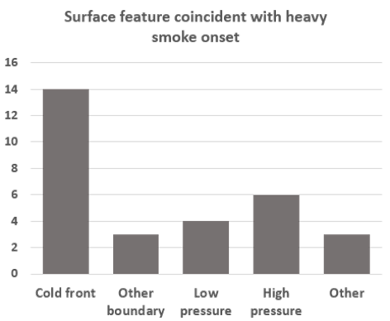
Mechanisms for Smoke Transport
Composite of relevant surface features present at the time of heavy smoke onset in Minnesota
Map adapted from NRC
Notes:
*Bit of a mess, but have a combination of subsidence from high pressure or cold air advection, perhaps pooling of particulates along a boundary other than a cold front such as a surface trough or stationary front, and then ”other”, which includes no apparent feature and/or uncertain features. One event featured smoke that seemed to be brought down from aloft via Lake Michigan, which then transported northwesterly around an area of high pressure. Similar event with Lake Superior influence in 2024. There was also a thunderstorm that influenced heavy ground-level smoke transport in 2021.

Slide 25
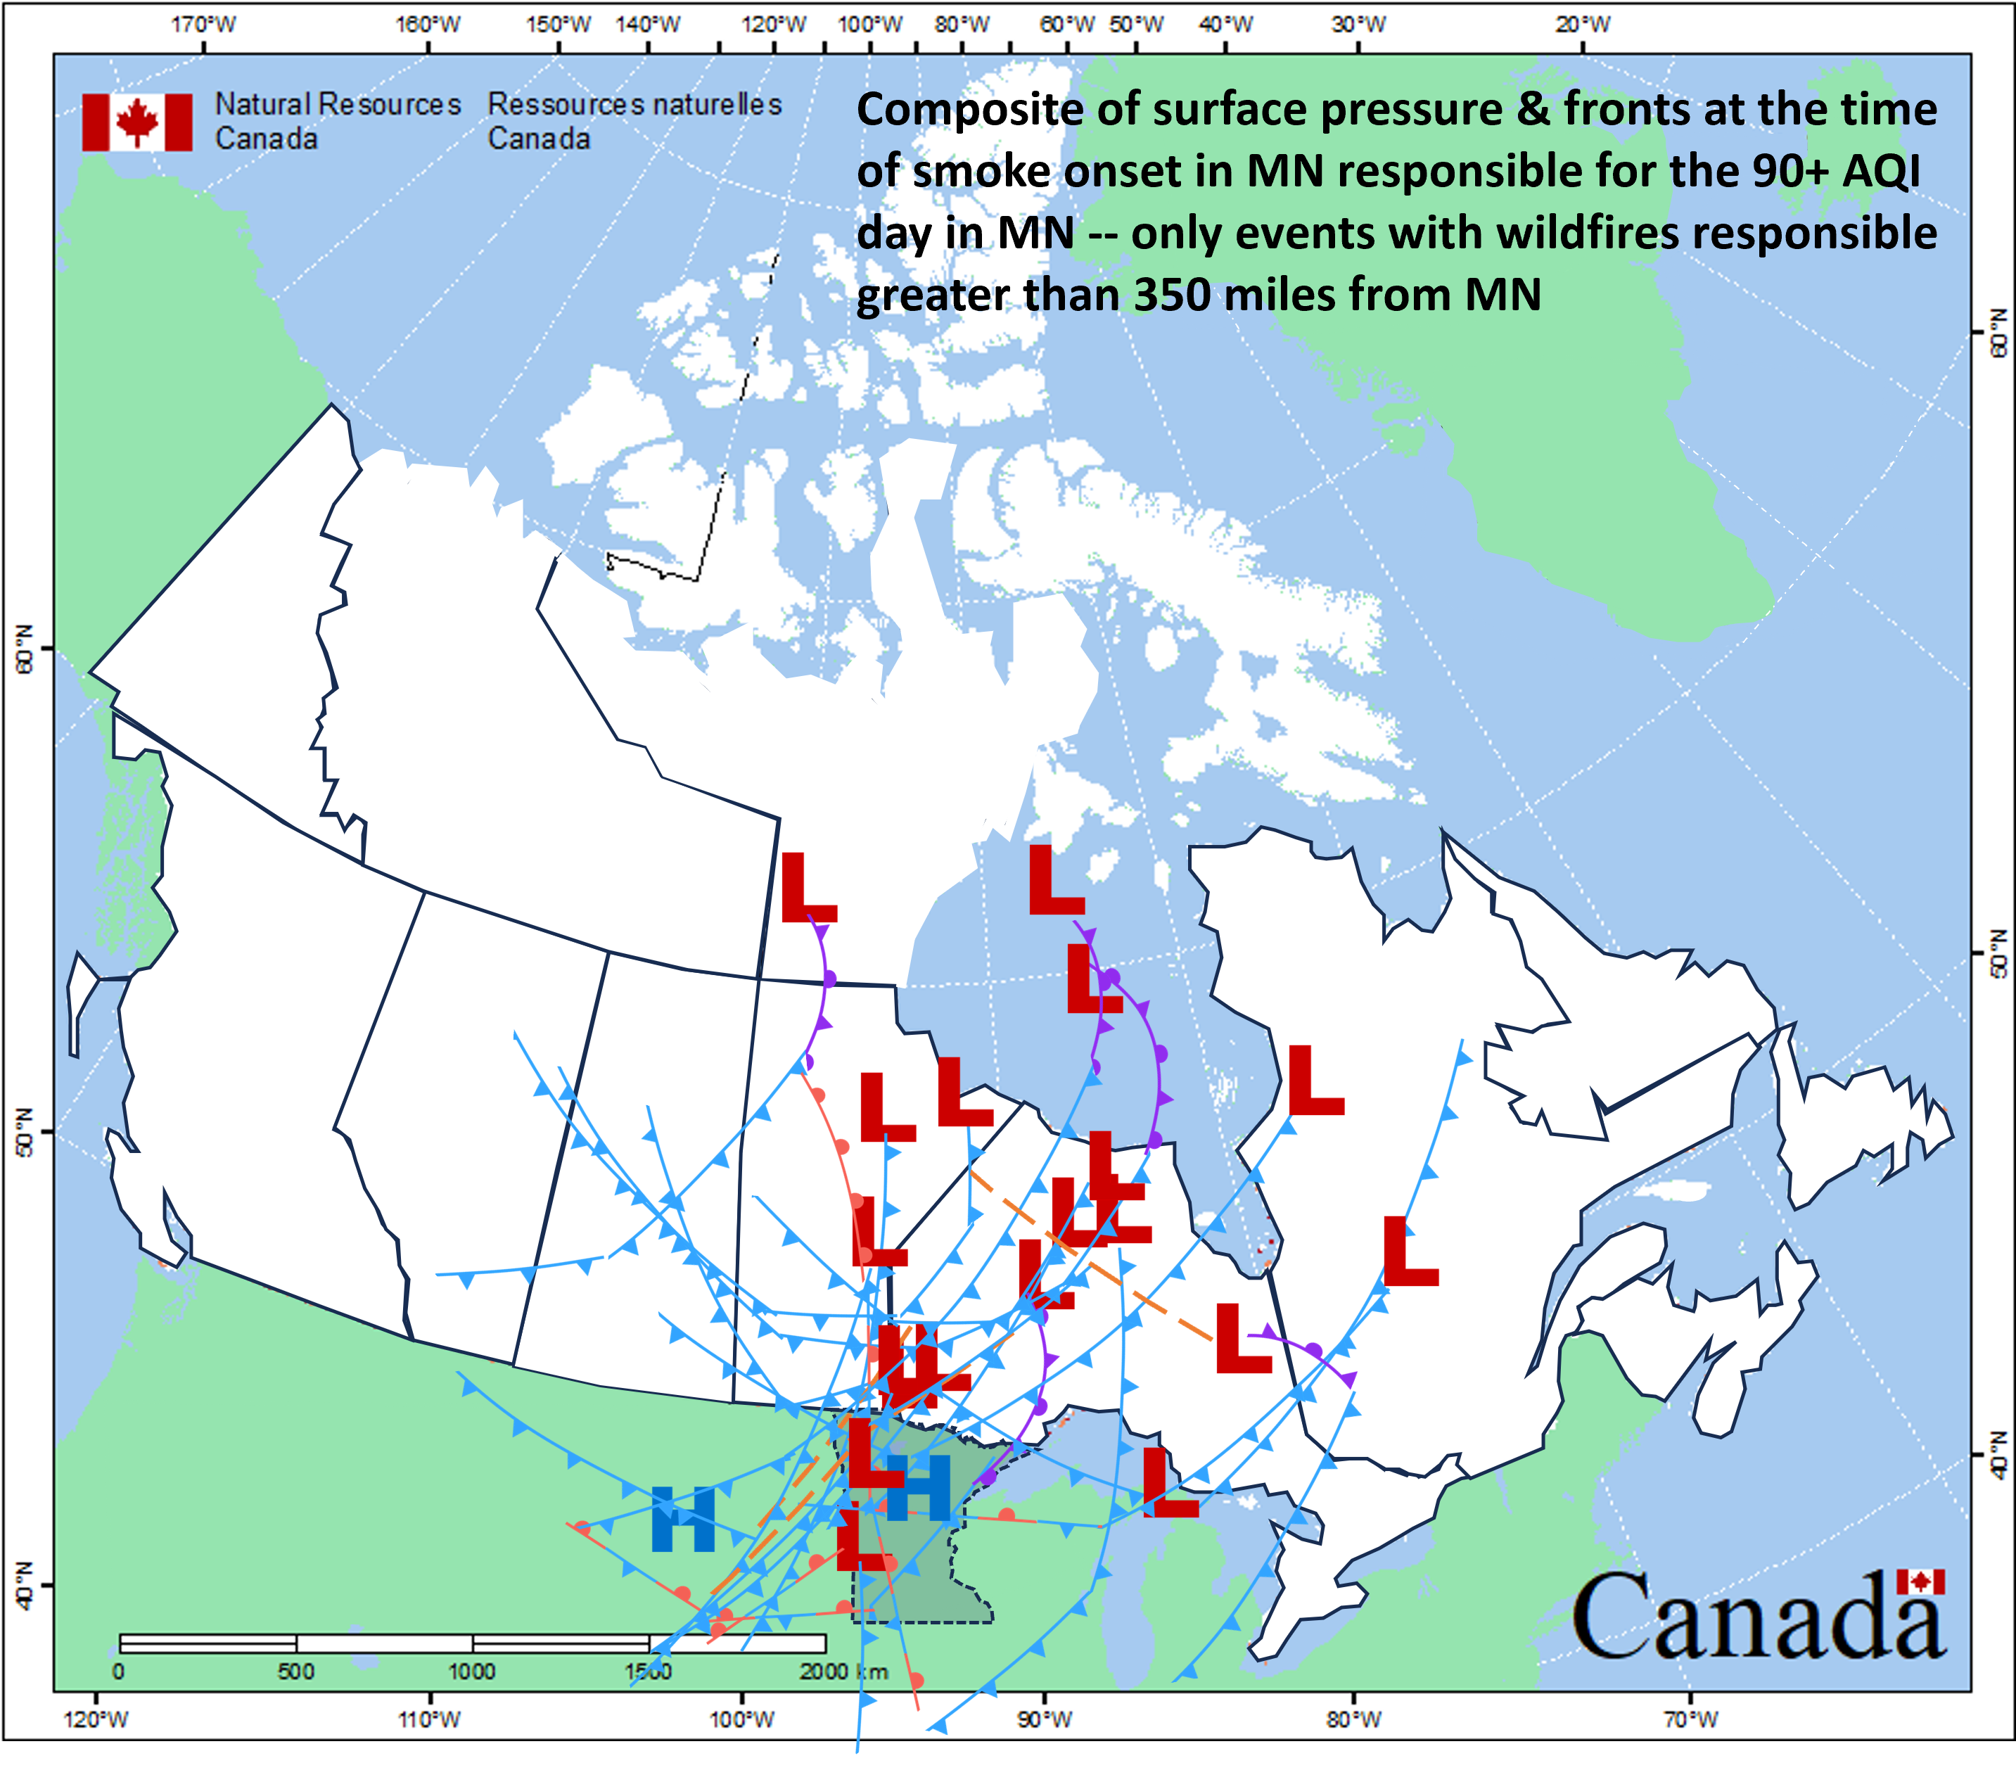
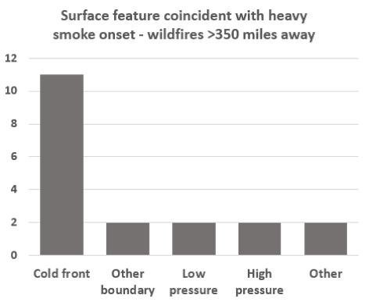
Mechanisms for Smoke Transport
Composite of relevant surface features present at the time of heavy smoke onset in Minnesota, but only with events who’s wildfires are >350 miles away from MN
Map adapted from NRC
Notes:
*Cold front is necessary most of the time to get heavy ground-level wildfire smoke when fires are more distant
(*) The map of mechanisms shows surface fronts… position of 850mb front could account for displacements.

Slide 26
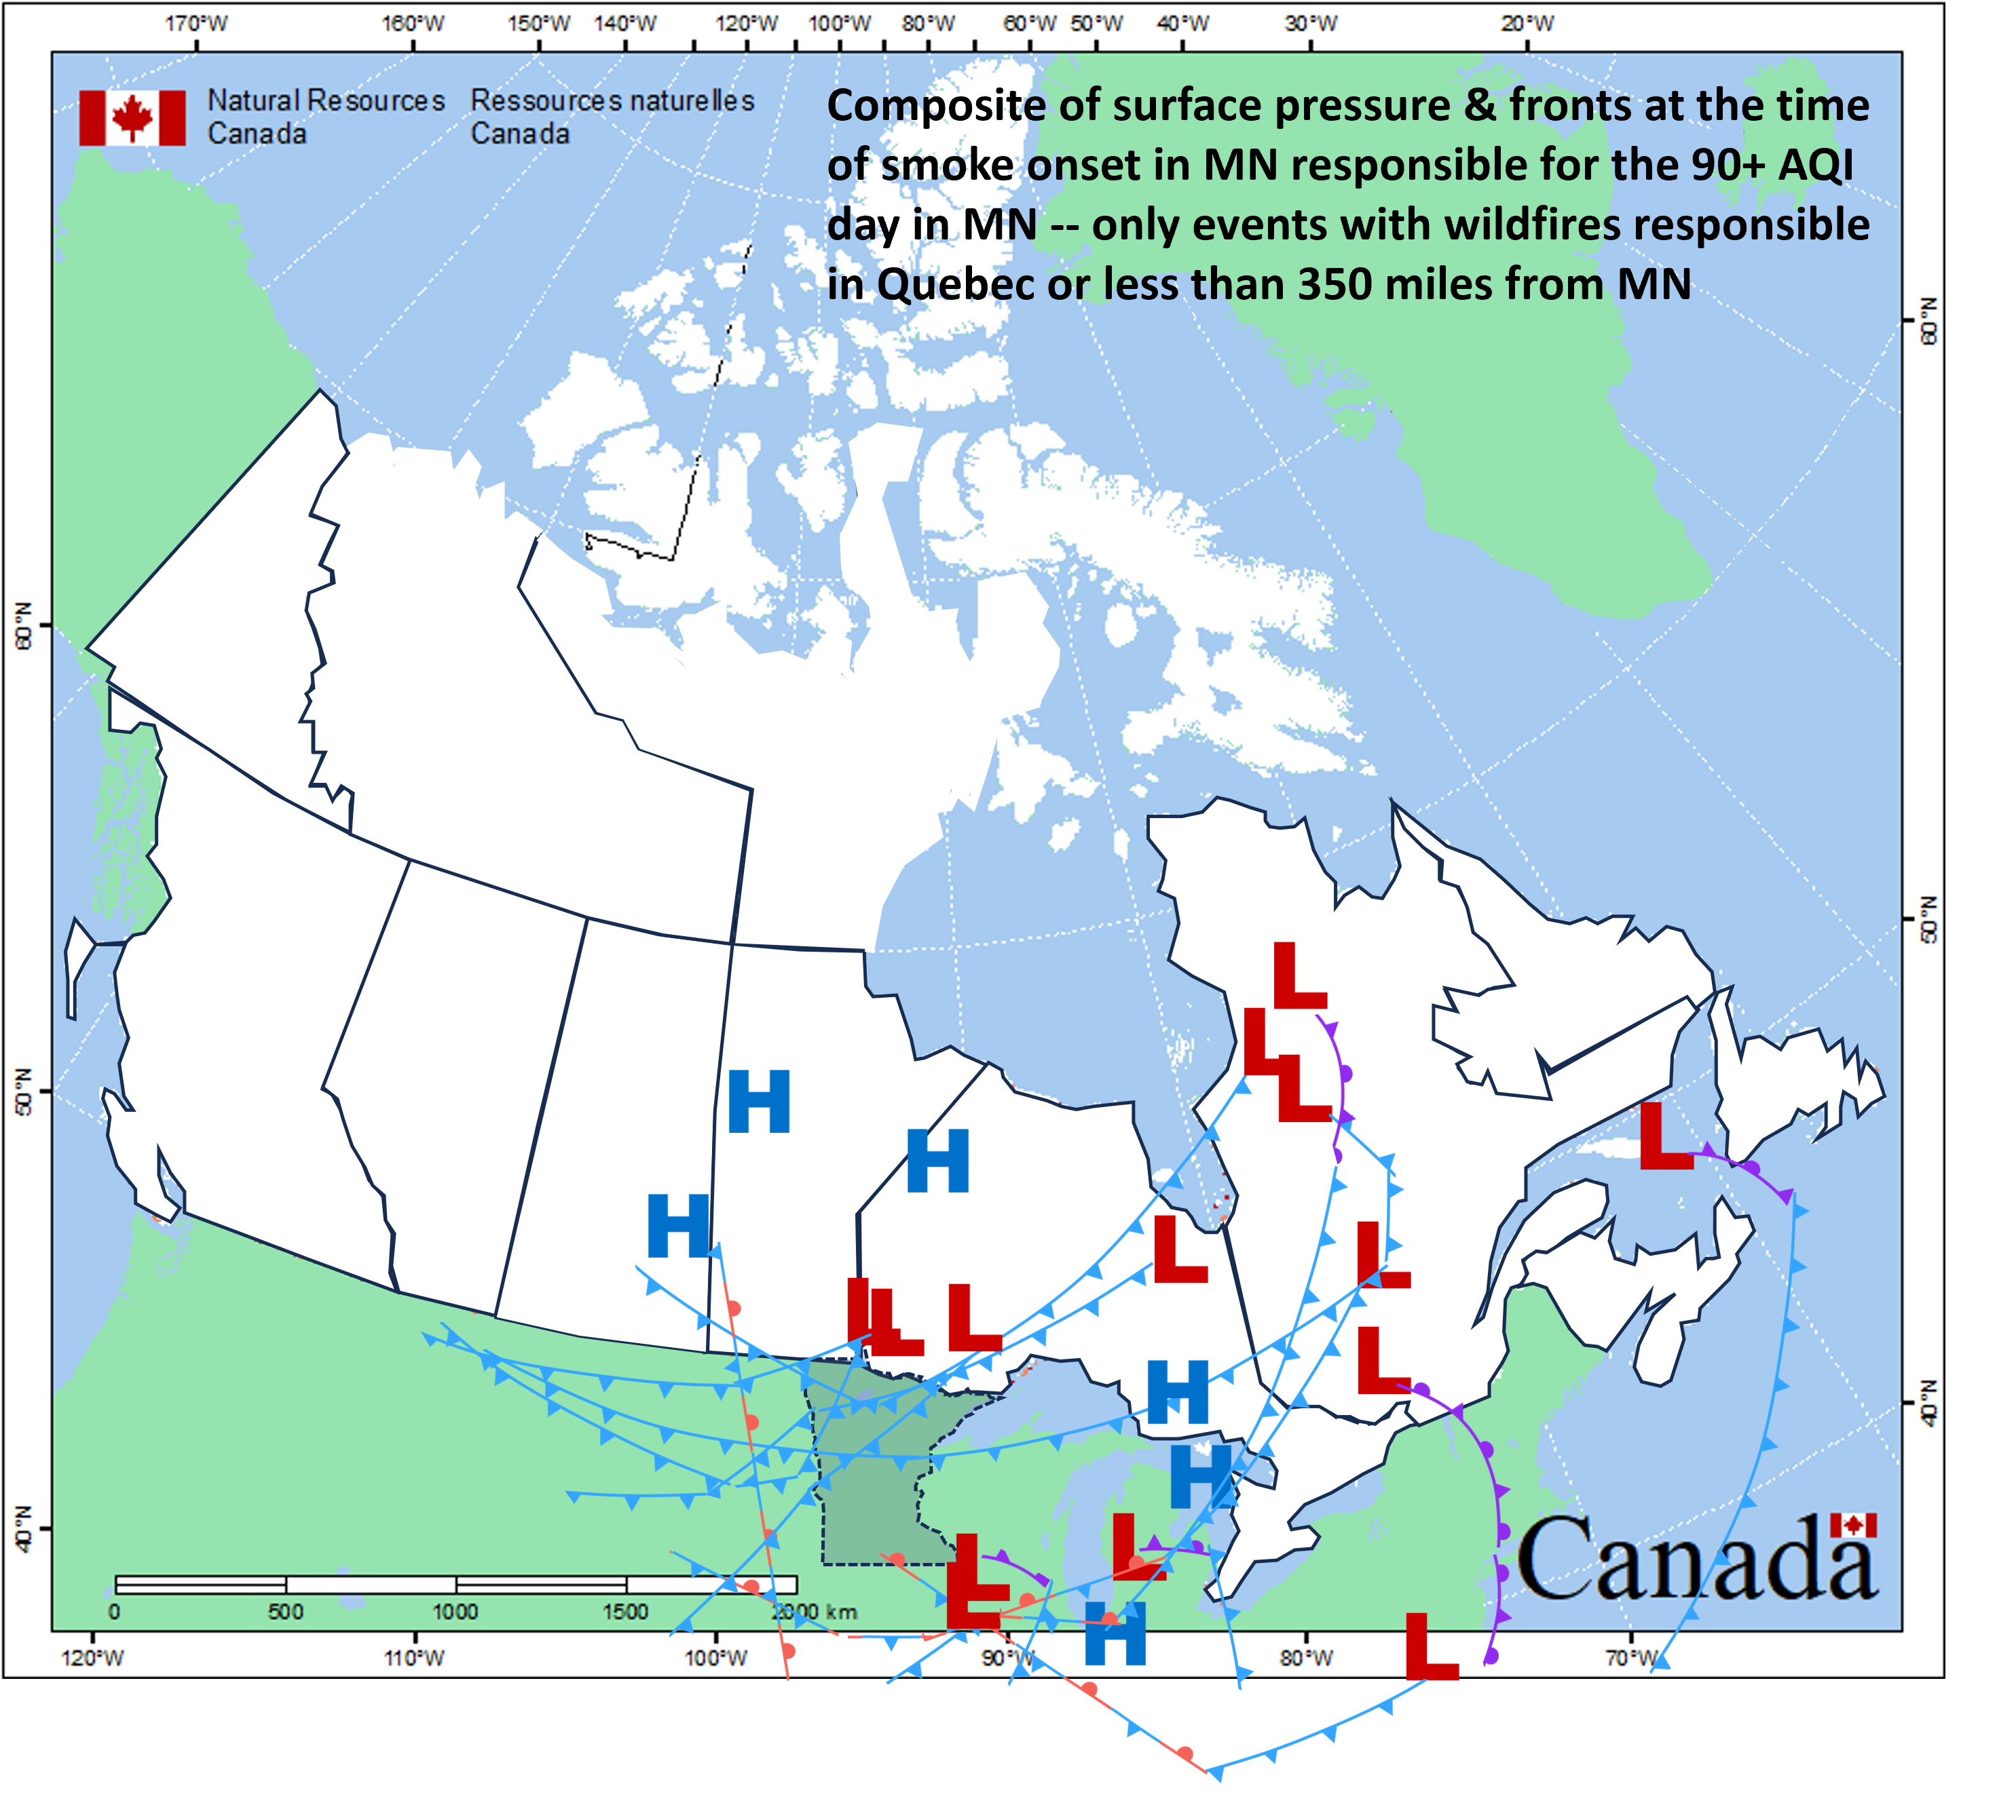
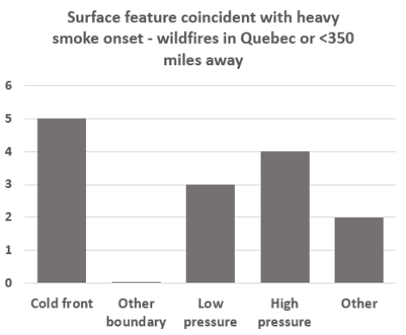
Mechanisms for Smoke Transport
Takeaway: Mechanisms for heavy smoke transport appear less limited when fires are closer
Same, but only <350 miles and Quebec events
Map adapted from NRC
Notes:
*Cold fronts still the most common feature, but much closer to being as common as other features
*Does this suggest that the probability for a bad smoke season in Minnesota increases if the potential for Canadian wildfires/drought is greatest closer to home? *While the 2024 Canadian wildfire season started early and was very active throughout, MN only had one exceedance event from May through early August when activity was focused mainly across northeastern British Columbia, but then several additional from mid Aug through mid Sept when numerous large wildfires were active in central Saskatchewan (about twice as close).

Slide 27
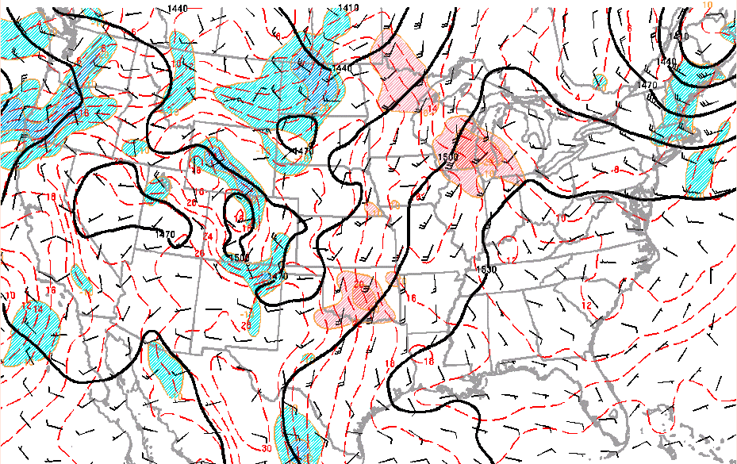
Magnitude of Cold air advection for cold fronts events
Storm Prediction Center’s Hourly Mesoscale Analysis data
Recorded the highest range of CAA associated with a front that led to heavy smoke in Minnesota around the time of the intrusion
Notes:
*https://www.spc.noaa.gov/exper/ma_archive/

Slide 28
Potential Future Work
Continue adding to the dataset
2024, future years’ events
Rolling 24 hour average
Sub-90 AQI events with very high 6-12 hour concentrations
Additional analysis
Hot Dry Windy Index
Uses wind speed and vapor pressure deficit in the lower atmosphere
Satellite-observed Fire Radiative Power
Relationship between distance from Minnesota and magnitude of FRP necessary for exceedance event?
Do smoke models handle certain ground-level smoke transport mechanisms better than others?
Timing and concentration
Notes:
*Many other ideas
*As for how the NWS AQM guidance could be better/strengths and weaknesses, would be amazing to have a user-defined option for magnitude of FRP - basically allow the user to turn new smoke on and off.
*Example scenario in which models currently struggle summarized by David Brown: "The models don't have the correct emissions for events where the fires grow rapidly in a day. On Friday, May 9th, 2024, the models had Thursday's emissions which were much lower. On Saturday, it was too late because most of the smoke had already been generated and transporting through the atmosphere“

