Slide 1
Air Quality Forecasters Workshop AirNow Updates
Rob Wildermann, AirNow Content and Systems Lead
October 9, 2024

Slide 2
Briefing Overview
AirNow Updates Overview
Proposed Changes to Reporting Areas
Background on Reporting Areas
What’s Not So Great for Observations
What’s Not So Great for Forecasting
So Now What?
Updates for Forecasting Submittal
Other Items Coming Up (Very Brief)
Questions / Discussion

Slide 3
Reporting Areas: Background
A Reporting Area in AirNow is a discrete geographic area in AirNow
They are used for both reporting Observations and for making Forecasts
This system originally served AirNow and its stakeholders well, but is showing its age
It is a key part of AirNow’s infrastructure and almost all AirNow’s products reflect this, at least somewhere

Slide 4
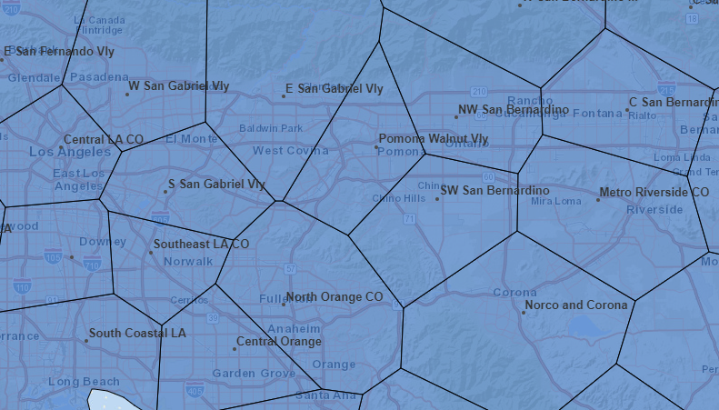
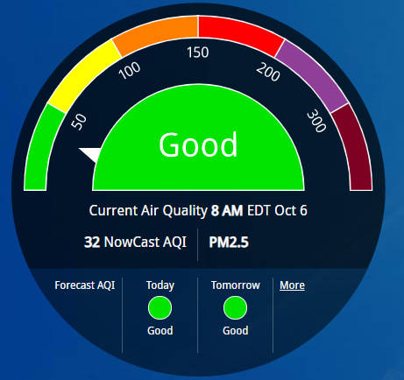
Reporting Areas: More Background
183 AQI
154 AQI
38 AQI
158 AQI
32 AQI
254 AQI
126 AQI
Notes:
Today we want to have a conversation with you on the AirNow Sensor Data Pilot. Namely why we are doing this, what exactly the pilot is and is not, and showing you the current prototype.
I know everyone is nervous about the data quality of low-cost sensors, so I will be sharing with you how EPA is address these concerns. A lot of great work has been done by the Agency on correcting sensor data and I am going to show you a few mockup examples during a wildfire event that demonstrates how corrected sensor data can be very useful.
Right up front let me say that EPA is not using the sensor data from this pilot for regulatory purposes. The intention of this sensor pilot is to provide supplemental information to the public to protect their health.
After showing you some example maps that EPA mocked up, we will have the US Forest Service do a live demo on the current prototype, highlighting various features of the map. Then we will talk about next steps and timeline.
Your feedback is encouraged during and after the webinar. We value your experience with sensors and air quality communication to the public. We want this to be an intuitive tool that is easy for the general public to use, especially during a wildfire event when people are desperate to find actionable information.

Slide 5
Reporting Areas: Observation Problems
Reporting Areas were originally created for reporting observations to the general public, but have developed these specific issues over time:
Highest, not closest, monitor reports AQI, which is sometimes very misleading
Monitoring sites can change and when not updated in the reporting area database, they can create misleading AQI reporting
Reporting areas based on single-pollutant monitors can also create confusing results
Notes:
Today we want to have a conversation with you on the AirNow Sensor Data Pilot. Namely why we are doing this, what exactly the pilot is and is not, and showing you the current prototype.
I know everyone is nervous about the data quality of low-cost sensors, so I will be sharing with you how EPA is address these concerns. A lot of great work has been done by the Agency on correcting sensor data and I am going to show you a few mockup examples during a wildfire event that demonstrates how corrected sensor data can be very useful.
Right up front let me say that EPA is not using the sensor data from this pilot for regulatory purposes. The intention of this sensor pilot is to provide supplemental information to the public to protect their health.
After showing you some example maps that EPA mocked up, we will have the US Forest Service do a live demo on the current prototype, highlighting various features of the map. Then we will talk about next steps and timeline.
Your feedback is encouraged during and after the webinar. We value your experience with sensors and air quality communication to the public. We want this to be an intuitive tool that is easy for the general public to use, especially during a wildfire event when people are desperate to find actionable information.

Slide 6
Observation Problem Breakdown
154 AQI
183 AQI
38 AQI
158 AQI
32 AQI
254 AQI
126 AQI
Notes:
Today we want to have a conversation with you on the AirNow Sensor Data Pilot. Namely why we are doing this, what exactly the pilot is and is not, and showing you the current prototype.
I know everyone is nervous about the data quality of low-cost sensors, so I will be sharing with you how EPA is address these concerns. A lot of great work has been done by the Agency on correcting sensor data and I am going to show you a few mockup examples during a wildfire event that demonstrates how corrected sensor data can be very useful.
Right up front let me say that EPA is not using the sensor data from this pilot for regulatory purposes. The intention of this sensor pilot is to provide supplemental information to the public to protect their health.
After showing you some example maps that EPA mocked up, we will have the US Forest Service do a live demo on the current prototype, highlighting various features of the map. Then we will talk about next steps and timeline.
Your feedback is encouraged during and after the webinar. We value your experience with sensors and air quality communication to the public. We want this to be an intuitive tool that is easy for the general public to use, especially during a wildfire event when people are desperate to find actionable information.

Slide 7
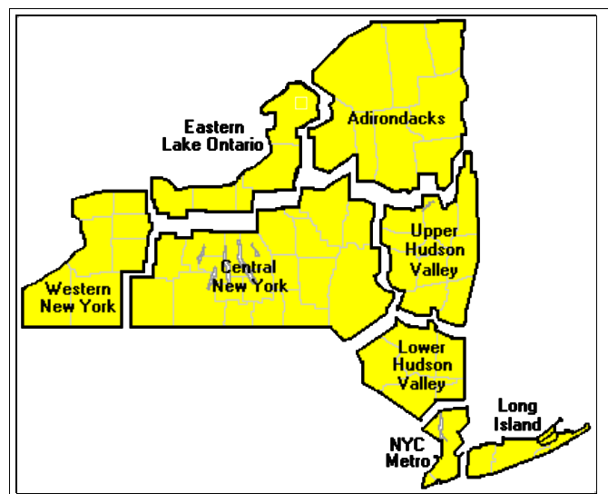
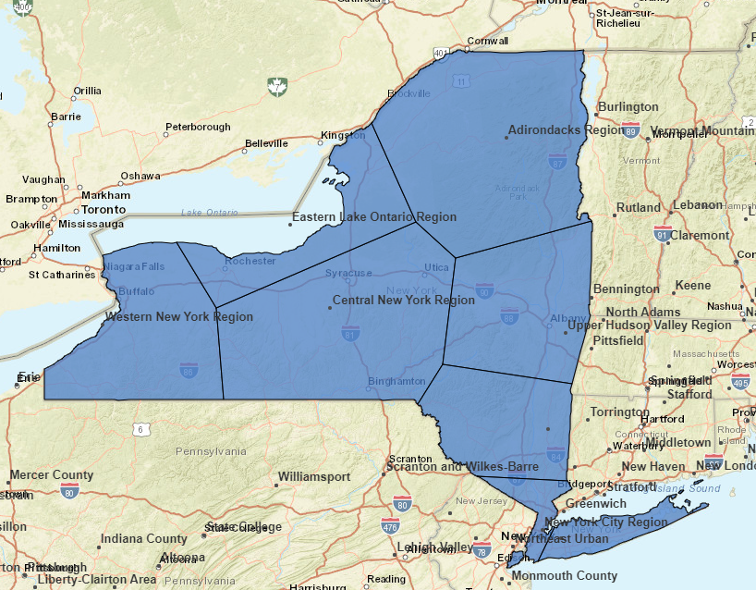
Forecasts: Spatial Problems
Center-point-based areas are can only approximate some desired forecast areas
Actual
AirNow
Notes:
Today we want to have a conversation with you on the AirNow Sensor Data Pilot. Namely why we are doing this, what exactly the pilot is and is not, and showing you the current prototype.
I know everyone is nervous about the data quality of low-cost sensors, so I will be sharing with you how EPA is address these concerns. A lot of great work has been done by the Agency on correcting sensor data and I am going to show you a few mockup examples during a wildfire event that demonstrates how corrected sensor data can be very useful.
Right up front let me say that EPA is not using the sensor data from this pilot for regulatory purposes. The intention of this sensor pilot is to provide supplemental information to the public to protect their health.
After showing you some example maps that EPA mocked up, we will have the US Forest Service do a live demo on the current prototype, highlighting various features of the map. Then we will talk about next steps and timeline.
Your feedback is encouraged during and after the webinar. We value your experience with sensors and air quality communication to the public. We want this to be an intuitive tool that is easy for the general public to use, especially during a wildfire event when people are desperate to find actionable information.

Slide 8
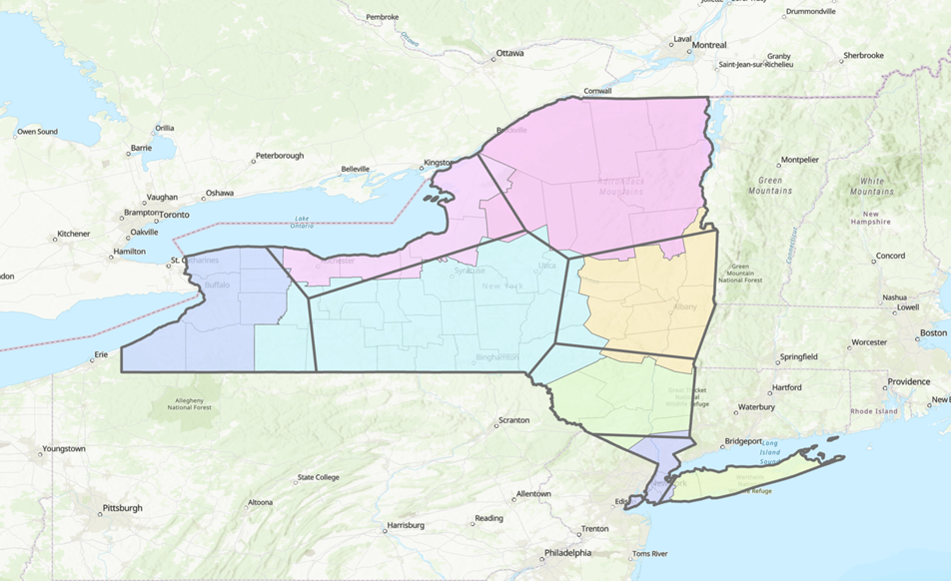
Forecasts: Spatial Problems Overlay
AirNow can only approximate what New York is trying to do. Around 15% of NY’s forecast area is mismatched in AirNow.
Some areas, like central New York, are particularly bad.
New York is not the only agency trying to make the reporting areas match counties or geography.
Other agencies in AirNow just accept the shortcomings.
We can do better.
Notes:
Today we want to have a conversation with you on the AirNow Sensor Data Pilot. Namely why we are doing this, what exactly the pilot is and is not, and showing you the current prototype.
I know everyone is nervous about the data quality of low-cost sensors, so I will be sharing with you how EPA is address these concerns. A lot of great work has been done by the Agency on correcting sensor data and I am going to show you a few mockup examples during a wildfire event that demonstrates how corrected sensor data can be very useful.
Right up front let me say that EPA is not using the sensor data from this pilot for regulatory purposes. The intention of this sensor pilot is to provide supplemental information to the public to protect their health.
After showing you some example maps that EPA mocked up, we will have the US Forest Service do a live demo on the current prototype, highlighting various features of the map. Then we will talk about next steps and timeline.
Your feedback is encouraged during and after the webinar. We value your experience with sensors and air quality communication to the public. We want this to be an intuitive tool that is easy for the general public to use, especially during a wildfire event when people are desperate to find actionable information.

Slide 9
Reporting Area Problems: Summary
Observation issues
Observations act in unexpected and misleading ways
Manual upkeep lags and creates user confusion
Observations may not be closest monitor– and are sometimes wildly different from closer monitors
Forecast issues
States cannot define forecast areas in AirNow to match their own
Users see these differences, the issues they create, and complain
Ultimately, users lose trust in AirNow and agencies when they spot inconsistencies that we do not fix.
Notes:
Today we want to have a conversation with you on the AirNow Sensor Data Pilot. Namely why we are doing this, what exactly the pilot is and is not, and showing you the current prototype.
I know everyone is nervous about the data quality of low-cost sensors, so I will be sharing with you how EPA is address these concerns. A lot of great work has been done by the Agency on correcting sensor data and I am going to show you a few mockup examples during a wildfire event that demonstrates how corrected sensor data can be very useful.
Right up front let me say that EPA is not using the sensor data from this pilot for regulatory purposes. The intention of this sensor pilot is to provide supplemental information to the public to protect their health.
After showing you some example maps that EPA mocked up, we will have the US Forest Service do a live demo on the current prototype, highlighting various features of the map. Then we will talk about next steps and timeline.
Your feedback is encouraged during and after the webinar. We value your experience with sensors and air quality communication to the public. We want this to be an intuitive tool that is easy for the general public to use, especially during a wildfire event when people are desperate to find actionable information.

Slide 10
AirNow is Changing Reporting Areas
AirNow is redefining Reporting Areas as shapes, not areas around a point.
How will this affect air agencies?
Short Answer– as little or as much as each individual air agency wants
Long Answer
Agencies can send us shapefiles, use an AirNowTech tool to define their own, or possibly ask us to create
We can also recreate the existing Reporting Areas as shapes for agencies that are happy with things as they are
Observations may be affected
Depending on what air agencies do, observations may be affected
Ultimately, this can simply become AirNow’s problem
Solutions include separating reporting areas from observations completely, using nearest pollutant monitor (with distance limits), possibly others
Notes:
Today we want to have a conversation with you on the AirNow Sensor Data Pilot. Namely why we are doing this, what exactly the pilot is and is not, and showing you the current prototype.
I know everyone is nervous about the data quality of low-cost sensors, so I will be sharing with you how EPA is address these concerns. A lot of great work has been done by the Agency on correcting sensor data and I am going to show you a few mockup examples during a wildfire event that demonstrates how corrected sensor data can be very useful.
Right up front let me say that EPA is not using the sensor data from this pilot for regulatory purposes. The intention of this sensor pilot is to provide supplemental information to the public to protect their health.
After showing you some example maps that EPA mocked up, we will have the US Forest Service do a live demo on the current prototype, highlighting various features of the map. Then we will talk about next steps and timeline.
Your feedback is encouraged during and after the webinar. We value your experience with sensors and air quality communication to the public. We want this to be an intuitive tool that is easy for the general public to use, especially during a wildfire event when people are desperate to find actionable information.

Slide 11
Other Improvements Coming
New Forecast Submittal System Planned
AirNow has reached out to 9 air agencies with diverse use cases
AirNow and AirNow developers will spec a new system based on this feedback
AirNow will refine these specs after making broader outreach to the forecasting community
Expect updates via AirNow Info Exchange Meetings
Others?
Notes:
Today we want to have a conversation with you on the AirNow Sensor Data Pilot. Namely why we are doing this, what exactly the pilot is and is not, and showing you the current prototype.
I know everyone is nervous about the data quality of low-cost sensors, so I will be sharing with you how EPA is address these concerns. A lot of great work has been done by the Agency on correcting sensor data and I am going to show you a few mockup examples during a wildfire event that demonstrates how corrected sensor data can be very useful.
Right up front let me say that EPA is not using the sensor data from this pilot for regulatory purposes. The intention of this sensor pilot is to provide supplemental information to the public to protect their health.
After showing you some example maps that EPA mocked up, we will have the US Forest Service do a live demo on the current prototype, highlighting various features of the map. Then we will talk about next steps and timeline.
Your feedback is encouraged during and after the webinar. We value your experience with sensors and air quality communication to the public. We want this to be an intuitive tool that is easy for the general public to use, especially during a wildfire event when people are desperate to find actionable information.

Slide 12
Questions and Discussion

Slide 13
Contact Info / Links
Contact Info
Rob Wildermann, AirNow Content and Infrastructure Lead
wildermann.rob@epa.gov
919-541-0120
John White, AirNow Program Manager
white.johne@epa.gov
Link
AirNow - https://www.airnow.gov/
Notes:
Today we want to have a conversation with you on the AirNow Sensor Data Pilot. Namely why we are doing this, what exactly the pilot is and is not, and showing you the current prototype.
I know everyone is nervous about the data quality of low-cost sensors, so I will be sharing with you how EPA is address these concerns. A lot of great work has been done by the Agency on correcting sensor data and I am going to show you a few mockup examples during a wildfire event that demonstrates how corrected sensor data can be very useful.
Right up front let me say that EPA is not using the sensor data from this pilot for regulatory purposes. The intention of this sensor pilot is to provide supplemental information to the public to protect their health.
After showing you some example maps that EPA mocked up, we will have the US Forest Service do a live demo on the current prototype, highlighting various features of the map. Then we will talk about next steps and timeline.
Your feedback is encouraged during and after the webinar. We value your experience with sensors and air quality communication to the public. We want this to be an intuitive tool that is easy for the general public to use, especially during a wildfire event when people are desperate to find actionable information.

