Slide 1
GEFS Aerosols Forecast Model
Partha S. Bhattacharjee¹, Li Pan¹, Raffaele Montuoro², Jeff McQueen² and Fanglin Yang²
¹ Lynker@NOAA/EMC, ²NOAA/EMC
NOAA Air Quality Forecasters Focus Group Workshop
9-10th October, 2024, College Park, MD

Slide 2
Outline
Global Aerosol model developments at NCEP/EMC
Current operational global aerosol model
Products, verification
Future model development activities
Conclusion

Slide 3
Prognostic aerosol capacity in NCEP global models started in 2012 (collaboration with NASA/GSFC)
Over the years multiple NOAA labs (GSL, ARL, NESDIS) and NASA collaborate with EMC in the development of the model
 | Model | Resolution and forecast length | Dust emission | Smoke emission | General comments
NGAC v1 (dust only) | Global Spectral Model (GSM GFS) | T126 (~1 deg), globally upto 5 days | GOCART dust | No fire emission | Operational in 2012 (Lu et al., 2016)
NGAC v2 (dust, black and organic carbon, seasalt and sulfate) | GSM-GFS | T126 (~1 deg), globally upto 5 days | GOCART dust | GBBePX fire emission from NESDIS | Operational in 2018 (Wang et al., 2018)
GEFS-Aerosols (v1) (5 species) | FV3 GEFS (single member in GEFS v12) | C384 (~0.25 deg), globally upto 5 days | FENGSHA dust | GBBePX fire emission (v3) | Operational in 2020 (Zhang et al., 2022)
GEFS-Aerosols (v2) or UFS Aerosol with Aerosol DA (experimental) | FV3 GEFSv13 | C384 (~0.25 deg), globally upto 35 days | FENGSHA dust (with updates) | GBBePX fire emission with updates, use of blended fire emission | Planned implementation in 2026

Slide 4
Current Operational Model
One additional member of GEFSv12 for aerosols (deterministic)
GEFS meteorology (based on GFSv15) at C384 (~25 km), 64 levels, to 120 hrs, 4x/day
Inline aerosol representation based on NASA/GSFC GOCART (WRF-Chem)
Emissions: CEDS-2019 (SO2, PSO4, POC, PEC), GBBEPx biomass burning, FENGSHA dust, GEOS-5 sea salt, marine DMS
Initial conditions: chemical tracers are cycled from the output of a previous forecast as the initial condition
Smoke plume rise: Wind shear dependent 1-d cloud model to simulate tilt of plume. Fire radiative power is used to calculate convective heat flux and determine injection height
Tracer transport and wet scavenging are included in Simplified Arakawa-Schubert (SAS) scheme. Fluxes are calculated positive definite.

Slide 5
Current Operational Model Products and Verification
3-hourly 0.25 deg grib2 forecast data (upto 5 days) contain total AOD, species AOD, Total and Dust PM2.5 and PM10,
along with total column density of aerosol species.
3-hourly 0.5 deg. grib2 forecast data (upto 5 days) contain vertical mixing ratios of aerosol species (all 64 model levels)
Data available through NOMADS ftp : https://nomads.ncep.noaa.gov/pub/data/nccf/com/gens/v12.3
Barcelona Supercomputing Center (BSC) uses near real time GEFS-Aerosols AOD, PM along with other models for dust forecast over N. Africa, Europe and Mediterranean region (part of WMO Sand and Dust Storm Warning Advisory and Assessment System (SDS-WAS) (https://dust.aemet.es/products/daily-dust-products).
CPC uses AOD and SSA at 340nm for UV index forecast product
GEFS-Aerosols total PM2.5 data is used in WMO program GAFIS (Global Air Quality Forecasting and Information System (GAFIS) : over East Asia and India. https://community.wmo.int/en/activity-areas/gaw/science-for-services/gafis
Both point and grid based verification of AOD and PM forecasts are done using DTC METplus tool using observations (AEORNET, AIRNOW, Satellites VIIRS, GOES, reanalysis products MERRA2, CAMS).
Other fields (like AOD in UV wavelengths, PM species, vertical mixing ratios) needs to be verified

Slide 6
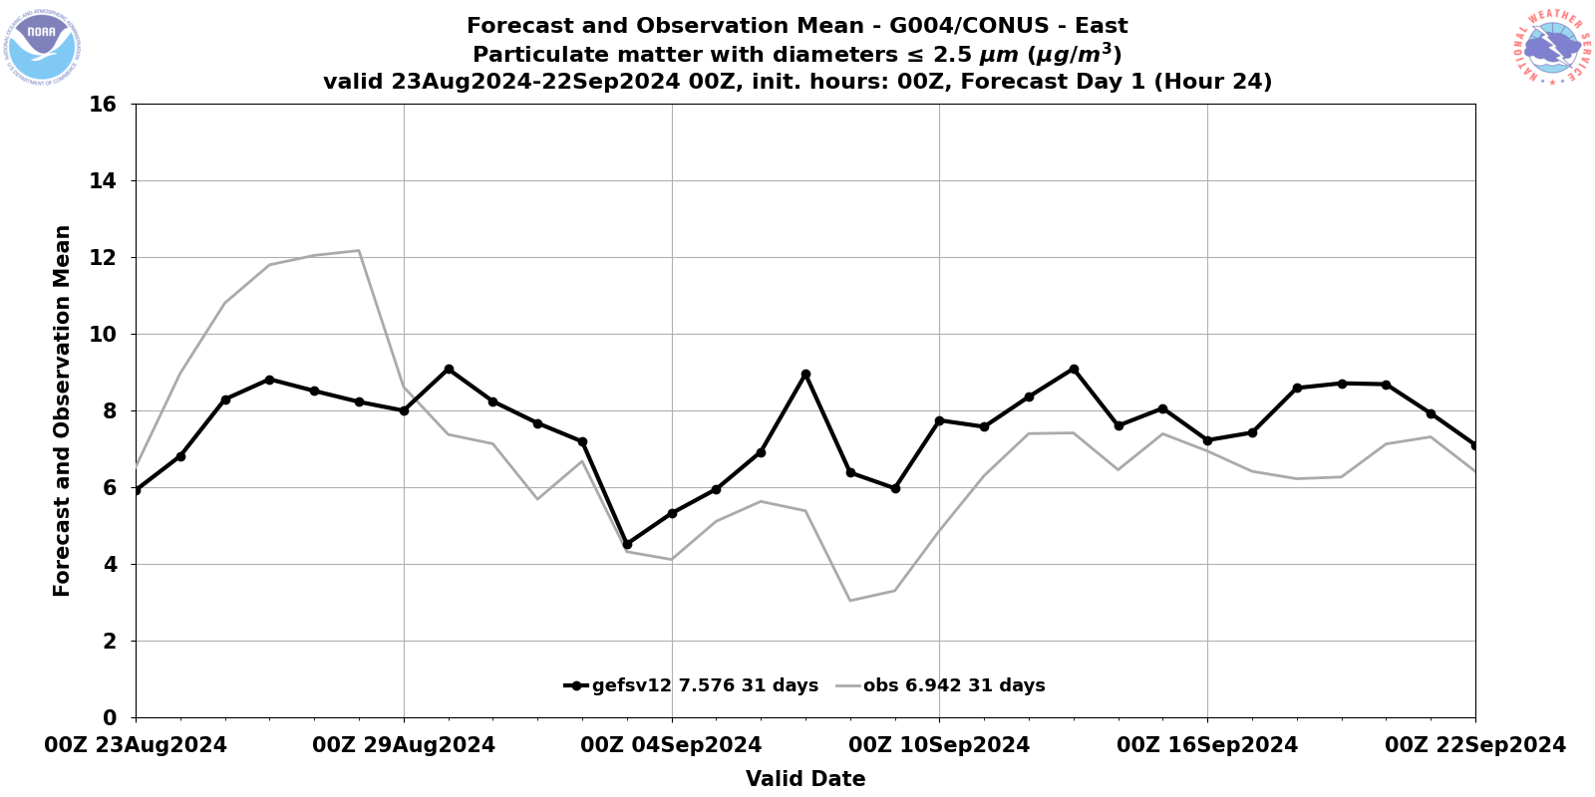
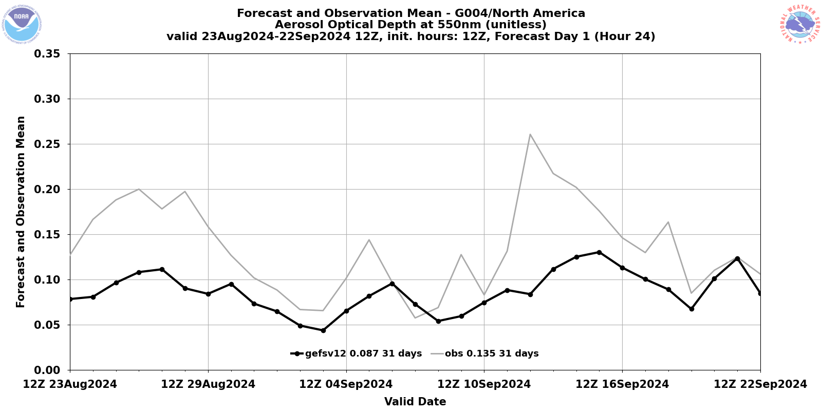
GEFS-Aerosols verification update
EMC Verification System (EVS) which uses METplus, added GEFS-Aerosols verifications (against PM2.5 and AERONET AOD) in real time parallel (will be incorporated in operations in EVS v2 (May, 2025).
AERONET AOD : https://www.emc.ncep.noaa.gov/users/verification/global/gefs/dev/chem/grid2obs/aeronet_aod/
Total PM2.5 : https://www.emc.ncep.noaa.gov/users/verification/global/gefs/dev/chem/grid2obs/airnow_pm25/
Daily forecast verification maps (against Multi-model Ensemble), comparison against satellite AOD :
https://www.emc.ncep.noaa.gov/gc_wmb/parthab/NCO-GEFSAerosol/html/fv3_aod_png.html#picture
https://www.emc.ncep.noaa.gov/gc_wmb/parthab/NCO-GEFSAerosol/html/fv3_viirsstat_png.html
https://www.emc.ncep.noaa.gov/gc_wmb/parthab/NCO-GEFSAerosol/html/fv3_geos5stat_png.html

Slide 7
GEFS-Aerosols verification update
GEFS-Aerosols performance in year 2023 from WMO SDS-WAS https://dust.aemet.es/products/daily-dust-products?tab=evaluation
Total AOD verified against ground AERONET stations
Correlation | CAMS | NASA-GOES | MetOffice | Silam | GEFS-Aerosols
N. Africa | 0.5 | 0.83 | 0.79 | 0.73 | 0.74
Mediterranean | 0.67 | 0.7 | 0.73 | 0.76 | 0.69
Middle East | 0.79 | 0.79 | 0.81 | 0.79 | 0.71
Europe | 0.26 | 0.34 | 0.38 | 0.24 | 0.32
RMSE | CAMS | NASA-GOES | MetOffice | Silam | GEFS-Aerosols
N. Africa | 0.29 | 0.19 | 0.19 | 0.25 | 0.23
Mediterranean | 0.15 | 0.14 | 0.11 | 0.16 | 0.16
Middle East | 0.2 | 0.18 | 0.14 | 0.24 | 0.24
Europe | 0.17 | 0.15 | 0.14 | 0.17 | 0.17
MBE | CAMS | NASA-GOES | MetOffice | Silam | GEFS-Aerosols
N. Africa | -0.13 | -0.07 | -0.03 | -0.14 | -0.1
Mediterranean | -0.11 | -0.09 | -0.05 | -0.13 | -0.12
Middle East | -0.16 | -0.12 | 0.03 | -0.2 | -0.18
Europe | -0.13 | -0.12 | -0.11 | -0.14 | -0.14
GEFS-Aerosols, without any aerosol DA, performance comparable
against other global models (some of them use DA)

Slide 8
ufs-weather-model https://github.com/ufs-community/ufs-weather-model
Current development for GEFSv13
NOAA’s Unified Forecast System (UFS) modeling applications currently in development as a coupled model for global prediction of weather
to seasonal time scales, targeting GFSv17 (medium range), GEFSv13 (sub-seasonal) and SFSv1 (seasonal) forecasting systems.
In the global coupled UFS development phase, discrete system prototypes were defined and evaluated within a fixed benchmark framework and
evaluation findings were used to inform subsequent development.
Atmosphere
FV3 dynamical core
GFS Physics with Thompson microphysics
CCPP physics driver
C384 (~25km), 127 levels
Ocean
MOM6 Modular Ocean Model
¼ degree tripolar grid, 75 hybrid levels
OM4 Set up [Adcroft, 2019]
Waves
WAVEWATCH III
½ degree regular lat/lon grid
ST4 Physics [Ardhuin, 2010]
Ice
CICE6 Los Alamos Sea Ice Model
¼ degree tripolar grid (same as ocean)
5 thickness categories
Mushy thermodynamics on (P7 onward)
Aerosols
NASA GOCART2G
Emissions: CEDS-2019 (SO2, PSO4, POC, PEC), QFED biomass burning, FENGSHA dust, GEOS-5 sea salt, marine DMS
Blend fire emission to climatology after 5 days
Sulfate, Organic Carbon, Black Carbon, Dust, Sea Salt, Nitrogen
MERRA2 ICs
Driver/Mediator
NEMS driver
CMEPS mediator

Slide 9
GEFS-Aerosols (v13) replaces GEFS-Aerosols v12.3, changes include meteorological model upgrades (GFS from v15 to v17) and chemical model changes (GOCART replaces WRF-CHEM)
The preliminary results for v13 are comparable to v12, which is encouraging. Tuning of large scale wet deposition scheme
in the experimental version improve accumulation of aerosol in higher latitude
Plan to perform evaluation of AOD and PM2.5 against operational model between October of 2022 to December of 2024

Slide 10
Aerosol data assimilation will be included in GEFS-Aerosols v13
Currently one of the few (only?) operational centers to not have aerosol DA initializing their aerosol prediction system
6-hourly cycles 4x a day with early and late cycles
Early cycle to initialize the GEFS long forecasts (one deterministic aerosol analysis provided from the cycling DA system)
Late cycle to initialize the high resolution GDAS forecast (without radiative feedback)
Analysis resolution C192L127 (~0.5 deg); background resolution C1152L127 (~9km)
3DVar FGAT with 3-hourly backgrounds
VIIRS EPS 550nm AOD from S-NPP, N20, N21
“DA is improving the forecast, but still more tuning is needed !” (Andy Tangborn)
Slide courtesy : Cory R. Martin

Slide 11
Conclusion
Current global aerosol model operational at NOAA since 2020 and uses GFSv15, it is one member of GEFSv12.
AQM uses GEFS-Aerosols boundary conditions.
Forecast validation of AOD and PM2.5 currently uses METplus tool and soon to be implemented in EMC Verification System (EVS)
Development work is underway for next model update to GEFSv13, with changes in meteorology from GFSv15 to GFSv17, physics and land
surface updates and various aerosol updates.
Addition of 3Dvar Aerosol DA in GEFSv13
Planned evaluation of AOD and PM2.5 from GEFSv13 against current operational model.

