Slide 1
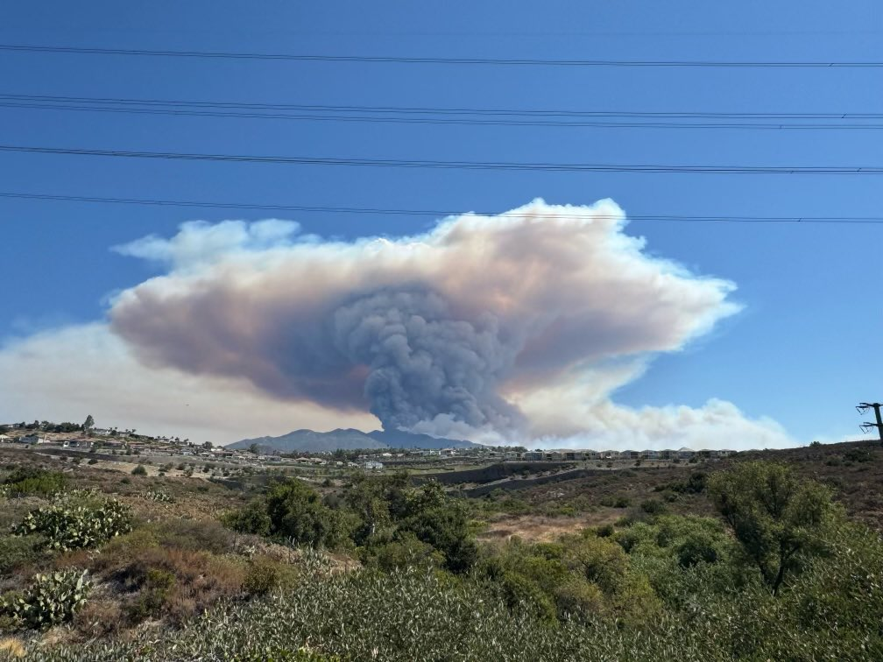
Evaluation of AQM Air Quality Forecasts in South Coast AQMD Jurisdiction
Air Quality Forecaster Focus Group Workshop
College Park, MD
October 9-10, 2024
Nico Schulte, Ph.D.
Scott A. Epstein, Ph.D.
South Coast Air Quality Management District

Slide 2
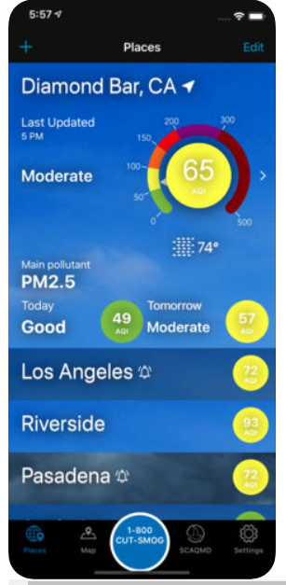
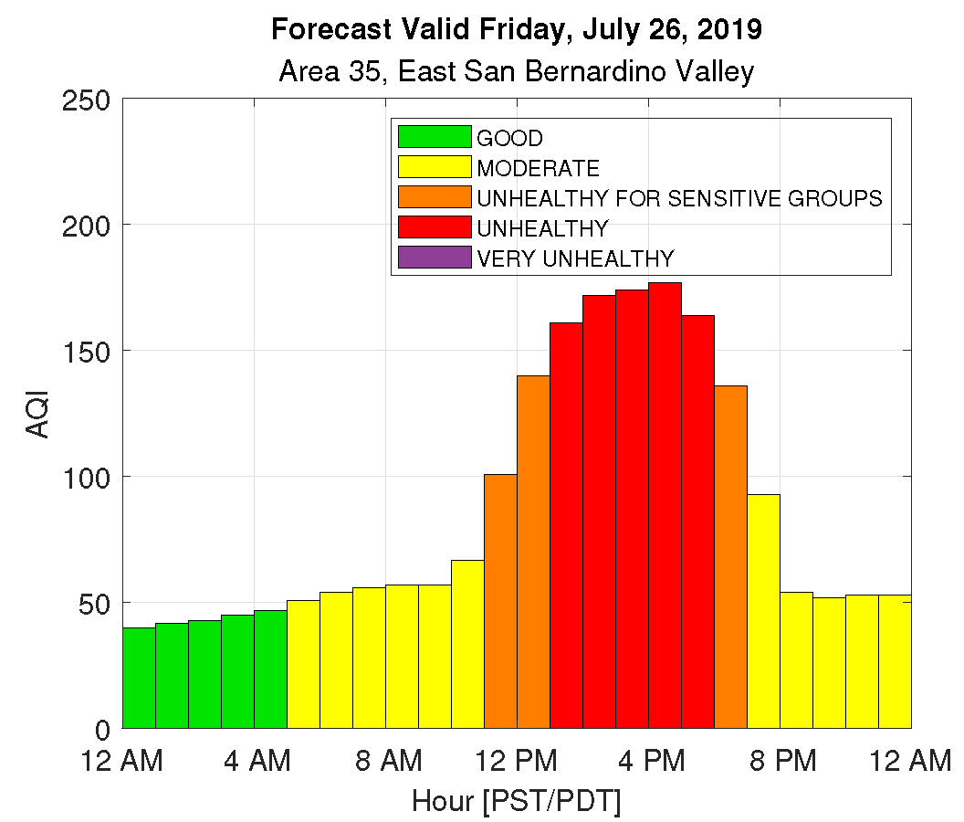
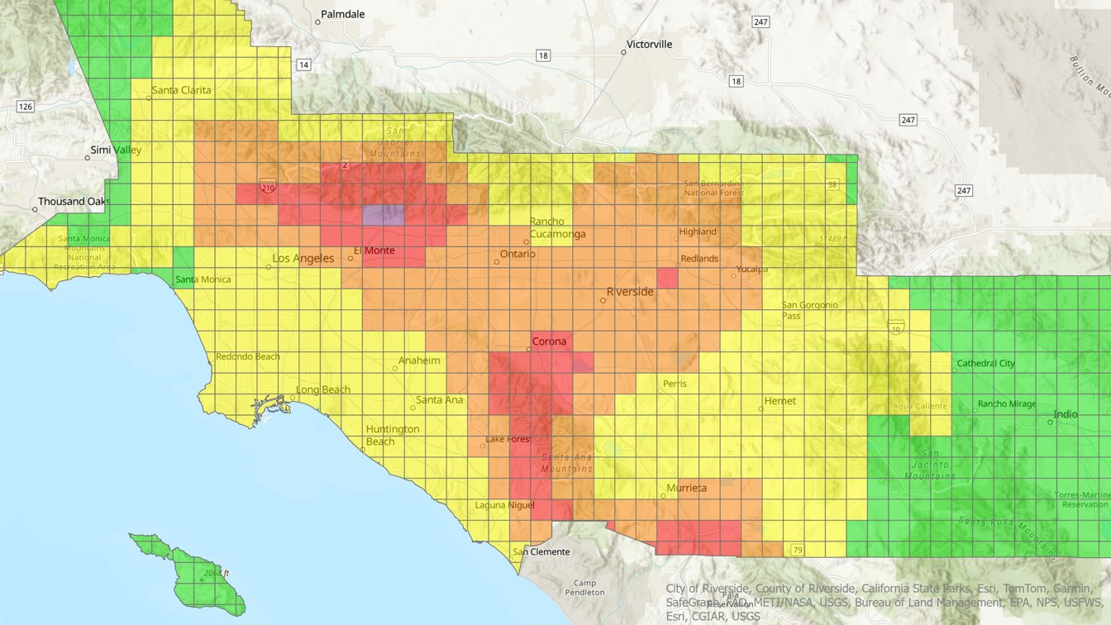
Outline
Forecast Products at South Coast AQMD
Process
Performance during recent high-impact Wildfires
Evaluation
Model residual trends

Slide 3
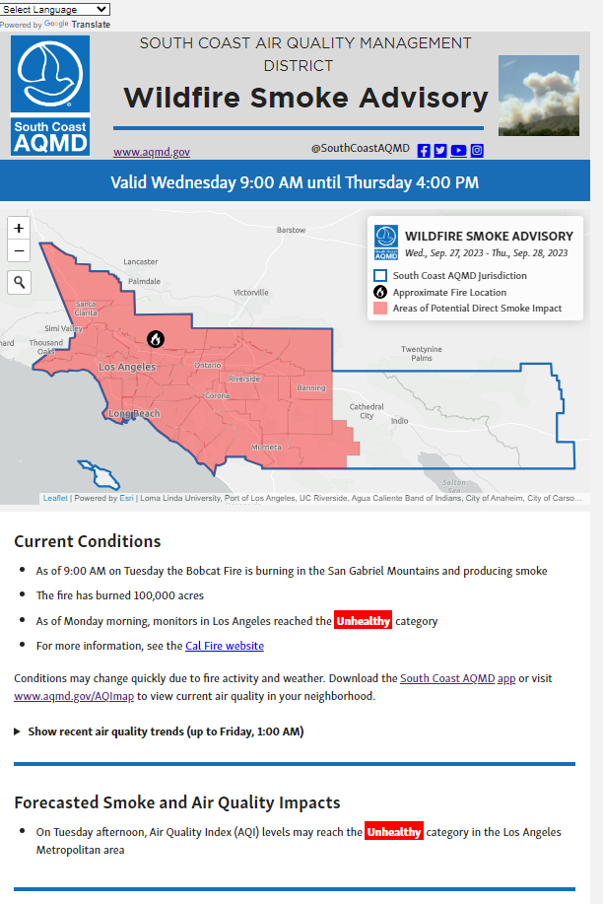
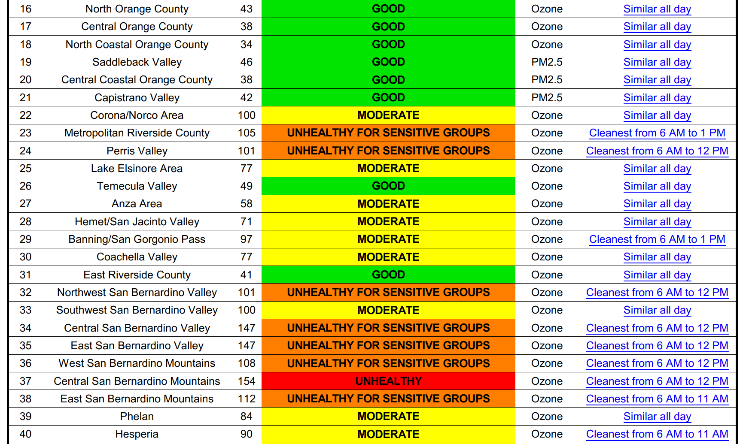
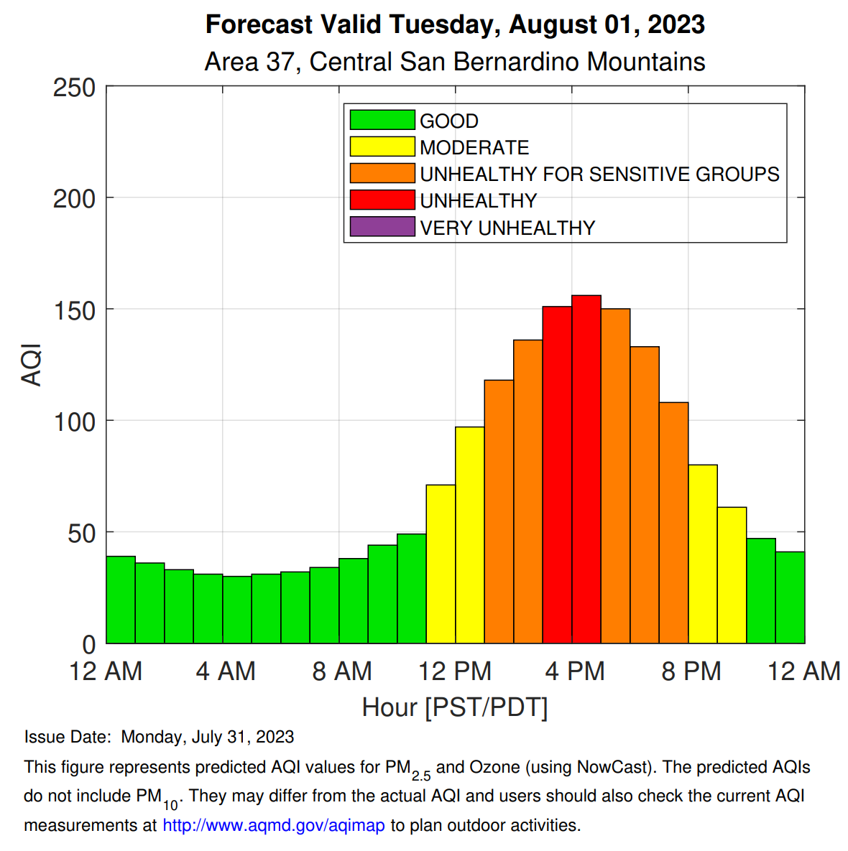
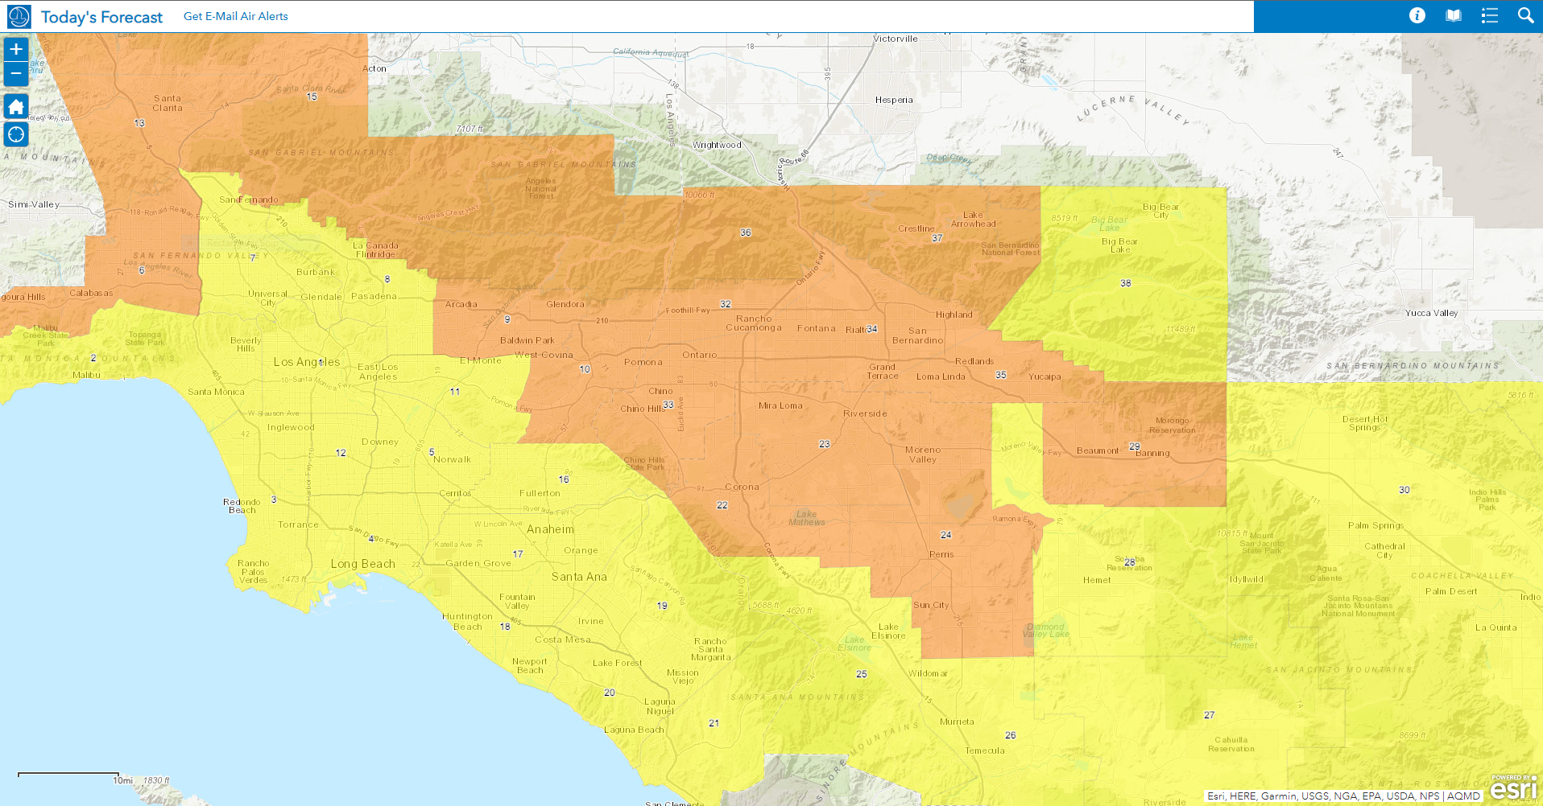
Forecast Products
Advisories
Daily Forecast With Cleanest Time Of Day
Hourly Forecast
Forecast-Based Rules
Fugitive Dust Control in Coachella Valley
Open Burning, No-Burn Days

Slide 4
Forecast Process
Component Models
NOAA AQM
South Coast AQMD: Analogmod*, Betamod*, Newmod*
Ensemble Calculation
Linear regression to estimate concentration from component models
Forecaster tunes concentration based on local knowledge and recent model performance
Hourly Forecast
Final Forecast
Combine NOAA AQM hourly trend with final daily forecast
Output
Post PDFs and data files to website
*In-House statistical models

Slide 5
AQM During Recent High-Impact Wildfires

Slide 6
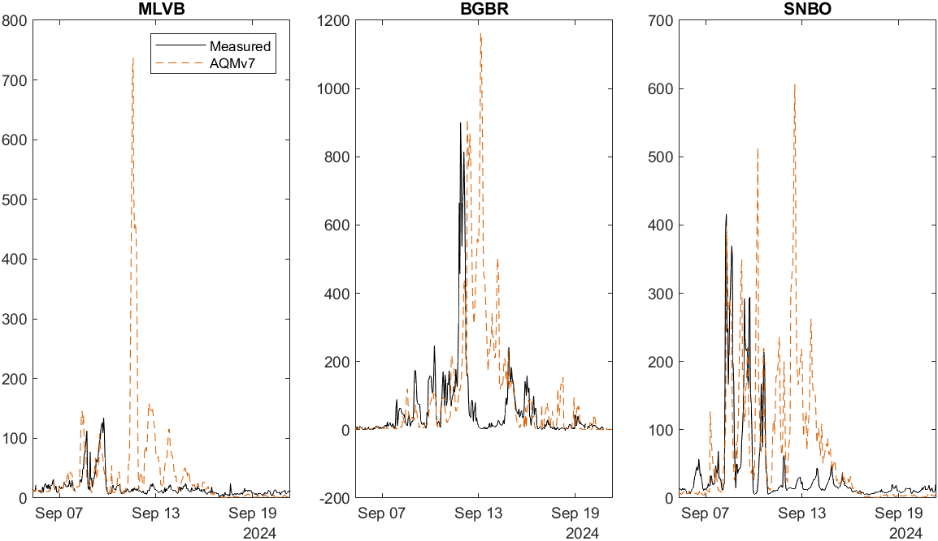
Line, Bridge, and Airport Fires (Sep 5, 2024) – PM2.5
BGBR
SNBO
MLVB
PM2.5 (1hr) [μg m⁻³]
PM2.5 (24hr) [μg m⁻³]
AQMv7 captured initial PM2.5 spike from Line Fire well at BGBR and SNBO
Starting Sep 11, AQMv7 overpredicted PM2.5 at SNBO and MLVB
AQMv7 overpredicted PM2.5 spike at BGBR from Sep 12 - 14

Slide 7
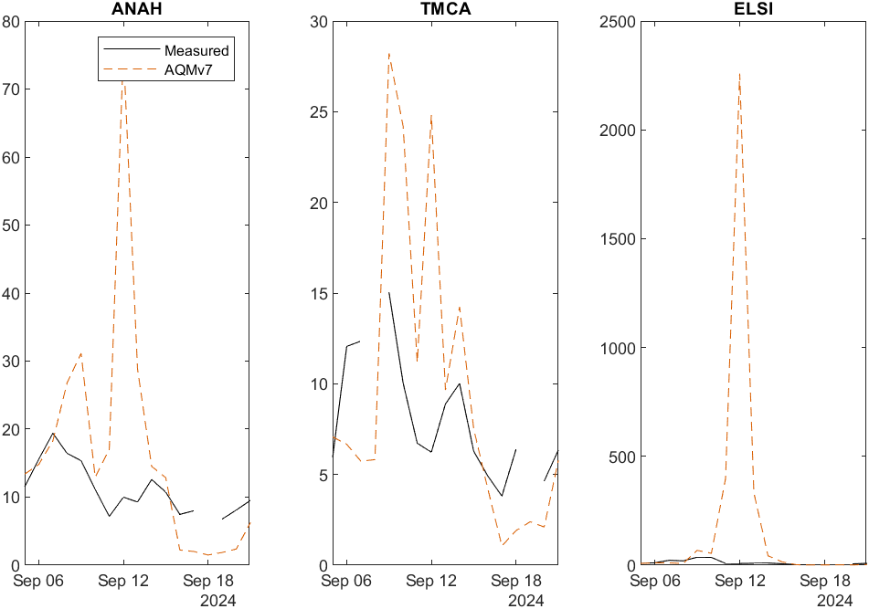
Line, Bridge, and Airport Fires (Sep 5, 2024) – PM2.5
ANAH
ELSI
TMCA
PM2.5 (24hr) [μg m⁻³]
AQMv7 overpredicted smoke impacts at ANAH, TMCA, and ELSI

Slide 8
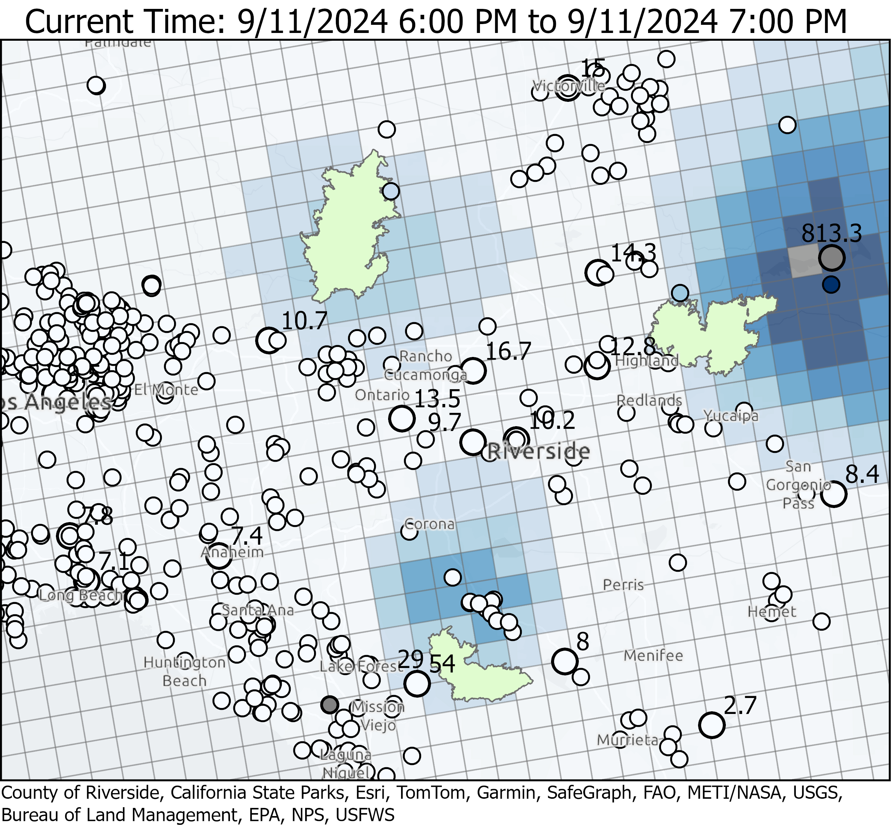
Line, Bridge, and Airport Fires (PM2.5 Map)
>460
>460
>460
Times are in PST (UTC-8)
Using NOAA 9/11/2024 6z forecast
AQM predicted PM2.5 spikes in Riverside/Corona but measured PM2.5 is low (< 18.2 ug/m3)
AQM correctly predicted PM2.5 spikes near the Big Bear Monitor

Slide 9
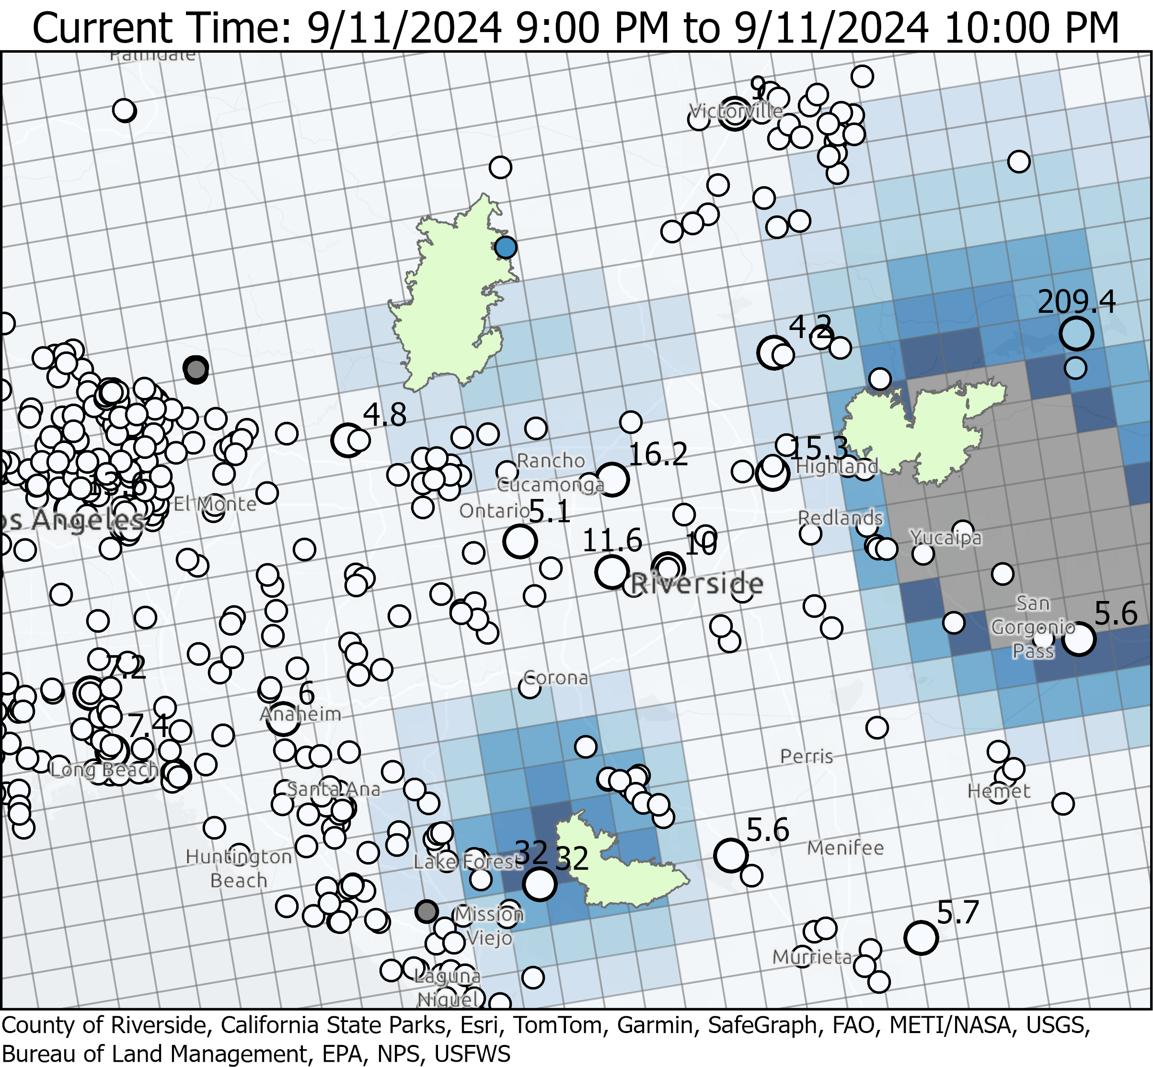
Line, Bridge, and Airport Fires (PM2.5 Map)
>460
>460
>460
Times are in PST (UTC-8)
Using 9/11/2024 6z run
AQM overpredicted PM2.5 in Redlands, Yucaipa, San Gorgonio Pass
AQM overpredicted PM2.5 near Lake Forest and in Corona/northeast of Santa Ana mountains

Slide 10
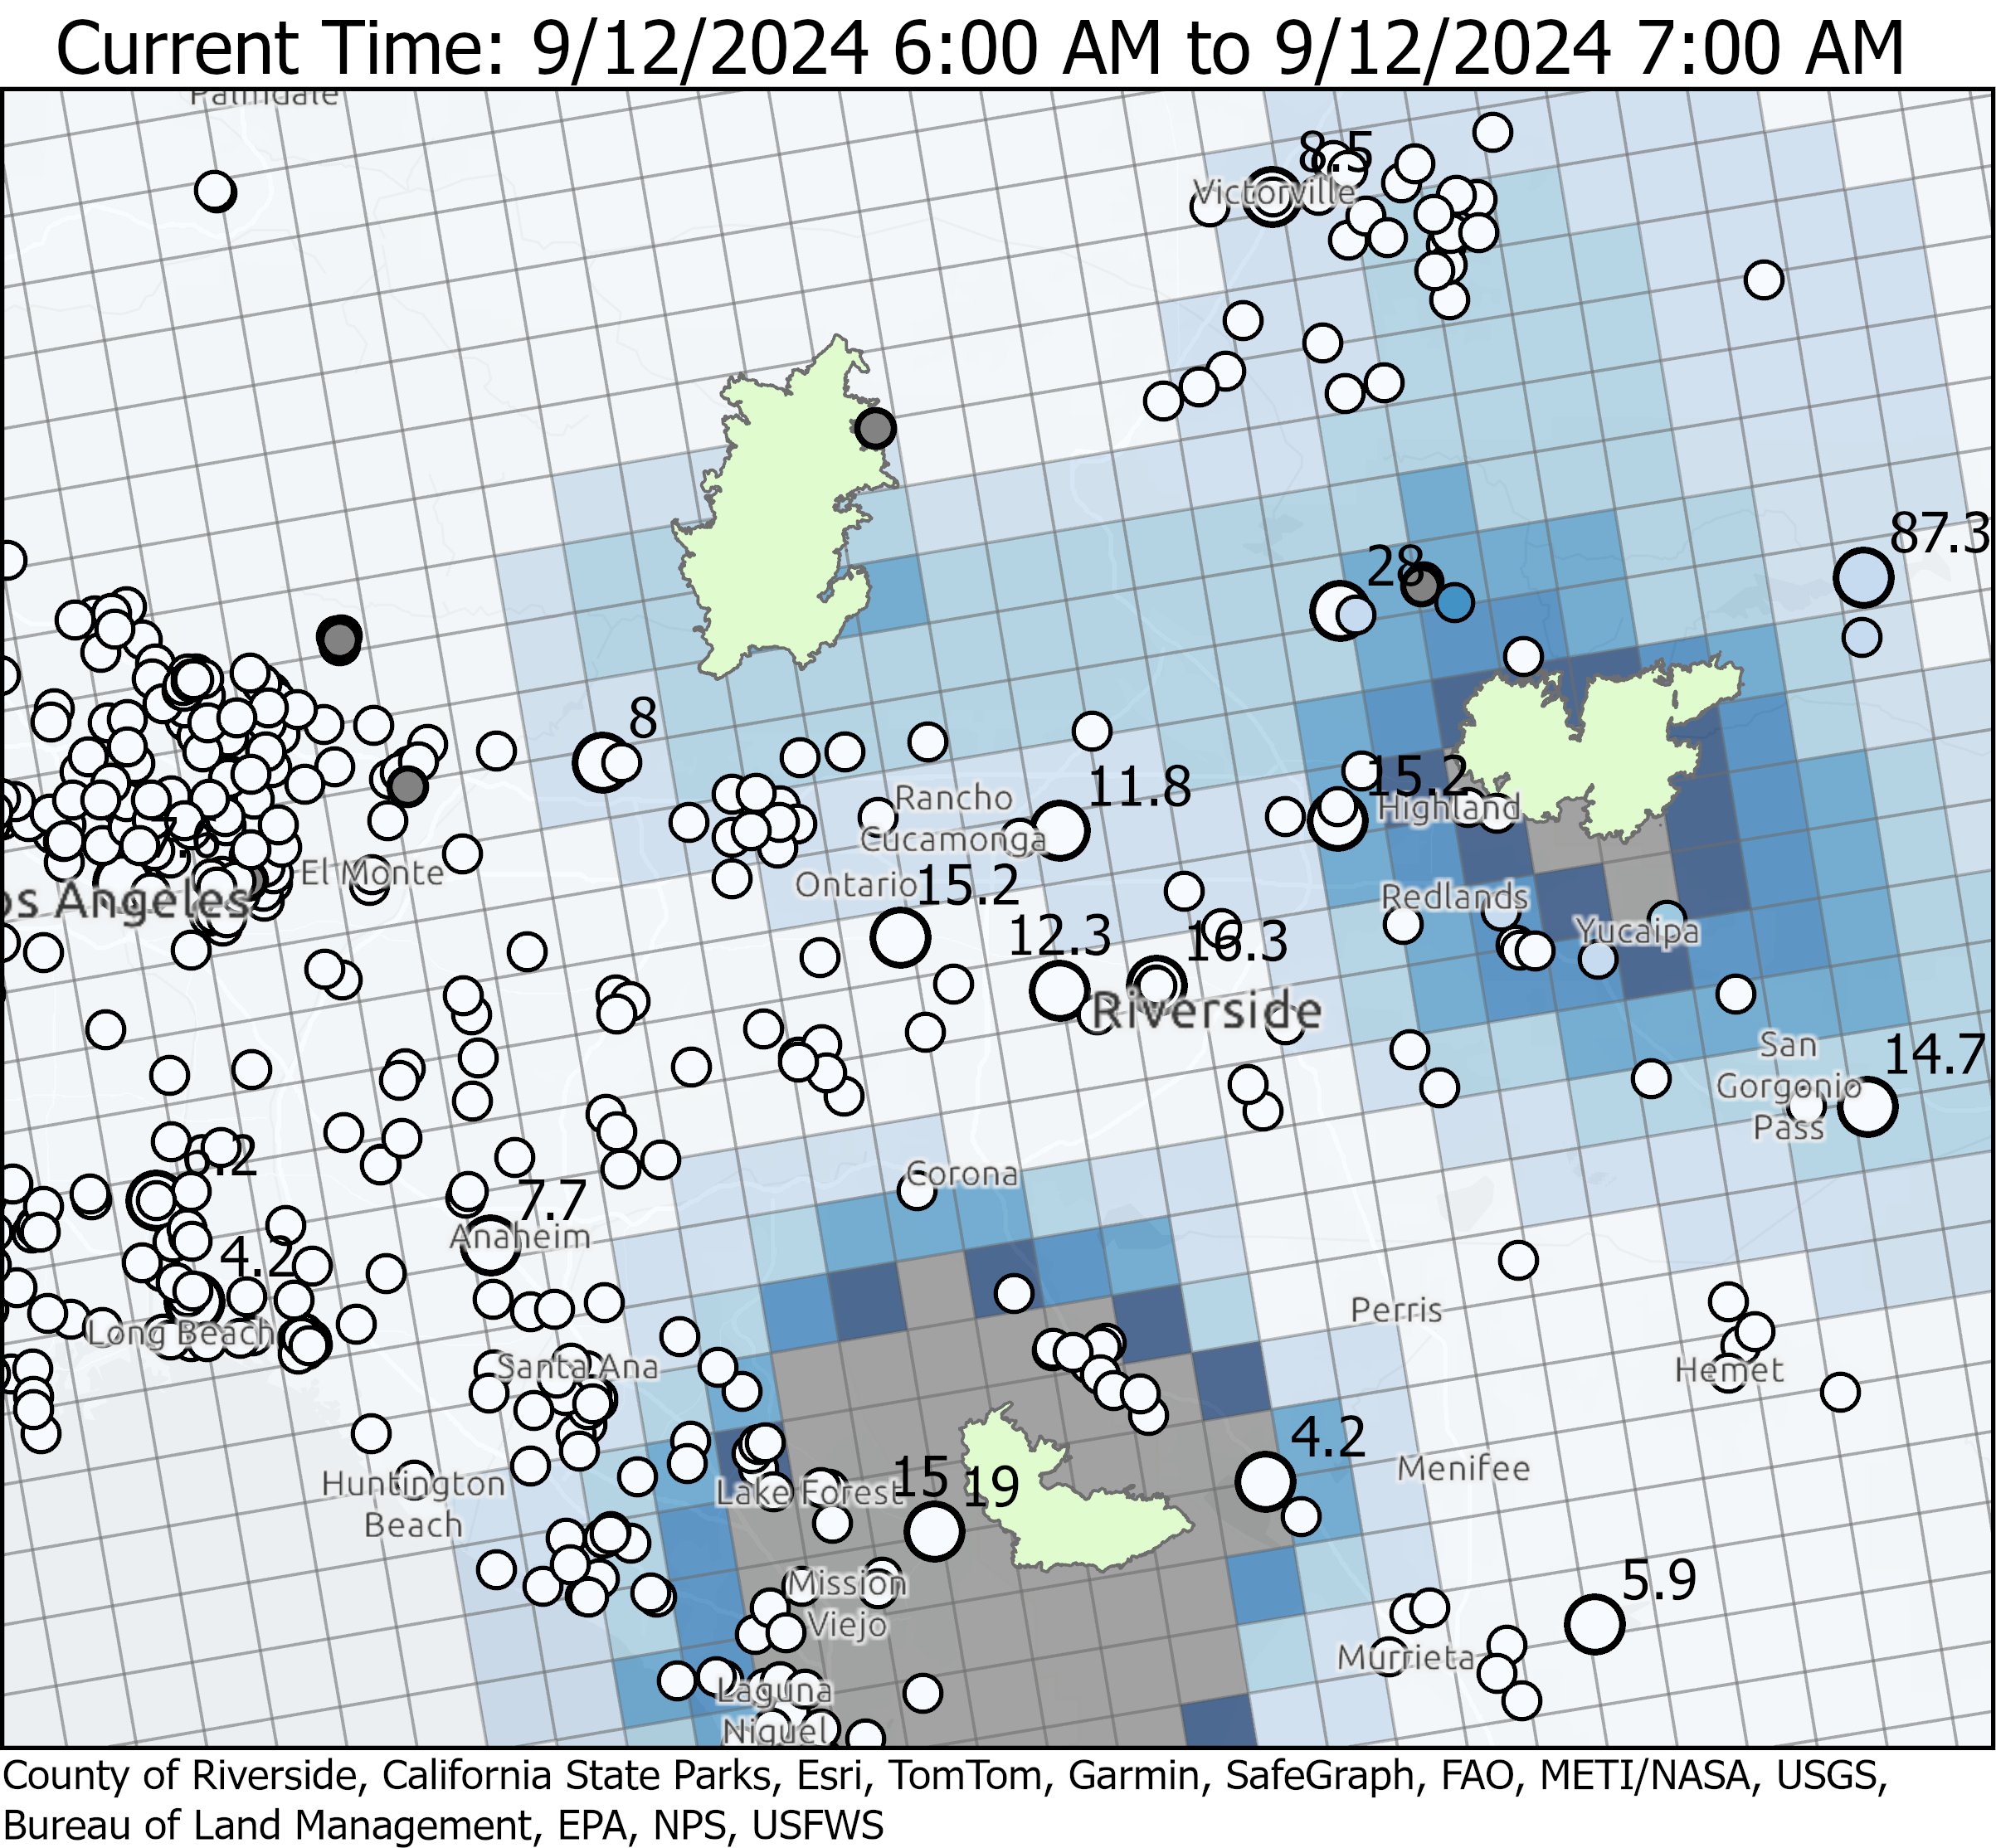
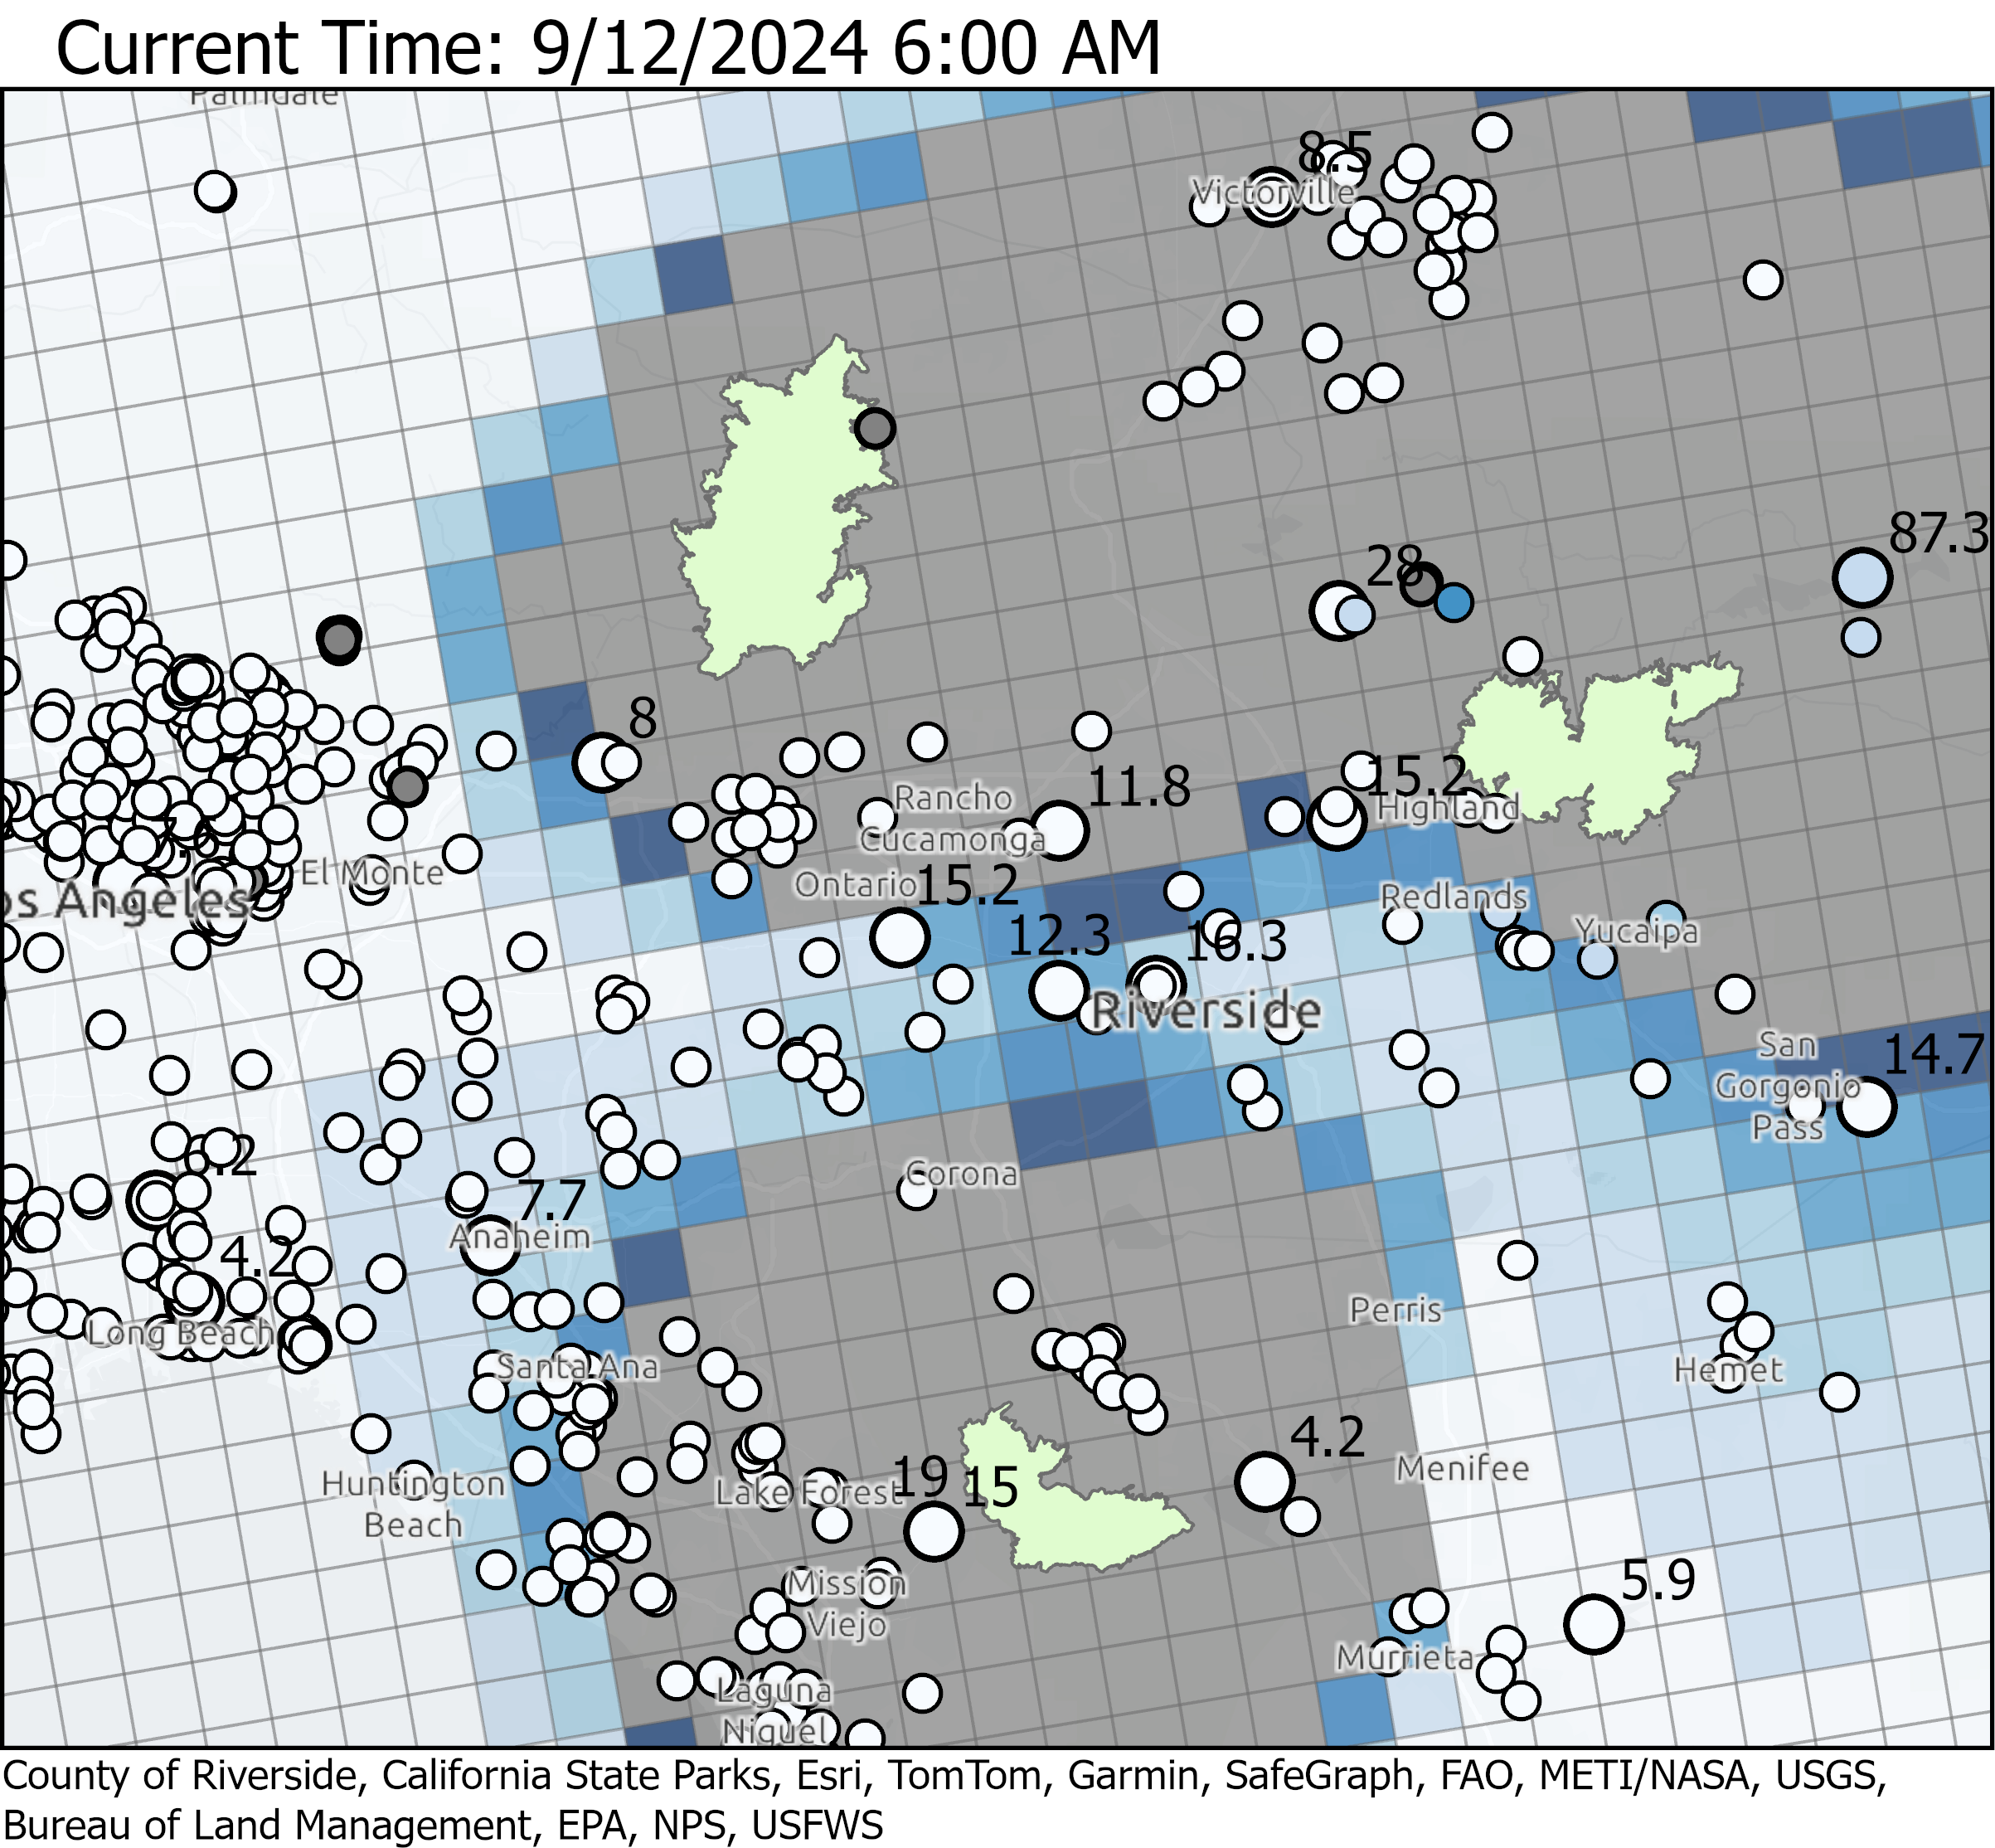
Line, Bridge, and Airport Fires (PM2.5 Map)
9/11/2024 6z run
9/12/2024 12z run
>460
>460
>460
Times are in PST (UTC-8)
Big Bear Lake: 6z 9/11 run compares well with measurements but 12z 9/12 run significantly overpredicts
Both runs significantly overpredict near Lake Elsinore and in Orange County

Slide 11
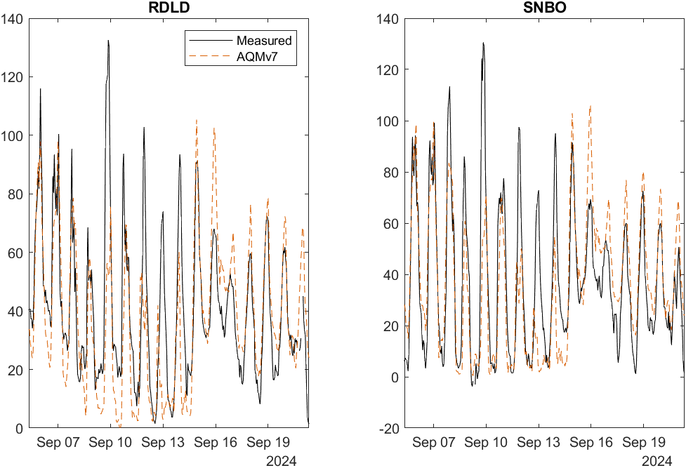
Line, Bridge, and Airport Fires (Sep 5, 2024) - Ozone
SNBO
RDLD
O3 (1hr) [ppb]
AQMv7 underpredicted ozone peaks on Sep 10 - Sep 14 at RDLD and SNBO

Slide 12
What caused PM2.5 overprediction at times during the fires?
Sep 11, 2024 view of Airport Fire
Did AQMv7 overpredict wildfire emissions?
Did AQMv7 overpredict vertical mixing of the plume down to the surface? (see photo of airport fire showing large plume rise)
AQMv7 is used to interpolate real-time monitor and sensor measurements for our real-time AQI map
From OC Fire Authority PIO

Slide 13
AQM Evaluation

Slide 14
Evaluation Metrics
Metric | Formula
Root Mean Square Errors (RMSE) | $$RMSE=\sqrt{\frac{1}{n}\sum_{i=1}^{n}{{\left(Obs_{i}−Mod_{i}\right)}^{2}}}$$
Mean Bias (MB) | $$MB=\frac{1}{n}\sum_{i=1}^{n}{Obs_{i}−Mod_{i}}$$
Heidke Skill Score (HSS) For binary true/false forecast | $$PC=\frac{True Positive+True Negative}{N}$$ $$HSS=\frac{PC−PC\left(ref\right)}{1−PC(ref)}$$ $PC(ref)$ is percent correct for a persistence forecast

Slide 15
Evaluation Summary
Station Overview
Average RMSE and MB for all stations
 | Model | O38hr Max [ppb] |  | PM2.5 [μg m⁻³]
 |  | 2023 | 2024 | 2023 | 2024
RMSE | AQMv7 | 7.98 | 8.13 | 4.61 | 6.39
 | Analogmod | 8.55 | 8.96 | 4.86 | 5.15
 | Persistence | 12.87 | 15.31 | 5.93 | 6.58
MB | AQMv7 | 0.07 | 1.02 | 0.33 | -0.06
 | Analogmod | -1.95 | 1.24 | -1.50 | -1.26
 | Persistence | -0.13 | 0.70 | 0.02 | 0.41
2023 data:
2022-7-1 through 2022-8-31
2022-12-1 through 2023-1-31
2023-4-1 through 2023-9-27
2024 data:
2023-10-1 through 2024-9-30
AQMv7 Ozone RMSE is best among the models
Analogmod PM2.5 RMSE is best among the models
Mean Bias is small for all models

Slide 16
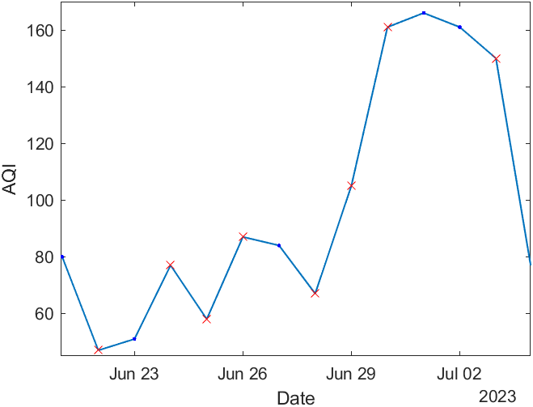
AQI-Change Dates Evaluation Method
Example of AQI-Change
Calculate RMSE and MB only on AQI-change dates
AQI-change dates:
Measured AQI changed by at least 10
This removes “persistent” time periods from evaluation data
Forecast is most useful when AQI is changing
CTOD calculated using full data set
x – AQI-change dates

Slide 17
Evaluation Summary
Station Overview
Average RMSE and MB for all stations
* Using AQI-Change dates
 | Model | O38hr Max [ppb] |  | PM2.5 [μg m⁻³]
 |  | 2023 | 2024 | 2023 | 2024
RMSE | AQMv7 | 9.15 | 6.81 | 5.54 | 5.44
 | Analogmod | 9.65 | 7.64 | 5.35 | 4.53
 | Persistence | 16.0 | 11.64 | 7.07 | 5.74
MB | AQMv7 | 0.92 | 0.46 | 0.74 | -0.21
 | Analogmod | -1.13 | 0.80 | -1.05 | -1.54
 | Persistence | 0.66 | 0.23 | 0.38 | -0.01
2023 data:
2022-7-1 through 2022-8-31
2022-12-1 through 2023-1-31
2023-4-1 through 2023-9-27
2024 data:
2023-10-1 through 2024-9-30
AQMv7 Ozone RMSE is best among the models
Analogmod PM2.5 RMSE is best among the models
Mean Bias is small for all models

Slide 18
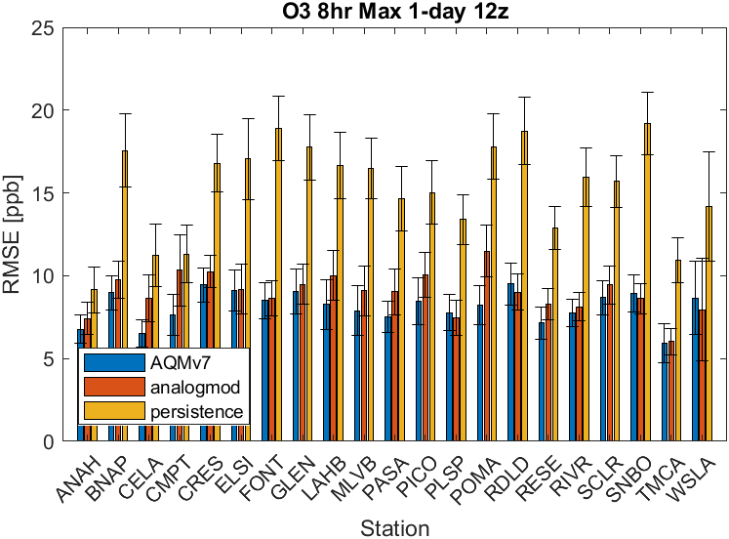
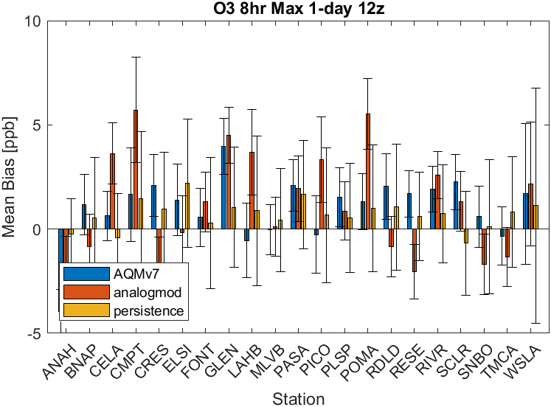
Ozone 8hr Average Max by Location*
AQMv7 and analogmod have similar RMSE and perform much better than persistence
AQMv7 generally has low (< 2 ppb) mean bias
Analogmod has higher bias in some cases
Model Overestimates |Model Underestimates
* Using AQI-Change dates

Slide 19
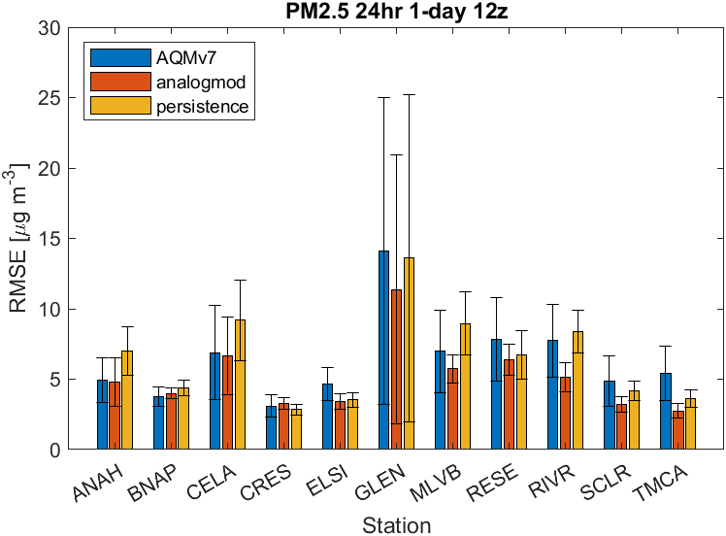
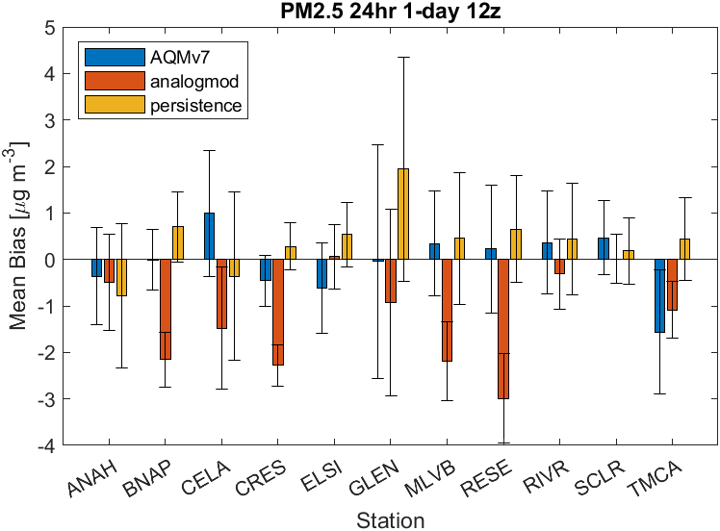
PM2.5 Daily Average by Location*
AQMv7 and analogmod have similar mean bias and similar performance to persistence
AQMv7 has small MB
Analogmod MB usually negative (overprediction). May need to be retrained using most recent measurement data to reduce bias.
Positive Mean Bias -> Model Underestimates
Model Overestimates |Model Underestimates
* Using AQI-Change dates

Slide 20
Model Residual Trends

Slide 21
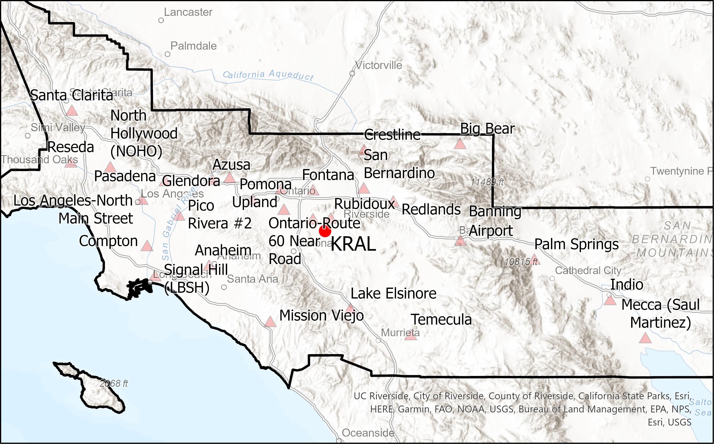
Residual Trends Analysis
Analyzed Residual vs Met Data
Met Data: Riverside Municipal Airport (KRAL) Automated Surface Observing System
Processed using AERMET to derive mixing height and surface friction velocity

Slide 22
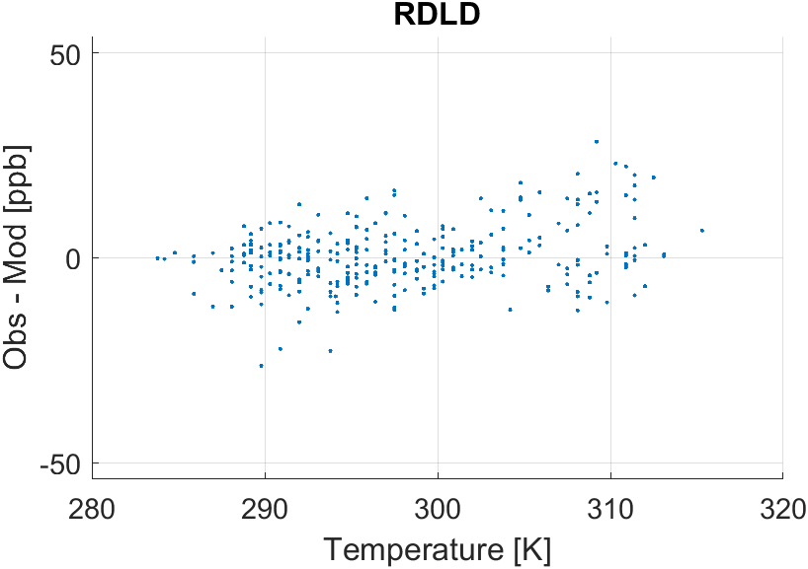
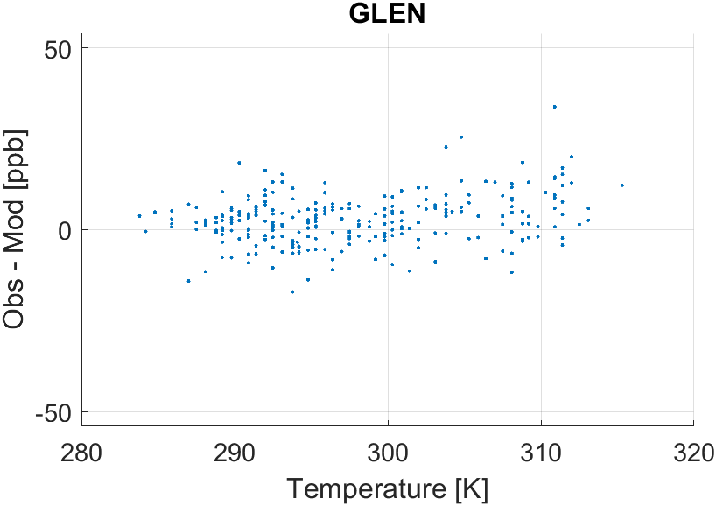
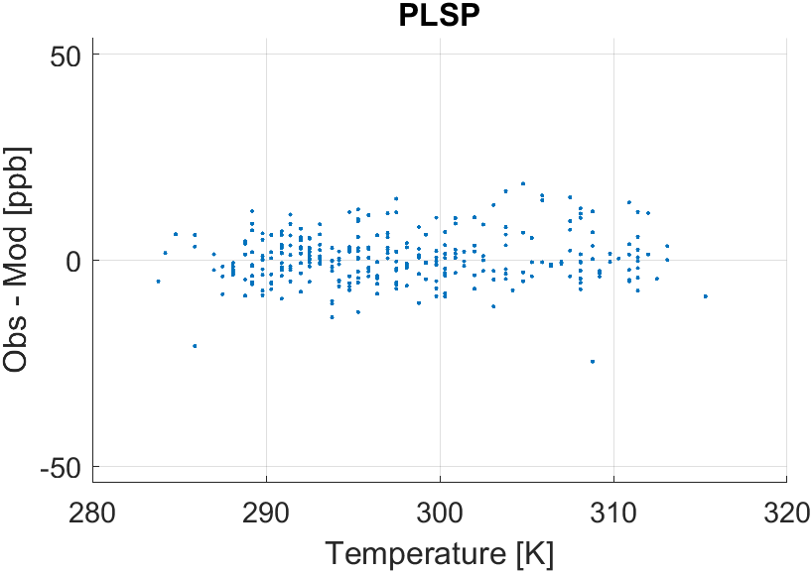
O3 8hr Max Residual vs Maximum Temperature
Plotted residual of daily maximum 8-hr average ozone vs daily max 10 m temperature at Riverside Airport (KRAL)
Model tends to underestimate Ozone at Glendora at high temperature (~> 310 K)
Less evidence of underestimation at Palm Springs and Redlands

Slide 23
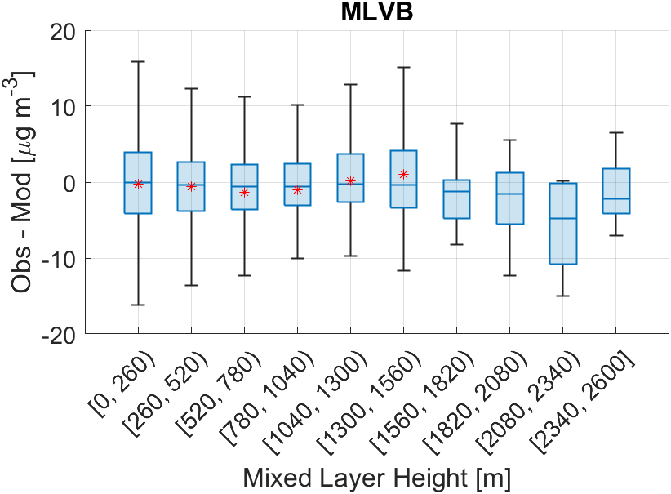
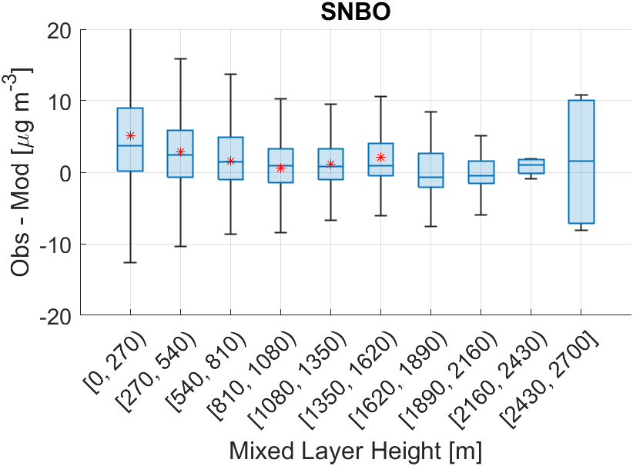
Mixed Layer Height
Underestimation of PM2.5 at SNBO when mixing height is low at Riverside Airport (KRAL)
Most other stations have low/no trend with mixing height
Hourly PM2.5
Hourly PM2.5
* average

Slide 24
Conclusions
AQMv7 has good ozone performance (among the best models in our jurisdiction)
Although during Line/Bridge/Airport fire the model underestimate Ozone spikes and underestimated/overestimated PM2.5 spikes in some cases
About the same PM2.5 performance at most stations
Nearly as good as the best PM2.5 model for our jurisdiction
AQMv7 tends to underestimated PM2.5 at SNBO when mixing height is low
Overall AQMv7 is one of the best-performing forecast models we use

Slide 25
Backup Slides

Slide 26
Air Quality Forecasting Models (South Coast AQMD Analog Forecast Model)
Model developed by AQ Assessment Group compares meteorological fields on forecasted day with historical meteorological fields
Identifies analogous days and uses them to make predictions
Daily predictions of O3, PM2.5, PM10, NO2, and CO at every measurement station
Temperature on Historical Days
Notes:
Our other main model was developed in our group
In short, this model makes predictions based on historical air quality
For tomorrow, it tries to find the set of the most similar days in the recent past by looking for days with similar meteorology
Uses several meteorological parameters that it determines are the most important for maximizing model performance
We find that this model does as well or even better than the chemical transport model operated by NOAA

Slide 27
Analog Model Training Methodology
For all pollutants at every monitoring station:
Identify Initial Set of MET Predictors and Apply Geographic Constraints
Use selection of important pollutant-specific predictors from hourly 12 km NAM (use intuition to pick variables)
Normalize predictor variables
Separate gridded data into four regions to represent all areas in forecast domain
Calculate Similarity Between Prediction Day and All Past Days
Determine mean squared error (MSE) between gridded meteorology on prediction day and all past days
Weight each MET variable by a factor of 0, 1, 5, 10
Sum weighted MSE for all important MET parameters
Identify Analog Days
5 Historical days with the lowest MSE
Repeat until all combinations of weights and training days are calculated
Finalize Model Configuration to Use for Predictions
Determine what combination of MET parameters and weights maximizes performance
Make Prediction Based on Analog Days
Calculate the mean, max, and min from analog days

Slide 28
Analog Day Selection Methodology
NAM Grid Cell Center Locations
NAM Grid Cell Center Locations
Analog Day Identification
Uses the meteorology for all grid cells in the region that the station resides

Slide 29
Analog Day Selection Methodology
NAM Grid Cell Center Locations
Mojave Desert Air Basin
Forecasting domain split into 4 regions
Antelope Valley portion of Mojave Desert Air Basin
South Coast Air Basin
Coachella Valley portion of Salton Sea Air Basin

Slide 30
Analog Prediction Methodology
For all pollutants at every monitoring station:
Calculate Similarity Between Tomorrow and All Past Days
Determine mean squared error (MSE) between tomorrow’s gridded meteorology and all past days
Apply weights to MSE calculated with training
Sum weighted MSE for all important MET parameters
Make Prediction Based on Analog Days
Calculate the mean, max, and min from analog days
Identify Analog Days
5 Historical days with the lowest MSE

Slide 31
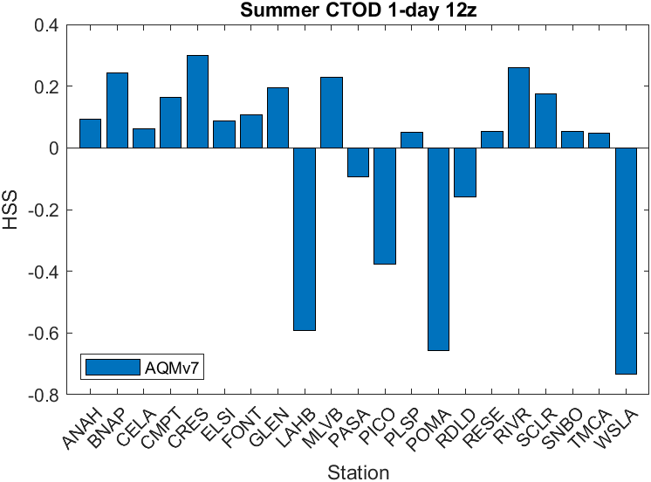
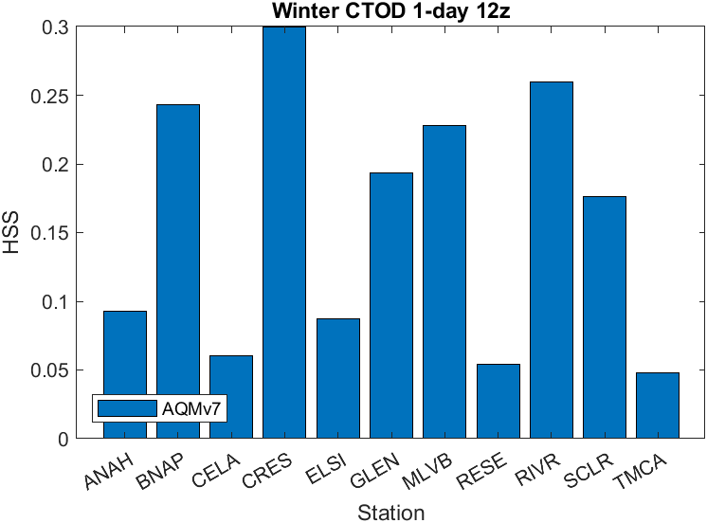
Cleanest Time Of Day
Cleanest Time of the Day:
Predicted AQI is at least 10 AQI points less than the day’s average AQI*
Binary true/false forecast for each hour
Used to present hourly forecast
HSS: Percent correct relative to a persistence forecast
At most stations HSS is moderate but positive
Indicates model has some skill in predicting hourly Ozone and PM2.5 trends
*AQI based on O3 and PM2.5

