Slide 1
2024 NOAA Model Performance in Alabama
Michael Leach
Geoff Healan
Dallas Roebling
Scott Southwick

Slide 2
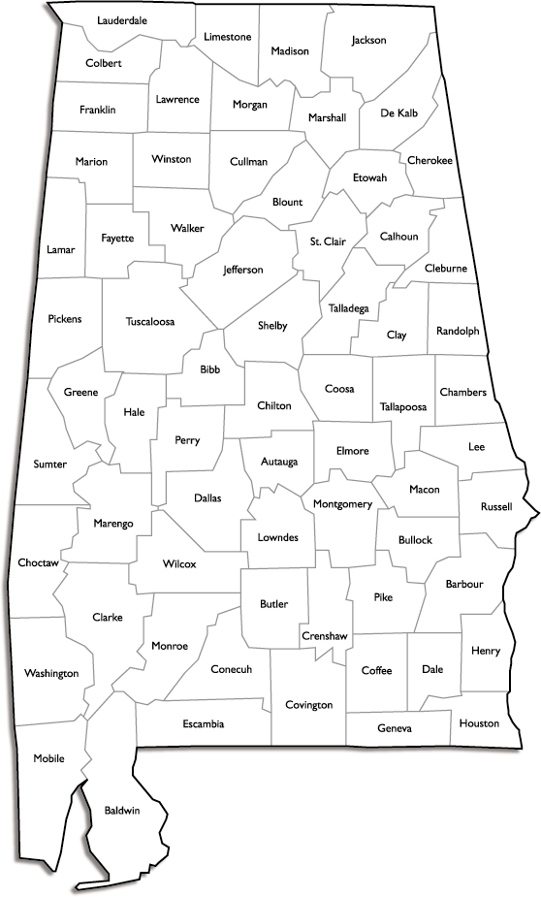
Ozone in Alabama
Huntsville
March 1, 2024 – October 31, 2024
Highest 8-hour Average YTD Huntsville: 63 ppb
Birmingham
Highest 8-Hour Average YTD Birmingham:76 ppb
Highest 8-Hour Average YTD Mobile: 64 ppb
Peak Ozone Month: June
Mobile

Slide 3
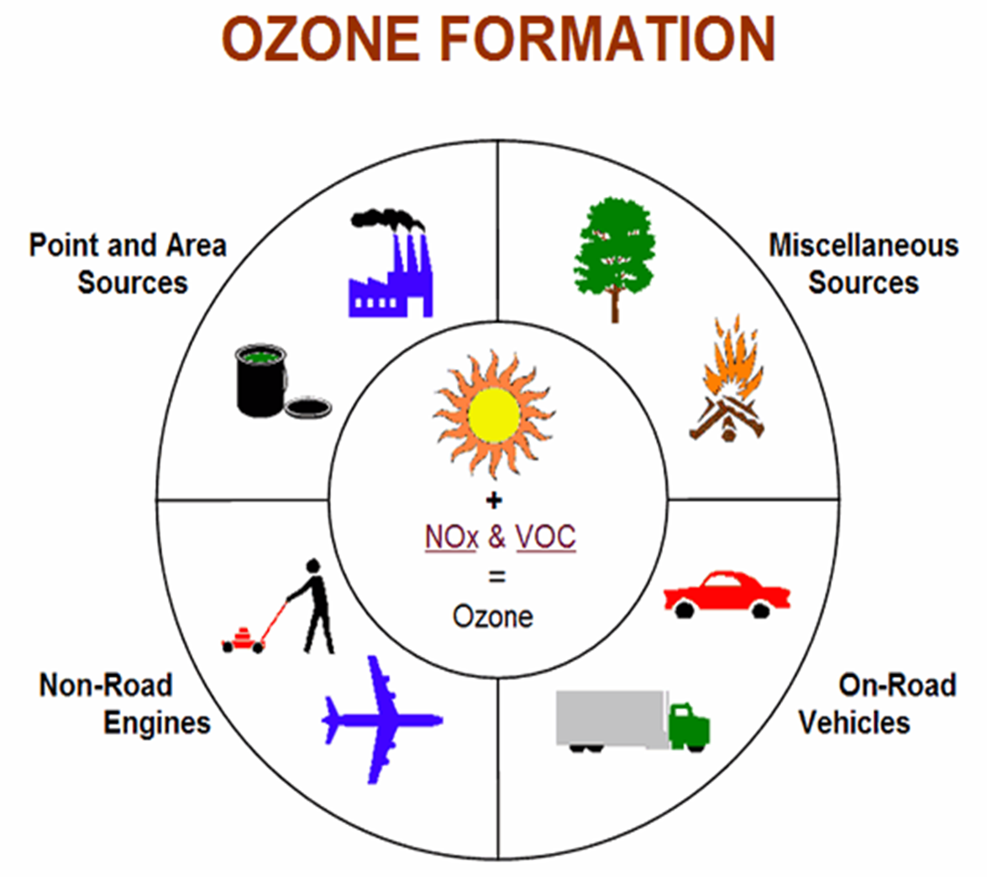
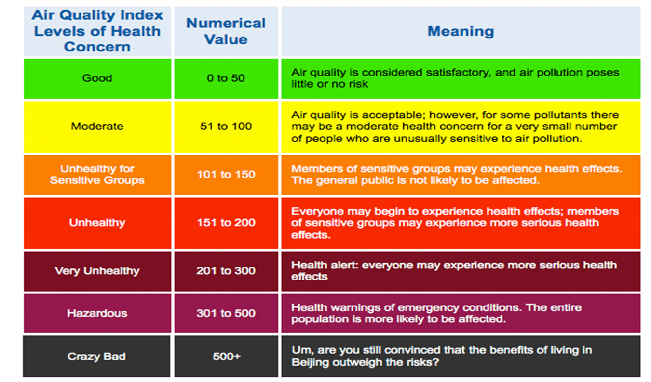

Slide 4
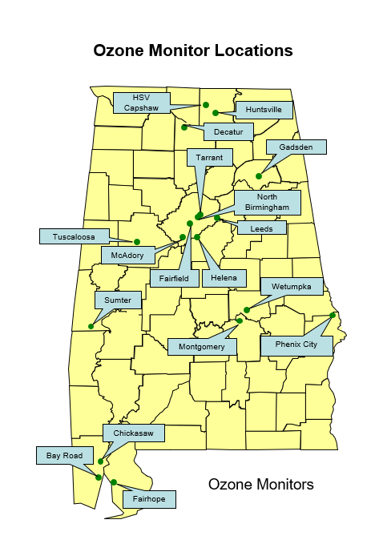
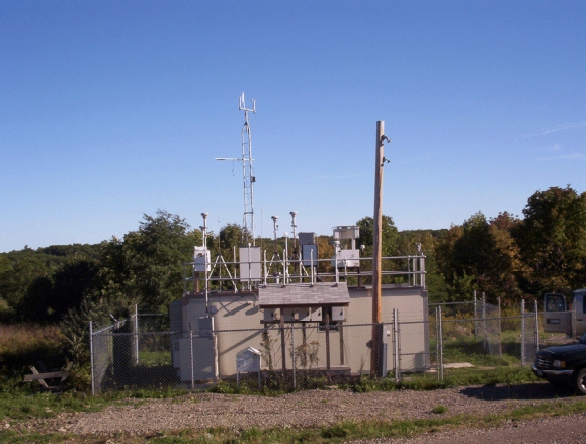
18 Ozone Monitors
Operated March 1-October 31

Slide 5
Huntsville Forecast vs. Observed
USG

Slide 6
Birmingham Forecast vs. Observed
USG

Slide 7
Mobile Forecast vs. Observed
USG

Slide 8
Model Statistics
Forecast City | NOAA Model Percent Correct (Color Code) | NOAA Model Bias (ppb)
Huntsville (O₃) | 81 | 2.29
Birmingham (O₃) | 63 | 1.80
Mobile (O₃) | 71 | 2.91

Slide 9
Ozone Model Statistics 2023 vs. 2024
Forecast City | NOAA Model Percent Correct (Color Code)
Huntsville (2023) | 78
Huntsville (2024) | 81
Birmingham (2023) | 71
Birmingham (2024) | 63
Mobile (2023) | 79
Mobile (2024) | 71

Slide 10
NOAA Model Conclusions
The NOAA Model did a decent job of forecasting ozone across Alabama in 2024.
The percent correct by color code decreased in Birmingham and Mobile when compared to 2023; however, the bias improved. This indicates that most of the days the NOAA model missed were borderline green/yellow days.
The NOAA model tends to have the highest bias (overprediction) at Mobile, likely due to the sea-breeze along the coast and the tendency to bring higher ozone values offshore to areas just along the coast.

Slide 11
Case Study April 16, 2024 Montgomery, Alabama (Smoke Impact)

Slide 13
Montgomery Airport Weather Observations
4/16/24

Slide 14
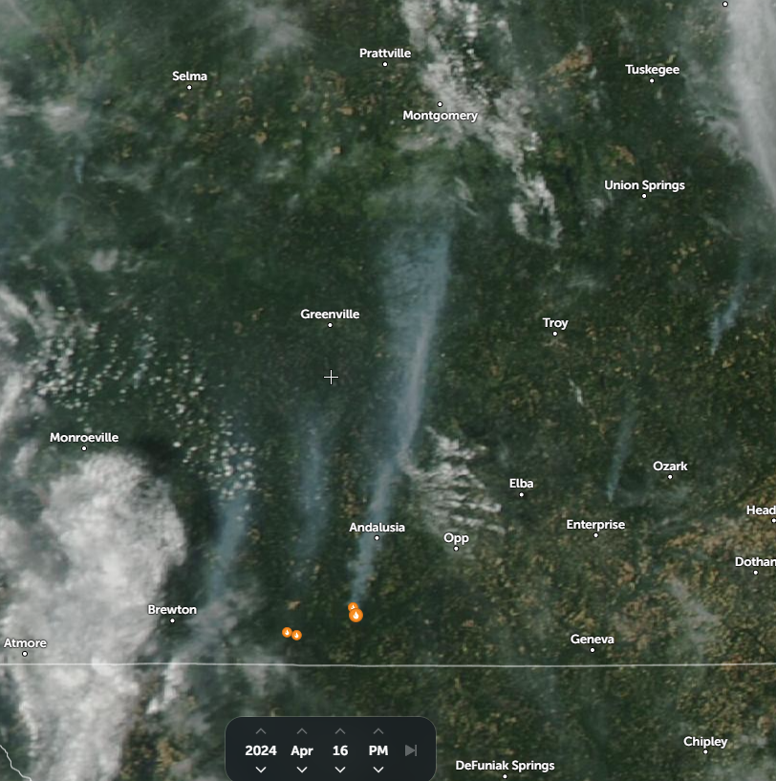
Satellite Data
4/16/24
Source – Zoom Earth
https://zoom.earth

Slide 15
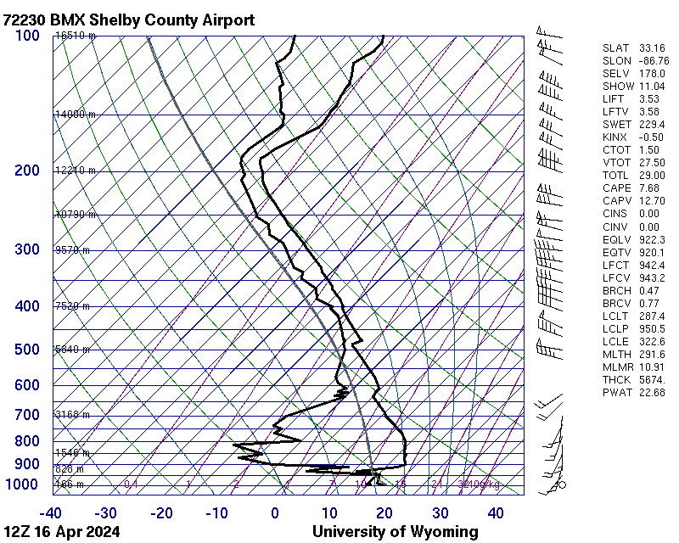
Strong low level inversion

Slide 16
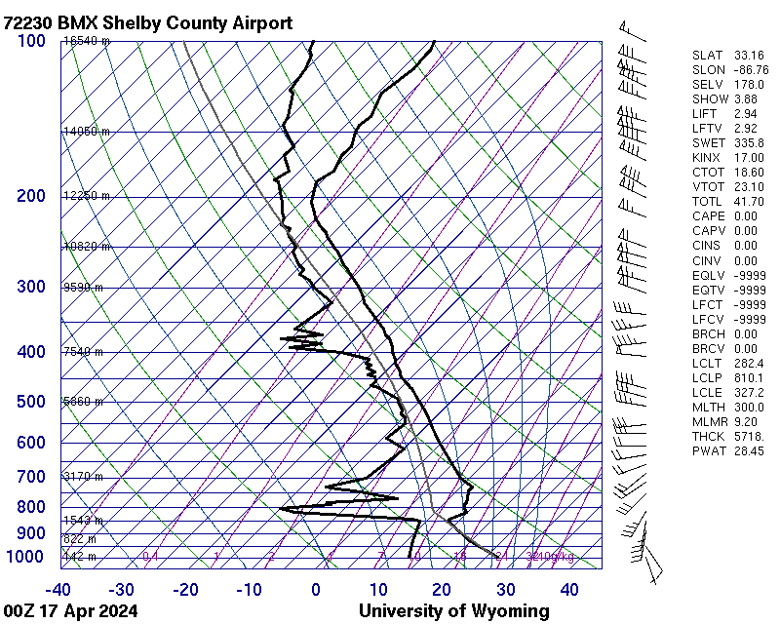
Strong inversion remained throughout the day.

Slide 17
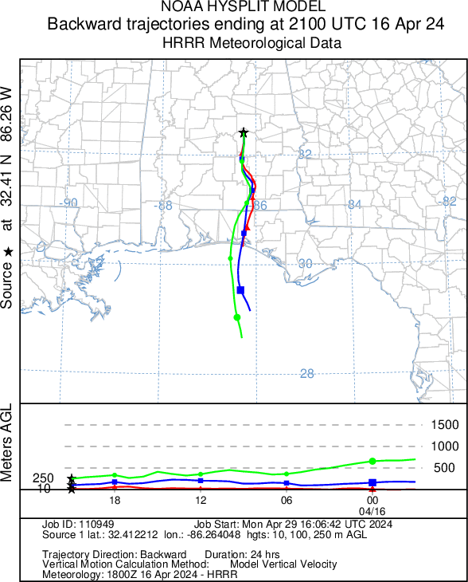
Back trajectories at all levels from the fire to the Montgomery monitor, indicating that the plume stayed intact vertically
Subsidence, sinking air, is also shown in the vertical velocity. This traps any pollutants close to the ground.
Unidirectional winds – trajectories line up together
Subsidence

Slide 18
NOAA Model Vs. Observed Data 4/16/24
Ozone
PM_{2.5}

Slide 19
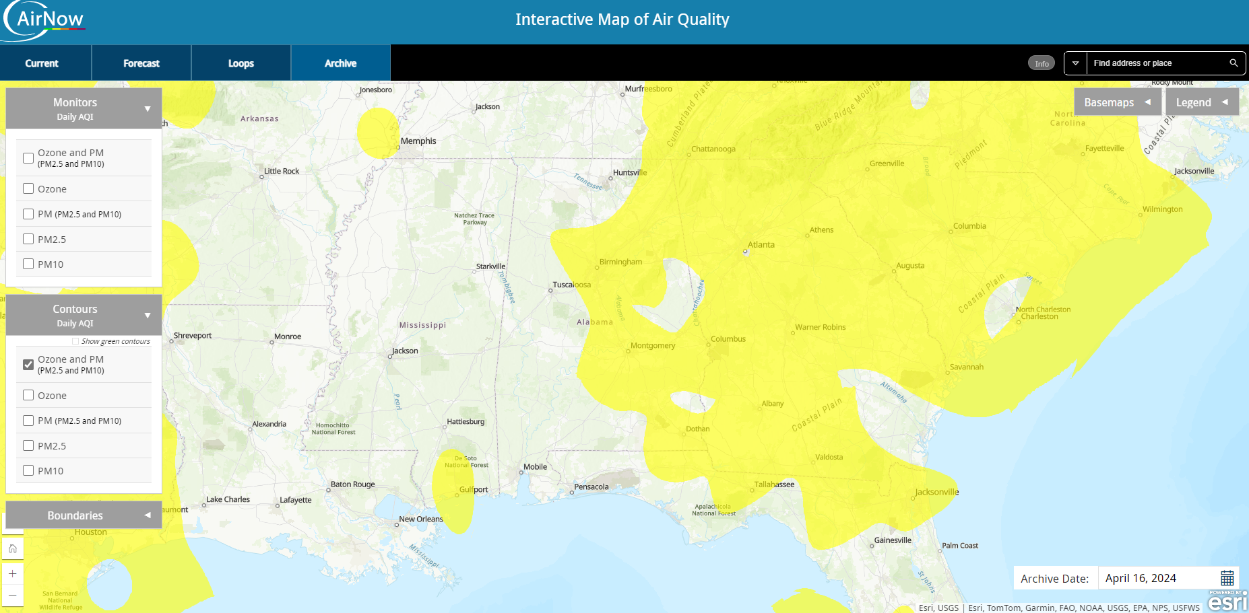
AirNow Map- 4/16/24

Slide 20
Case Study Conclusions
This case study along with a few previous events show that it takes a dense localized smoke plume to increase ozone concentrations.
This increase in ozone is due to the dense smoke plume having high levels of NO2 and VOC’s. Which downwind, leads to ozone formation if the weather conditions are favorable.
PM2.5 was also considerably higher than expected due to the dense smoke plume not dispersing.
For a dense smoke plume to travel a long distance and cause increases in both ozone and PM2.5, certain weather conditions need to be present.
-A strong low-level inversion seen on the sounding.
-Unidirectional winds from the surface to the inversion shown in the back trajectory.
Thoughts/Questions?

