Slide 1
Focus Group Evaluation CMAQ PM2.5 and Ozone 2024
Michael Geigert
Bureau of Air Management

Slide 2
Introduction
The summer of 2024 was the warmest over the past 6 years, with June being the hottest month.
Surface PM2.5 levels due to smoke were lower than last year, but likely raised ozone levels at the surface on several occasions.
Most of the ozone episodes were well modeled with fewer false alarms than last year.
During August, the PM2.5 BC model retained moderate levels for several days, even though good air quality was being monitored.

Slide 3
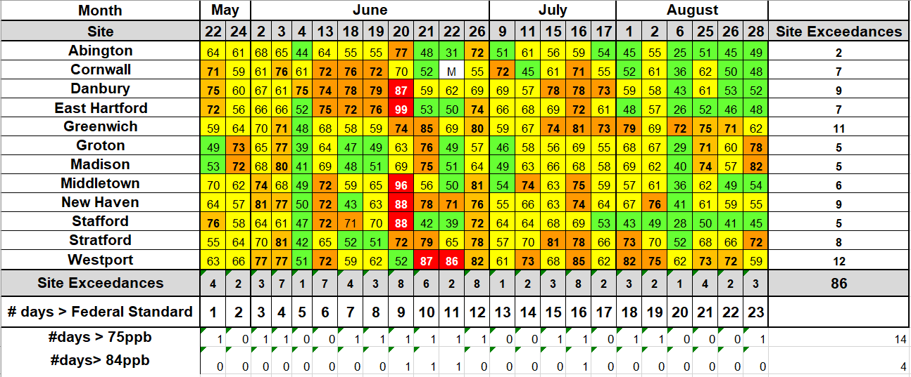
2024 Ozone Exceedance Summary Table
Connecticut had 23 ozone exceedance days with the highest levels occurring in June.

Slide 4
Ozone Site Exceedances
Connecticut had more site exceedances in 2024 than the past 5 years. This surpassed 2023, when smoke was more of an issue.

Slide 5
Cooling Degree Days
This was the warmest summer since 2018 for cooling degree days, which may have been a factor for the increase in site exceedances.

Slide 6
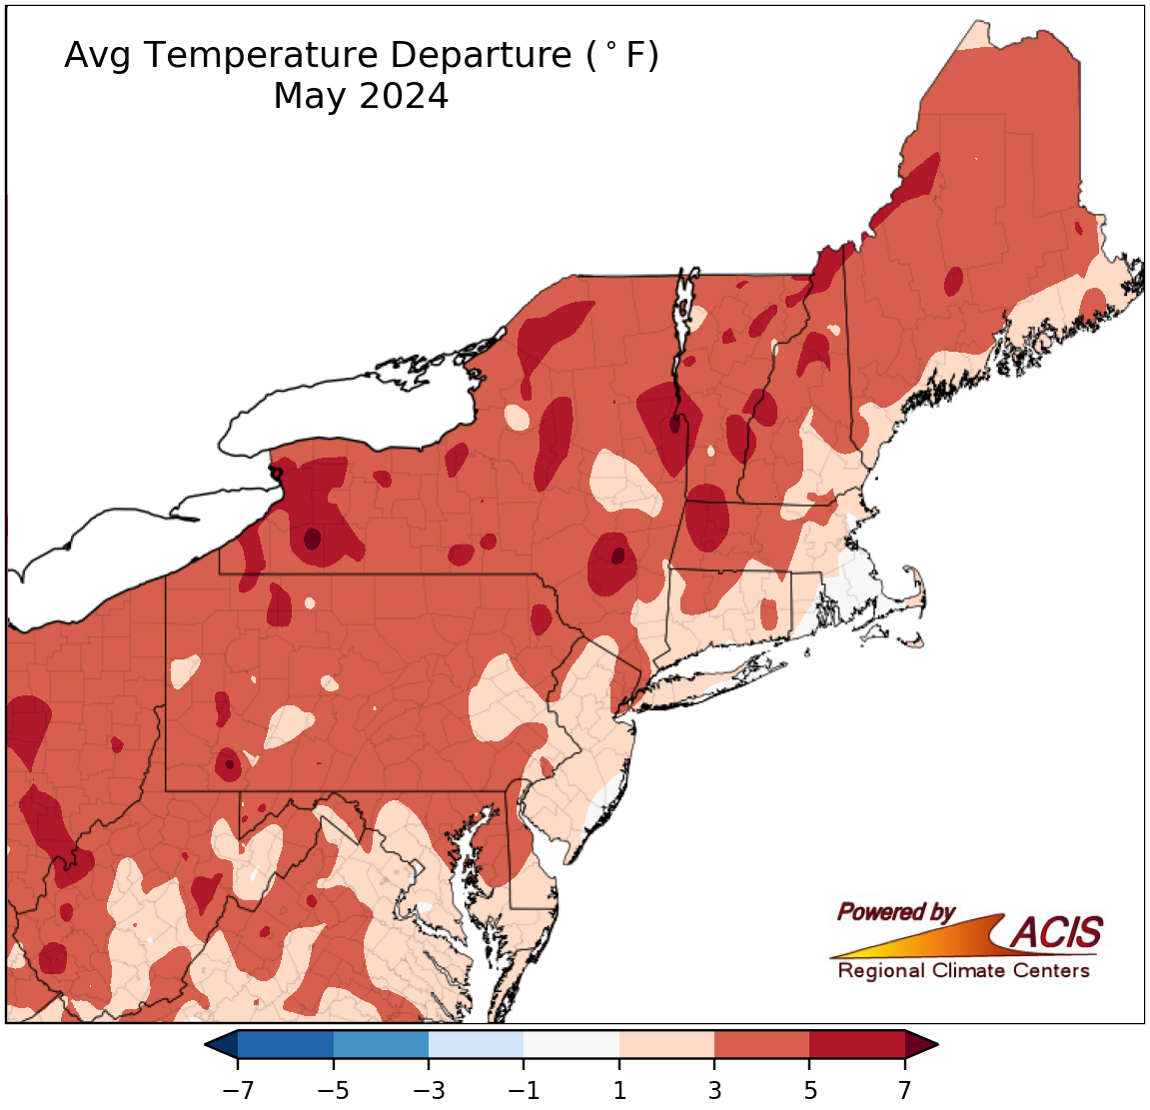
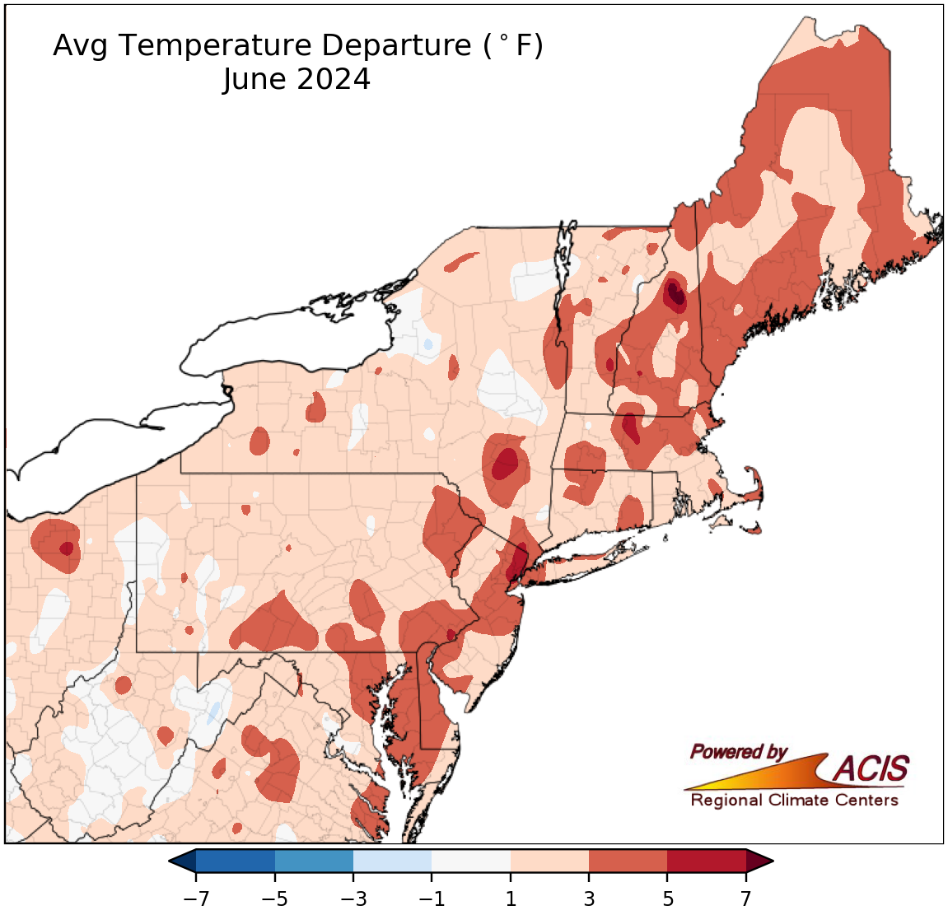
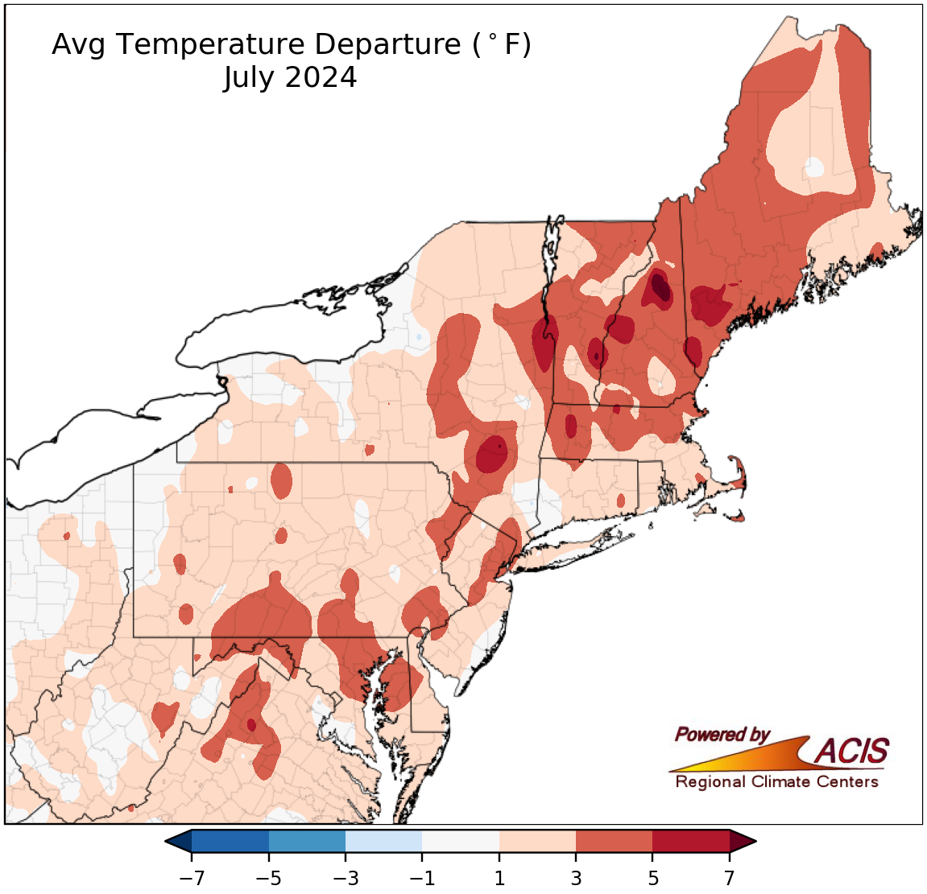
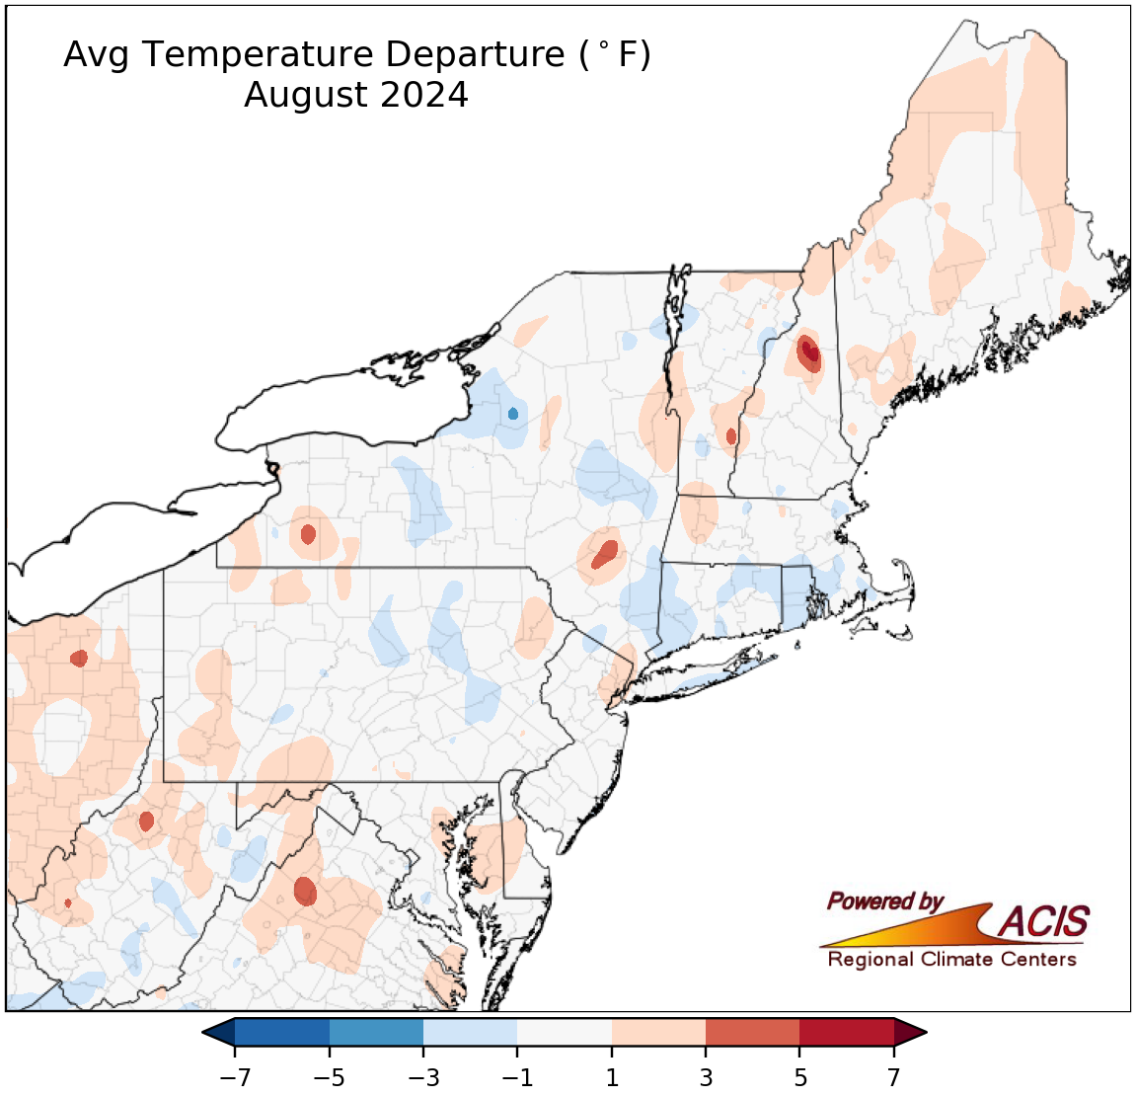
Monthly Temperature Departures
May was well above normal for the entire Northeast, with temperatures cooling to near normal levels by August.

Slide 7
Ozone Model Evaluation
The upcoming slides are from selected ozone episodes throughout the summer.
The images from the ‘raw’ model output are compared to that from the bias corrected.
All images are from the 06z Day 1 model run.
Time series graphs are included showing comparisons with observed data for sites of interest.

Slide 8
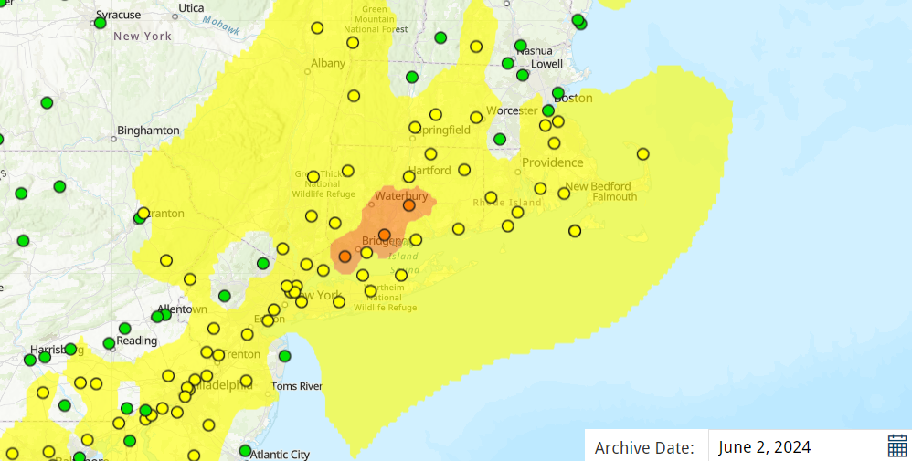
June 2, 2024 Ozone
Three sites in Connecticut exceeded the 70 ppb NAAQS, surrounded by a large area of moderate ozone.

Slide 9
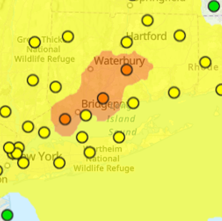
June 2, 2024 Ozone Model Performance
June 2, 2024 06z Ozone
June 2, 2024 06z Ozone BC
The raw output showed USG levels, albeit displaced too far south. The BC output was much too low.

Slide 10
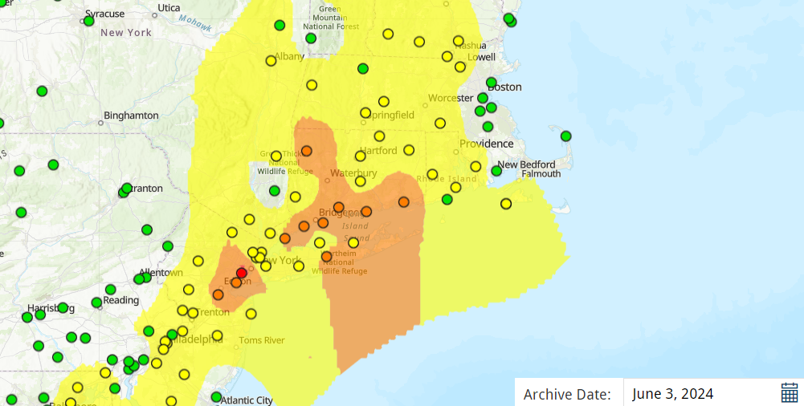
June 3, 2024 Ozone
This was a widespread coastal event, extending into northwest Connecticut. A high of 81 ppb was recorded at Stratford.

Slide 11
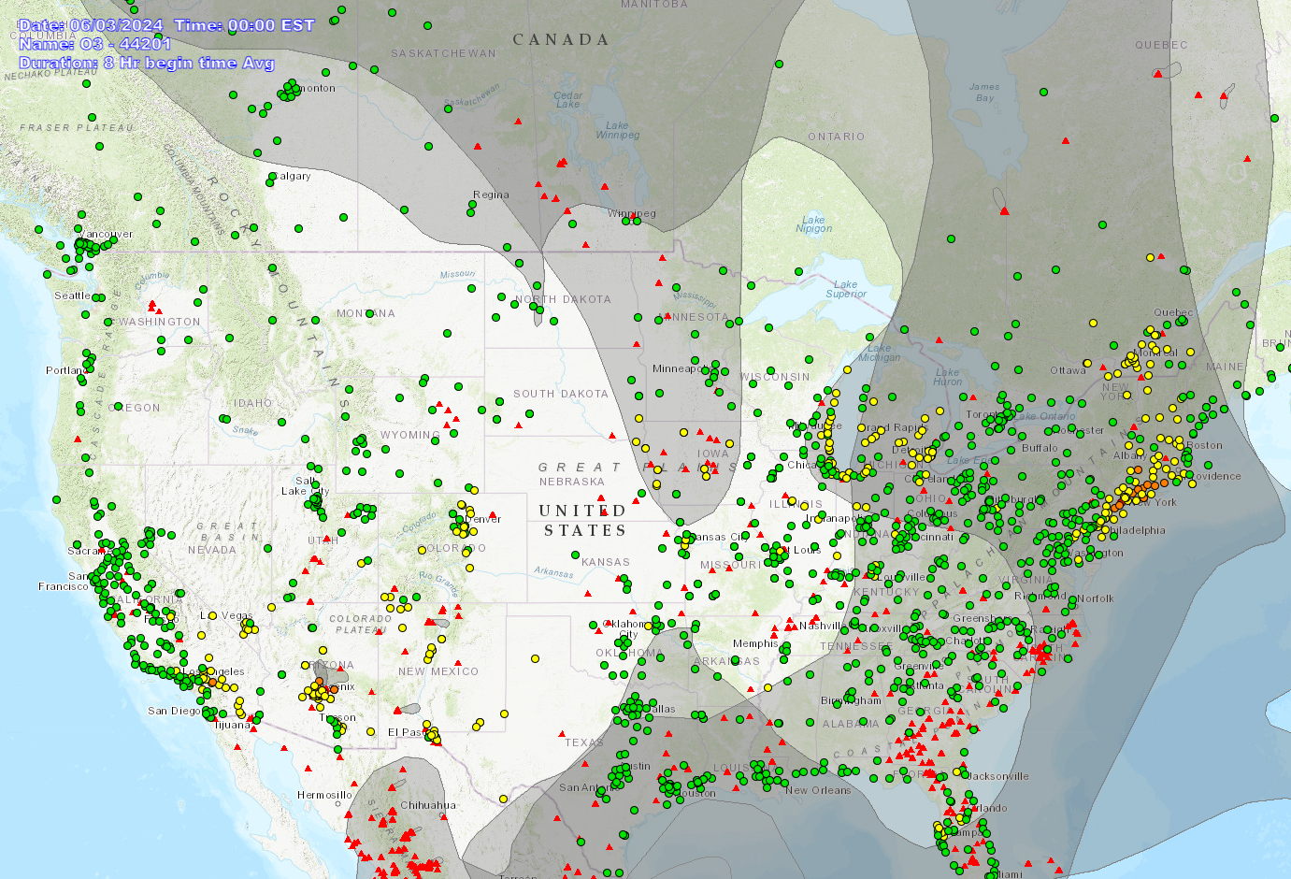
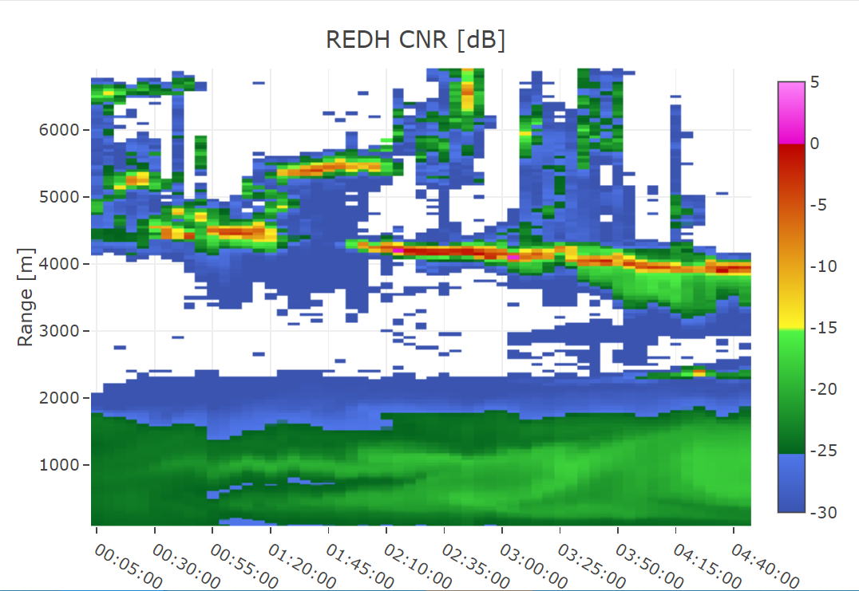
June 3, 2024 Ozone
A HMS smoke plume was analyzed over the East Coast, with the Redhook NY backscatter LIDAR showing a light smoke plume reaching the surface.

Slide 12
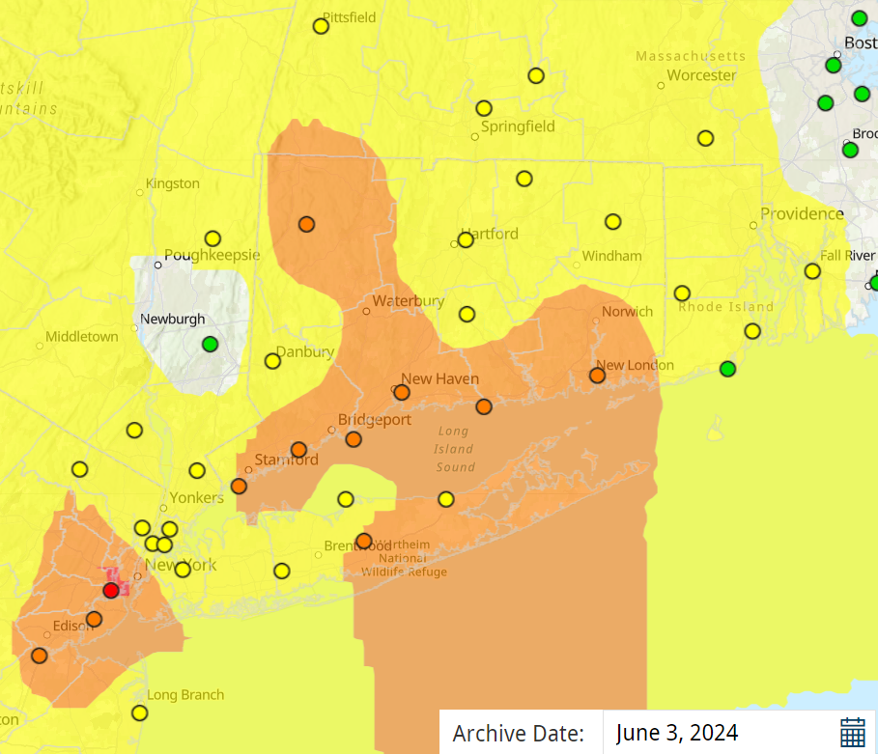
June 3, 2024 Ozone Model Performance
June 3, 2024 06z Ozone
June 3, 2024 06z Ozone BC
On this day, both models greatly under estimated the ozone levels. Smoke?

Slide 13
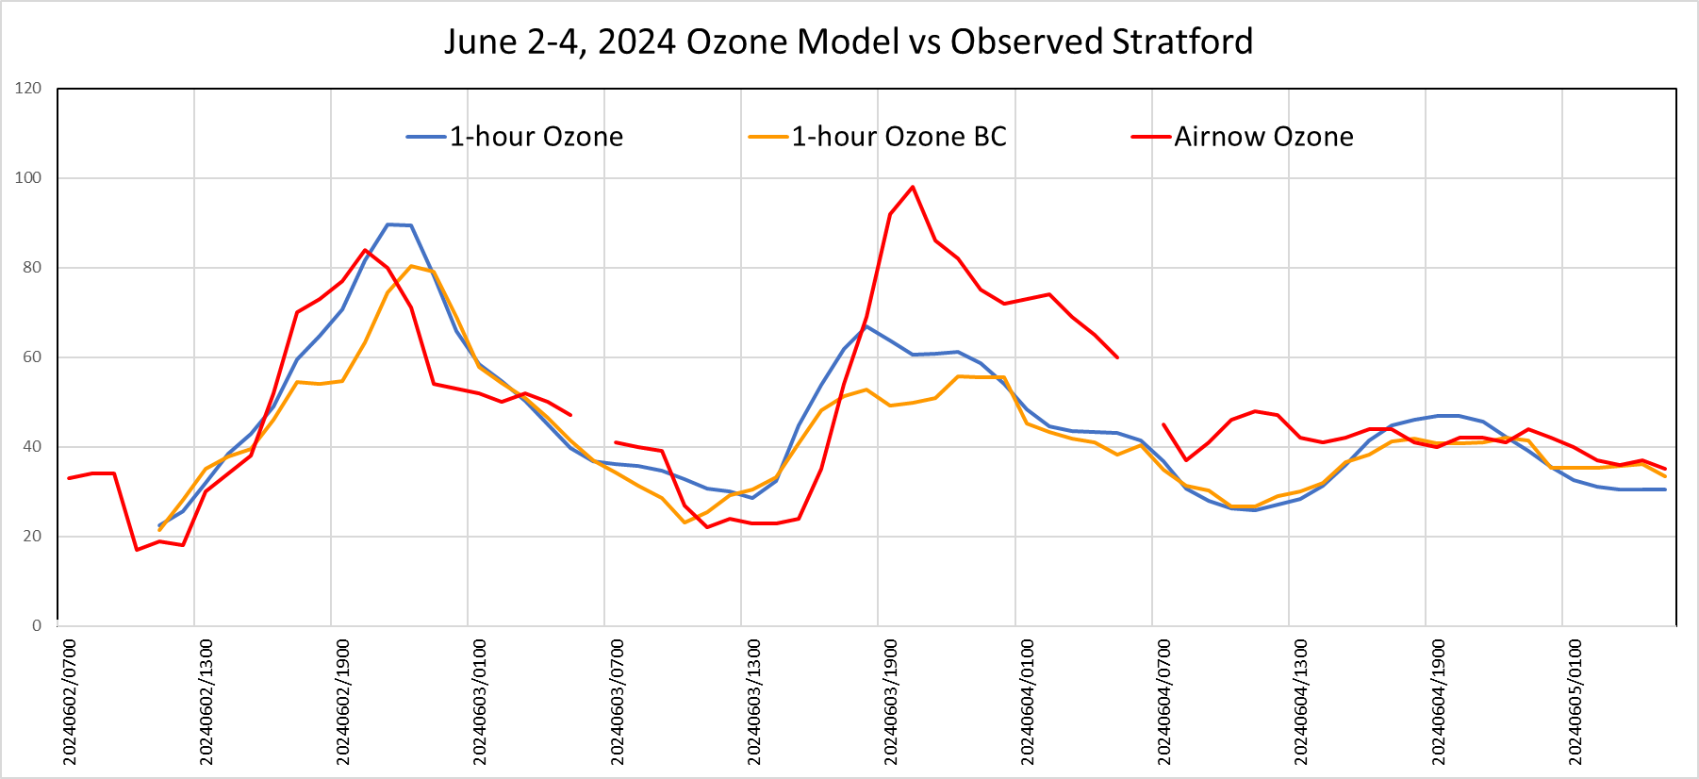
June 2-4, 2024 Ozone Model Stratford
The raw model performed the beat for this episode, but June 3rd was modeled much too low in both versions.

Slide 14
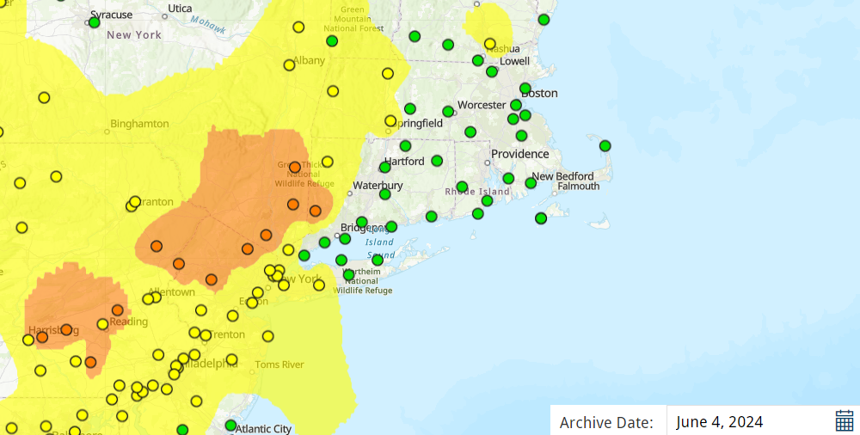
June 4, 2024 Ozone
June 4th only had one exceedance in far western Connecticut.

Slide 15
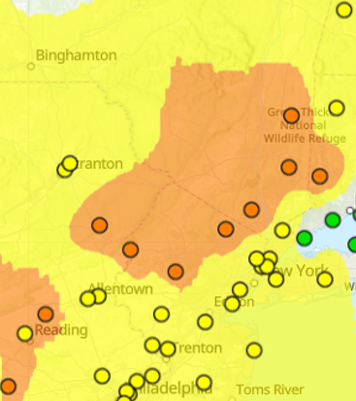
June 4, 2024 Ozone Model Performance
June 4, 2024 06z Ozone
June 4, 2024 06z Ozone BC
The raw model had the USG displaced too far south.

Slide 16
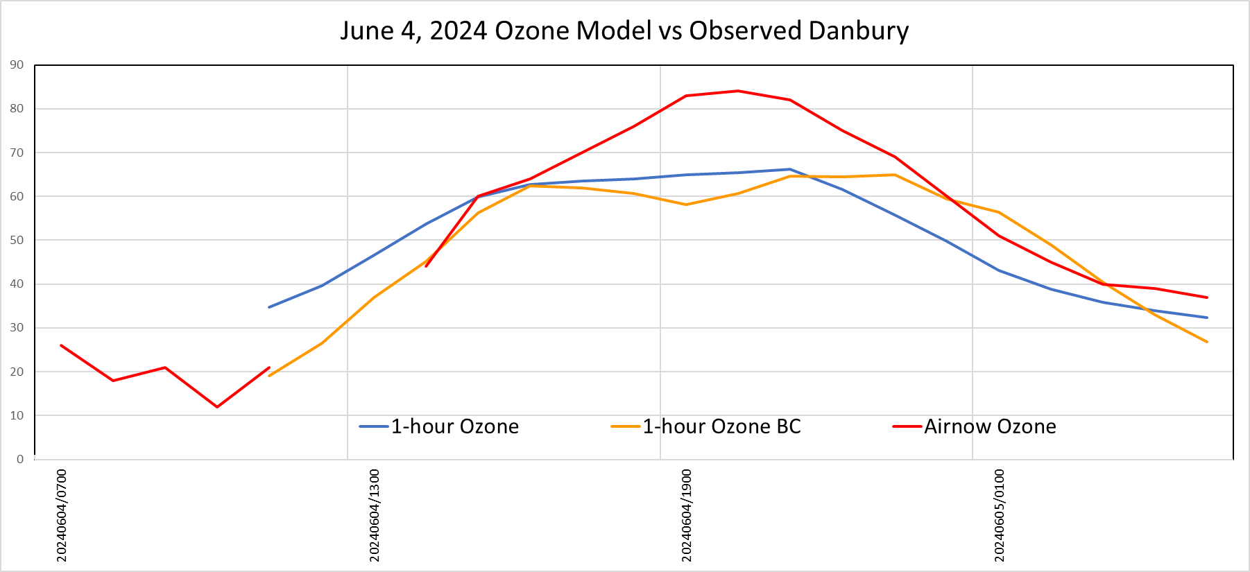
June 2-4, 2024 Ozone Model Danbury
Both models missed the ozone exceedance at Danbury.

Slide 17
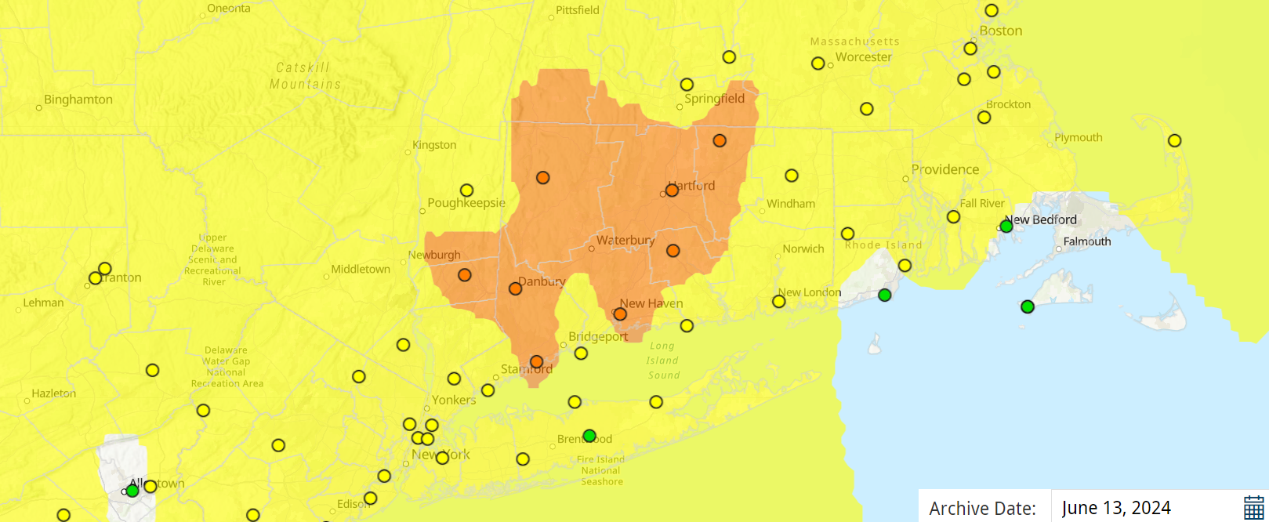
June 13, 2024 Ozone
This was another widespread exceedance across the State. East Hartford was the highest at 75 ppb.

Slide 18
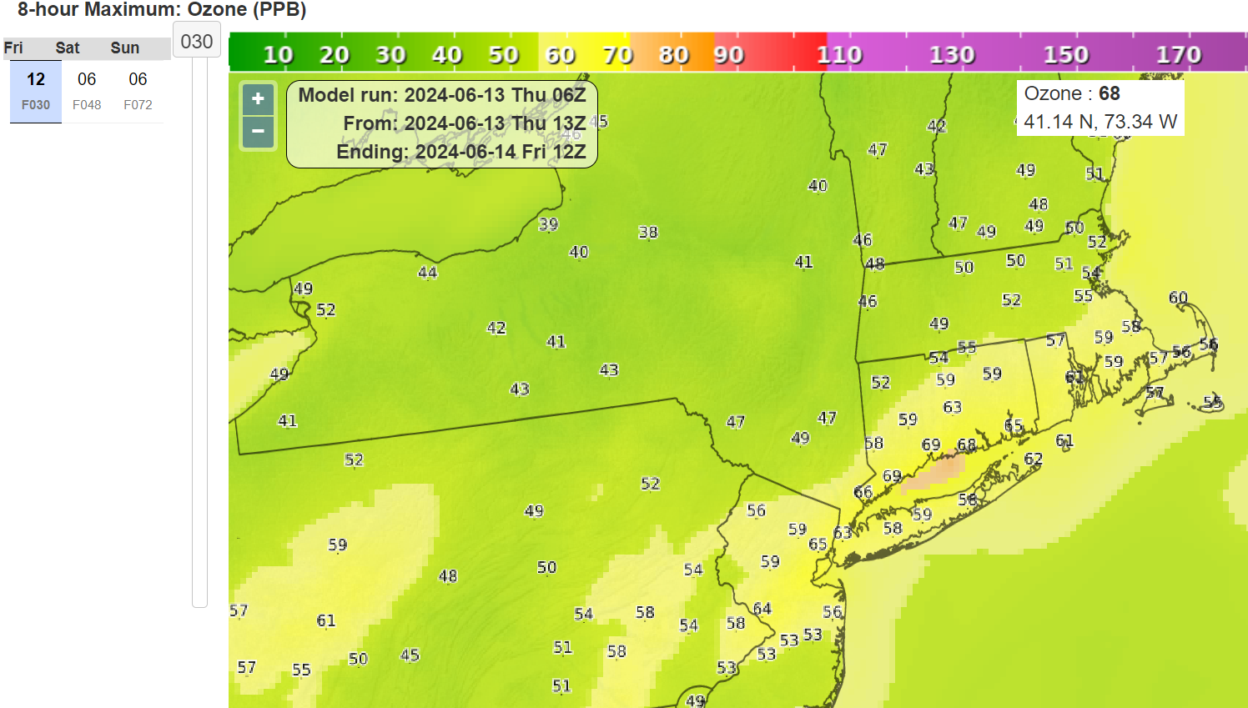
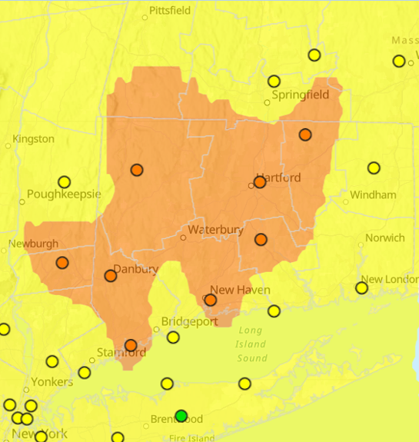
June 13, 2024 Ozone Model Performance
June 13, 2024 06z Ozone
The model totally missed the ozone exceedances on this day.

Slide 19
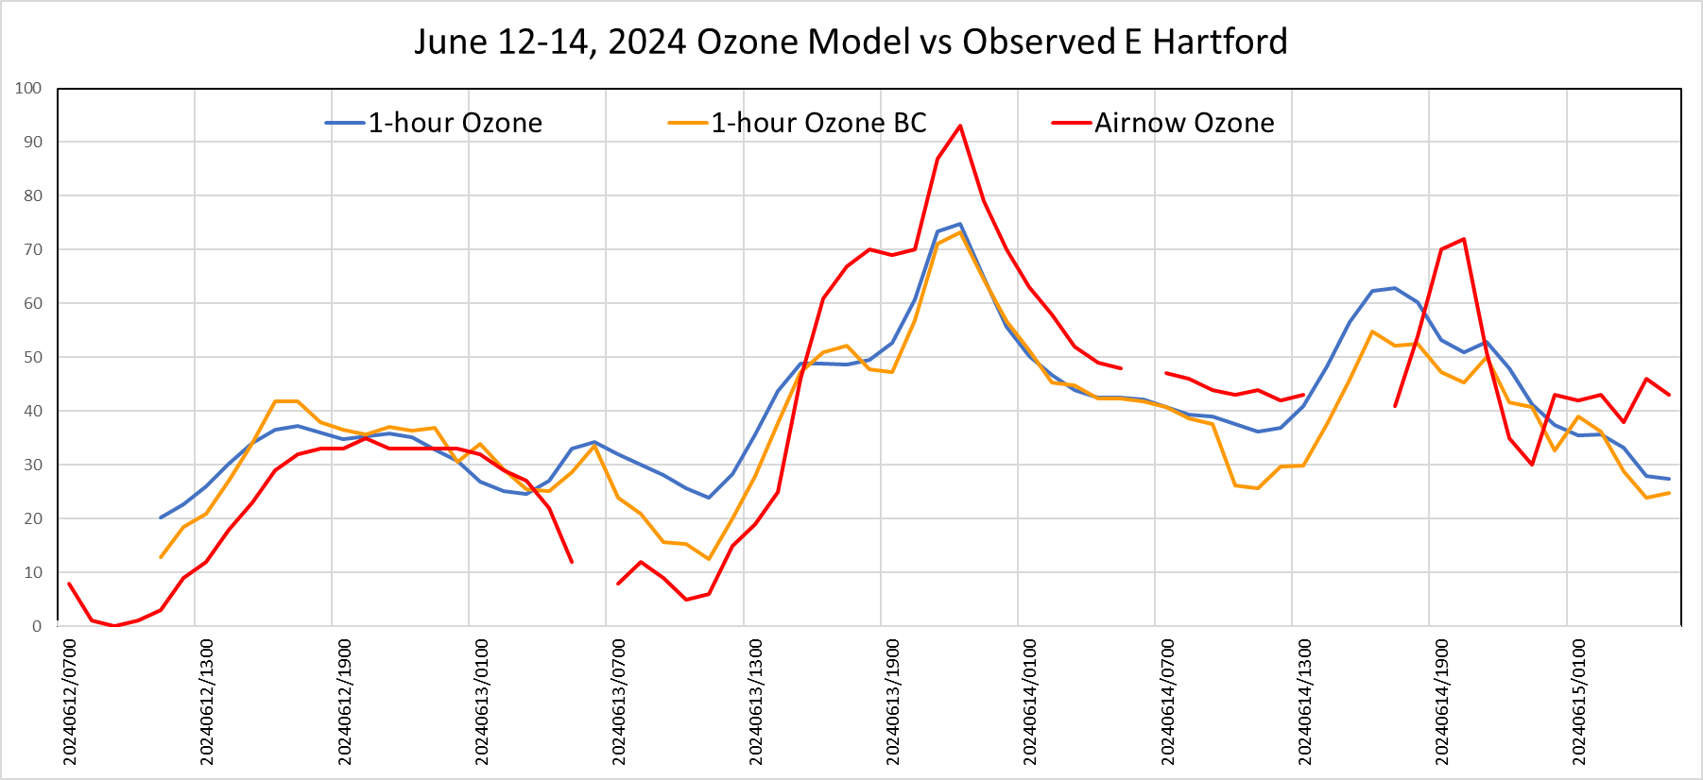
June 13, 2024 Ozone Model East Hartford
The East Hartford monitor had the highest 1-hour ozone.

Slide 20
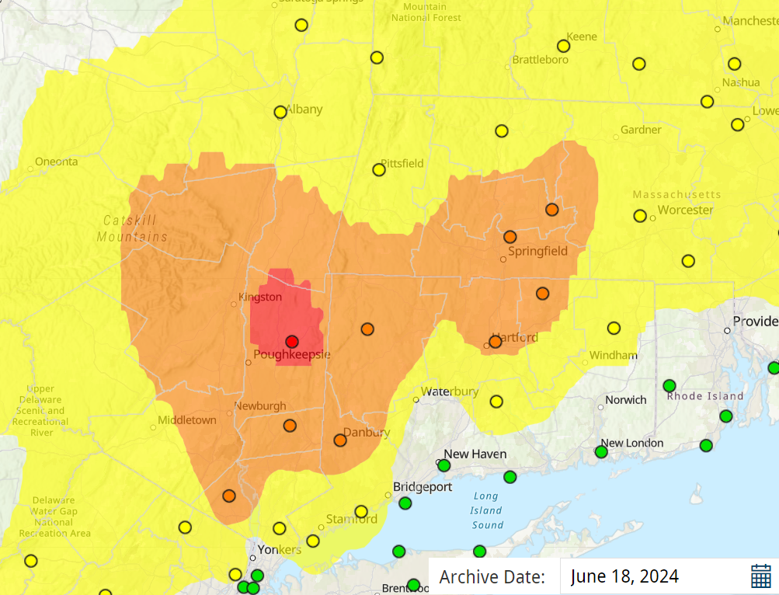
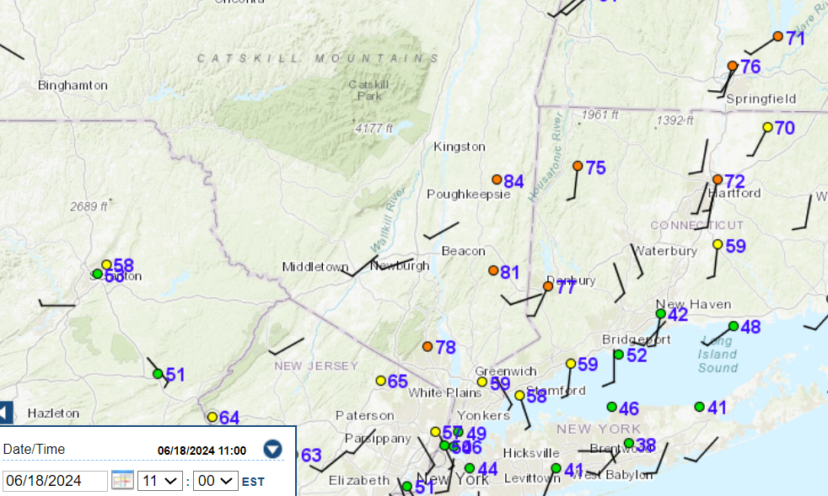
June 18, 2024 Ozone
These ozone exceedance occurred well inland, being pushed northward by the Atlantic southerlies.

Slide 21
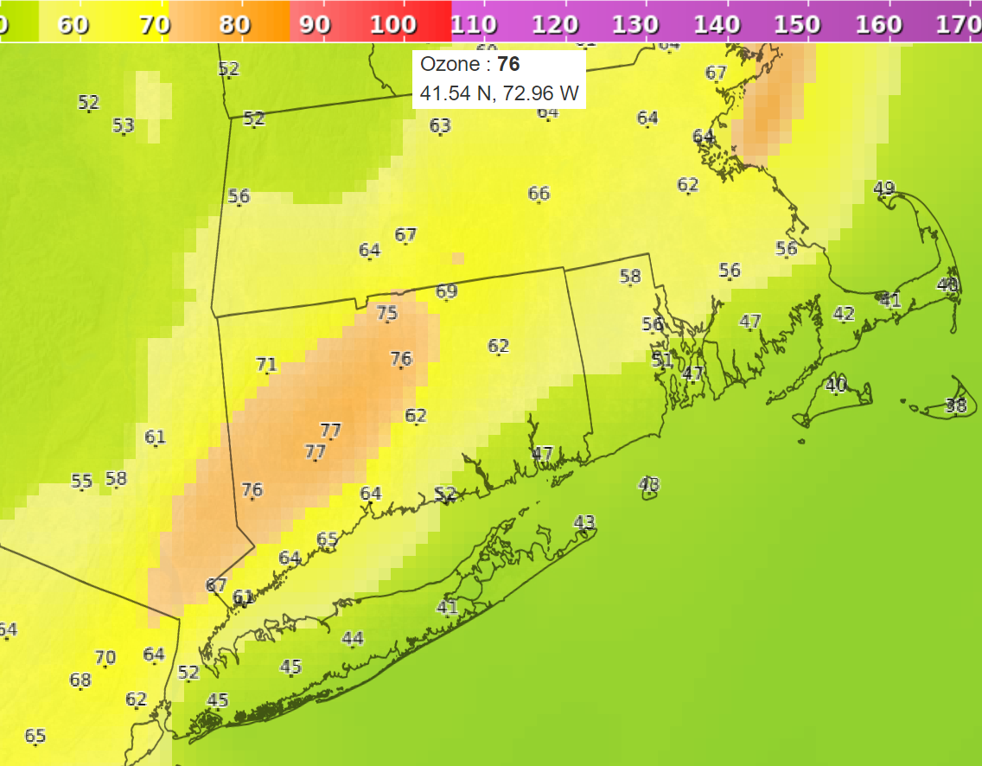
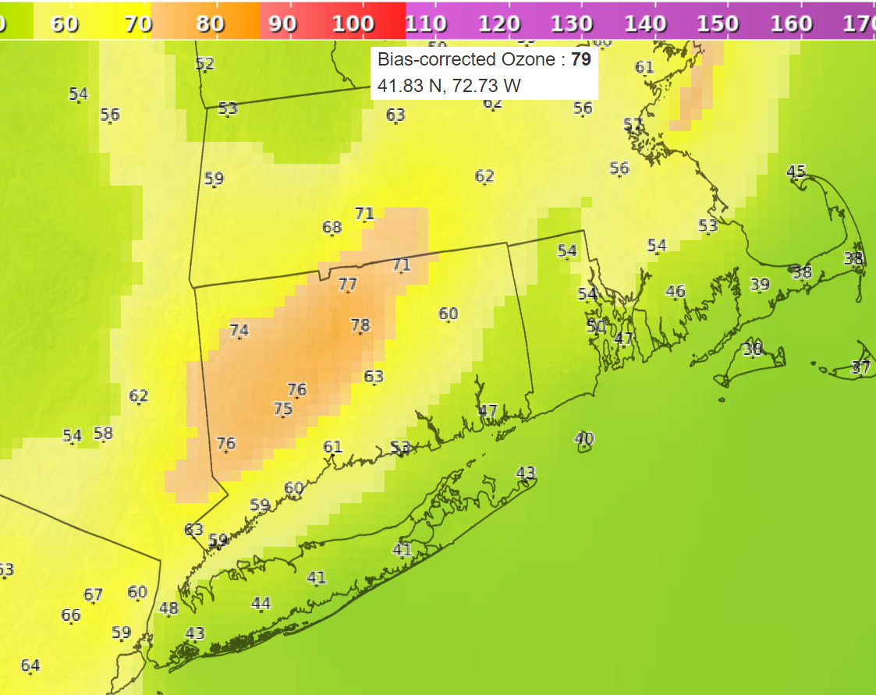
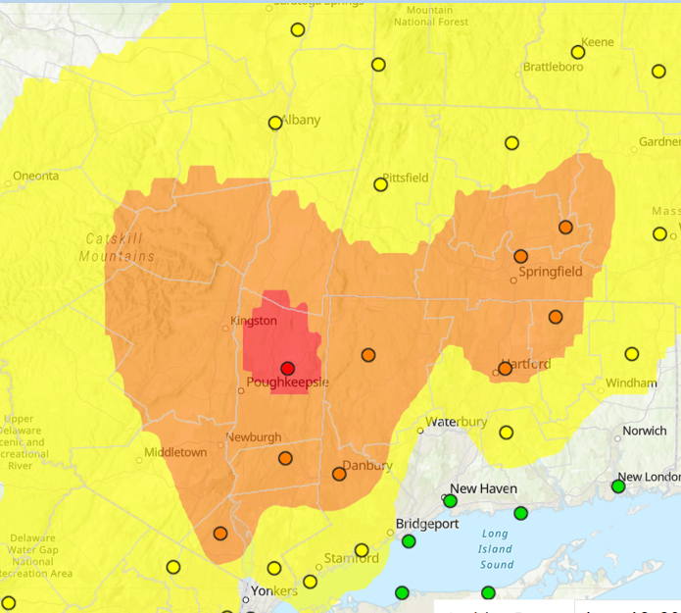
June 18, 2024 Ozone Model Performance
June 18, 2024 06z Ozone
June 18, 2024 06z Ozone BC
Both models captured the ozone plume very well.

Slide 22
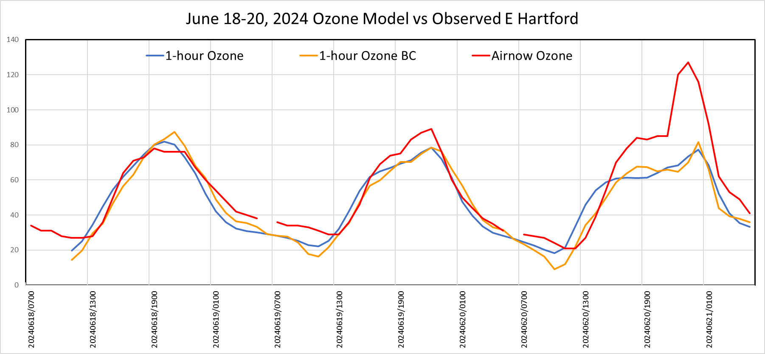
June 18-20, 2024 Ozone Model East Hartford
Both models did well for June 18-19, but missed the ozone spike on June 20th over East Hartford on Day 3.

Slide 23
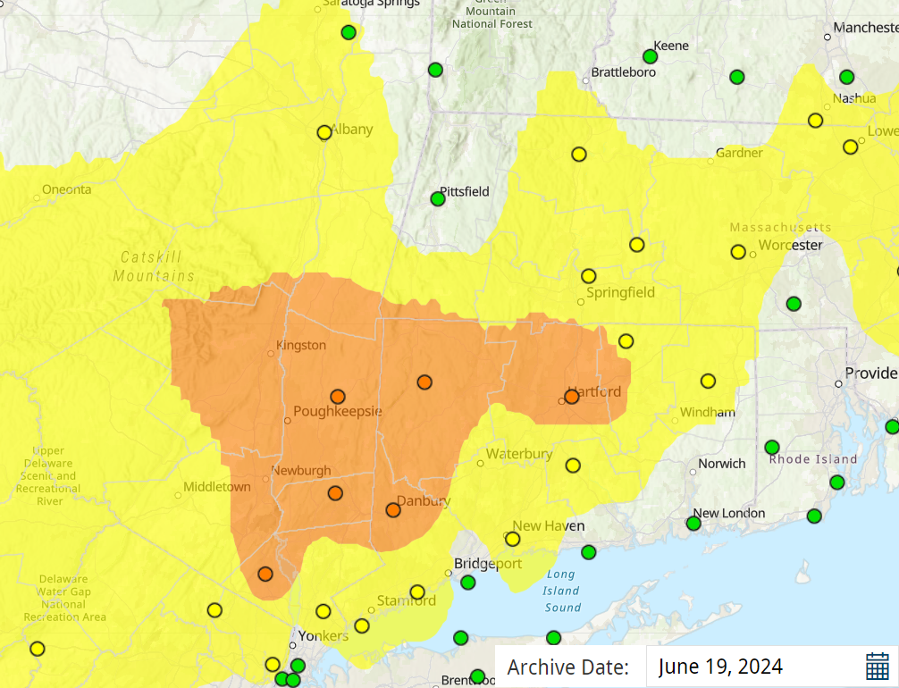
June 19, 2024 Ozone
The highest ozone levels once again occurred well inland.

Slide 24
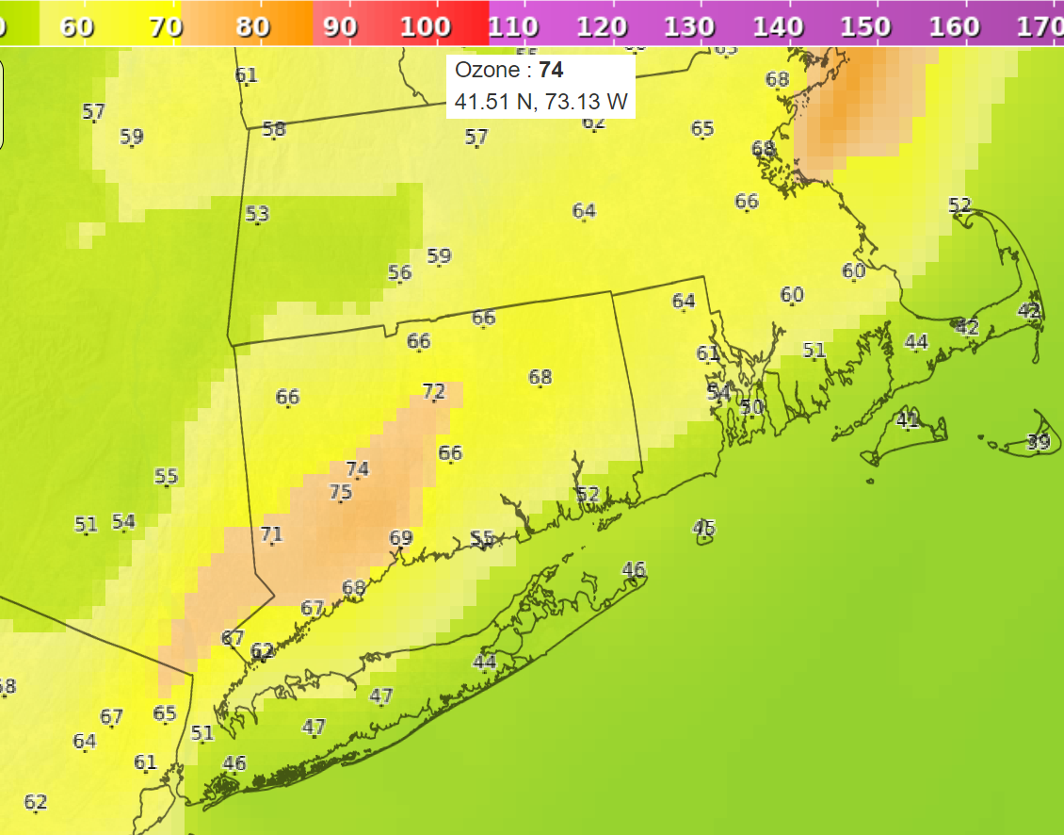
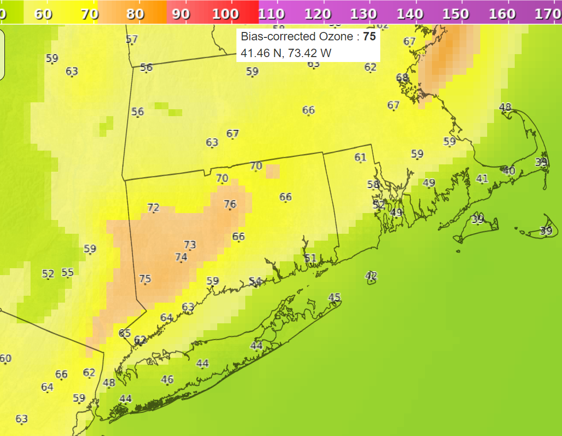
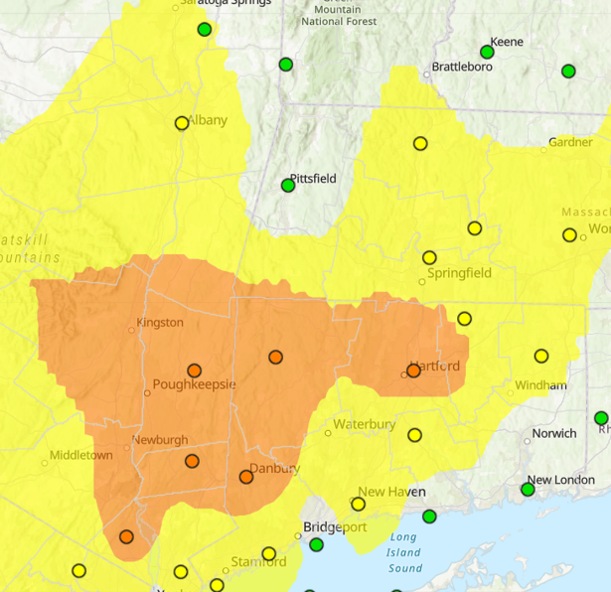
June 19, 2024 Ozone Model Performance
June 19, 2024 06z Ozone
June 19, 2024 06z Ozone BC
Both models did well for placement and concentrations.

Slide 25
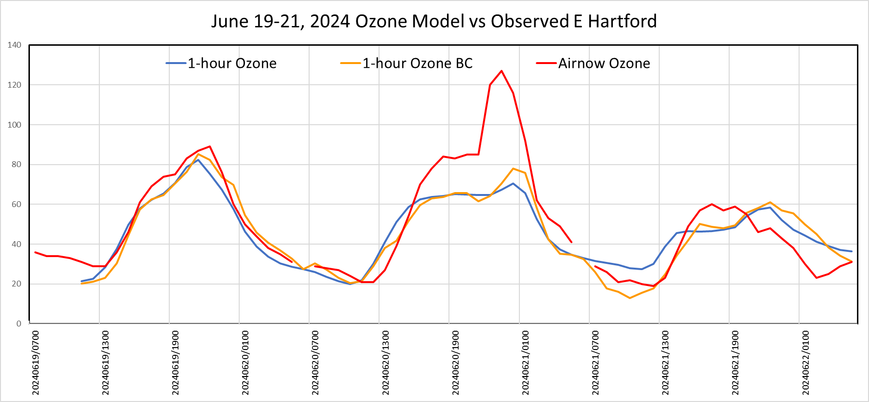
June 19-21, 2024 Ozone Model East Hartford
Day 2 over East Hartford is once again modeled much too low.

Slide 26
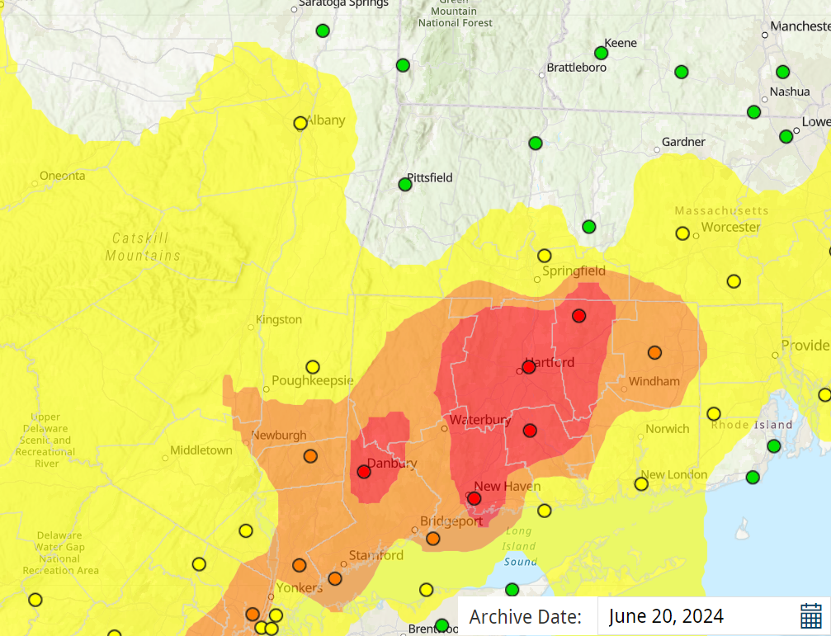
June 20, 2024 Ozone
June 20th was the highest ozone day over Connecticut

Slide 27
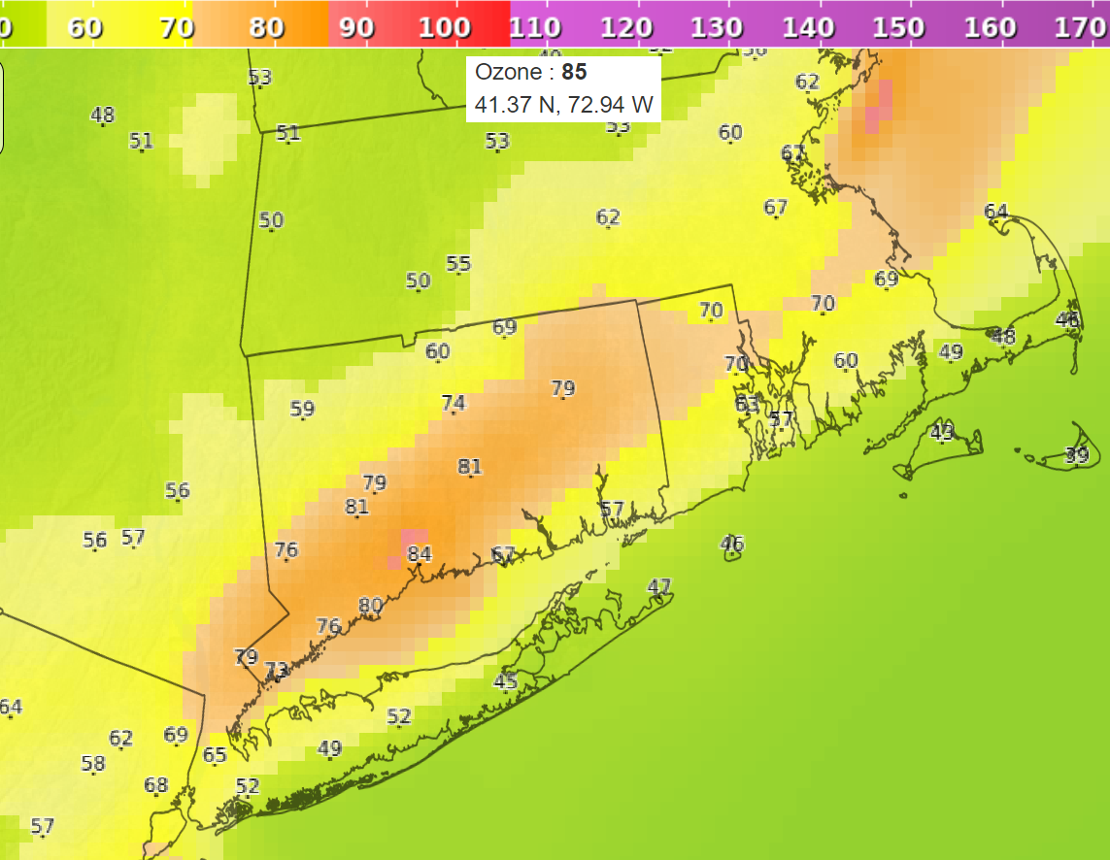
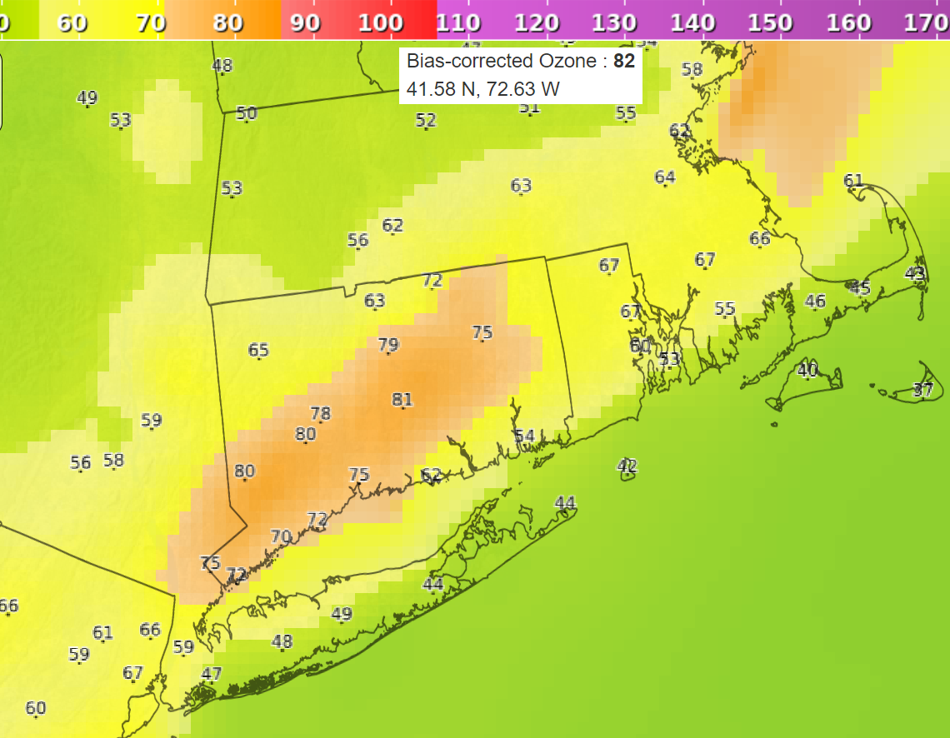
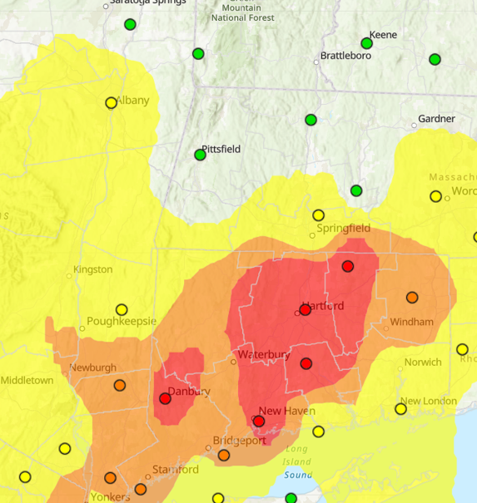
June 20, 2024 Ozone Model Performance
June 20, 2024 06z Ozone
June 20, 2024 06z Ozone BC
Models had good placement, but levels were too low.

Slide 28
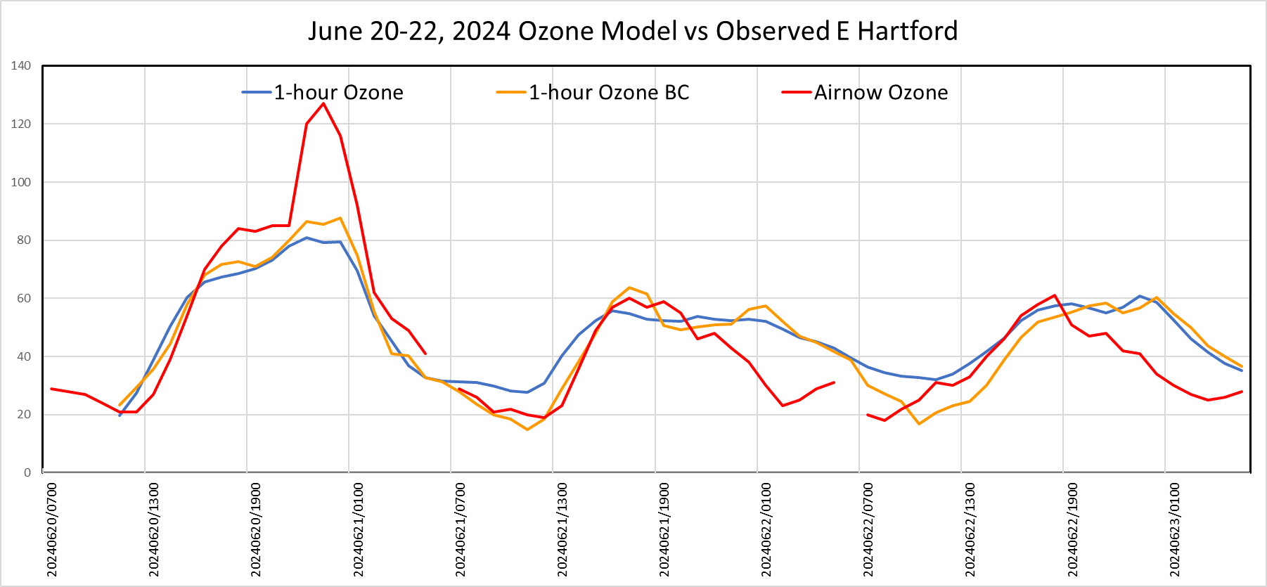
June 20, 2024 Ozone Model East Hartford
Ozone levels were somewhat higher than previous runs, but still too low.

Slide 29
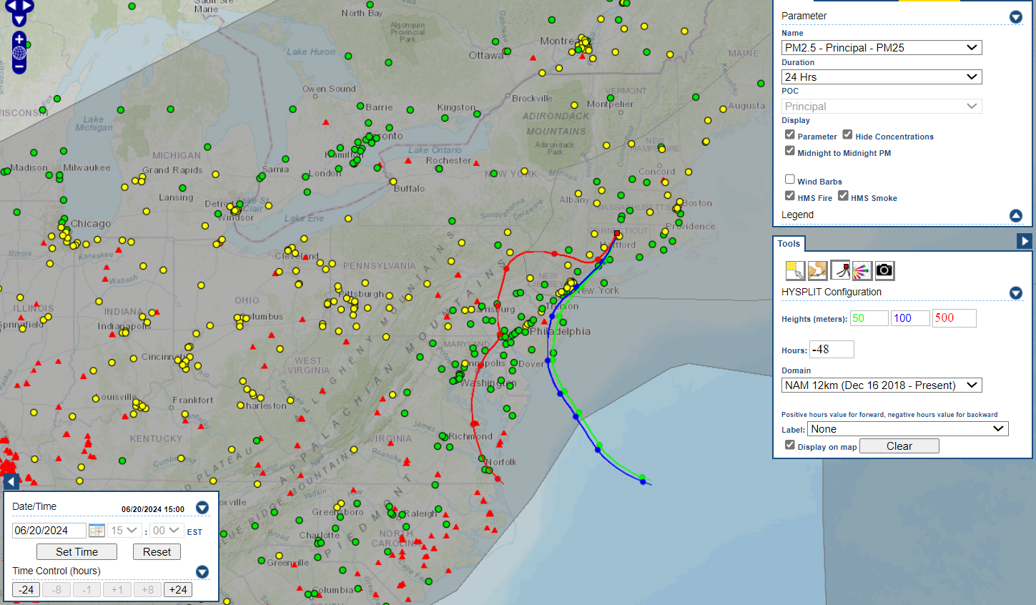
June 20, 2024 smoke Analysis
HMS smoke analysis confirms the presence of a smoke plume overhead. The NY Redhook backscatter LIDAR shows smoke aerosols reaching the surface.

Slide 30
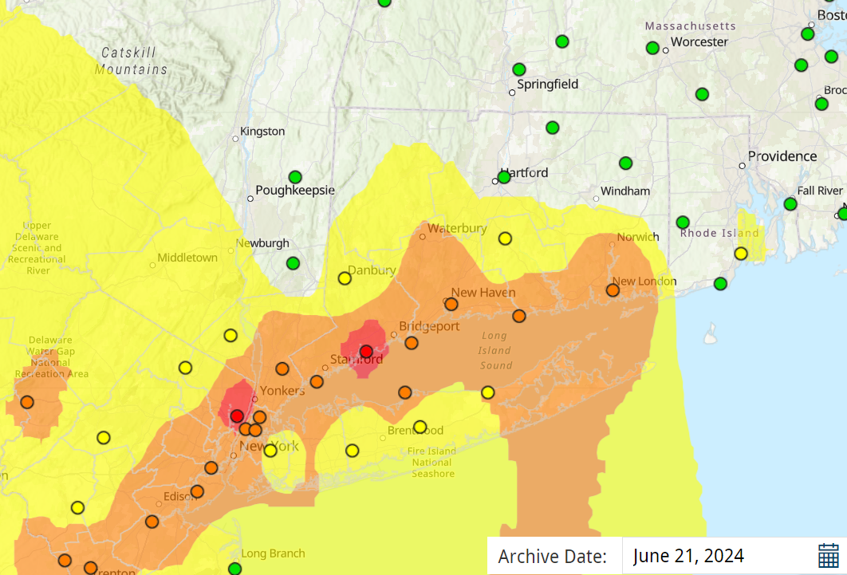
June 21, 2024 Ozone
June 21st monitored high ozone levels along the Connecticut coast. Westport had a high of 87 ppb.

Slide 31
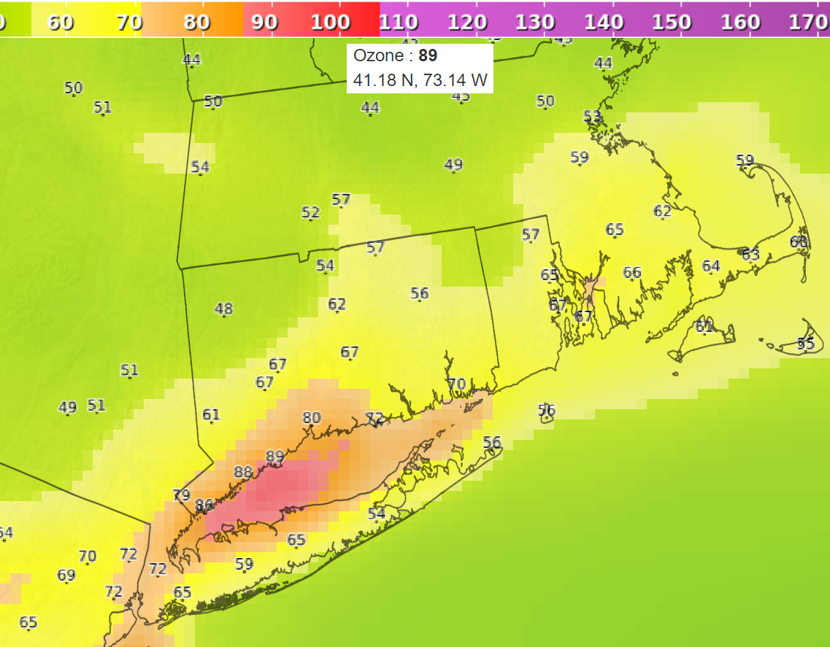
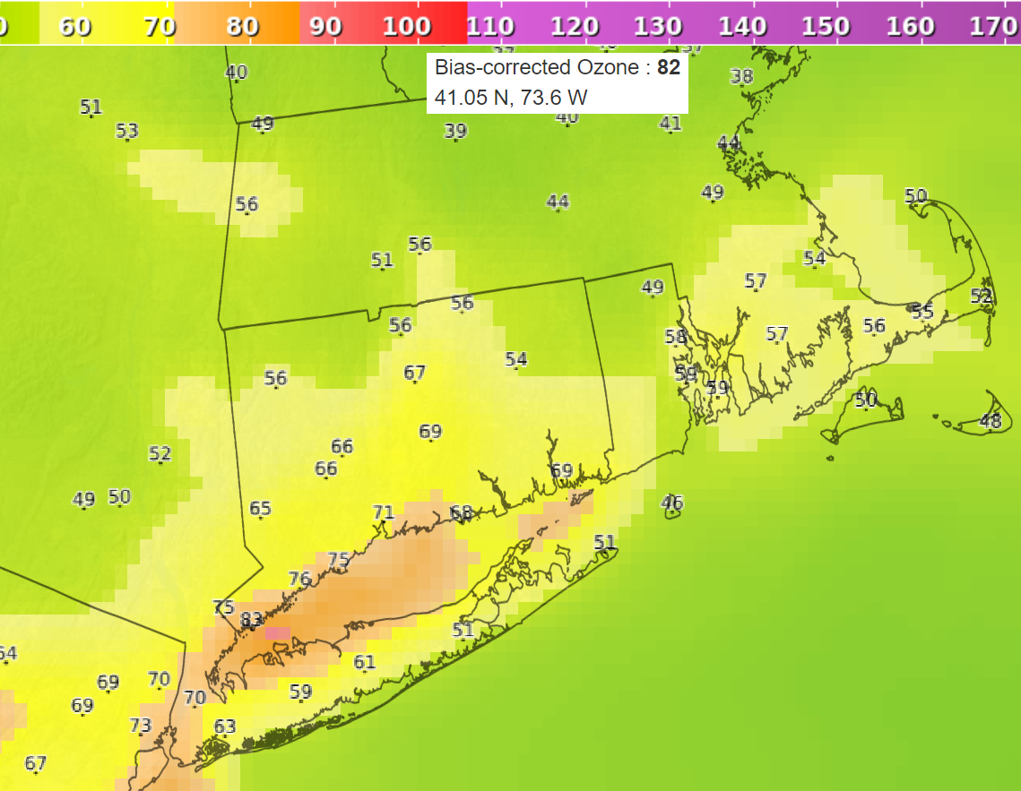
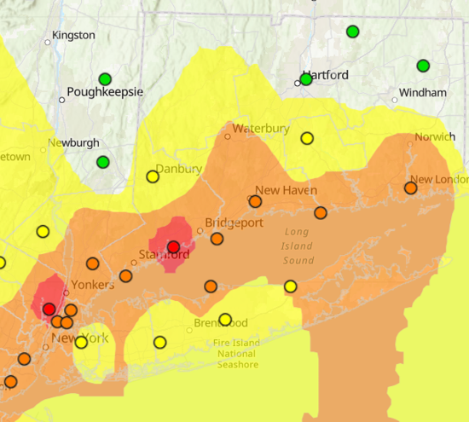
June 21, 2024 Ozone Model Performance
June 21, 2024 06z Ozone
June 21, 2024 06z Ozone BC
The BC version was lower than what was observed, so the raw model is preferred.

Slide 32
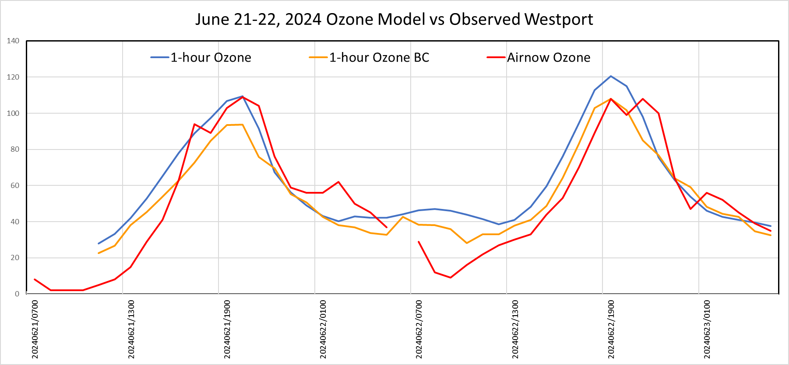
June 21-22, 2024 Ozone Model Westport
The raw model performed the best for Westport day 1, but was too high for day 2.

Slide 33
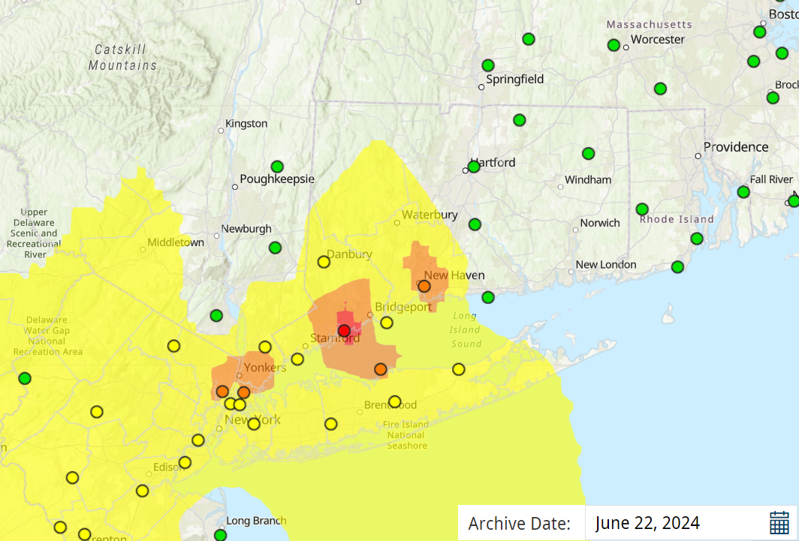
June 22, 2024 Ozone
On June 22nd, Westport had the highest ozone at 86 ppb.

Slide 34
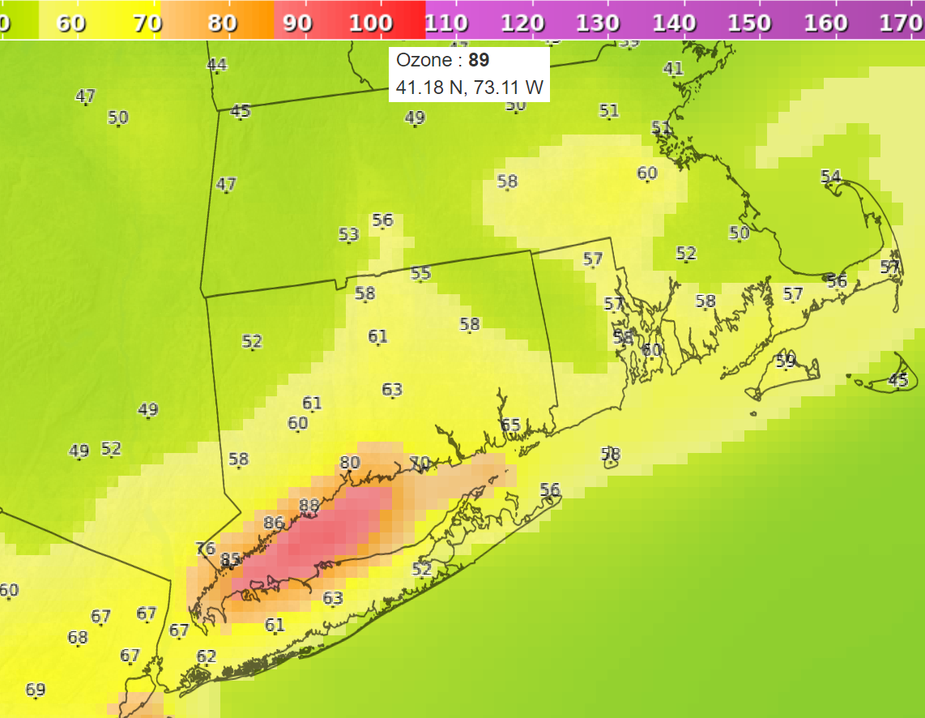
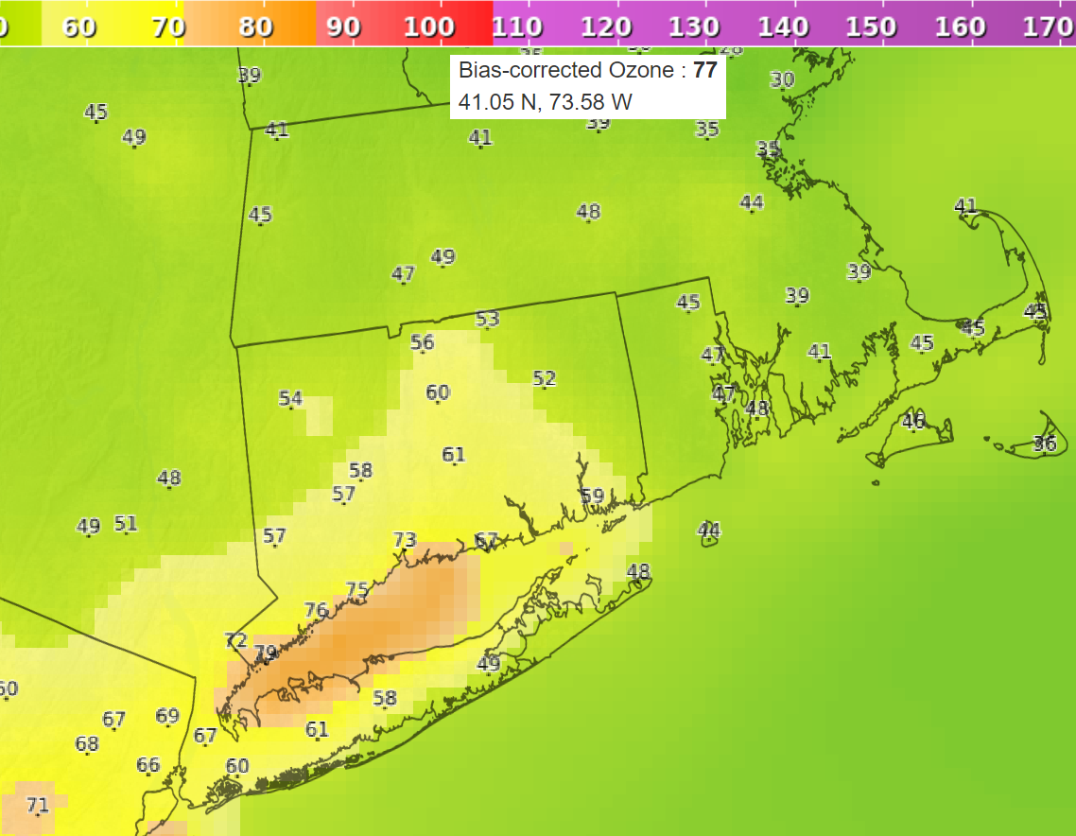
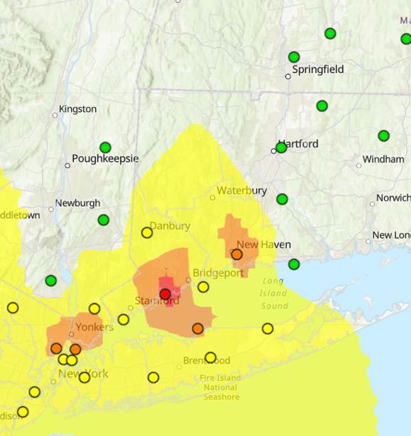
June 22, 2024 Ozone Model Performance
June 22, 2024 06z Ozone
June 22, 2024 06z Ozone BC
The raw model better captured the high ozone at Westport.

Slide 35
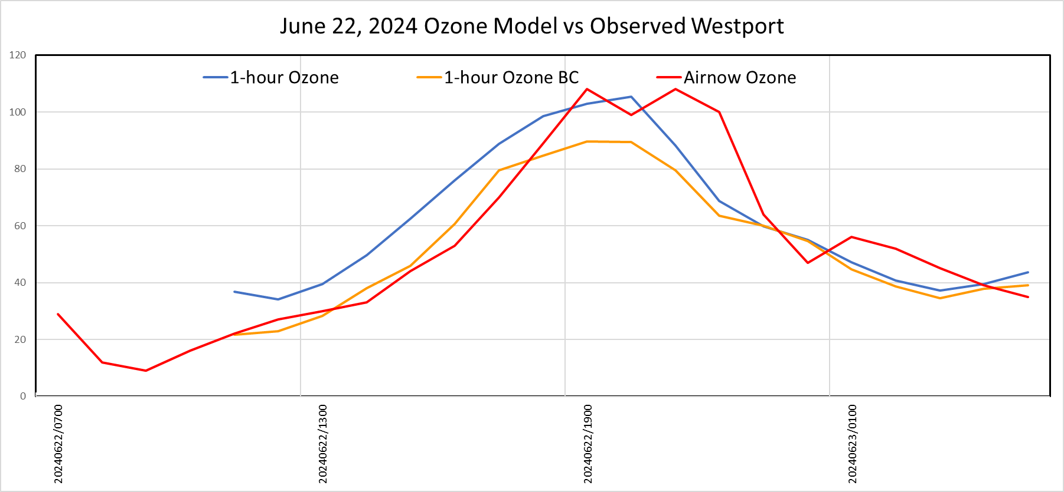
June 22, 2024 Ozone Model Performance
The day 1 model run for Westport shows the BC version being too low.

Slide 36
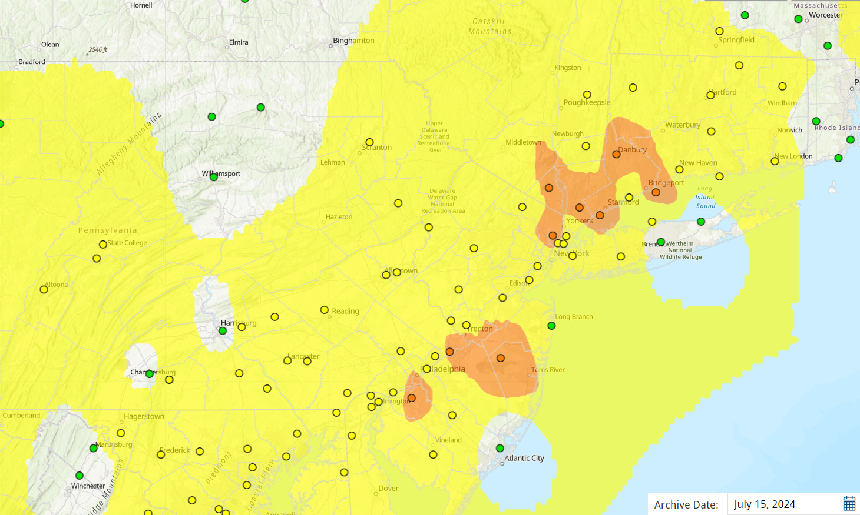
July 15, 2024 Ozone
This was the beginning of a 3-day episode. The highest ozone was 81 ppb at Stratford.

Slide 37
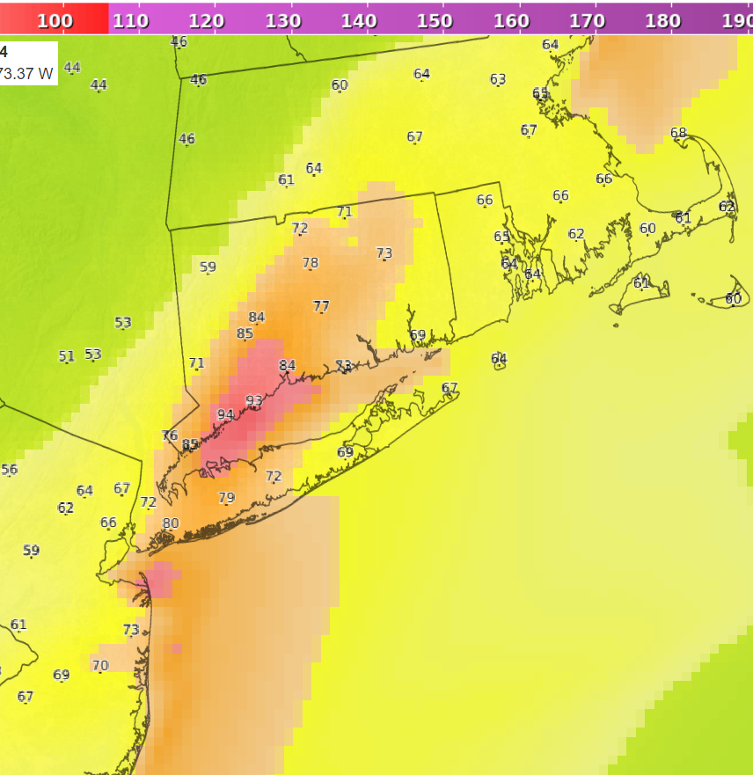
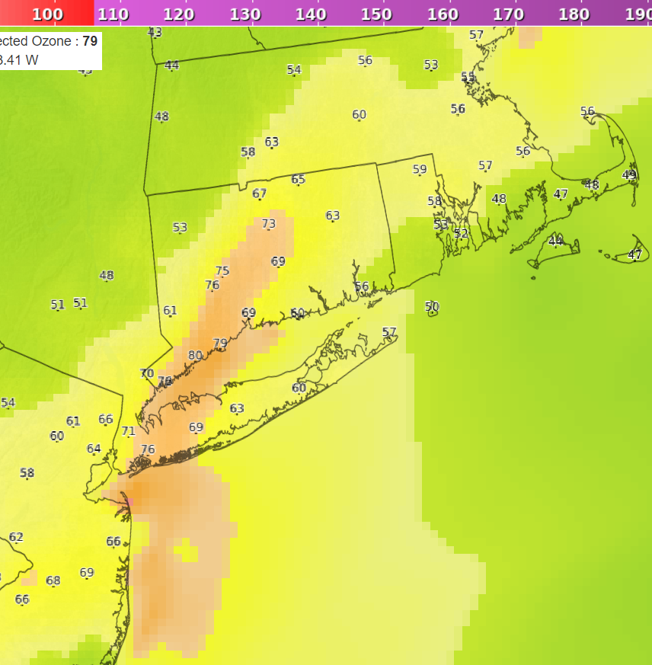
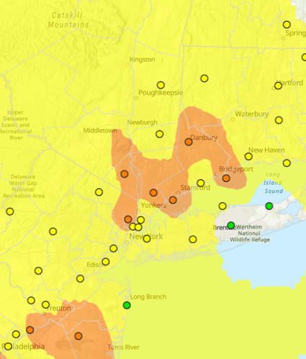
July 15, 2024 Ozone Model Performance
July 15, 2024 06z Ozone
July 15, 2024 06z Ozone BC
For this case, the BC version was more accurate than the raw version.

Slide 38
July 15-17, 2024 Ozone Model Performance
On July 15th, the Greenwich monitor had a sudden dip that confounded the models. There was a sudden spike on Day 2 that both models missed.

Slide 39
July 16, 2024 Ozone
July 16th was a widespread event, with Westport being the highest at 85 ppb.

Slide 40
July 16, 2024 Ozone
Smoke was again present on the HMS analysis. The early morning satellite image also showed smoke.

Slide 41
July 16, 2024 Ozone Model Performance
July 16, 2024 06z Ozone
July 16, 2024 06z Ozone BC
The raw version best captured the widespread event and the high ozone at the Westport monitor.

Slide 42
July 16-18, 2024 Ozone Model Performance
Both models performed in a similar fashion, but they missed the day 1 ozone spike, possibly due to smoke enhancement.

Slide 43
July 17, 2024 Ozone
June 17th only had a few ozone exceedances around NYC. Danbury and Greenwich both monitored 73 ppb.

Slide 44
July 17, 2024 Ozone Model Performance
July 17, 2024 06z Ozone
July 17, 2024 06z Ozone BC
The raw model was too high and the BC was too low, but did well for Greenwich.

Slide 45
July 17-18, 2024 Ozone Model Performance
This shows the raw model being much too high for Greenwich and the BC being very close.

Slide 46
August 25, 2024 Ozone
August 25th was a coastal event with Greenwich being the highest at 75 ppb.

Slide 47
August 25, 2024 Ozone Model Performance
August 25, 2024 06z Ozone
August 25, 2024 06z Ozone BC
The raw version captured the event well, while BC was much too low.

Slide 48
August 25-27, 2024 Ozone Model Performance
There was a growing spread of >10 ppb between the raw and BC at Greenwich. Both models were much too low on day 2.

Slide 49
August 26, 2024 Ozone
Only two Connecticut monitors exceeded on August 26th, with Westport at 72 ppb.

Slide 50
August 26, 2024 Ozone Model Performance
August 26, 2024 06z Ozone
August 26, 2024 06z Ozone BC
The raw version was most correct on this day, with the BC version much too low.

Slide 51
August 28, 2024 Ozone
The ozone was highest on east coastal Connecticut, with Madison at 82 ppb.

Slide 52
August 28, 2024 Ozone Model Performance
August 28, 2024 06z Ozone
August 28, 2024 06z Ozone BC
Both models vastly under estimated the ozone levels on this day.

Slide 53
August 28, 2024 Ozone Model Performance
Both models were about 20 ppb too low for Day 2 at Madison.

Slide 54
August 28, 2024 Smoke Analysis
Once again, there was a vast smoke plume being reported that may have enhanced the ozone levels.

Slide 55
Ozone Over Predictions July 8, 2024
July 8, 2024 06z Ozone
July 8, 2024 06z Ozone BC
There were no exceedances on this day. The BC version correctly lowered the ozone values for Connecticut.

Slide 56
Ozone Over Predictions
July 9, 2024 06z Ozone
July 9, 2024 06z Ozone BC
Only Cornwall exceeded on July 9th at 72 ppb. The raw version was too widespread while the BC was more accurate, but displaced to the south.

Slide 57
Ozone Over Predictions
August 3, 2024 06z Ozone
August 3, 2024 06z Ozone BC
There were no exceedances on this day. The BC was still too high along the coast.

Slide 58
PM2.5 Model Performance
July 31, 2024 06z PM2.5 BC
Although there was a smoke plume overhead, the surface PM2.5 levels were modeled too high over the Northeast states.
Over Prediction

Slide 59
PM2.5 Model Performance
August 14, 2024 06z PM2.5 BC
Moderate PM2.5 levels were monitored across New England. The PM2.5 BC model was forecasting mostly good levels.
Under Prediction

Slide 60
PM2.5 Model Performance
August 15, 2024 06z PM2.5 BC
By August 15th, the model was showing some moderates, while every monitor was at moderate levels.
Under Prediction

Slide 61
PM2.5 Model Performance
August 17, 2024 06z PM2.5 BC
By August 17th, the model was forecasting moderate PM2.5, just slightly below monitored levels.
Good Forecast

Slide 62
August 18th Rainfall
On August 18th, historic rainfalls occurred over parts of Connecticut, greatly reducing the PM2.5 levels

Slide 63
PM2.5 Model Performance
August 19, 2024 06z PM2.5 BC
On August 19th, the model was still holding on the moderate levels, while very low PM2.5 levels were being monitored.
Over Prediction

Slide 64
PM2.5 Model Performance
August 20, 2024 06z PM2.5 BC
On August 20th, the model was still mostly moderate, while very low PM2.5 levels were being monitored.
Over Prediction

Slide 65
Conclusions
The ozone models performed much more consistently this year, with the BC version very close to the raw during a few episodes.
During other episodes the BC was bias lower by 10 ppb or more, which caused it to under predict during widespread events.
There appeared to be less false alarms than last year for ozone.
The urban plume enhancement downwind of NYC that I observed last year, did not seem to be happening this year.
There were some sudden spikes in monitored ozone, likely due to smoke enhancement that the models could not predict.
The PM2.5 BC is usually very reliable, but during mid-August it began over-predicting PM2.5 levels, possibly because of missing the rain event or from recirculation from off the domain.

