Slide 1
Air Quality Forecasting Updates for the District of Columbia
NOAA Air Quality Forecasters Focus Group Workshop
Kane D. Samuel
Monae Scott
October 9, 2024
TAG THIS PRESENTATION @DOEE_DC

Slide 2
Our newest staff forecaster
@DOEE_DC

Slide 3
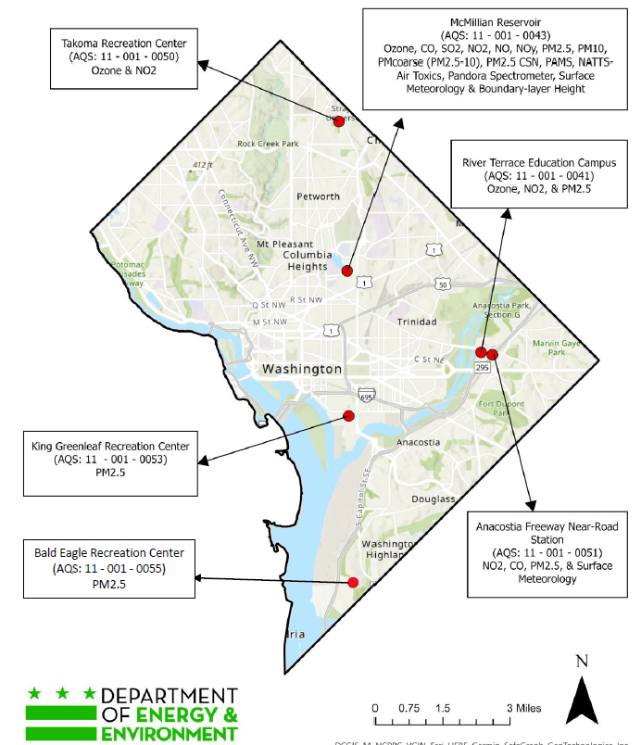
Bald Eagle Recreation Center
Strategically placed in ward 8
Residents were involved in the selection process of the monitor
Currently measures PM2.5, with plans to expand
Real-time being integrated into our forecast models.
@DOEE_DC
Notes:
DOEE received funding to complete a citywide climate adaptation plan from the Sustainable DC Innovation Fund in FY2013.
DOEE then awarded a grant in April 2014 to develop a plan to include:
1)The development of local climate change scenarios
2)An assessment of risks and vulnerabilities with a focus on critical facilities and infrastructure
3)A plan that will identify and prioritize adaptation solutions

Slide 4
Air Sensor Lending Program
It’s completely free!!!!
@DOEE_DC
Notes:
DOEE received funding to complete a citywide climate adaptation plan from the Sustainable DC Innovation Fund in FY2013.
DOEE then awarded a grant in April 2014 to develop a plan to include:
1)The development of local climate change scenarios
2)An assessment of risks and vulnerabilities with a focus on critical facilities and infrastructure
3)A plan that will identify and prioritize adaptation solutions

Slide 5
Forecasting Model Enhancements for PM2.5
Develop a tool to develop hourly PM2.5 concentrations using historical air quality data and weather forecasts.
Using:
NOAA HRRR Forecasts
Historical Hourly PM2.5 Data
Appling Machine learning
While its still in the testing phase, the tool could provide more localized real-time predictions.
@DOEE_DC
Notes:
MPAS can provide precise forecasts of air pollution levels in different neighborhoods across D.C., particularly in areas known for high traffic and industrial activity.
the model can account for how the urban landscape, including buildings and roads, influences local air quality, allowing for targeted interventions.

