Slide 1
2024 AIR QUALITY FORECAST ACCURACY FOR NORTHEAST OHIO
National Oceanic and Atmospheric Administration (NOAA) Air Quality Forecasters Workshop
October 9-10, 2024
Northeast Ohio Areawide Coordinating Agency (NOACA)
Joe MacDonald
Kirk Kallenborn

Slide 2
OVERVIEW
What is NOACA?
NAAQS History
Air Quality Monitors
NOAA Forecast Analysis
2024 Model Performance
Questions?

Slide 3
WHAT IS NOACA?
Metropolitan Planning Organization (MPO) and Areawide Agency for Northeast Ohio
Transportation, air & water quality, economic development
Controls approximately $50M in spending per year
Notes:
NOACA is the metropolitan planning organization for Northeast Ohio, covering Cuyahoga, Geauga, Lake, Lorain & Medina counties
Federally mandated agency that determines how transportation dollars will be spent within metropolitan area
Focuses on two main areas: transportation & environmental planning
All told, NOACA directly controls approximately $50 million in transportation projects within the region each year
This funding intended to carry out our organization’s vision statement: NOACA will STRENGTHEN regional cohesion, PRESERVE existing infrastructure, and BUILD a sustainable multimodal transportation system to SUPPORT economic development and ENHANCE quality of life in Northeast Ohio.

Slide 4
NOACA’S VISION STATEMENT
NOACA will STRENGTHEN regional cohesion, PRESERVE existing infrastructure, and BUILD a sustainable multimodal transportation system to SUPPORT economic development and ENHANCE quality of life in Northeast Ohio.

Slide 5
TRANSPORTATION CHALLENGES
NOACA established in 1968, developed first Long-Range Transportation Plan
Assumed regional population would grow by one million
1970 Census: 2.32 million residents
2020 Census: 2.09 million residents
Notes:
MPOs introduced by Federal Aid Highway Act in 1962, NOACA established as an agency in 1968
One of an MPOs main tasks is to develop a long-range transportation plan
20 year vision outlining transportation planning priorities for a region
NOACA developed its first LRTP in 1968
1968 LRTP projected that the population of the NOACA region would grow by 1 million people
Regional population peaked at 2.32 million people in 1970
By 2010, it had fallen to just 2.08 million residents
We designed a transportation system for a population 50% larger than what we have – this has had major consequences for our region

Slide 6
Overbuilt Transportation System
Suburban Spread, Population Loss
Lack of Alternative Transportation Options
Reliance on Single-Occupancy Vehicles
Limited Economic, Social Mobility
Poor Quality of Life
Notes:
Our overbuilt transportation system has contributed to a number of our region’s persistent challenges
It contributed to suburban sprawl & population loss
2007 study found that each new urban highway was associated with an 18% drop in center city population (Baum-Snow, Nathaniel. "Did highways cause suburbanization?." The Quarterly Journal of Economics (2007): 775-805.)
Population density plummeted as region sprawled: average number of people per developed acre has fallen by one-fourth
As population spread out, alternative forms of transportation have become less reliable
Reliable transit requires a minimum of 7 residential units per acre, double that for high-frequency service
Makes transit unfeasible for much of the region
Greater Cleveland RTA relies on 1% sales tax for roughly 70% of its revenues
Cuyahoga County’s population decline since 1970 has cost RTA $68 million per year in revenues
This has contributed to our region’s heavy reliance on single-occupancy vehicles to get around
82.3% of commuters in NOACA region drive to work alone
Higher than national average (76.4%), up from 78.4% in just 1990
This mono-modal system undermines economic & social mobility
Just 57% of residents have access to transit, 10% of households lack a car
The disconnect between jobs and housing is growing – Cleveland had the largest decrease in the number of jobs accessible within a typical commute of any city from 2000-2012
Nearest regional job hub is a 75 minute commute for transit users, just 20 minutes for drivers
Contributes to poor quality of life
Increases the financial burden on governments to maintain this infrastructure, even as tax base does not grow
Limits active transportation, contributing to obesity, other health issues
Increases impervious surface area, undermining water quality & exacerbating stormwater runoff
Contribute to our region’s air quality issues, as I will discuss next

Slide 7
NAAQS HISTORY

Slide 8
O₃ NAAQS TIMELINE
April 30, 2018: U.S. EPA designated Northeast Ohio counties “marginal nonattainment” for 2015 eight-hour ozone NAAQS (70 ppb)
August 3, 2021: Missed deadline (“bump up” to moderate nonattainment)
October 7, 2022: Determinations of Attainment posted to Federal Register
August 3, 2024: Missed deadline (anticipate “bump up” to serious nonattainment)
Source: Chicago Tribune
Notes:
I want to focus briefly on the links btwn transportation & air quality because, well, that’s my job
Portions of Northeast Ohio are currently in nonattainment for 4 of the EPA’s National Ambient Air Quality Standards: ground-level ozone, fine particulate matter, sulfur dioxide & lead
Transportation is an important source of both ozone precursors & PM2.5
Ozone precursors: 50% of NOx, 35% of VOCs
PM2.5: 15%
Transportation sector is also the 2nd largest source of GHGs
Let’s focus specifically on one pollutant – fine particulate matter
It’s the single most harmful of the 6 criteria pollutants
Tied to a host of health issues, from asthma to heart attack to strokes to lung cancer to dementia
On-road vehicles released 2,200 tons of PM2.5 in 2011 – last year for which we have data
Using U.S. EPA estimates, this generated nearly $1.8 billion in social costs for the region
2013 study found that mobile emissions of PM2.5 account for 384 premature deaths per year in Greater Cleveland

Slide 9
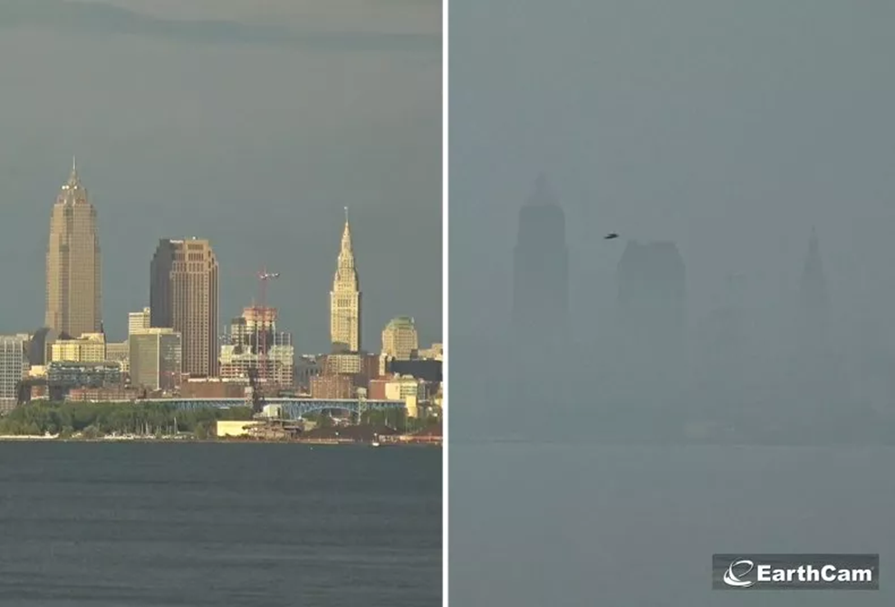
PM_{2.5} NAAQS TIMELINE
2006: U.S. EPA strengthens PM_{2.5} 24hr standard from 65 µg/m³ to 35 µg/m³
2012: U.S. EPA strengthens PM_{2.5} annual standard from 15 µg/m³ to 12 µg/m³
2024: U.S. EPA strengthens PM_{2.5} primary annual standard from 12 µg/m³ to 9 µg/m³
May 6, 2024: PM_{2.5} primary annual standard takes effect. Cuyahoga County to exceed the standard
Source: Newsweek

Slide 10
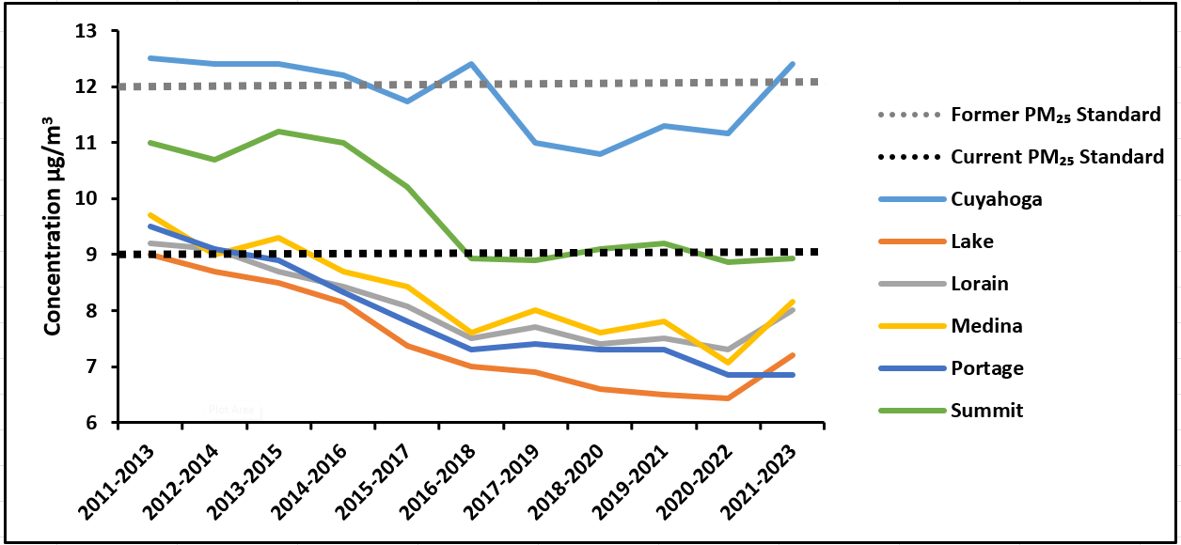
THREE-YEAR ROLLING AVERAGES FOR ANNUAL PM_{2.5} IN NORTHEAST OHIO COUNTIES

Slide 11
AIR QUALITY MONITORS

Slide 12
AIR QUALITY MONITOR LOCATIONS IN NORTHEAST OHIO
Ohio Environmental Protection Agency (Ohio EPA) monitors in Northeast Ohio
O₃: 12 monitors for ground-level ozone
PM_{2.5}: Nine (9) monitors for fine particulate matter
Air Quality Monitoring Region includes:
NOACA counties (5): Cuyahoga, Geauga, Lake, Lorain, Medina
AMATS counties (2): Portage and Summit
Ashtabula County

Slide 13
NORTHEAST OHIO O₃ MONITORS
Monitor | County | FIPS ID | Site ID | Latitude | Longitude | Site Name | Address
1 | Ashtabula | 7 | 1001 | 41.95 | -80.57 | Conneaut | 770 Lake Rd., Conneaut
2 | Cuyahoga | 35 | 0034 | 41.55 | -81.57 | District | 891 E. 152 St.
3 |  |  | 0060 | 41.49 | -81.67 | GT Craig | GT Craig, E. 14th St. & Orange Ave., Cleveland
4 |  |  | 0064 | 41.36 | -81.86 | Berea | Board of Education, 390 Fair St., Berea
5 |  |  | 5002 | 41.53 | -81.45 | Mayfield | 6116 Wilson Road, Mayfield
6 | Geauga | 55 | 0004 | 41.51 | -81.24 | Notre Dame | Notre Dame School, Munson TWP.
7 | Lake | 85 | 0003 | 41.67 | -81.42 | Eastlake | Jefferson School, Eastlake
8 |  |  | 0007 | 41.72 | -81.24 | Painesville | 177 Main St., Painesville
9 | Lorain | 93 | 0018 | 41.42 | -82.09 | Elyria | 4706 Detroit Rd., Sheffield
10 | Medina | 103 | 0004 | 41.06 | -81.92 | Chippewa | Ballash Rd., Lafayette Twp.
11 | Portage | 133 | 1001 | 41.18 | -81.33 | Lake Rockwell | 1570 Ravenna Rd., Kent
12 | Summit | 153 | 0026 | 41.10 | -81.49 | North High | 985 Gorge Blvd., Akron

Slide 14
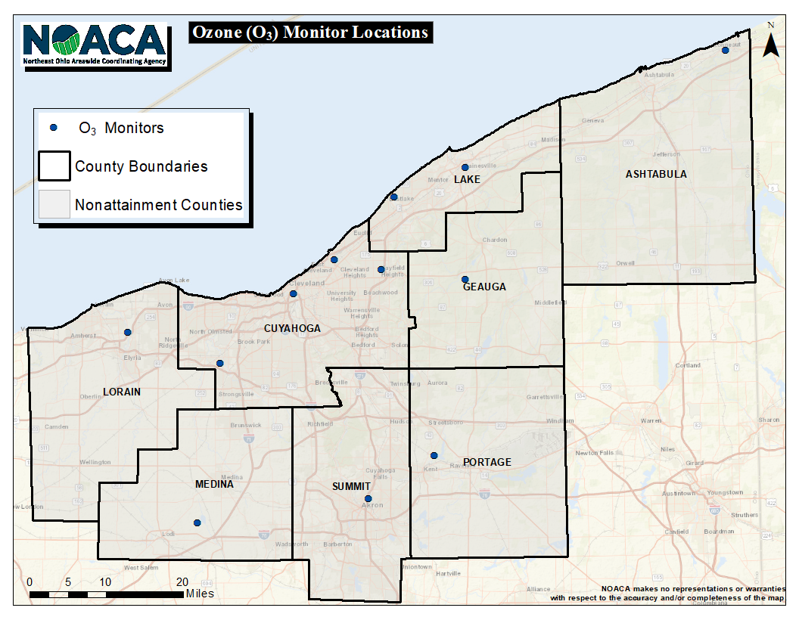
Notes:
Ohio EPA internally changed the name of Elyria monitoring station to "Sheffield" as of 7.24.2018

Slide 15
NORTHEAST OHIO PM_{2.5} MONITORS

Slide 16
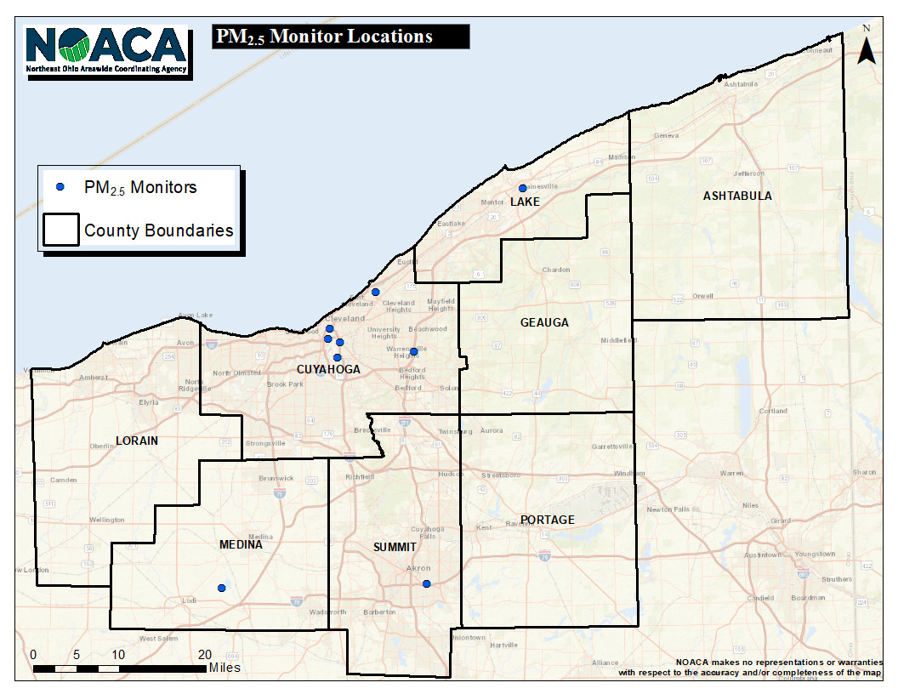
Notes:
Ohio EPA internally changed the name of Elyria monitoring station to "Sheffield" as of 7.24.2018

Slide 17
NOAA FORECAST ANALYSIS

Slide 18
AIR QUALITY FORECASTS IN NORTHEAST OHIO
NOACA forecasts daily peak fine particulate matter concentrations eight-hour ground-level ozone concentrations.
Daily forecasts for fine particulate matter are year-round
In 2024, daily forecasts for ozone began March 1 and will conclude October 31
NOACA posts daily air quality forecasts through AirNowTech, in affiliation with the United States Environmental Protection Agency (U.S. EPA)

Slide 19
O₃ AND PM_{2.5} ANALYSIS METHODOLOGY
Analyzed O₃ and PM_{2.5} monitoring locations
Technical support from NOAA and Division of Air Pollution Control within Tennessee Department of Environment and Conservation
Staff previously collected NOAA forecast data manually
Technical support helped staff develop scripts that automatically retrieve NOAA’s daily forecast data
Retrieved archived forecast data from the National Centers for Environmental Information (NCEI)
Collected daily Ohio EPA observation data
Compared and analyzed forecast versus observation data

Slide 20
PM_{2.5} MONITOR CHALLENGES
Duplicate data for multiple sites
Number of significant figures in latitude/longitude coordinates affects results

Slide 21
2024 MODEL PERFORMANCE

Slide 22
NOACA AND NOAA 2024 FORECAST PERFORMANCE: O₃
FORECAST |  | THRESHOLD
 |  | 50ppb | 70ppb
AGENCY | NOACA | 81% | 93%
 | NOAA 6Z (M/B) NOAA 12Z (M/B) | (77/76)% (78/77)% | (94/93)% (93/93)%
M = Model; B = Bias-Corrected Model

Slide 23
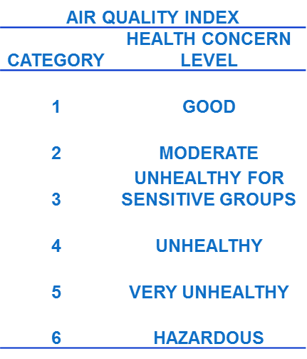
EXCEEDANCE DAYS FOR 2024 (O₃)
 | FORECAST AQI |  | OBSERVED AQI
DATE | NOAA 6Z(M/B)/ 12Z(M/B) | NOACA | PEAK (ppb) | # STATIONS
MAY 20 | 2/2/2/2 | 3 | 3 (81) | 3
MAY 21 | 2/2/2/2 | 3 | 3 (73) | 2
MAY 24 | 2/3/2/3 | 2 | 3 (72) | 2
JUNE 19 | 3/2/3/2 | 2 | 3 (71) | 1
JUNE 20 | 2/2/3/2 | 2 | 3 (74) | 2
JUNE 21 | 2/2/2/2 | 2 | 3 (73) | 2
JUNE 22 | 2/2/2/2 | 2 | 3 (73) | 2
JULY 31 | 2/1/2/1 | 2 | 3 (71) | 1
AUGUST 24 | 2/2/2/2 | 2 | 3 (77) | 2
M = Model; B = Bias-Corrected Model
Notes:
GREEN – Both NOACA and NOAA correct
BLACK – One agency correct (either NOACA or NOAA)
RED – Both NOACA and NOAA incorrect

Slide 24
NOAA VERSUS NOACA EXCEEDANCE FORECAST PERFORMANCE: O₃
“Missed Opportunities” – Seven (7) days NOACA did not forecast observed categorical exceedance of 2015 eight-hour ozone standard (70 ppb); NOAA missed opportunities eight (8) days with 6Z M/B; seven (7) days with 12Z M; and eight (8) days with 12Z B.
“False Alarms” – Eight (8) days NOACA forecast categorical exceedance of 2015 eight-hour standard (70 ppb) when observed concentrations did not exceed. NOAA had false alarms four (4) days with 6Z M; seven (7) days with 6Z B; and six (6) days with 12Z M/B.
M = Model; B = Bias-Corrected Model

Slide 25
EXCEEDANCE STATIONS
39 exceedance stations (events when either the forecast, the observation, or both exceeded the 2015 O₃ NAAQS at individual monitors).
“Missed Opportunities” – Both the M and B Models missed observed exceedance at a station 15 times (39%).
“False Alarms” – At least one model falsely predicted exceedance at a station 22 times (56%)
“Success” – Both M and B models predicted exceedance at a station two (2) times (5%)
M = Model; B = Bias-Corrected Model

Slide 26
EXCEEDANCE STATIONS
 | SUCCESSFUL PREDICTIONS
YEAR | SUCCESS | TOTAL | %
2020 | 5 | 39 | 12.8%
2021 | 2 | 20 | 10.0%
2022 | 4 | 37 | 10.8%
2023 | 11 | 65 | 16.9%
2024 | 2 | 39 | 5.1%
M = Model; B = Bias-Corrected Model

Slide 27
NOACA AND NOAA 2024 FORECAST PERFORMANCE: PM_{2.5}
FORECAST |  | THRESHOLD
 |  | 12 µg/m³ | 35 µg/m³
AGENCY | NOACA | 68% | 100%
 | NOAA 6Z (M/B) NOAA 12Z (M/B) | (75/72)% (75/74)% | (100/100)% (100/100)%
M = Model; B = Bias-Corrected Model

Slide 28
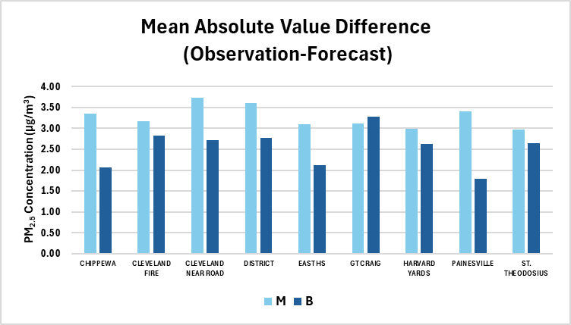
PM_{2.5} MONITOR PERFORMANCE
M = Model; B = Bias-Corrected Model

Slide 29
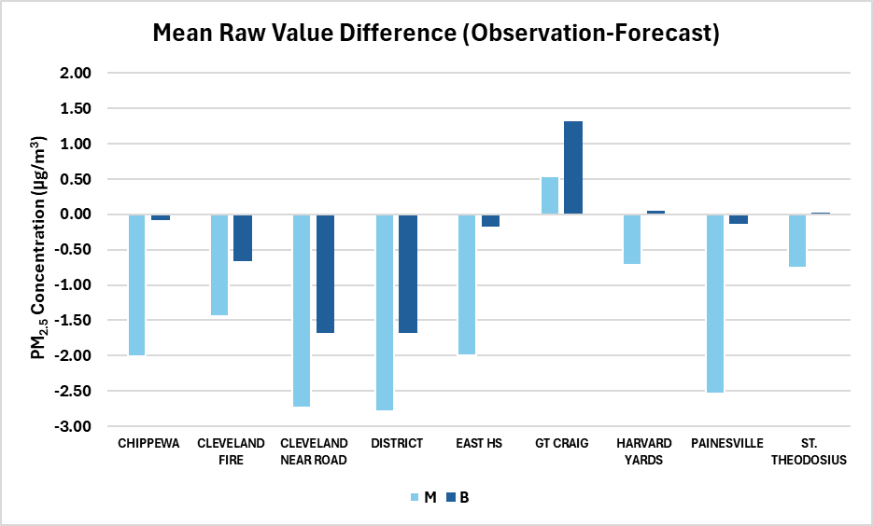
PM_{2.5} MONITOR PERFORMANCE
M = Model; B = Bias-Corrected Model

Slide 30
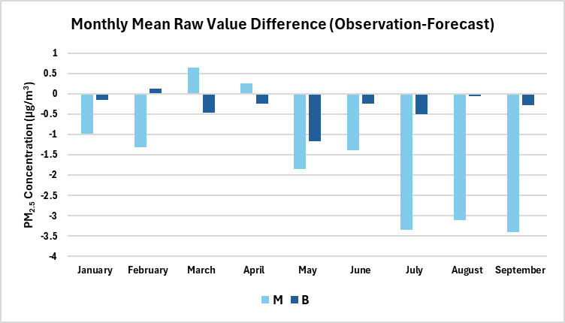
PM_{2.5} MONITOR PERFORMANCE
M = Model; B = Bias-Corrected Model

Slide 31
CONCLUSION
NOAA models did not forecast ozone concentrations around the exceedance threshold quite as well this season
Numerous, isolated, low-level exceedance events
Low accuracy of exceedance prediction at individual stations (5%)
NOAA’s PM_{2.5} bias-corrected model (B) produced more accurate forecasts than the raw model (M)
NOAA’s PM_{2.5} model forecast concentrations were generally higher than the observed concentrations
NOAA’s PM_{2.5} model forecast concentrations were substantially higher than observed concentrations during the warmer months (May-September)

Slide 32
ACKNOWLEDGEMENTS
Dave Miller, Research Associate, Programmer
Jack Kain, Senior Technical Program Manager
Youngsun Jung, Program Manager
Kyle Spangle, Environmental Consultant within the Division of Air Pollution Control

Slide 33
QUESTIONS?

