Slide 1
CMAQ bias-correction for AQM v7.0.7 data NOAA/PSL
Jim Wilczak, Irina Djalalova, Dave Allured
October 7, 2024

Slide 2
Humidity as a new predictor for ozone
AQMv7 bias correction currently uses 7 predictors:
Ozone, Hpbl, Dswrf, Temp2m, Wdir10, Wspd10, Nox;
Tested new predictor, 2m Relative Humidity (RH), at the 1484 AirNOW site locations;
The following slides show a consistent skill improvement in the 2022 - 2024 time frame, both annually and seasonally;
The largest improvement is in regions with higher humidity;
RH as a predictor for PM_{2.5} does not show a consistent improvement.

Slide 3
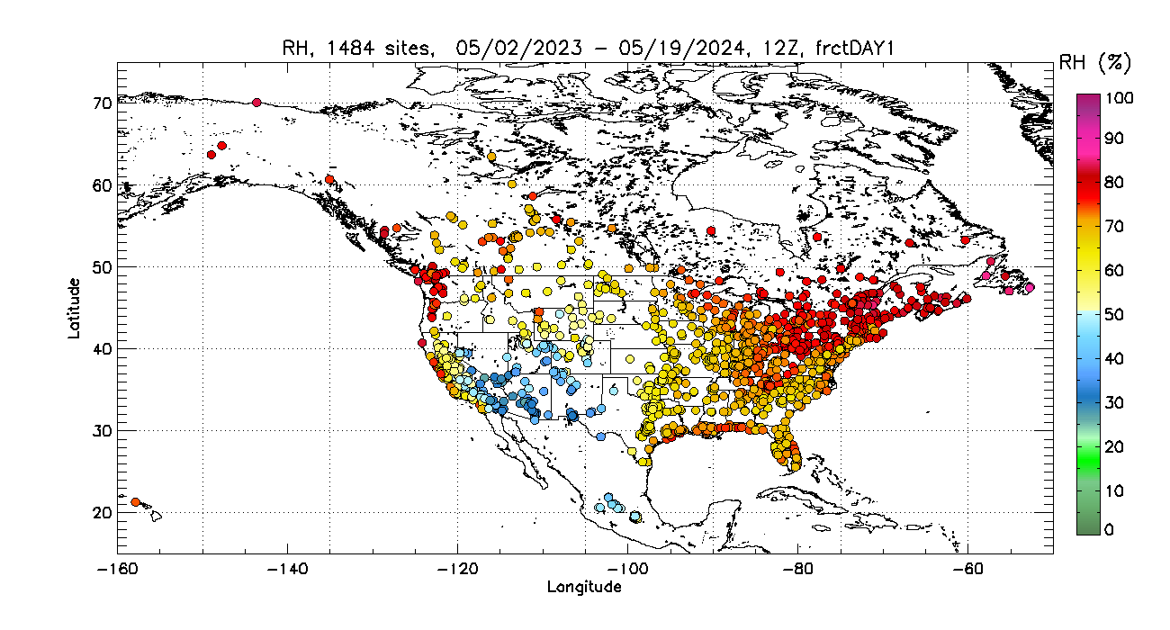
Annual mean RH

Slide 4
Annual mean Ozone

Slide 5
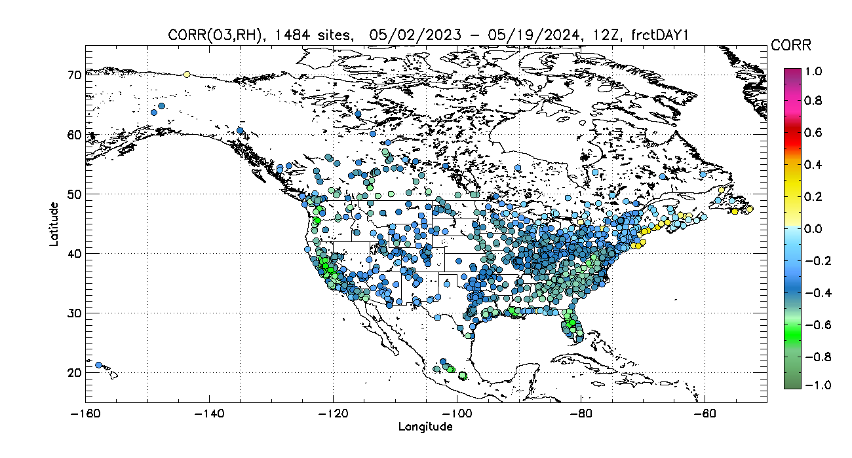
Ozone vs RH correlation coefficients:
strongly anti-correlated

Slide 6
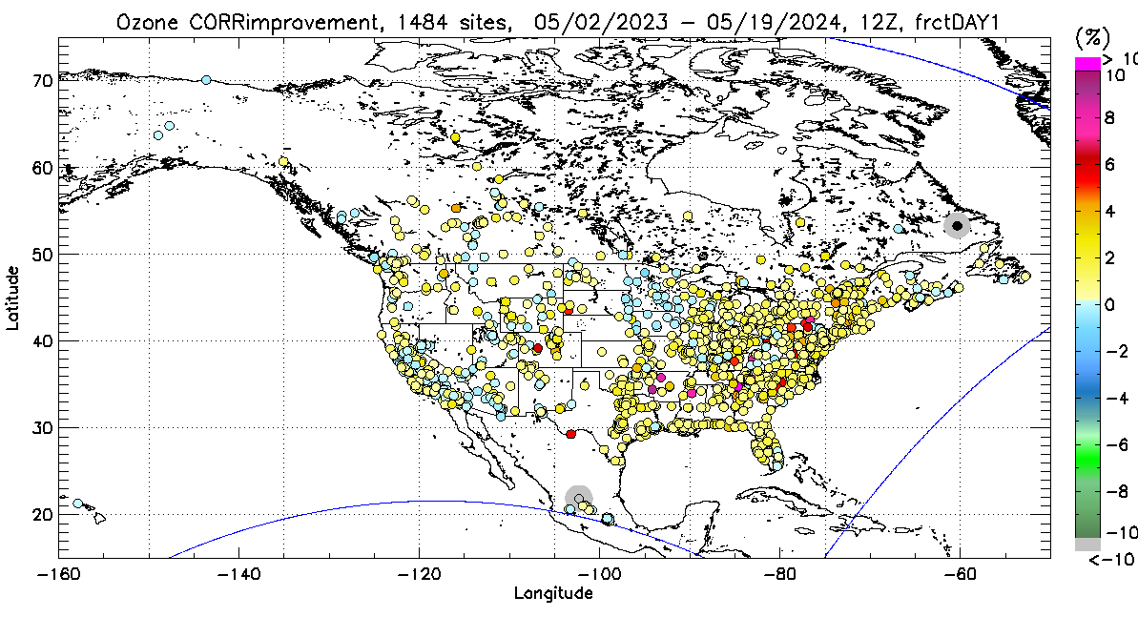
Annual Improvements in %
RH (8 predictors) vs no RH (7 predictors)
frct day 1
RMSE improvement
1.5%
Operational predictor set
plus RH,
equal predictor weights
Correlation improvement
0.9%

Slide 7
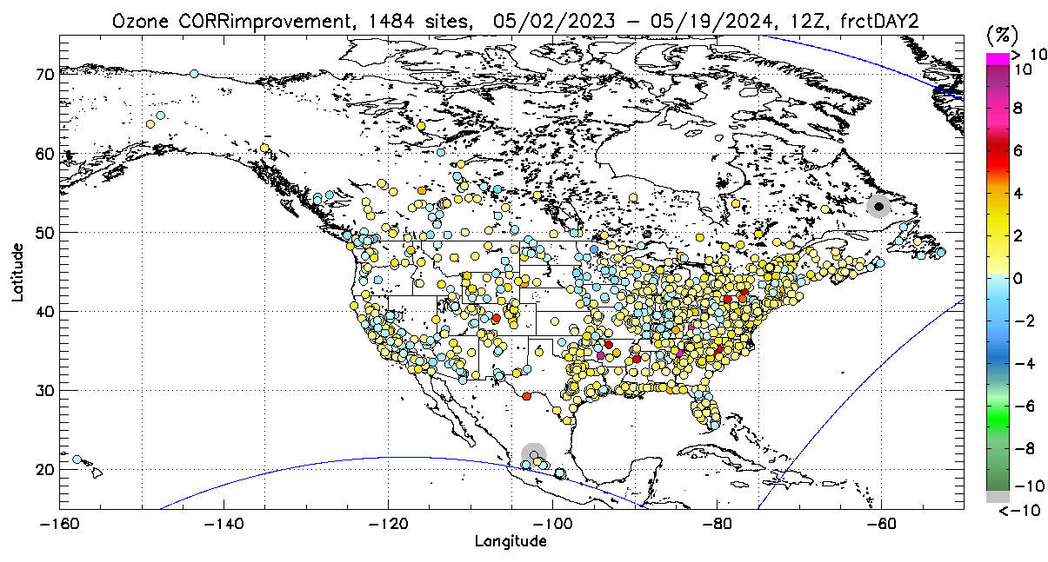
Annual Improvements frct day 2 in %
RMSE improvement
1%
Correlation improvement
0.7%

Slide 8
Annual
Improvements frct day 3 in %
RMSE improvement
0.7%
Correlation improvement
0.5%

Slide 9
Mean RH for 80 days in spring, 2024

Slide 10
Spring, 2024 RMSE improvement
2.1%

Slide 11
6 seasons test
Winter 2022-2023, 22DJF
Spring 2023, 23MAM
Summer 2023, 23JJA
Fall 2023, 23SON
Winter 2023-2024, 23DJF
Spring 2024, 24MAM
Evaluation Period
Month 1 | Month 2 | Month 3

Slide 12
OZONE, 15 days evaluation period

Slide 13
Spring, 2023
Ozone vs RH
correlation
coefficients

Slide 14
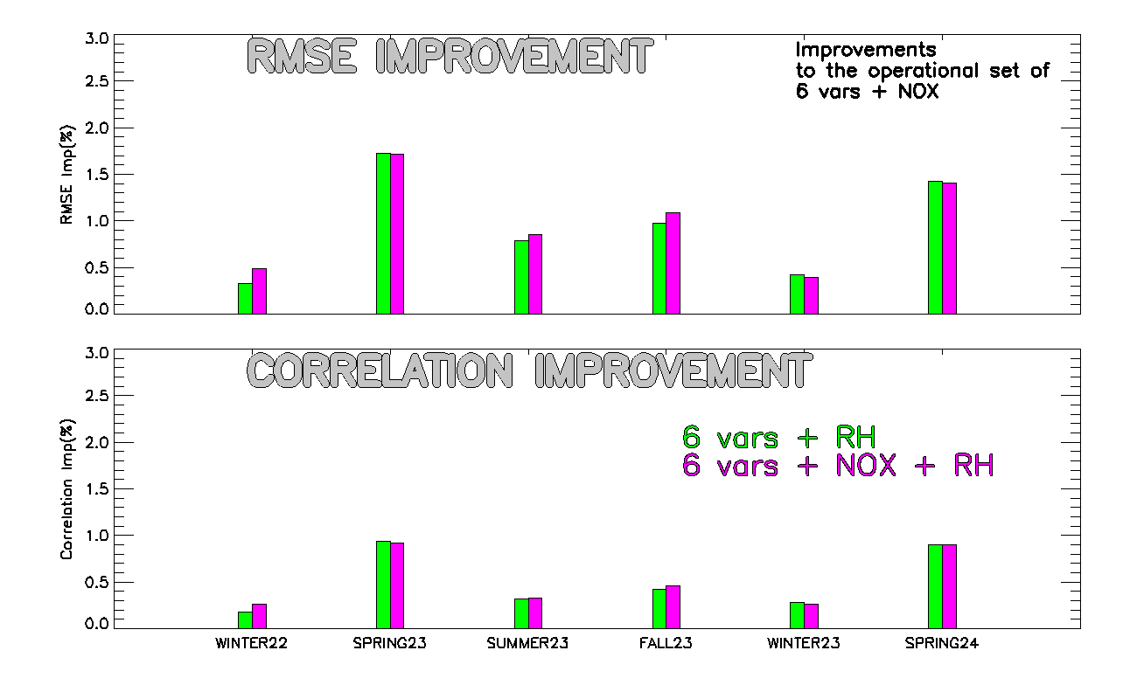
OZONE, 90 days evaluation period

Slide 15
PM_{2.5}

Slide 16
Conclusions
Ozone and RH are negatively correlated, both spatially and temporally;
Using RH as a new predictor for ozone bias-correction gives ~2% RMSE and ~1% correlation improvements;
Improvements vary by season, showing the highest improvement in spring;
The improvements are the largest over the eastern US;
Improvement of PM_{2.5} forecast skill by including RH as a predictor is smaller and less consistent.
Further tests are being run using water vapor deficit as the analog search variable instead of RH.

