Slide 1
Update of the AQM operational forecast systems for the National Air Quality Forecasting Capability
Jianping Huang (NOAA/NWS/NCEP/EMC)
Fanglin Yang, Jeffrey McQueen, Cory Martin, Raffaele Montuoro (NWS/NCEP/EMC), Kai Wang, Ho-Chun Huang, Brian Curtis, Anna Smoot
Hyundeok Choi, Haixia Liu (EMC, Lynker),
Barry Baker (OAR/ARL), Youhua Tang, Patrick Campbell(ARL, GMU). Daniel Tong (GMU)
Georg Grell (OAR/GSL)
Hongli Wang, Ruifang Li (GSL, CIRES)
2024 AQ Forecaster Focus Group Workshop
James Wilczak (OAR/PSL)
Irina Djalalova, Dave Allured (PSL, CIRES)
Shobha Kondragunta (NESDIS/STAR)
Chuanyu Xu, Zigang Wei (IMSG, NESDIS/STAR)
Fangjun Li and Xiaoyang Zhang (SDSU)
Jack Kain, Youngsun Jung (STI)
College Park, MD, October 10, 2024

Slide 2
Outline
AQM v7.0.7 Implementation (May 14, 2024)
Major Changes
Model Configurations
Performance Highlights
AQM v7.0.8 Implementation (October 1, 2024)
Major Changes
Performance Highlights
AQM v8.0 Development (Planed for Q1 2026)
Major Changes Proposed
Preliminary Results
Future Plans

Slide 3
Major Changes for AQM v7.0.7
Transition operational AQM from the GFS-CMAQ offline-coupled system to a UFS-based online-coupled atmosphere-air quality system, UFS-AQM.
Replace individual model domains for CONUS, Alaska, and Hawaii with a single unified domain at 13-km horizontal resolution.
Increase the model’s vertical levels from 35 to 65 and extending the model’s top from 60 hPa to 0.2 hPa.
Replace daily Blended Global Biomass Burning Emissions Product (GBBEPx) inputs with hourly Regional ABI and VIIRS fire Emissions (RAVE) data at higher horizontal resolution (0.03 degrees) to improve diurnal variation, intensity, and vertical distribution of wildfire emissions.
Replace the Biogenic Emissions Inventory System (BEIS) with aerosol and gaseous emissions estimated using the Model of Emissions of Gases and Aerosols from Nature (MEGAN).
Apply the Kalman Filter Analog (KFAN) bias correction technique over the large unified domain to improve near-surface ozone (O₃) and fine particulate matter (PM_{2.5}) predictions.

Slide 4
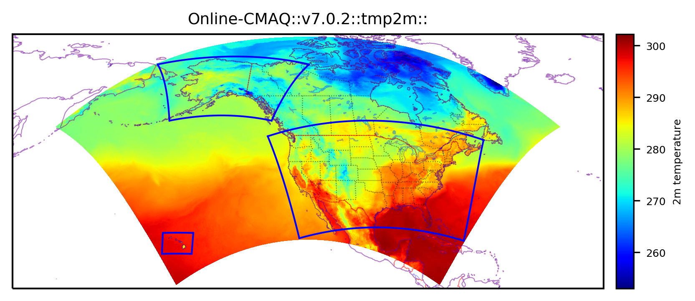
Model Configurations for the AQMv7.0.7 Implementation
Atmos. & air quality models | UFS-Atmos + CMAQv5.2 Online-coupling
Gas mechanism & aerosol model | CB6r3 + Aero6
Grid_spacing & vertical levels | 13 km & 65 levels (topped at 0.2 hpa)
Anthropogenic emissions | NEI 2016v1 for CONUS + EDGAR-for-HTAPv2, CEDSv2 & OMI-HTAP for O-CONUS
Fire emissions | RAVE v1 (hourly, 0.03 deg) + Sofiev plumerise algorithm, linearly-distributed, VOCs off
Biogenic & dust emissions | MEGANv2 & Fengsha
Dynamics & physics | FV3 & CCPP GFSv16 suite
Chem-LBCs | AM4 for gases + GEFS for aerosols
AK
CONUS
HI
Huang et al. (BAMS in review)
A single large North American domain covers three operational product domains (i.e., CONUS, AK and HI)
NOAA’s UFS-AQM based AQMv7.0.7 was implemented on May 14, 2024

Slide 5
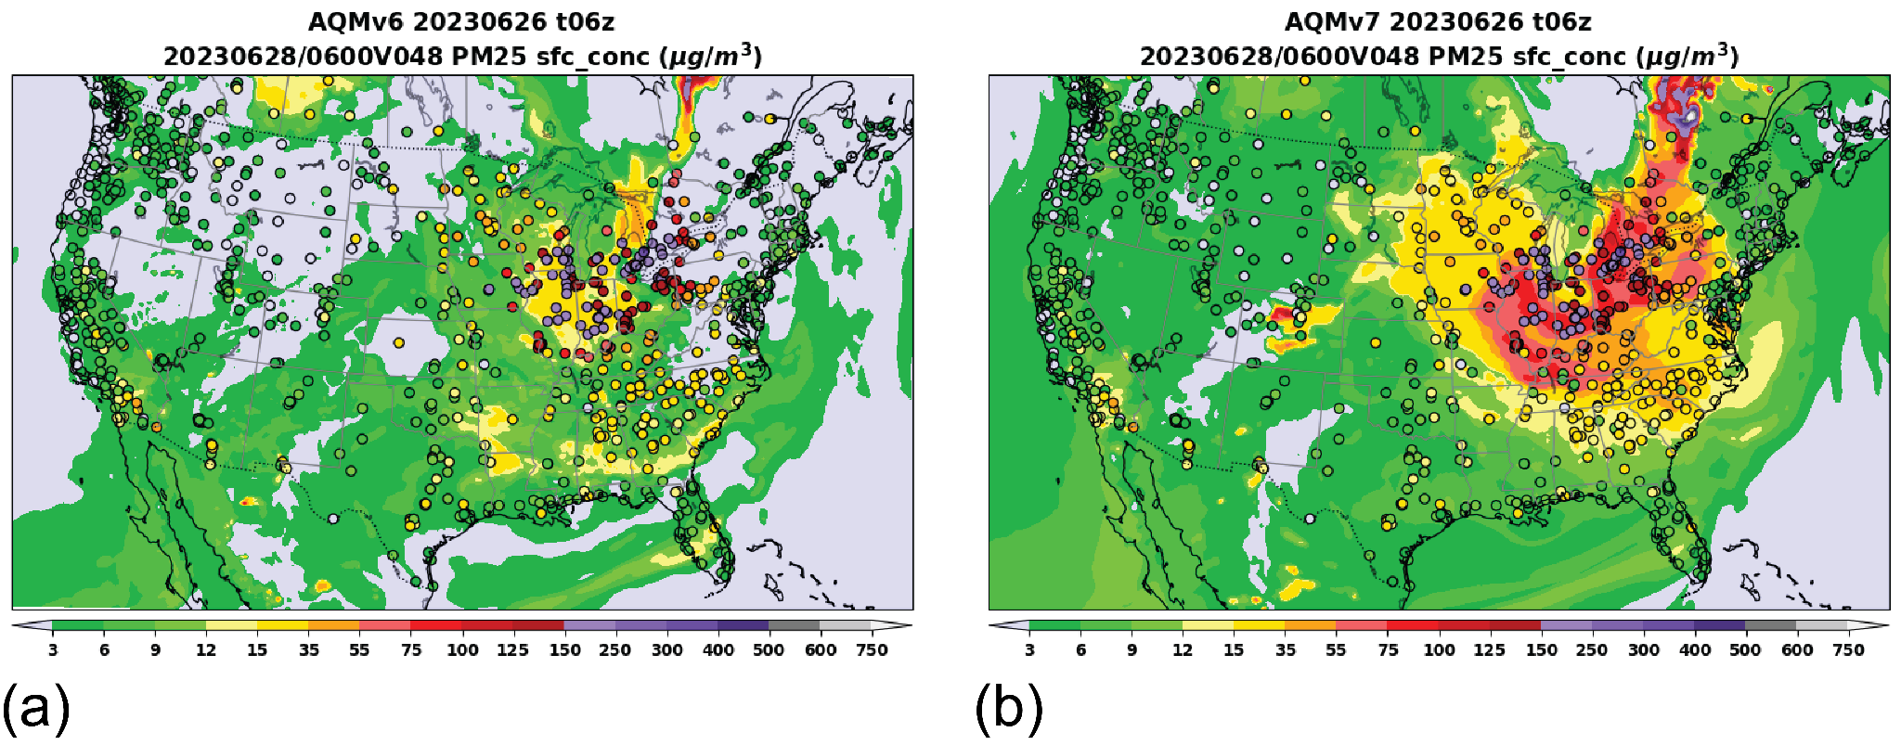
AQMv6 (GBBEPx) vs. AQMv7.0.7 (RAVE v1): PM_{2.5} Predictions
Huang et al. (BAMS submission, 2024)

Slide 6
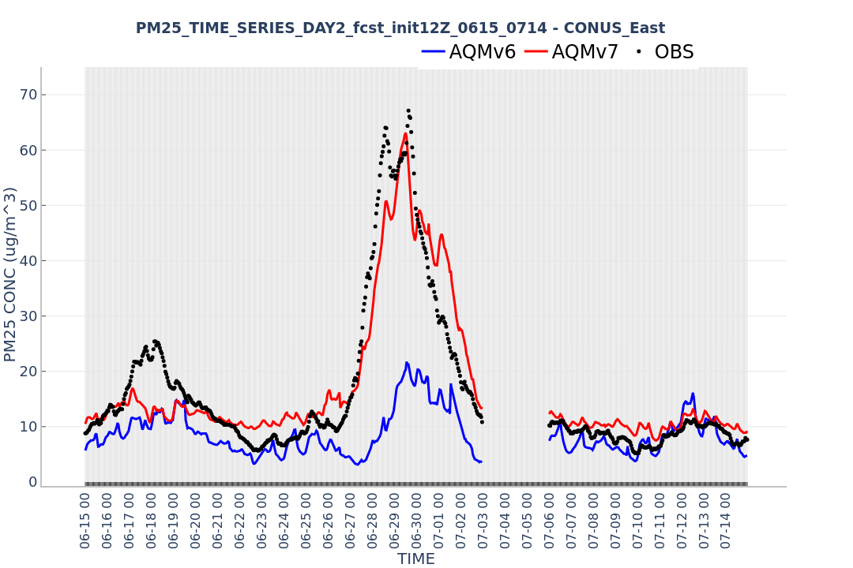
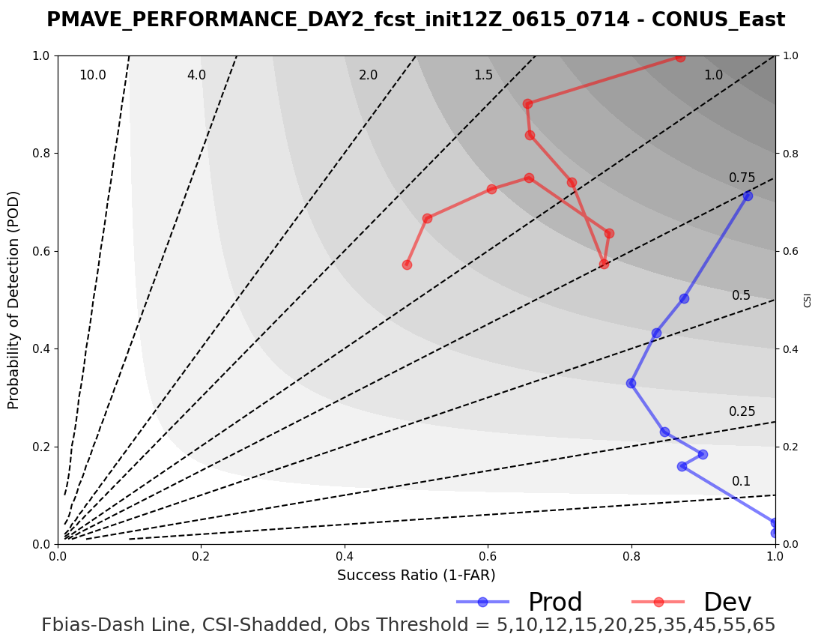
AQMv7 Improves PM_{2.5} during Quebec Fire 2023

Slide 7
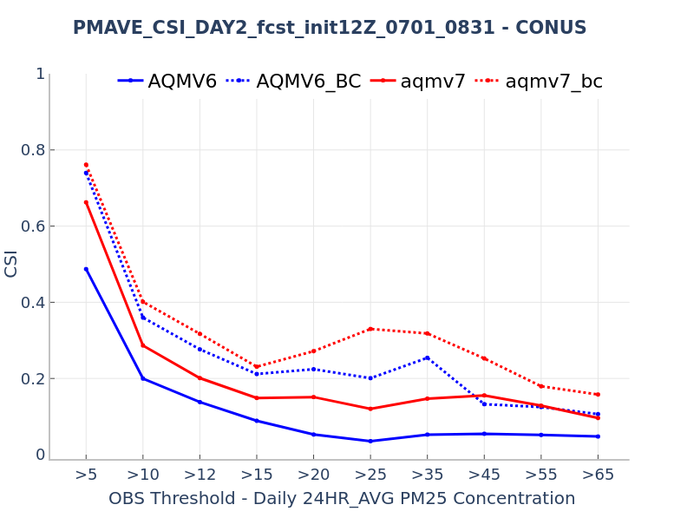
AQMv7.0.7 Improves 24-hr ave. PM_{2.5} in Summer
AQMv7 demonstrates higher CSI values for 24-hr ave. PM_{2.5} for both the raw model and bias-corrected (BC) products (dashed) than AQMv6.
AQMv7 exhibits enhanced predictive capabilities for PM_{2.5} exceedance events (≥35 ug/m³).

Slide 8
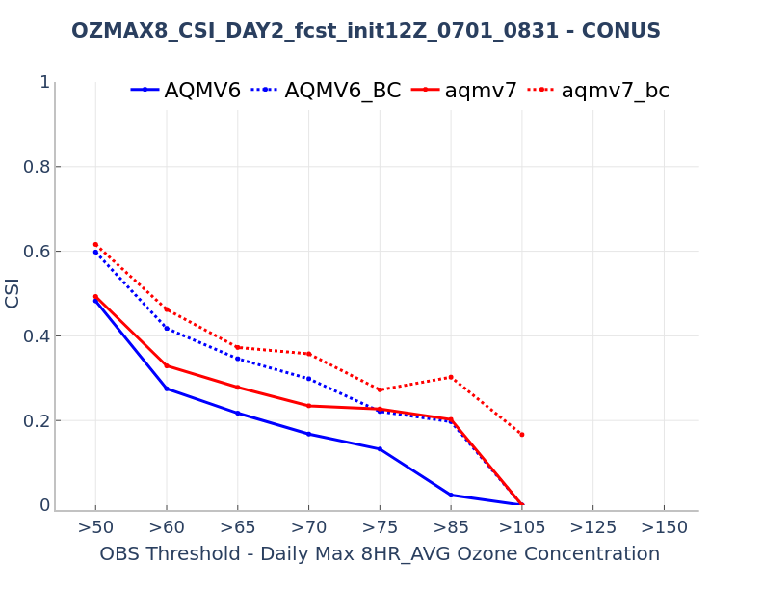
AQMv7.0.7 Improves O₃ Exceedance Predictions in Summer
AQMv7 demonstrates higher Critical Success Index (CSI) values for daily max. 8-hour ave. O₃ for both the raw model (solid) and bias-corrected (BC) products (dashed) than AQMv6.
AQMv7 exhibits enhanced predictive capabilities for O₃ exceedance events (≥70 ppb).
better

Slide 9
Upgrade of the AQM Operational System: v7.0.8
Major Changes:
Update the Regional hourly Advanced Baseline Imager (ABI) and Visible Infrared Imaging Radiometer Suite (VIIRS) Emissions (RAVE) input datasets from version 1.3 to version 2.0, which use observations from NOAA's latest generation of U.S. polar-orbiting satellites (NOAA-21).
Update the list of AirNow's observational surface sites for ozone (O₃) and fine particulate matter (PM_{2.5}) to improve bias-corrected products.
Mitigate overprediction of fugitive dust.
Increase accuracy of predicted dry deposition velocities for small gravitational settling and aerodynamic resistance values.
Implement bug fixes and other code improvements.
Implemented: Oct. 1, 2024

Slide 10
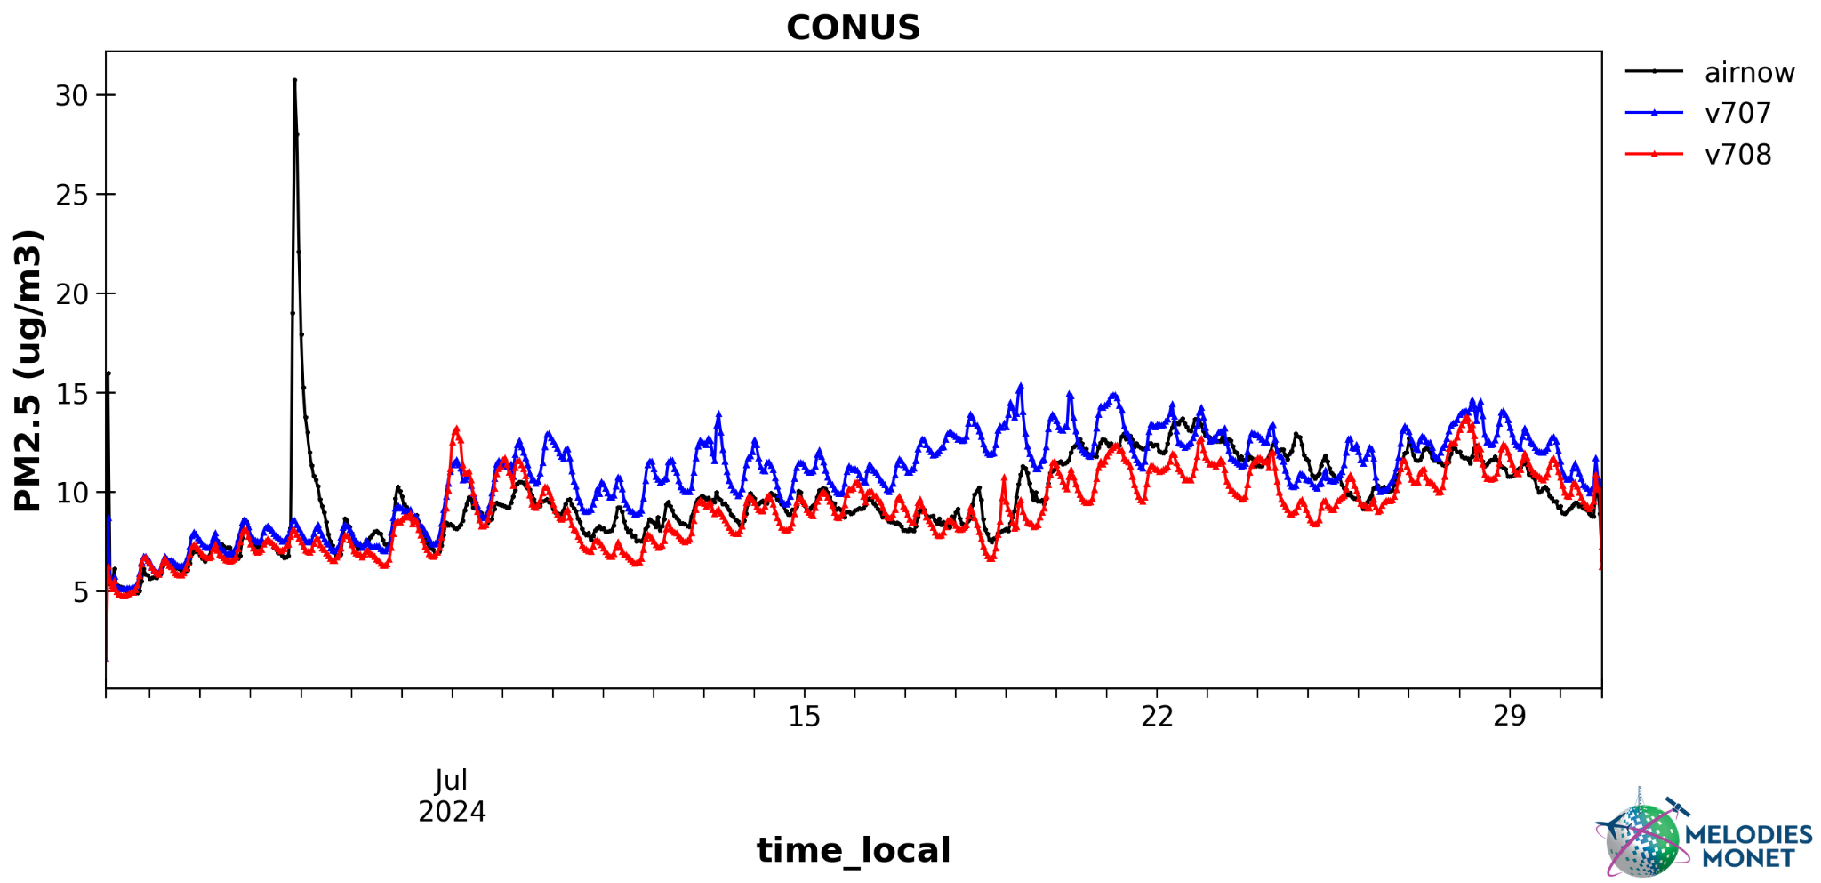
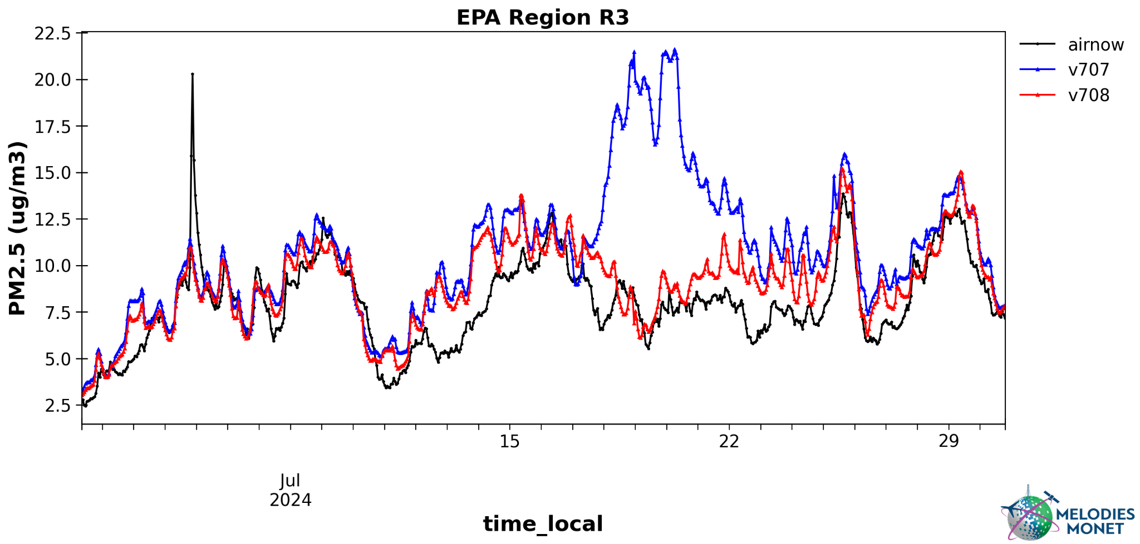
AQMv7.0.8 Improves PM_{2.5} Predictions in July 2024

Slide 11
Proposed Changes for AQM v8.0
Increase model grid-spacing resolution from 13-km to 9-km.
Update the Finite-Volume Cubed-Sphere (FV3) dynamical core based UFS-Atmosphere model.
Upgrade the Common Community Physics Package (CCPP) to align with the version used in the Global Forecast System (GFS) v17.
Upgrade CMAQ from version 5.2.1 to version 5.4.
Update the National Emission Inventory (NEI) from 2016 to 2019.
Refine fire emission representations and activate Volatile Organic Compound (VOC) emissions from wildfires.
Implement a short training period for PM_{2.5} bias correction during intense wildfire events.
The implementation is planned for December 2025.

Slide 12
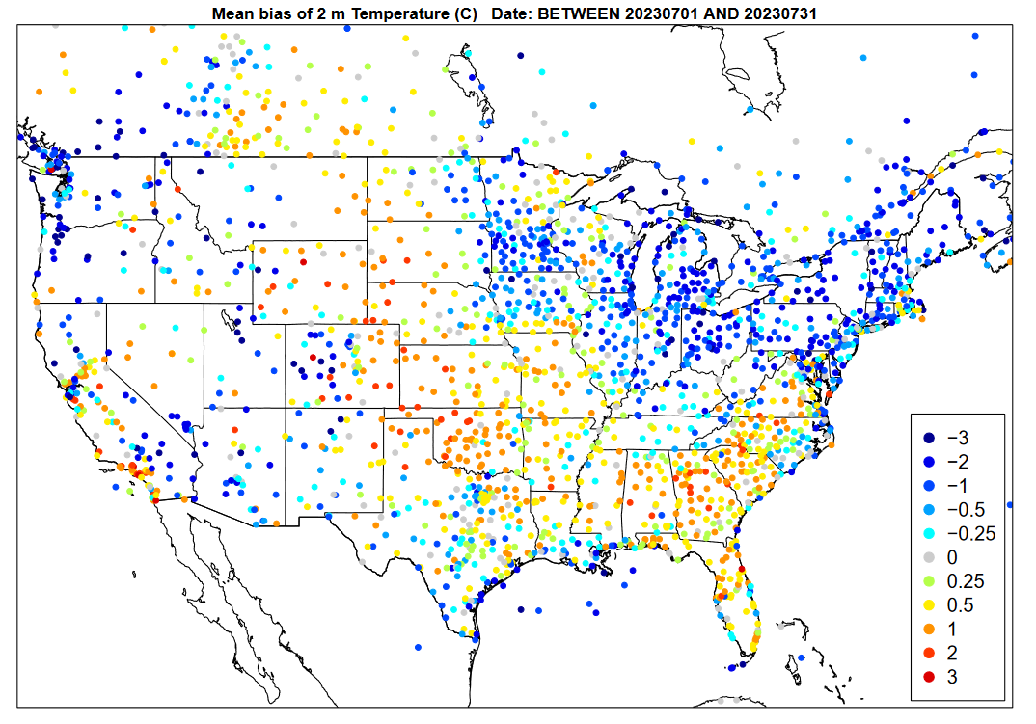
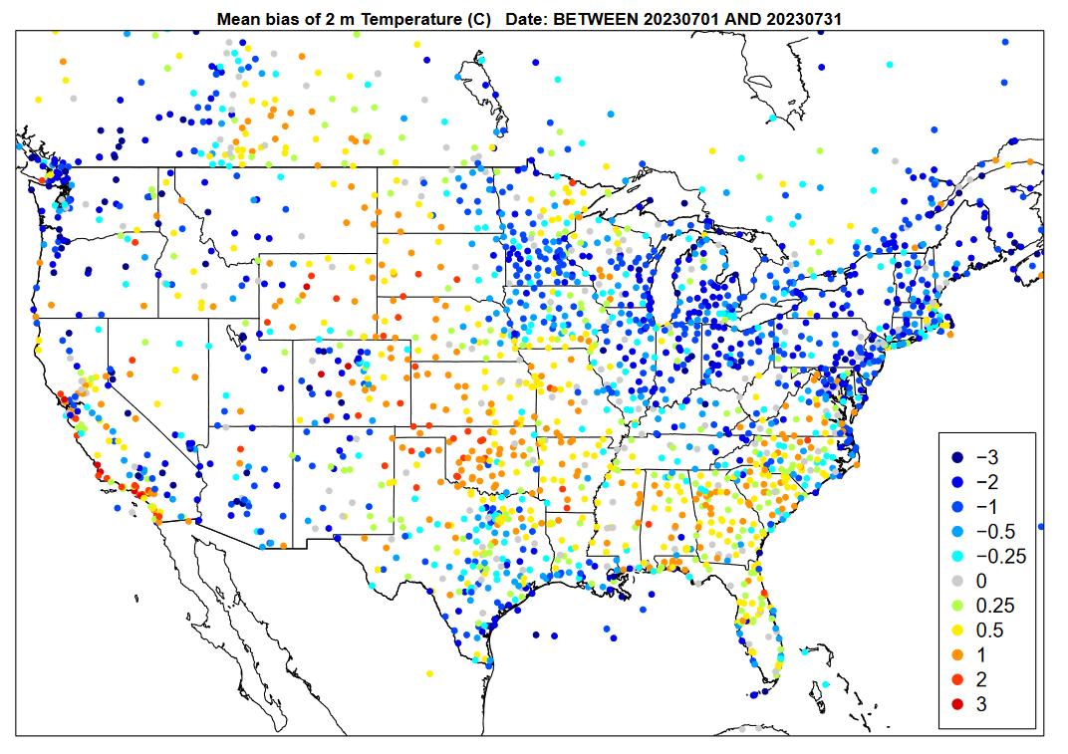
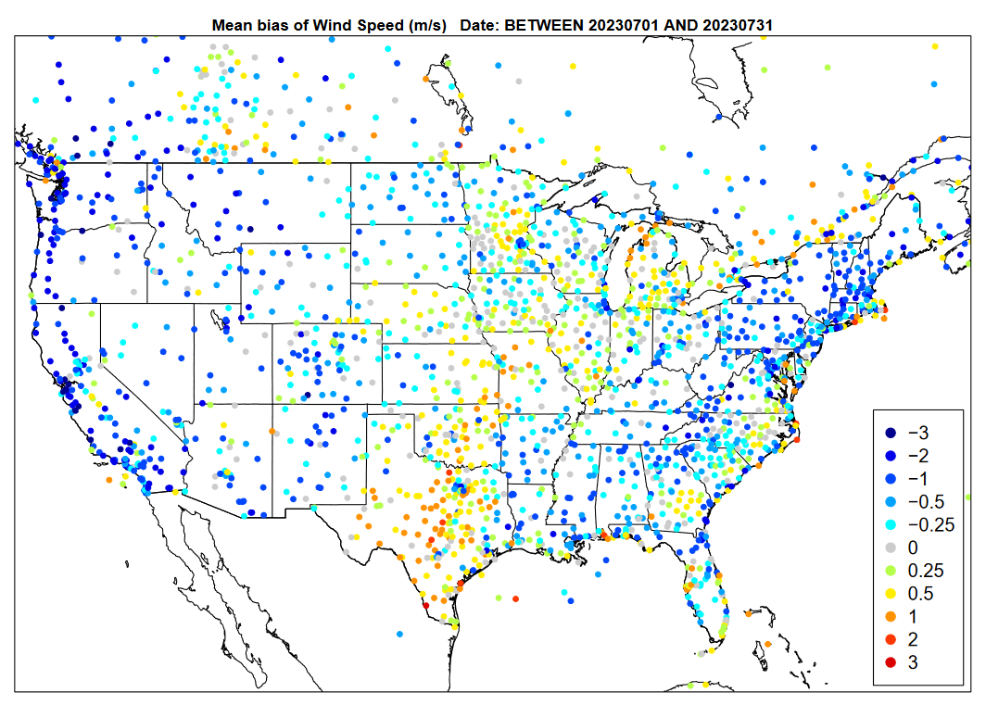
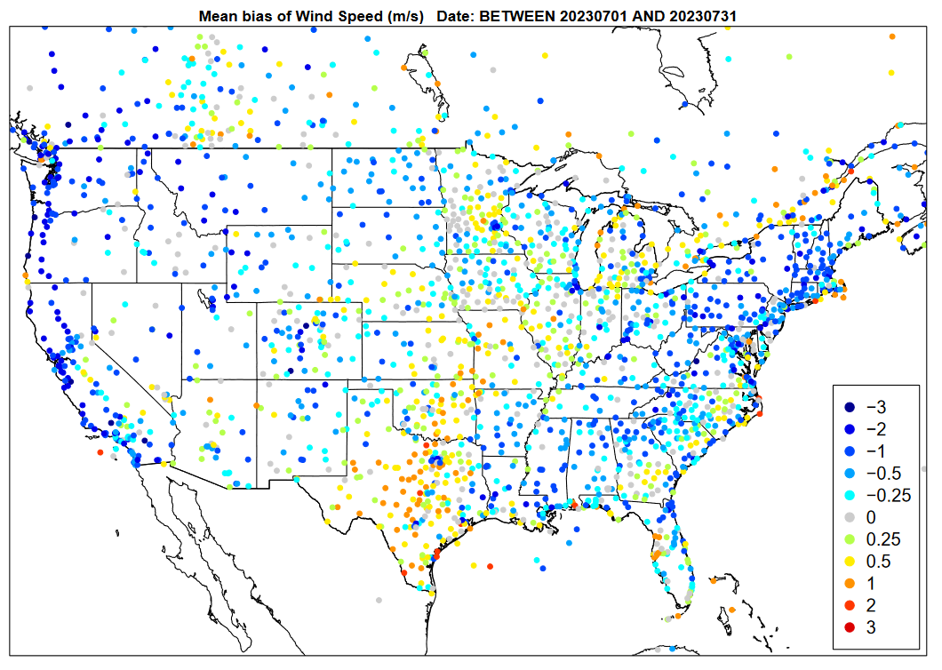
T2
T2
Bias
-0.03%
Bias
-0.04%
WS10
AQM v7
WS10
AQM v8
Bias
-11.2%
Bias
-8.3%

Slide 13
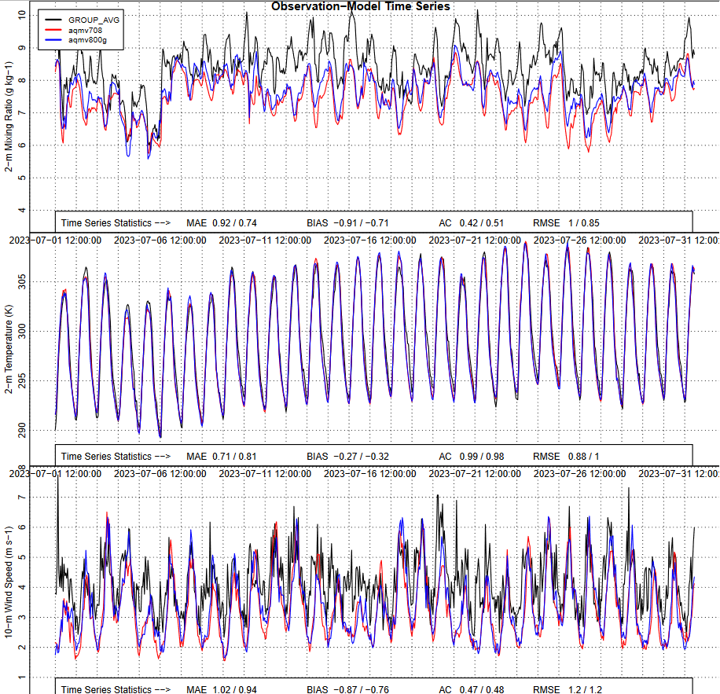
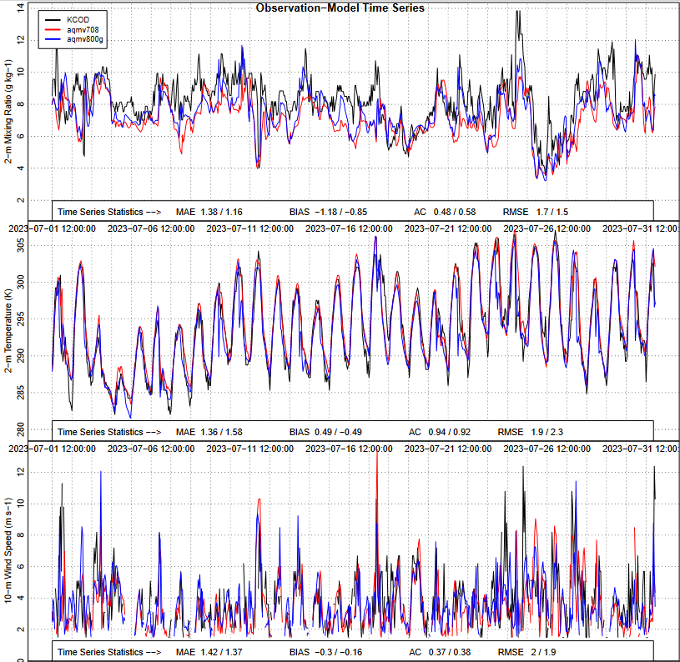
Q2
Western US
Cody, Wyoming (KCOD)
T2
W10

Slide 14
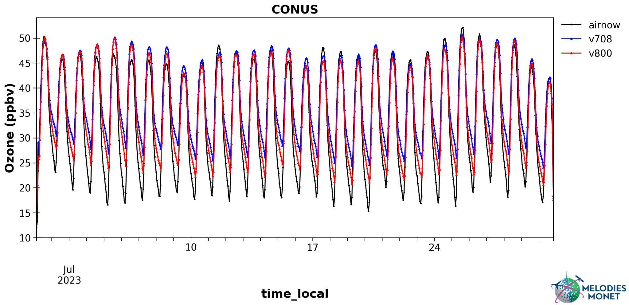
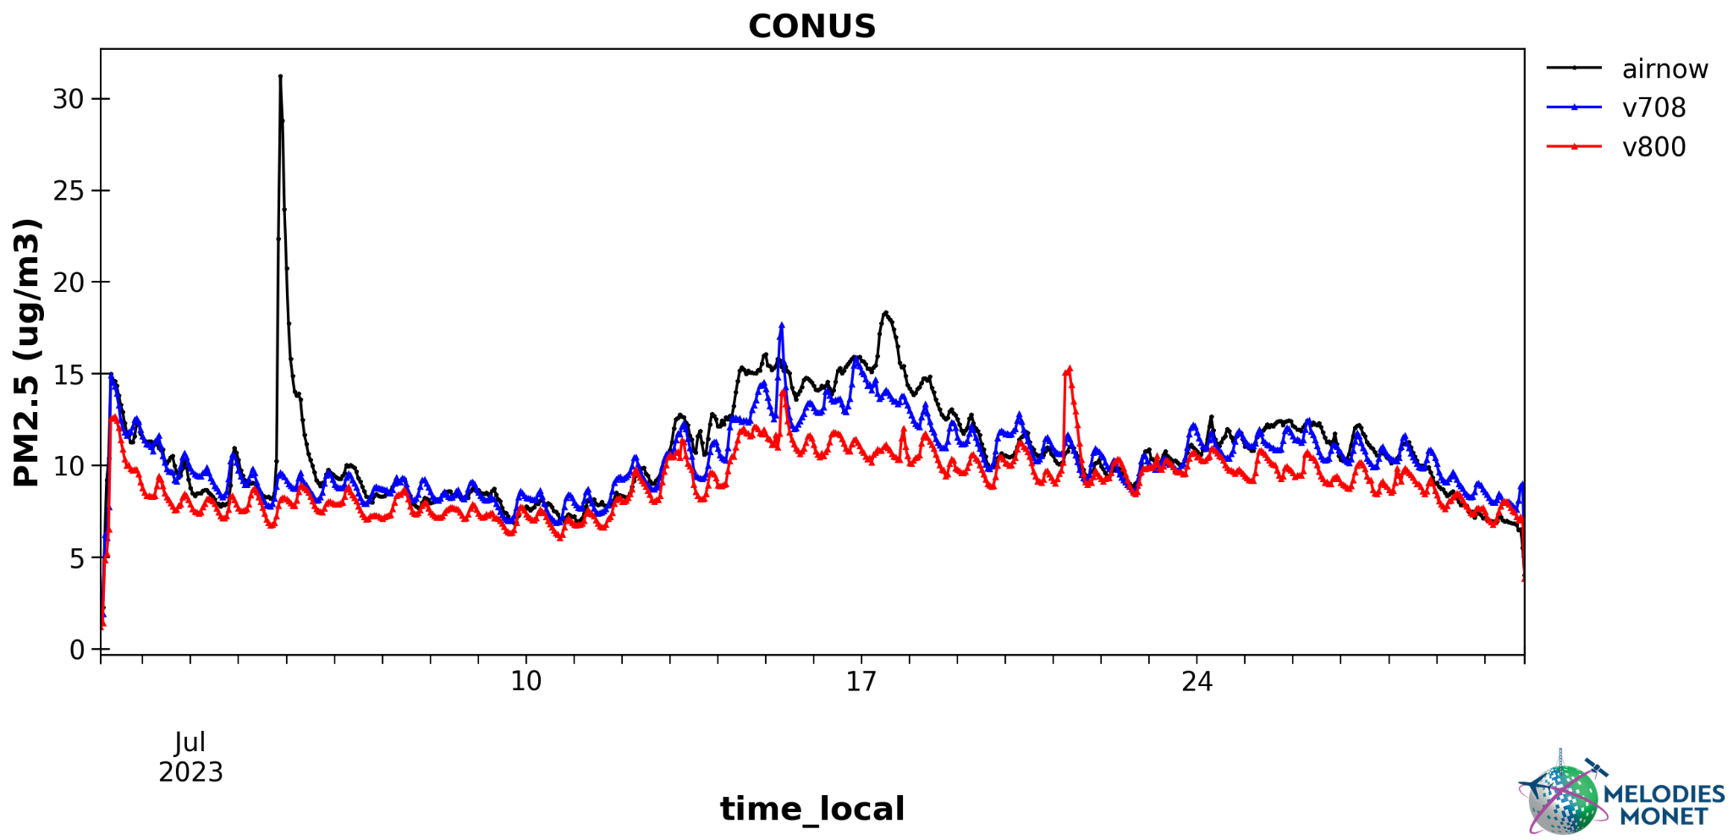
v8.0 improves O₃ predictions (e.g., nighttime)
v8.0: dust module requires refinement

Slide 15
Summary
The UFS based online-coupled AQMv7.0.7 was successfully implemented on May 14, 2024, showing substantial improvements in performance during intense wildfires and O₃ exceedance events.
An updated version (AQMv7.0.8) was implemented along with code bug fixes to support the upgrade of RAVE v2 fire emission products on Oct. 1, 2024.
Development of AQM v8.0 is underway by refining model grid-spacing, upgrading CMAQ, the UFS-Atmosphere model, and the National Emission Inventory, with implementation planned for Q1 FY 2026 with a possible delay.

Slide 16
Future Plans
Incorporate data assimilation (i.e., JEDI) to constrain chemical initial conditions.
Use Tropospheric Monitoring Instrument (TROPOMI) and Tropospheric Emissions: Monitoring of Pollution (TEMPO) retrieval data to constrain ICs of NO₂, O₃, and other chemical species
Use AirNow surface PM_{2.5}/O₃ and satellite-retrieved AOD to constrain ICs of PM_{2.5}/O₃
Switch to the MPAS dynamic core.
Employ higher resolution (e.g., 3-km) or nested domain for CONUS.
Develop an AI/ML based forecast model for AQM.

Slide 17
A flowchart of the UFS-AQM online system (AQMv7.0)
WildFire
Emission
(RAVE)
GEFS/Aero +
Chem. Climat. LBCs
Anthrop.
Emission
UFS-AQM
Coupled forecast model
NEXUS
(NOAA Emission and Exchange Unified System)
CMAQ
(gas-chem. and aerosols)
FV3 Atmos.
(transport/physics)
ICs and BCs
Met fields
Biogenic Emission
UFS_Utils
UPP & Post
(PM_{2.5})
Bias Correction
New parallel emissions preprocessing system
GFS outputs
Products
(CS, AK,HI)
Verification
Notes:
RAVE: Regional ABL and VIIRS fire emissions

Slide 18
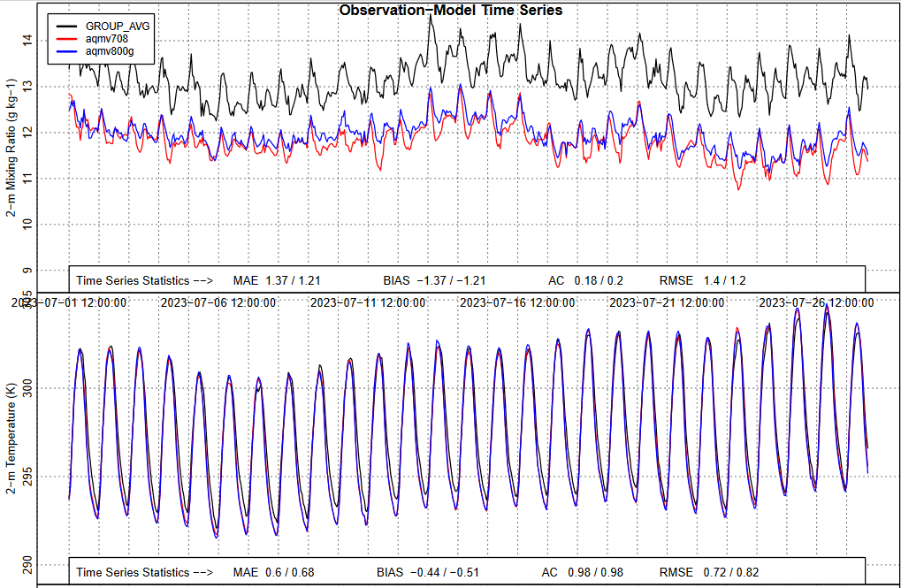
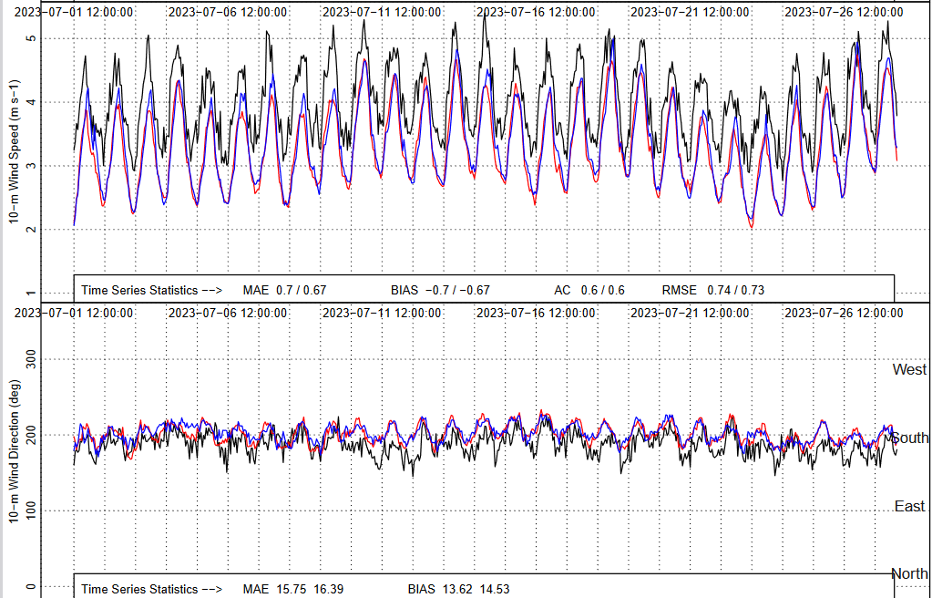

Slide 19
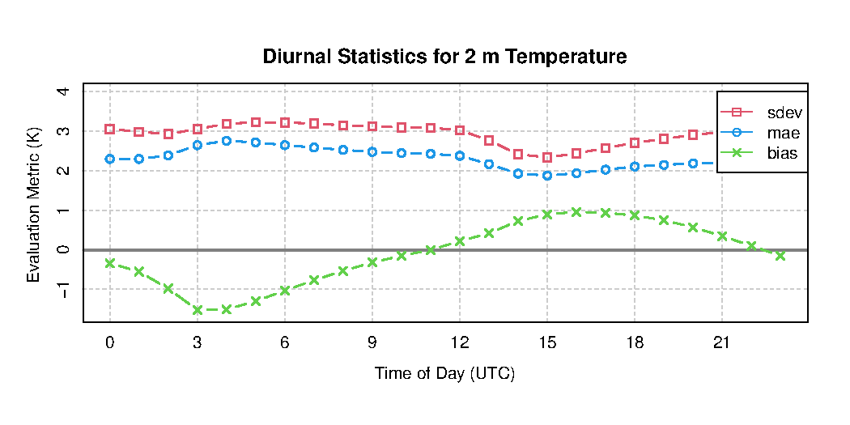
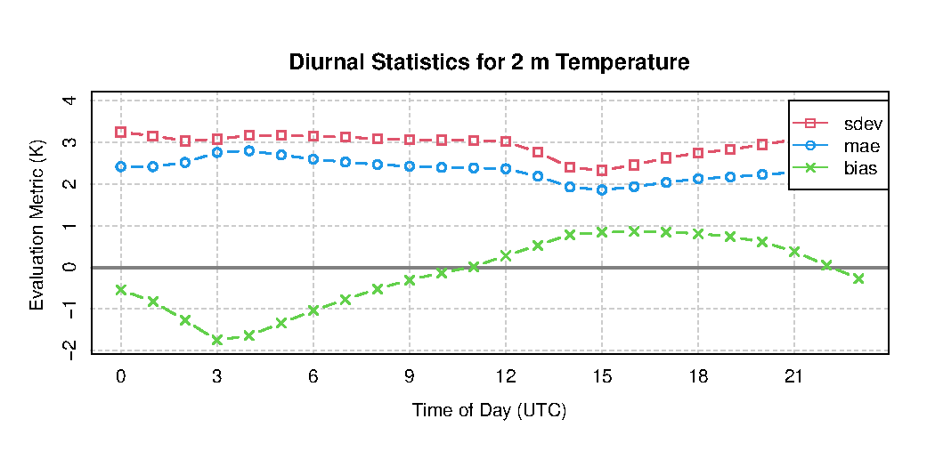
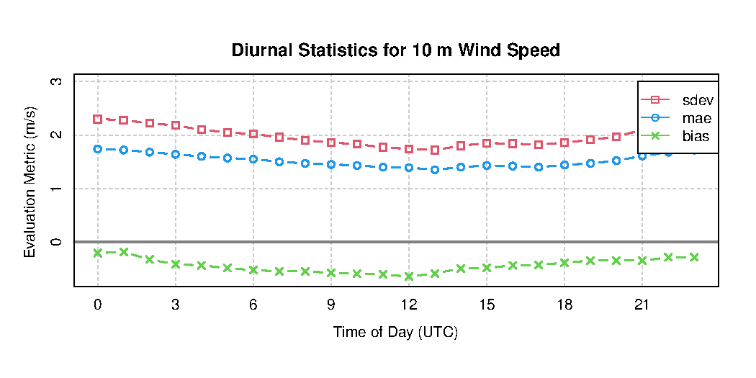
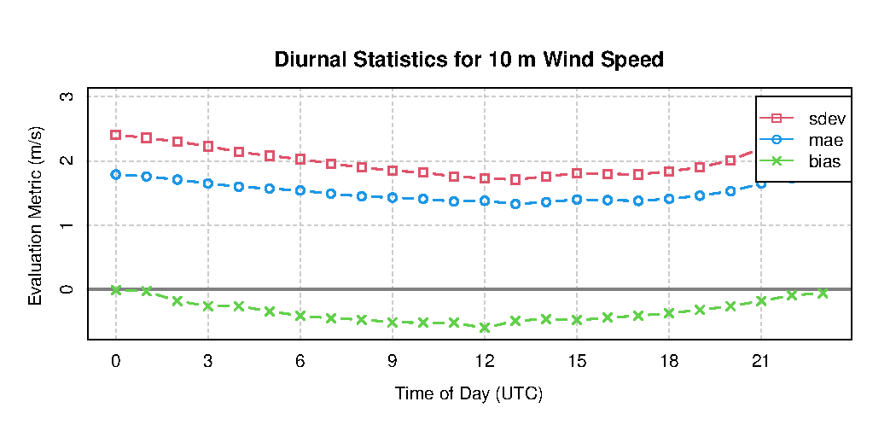
T2
WUS
T2
AQM v7
AQM v8
WS10
WS10
WUS

