Slide 1
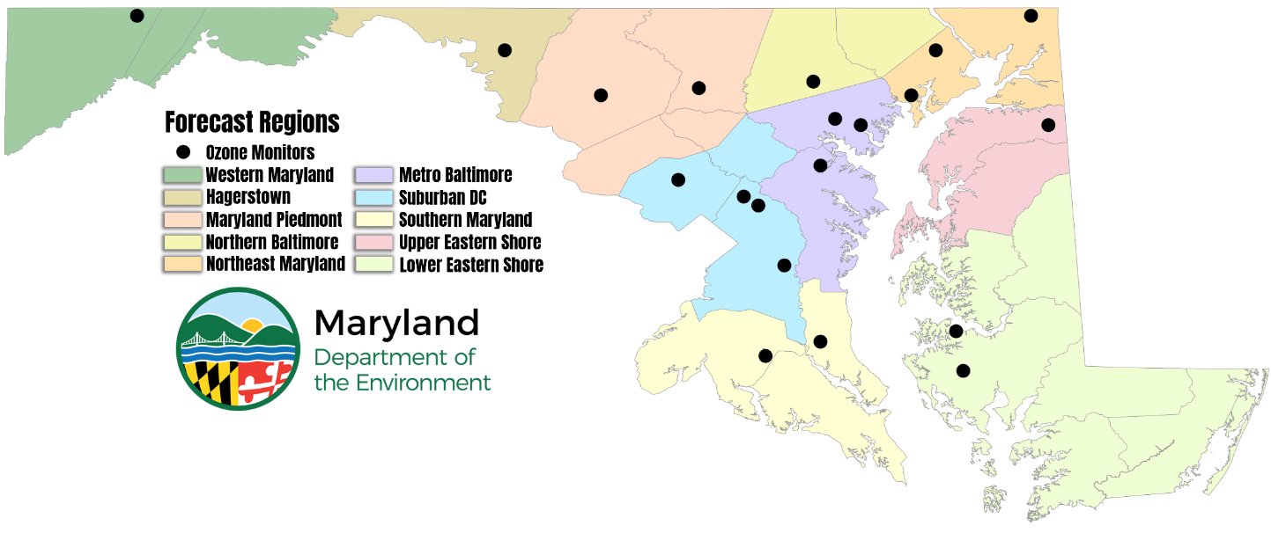
Maryland’s 2024 Ozone Season NOAA Feedback
James Boyle
Joel Dreessen
October 9-10, 2024
AQ Forecaster Focus Group

Slide 2
Overview
National
Ozone: Monthly Forecast Bias
Ozone: Seasonal Bias
2024 vs 2023
Ozone: Correct AQI Category
Maryland
Operational versus Bias Corrected
False Alarms/Misses/Hits
Specific Examples
Model Bias at Low O₃ Concentrations
Low Model Bias at High O₃ Concentrations
Page 2

Slide 3
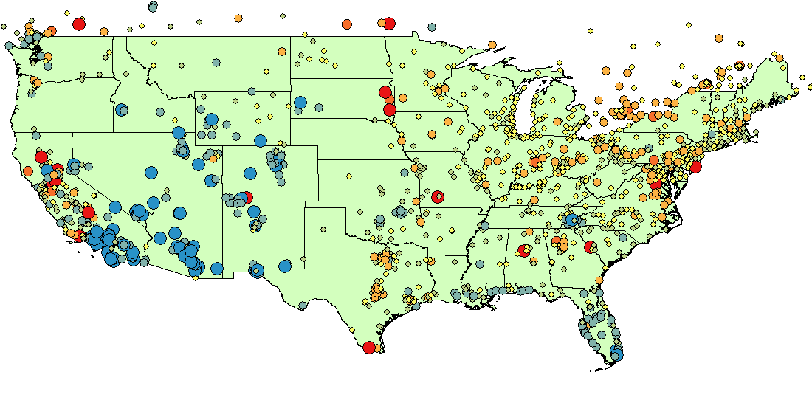
April: 2024
Monthly BIAS – 8hr Ozone
12Z: Day 2
April Bias (ppb)
Operational Model
- = Model Under predicted
+ = Model Over predicted
*2024 data is preliminary
Page 3

Slide 4
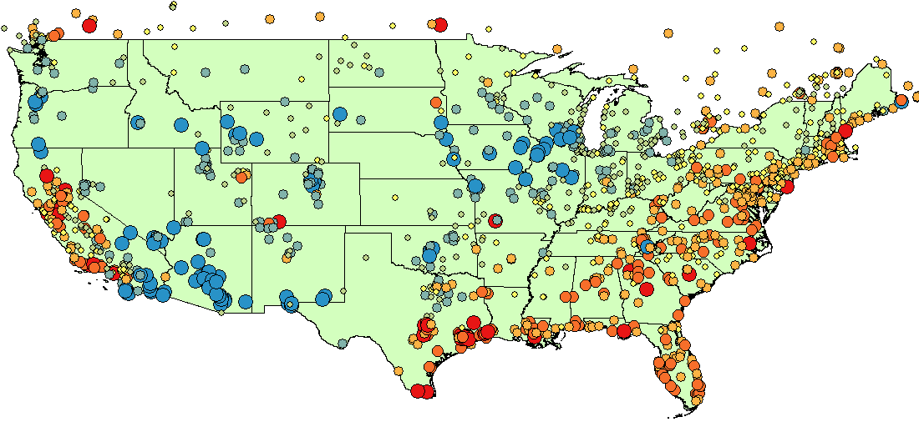
May: 2024
Monthly BIAS – 8hr Ozone
12Z: Day 2
May Bias (ppb)
Operational Model
- = Model Under predicted
+ = Model Over predicted
Page 4

Slide 5
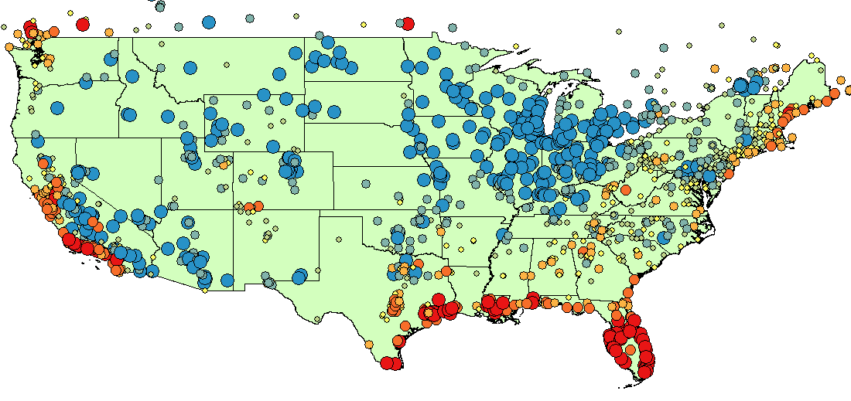
June: 2024
Monthly BIAS – 8hr Ozone
12Z: Day 2
June Bias (ppb)
Operational Model
- = Model Under predicted
+ = Model Over predicted
Page 5

Slide 6
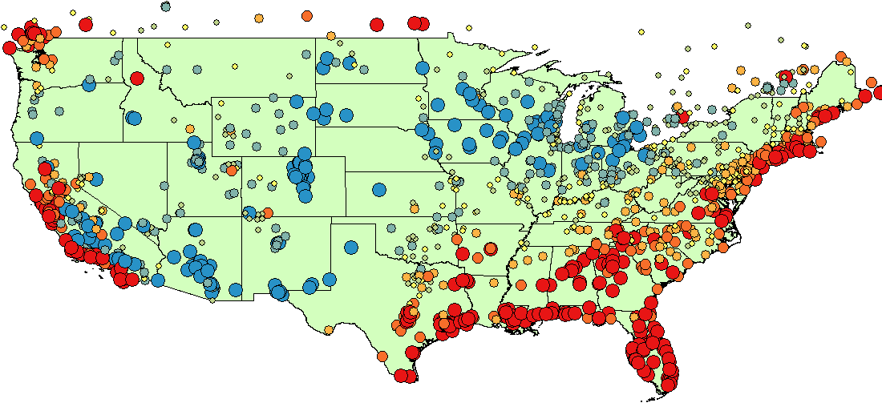
July: 2024
Monthly BIAS – 8hr Ozone
12Z: Day 2
July Bias (ppb)
Operational Model
- = Model Under predicted
+ = Model Over predicted
Page 6

Slide 7
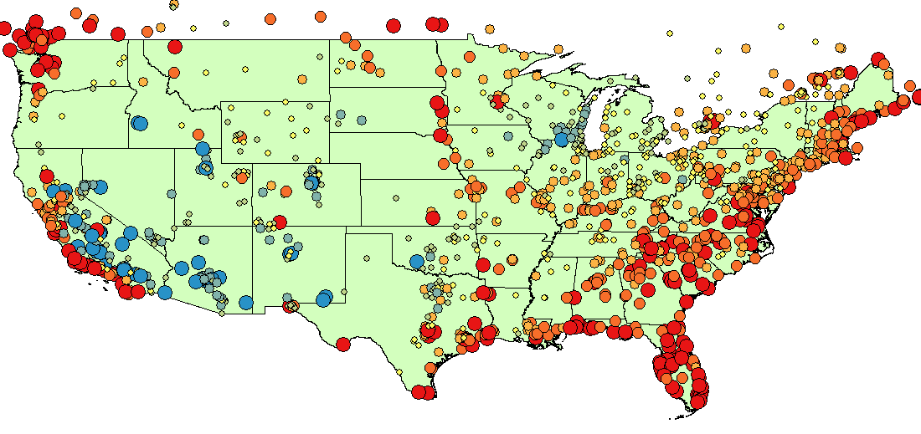
August: 2024
Monthly BIAS – 8hr Ozone
12Z: Day 2
August Bias (ppb)
Operational Model
- = Model Under predicted
+ = Model Over predicted
Page 7

Slide 8
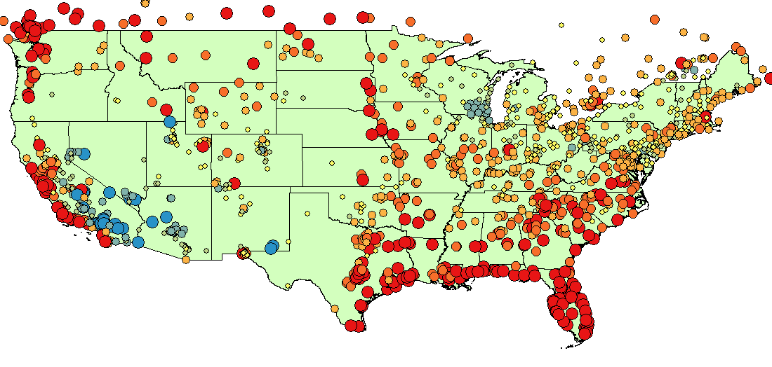
Sept*: 2024
Monthly BIAS – 8hr Ozone
12Z: Day 2
Sept Bias (ppb)
Operational Model
- = Model Under predicted
+ = Model Over predicted
*Valid for Sept 1st – Sept 20th
Page 8

Slide 9
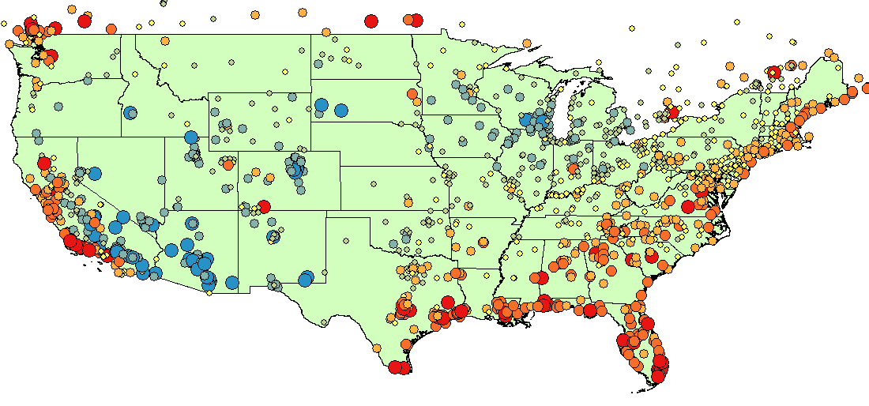
Operational
Seasonal BIAS – 8hr Ozone
Seasonal 4/01 – 9/20 Bias (ppb)
12Z: Day 2
2024
- = Model Under predicted
+ = Model Over predicted
Page 9

Slide 10
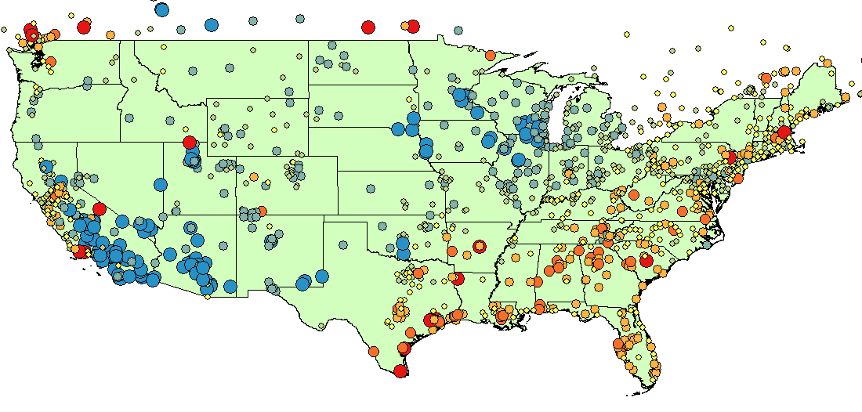
Operational
Seasonal BIAS – 8hr Ozone
Seasonal 4/01 – 9/15 Bias (ppb)
12Z: Day 2
2023
- = Model Under predicted
+ = Model Over predicted
Page 10

Slide 11
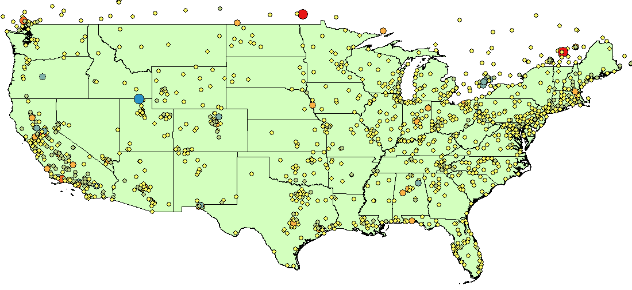
Bias Corrected
Seasonal BIAS – 8hr Ozone
Seasonal 4/01 – 9/20 Bias (ppb)
12Z: Day 2
2024
- = Model Under predicted
+ = Model Over predicted
Page 11

Slide 12
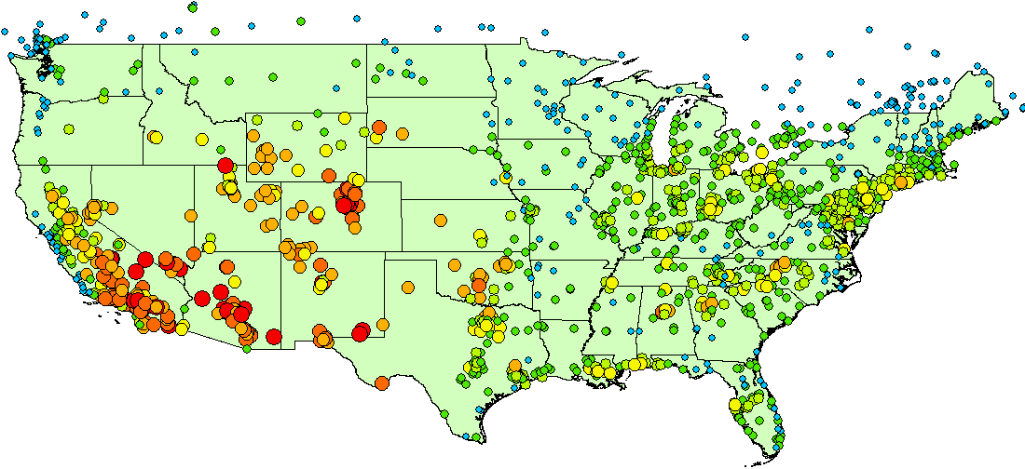
Operational
Seasonal Correct AQI Category: Ozone
Seasonal 4/01 – 9/20 Correct AQI (%)
12Z: Day 2
2024
Page 12

Slide 13
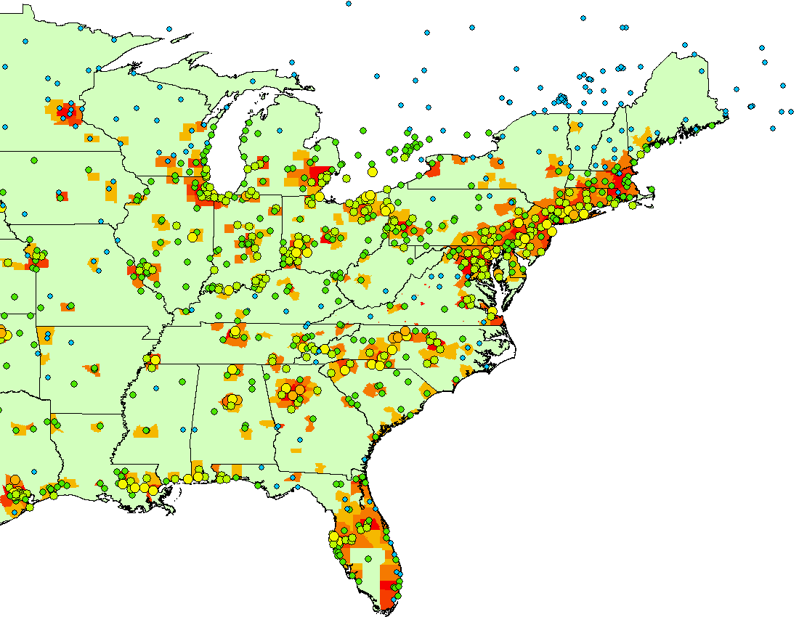
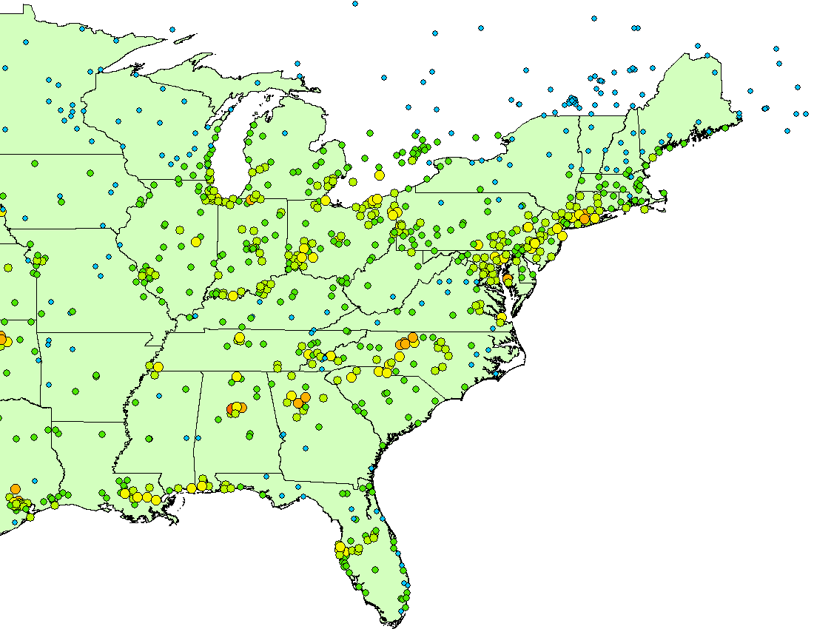
Seasonal Correct AQI Category: Ozone
Seasonal 4/01 – 9/20 Correct AQI (%)
Population Density (ppl/km²)
Emissions issue?
2024
12Z: Day 2 Operational
Page 13

Slide 14
NOAA DAY-2 MARYLAND ERRORS (Model - Observations)
Operational
April: 0
May: 3.18
June: -2.93
July: 2.74
August: 5.62
Sept*: 2.88
All: 1.89
Bias Corrected
April: 1.16
May: 0.95
June: -0.29
July: 0.86
August: 0.04
Sept*: 0.03
All: 0.49
Page 14

Slide 15
NOAA DAY-2 MARYLAND ERRORS (Model - Observations)
Operational 2024 vs 2023
+ = Model Over predicted
- = Model Under predicted
Seasonal ebbs and flows comparable (generally neutral 1st half and broad overprediction 2nd)
Significant improvement in June – mid-July timeframe…
Page 15

Slide 16
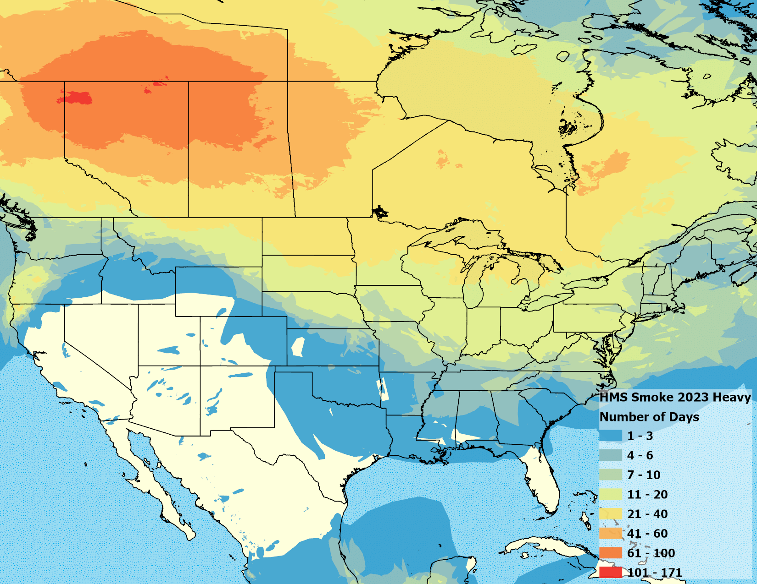
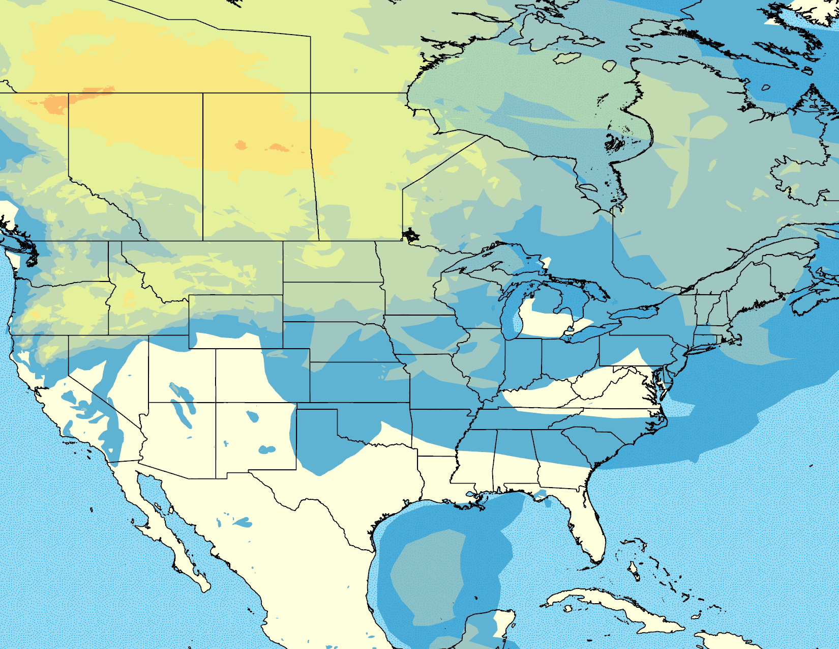
HMS Heavy Smoke Days: April – Sept 2023 vs 2024
What smoke there was, was diffuse across the Mid-Atlantic leading to less impacts on the overall model performance.
2023
2024
Page 16

Slide 17
Maryland Ozone Exceedance Statistics
Operational 12Z: Day 2
May 24th
Maryland Stats
Hit | 7
Miss | 6
False Alarm | 9
Bias Corrected 12Z: Day 2
June 27th
Maryland Stats
Hit | 3
Miss | 10
False Alarm | 1
Ozone Exceedance Days: 13
Page 17

Slide 18
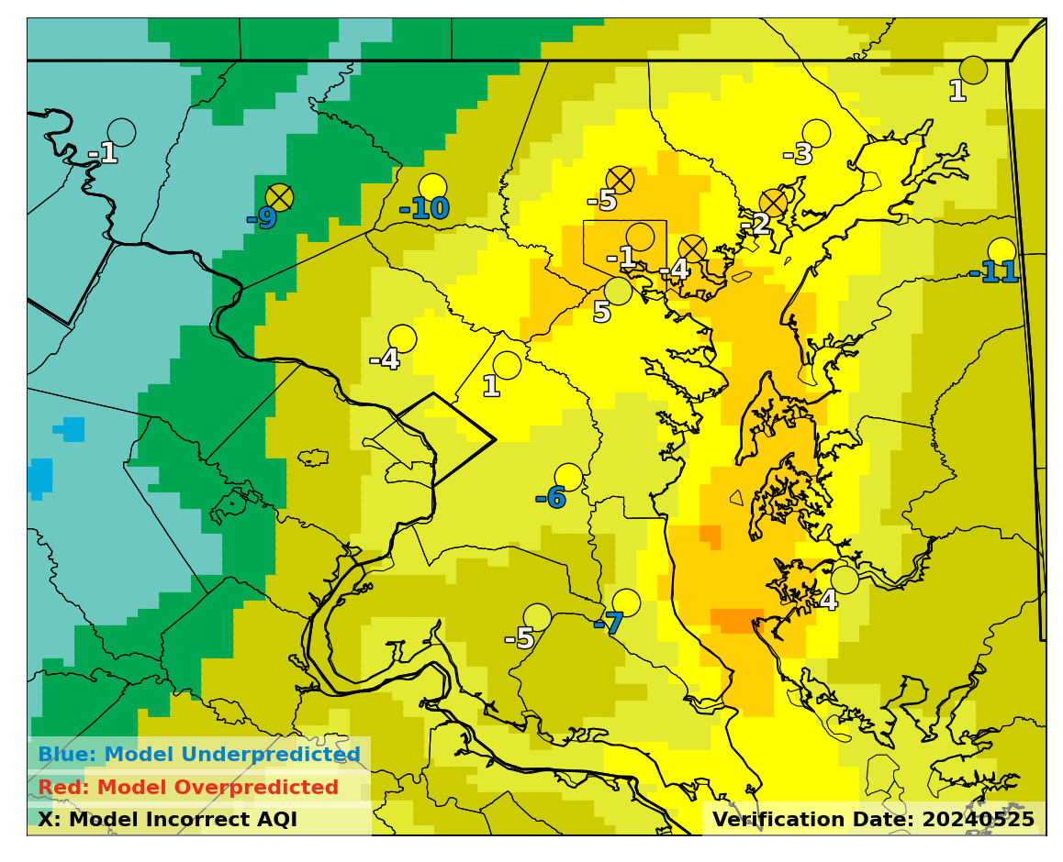
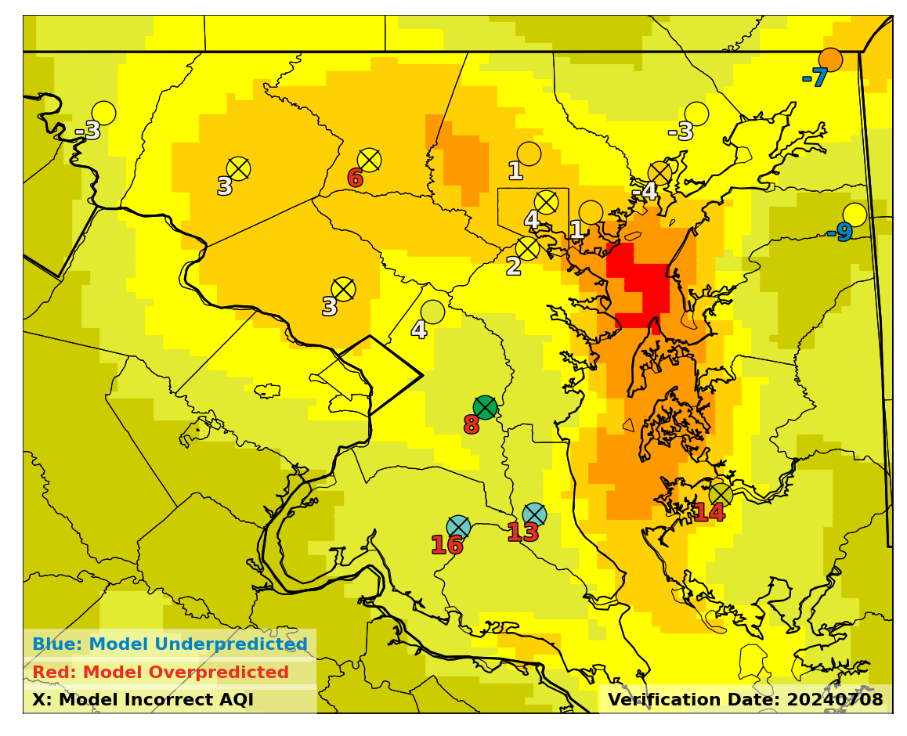
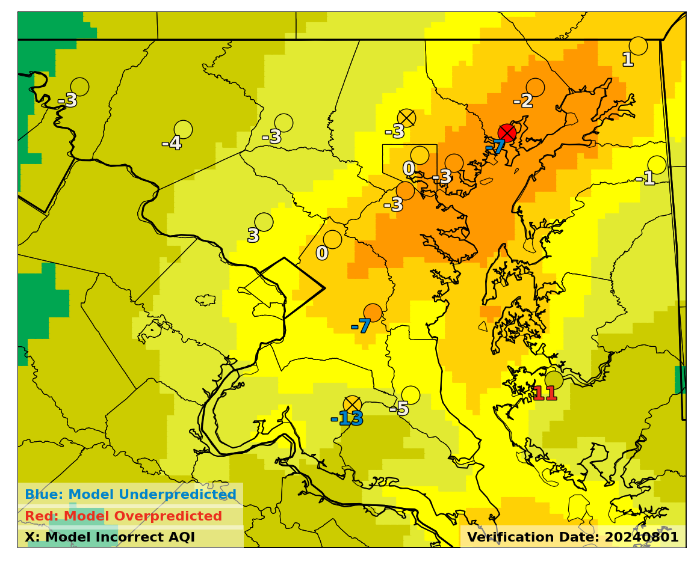
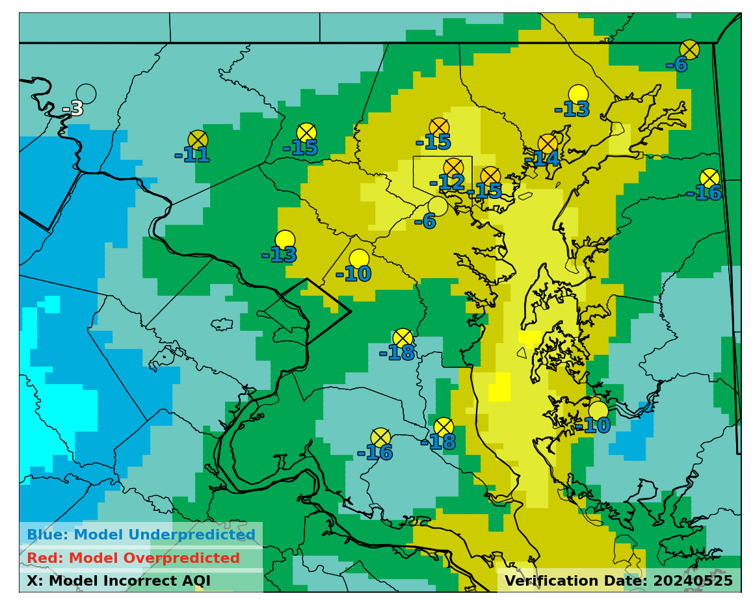
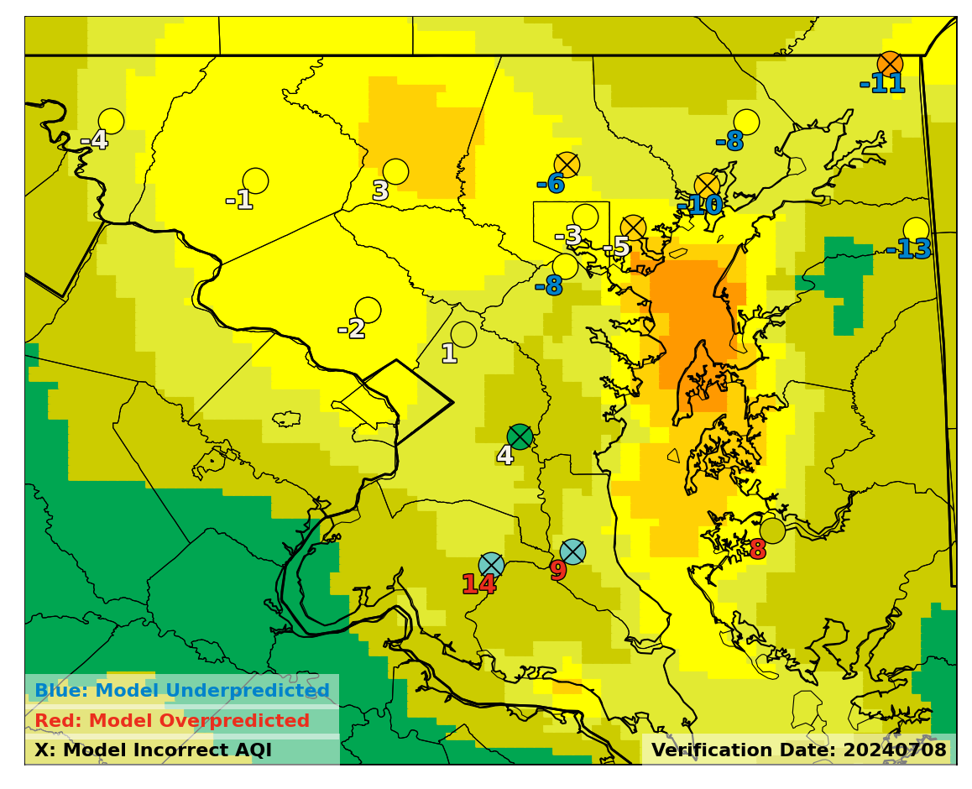
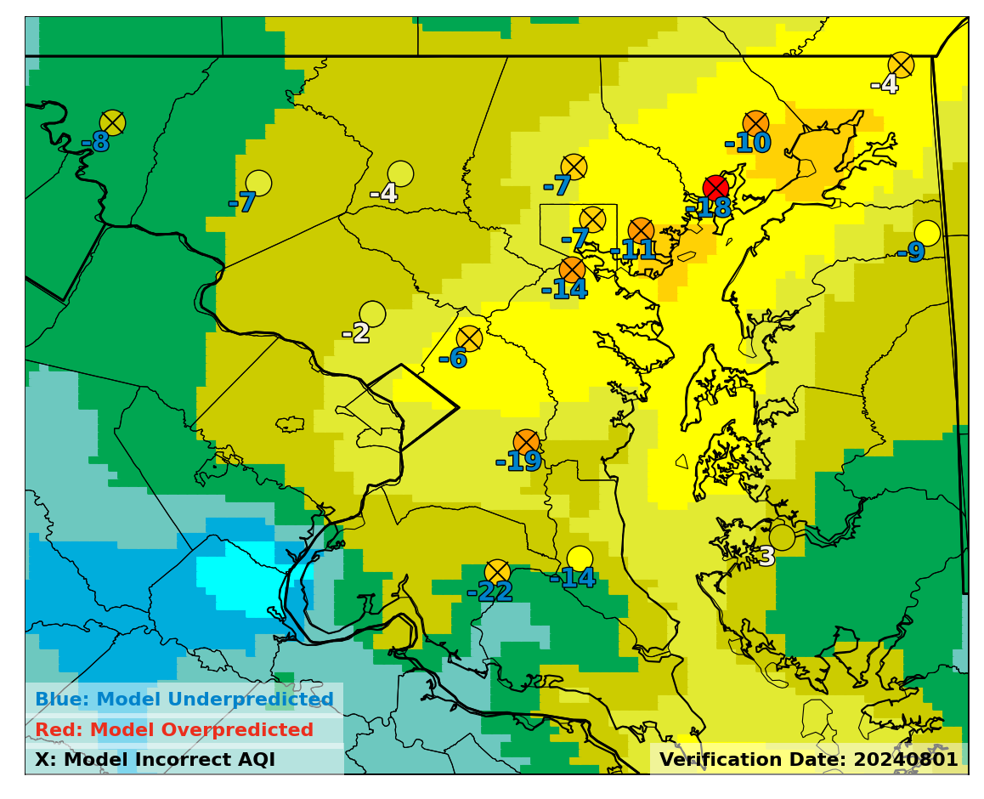
Maryland Ozone Exceedance Statistics
Hits
12Z : Day 2
May 25th
July 8th
August 1st
Operational
Operational
Operational
**Bias Corrected tends to overdue the correction on Maryland exceedance days**
Bias Corrected
Bias Corrected
Bias Corrected
Page 18

Slide 19
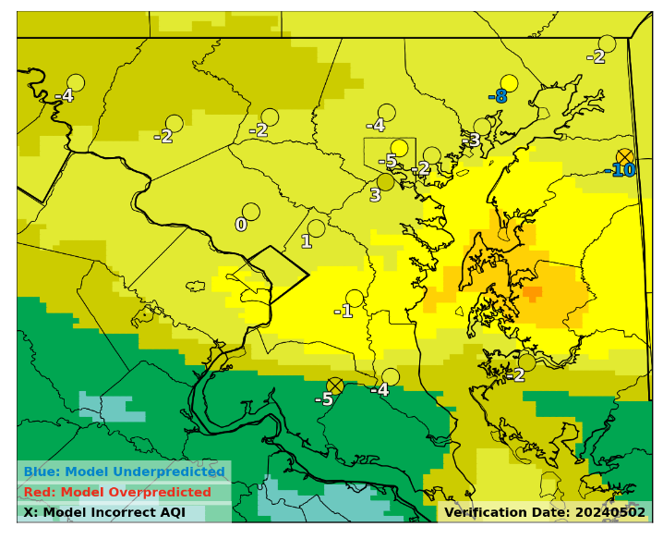
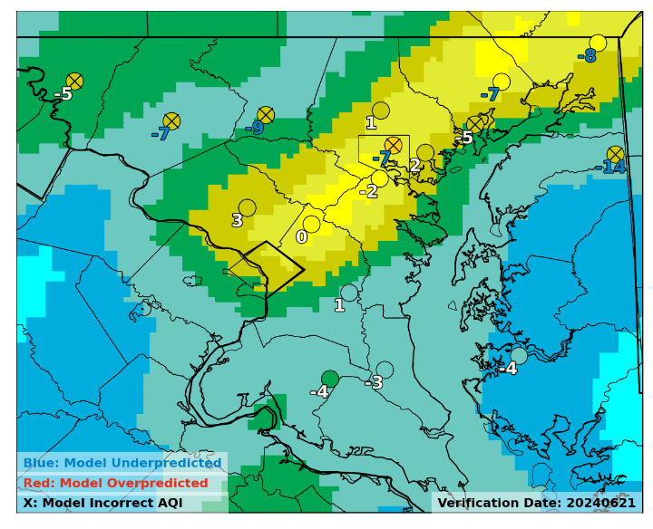
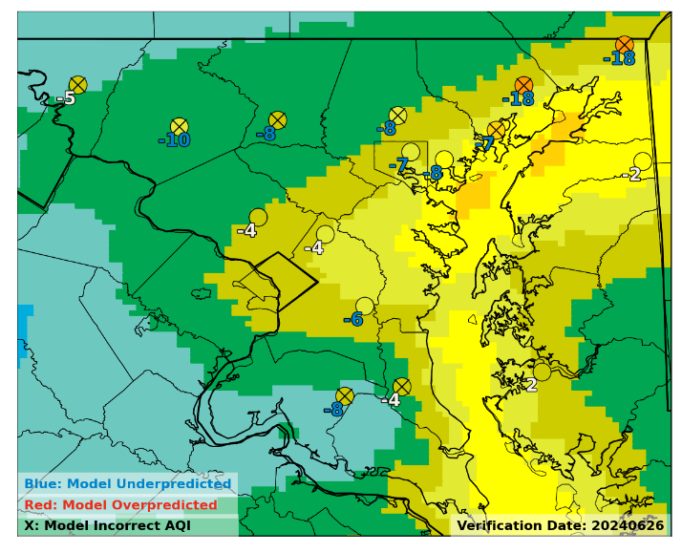
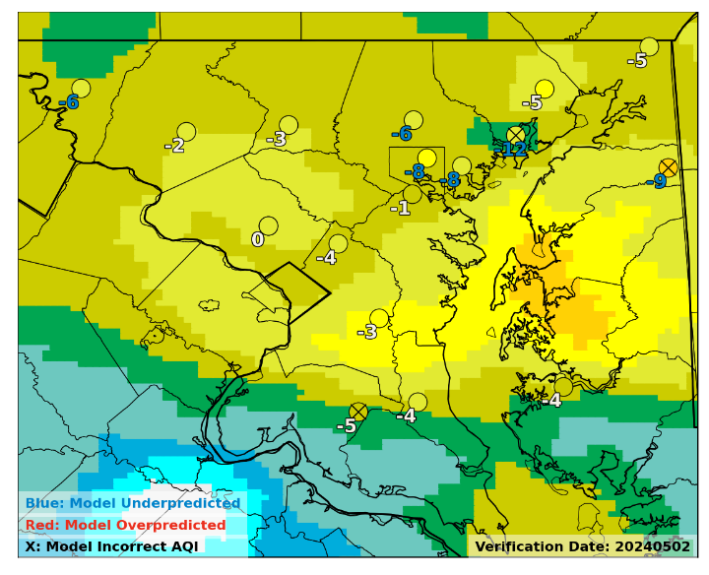
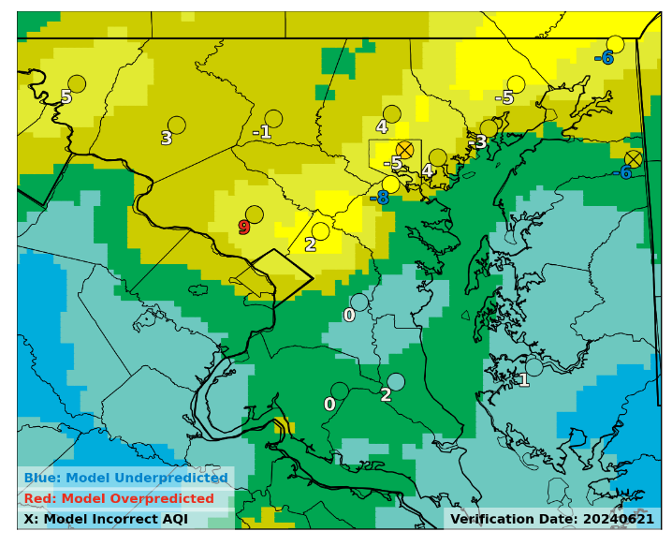
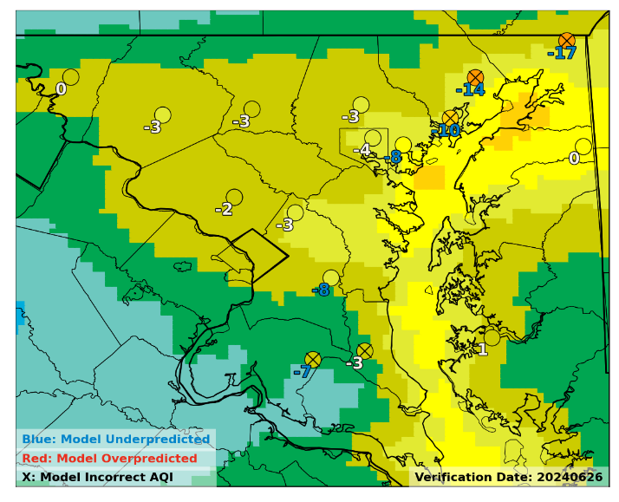
Maryland Ozone Exceedance Statistics
12Z : Day 2
Misses
May 2nd
June 21st
June 26th
Operational
Operational
Operational
Numerous near misses: primarily model resolution and/or meteorologically linked
Both models were comparable, BC showed improvements in Piedmont Region
Bias Corrected
Bias Corrected
Bias Corrected
Page 19

Slide 20
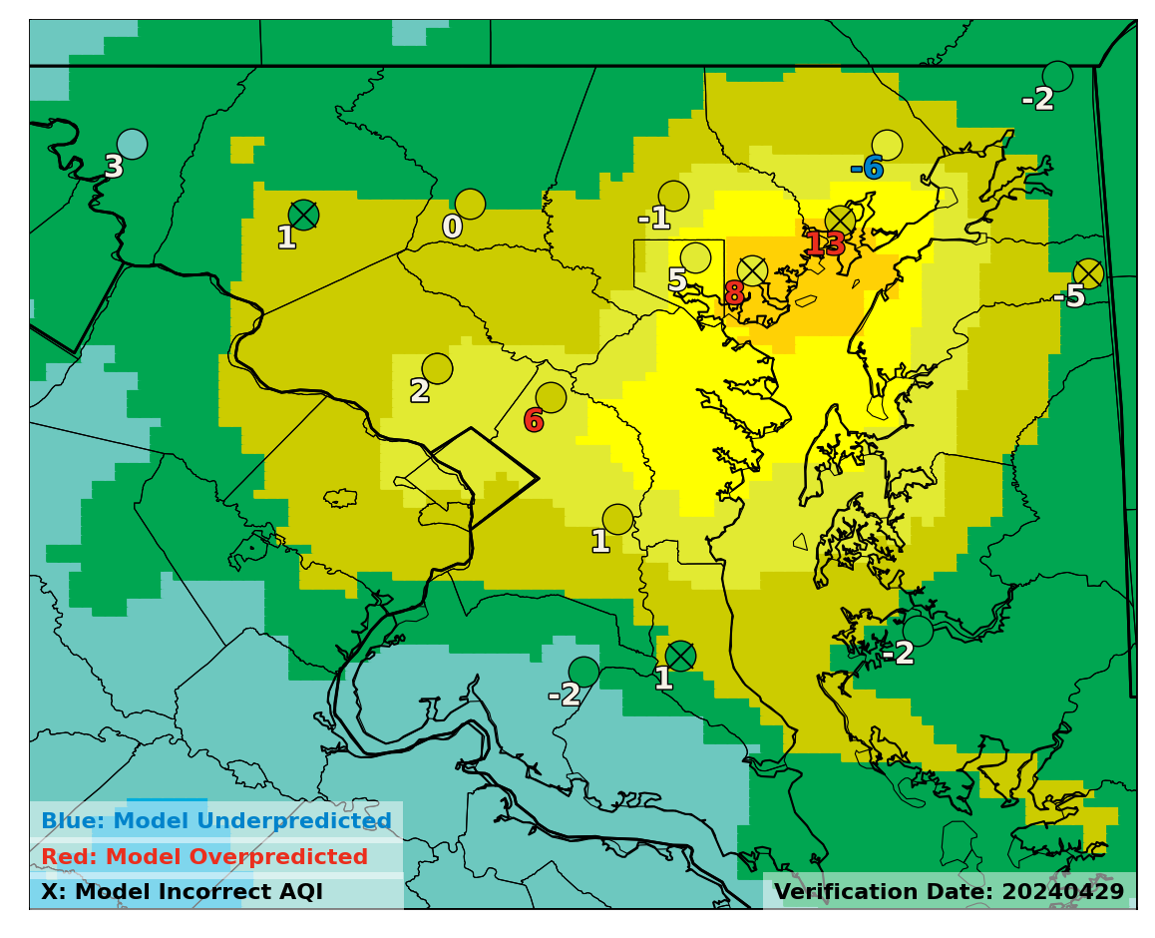
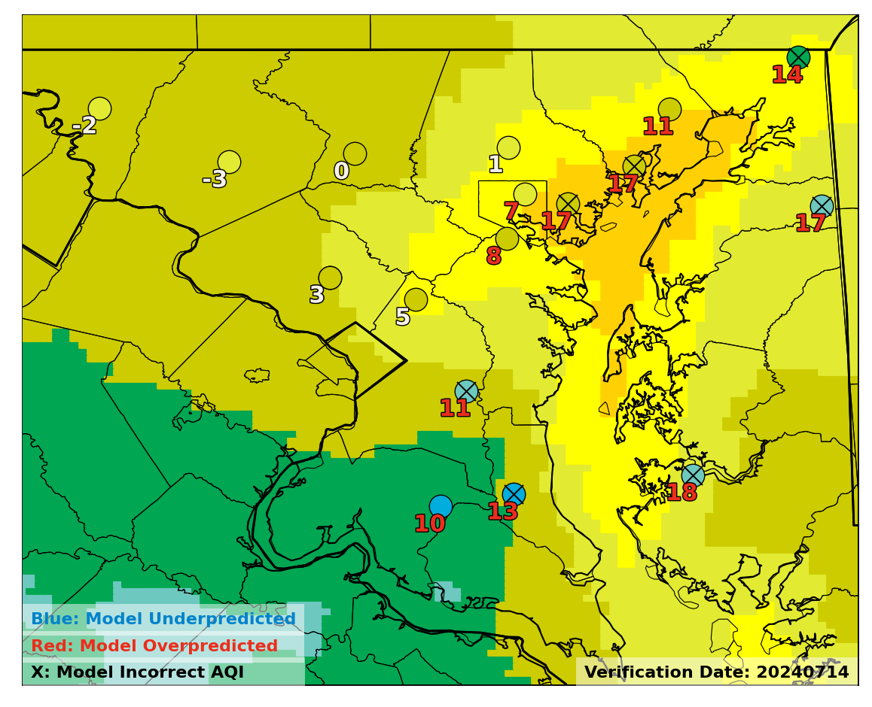
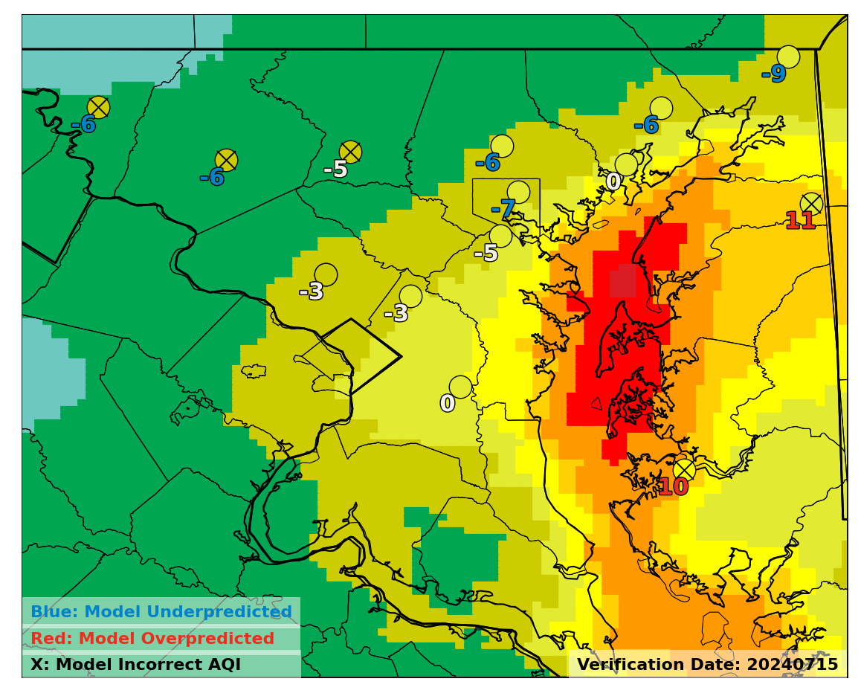
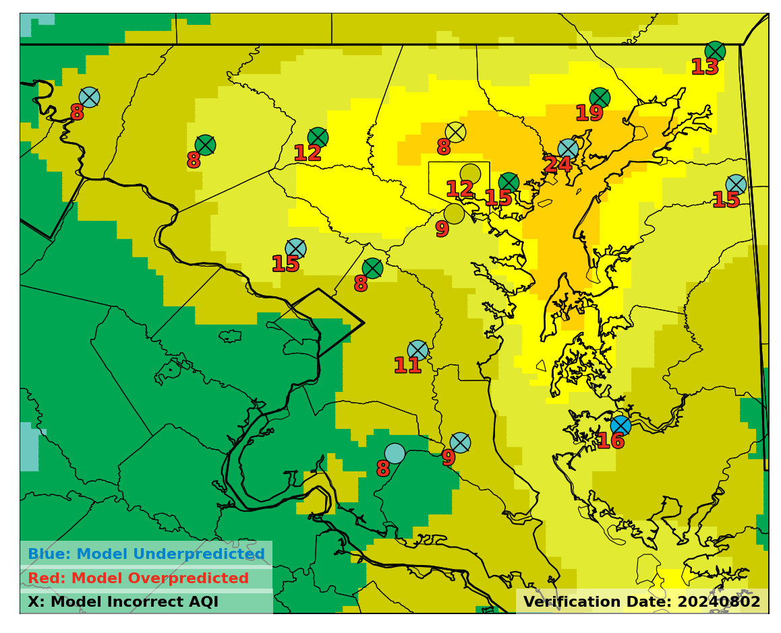
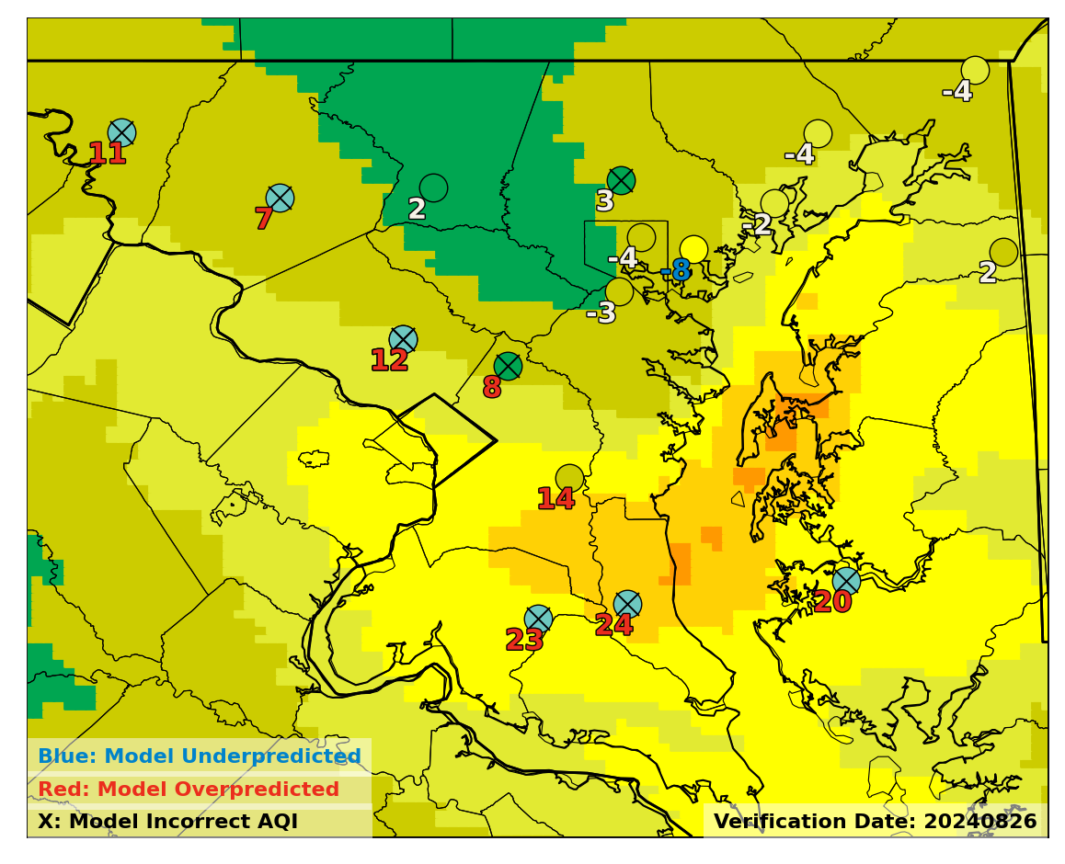
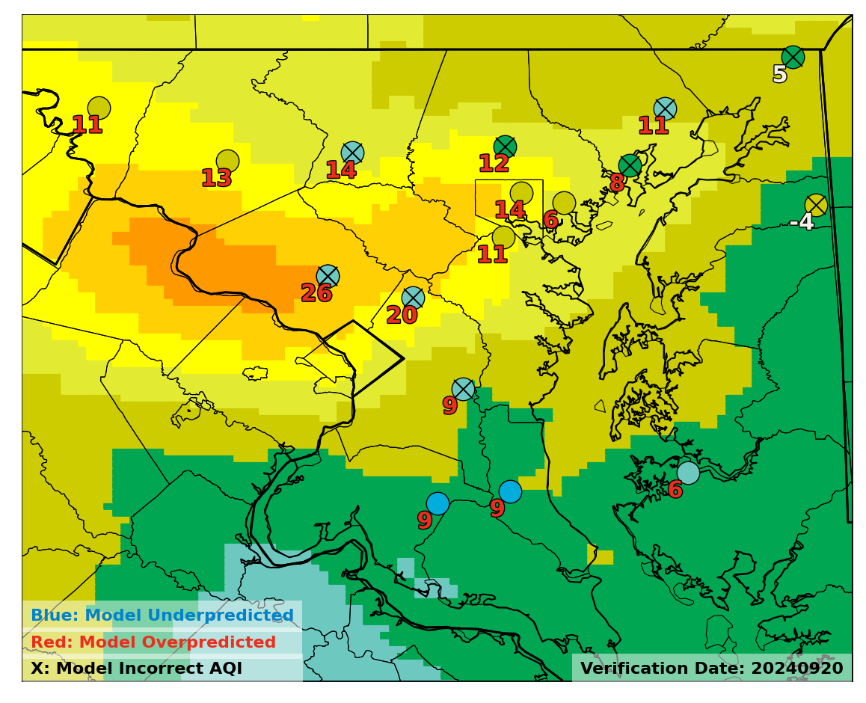
Maryland Ozone Exceedance Statistics
Operational
12Z : Day 2
False Alarms
More common during the end of the ozone season
5/9 FA within 6ppb of USG…
April 29th
July 14th
July 15th
O₃: 65ppb
O₃: 66ppb
O₃: 68ppb
August 2nd
August 26th
Sept 20th
O₃: 63ppb
O₃: 66ppb
O₃: 59ppb
Page 20

Slide 21
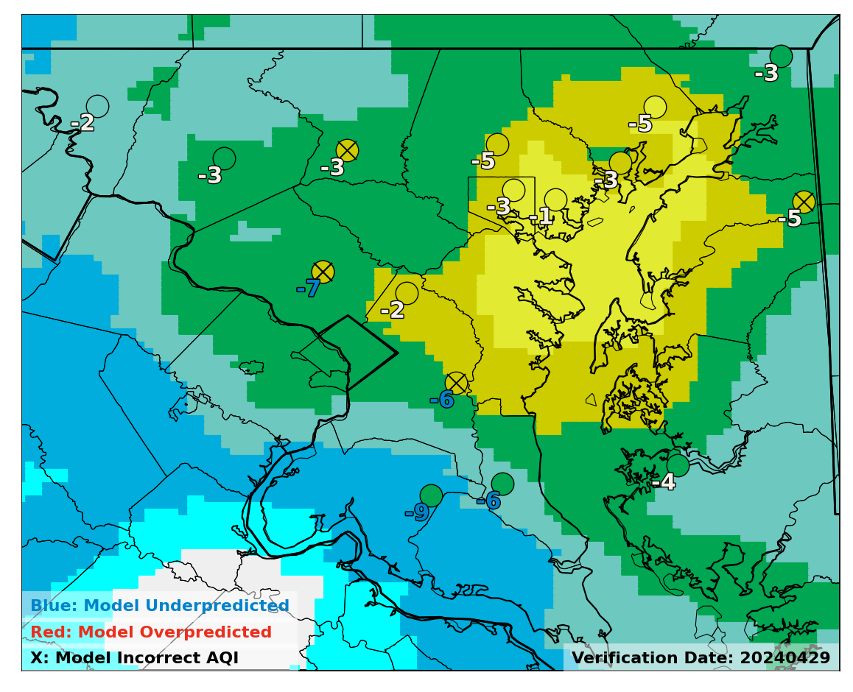
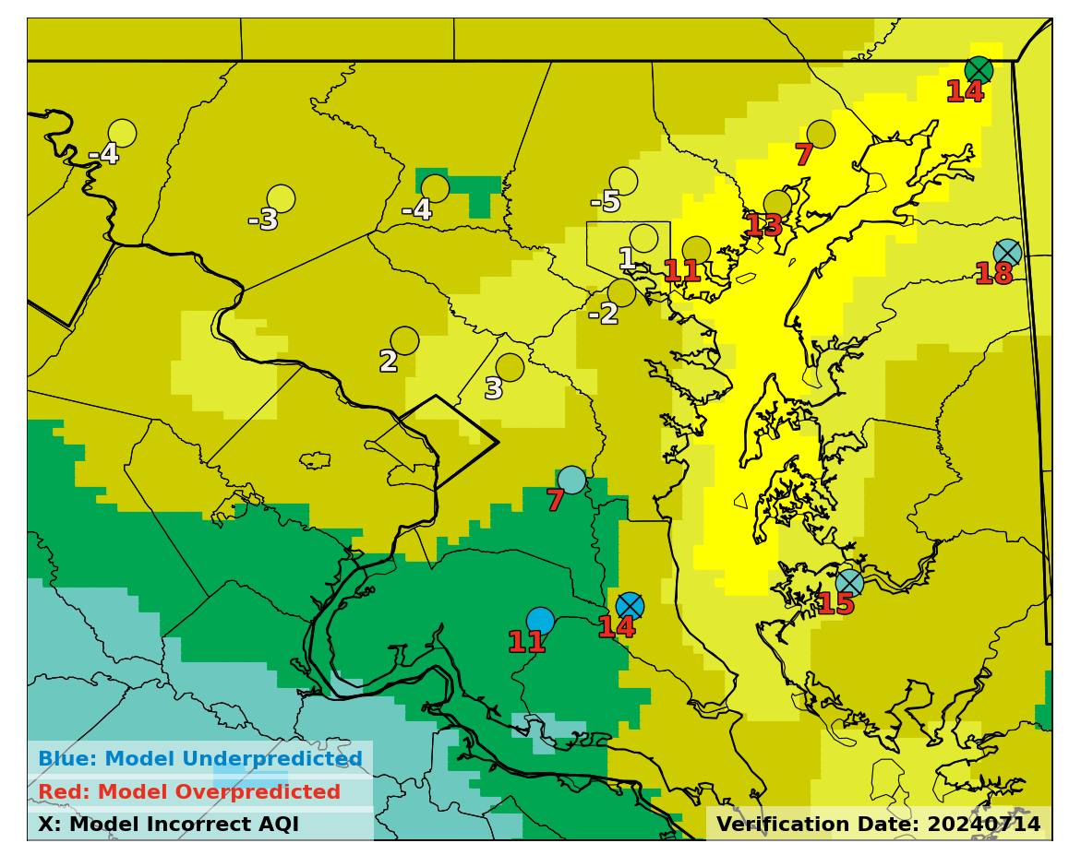
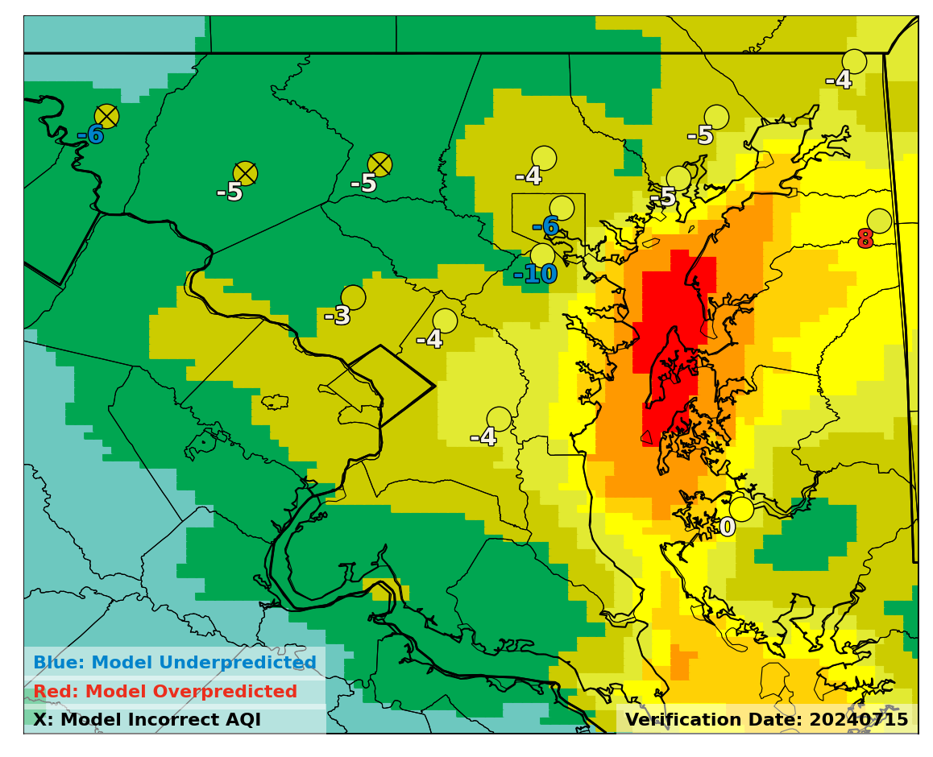
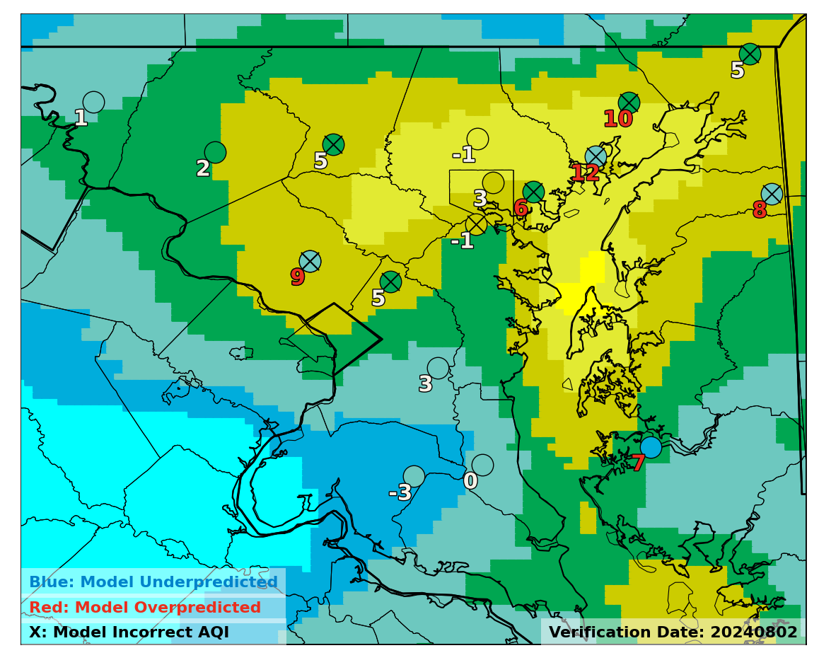
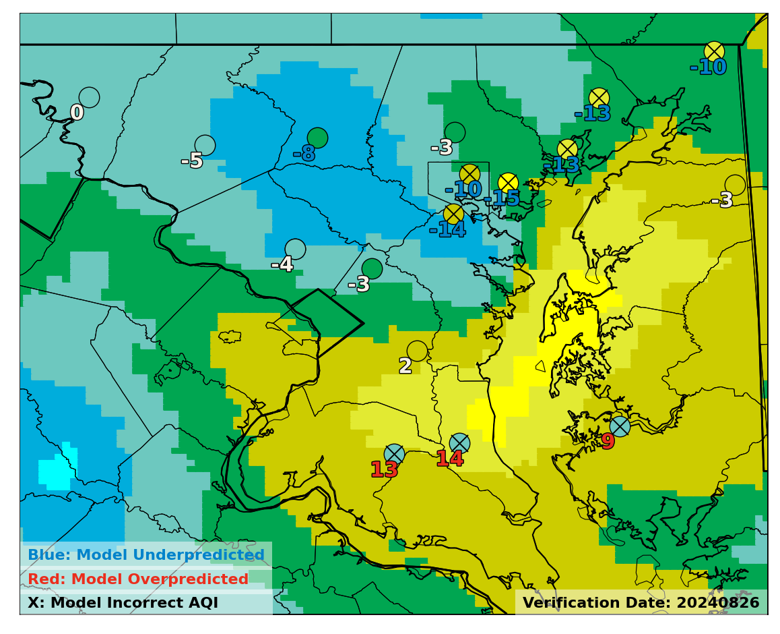
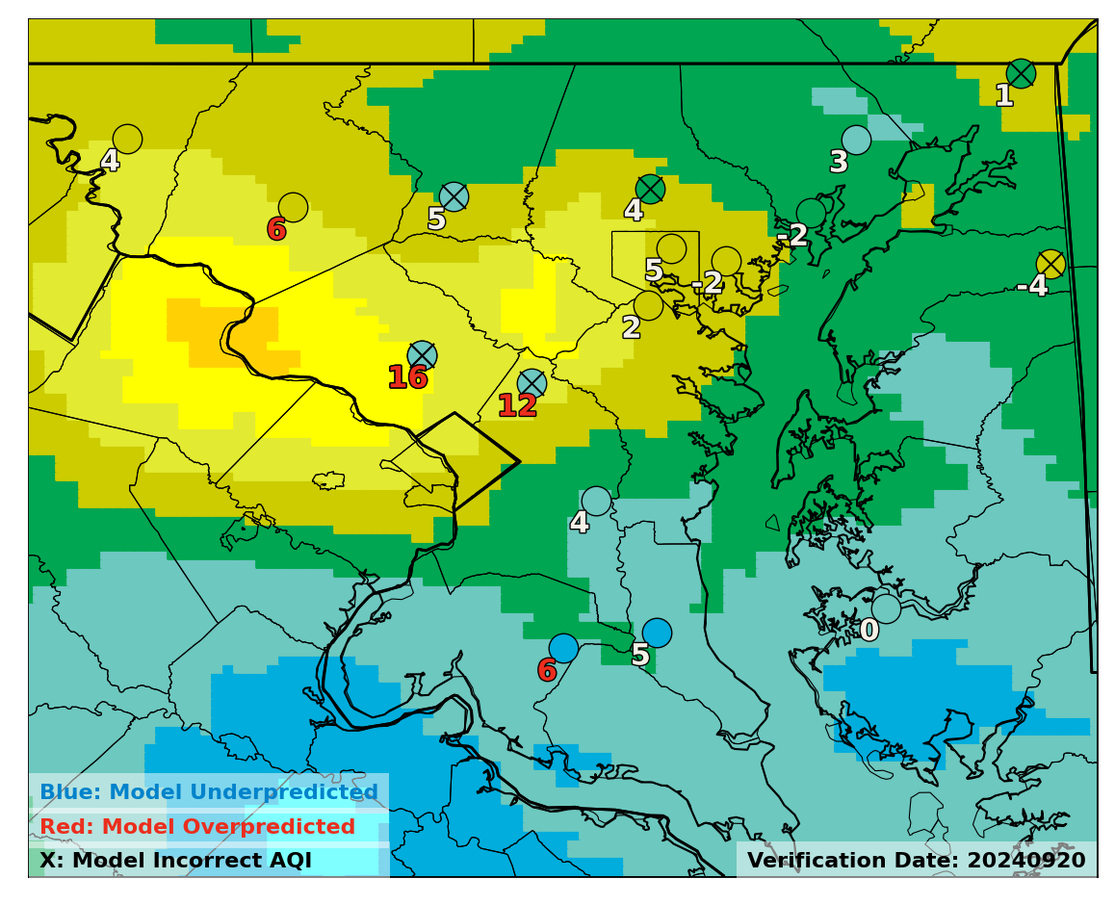
Maryland Ozone Exceedance Statistics
Bias Corrected
12Z : Day 2
False Alarms
Bias correction shows improvement on late season false alarms
April 29th
July 14th
July 15th
O₃: 65ppb
O₃: 66ppb
O₃: 68ppb
August 2nd
August 26th
Sept 20th
O₃: 63ppb
O₃: 66ppb
O₃: 59ppb
Page 21

Slide 22
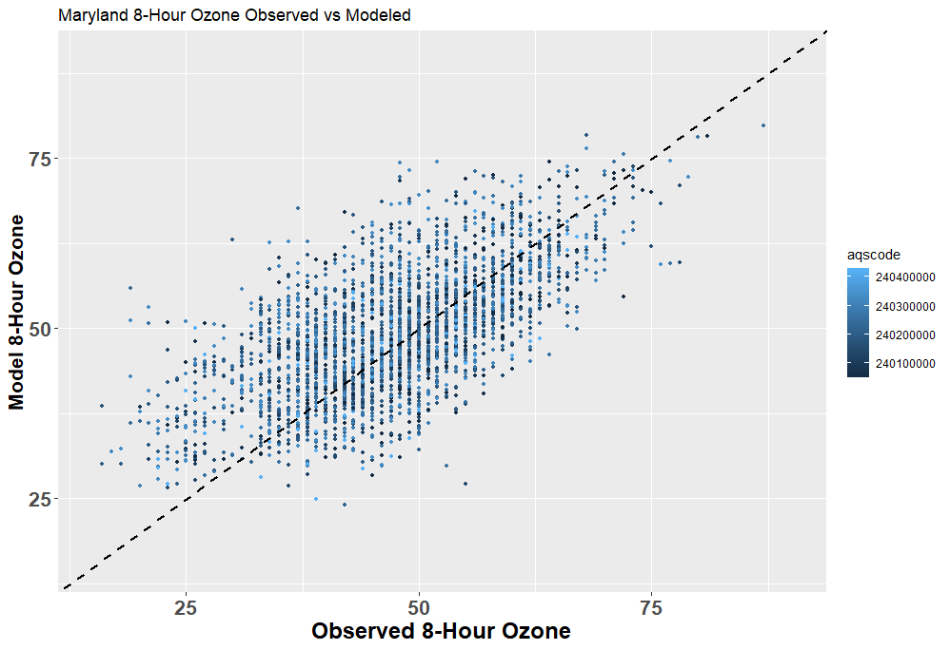
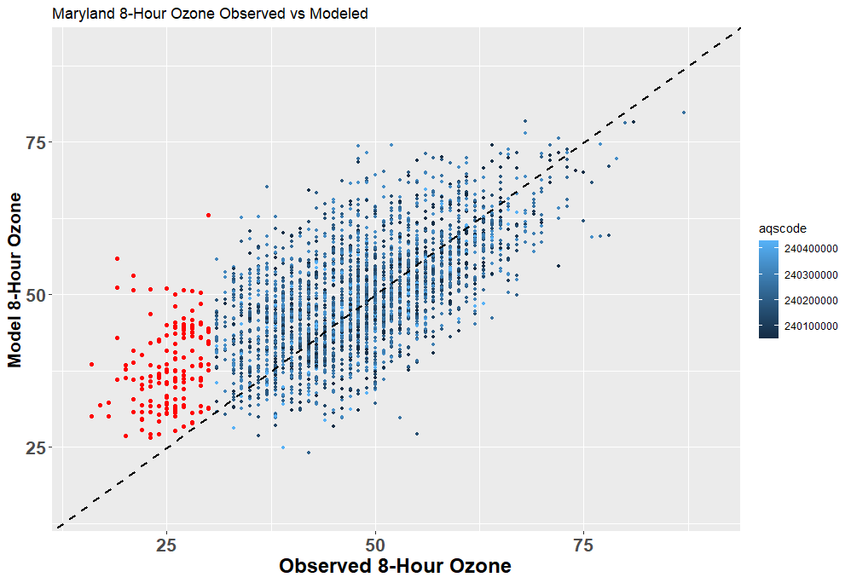
Model Error Assessment
Not a lot of points above 70 for either the model or observations
Look for outlier patterns
Noticeable overprediction at lowest tail of forecasts
Red Points
Model is high
Model is low
Page 22

Slide 23
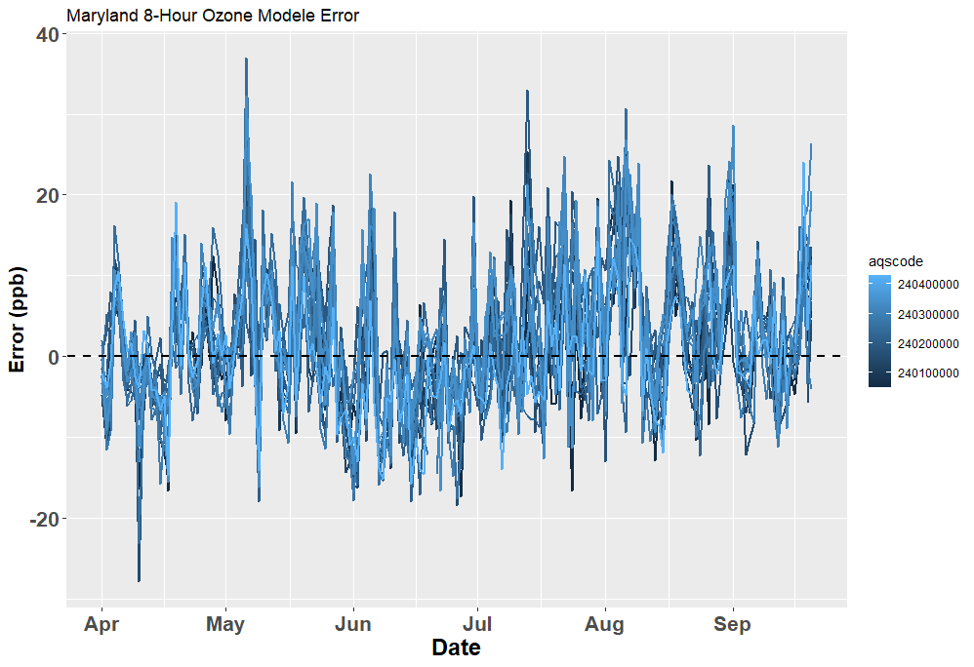
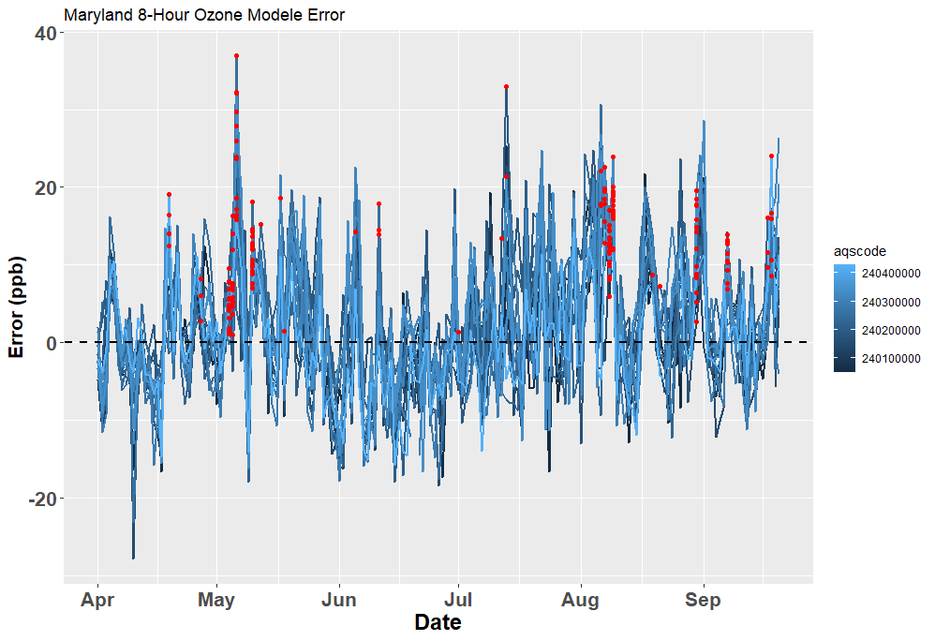
Positive Model Bias at Low O3 Concentrations
MD8AO Concentrations < 31ppb
Model is high
21 of 23 days of low concentration but over-prediction by the operational model were associated with rain
2 of the 23 days were due to tropical and/or marine air off the ocean
Model is low
Page 23

Slide 24
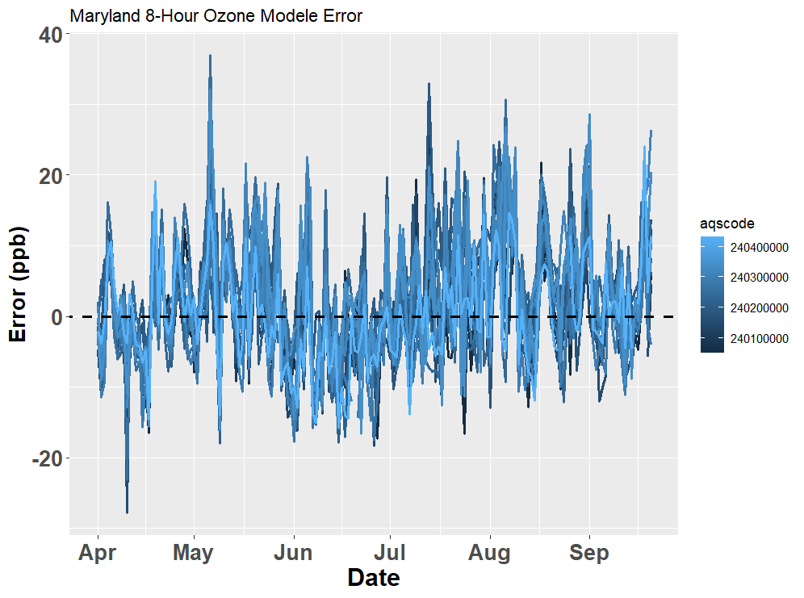
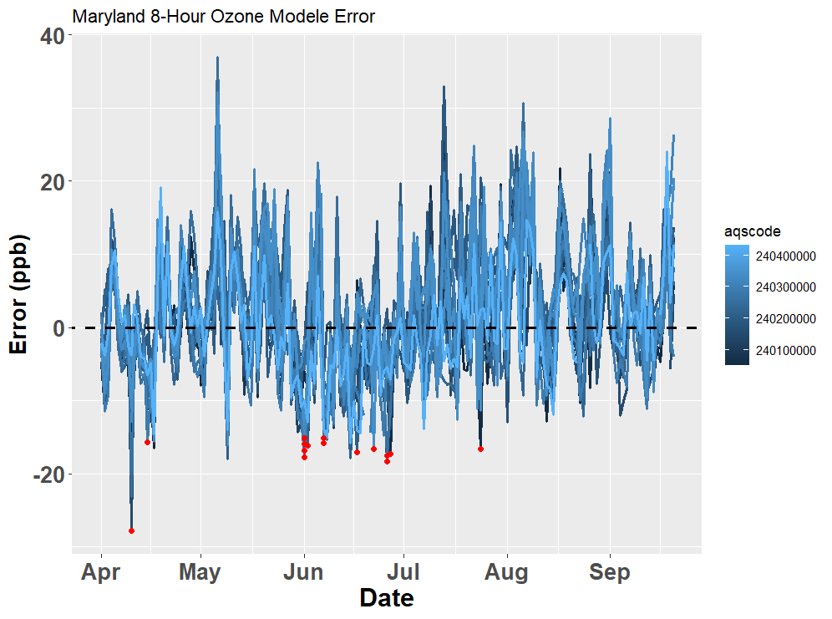
Large Negative Model Bias and High Ozone Observations
MD8AO Concentrations > 55 ppb &
Model error <=-15 ppb
Model is high
Highly local phenomenon or features not appropriately captured at 12km scale
6/27 – Essex (Baltimore) only had issues…likely due to complexities of scale and emissions (91°F)
Model is low
Page 24

Slide 25
Conclusions
We’re at the point where the only significant improvements would be by 1 or all of 3 things:
Better representation of smoke and smoke chemistry
Better representation of local emissions
Finer model resolution
When you look at the seasonal average it does a good job. The bias is right around zero but the day-to-day variability makes it sometimes difficult to use
Operational model did a decent job predicting MD ozone exceedances
Slightly over done late season, bias correction fixes this generally
Bias correction shows seasonal bias near zero however is a fine line between improving false alarms and missing ozone exceedances.
General rule of thumb, trust the operational model more during the first half of the season and bias corrected in the second half but day-to-day understanding of each model performance is key.
Suggestions:
Suggest emissions and met files be made available to assess seasonal biases for continued/deeper feedback towards model improvement
Page 25

Slide 26
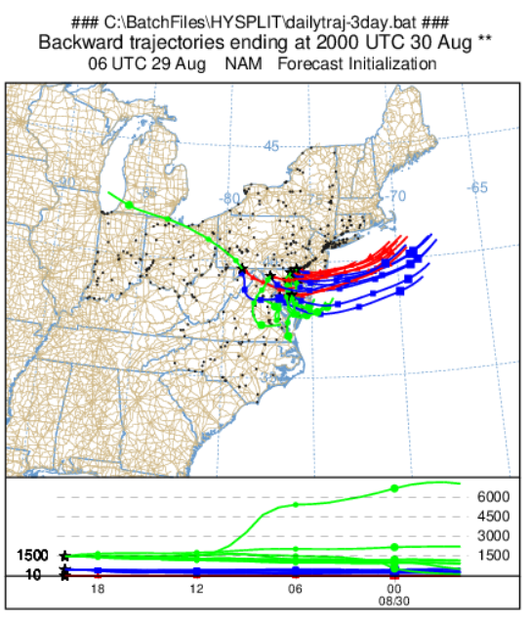
Dates with high model bias at low O3 concentrations
“2024-04-19 EDT" – Rainfall, particularly over northern areas of Maryland (some large errors here)
"2024-04-27 EDT" – Rainfall, midday whole state (good test case of met or emissions) (smaller errors here)
"2024-05-04 EDT" "2024-05-05 EDT" "2024-05-06 EDT" – Rainfall period across network
"2024-05-10 EDT" "2024-05-12 EDT" – Rainfall. One site 5/12 (Edgewood – very specific rainfall pattern…good test)
"2024-05-17 EDT" "2024-05-18 EDT" (5/17 – Piney Run only, Heavy Rainfall there)(5/18, Rockville, Heaviest Rain there)
"2024-06-05 EDT" Rain
"2024-06-11 EDT" (Rain south Bay only. Errant monitors are Edgewood, Aldino, FairHill, no rain there) Very light rain there per BWI TDWR
"2024-07-01 EDT“ – Very small error here, but fits search criterion
"2024-07-12 EDT" "2024-07-13 EDT" – Rain period across eastern half of Maryland; 7/13 Horn Point had one of the highest errors all season – Rain!!
"2024-08-06 EDT" "2024-08-07 EDT" "2024-08-08 EDT" "2024-08-09 EDT" – (8/6, Tropical Air Boundary – “southern monitors not clean enough” – Also Edgewood had a thunderstorm but MD8AO was >31ppb. All other days are rain related.
"2024-08-19 EDT" "2024-08-21 EDT“ (8/19 Scattered cells in afternoon, morning rain; 8/21 Windy and cool…not a big deal)
"2024-08-30 EDT" No Rain here, just cool easterly winds!
"2024-09-07 EDT" – Light rain but widespread
"2024-09-17 EDT" "2024-09-18 EDT“ – 9/18 Hagerstown (24ppb error!!); Rain both days
Page 26

Slide 27
Dates with low model bias and high Observations
"2024-04-10 EDT"
"2024-04-15 EDT" Scattered Storms- Millington wasn’t hit
"2024-06-01 EDT" "2024-06-02 EDT" (6/1; No rain. 5 stations > 15ppb error, 85 F high, stagnant (Saturday, high clouds increasing, but plenty of sun) Northern monitors in MD, Transport?!
"2024-06-07 EDT"
"2024-06-17 EDT“ Frederick – Downwind of DC??
"2024-06-22 EDT" – HU-Castnet Site(76)…but HUB was 67!! Highly local or features not appropriately captured
"2024-06-26 EDT" "2024-06-27 EDT“ 6/26 – FH & Aldino had issues (BB?); 6/27 – Essex Only had issues…likely due to complexities of scale and emissions (91F)
"2024-07-24 EDT"
Page 27

