Slide 1
Verification and Validation of Operational AQMv7.0.7 and AQMv7.0.8
Ho-Chun Huang and EMC VPPPG Branch
October 10 2024, NCWCP, College Park, MD

Slide 2
Outline
The operational Air Quality Model (AQM) verification
Comparison of model performance between AQMv7.0.7 and AQMv7.0.8 in the summer 2024.
Summary

Slide 3
AQM O₃/PM₂₅ Verification by the EVS
EMC Verification System (EVS) was implemented on March 26, 2024, i.e., EVSv1.0.7 for AQMv6 verification.
EVSv1.0.8 was implemented to support AQMv7.0.7 verification.
EVS provides 24/7 operational support for all NCEP modeling suites including AQM.
The community-based METplus verification software system is the core of the EVS.
Verification graphics are displayed on the EMC website for real-time updates.

Slide 4
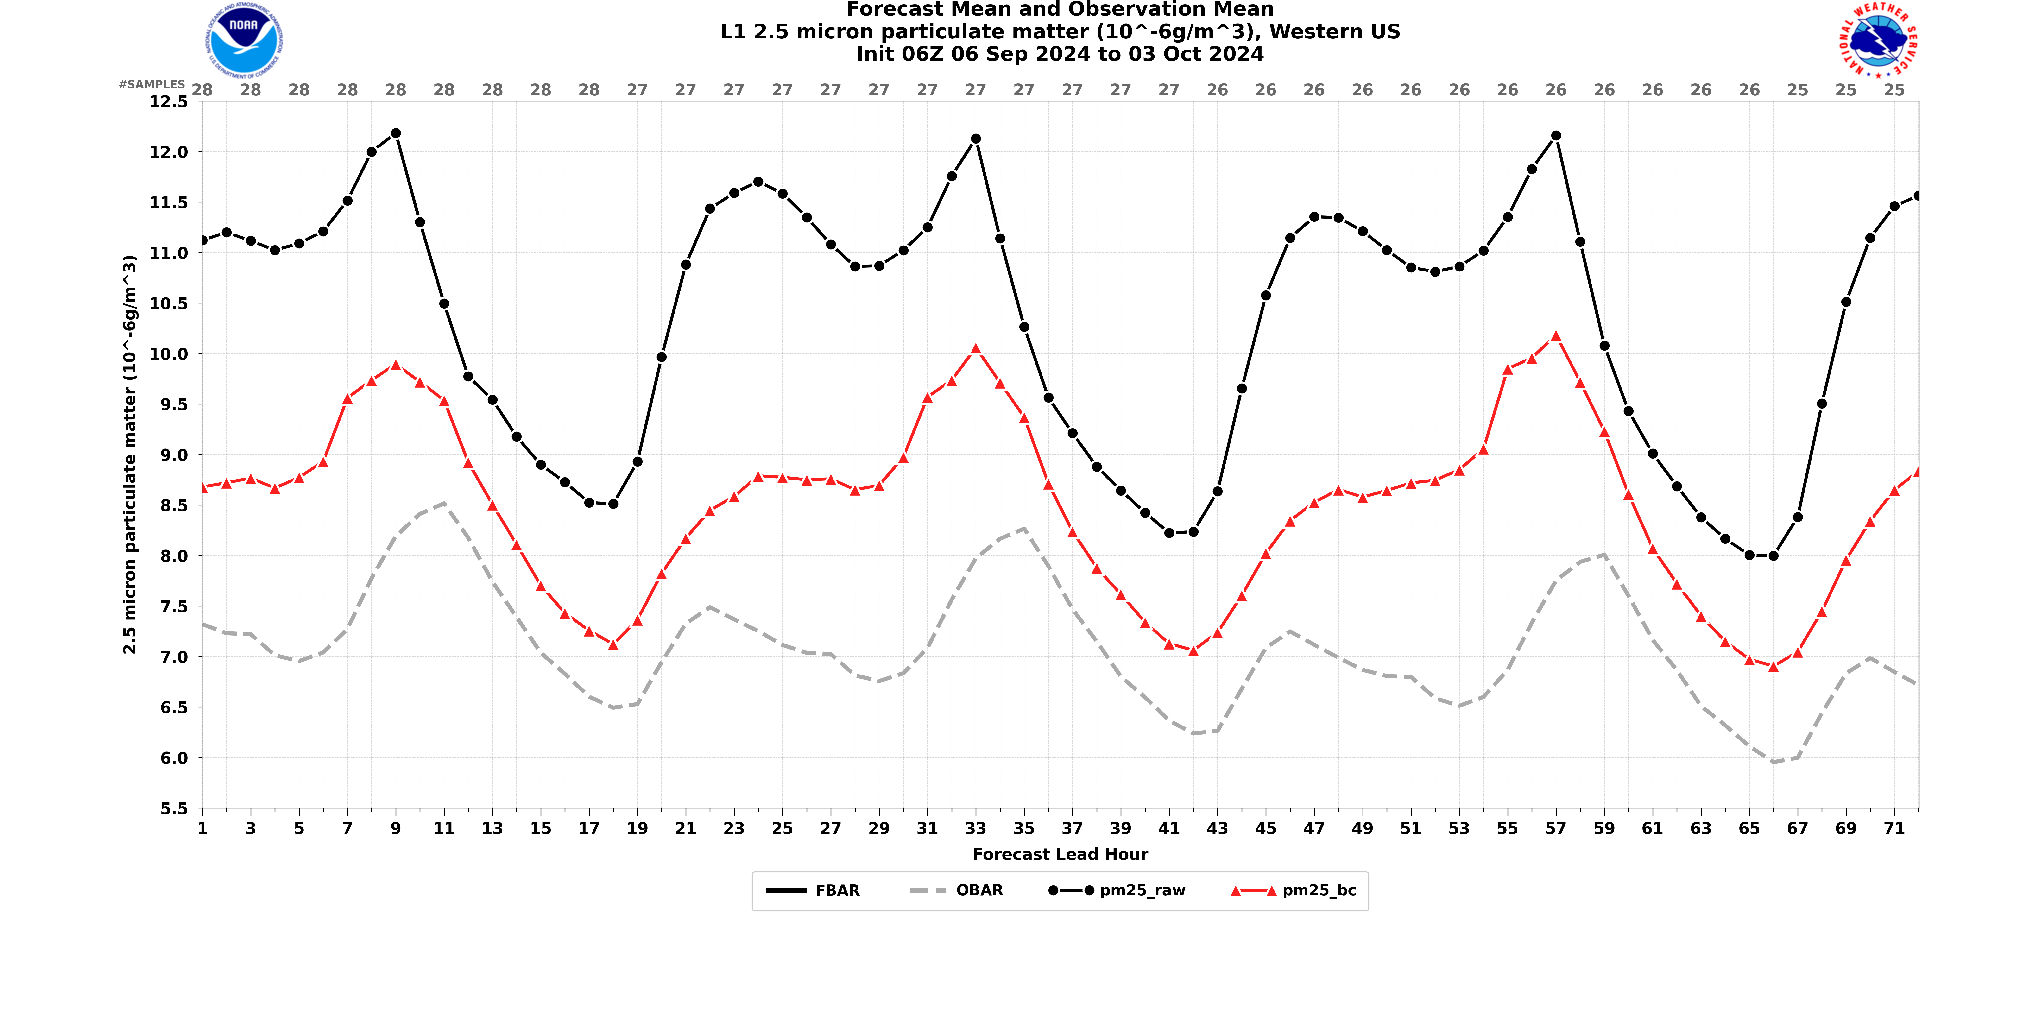
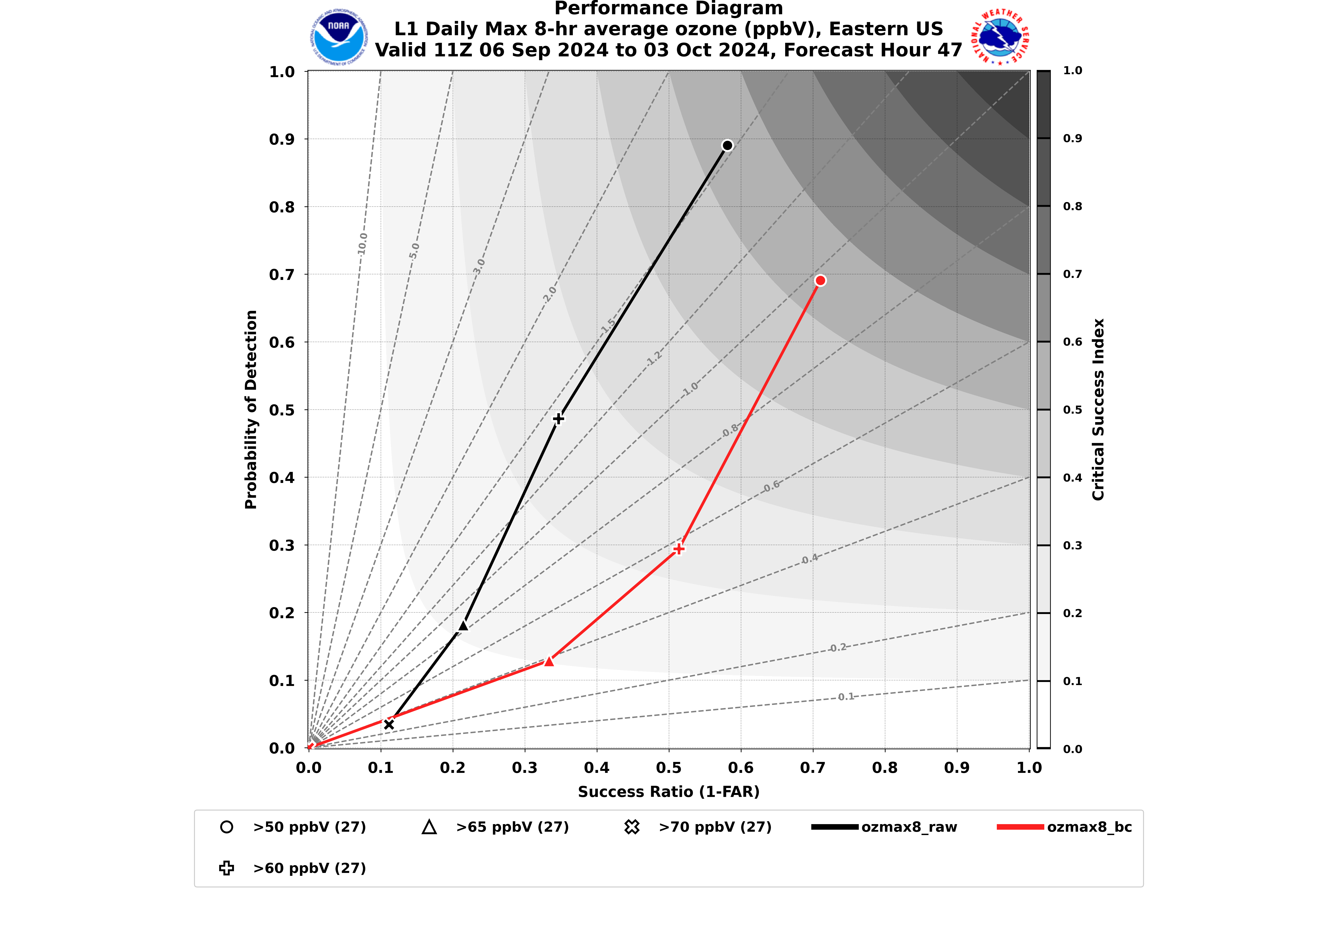
Operational AQM O₃/PM₂₅ Verification
Location: https://www.emc.ncep.noaa.gov/users/verification/air_quality/aqm/prod/
Statistic metrics for a period of last 31 days are updated daily.
Multiple verification regions (Bukovsky Regions and grouped regions)
O₃/PM₂₅ mean concentration of observed, raw model, and bias corrected by predicted hours
Performance diagram for daily Max 8HR-AVG O₃ and 24HR-AVG PM₂₅ (day 1-3 prediction)

Slide 5
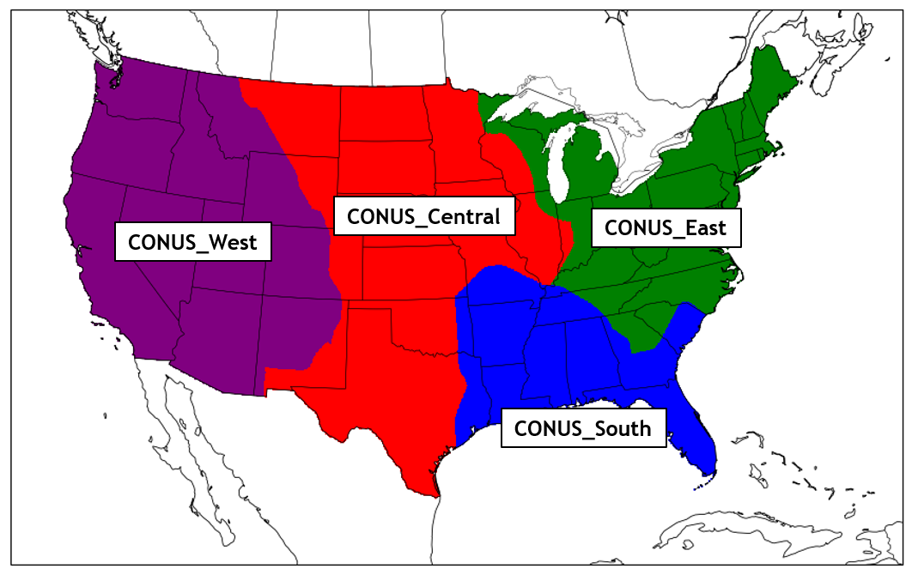
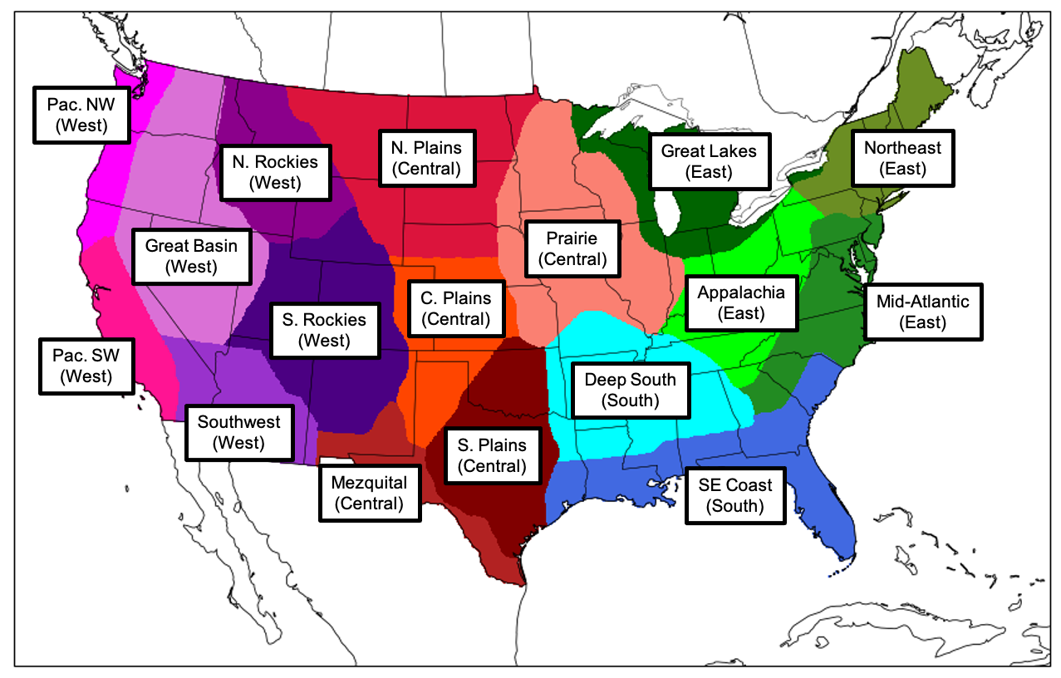
EVS Verification Regions
Bukovsky Regions were developed to group areas of similar regional climatologies.

Slide 6
Model Performance Comparison
AQMv7.0.7 and AQMv7.0.8
Ozone and PM_{2.5}
June-August 2024
12z cycle run and day 2 forecast
CONUS_East, CONUS_Central, CONUS_South, and CONUS_West

Slide 7
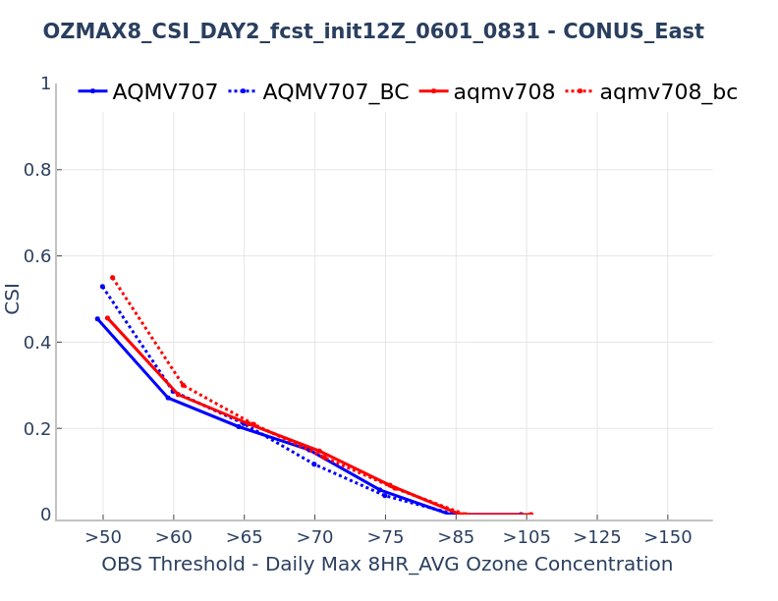
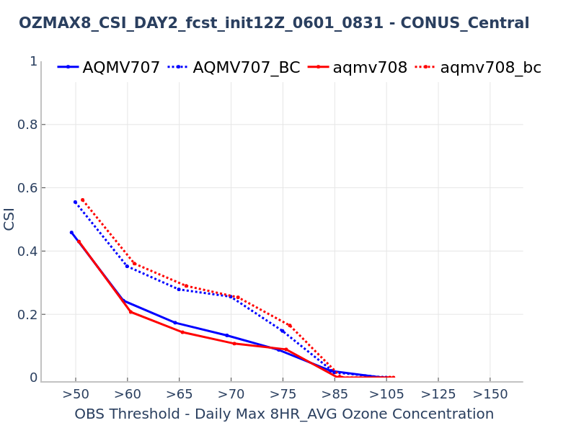
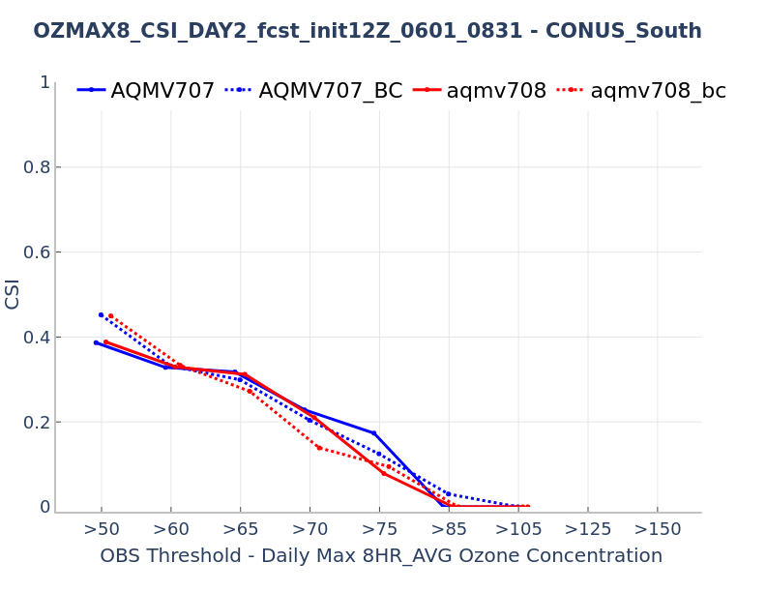
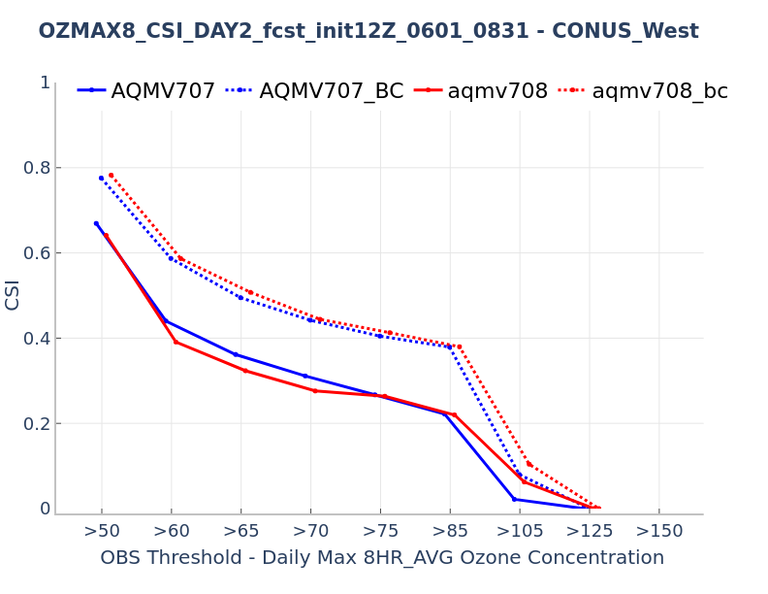
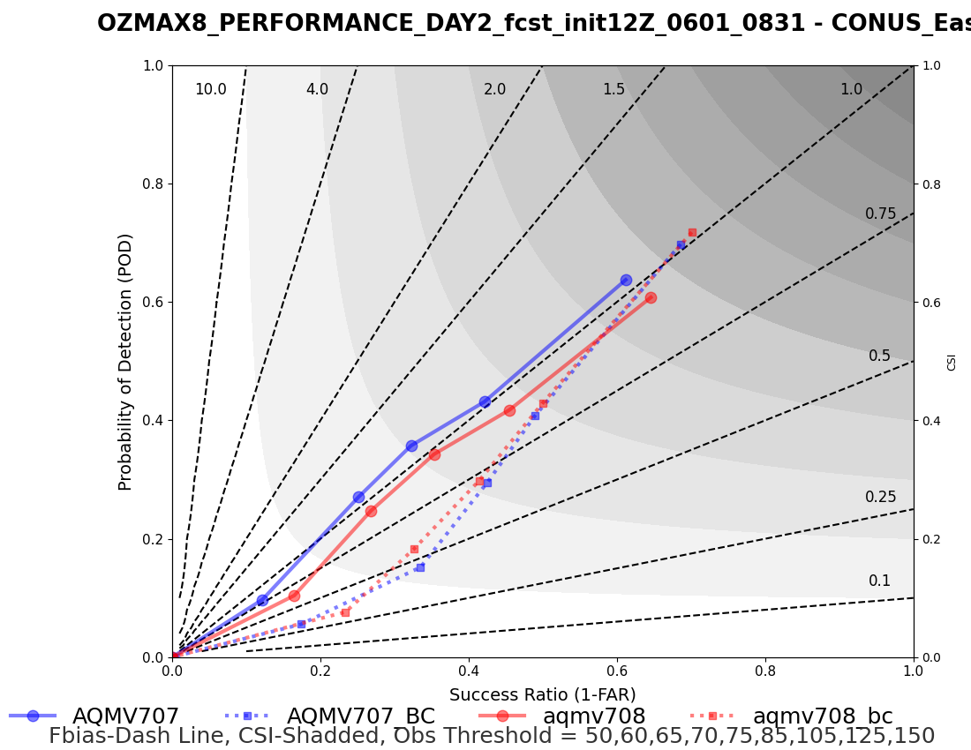
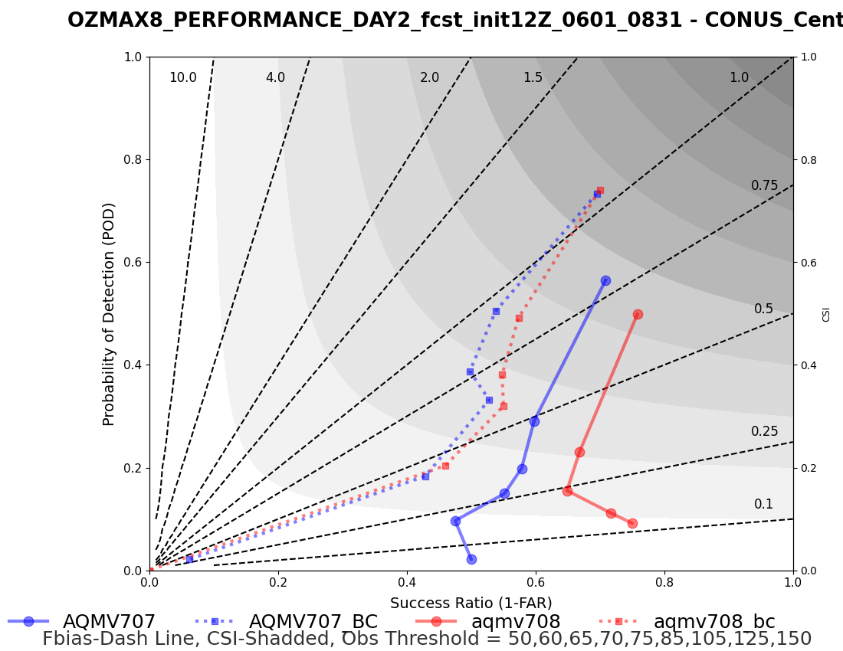
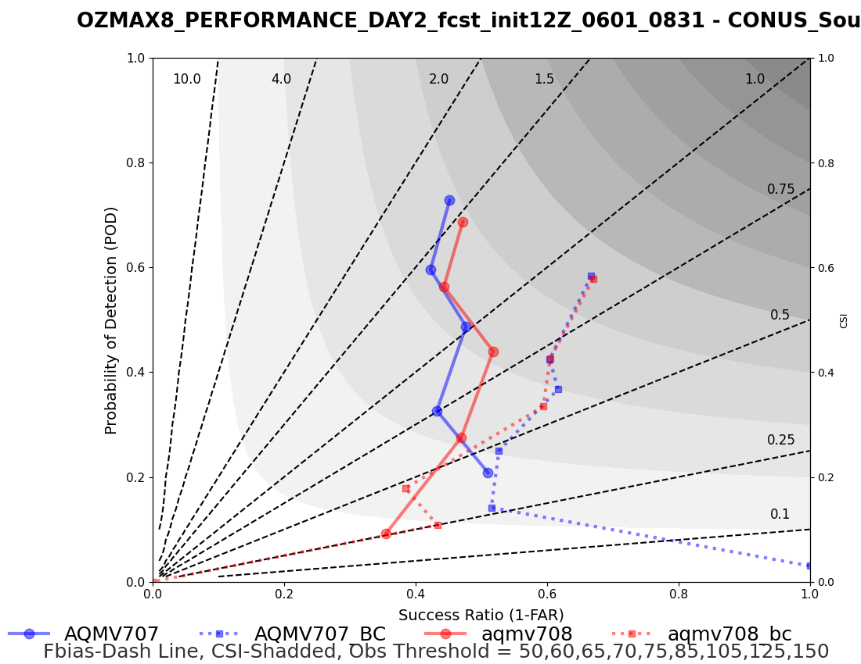
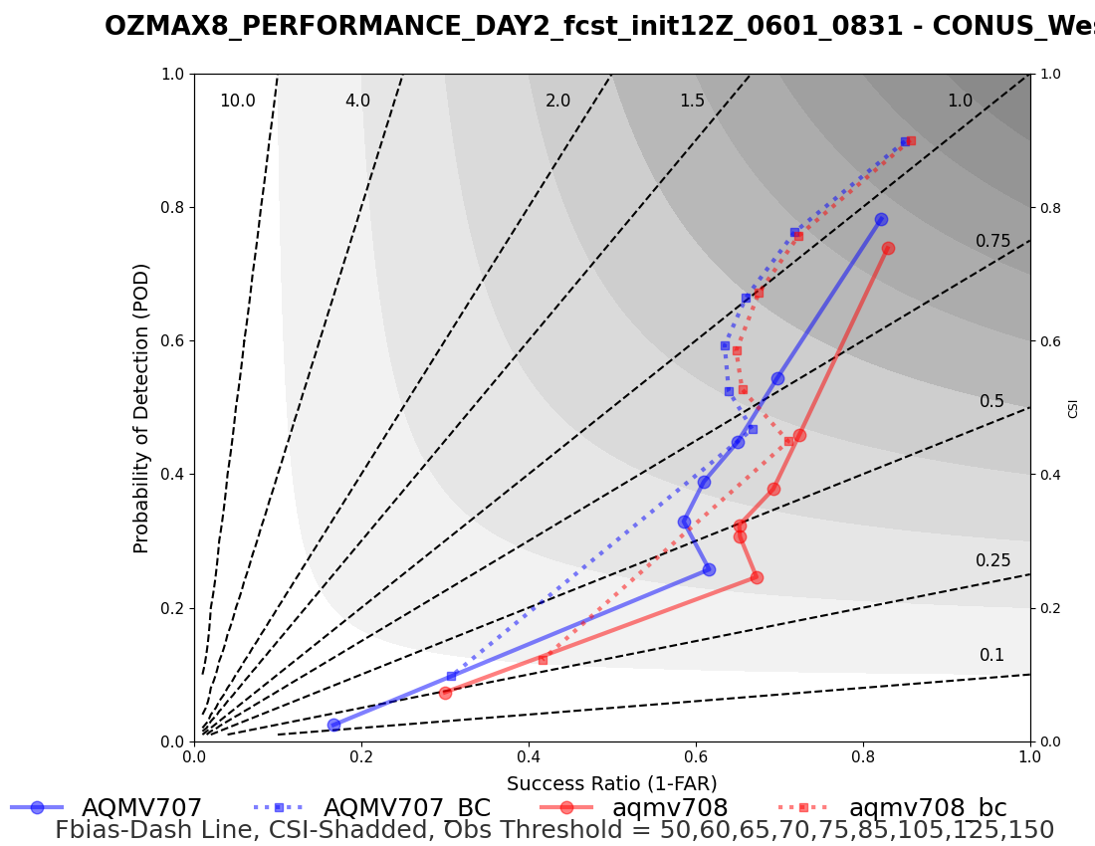
Daily Maximum 8HR-AVG O₃
Conus_East
Conus_Central
Conus_South
Conus_West
Slightly worse in higher threshold
Slightly better in higher threshold
Underestimates events
Underestimates events

Slide 8
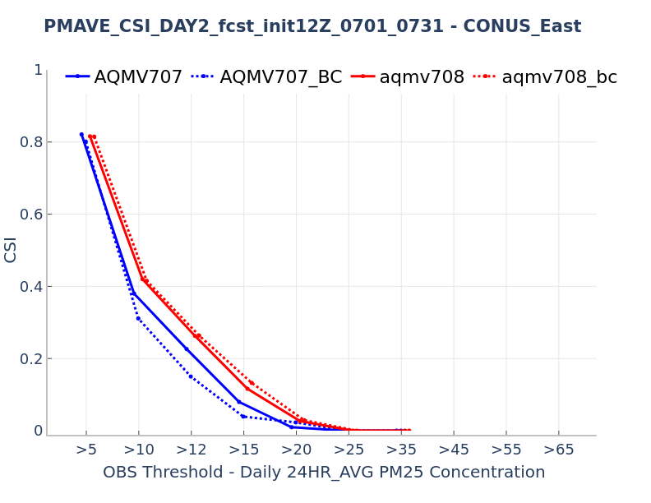
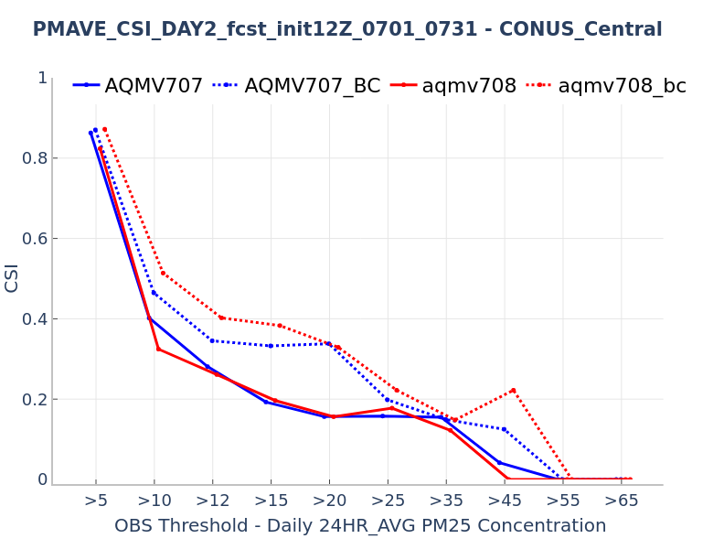
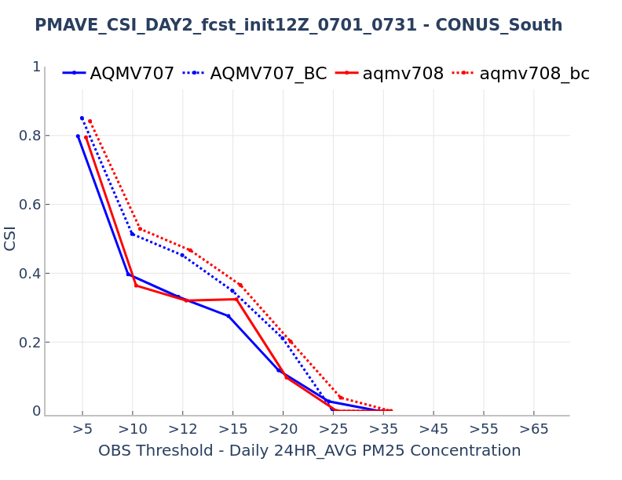
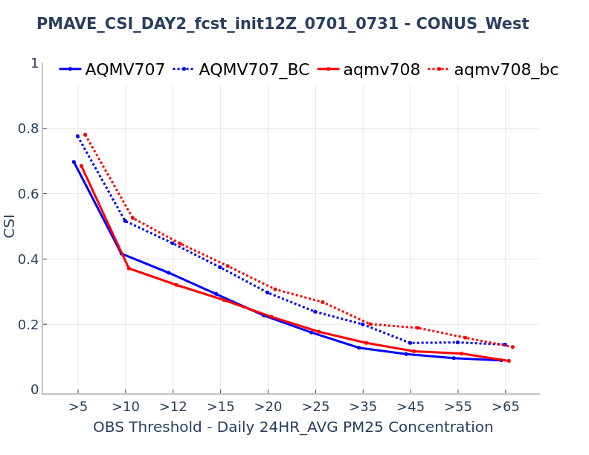
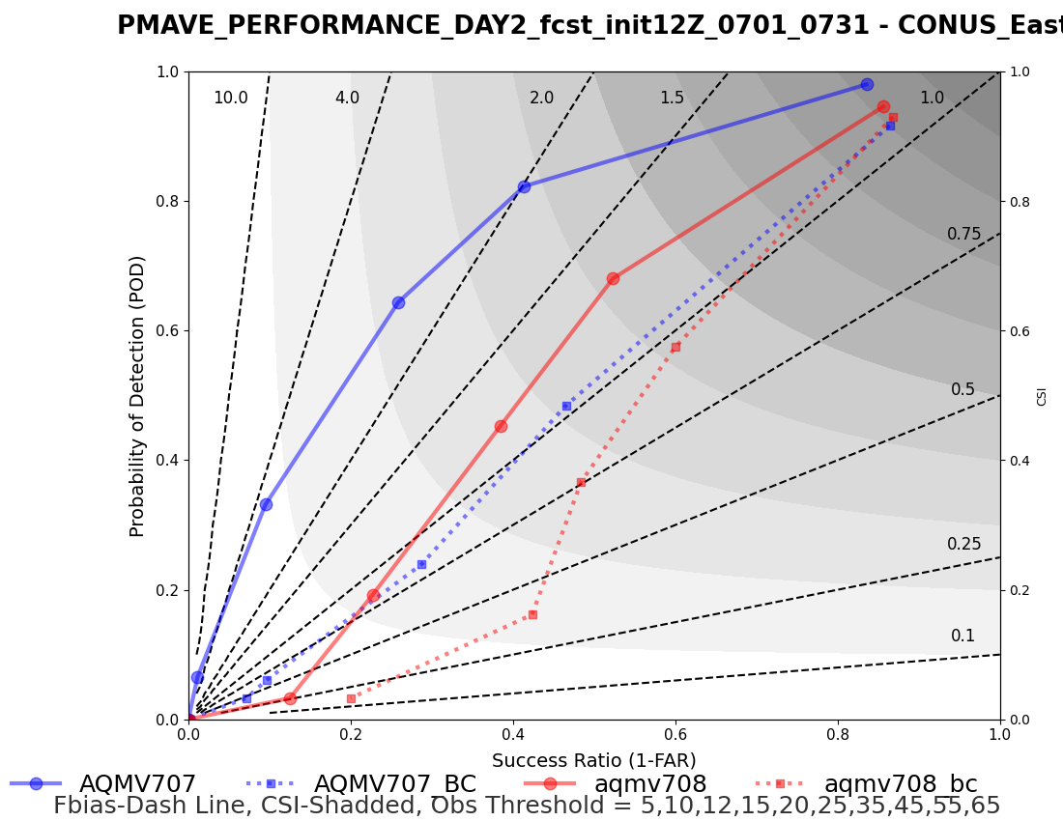
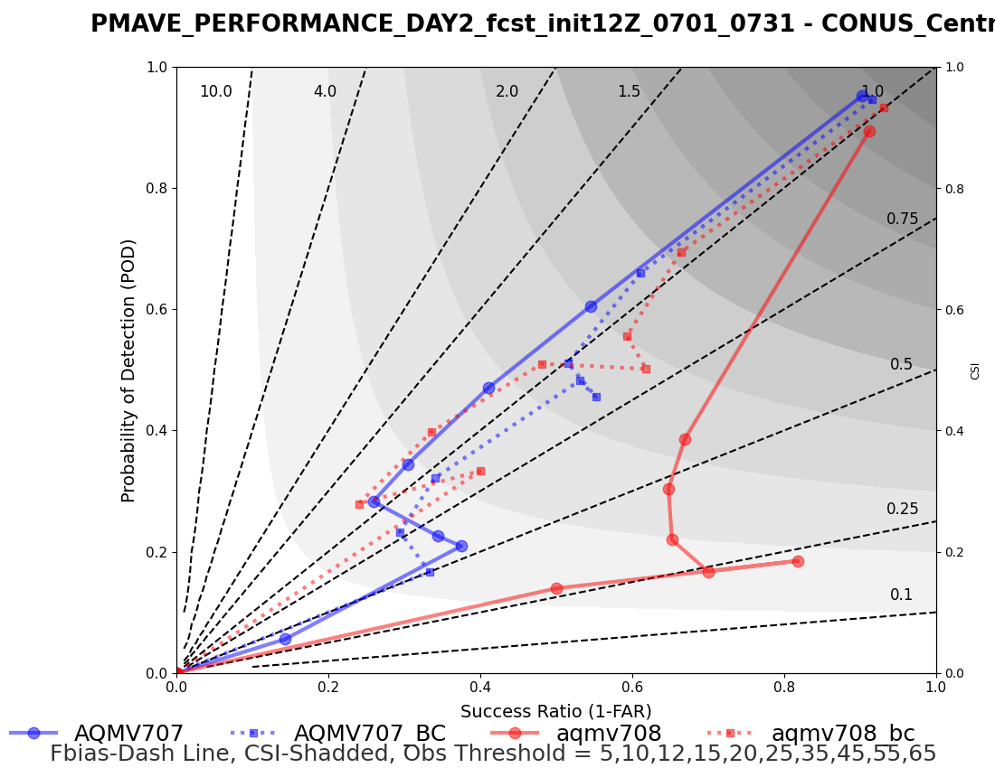
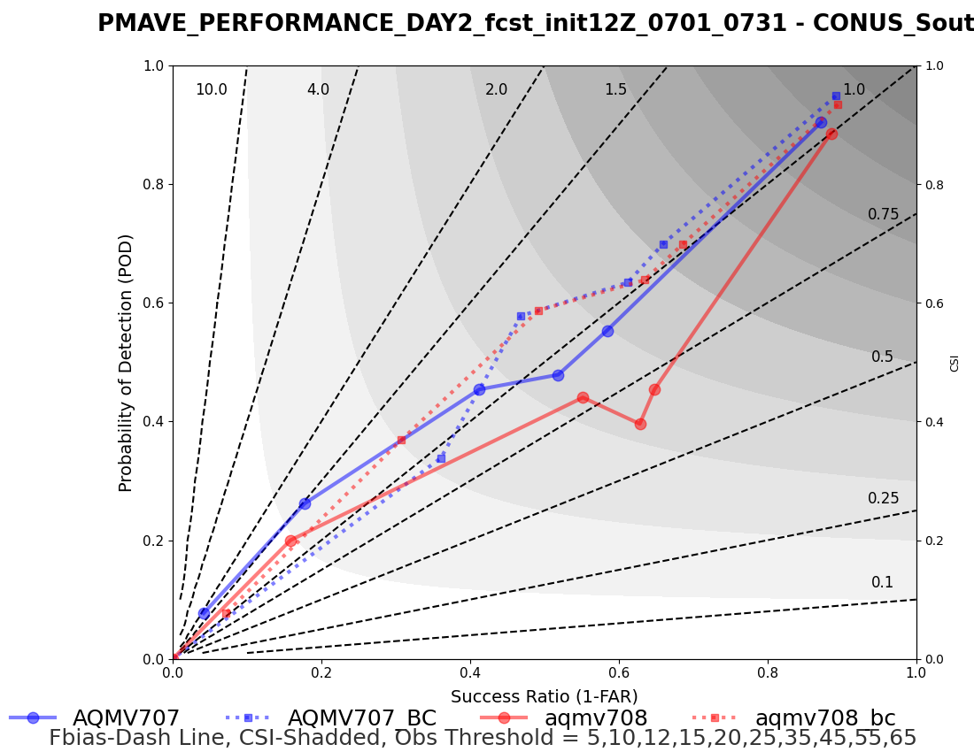
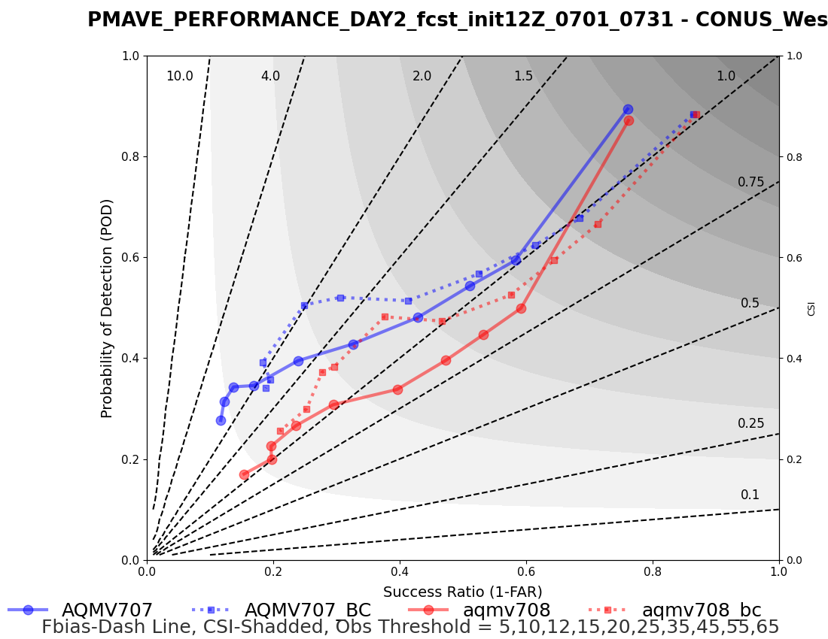
24HR-AVG PM25
Conus_East
Conus_Central
Conus_South
Conus_West
Slightly worse in higher threshold
Slightly better in higher threshold
Events prediction improved
Underestimates events

Slide 9
Summary
NCEP's operational AQM model is verified with the EMC Verification System (EVSv1.0).
The operational website/products reveal the mean performance of operational AQM of previous 31 days in near real-time.
AQMv7.0.8 was implemented on October 1 2024. It has a similar model performance as compared to AQMv7.0.7, but with a slightly better performance in the CONUS_West.
EVSv2.0 will include more AQM verification graphics and performance metrics as well as last 90 days performance in AQM operational websites. EVSv2.0 is scheduled to be implemented in Fall 2025.
Notes:
Please provide feedback on the EVS for both operational and developmental verification and validation – on any additional statistics metrics figures you are interested and users-defined regions to facilitate your assessments. EMC will try our best to provide the requested materials with the consideration of available disk space and resource.

