Slide 1
AirFuse A multi-pollutant fusion system
Barron H. Henderson^{1,4} and Phil Dickerson^{1,4}
Co-authors: Pawan Gupta^{2,4}, Shobha Kondragunta^{3,4}, Yang Liu^{4,5}, Alqamah Sayeed, Hai Zhang^{3,4}, Janica Gordon⁵, Halil Cakir¹, Brett Gantt¹, Benjamin Wells¹, Marcus Proctor^{6,7}, Steven Proctor^{6,8}, Youngsun Jung⁹, and the HAQAST AirNow Teams⁴
¹US EPA Office of Air Quality Planning and Standards; ²National Aeronautics and Space Administration; ³National Oceanic and Atmospheric Administration / National Environmental Satellite, Data, and Information Service; ⁴NASA Health and Air Quality Applied Sciences Team and Tiger Teams; ⁵North Carolina Agricultural and Technical State University; ⁶AirNow Data Management Center; ⁷Tantus Technologies Inc.; ⁸GoldSystems Inc.; ⁹National Oceanic and Atmospheric Administration / National Weather Service
Disclaimer: The views expressed in this presentation are those of the authors and do not necessarily reflect the views or policies of the U.S. Environmental Protection Agency.

Slide 2
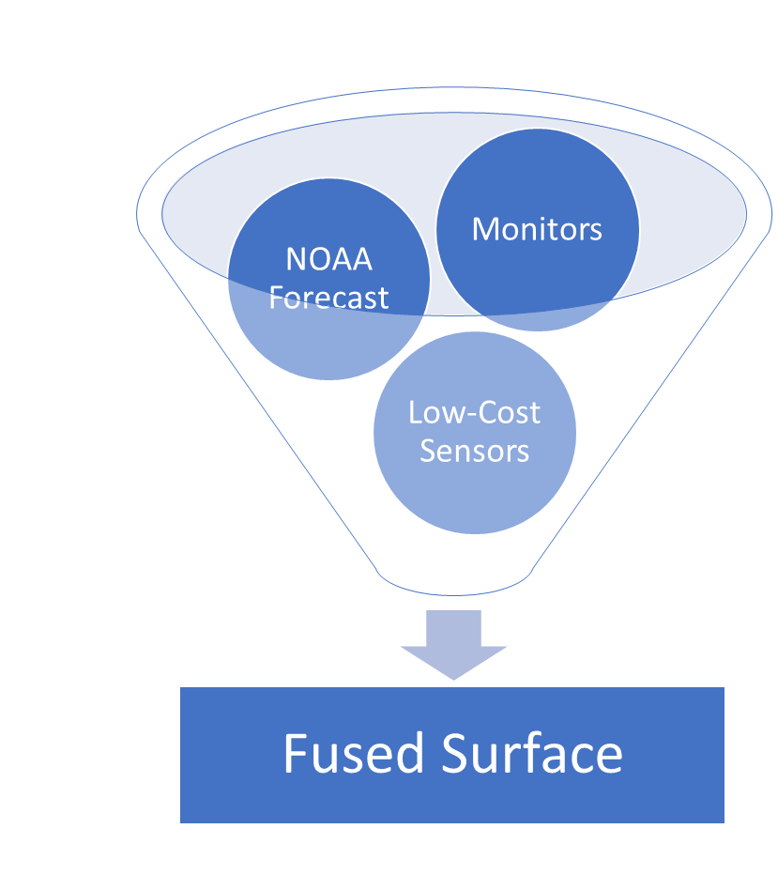
AirFuse: better air quality maps for AirNow
Satellite
(not yet)
AirFuse is a method of combining multiple observation sources
An OAQPS (AQAD & OID) collaborative product
Developed with input from NOAA and NASA collaborators
Tests show provides better skill than current AirNow mapping methods
AirFuse brings together data from multiple sources to improve estimates over any single data source
Pilot will include NOAA forecast modeling, AQ monitors and PurpleAir PM_{2.5} sensors
Future enhancements could include incorporation of satellite data to cover unmonitored areas

Slide 3
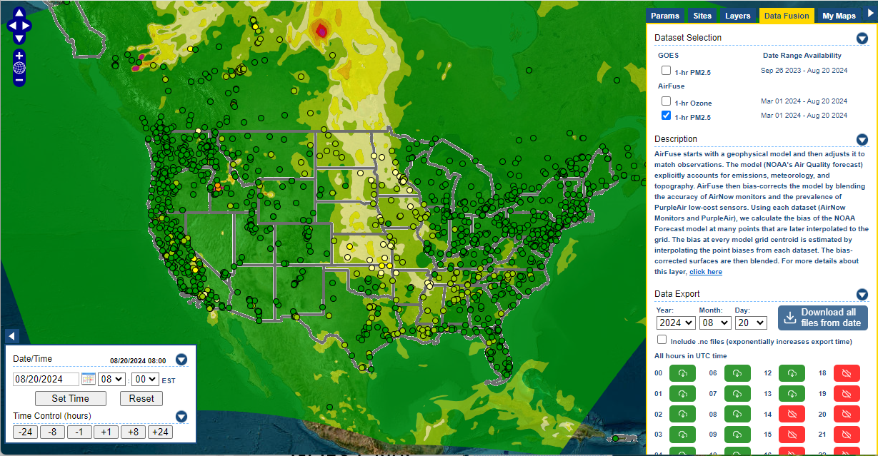
How-to: https://airnowtech.org/
Login to ANT
Choose Navigator
On Navigator, choose the Data Fusion tab.
Select an AirFuse Layer
Thanks AirNow team!

Slide 4
Pilot Goals
Pilot AirFuse in AirNowTech from March 2023 to March 2024
State/Local/Tribal Agency input is critical
What is working well?
What needs improvement?
We want your feedback to ensure there are no surprises
During the pilot
Investigate incorporation into other parts of AirNow
AirNow reports highest-monitor AQI in SLT defined groups*
Better AQI maps may allow for more local information
So, what is AirFuse and how does it work?
Okay, but how has AirFuse been doing?
*Groups are called reporting areas and their scope changes from day to day.
Notes:
*Groups are called reporting areas and their scope changes from day to day.

Slide 5
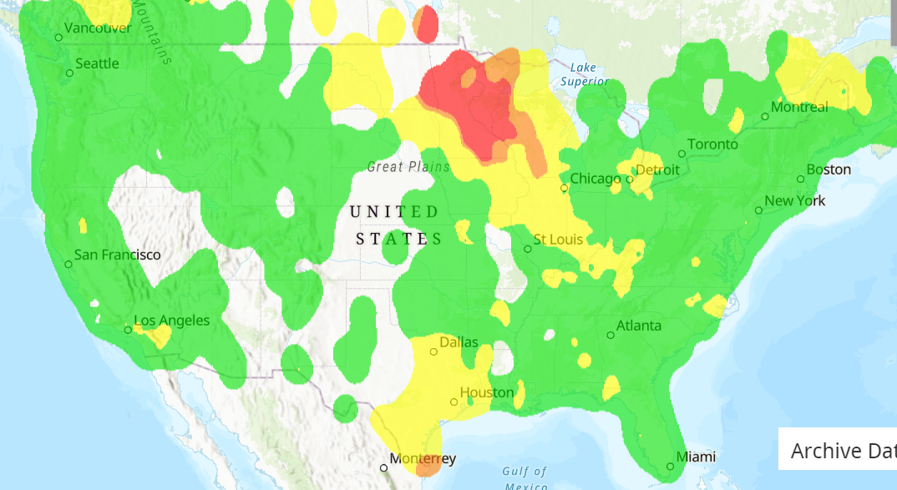
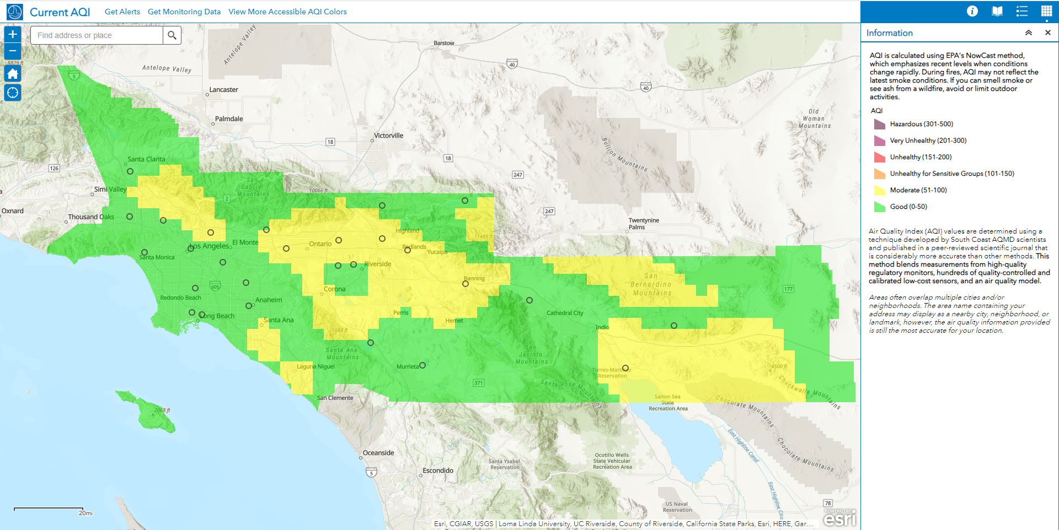
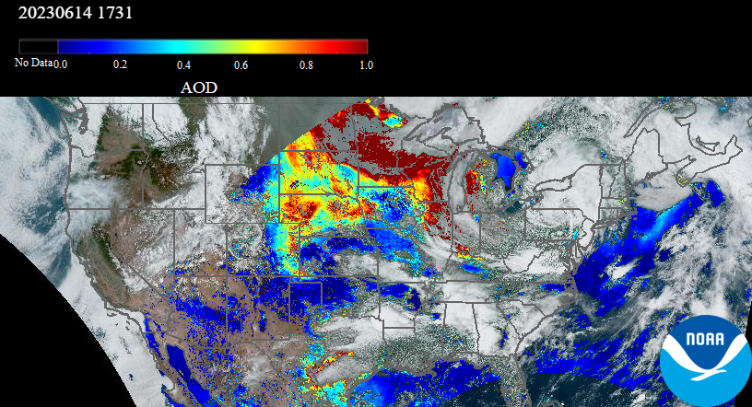
AirFuse
Example Day in AirNow and Aerosol Watch
AirFuse uses a NOAA’s forecast and integrates multiple sources of observations.
8x+ more PurpleAir sensors than monitors
Increased the spatial coverage of monitored particulate matter.
Spoiler alert: sensor data improves predictions.
Near-real-time satellite observations
Recent development by NOAA/NESDIS/STAR
NASA HAQAST project connecting AirNow to NOAA geostationary satellite data
Ideally, use similar methods for ozone too.
Yellow in between green monitors must be from fusion.
2023-06-14 11:53

Slide 6
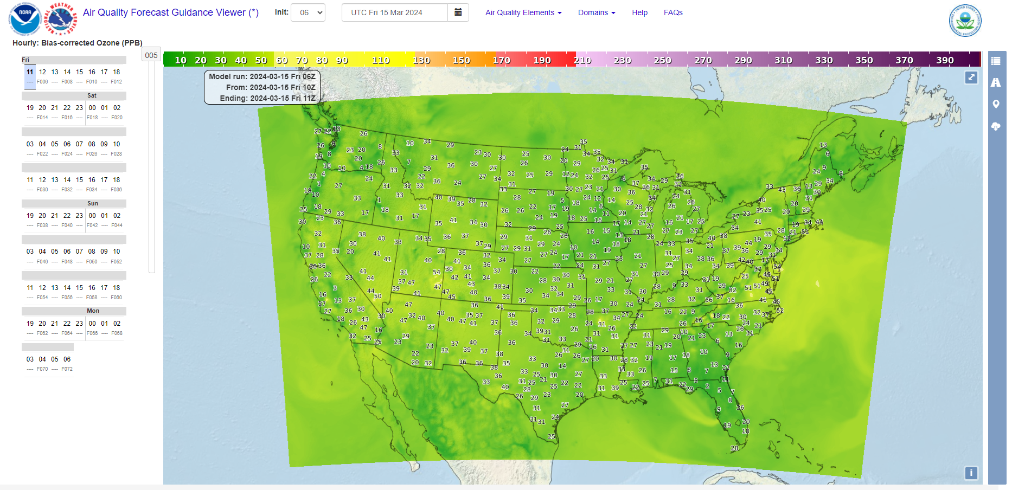
Starts with a numerical forecast.
All models are wrong, some are useful.
NOAA reports a bias corrected forecast.
Forecasts concentration with CMAQ.
Forecast bias at monitors (Kalman Filter Analog)
Interpolates bias to grid cells and correct model.
– George Box
https://digital.mdl.nws.noaa.gov/
Why not use this directly?
We don’t have to forecast the bias, it already happened.
Correcting based on multiple observations.
Notes:
EPA Fire and Smoke Map

Slide 7
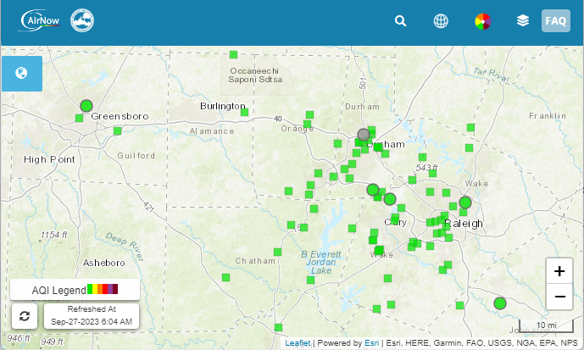
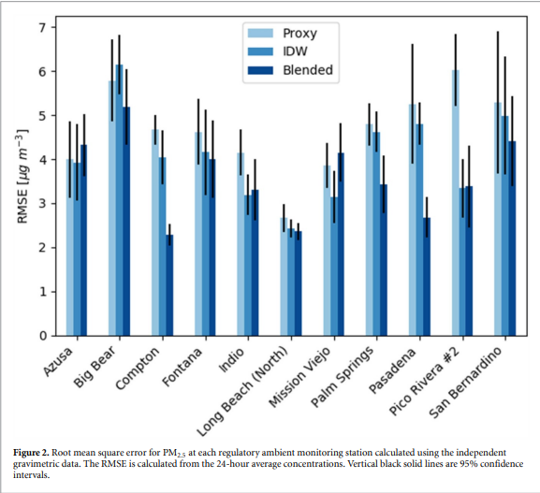
Monitors and PurpleAir sensors
Fire and Smoke Map
Way more in RTP
Many agencies report monitor data to AirNow
~1000 reporting monitors per hour
Publicly available thru AirNowAPI
Gold standard data!
PurpleAir low-cost sensors with EPA correction
Barkjohn et al. 2021 developed a national correction
When PurpleAir is less than 210 micrograms/m3, PM is reduced by 0.0862 x Relative Humidity% (50%: -4.31 and 35%: -3.02)
South Coast uses a similar system with PurpleAir
Schulte et al (2020) residual Kriging
NOAA Forecast model
Model Correction : Y = M_{n} - Krig(M_{n} – O_{n})
Observations (O) from both AirNow and PurpleAir
Improved performance of PM2.5 in leave-one-out validation and compared to Federal Reference Monitors
What about satellites?
2x in Greensboro
Better RMSE in Los Angeles
Schulte et al 2020 (10.1088/1748-9326/abb62b)

Slide 8
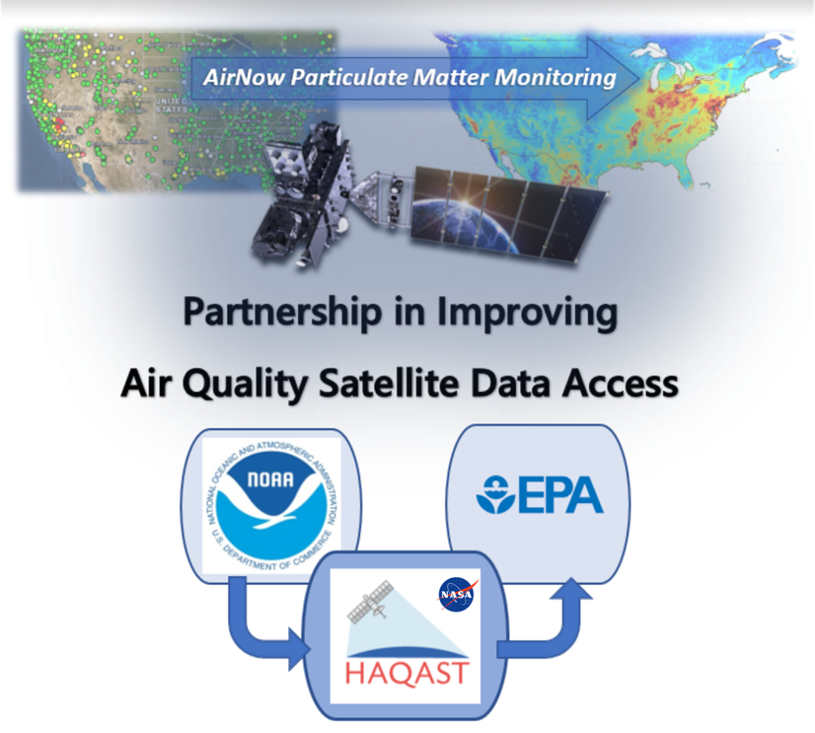
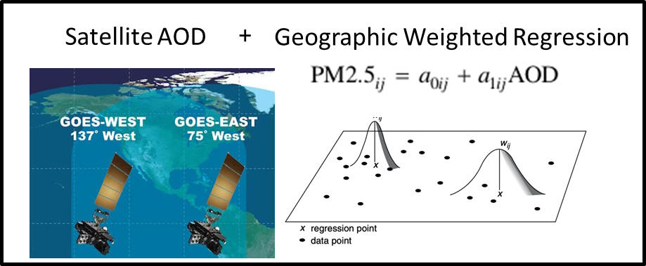
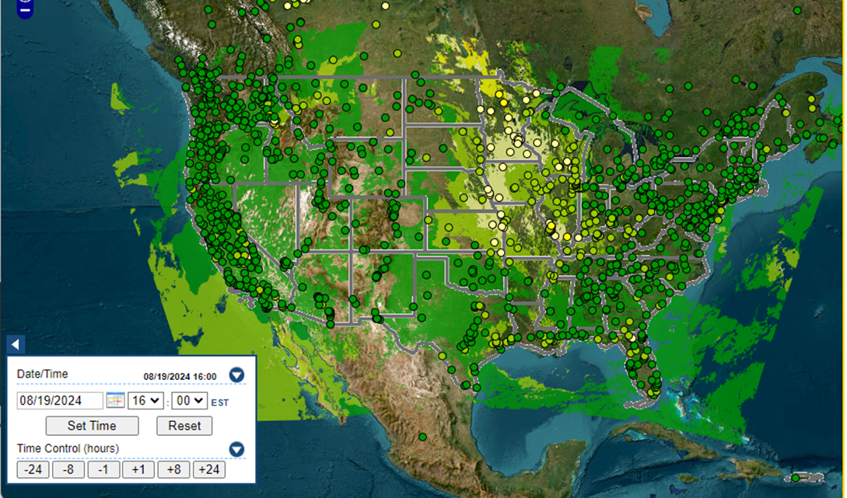
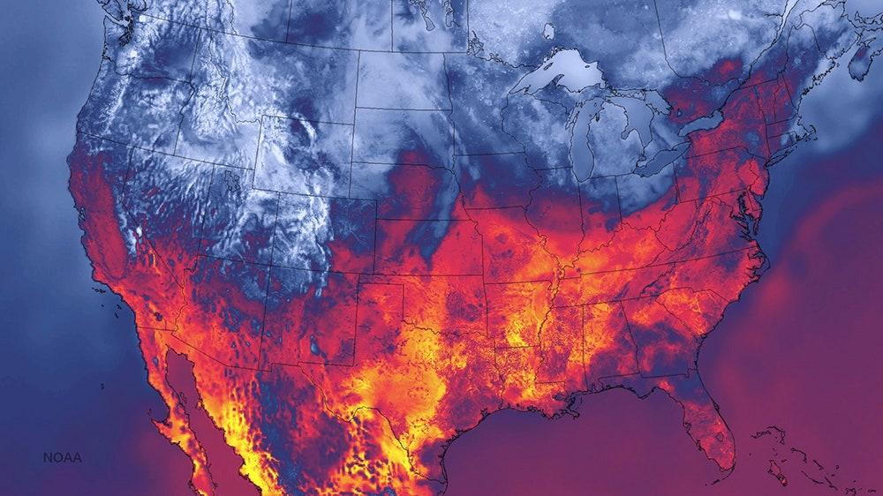
GOES-PM25
HAQAST “AirNow” Tiger Team
Team Lead: HAQAST investigator Pawan Gupta
Partners: Phil Dickerson and Barron Henderson with the US Environmental Protection Agency (EPA), and Shobha Kondragunta with the National Oceanic and Atmospheric Administration (NOAA)
HAQAST Members and Collaborators: Jingqiu Mao, Yang Liu, Kel Markert, Robert Levy, Randall Martin, Amber J. Soja, Martin Stuefer, Jenny Bratburd, Emily Gargulinksi, Yanshun Li, and Daniel Tong also contribute to this team.
Yang Liu
[1]
Pawan Gupta
2024 Team led by Yang Liu
Available on AirNow Tech
GOES AOD
Machine Learning
14 Blended
Deep Neural Networks
[2,3]
[4]
Hourly product with gaps
[5]
Population-weighted N Days with Observations
NOAA HRRR Model (3km)
Bratburd et al.: Air Quality Data When You Need It: Incorporating Satellite Data Updates into AirNow, EM Plus, 2022.
Zhang et al.: Nowcasting Applications of Geostationary Satellite Hourly Surface PM2.5 Data. Weather and Forecasting, 37(12), 2313-2329, 2022. doi: 10.1175/WAF-D-22-0114.1
Sayeed et al: Deep Neural Network bias corrections (submitted);
O'Dell et al.: Public Health Benefits from Improved Identification of Severe Air Pollution Events with Geostationary Satellite Data, GeoHealth, 2023.
Notes:
Available on AirNowTech
Geostationary satellites are home bodies while polar satellites are globe trotters.
Geostationary Operational Environmental Satellites (GOES) stare at the US all day long.
Not like polar satellites passing once at 10am and once at 2pm (if you have two satellites)
From an US perspective, GOES satellites view the western US from the pacific and the eastern US from the atlantic.
Shobha Kondragunta and Hai Zhang fused with AirNow monitors by a geographic weighted regression.
Pawan led a tiger team to connect that data back to EPA.
There are a lot of technical details, but the upshot is simple.
We extensively evaluated the data, applied machine learning corrections, and we’re putting that data into various airnow systems like AirNowTech.
This is a great idea: federal agencies working together to provide tangible benefits to the American people from satellite data.
This project is taking that data a step further.
We’re going to bring the satellite data

Slide 9
How-to: https://airnowtech.org/
Login to ANT
Choose Navigator
On Navigator, choose the Data Fusion tab.
Select an AirFuse or GOES Layer
Thanks AirNow team!

Slide 10
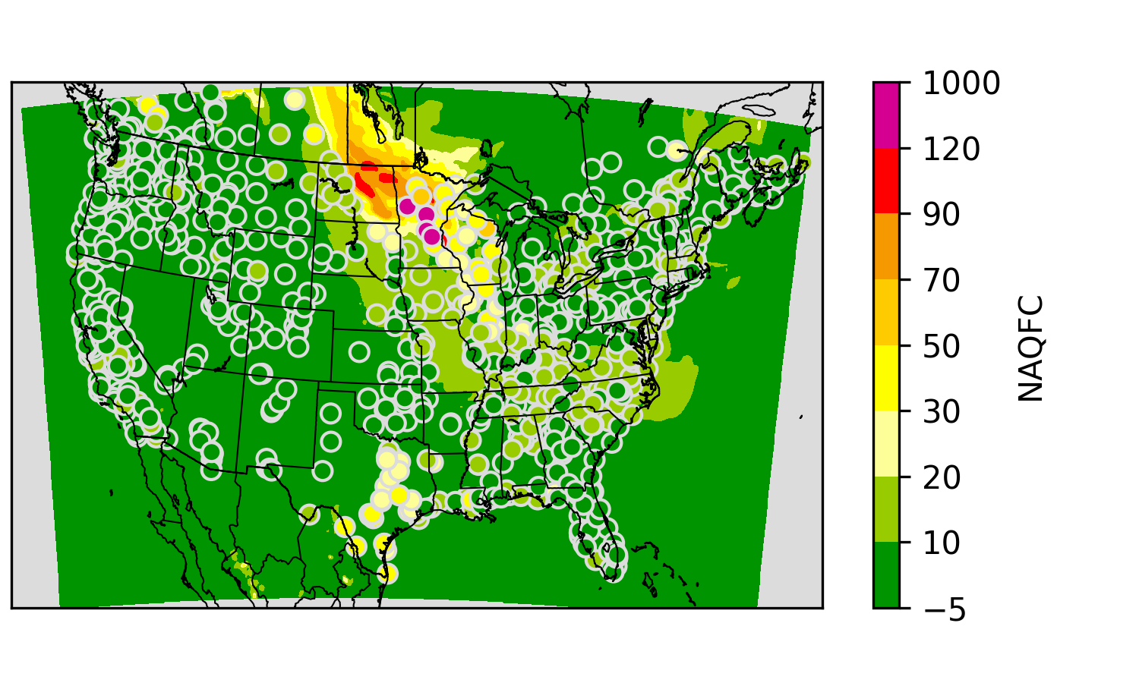
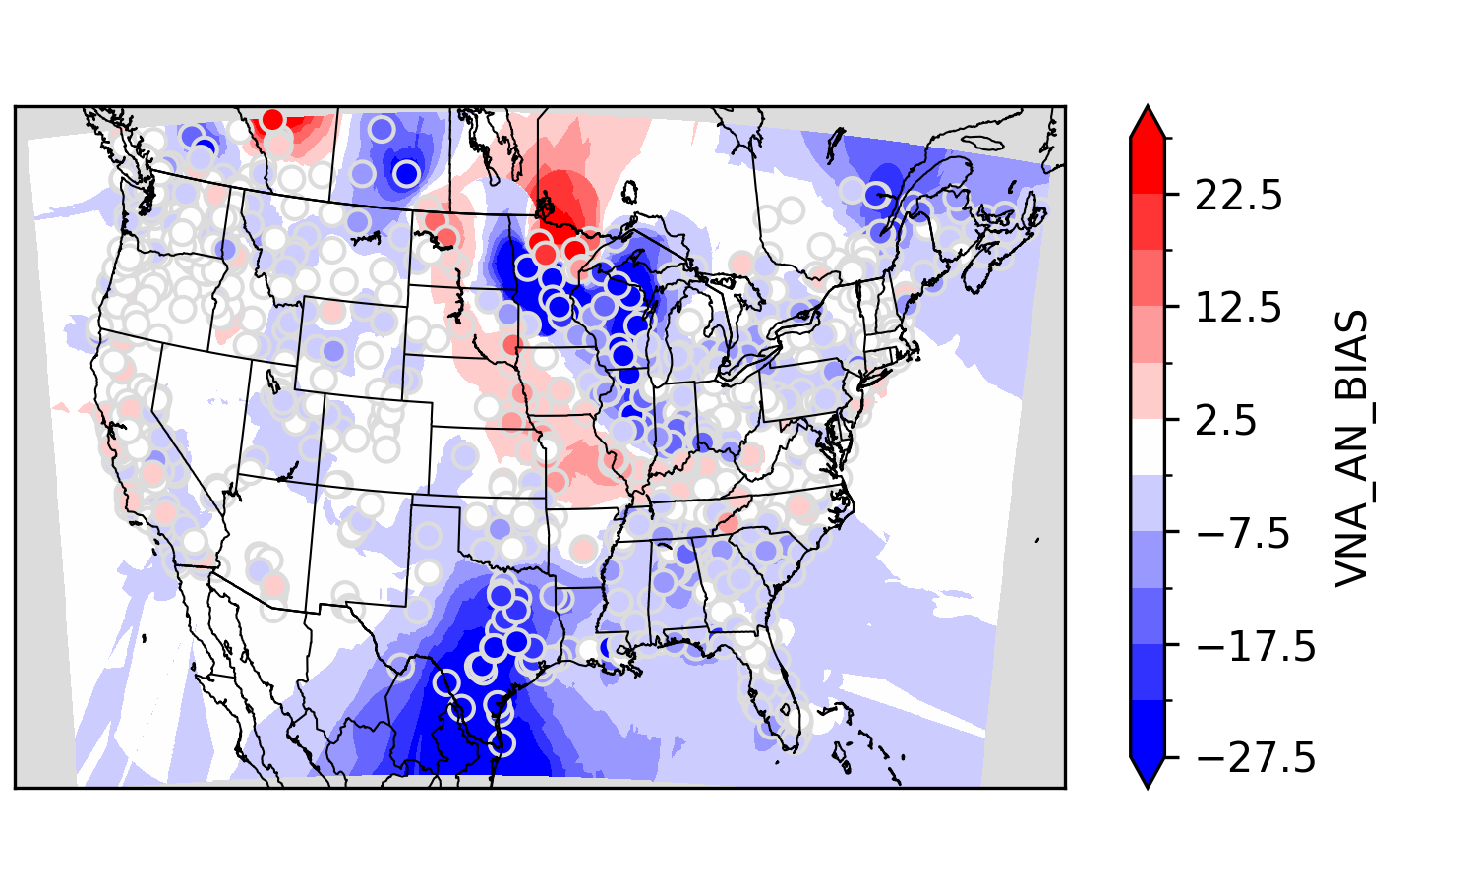
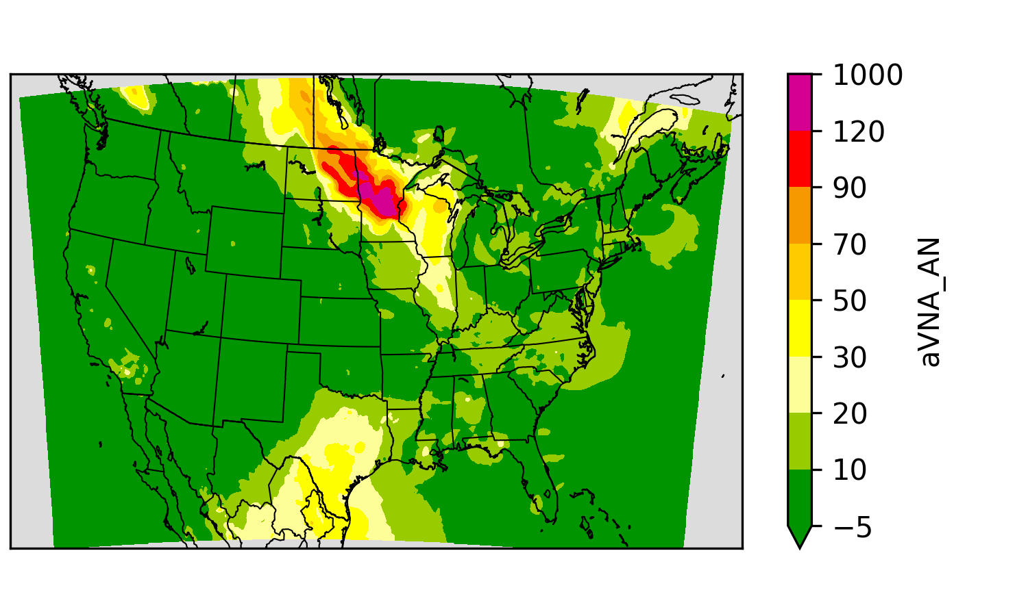
Hourly National-scale Fusion Ensemble
One layer from AirNow monitor (Y_{M}) observations:
mostly regulatory grade hourly observations
paired with collocated grid cell.
Model
Monitor Bias
Y_{M} = f(model, monitor)
*A multiplicative corrector of this type is called extended VNA (eVNA)
**Piece-wise regression as in Fire and Smoke Map
Notes:
NAQFC

Slide 11
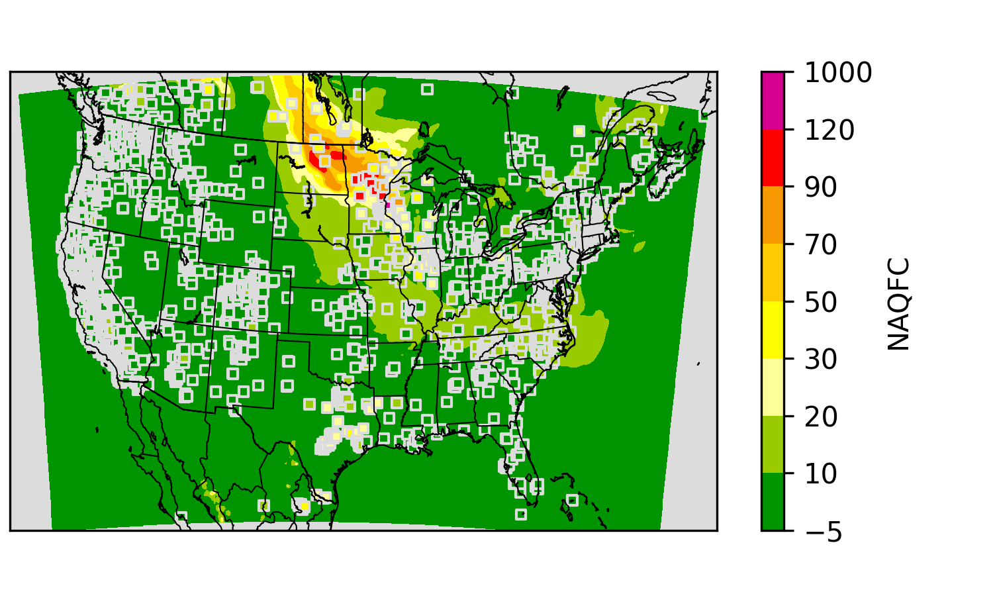
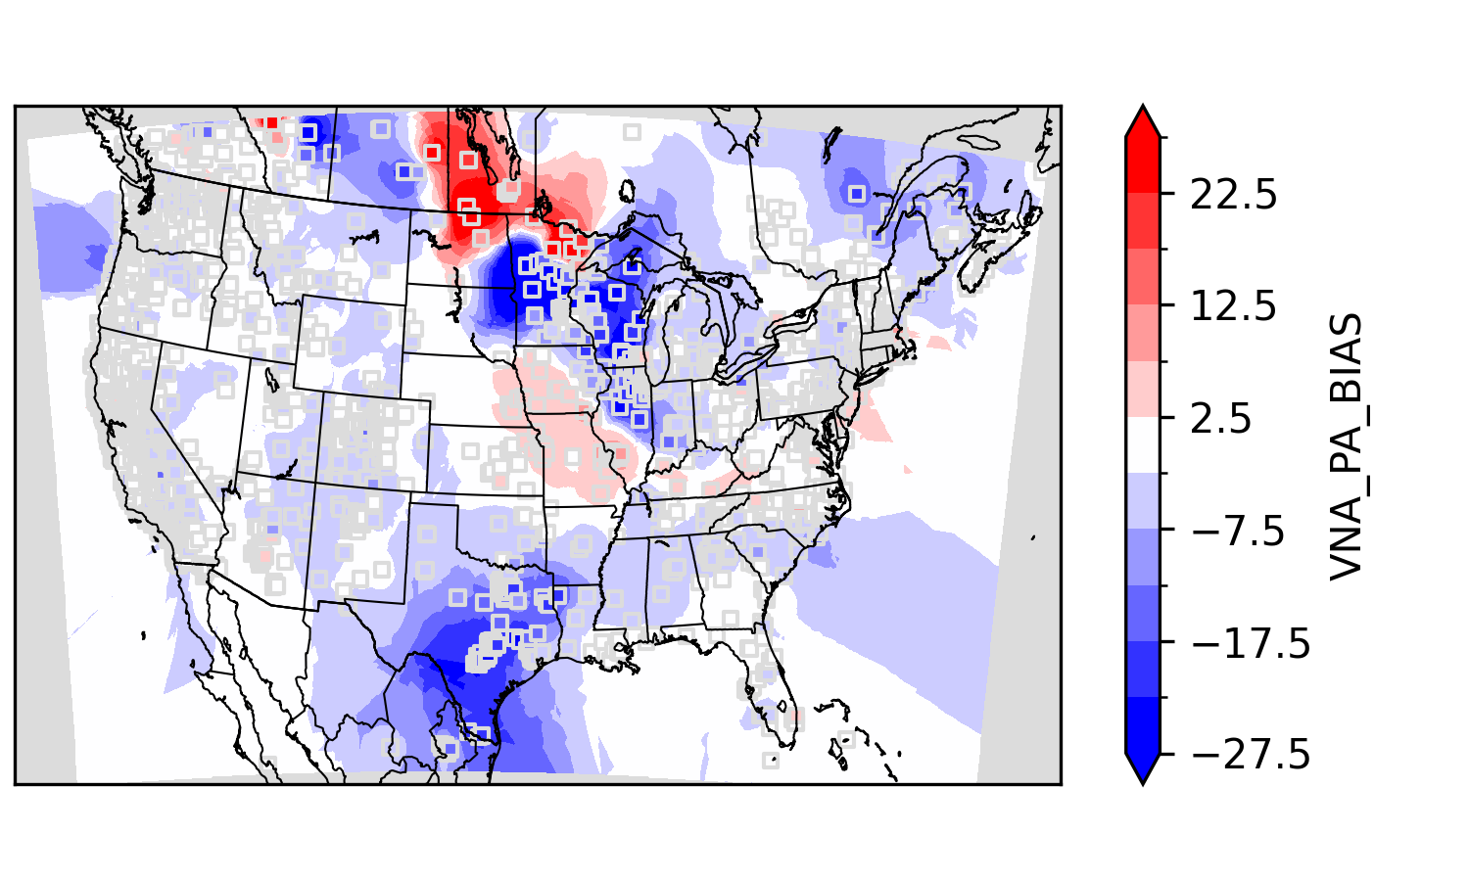
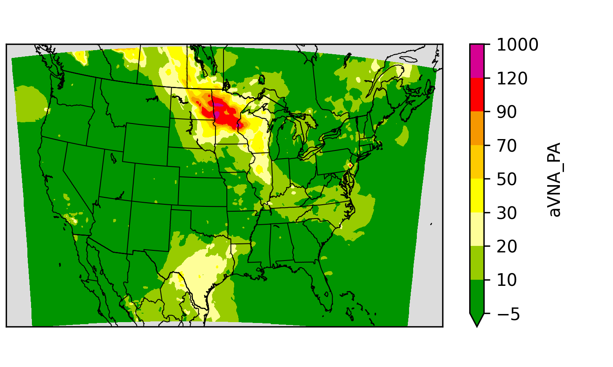
Hourly National-scale Fusion Ensemble
One layer from AirNow monitor (Y_{M}) observations:
mostly regulatory grade hourly observations
paired with collocated grid cell.
One layer from PurpleAir (Y_{P}) observations:
low-cost sensor hourly observations with calibration**
Aggregated within grid cells to create a pseudo-observation
Model
PurpleAir Bias
Y_{P}=f(model, sensors)
Y_{M}
Notes:
NAQFC

Slide 12
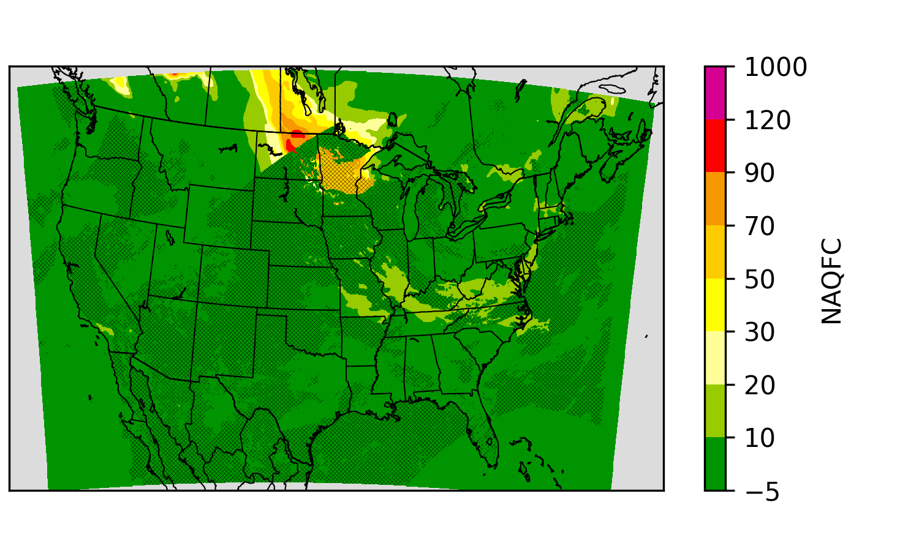
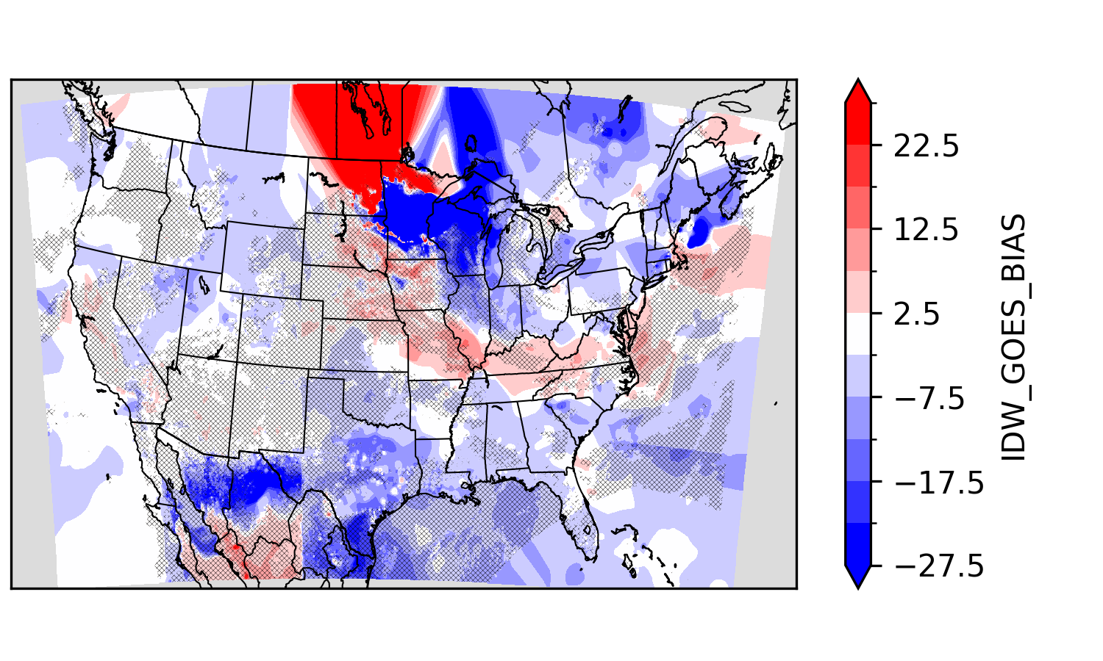
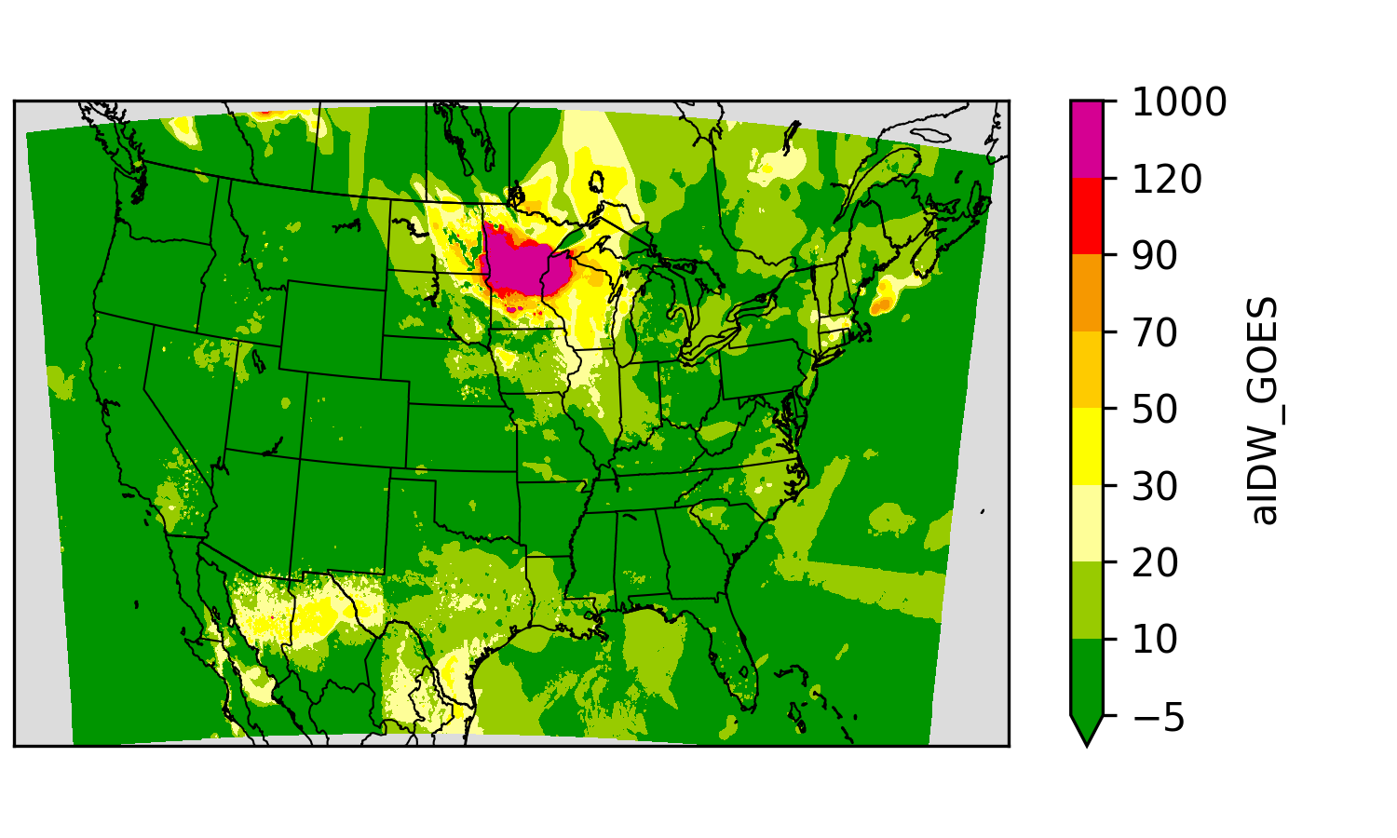
Hourly National-scale Fusion Ensemble
One layer from AirNow monitor (Y_{M}) observations:
mostly regulatory grade hourly observations
paired with collocated grid cell.
One layer from PurpleAir (Y_{P}) observations:
low-cost sensor hourly observations with calibration**
Aggregated within grid cells to create a pseudo-observation
One layer from GOES-PM25 (Y_{G}) “observations”
Geostationary Operational Environmental Satellite (GOES)
Not clustered like monitors, so VNA interpolation is not necessary.
Model
GOES-PM25 Bias
Y_{G} = f(model, satellite)
Y_{M}
Y_{P}
Notes:
NAQFC

Slide 13
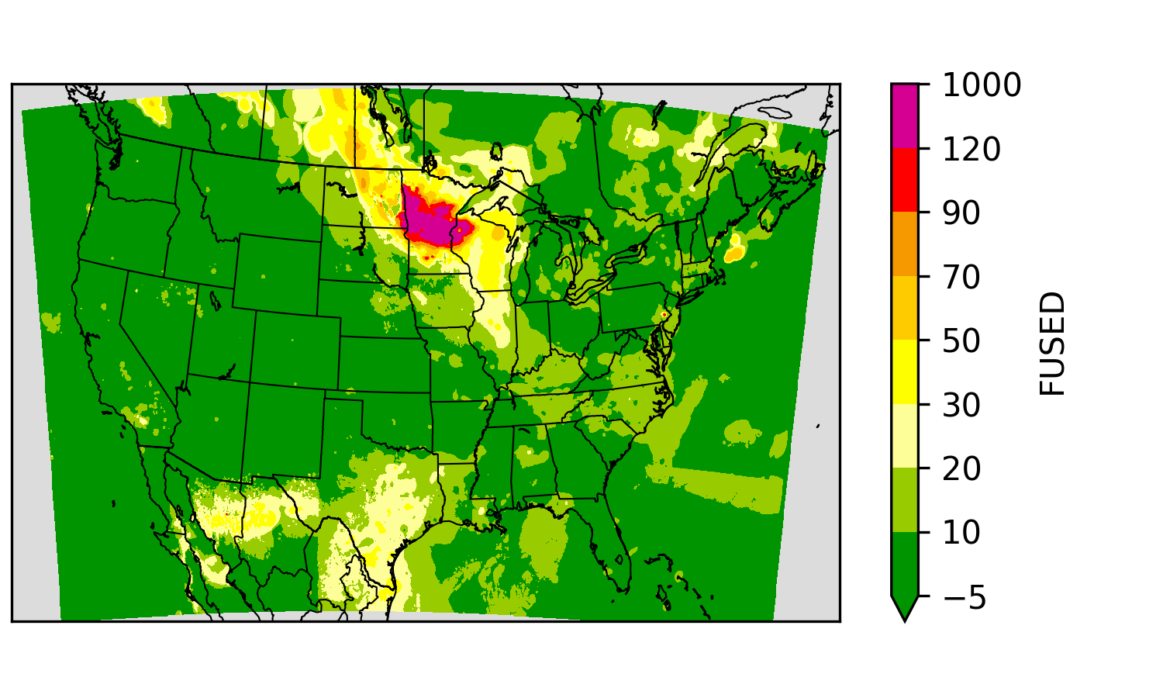
Hourly National-scale Fusion Ensemble
One layer from AirNow monitor (Y_{M}) observations:
mostly regulatory grade hourly observations
paired with collocated grid cell.
One layer from PurpleAir (Y_{P}) observations:
low-cost sensor hourly observations with calibration**
Aggregated within grid cells to create a pseudo-observation
One layer from GOES-PM25 (Y_{G}) “observations”
Geostationary Operational Environmental Satellite (GOES)
Not clustered like monitors, so VNA interpolation is not necessary.
Weight based on distance (m, p, g)
Fused = mY_{M} + pY_{P} + gY_{G}
Y_{M}
Y_{P}
Y_{G}
Notes:
NAQFC

Slide 14
Weight the ensemble of surfaces on distance
Y = mY_{M} + pY_{P} + gY_{G}
m' = (1 x d_{AN})⁻²
p' = (2 x d'_{PA})⁻² : d'_{PA} = max(d_{PA}, 3.6)
g' = 0 # Not yet!
Normalize : e.g., m = m' / (m' + p' + g')

Slide 15
Validation Methodology
Running hourly since March 6th
~30k obs/model pairs per day
~4M obs/model pairs so far
Validation by 10-fold cross validation
Validation by Leave-One-Out (LOO) validation

Slide 16
Pilot Validation Summary
Using only monitors aVNA performing worse than IDW
Including PurpleAir improves:
Prediction standard deviation,
Prediction correlation, and
Root mean squared error.
Hourly National Mean Concentration
Notes:
Hourly National Mean Concentration

Slide 17
Leave-1-out Validation: National Correlation
Standard Deviation
Days with large spatial variability are hard for any technique.
Especially with mobile monitors in fires
NAQFC has a few days with spotty huge concentrations (1000s).
Adding PurpleAir “tacks” prevents large deviations.
Longer-term NAQFC filtering is probably necessary and results like these would not reach the public.
Correlation
Notes:
Standard Deviation

Slide 18
Diurnal Variation of PM and AirFuse
Hourly particulate matter is highest at night during high humidity.
CMAQ forecast over does the variability
IDW and AirFuse w/out PurpleAir capture that variability.
Adding PurpleAir mutes the diurnal variability.*
Mean Conc Hour of Day [LST]
Normalized Mean Bias
*Correction was developed from daily averages, so investigating update to correction.
Notes:
*Correction was developed from daily averages, so investigating update to correction.

Slide 19
Summary
AirNow needs an updated interpolation method.
EPA has long used models and statistical fusion to fill gaps with regulatory but has not incorporated these methods into AirNow.
Schulte et al. demonstrated including models and PurpleAir improved on simple interpolations and applied it in an AirNow-like system.
HAQAST Tiger Team evaluated GOES PM25 for real-time-applications.
Fusion with PurpleAir is ready.
Discontinuities are less stark than GOES because datasets are more spatially consistent (ie sparse in the same places).
Value of PurpleAir is obvious because they are dense near monitors.
Fusion with GOES PM25 ongoing work
HAQAST Tiger Team 2021 (Gupta) – now 2023 (Yang Liu)
Conceptually, the satellite value is highest away from monitors and sensors… making it hard to evaluate
~5% of monitors are further than 30km from their nearest withheld monitor…
Need your feedback!
Statistics will only tell us so much.
How does your area look?
When does AirFuse give weird answers?

Slide 20
How-to: https://airnowtech.org/
Login to ANT
Choose Navigator
On Navigator, choose the Data Fusion tab.
Select an AirFuse or GOES Layer
Thanks AirNow team!

Slide 21
Piloting AirFuse
AirFuse maps are available in AirNowTech!
Running hourly from now until March 2025
Preloaded back to Mar 1, 2024
Download outputs to investigate further
Get your feedback
Collect feedback from forecasters and SLTs
Like it? Great. Don’t like it? Even better.
Your input can help us make this better.
Currently, updated once per hour – may not include lately submitted data.

Slide 22
Questions?
henderson.barron@epa.gov

