Slide 1
Wildfire R&D with HYSPLIT
Hyun Cheol Kim ^{1,2}, Charles Fite^{1,3}, Sonny Zinn ¹, Tianfeng Chai ¹, Christopher Loughner¹, Ravan Ahmadov⁴, Shobha Kondragunta ⁵, Daniel Tong ³, and Mark Cohen ¹
¹ Air Resources Laboratory, National Oceanic and Atmospheric Administration, College Park, MD
² Cooperative Institute for Climate and Satellite, University of Maryland, College Park, MD
³ Dept. of Atmospheric, Oceanic and Earth Sciences, George Mason University, Fairfax, VA
⁴ Global Systems Laboratory, National Oceanic and Atmospheric Administration, Boulder, CO
⁵ National Environmental Satellite, Data, and Information Service, National Oceanic and Atmospheric Administration, College Park, MD

Slide 2
Upgrading HYSPLIT fire modeling system
Why HYSPLIT?
Fast & Linearized Lagrangian processes
TCM-based emissions inverse modeling
Ensemble fire modeling
Comprehensive fire modeling testbed
Coverage
Spatial: Local to global
Temporal: Real-time (forecast) and retrospective (research) runs
Emission: Wild to prescribed (Satellite & BlueSky)
Fire science
Plume rise algorithms – Briggs, Sofiev & Freitas schemes
Emissions inverse modeling (spatial, vertical and temporal)
Evaluation & Impact assessment
Surface and satellite inter-comparisons
Burn permit guidance & cross-border impacts assessment

Slide 3
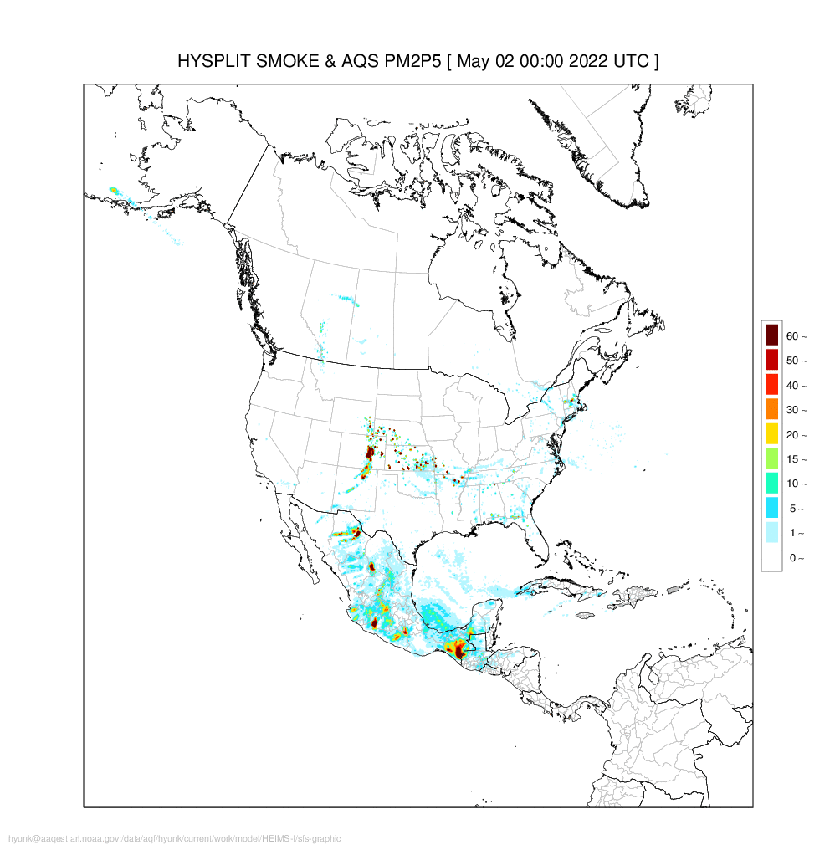
HYSPLIT fire System – Wildfire forecasts
HYSPLIT fire modeling system
HYSPLIT dispersion model
Fire emissions inventories
GBBEPx – FRP, daily
RAVE – FRP, hourly
FINN – MODIS/VIIRS fire detection, daily
Emissions inverse modeling
BlueSky – Bottom up
AQS surface observations
New Smoke Forecast System

Slide 4
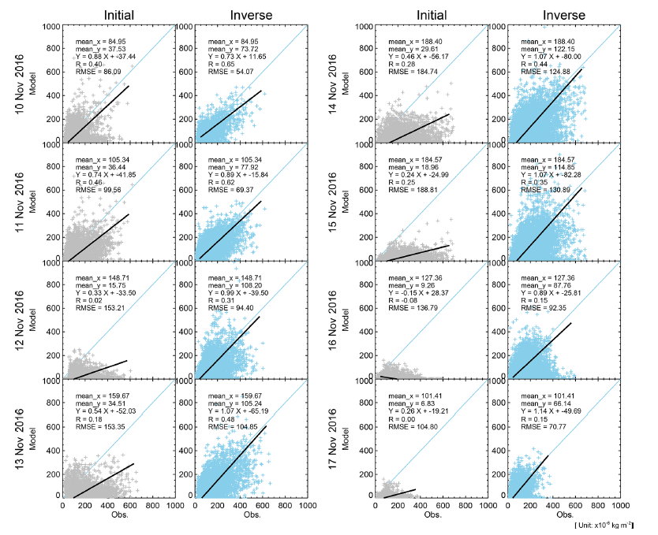
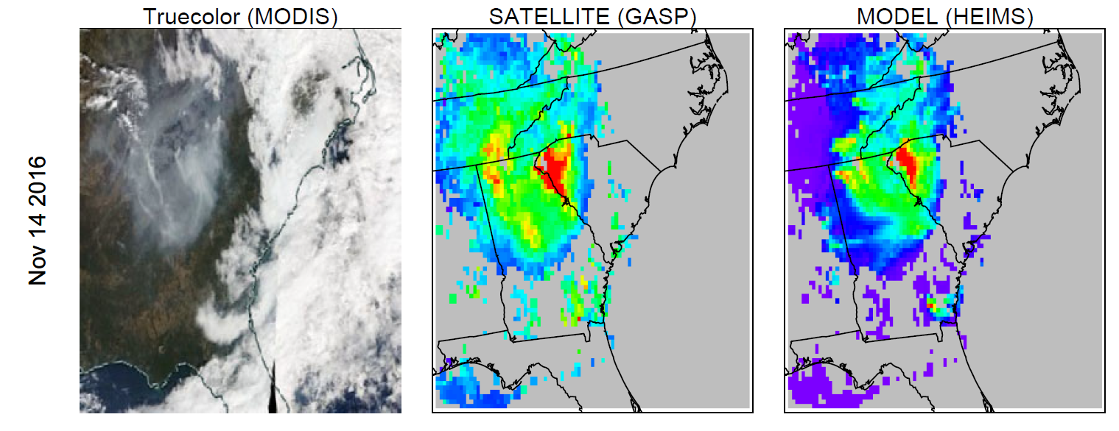
Inverse modeling of fire emissions
An independent HYSPLIT simulation starting at each HMS fire location with given starting time and duration is run with a unit source, at several possible release height to generate a Transfer Coefficient Matrix (TCM).
Source terms are solved by minimizing a cost function based primarily on the differences between model predictions and observations, following a general data assimilation approach.
Scatterplot comparison between initial and assimilated smoke mass loading using adjusted fire emissions.
HYSPLIT
OBS
First guess
Fire emissions (HEIMS-f): Smoke forecasts have been challenged by high uncertainty in fire emission estimates. The HEIMS-f is designed to assimilate wildfire emissions based on the GOES Aerosol/Smoke Product (GASP) and HYSPLIT dispersion simulations (Kim et al., 2020)

Slide 5
Wildfire events and emissions adjustment
Canadian fires (2023)
Canadian fires (2023)
Central American fires (2024)
Wyoming/Idaho fires (2024)

Slide 6
Emission adjustment (single source & multi source)
Single source adjustment
Multi source adjustment
(daily)

Slide 7
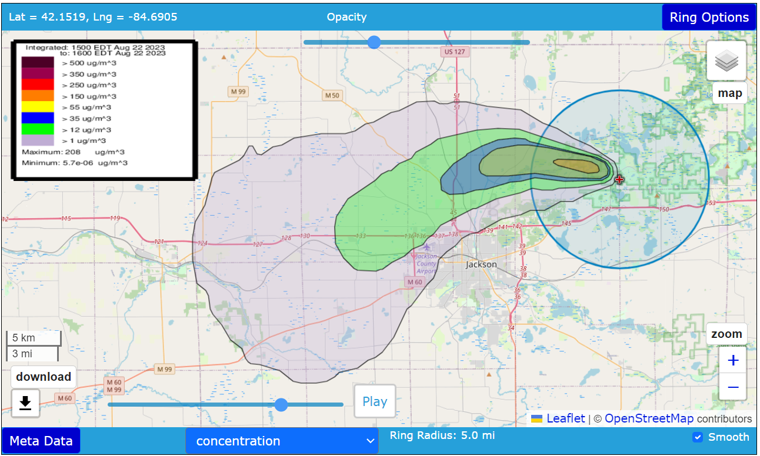
Current HYSPLIT Prescribed Burn Capability
ARL has a current capability to calculate prescribed fire emissions estimates and run either a retrospective or forecast HYSPLIT dispersion simulation for a single fire using the BlueSky emissions modeling framework (https://www.ready.noaa.gov/HYSPLIT_disp.php)
Pros: bottom-up emissions estimate, easy to use, adjustable fuel/fire info knobs.
Cons: only one fire can be run at a time

Slide 8
A multi-fire BlueSky-based emissions forecast methodology
The BlueSky framework from the USFS takes inputs of burned area, fuel load information, and meteorology to model the fuel consumption and emissions process in a bottom-up manor.
Bottom-up emissions estimates can be informative, but more difficult to use for air quality forecasts due to longer data latency times compared to NRT FRP-based emissions estimates.
We are trying to use a hybrid methodology that uses NRT FRP measurements to derive burned area estimates that can be fed into BlueSky to estimate emissions for HYSPLIT dispersion simulations

Slide 9
NRT Burned area estimation from FRP
FRE
FRP x duration x DM factor / Fuel Consumption Rate (FC) = burned area
MW x sec. x kg/MJ / kg/acre = acres
Using hourly FRE from RAVE v2
0.368 kg/MJ from Wooster et al. (2005)
Field studies compilation from van Wees et al. (2022), IGBP land cover dependent
Capped at RAVE grid cell size
Burned area can then be fed into BlueSky emissions framework
First step is to IGBP classify each fire, and then map other conversion factors by IGBP type.
If using FRE from RAVE, would have FRE resolved hourly

Slide 10
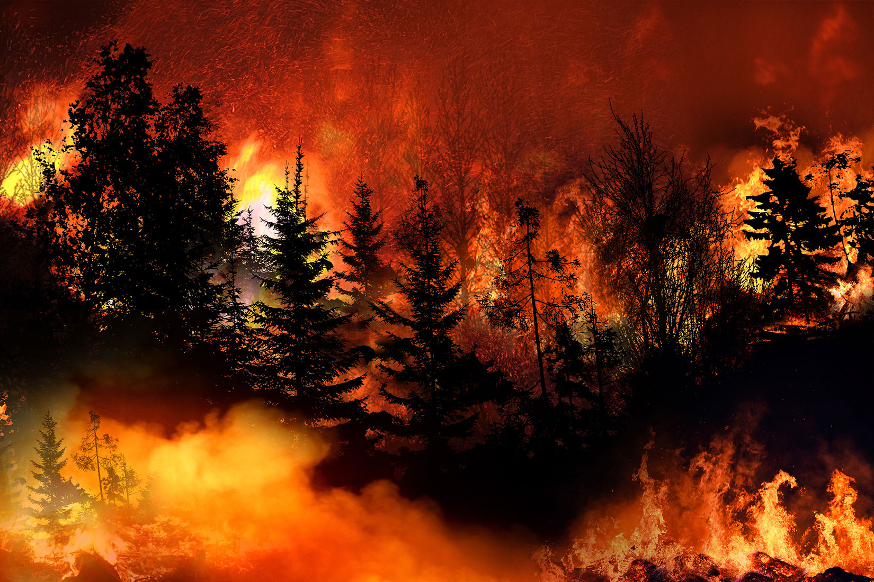
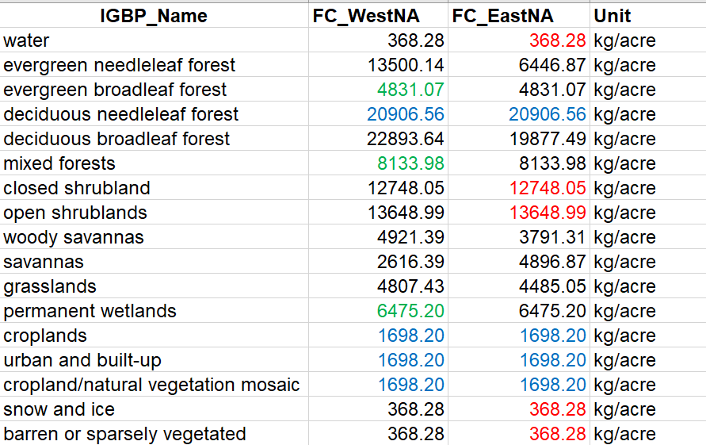
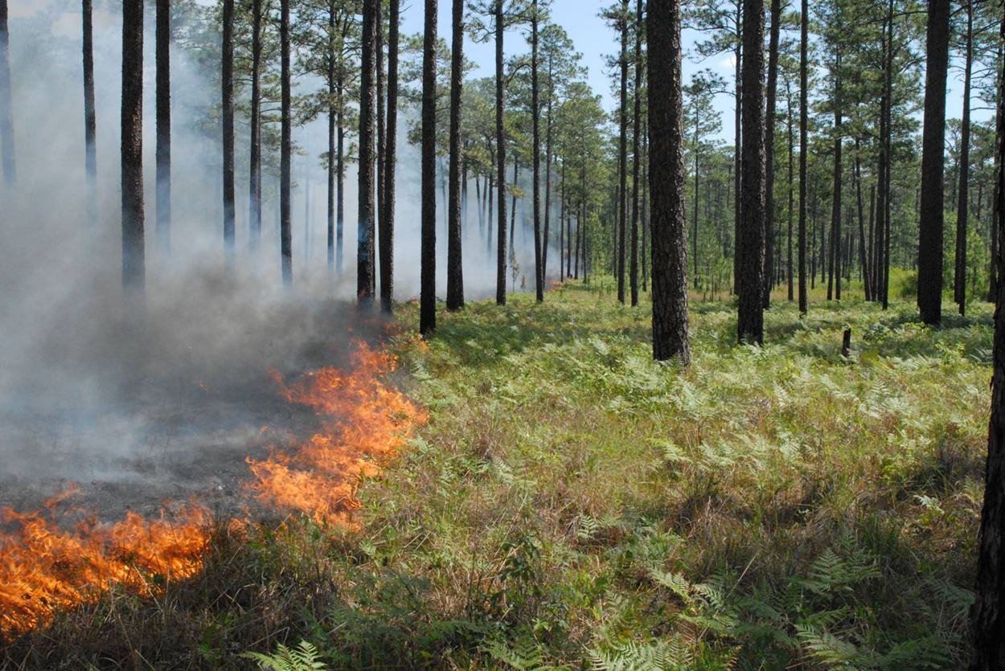
Fuel Consumption by IGBP land cover type
Western US is defined as west of 102°W
(western border of Kansas)
Western US:
13,500 kg/acre
Evergreen Needleleaf Forest
Eastern US:
6,446 kg/acre
van Wees et al. (2022)

Slide 11
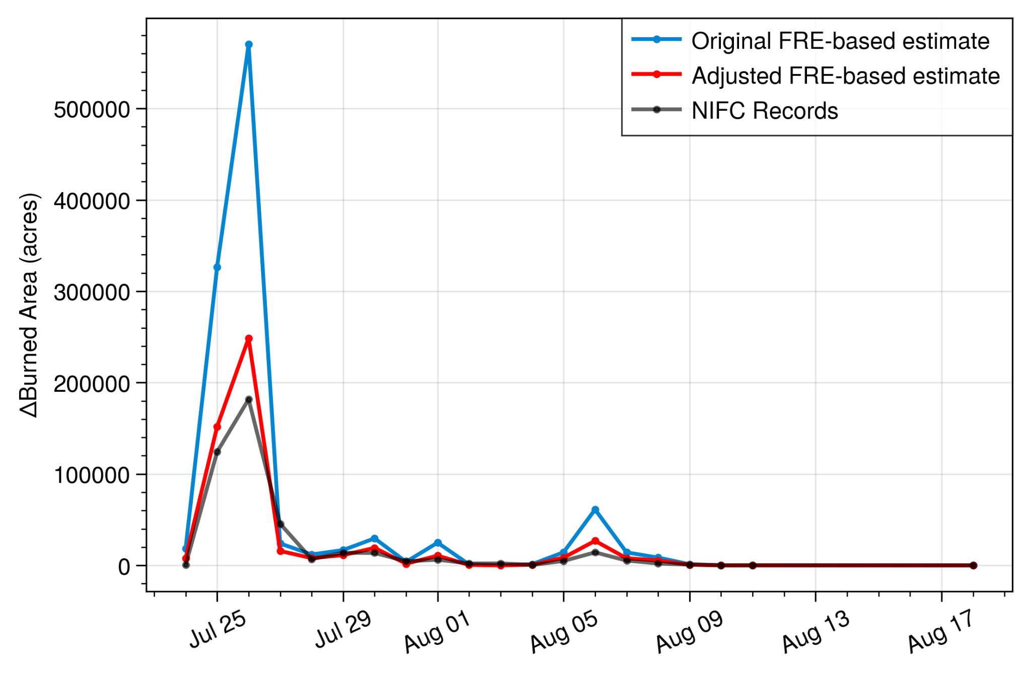
RAVE FRE-based Burned Area Estimate
Park Fire
Totals Acres:
Original estimate.: 1,127,889
Adjusted estimate: 525,227
NIFC Record: 429,387
Where “A” is original burned area estimate, “C” is grid cell area from RAVE, and
“A_{adj}” is the adjusted burned area estimate

Slide 12
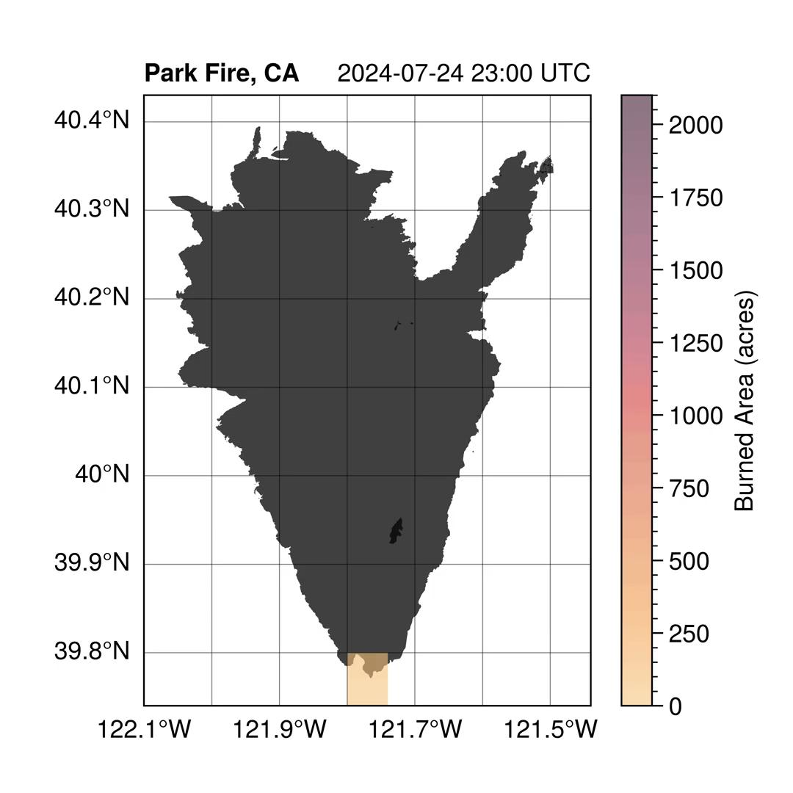
FRE-based burned area (adjusted)
Some of our overestimation after area-adjustment could be due to edges of burn scar where grid cell indicates more burned area than reality

Slide 13
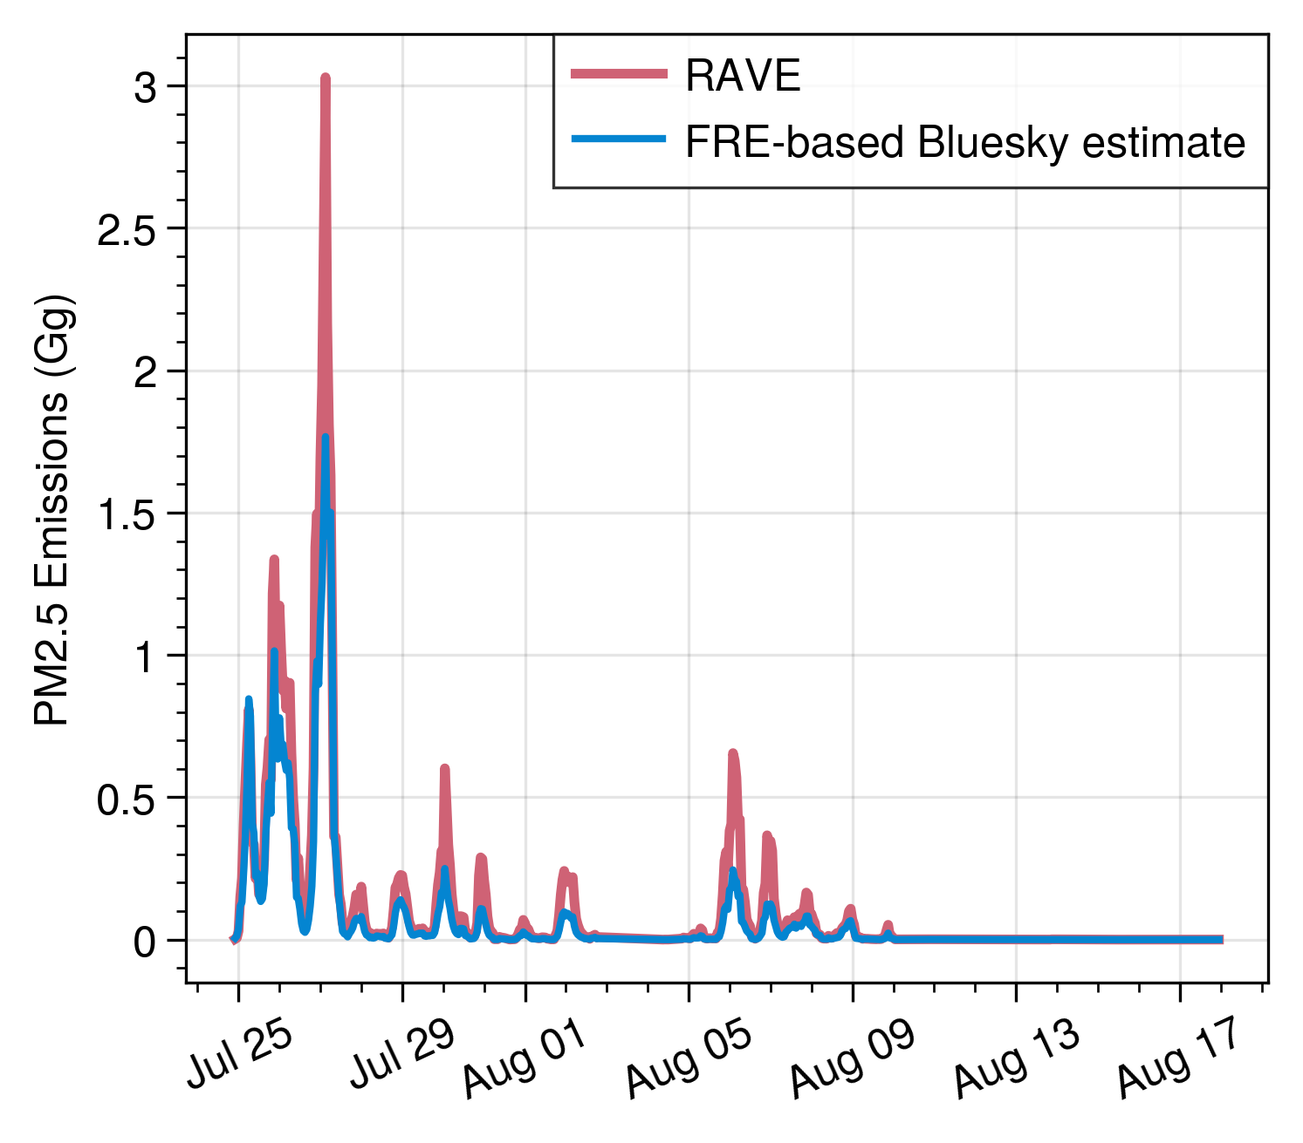
Bluesky PM2.5 emissions estimate using burned area
Park Fire
Bluesky based estimate is lower than RAVE v2, could be due to model fuel consumption processes, default configuration, or differences in emission factors…etc.

Slide 14
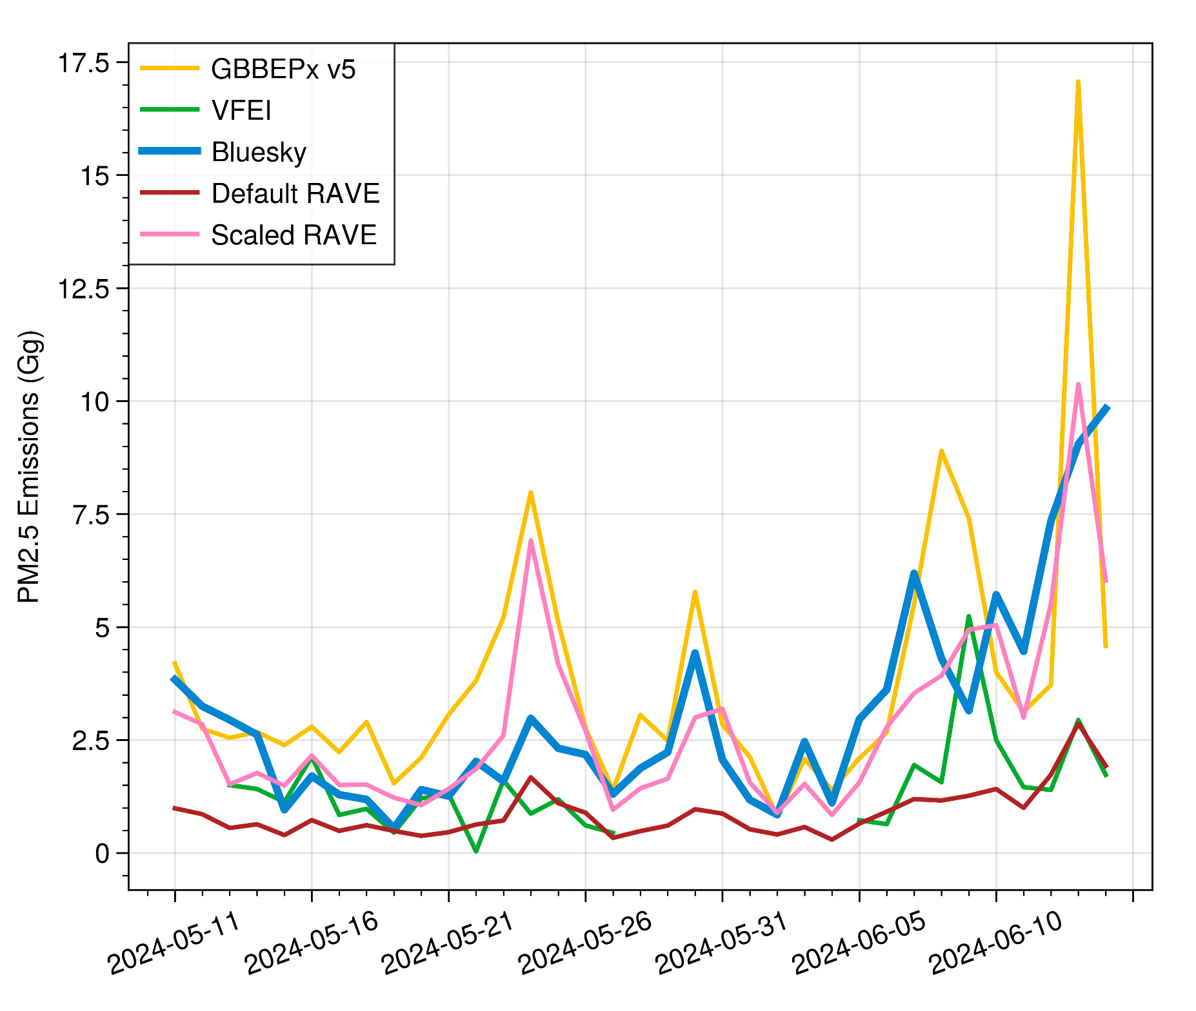
Daily Emissions
CONUS sum
(May 11-June 14, 2024)
Bluesky is within range of all inventories (good to see!)

Slide 15
Future Steps
Validate burned area estimates against observations for additional wildfires, and for eastern US prescribed fires against burn permit records
Feed multi-fire BlueSky emissions estimates into HYSPLIT dispersion simulations for CONUS evaluation against AirNow PM2.5 observations

Slide 16
Conclusions/Applications
At ARL, we have developed a methodology to estimate burned area using NRT satellite thermal detections (FRP), useful for bottom-up emissions estimates.
This method is most novel for representing burned area of small and low intensity fires that are smaller than the representative grid cell
Bottom-up fire emissions estimates are rare to have for air quality forecasting applications, so this can be a good addition to other top-down fire emissions inventories developed by NOAA (e.g., RAVE, GBBEPx)
BlueSky provides more outputs than traditional FRP-based inventories:
Numerous chemical species (PM2.5, CO, CO2, NOx, VOCs etc.)
A breakdown of fuel consumption and emissions into flaming vs. smoldering combustion, meaning custom emissions factors (EFs) can be applied based on combustion phase
Heat release, which can be used for determining plume rise height in dispersion modeling

