Slide 1
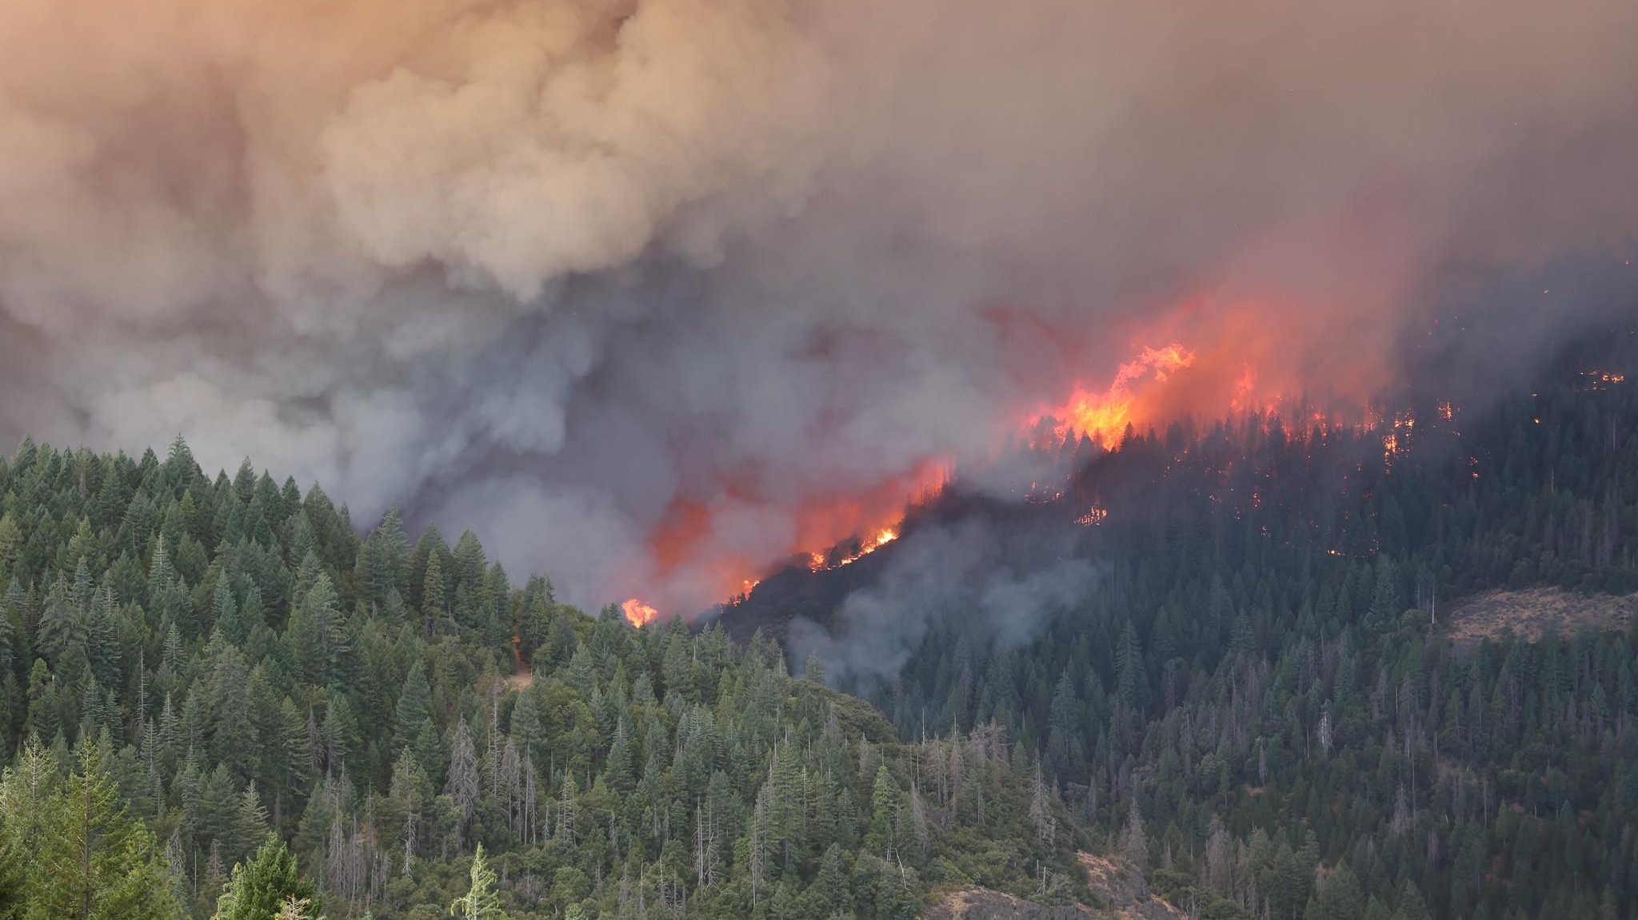
Hourly RAVE Emissions for Air Quality Forecast
Image credit: CAL FIRE
Fangjun Li (SDSU)
Science Team
Xiaoyang Zhang (SDSU), Shobha Kondragunta (NOAA), Chuanyu Xu (NOAA)
NOAA Air Quality Forecasters Focus Group Workshop October 9, 2024

Slide 2
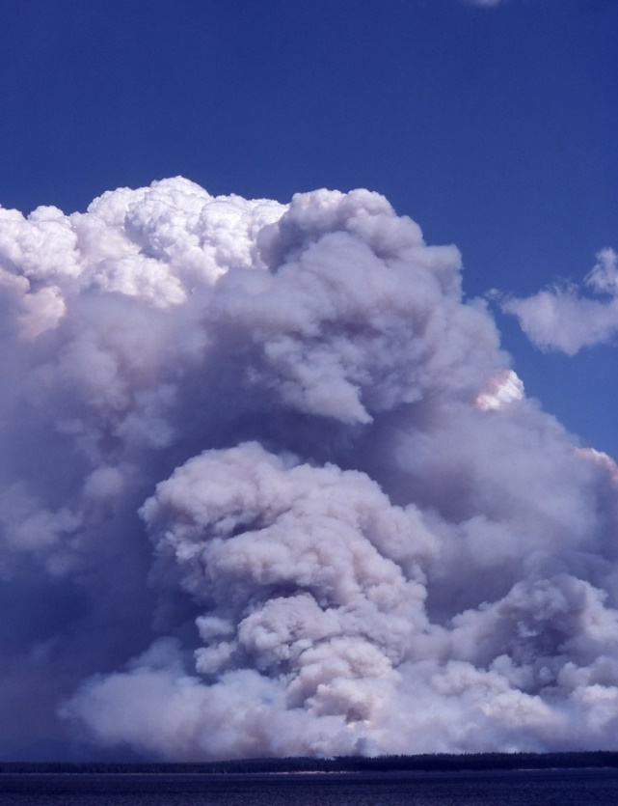
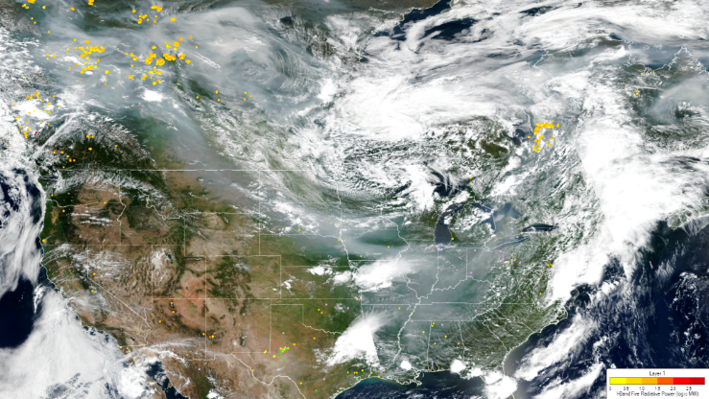
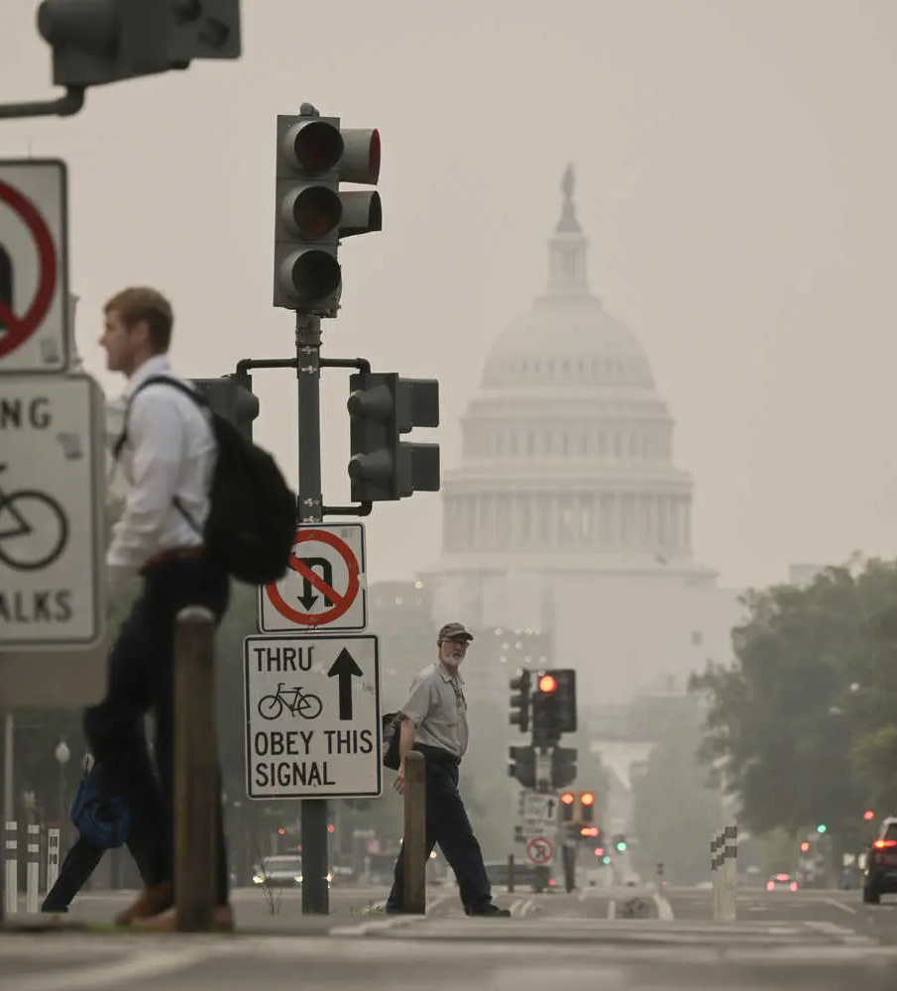
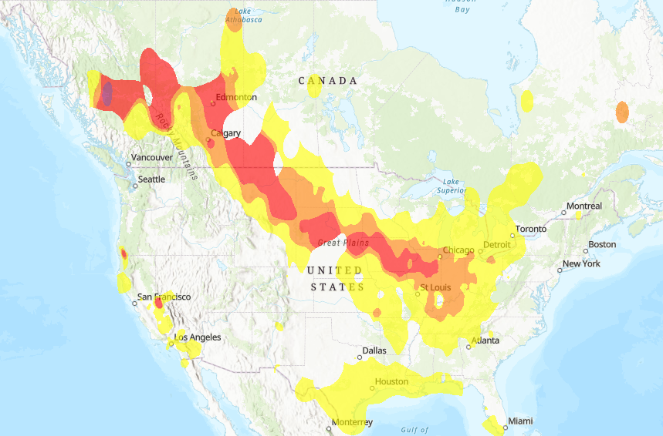
Wildfire Smoke Impacts Human Health
Wildfires emit massive amounts of trace gases and aerosol emissions
Smoke pollutants degrade downwind air quality
Exposure to wildfire smoke causes health issues
NO_{x}
Coughing
Asthma
Heart failure
Heart attack
Stroke
…
CO
CO₂
NH₃
CH₄
PM_{2.5}
OC
BC
SO₂
TPM
VOCs
VIIRS
16 July 2023
AQI
Image credit: the New York Times

Slide 3
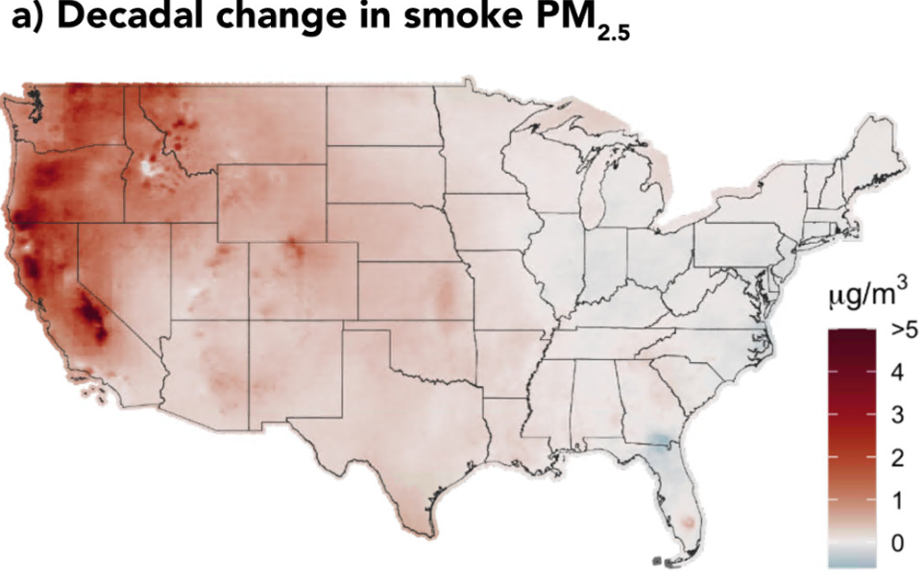
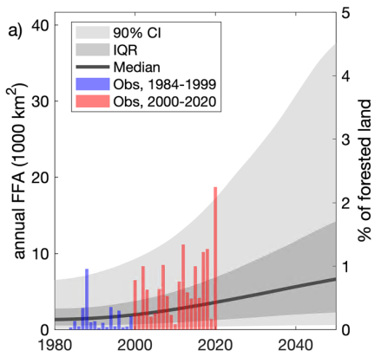
Increasing Fire Activities in the United States
Fire activity has increased in the past few decades
fire area, fire season length, and frequency
Smoke contributions to PM_{2.5} has increased since 2016
Fire activity is projected to increase in the next few decades
2006–2010
2016–2020
Westerling et al. 2006
Childs et al. 2022
Abatzoglou et al. 2021

Slide 4
Fire Emissions for Air Quality Forecasting
Fire emissions are essential inputs for air quality models
hourly fire emissions (for aerosol species)
hourly fire intensity (FRP) for modeling plume injection height
Inventory | Approach | Resolution | Parameters | Forecast Applications
GFED5 | Conventional | 0.25° monthly | MODIS burned area and MODIS/VIIRS fire detections; modeled fuel
FINN2.5 | Conventional | fire point daily | MODIS/VIIRS fire detections; fuel compiled from published literature | CMAQ
FLAMBE | Conventional | fire point daily | MODIS & GEO satellites fire detections | NAAPS
GFAS1.4 | FRP-based | 0.1° daily/hourly | MODIS FRP | ECMWF CAMS
FEER1.0 | FRP-based | 0.1° daily | MODIS FRP
QFED2.5 | FRP-based | 0.1° & 0.25° daily | MODIS FRP | NASA GEOS-5
GBBEPx4/5 | FRP-based | 0.1° & 0.25° & FV3 daily | VIIRS FRP | NWS global aerosol models
RAVE1.2/2.0 | FRP-based | 3km & 13km, hourly | ABI and VIIRS FRP | NOAA EMC AQM/CMAQ NOAA RRFS

Slide 5
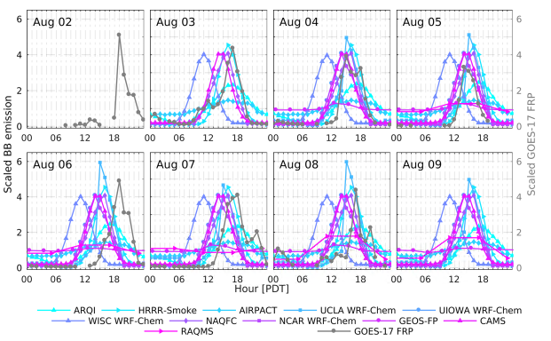
Fire Emissions for Air Quality Forecasting
Data gap - lack of hourly fire emissions
Two common strategies
persistent emissions
redistribute daily emissions using a shape-fixed climatology
Challenges
Misrepresent diurnal patterns of fire emissions.
Result in underprediction or overprediction
Williams Flat Fire 2019
Ye et al. 2021

Slide 6
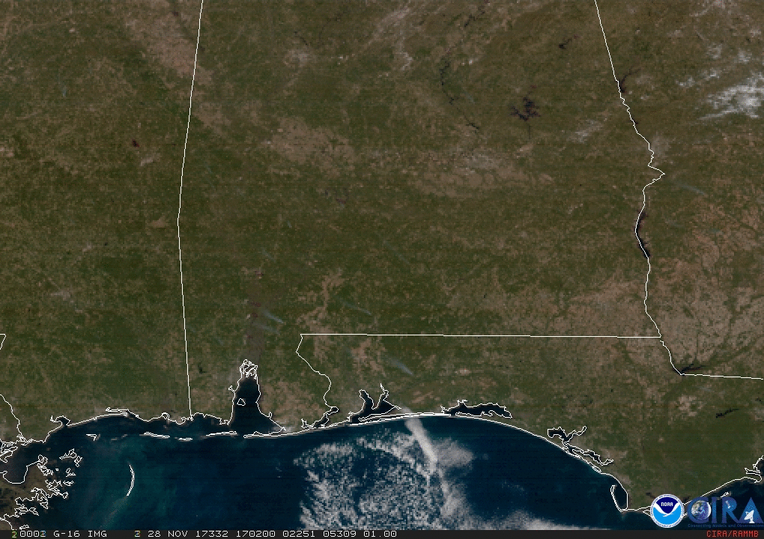
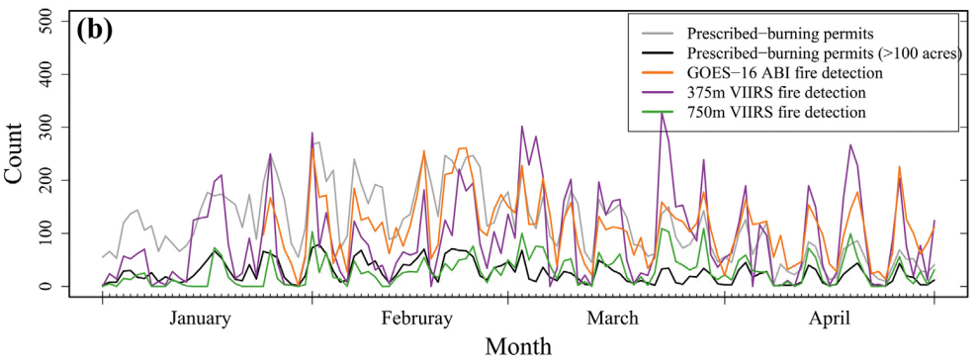
ABI and VIIRS Sensors Provide New Opportunities
Sensor | Footprint Size | Frequency | Detection Capability
ABI | 2 km (nadir) | CONUS: 5 min Full-disk: 10 min | detect fires ≥ 34 MW
VIIRS | 0.375 km | twice daily | detect fires ≥ 1 MW
GOES-16 ABI, Southeast US, 11/28/2017
Prescribed burn permits and satellite detections during Jan - Apr 2018 in Florida
Li et al. 2020

Slide 7
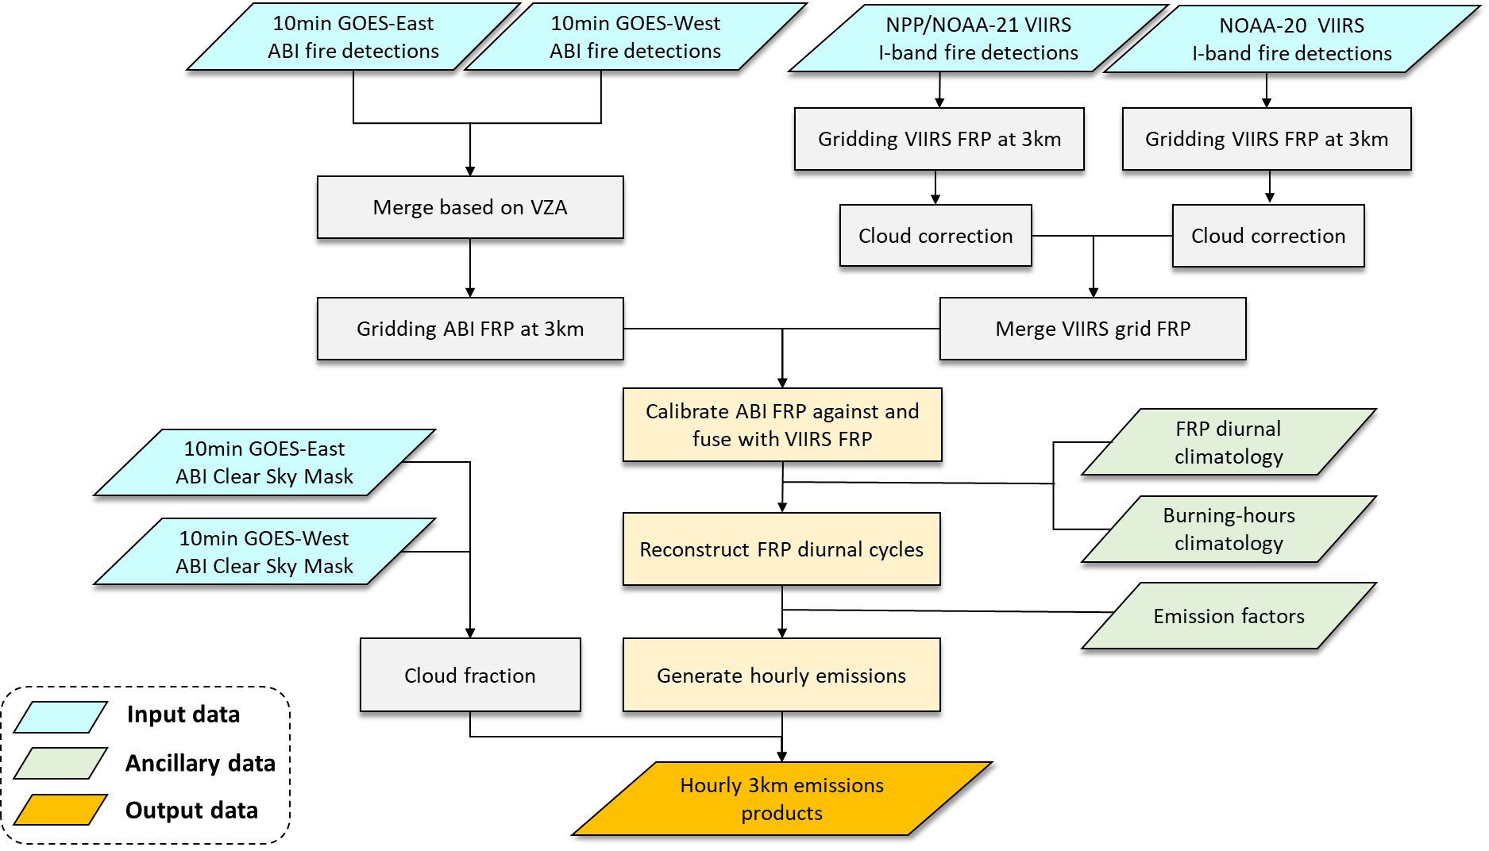
RAVE Algorithm
Processing steps
① Grid FRP at 3km
② Fusing ABI & VIIRS FRP
③ Reconstruct FRP diurnal cycles
④ Estimate hourly emissions

Slide 8
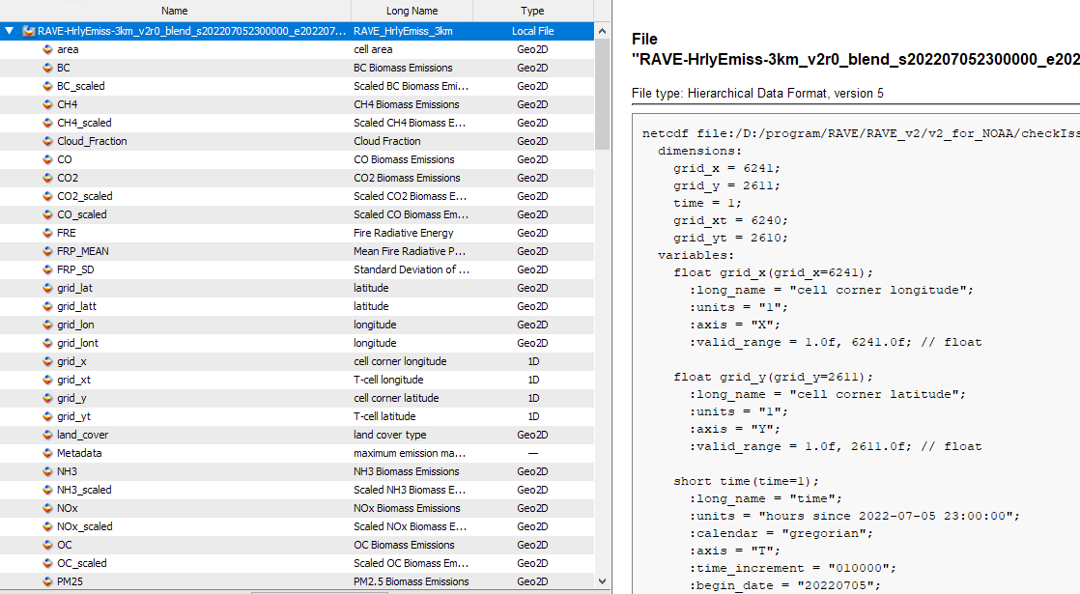
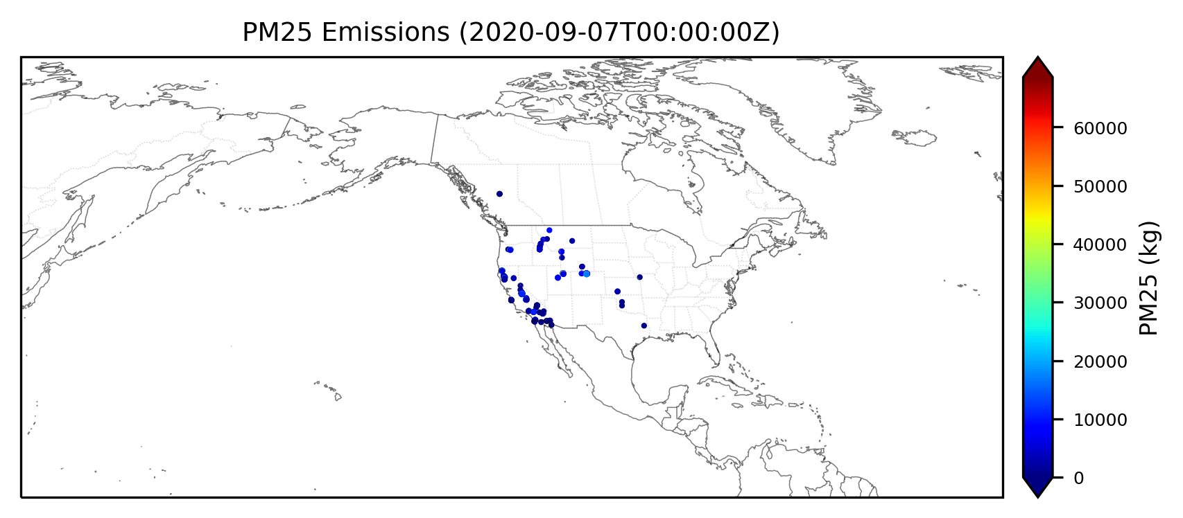
RAVE Product (3km & 13km)
Hourly estimates
Emission mass for 11 chemical species (CO2, CO, PM2.5, BC, OC, NOx, CH4, NH3, SO2, TPM, and VOCs)
Scaled emission mass for aerosol species
FRP (Mean & SD) and FRE
FRP prediction flag
Cloud fraction
QA

Slide 9
Upgrade from V1 to V2
Updates in V2
Use NOAA’s new VIIRS active fire products – NOAA-20 and NOAA-21 EFIRE
Correct terrain-caused parallax errors in the ABI fire pixel locations
Update the FRP time series fitting algorithm to avoid negative predictions and overpredictions

Slide 10
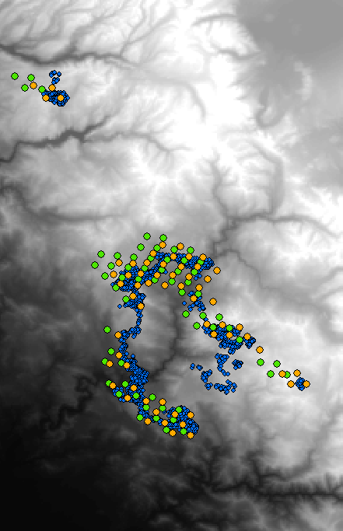
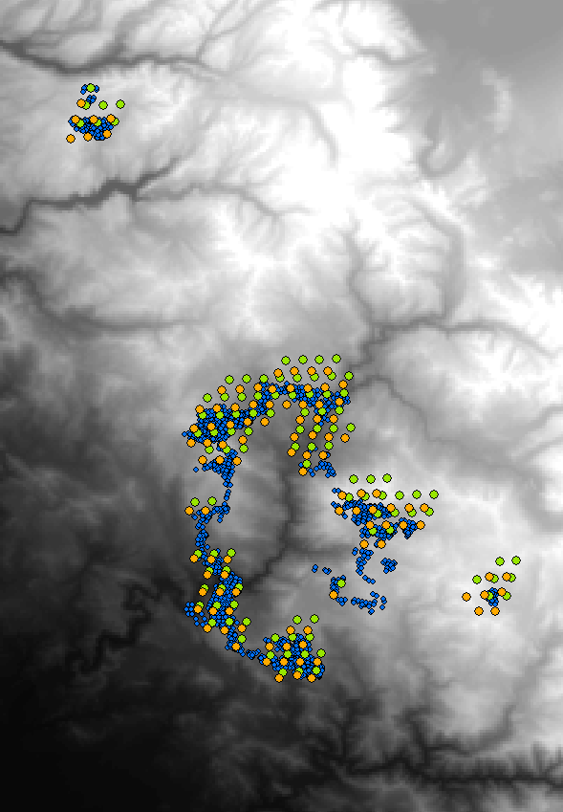
Parallax Correction - Examples (California)
GOES-16
GOES-17
Fire Pixels
VIIRS
ABI (before correction)
ABI (after correction)
DEM (Altitude)
low
high

Slide 11
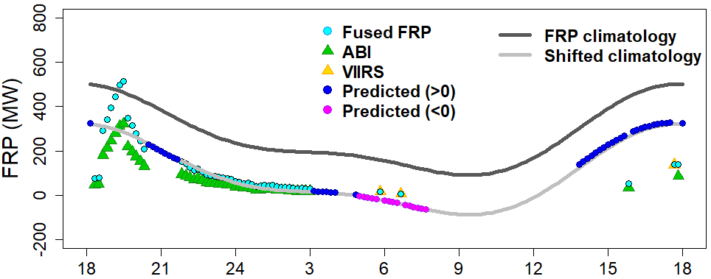
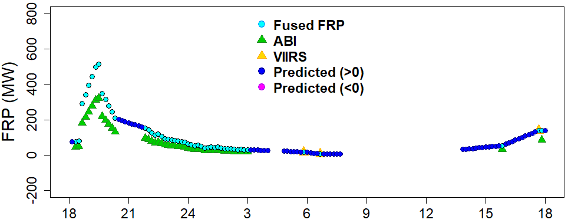
Update FRP Fitting Algorithm
V1
V1 - Shifting FRP diurnal Climatology
Negative FRP predictions
FRP overpredictions
V2 -Fitting with normalized FRP diurnal climatology
Fix negative predictions and overpredictions
V2

Slide 12
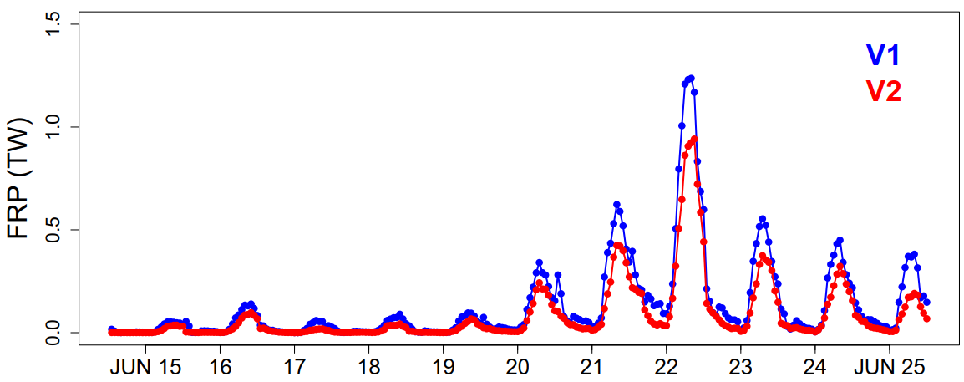
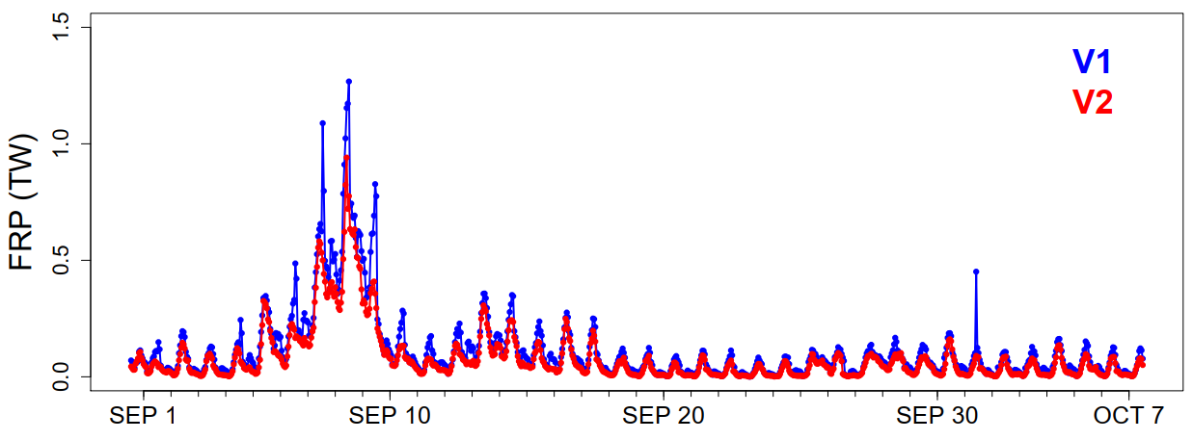
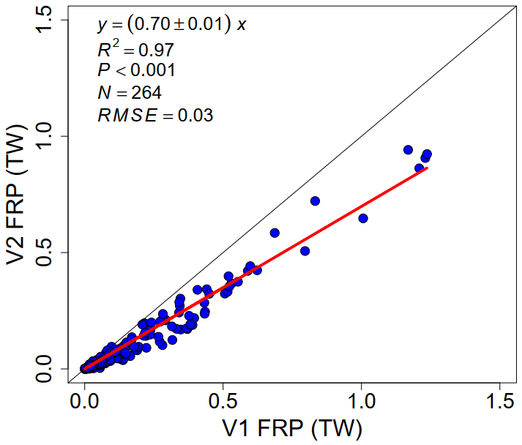
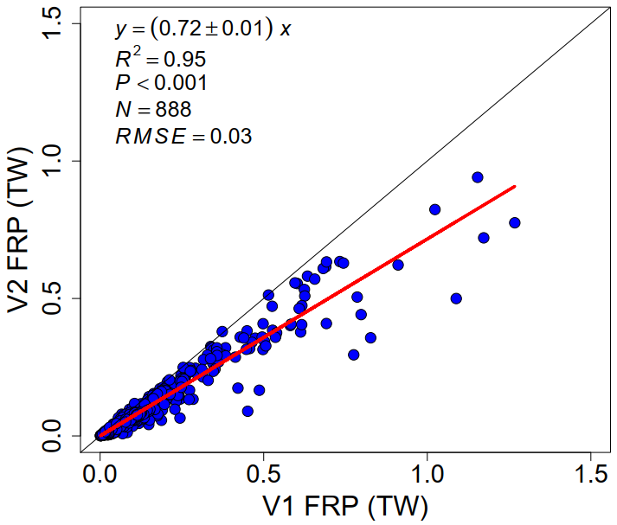
V2 vs. V1
Quebec Fires 2023
Western US 2020
~30% difference

Slide 13
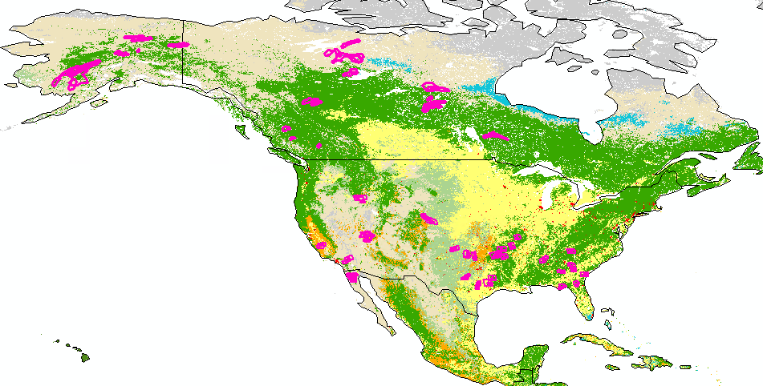
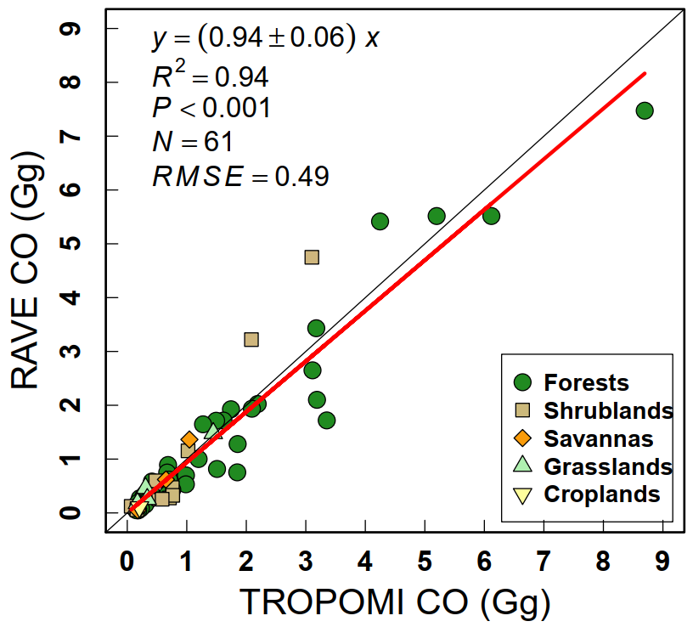
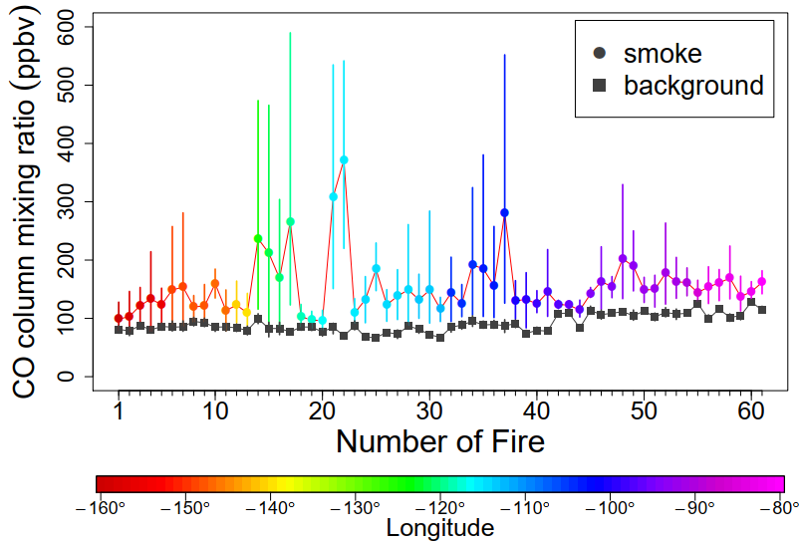
Evaluation of RAVE Emission with TROPOMI CO
RAVE CO and TROPOMI CO are generally comparable over a total of 61 fresh smoke plumes
Li et al. 2024 in review.

Slide 14
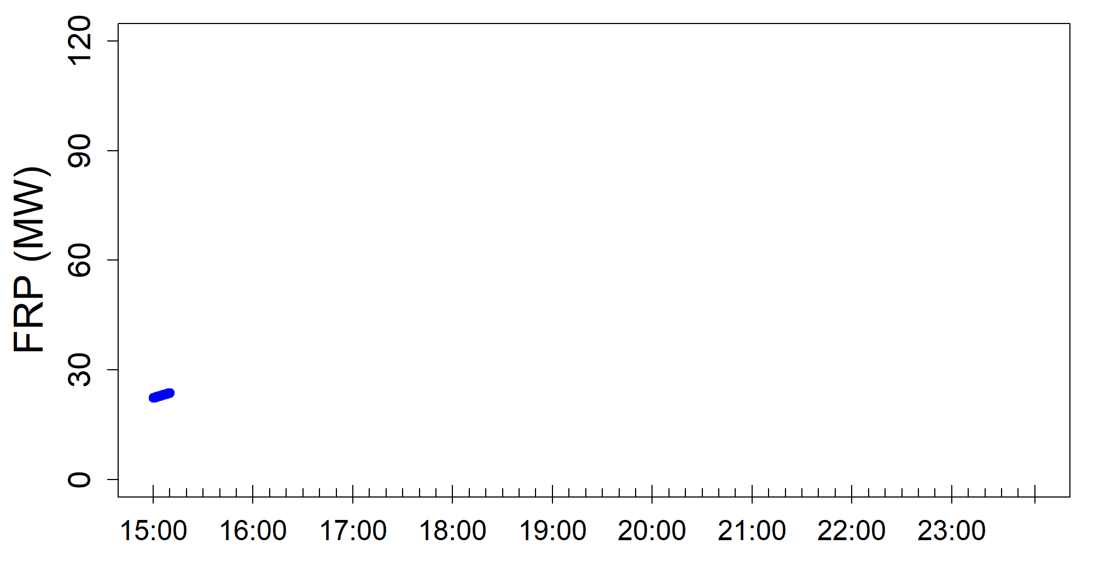
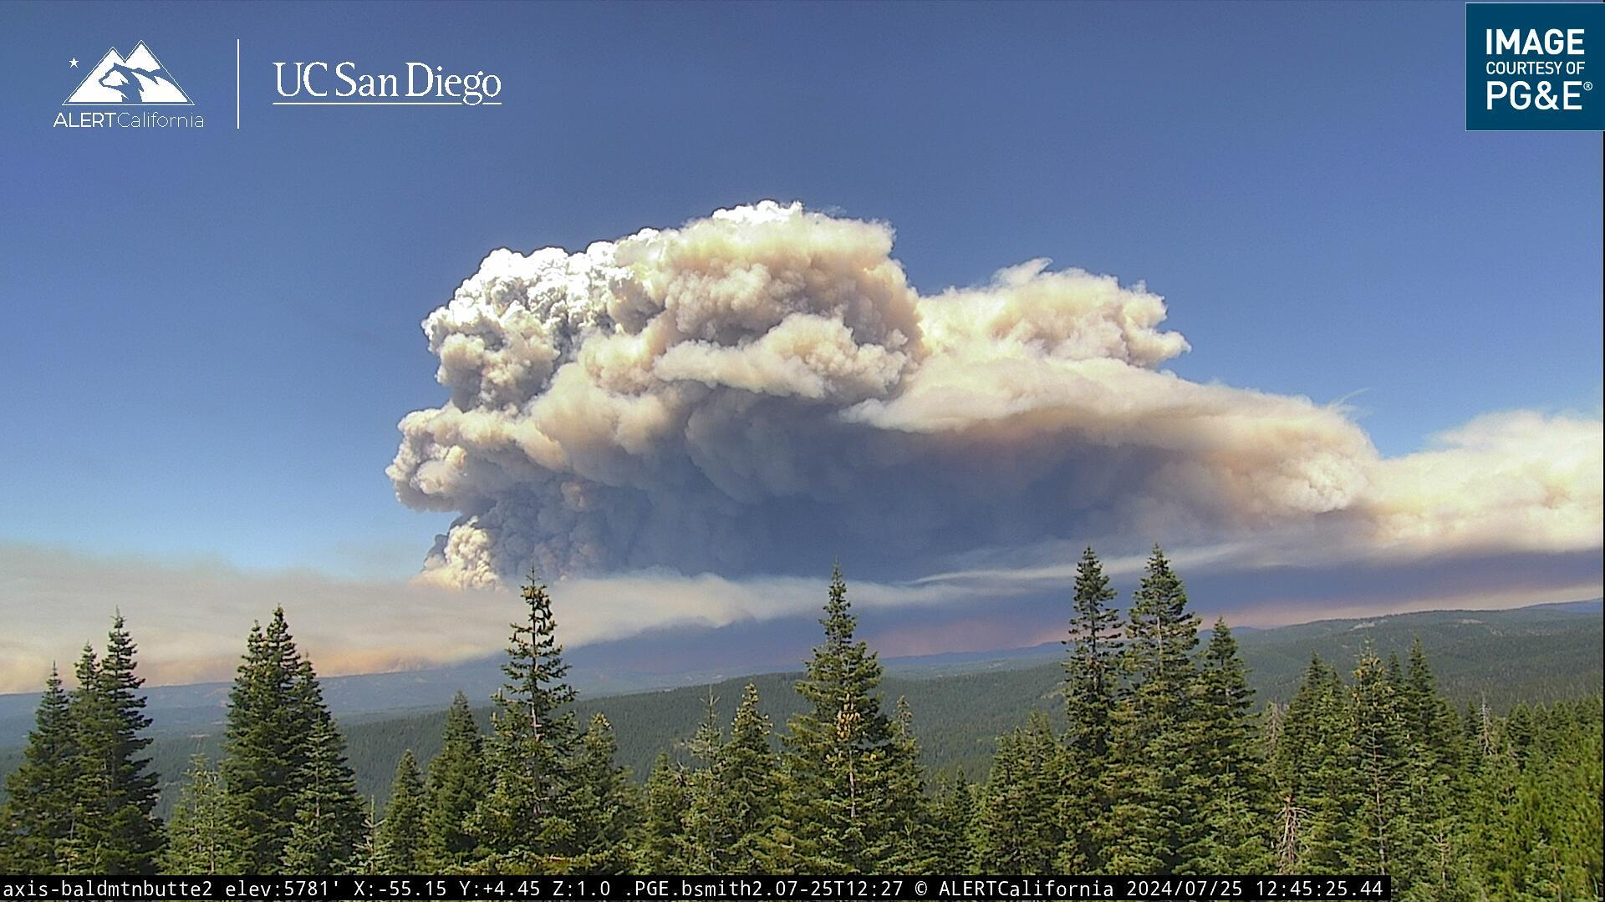
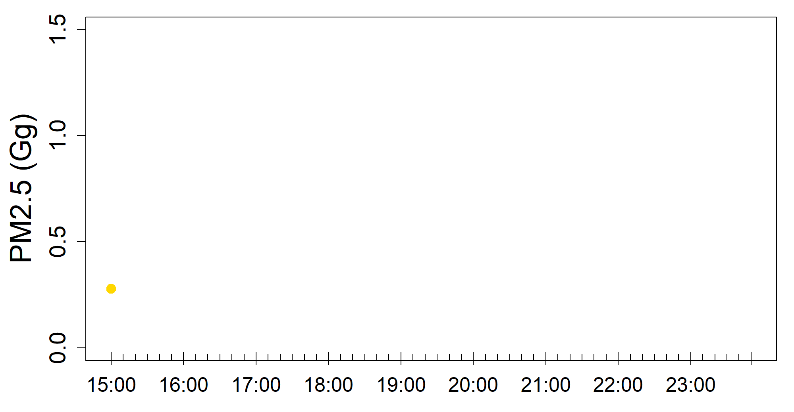
RAVE Examples: Park Fire, California 2024
10min FRP time series
July 25, 2024
hourly PM2.5

Slide 15
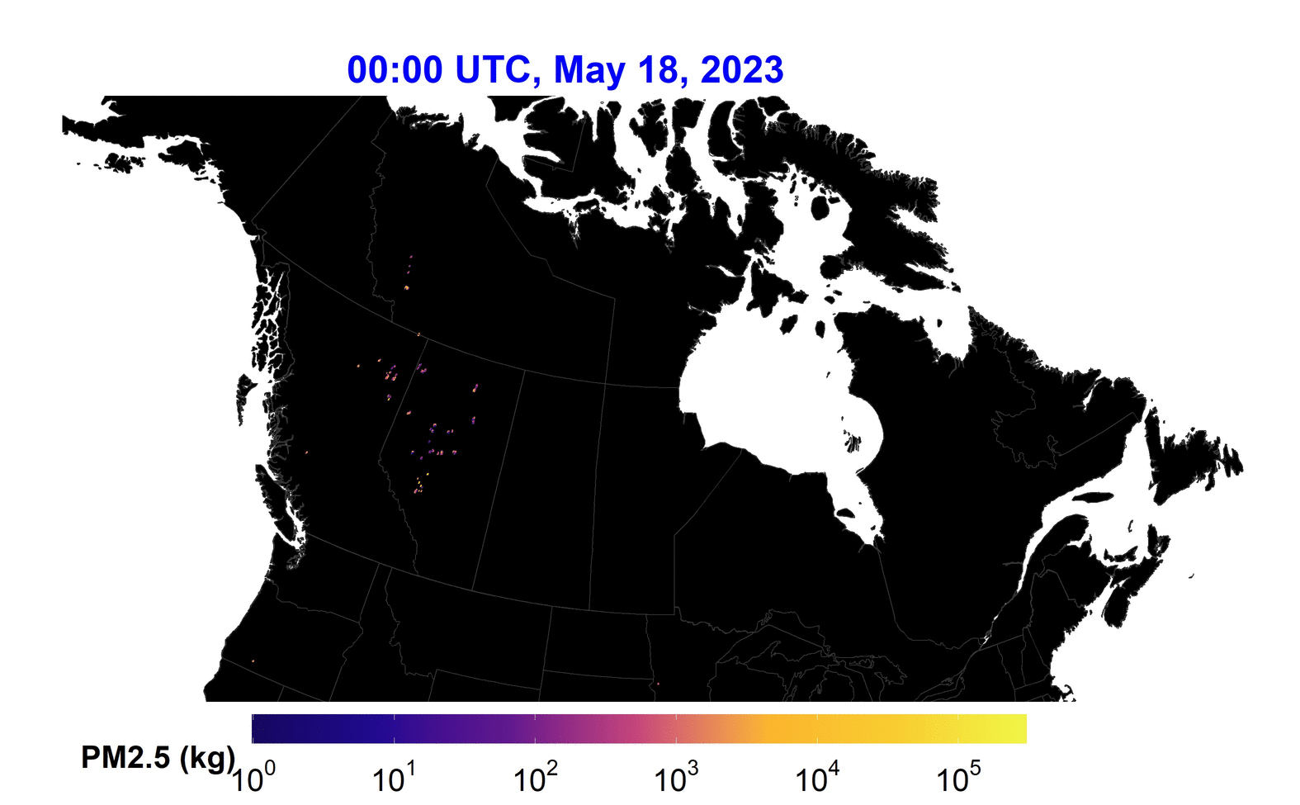
RAVE Examples: Canadian Wildfires 2023
Hourly RAVE PM2.5 emissions on 18 May 2023

Slide 16
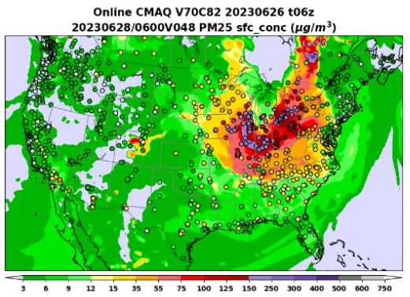
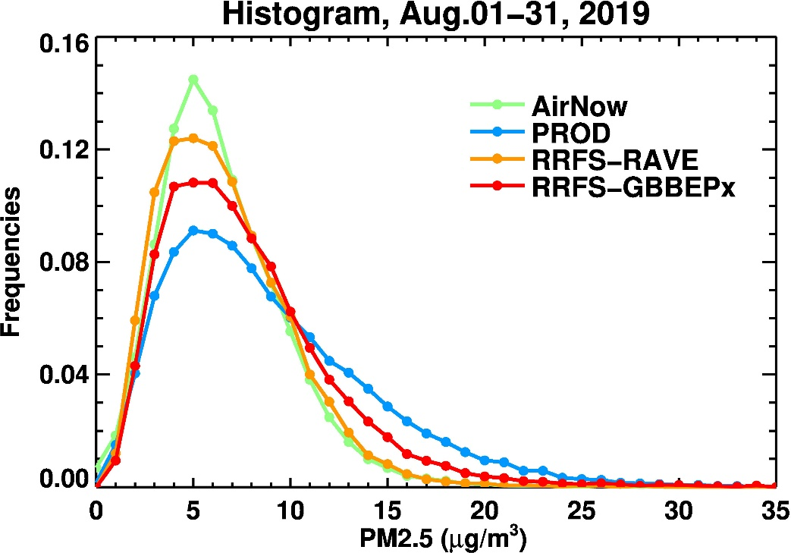
RAVE Product Applications
Testing RAVE product in NOAA’s AQM-CMAQ and RRFS-CMAQ models
AQM-CMAQ
RRFS-CMAQ

Slide 17
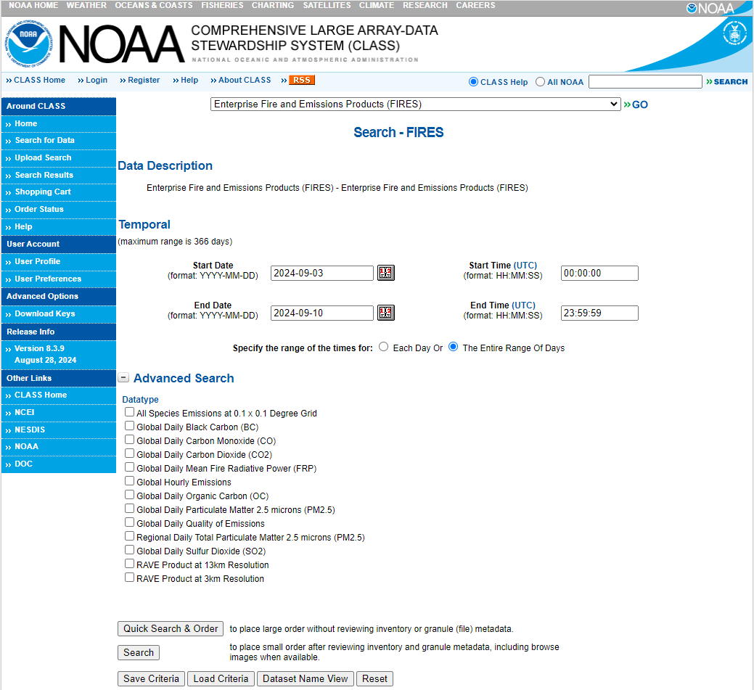
Product Access
Near-real time product
NOAA CLASS
NOAA NESDIS/STAR (shobha.kondragunta@noaa.gov)
Reprocessed data (2019-2023)
RAVE Science Team
https://www.class.noaa.gov/saa/products/search?datatype_family=FIRES

Slide 18
Thank You!
Image credit: CAL FIRE

