Slide 1
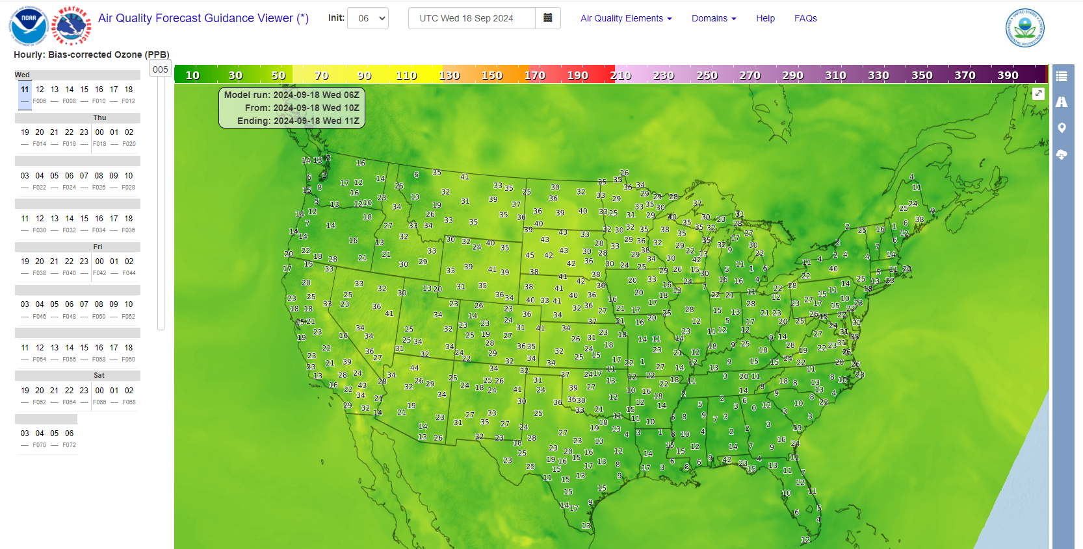
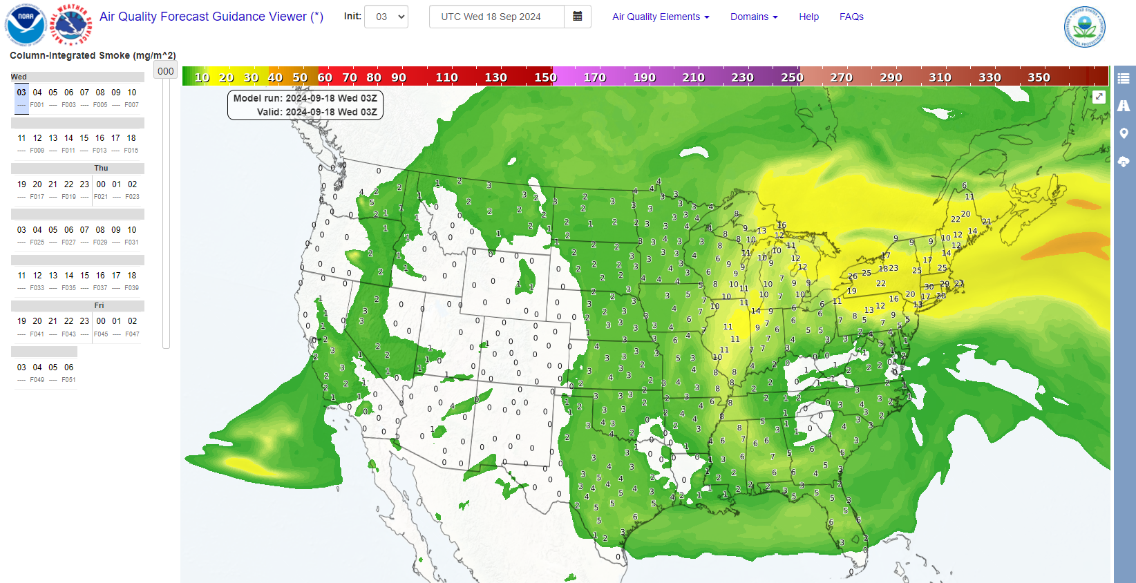
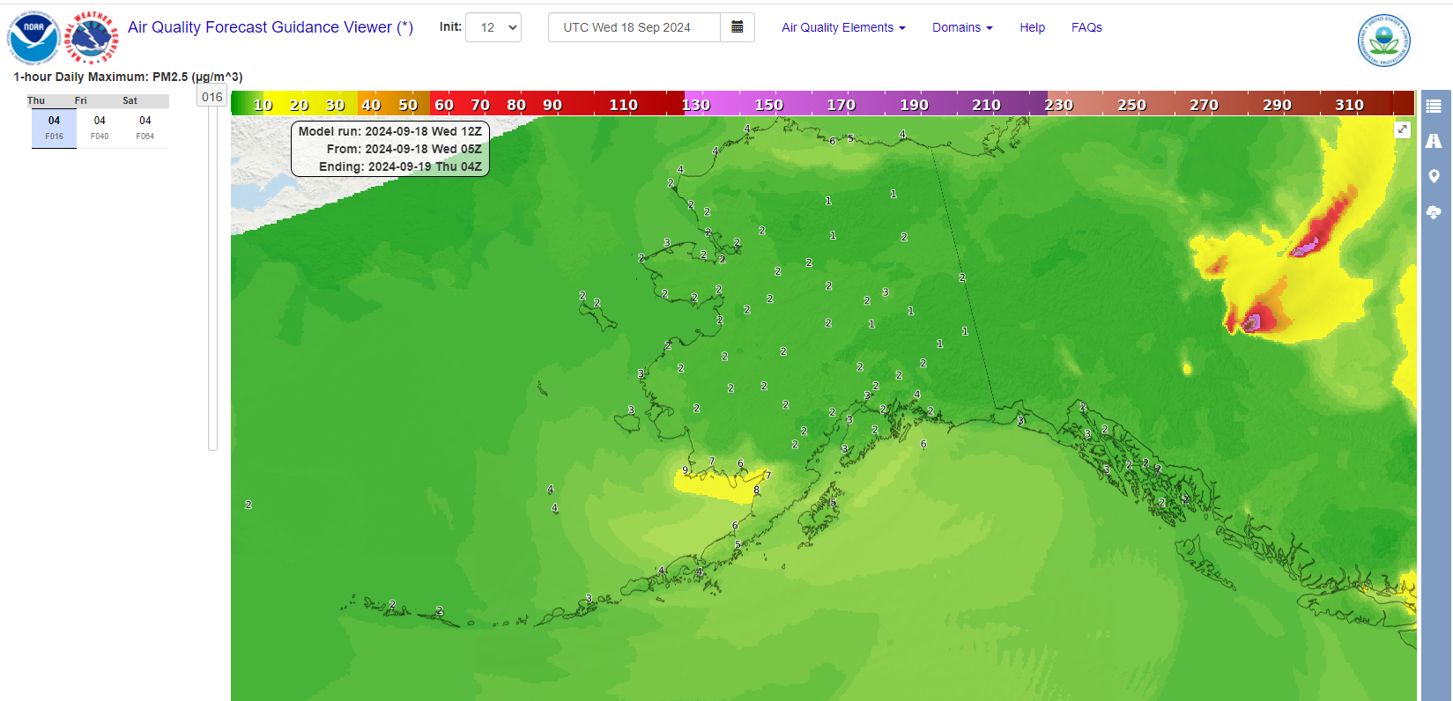
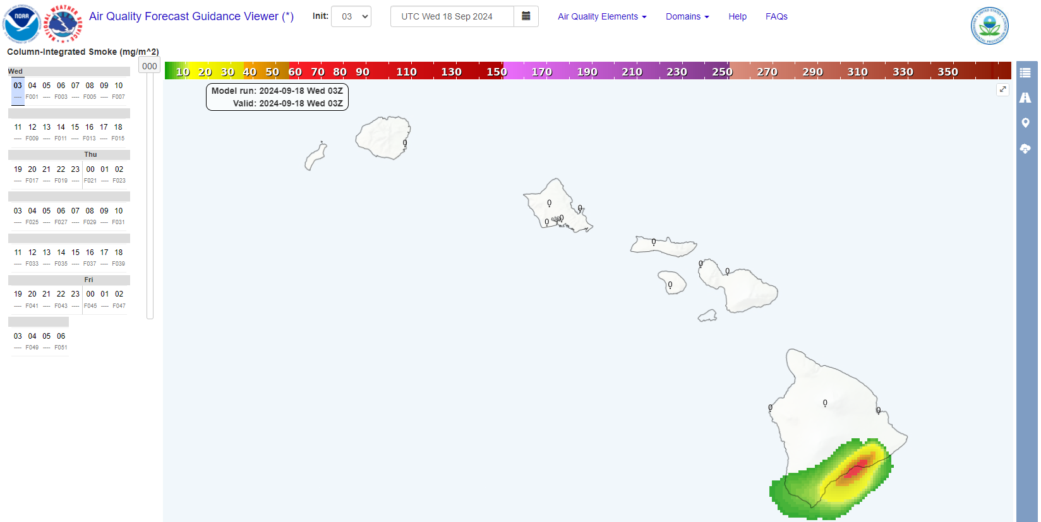
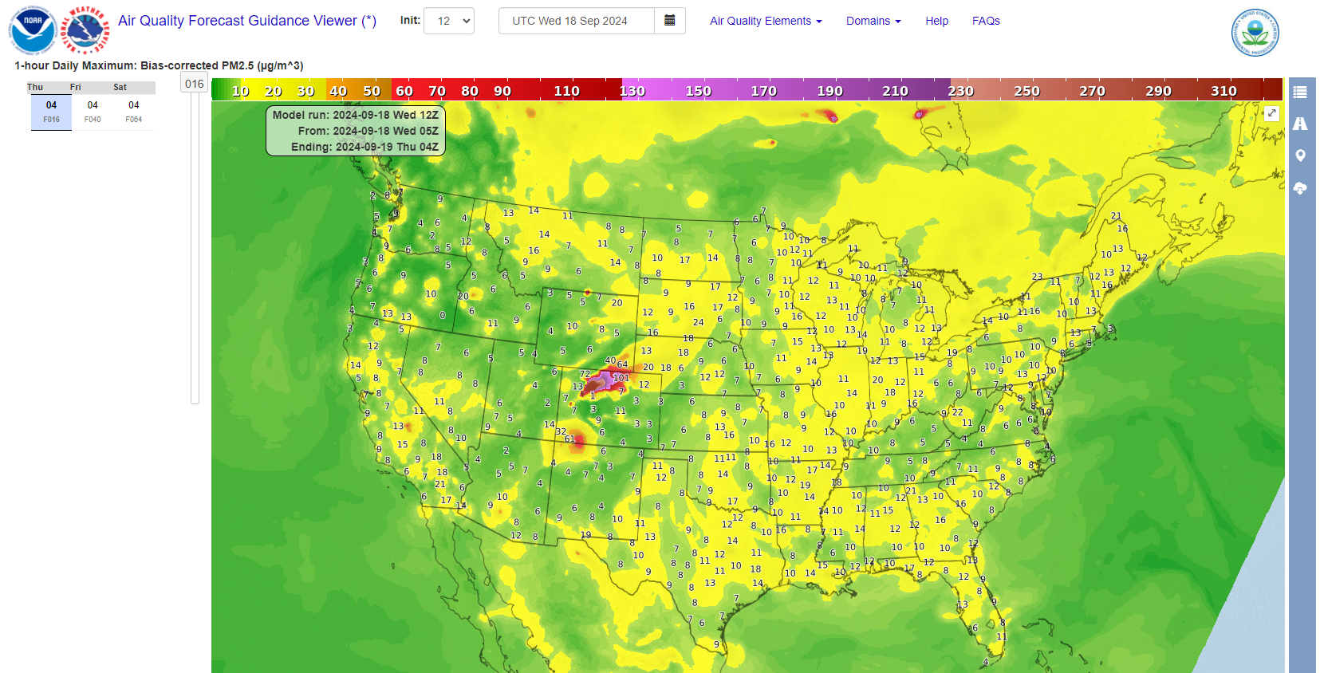
Display of NOAA’s Air Quality Forecast Guidance https://airquality.weather.gov/
_____________________________________________________
Air Quality Forecaster Focus Group Workshop
October 2024
David Miller
NWS Meteorological Development Laboratory

Slide 2
AQFG Display on the Web via
Amazon Web Services (AWS) Moved to Operations
- The prototype version of the Air Quality Forecast Guidance web display on Amazon Web Services (AWS) became operational March 2024 and took the place of the old display at https://airquality.weather.gov.
- As listed in previous years, the AQFG web page features:
-- Zoom, roam, and data value display via mouse over
-- Faster data refresh
-- Point information display via mouse click, latitude/longitude entry, or location name
– Download AQFG values at select state locations in text table format
-- Generation of color-coded table listing of elements at a location

Slide 3
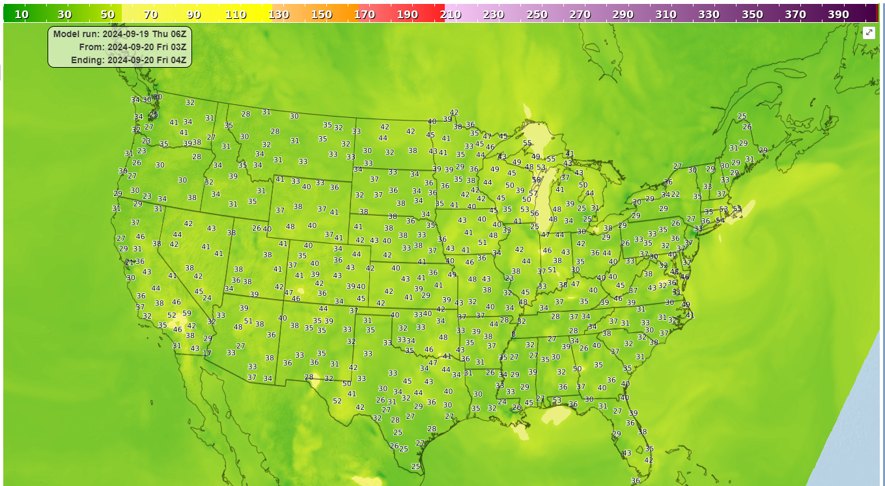
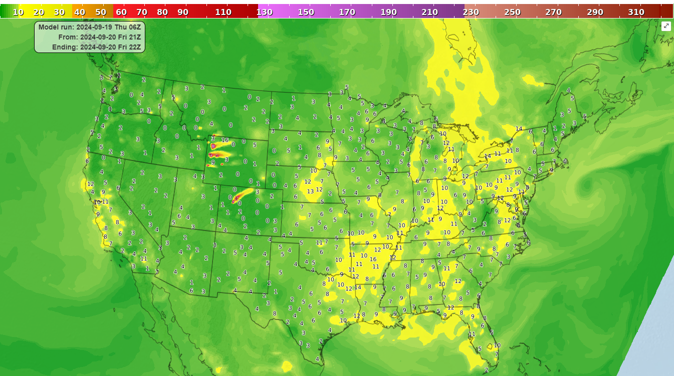
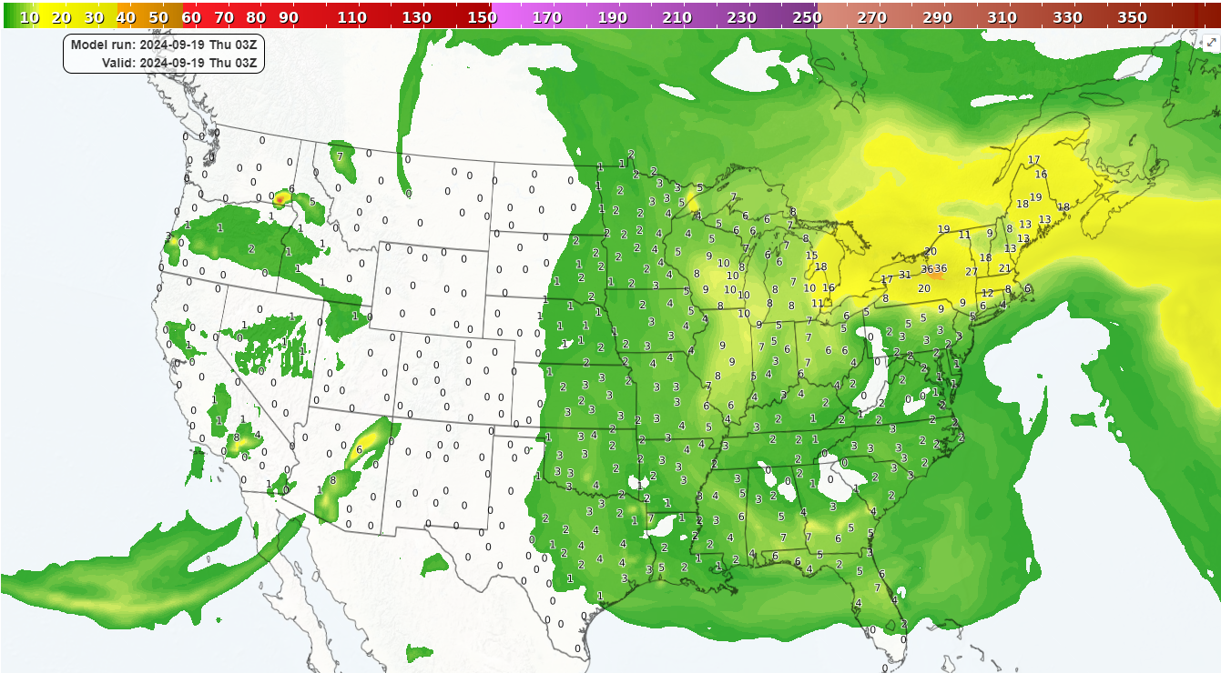
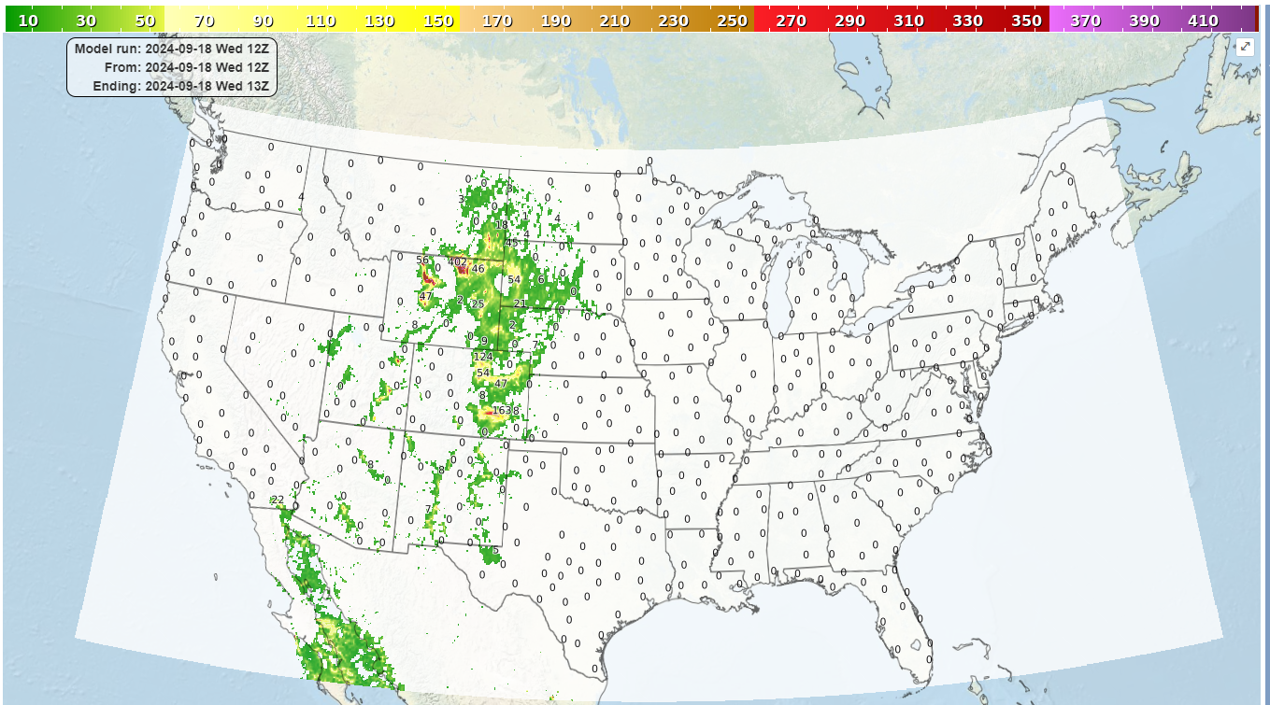
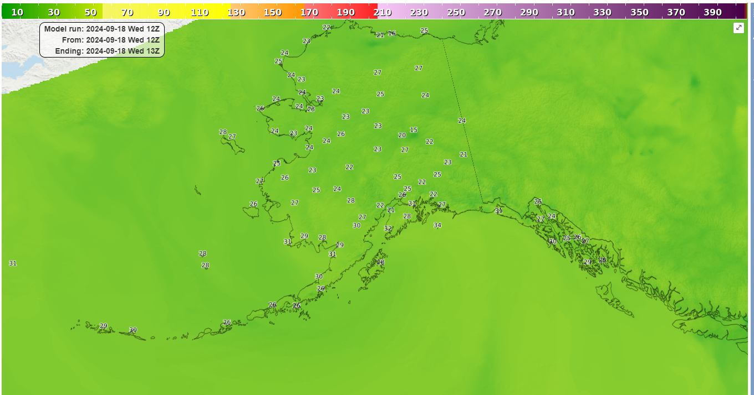
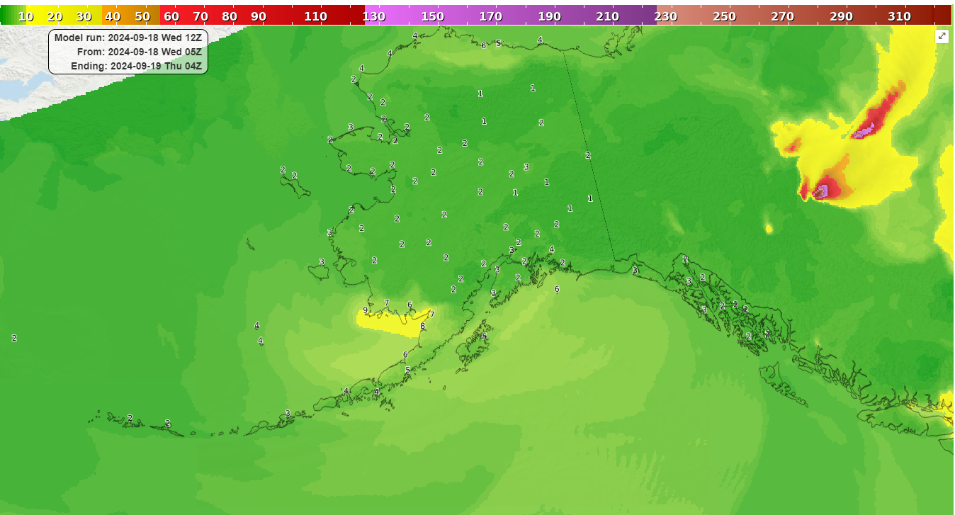
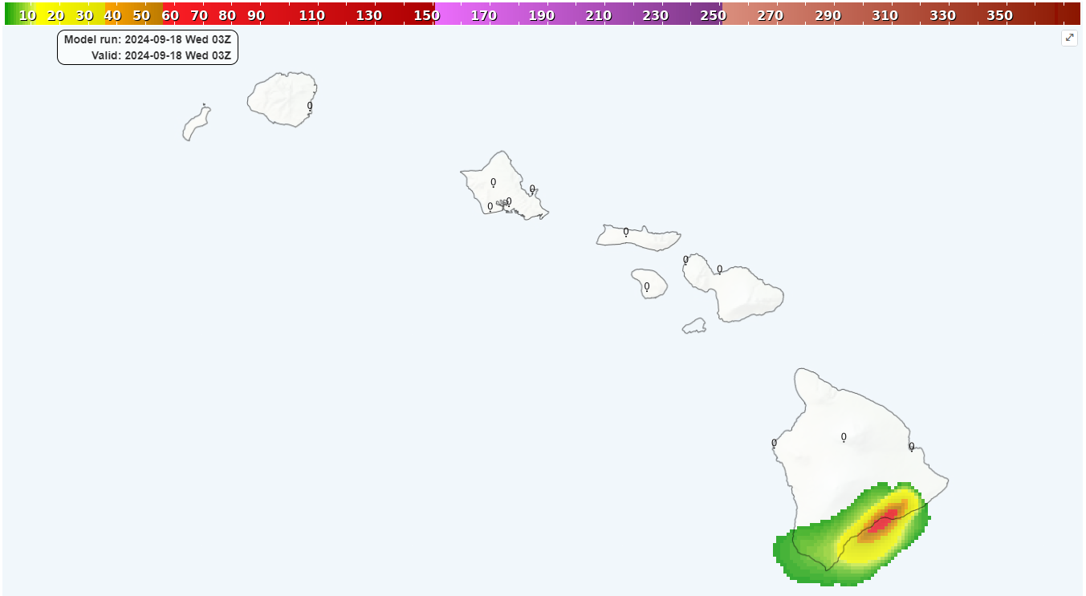
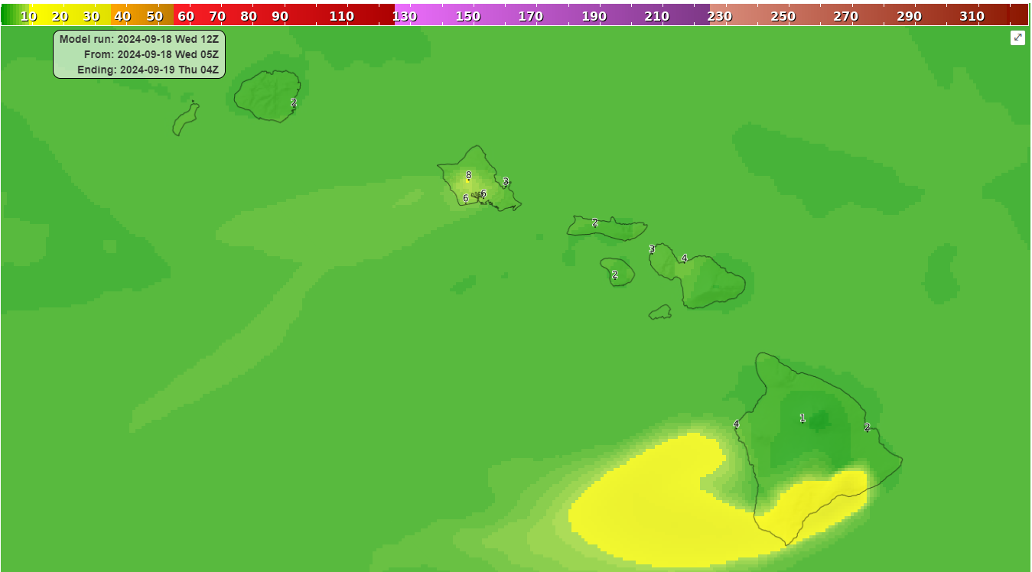
Air Quality Forecast Guidance Images on the Web (https://airquality.weather.gov/)
Ozone & PM2.5
Smoke & Dust
Alaska
Hawaii

Slide 4
AWS AQFG Display Products:
1hr/8hr Average Ozone, Raw and Bias-corrected
Daily Maximum 1hr/8hr Ozone, Raw and Bias-corrected
1hr Average/Daily Max/Daily 24-hour Average PM 2.5, Raw and Bias-corrected
Surface/Lowest 5km Dust Concentration
Near-Surface/Column-Integrated Smoke (from RAP model)
Three domains: CONUS, Alaska, Hawaii
Cycle times 06Z and 12Z, except Smoke 03Z
Note: Bias-corrected and Dust are CONUS only

Slide 5
Text AQ Forecast Guidance and
MDL’s “degrib” Program
With the NCEP’s supercomputer upgrade back in 2022, EMC was unable to continue producing AQ Forecast Guidance text products at locations for several state AQ agencies
Two solutions:
MDL’s degrib program can provide AQ forecast guidance output in text/csv format from GRIB files for a given latitude/longitude. Training presentation is available.
Text AQ forecast guidance tables for a few states that had requested such support are available for download via the AWS AQ Forecast Guidance website

Slide 6
Demos:
https://airquality.weather.gov/
Contours/Wind barbs on Map Display and AQ Point Visualization

Slide 7
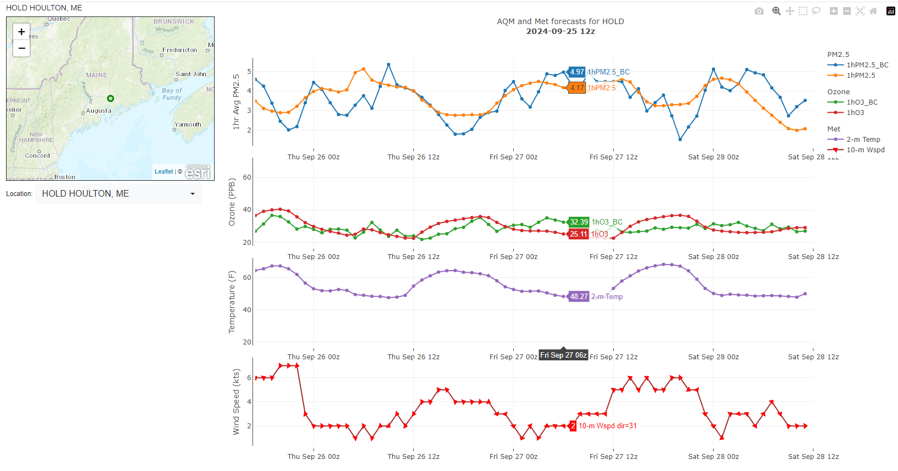
AWS AQFG Web Page Display Future Changes/Possibilities
Color curves (feedback needed)
Display highlighted contours of additional fields such as NO2, NO, Temperature, etc. (Presently prototyping this capability)
Display pertinent weather forecast guidance values (overlay or comparison view, could be worked into contouring)
Download AQFG grid values at any location (enhancement to table)
Image download
Highlight AQ guidance point values beyond a threshold or thresholds
2D Point visualizations
(prototyping)
3D visualizations
(highly dependent on data availability)

Slide 8
Air Quality Forecast Guidance Data Access:
Air Quality Forecast Guidance Displays:
https://airquality.weather.gov/
GRIB2 Data Download:
Real time:
https://tgftp.nws.noaa.gov/SL.us008001/ST.opnl/DF.gr2/DC.ndgd/GT.aq/AR.conus
https://tgftp.nws.noaa.gov/SL.us008001/ST.opnl/DF.gr2/DC.ndgd/GT.aq/AR.alaska
https://tgftp.nws.noaa.gov/SL.us008001/ST.opnl/DF.gr2/DC.ndgd/GT.aq/AR.hawaii
https://tgftp.nws.noaa.gov/SL.us008001/ST.expr/DF.gr2/DC.ndgd/GT.aq/AR.conus
(when data is available)
Archived:
https://www.ncei.noaa.gov/products/weather-climate-models/national-digital-guidance-database
Web Questions, Suggestions:
OSTI/AQ: https://vlab.noaa.gov/web/osti-modeling/contact-us
Email David.T.Miller@noaa.gov

