Slide 1
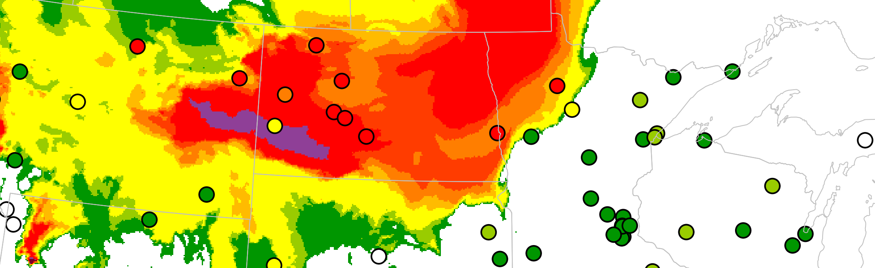
Evaluating RRFS smoke forecasts during 2024 wildfire season
David Brown | Air Quality Meteorologist
October 9-10, 2024

Slide 2
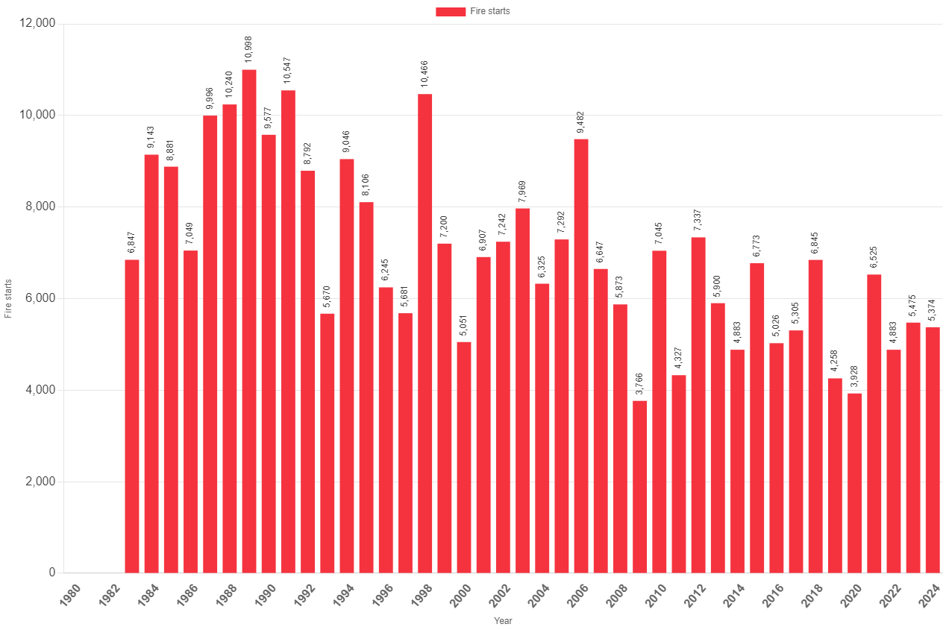
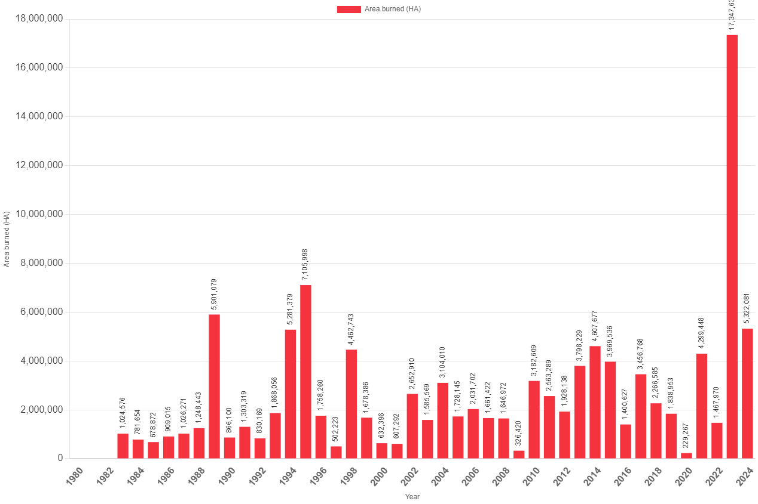
2024 Wildfire Season
2024 Canadian wildfire statistics
  5,374 fire starts
  5,322,081 hectares burned
    4th highest on record
Annual Fires
Annual Area Burned
Canadian Interagency Forest Fire Centre Inc.

Slide 3
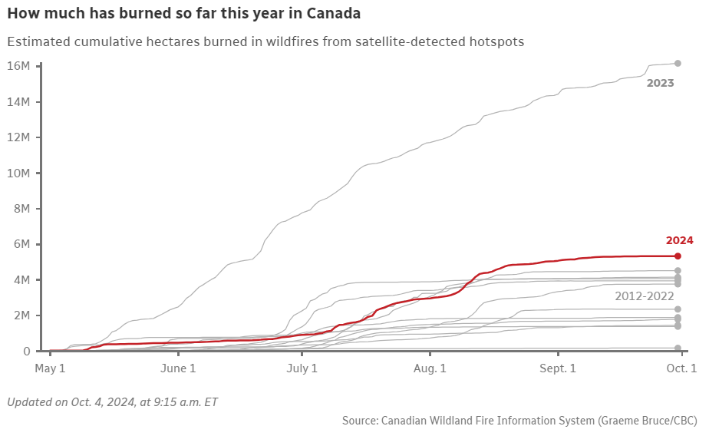
2024 Wildfire Season
https://www.cbc.ca/news/climate/wildfires-2024-charts-1.7341341

Slide 4
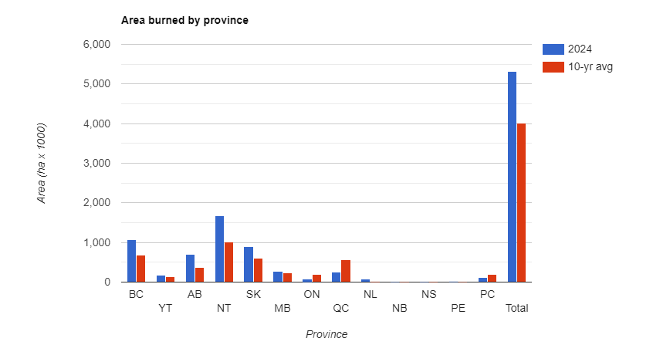
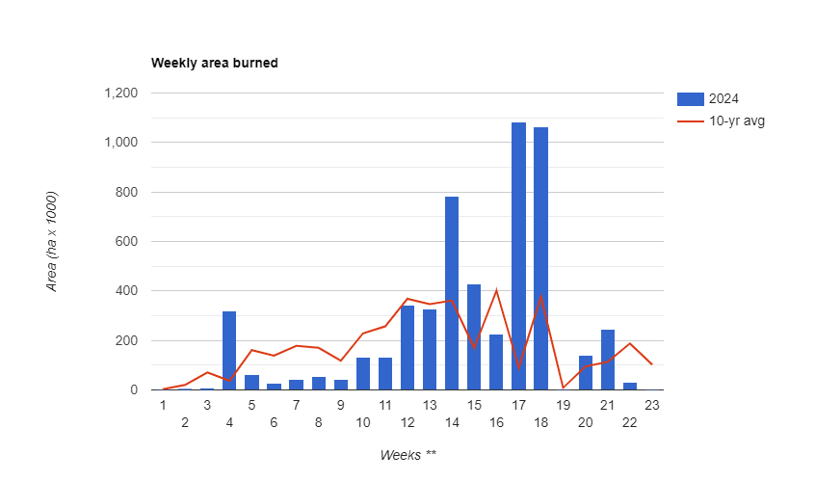
2024 Wildfire Season
Northwest Territories and British Columbia had most area burned
Saskatchewan fires had most impact on air quality in the Northern Plains of the U.S.
Notes:
The x-axis on the lower plot shows weeks since the official start of the Canadian wildfire season in late April.

Slide 5
MN Wildfire Smoke Summary
Date | Maximum PM2.5 Concentration (ug/m^3)
05/12/2024 | 92.5
05/13/2024 | 61.9
08/13/2024 | 45.1
08/14/2024 | 35.7
09/01/2024 | 36.2
09/02/2024 | 36.7
09/11/2024 | 39.8
Number of days with Orange or higher AQI | 7
Maximum 24-hr average PM2.5 concentration (ug/m^3) | 92.5
Number of Air Quality Alerts issued | 4
Notes:
ND observed 14 days with Orange or higher AQI in 2024 due to wildfire smoke and max concentration was 94.2 ug/m^3.
16 alerts issued due to wildfire smoke in 2023

Slide 6
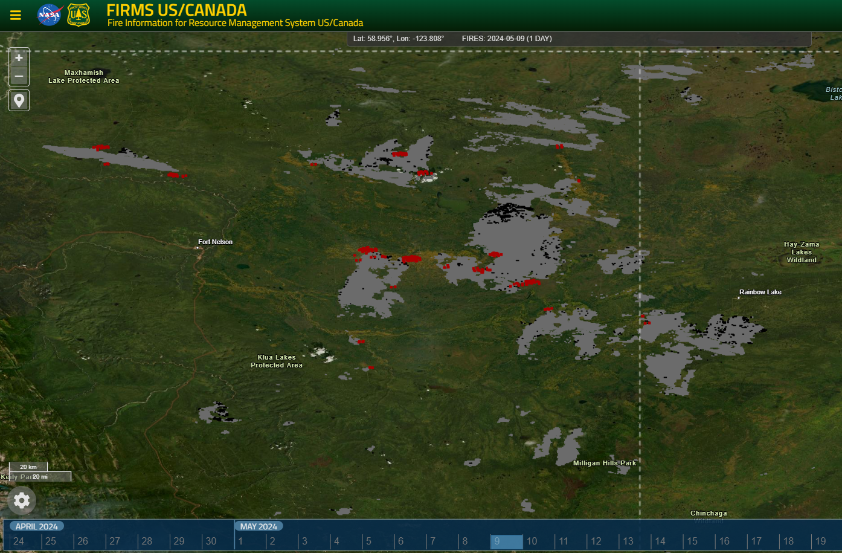
BC Holdover Fires – May 9, 2024

Slide 7

BC Holdover Fires – May 10, 2024

Slide 8
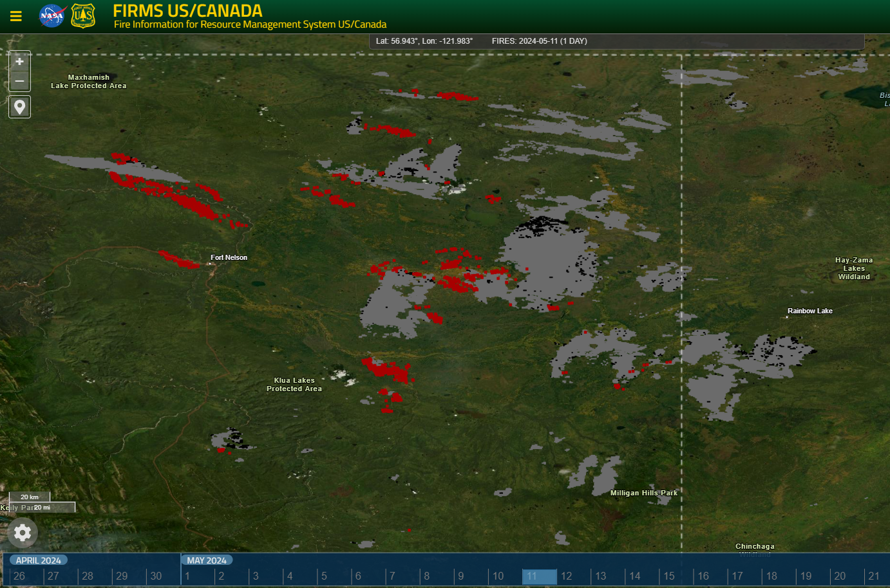
BC Holdover Fires – May 11, 2024

Slide 9
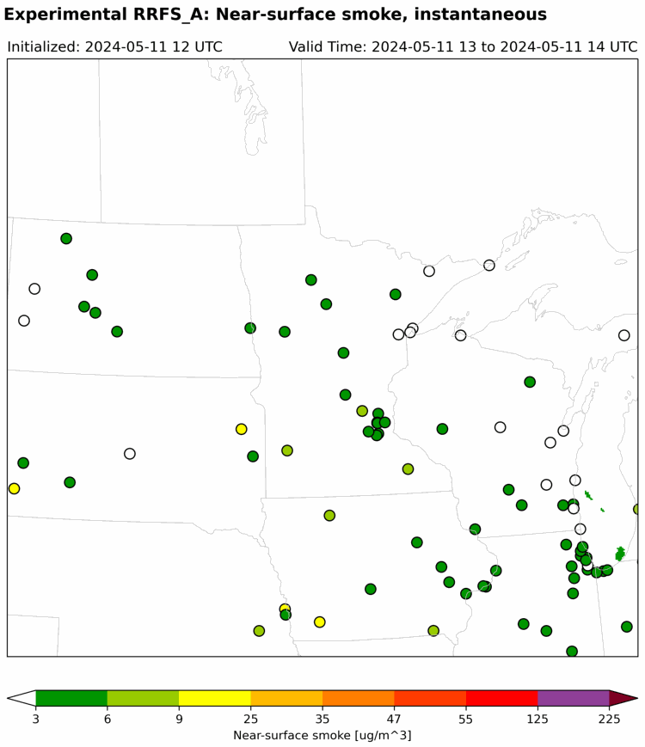
RRFS Smoke Forecast Initialized 05/11 12Z
Notes:
Only instantaneous smoke fields found in grib2 files for this model run. Not a direct comparison to hourly average observations.

Slide 10
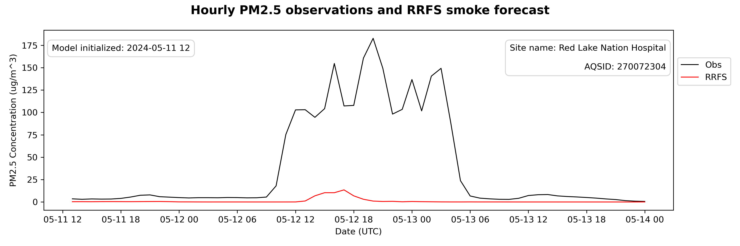
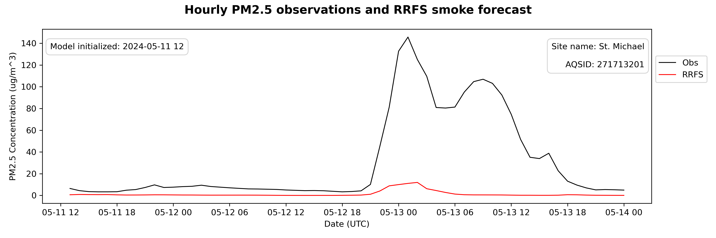
RRFS Smoke Forecast Initialized 05/11 12Z

Slide 11
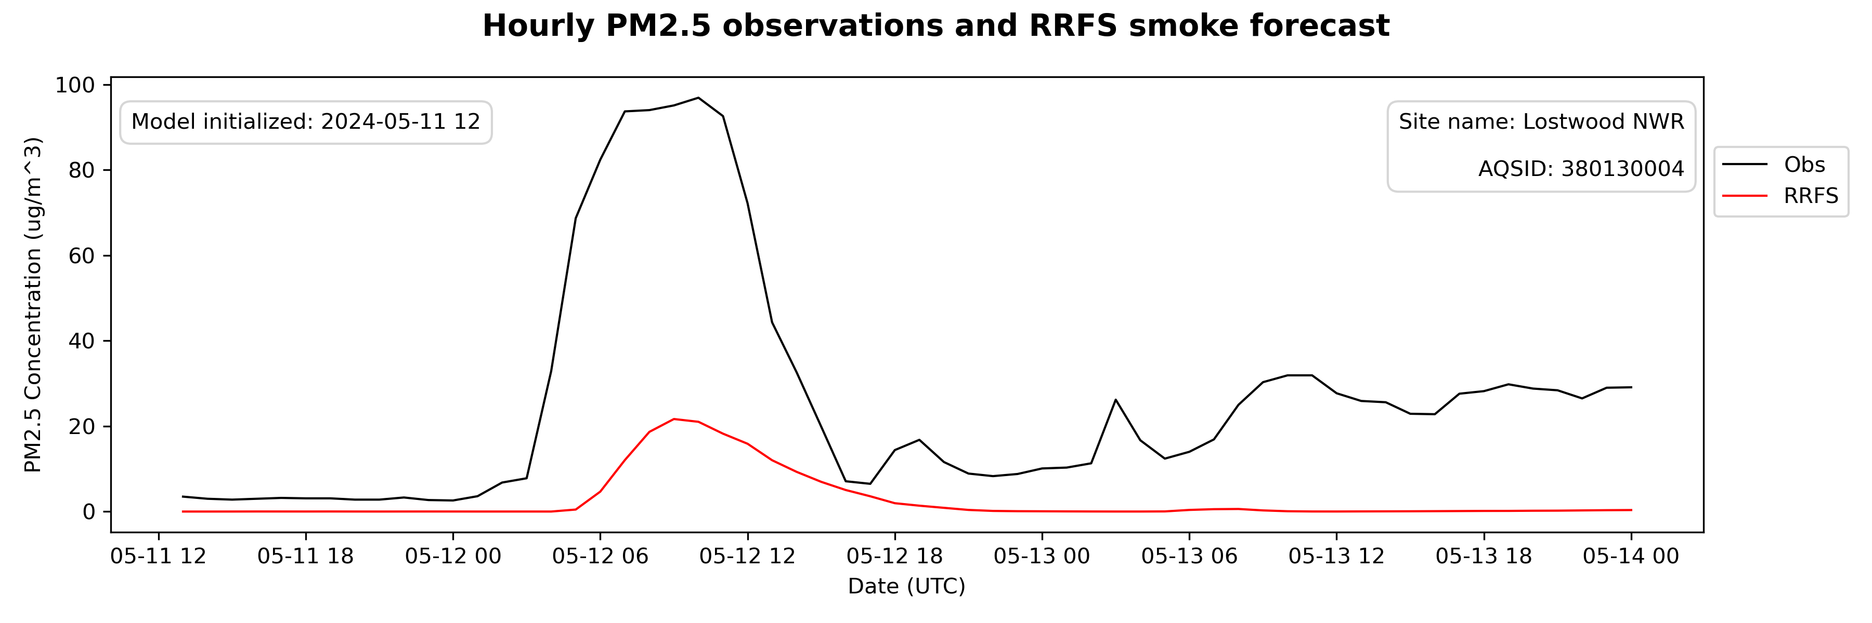
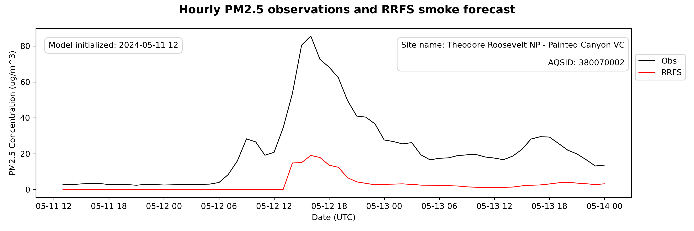
RRFS Smoke Forecast Initialized 05/11 12Z

Slide 12
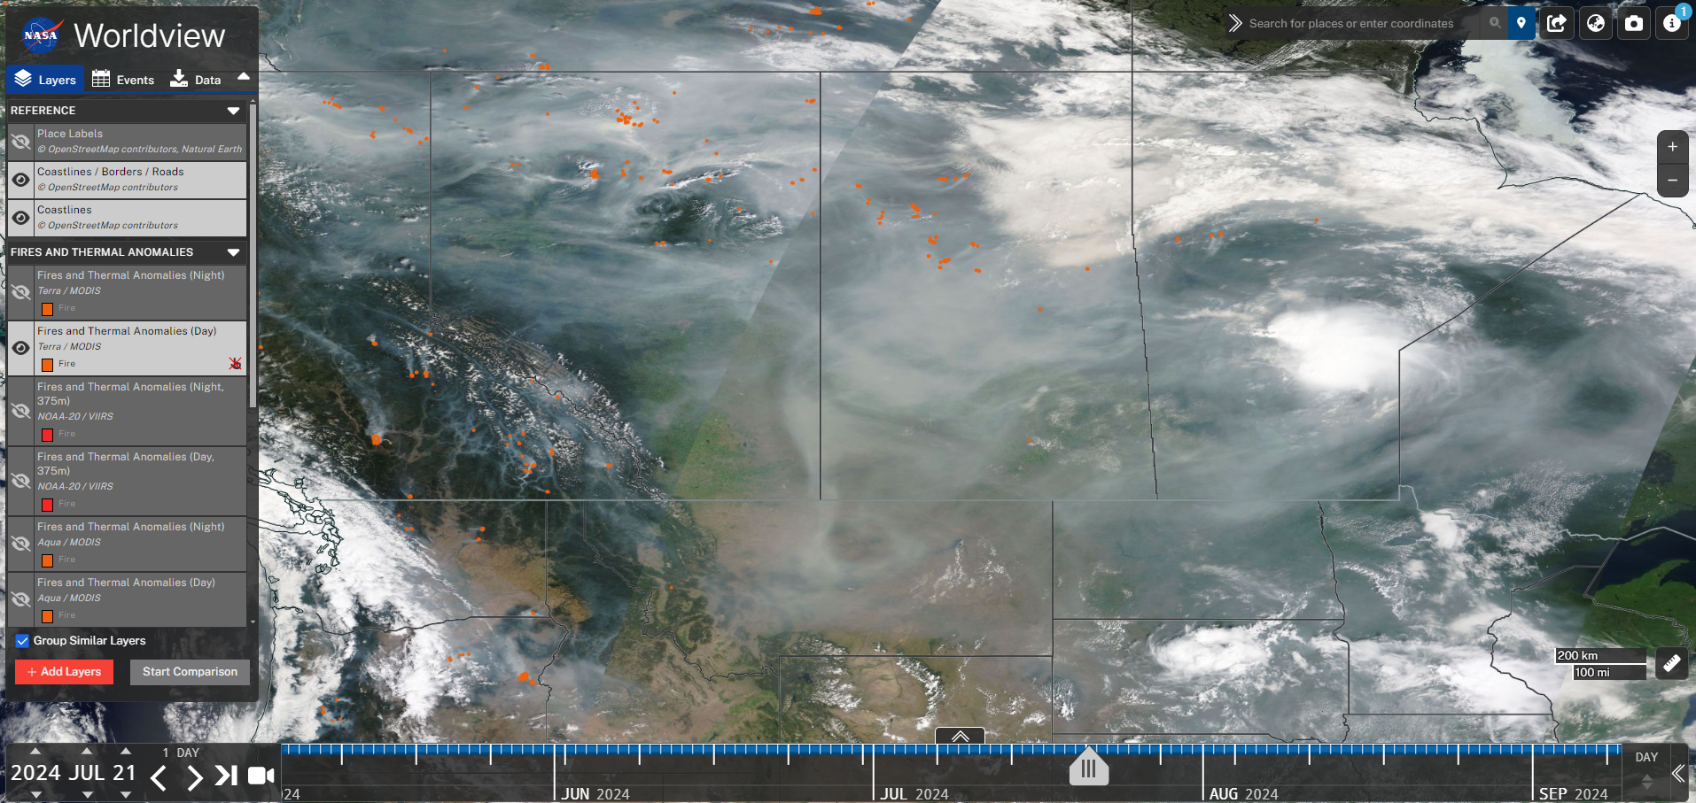
July 21-24 Wildfire Smoke Event Impacts Dakotas

Slide 13
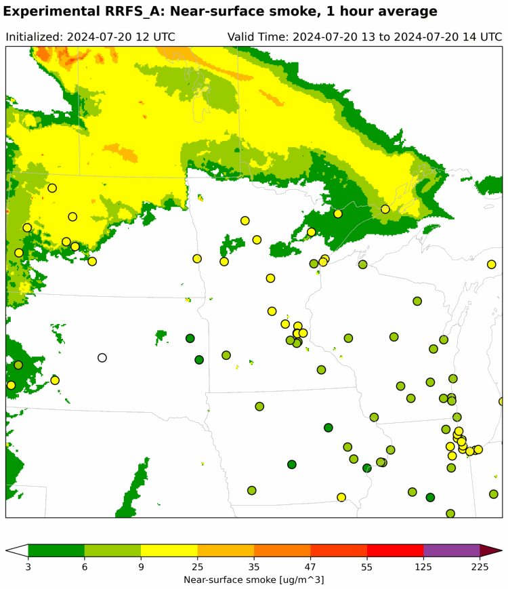
RRFS Smoke Forecast Initialized 07/20 12Z

Slide 14
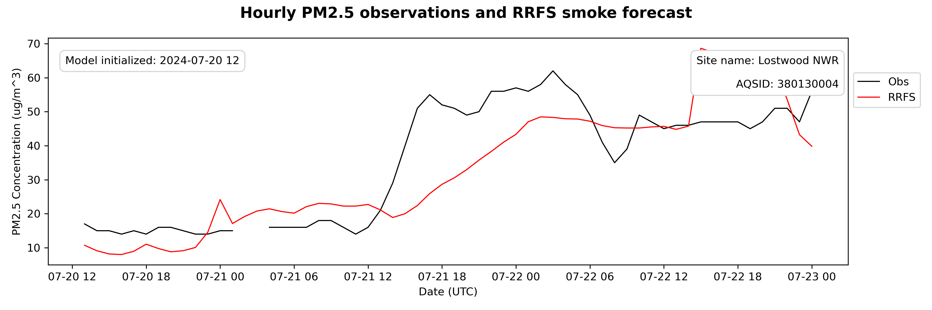
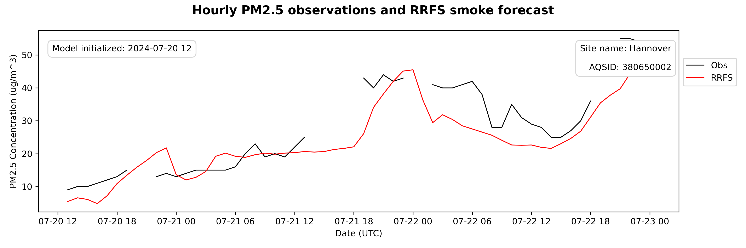
RRFS Smoke Forecast Initialized 07/20 12Z

Slide 15
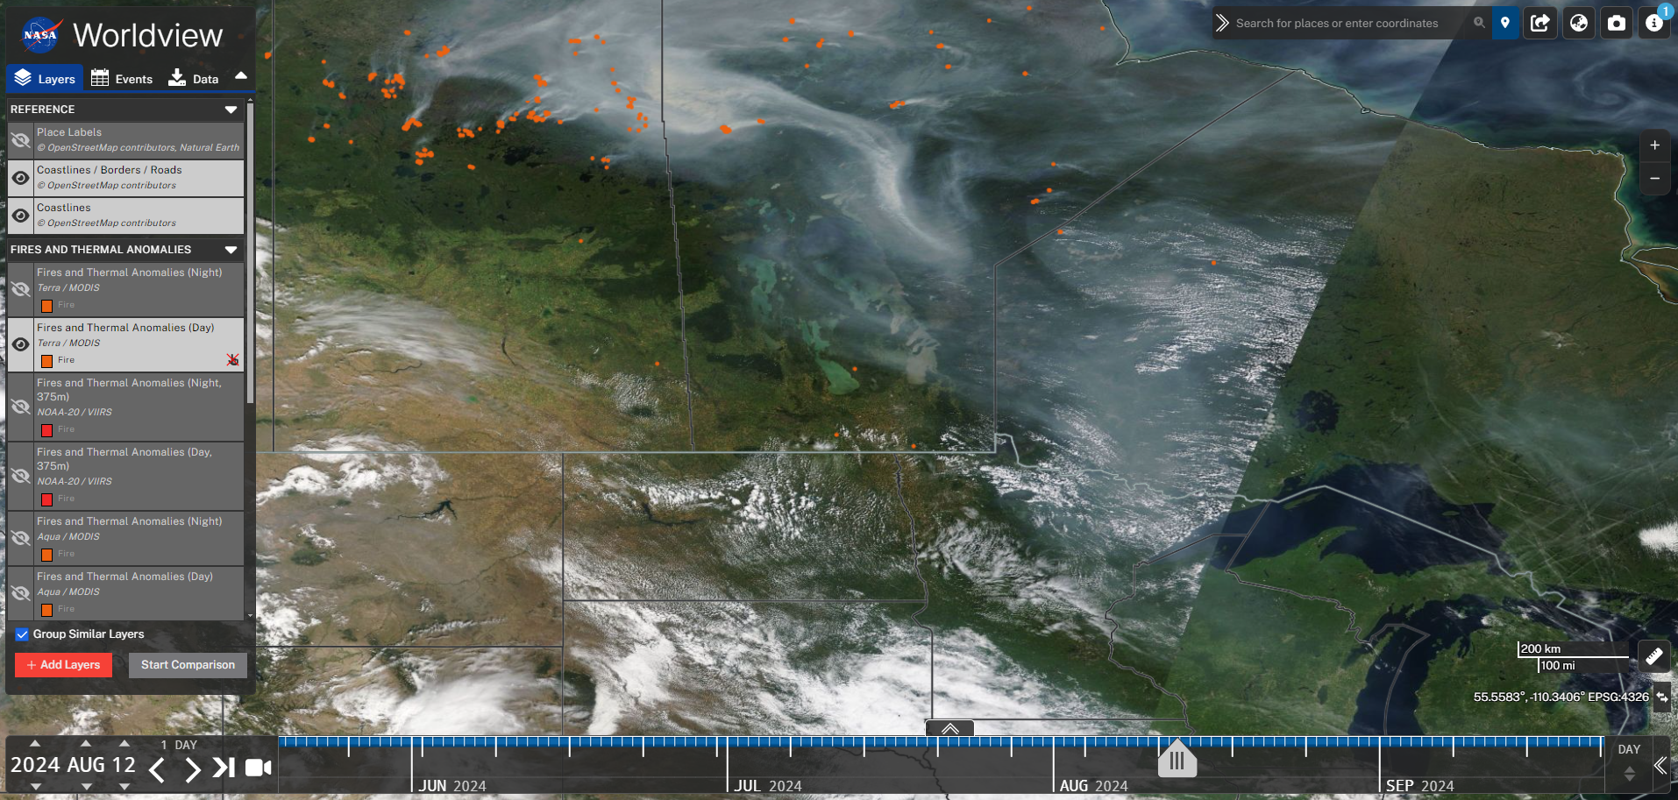
Aug 12-14 Wildfire Smoke Event Impacts North Shore
Notes:
Elevated smoke plume advects southeast over Lake Superior. Lake breeze pulls smoke to the surface and is trapped for several days, impacting monitors along lake shore.

Slide 16
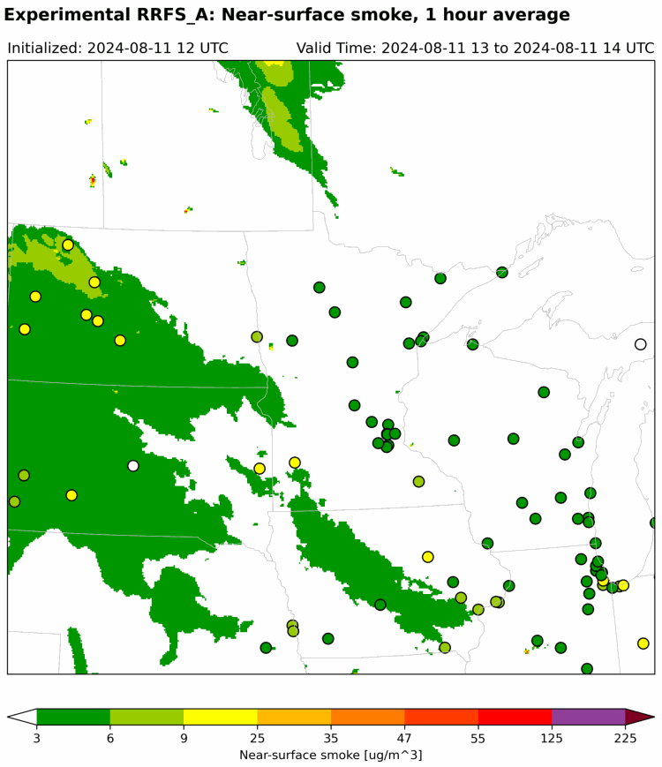
RRFS Smoke Forecast Initialized 08/11 12Z

Slide 17
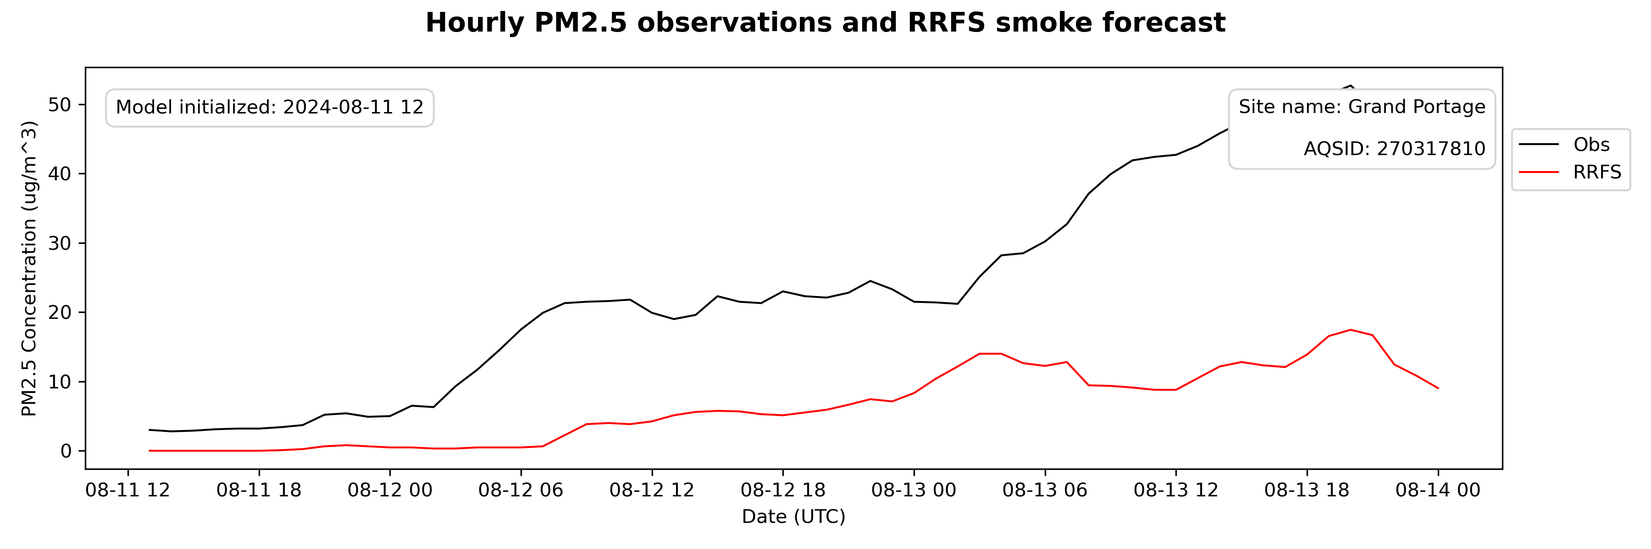
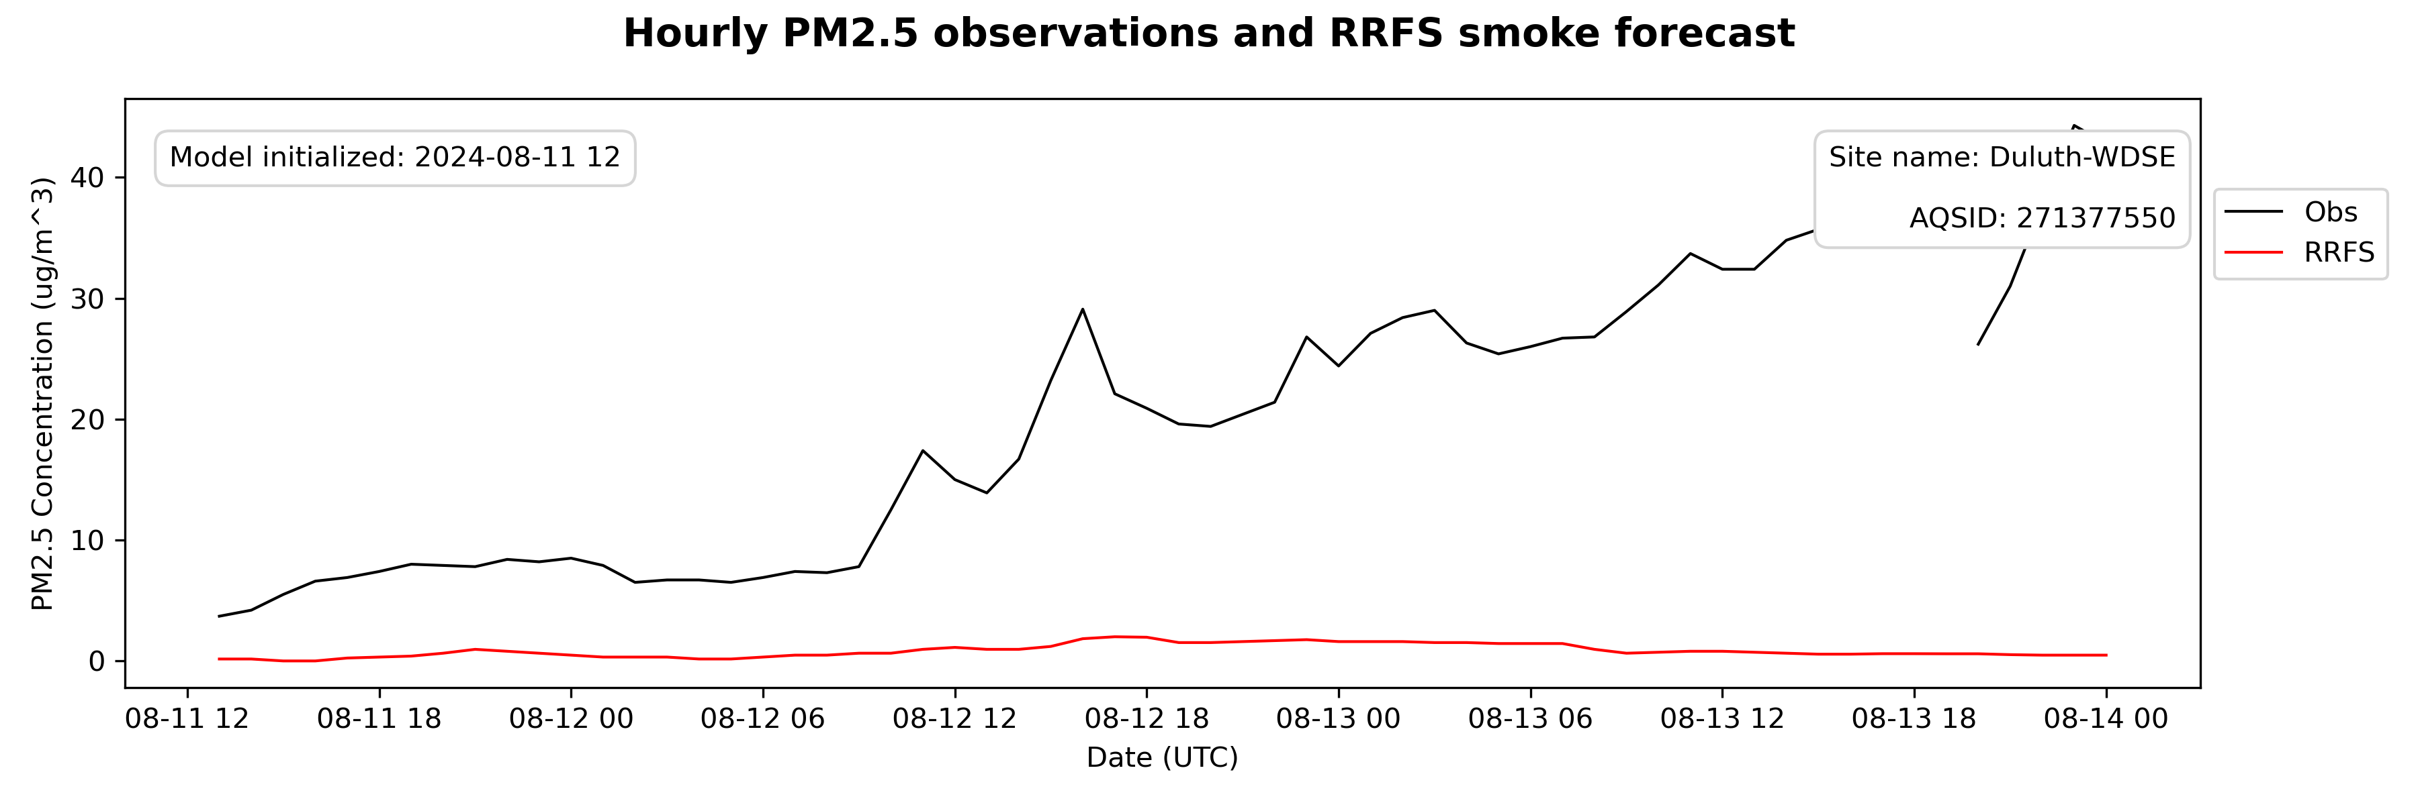
RRFS Smoke Forecast Initialized 08/11 12Z

Slide 18
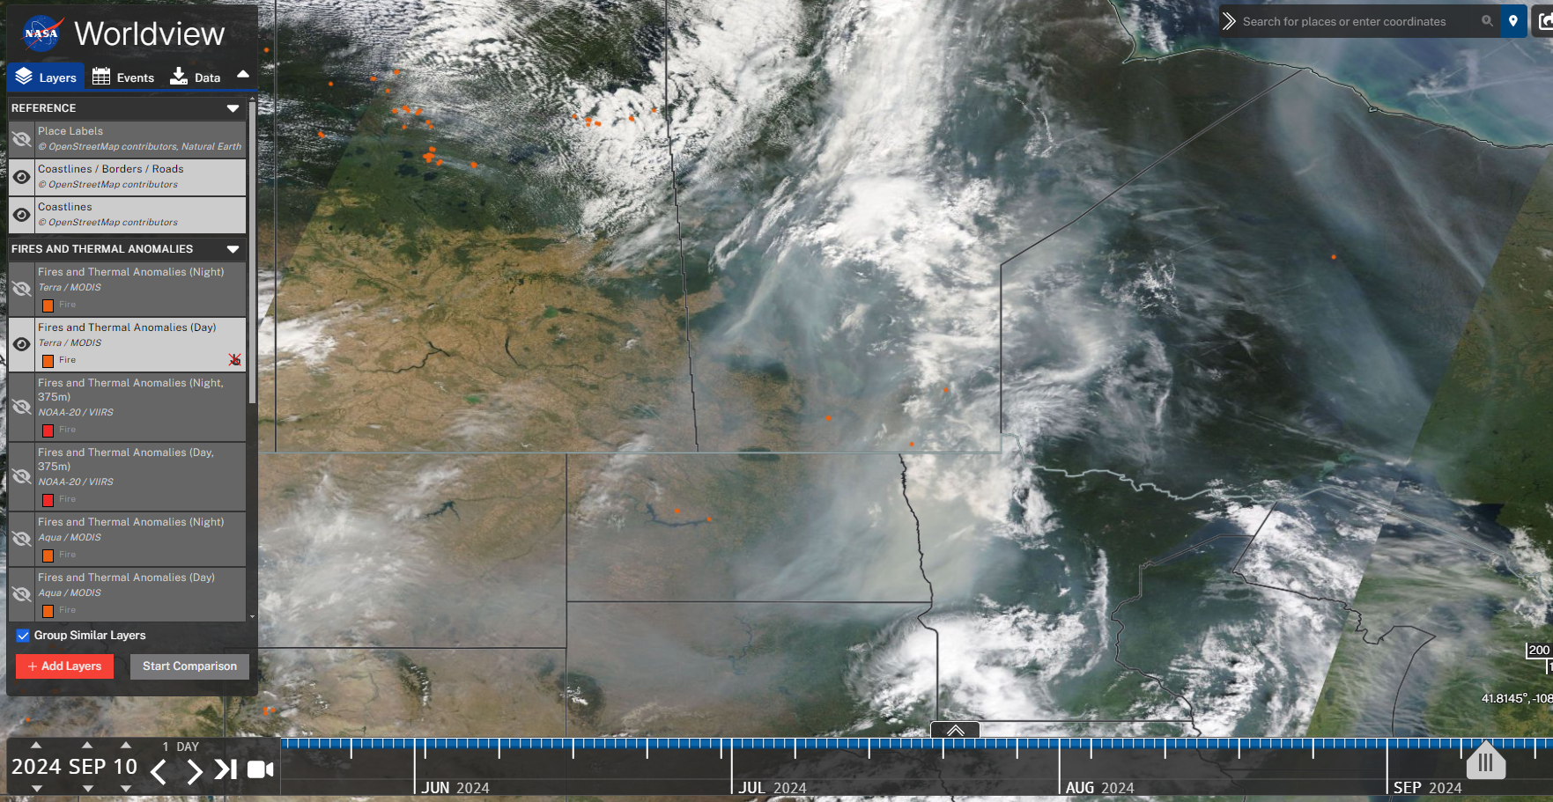
Sep 11 Wildfire Smoke Event Impacts Northwest MN

Slide 19
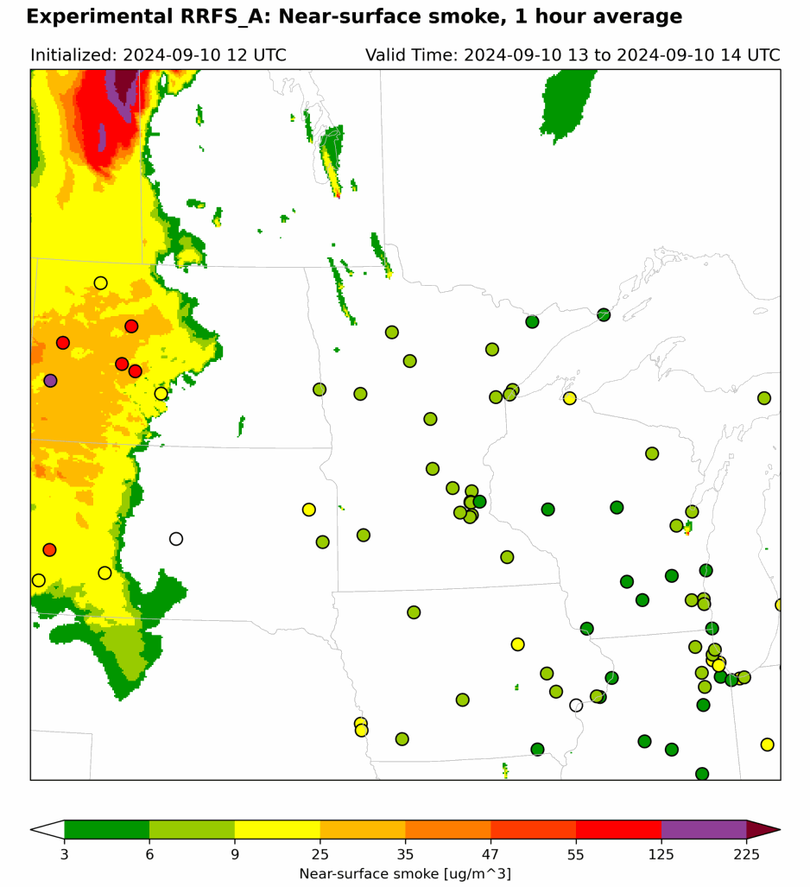
RRFS Smoke Forecast Initialized 09/10 12Z

Slide 20
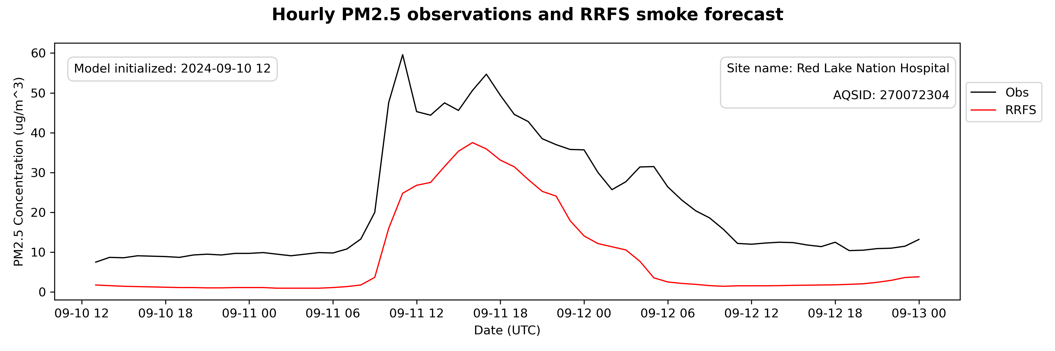
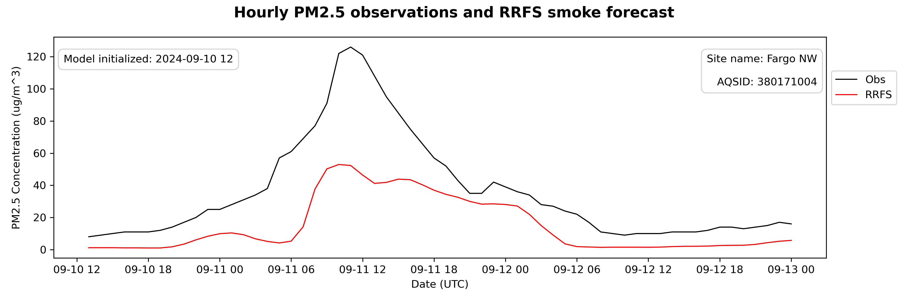
RRFS Smoke Forecast Initialized 09/10 12Z

Slide 21
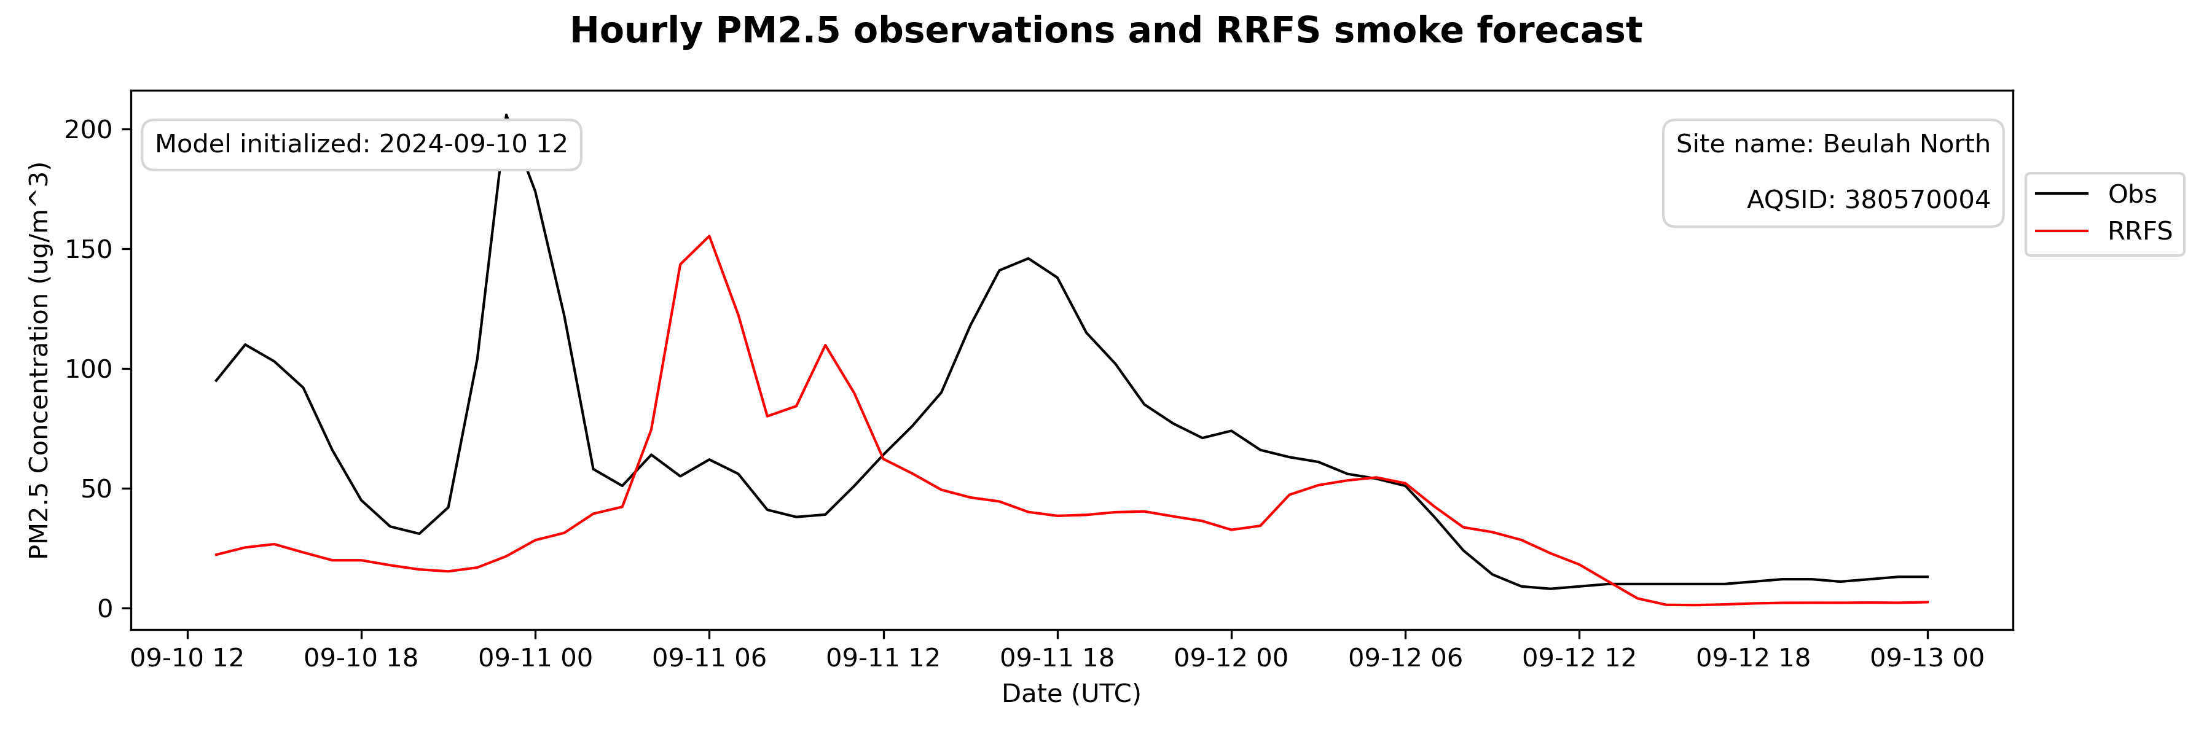
RRFS Smoke Forecast Initialized 09/10 12Z

Slide 22
Summary
Surface PM2.5 was significantly underpredicted for May 11-12 smoke event
Model performance improved for events later in the summer
Significant improvement in wildfire smoke predictions across northern U.S. compared to HRRR-Smoke in 2023

Slide 23
Future Work
Estimate smoke fraction of measured PM2.5 to compare to RRFS smoke predictions
Calculate error statistics using model-observation pairs during wildfire smoke event time periods
Compare performance to other models, including HRRR-Smoke, AQM, and Firework

Slide 24
Thank you!
David Brown
David.L.Brown@state.mn.us
651-757-2227

