Slide 1
Air Quality Forecaster Focus Group Workshop
Kevin Garrett
Office of Science and Technology Integration
Contributions from:
Youngsun Jung, Jack Kain
October 9, 2024

Slide 2
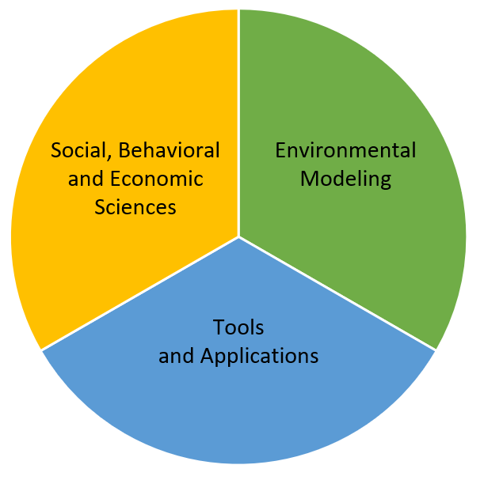
NWS Office of Science and Technology Integration
Modeling Program
STI Modeling Division
NWS/STI 10-year Vision
“Transform the NWS Mission through the Innovative Application of Science and Technology”
“Advance NWS integrated operational environmental modeling through open science to support accurate, reliable, equitable, and actionable analysis and forecast information”
National Air Quality Forecast Capability Drivers
Energy Policy Act (2002)
NOAA/EPA MOA (2021)
NOAA SAB Priorities in Weather Research report (2021)
EMC Center Review (2023)
Air quality forecasters
R2O
Notes:
Cost is not always structural.

Slide 3
Investments in Air Quality Forecasting
NWS Air Quality Program - NAQFC ($1.4M)
AQM R2O, O&M
Wildfire Emissions
Bias correction
Visualization (airquality.noaa.gov)
IIJA/BIL ($50M)
Fire Weather Testbed
S2S / long term fire weather outlooks
Urban scale smoke/fire/fire behavior modeling and data assimilation
Wildfire impacts on PBL
Satellite-based emissions
SBES
FY22 Disaster Supplemental ($20M)
UFS-CMAQ (AQMv7 and beyond) and UFS-Smoke/Dust (HRRR-smoke successor)
Ending ~FY26
Ending FY25
Notes:
Air quality forecast models and forecasts will benefit from larger investments in wildfire prediction.
S2S prediction and long term fire weather outlooks- Long range risks to air quality
Short-range fire weather and hazards risks
After ignition, can we model fire behavior (including suppression), and therefore emissions, and plume evolution and transport?
Recent studies have demonstrated that upward trends in PM2.5 are due to increases in wildfires

Slide 4
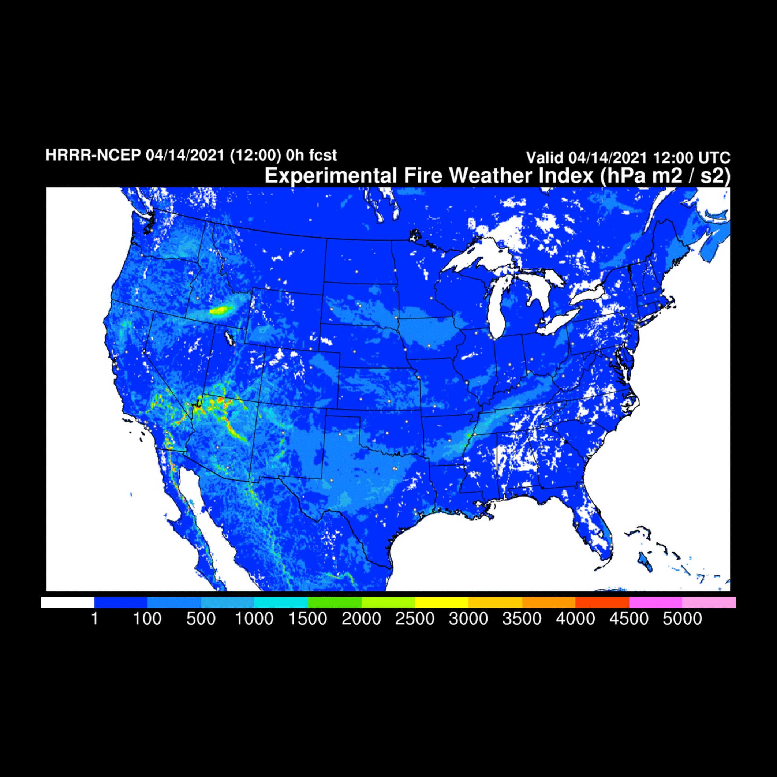
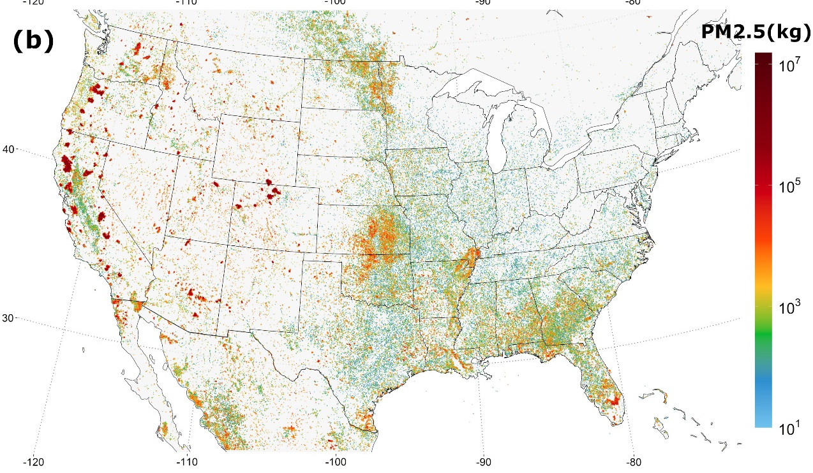
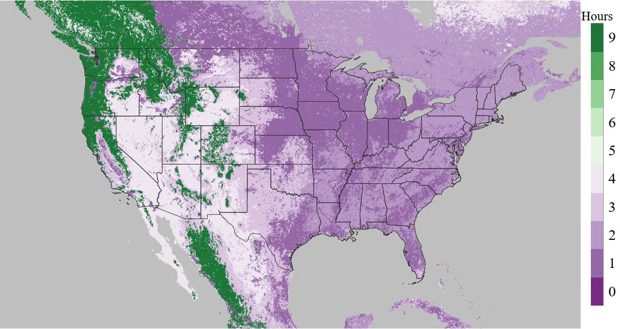
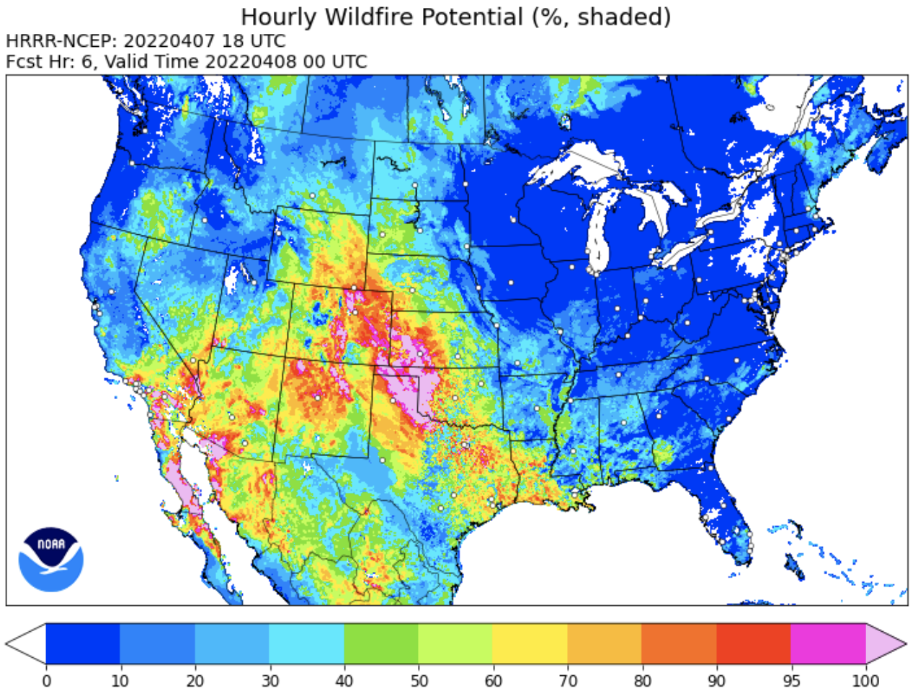
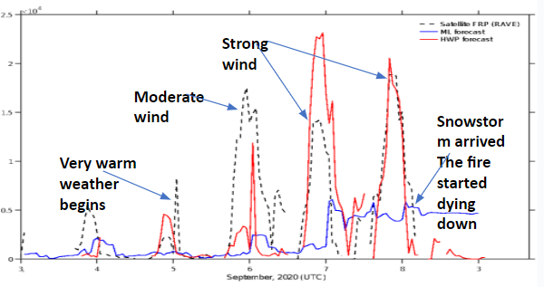
FY19 Supplemental Accomplishments
a)
RAVE PM2.5 emissions in 3 km grids from April 2020 – March 2021 (a) and static fire duration map (b)
b)
Fire Weather Index (FWI) delivered to SPC
Improved diurnal cycle of fire emissions
Hourly Wildfire Potential (HWP)
Notes:
Other work 1) on online-CMAQ, 2) assimilation of AOD, 3) RRFS-SD continued to FY22 DRSA.

Slide 5
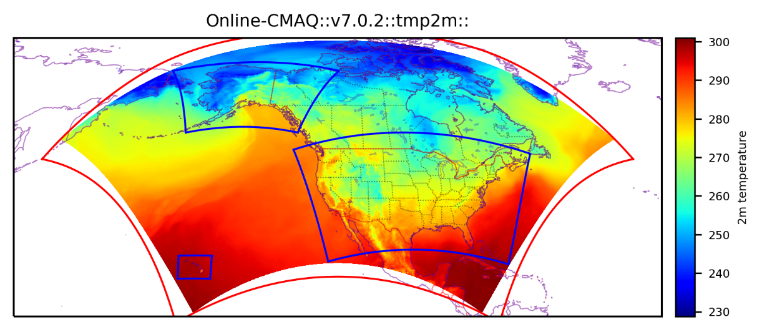
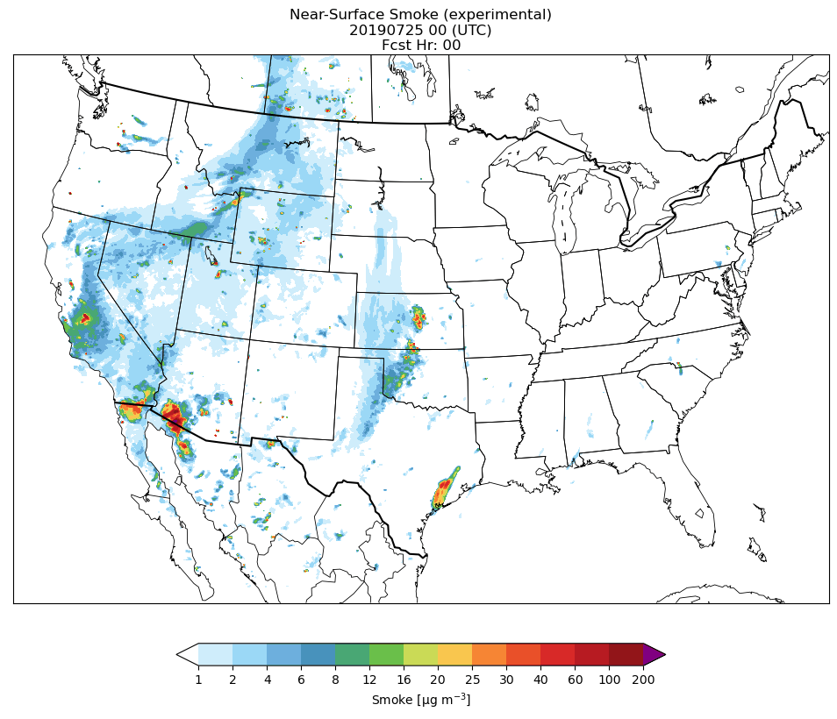
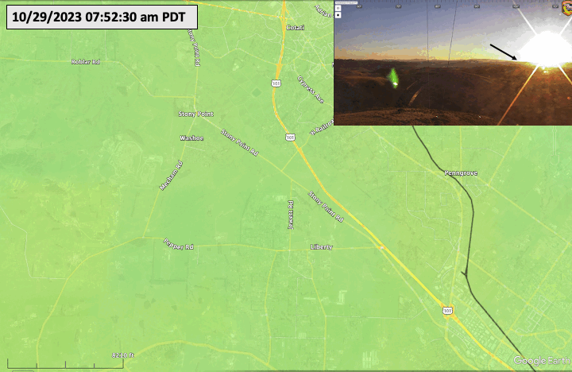
FY22 Disaster Supplemental Projects include…
RRFS-SD (3 km) development
Accelerate implementation of online-CMAQ
NOAA GOES-R Fire Detection Capability

Slide 6
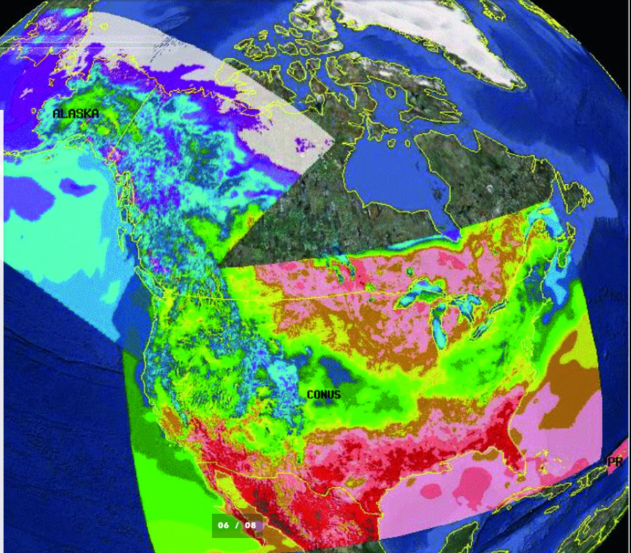
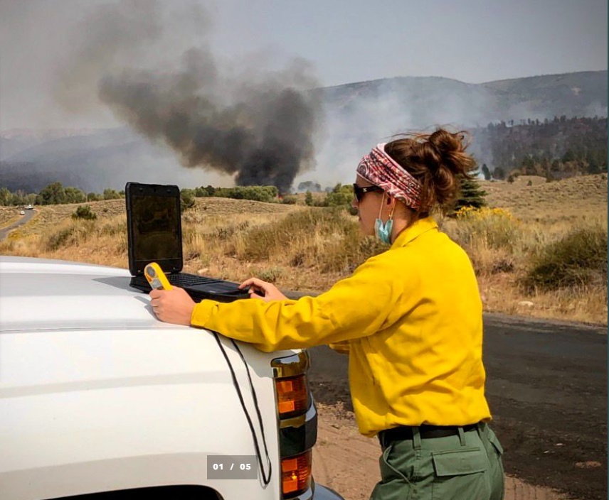
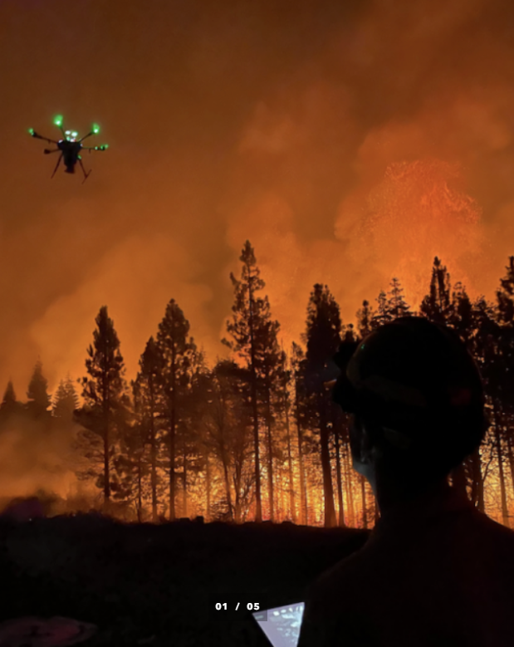
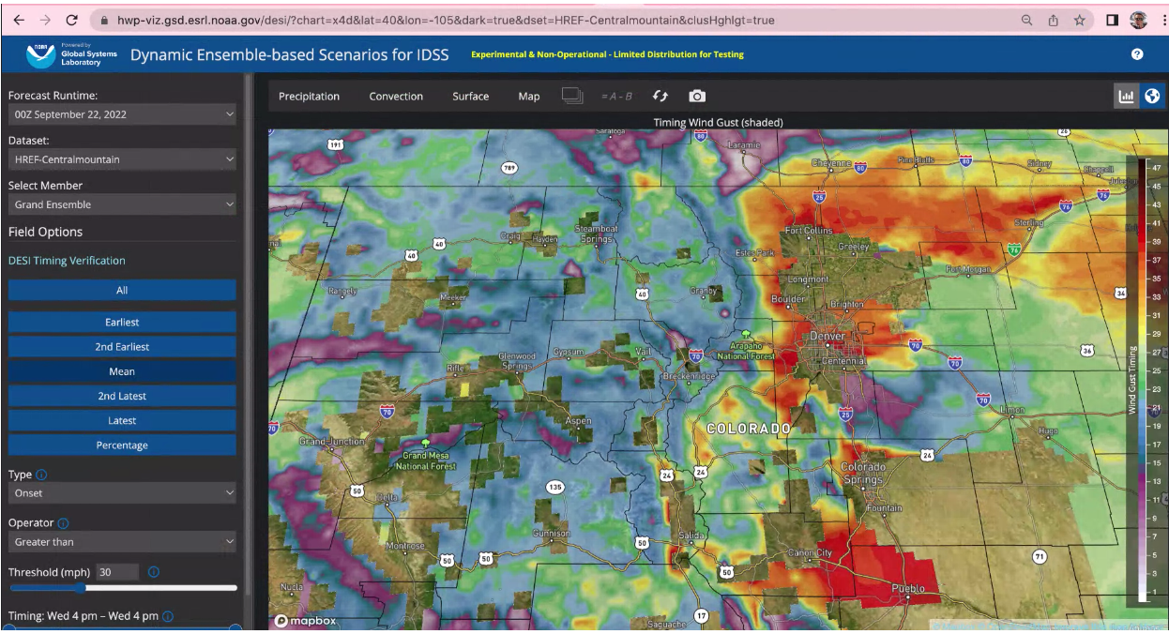
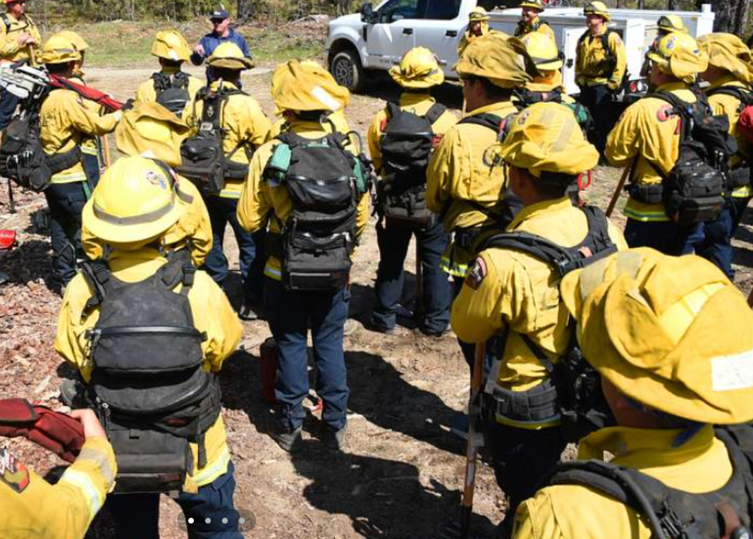
IIJA/BIL Expected Outcomes
Advance early detection tools and predictive capabilities
Equip IMETs
Deploy new observing systems
Engage the broader fire weather community
Accelerate the development of user-specific decision support tools

Slide 7
NAQFC Near-term Strategy
UFS Framework
Unified modeling and data assimilation
Community modeling, open science
Probabilistic guidance
Accelerate innovations - AI/ML
Risk communication
Enhanced partnerships
State and local AQ agencies
International and federal agencies
Notes:
This is a part of NOAA wide collaboration, including NOAA One Health activities, Fire Weather forecast, Fire fighter support, etc. We also look into extending our service to support longer-term outlooks.
We are going to ask what kind of service they want us to improve to better support their decision-making at this workshop. We want to keep improving our collaboration with our partners.

