Slide 1
Air Quality Forecaster Focus Group Workshop, College Park, Maryland, October 9-10, 2024
Overview of NCEP Atmospheric Composition and Air Quality Modeling Activities
Fanglin Yang
Chief, Physics and Dynamics Division
NWS/NCEP Environmental Modeling Center
Acknowledgement: I would like to thank Jianping Huang, Jeff McQueen, Pan Li, Partha Bhattacharjee, Cory Martin, Ravan Ahmadov, Binyu Wang and Mark Cohen for providing some of the materials included in this presentation. Additionally, EMC collaborates with NWS/OSTI program office, OAR labs, NESDIS, and various universities for the development and operational transition of NCEP atmospheric composition and air quality models.

Slide 2
NOAA/NWS/NCEP
Environmental Modeling Center (EMC)
Director
EMC’s mission is to maintain, enhance and transition-to-operations advanced numerical guidance systems for the Nation's weather/water/climate enterprise and the global community for the protection of life and property and the enhancement of the economy.
Senior Scientist
Deputy Director
Data Assimilation Division (DAD)
Physics & Dynamics Division (PDD)
Coupled Modeling Division (CMD)
Engineering and Implementation Division (EID)
Verification and Products Division (VPD)
Model Physics Group
Physics & Dynamics
land
Collaborating with NOAA/OAR labs and universities to develop and transition atmospheric composition and air quality modeling to NOAA operations, serving the community effectively.
Space weather
Air quality & Atmos Composition

Slide 3
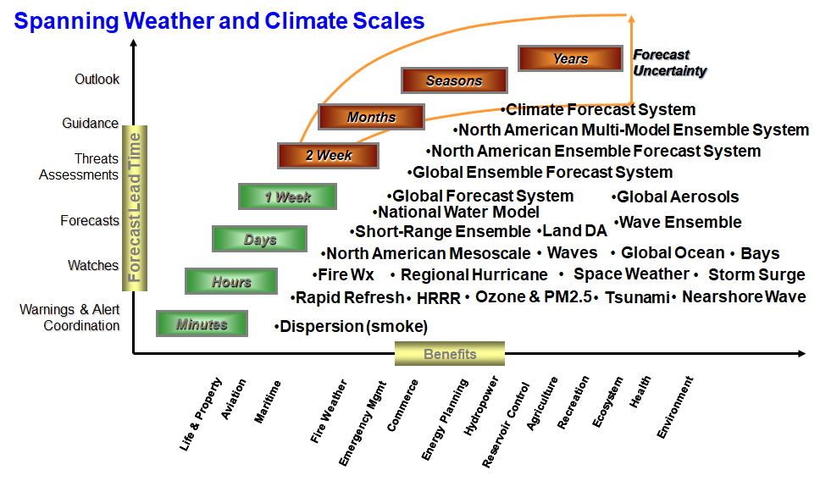
NOAA/NWS/NCEP Environmental Modeling Center (EMC)
Domain scope:
Earth system - multiple components
Role:
Integrate research and development into operations
Validate observing requirements and data impacts
EMC develops and implements the prediction systems that provide operational numerical guidance, spanning weather and climate, for use across the NWS and its worldwide partners.

Slide 4
Moving Towards a Unified Forecast System (UFS)
The UFS is open source software supporting both research and operation for many different modeling applications.
UFS driver
HYCOM
WW3
Noah MP
Global:
GFS - Medium-Range Deterministic Weather Forecast Model (9 km)
GEFS- Global Ensemble Sub-Seasonal Forecast System (25 km)
Including global aerosol modeling
SFS - Seasonal Forecast System (50 km)
WAM - Whole Atmospheric Model (up to 500 km; 50 km)
Regional:
HAFS - Hurricane Analysis and Forecast System (parent 3km; nest 1.8 km)
RRFS - North America Rapid Refresh Forecast System (3km)
Including simplified smoke and dust modules
UFS-CMAQ - North American Air Quality Model (12km)
FV3ATM
CICE6
CMEPS
FV3dycore
wrt
CCPP
wrt
MOM6
CDEPS
GOCART
CMAQ

Slide 5
Global Aerosol Predictions
NGAC: The NCEP GFS Aerosol Component (NGAC), implemented into operation in 2012, was the first global system to allow for interactive aerosol forecasting at NCEP. It was developed by EMC and GSFC using the NASA GOCART aerosol model.
GEFSv12 - Aerosol
Aerosol component module was developed through collaboration between EMC and OAR labs (GSL, CSL, and ARL) and was integrated online with FV3-based GFS within the NEMS/NUOPC framework.
It was based on WRF-Chem and incorporated several key elements: the bulk modulus from GOCART, the biomass burning plume rise module from HRRR-Smoke, the FENGSHA dust scheme developed by ARL, GBBEPx.v3 for biomass burning emissions, and the CDES global anthropogenic emission inventory.
Sub-grid-scale transport, wet scavenging and deposition were handled inside the atmospheric physics routines. with updates to AOD and wet scavenging computations
It was implemented into NCEP operations as part of the GEFS ensemble in September 2020, utilizing a 25-km resolution, 4 cycles per day, and forecast up to 5 days.
Primary products are PM2.5 and PM10
Total AOD, August 25, 2019 (Zhang et al., GMD, 2022)
GEFSv13-Aerosol is still under development

Slide 6
GEFSv12 vs GEFSv13
(See Partha Bhattacharjee’s presentation )
Components |  | V12 (Sep 23. 2020) | V13 (targeting FY26)
Atmos | Dynamics | FV3 (Finite-Vol Cubed-Sphere) GFSv15 | FV3 (Finite-Vol Cubed-Sphere) GFSv17
 | Physics | saSAS, GFDL-MP, K-EDMF, oroGWD | saSAS, Thompson-MP, sa-TKE-EDMF, uGWD
 | Initial perturbation | EnKF f06 (previous cycle) | EnKF f00 (early cycle)
 | Model uncertainty | 5-scale SPPT and SKEB | 5-scale SPPT, SKEB, SPP, CA
 | Boundary (ocean surface) | NSST + 2-tiered SST | NSST
 | Resolutions | C384L64 (25km) | C384L127 (25km)
Land | Model | NOAH-LSM | NOAH-MP
 | Initial perturbation | N/A | Soil moisture
Ocean | Model | N/A | MOM6 (0.25ºL75)
 | Initial perturbation |  | SOCA-Ens
 | Model uncertainty |  | 5-scale oSPPT and ePBL
Ice | Model |  | CICE6 (0.25º)
 | Initial perturbation |  | SOCA-Ens
Wave | Model | WW3 (1-way) (0.5º) | WW3 (2-way) (0.25º lat/lon grid)
Aerosol | Model | WRF-Chem (1 member) | GOCART

Slide 7
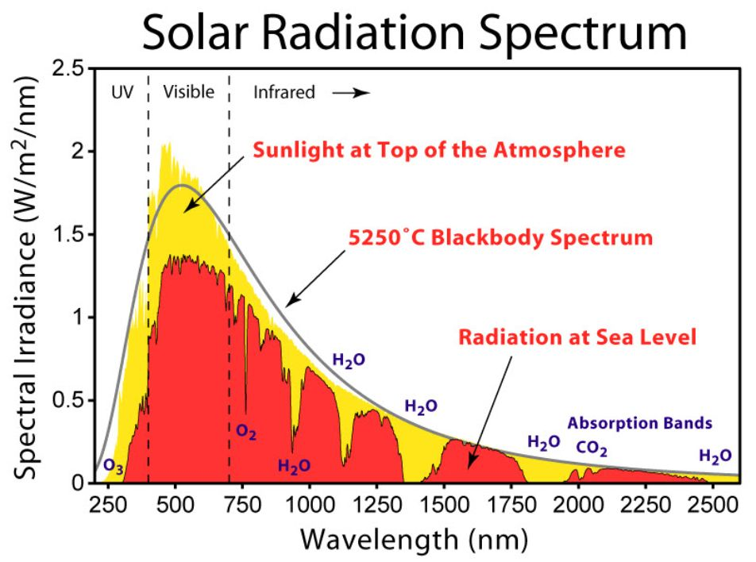
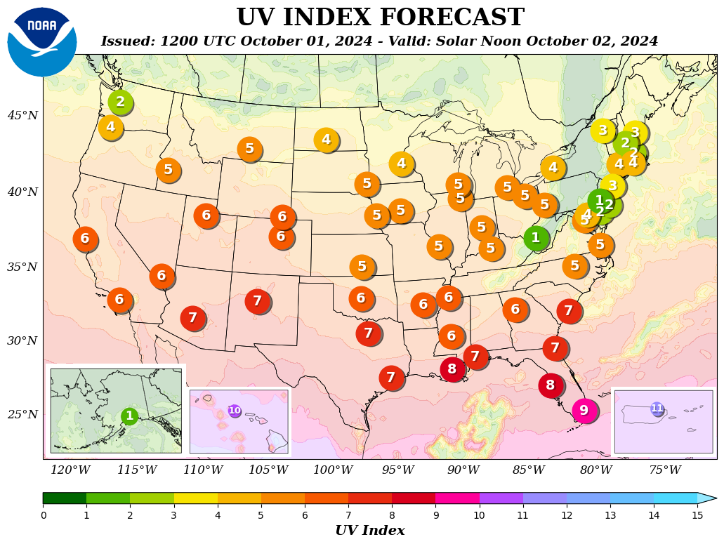
GFS -- Stratospheric Ozone Prediction
McCormack et al. (2006) Parametrization for Ozone Forecast
Stratospheric Ozone contributes significantly to model radiation balance
First-order Taylor series in three variables for the ozone rate of change
dr_{O3}/dt = P-L = (P-L)₀ + d(P-L)/dr_{O3}|₀ (r_{O3} - r_{O3,0}) + d(P-L)/dT|₀ (T - T₀) + d(P-L)/dS_{O3}|₀ (S_{O3} - S_{O3,0})
S is partial column ozone above that point
All terms calculated using 2-D chemistry model CHEM2D
NCEP/CPC uses GFS ozone forecast as input for predicting UV index
For O3 initialization, GFS/GDAS assimilates retrievals from OMI on Aura and OMPS on NPP and NOAA-21 satellite observations. The OMPS products are both a profile and a total column.
https://www.cpc.ncep.noaa.gov/
Notes:
UV radiation is a type of short-wave (100-400 nm) electromagnetic radiation that is invisible to the naked human eye. The UV radiation spectrum is divided into three bands: UVA (315-400 nm), UBV (280-315 nm) and UVC (100-280 nm). UVC and 90% of UVB radiation are mostly absorbed by the ozone layer, but also by the oxygen, hydrogen and carbon dioxide in the atmosphere. The UV radiation that reaches the Earth’s surface consists of UVA and a small proportion of UVB.

Slide 8
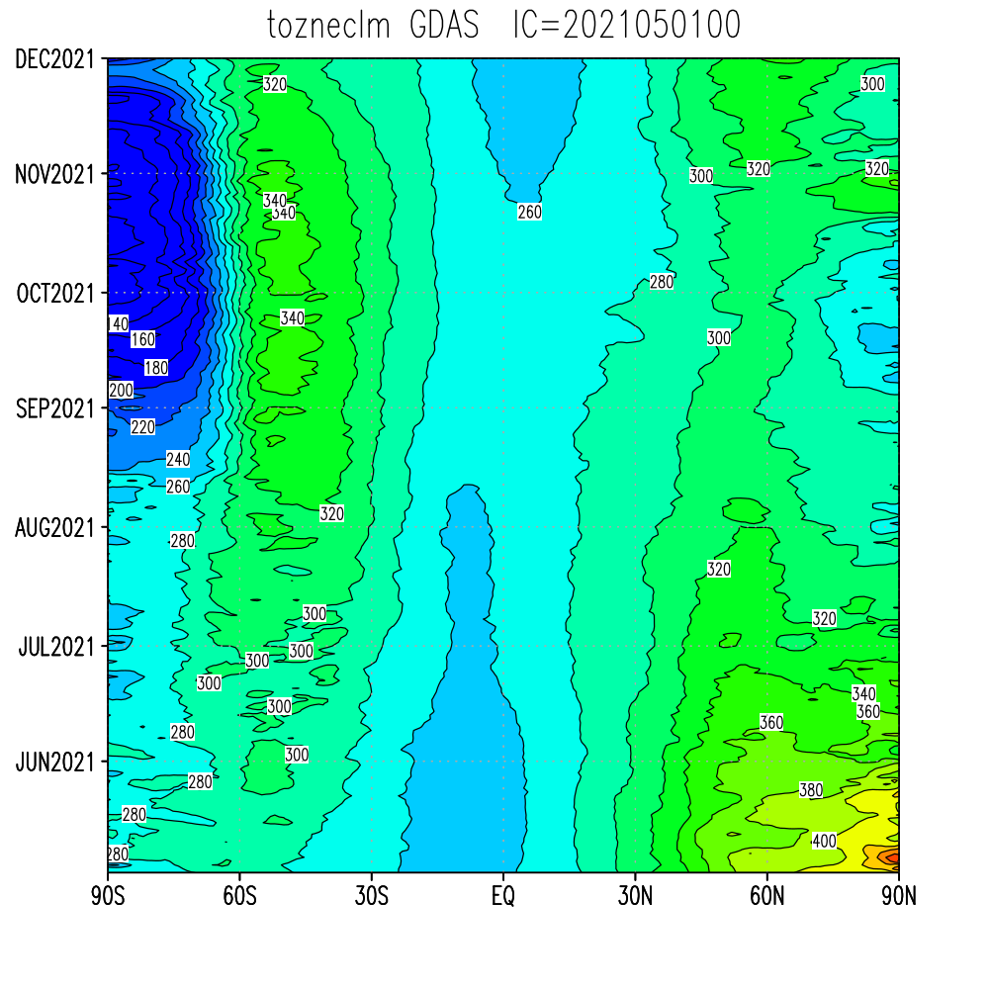
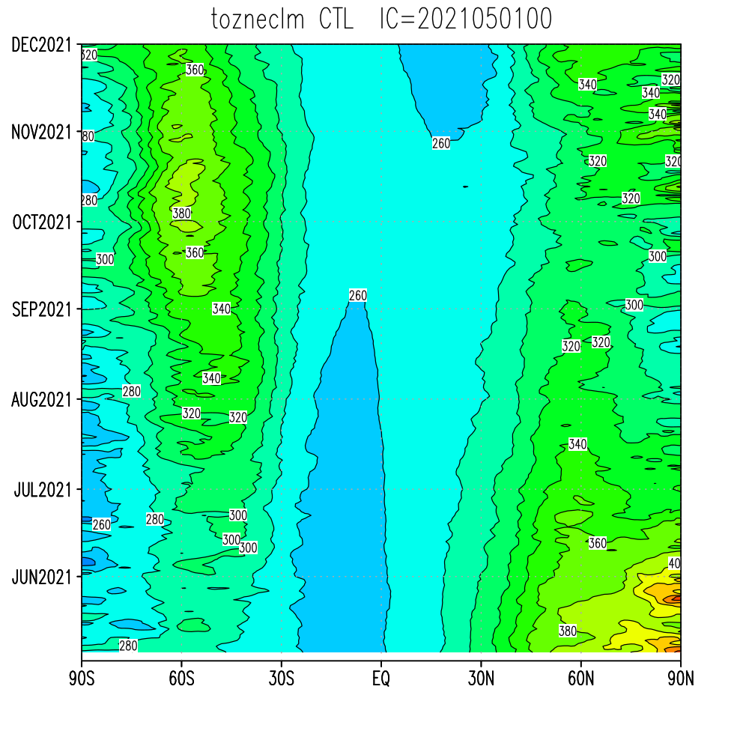
The McCormack parameterization employed by current GFS is not able to capture the Ozone Hole in the Southern Polar Stratosphere
GDAS Analysis
GFS Free Forecast (50-km resolution)
Need to develop gas-phase chemistry to better simulate trace gases for NOAA global modeling at the S2S time scale
Credit: Wesloh, Zhou and Yang (EMC)

Slide 9
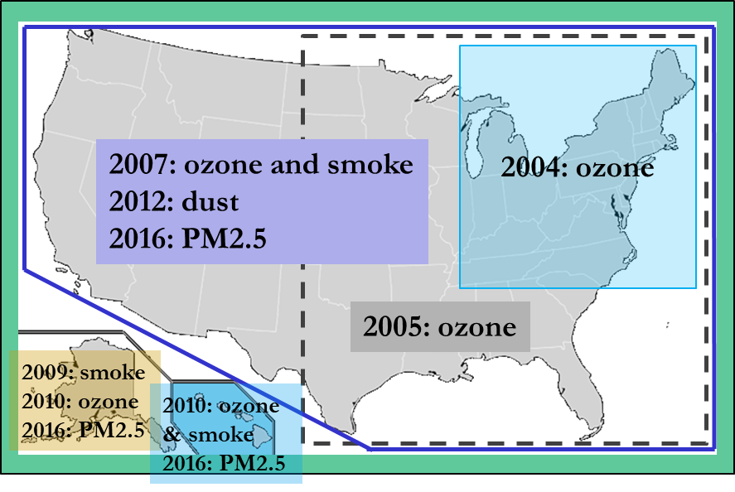
AQM -- Regional Air Quality Forecast Model
Jianping Huang’s presentation
Chemistry model: EPA Community Multiscale Air Quality (CMAQ) model: gas-chemistry mechanisms (e.g., CB6) and aerosol module (e.g., Aero6)
Meteorological model:
NOAA/NCEP North American Mesoscale (NAM) numerical weather prediction models: Eta, WRF/NMM, NMMB
NOAA/NCEP Global Forecast System (GFS)
Forecast Guidance:
O₃, PM_{2.5}, and smoke: nationwide
Dust: CONUS
AMQ v6 and earlier: GFS-CMAQ offline system
AQM v7: UFS-CMAQ online system
AQM v8: under development, scheduled for Q1FY26

Slide 10
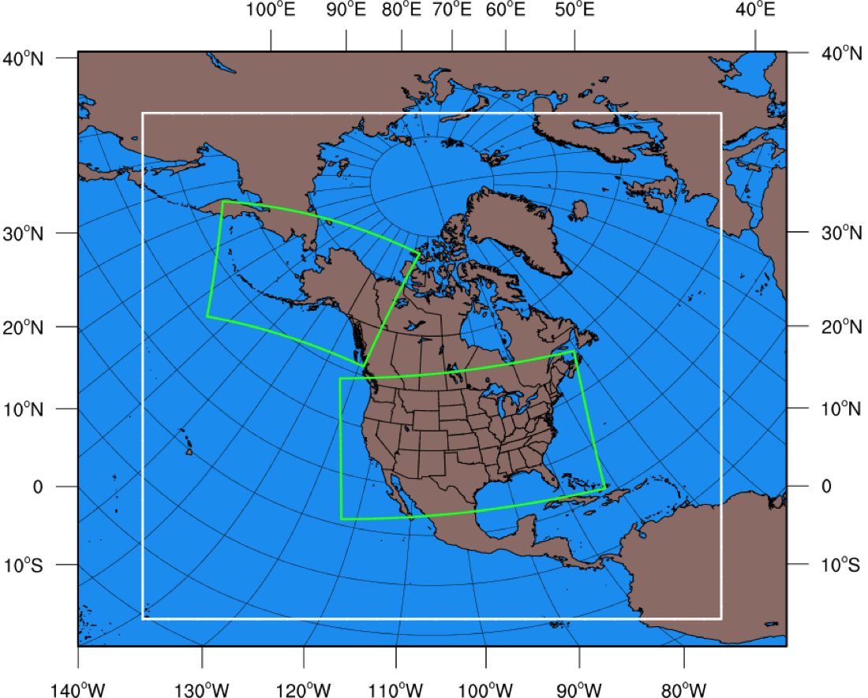
RAP/HRRR -- Operational Regional Smoke/Dust Modeling
A smoke tracer is added to the operational RAP/HRRR weather forecast models in late 2020
The satellite fire radiative power (FRP) data are used to estimate the fire emissions and heat fluxes in real time
RAP-Smoke (13km) enables simulating smoke transport over Central and North Americas, and provides lateral boundary conditions of smoke to HRRR-Smoke.
The HRRR-Smoke (3km) model is able to capture the mesoscale flows and smoke transport in complex terrain
Smoke feedbacks on radiation and visibility are included in these models
RAP-Smoke
HRRR-Smoke AK
HRRR-Smoke CONUS
Rapid Refresh (RAP), 13.5km resolution
High-Resolution Rapid Refresh (HRRR), 3km res.
(https://rapidrefresh.noaa.gov/)
See Ravan Ahmadov’s presentation

Slide 11
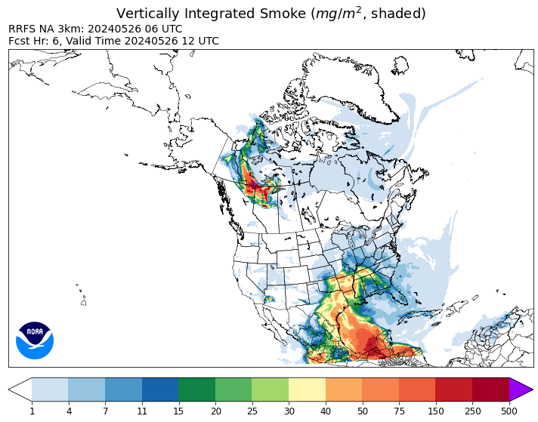
Transitioning to RRFS-Smoke-Dust (RRFS-SD)
Smoke (primary PM2.5 from wildland fire emissions) and fine and coarse dust aerosols are included.
The smoke emissions are based on the VIIRS and GOES-16/17 fire radiative data.
A new forecast is generated every hour. It goes out to 60 hours 4 times a day, 18 hours for other cycles.
The impact of smoke and dust aerosols on radiation and visibility is included.
A new fire weather index – Hourly Wildfire Potential is provided by the model to the users.
The RRFS-SD model is being tested in real-time by EMC.
The fire weather, smoke, and dust fields are displayed on a public website: https://rapidrefresh.noaa.gov/RRFS-SD/
3 km RRFS limited area model domain
NOAA’s new NWP model:
Rapid Refresh Forecasting System (RRFS)

Slide 12
HYSPLIT -- Atmospheric transport and dispersion modeling
Courtesy of OAR/ARL
Atmospheric transport and dispersion modeling is critical for emergency response and assessment for pollutants released to the air
HYSPLIT is driven by weather model outputs from NOAA operational models, including GFS, GDAS, GEFS, HRRR, NAM, HREF
HYSPLIT model has been under continuous development at NOAA ARL for more than 40 years
EMC collaborates with ARL for the transition of HYSPLIT upgrades into NCEP operation
A plume of air pollutants emitted from an industrial fire in Deer Park, Texas, March 2019.
AP Photo: David J. Philip
Notes:
Atmospheric transport and dispersion modeling is important for Emergency Response and Assessment of pollutants released to the air
The NOAA OAR ARL HYSPLIT model was developed to carry out this task, and we have been working to improve the model and its application for more than 40 years.
Work in close collaboration with NOAA NWS – HYSPLIT is driven by NOAA meteorological model outputs

Slide 13
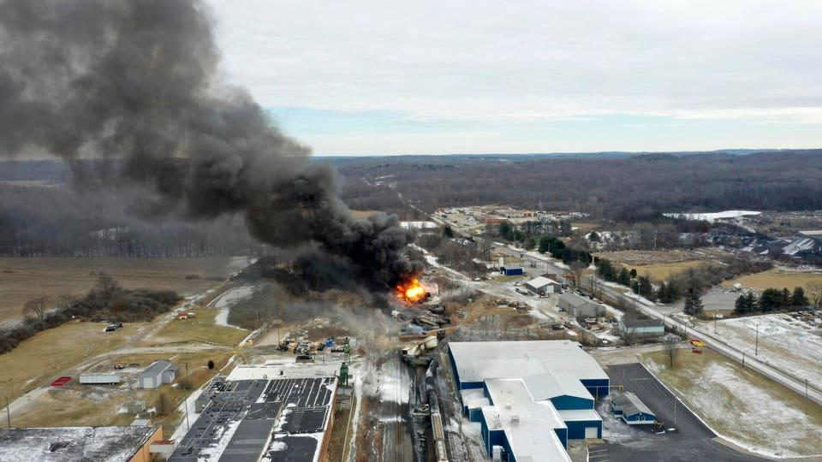
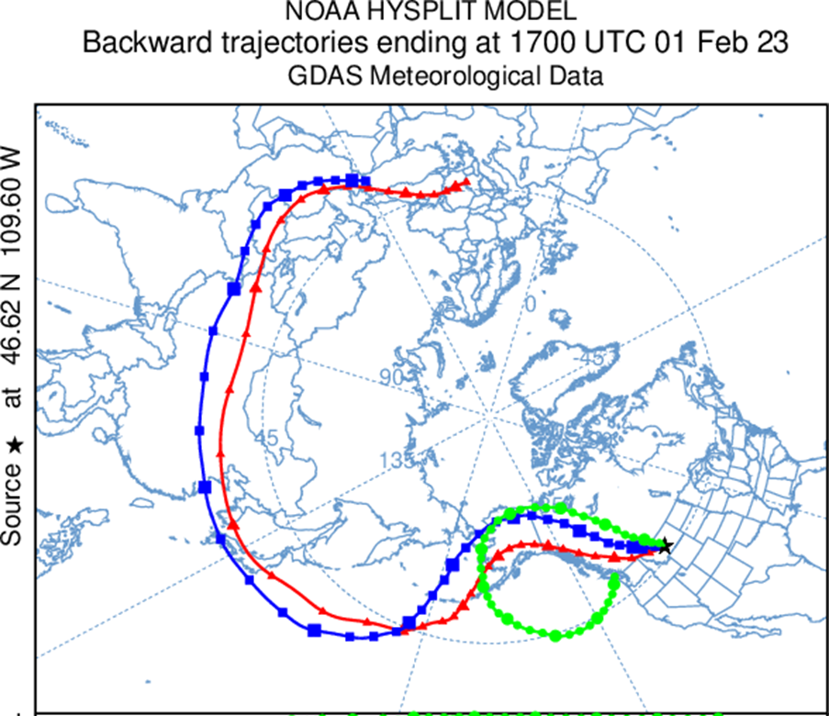
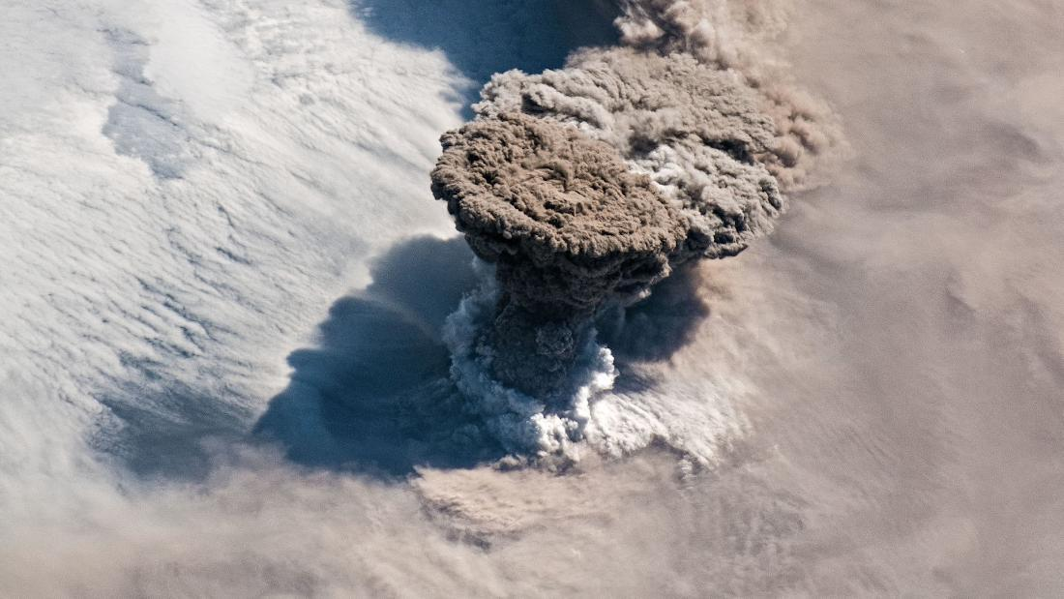
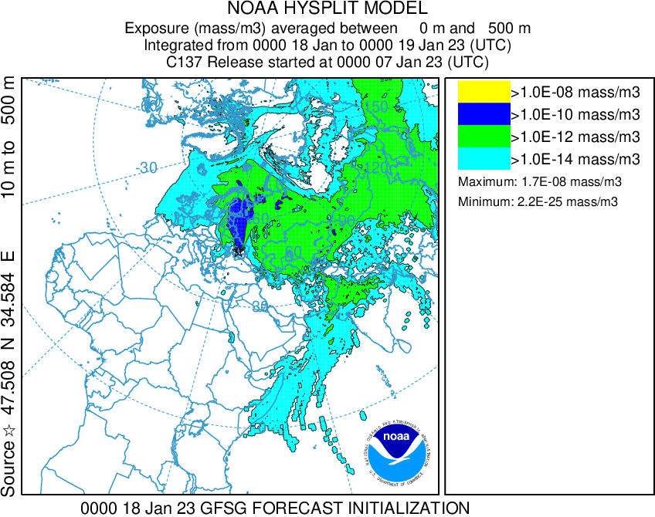
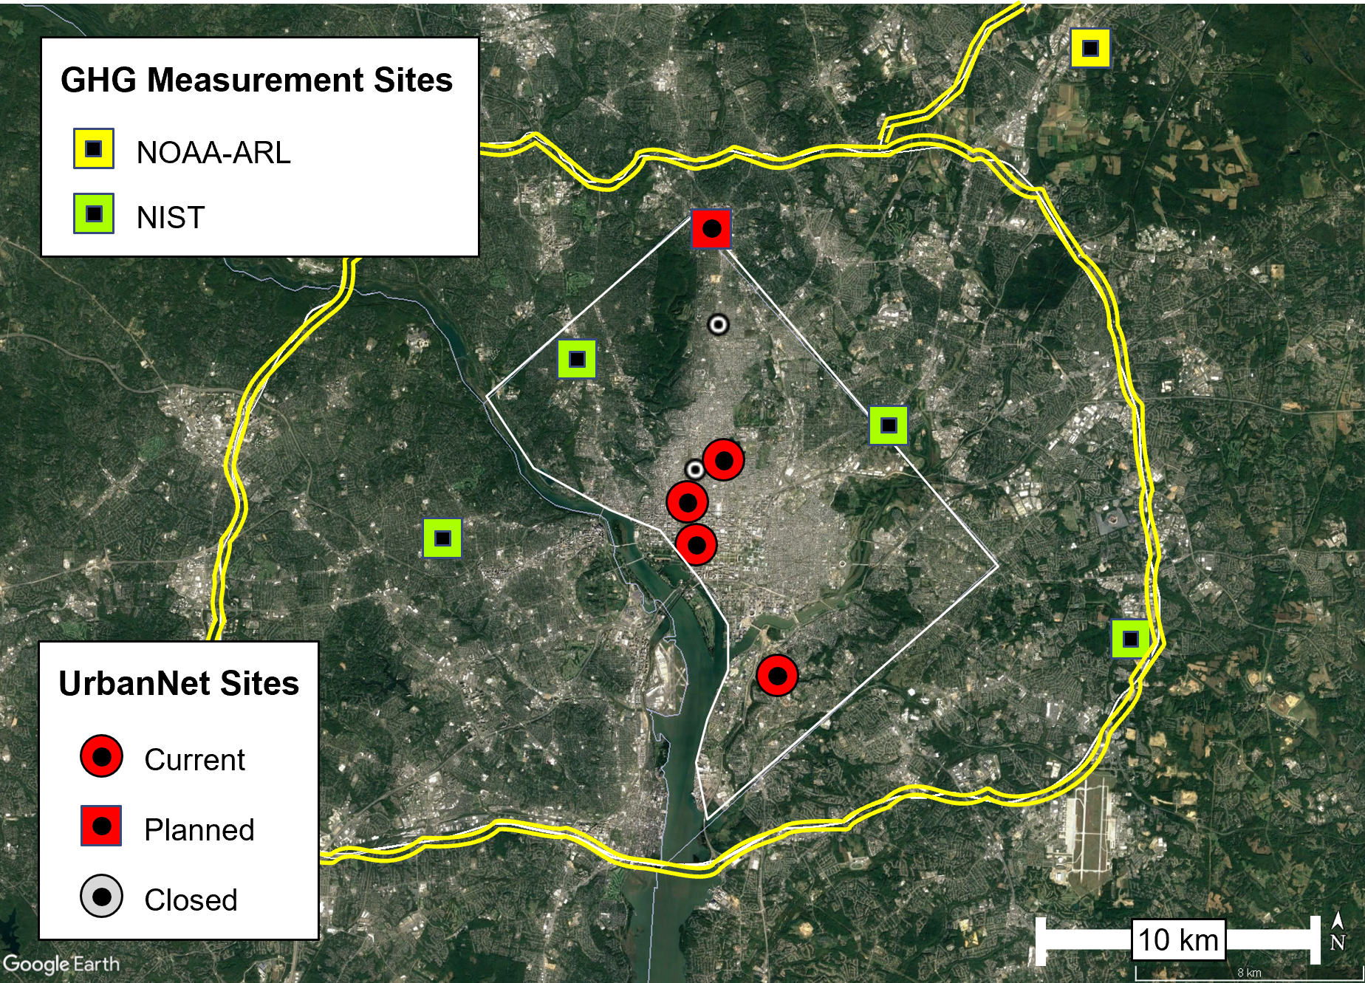
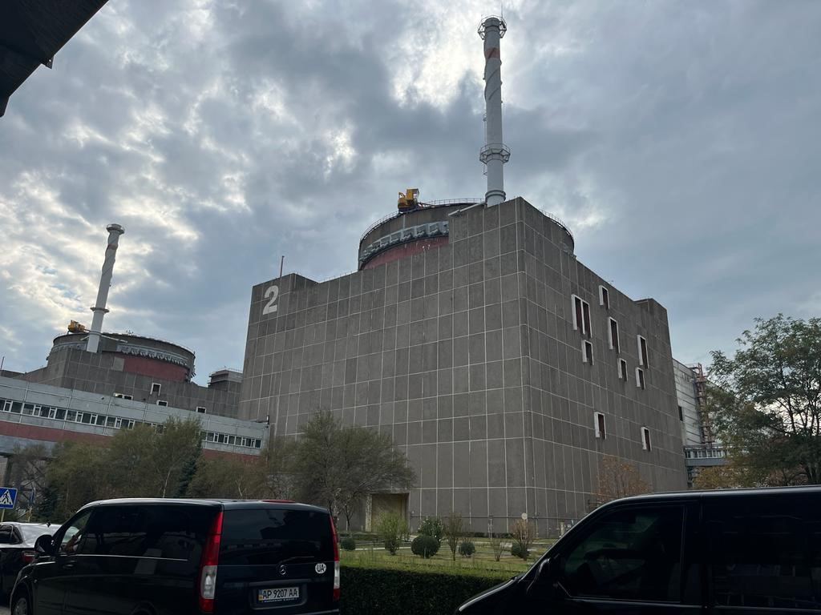
The HYSPLIT Model: Spy Balloons, Train Derailments, Greenhouse Gases, and more
Mark Cohen, Leader of the HYSPLIT Modeling Group, NOAA Air Resources Laboratory
Where do things in the air go?
Where do things in the air come from?
Tracking the Spy Balloon from Montana back to China
Feb 2023
Research, development, and transition to operations for ~75 years
Driven by NOAA meteorological models (and others)
Used at NOAA and around the world for emergency response, planning, assessment, and for estimating emissions
East Palestine, Ohio
Train Derailment
Feb 2023
North Pole
East Palestine
China
Raikoke eruption, Kurile islands,
June 2019; Picture taken from International Space Station (CNN)
Run the model backwards from Green House Gas (GHG) measurement sites
Estimate the emissions of GHG in the Washington DC area
Independently check progress on emissions reduction
Simulation of impact of a hypothetical release of radioactive material from the Zaporizhzhia Nuclear Power Plant
Zaporizhzhia Nuclear Power Plant, Unit 2, Ukraine
Notes:
Possible Questions:
How do you know how accurate the model is?
What are the biggest uncertainties in the model?
How do we improve the model?
What’s the most unusual thing the model has been used for?
How many online runs of the model are there per year?
What was the genesis of the model ~75 years ago?
Script:
The HYSPLIT atmospheric transport and dispersion model has been under development for about 75 years, starting with a laboratory that eventually became the NOAA OAR Air Resources Laboratory.
The model is driven by meteorological models and measurements from NOAA and elsewhere
And it is used to answer two types of questions:
Where do things in the air go, for example, pollutants emitted from a manmade or natural disaster?
Industrial accidents, like the recent train derailment in East Palestine, Ohio: What concentrations of pollutants will people downwind be exposed to – Should they be evacuated? Shelter in place?
Volcanic eruptions, to be able to warn aircraft away from regions of dangerous ash concentrations that could cause their engines to fail
Real or potential accidents at nuclear power plants
Wildfires and prescribed burns
Dust storms
In these applications, it is used operationally for emergency response in for a real event, and it is also used to help plan and assess the risk from a potential event
And where do things that we see in the air come from?
Instead of running the model forward, you can run the model backwards to see where air parcels that arrived at a given location came from
One very widely used application of the model is to carry out simulations of back-trajectories.
The example shown here is a back-trajectory from the observed location of the spy balloon over Montana in the U.S. to see where it might have come from.
The back-trajectory shows that the balloon may have come from China.
The different color trajectories are started at different heights.
Another important application is to run the model backward from atmospheric measurement locations to estimate the location and amount of emissions that must have occurred upwind to have caused those measurements to be what they are.
One example of this type of use is a multi-agency project to independently estimate GHG emissions from the Washington DC urban area, based on measurements of GHG in the region. These so-called “top-down” emission estimates are used to check conventional “bottom-up” emissions estimates to independently verify claims of emissions increases or reductions.
Thanks for your attention.
===================================================================
CDC Workers Canvass East Palestine To Investigate Health Risks From Train Derailment
Ty Roush, Forbes Staff, Feb 25, 2023
https://www.forbes.com/sites/tylerroush/2023/02/25/cdc-workers-canvass-east-palestine-to-investigate-health-risks-from-trail-derailment/?sh=2e03273c79be
Raikoke eruption, Kurile islands, June 2019; Picture taken from International Space Station (CNN)
Reactor 2 during the September 2022 IAEA inspection
By IAEA Imagebank - https://www.flickr.com/photos/35068899@N03/52329096480/, CC BY 2.0, https://commons.wikimedia.org/w/index.php?curid=122588029
The IAEA Support and Assistance Mission to Zaporizhzhya (ISAMZ) arrives at the Zaporizhzhya nuclear power plant in Ukraine, comprising IAEA nuclear safety, security, and safeguards staff. Photo credit: IAEA IAEA Senior Staff: Rafael Mariano Grossi, IAEA Director-General Jacek Bylica, IAEA Chief of Cabinet Lydie Evrard, IAEA Deputy Director-General and Head of the Department of Nuclear Safety and Security Massimo Aparo, IAEA Deputy Director-General and Head of the Department of Safeguards Diego Candano Laris, Senior Advisor to the Director-General Florin Abazi, IAEA Senior Inspector Fredrik Dahl, IAEA Spokesperson, Office of Public Information and Communication
An example product from ARL’s emergency system developed to respond to a potential nuclear accident at one of Ukraine’s nuclear power plants. This example is for a hypothetical accident at the Zaporizhzhia nuclear facility. The system is designed to be able to quickly update the analysis whenever new emissions estimates are obtained.
Back-trajectory simulation for spy balloon carried out by Dr. Tianfeng Chai, NOAA Air Resources Laboratory
GHG emissions-estimating system under development, with extensive collaboration within NOAA and with other agencies (e.g., NIST)

Slide 14
HYSPLIT.v9 Implementation in Q3FY25
Inclusion of Transfer Coefficient Matrix (TCM) methodology for Radiological RSMC and Volcanic Ash capabilities -- The TCM method computes atmospheric transport and dispersion, and if emissions are updated, the downwind impacts can be easily updated, without having to redo the transport and dispersion simulations. RSMC: 2 weeks of emission, 3 weeks of post-emission transport for two simultaneous nuclear events. 31 h runs for 10 volcano sites 4x per day
Change HYSPLIT packed fields for GFS
For the GFS 1 degree: Increase the number of vertical levels from 21 levels (up to 100 mb) to 41 levels (up to 0.01 mb).
For the GFS 0.25 degree: increase the number of vertical levels from 56 to 60 levels. extend the forecast period from 3.5 days to 15 days.
Change HYSPLIT packed fields for GEFS: extend the forecast period from 84 hours to 15 days.
Upgrade of HYSPLIT code to ARL v5.3
Notes:
Summary of the changes in HYSPLITv9.0 compared to v8.0

Slide 15
Data Assimilation of Atmospheric Composition
Cory Martin’s presentation
GFSv17 DA for aerosols: first time to include aerosol initializing in NCEP GEFS-aerosol prediction system
6-hourly cycles 4x a day with early and late cycles
Analysis resolution C384L127 (~0.25 deg); background resolution C1152L127 (~9km)
3DVar FGAT with 3-hourly backgrounds
VIIRS EPS 550nm AOD from S-NPP, N20, N21
Regional DA for AQM: AQMv7 has no DA for initialization. R&D includes
Nitrogen dioxide (NO₂) from TROPOMI (EMC)
TEMPO (JCSDA + EMC)
AOD and PM (GSL)
Future: state + emissions adjustment through strongly coupled DA; GeoXO
Notes:
Summary of the changes in HYSPLITv9.0 compared to v8.0

Slide 16
Current AC and AQ Modeling in a few International Centers
ECMWF | Global: T511 (50km) CAMS global analyses and reanalyses, including O3, NOx, SO2, CO, CH4, NH3, various aerosol components (including dust, sea salt, sulfate, black carbon, and organic matter). Other high-res models use CAMS analyses or climatology
Met Office | Global: Interactive prognostic dust (climatologies of other aerosols): Global 10km L70 & 20km L70 EPS Regional: 12km L70 online chemistry and aerosol model (UM + UKCA). Once per day T+120h forecast.
Météo France | Global and regional: Chemistry-transport model MOCAGE : tropo&stratospheric chemistry; aerosols, Assimilates aerosols AOD, for volcanic SO2 (sat. Total columns) and for ozone (sat. Infrared radiances).
DWD | Global and regional: ICON-ART mineral dust forecasts system
Navy/NRL | Global: off-line Dust, Smoke, Pollution, Sea Salt, including DA Regional: In-line Dust, Smoke, Pollution, Sea Salt. Initialized off global DA
Notes:
ozone, nitrogen oxides (NOx), sulfur dioxide (SO2), carbon monoxide (CO), methane (CH4), ammonia (NH3), various aerosol components (including dust, sea salt, sulfate, black carbon, and organic matter), and a range of other reactive gases

Slide 17
Future Development of AC and AQ Modeling at EMC
Regional:
Km-scale High resolution UFS-based AQ modeling
A unified regional AQ prediction system
Global: expand aerosol prediction system to include gas-phase chemistry, providing lateral and boundary conditions for regional modeling
Develop AQ/AC data assimilation
Use AI/ML for AQ/AC modeling, bias correction, and down scaling
Secure additional funding, and collaborate with the community, especially OAR labs and the user community, to enhance AQ/AC modeling capacity and improve forecast accuracy.
Notes:
Summary of the changes in HYSPLITv9.0 compared to v8.0

Slide 18
Thank You

Slide 19
GEFS-Aerosol Version 12
One additional member of GEFSv12 for aerosols (V12 implementation date 9/23/2020)
GEFS meteorology (based on GFSv15) at C384 (~25 km), 64 levels, to 120 hrs, 4x/day
Inline aerosol representation based on GOCART (GSL-Chem): Sulfate, Organic Carbon, Black Carbon, Dust, Sea Salt
Emissions: CEDS-2019 , GBBEPx biomass burning, FENGSHA dust, GEOS-5 sea salt
Smoke plume rise: Wind shear dependent 1-d cloud model to simulate tilt of plume.
V12.3: Improvements to AOD calculation and wet scavenging
V12
V12.3
Monthly average AOD bias vs MERRA-2 analysis for August 2021 day 1 forecasts.

Slide 20
Recent EMC Modeling Achievements
Model version# | Implementation date
RTMA/URMAv2.10.5 | 1/24/2023
GLWUv2 | 5/9/2023
HAFSv1 | 6/27/2023
HAFSv2 | 7/16/2024
NAEFSv7 | 12/5/2023
EVSv1 | 3/26/2024
Model version# | Implementation date
AQMv7 | 5/14/2024
AQMv7.08 (RAVE2) | 10/1/2024
HYSPLIT v8 | 12/6/2022
GEFS-aerosol (v12.3) | 12/01/2022
GFS.v16.3 | 11/29/2022
https://www.nco.ncep.noaa.gov/pmb/changes/

