Slide 1
Advanced Air Quality Forecasting Capabilities Using NOAA’s Unified Forecast System
Barry Baker, Lacey Holland, Youhua Tang, Patrick Campbell, Zach Moon, Wei-Ting Hung, Margaret Marvin, Beiming Tang, Wei Li, Irena Ivanova
National Oceanic and Atmospheric Administration (NOAA)
Office of Oceanic and Atmospheric Research (OAR)
NOAA Air Resources Laboratory (ARL)
Cooperative Institute for Satellite Earth System Studies (CISESS)
George Mason University (GMU)
barry.baker@noaa.gov

Slide 2
NOAA Air Resources Laboratory
Chemical Modeling & Emissions Group
ARL
Federal
Dr. Barry Baker, Physical Research Scientist, Lead of the CM&E Group
Dr. Lacey Holland, Physical Research Scientist
George Mason University, Fairfax, VA
Center for Spatial Information Science and Systems
Cooperative Institute for Satellite Earth System Studies (CISESS)
Dr. Youhua Tang, Research Assistant Professor
Dr. Patrick Campbell, Research Assistant Professor
Dr. Wei-Ting Hung, Postdoctoral Associate
Dr. Margaret Marvin, Postdoctoral Associate
Dr. Beiming Tang, Postdoctoral Associate
Dr. Wei Li, Postdoctoral Associate
Dr. Irena Ivanova , Postdoctoral Associate
ERT, Inc.
Dr. Zach Moon, Scientific Software Engineer
Air Quality Forecaster Focus Group Workshop, October 20-21, 2024
NOAA | OAR | Air Resources Laboratory

Slide 3
NOAA Air Resources Laboratory CM&E Group
Overview of the ARL modeling efforts
National Air Quality Forecast Capability - AQM
Updates, emissions, innovation and science improvements
NOAA Emissions and eXchange Unified System (NEXUS)
Emissions datasets and algorithms for NOAA AC models
Global Ensemble Forecast System (GEFS)-Aerosol
Updates to global aerosol model – GEFSv12.3
UFS-Aerosol -> GEFSv13 – subseasonal-to-seasonal (S2S)
UFS-based global aerosol model -> fully coupled ESM
Seasonal Forecast System - Seasonal 1 year forecasts
Future UFS-based global ensemble forecast replacing CFS
RRFS-Smoke/Dust
Aerosol-aware RRFS - with FENGSHA dust scheme and RAVE Fire
MELODIES-MONET
Verification collaboration between NOAA ARL/CSL/GSL and NCAR
Configurable Atmospheric Chemistry (CATChem)
New development of a unified chemistry component for all UFS Applications
Air Quality Forecaster Focus Group Workshop, October 20-21, 2024
NOAA | OAR | Air Resources Laboratory

Slide 4
Outline
Advancements to the Science and Emissions for the Future of NOAA's AQM
Patrick Campbell
Evaluation of NAQFC with Other Observations: A Study in Summer 2023
Youhua Tang
Path Forward for UFS based air composition forecasting: UFS-CMAQ, UFS-Aerosols, NEXUS and UFS-Chem
Barry Baker
Air Quality Forecaster Focus Group Workshop, October 20-21, 2024
NOAA | OAR | Air Resources Laboratory

Slide 5
Advanced Air Quality Forecasting Capabilities Using NOAA’s Unified Forecast System
Barry Baker, Lacey Holland, Youhua Tang, Patrick Campbell, Zach Moon, Wei-Ting Hung, Margaret Marvin, Beiming Tang, Wei Li, Irena Ivanova
National Oceanic and Atmospheric Administration (NOAA)
Office of Oceanic and Atmospheric Research (OAR)
NOAA Air Resources Laboratory (ARL)
Cooperative Institute for Satellite Earth System Studies (CISESS)
George Mason University (GMU)
barry.baker@noaa.gov

Slide 6
Outline
Current status of ARL R2O transitioning
AQM
RRFS
GEFSv13
Updates to Biogenic Emissions
Developments in dust modeling
Wildfire spread
CATChem - Configurable Atmospheric Chemistry Component in the UFS
NEXUS updates
MELODIES-MONET: New Capabilities
Air Quality Forecaster Focus Group Workshop, October 20-21, 2024
NOAA | OAR | Air Resources Laboratory

Slide 7
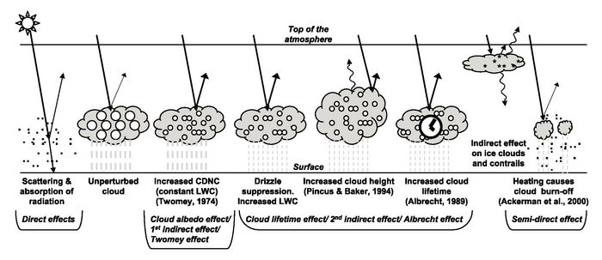
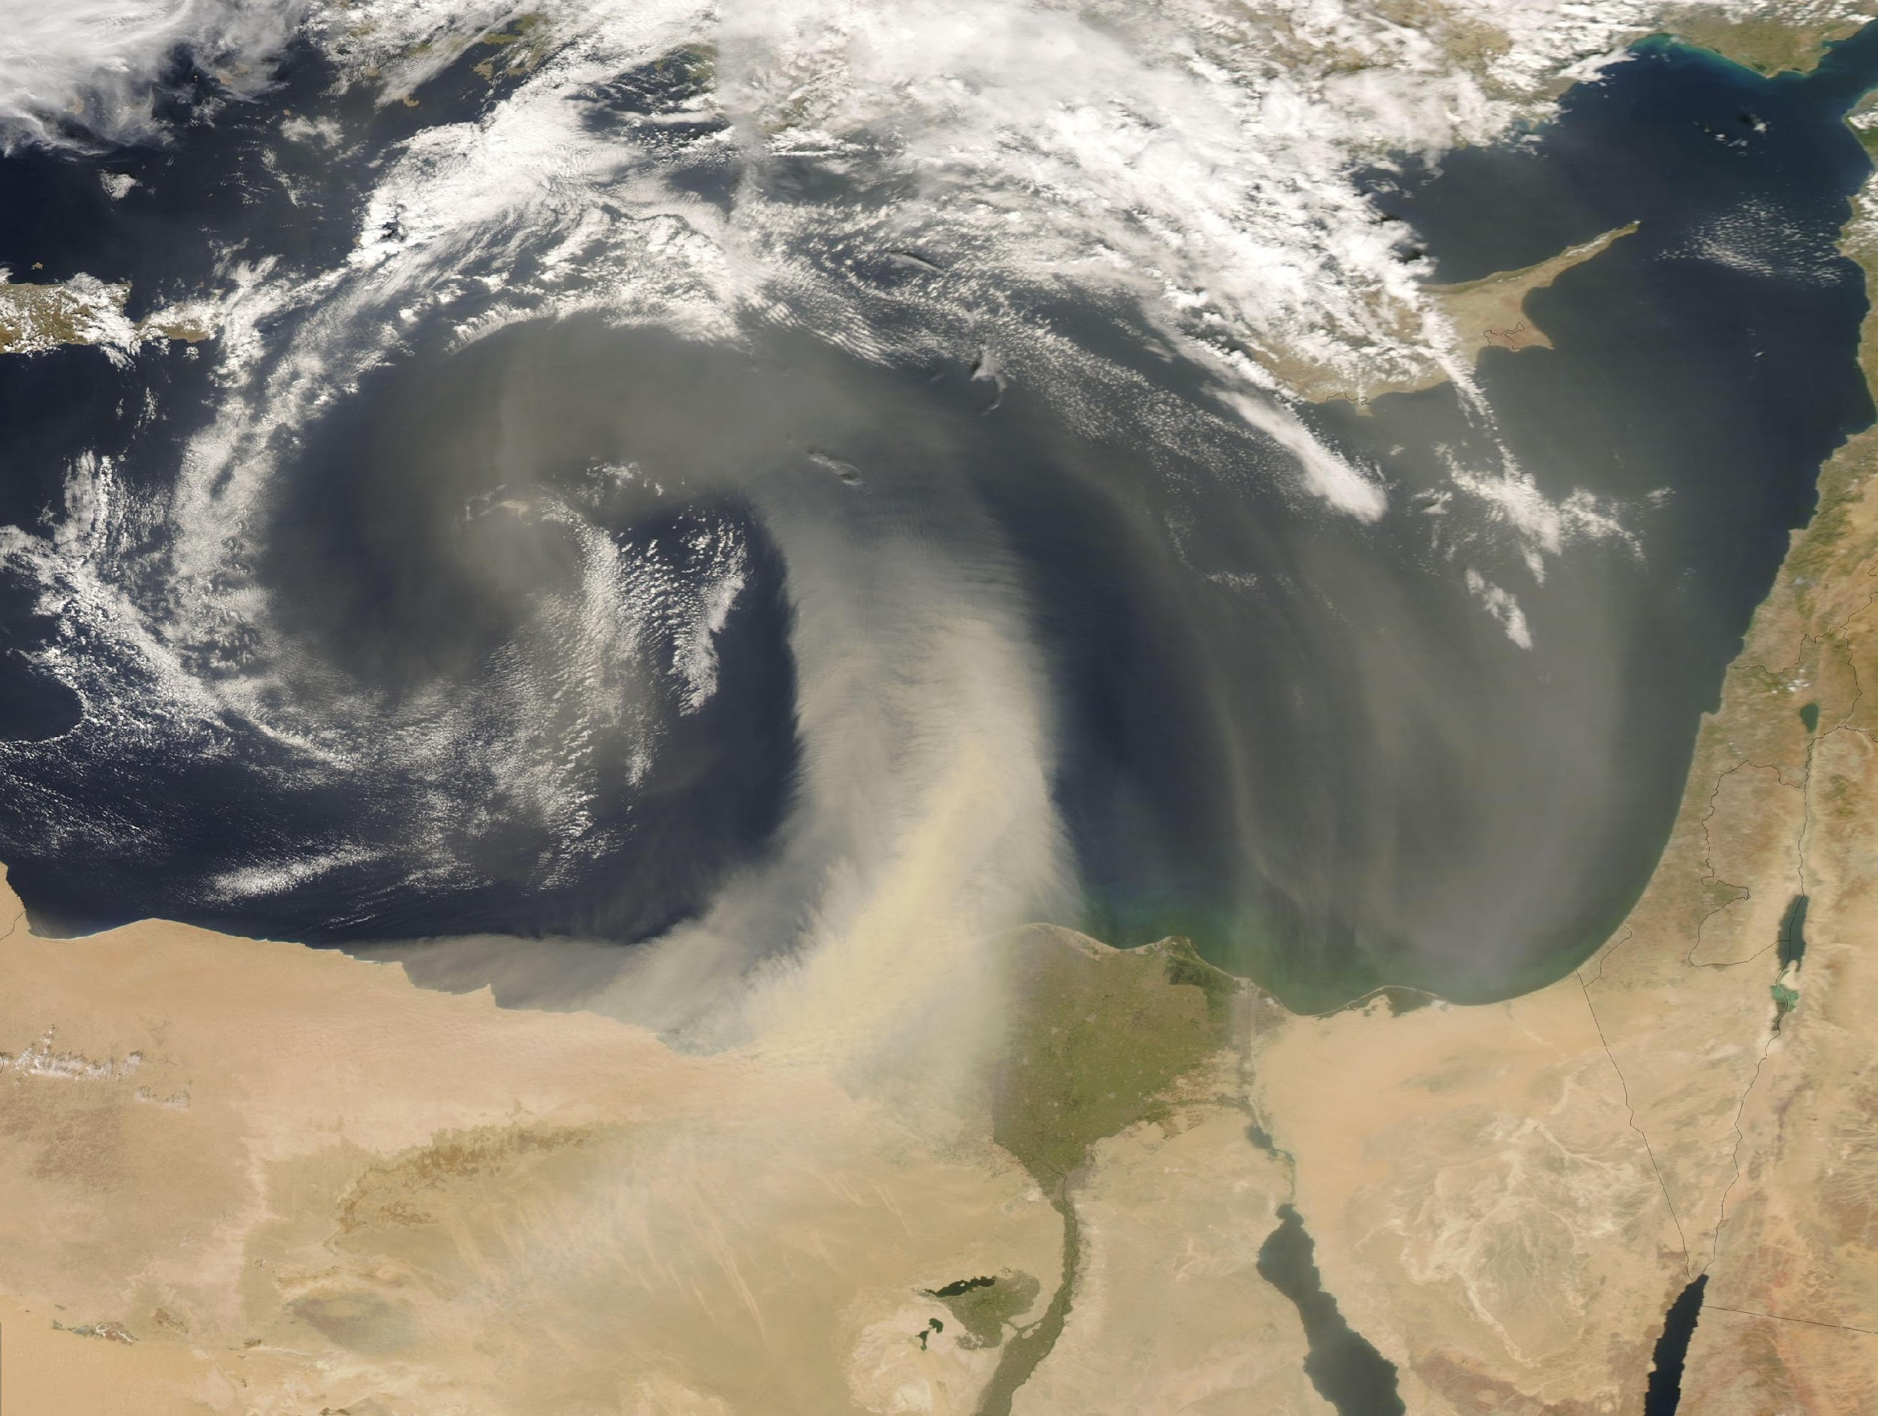
UFS Atmospheric Composition Modeling
Aerosols and trace gases alter the solar/terrestrial energy balance and cloud physics, affecting meteorology and climate on various timescales.
Poor air quality has significant societal impacts, including degraded human health and visibility.
NOAA has numerous legislative, interagency, and international mandates for its research and forecasts of atmospheric composition.
Annual U.S. premature mortality
Air Quality Forecaster Focus Group Workshop, October 20-21, 2024
NOAA | OAR | Air Resources Laboratory
Notes:
Summary slide describing what this talk is about and why we care about this topic.

Slide 8
NOAA Air Resources Laboratory CM&E Group
Overview of the ARL modeling efforts
National Air Quality Forecast Capability - AQM
Updates, emissions, innovation and science improvements
NOAA Emissions and eXchange Unified System (NEXUS)
Emissions datasets and algorithms for NOAA AC models
Global Ensemble Forecast System (GEFS)-Aerosol
Updates to global aerosol model – GEFSv12.3
UFS-Aerosol -> GEFSv13 – subseasonal-to-seasonal (S2S)
UFS-based global aerosol model -> fully coupled ESM
Seasonal Forecast System - Seasonal 1 year forecasts
Future UFS-based global ensemble forecast replacing CFS
RRFS-Smoke/Dust
Aerosol-aware RRFS - with FENGSHA dust scheme and RAVE Fire
MELODIES-MONET
Verification collaboration between NOAA ARL/CSL/GSL and NCAR
Configurable Atmospheric Chemistry (CATChem)
New development of a unified chemistry component for all UFS Applications
Air Quality Forecaster Focus Group Workshop, October 20-21, 2024
NOAA | OAR | Air Resources Laboratory

Slide 9
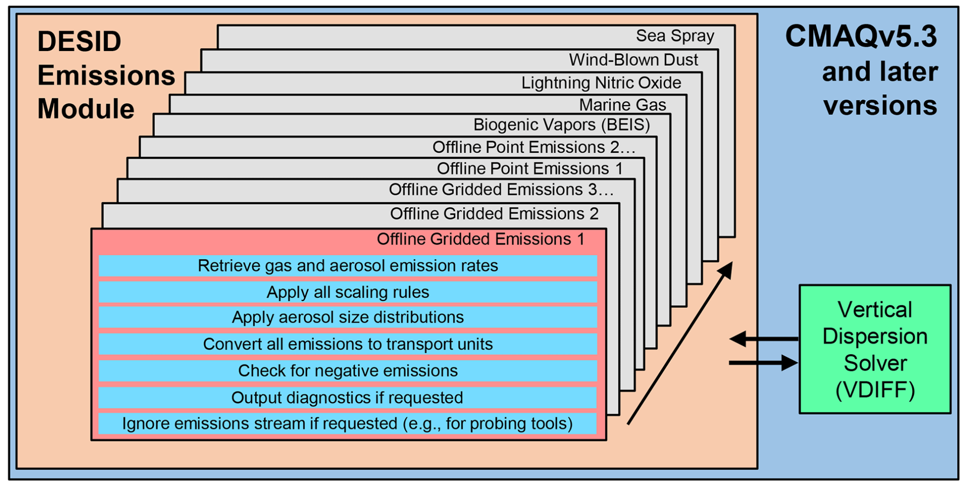
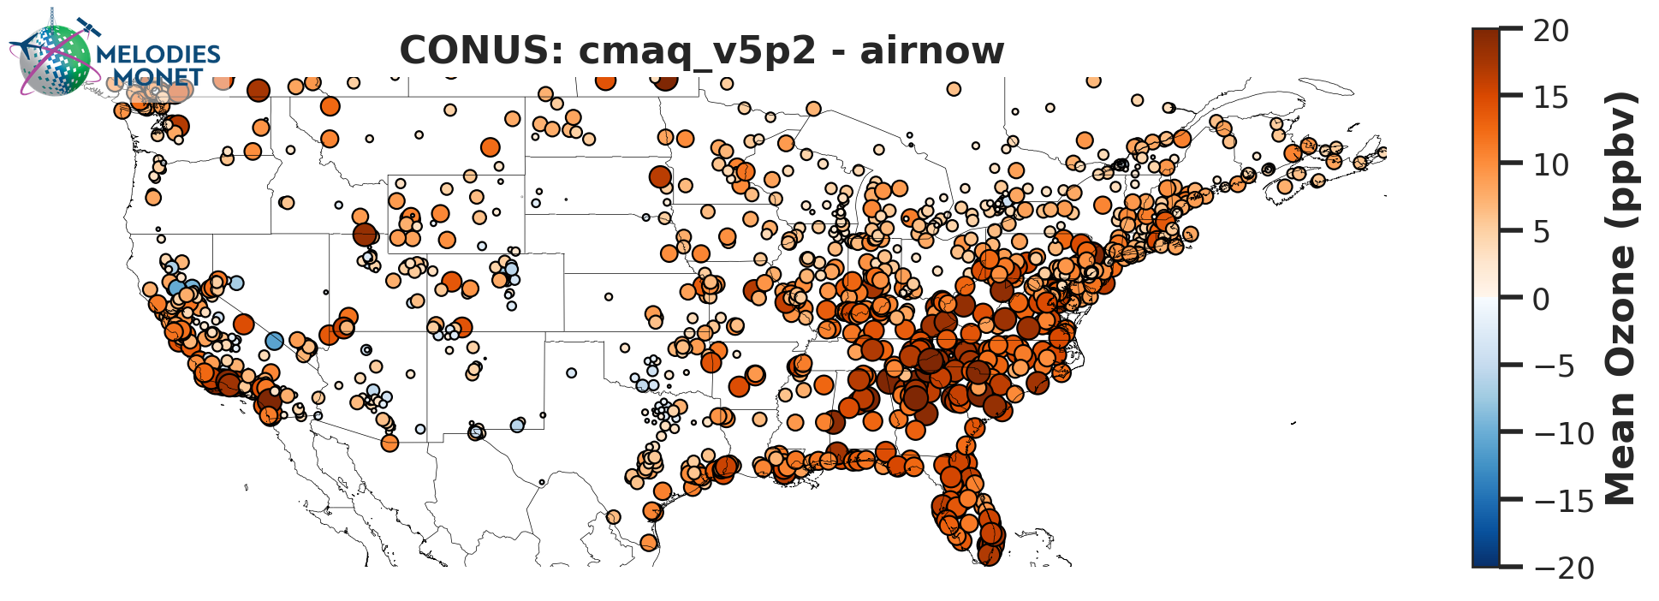
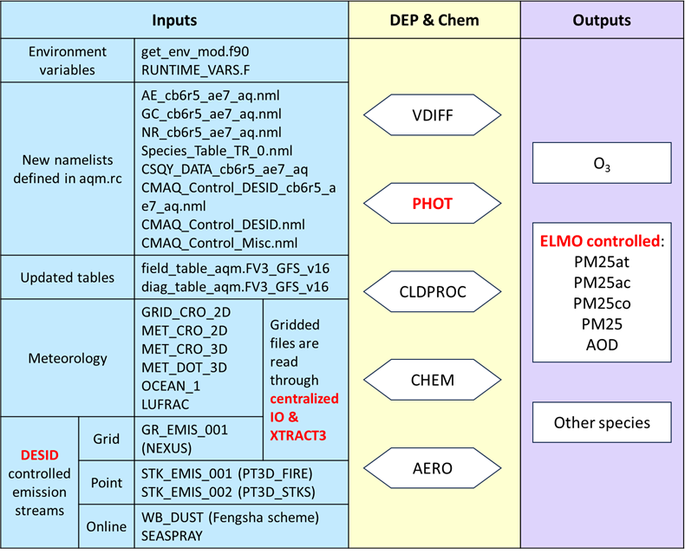
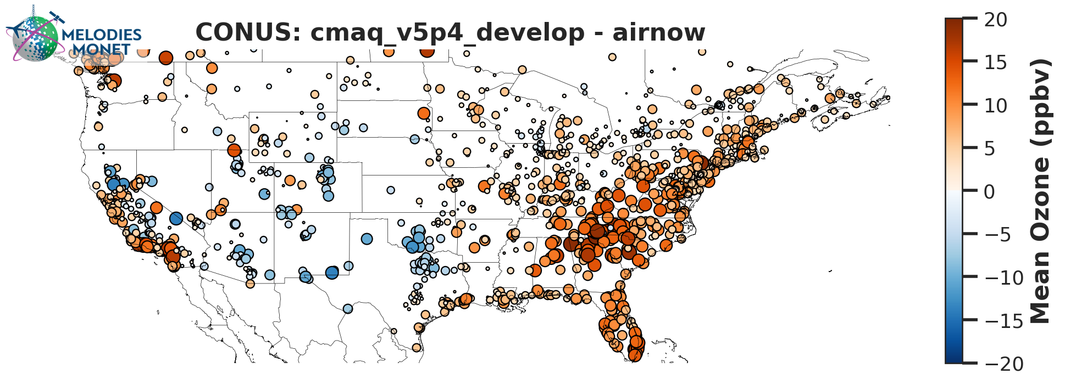
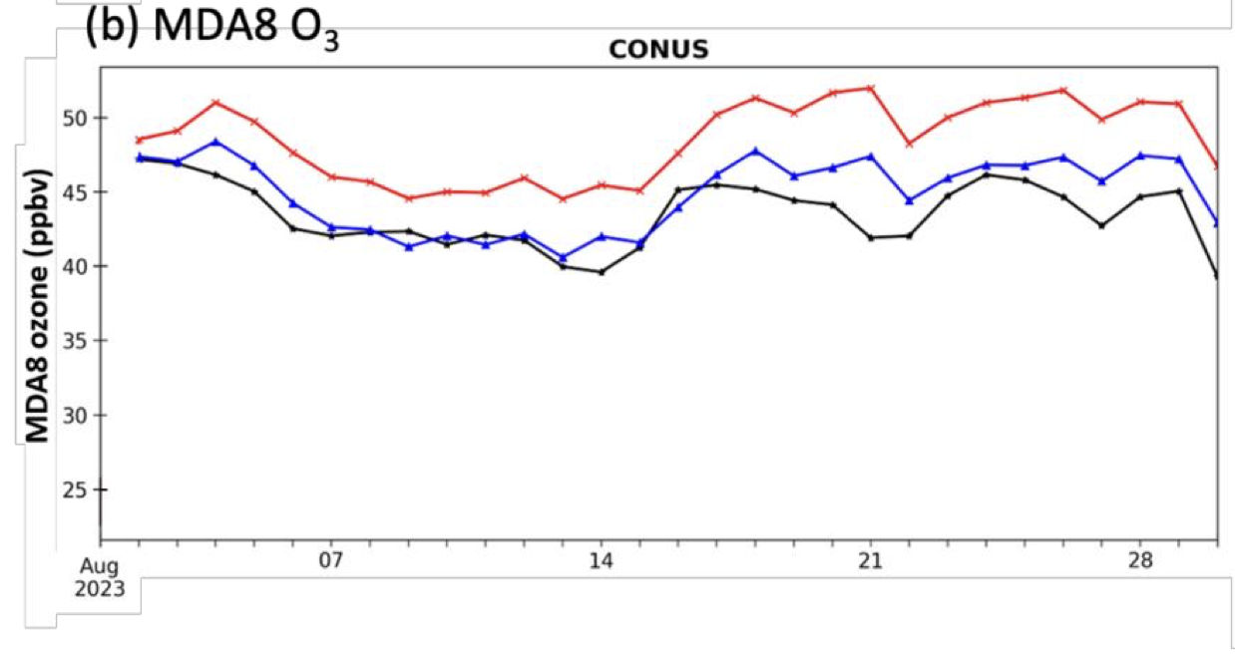
Preliminary Evaluation of Updated CMAQv5.4 in AQMv7 Ozone
Summary of Changes
New environment variable functions.
New namelists, field and diag tables.
Updated XTRACT3 function to use centralized IO
Streamline emission sources for DESID module
PM2.5 fraction and AOD are controlled through ELMO
OLD
Large improvements in O3 forecasting, with improvements spatially and decreasing the MDA8 O3 bias drastically
OLD
NEW
Obs
NEW
Air Quality Forecaster Focus Group Workshop, October 20-21, 2024
NOAA | OAR | Air Resources Laboratory

Slide 10
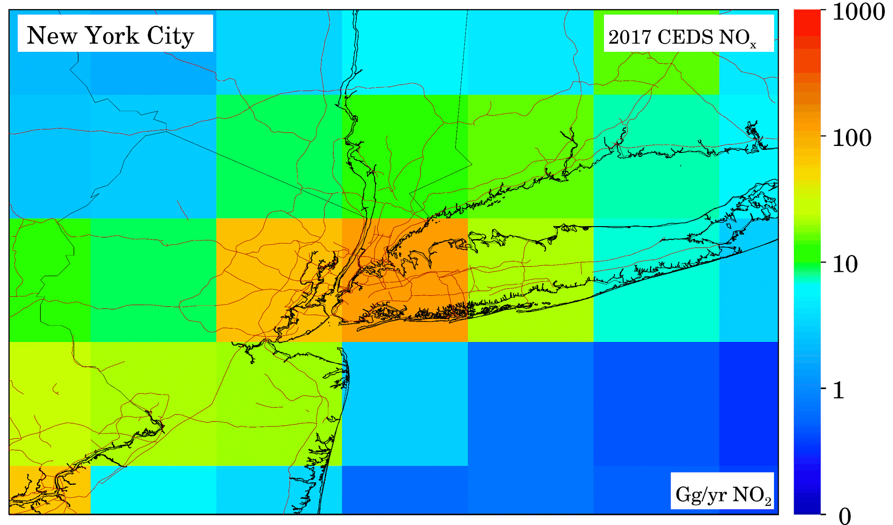
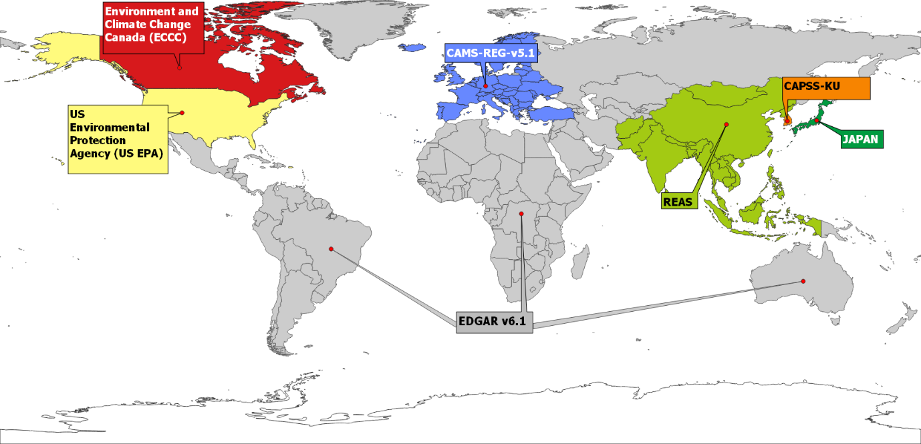
Updates to Emissions -> NEI Updates, New Diurnal Profiles, HTAPv3
NEMO High Resolution 1 km Emissions for 2019
EDGAR/HTAPv3:
Applying Diurnal Profile to global datasets
January 5: Total NO Emissions differences (mt)
Crippa et al. (2023)
Example of difference in NO emission in NEI 2019
NEI2016v1 → GMU/NEMO NEI2019 (Inside CONUS only)
HTAPv2 2010 → HTAPv3 2018 (Outside CONUS)
Global No Diurnal for major gas emissions → CAMS-TEMPO gridded weights (outside CONUS)
HTAPv3 extends temporal coverage, sectoral breakdown and geographical coverage.
Global mosaic of monthly air pollutant (SO2, NOx, CO, NMVOCs, NH3, PM10, PM2.5, BC, OC) emission gridmaps at 0.1x0.1 degree resolution.
Updates HTAP emissions from v2 (2010) -> v3 (2018)
 | Current (mt) | Updated (mt) | Percent Difference (%)
East | 431 | 276 | -36
West | 192 | 114 | -40
CONUS | 624 | 390 | -37
Air Quality Forecaster Focus Group Workshop, October 20-21, 2024
NOAA | OAR | Air Resources Laboratory

Slide 11
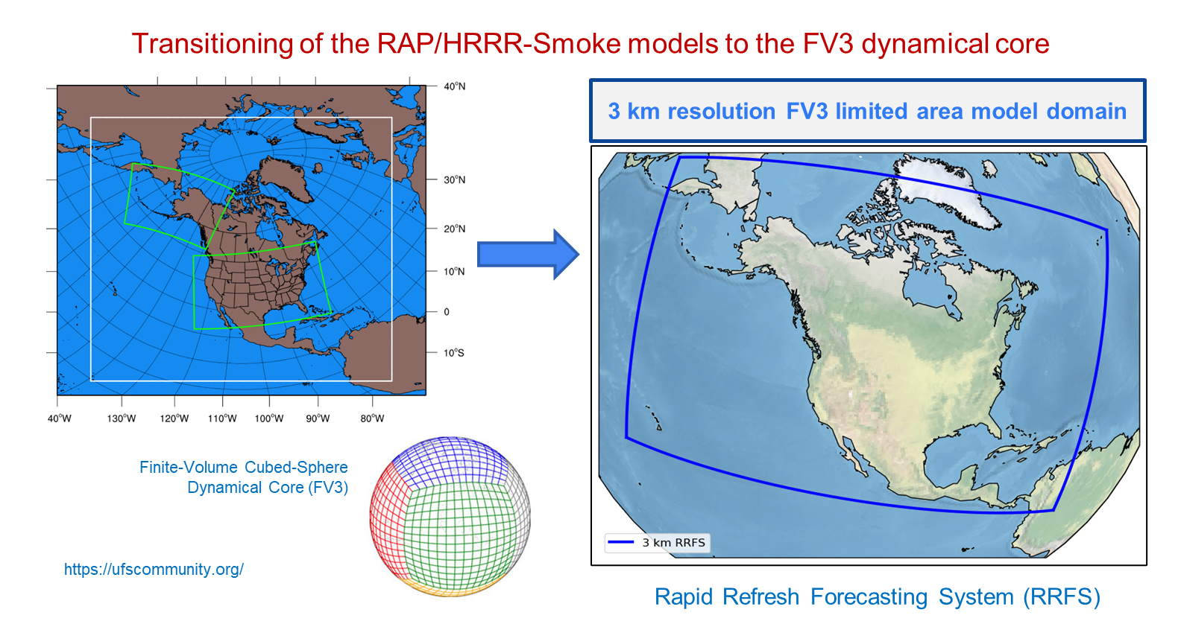
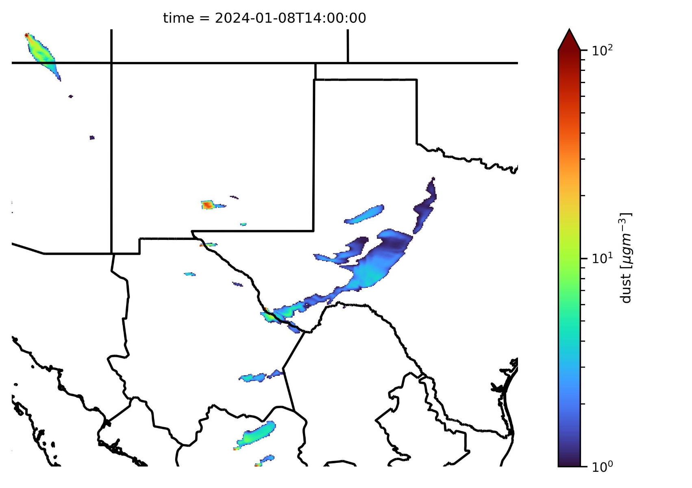
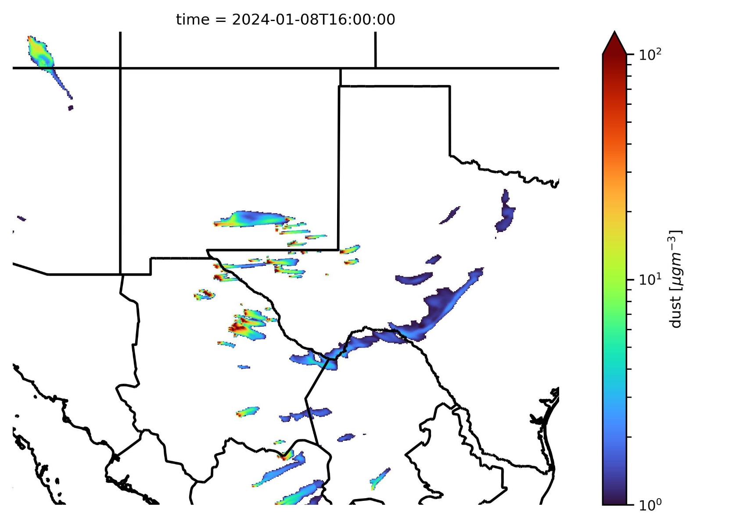
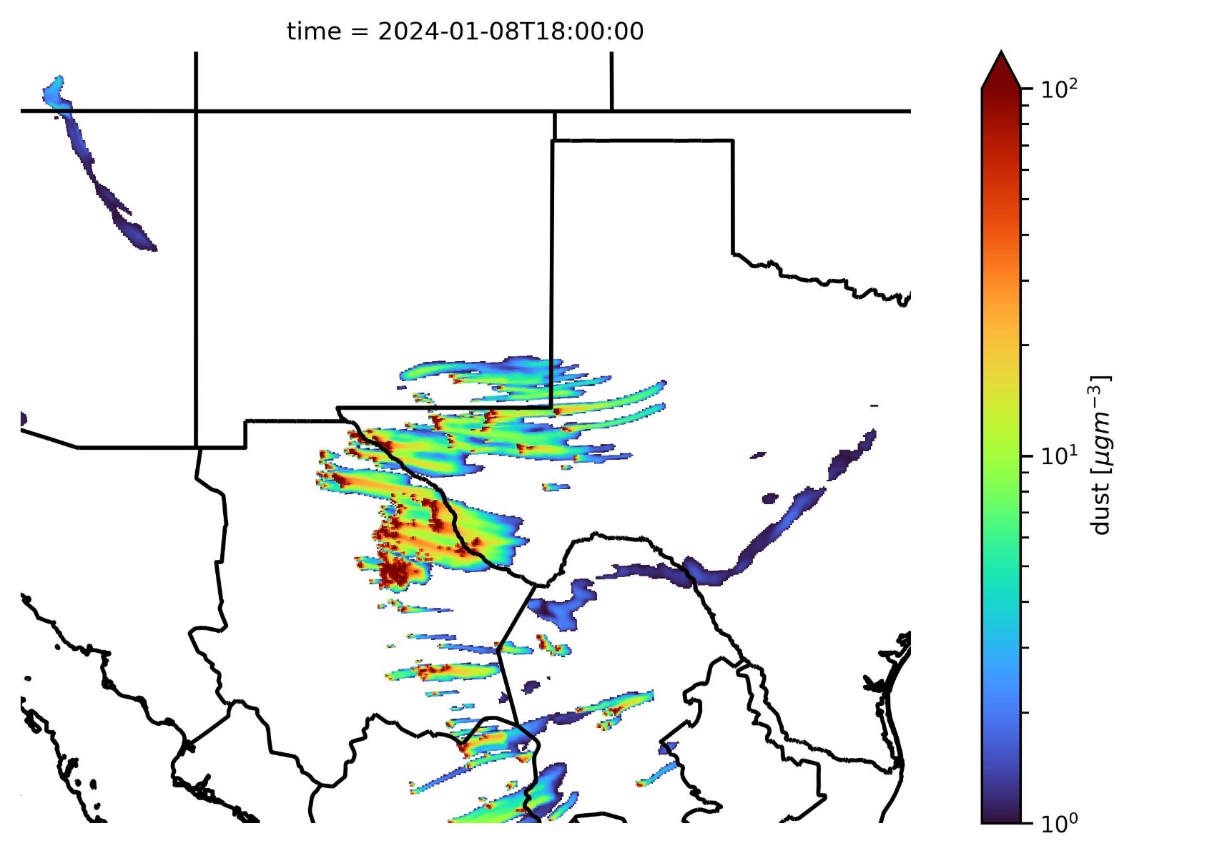
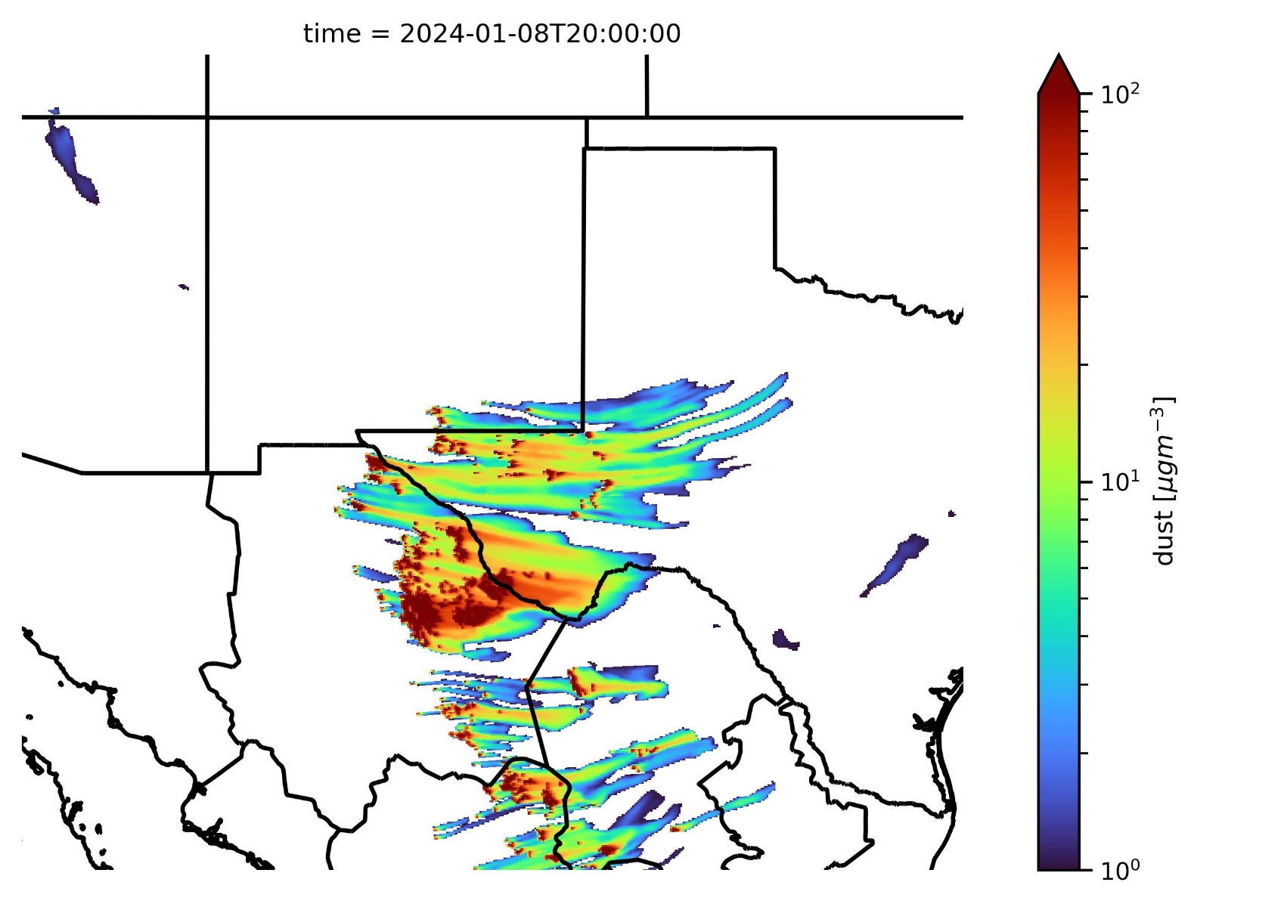
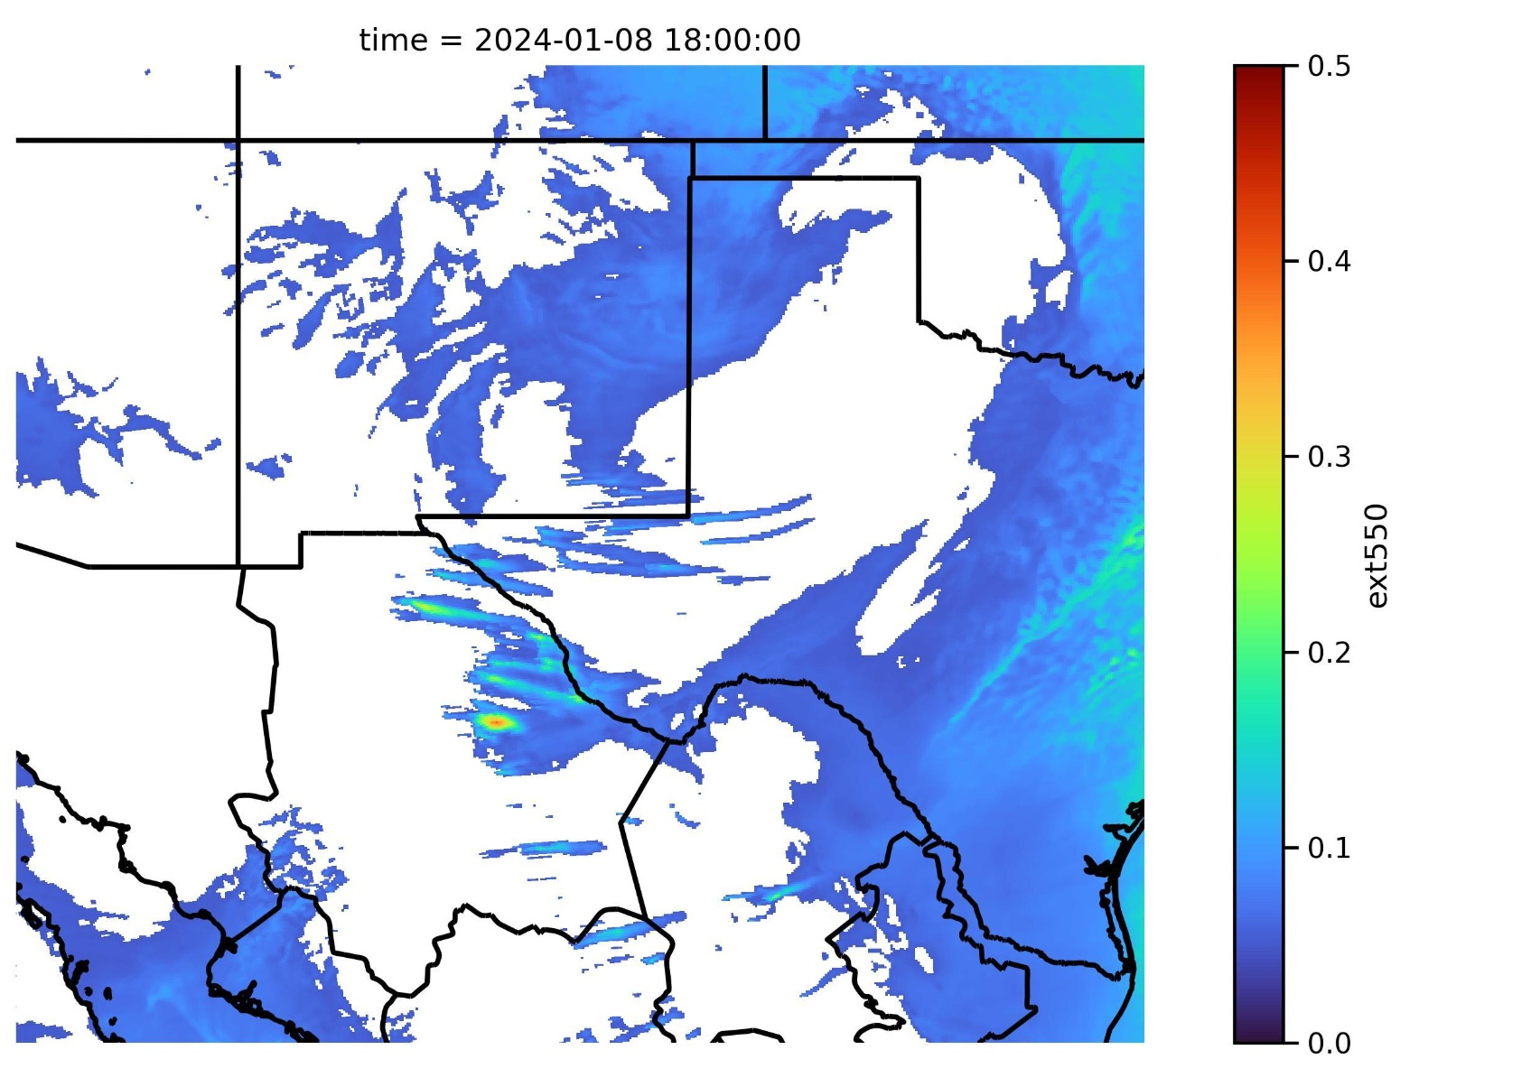
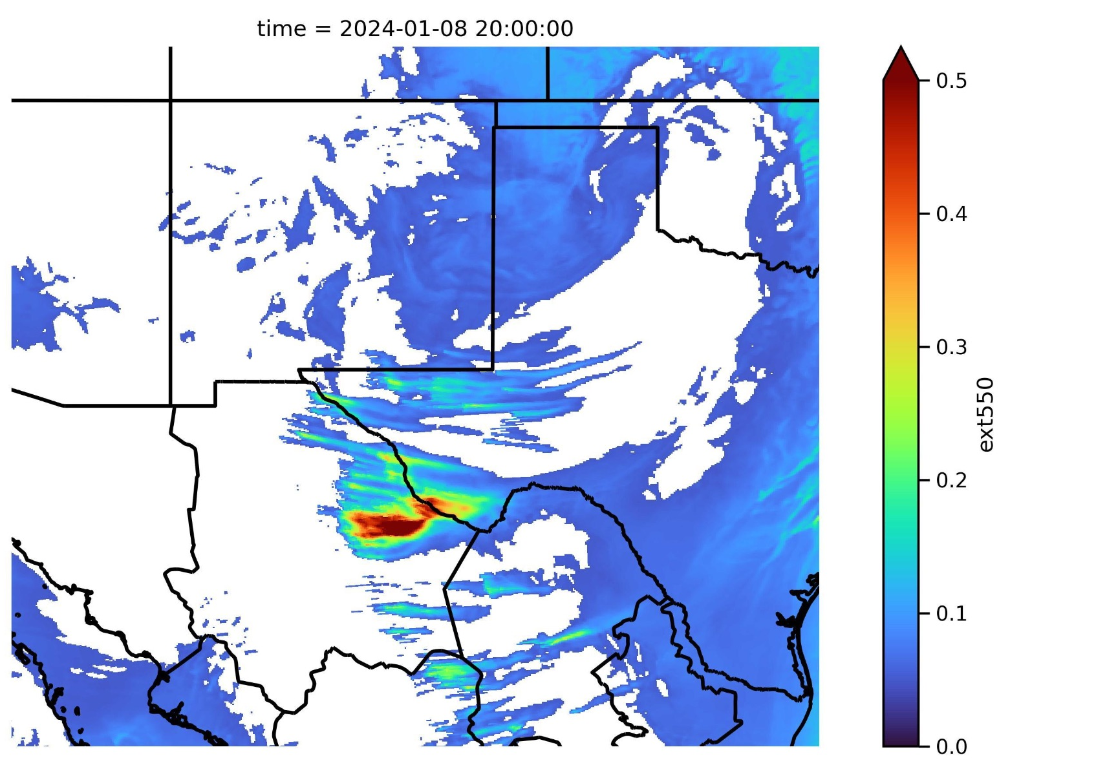
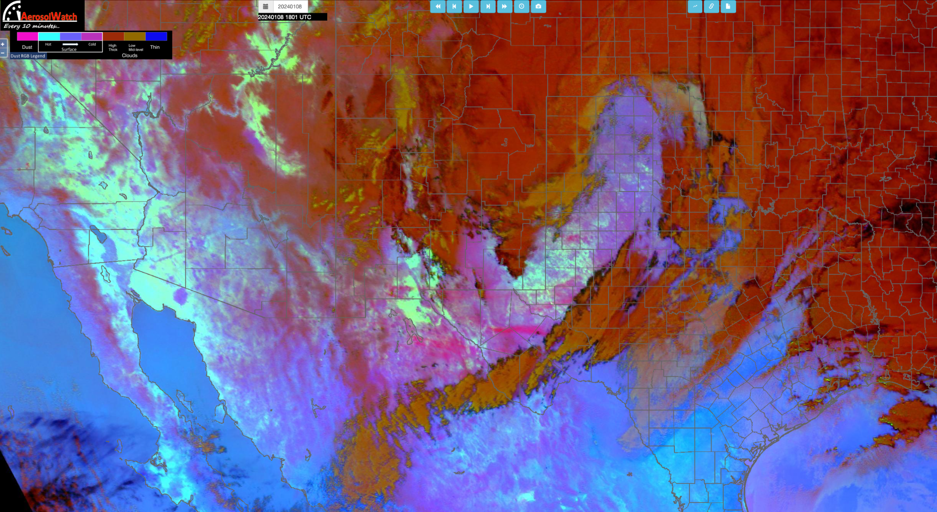
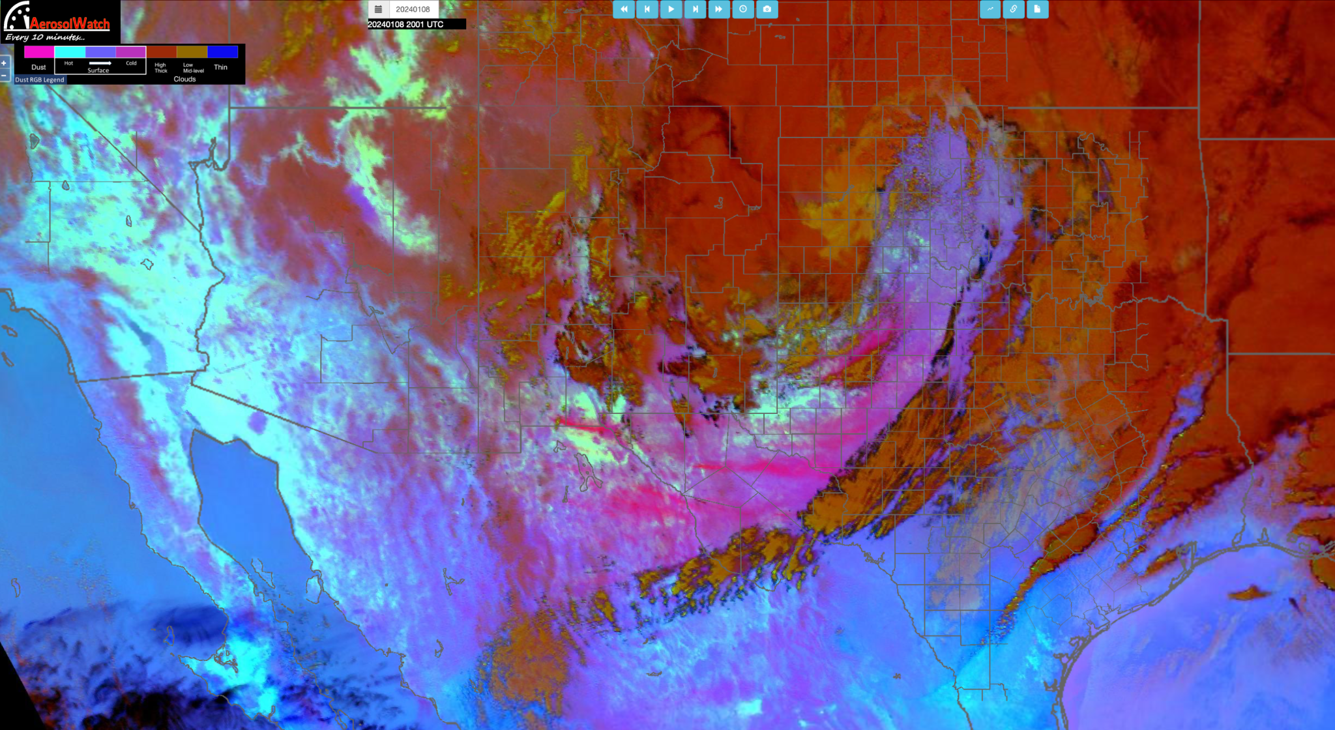
Rapid Refresh Forecast Model with Smoke and Dust
January 8th 2024
14z
16z
Storm front pushed dust up over the Chihuahuan Desert blowing over multiple US Cities including El Paso and Odessa TX
Overall the RRFS-SD system captured this event well
Though a notable miss from southern NM which was responsible for the elevated PM in El Paso
18z
RRFS-SD AOD 550nm
18z
GOES DUST RGB
20z
18z
20z

Slide 12
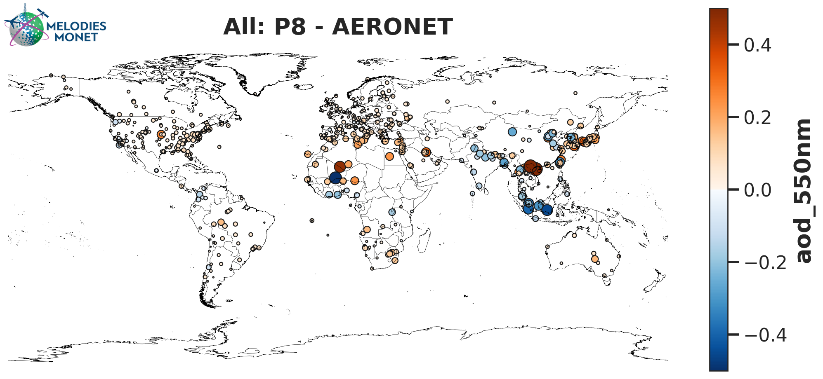
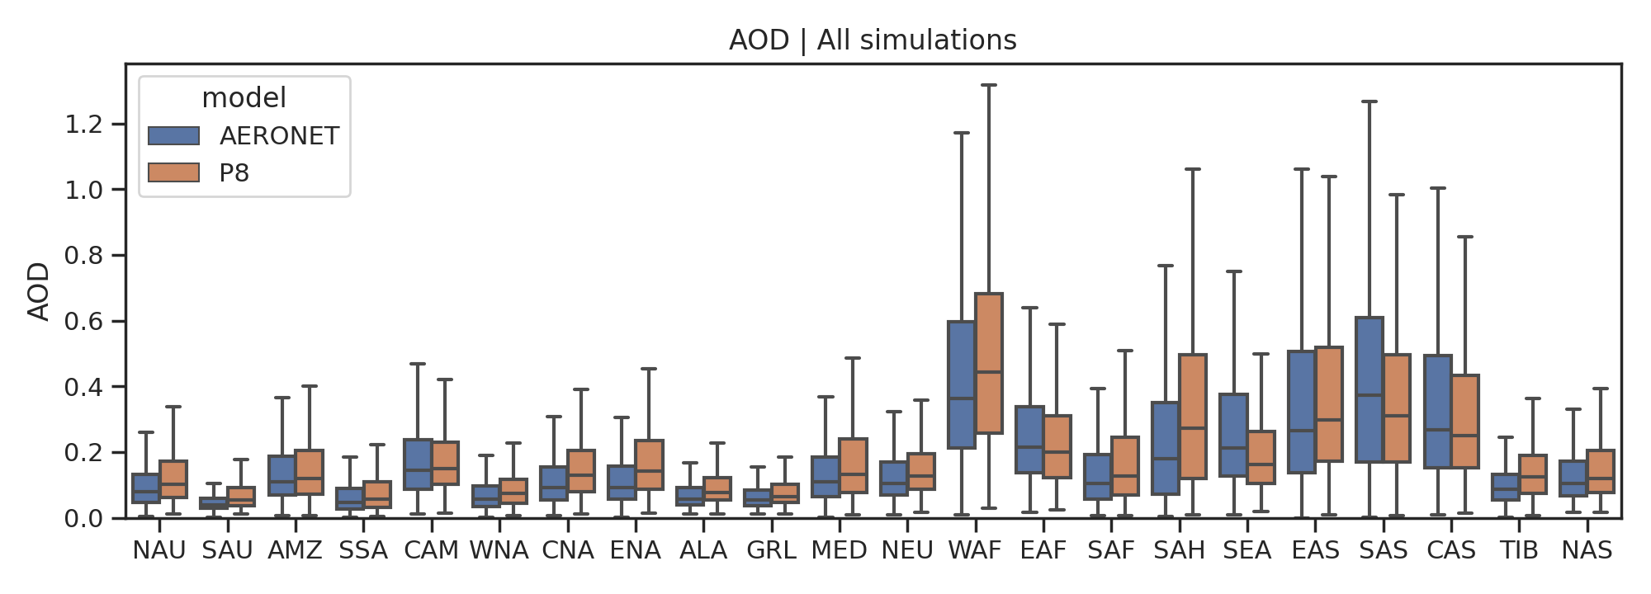
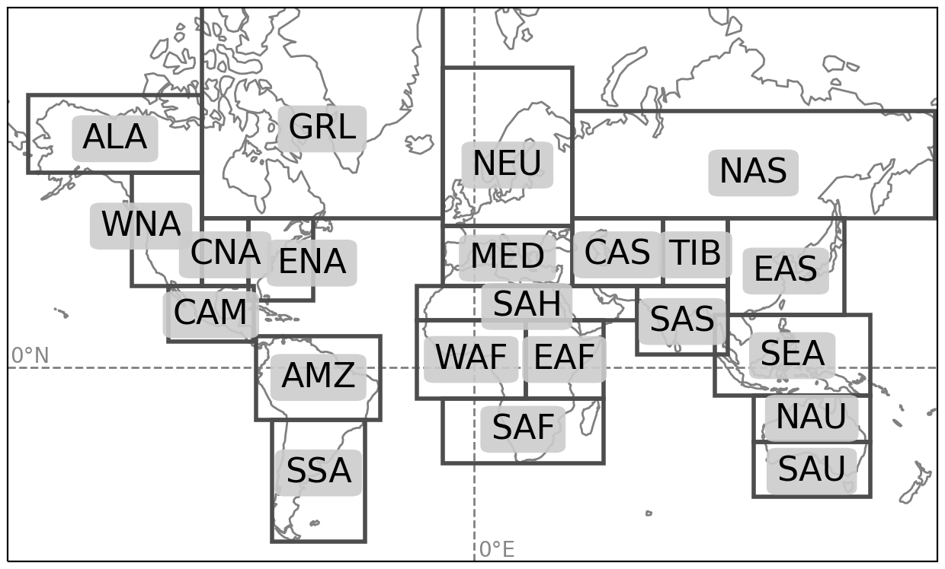
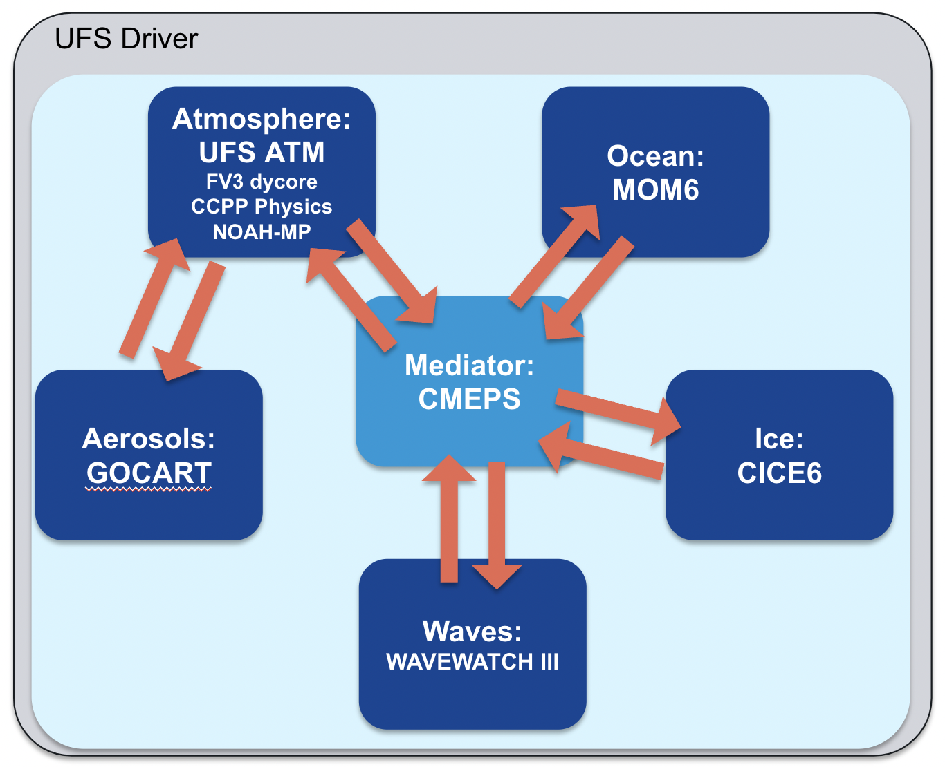
UFS-Aerosols: GEFSv13
One NOAA Unified Forecast System (UFS) modeling applications currently in development is a coupled model for global predictions of weather to seasonal time scales, targeting NOAA/NCEP operational Medium Range (GFS v17), Subseasonal (GEFS v13), and Seasonal (SFSv1) forecasting systems.
In the Global Coupled UFS development phase, discrete system prototypes were defined and evaluated within a fixed benchmark framework. Evaluation findings were used to inform subsequent development.
Prototype 8 (P8) is the last of these prototypes before tailored development for GFSv17/GEFSv13/SFSv1
Target configuration
(GFSv17, GEFSv13, SFSv1)

Slide 13
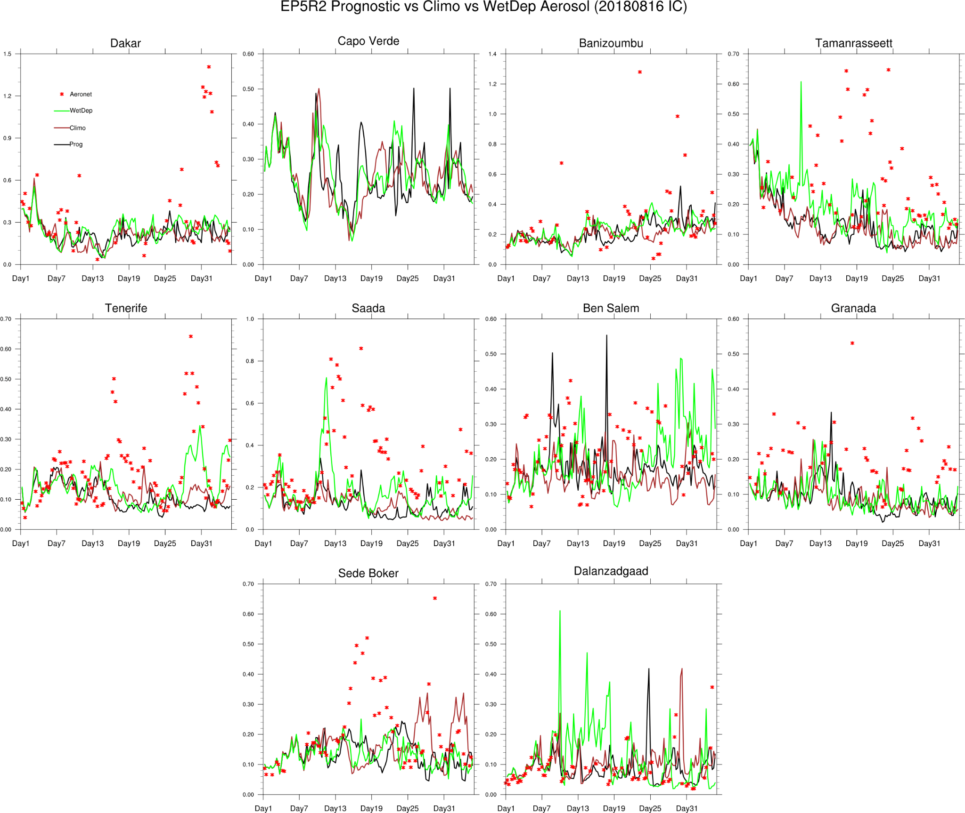
Improvement in dust emission over Sahara
Improvement in dust emission over Sahara
More dust emission from Taklamakan desert
Air Quality Forecaster Focus Group Workshop, October 20-21, 2024
NOAA | OAR | Air Resources Laboratory

Slide 14
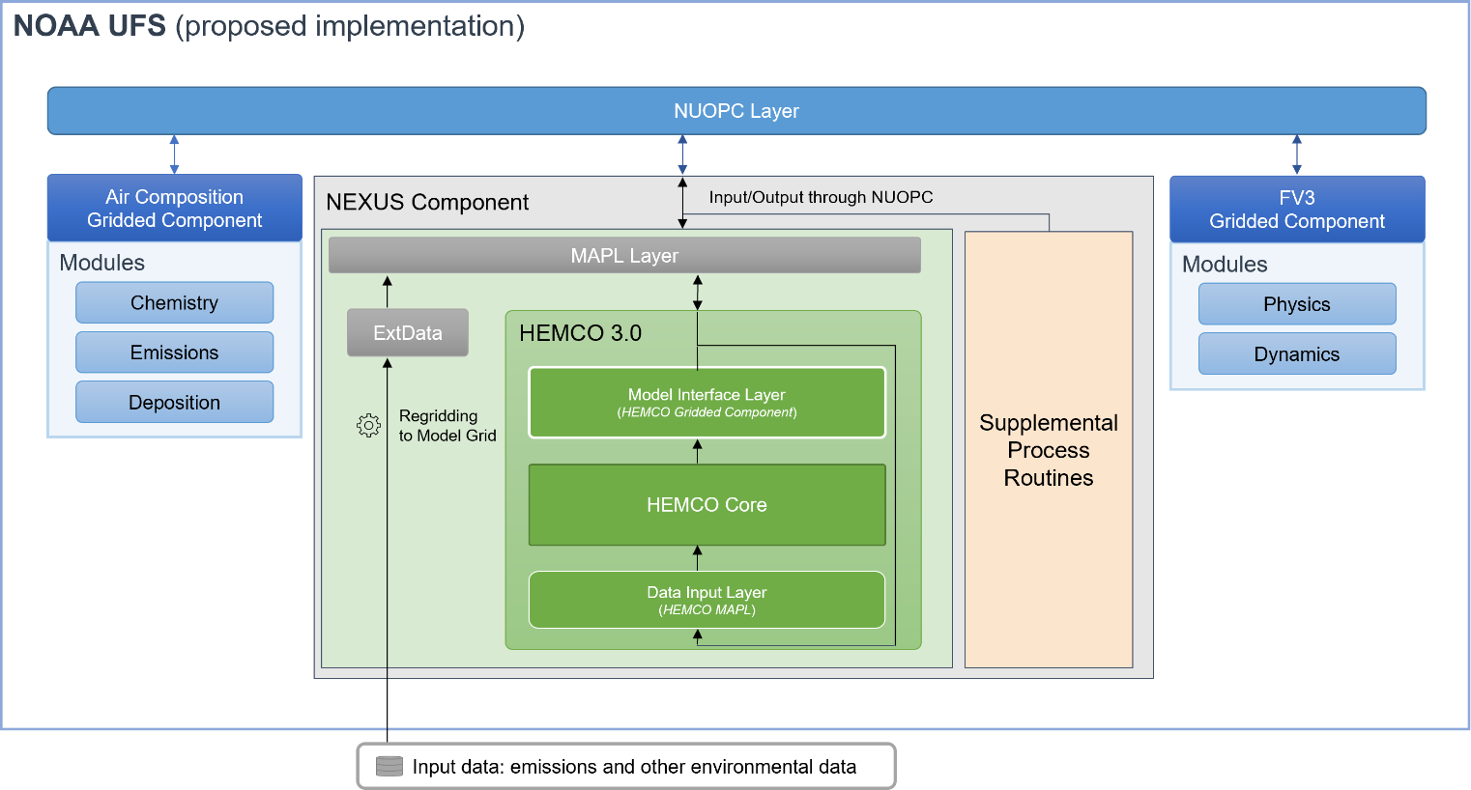
NOAA Emissions and eXchange Unified System (NEXUS)
Barry Baker, Patrick Campbell, Daniel Tong and Zach Moon (ARL)
Aerosols
Historical
&
Future Projections
(IPCC, RCP)
Anthropogenic
&
Biofuel
Operations
Biomass Burning
Halogens
NEXUS
Model-Ready Emissions Data
Extensions
(Dust, Sea-Salt Biogenic, etc.)
Natural Sources
Research
Community emissions processing system for UFS atmospheric composition models (both global and regional)- Based on HEMCO (Lin et al. 2021)
Collaborators: Harvard, NASA, NCAR
Anthropogenic
Aircraft
&
Ship
Non-Emission Data
(Satellite O₃, LAI, Albedo, etc.)
Lin et al. https://doi.org/10.5194/gmd-14-5487-2021
Air Quality Forecaster Focus Group Workshop, October 20-21, 2024
NOAA | OAR | Air Resources Laboratory

Slide 15
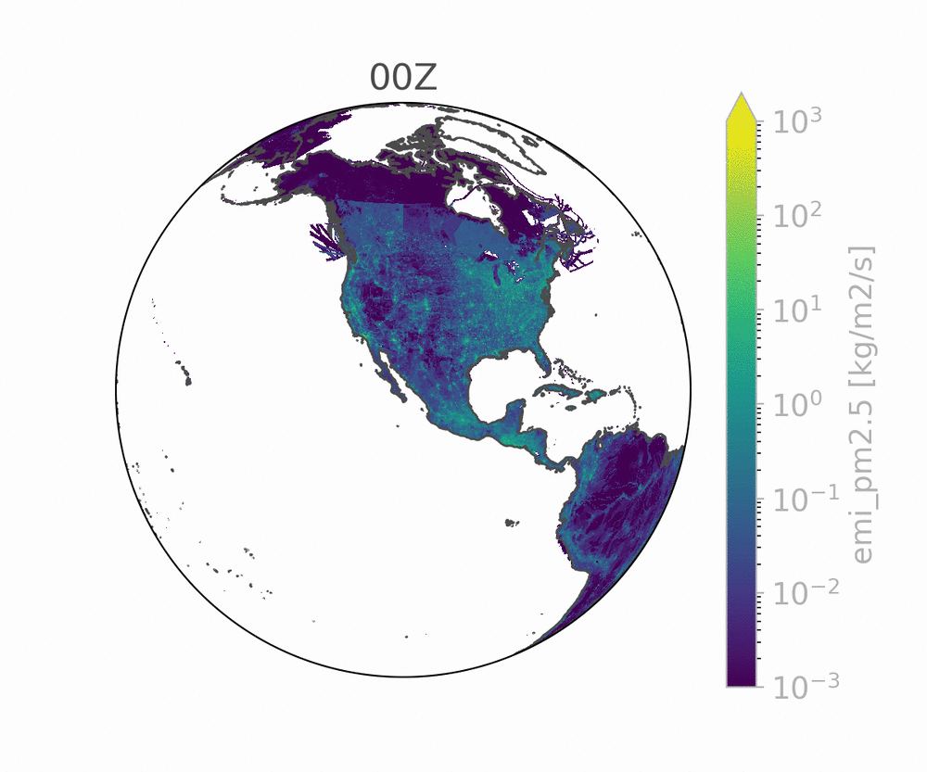
Future of NEXUS for the UFS-AQM and Beyond
Initial NUOPC driver for standalone NEXUS has been created
Will replace the current standalone NEXUS
Next steps:
(one-way) coupling to CDEPS via NUOPC
Data atmosphere will enable research and testing of long NEXUS simulations with emissions that depend on environmental parameters
two-way coupling to UFS-AQM via NUOPC
Ideal, science-wise
Alternate biogenic emissions options in development:
(Current is HEMCO’s MEGAN2.1 implementation)
Silva et al. (2020) (reduced-complexity “surrogate” version of MEGAN3)
Canopy-App Leaf-Scale BVOCs
NEXUS-specific continuous integration in place
Currently only tests build, small-domain test cases in development
Air Quality Forecaster Focus Group Workshop, October 20-21, 2024
NOAA | OAR | Air Resources Laboratory
Notes:
Finally, NEXUS is being further developed to become its own NUOPC component in the UFS, where an initial NUOPC driver for standalone NEXUS has been created. This is being tested using a data atmosphere in stand-alone mode right now in NEXUS for process-based dynamic emissions sources like biogenic emissions, windblown dust, sea-salt, et. Then two-way coupling will be tested next for the AQM.
Furthermore, we are developing new capabilities for the advanced NEXUS, for example advanced biogenic emissions using online MEGAN or for our “canopy-app” leaf-scale emissions.
The animation shows a NEXUS provided diurnal pattern of primary PM2.5 emissions.

Slide 16
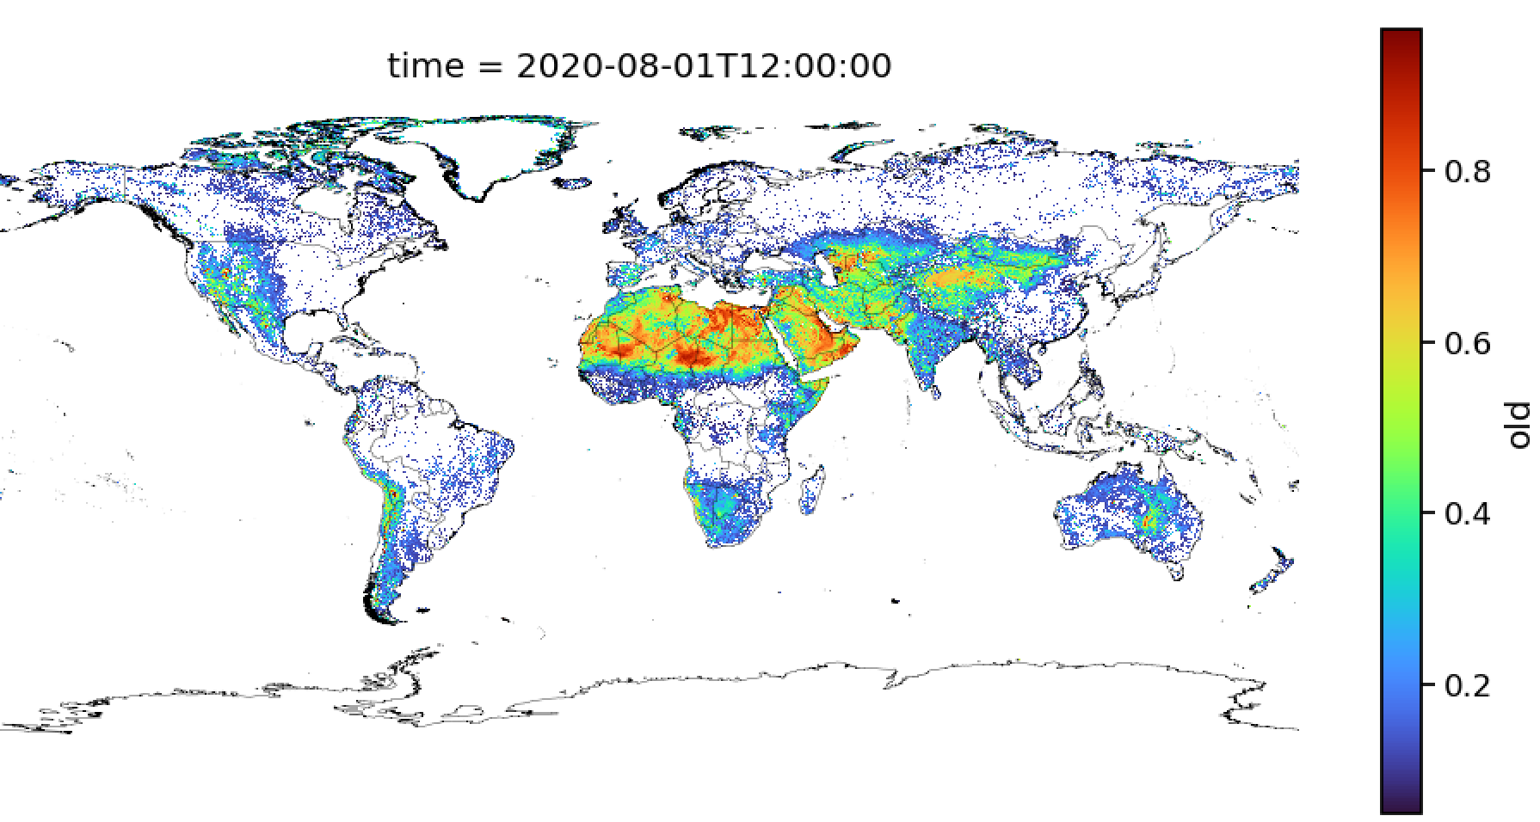
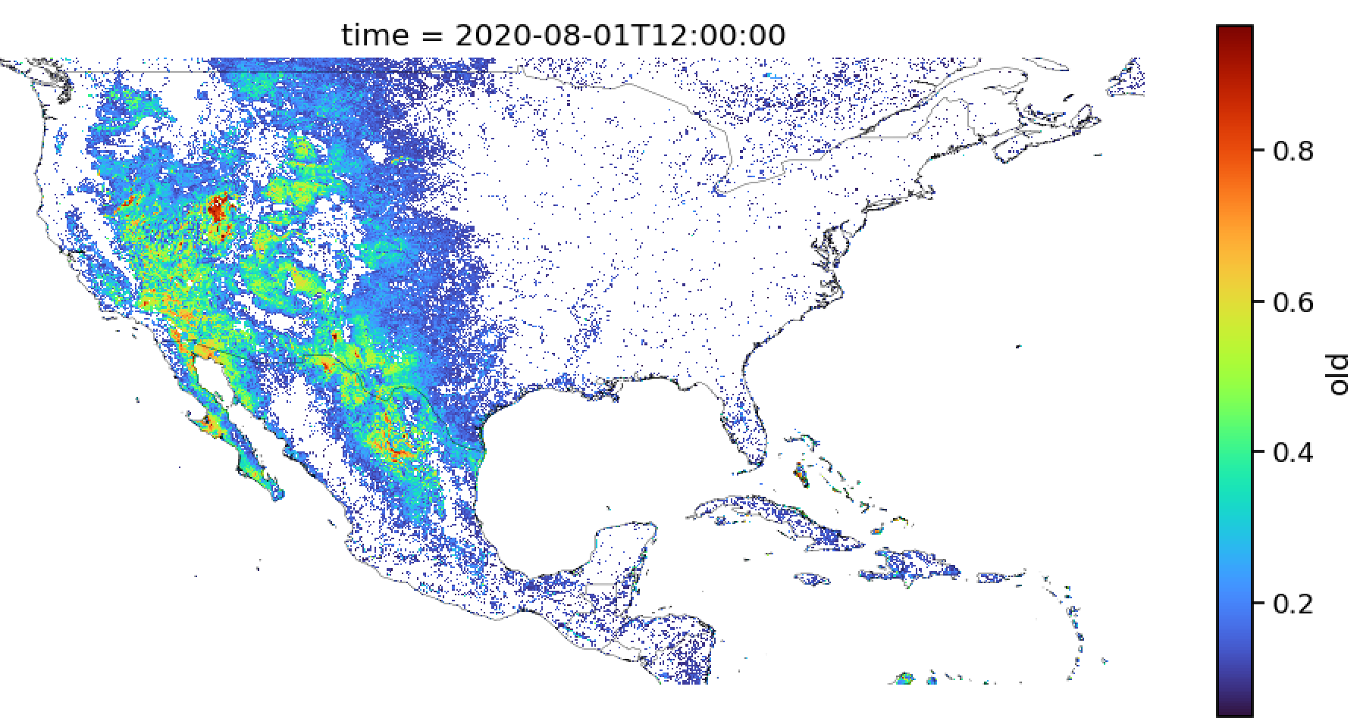
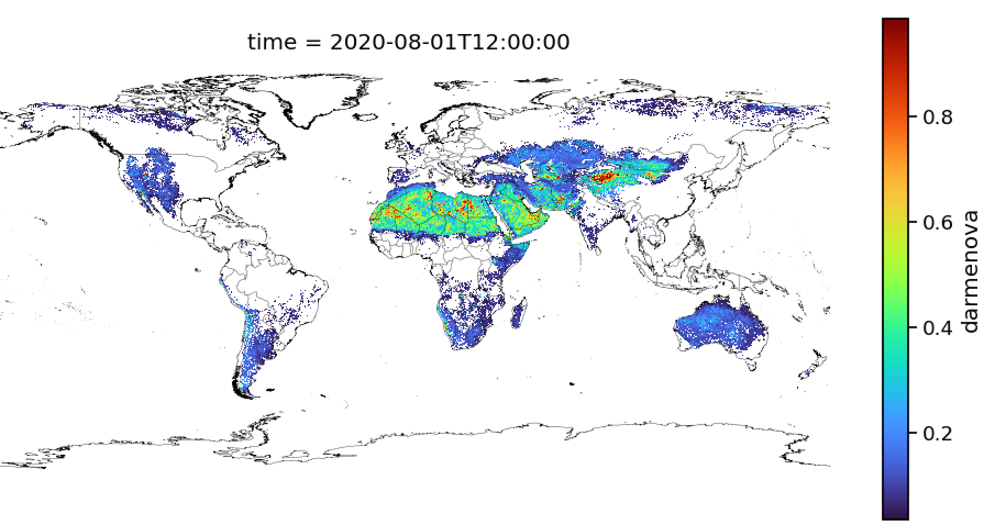
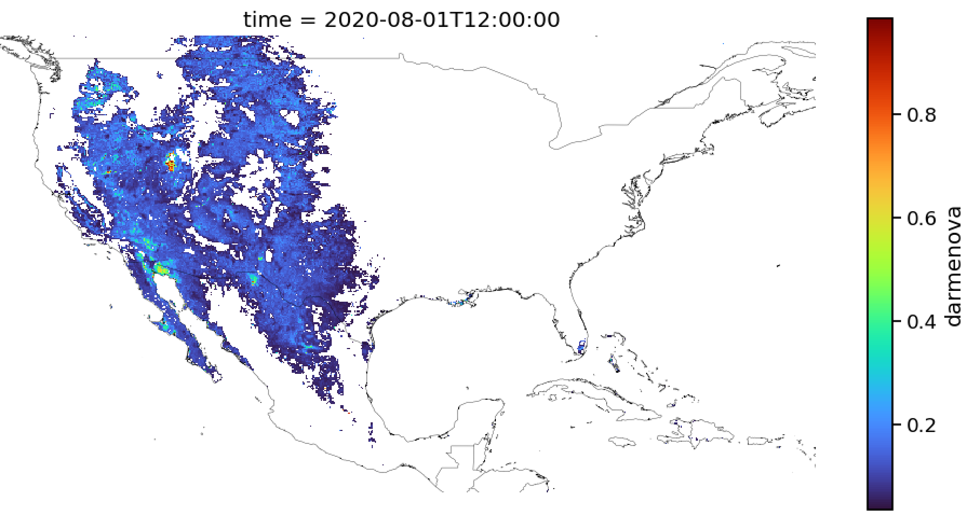
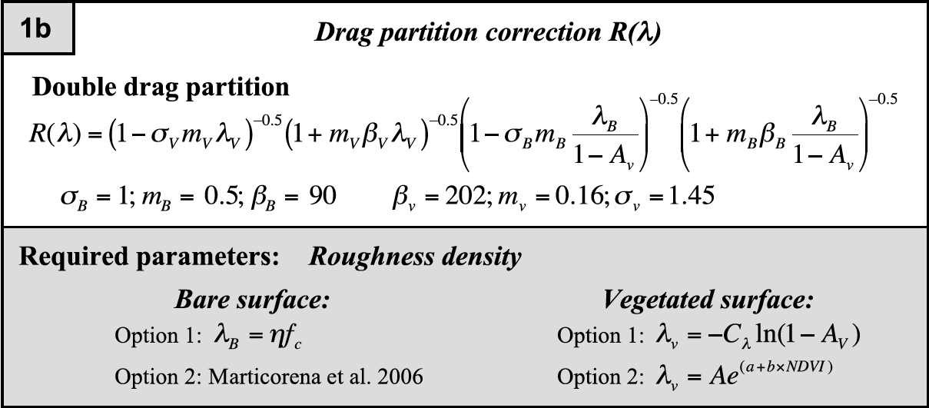
Dust Drag Partition development
Following Marticorena et al. 2004 and Laurent et al a new drag partition is developed using VIIRS/MODIS for use in dust modeling. It combines the benefits of possible NRT satellite data with land surface model parameters (GVF/LAI) for inclusion into GEFS/RRFS-SD/AQM
Air Quality Forecaster Focus Group Workshop, October 20-21, 2024
NOAA | OAR | Air Resources Laboratory

Slide 17
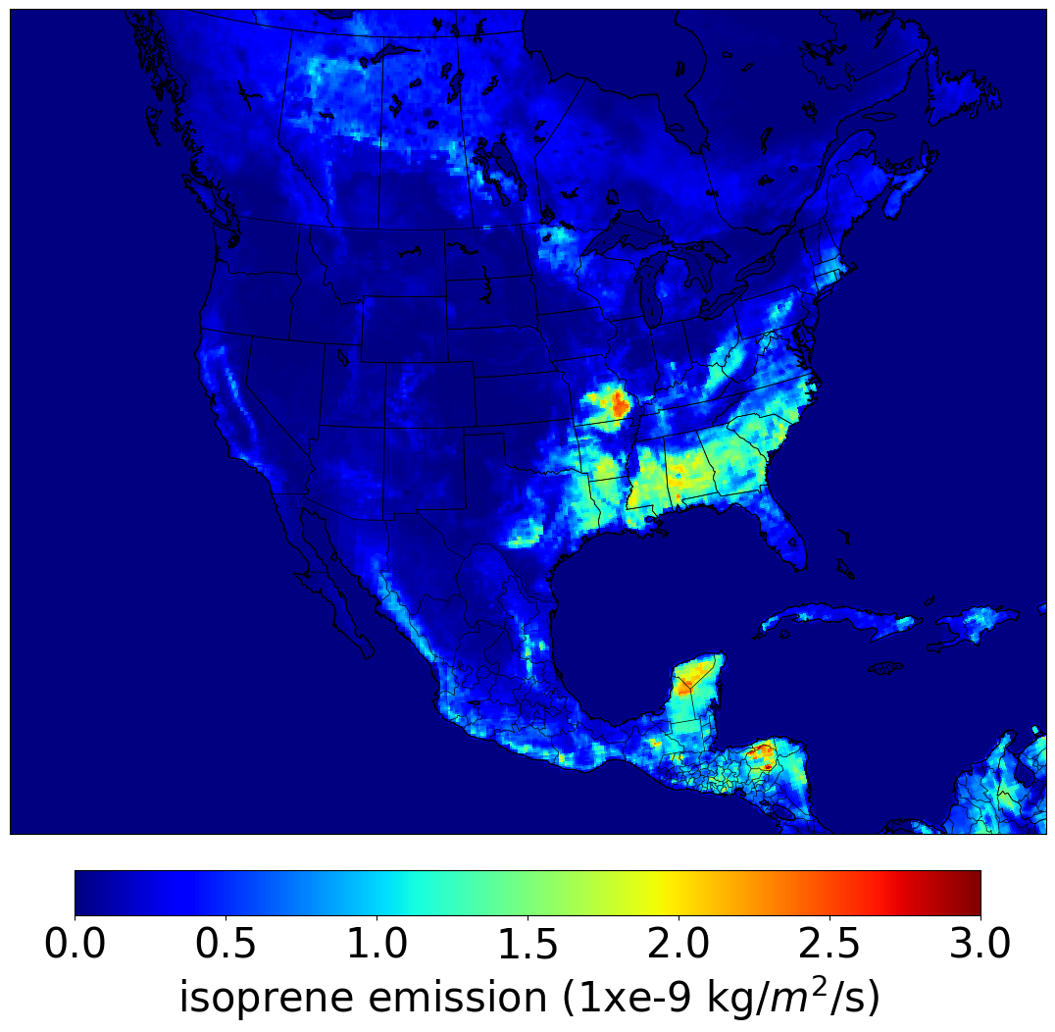
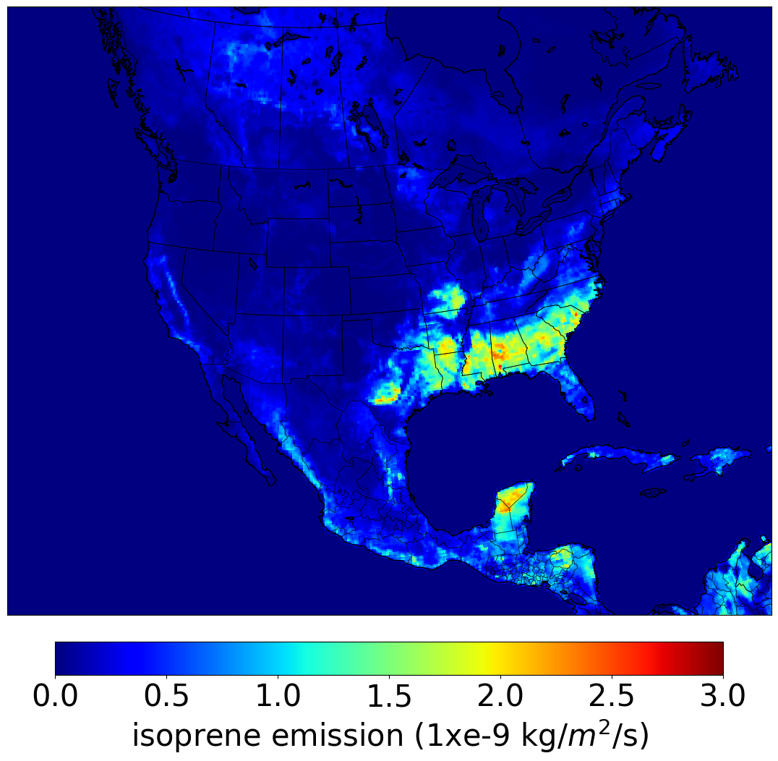
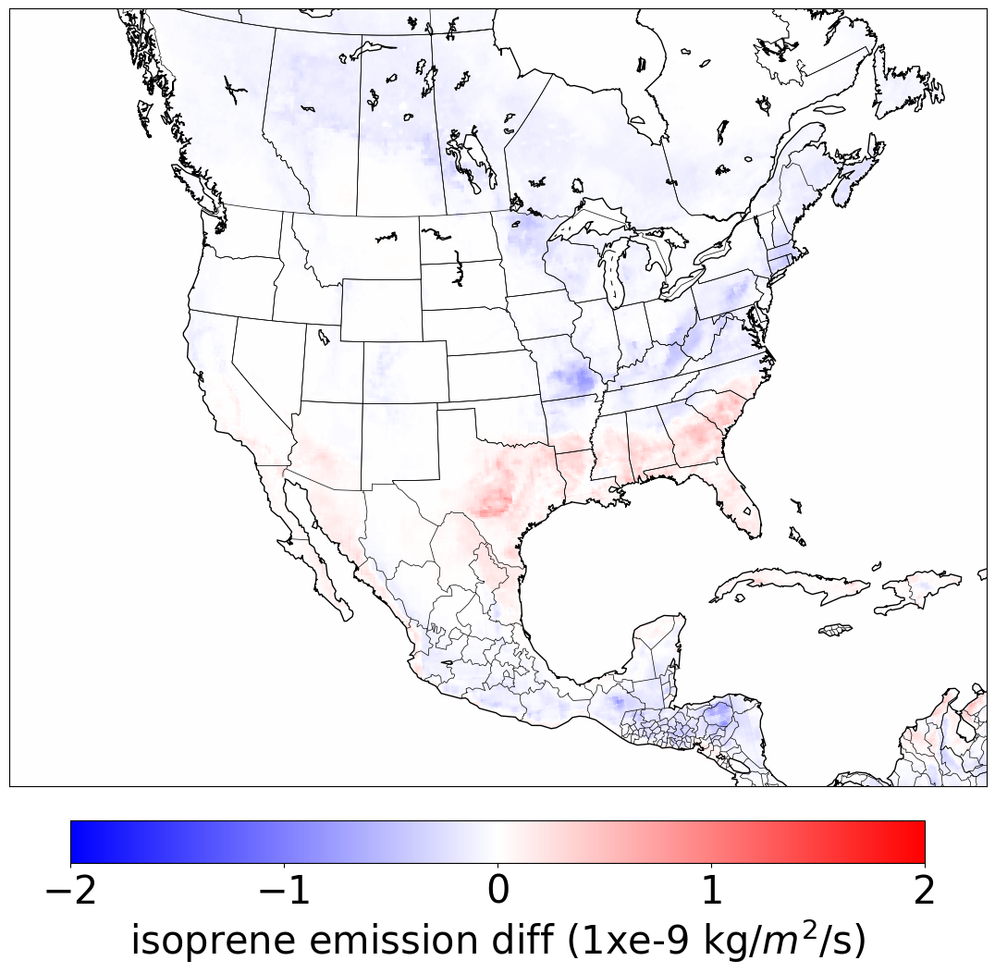
Improving the Biogenic Emissions for AQM and GEFS
With the decrease of anthropogenic emissions year after year biogenic emissions are becoming a larger source for ozone formation in comparison.
Biogenic emissions are modified in AQMv7 from BEIS -> MEGANv2.1
Update MEGANv2.1 with simplified canopy effects following Silva et al. (2020)
New Canopy effects improves ozone distributions
New canopy effects isoprene emissions with increased ISOP in the southeast US while decreases in the northern part of the domain
Simplified
Canopy Effects
Default
New - Old
Air Quality Forecaster Focus Group Workshop, October 20-21, 2024
NOAA | OAR | Air Resources Laboratory

Slide 18
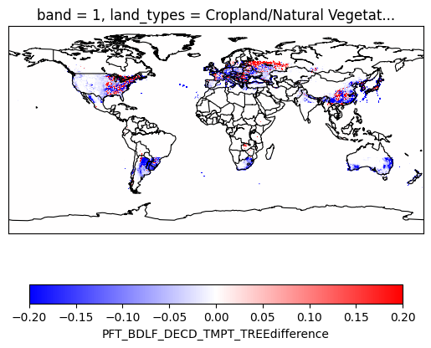
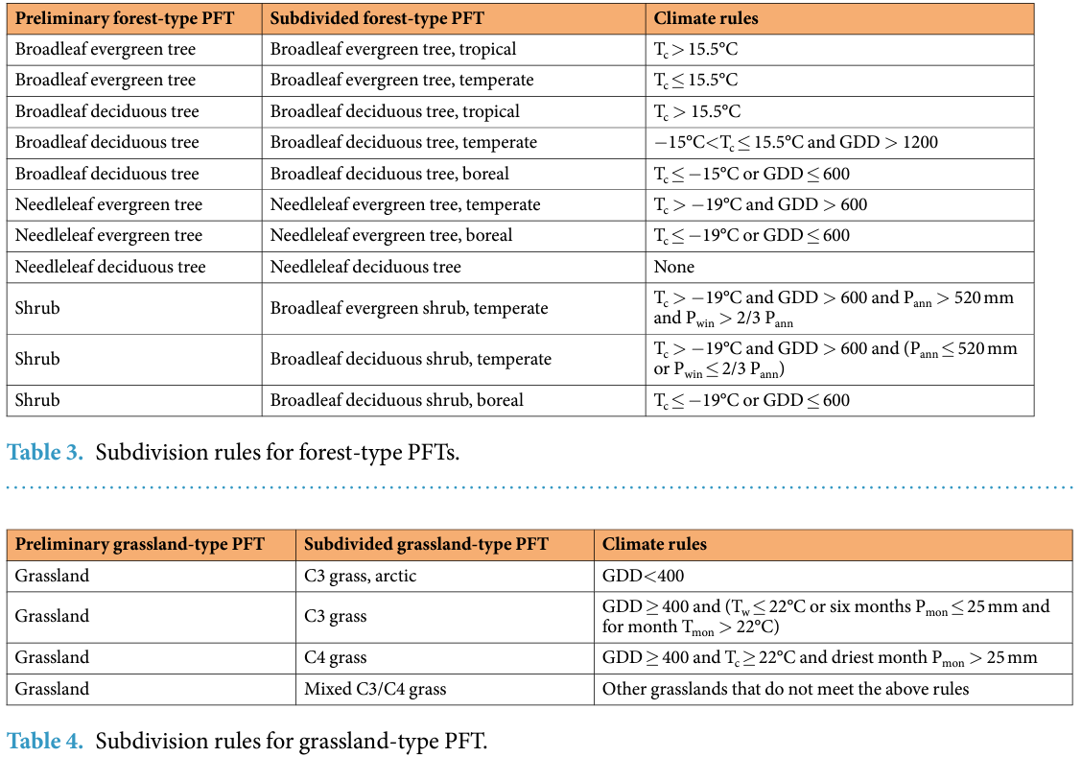
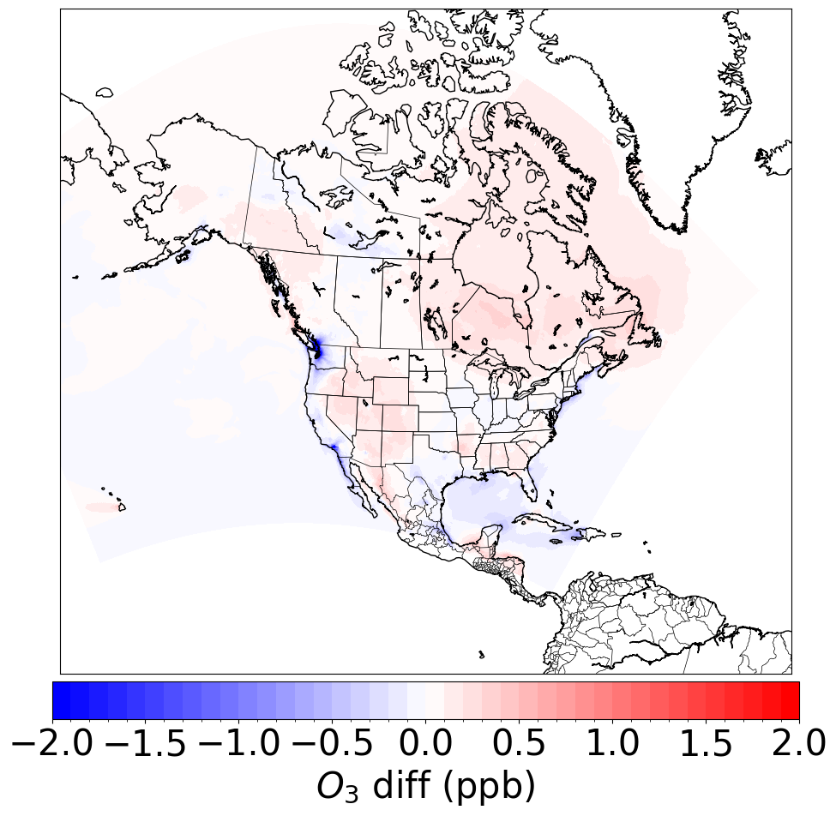
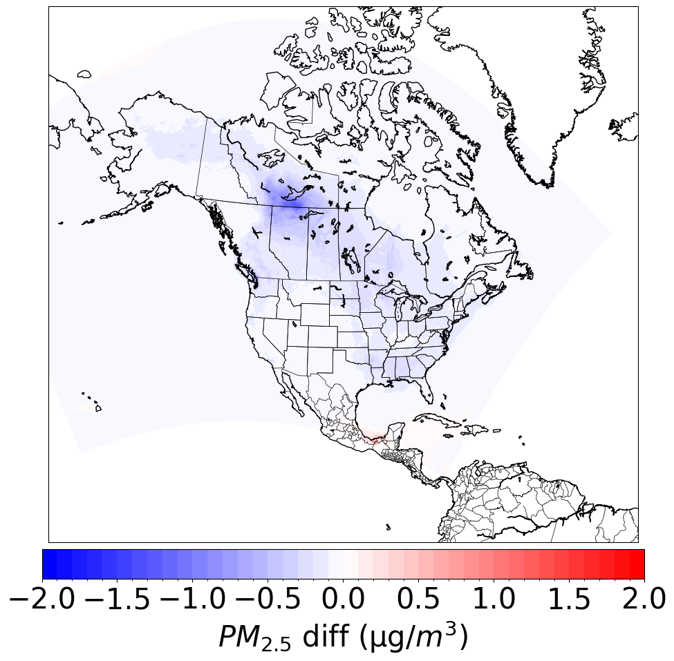
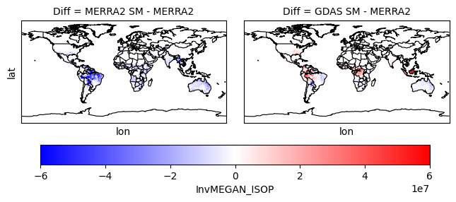
Improving the Biogenic Emissions for AQM and GEFS
Currently the plant functional types (PFTs) are static in MEGANv2.1 within NEXUS. This discounts land use change and so following Chen et al. (2022) using the IGBP class satellite observations and historical climate regimes.
Temperate broadleaf deciduous tree difference
Default
PFTs have changed since 2001
Minimal differences in ISOP but more differences in other species (APIN etc).
New PFT method allows dynamic response and higher integration with UFS land models.
Further research to better integrate with the land models including further integrating soil moisture vs GWETROOT
Simplified
Canopy Effects
August 2023 O₃ diff
August 2023 PM_{2.5} diff
Air Quality Forecaster Focus Group Workshop, October 20-21, 2024
NOAA | OAR | Air Resources Laboratory

Slide 19
Current Structure of the UFS for Atmospheric Chemistry and Composition
Model | Chemistry Available | Application
RRFS-Smoke/Dust | Simplified Aerosols: Smoke + Dust tracers | Regional Wildfire Smoke Forecasts
UFS-Aerosols | Simplified Aerosols: GOCART | Global Weather Forecasts with aerosol feedbacks
UFS-AQM | Complex chemistry from CMAQ: Ozone and Aerosols | Regional Air Quality Forecasts
UFS-RAQMS | Simplified chemistry with data assimilation: Ozone and Aerosols | Global air quality forecasts
Problems:
Chemistry-related code is duplicated across the UFS, which is not unified and time intensive to maintain
The reliance on multiple externally developed models also limits expertise within NOAA
We would like to add research capabilities for atmospheric composition and chemistry, but it is unclear how to do this with chemistry divided across so many models/applications
Air Quality Forecaster Focus Group Workshop, October 20-21, 2024
NOAA | OAR | Air Resources Laboratory

Slide 20
Development of
None
Increasing complexity & computational cost
Aerosol Schemes
Smoke + dust tracers
UFS-Chem will be flexible and configurable where users can choose the aerosol scheme and the gas-phase chemical mechanism of the right complexity for their desired application or science question
GOCART
ISORROPIA (CMAQ)
None
Gas-phase chemical mechanisms
Greenhouse gas tracers
REDHC - RAP-Chem
Increasing complexity & computational cost
Carbon Bond (CMAQ)
Complex research mechanisms
Air Quality Forecaster Focus Group Workshop, October 20-21, 2024
NOAA | OAR | Air Resources Laboratory

Slide 21
Options to use gas & aerosol chemistry of varying complexity
None
RRFS-Smoke/Dust
Aerosol Schemes
Smoke + dust tracers
UFS - Aerosols
GOCART
Online CMAQ
ISORROPIA (CMAQ)
None
Research questions (e.g., addressing new emerging emissions sources)
Gas-phase chemical mechanisms
Greenhouse gas tracers
REDHC - RAP-Chem
Carbon Bond (CMAQ)
New applications for connections to climate
Complex research mechanisms
Air Quality Forecaster Focus Group Workshop, October 20-21, 2024
NOAA | OAR | Air Resources Laboratory

Slide 22
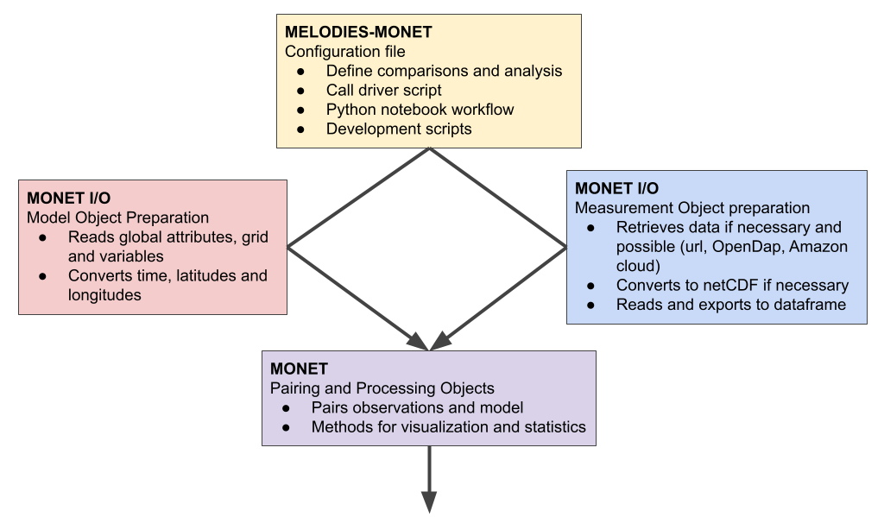
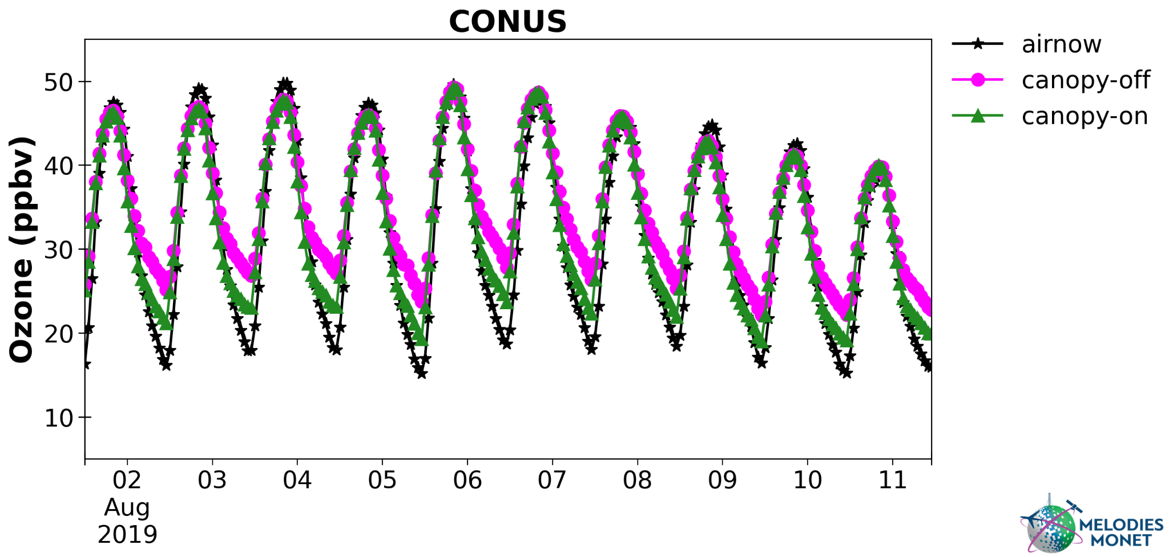
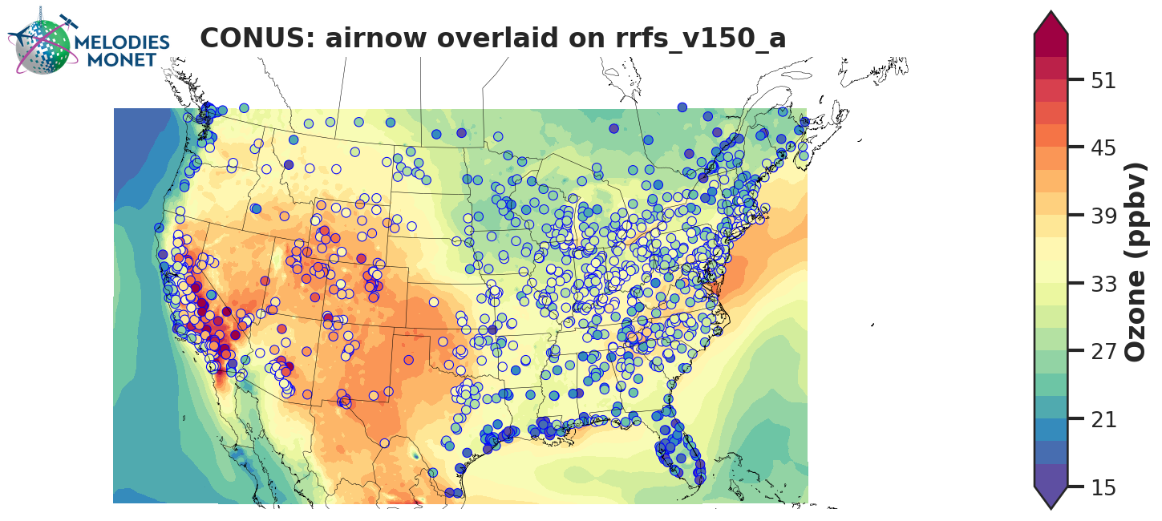
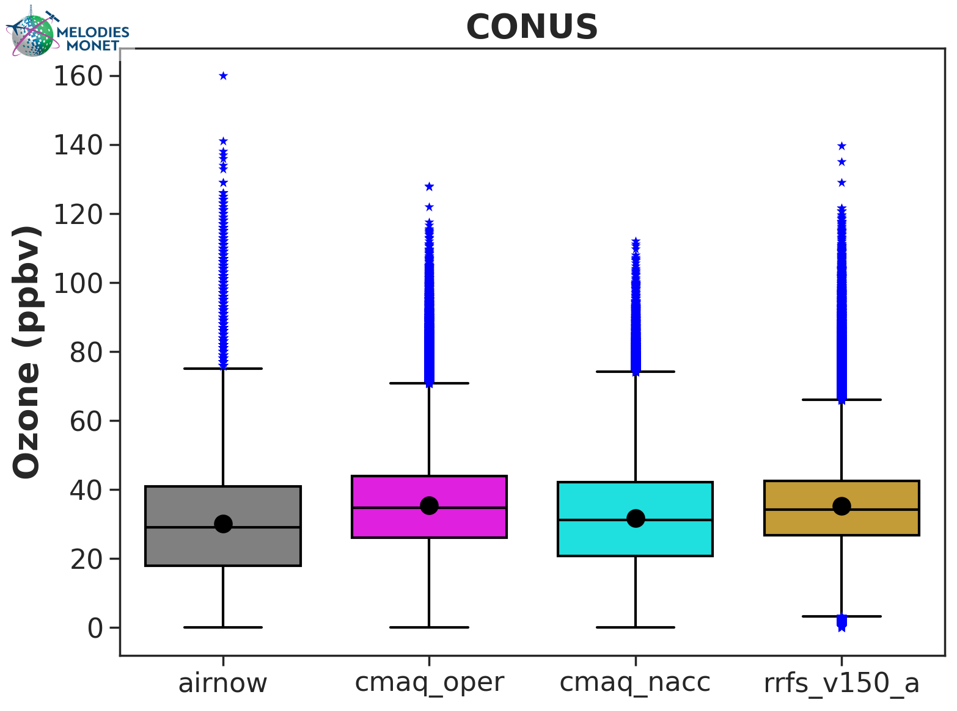
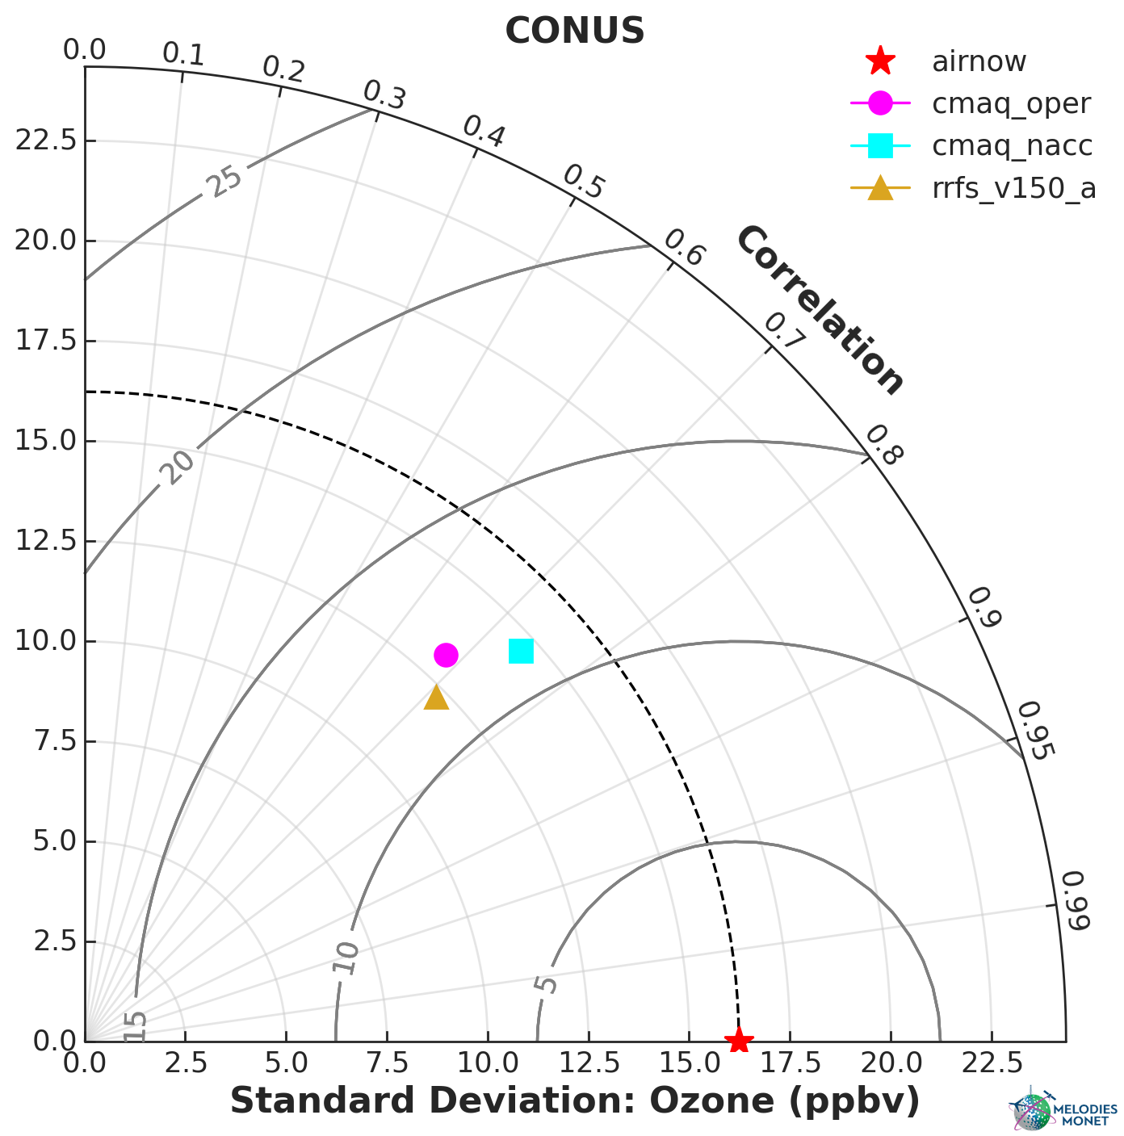
MELODIES MONET is the model diagnostic/evaluation tool that uses the functionality already developed in MONETIO for reading in model/observation data and in MONET for analysis and plotting to quickly generate hundreds of plots and statistics through a easy to use interface
Source code is publicly available:
https://github.com/noaa-oar-arl/monet
https://github.com/noaa-oar-arl/monetio
https://github.com/noaa-csl/melodies-monet
User guide is on ReadTheDocs:
https://monet-arl.readthedocs.io
https://monetio.readthedocs.io
https://melodies-monet.readthedocs.io
Capabilities to produce hundreds of plots for quick diagnostic assessments while also being flexible enough to produce publication quality plots
Air Quality Forecaster Focus Group Workshop, October 20-21, 2024
NOAA | OAR | Air Resources Laboratory

Slide 23
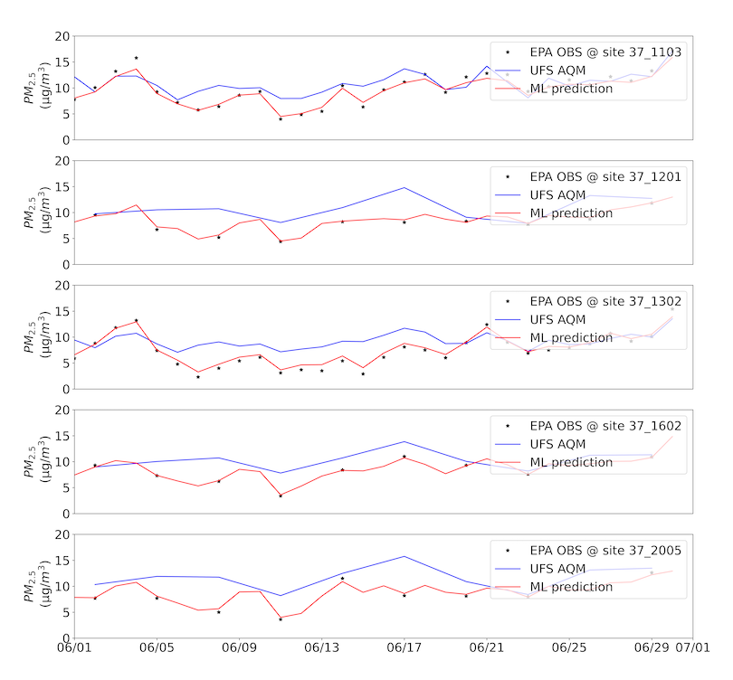
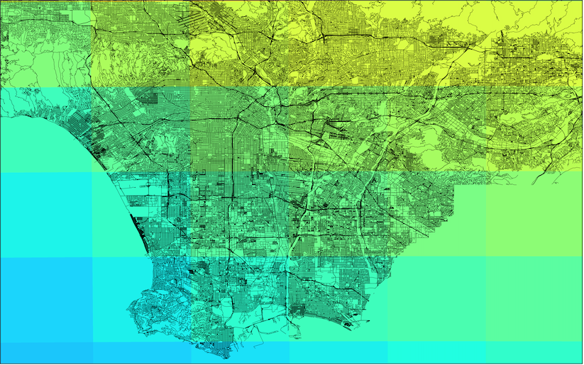
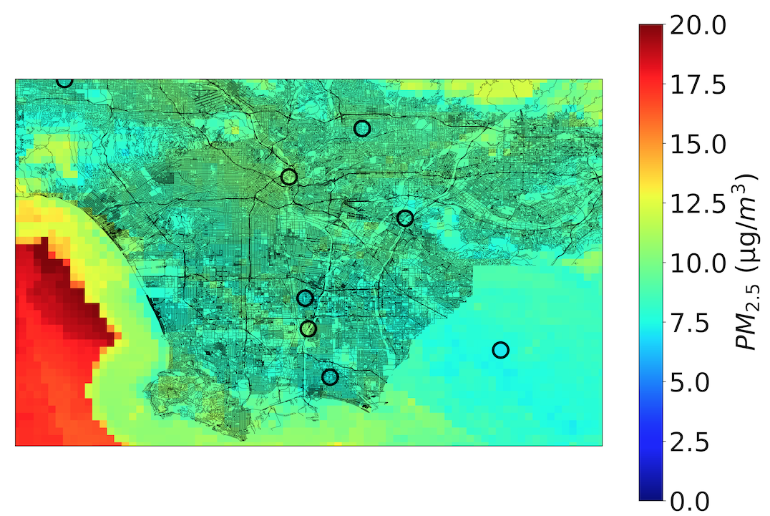
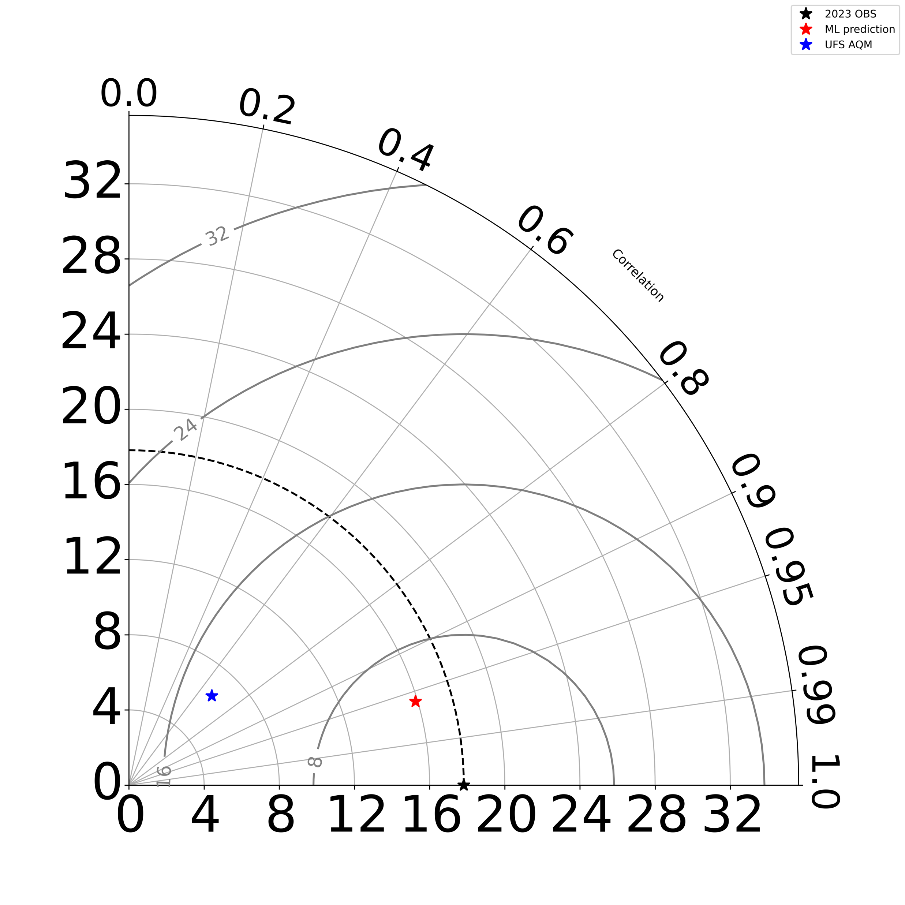
Dynamic Downscaling of UFS-AQM
AQM
We constantly hear that AQM is not high enough resolution but the model itself is extremely expensive and so we need to develop ways to create higher resolution forecasts in a timely manor. To do this we follow Tang et al. (2024). Preliminary results are showing impressive results but currently in a “reanalysis mode” not “forecast” mode
AQM
DD-AQM
DD-AQM
Workflow
UFS-AQM
PM2.5 | R | RMSE (μg/m³) | STD model (μg/m³) | STD obs (μg/m³)
ML model | 0.96 | 5.03 | 15.84 | 17.82
Original UFS-AQM | 0.68 | 15.32 | 6.48 | 17.82
For more information see Tang et al. (2024) https://doi.org/10.1016/j.atmosenv.2024.120603
Air Quality Forecaster Focus Group Workshop, October 20-21, 2024
NOAA | OAR | Air Resources Laboratory
ML prediction

Slide 24
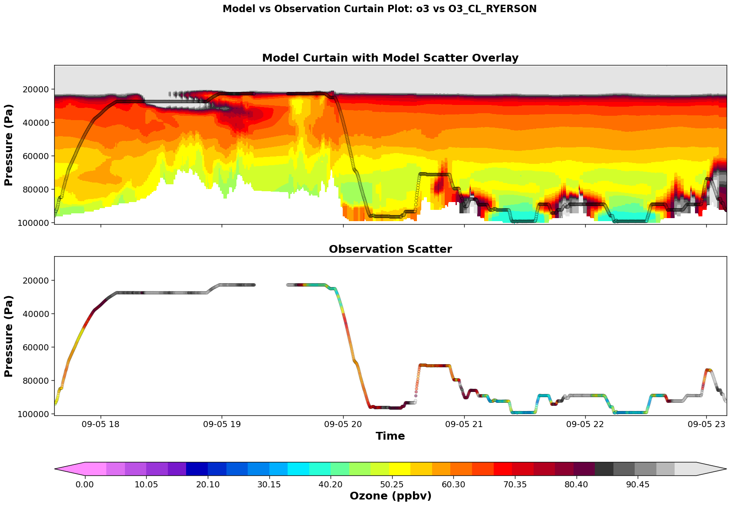
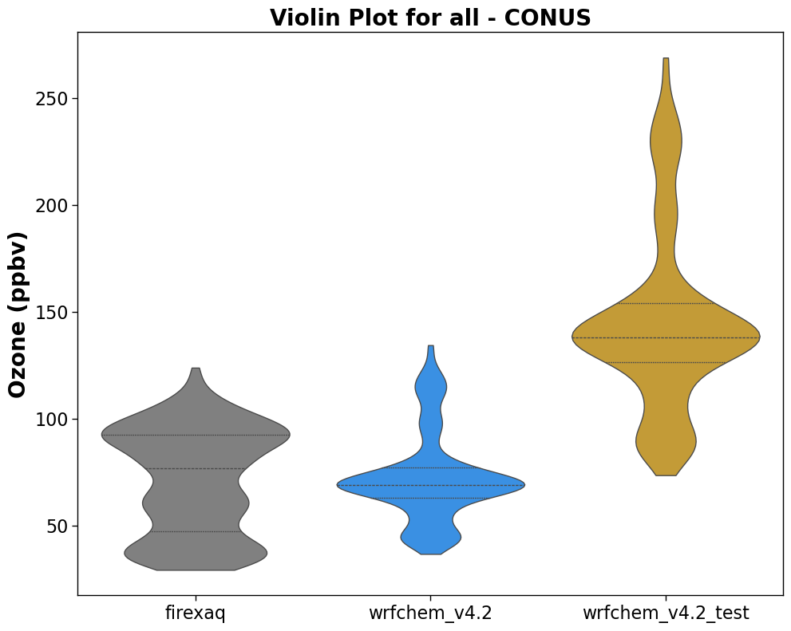
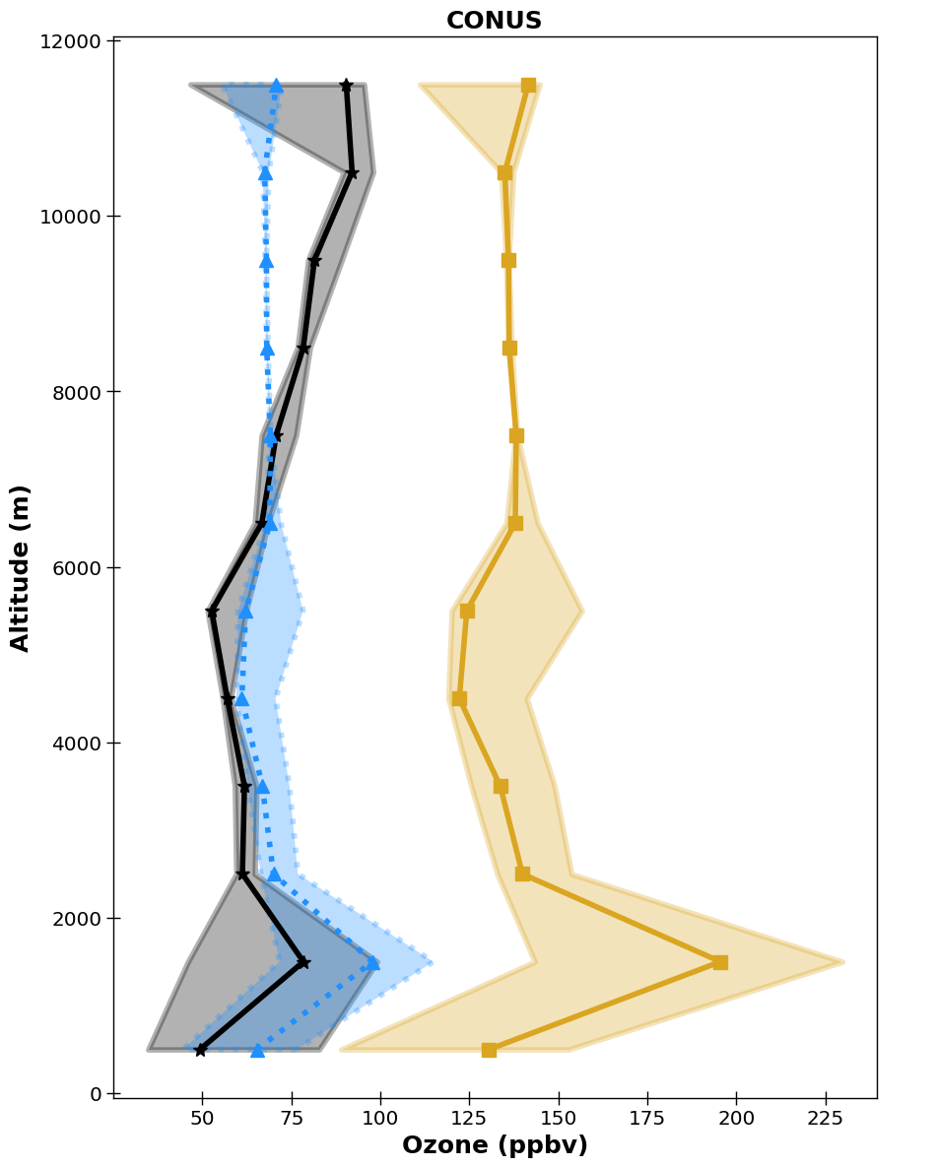
Adding new capabilities to Melodies-MONET
New Capabilities
Added capability to verify using aircraft data in MM
Curtain Plots
Vertical Profile Plotting
Violin Plots
Model vs Obs contour plots
Added ability to do ozone sounder verification
Vertical plots
Added the GEOMS reader to MONETIO to read Pandora and TOLNet data
Added Methods to retrieve NESDIS VIIRS AOD/LAI/NDVI and AVHRR AOD
Added NASA MODIS AOD
Added TROPOMI
Future
Adding TEMPO
Support more NESDIS satellite observations
Expanded current GOES support in monetio for inclusion in MM
More vertical profiling including
Air Quality Forecaster Focus Group Workshop, October 20-21, 2024
NOAA | OAR | Air Resources Laboratory

