Slide 1
NOAA Air Quality Program: National Air Quality Forecast Capability
September 9, 2024
Youngsun Jung¹ and Jack Kain^{1,2}
¹NOAA/National Weather Service/Office of Science and Technology Integration, ²IBSS
Thanks to Alex Alder, Shira Francis, and the AQ model development team

Slide 2
Outline
NOAA’s AQ/AC Research and Services
Overview of NAQFC Program
Recent Implementations
Upcoming Model Upgrades
Phased Transitioning to UFS

Slide 3
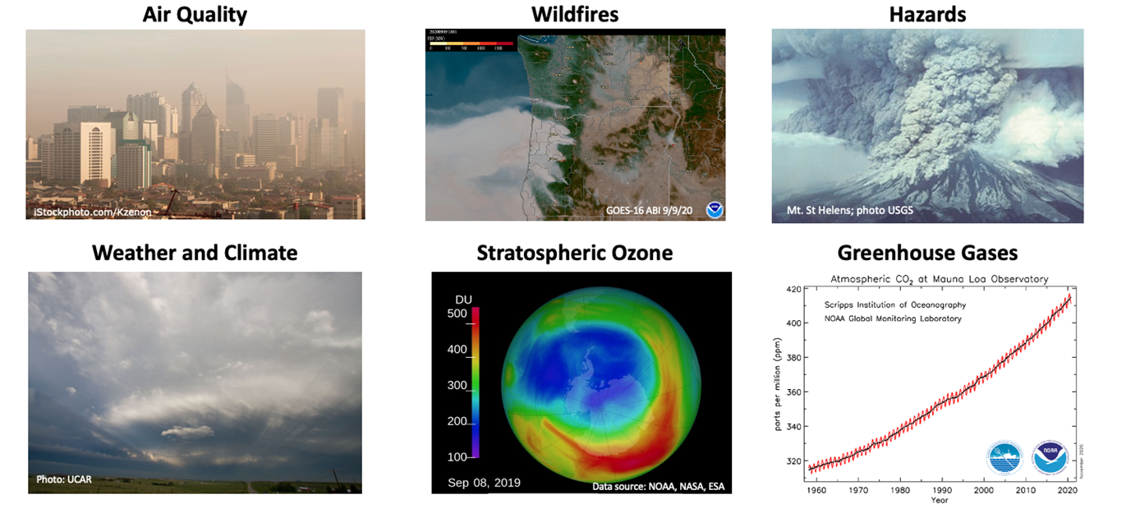
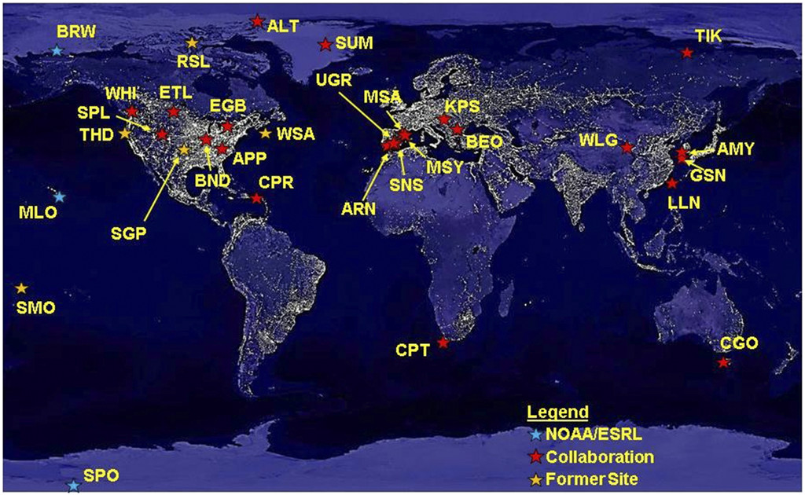
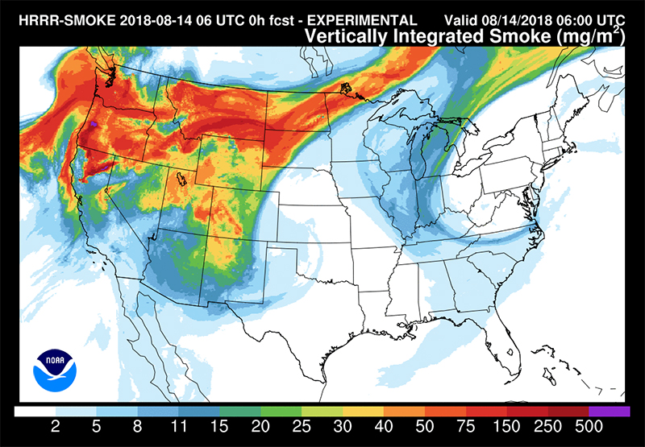
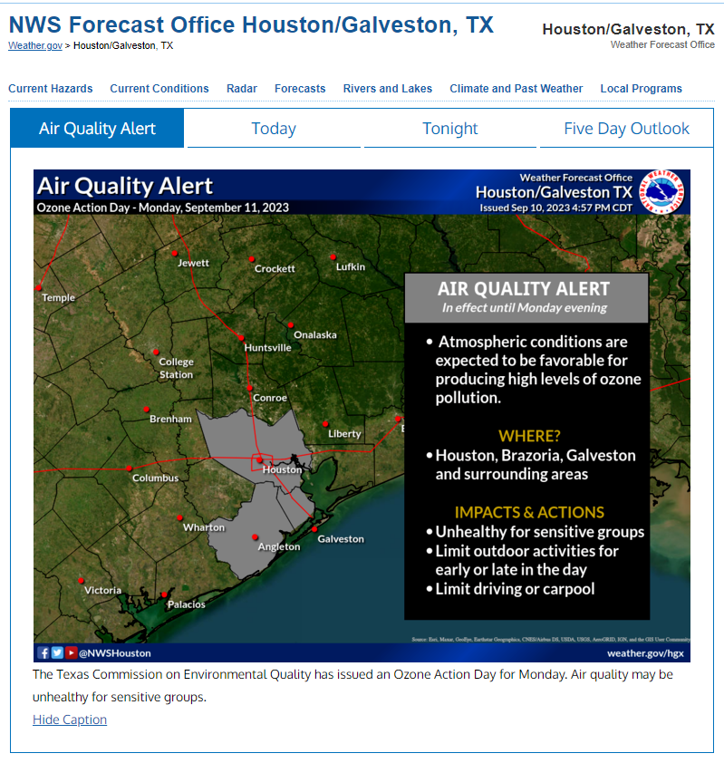
NOAA’s mandates for atmospheric composition research, operations, and products
NOAA has numerous legislative, interagency, and international mandates for its research and operational predictions of atmospheric chemistry and composition for various hazardous weather conditions.
NOAA’s Atmospheric Composition research and operations support the agency’s mission to protect lives and property.
Measurement
Monitoring
Services
Models
Adapted from Kopacz et al. (2023)

Slide 4
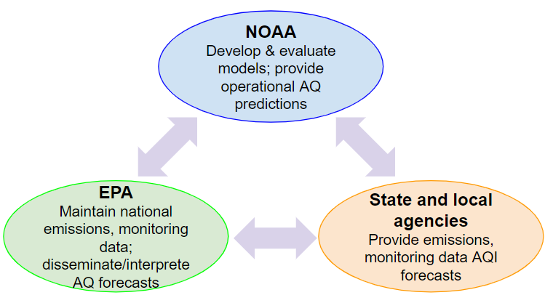
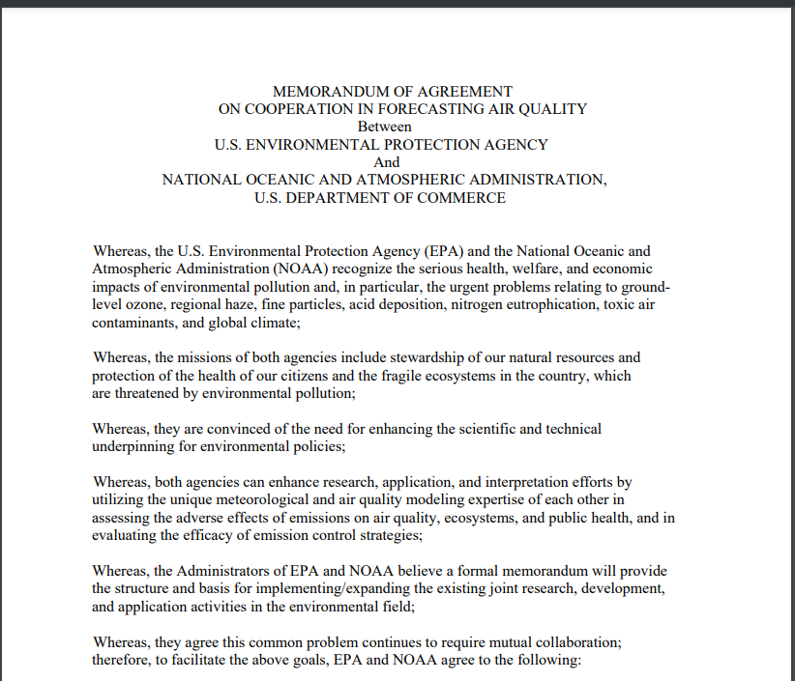
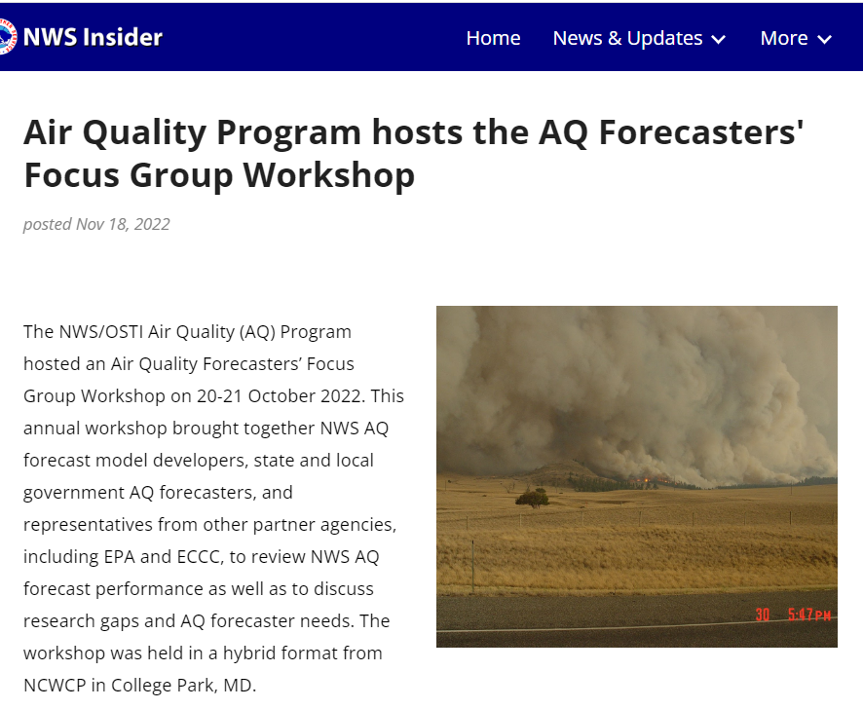
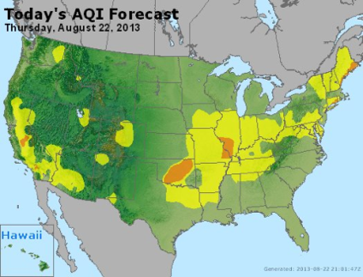
National Air Quality Forecast Capability
We improve the basis of air quality alerts and provide air quality information to people at risk to further NWS mission of protecting life and property and the enhancement of the national economy.
National Air Quality Forecast Capability (NAQFC) develops and implements operational air quality forecast guidance for the United States.
Operational Forecast Products (72/48 hours):
Ozone nationwide (AQM with CMAQ)
Fine particulate matter (PM2.5) nationwide (AQM with CMAQ)
Smoke nationwide (RAP-Smoke)
Dust over CONUS (HYSPLIT)
Air quality forecasting relies on a strategic partnership with the Environmental Protection Agency (EPA) and state and local air quality forecasters.
NOAA/EPA MOA
EPA AirNow
https://www.airnow.gov/national-maps/
Notes:
AQM: Air Quality Model

Slide 5
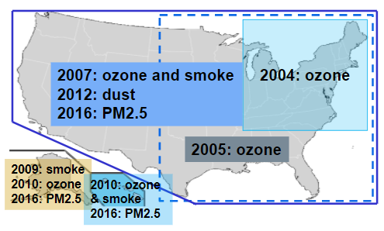
Evolution of NAQFC Product Services
2004: 48-hour forecast guidance for ozone in Northeastern US
2005: Extend domain to Eastern US
2007: Extend domain to CONUS and add smoke forecast guidance
2009: Extend smoke prediction to Alaska
2010: Extend ozone prediction to nationwide
2012: Implement dust over CONUS
2016: Implement raw and bias-corrected PM2.5 predictions nationwide
2018: Add bias-corrected ozone in CONUS
2021: Extend ozone and PM2.5 forecast lengths to 72 hours
NWS Directives 10-516:
Description on Issuance criteria, Contents, Product formats, etc

Slide 6
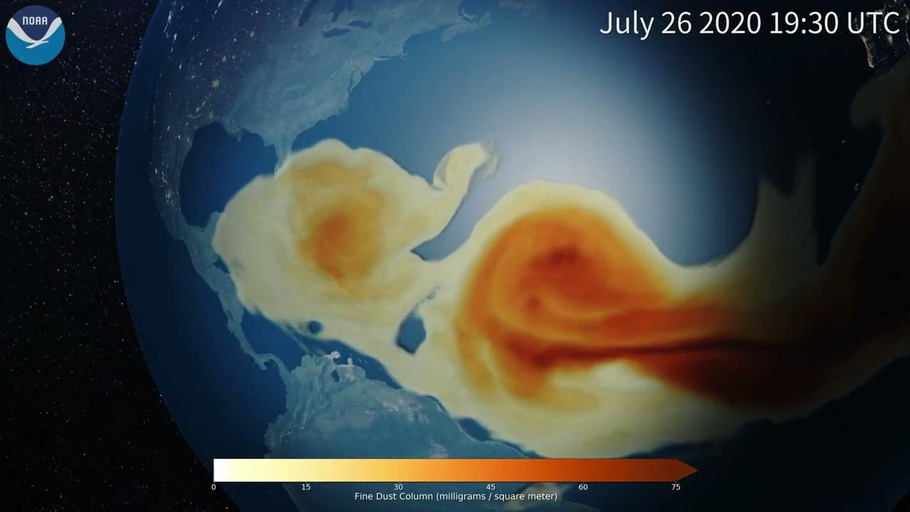
Operational Models: Global
GEFS-Aerosol (EMC, ARL, CSL, GSL, STAR)
One member of GEFSv12
Coupled atmosphere-wave-aerosol
Aerosol Optical Depth (AOD), Particulate Matter (PM), PM smaller than 2.5 μm for up to 5 days
Provide LBC to AQM
Planned upgrade to GEFSv13 in FY26
Fully coupled: atmosphere-land-wave-ocean-ice-aerosol
Control member
Long-range transportation of
Saharan dust (July 2020)
Image credit: Eric Hackathorn, NOAA Global Systems Laboratory

Slide 7
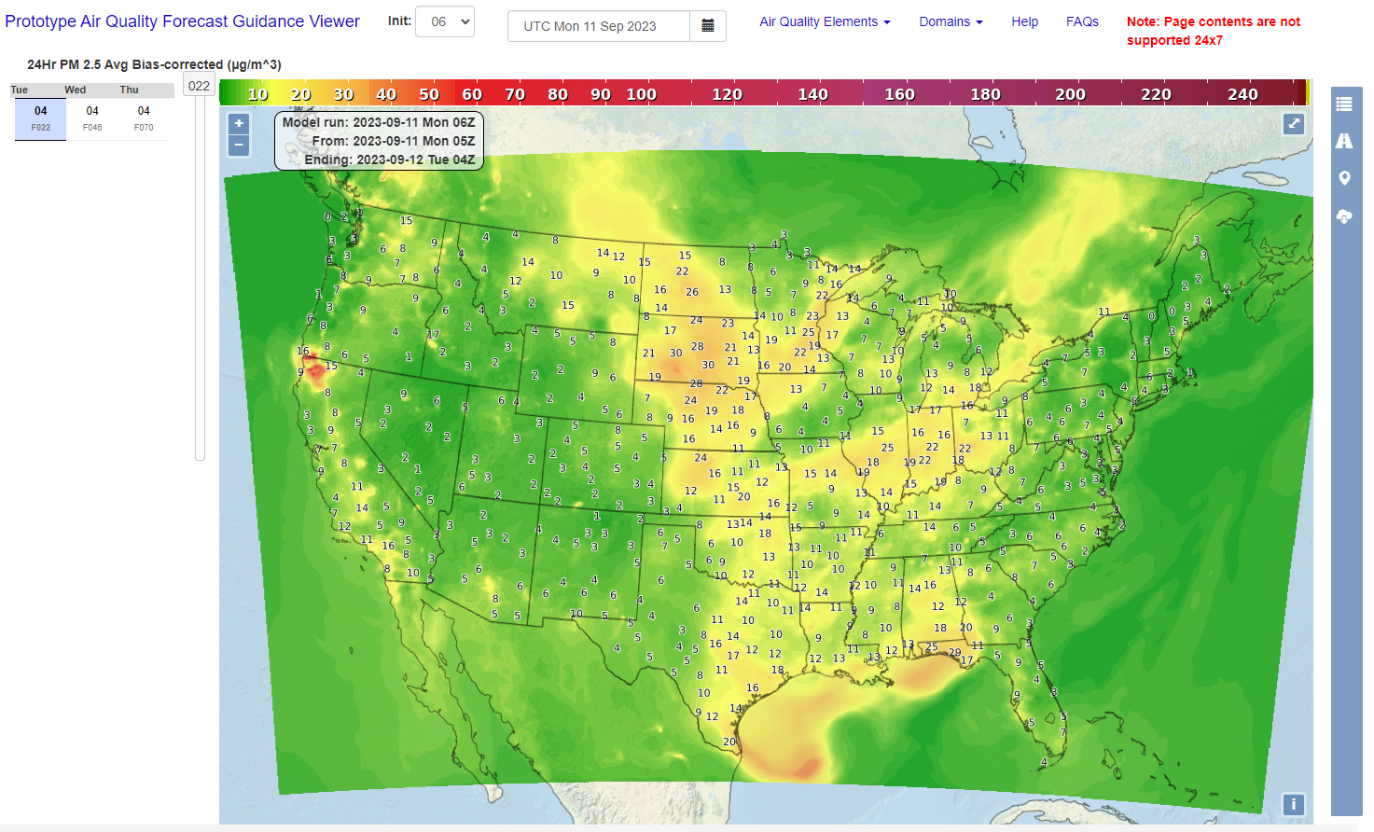
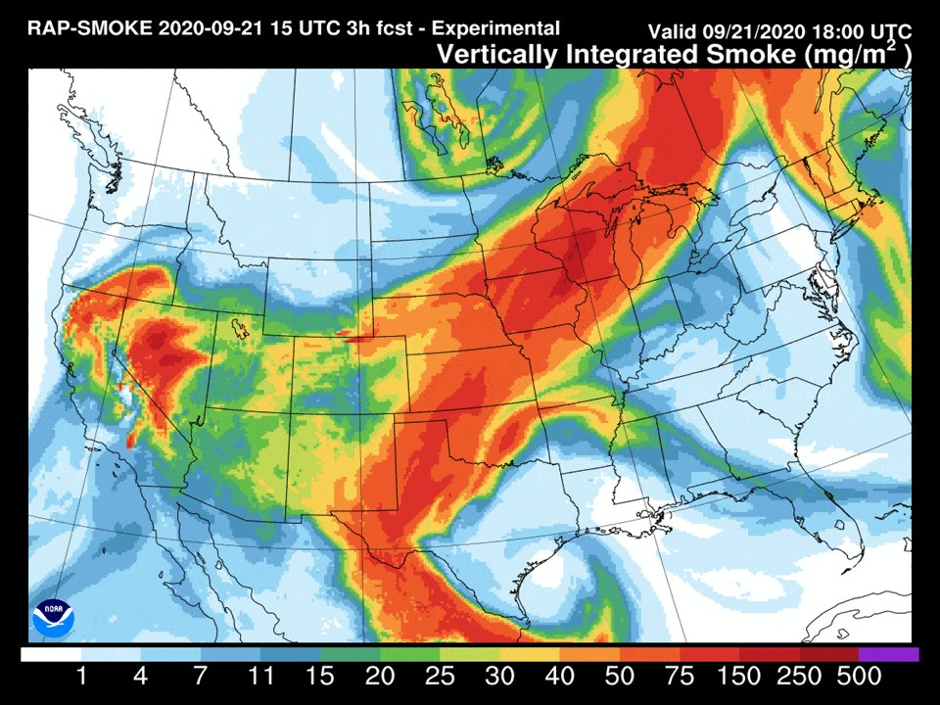
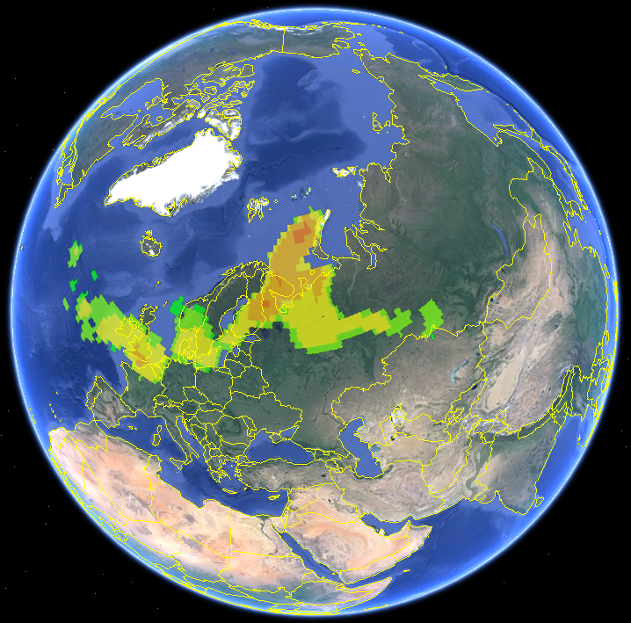
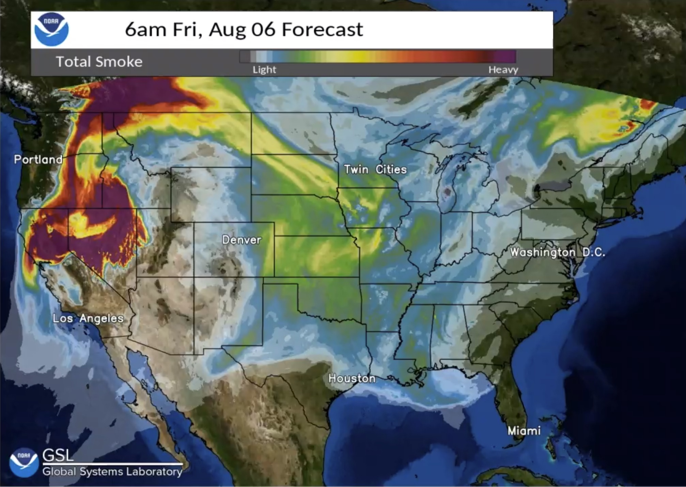
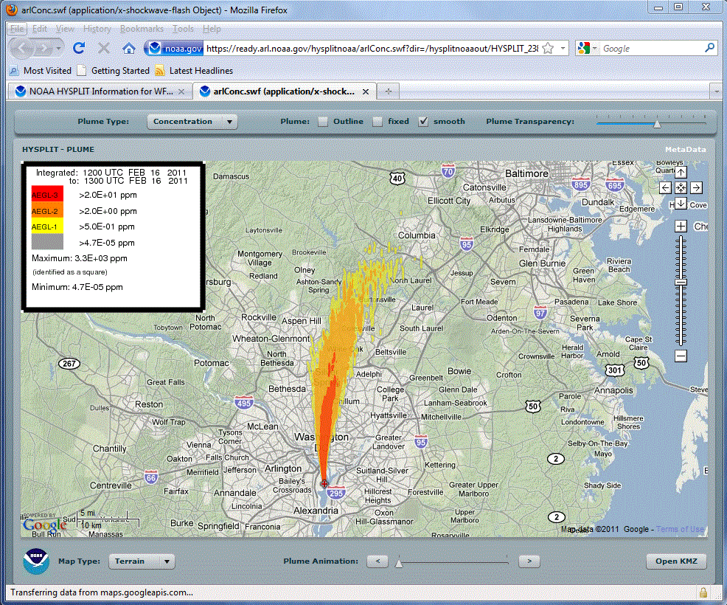
Operational Models: Regional
AQM (EMC, ARL, PSL, STAR)
O₃ and PM2.5
HYSPLIT-Dust
RAP- and HRRR-Smoke
On-demand HYSPLIT runs for radioactive/chemical events and volcanic ash ensemble
RAP-Smoke
AQM
HYSPLIT
HRRR-Smoke

Slide 8
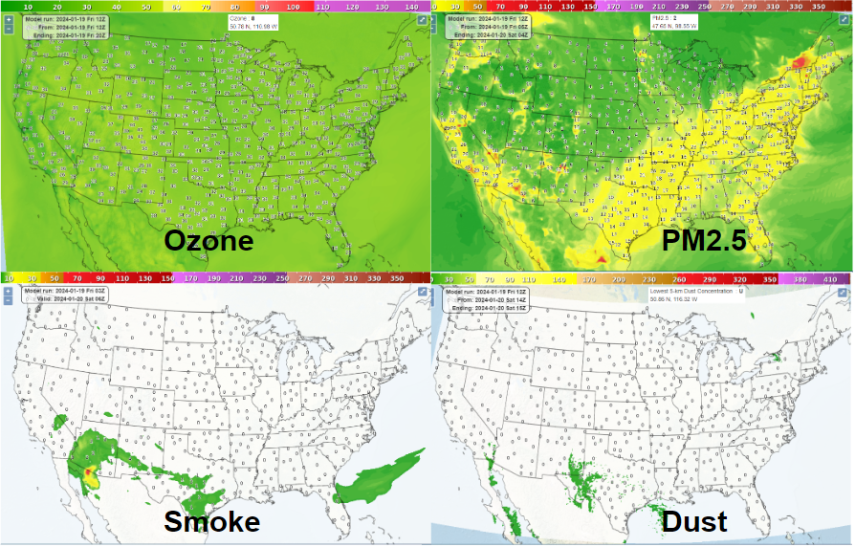
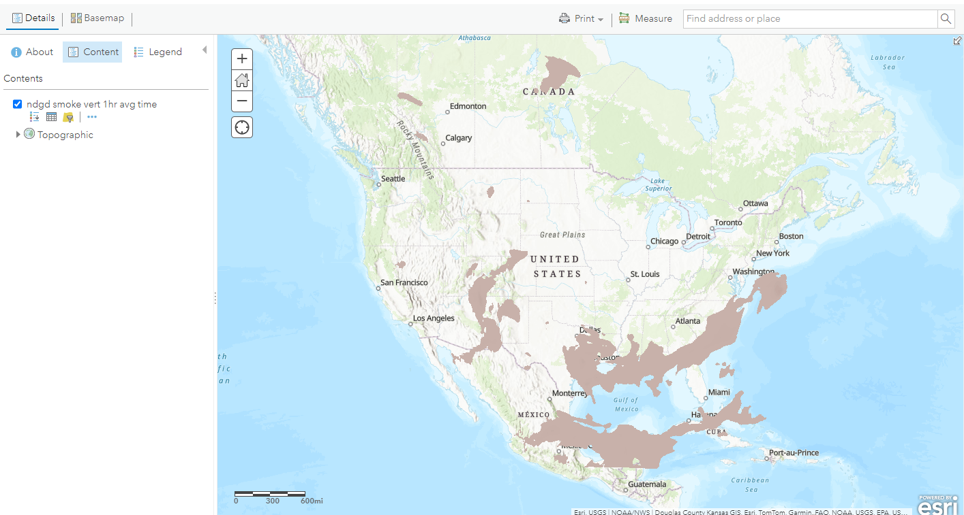
Graphical Forecasts
NAQFC Graphics on AWS:
https://airquality.weather.gov
GIS data on AWS: https://www.weather.gov/gis/cloudgiswebservices
Smoke

Slide 9
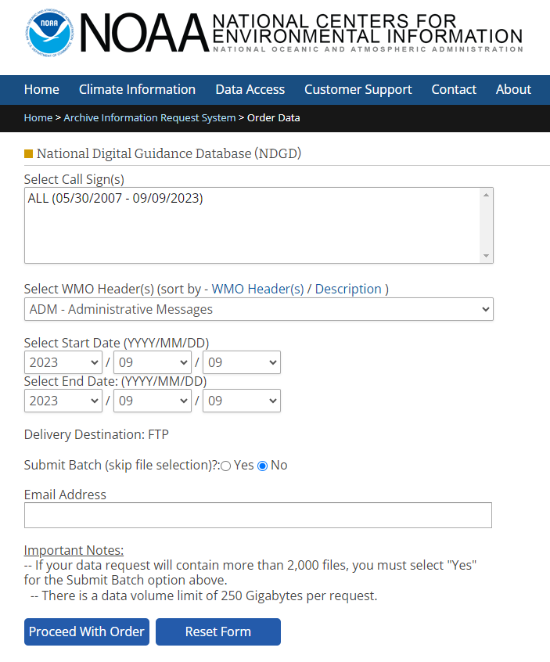
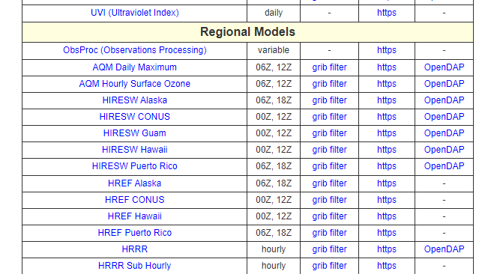
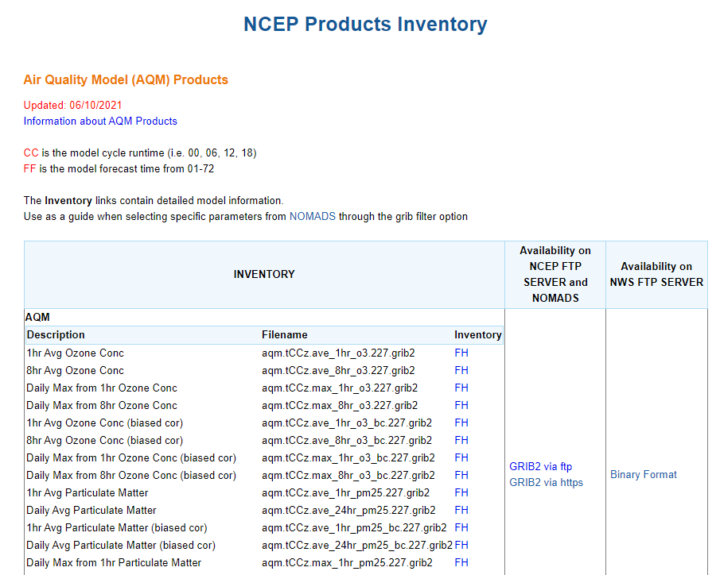
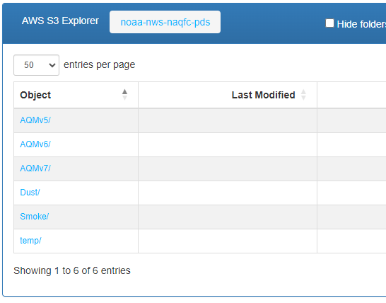
Gridded Binary File
GRIB2 format
NOAA Operational Model Archive and Distribution System (NOMADS) : https://nomads.ncep.noaa.gov/
TGFTP: https://www.nco.ncep.noaa.gov/pmb/products/aqm/
NOAA Open Data Dissemination (NODD)
https://noaa-nws-naqfc-pds.s3.amazonaws.com/index.html
Historical database (National Digital Guidance Database):
https://www.ncei.noaa.gov/has/HAS.FileAppRouter?datasetname=9950_01&subqueryby=STATION&applname=&outdest=FILE
NEW

Slide 10
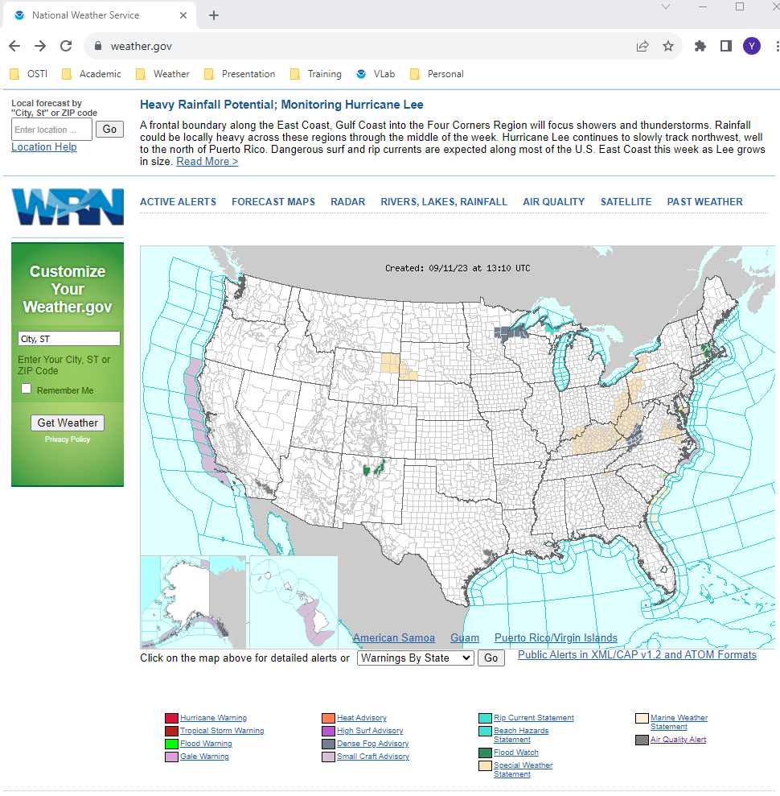
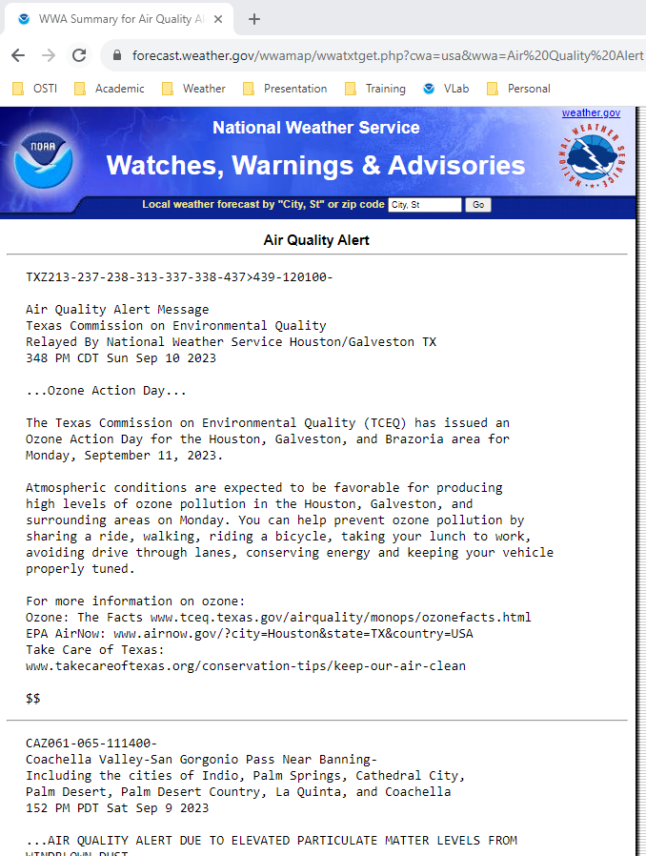
Alerts and Warnings
Weather.gov

Slide 11
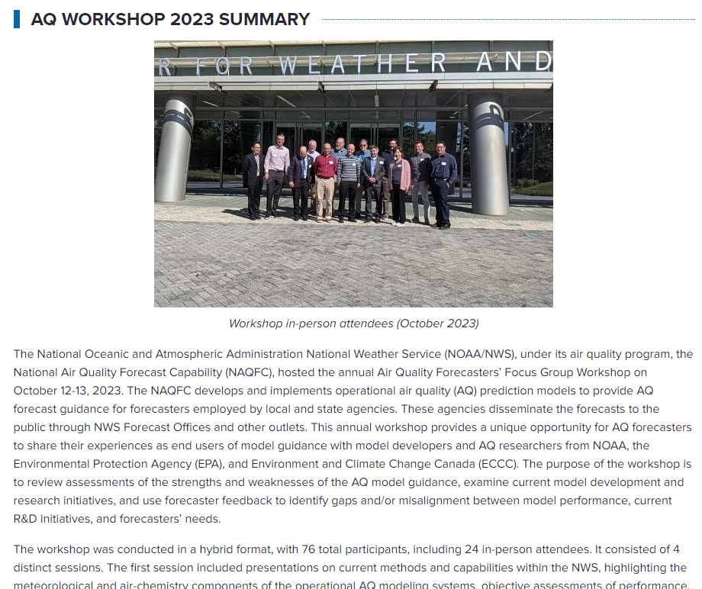
Air Quality Forecasters Workshop
Date: 12-13 October 2023
Cadence: Annual
Location:College Park, MD
Purpose: Bring together NWS AQ forecast model developers, state and local government AQ forecasters, and representatives from other partner agencies to review NWS AQ forecast performance as well as to discuss research gaps and AQ forecaster needs.
Workshop Summary: https://vlab.noaa.gov/web/osti-modeling/aq-workshop-2023-summary

Slide 12
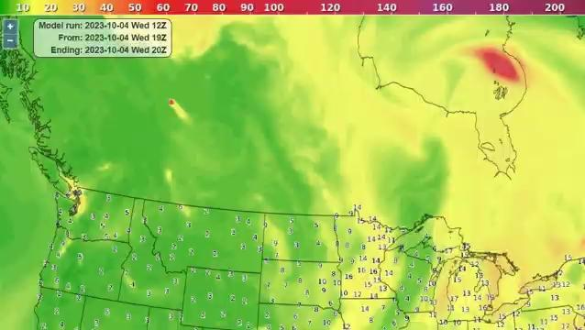
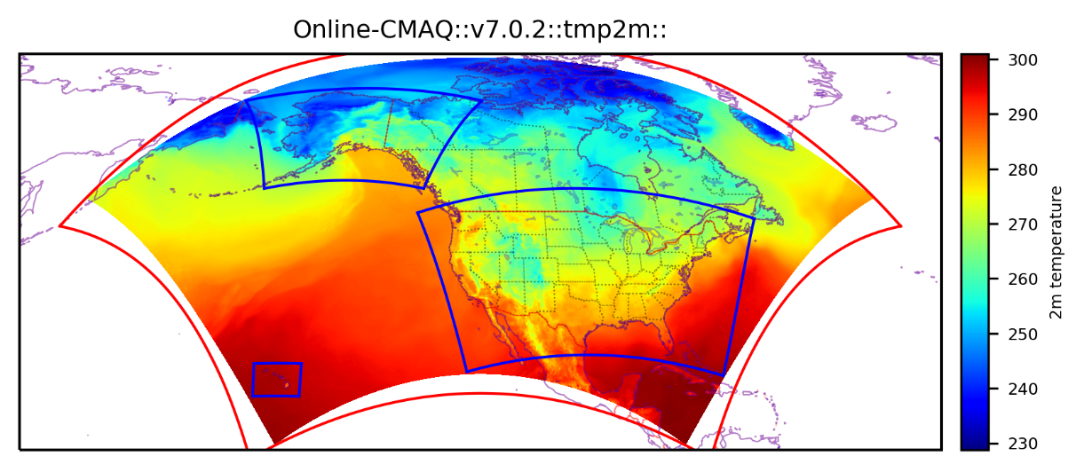
AQM v7.0.7 Implementation
(May 2024)
Implemented on May 14, 2024
First online-coupled weather and chemistry model in NOAA
13-km grid spacing over north America
High-resolution hourly Regional ABI and VIIRS fire Emissions (RAVE)
Sofiev plume-rise algorithm
Updated LBC (AM4+GEFS-Aerosols) and wet deposition
Fengsha dust module
Public Information Statement (https://www.weather.gov/notification/)
Smoke intrusion from wildfires in Canada (Oct. 2023)
AQMv6: Operational AQM
AQMv7

Slide 13
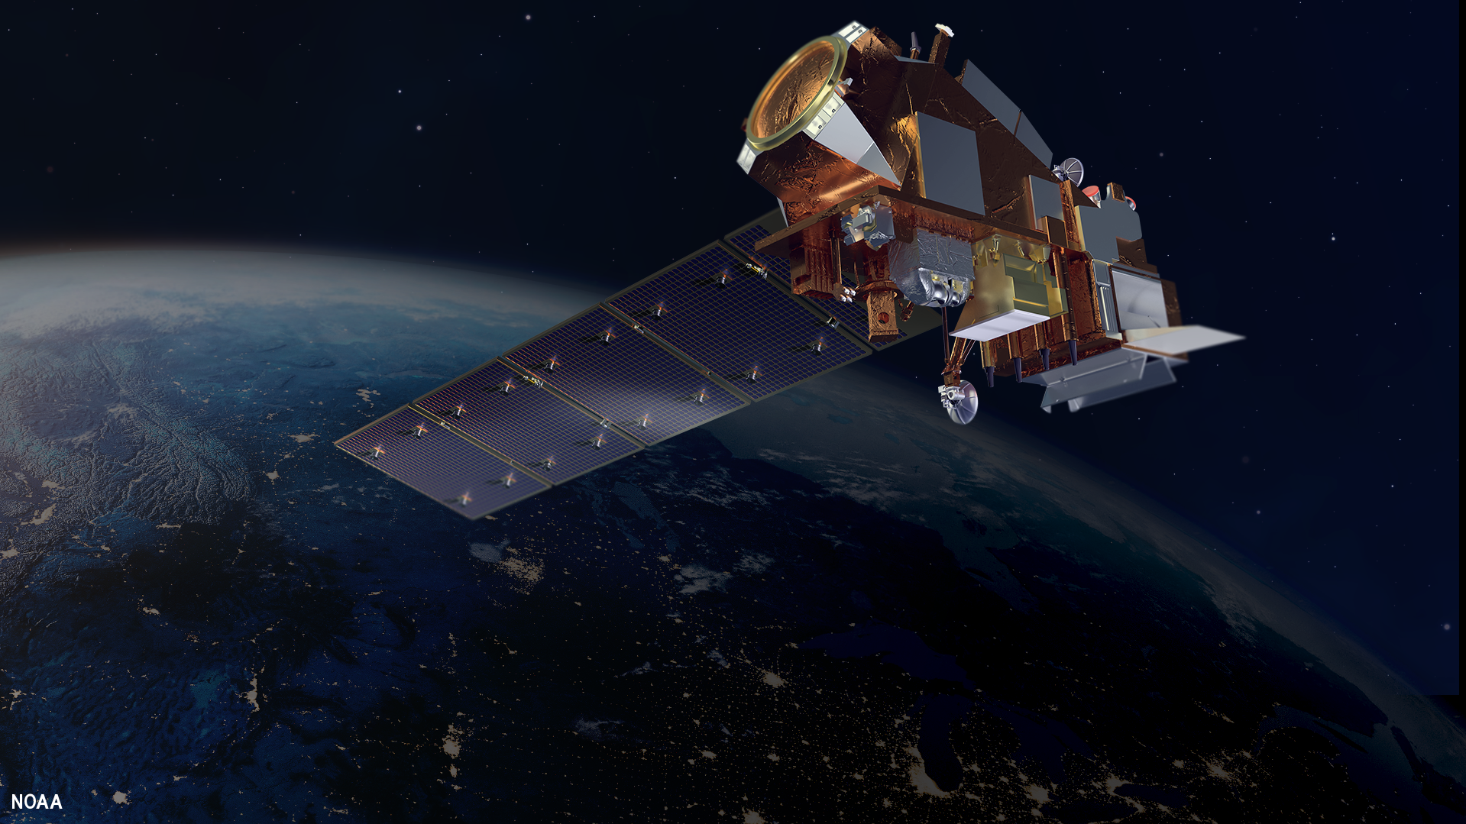
AQM v7.0.8 Implementation
(Oct 2024)
“Non-Science” update, compelled by upgrades in RAVE* fire emissions input data, also including these “changes of opportunity”:
Fix POC (primary organic carbon) emissions for wildfire and point sources
Fix to snow cover related dust emissions
Fix BC code for intermittently missing data from obs sites
BC code Bulls-eye fix
*RAVE = Regional Hourly Advanced Baseline Imager (ABI) and Visible Infrared Imaging Radiometer Suite (VIIRS) Emissions product
RAVEv2 upgrades:
changed primary satellite source from JPSS NOAA-20 to NOAA-21
Correct terrain-related parallax in ABI fire product
Application of calibrated scaling factors for PM2.5, black carbon and organic carbon

Slide 14
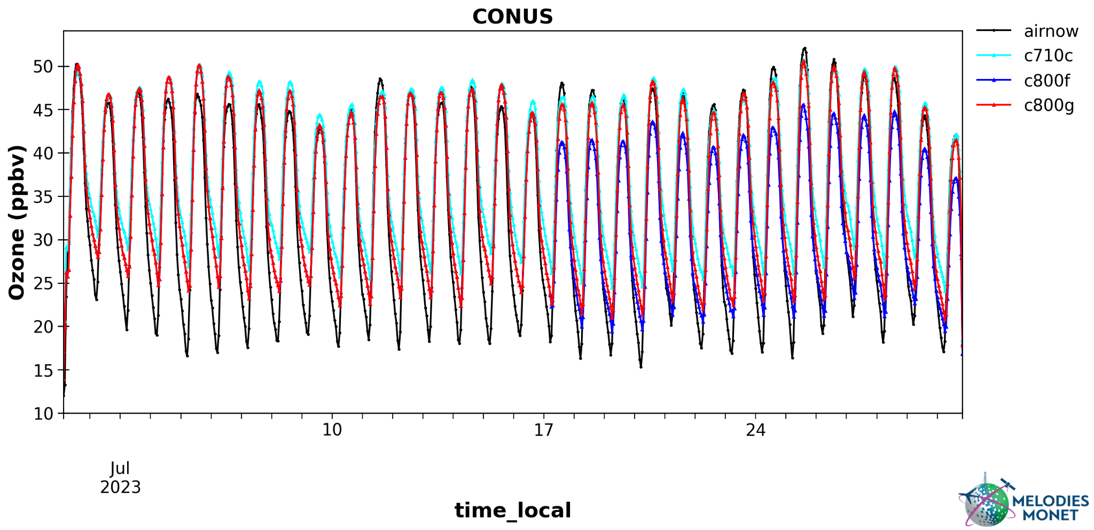
AQM v8.0:
Targeting December 2025 Implementation
Planned Major Upgrades:
Resolution: 13km => 9km dx
UFS-Atmosphere model: GFSv16 => GFSv17
EPA air chemistry model: CMAQ v5.2 => CMAQ 5.4
National Emission Inventory (NEI): 2016 => 2019 base year
Bias correction code: Short training period for PM2.5?
Dust module calibration
AQMv7.0.8
AirNow Obs
Various AQMv8 configs
Prelim Results: Month of August 2023

Slide 15
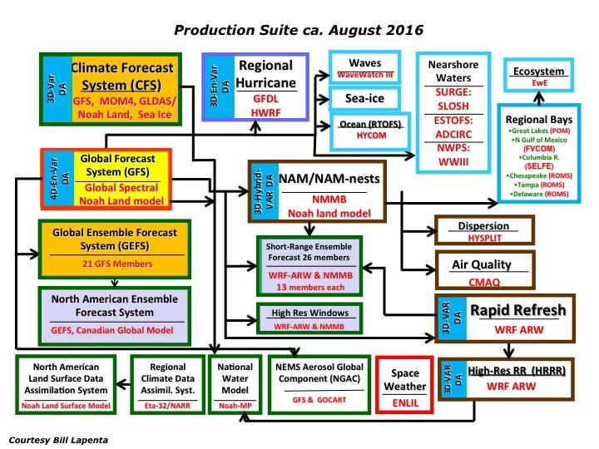
Simplifying NCEP Production Suites
NCEP Modeling reviews by the UCAR Community Advisory Committee for NCEP (UCACN), 2015 - 2017: “Reduce the complexity of the NCEP Production Suite.”, “a unified, collaborative strategy for model development” and “better leverage the capabilities of the external community”
UCACN Reports (2015, 2016, 2017): https://ufscommunity.org/documents/repository/
→ Unified Forecast System (UFS): community-based, fully-coupled, comprehensive Earth Modeling System

Slide 16
AQM v8
EMC Migration Plan to UFS-based Modeling Suites

Slide 17
Transitioning to UFS
RRFS-Smoke and Dust (RRFS-SD)
3-km resolution smoke and dust forecast capability
Outperformed HRRR-smoke for many smoke cases
To be implemented in the RRFSv1 control member
AQM to be merged to RRFSv2
Control member of RRFSv2 at 3-km resolution
Challenges:
available computational resources

