Slide 1
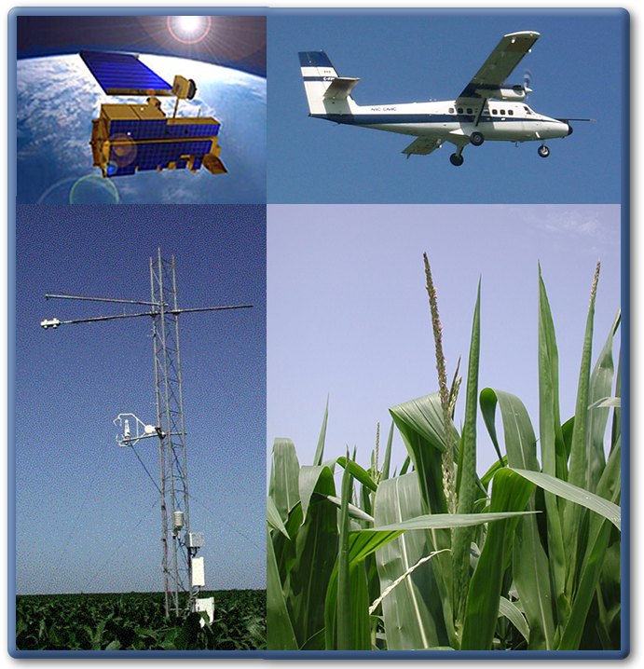
Enhancing NCEP GFS Forecasts via Assimilating Satellite Soil Moisture, Vegetation and Snow Observations
Christopher Hain, Jicheng Liu, Li Fang, Jifu Yin
Earth System Science Interdisciplinary Center, University of Maryland, NOAA-NESDIS
Xiwu Zhan
NOAA-NESDIS-STAR
Martha C. Anderson USDA-Agricultural Research Service
Hydrology and Remote Sensing Laboratory
Beltsville, MD
Michael Ek, Weizhong Zheng, Jiarui Dong, Jesse Meng
NCEP-EMC

Slide 2
Recent research has shown the unique value of assimilating satellite-based soil moisture (SM), vegetation and snow retrievals towards improving land-atmosphere water and energy fluxes.
While most studies have focused on assimilation with uncoupled LSMs (e.g., NLDAS), the greater potential impact of land data assimilation should be realized within fully coupled NWP models (e.g., NAM; GFS).
Several global forecast centers are already operationally assimilating or currently testing assimilation of land data products:
ECMWF has shown positive impacts from the assimilation of satellite-based SM and snow observations, for example, the assimilation of ASCAT SM led to improvements in forecasts of near-surface variables.
UK Met Office has begun development/testing of an extended-KF based assimilation system and shown improvements in screen-level T/q.
Environment Canada has begun implementation of a land data assimilation system using the EnKF which will assimilate satellite observations of SM and SWE.
Land Data Assimilation

Slide 3
Approaches to Satellite-based Soil Moisture
Thermal Methods
Changes in soil moisture can be related to changes in soil/vegetation temperatures and ET (e.g., vegetation stress is observed through elevated canopy temperatures)
The SM signal is dominated by surface soil moisture over low vegetation and root-zone soil moisture over very dense vegetative canopies.
Higher resolution (1-5 km); requires mid-morning clear-sky retrievals of LST
Microwave Methods
Retrievals of surface soil moisture from MW T_{b} exploit large differences in the dielectric constant of dry soil and wet soil (passive sensors) and the effect of soil moisture on backscatter (active sensors)
Lower resolution (3 – 40 km); can retrieve through non-precipitating cloud cover; issues with vegetation (passive) and surface roughness (active)
Land Surface Models
Estimates of precipitation and atmospheric forcing is used to predict the evolution of soil moisture
Requires accurate specification of precipitation; accurate representation of parameters used to describe the land surface; accurate model physics.

Slide 4
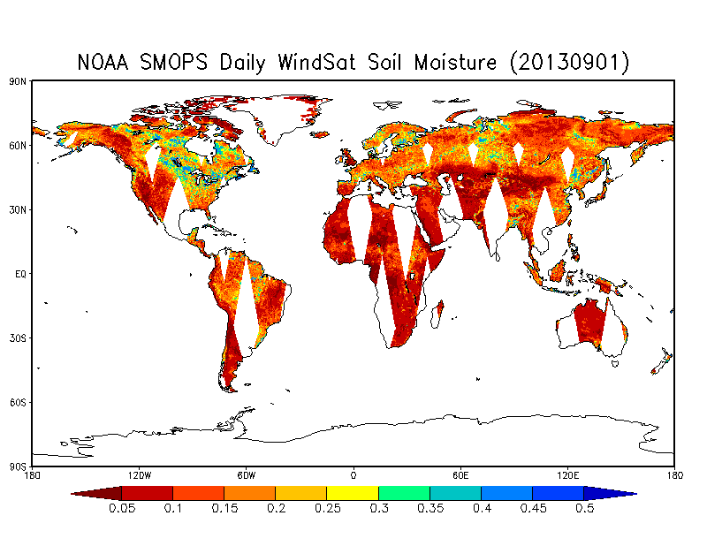
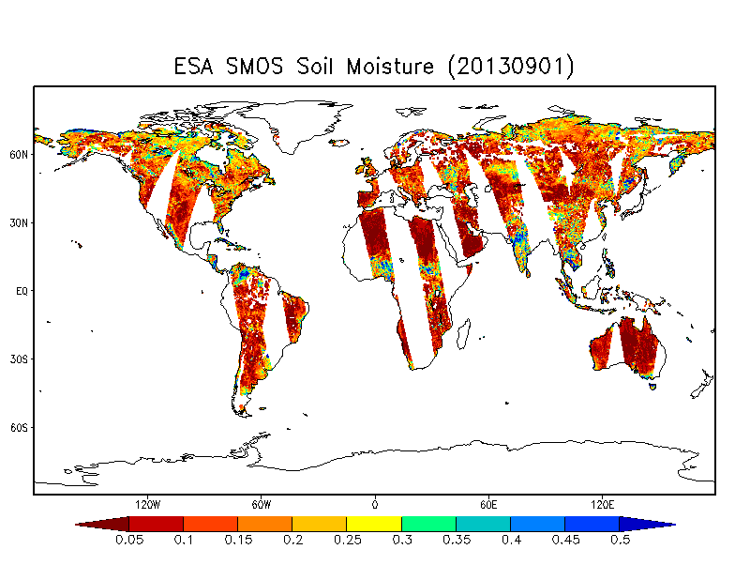
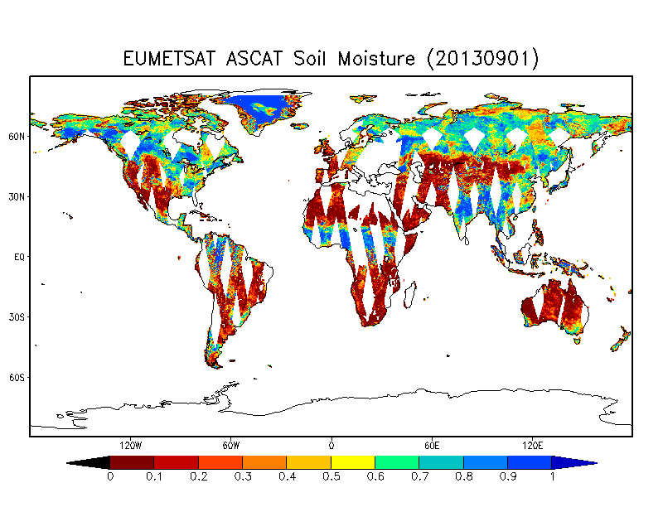
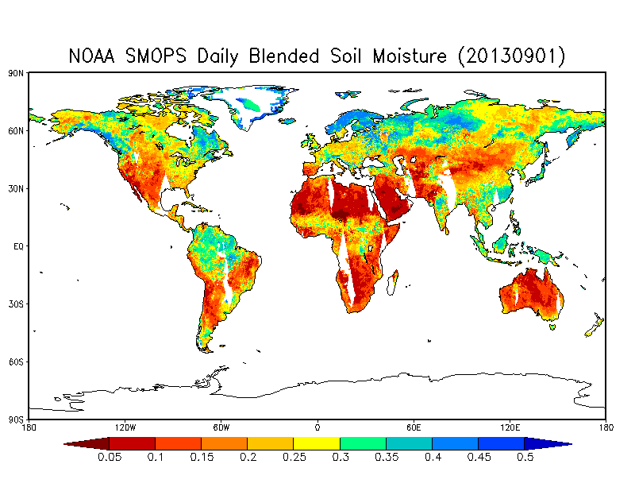
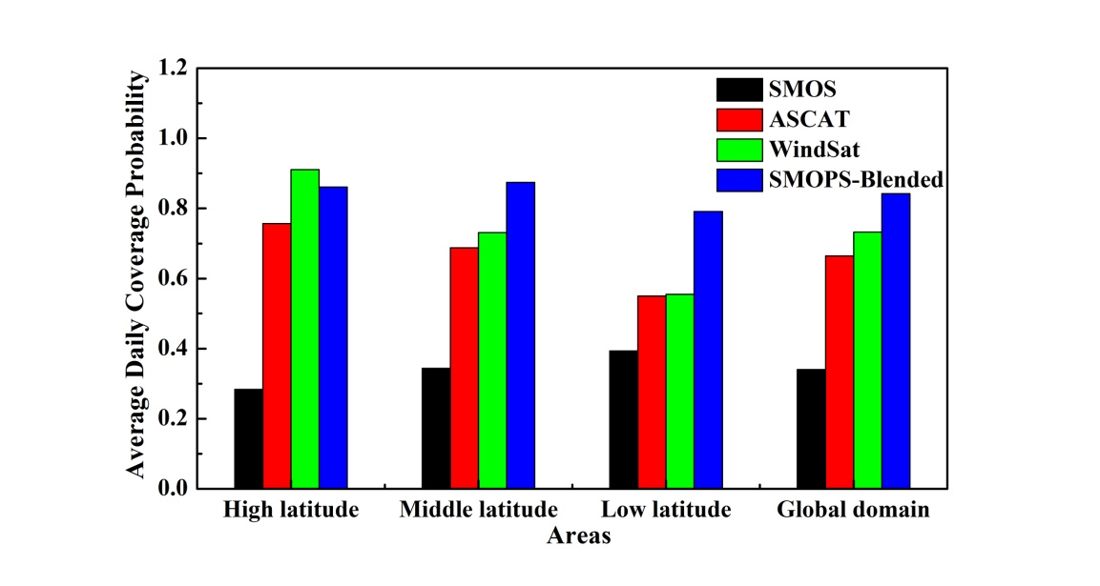
NOAA Soil Moisture Product System (SMOPS)
WindSat
SMOS
ASCAT
Blended

Slide 5
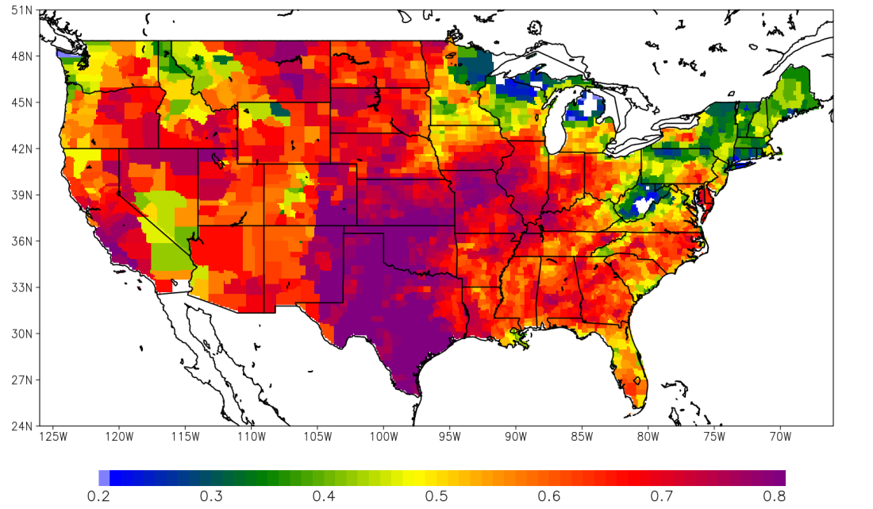
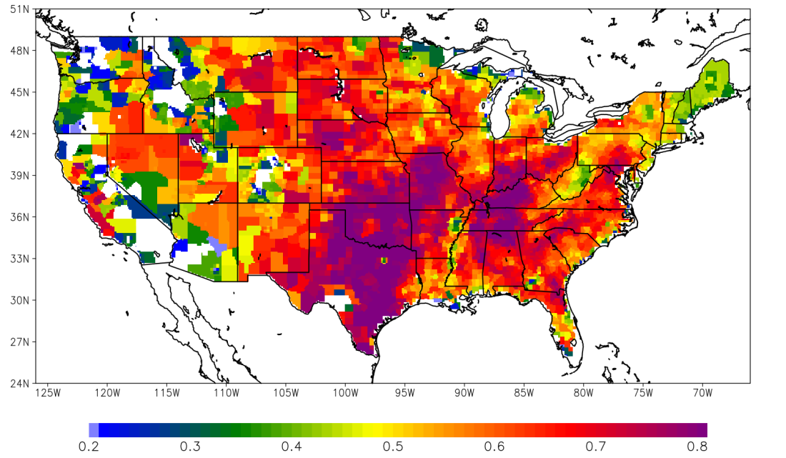
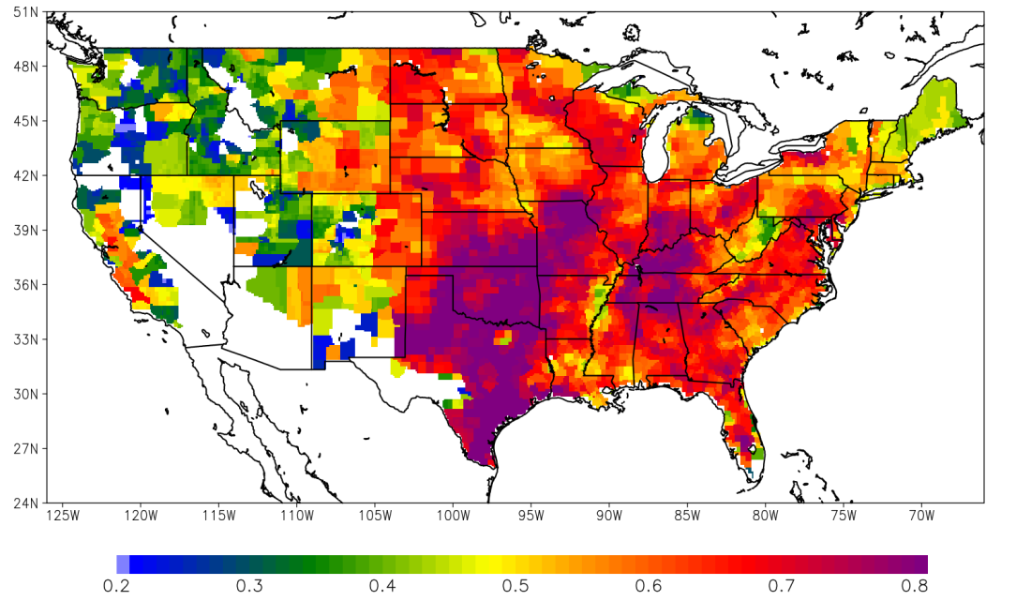
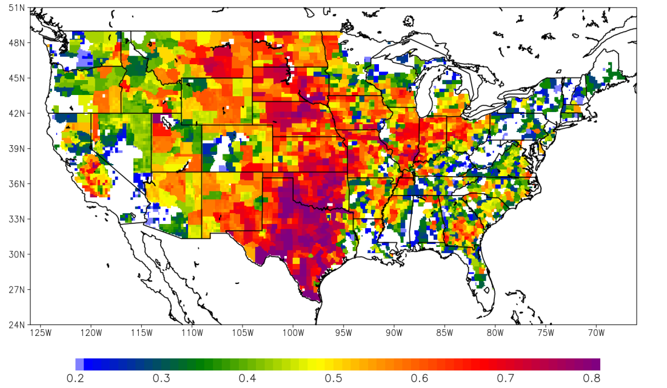
a) Noah Sfc / ALEXI (r = 0.62)
b) Noah Sfc / MW Combined (r = 0.57)
c) Noah Sfc / MW Active (r = 0.51)
d) Noah Sfc / MW Passive (r = 0.46)
*Anomaly correlations computed with 2-week composites over May – October, 2000-2014

Slide 6
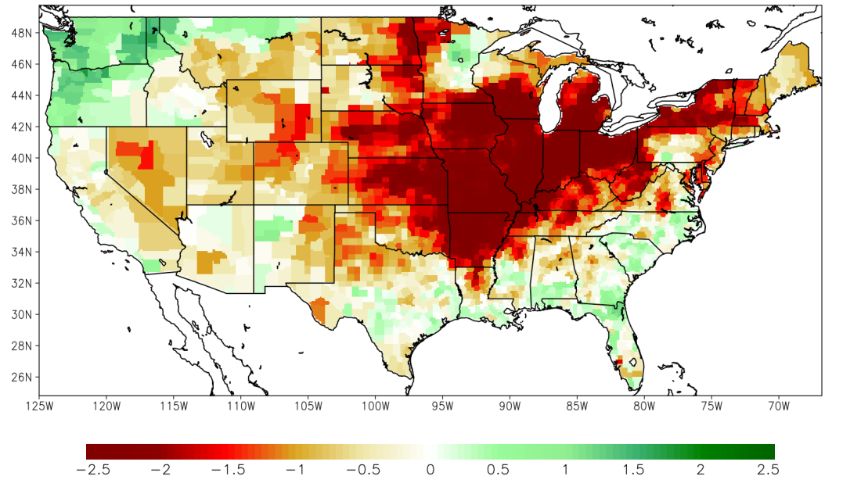
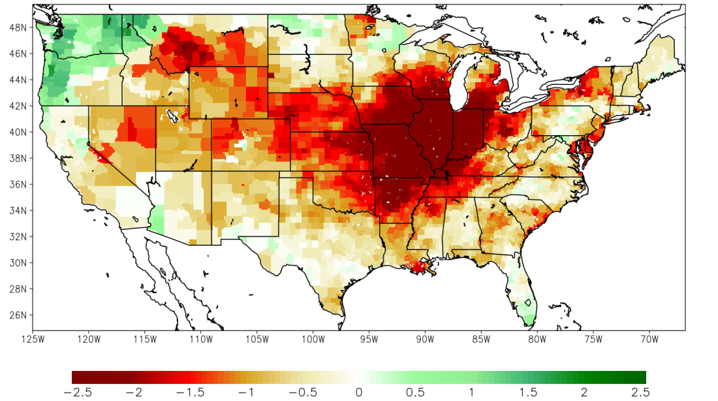
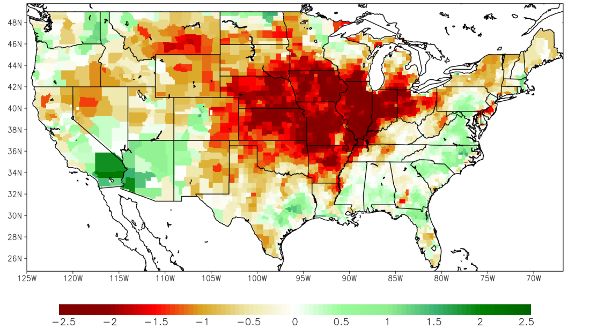
5 August 2012
a) Noah (uncoupled)
b) ALEXI
c) ECV Combined

Slide 7
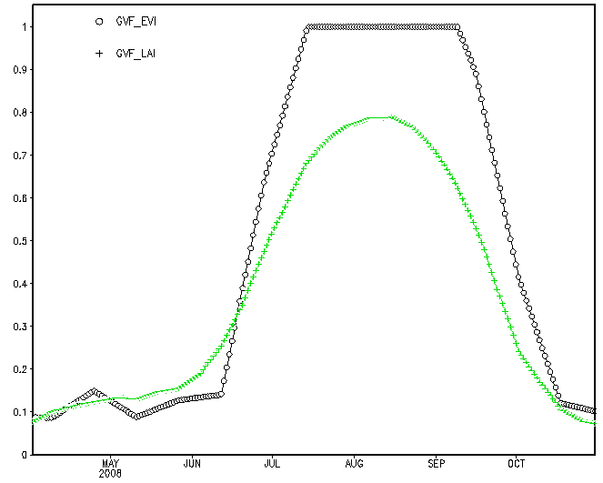
The specification of the GVF used to partition energy between the soil/veg surfaces is generated from a multi-year, seasonally varying climatology.
Variability in GVF can occur due to a number of reasons: (1) anomalously wet/dry condition and that impact on biomass; (2) early or late emergence/senescence; or (3) changes in land use/vegetation type.
NDVI/EVI-based fraction of green vegetation
Issues with saturation over moderate/dense vegetation
Tends to overestimate GVF over agricultural regions
LAI-based fraction of green vegetation
- No NOAA VIIRS LAI product (future NASA product under development)
Approaches to Satellite Vegetation
NASS Cropland Data Layer for EVI/LAI Pixel
Corn | 31.7% | 73.6%
Soybean | 28.1%
Forest | 13.8%
Open Water | 10.6% | 26.4%
Developed | 8.2%
Pasture | 7.6%
Bondville, IL

Slide 8
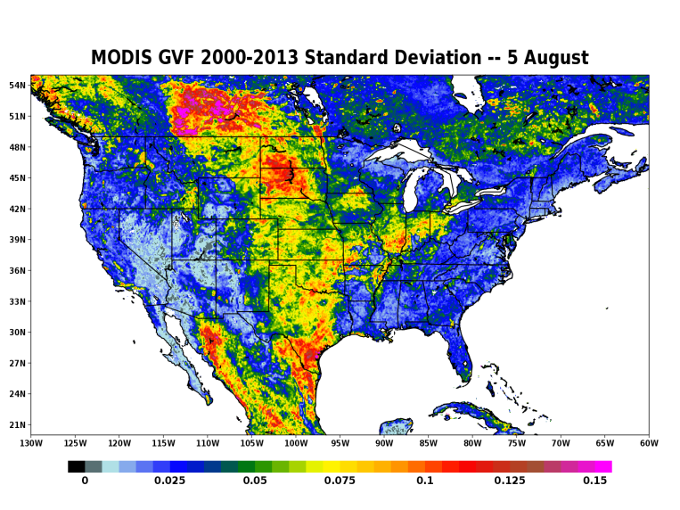
August GVF Standard Deviation (sampled from 2000-2014)

Slide 9
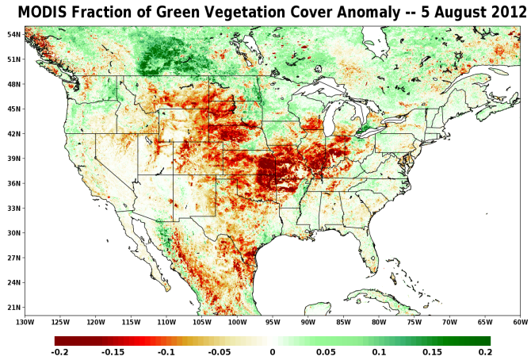

Slide 10
Issues with Direct LST Assimilation
Bias between observations of LST and model-predicted/diagnosed LST
Differences between LST retrieval algorithms
View angle considerations
LST is *not* a prognostic variable in Noah
Differences between quantity viewed from satellite platform and model predicted/diagnosed LST
Need for ancillary real-time vegetation datasets / unrepresentative heterogeneity in model compared to heterogeneity viewed from satellite platform
More complicated observation operators (w.r.t soil moisture) when compared to assimilation of soil moisture
Diurnal bias correction
Updates to model LST can lead to large dynamic changes in model (i.e. unrealistic flux responses in response to assimilated LST)
Assimilation of LST may not correct the reason for incorrect prognostic/diagnosed LST (i.e. small temporal footprint)
The lack of a system that directly assimilates LST is mitigated by the inclusion of the global ALEXI TIR product, where ALEXI acts as a “forward-operator” to project direct LST observations into a physical quantity which are not hampered by the issues with direct LST assimilation (e.g., SM-proxy, normalized ET)
Why Not Land Surface Temperature ?

Slide 11
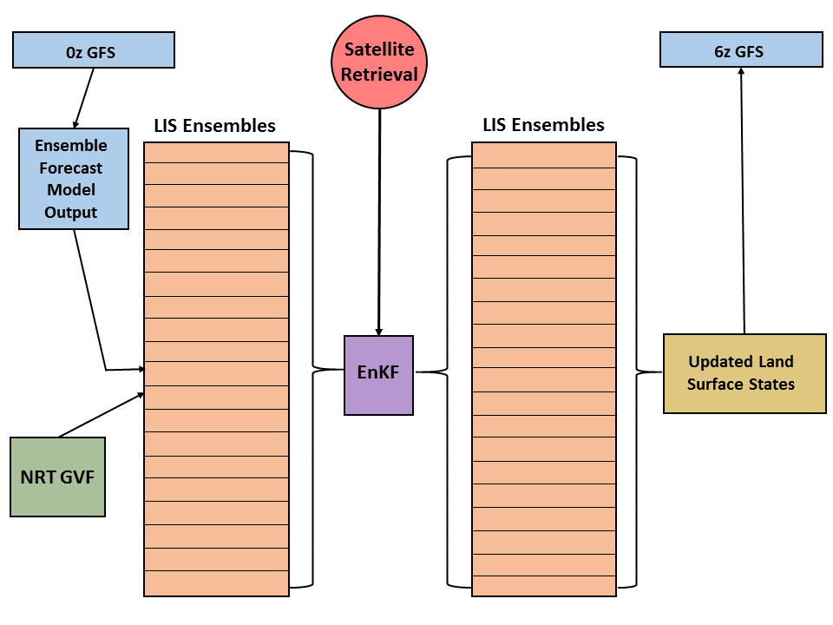
Semi-coupled GFS/LIS Assimilation System

Slide 12
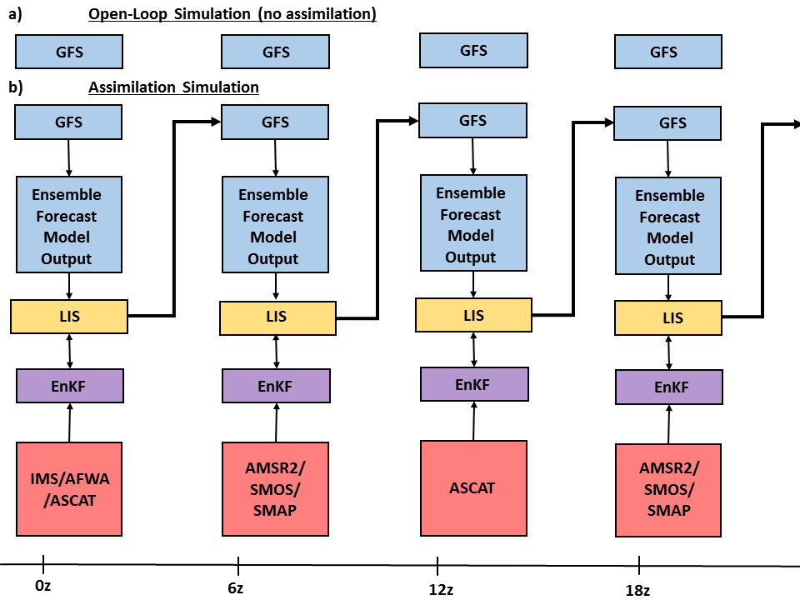
Semi-coupled GFS/LIS Assimilation System
ALEXI TIR SM

Slide 13
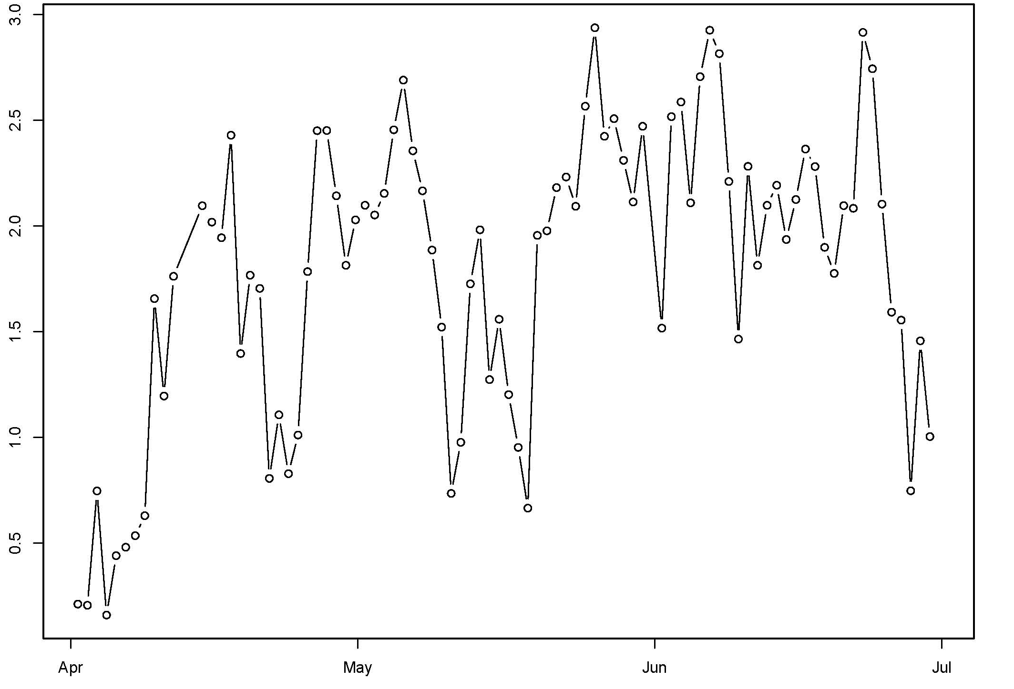
The implementation of near-realtime GVF from MODIS has been tested during the 2012 warm season (April-October) in the NUWRF framework which allows for a coupling of WRF and LIS.
The warm season of 2012 saw extreme dryness/drought over much of the central CONUS and large departures from climatological GVF.
In general, the use of NRT GVT lead to improvements in 2-meter temperature and moisture fields for most of the 2012 warm season.
The impact on QPF was neutral.
Early Regional Results (NUWRF / NAM)
F18 2-m T
RMSE Difference (CTL-NRT GVF)
Forecast Date

Slide 14
The synergy between TIR and MW observations is further being exploited by the development of LST observations from MW observations(Ka-band).
The integration of MW LST into a coupled TIR/MW ALEXI system will allow for retrieval of surface fluxes under cloud cover (where TIR-only retrievals are not possible).
This capability fills in a significant gap in a TIR-only system over tropical equatorial regions where clear-sky retrievals may only be possible 1 to 3 times per month, particularly during the wet season .
Question: Will this methodology improve use of MW products over dense vegetation, where retrievals of MW SM (using C/X/L-band) are adversely affected by vegetation attenuation?
Future Land Products Under Development

Slide 15
This study will develop/implement/evaluated a semi-coupled GFS/LIS system which will assimilate several MW and thermal-based SM products, ingest NRT GVG and supplement current applications of RS-based snow products.
The assimilated snow and SM products will have reduced sensitivity to errors in current initializations of SM and snow fields in the Noah LSM (used in GFS/LIS), leading to potential improvements in simulated surface and boundary-layer processes within the GFS.
The LIS and GFS simulations will also use near-real-time green vegetation cover (GVF) product from MODIS/VIIRS, replacing a climatology-based GVF field.
The NRT GVG product also holds potential for improving surface and boundary-layer processes due to actual GVF not being well represented by climatology.
Improvements in the specification of GVF have been shown by our research team to lead to improved forecasts of 2-meter temperature/moisture fields over North America (NAM domain).
This study will make use of multiple complementary remotely-sensed datasets (e.g. snow and soil moisture) and will be adaptable to future sensors (e.g. SMAP). All of which are not currently assimilated into NCEP operational models.
Summary

