Slide 1
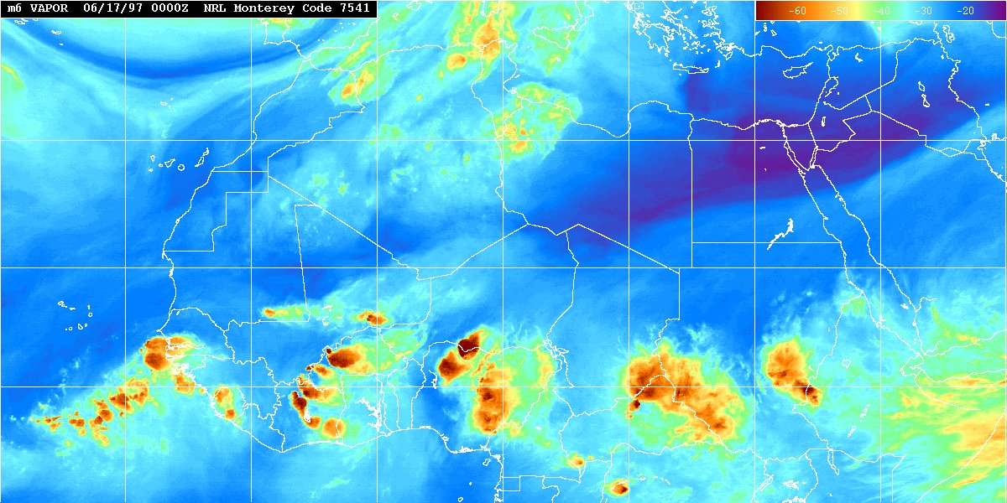
Exploitation of Ensemble Prediction System in support of Atlantic Tropical Cyclogenesis Prediction
Chris Thorncroft
Department of Atmospheric and Environmental Sciences,
University at Albany
Jason Dunion
University of Miami/RSMAS/CIMAS

Slide 2
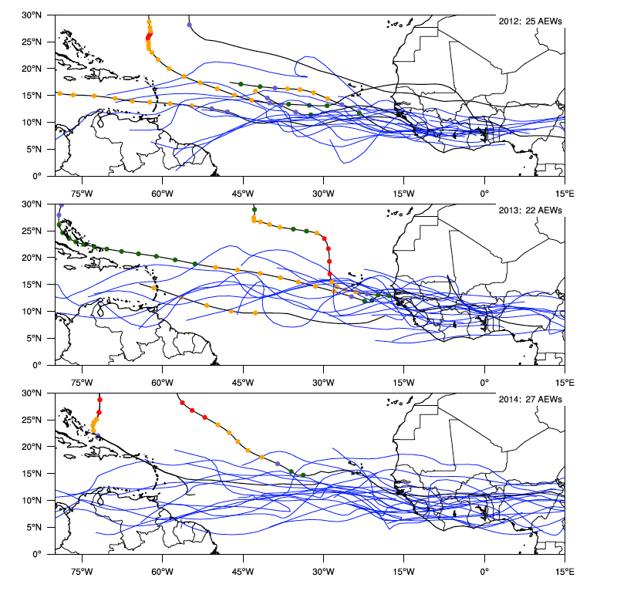
Introduction – Which AEW will develop?
2012 24 AEWs
2013 22 AEWs
2014 25 AEWs
AEW tracks based on CFSR vorticity analyses - JAS

Slide 3
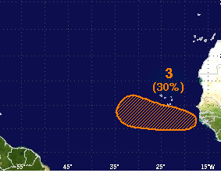
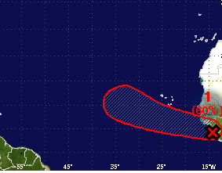
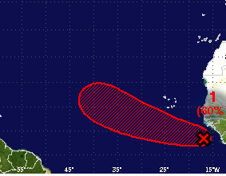
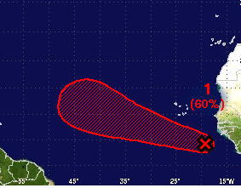
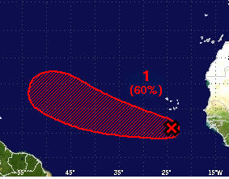
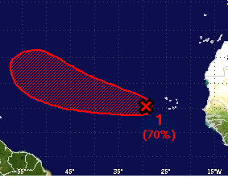
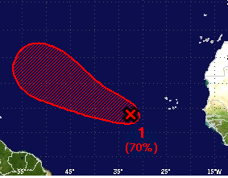
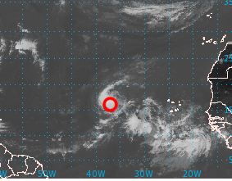
Edouard NHC forecasts
2014/09/06
2014/09/07
2014/09/07
2014/09/08
2014/09/08
2014/09/09
2014/09/10
2014/09/11

Slide 4
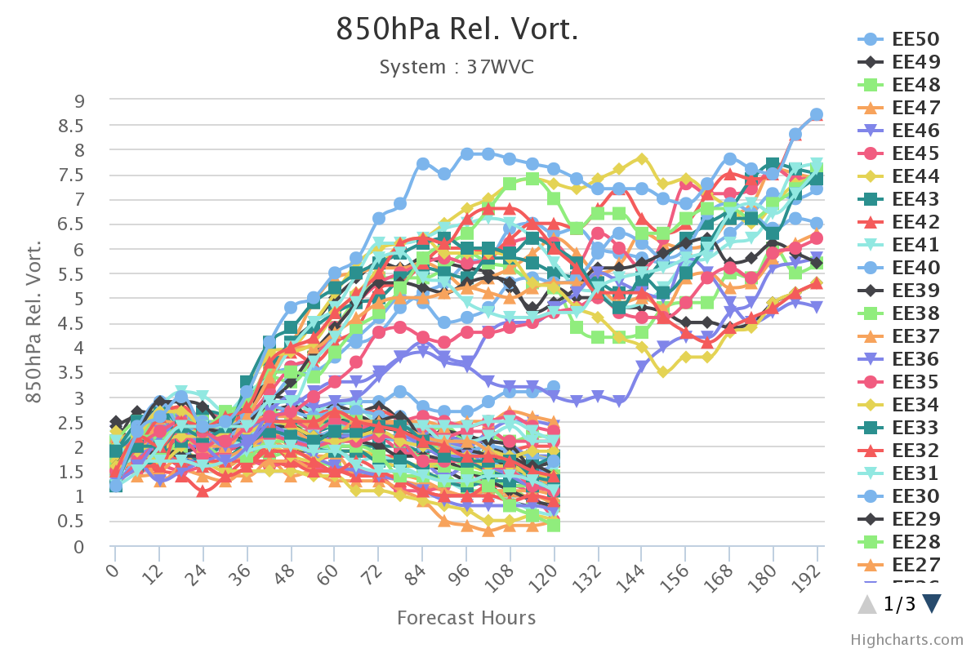
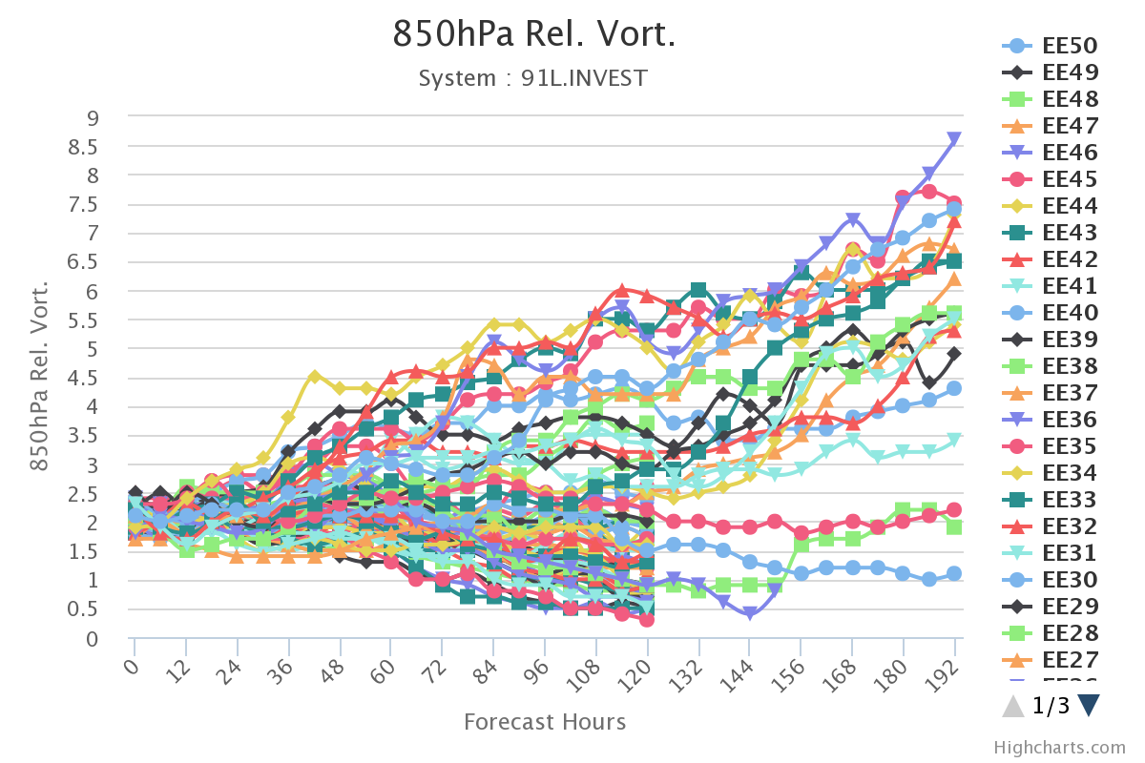
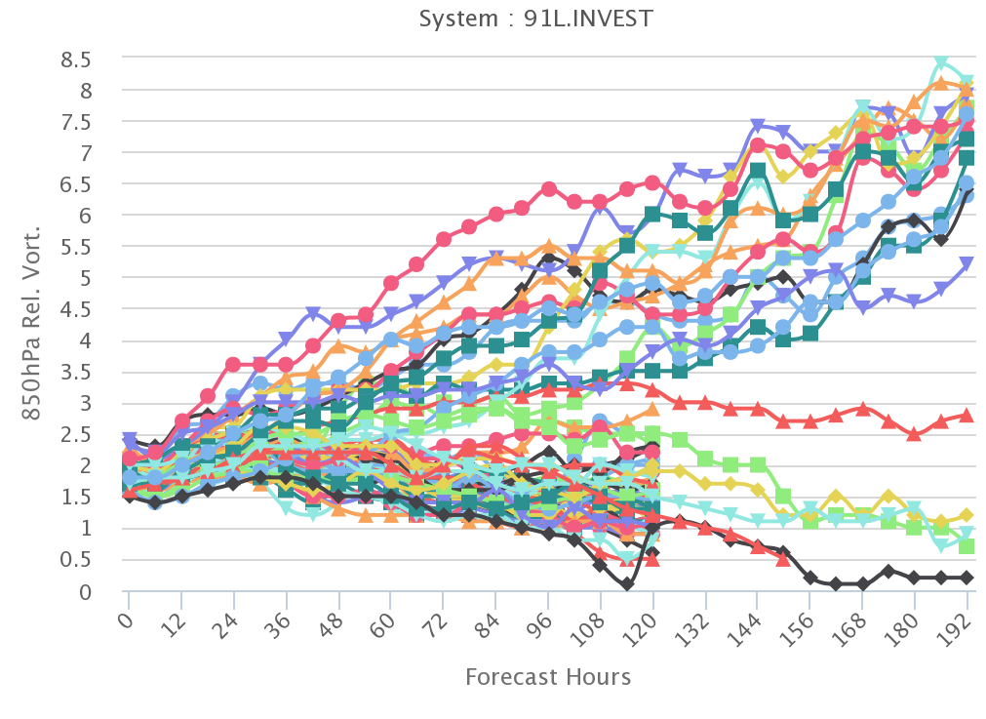
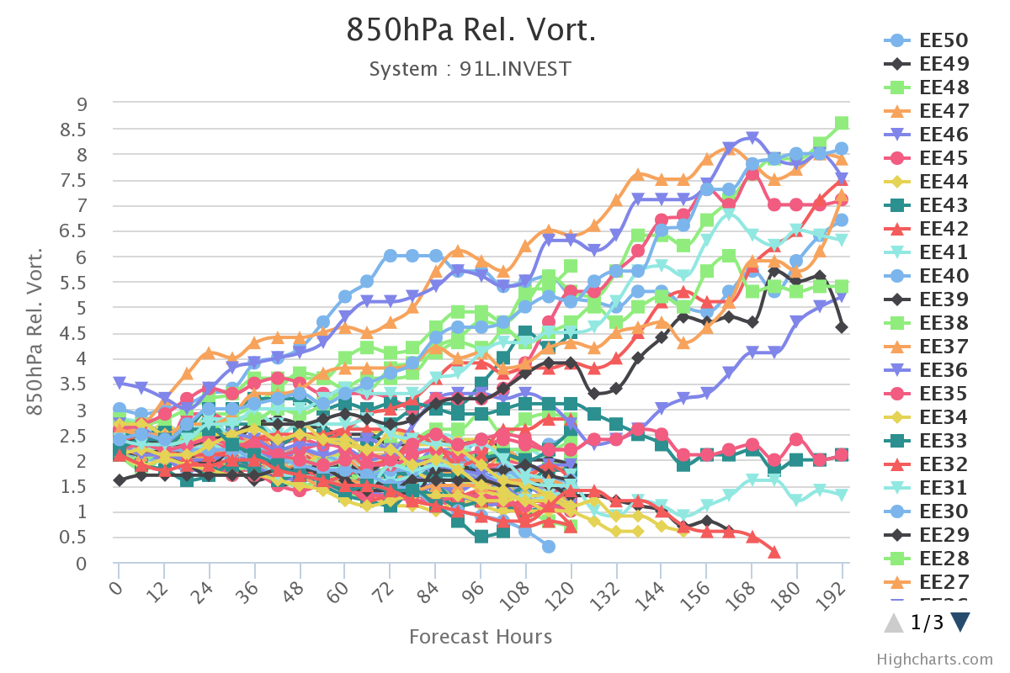
Eduoard Ensembles
Edouard forecast
2014/09/07
2014/09/08
GEFS
GEFS
ECMWF
ECMWF
2014/09/09
2014/09/10
GEFS
GEFS
ECMWF
ECMWF

Slide 5
Introduction
More guidance is needed for understanding forecasts and how they evolve.
This forecast requirement is reflected in the priority area of need identified by NHC, the Central Pacific Hurricane Center, and the Joint Typhoon Warning Center, NHC-5/JTWC-11: Techniques or products to support pre-genesis disturbance track, intensity, size, and wind speed probability forecasts.

Slide 6
Some recent research
(NSF and NASA-HS3)

Slide 7
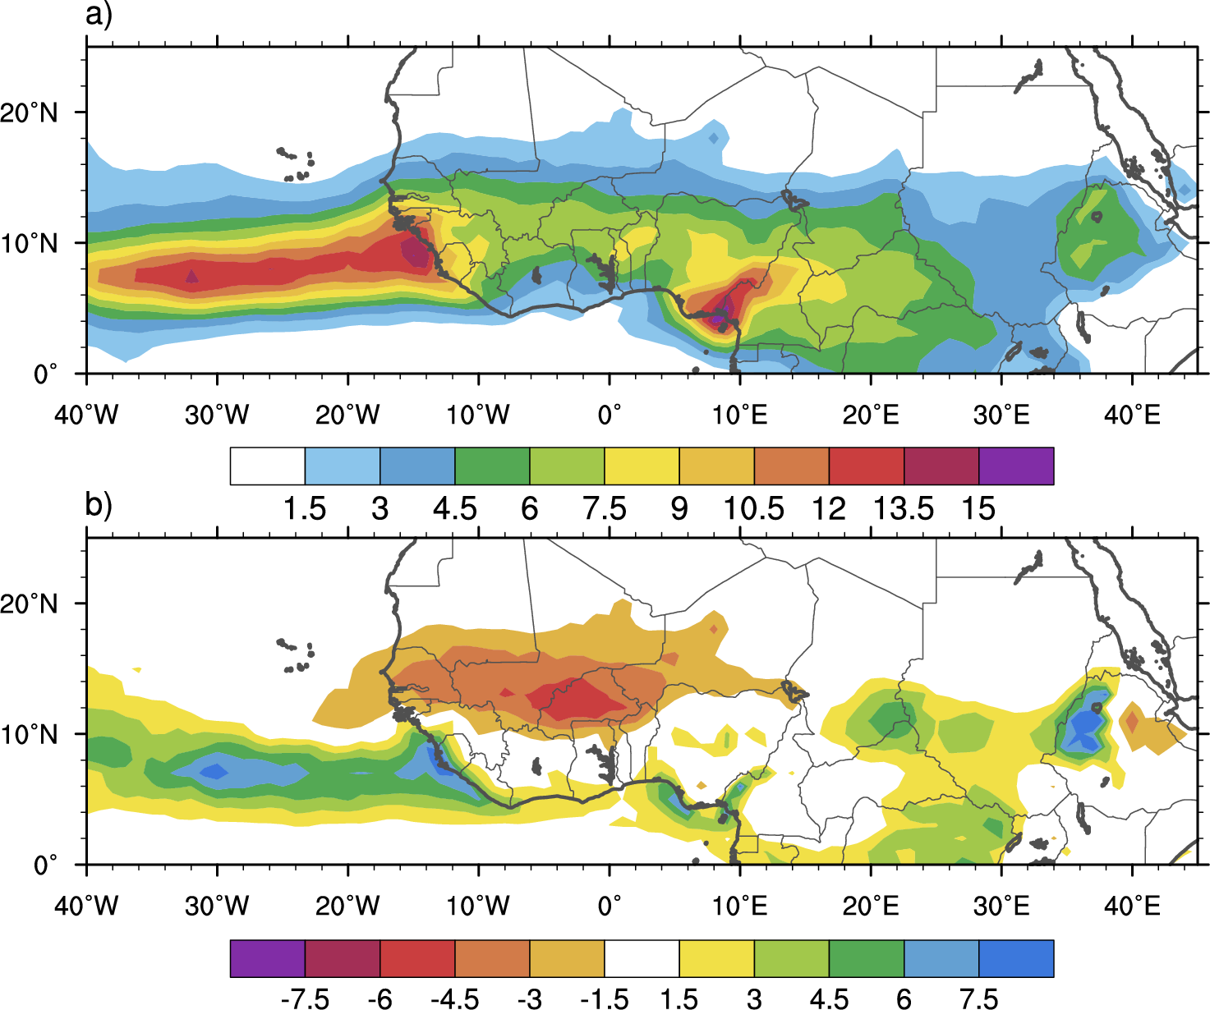
TRMM 3B42 Rainrate (mm day⁻¹, shaded)
[mm day⁻¹]
Do the AEW-characteristics at the West Coast significantly impact the probability of tropical cyclogenesis downstream?

Slide 8
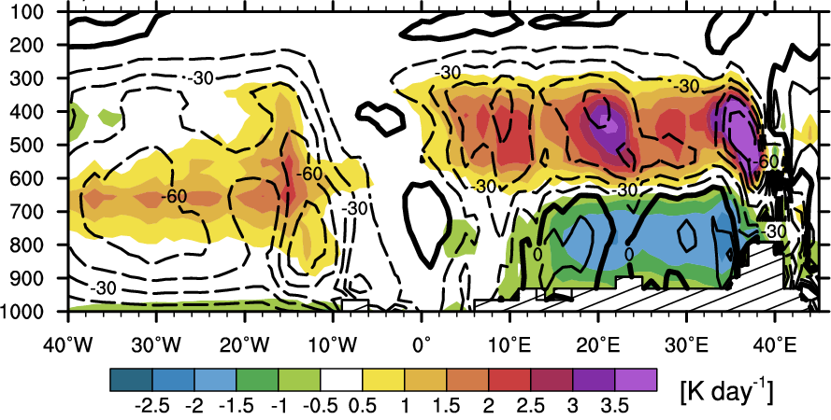
5-13°N JAS 98-09
CFSR explicit latent heating (K day⁻¹, shaded) and ω (hPa day⁻¹, contours)
Variability in low-level vorticity generation in the East Atlantic impacts the probability of tropical cyclogenesis.

Slide 9
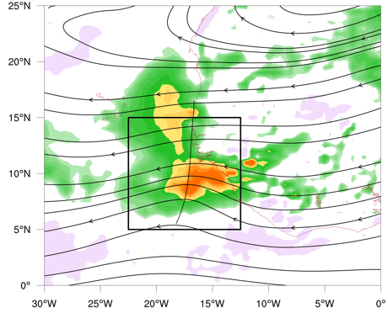
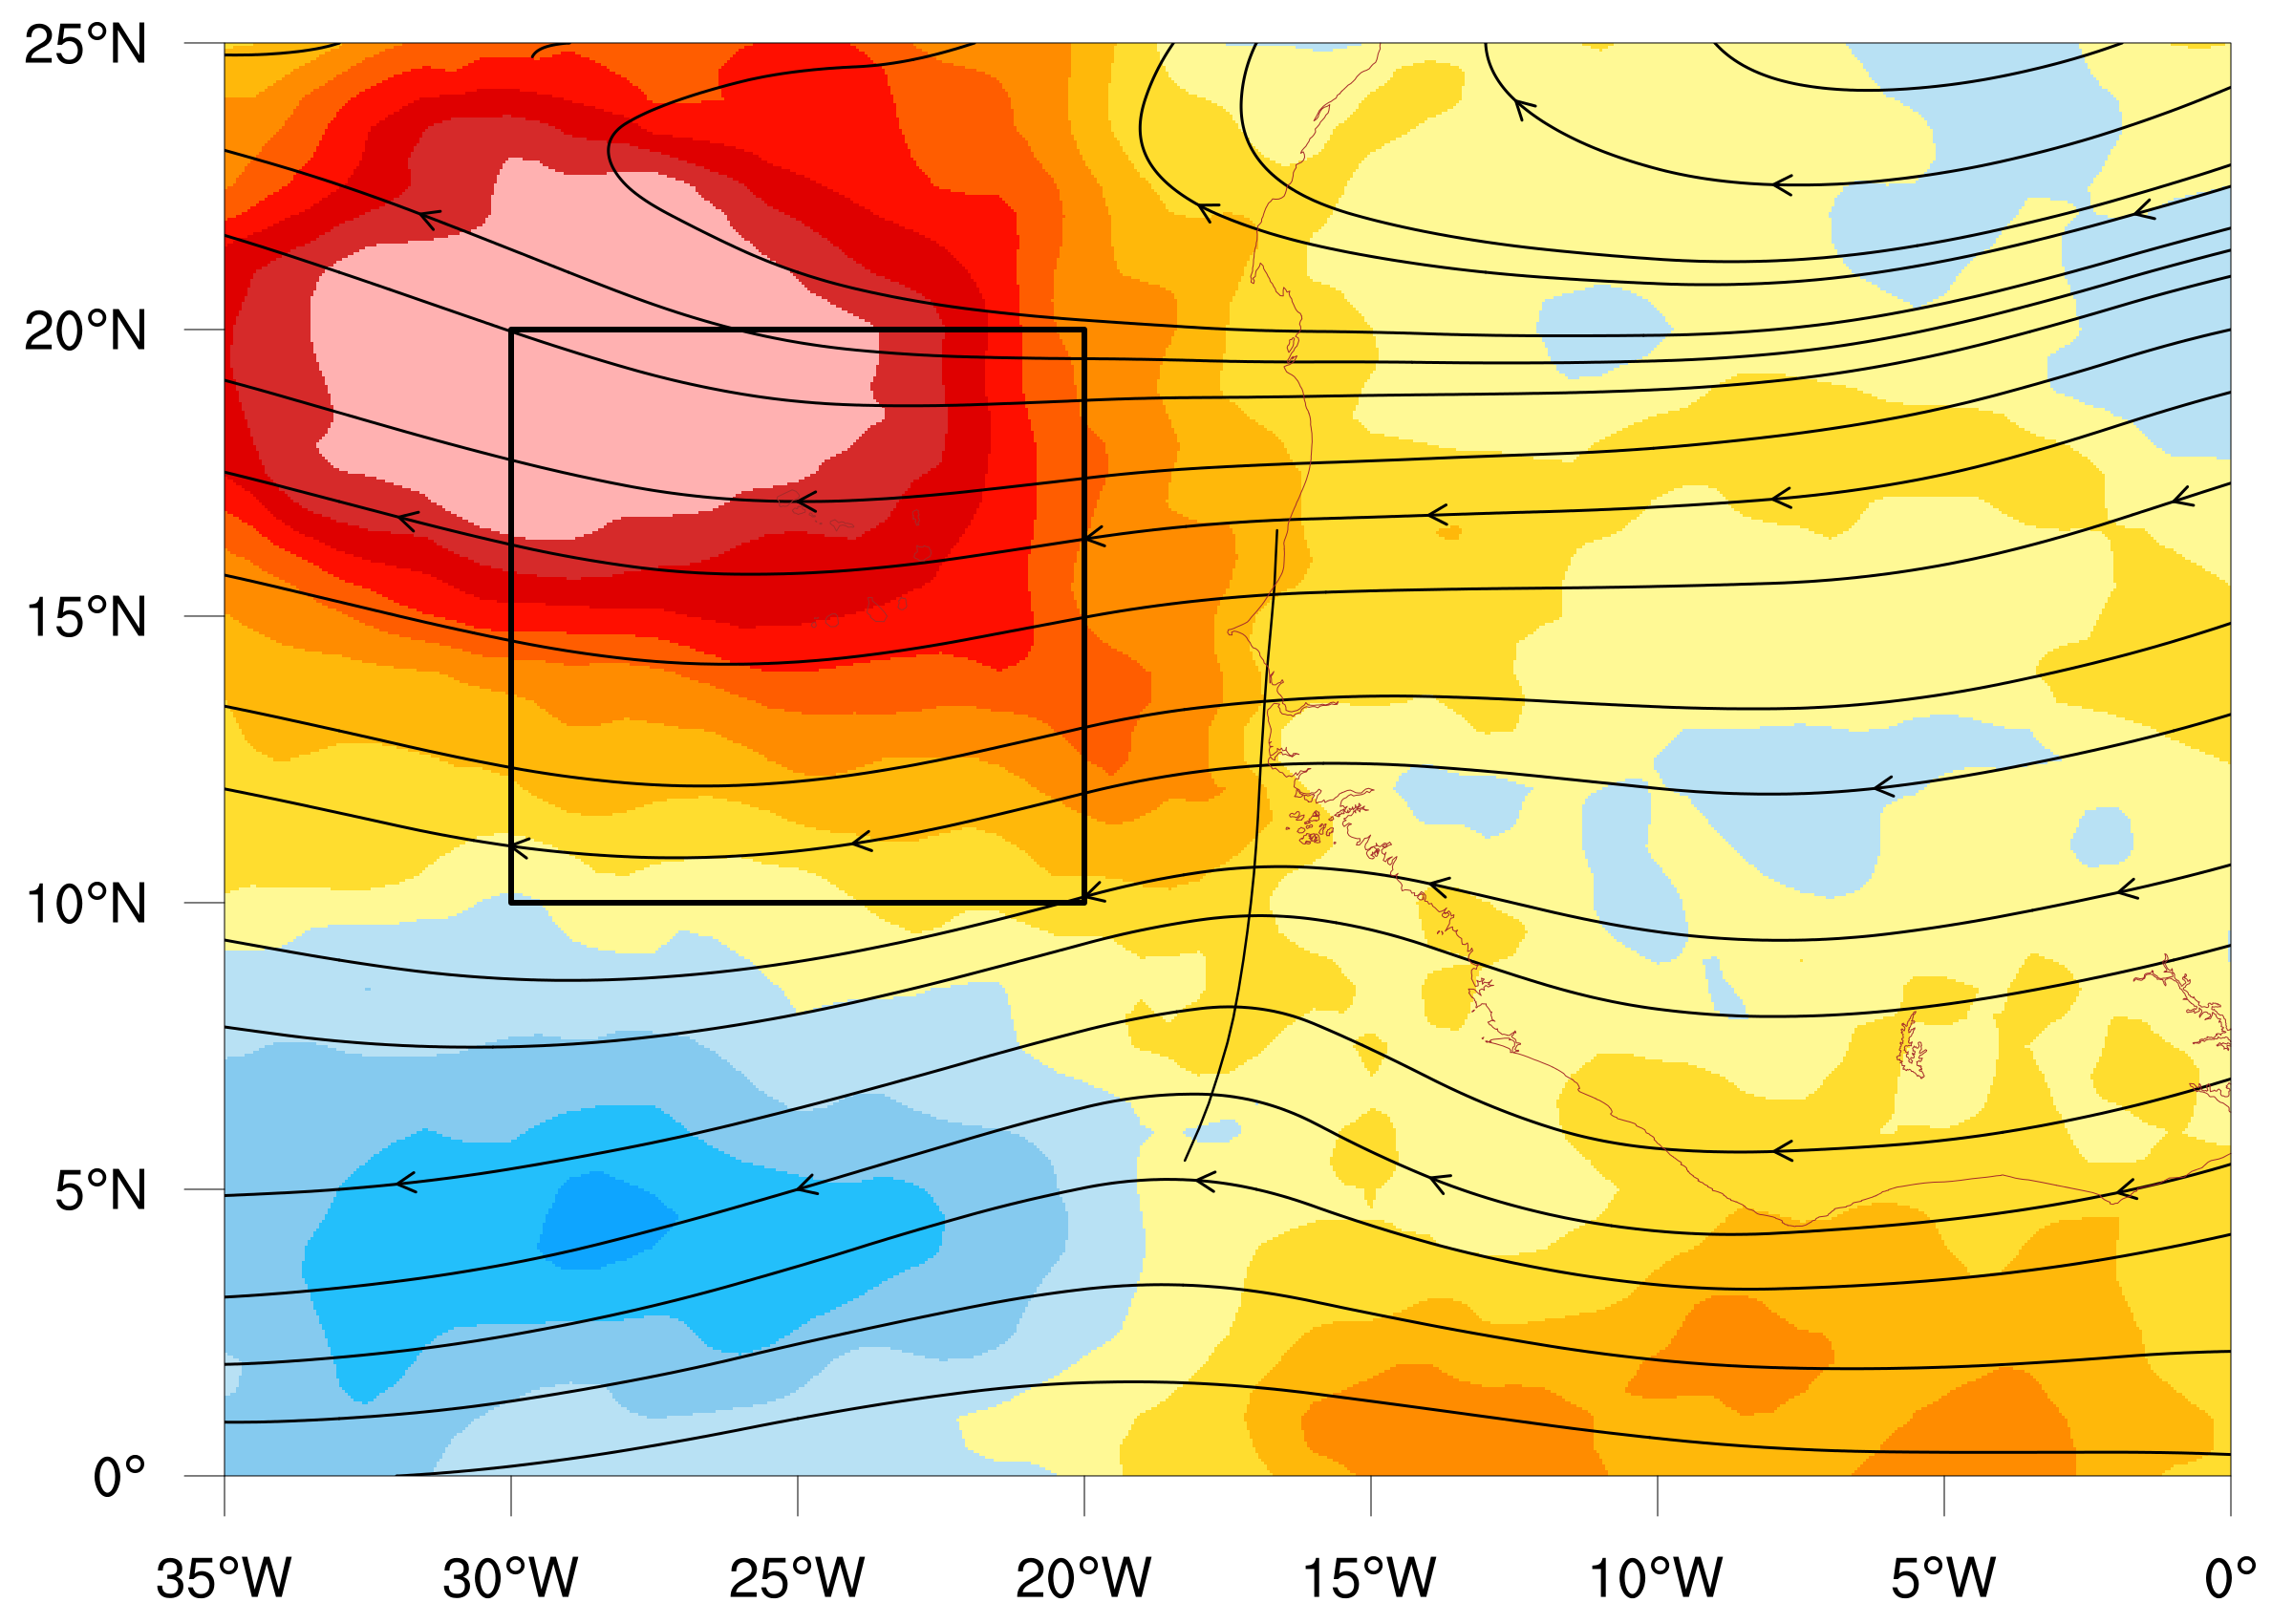
Characterising AEWS in CFSR – Brammer and Thorncroft 2015
Trough Scale
Environment
EA- Precipitable Water
RV: Relative Vorticity – 850mb
TA: Temp. anomaly - 400-200mb
VV: Vertical Velocity - 800-300mb

Slide 10
Curvature vorticity in CFSR – 2014 and ”traffic lights”!
Favorability index based on AEW characteristics
TA RV VV
EA
Non-developing AL90
Developing AL91
Pre-Edouard

Slide 11
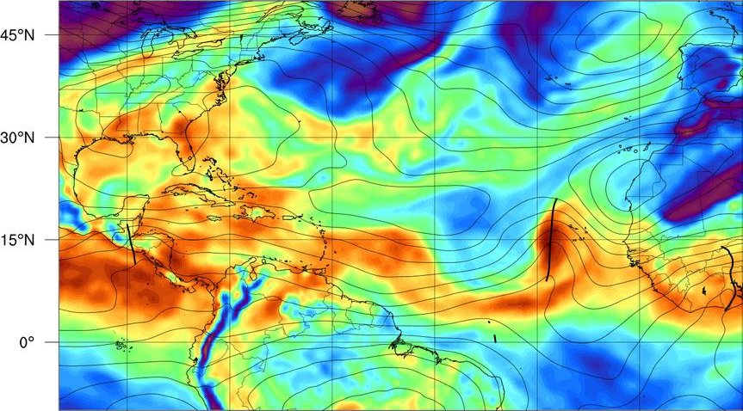
Non-Developing AL90
GFS TPW and 700hPa Streamfunction
Storm-relative streamlines 850hPa and 700hPa and humidity anomalies at 850hPa

Slide 12
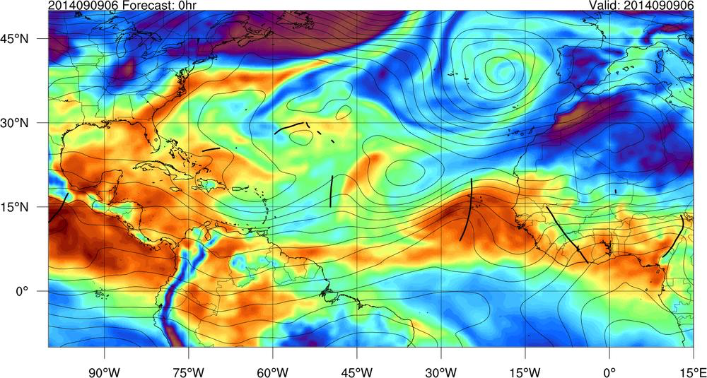
Developing AL91 (Pre-Edouard)
GFS TPW and 700hPa Streamfunction
Storm-relative streamlines 850hPa and 700hPa and humidity anomalies at 850hPa

Slide 13
Introduction
The overarching goals of this project are:
(i) To ensure that recent and current research concerned with the variability of AEW structures and downstream tropical cyclogenesis probability is transferred into operational decision-making at NHC.
(ii) To develop and evaluate tools that exploit key information in dynamical ensemble prediction systems in support of tropical cyclogenesis prediction.

Slide 14
1. Development of Dynamical Ensemble Prediction Tools for Tropical Cyclogenesis Guidance
In collaboration with NHC we will develop new tools to provide probabilistic guidance.
A key aspect of this work will be a robust automatic tracking methodology developed at UAlbany (Brammer and Thorncroft, 2015).
A number of key tasks will be carried out involving research and transfer to operations
Emphasis will be given to 5-day forecasts for AEWs leaving the West African coast.

Slide 15
1. Development of Dynamical Ensemble Prediction Tools for Tropical Cyclogenesis Guidance
Ensemble Prediction System Forecasts
GEFS Reforecast v2 (Hamill et al 2013) – 8-day forecasts (30 years)
ECMWF from TIGGE - (7 years)
(ii) Hurricane Best Track

Slide 16
1. Development of Dynamical Ensemble Prediction Tools for Tropical Cyclogenesis Guidance
Task 1: Development and Evaluation of Objective Tropical Cyclogenesis Probabilities associated with AEWs
AEWs will be tracked automatically in GEFS and ECMWF ensembles to provide a genesis probabilites.
Predicted genesis probabilities will be compared with observed outcomes. Skill scores will be provided as a function of region and lead-time to provide utility of the forecasts.

Slide 17
1. Development of Dynamical Ensemble Prediction Tools for Tropical Cyclogenesis Guidance
Task 2: Analysis of AEW-Tropical Cyclogenesis statistics in Ensemble Prediction Systems
Following Brammer and Thorncroft (2015) an objective analysis will be carried out to highlight the key factors that distinguish AEWs that are associated with forecasted tropical cyclogenesis in the GEFS and ECMWF EPSs and and those that are not. These factors will be explored as a function of lead-time and longitude.
This information will be useful guidance for forecasters interpreting variability in outcomes between the different EPSs.

Slide 18
1. Development of Dynamical Ensemble Prediction Tools for Tropical Cyclogenesis Guidance
Task 3: Analysis of the Causes of Good and Poor Skill in the Ensemble Prediction Systems
We will explore the reasons for the skill variations in the context of the sensitivities highlighted in task 2. This should facilitate the identification the causes of biases in the ensemble prediction system as they relate to tropical cyclogenesis associated with AEWs.
In support of this analysis we will also explore in more detail the reasons for particularly good and poor forecasts from the ensemble prediction systems.

Slide 19
1. Development of Dynamical Ensemble Prediction Tools for Tropical Cyclogenesis Guidance
Task 4: Development of Tools for Guiding Operational Tropical Cyclogenesis Prediction Probabilities
The results obtained from tasks 1-3 will be exploited through the development of operational forecasting tools. Utilizing the pre-invest tracks and forecast cyclone tracks from the official cyclone tracker, a suite of ensemble based products can be provided.

Slide 20
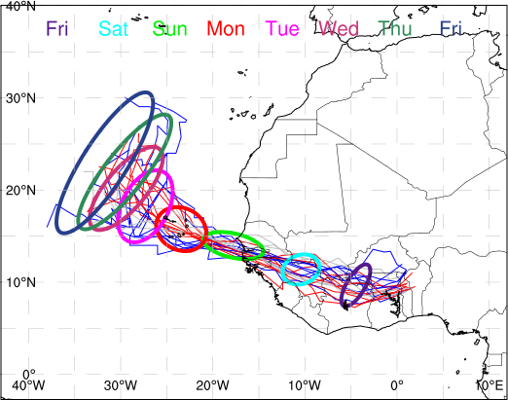
1. Development of Dynamical Ensemble Prediction Tools for Tropical Cyclogenesis Guidance
Tools would include: (i) threshold probability maps for individual storms – see Figs below; (based on the work outlined in Task 1 these could be bias corrected to provide more confidence in the total probability)
GEFS ensemble tracks with 90% confidence ellipses every 24 hours. Blue tracks represent the strongest 25% and red the weakest 25%. Spread in track at this time is small out to 4 days.

Slide 21
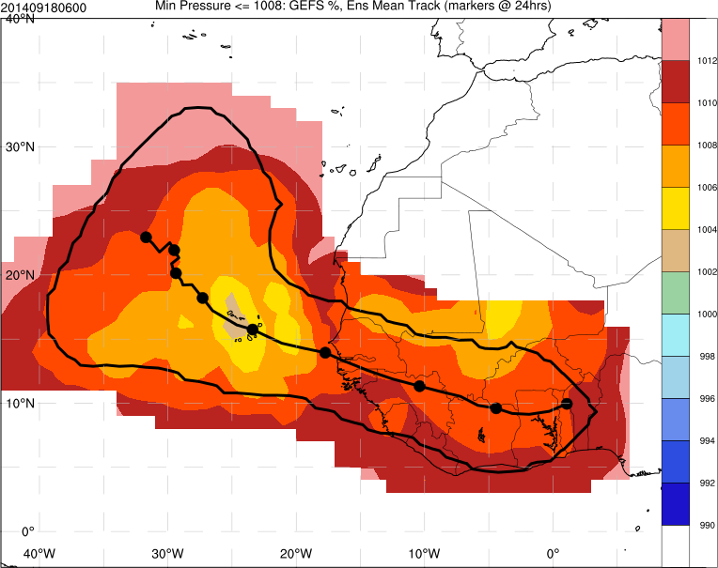
1. Development of Dynamical Ensemble Prediction Tools for Tropical Cyclogenesis Guidance
Tools would include: (i) threshold probability maps for individual storms – see Figs below; (based on the work outlined in Task 1 these could be bias corrected to provide more confidence in the total probability)
Minimum pressure across ensemble tracks. Black contour represent track confidence with the ensemble mean track plotted with 24 hour markers. This figure could be applied to various metrics and will highlight the variability of characteristics of the systems across ensemble members.

Slide 22
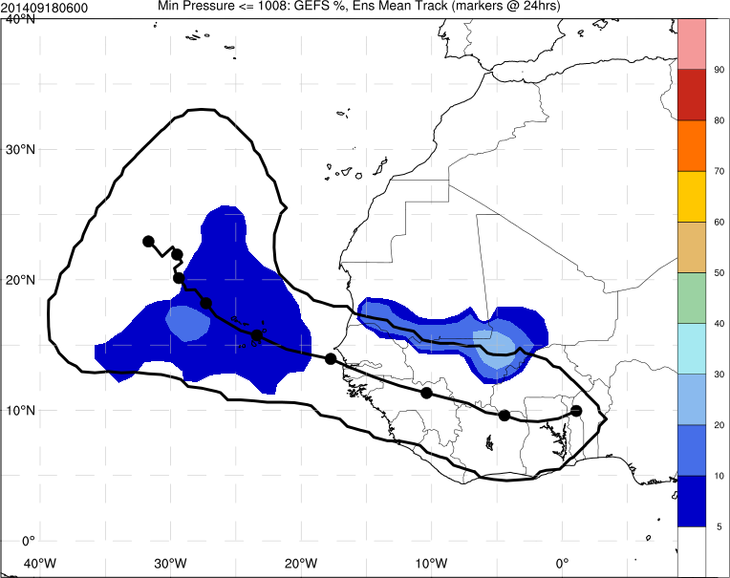
1. Development of Dynamical Ensemble Prediction Tools for Tropical Cyclogenesis Guidance
Tools would include: (i) threshold probability maps for individual storms – see Figs below; (based on the work outlined in Task 1 these could be bias corrected to provide more confidence in the total probability)
Shading represents the probability of threshold criteria being attained across ensemble members. Shown here is the probability of ensemble storms having a minimum pressure less than 1008hPa.

Slide 23
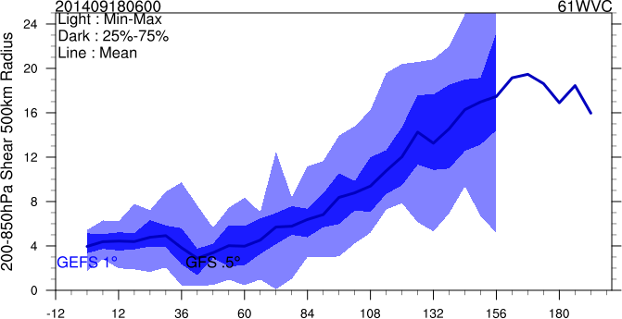
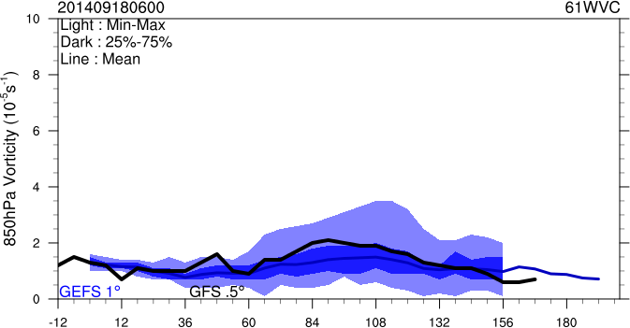
1. Development of Dynamical Ensemble Prediction Tools for Tropical Cyclogenesis Guidance
Tools would also include: (ii) distribution time-series of variables highlighting the forecast range of outcomes across ensemble members (see below) and (iii) Predicted skill of tropical cyclogenesis forecasts. These products would all be produced automatically in real-time and allow the forecaster to quickly learn about the structure and probability of tropical cyclogenesis based on the ensemble prediction systems.
Vertical shear 850mb vorticity

Slide 24
1. Development of Dynamical Ensemble Prediction Tools for Tropical Cyclogenesis Guidance
Task 5: Establishing a Website in Support of Operational Forecasting
A website will be created that includes all the agreed products developed in Task 4. This will be created and tested at UAlbany but will be transferred to NCEP

Slide 25
2. Statistical Tropical Cyclogenesis Prediction Model using Ensemble Information
This part of the project will combine the methodology and knowledge from the previous section to evaluate an extension to the Tropical Cyclone Genesis Index product developed by Dunion et al. in a continuing Joint Hurricane Testbed Project.

Slide 26
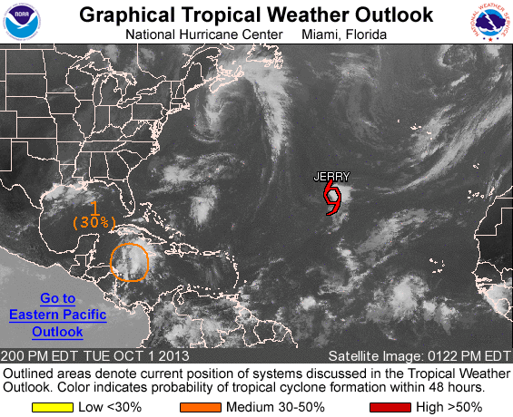
TC Genesis Index (TCGI)
Real-time, objective, disturbance-centric scheme for identifying the probability of TC genesis in the North Atlantic
Forecasts the probability of 0-48 hr & 0-120 hr TC genesis
Runs on North Atlantic invests identified by NOAA NHC
Run times: 00/06/12/18 UTC
NOAA NHC’s Tropical Weather Outlook (TWO)
Notes:
Key point: this is an objective, disturbance-centric scheme to aid forecasters in their forecasts of TC genesis
We were just funded to expand TCGI into the EPAC

Slide 27
2. Statistical Tropical Cyclogenesis Prediction Model using Ensemble Information
Task 6: Evaluate the TCGI on the 2014 and 2015 seasons to determine the best utilization of the ensemble information.

Slide 28
2. Statistical Tropical Cyclogenesis Prediction Model using Ensemble Information
Task 6: Evaluate the TCGI on the 2014 and 2015 seasons to determine the best utilization of the ensemble information.
Task 7: Evaluate the skill of TCGI on storm tracks prior to invest definition, allowing for TCGI probabilities to be verified for up to 5 days where invest locations were not defined.

Slide 29
2. Statistical Tropical Cyclogenesis Prediction Model using Ensemble Information
Task 6: Evaluate the TCGI on the 2014 and 2015 seasons to determine the best utilization of the ensemble information.
Task 7: Evaluate the skill of TCGI on storm tracks prior to invest definition, allowing for TCGI probabilities to be verified for up to 5 days where invest locations were not defined.
Task 8: Development of a beta ensemble based TCGI product to be run in real-time both on pre-invests and invests. If successful this will likely motivate the submission of a JHT proposal to extend the TCGI product.

Slide 30
3. Collaborations and Timeline

Slide 31
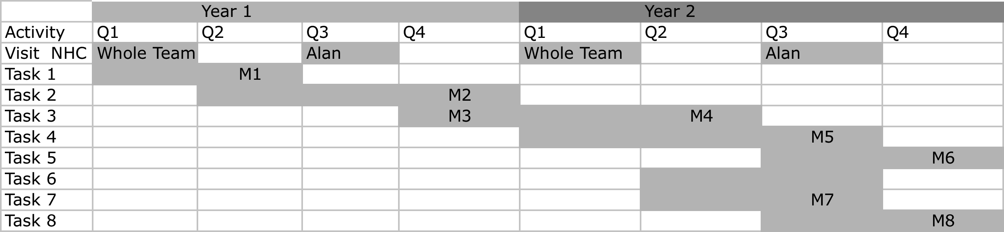
3. Collaborations and Timeline

Slide 32
Final Comments
While emphasis is given to 0-5 day outlooks (due to operational needs) we will also explore 5-10 day forecasts.
We believe that this work has two important broader impacts for the R2O initiative: (1) Key diagnostics will be created that will allow objective evaluation of the fidelity of dynamical models and (2) The identified model sensitivities can guide research on the creation of ensemble members.

