Slide 1
Application of a Hybrid Dynamical-Statistical Model for Week 3 and 4 Forecast of Atlantic/Pacific
Tropical Storm and Hurricane Activity
Jae-Kyung E. Schemm and Hui Wang
Climate Prediction Center, NCEP/NWS/NOAA
NGGPS External PI Meeting
July 17, 2015
NCWCP, College Park, MD

Slide 2
Tropical Storm Activity Prediction at CPC
NOAA Hurricane Season Outlooks for ATL/ENP basins issued since 1998
- CFS-based hybrid dynamical-statistical prediction system developed
in 2008
- Dynamic prediction system with the T382 CFS introduced in 2009;
one of early CTB projects
- The dynamic system upgraded to the T382 CFSv2 in 2014
Experimental Intra-seasonal TS activity prediction introduced in 2015
to support CPC Global Tropics Hazards Outlooks; development partly
funded by CPO/MAPP program
- Week 1 – 4 TS activity prediction based on the CFSv2 45-day forecast
- Model TS statistics and false alarm climatology constructed with
the 1999-2012 CFSv2 45-day hindcast

Slide 3

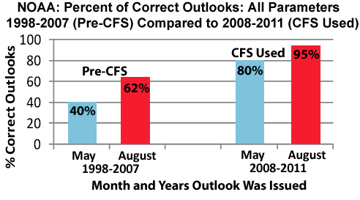
Atlantic Outlook Verification: All Parameters
The use of dynamical models since 2008, especially the CFS, has contributed to a large improvement in outlook accuracy.

Slide 4
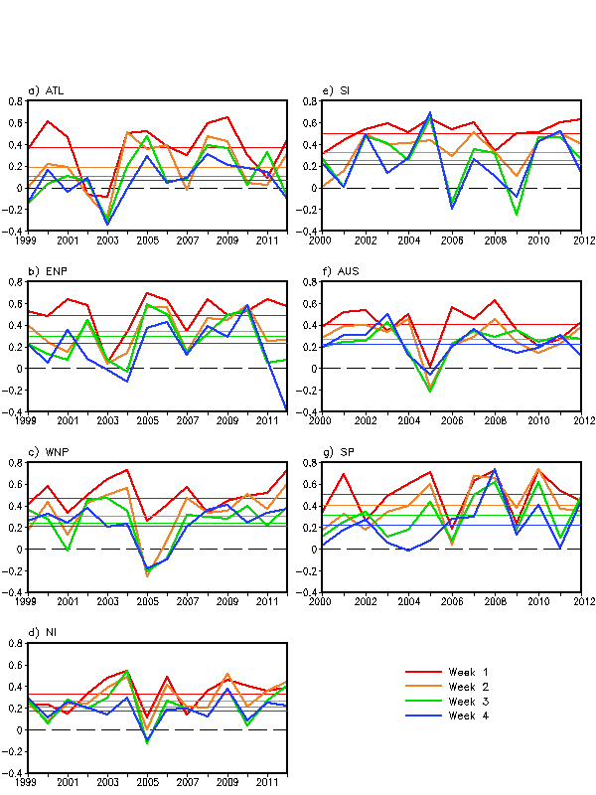
Hindcast Results
Storm Count Anomaly Correlations for
Week 1 - 4
ENP, WNP, SI and SP show highest week 1 values (0.48-0.51)
ATL brought down by two bad years (2002 and 2003)
2005 also seems to be a difficult year in many basins (but surprisingly not ATL)
Currently looking into wind shear forecasts to account for dips in skill
Horizontal lines represent average correlation

Slide 5
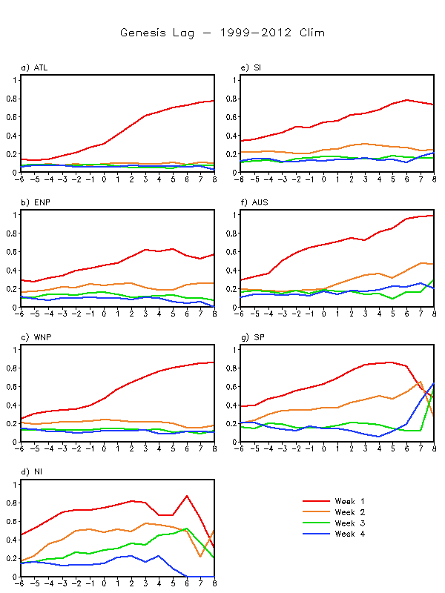
Climatological storm track genesis skill as function of lag time in days with the CFSv2 hindcast runs for 1999-2012
Lag days -6 to -1 (left of day 0) show the model’s ability to predict both storm genesis and track
Lag days 0 to 8 (right of black line) show the model’s ability to predict the storm track. At 0, storm is present in initial conditions.

Slide 6
Project Objective
1. Develop a hybrid dynamical-statistical model for weeks 3
and 4 TS and hurricane activity forecast with the CFSv2
45-day hindcast data for 1999-2012.
A hybrid prediction system has been in operation since 2009
at CPC for the NOAA Hurricane Season Outlooks.
2. Test the hybrid model for real-time prediction for the 2016
hurricane season.
Implement the model into operations at CPC in 2017.
Contribute towards CPC’s effort for developing Week 3
and 4 forecast products.

Slide 7
Hybrid Dynamical-Statistical Prediction System
A Multiple regression relationship established between weekly tropical storm activity over the Atlantic/Pacific basins and predicted circulation variables.
Predictors:
Weekly wind shear (U200-U850), SST, mean sea level pressure,
500hPa height and relative humidity, and two MJO indices
Predictands:
Weekly total number of named storms and hurricanes
CFSv2 Hindcast data:
Period; 1999-2012
IC Months; April through November
Hindcast evaluations will be performed in a cross-validation mode
Ref: Wang, H., J. E. Schemm, A. Kumar, W. Wang, L. Long, M. Chelliah, G. D. Bell,
and P. Peng, 2009: A Statistical Forecast Model for Atlantic Seasonal
Hurricane Activity Based on the NCEP Dynamical Seasonal Forecast.,
J. Climate, 22, 4481–4500.

Slide 8
Project Work Plan
Year 1
1. Establish a multiple regression relationship among TS
activity, SST and atmospheric circulation variable indices.
2. Develop the hybrid forecast model for weeks 3 and 4 TS
activity prediction based on the CFSv2 45-day hindcast for
1999-2012, including the cross-validated evaluations.
Year 2
1. Real-time forecast test during the 2016 hurricane season
2. Operational implementation at CPC for the 2017 season

Slide 9
Some Results from Preliminary Analyses

Slide 10
List of Utilized Data
CFSR for 1999 – 2014
NOAA OISST v2 for 1999 – 2014
Best Track TC data from NHC and JTWC
CFSv2 45-day hindcast data for 1999 – 2012

Slide 11
Observational Analysis
Correlation between weekly TC activity and corresponding weekly SST/atmospheric circulation fields
Weekly mean data: 7-day average from Sunday to Saturday
Total 34 weeks from May to December
Weekly SST: NOAA OISST v2
Atmospheric fields (CFSR): vertical wind shear U200–U850, 500-mb height and relative humidity, sea level pressure
Weekly TC activity: sum of the days of each TC over the 7-day period
Relationship between Weekly TC activity and the MJO phase
A similar correlation analysis will be performed using the observed weekly TC activity and the SST/circulation from the CFSv2 45-day hindcasts. The regions of high correlations will be used to make up for area-averaged indices as potential predictors.

Slide 12
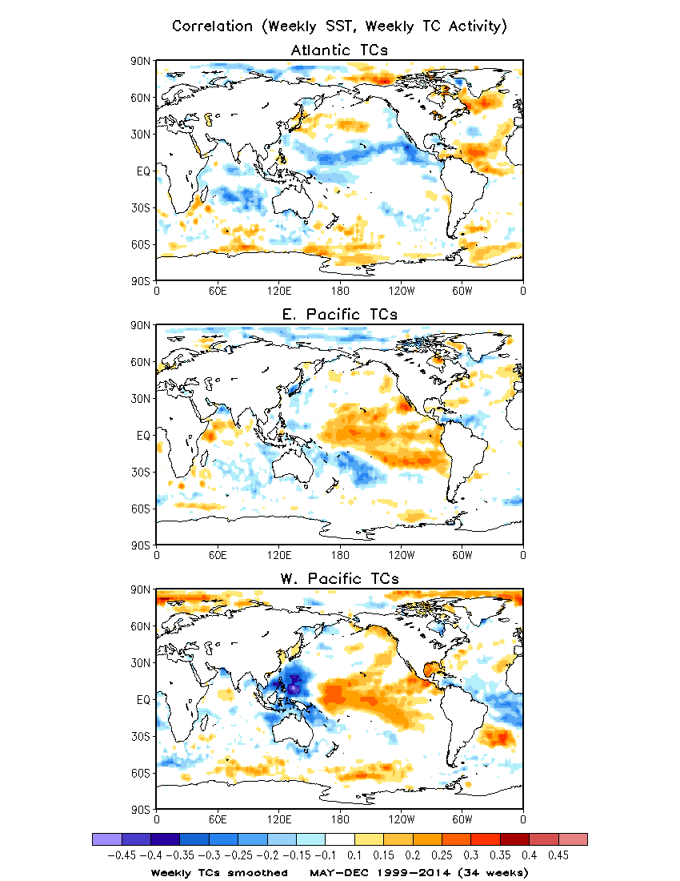
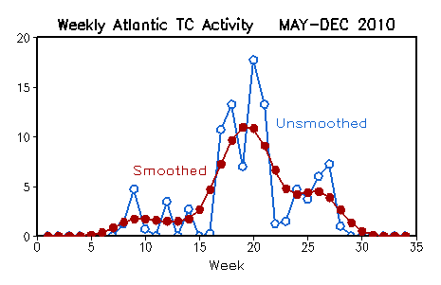
Correlation between
Weekly SST and Weekly TC Activity
Weekly TC activity smoothed
Example of Atlantic weekly TC activity
Smoothed vs. Unsmoothed
Color shadings (correlation > 0.1):
Above the 95% significance level
/cpc/namecpt/hui/2015_R2O/SST

Slide 13
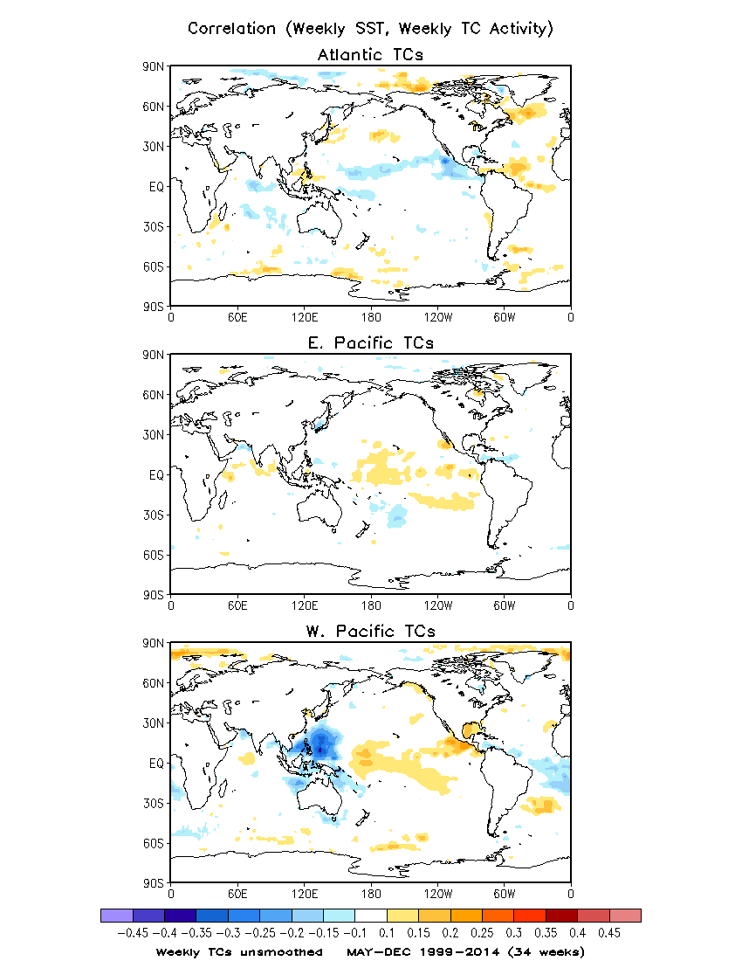
Correlation between
Weekly SST and Weekly TC Activity
Weekly TC activity unsmoothed
Example of Atlantic weekly TC activity
Smoothed vs. Unsmoothed
The correlations of SST with the unsmoothed TC activity are weaker.

Slide 14
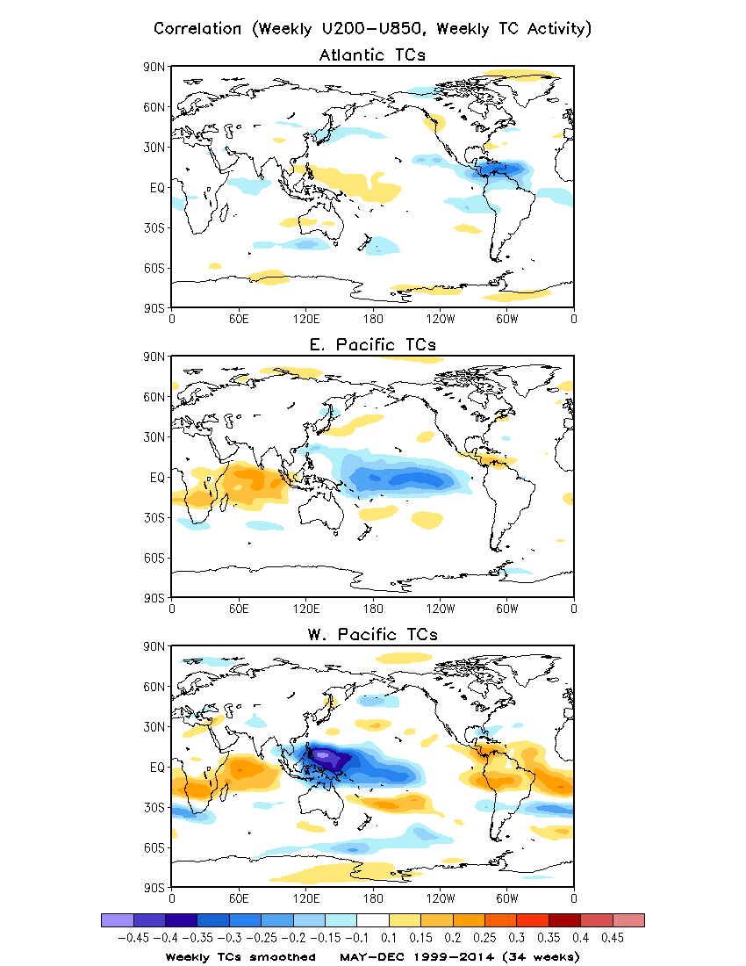
Correlation between
Weekly Wind Shear and Weekly TC Activity
Weekly TC activity smoothed
Vertical wind shear = U200 – U850

Slide 15
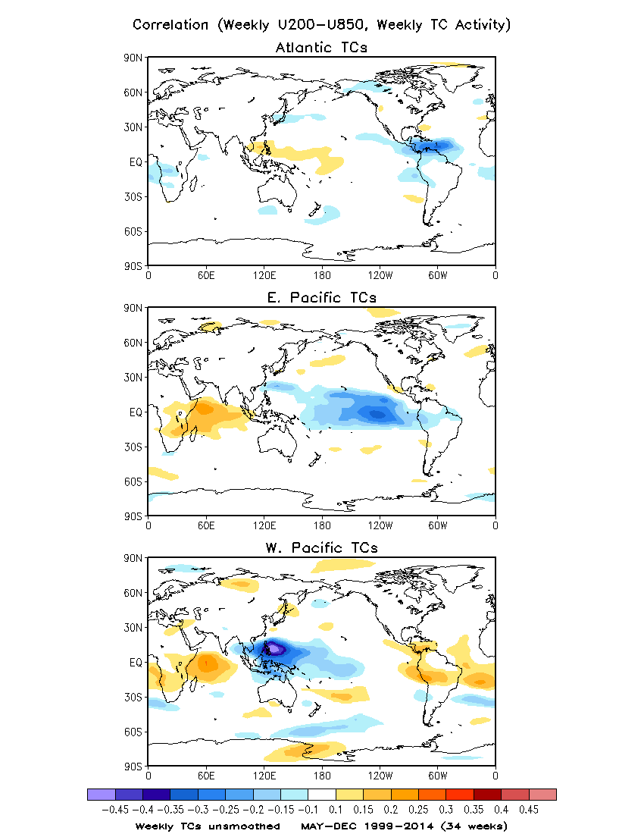
Correlation between
Weekly Wind Shear and Weekly
TC Activity
Weekly TC activity unsmoothed
Unlike SST field, vertical wind shear is also highly correlated with the unsmoothed TC activity .

Slide 16
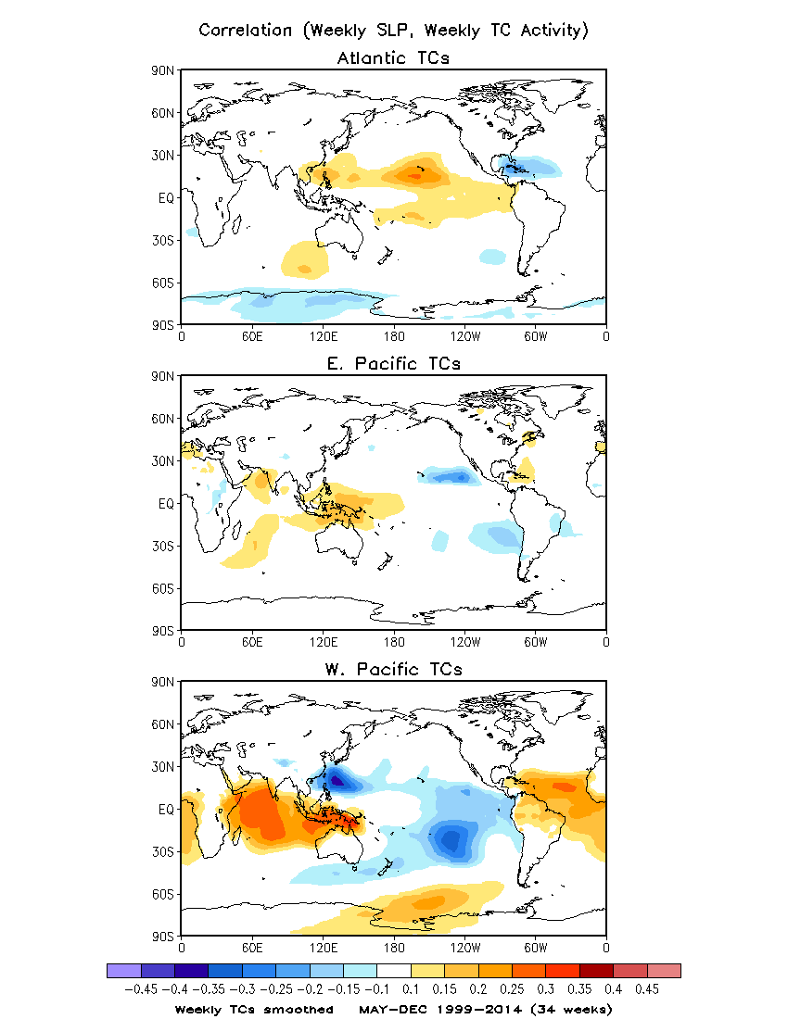
Correlation between
Weekly Sea Level Pressure and Weekly TC Activity
Weekly TC activity smoothed
The weekly TC activity is negatively correlated with local SLP.

Slide 17
Effect of MJO on Weekly TS Activity
Daily MJO index
Weekly MJO index (7-day average of daily MJO index)
Composite of weekly TCs based on 8 MJO phases

Slide 18
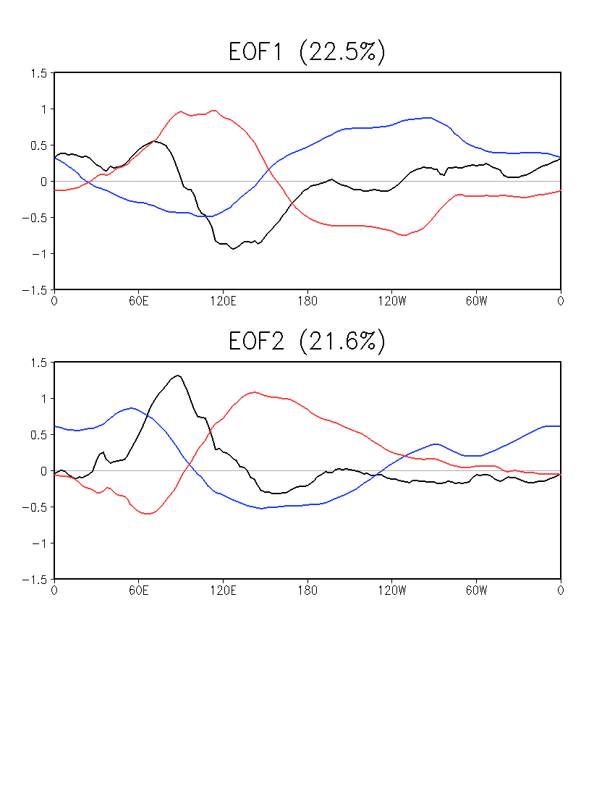
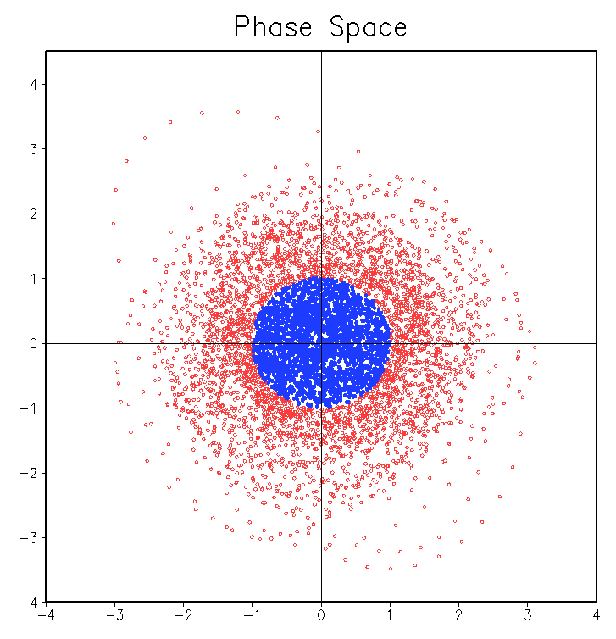
MJO (Wheeler and Hendon 2004)
Combined EOFs of u850, u200, and OLR
Averaged over 15ºS–15ºN
Daily data, 01 Jan 1999–31 Dec 2014
NOAA Interpolated OLR, 1999–2013
CFSR OLR for 2014
CFSR u850 and u200, 1999–2014
Anomaly w.r.t daily climatology
20–100-day band-pass filter prior to EOF
Weak MJO
OLR U850 U200
PC2
Daily MJO Index
Normalized PC1 and PC2
Weak MJO: (PC1² + PC2²) ^{1/2} < 1
PC1

Slide 19
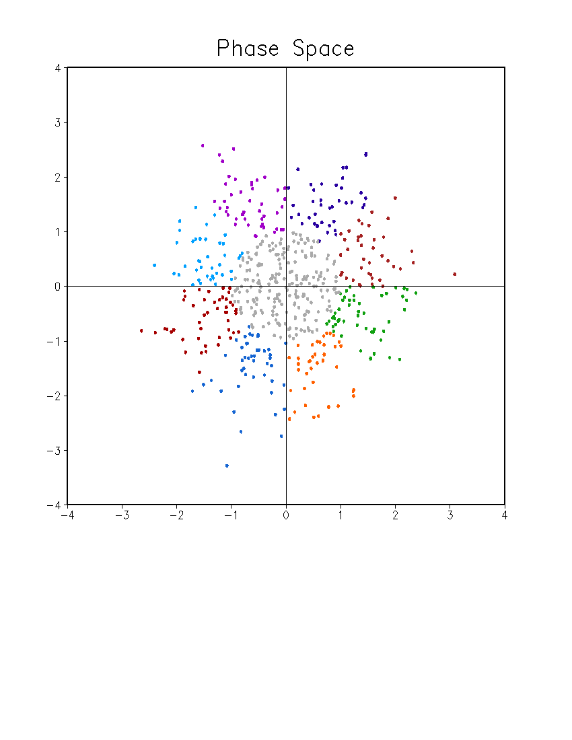
MJO Phases: 8
7-day mean index
Normalized
May – December
35 weeks (1 May – 31 December)
Phase 7
Phase 6
Phase 8
Phase 5
PC2
Weak MJO
Phase 1
Phase 4
Phase 2
Phase 3
PC1

Slide 20
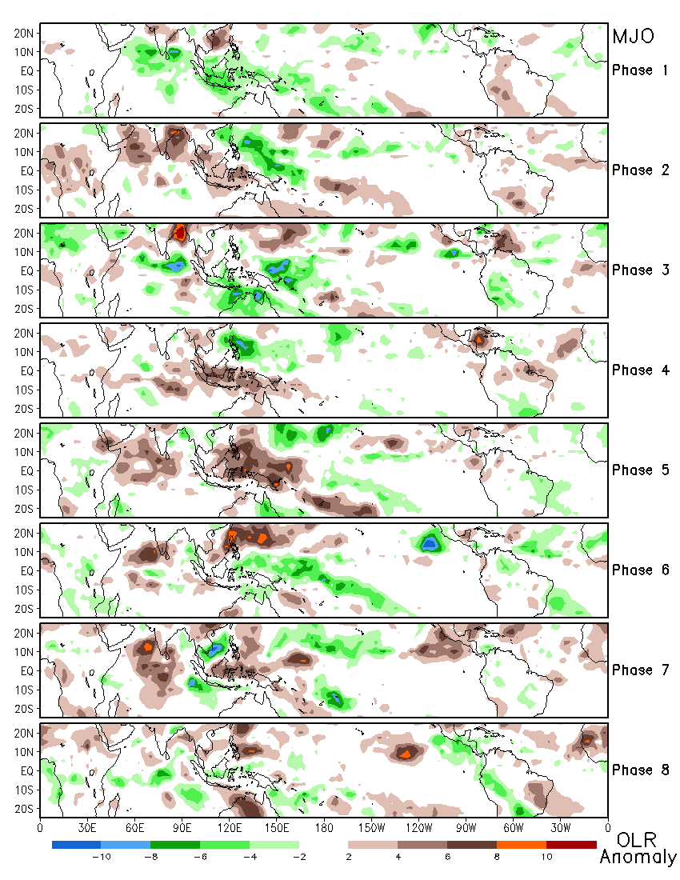
Composite of OLR Anomaly for Different MJO Phases Based on Weekly MJO Index
May – Dec, 1999 – 2014
Weekly OLR anomaly:
unfiltered

Slide 21
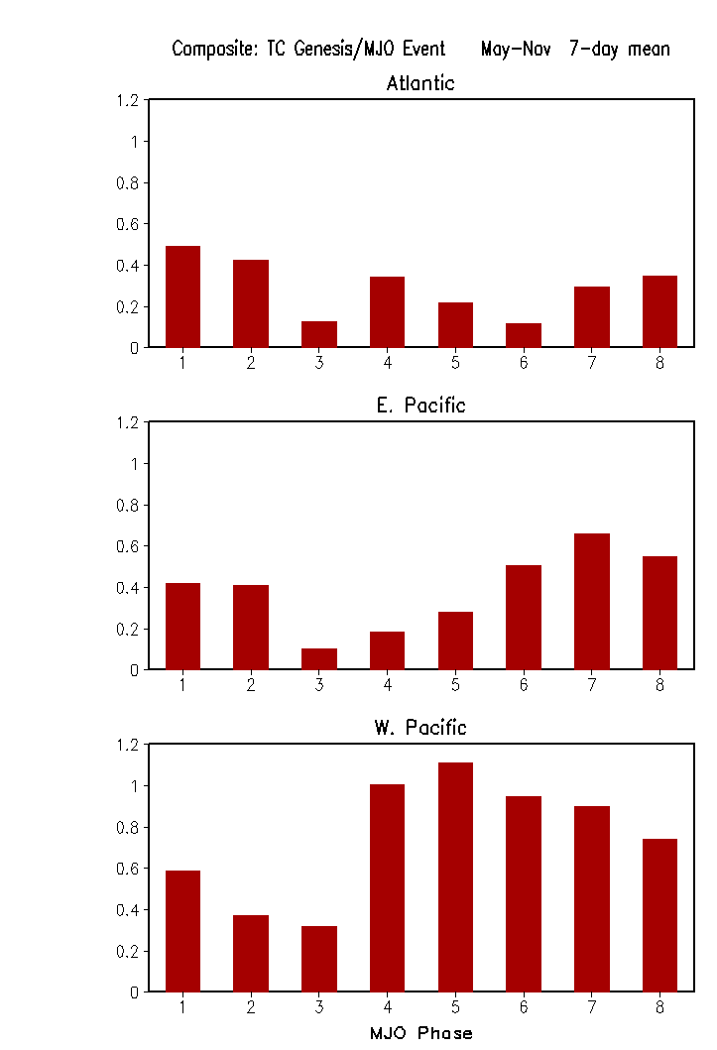
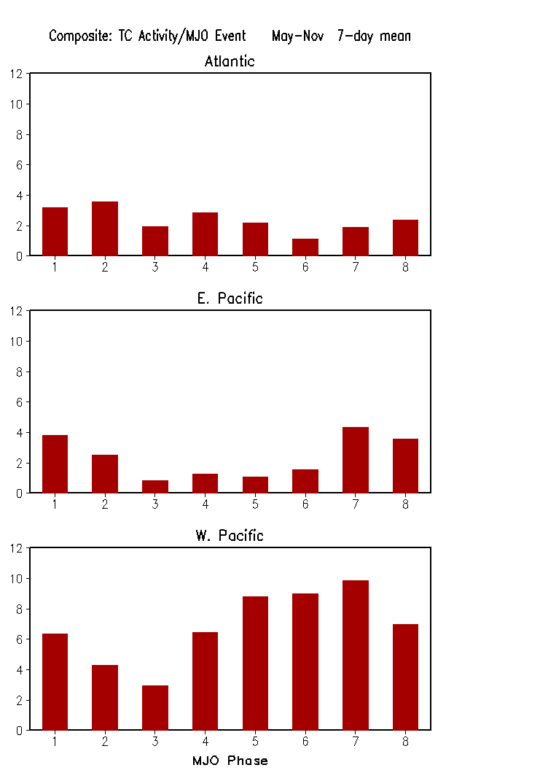
Composites of TC Genesis and TC Activity Based on MJO Phase

Slide 22
CFSv2 45-day Hindcast Evaluation

Slide 23
Wind shear: U200 – U850
Anomaly correlation between CFSv2 45-day hindcasts and CFSR
Weekly data: 7-day average from Sunday to Saturday
May – November: 31 weeks
1999 – 2012
Different leads: week 1 to week 4
Correlation between observed weekly TC activity and CFSv2 45-day hindcast wind shear
Atlantic, E. Pacific, W. Pacific TC activities
OBS: CFSR
CFSv2 45-day hindcasts: from week 1 to week 4
Potential predictors: area-average over regions with high correlations

Slide 24
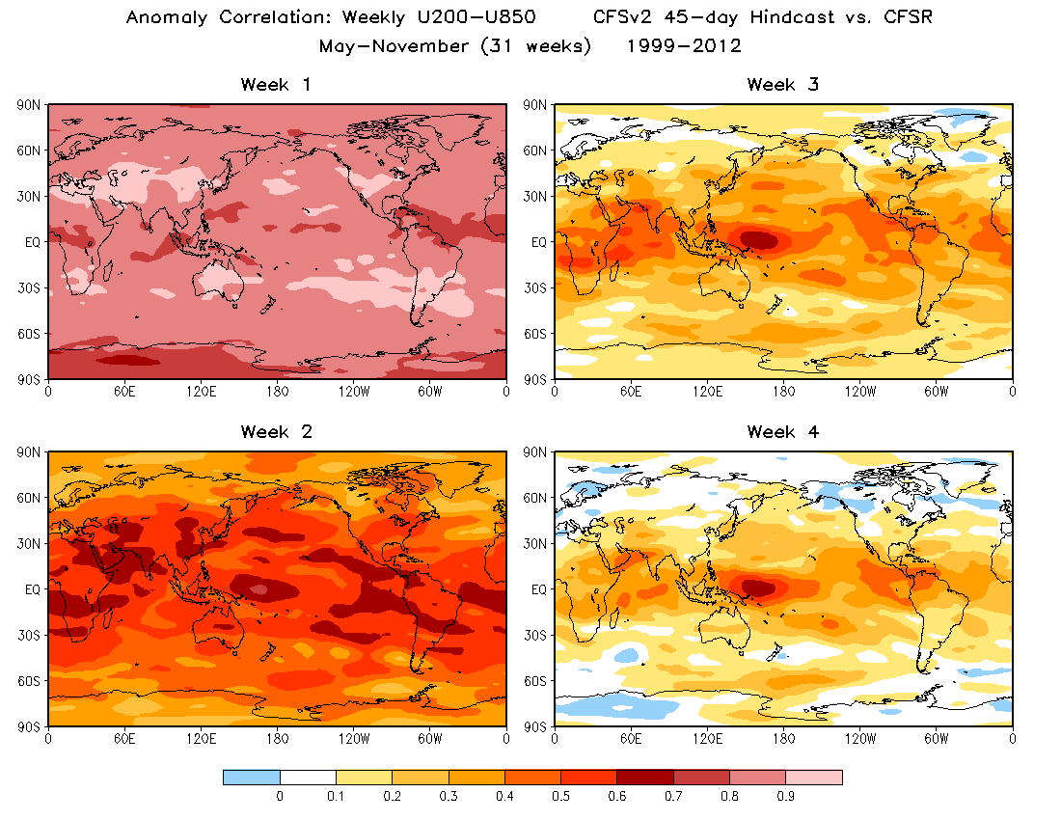

Slide 25
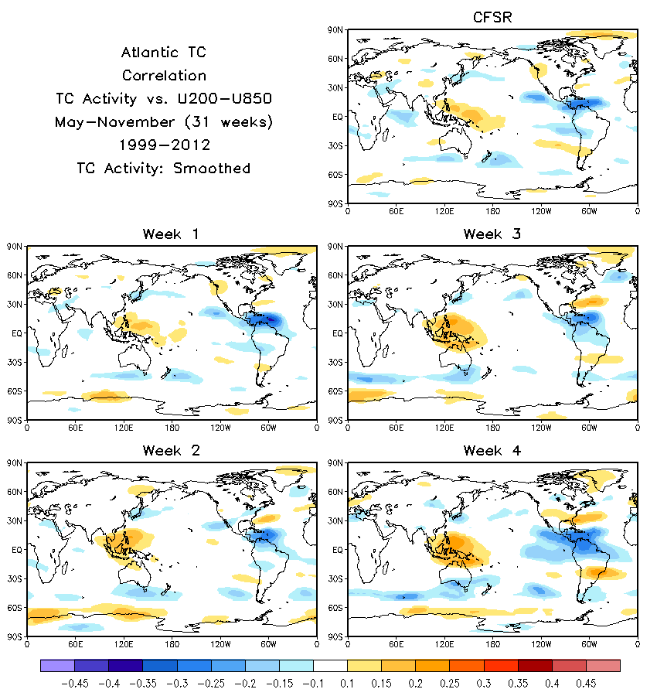

Slide 26
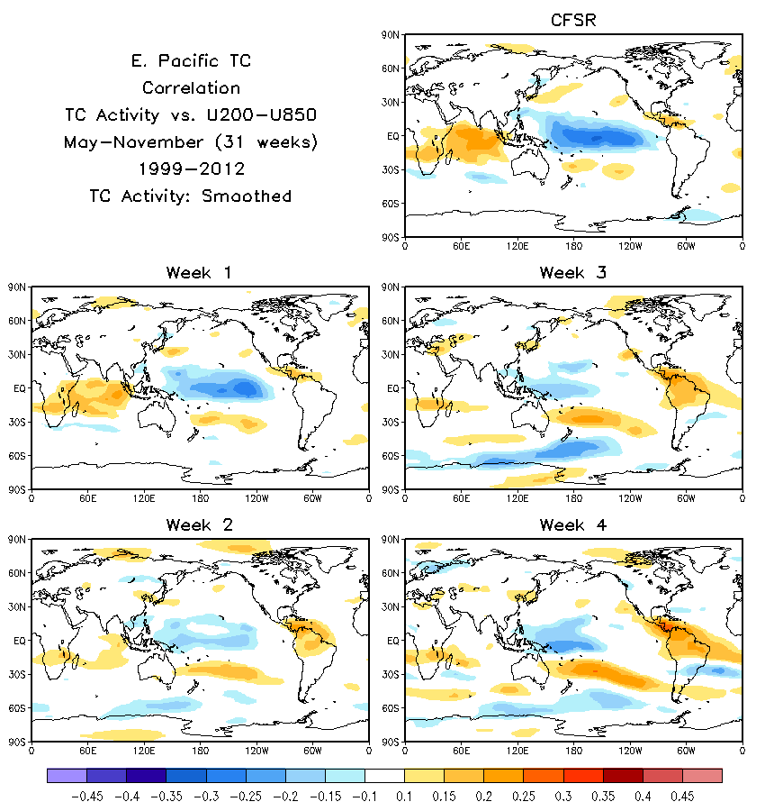

Slide 27
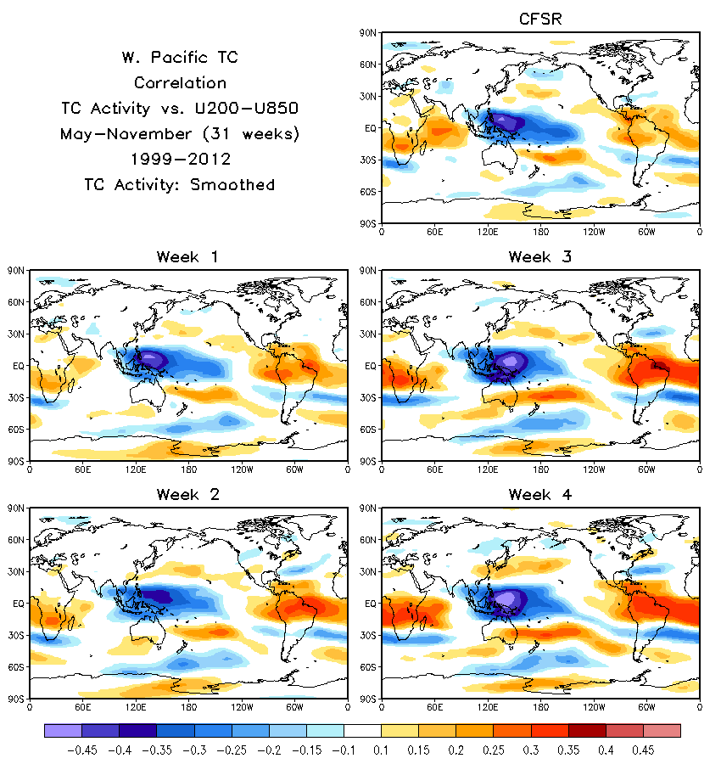

Slide 28
Sea Level Pressure (SLP)
Anomaly correlation between CFSv2 45-day hindcasts and CFSR
Weekly data: 7-day average from Sunday to Saturday
May – November: 31 weeks
1999 – 2012
Different leads: week 1 to week 4
Correlation between observed weekly TC activity and CFSv2 45-day hindcast SLP
Atlantic, E. Pacific, W. Pacific TC activities
OBS: CFSR
CFSv2 45-day hindcasts: from week 1 to week 4
Potential predictors: area-average over regions with high correlations

Slide 29
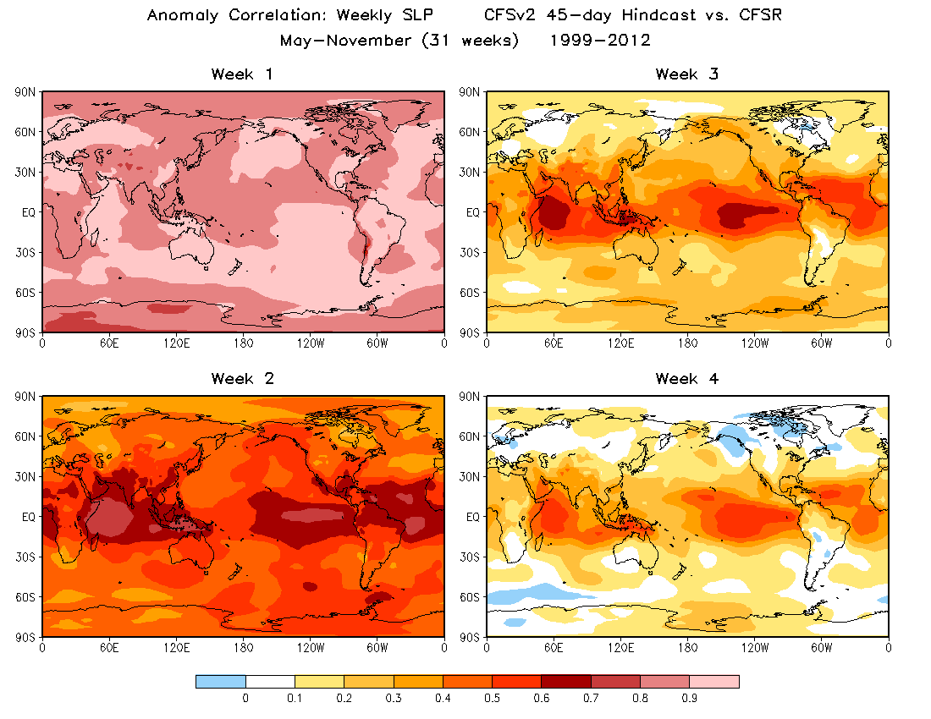

Slide 30
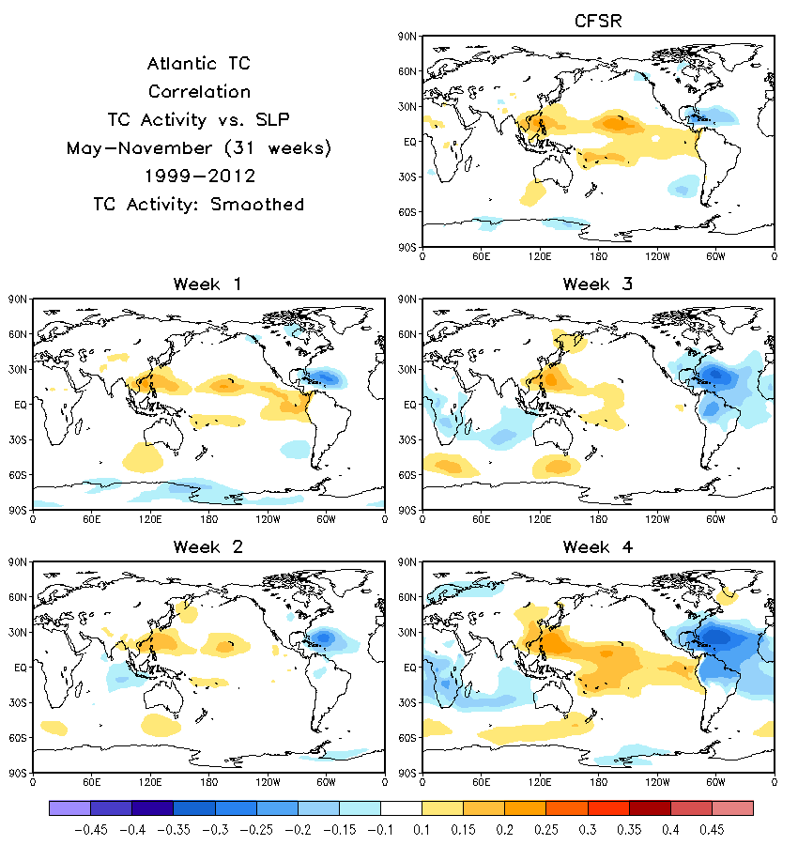

Slide 31
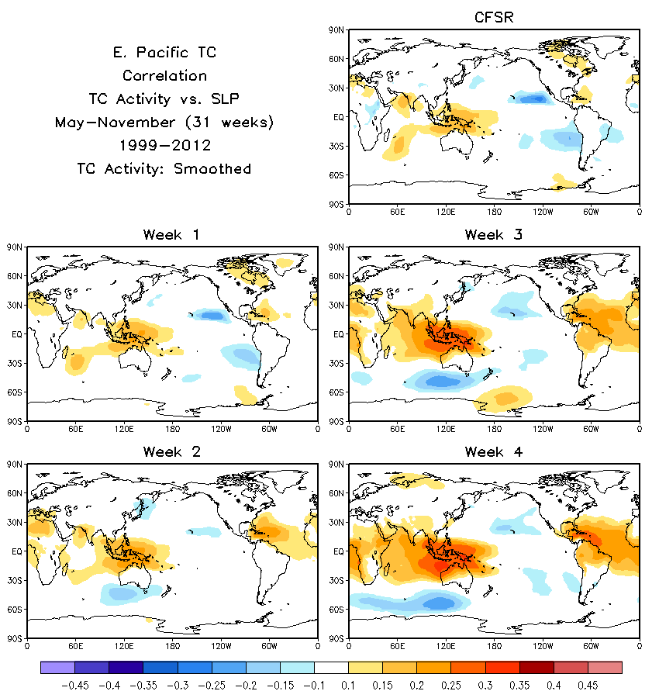

Slide 32
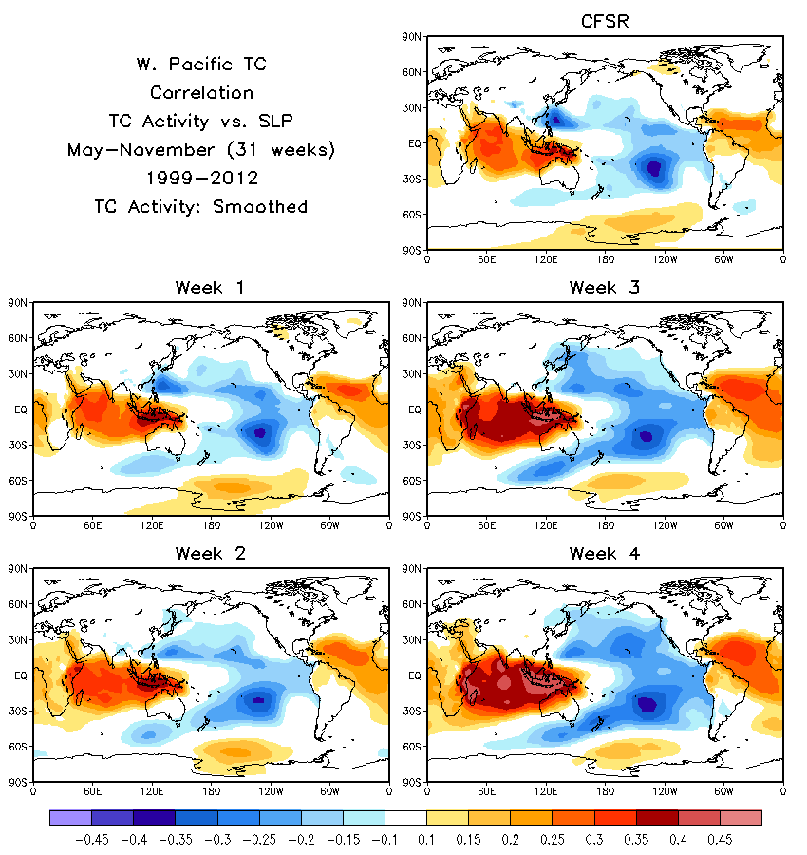

Slide 33
Summary
Evaluation of the CFSv2 45-day hindcasts for the hybrid model formulation for Weeks 1 – 4 TS activity prediction in progress.
Multiple regression relationship for the weekly TS activity will be established based on the CFSv2 hindcast data for 1999-2012. The hybrid model performance will be evaluated in cross-validation mode with the hindcast experiment.
It is planned to start the real-time prediction experiment based on this hybrid system during the 2016 tropical storm season. It is hoped to complement the dynamic weekly TS activity prediction system based on CFSv2.
This project contributes towards the NGGPS/R2O objective on the development of forecast products for Week 3 and 4.
CFSv2 diagnostics conducted in this project will contribute towards development of the next version of CFS.

