Slide 1
Incorporation of near-real-time Suomi NPP Green Vegetation Fraction and Land Surface Temperature data into the NCEP Land modeling suite
Ivan Csiszar, Marco Vargas, Yunyue Yu
NOAA/NESDIS Center for Applications and Research
Zhen Song
University of Maryland
Mike Ek
NCEP/EMC
Yihua Wu, Weizhong Zheng, Helin Wei
IMSG

Slide 2
Project objectives
Improve the use of two operational land surface data products derived from the Visible Infrared Imaging Radiometer Suite (VIIRS) on the Suomi National Polar-orbiting Partnership (SNPP) Satellite.
Comprehensive evaluation of the impact of the operational SNPP Green Vegetation Fraction (GVF) product
Integration of a SNPP Land Surface Temperature (LST) product and model performance evaluation

Slide 3
Expected benefits
Better representation and characterization of surface fluxes
Improved model performance near land surface and related processes (i.e. convection, precipitation)
Better utilization of improved information from NOAA space assets
Supports development of the NGGPS, effective use for environmental observations at global and regional scales and other high-impact weather forecast models that meet societal requirements to effectively mitigate economic disruption
Supports the goals of Land Data Assimilation topical area of JCSDA and the JCSDA testbed
Supports the goals of NOAA JPSS Land Proving Ground Initiative

Slide 4
JPSS Land Data Proving Ground Initiative
The overarching goal of the JPSS Land Proving Ground Initiative is to maximize the utilization of JPSS land surface environmental data products, as well as data products from other environmental satellites, by the NOAA numerical weather prediction community.
The ultimate scientific objective of the collaboration is the characterization of the sensitivity NCEP’s coupled environmental prediction models to improved land surface data input and assimilation.
This will be achieved by the initial utilization and testing the performance of NCEP’s stand-alone land surface modeling suite with use of the most accurate and updated land surface data products from the S-NPP satellite and other missions.

Slide 5
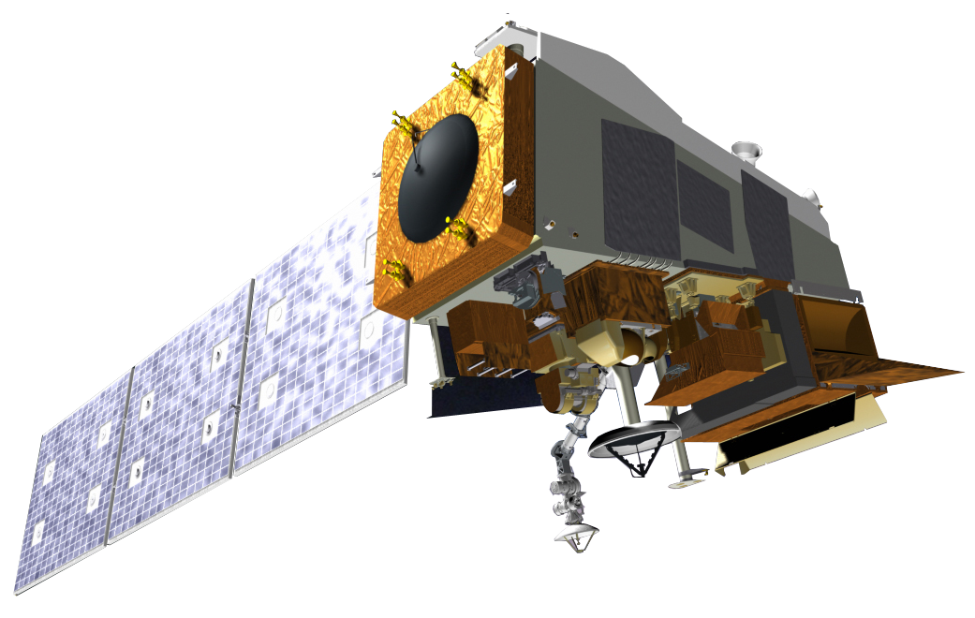
JPSS / Suomi NPP Spacecraft
Ozone Mapping Profiler Suite (OMPS)
Advanced Technology Microwave Sounder (ATMS)
Cross-track Infrared Sounder (CrIS)
Visible Infrared Imaging Radiometer Suite (VIIRS)
Clouds and the Earth’s Radiant Energy System (CERES)

Slide 6
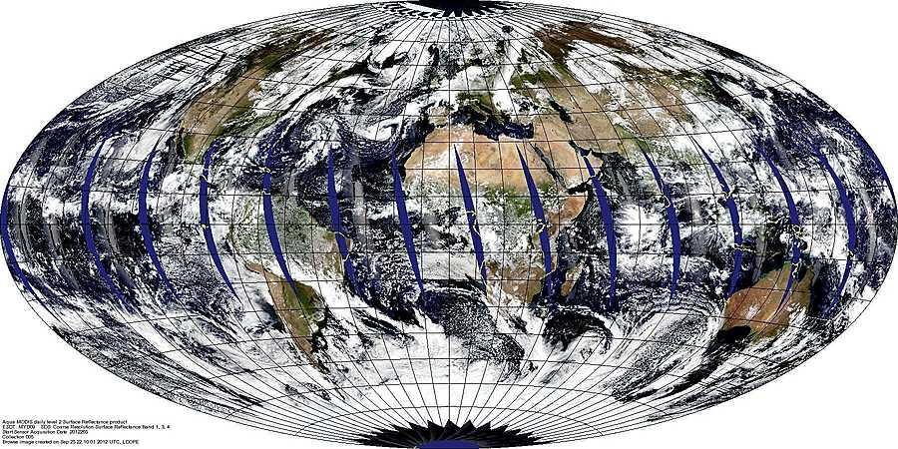
Aqua MODIS Global Browse
landweb.nascom.nasa.gov
Daily Land Surface Reflectance Bands 1,4,3 (MYD09)
September 21, 2012
NASA LandPEATE

Slide 7
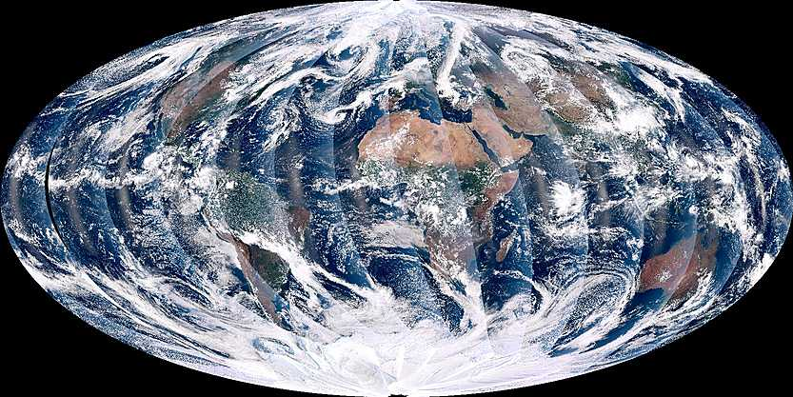
Suomi NPP VIIRS Global Browse
landweb.nascom.nasa.gov
NPP_VMAE_L1 L1B Moderate input, Day Band 5,4,3
September 21, 2012
NASA LandPEATE

Slide 8
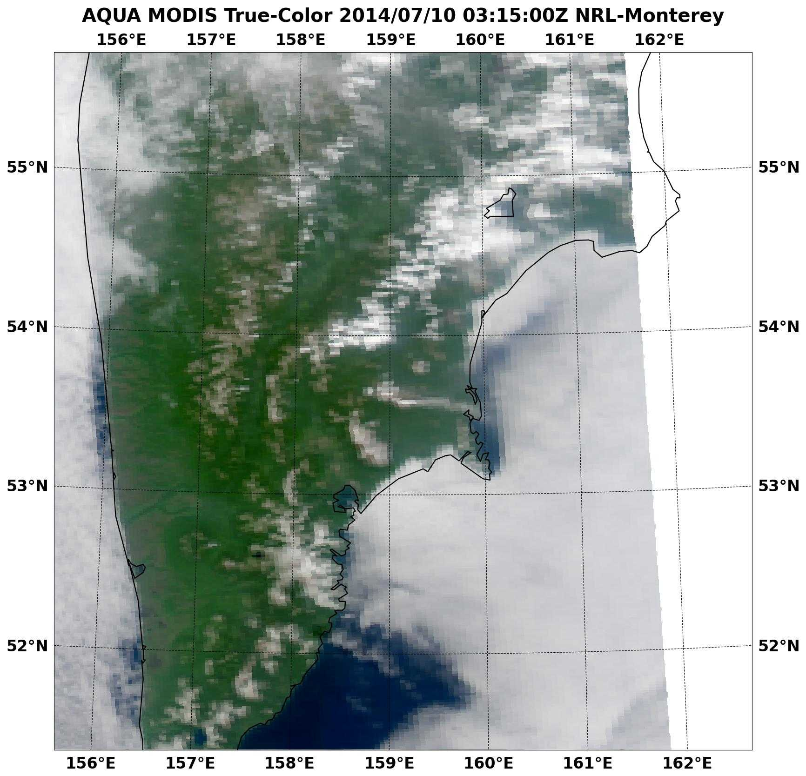
Comparing MODIS (250m) to VIIRS (375m)
Edge of Scan
edge of scan
NRL / Monterey

Slide 9
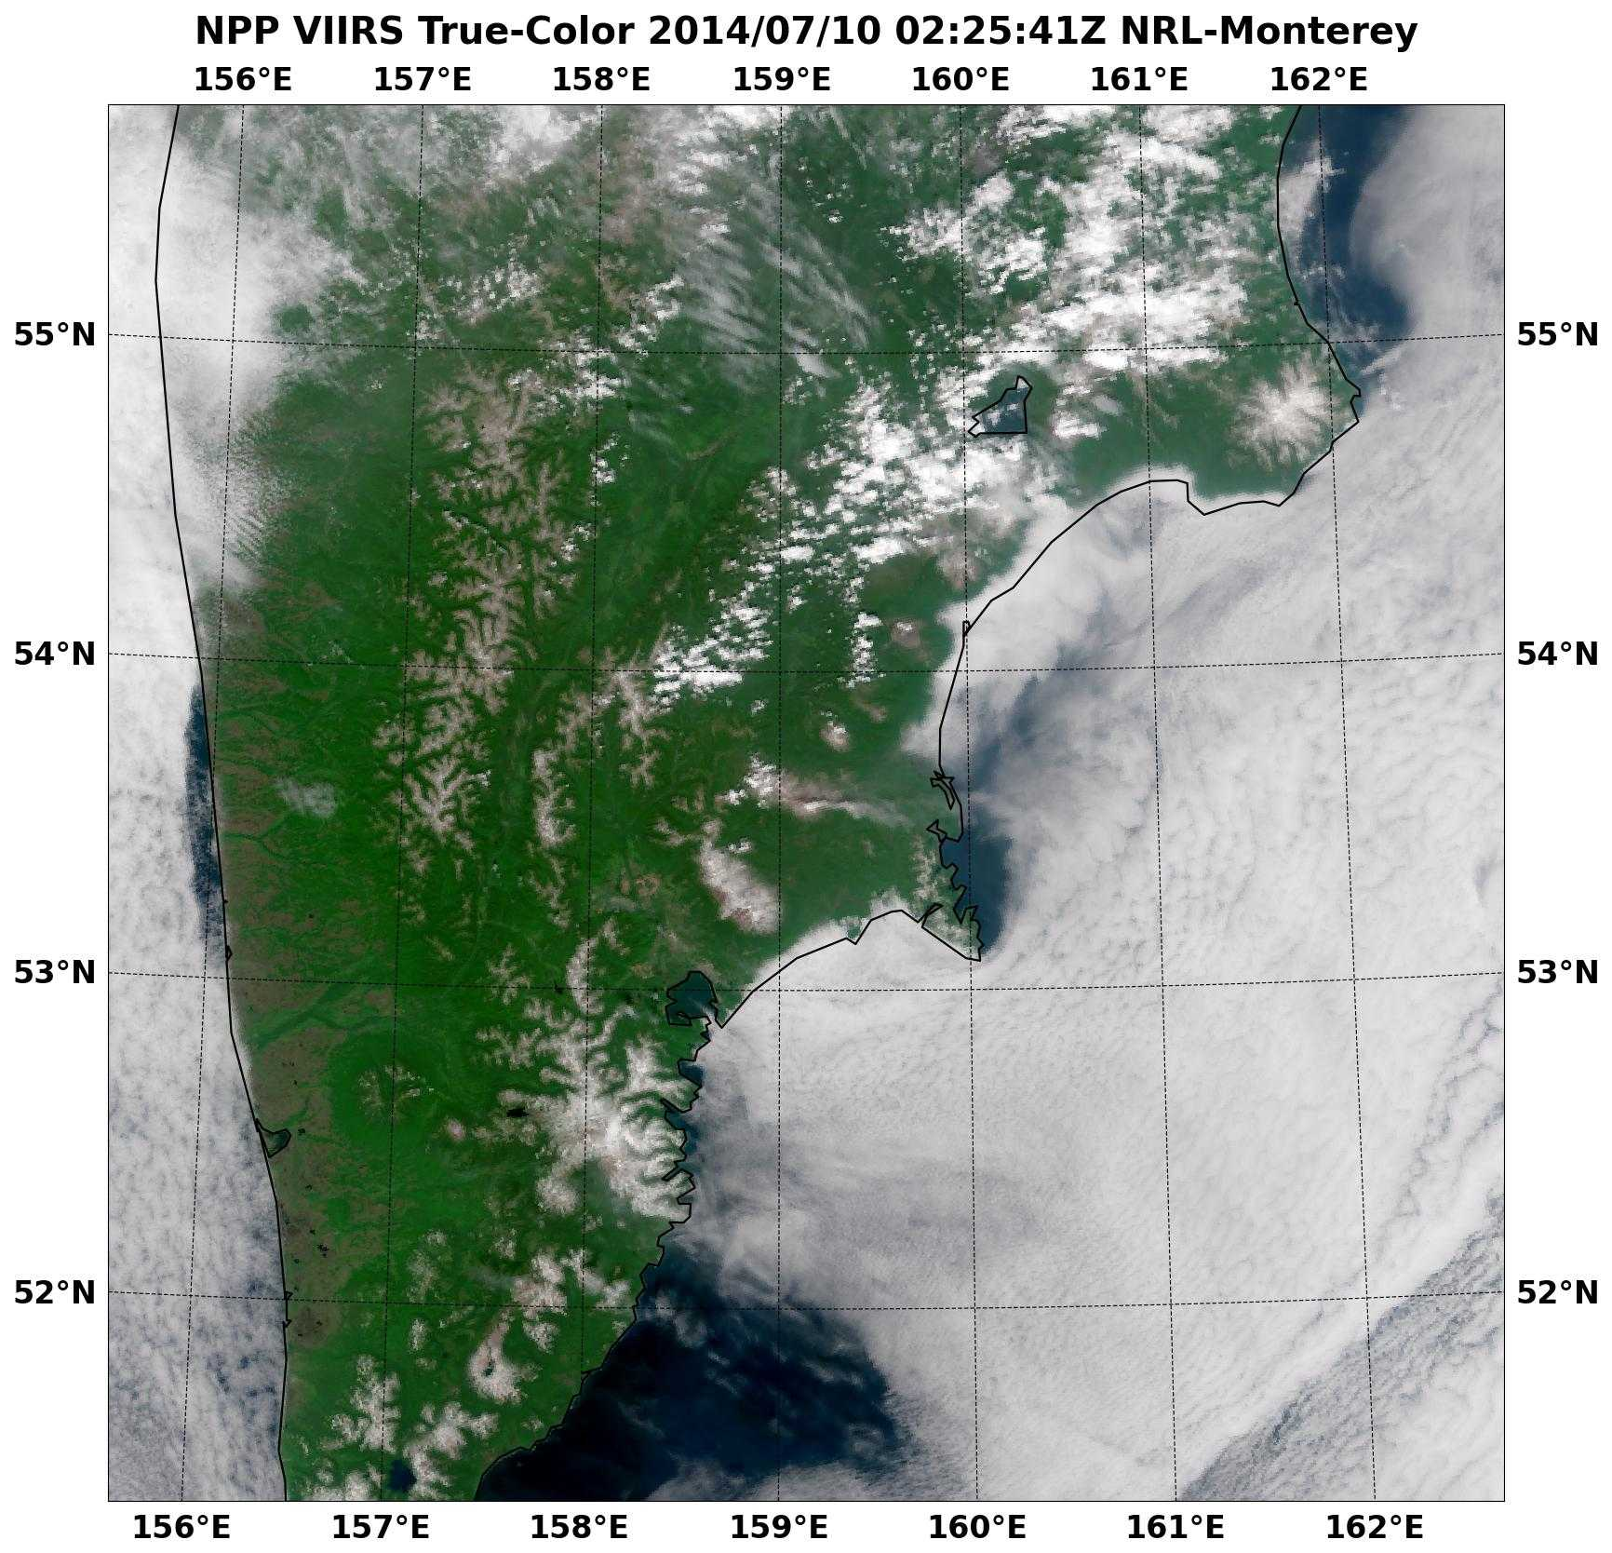
Comparing MODIS (250m) to VIIRS (375m)
Edge of Scan
edge of scan
NRL / Monterey

Slide 10
Suomi NPP Data Product Cal/Val Process Overview
Build Team
Build Team
Sensor
Sensor
Characterization
Characterization
Estab
Estab
. Sensor
. Sensor
Stability
Post
Stability
Post
-
-
Launch
Launch
Plan Dev.
Plan Dev.
EDR Validation
SDR Validation
EDR Validation
SDR/EDR Alg.
SDR Validation
Resource ID
SDR/EDR Alg.
Resource ID
Tuning
& Development
Tuning
& Development
Key EDR
Key EDR
Product
Operationalization
Validation
Quick
Validation
Quick
-
-
Look
Alg. Assessment
Look
Alg. Assessment
Analysis
& Verifications
Analysis
& Verifications
Mission
SDRs/EDRs
Mission
SDRs/EDRs
Integration
Sens
Integration
Sens
or
Cal/Val Tool
or
Cal/Val Tool
Monitor Sensor
Charar
Monitor Sensor
Charar
.
.
Product Ops
Development
Product Ops
Development
Stability
&Calibration
Stability
&Calibration
Viability
Viability
LAUNCH
PRE
LAUNCH
PRE
-
-
LAUNCH
LAUNCH
EOC
EOC
ICV
ICV
LTM
LTM
Four Phases of Cal/Val:
Pre-Launch; all time prior to launch – Algorithm verification, sensor testing, and validation preparation
Early Orbit Check-out (first 30-90 days) – System Calibration & Characterization
Intensive Cal/Val (ICV) – xDR Validation
Long-Term Monitoring (LTM); through life of sensors

Slide 11
Project team
STAR:
Ivan Csiszar: PI; overall management
Marco Vargas: GVF product lead
TBD (in process): GVF support
Yunyue Yu: LST product lead
Zhen Song: LST support (UMD/CICS)
EMC
Mike Ek: co-PI
Yihua Wu (IMSG)
Weizhong Zheng (IMSG)
Helin Wei (IMSG)

Slide 12
The “Science”: Surface Fluxes
Latent heat flux
(Evapotranspiration)
Sensible heat flux
from soil surface/canopy
Canopy Water
Evaporation
Transpiration
canopy water
Bare Soil
Evaporation
canopy (GVF)
Soil heat flux
soil
to canopy/soil surface
Surface fluxes balanced by net radiation (Rn), = sum of incoming and outgoing solar and terrestrial radiation, where GVF is important for energy partition between H, LE and
G, i.e. surface roughness & near-surface turbulence (H), vegetation processes (LE), and heat transport through canopy (G), affecting evolving boundary-layer, clouds/convection, and precipitation.

Slide 13
Land Model Requirements
To provide these proper boundary conditions, land model must have:
• Atmospheric forcing to drive land model,
• Appropriate physics to represent land-surface processes,
• Proper initial land states, such as snow & soil moisture (analogous to initial atmospheric conditions, though land states may carry more “memory”, especially deep soil moisture, similar to ocean SSTs),
• Land data sets, e.g. land use/land cover (vegetation type), soil type, surface albedo, and associated parameters, e.g. surface roughness, soil and vegetation properties (e.g. GVF, LAI, canopy height)

Slide 14
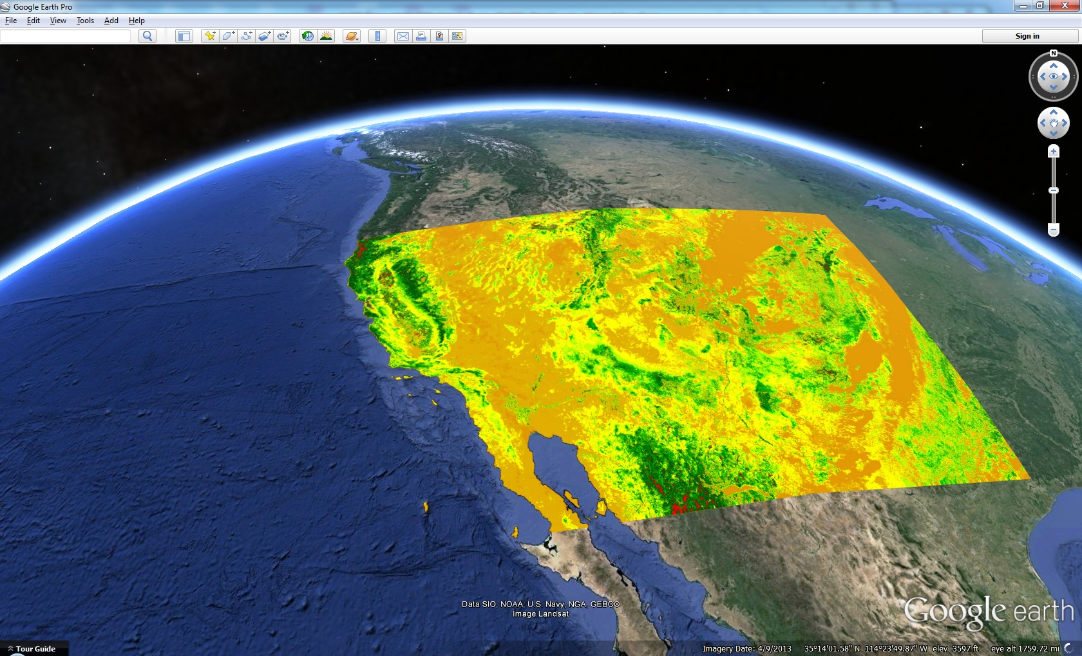
Example of core vegetation product in IDPS
Product not directly applicable for ingest into land models
TOA NDVI
August 28, 2014
VIVIO_npp_d20140828_t2038279_e2039520_b14691_c20140829030212719401_noaa_ops.h5
VIVIO_npp_d20140828_t2039533_e2041174_b14691_c20140829030212719401_noaa_ops.h5
VIVIO_npp_d20140828_t2041187_e2042428_b14691_c20140829031109580173_noaa_ops.h5

Slide 15
Green Vegetation Fraction (GVF): Background and current status
GVF has significant effects on surface energy and water budget, and plays very important role in the interactions between the atmosphere and land surface
GVF has big inter-annual and inter-seasonal variations
A five year climatology of GVF is used currently, which does not reflect inter-annual and inter-seasonal variations of GVF

Slide 16
GVF product overview
SNPP VIIRS GVF declared operational by the NOAA SPSRB on 02/12/2015
SNPP VIIRS GVF produced at NDE
SNPP VIIRS GVF consists of two products:
1) Weekly 4km global GVF at 4 km
2) Weekly 1km regional GVF
(Lat 7.5°S to 90°N, Lon 130°E to 30°E)
Sliding weekly composites are produced daily in Plate Carrée projection in NetCDF4 format
The regional product file size is 80MB and 15MB for the global product.
The Global 4km resolution VIIRS GVF product is available from
NOAA CLASS (www.class.noaa.gov), starting Feb. 13, 2015

Slide 17
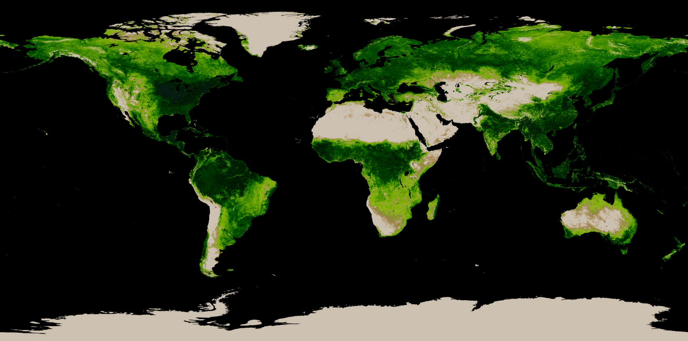
VIIRS Green Vegetation Fraction
4-km Global GVF (Sep 1-7, 2014)
Coverage Lat 90°N - 90°S, Lon 180°W - 180°E

Slide 18
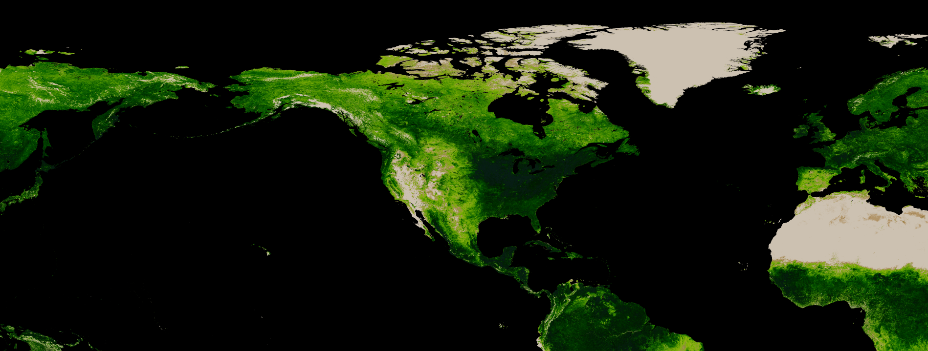
VIIRS Green Vegetation Fraction
1-km Regional GVF (Sep 1-7, 2014)
Coverage Lat 90°N - 7.5°S, Lon 130°E - 30°E

Slide 19
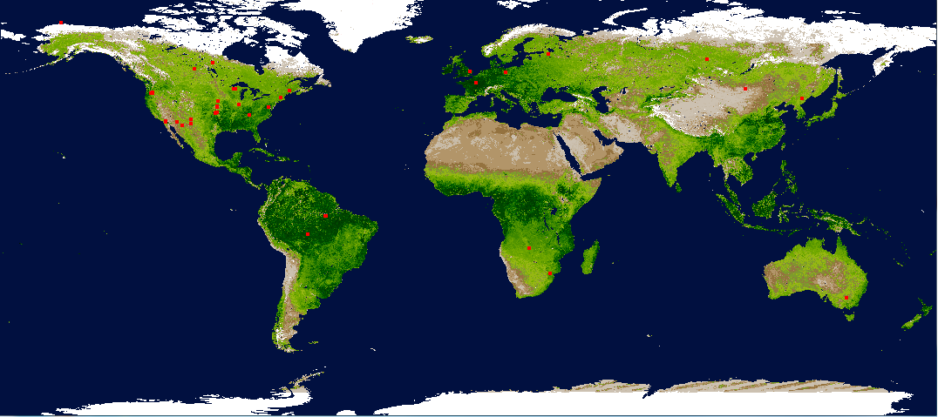
VIIRS Green Vegetation Fraction
GVF Validation Sites
The EOS Land Validation Core Sites are intended as a focus for land product validation over a range of biome types (http://landval.gsfc.nasa.gov/coresite_gen.html)

Slide 20
VIIRS GVF Performance
Attribute Analyzed | L1RD Threshold | Validation
Measurement accuracy
1. Global | 0.12 | 0.07
2. Regional | 0.12 | 0.06
Measurement precision
1. Global | 0.15 | 0.10
2. Regional | 0.15 | 0.12
Measurement uncertainty
1. Global | 0.17 | 0.13
2. Regional | 0.17 | 0.14
20

Slide 21
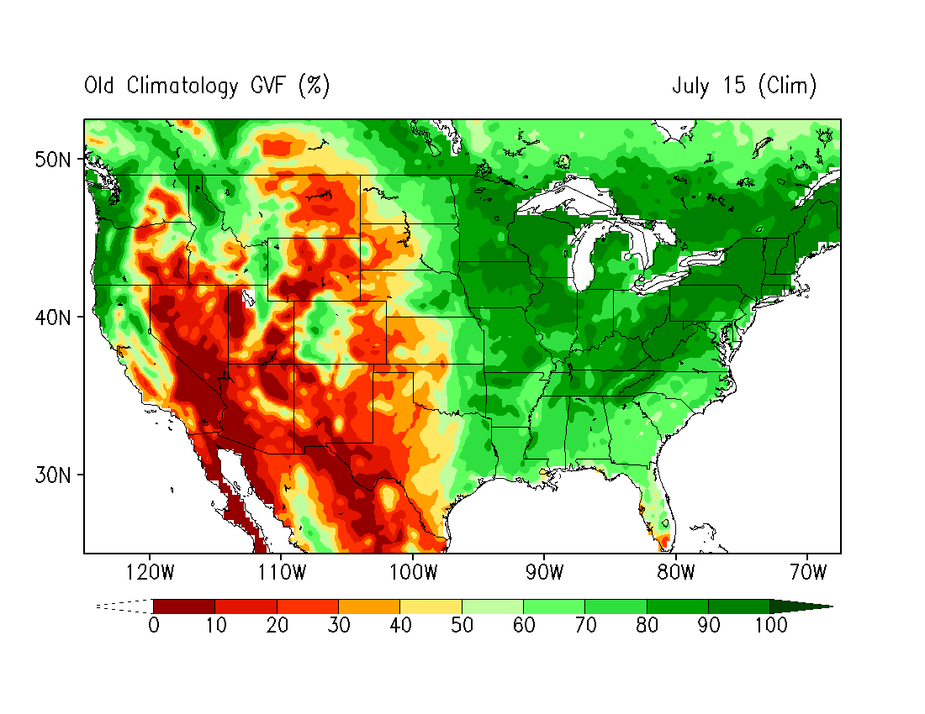
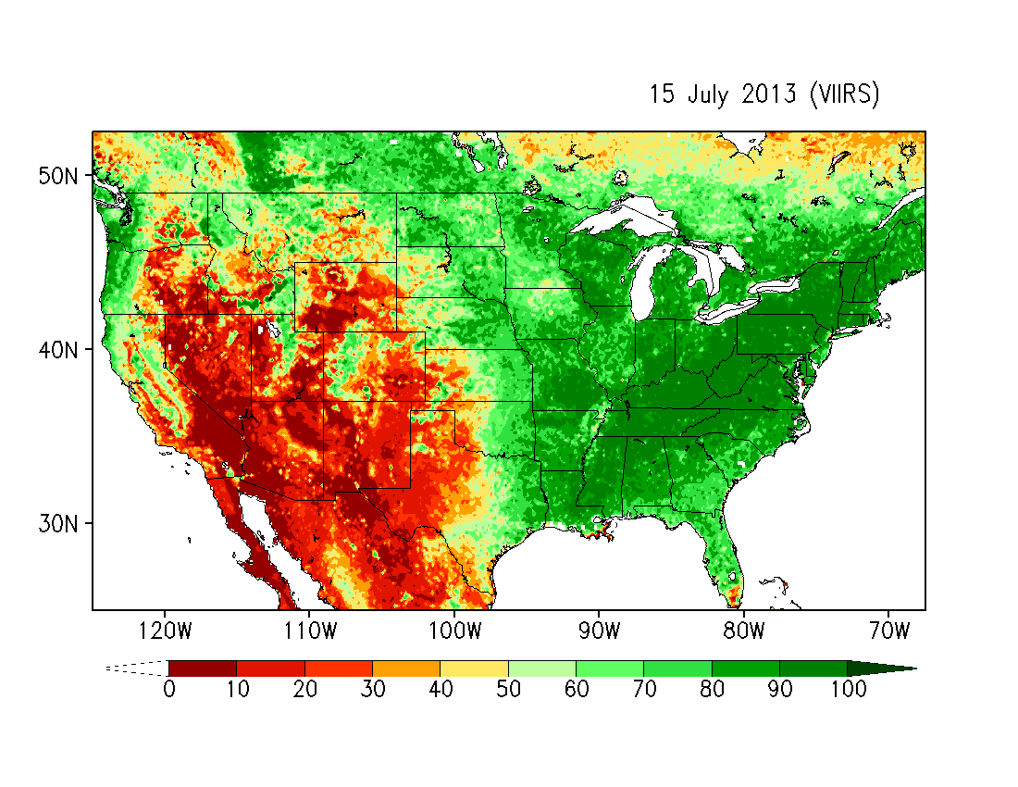
NOAA NESDIS VIIRS Green Vegetation Fraction
AVHRR Climatology (16km)
VIIRS weekly composite (4km)
Weekly GVF composites updated daily are being generated for use by the NOAA National Weather Service (NWS) National Centers for Environmental Prediction (NCEP). Early sensitivity studies have shown a reduction of errors of temperature, humidity and wind speed forecasts, and an improvement of precipitation scores in Global Forecasting System (GFS) performance, compared to the use of the heritage AVHRR-based climatology.
Notes:
21

Slide 22
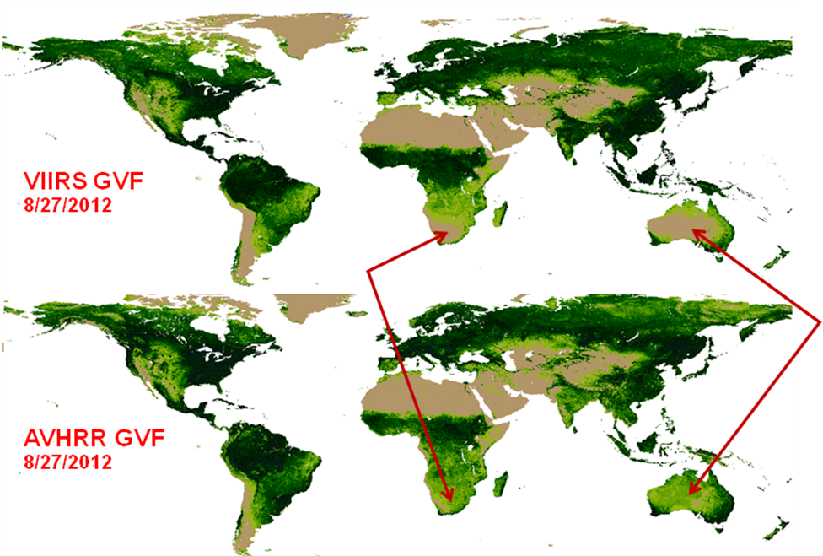
VIIRS vs. AVHRR GVF
differences need to be understood and characterized to ensure continuity and incremental improvements

Slide 23
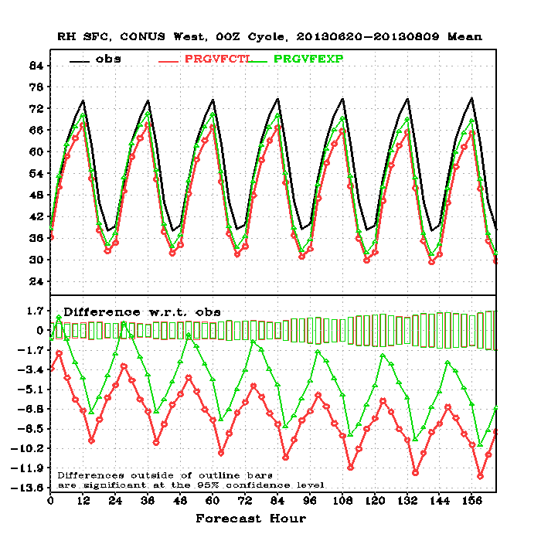
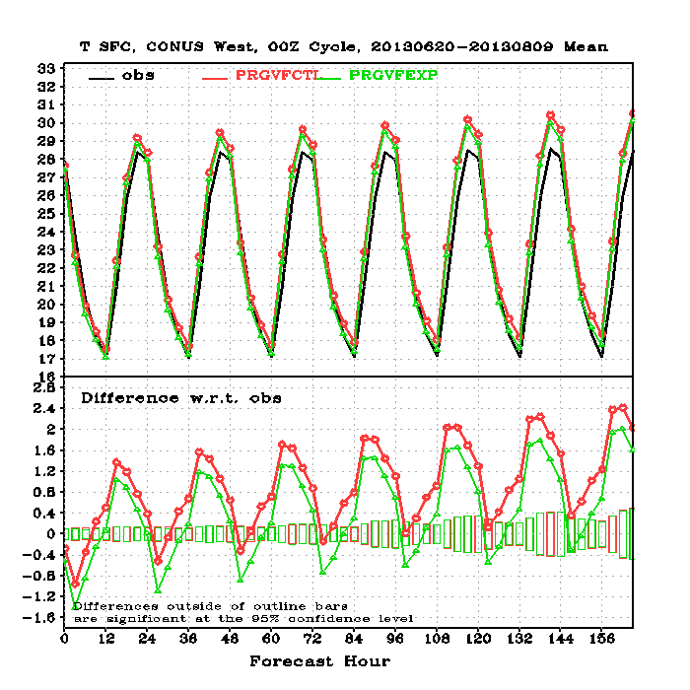
GVF impact studies: Summer 2013 example
Surface relative humidity (left) and air temperature (right) GFS model runs for the Western CONUS for June 20 – August 9 2013. Black: observed; red: control run using AVHRR climatology; green: experimental run using VIIRS near-real-time data.
Notes:
23

Slide 24
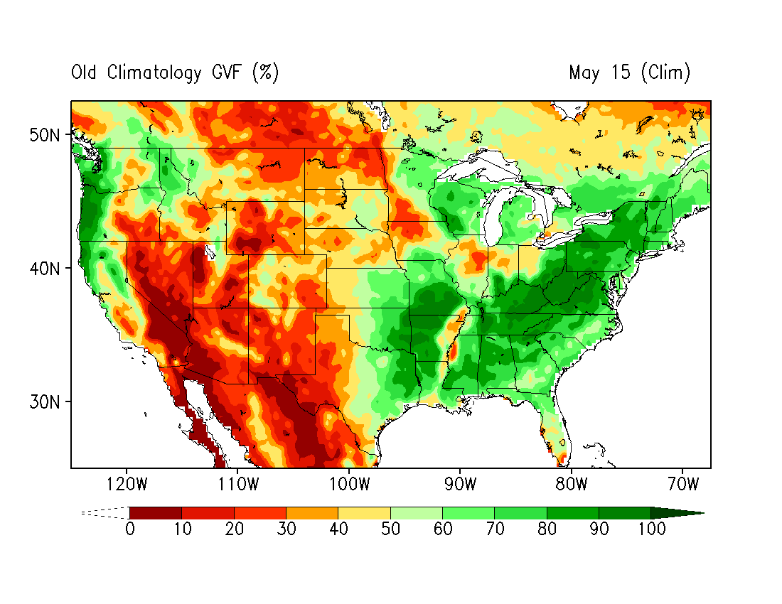
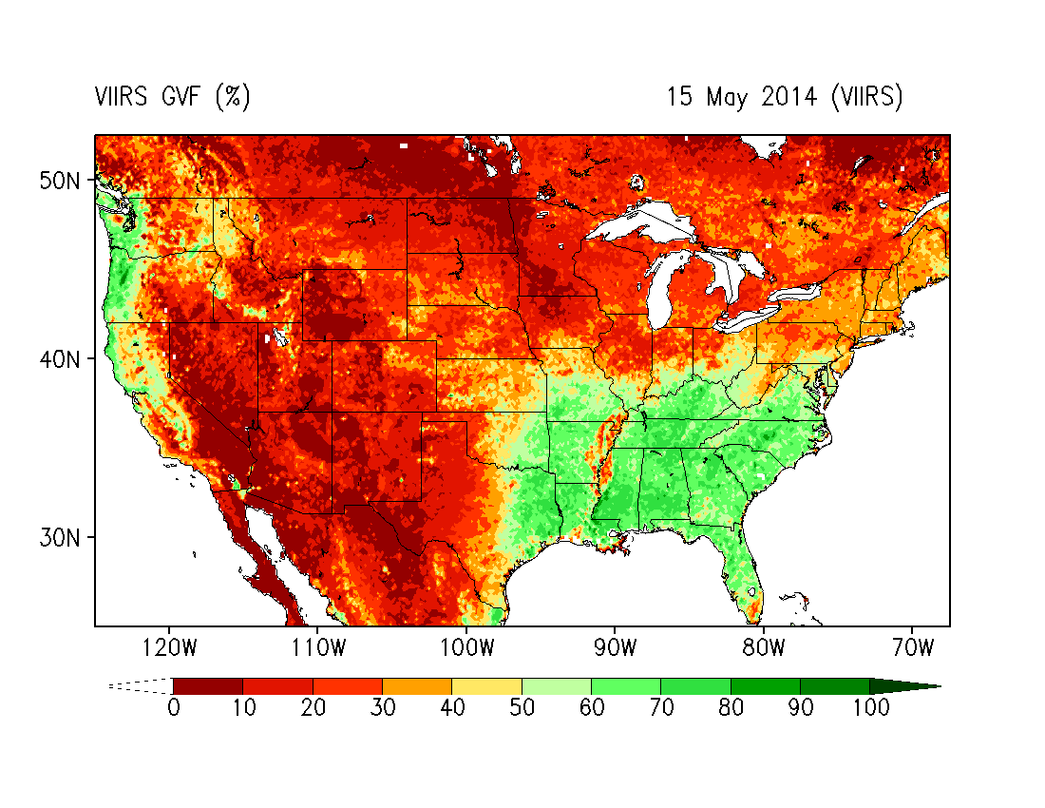
GVF impact studies: Spring 2014 example
GVF: 15 May 2014
Drought in Spring
Clim
VIIRS
Notes:
24

Slide 25
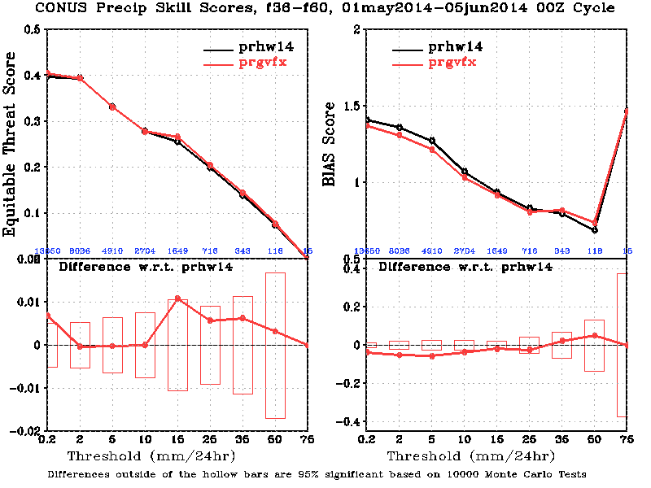
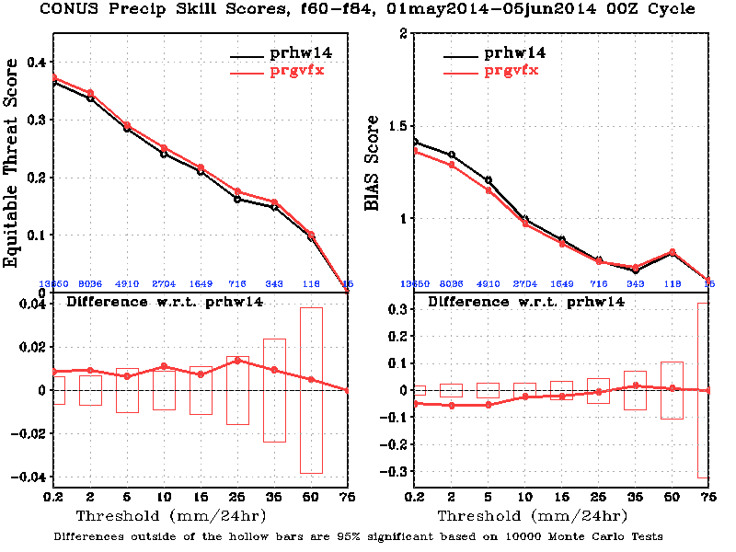
GVF impact studies: Spring 2014 example
Precipitation Skill Scores over CONUS: f36-f60 and f60-f84
f36 - f60
f60 - f84
f36-f60 & f60-f84: Improved the scores for light and medium precipitation and reduced the biases
Notes:
25

Slide 26
GVF milestones: Year 1
May 2015 − April, 2016: acquire VIIRS GVF data product from CLASS or NDE PE-1 distribution zone
May 2015 − April, 2016: acquire AVHRR derived GVF data product from CLASS
August 2015 − September, 2015: develop software application to ingest GVF datasets (AVHRR and VIIRS), perform statistical analyses and implement data display tools.
October 2015 − March, 2016: perform statistical analysis to establish the relationship between GVF datasets (AVHRR and VIIRS) and the 5 year AVHRR derived monthly climatology currently used in NCEP models.
March 2016 − April, 2016: summarize results.

Slide 27
GVF milestones: Year 2
May 2016 − June, 2016: select extreme weather events occurred during years 2014 and 2015 to use as case studies in the NWP simulations (i.e. Noah impact assessment)
July 2016 − Sept, 2016: incorporate the new VIIRS GVF data set into coupled model runs
Oct 2016 − February, 2017: demonstrate the impacts and utility of the high resolution, daily rolling weekly VIIRS GVF data set by comparing the surface energy budget using the VIIRS GVF to that using the current AVHRR derived GVF monthly climatology.
Oct 2016 − February, 2017: quantify the reduction of errors in temperature, humidity, wind speed forecasts, and the level of improvement in precipitation scores
March 2017 − April, 2017: summarize results

Slide 28
GVF progress (STAR)
Acquired weekly AVHRR GVF derived from NOAA CLASS (April 2009 to March 2015)
Weekly VIIRS GVF products from August 2012 to present time are available from STAR development environment
Software tools in planning stage

Slide 29
GVF progress (EMC)
The GVF data in GFS was upgraded with the weekly real-time VIIRS to replace the 5-year mean monthly climatology.
A series of sensitivity tests for different seasons were performed to examine the impact on NWP.
The preliminary results indicate reduction of errors of temperature, humidity and wind forecasts, and improvement of precipitation scores, compared to the original GVF data.

Slide 30
LST overview
Satellite LST is defined as Radiometric Skin Temperature
Currently Suomi NPP provides granule VIIRS LST product only; overpass time for a give location varies
e.g. over CONUS: day: 11:00~15:00 ; night: 0:00~4:00 (local)
LST may have significant variation in a small temporal scale; time match-up to model data is critical
Global LST map is available through the STAR LST monitoring system; global gridded data can be generated
Comparisons between the VIIRS LST and Model LST
Model grid size, instantaneous observation
Statistical means : daily/weekly maximum, minimum
LST comparisons can be used to evaluate GVF impact

Slide 31
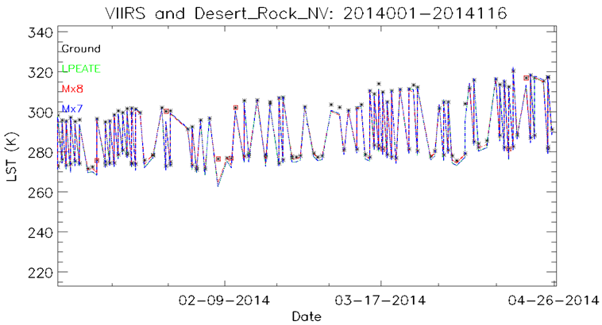
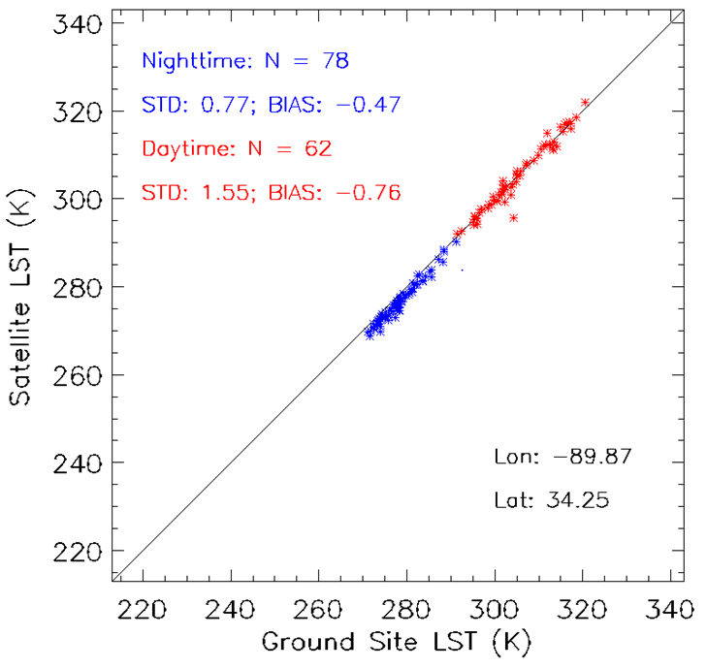
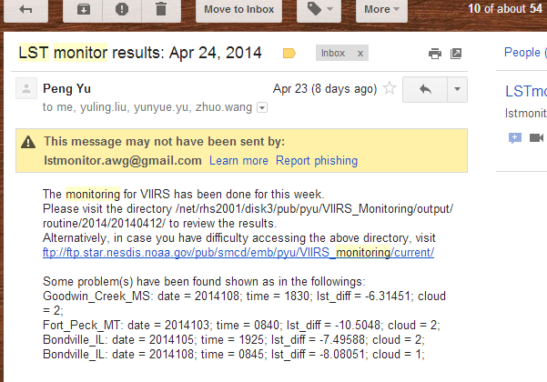
Land Surface Temperature: Product Monitoring
Cron start
Online Data inquiry
VIIRS SURFRAD
Geo-location & temporal matchup
FTP server
QC & Cloud Screening
Graphics, Data table, & log
Email to users
DesertRock: 2014001-2014116
End
Notes:
Monitoring tool feature:
Automatic run (once a week)
Email notice for the results (posted to a ftp site
Variant plots for the analysis

Slide 32
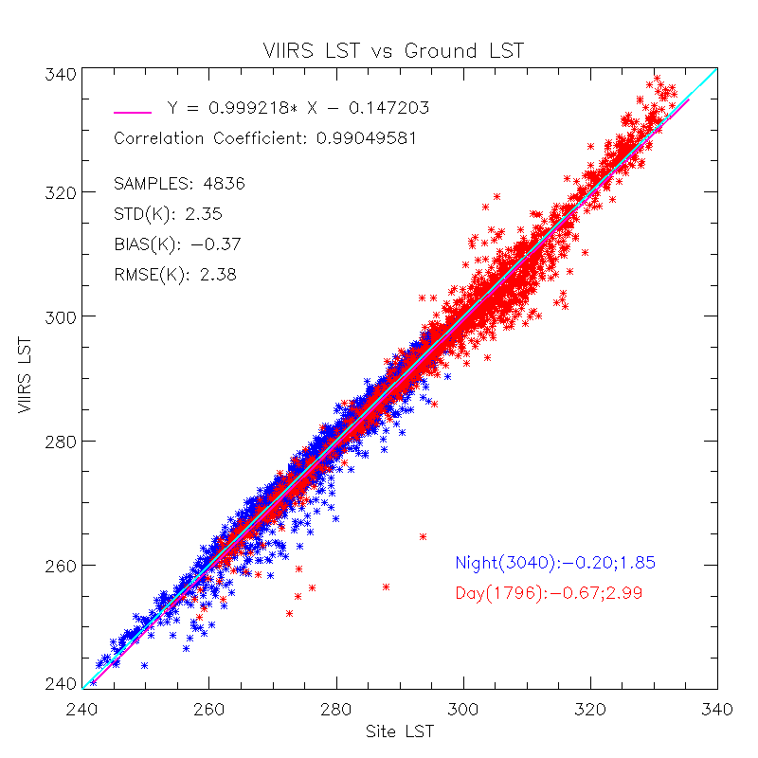
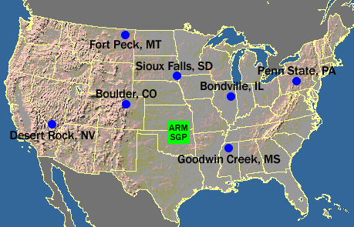
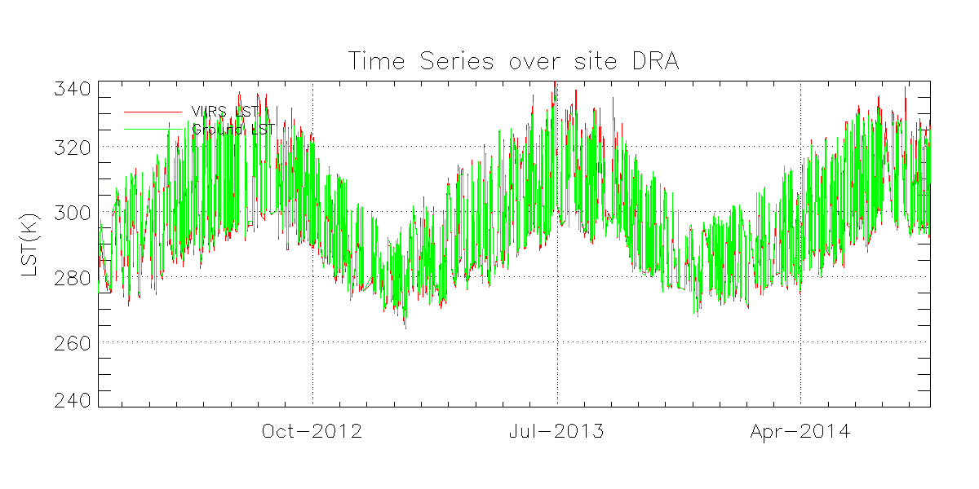
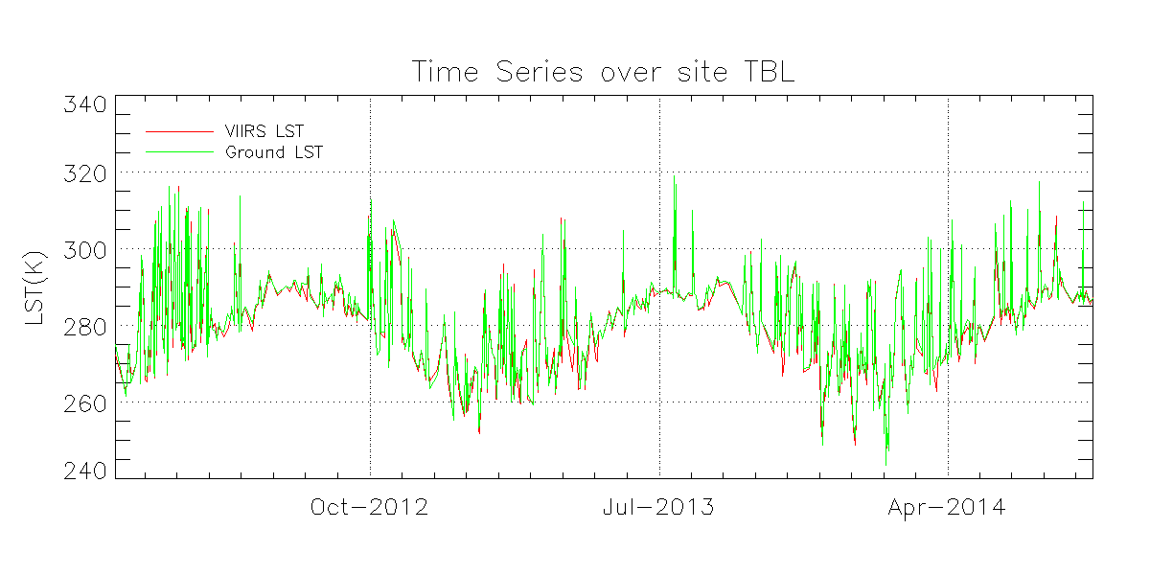
LST Quality Analysis/Validation: SURFRAD
Season | Samples | Overall |  | Day |  | Night
 |  | Bias | STD | Bias | STD | Bias | STD
Spring | 1297 | -0.54 | 2.78 | -0.69 | 3.82 | -0.46 | 1.97
Summer | 1403 | -0.1 | 2.43 | -0.87 | 3.68 | 0.26 | 1.39
Fall | 1160 | -0.28 | 1.9 | -0.32 | 2.04 | -0.24 | 1.79
Winter | 976 | -0.65 | 2.01 | -0.83 | 1.65 | -0.53 | 2.21
IGBP type | Samples | Overall |  | Day |  | Night
 |  | Bias | STD | Bias | STD | Bias | STD
4 | 18 | -1.41 | 3.01 | -1.82 | 2.66 | -1.26 | 3.22
6 | 96 | -0.98 | 1.41 | -0.5 | 1.88 | -1.32 | 0.84
7 | 955 | -0.2 | 1.59 | 0.24 | 2.06 | -0.61 | 0.79
8 | 286 | 0.19 | 2.56 | -1.7 | 2.6 | 1.38 | 1.66
10 | 1048 | -0.49 | 1.81 | -0.85 | 2.3 | -0.37 | 1.59
12 | 1238 | -0.35 | 2.68 | -0.63 | 3.8 | -0.22 | 1.91
14 | 857 | -0.28 | 2.54 | -1.28 | 2.4 | 0.19 | 2.47
15* | 189 | -1.72 | 4.31 | -1.72 | 4.31
16 | 149 | -0.23 | 1.55 | 0.87 | 1.67 | -1.04 | 0.75

Slide 33
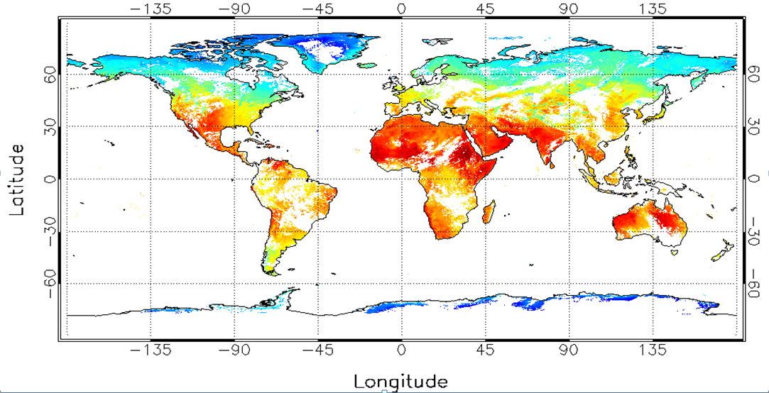
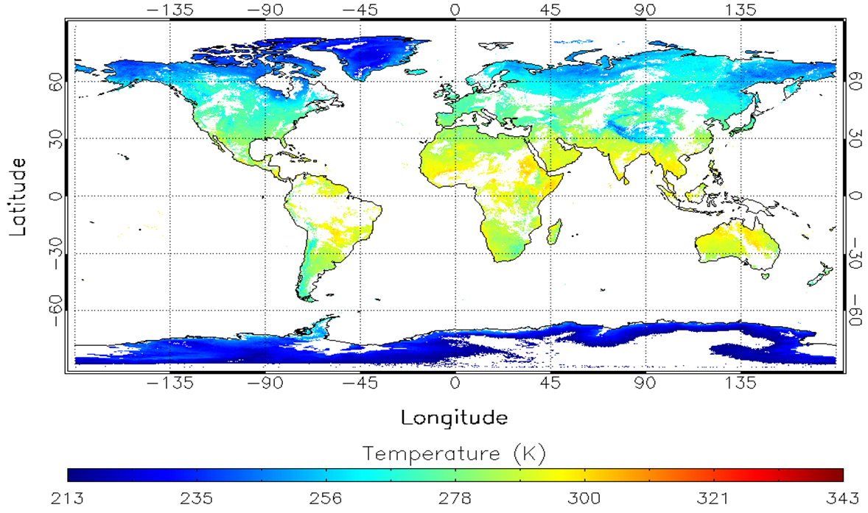
S-NPP VIIRS LST Maps
S-NPP/VIIRS LST Images on April 9th, 2014; daytime (top-left), nighttime (bottom-right)
Notes:
The provisional version is installed (running) on IDPS. I developed a tool to produce global and regional LST maps

Slide 34
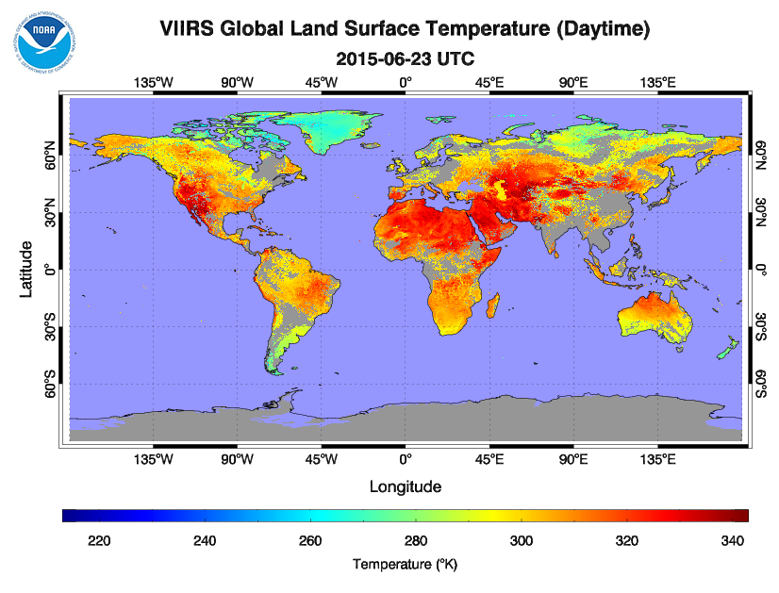
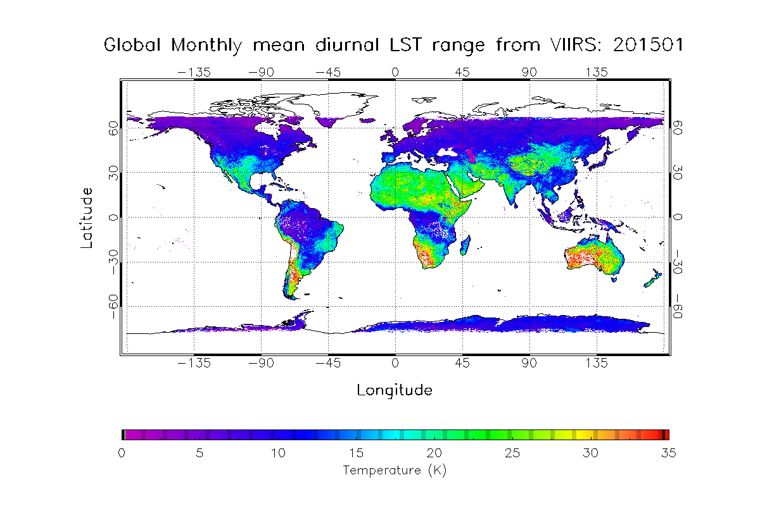
LST progress and immediate plans
Global VIIRS LST maps are available through long-term monitoring system:
daily LSTs at day and night;
Monthly LST diurnal range
Significance:
some tools are ready for the global gridded LST data generation

Slide 35
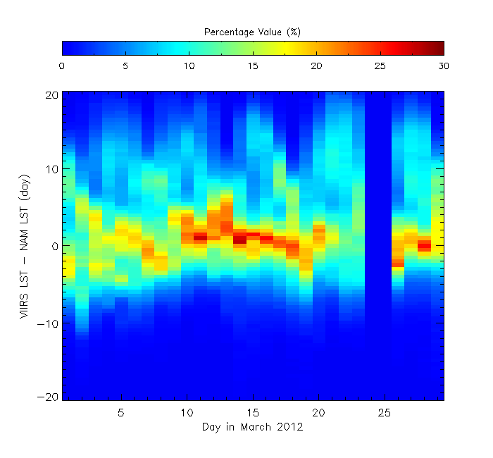
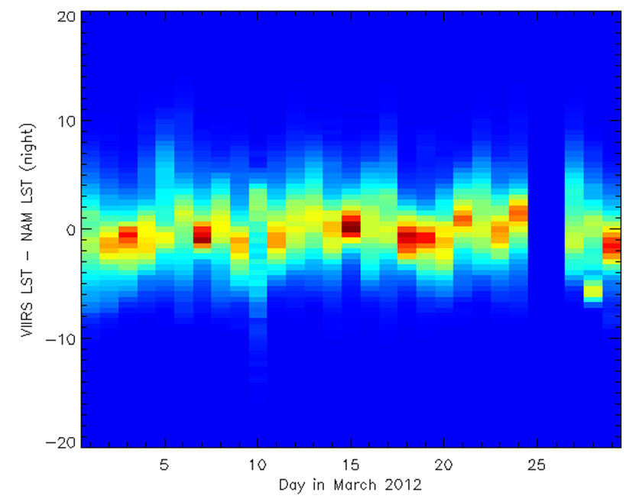
Observed vs. model LST
Performed comparison of VIIRS Granule LST data and NAM model data
Period: March 2012
Resolution: 0.05 deg
Results
VIIRS LST and NAM LST agree with each other better in nighttime.
The monthly mean biases are 0.47 and 3.76 during nighttime and daytime, respectively.
Granule level comparisons show that the VIIRS-NAM difference over west region is higher than that over east region.
Issues
Temporal interval of NAM data is 3hr, which make the match-up to VIIRS data difficult.

Slide 36
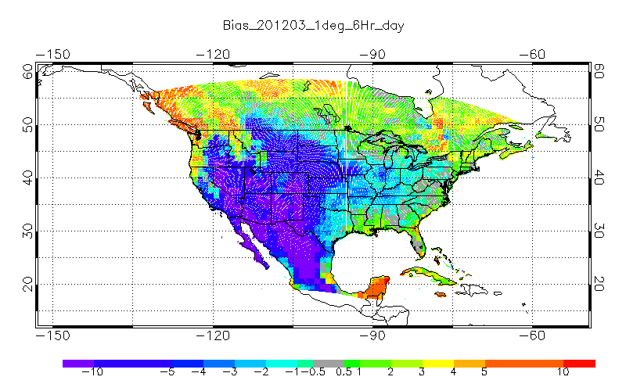
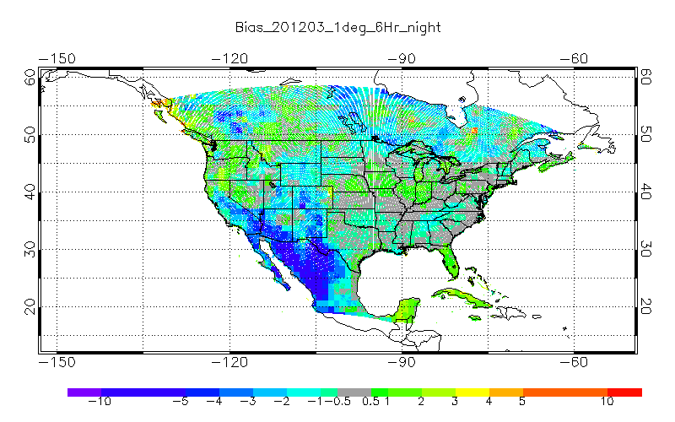
Observed vs. model LST
Distribution of monthly mean LST difference (NAM−VIIRS) between NAM hourly forecast (f00 cycle) and VIIRS LST in March 2012. Left; daytime; right: nighttime

Slide 37
LST milestones: Year 1
May − November, 2015: develop the methodology and software package to process the VIIRS granule LST data for gridded LST dataset that matches up all four model datasets; global gridded VIIRS LST files on each day in grib2 format at resolution of 0.036°.
December, 2015 − May, 2016:
on the weekly basis, download all VIIRS granule data including all VIIRS granule-level temperature and geo-location data, and run the software package to produce the continuous global gridded VIIRS LST data at 0.036° resolution; time stamp of each VIIRS LST data is needed as attribute.
Develop software package that extract all the four model datasets that matches VIIRS LST at each grid, each time.
By the end of May 2016, generate one year global gridded daily VIIRS LST product at resolution of 0.036°; the match-up model data are ready for the comparison analyses.

Slide 38
LST milestones: Year 2
June − August, 2016: evaluate LST from NCEP NAM
September − November, 2016: evaluate LST from NCEP GFS
December, 2016 − February, 2017: evaluate LST from NLDAS
March − April, 2017: summarize results.
By the end of April 2017, the gridded VIIRS LST product can be utilized to assess the LST simulated from NOAA NCEP weather forecast models at regional and global scales.

Slide 39
Pathway for operational implementation
GVF: already operational
Gridded LST: development within STAR testbed; operational implementation in NDE
EMC ingest: follow generic process (39 months EMC total?)
development of land-related upgrades
(interface with operational codes & data structures)
testing over specified number of seasons, including 30-day parallel runs
pre-implementation testing

Slide 40
NOAA’s Operational Numerical Guidance Suite (Feb 2015)
Climate Forecast
System (CFS)
Regional Hurricane GFDL, WRF-NMM + Noah
Waves
WaveWatch III
SURGE
SLOSH
3D-VAR
DA
3D-VAR
DA
GFS, MOM4, GLDAS/LIS/Noah, Sea Ice
Ecosystem
EwE
Ocean (RTOFS)
HYCOM
P-SURGE
SLOSH
ESTOFS
ADCIRC
Regional Bays
Great Lakes (POM)
N Gulf of Mexico (FVCOM)
Columbia R. (SELFE)
Chesapeake (ROMS)
Tampa (ROMS)
Delaware (ROMS)
Global Forecast System (GFS)
3D-En-Var
DA
Regional NAM
NMMB
Noah land model
Global Spectral
Noah LSM
3D-VAR
DA
Global Ensemble Forecast System (GEFS)
Dispersion
HYSPLIT
Short-Range Ensemble Forecast 21members
21 GFS Members
Air Quality
WRF (ARW + NMM)
NMMB 7members each
CMAQ
RUC LSM
North American Ensemble Forecast System
Rapid Refresh
High Res Windows
3D-VAR
DA
GEFS, Canadian Global Model
WRF-ARW & NMMB
WRF ARW
North American Land Surface Data Assimilation System
NEMS Aerosol Global Component (NGAC)
Space
Weather
High-Res RR (HRRR)
3D-VAR
DA
WRF ARW
Noah Land Surface Model
GFS & GOCART
ENLIL

Slide 41
Summary and conclusions
This project is aimed at the operational use of existing Suomi NPP GVF and LST products in EMC modeling
Initial results are encouraging
Part of a broad effort for land product data assimilation / ingest
internal consistency among various land products
Incremental, well characterized improvements in satellite data production and modeling to ensure smooth transition
Supports NGGPS, JCSDA Land Data Assimilation Theme and JPSS Land Proving Ground Initiative

