Slide 1
Test and Evaluation of Rapid Post-Processing and Information Extraction From Large Convection Allowing Ensembles Applied to 0-3hr Tornado Outlooks
James Correia, Jr. OU CIMMS/SPC
Daphne LaDue, OU CAPS
Chris Karstens, OU CIMMS/NSSL
Kent Knopfmeier, OU CIMMS/NSSL
Dusty Wheatley, OU CIMMS/NSSL

Slide 2
R2O: Where do we fit?
Addresses NOAA objective:
“…post-processing tools and techniques to provide effective decision support for high-impact weather.”
Addresses high priority topic 4:
“…daily severe weather prediction using rapidly updating ensemble radar data assimilation and forecasts while minimizing data latency via post processing strategies for information extraction.”

Slide 3
Project Goals
Design & evaluate a fast, adaptable object-centric post-processing procedure.
Move data and information; not just grids.
Help forecasters address the “problem of the day”
  Match the variables to the forecast challenge
  Discriminate which storms will be tornadic
Evaluate feasibility and usefulness of this approach

Slide 4
NSSL Experimental Warn-on-forecast System for ensembles
ARW 3.6.1 using DART (EAKF)
Start from GEFS w/ 36 members
Hourly cycling of “conventional” obs from 00 UTC through radar assimilation start (around convection initiation)
15-min cycling of radar/cloud water path variables
MRMS Refl, velocity from 5 radars, cloud water path
18 members for 90 minute forecasts twice an hour with output every 5 minutes
Relocatable domain 2
Δx = 3km
See WAF/NWP Knopfmeier et al. 9A6 and Wheatley et al. 9A7 for more
Δx = 15km

Slide 5
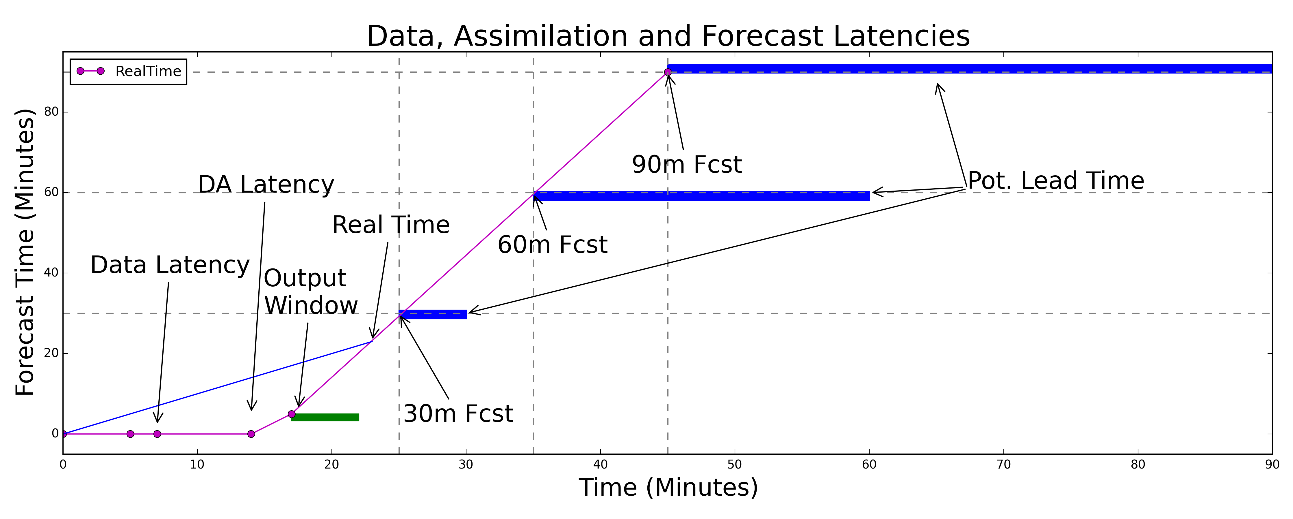
NEWS-e during HWT 2015
Have minutes to post-process and deliver to stay relevant
Not as simple as probability [rare events]
Predictability decreases with age [phenomena & spread]

Slide 6
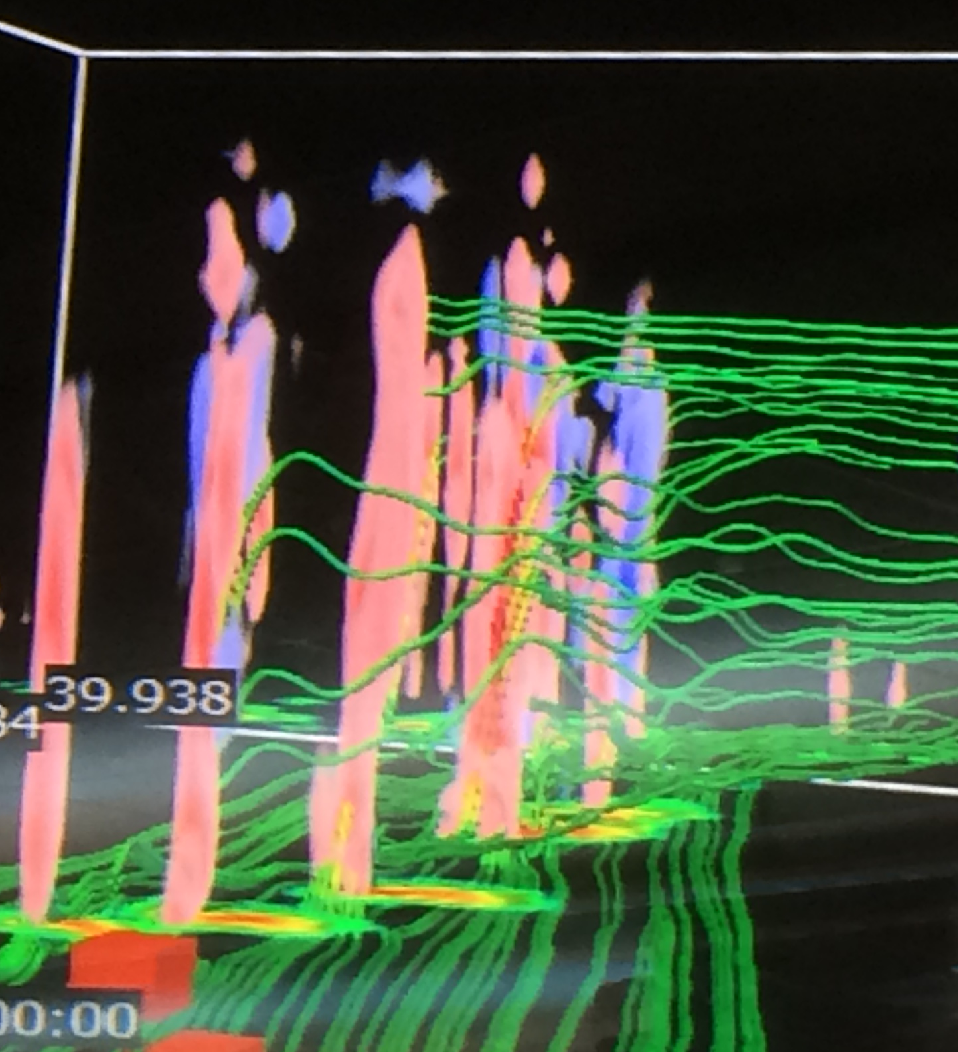
3D Object Post-processing
Updraft helicity towers depicted from 3km model
Post-processing inside and outside the model (e.g. “hourly max fields”)
Desire to capture rapid evolution of in time and space
As grid spacing <= 3km, these features tilt (vertical integrals will fail) and acquire complex structure!

Slide 7
Post-processing Strategy
The proposed post-processing paradigm will consist of five steps:
  Rapid identification of predefined but broad objects via degridding for the purposes of filtering and data reduction,
  Transmitting reduced data sets while retaining information (why send zeros!)
  Reception and regridding data (adaptable)
  Generation of predefined probabilities (static probabilities – broad applicability)
  Generation of user-defined generation of probabilities (on-the-fly post processing for INSIGHT in Scientific forecasting)
Core and specialized sets of post-processing

Slide 8

Ensemble Probabilities are the Future & ~∞!
Updraft Helicity: 25,50,75,100 threshold* probability
  2 (raw or neighborhood) x 4 thresholds x 6 time intervals [5,30,45,60,120, 240m]
  ~50 combinations of probability!
3D vorticity: Supercell mesocyclone, tornado cyclone, & tornadoes
  Different scales of motion & models [effective resolution]
    mesocyclone rotation (10⁻³ – 10⁻² s⁻¹)
    tornado-vortex like rotation (10⁻¹s⁻¹)
    tornado-like rotation (1s⁻¹).
Situation dependent
*4km grid spacing. More resolution, more thresholds?

Slide 9
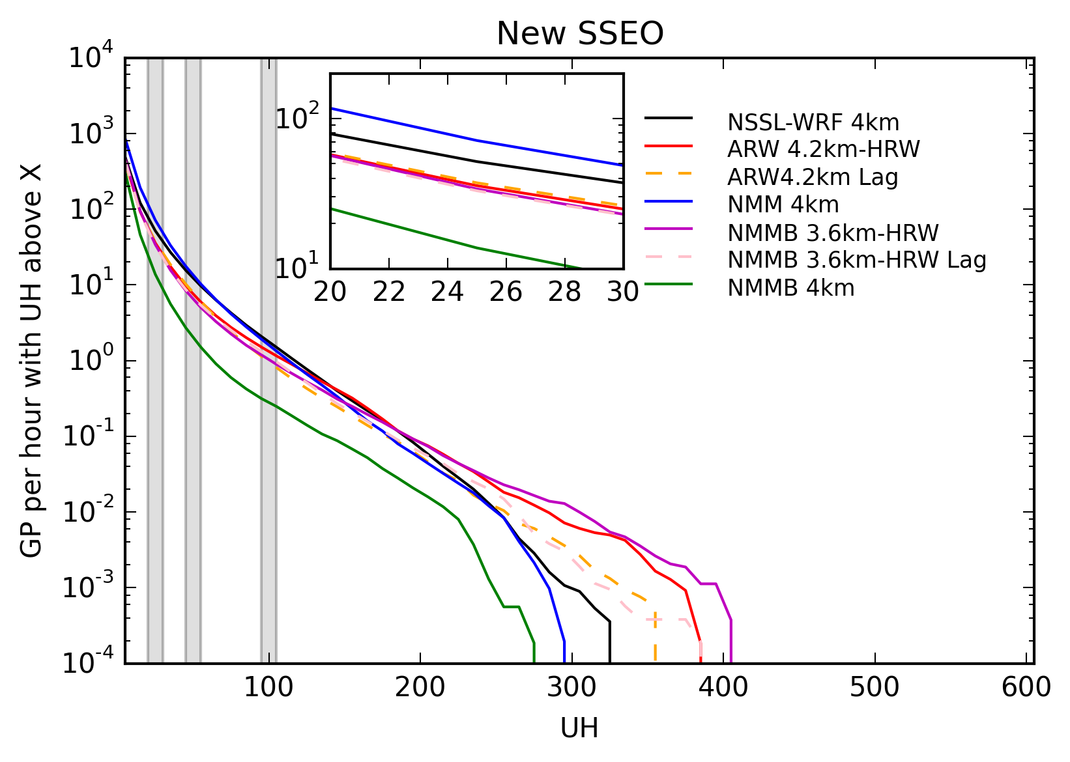
Develop context for variables
What values are “important” and common?
Informs our choice of thresholds for probabilities
Important as resolution increases (finer grid spacing) or change model & physics

Slide 10
Interacting with the data
Fire hose of data (data paralysis; Andra et al. 2002)
  View ALL the DATA! (Novak et al. 2008)
  Must evaluate how they use the data to extract information &
  Does this contribute positively to their decision-making
Match the needs of forecasters with tools, data, and information that can help them make better judgments/decisions.

Slide 11
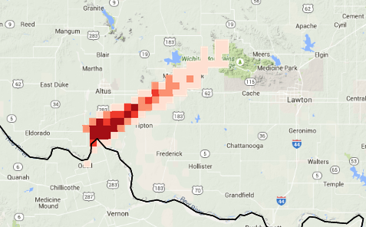
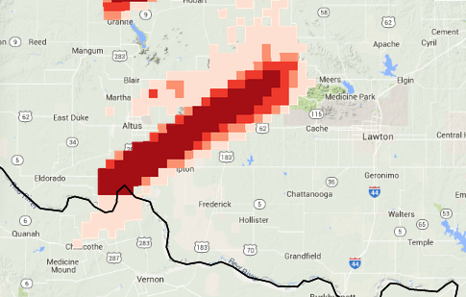
Vorticity 0-2km Probability
PHI tool
Allow forecasters to see the data
Interact with the data
Apply to outlooks and warnings
Measure outcomes
1 hour aggregate forecasts
Now Imagine having the forecaster pick:
The variable
the layer
the threshold
for the probabilistic assessment (i.e. human-machine cognition)
Supercell w/ no vorticity probs
Updraft Helicity 2-5km Probability

Slide 12
Social Science applied to forecasters
Tools adapted for Decision Centered Design, such as:
Cognitive Task Analysis Recent Case Walk Through
(Hoffman 2005, Heinselman et al. 2015)
NASA Task Load Index (Hart 2006):
Measures – Mental and Physical Workload, Time Pressure, Effort, Performance, Frustration
Will accomplish the following:
  Effectively illustrate precisely whether and how forecasters' decisions were aided or compromised (data paralysis) in this new paradigm,
  Address HWT participants' use of — and meaning derived from probabilistic products,
  Where and why they chose auto vs. manual generation, and
  Whether they identified the problem(s) of the day (related to tornadoes) and created probabilities addressing them
  These will be co-analyzed with a history of products displayed within the PHI tool.
  Co-creating knowledge with the forecasters

Slide 13
Deliverables
Quantify data transfer speed up of select but key severe weather proxy variables – bandwidth reduction, reduced data latency
Quantify information content production – on the fly probability generation
Qualify the agility of probability generation to conform to the problem of the day
Assess forecasters’ ability to adapt to new information generation, including analysis of forecaster workload
Identify precisely where and how severe weather proxy variables aided forecast generation.

Slide 14
Metrics for success
Realize space & time savings in data transmission
Realize interactive data access and information generation that benefits the forecaster and forecast
Acquire forecaster feedback on challenges of this approach and if it helps improve the forecasting process

Slide 15
Status Update
Obtained IRB approval on May 13, gave us time for a 2 week shakedown at the 2015 HWT.
Accomplished:
  Cognitive interviews and a few sample forecaster surveys
  Test infrastructure post-processing
  Preliminary model code developed
Next up:
  Refine survey instruments & prepare for 2016 HWT

Slide 16





Applications for a CONUS-wide Multi-Radar, Multi-Sensor Database
Kiel Ortega, Travis Smith, Chris Karstens
OU/CIMMS & NOAA/OAR/NSSL
James Correia, Jr.
OU/CIMMS & NOAA/NWS/SPC

Slide 17
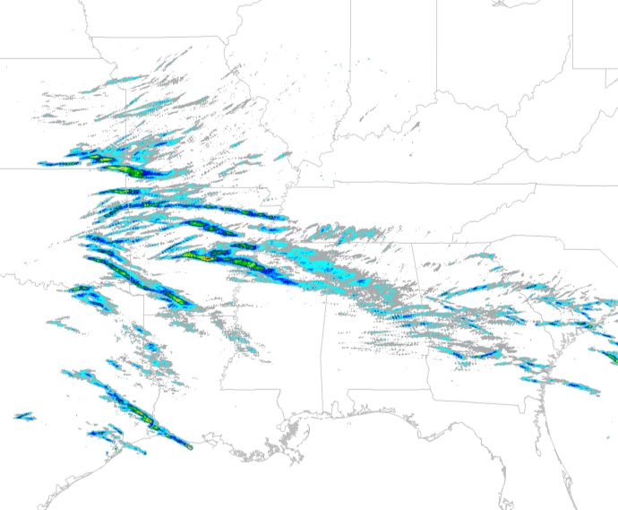
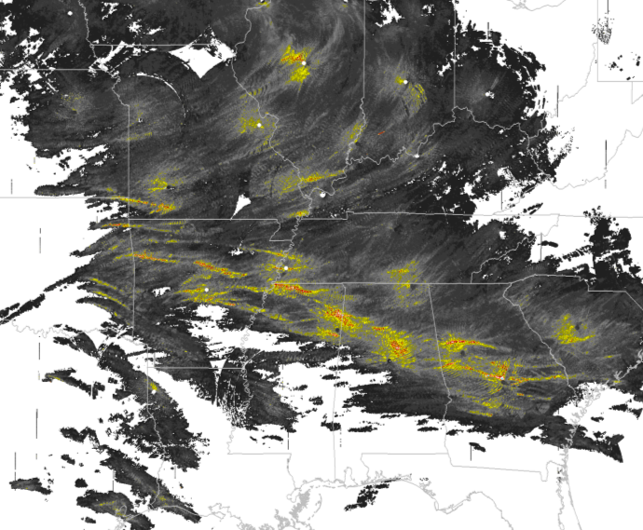
MYRORSS
All WSR-88D Level II processed through MRMS: 2000-2011
~Consistent 4D gridded radar data over entire CONUS
Work in-progress developing MRMS-based hail climatology
MYRORSS integral part of FACETs
Begin to develop radar-based probabilities for severe weather
Will provide baseline skill & new evaluation database for WoF & storm-scale models
10 May 2008
Thank you to:
CICS, CIMMS, NCEI, NSSL
Kiel.Ortega@noaa.gov

Slide 18
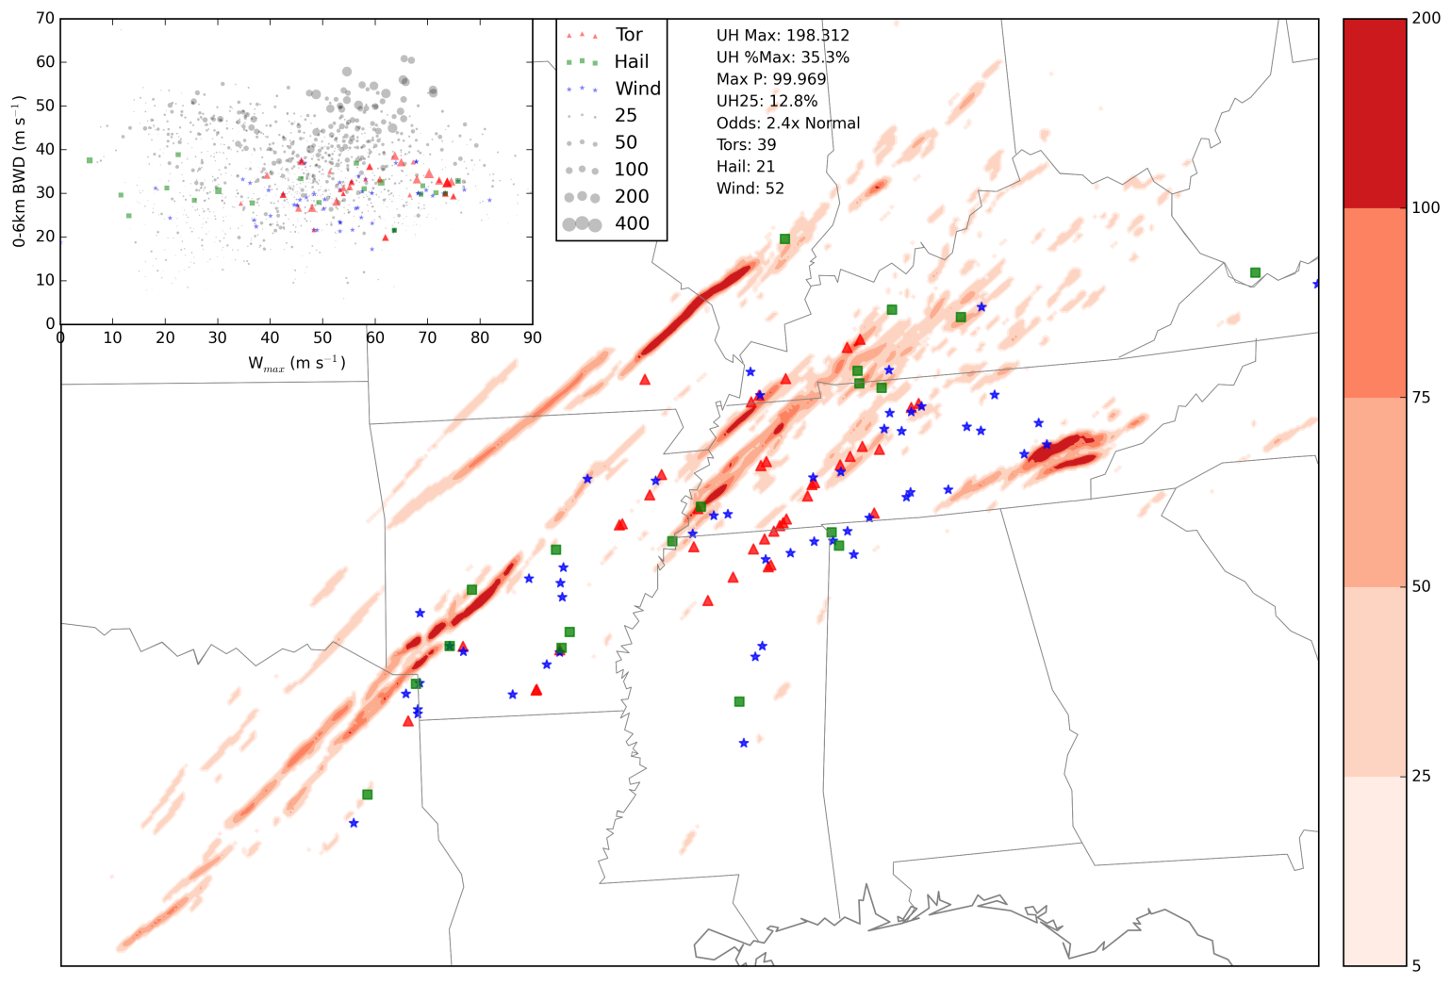
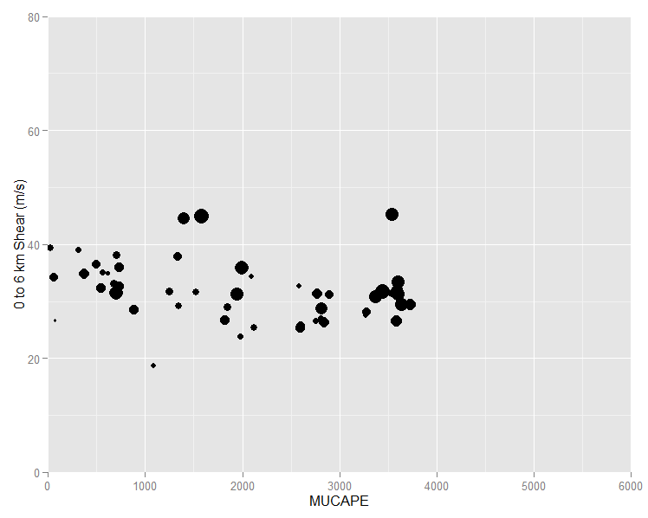
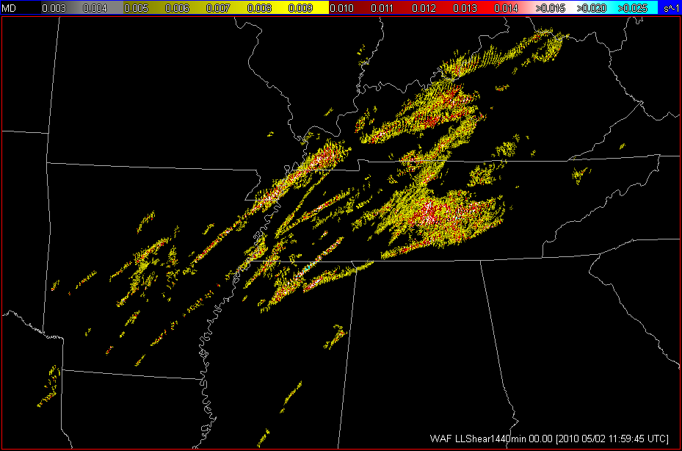
1 May 2010
Proof of concept to make radar data available for use in guiding modeling assessments, capabilities, and verification.
LL Shear

Slide 19
MYRORSS Current Status
Years 2000 thru 2011 completed
  CIMMS/NSSL continues QC effort
  Only 4 years completely QC’d
Public availability?
  Was hoping late 2015
  3D reflectivity grids, few simple derived grids
2012 thru current: NSSL waiting for raw data from NCEI for 2012 & 2013
Huge database*! ~5 TB/year
* - MRMS data only; does not include storage of single radar data

