Slide 1
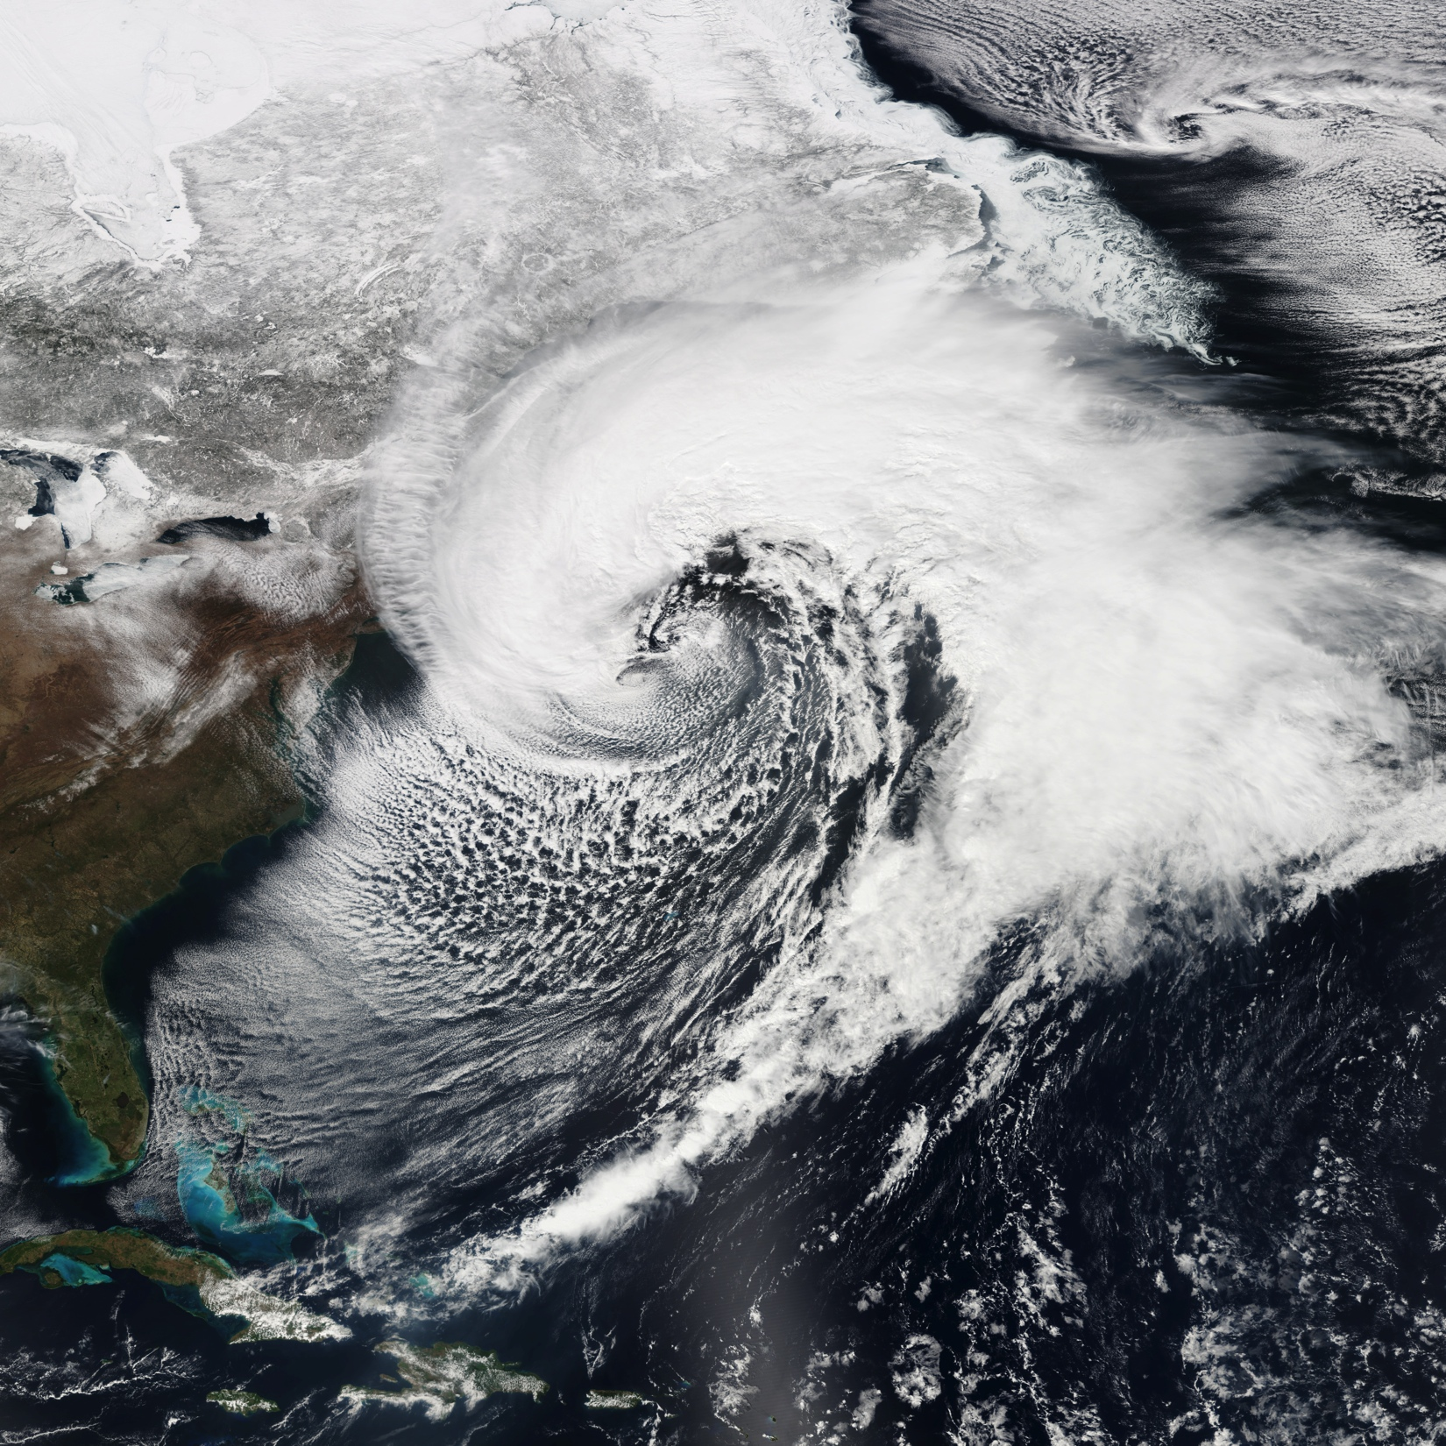
Validation of Significant Weather Features and Processes in Operational Models Using a Cyclone Relative Approach
Brian A. Colle and Edmund Chang
School of Marine and Atmospheric Sciences, Stony Brook University, Stony Brook, NY
Partners:
NCAR-Developmental Testbed Center (NCAR-DTC),
Environmental Modeling Center, Weather Prediction Center, Ocean Prediction Center, and Aviation Weather Center)

Slide 2
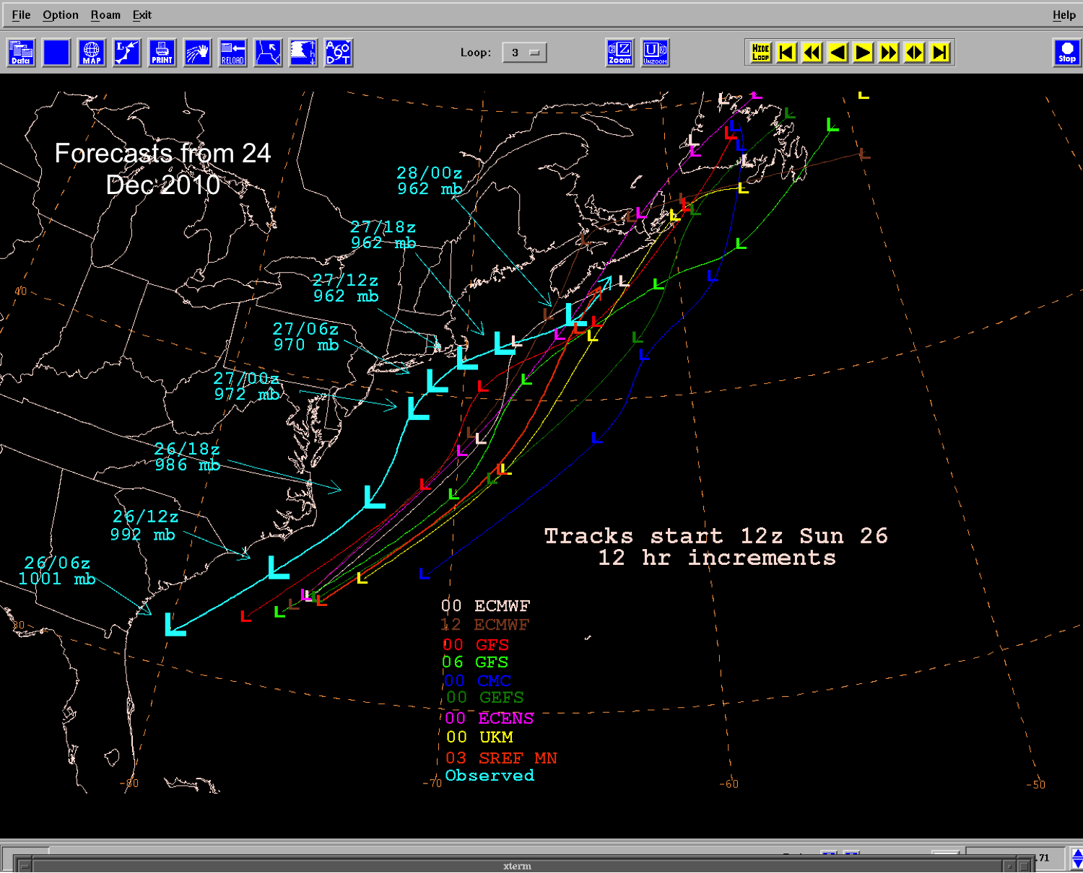
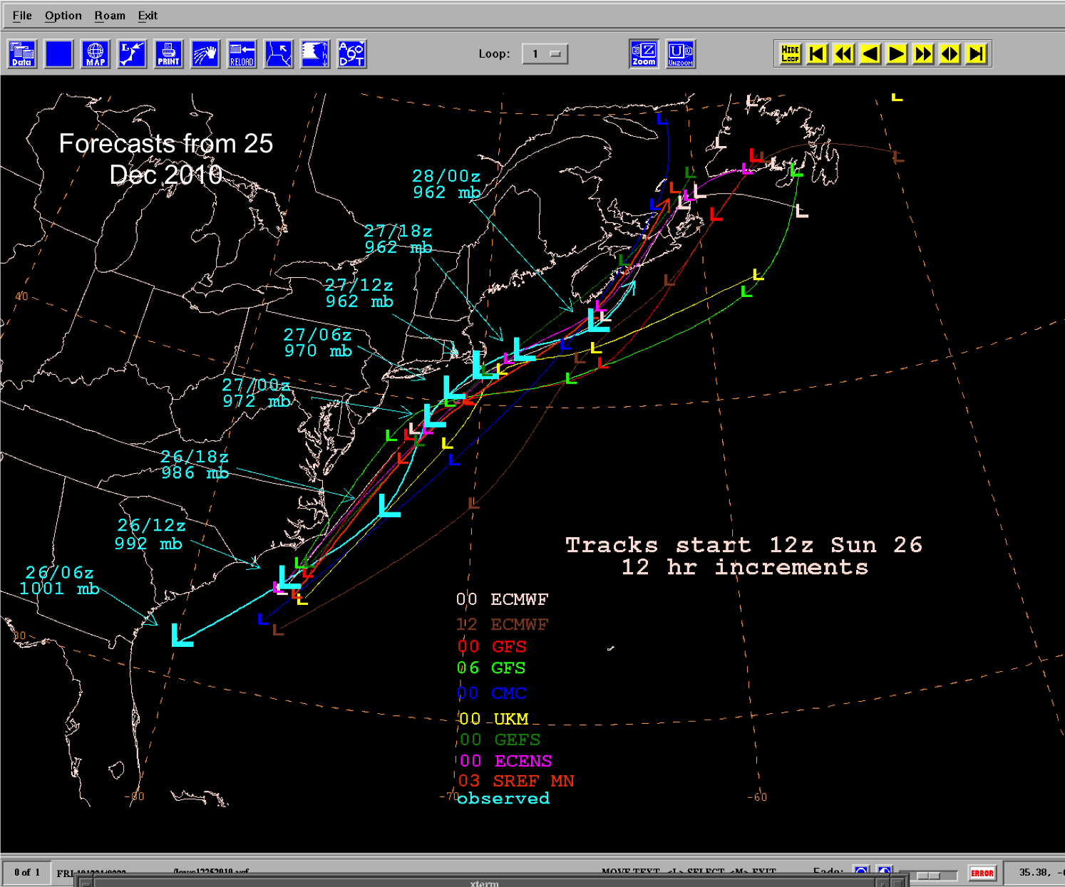
Ensemble Cyclone Predictability Challenges
Extratropical cyclones have large societal impacts with heavy snow, mixed precipitation, damaging winds, and large storm surge.
Conveying confidence in weather forecasts at the medium range is challenging, especially for high impact weather.
Shifting the entire ensemble envelope even during the short range (48-72 h) along the East Coast can be very problematic.
Courtesy: Dan Petersen

Slide 3
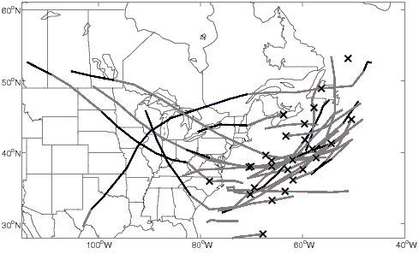
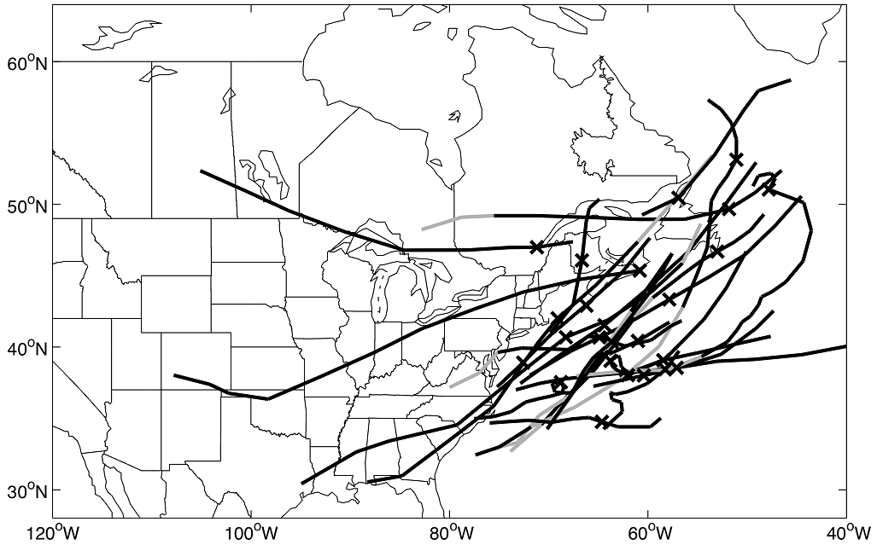
Systematic Cyclone Errors
Need to know the origin and impact of any systematic errors for cyclones. Past studies (e.g., Colle and Charles 2011) showed errors (e.g., GFS), but limited R2O).
Underdeepened day 4 storms
Overdeepened day 4 storms
From Colle and Charles (2011). Forecast cyclone tracks for western Atlantic (WA region) GFS cyclones with large (> 1.5 std. dev.) central pressure errors for cases with (a) positive and (b) negative central pressure errors at hour 96 that are more than 1.5 standard deviations above (below) the mean error of cyclones with positive (negative) error.

Slide 4
Motivation
There has been little effort to quantify model forecast errors for significant weather associated with extratropical cyclones.
Verification need to move to a more feature-based approach.
We hypothesize that one reason why forecasters have not utilized ensembles to the full extent is their limited understanding/verification of the capabilities of these ensembles to predict extreme weather related to cyclones.
Model developers and forecasters need more opportunities to interact with verification data.
New verification approaches are needed focusing on the processes associated with various weather phenomena, and these processes need to be compared within the different operational models.

Slide 5
Project Goals
Collaborate with NCEP/EMC on the cyclone validation of the operational GFS and Global Ensemble Ensemble Forecast (GEFS) using one or more tracking algorithms.
Complete cyclone relative verification for different cyclone stages (from genesis to decay). Separate the bias results by flow regime and relate to other important phenomena in the medium to long-range (e.g., Rossby wave packets).
Develop cyclone-relative verification for physical processes: stability, surface fluxes, cloud cover, moisture flux, etc…
Work with the NCAR-DTC to develop a software interface for operational experiments (e.g., Winter Weather Experiment).
Identify cases that allow model developers and forecasters to better understand the origin of model errors, re-run cases, and access enhanced diagnostic tools.

Slide 6
Approach
Cyclone tracking, matching, and verification (SBU/EMC lead). Focus on GFS and GEFS day 0-10 (compare with CMC/EC).
Use GEFS reforecast to help with flow regime results, and relate with our Rossby wave packet verification/analysis dataset (SBU lead).
Cyclone-relative verification and diagnostic software (SBU and NCAR-DTC leads MET effort).
Interaction with NWS Partners:
EMC (data, cyclone tracks, Model Evaluation Group, feedback to/from model developers)
WPC (test approaches in Winter Weather Expt)
OPC (test and provide gridded scatterometer wind product for cyclones)
AWC (MET/MODE to validate parameters around the cyclone relevant to aviation --aircraft turbulence, icing, and cloud cover)

Slide 7
Cyclone Tracking Process
Data: TIGGE: THORPEX Interactive Grand Global Ensemble (2007-2015)
  20 member NCEP - GEFS: Global Ensemble Forecast System
  50 member ECMWF: European Center for Medium-Range Weather Forecasts
  20 member CMC: Canadian Meteorological Center Ensemble
  Control Members are included for statistical comparison
Track ensemble, control, and reanalysis cyclones using Hodges (1995) surface cyclone tracking scheme
  ECMWF ERA-Interim Re-Analysis is used to verify cyclone properties from October to March
  All MSLP data is 1˚ x 1˚ resolution
  Data is filtered to remove planetary scale effects (small wavenumber) and small scale effects (large wavenumber)
  Cyclone tracking conditions: 24 h lifetime and 1000 km distance traveled (Colle et al. 2013)
Preprocess Data: Bandpass Filter
Cyclone Verification/ Matching Process
Displacement/Intensity Error Calculations
Mean Error Calculations
Hodges Cyclone Tracking
Calculate Cyclone Intensity
Subset Tracks For Active Cyclone Regions

Slide 8
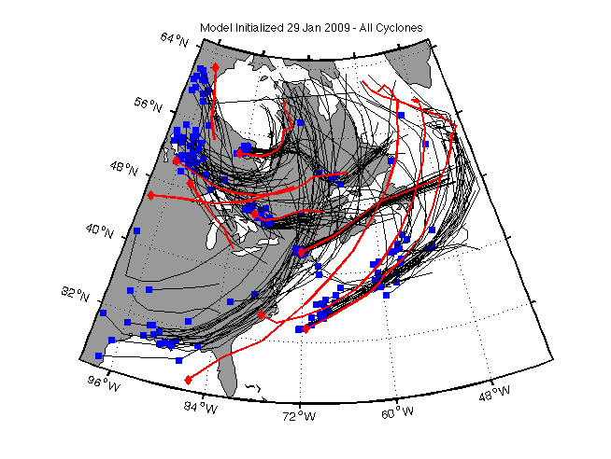
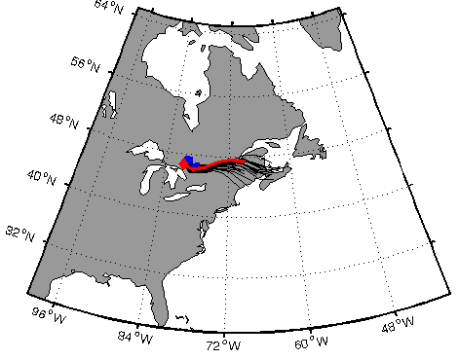
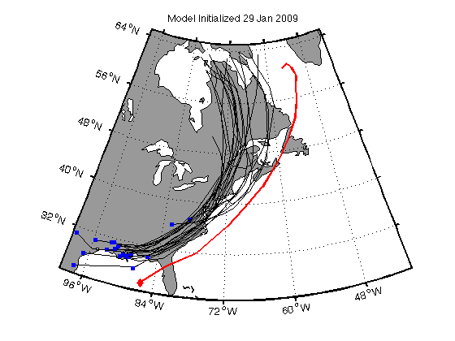

Cyclone Verification Criteria
Two criteria need to be satisfied to successfully match the forecast and reanalysis cyclone (modified criteria from Froude et al. 2007)
The pairing distance d of a point in an individual forecast track to a point in the analysis track, which coincides in time with the analysis track, is less than the maximum pairing distance d_{max}.
d ≤ d_{max} (d_{max} = 1500 km)
At least T% of the points in the forecast track coincided in time with the analysis track and satisfied d ≤ d_{max}.
100 × [2n_{M}/(n_{A} + n_{F})] ≥ T (T = 60%)
* Currently, comparing out tracking and matching approach with that used by EMC (archive of tracks/matches form Guang Luo)
Storm #1
Storm #2
Notes:
Some idea of paring success as compared to manual inspection? What fraction of model or obs storms are paired. If not paired, then not used (so these scores may be optimistic).

Slide 9
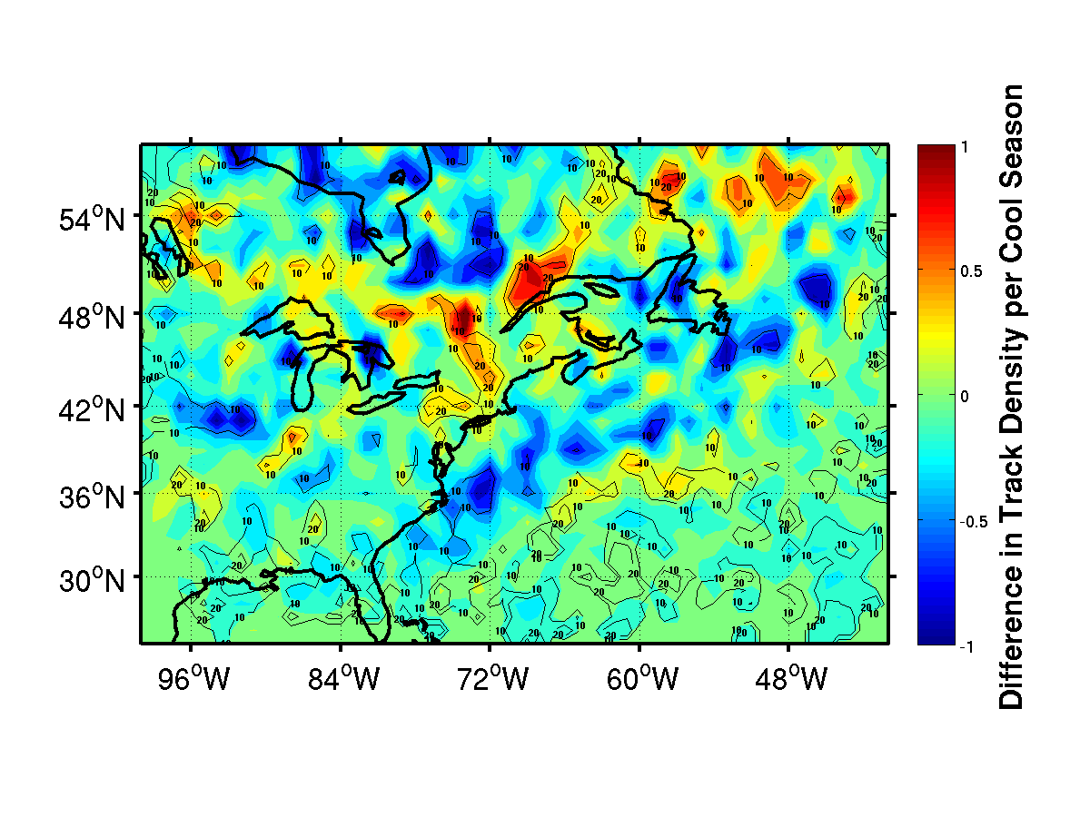
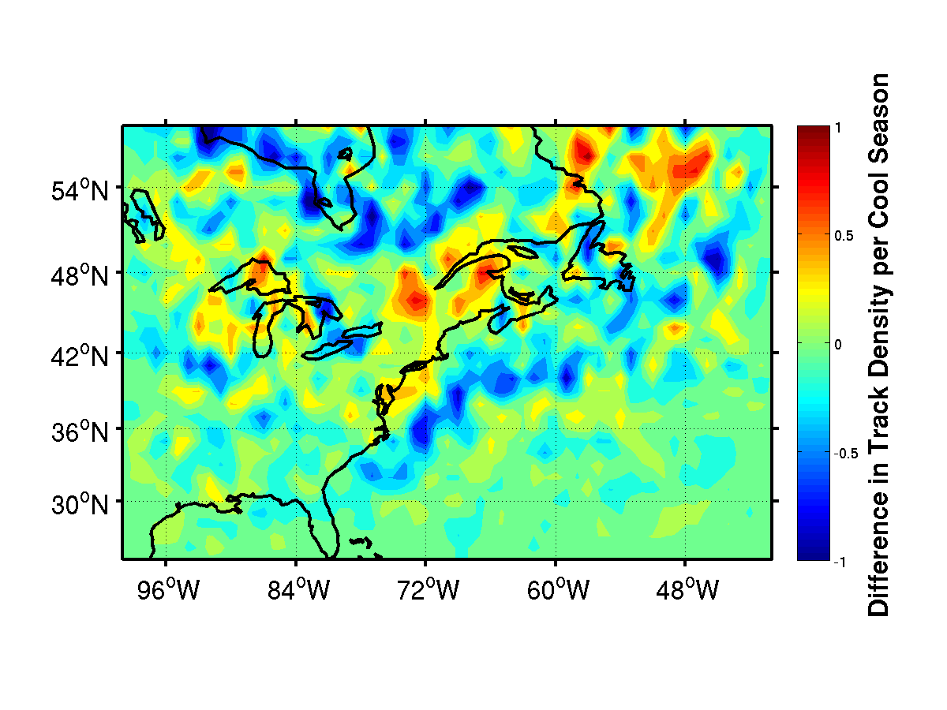
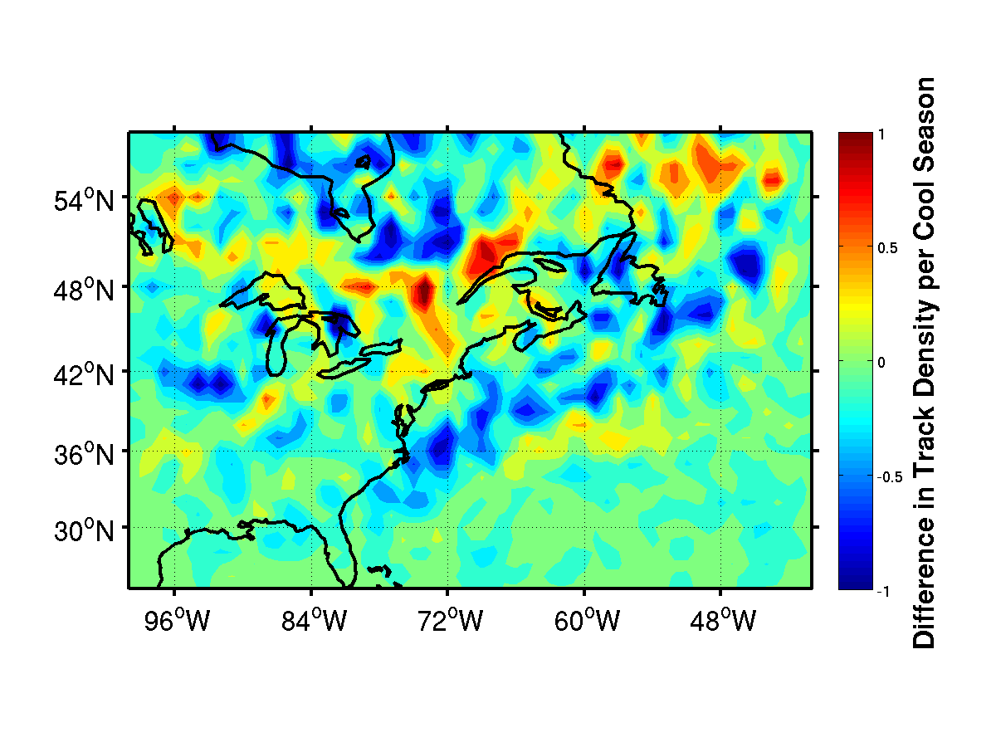
Current Effort #1: Day 1-6 Cyclone Verification
ECMWF and NCEP Control Cyclone Density Difference
ECMWF Control Day 4-6
NCEP Control Day 4-6
Difference in track density amounts to 5-10% error where cyclones are underpredicted off the East Coast and near Hudson’s Bay
Both NCEP and ECMWF tend to overpredict over northern New England

Slide 10
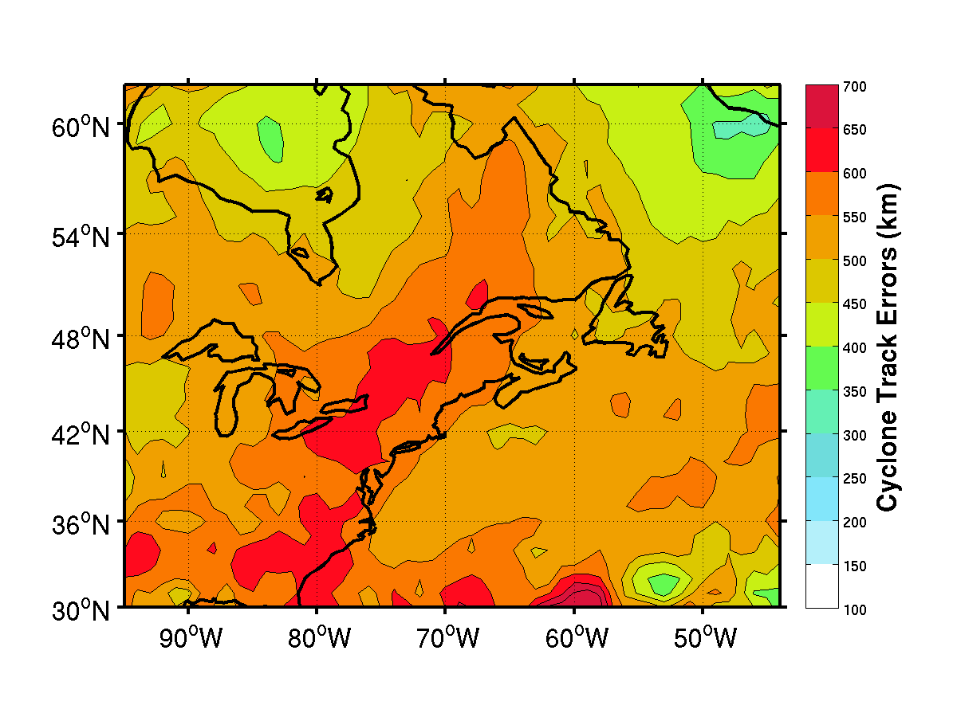
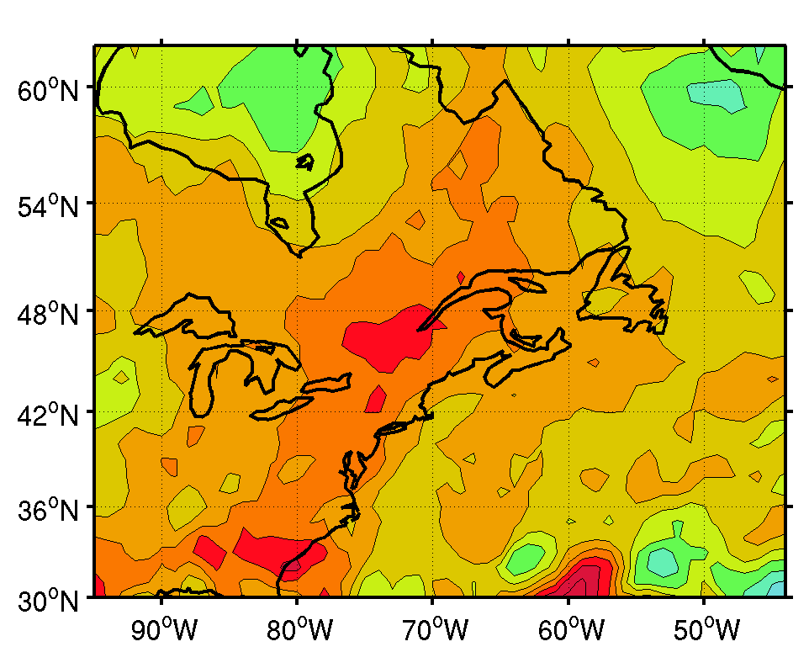
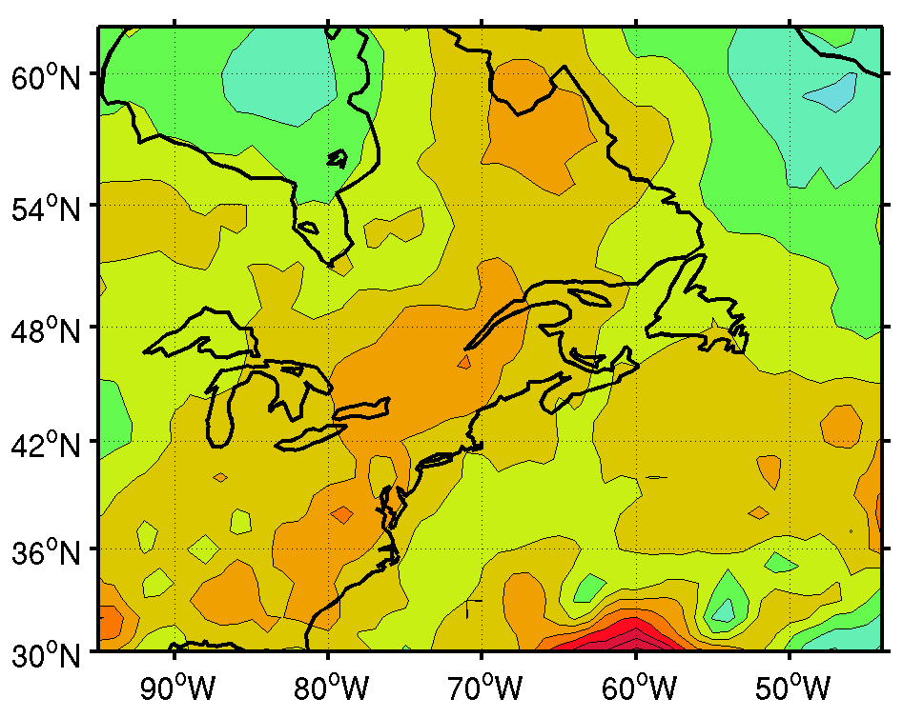
All Cyclones - Average Cyclone Track Errors Day 4-6
CMC
NCEP
CMC shows the highest domain wide error during the medium range
  largest errors extending the NE US
NCEP has larger magnitude errors in northern New England
Strong cyclone track error gradient near the coast
ECMWF

Slide 11
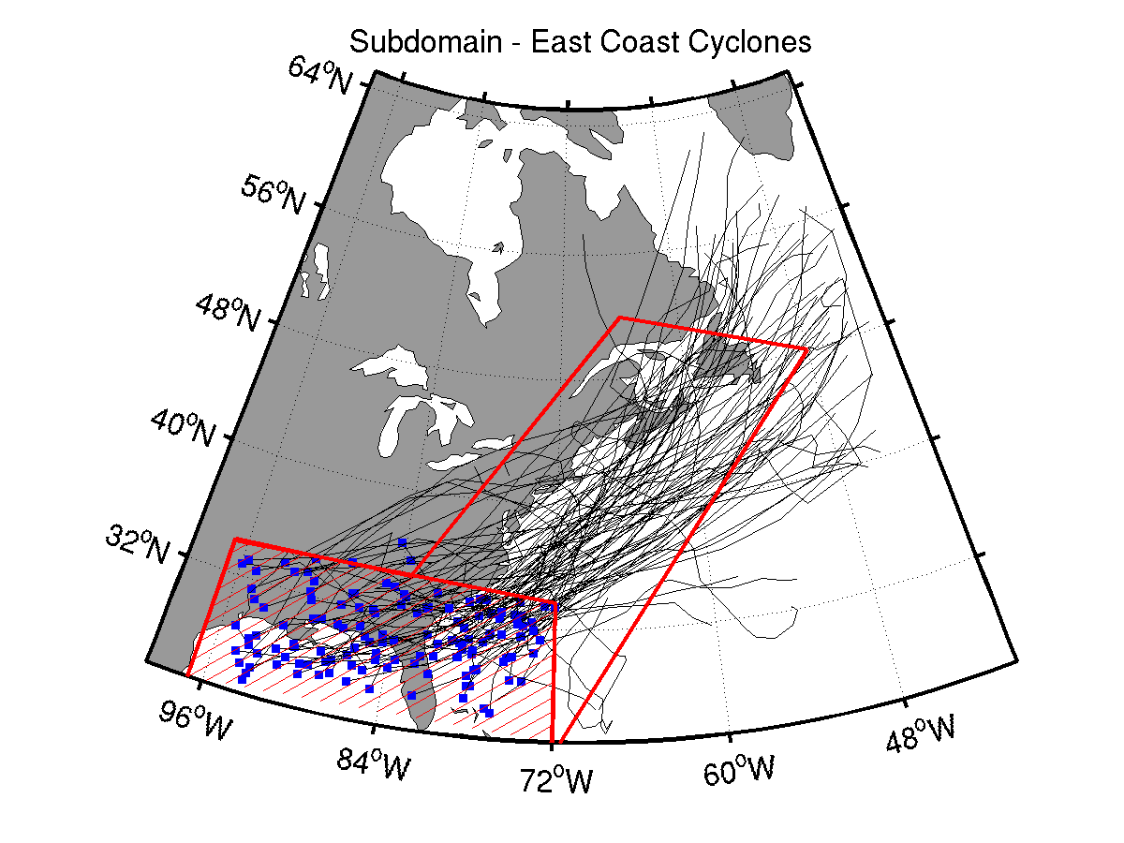
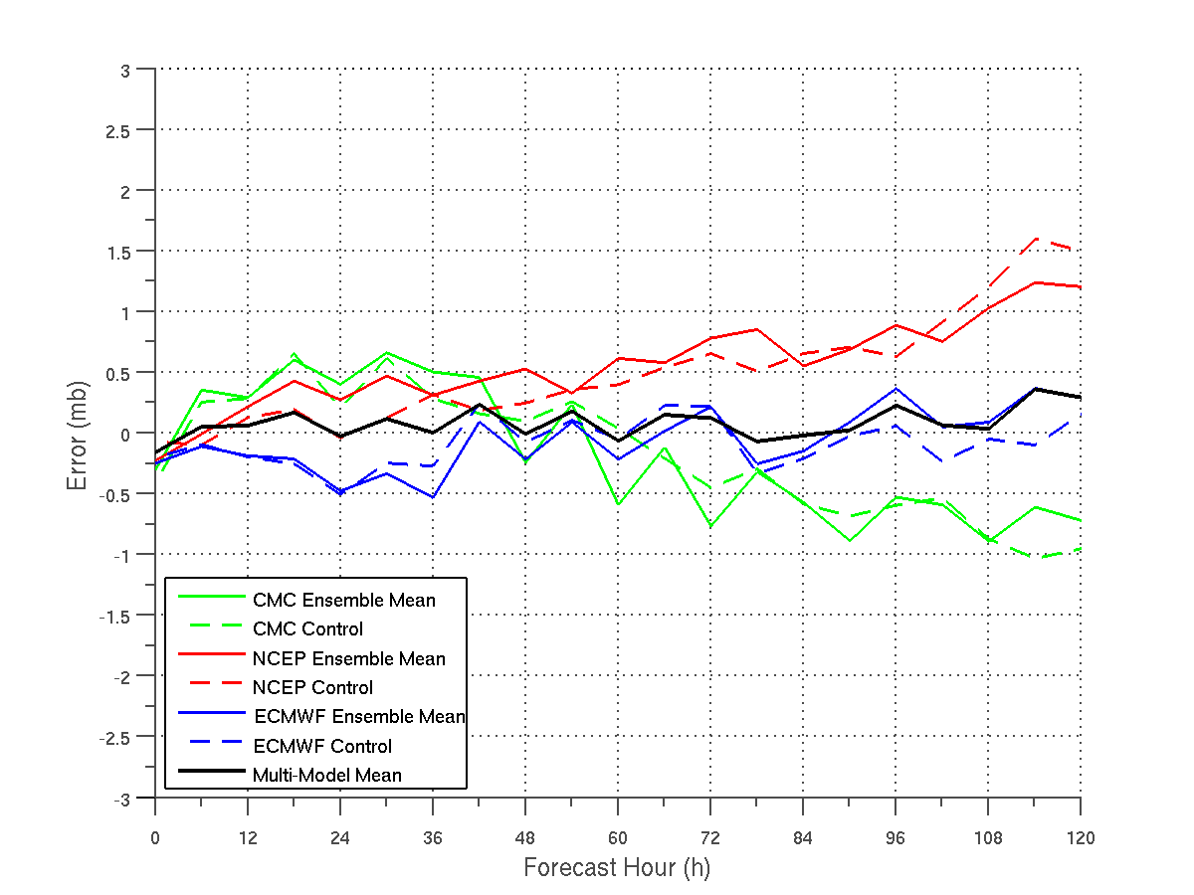
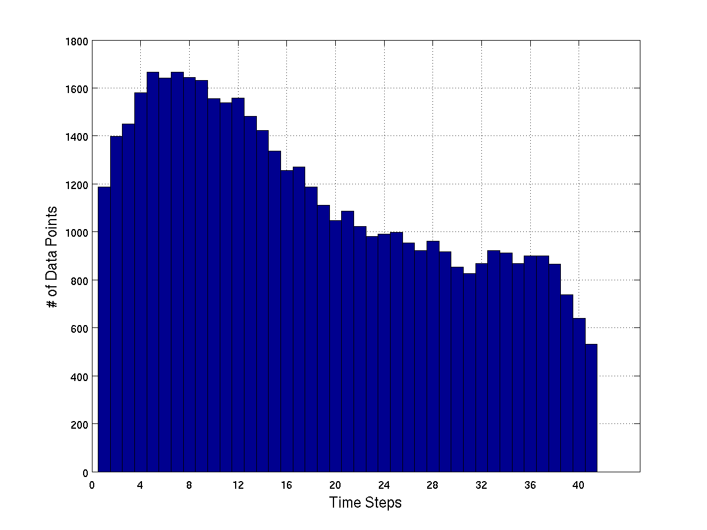
Miller A Cyclone Intensity ME
  NCEP mean underdeepens cyclones by 0.75 hPa to 1.25 hPa from hour 72 to 120
  CMC mean underdeepens cyclones in short range and overdeepens cyclones in the medium range
  ECMWF mean closely follows the multi-model mean from hour 48 to 120
• The range of data points varies from 1,600 in the short range to 1,000 in medium range

Slide 12
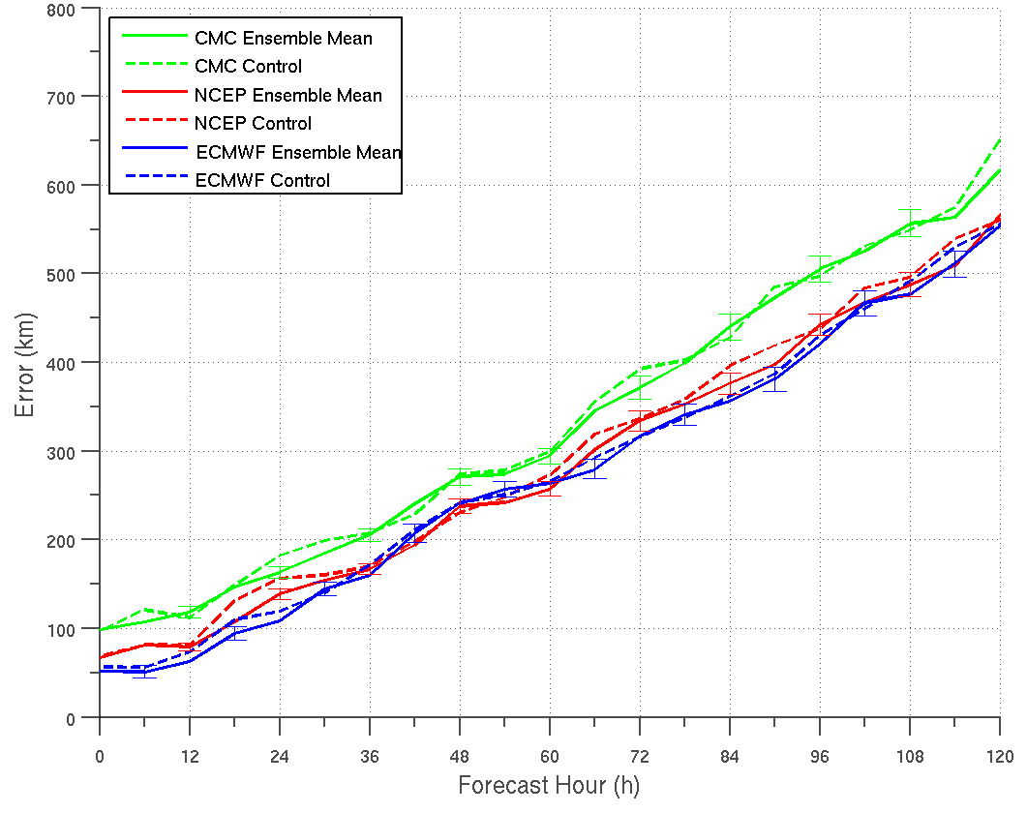
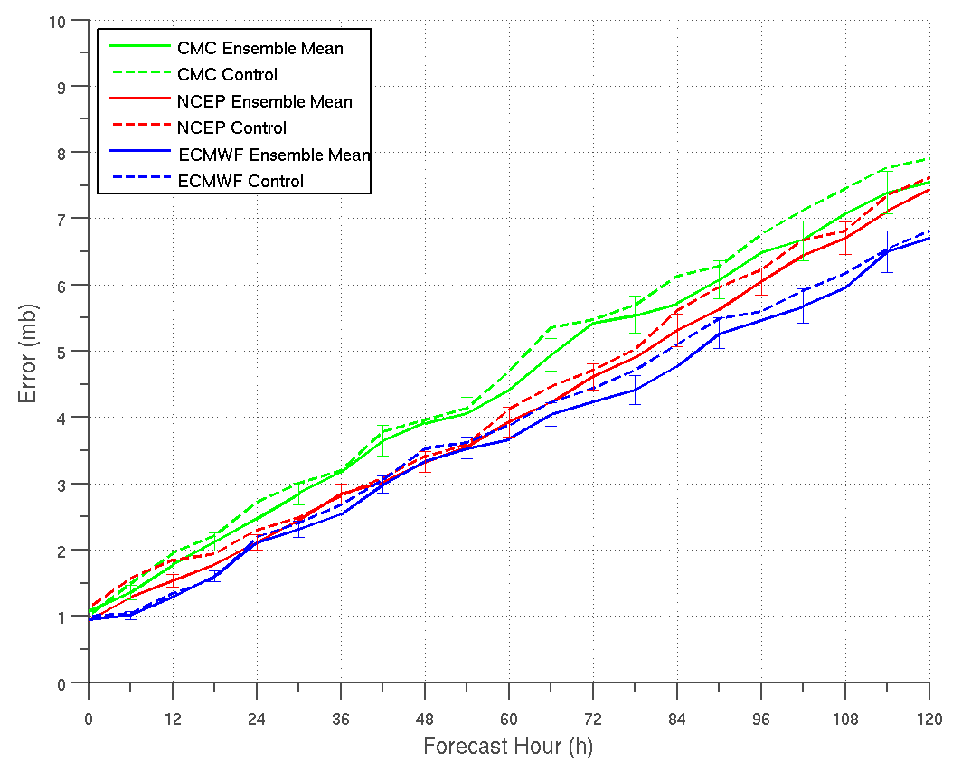
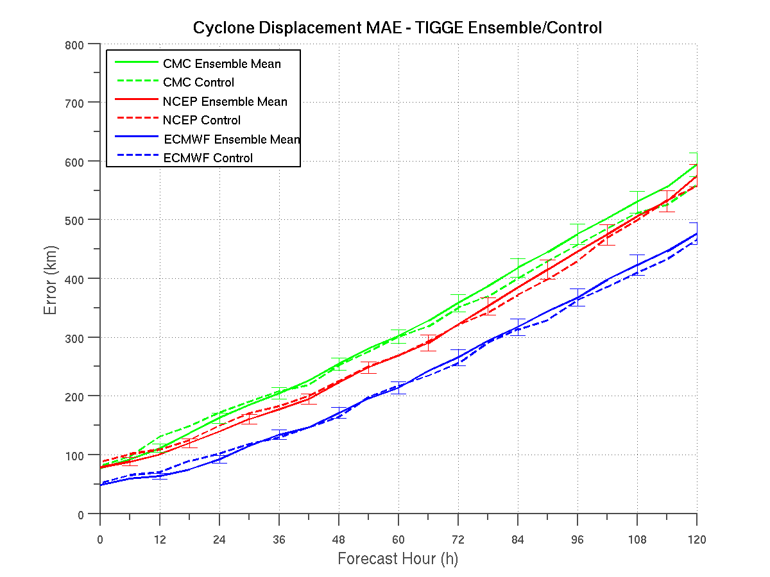
“Miller A” Cyclone MAE’s
Miller (1946)
  A total of 92 Miller A cases identified (Miller 1946)
  The EPSs with the lowest displacement error varies between the ECMWF and NCEP mean
  NCEP and ECMWF have comparable Miller A cyclone displacement errors
All Cyclones - Displacement MAE
Notes:
Need to emphasize how different than all cyclones – NCEP and EC comparable using a bullet point.

Slide 13
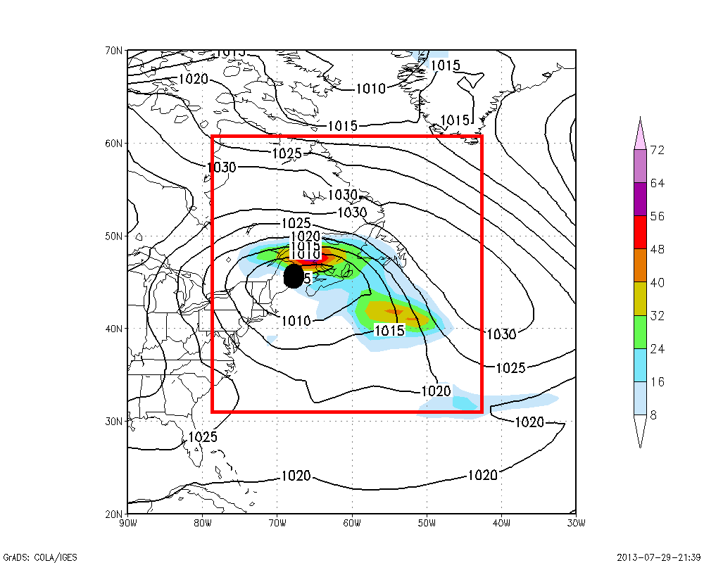
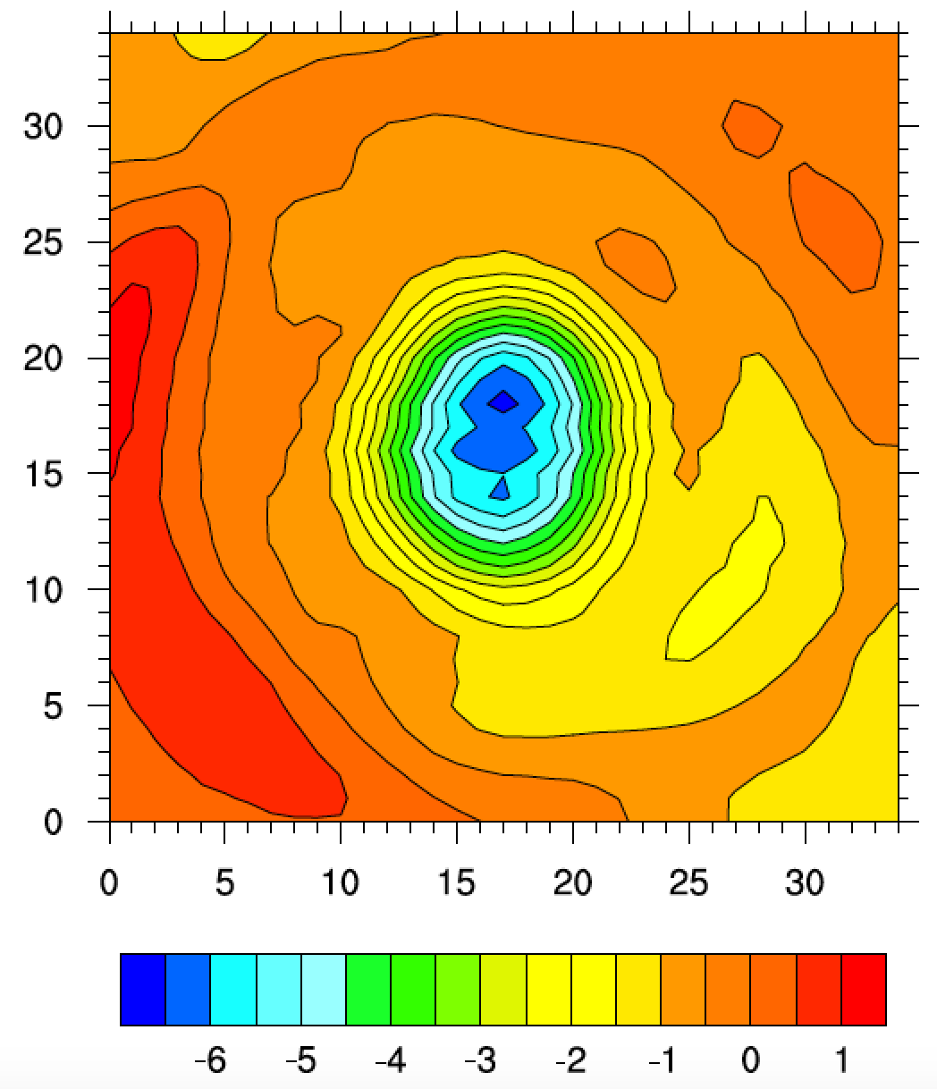
Current Effort #2 (SBU lead)
Cyclone Characteristics using Cyclone Relative Approach
Composite Average (0.5 deg grids) and Difference between forecast and analysis
Example 6-h time for MSLP & Precipitation
Composite difference MSLP (in hPa) for NCEP-GFS – ERA-Interim for Sandy on 27 Oct 2012 (24-48 h forecast) plotted every 0.5 degree

Slide 14
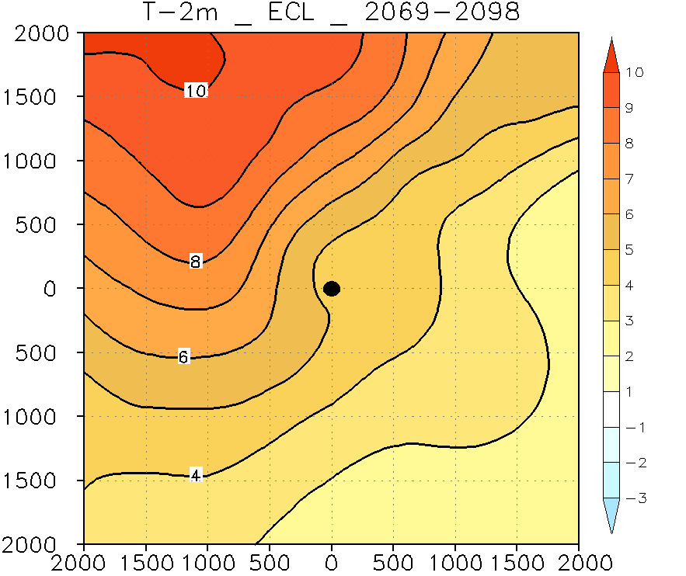
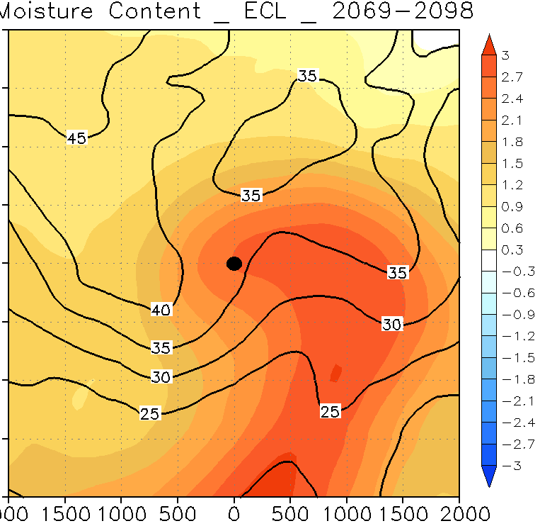
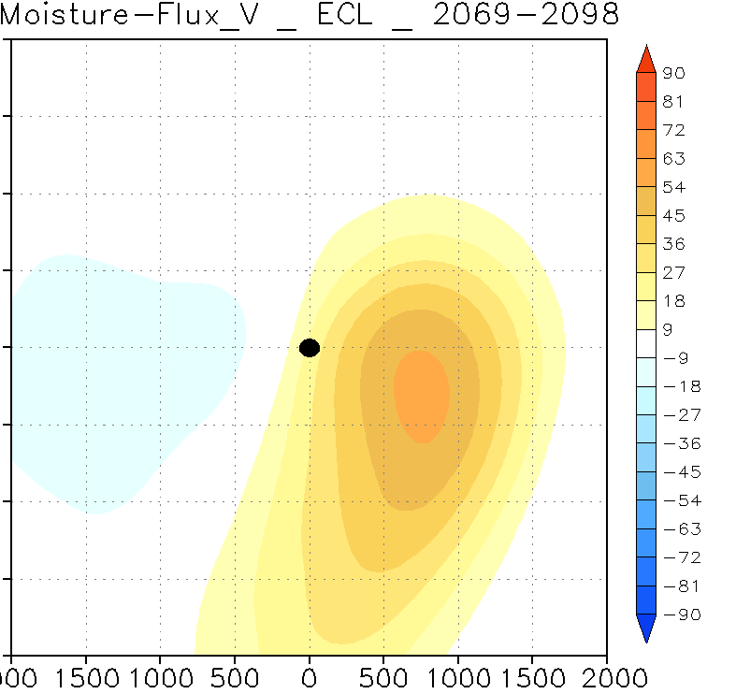
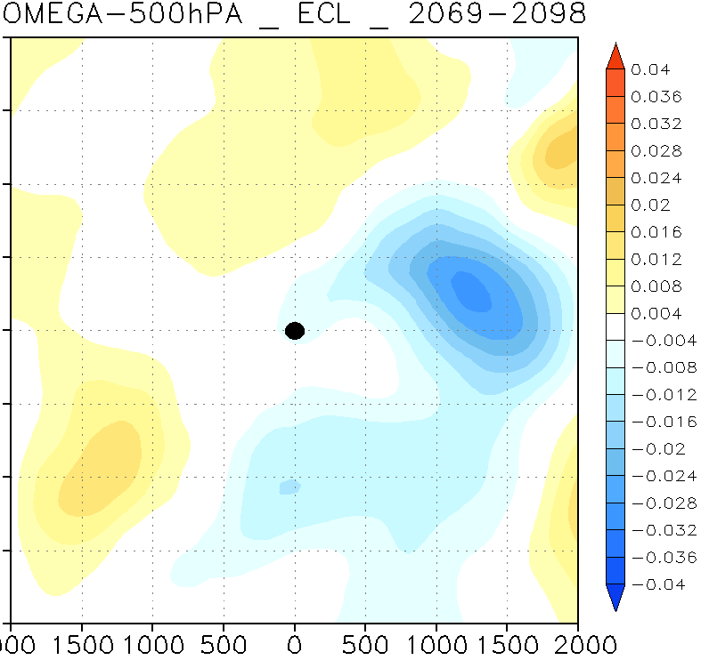
Cyclone-Relative Diagnostics (Differences with Analyses) – Currently FORTRAN/Matlab, but will put into DTC MET software
Moisture Content
850-250 hPa
(Kg/m**2)
T_2m (K)
Meridional
Moisture Flux
850-250 hPa
(Kg/m*s)
500 hPa
Omega
(hPa/s)

Slide 15
NCAR-Developmental Testbed Center
(NCAR-DTC) Efforts
* Focus on Development of Meteorological Evaluation Tools (MET) for Extratropical Cyclones
Paul Kucera, Tara Jensen, John Halley-Gotway, Jamie Wolff, Michelle Harrold, Tatiana Burek, Louisa Nance, and Barbara Brown
National Center for Atmospheric Research (NCAR)/Research Applications Laboratory (RAL)

Slide 16
Can Leverage Existing MET for Tropical Cyclones
MET-TC components
Dark circles represent MET-TC modules
Light boxes represent input/output
Primary functions of the code are:
  Compute pair statistics from ATCF input files
  Filter pair statistics based on user specifications
  Compute summary statistics

Slide 17
TC_STAT
Provides summary statistics and filtering jobs on TCST output
Filter job:
  Stratifies pair output by various conditions and thresholds
Summary job:
  Produces summary statistics on specific column of interest
Input: TCST output from tc_pairs
Output: TCST output file for either filter or summary job

Slide 18
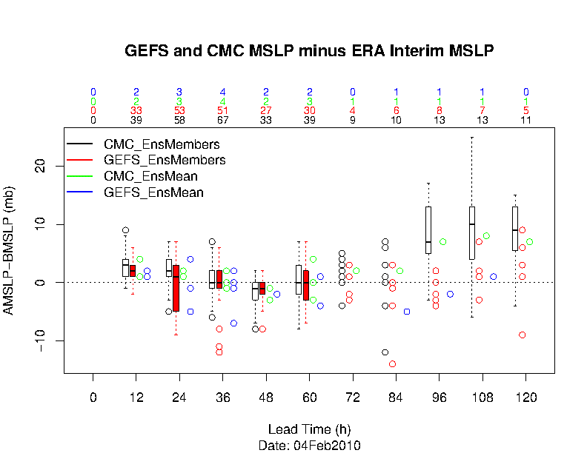
MET Example for 4 February 2010 Storm

Slide 19
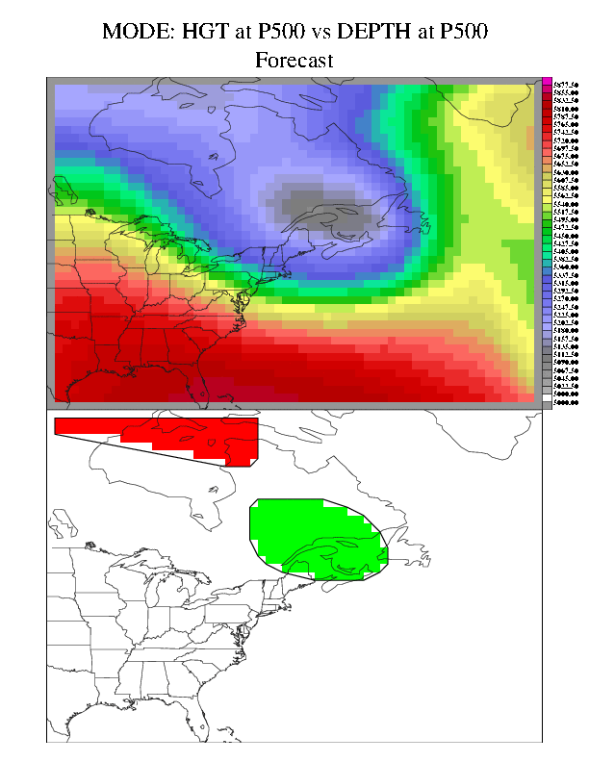
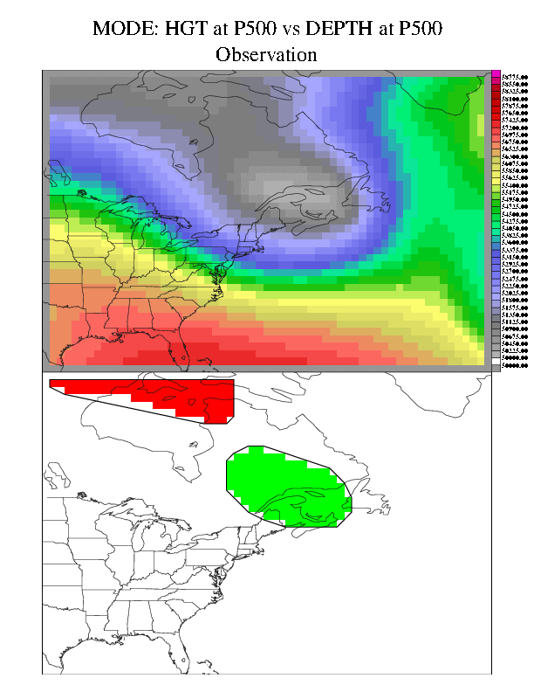
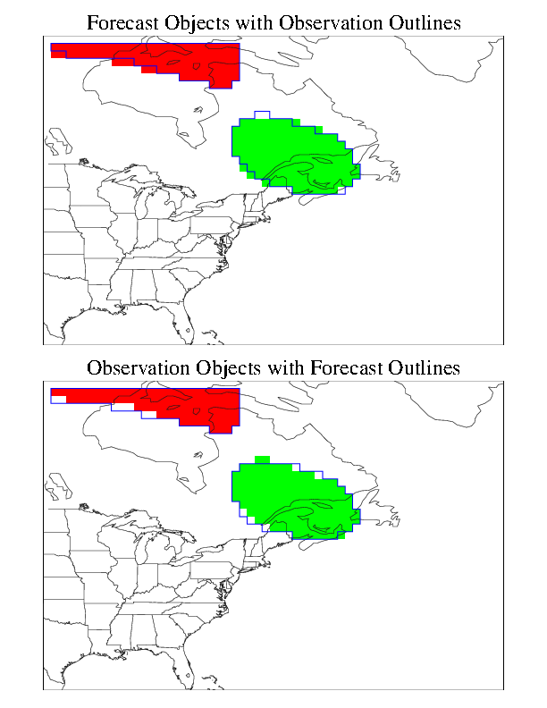
MODE for ExtraTropical Cyclones
GFS
ERA
FCST OBJECTS – OBS OUTLINE
Symmetric Difference:
Non-Intersecting Area
Fcst HR | Symm Diff / % | Fcst HR | Symm Diff
00 | 8 / 6% | 30 | 30 / 28%
06 | 7 / 5% | 36 | 30 / 47%
12 | 17 / 11% | 42 | 29 / 47%
18 | 35 / 22% | 48 | 42 / 82%
24 | 34 / 18% | -
GFS forecasts cyclone position fairly well with only small deviations in general shape
December 17 2009 – 00 UTC – 500 MB height – 0-48hr Fcst
100 m BIAS removed by changing convolution thresholds
% = symmetric difference
obs area
Notes:
Forecasts and Observed Lows are pretty well aligned once bias is accounted for
We can use Symmetric Difference – which measures the non-intersecting area to quantify the differences – as well as normalizing symmetric difference by the observed object area size – we gain a sense of how well the forecast is performing
It looks like forecasts do pretty well through 30 hours but then as the Low tightens the forecast lags the observed track producing some displacement errors NOTE: look at animated objects to see that forecast is lagging observation.

Slide 20
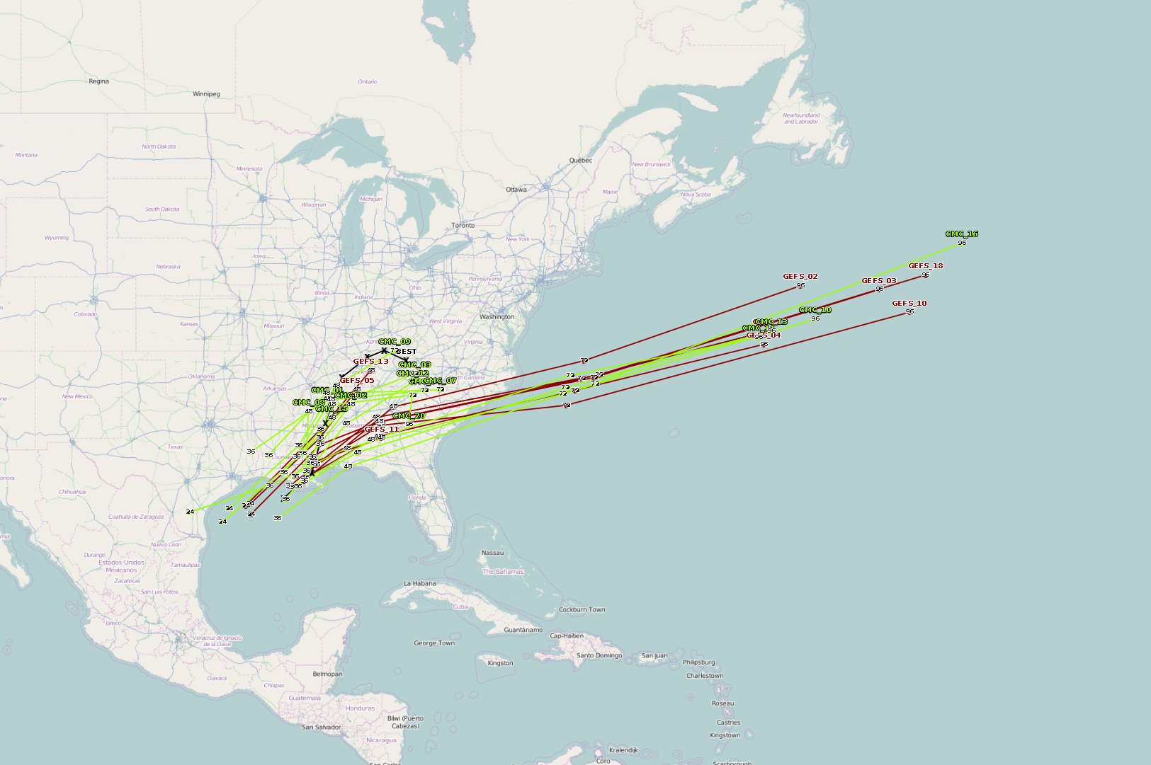
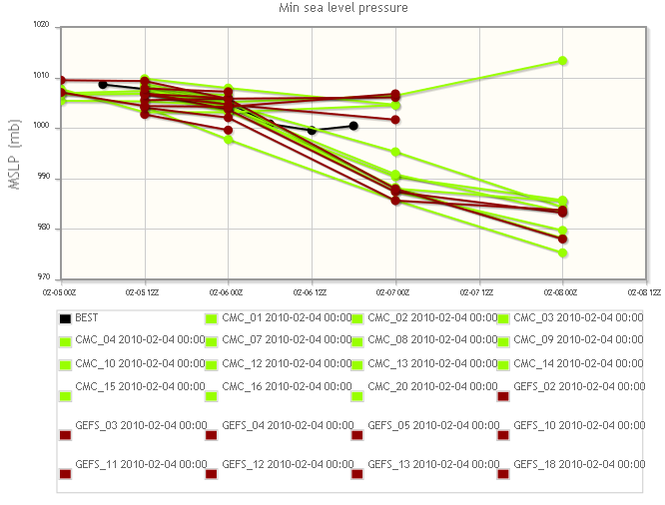
Convert NHC Interactive Display System to Track/Verify Extratropical Storms

Slide 21
Year 1 Goals (Red = done)
Dataset collection (GFS and GEFS forecasts). – SBU
Tracking of cyclones and matching of obs/model (SBU and EMC)
Basic verification metrics for cyclones (intensity, speed, track) using analyses (CFSR and RUC). (SBU and EMC).
Collection of other observational datasets and interpolation to grid (multi-sensor precipitation, cloud products, etc.). (SBU and NCAR-DTC)
Track other important cyclone features instead of central pressure (moisture plumes, low-level jets, etc…). (SBU and NCAR-DTC)
Complete cyclone relative verification for different cyclone stages (from genesis to decay) and storm intensity of the temperature, moisture, precipitation, and winds around the cyclone. (SBU – with visits to NCAR-DTC, and EMC)
Develop MET module (METViewer) to composite statistics around cyclone (plot spatially and calculate metrics).

Slide 22
Long-term Goals
Evaluate methods to identify different flow regimes and compute evaluation statistics in a cyclone relative framework; Apply MODE to validate important features around the cyclone (e.g. jet streaks, low-level jets, heavy precipitation, strong surface winds, etc.) (NCAR-DTC).
Map the cyclone relative verification results back to the Earth-relative grid (SBU and NCAR-DTC).
Compute cyclone relative verification for relevant physical processes: stability, surface fluxes, temperature gradients, cloud cover, and a moisture budget around the storm (SBU).
Provide MET software tools for various operational centers to continue the validation efforts after this project for next generation of models. (NCAR-DTC and EMC).
Use software and scripts for operational ensembles and in WPC Winter Weather Experiment. (SBU and WPC).
Add several additional cases to the Mesoscale Model Evaluation Testbed (MMET) based on results and make them (NCAR-DTC).

