Slide 1


Small business innovation research program
Nws STI R2O Overview – april 19, 2021
Pete Roohr
NOAA/NWS SBIR Program Manager

Slide 2
What is small business innovation research??
The SBIR program is a United States Government program, coordinated by the Small Business Administration, intended to help certain small businesses conduct research and development (R&D). Funding takes the form of contracts or grants. The recipient projects must have the potential for commercialization and must meet specific U.S. government R&D needs.
The overall program gives businesses smaller than 500 people a huge chance to compete against bigger companies like Lockheed-Martin, Boeing, Booz Allen Hamilton.
Commercialization and innovation are the key to success!!

Slide 3
What is STTR? Small Business Technology Transfer
STTR requires the small business to have a formal collaboration agreement with a nonprofit research institution during Phases I and II. The research institution is responsible for at least 30 percent of the total effort for the project, and the small business is responsible for at least 40 percent.
The NOAA Technology Transfer award recognizes NOAA scientific, engineering, and technical employees for the transfer of a NOAA-developed technology to private industry, academia, or other government (federal, state, local) agencies. The ideal candidate will have shown substantial creativity, innovation, and effort above and beyond their normal duties in getting the technology successfully transferred to their partner(s).

Slide 4
What is the difference between Sbir and sttr??
The major difference between the SBIR and STTR is that the STTR requires the small business to partner/collaborate with a U.S. non-profit research institution, while the SBIR allows you partner/collaborate.

Slide 5
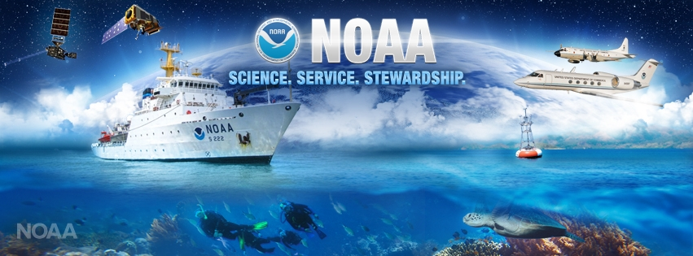

National Oceanic and Atmospheric Administration
https://www.sbir.gov
https://techpartnerships.noaa.gov/SBIR

Slide 6
NOAA : National Oceanic and Atmospheric Administration
Mission:
To understand and predict changes in climate, weather, oceans and coasts.
To conserve and manage coastal and marine ecosystems and resources.
To share that knowledge and information with others.

Slide 7
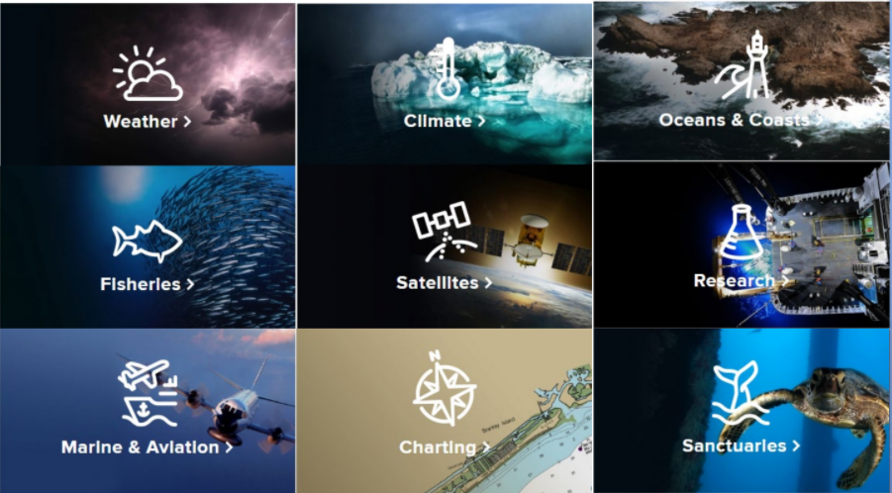
Noaa Mission areas

Slide 8
Organization – Line Offices UNDER SBIR
National Weather Service (NWS)
National Environmental Satellite Data & Information Service (NESDIS)
National Marine Fisheries Service (NMFS)
National Ocean Service (NOS)
Oceanic and Atmospheric Research (OAR)

Slide 9
Funding and awards for sbir/sttr
Small Business Innovation Research (SBIR) and Small Business Technology Transfer (STTR) programs
Supports R&D and financing of cutting
edge technologies
~$2.5 billion annual set aside
~160,000 awards granted
~10 patents per day
www.sbir.gov

Slide 10
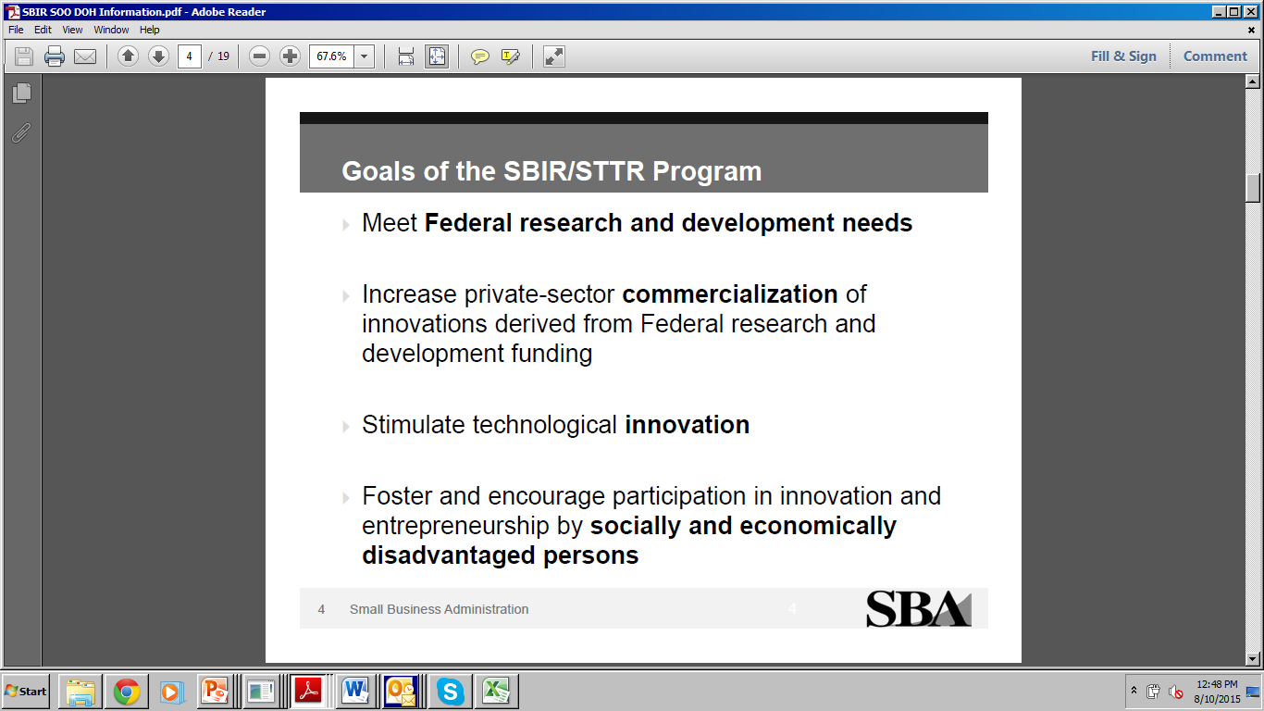

Slide 11
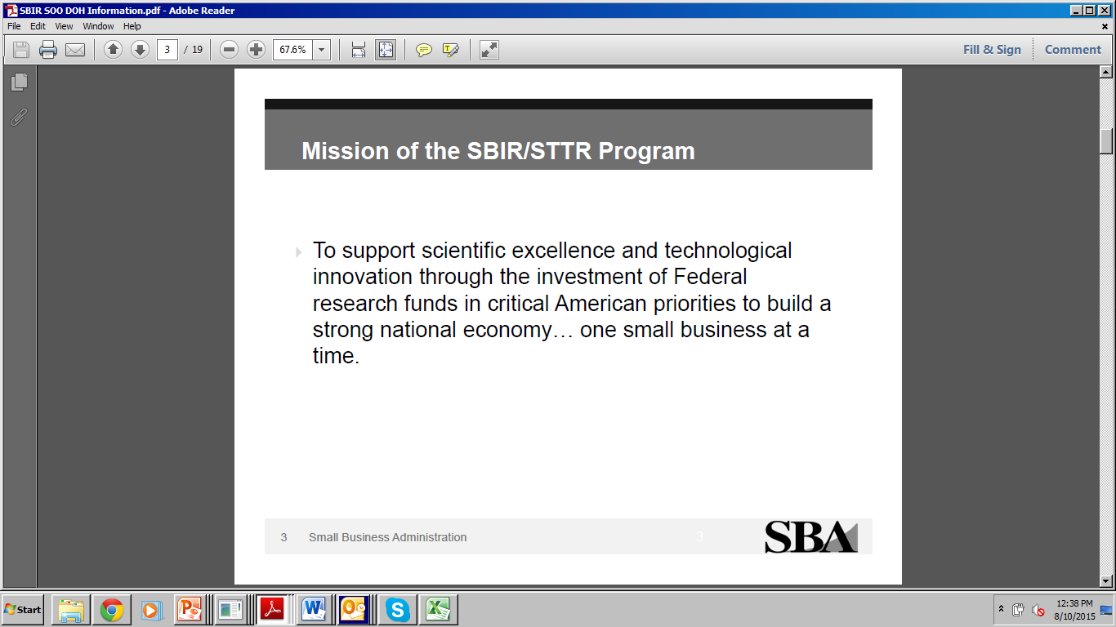

Slide 12
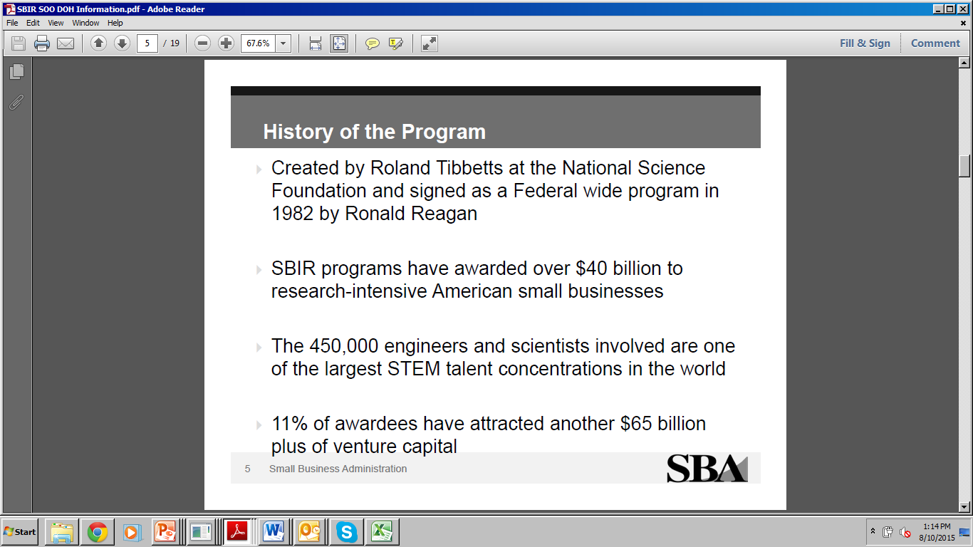
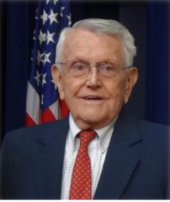

Slide 13
The Small Business Innovation Research (SBIR) Program
A set-aside program for small business to engage in Federal R&D with potential for commercialization
3.2% of the extramural research budget (FY2015 ~2.0 Billion in summation) for all agencies with a budget greater than $100M per year. It was about 2.4% when I took over NWS SBIR from Jamie Vavra in 2010
FY 2011 | FY 2012 | FY 2013 | FY 2014 | FY 2015 | FY 2016 | FY 2017 | FY2018 | FY2019 | FY2020
2.5% | 2.6% | 2.7% | 2.8% | 2.9% | 3.0% | 3.2% | 3.2% | 3.2% | 3.2%

Slide 14
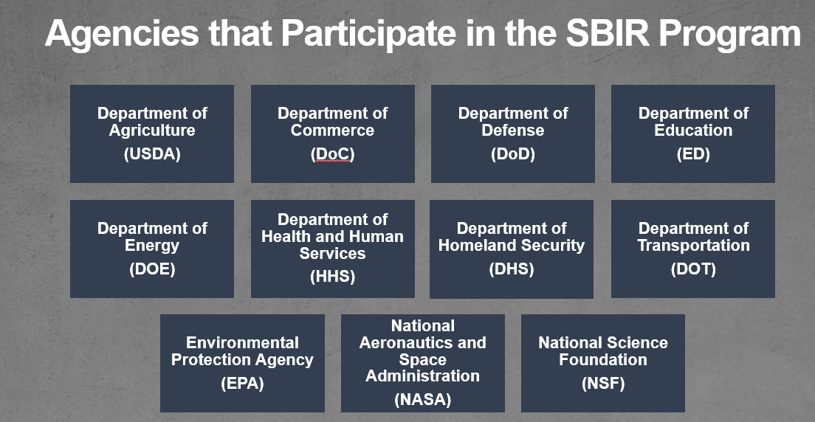

Slide 15
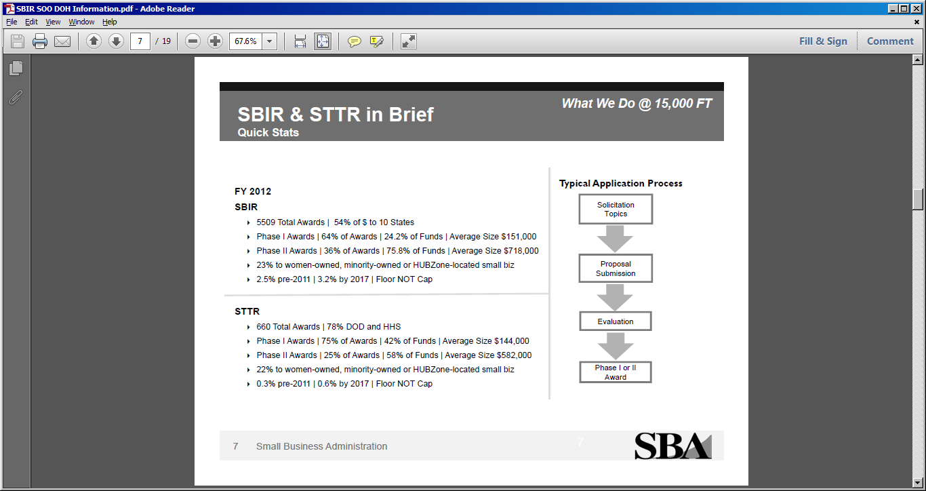

Slide 16
FUNDING BY STATE IN fy2018 (TOP 10)
State | # Phase I | $ Phase I (Millions) | # Phase 2 | $M Phase 2 (Millions) | # SBIR | $M SBIR (Millions)
California | 660 | $126.0 | 338 | $456.6 | 998 | $582.6
Massachusetts | 325 | $68.3 | 201 | $253.8 | 526 | $322.1
Virginia | 154 | $27.1 | 117 | $136.8 | 271 | $164.0
Maryland | 173 | $39.1 | 74 | $93.8 | 247 | $132.9
Colorado | 139 | $23.7 | 95 | $98.9 | 234 | $122.7
Pennsylvania | 125 | $23.5 | 74 | $93.6 | 199 | $117.2
New York | 136 | $26.6 | 67 | $88.4 | 203 | $115.1
Ohio | 118 | $19.2 | 76 | $86.6 | 194 | $105.8
Texas | 130 | $26.2 | 67 | $76.0 | 197 | $102.2
North Carolina | 112 | $24.1 | 46 | $62.6 | 158 | $86.8

Slide 17
FUNDING BY STATE IN fy2018 (BOTTOM 10)
State | # Phase I | $ Phase I (Millions) | # Phase 2 | $M Phase 2 (Millions) | # SBIR | $M SBIR (Millions)
West Virginia | 5 | $0.71 | 4 | $3.6 | 9 | $4.4
South Dakota | 5 | $0.74 | 2 | $0.32 | 7 | $3.9
Maine | 6 | $1.4 | 2 | $2.2 | 8 | $3.6
Wyoming | 7 | $1.0 | 2 | $2.6 | 9 | $3.6
Nevada | 4 | $0.59 | 2 | $2.6 | 6 | $3.1
Idaho | 5 | $0.60 | 1 | $1.8 | 6 | $2.3
Mississippi | 2 | $0.32 | 3 | $2.2 | 5 | $2.5
Puerto Rico | 4 | $1.4 | 0 | $0 | 4 | $1.4
North Dakota | 1 | $0.09 | 0 | $0 | 1 | $0.09
Alaska | 0 | $0 | 0 | $0 | 0 | $0

Slide 18
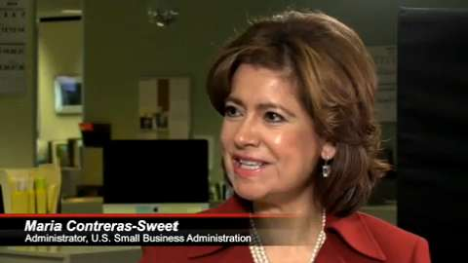

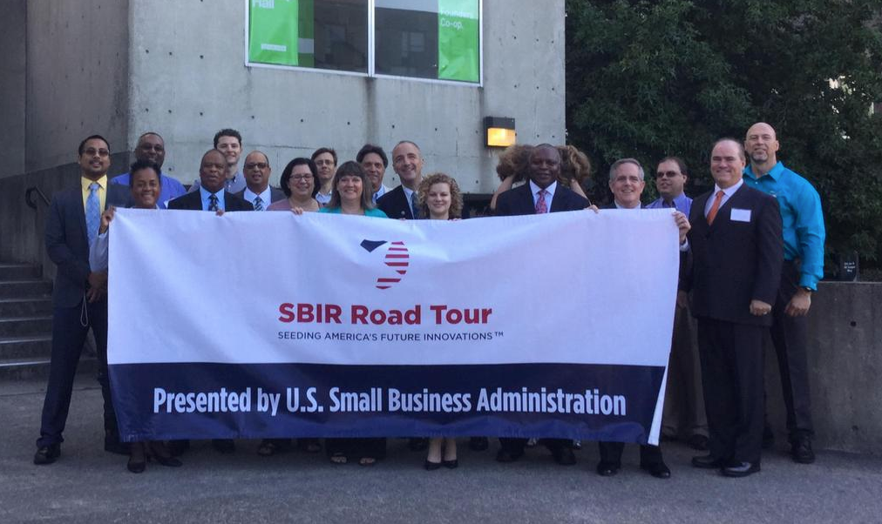
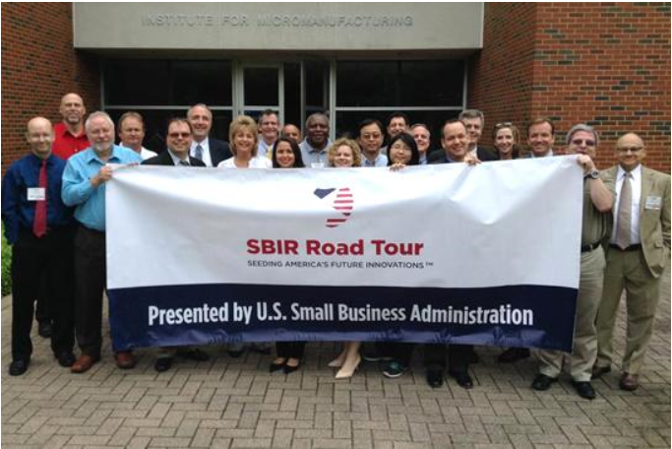
These great differences led to Road Tours

Slide 19
Whole new way of engaging small businesses
“American innovation is not restricted by geographic or cultural boundaries, and we are dedicated to supporting America’s entrepreneurs wherever they are. This tour reflects our commitment to ensuring that these innovators are aware of the resources that can help them turn a big idea into another great American success story,” John Williams (SBA)
Started in April 2015, going through Louisville, Nashville, Atlanta and Columbia SC
National outreach effort targeting advanced technology communities, especially in areas of country where number and percentage of SBIR awards are much smaller.
Each SBIR Road Tour stop will be hosted by a local organization involved in supporting technology-based entrepreneurship, and
Attendees have a face-to-face opportunity (5 min chats) to talk directly to federal agency program managers and decision makers. Federal agencies like NIST, NOAA, DoD, DHS et al speak briefly about programs
After busy mornings, group of Feds will travel up to 4-5 hours in a bus, stopping at hotel of next location
I have represented NOAA in 7 of the tours over a span of 4 years…very invigorating to talk about NOAA and hear so much creativity….some fun times as well!

Slide 20
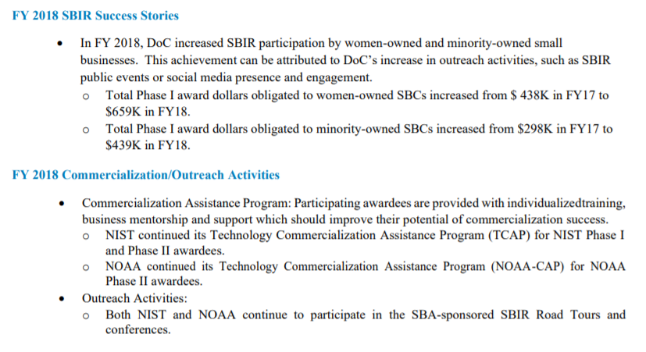
Department of commerce in 2018

Slide 21
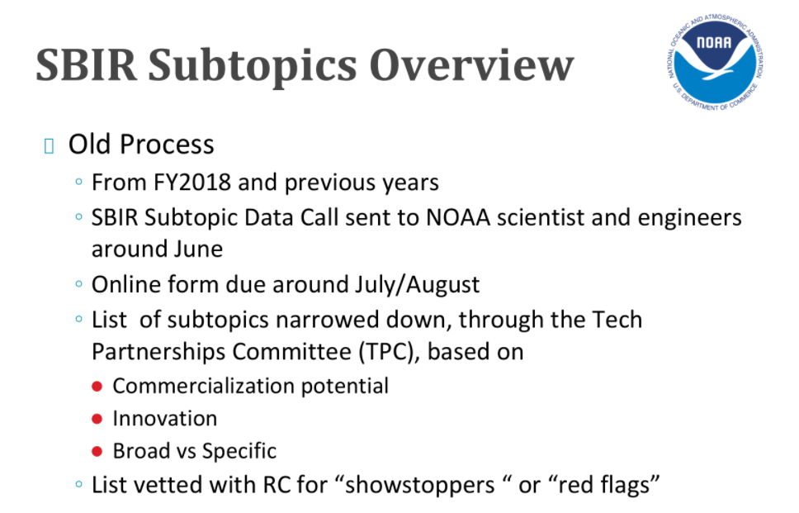

Slide 22
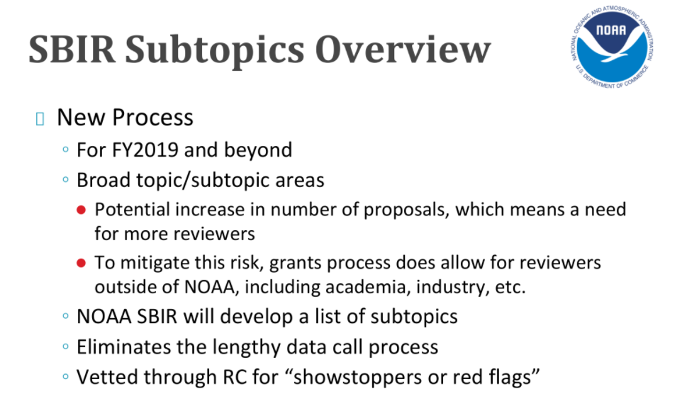

Slide 23

NOAA’s SBIR Program
NOAA's SBIR Program is seeking highly innovative products and services with excellent commercial potential. All SBIR proposals must directly benefit the NOAA mission, as well as be responsive to the greater market demands in order to be successful.

Slide 24
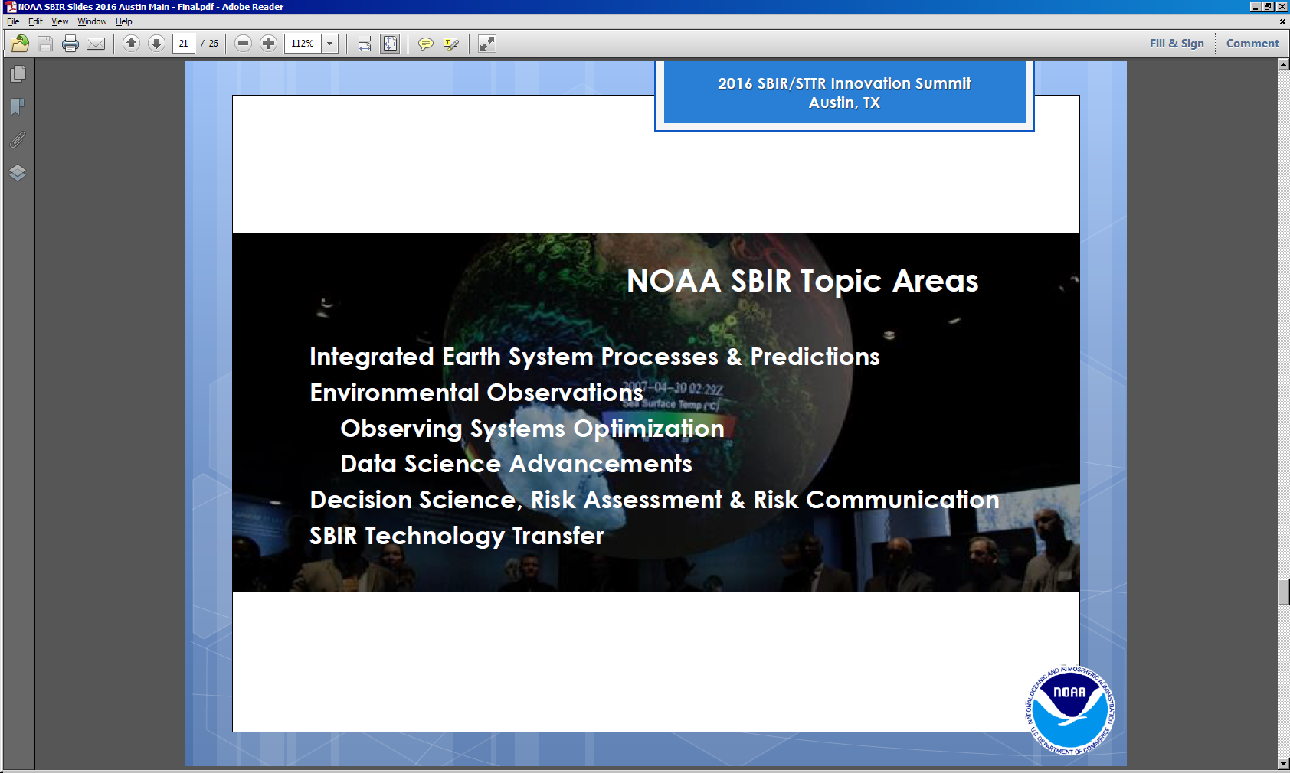
NOAA SBIR Topics for fy2018
NOAA Chief Scientist and Technology Partnership Office emphasize
use of the Strategic Research Guidance Memorandum (SRGM)

Slide 25

Three-Phase Program
PHASE I
      Feasibility Study, Proof of Concept
      $190K Max (↑ from $150K)
      Period of performance – 6 months
PHASE II
      Full Research and Development Effort
      $690K Max (↑ from $450K)
      Period of performance – 2 years
PHASE III
      Commercialization Stage
      Non-SBIR Federal Funding, third party $

Slide 26
SBIR program information
Awards via Grants (used to be contracts….painful)
      Fed
One solicitation per fiscal year (mid-Oct); FY25 due Jan 25 2025
      Available at Grants.gov
Typical Phase I Awards – 25 to 35 projects; Phase II Awards – 15-20 projects
Phase I to Phase II award percentage = >50%
SBIR Funding
      FY24: ~$17M
Proposal submissions via email
Small businesses are warned to read the solicitation carefully and follow instructions!

Slide 27
NOAA’s SBIR PROCESS
SBIR Solicitation Released
Mid-October
2024
Proposals Due
Mid-January
2025
NOAA Acquisition Lead Time
April - May
2025
Proposal Evaluation
January – March
2025
Phase I Awards
June
2025
Topic Review
June – August
2024

Slide 28
Program Schedule
Solicitation Release Date mid-October
Proposals Due mid-January
Review Period late Jan – early Mar
Phase I Contracts Awarded June
Phase II Contracts Awarded July

Slide 29

NOAA’s SBIR Proposal Evaluation
Ratings
Outstanding, Good, Acceptable, Marginal, Unacceptable
Five Criteria
Technical Approach & Anticipated Agency and Commercial Benefits
Level of Innovation Proposed Effort Offers to Topic Area
Fulfillment of Subtopic Requirements
Commercial Potential
Qualifications of Team
All outlined in solicitation

Slide 30
NOAA SBIR FY2025 topic Areas
Current Topics
Extreme Events and Cascading Hazards
Coastal Resilience
The Changing Ocean
Water Availability, Quality, and Risk
Effects of Space Weather
Monitoring and Modeling for Climate Change Mitigation
Cross-Cutting Focus Areas
Uncrewed Systems (UxS)
Artificial Intelligence
Data and Cloud Computing
‘Omics
Citizen Science

Slide 31
How does OSTI fall into this?
Work with NOAA SBIR Office on Topics and Sub-Topics
Collaborate w/ Small Businesses on SBIR Proposals/Topics
Coordinate Review Process for Phase 1 and Phase II Proposals (Pete will do about 8 Ph 1 and 2-3 Ph 2)
Work with Larta Inc and NOAA on Review of Phase II Projects and Guidance on Phase III (Commercialization Stage)
Participate in SBIR Road Tours (engage with businesses in states not successful with SBIR Grants) – Have done 7 since 2015

Slide 32
These great differences led to Road Tours

Slide 33
Whole new way of engaging small businesses
“American innovation is not restricted by geographic or cultural boundaries, and we are dedicated to supporting America’s entrepreneurs wherever they are. This tour reflects our commitment to ensuring that these innovators are aware of the resources that can help them turn a big idea into another great American success story,” John Williams (SBA)
Started in April 2015, going through Louisville, Nashville, Atlanta and Columbia SC
National outreach effort targeting advanced technology communities, especially in areas of country where number and percentage of SBIR awards are much smaller.
Each SBIR Road Tour stop will be hosted by a local organization involved in supporting technology-based entrepreneurship, and
Attendees have a face-to-face opportunity (5 min chats) to talk directly to federal agency program managers and decision makers. Federal agencies like NIST, NOAA, DoD, DHS et al speak briefly about programs
After busy mornings, group of Feds will travel up to 4-5 hours in a bus, stopping at hotel of next location
I have represented NOAA in 7 of the tours over a span of 4 years…very invigorating to talk about NOAA and hear so much creativity….some fun times as well!

Slide 34
NWS-Related SBIR Subtopics 2013-2016
Solicitation Number | Subtopic Number | Subtopic Title | Project Title | Company Name
NOAA 2013-1 | 9.4.3 | Delivering a Solar Flare Forecast Model that Improves Flare Forecast (Timing and Magnitude) Accuracy by 25% | Delivering a Solar Flare Forecast Model that Improves Flare Forecast (Timing and Magnitude) Accuracy by 25% | NorthWest Research Associates, Inc. (NWRA)
NOAA 2013-1 | 9.3.2 | Detection and Evidence Collection of Climate Buoy Vandalism | Buoy Guard System | McQ, Inc
NOAA 2013-1 | 9.4.2 | Developing Mobile VHF Lightning Mapping Technology | Mobile VHF Lightning Mapping System | Toyon Research Corporation
NOAA-2014-1 | 8.4.2 | Multi-Purpose Above Surface/Below Surface Expendable Dropsondes (MASED) | Multipurpose Atmospheric/Underwater Expendable Dropsonde | Boston Engineering Corporation
NOAA-2014-1 | 8.4.3 | New METSAT Display Service for Weather-Ready Nation | New METSAT Display Service for Weather-Ready Nation | Carr Astronautics
NOAA-2014-1 | 8.4.4 | Rip Current Sensor and Warning System | A Stereo Camera System for Measuring Coastal Currents | 3SRM Inc.
NOAA-2014-1 | 8.4.5 | Unmanned Aircraft System-Borne Atmospheric and Sea Surface Temperature (SST) Sensing | 120-X-2 Unmanned Aircraft System-Borne Atmospheric & Sea Surface Temperature (SST) Sensing | Piasecki Aircraft
NOAA-2015-1 | 8.4.1 | Monitoring Active Region Development on the Far-Side of the Sun | Monitoring Active Region Development on the Far-Side of the Sun | NorthWest Research Associates
NOAA-2016-1 | 8.4.2 | Satellite Environment Space Weather Products | A satellite Charging Assessment Tool (SatCAT) | Space Hazards Applications, LLC
NOAA-2016-1 | 8.4.3 | Satellite ground station network for real-time space weather data | Satellite ground station network for real-time space weather data | USML LLC (doing business as US Microwave Laboratories)
NOAA-2016-1 | 8.4.1 | Unmanned Aerial Vehicle (UAV) Applications Supporting the NWS Mission | Low Cost, Long Endurance, Aerial Vehicle for Weather Monitoring | NEOEx Systems, Inc.
NOAA-2016-1 | 8.4.1 | Unmanned Aerial Vehicle (UAV) Applications Supporting the NWS Mission | Small UAS Platform for NWS Missions | Toyon Research Corporation

Slide 35


Michele Pollard Peter Roohr
NOAA SBIR Program Manager NWS SBIR Program Manager
Michele.pollard@noaa.gov peter.roohr@noaa.gov
(301) 628-1011 (301) 427-9274
techpartnerships.noaa.gov
@NOAASBIR

Slide 36
More information……

Slide 37
NWS-Related SBIR Subtopics 2001-2005
Solicitation Number | Subtopic Number | Subtopic Title | Project Title | Company Name
NOAA-2001-1 | 8.1.6 | Observing Stations Meta Data System | Observing Station Metadata System | Mayur Technologies, Inc.
NOAA-2002-1 | 8.1.4 | Wireless Environmental Sensor Communications Interface | Wireless Interconnects for Environmental Sensing Applications | Luna Innovations, Inc.
NOAA-2002-1 | 8.1.3 | Automated Sonde Launching System | A Low-Cost Mobile Automated Sonde Launching System | Yankee Environmental Systems, Inc.
NOAA-2003-1 | 8.1.7 | Interlinked Distributed PC/Workstation System Grid with Ontology Capabilities to Internet | Demonstrate the Feasibility of Building an AWIPS-Based System Grid with Weather Ontology Capabilities | Fairfield Technologies, Inc.
NOAA-2004-1 | 8.2.3 | Low Maintenance Conductivity-Temperature Sensor | Non-Fouling Oceanographic Temperature and Conductivity Sensor | Arete Associates
NOAA-2005-1 | 8.3.8 | New Data Telemetry Protocol for Automated Flood Warning Systems (AFWS) | Forward Error Correction Enabled Open-Source Packet Modern Development | Blue Water Design LLC
NOAA-2005-1 | 8.3.1 | Predictive Modeling of Solar Insolation in the Marine Environment for Solar Power System Applications | Predictive Modeling of Solar Insolation in the Marine Environment for Solar Power System Applications | Irradiance, Inc.
NOAA-2005-1 | 8.3.2 | NOAA Weather Radio (NWR) Broadcast Simulator | NOAA Weather Radio (NWR) Broadcast Simulator | Albido Corporation
NOAA-2005-1 | 8.3.5 | Measurement of Profiles of Temperature and Water Vapor in the Marine Environment from Moored Buoys | Affordable Microwave Salinity Sensor for Near-Shore Platforms | ProSensing, Inc.
NOAA-2005-1 | 8.3.7 | Low-Cost Floating Wave Staff Data Buoys for Offshore Monitoring | Low-Cost Wave Data Buoys for Offshore Monitoring | Planning Systems, Inc.

Slide 38
NWS-Related SBIR Subtopics 2006-2009
Solicitation Number | Subtopic Number | Subtopic Title | Project Title | Company Name
NOAA-2006-1 | 8.3.5 | Measurement of Profiles of Temperature and Water Vapor in the Marine Environment from Moored Buoys | All Weather Temperature and Water Vapo Profiling Radiometer for Marine Environment | Boulder Enviornmental Sciences and Technology, LLC
NOAA-2006-1 | 8.3.7 | NOAA Weather Radio (NWR) "Smart Receiver" | NOAA Weather Radio (NWR) "Smart Receiver" | Hy-Tek, Ltd.
NOAA-2007-1 | 8.3.10 | Development of Open Source Initiative (OSI) Model Application Layer for Hydrologic Radio Telemetry Data | ALERT-2 Protocol Development | Salo IT Solutions, Inc.
NOAA-2008-1 | 8.4.1 | Radar Algorithm for Lightning Probabilities with Lightning Threat Web Page Display | Lightning Probability Nowcasting and Forecasting with PRA Strike Insight Technology | Propagation Research Associates, Inc.
NOAA-2009-1 | 8.3.1 | In Situ GPS Measurements from a Low-Cost Balloon-Borne GPS Instrument | GPS Reference for Radiosonde Validation | International Met Systems
NOAA-2009-1 | 8.3.2 | Compact, Eye-Safe, All-Weather Ground-Based Water Vapor Profiling Lidar | Near-IR Differential Absorption Lidar for Automated Water Vapor Profiling | Physical Sciences, Inc.
NOAA-2009-1 | 8.3.2 | Compact, Eye-Safe, All-Weather Ground-Based Water Vapor Profiling Lidar | Ground-Based Water Vapor Profiling Lidar | Bennett Aerospace, LLC

Slide 39
NWS-Related SBIR Subtopics 2010-2012
Solicitation Number | Subtopic Number | Subtopic Title | Project Title | Company Name
NOAA 2010-1 | 8.2.4 | Airborne in situ Sensors for Measurement of Upper Troposphere Water Vapor | Photoacoustic Sensor for High-Sensitivity Measurement of Water Vapor | Masstech, Inc.
NOAA 2010-1 | 8.4.2 | Weather Data Linder (WDL) - Sharing Data Among Systems of Systems | A Pilot Weather Data Linker | GeoOptics LLC
NOAA 2010-1 | 8.2.4 | Airborne in situ Sensors for Measurement of Upper Troposphere Water Vapor | Upper Tropospheric Water Vapor Sensing System | Spectrasensors, Inc.
NOAA 2011-1 | 8.4.1 | Two-Way Communications Protocol for Environmental Data Sensing Systems | Wide-Area Enviornmental Sensing and alerTing Networks (WESTnets) | Salo IT Solutions
NOAA 2012-1 | 8.4.4 | Reducing Impact of Severe Space Weather on Global Positioning System (GPS) Satellite Signal Users | Reducing Impact of Severe Space Weather on Global Positioning System (GPS) Signal Users | Propagation Research Associates, Inc.

Slide 40
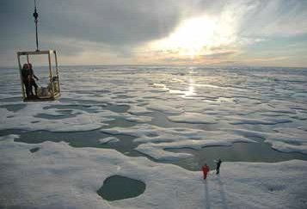
Climate Adaption and Mitigation
What is the state of the climate system and how is it evolving?
What causes climate variability and change on global to regional scales?
What improvements in global and regional climate predictions are possible?
How can NOAA best inform and support the Nation’s efforts to adapt to the impacts of climate variability and change?
Ice and open water in the Beaufort Sea north of Alaska. Credit: NOAA

Slide 41
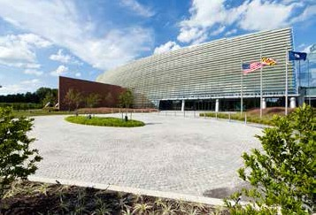
A Weather Ready Nation
How can we improve forecasts, warnings, and decision support for high-impact weather events?
How does climate affect seasonal weather and extreme weather events?
How can we improve space weather warnings?
How can we improve forecasts for freshwater resource management?
NOAA center for weather and climate prediction, College Park, Maryland. Credit: University of Maryland

