Slide 1
Improving Atmospheric Models by Accounting for Chaotic Physics
Prashant.D.Sardeshmukh@noaa.gov
With Jih-Wang Aaron Wang, Gil Compo, and Cecile Penland
CIRES/University of Colorado and Physical Sciences Laboratory/NOAA
NOAA/WPO Webinar 06 February 2023
Weather and climate predictions are inherently probabilistic. In practice, the forecast probability distributions are estimated using an ensemble of forecasts from slightly different initial conditions.
Such ensemble forecasts are typically overconfident: reality too often falls outside the forecast uncertainty indicated by the ensemble spread. When averaged over many cases, the r.m.s. error of the ensemble-mean forecasts is almost always found to be larger than the ensemble spread.
A popular way to reduce the gap between the forecast error and spread is to stochastically perturb the forecast model’s parameterized diabatic tendencies. Many studies show that this robustly increases the forecast spread. Less clearly, it also reduces the forecast error.
However, we find clear reductions of forecast errors in large ensembles of 15-day GFS forecasts.
They arise in effect from improving the model’s evolution operator by stochastic noise-induced drifts.
5. We also find significant impacts on the mean climate and variability of the FV3GFS model.

Slide 2
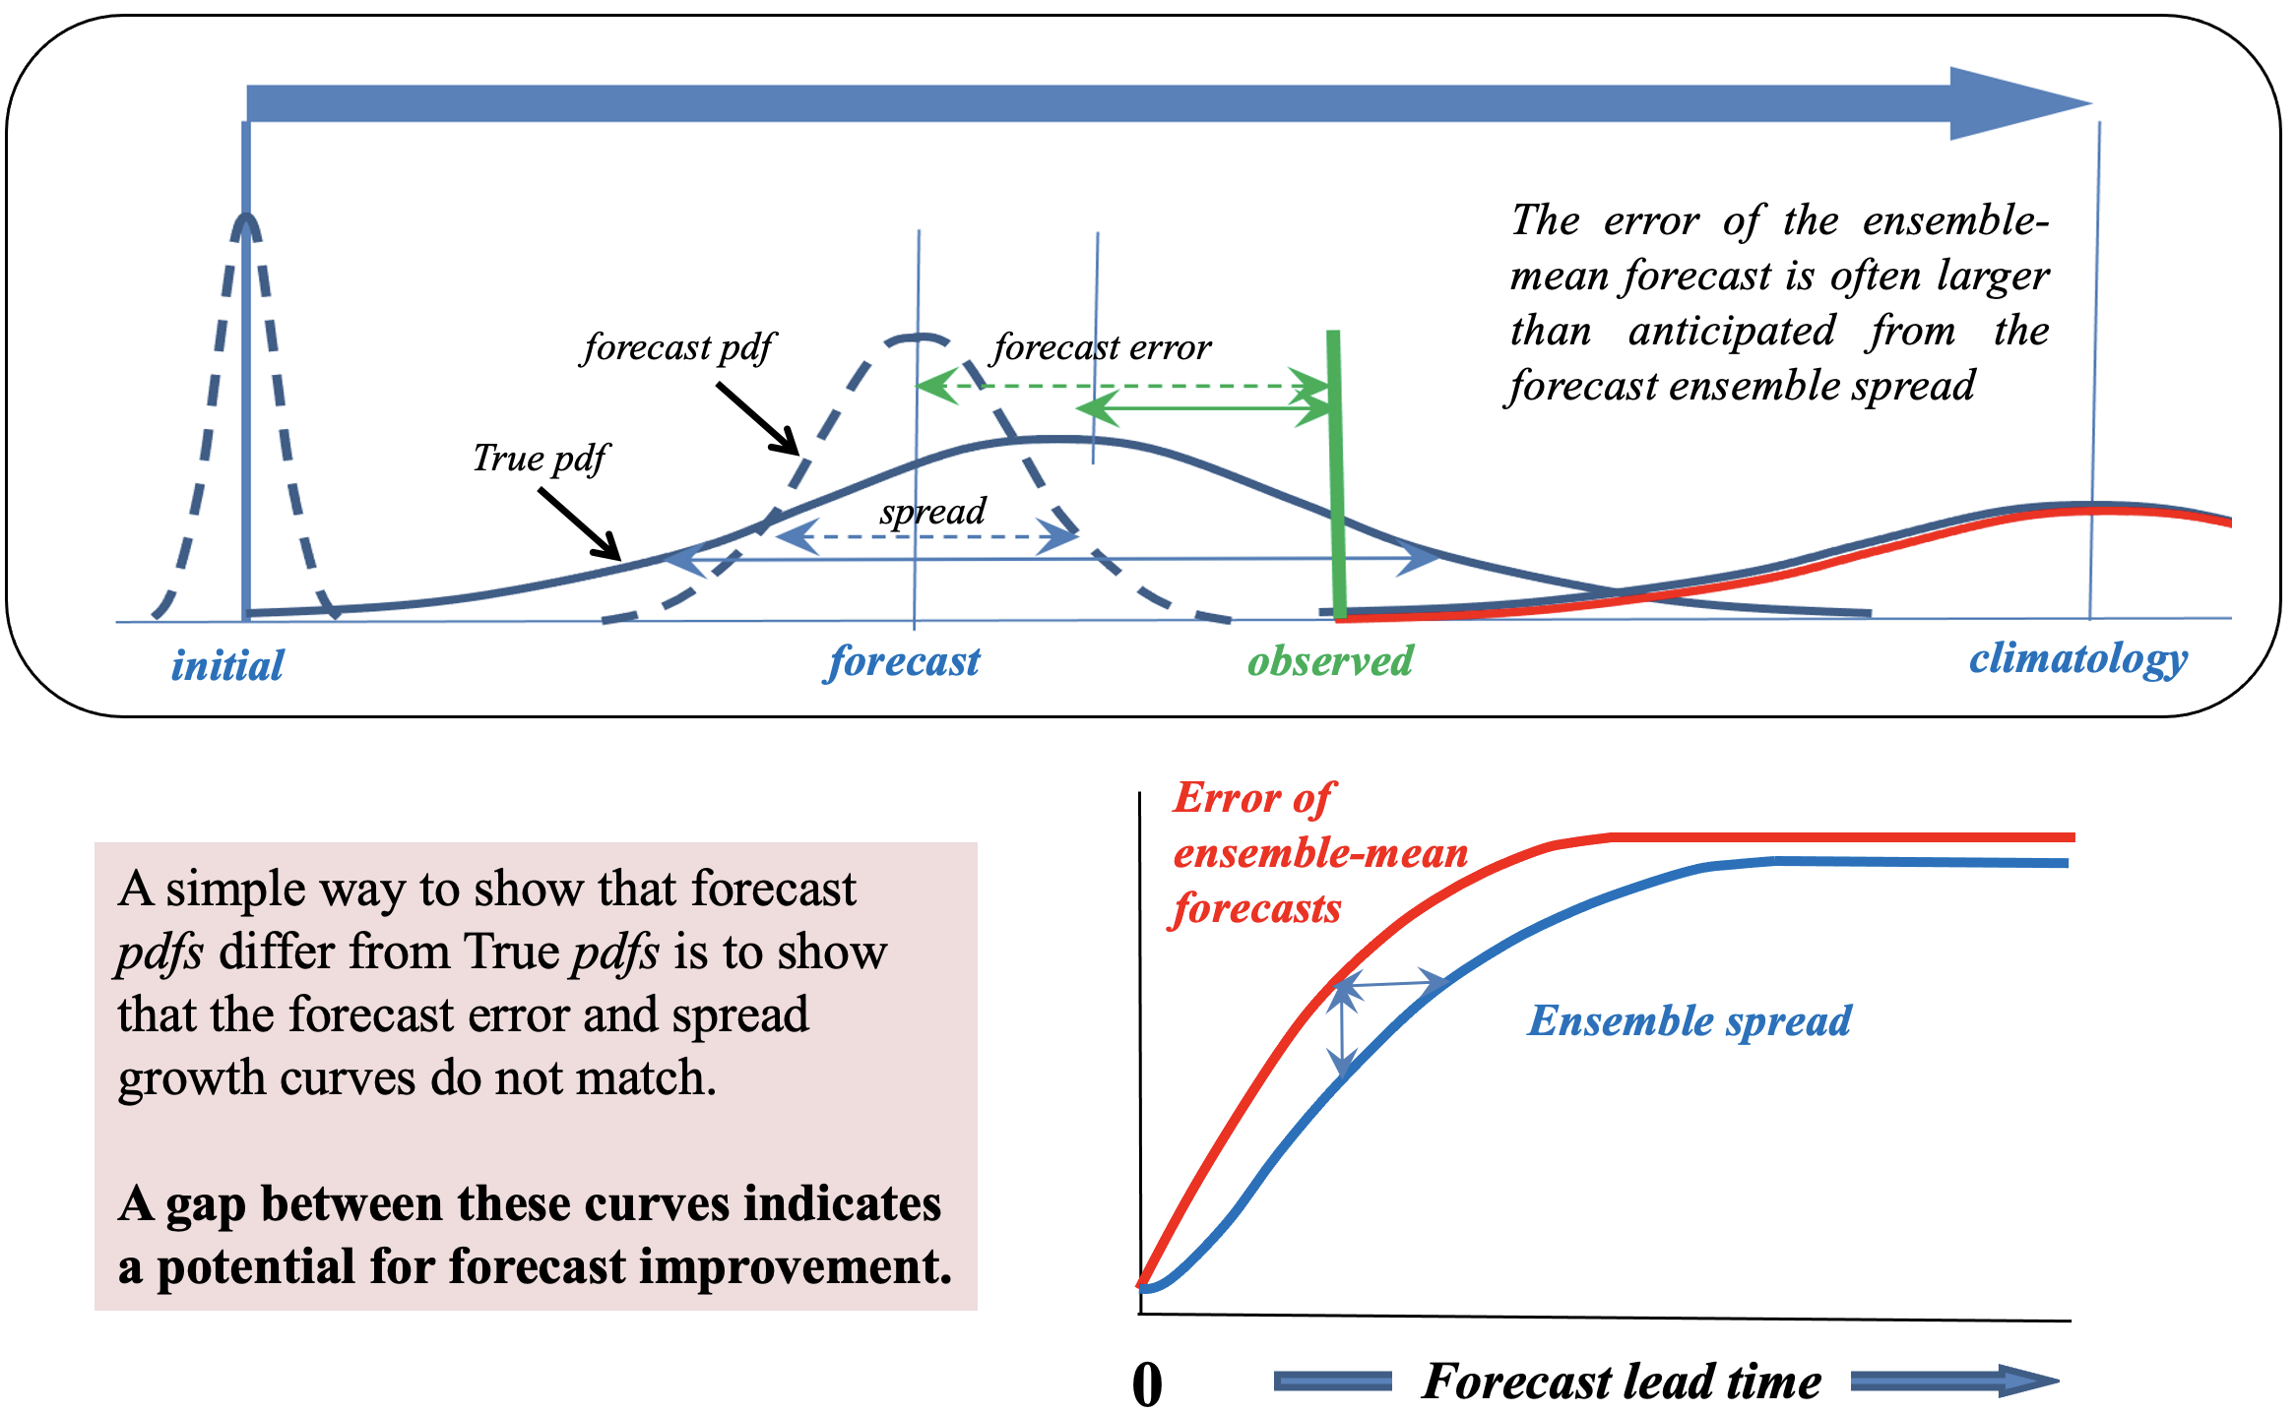
x
A forecast pdf differs from the true pdf because of both model errors and initial errors

Slide 3
x
An increasingly popular approach to reducing the gap between the forecast error and spread curves is to introduce additional stochastic terms in the model’s equations.
Here x is the model state vector.
$$\frac{dx}{dt} = A\left(x\right) + P\left(x\right) + R$$
adiabatic diabatic tendency
tendency tendency error
$$≈ A\left(x\right) + \left(1+r\right)P\left(x\right)$$
Specifying R ~ r P(x) at every model grid point, where r is a random number between +1 and -1 and has spatial and temporal correlations scales of ~500 km and ~6 hours is an effective way to account for chaotic diabatic physics in models
Even this crude approach has proven successful at reducing the gap in several weather and climate prediction contexts, mainly by increasing the ensemble spread, but sometimes also by decreasing the forecast error.
(See Palmer et al 2009, Berner et al 2017, Leutbecher et al 2017, Zhu et al 2018, Palmer 2019)

Slide 4
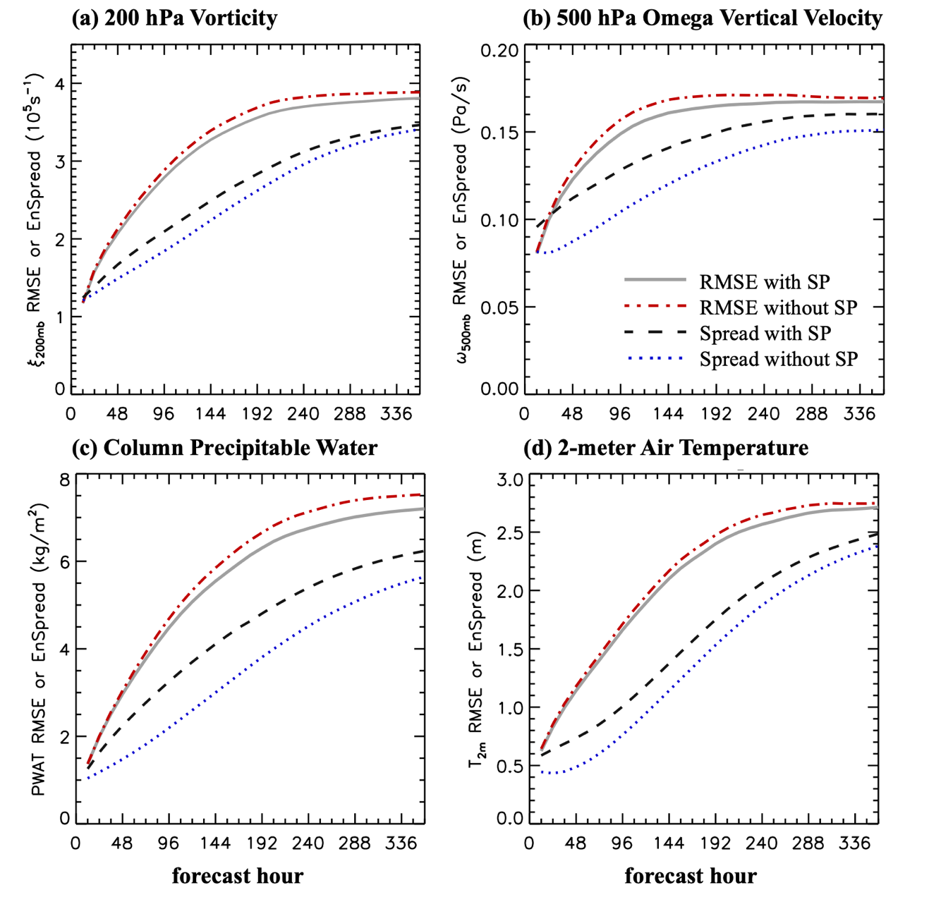
x
For example, stochastic parameterizations of the form in the NCEP/GFS model leads to both a reduction of the rms error of the ensemble-mean and an increase of the spread of 15-day ensemble forecasts throughout the forecast range
$$\left(1+r\right)P\left(x\right)$$
These results are for T254 80-member ensemble forecasts for 80 separate forecast cases in Jan-Mar 2016. (Sardeshmukh, Wang, Compo, and Penland, 2023, in review)

Slide 5
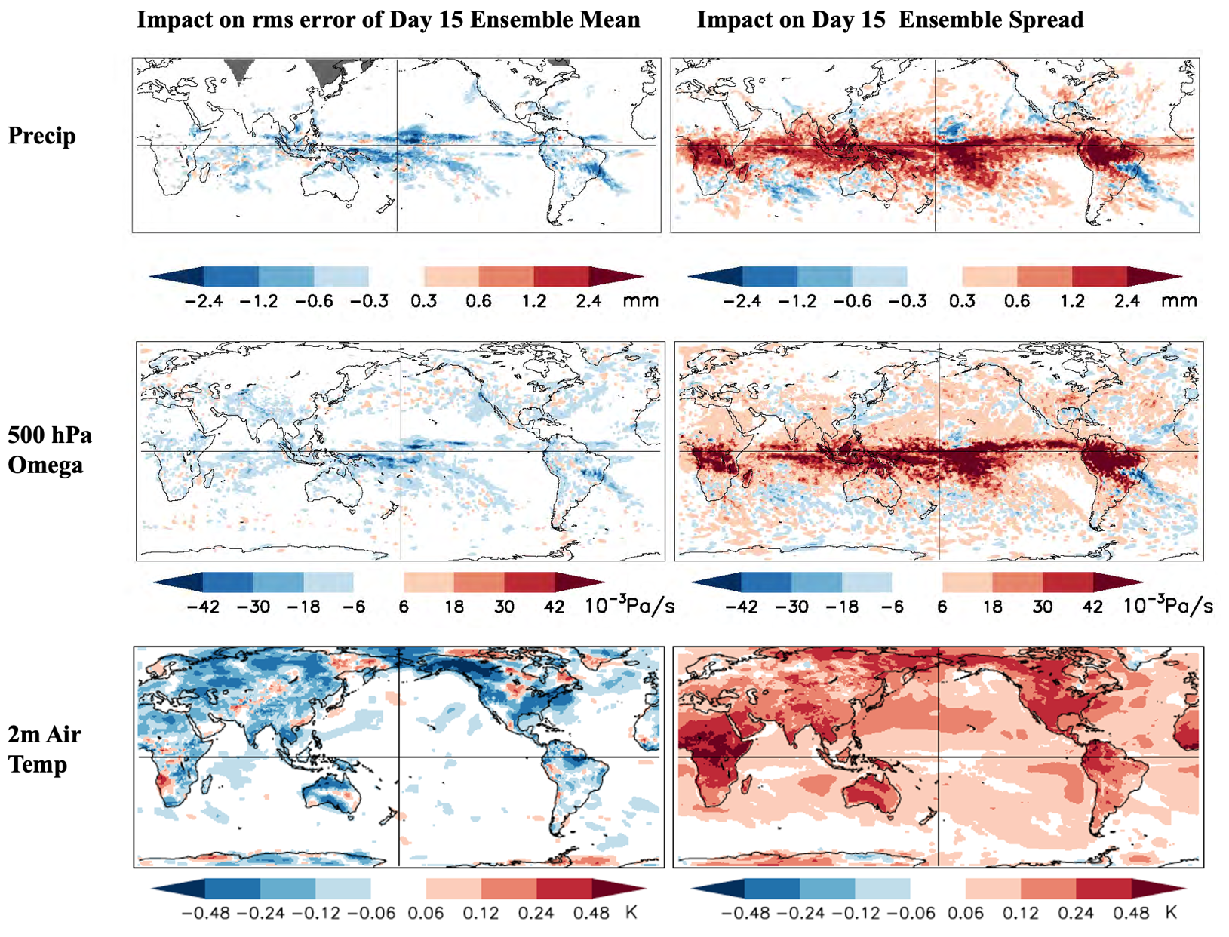
x
These beneficial impacts of the stochastic perturbations are also clearly evident locally
Sardeshmukh, Wang, Compo, and Penland 2023 (in review)

Slide 6
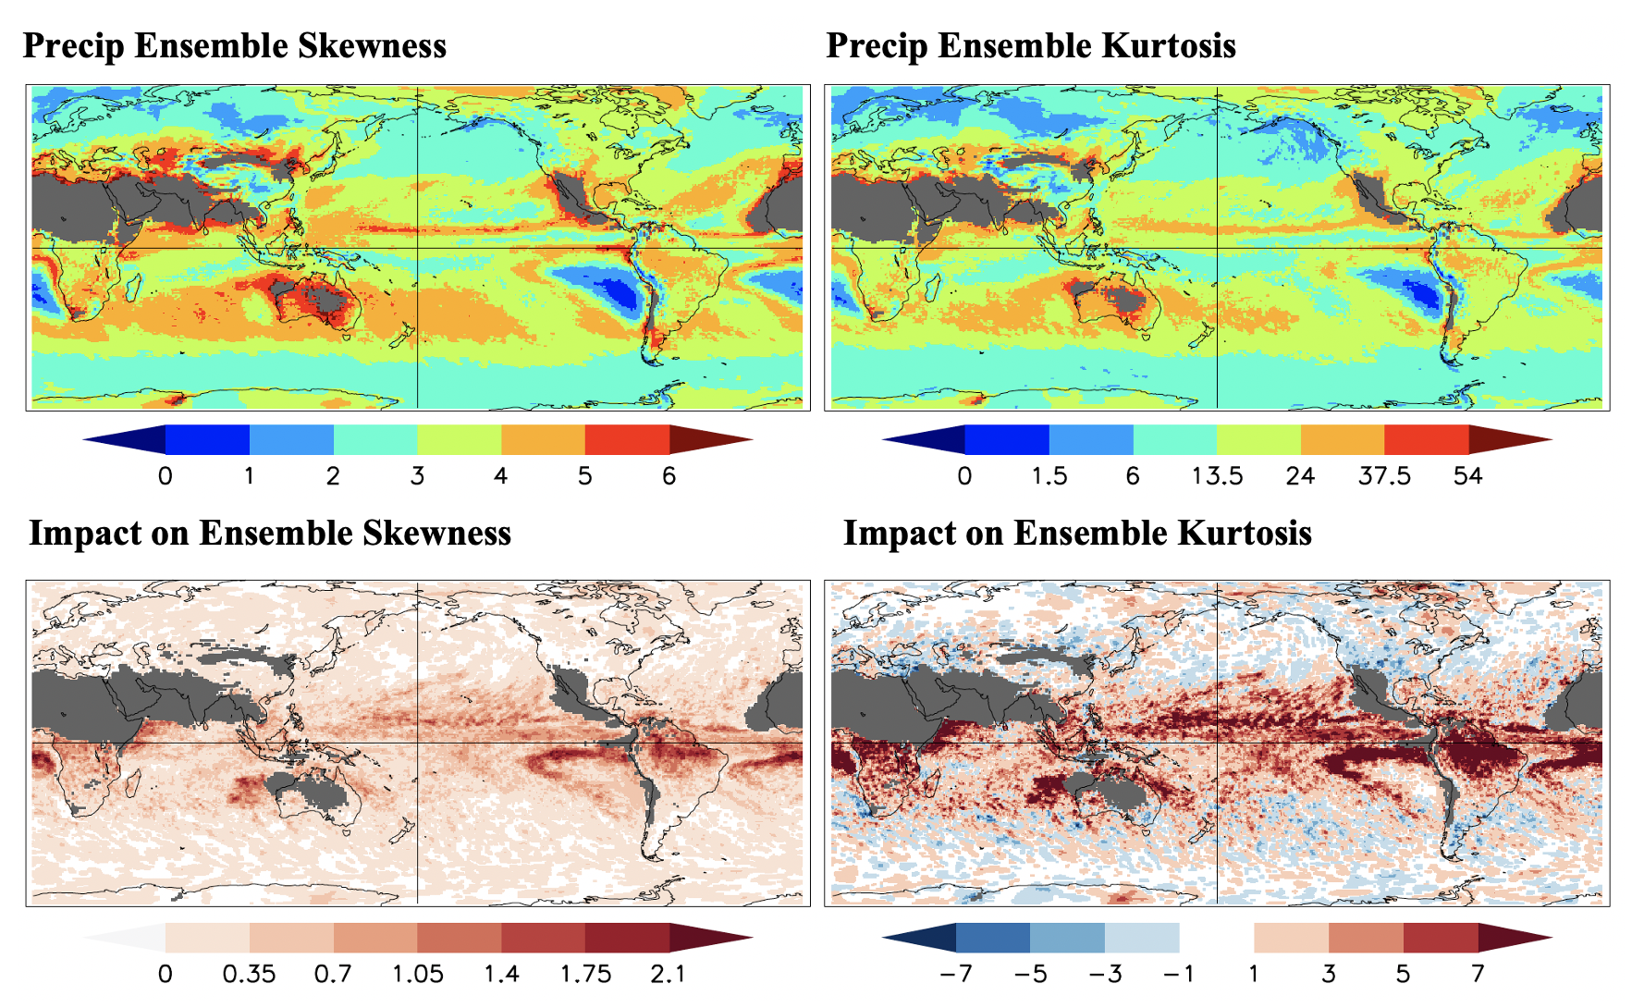
x
The stochastic perturbations also make the probability distributions of 12-hourly precipitation more realistically skewed and heavy-tailed
The Skewness S and Excess Kurtosis K (a measure of tail heaviness) better satisfy
the relationship K = 1.5 S² associated with Gamma probability distributions.
at Day 15 at day 15
Sardeshmukh, Wang, Compo, and Penland 2023 (in review)

Slide 7
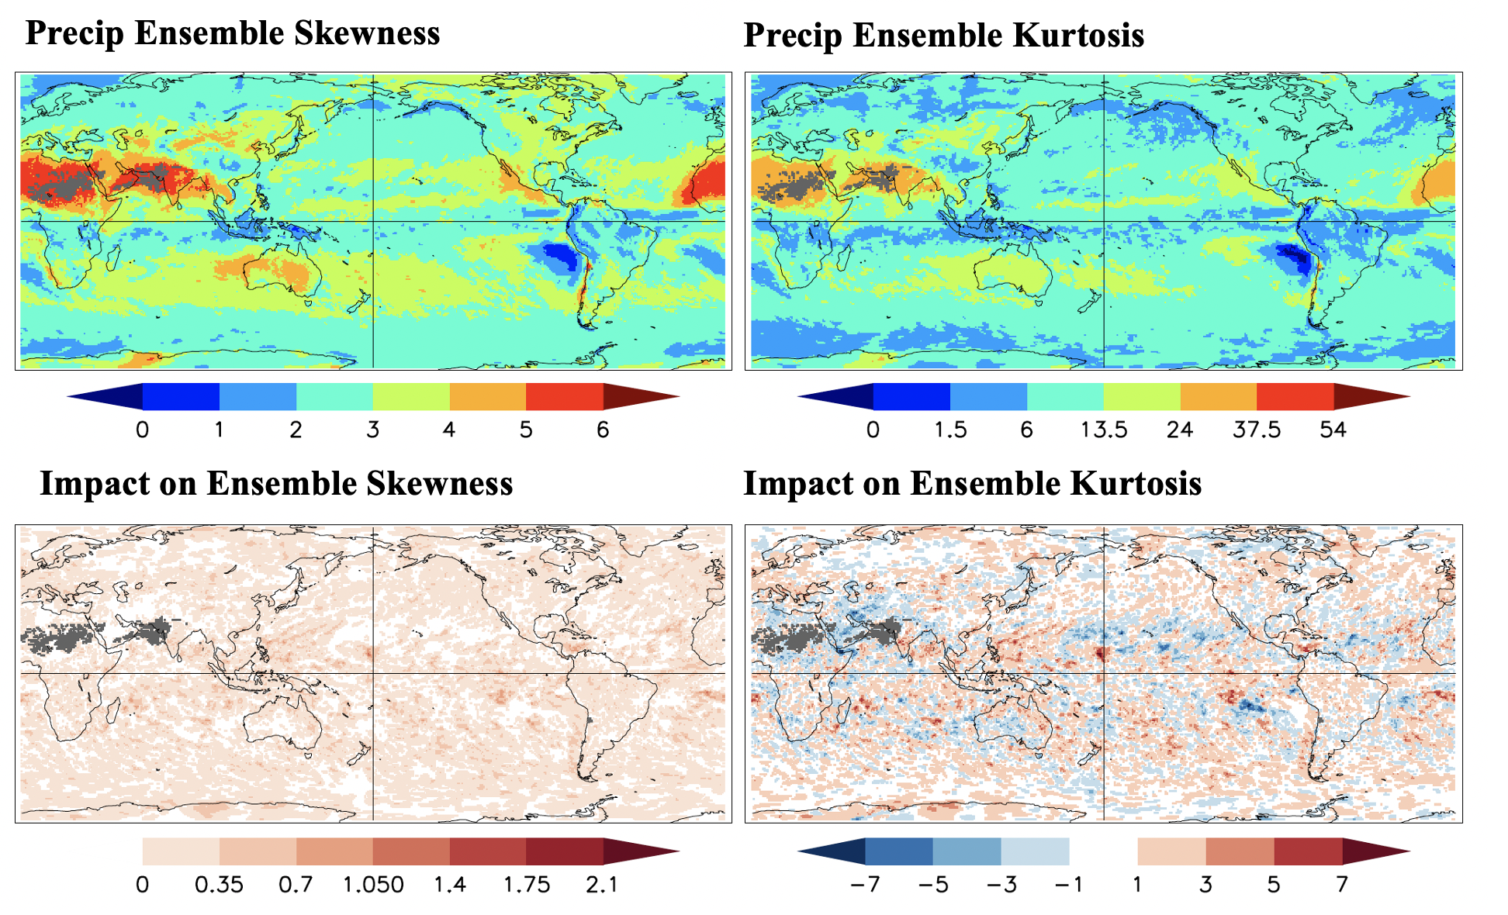
x
Similar impacts are obtained in a 40-member ensembles of AMIP simulations of the January-March 2016 period using the FV3GFS model

Slide 8
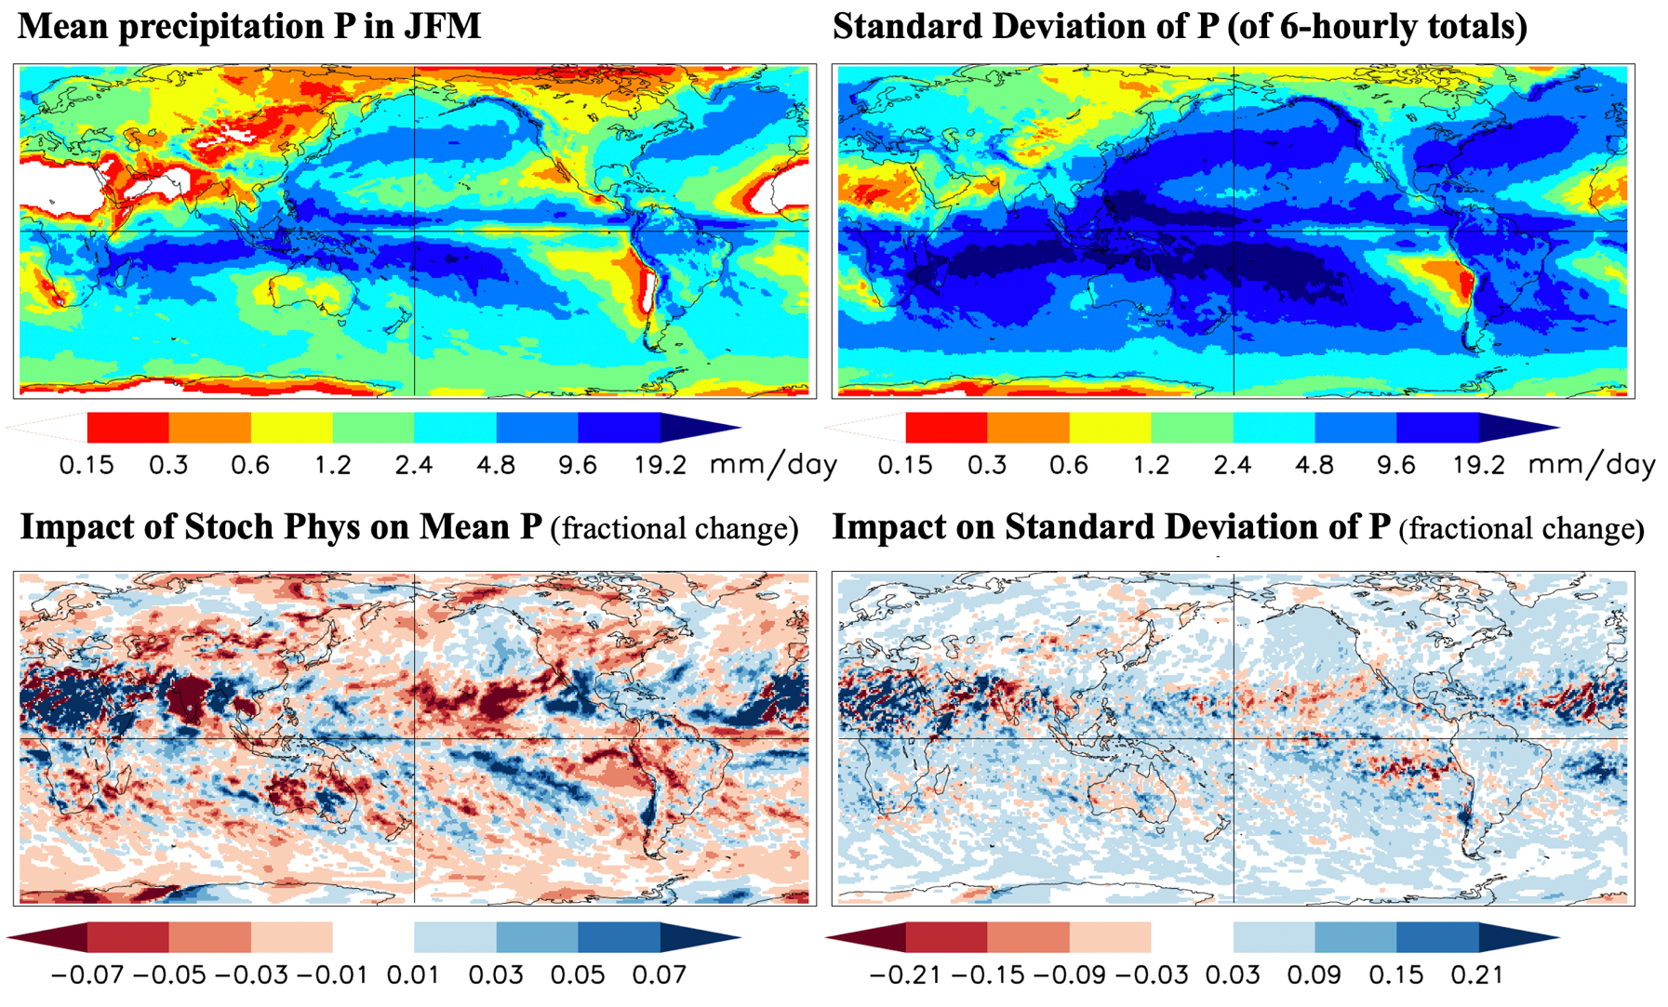
x
The 40-member large ensemble FV3GFS simulations of the 20-yr 1999-2018 period performed (at C128 ~ 70 km resolution) with and without stochastic perturbations show clear impacts on the mean precipitation and 6-hourly precipitation variability
Note the drying impact over the U.S., possibly due to a decrease in atmospheric river activity.

Slide 9
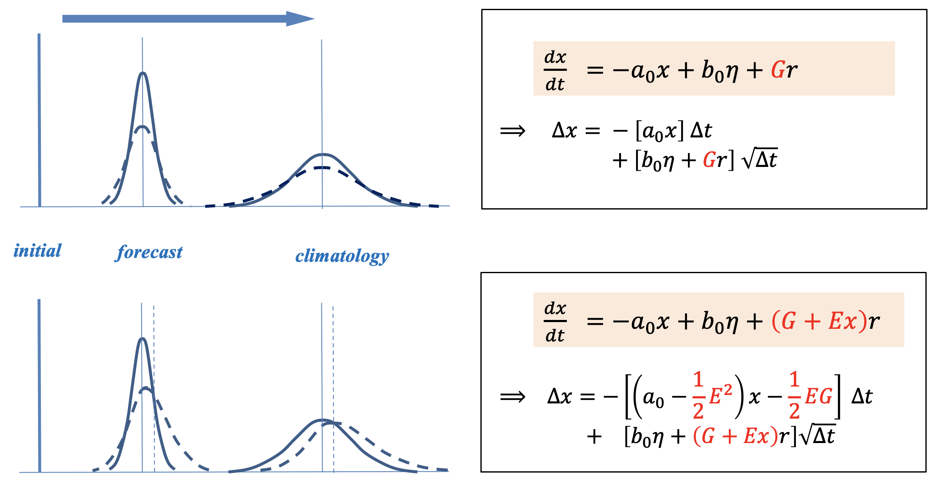
x
Basic understanding of the stochastic impacts in a simple framework
The stochastic terms P(x) r can be represented as (G+Ex) r in the simple Markov model below. They not only increase the spread, but also change the mean, skewness, and tails of the pdfs (dashed curves)
If , the ensemble-mean forecasts and mean climate are altered by these “noise-induced drifts”, and the skewness and tail heaviness by the asymmetric and larger stochastic forcing for larger magnitudes of x.
$$E ≠0$$

Slide 10
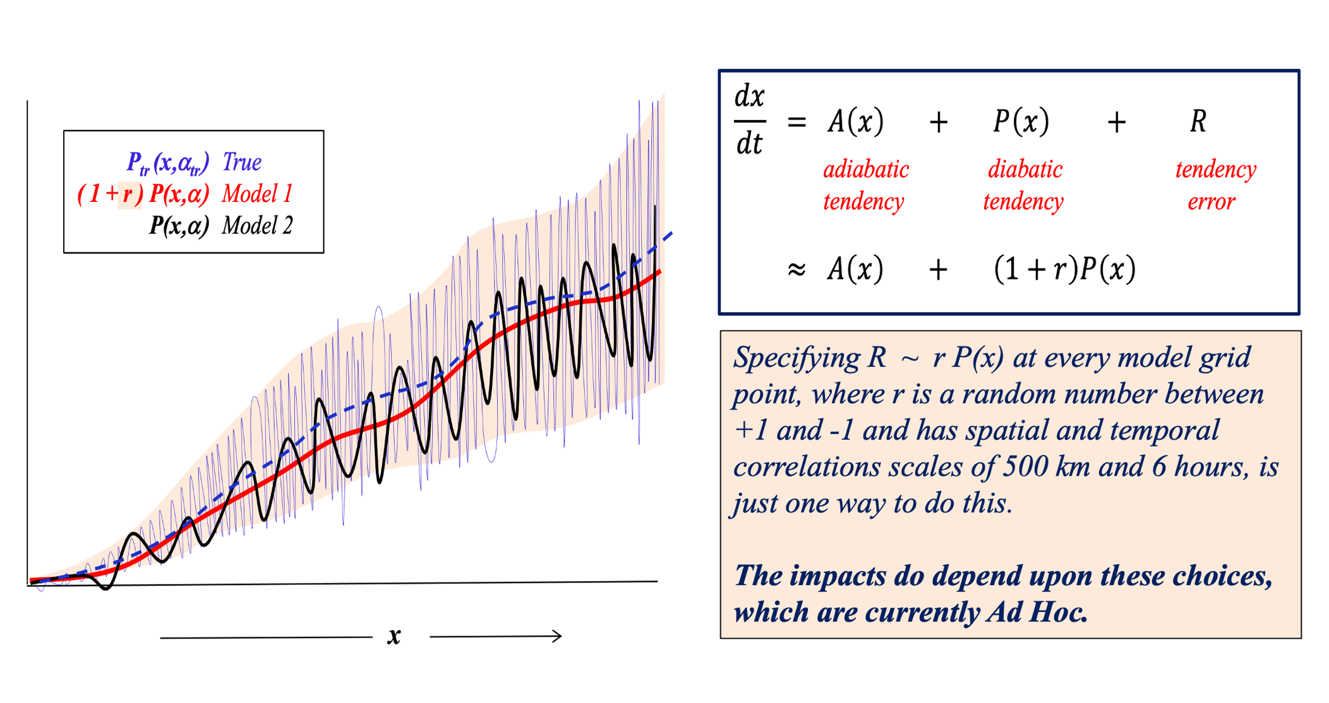
x
TO RECAP: Randomizing the parameterized diabatic tendencies P(x) in a model as (1+r) P(x) is a crude but effective way to account for chaotic physics in the real atmosphere
One way to make these choices less ad hoc is to observationally constrain the space and time scales of r by the statistics of the model’s initial tendency (or short-range forecast) errors R , estimated with respect to analyses generated using the same model for data-assimilation.

Slide 11
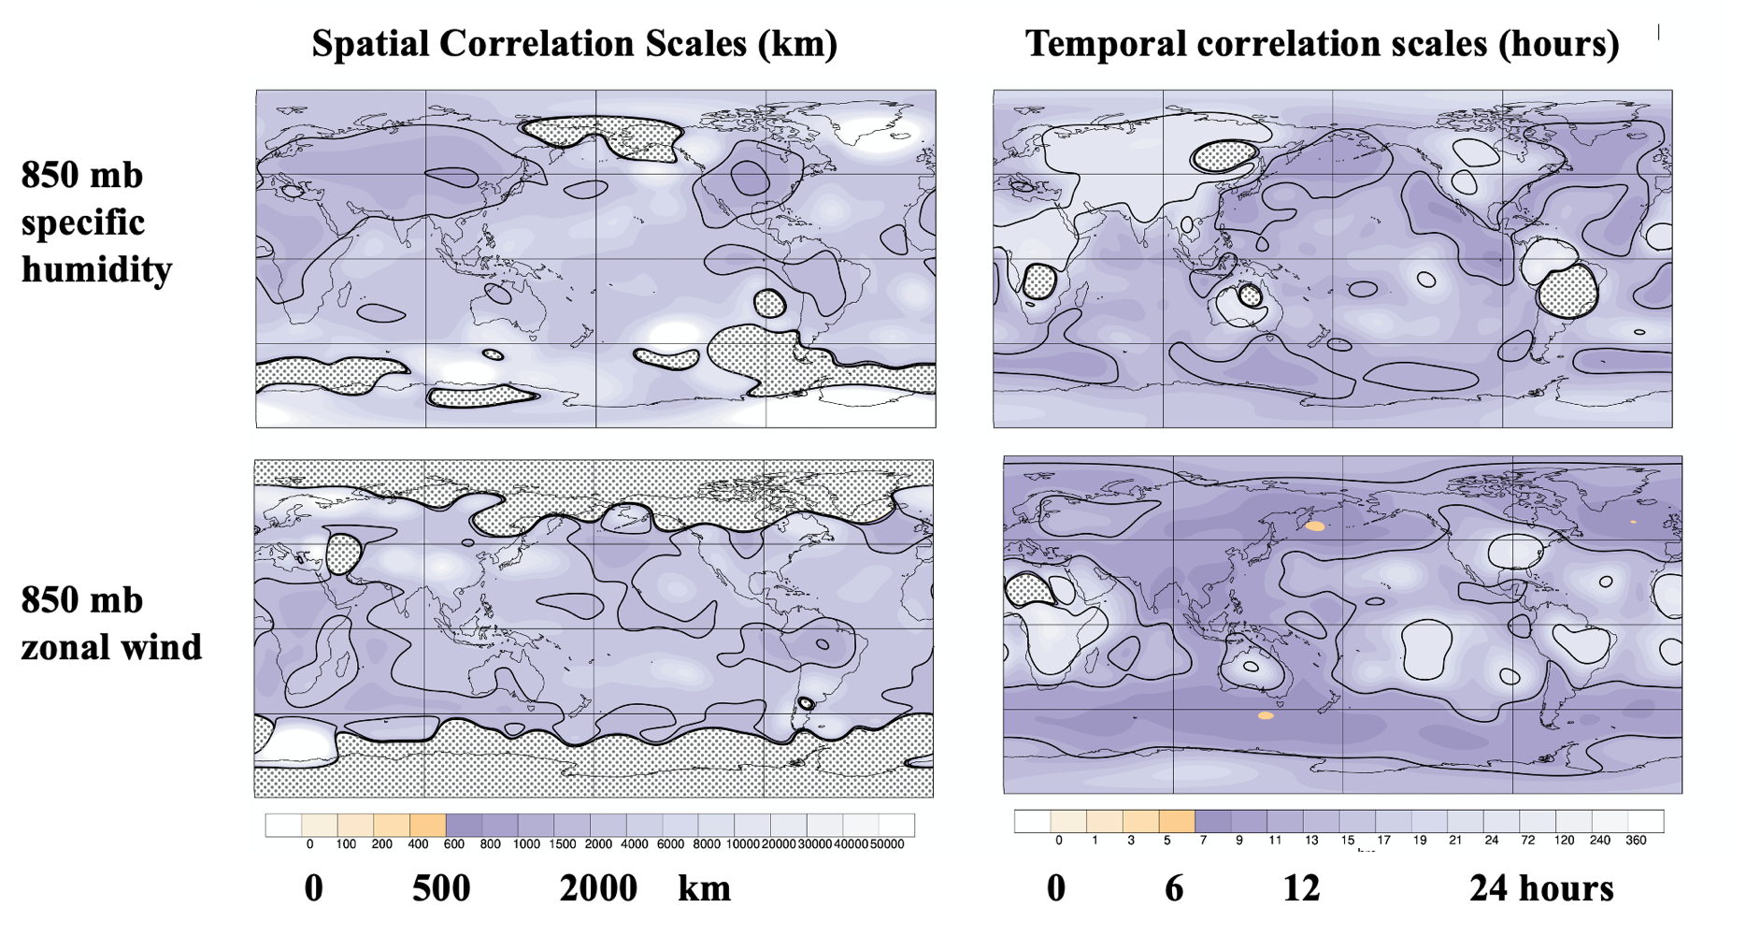
x
To observationally constrain the statistics of r, we approximate R ~ rP and use the simple relationship among the covariances of R, r, and P to estimate the the covariance of r given the covariances of R and P. These calculations yield estimates of the space and time scales of r that are generally larger than the 500 km and 6 hours specified in our experiments.
THIS IS A MASSIVE CALCULATION! We used the 2-hour error statistics of 80-member ensemble FV3GFS forecasts at ~ 50 km resolution made from every hour in the June-to-December 2020 period without stochastic perturbations in the model. The forecast errors were determined with respect to analyses performed with a customized hourly DA system that uses a non-hydrostatic atmosphere/land model of the UFS (the “Weather Application) at ~50 km resolution.

Slide 12
Summary and Concluding Remarks
Many previous studies have demonstrated improvement in probabilistic forecast skill through increases in forecast ensemble spread generated by randomizing the parameterized diabatic tendencies $P\left(x\right)$ as (1+r)P(x).
Here we have stressed that such randomizations can also improve the mean, skewness, and kurtosis of the forecast distributions throughout the extended 15-day forecast range. They can also change a model’s mean climate and variability and increase its sensitivity to external forcing.
These additional impacts arise, in effect, from stochastic noise-induced drifts which improve the model by improving its deterministic evolution operator.
Stochastic impacts are generally found to be appreciable only when the specified space and time scales of the random perturbations r (500 km and 6 hours in our experiments) are much larger than the model grid size and time step. Such larger scales are hard to justify if the stochasticity is meant to account only for chaotic feedbacks from unresolved scales, as is usually done.
The larger scales are better justified, and better specified, if the statistics of r are observationally constrained by the statistics of short-range forecast errors.

