Slide 1
Neural network based methods to post-process probabilistic weeks 3-4 precipitation accumulation forecasts
Weeks 3-4/S2S Webinar - February 6, 2023
Rochelle Worsnop^{1,2}, Michael Scheuerer³, Thomas M. Hamill⁴
Collaborators: Tim Smith^{1,2}, Nachiketa Acharya^{1,2}, Dave DeWitt⁵
¹Cooperative Institute for Research in Environmental Sciences, CU Boulder
²NOAA/ESRL/Physical Sciences Laboratory
³Norwegian Computer Center
⁴IBM/Weather Company
⁵Climate Prediction Center

Slide 2
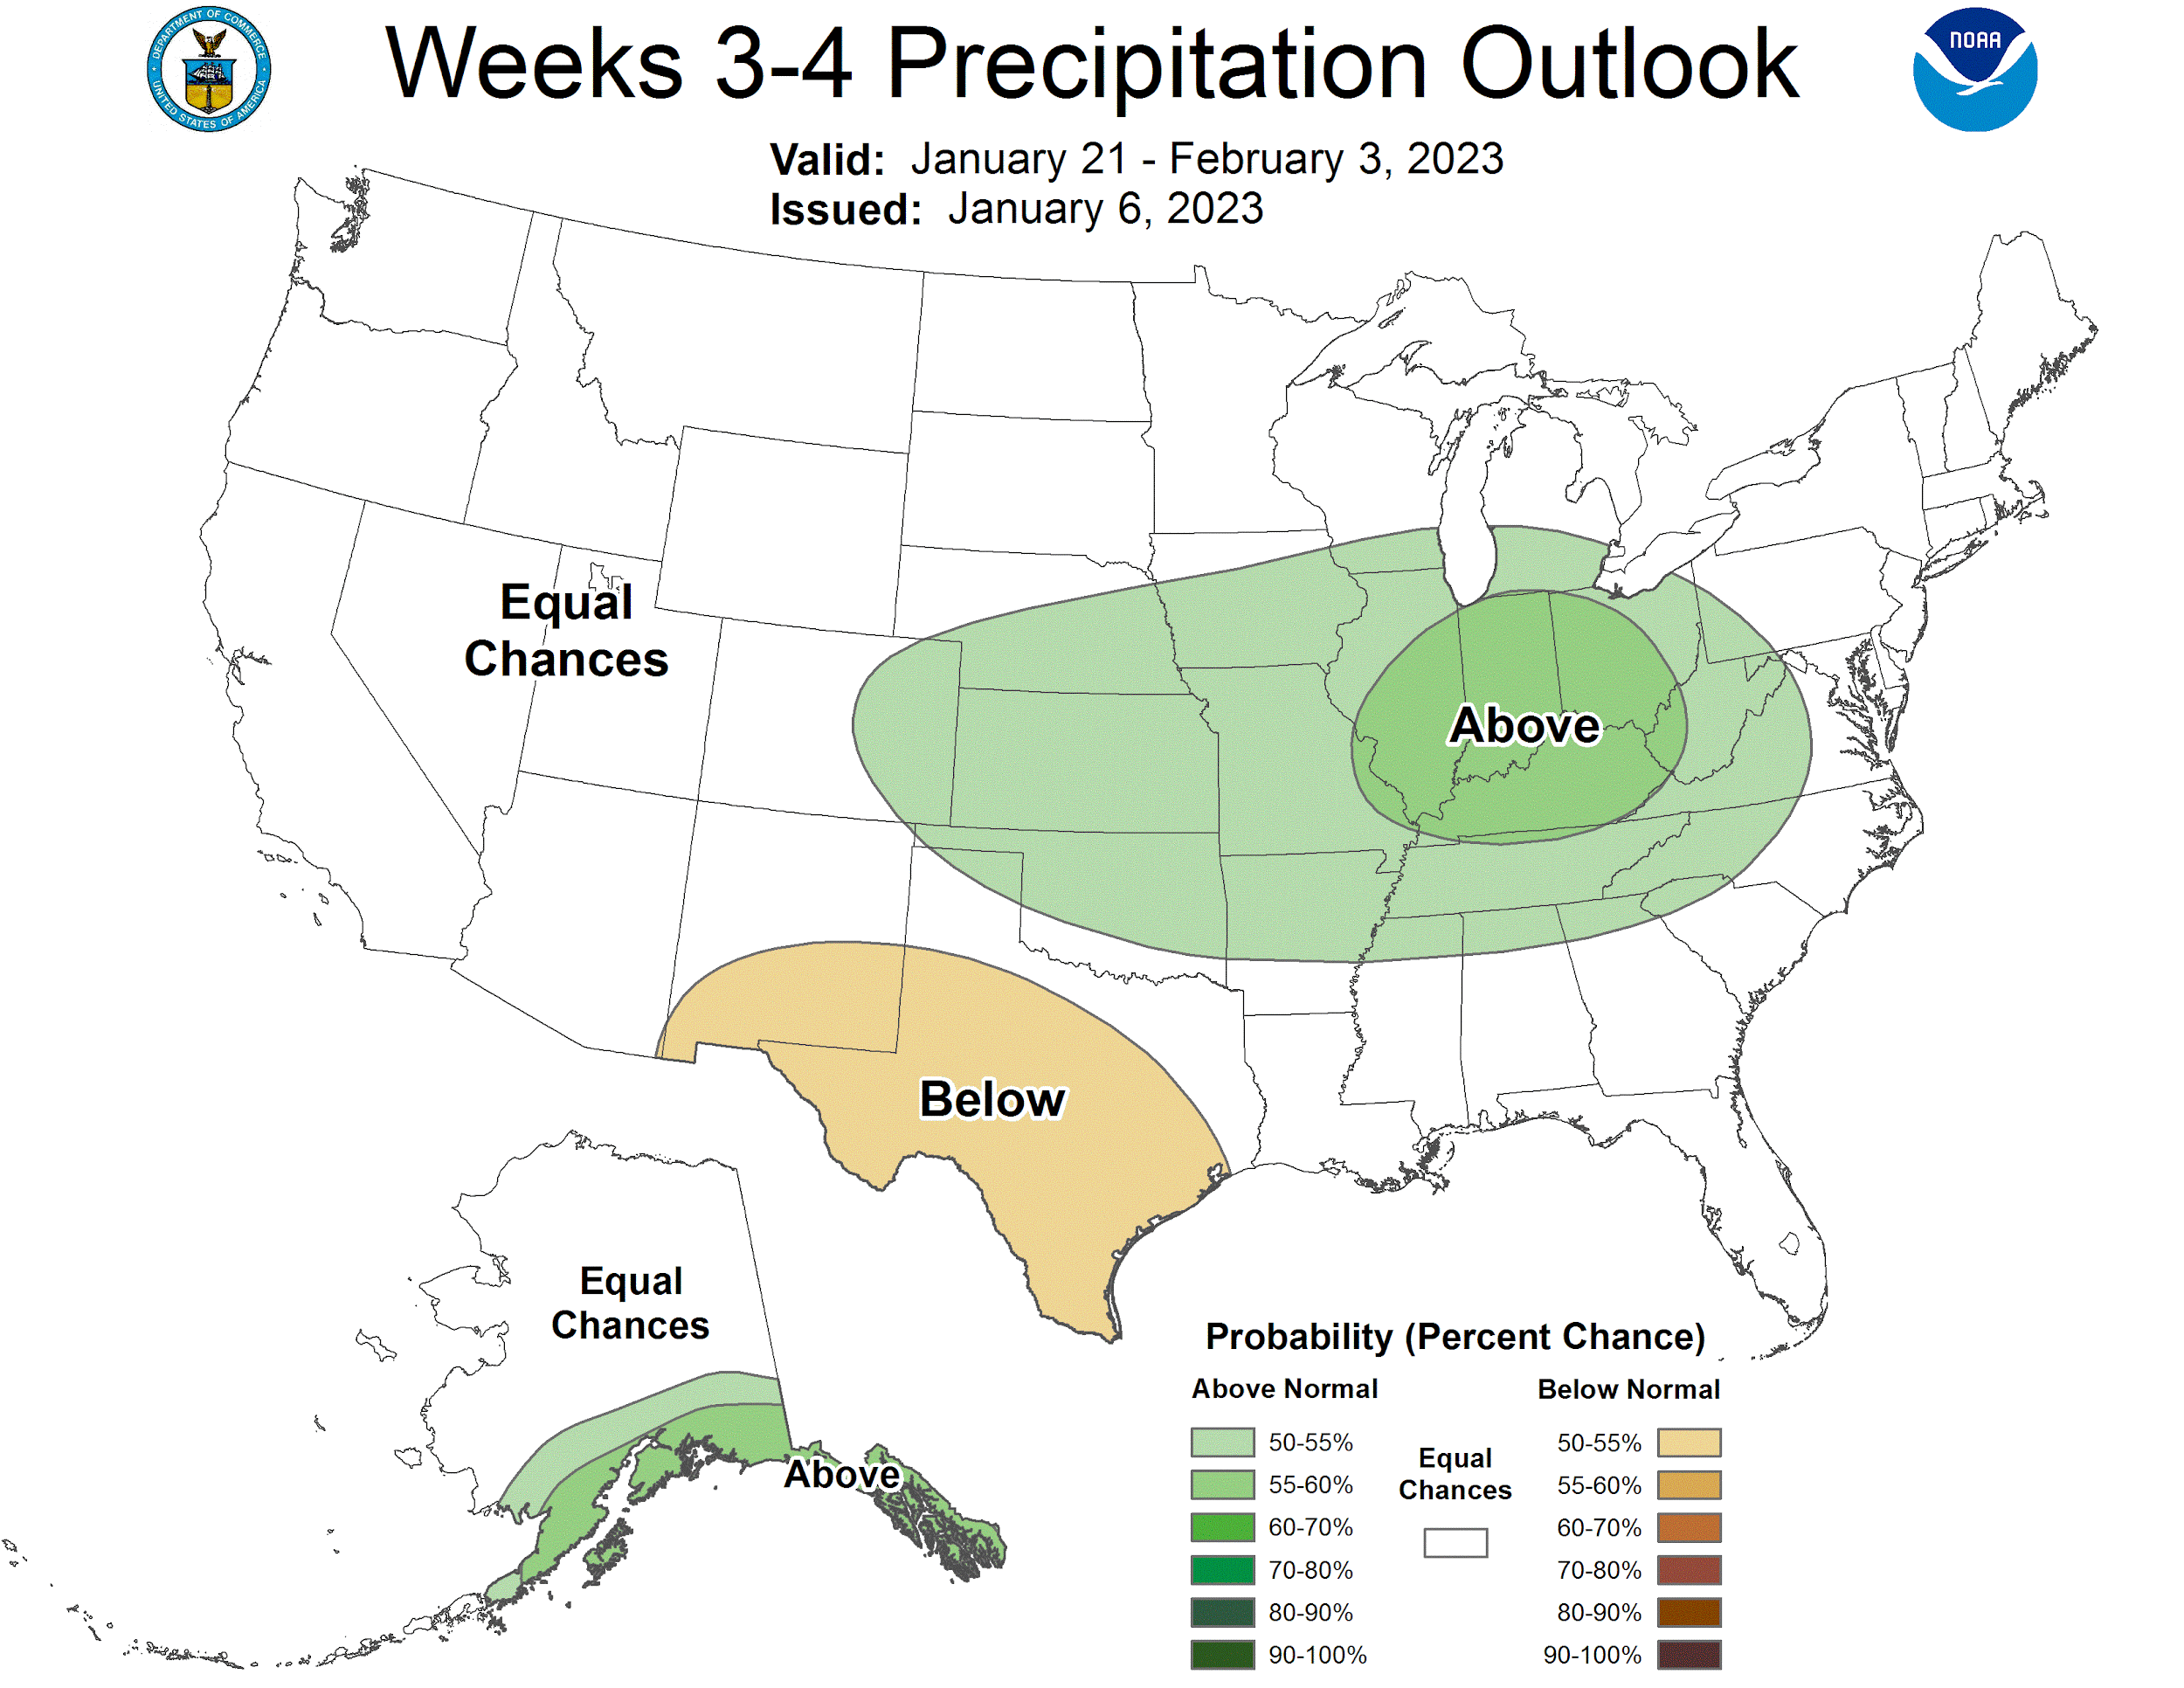
CPC generates subseasonal
precipitation outlook maps & map discussions
Motivation
Weeks 3-4 precipitation forecasts may be used for:
Managing water resources
Monitoring ongoing and building droughts
Identifying locations & times of enhanced or suppressed wildfire risk
Our methods aim to improve guidance provided in figures like this through artificial intelligence
www.cpc.ncep.noaa.gov

Slide 3
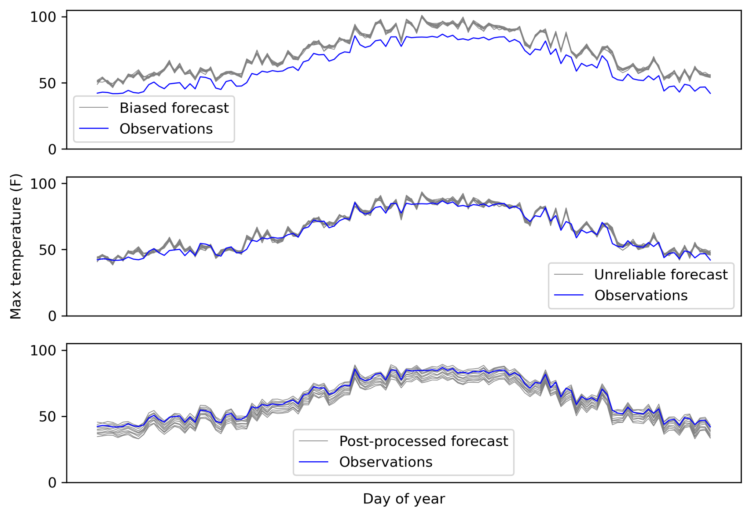
Post-processing aims to yield a skillful forecast
that more accurately quantifies the level of uncertainty
Motivation
Adjust mean for better calibrated forecasts
Spread needs to be adjusted too for ensembles

Slide 4
Post-processing aims to yield a skillful forecast
that more accurately quantifies the level of uncertainty
Motivation
Adjust mean for better calibrated forecasts
Spread needs to be adjusted too for ensembles

Slide 5
Post-processing aims to yield a skillful forecast
that more accurately quantifies the level of uncertainty
Motivation
Adjust mean for better calibrated forecasts
Spread needs to be adjusted too for ensembles

Slide 6
We use 20 years of past forecast-observation pairs to develop our post-processing models
Methods
Ensemble reforecasts – reran with same model version to generate past forecasts
Global Ensemble Forecast System (GEFSv12)¹
20-yr hindcasts for every Wednesday between 2000-2019
Initialized at 00Z, 28-day forecast horizon, 6 hourly intervals
11 ensemble members, 1x week
0.5 deg horizontal resolution (~56 km, 61 x 139 grid points)
Domain: 23-53N latitude, 134-65W longitude
Total precipitation variable
Accumulated precipitation over Week 1, Week 2, Week 3, Week 4, and Weeks 3 & 4.
PRISM – “ground truth” for training and verification
Parameter Elevation Regression on Independent Slopes Model (PRISM)²
Daily, gridded total precipitation
4 km horizontal resolution, upscaled to forecast grid with conservative regridding
Used same time period and spatial domain as reforecasts
Accumulated precipitation over Week 1, Week 2, Week 3, Week 4, and Weeks 3 & 4
¹https://registry.opendata.aws/noaa-gefs-reforecast/
²https://prism.nacse.org/formats/
Photo credit: USFS

Slide 7
We use 20 years of past forecast-observation pairs to develop our post-processing models
Methods
Ensemble reforecasts – reran with same model version to generate past forecasts
Global Ensemble Forecast System (GEFSv12)¹
20-yr hindcasts for every Wednesday between 2000-2019
Initialized at 00Z, 28-day forecast horizon, 6 hourly intervals
11 ensemble members, 1x week
0.5 deg horizontal resolution (~56 km, 61 x 139 grid points)
Domain: 23-53N latitude, 134-65W longitude
Total precipitation variable
Accumulated precipitation over Week 1, Week 2, Week 3, Week 4, and Weeks 3 & 4.
PRISM – “ground truth” for training and verification
Parameter Elevation Regression on Independent Slopes Model (PRISM)²
Daily, gridded total precipitation
4 km horizontal resolution, upscaled to forecast grid with conservative regridding
Used same time period and spatial domain as reforecasts
Accumulated precipitation over Week 1, Week 2, Week 3, Week 4, and Weeks 3 & 4
¹https://registry.opendata.aws/noaa-gefs-reforecast/
²https://prism.nacse.org/formats/
Photo credit: USFS

Slide 8
Neural network task (Scheuerer et al. 2020, MWR)
Methods
For each grid point, predict the probability of a precipitation forecast falling within 20 precipitation bins
Train an ANN separately for each month & lead time
Predictors: normalized precipitation forecasts & normalized geographic information pooled together from the whole CONUS domain.

Slide 9
Neural network task (Scheuerer et al. 2020, MWR)
Methods
For each grid point, predict the probability of a precipitation forecast falling within 20 precipitation bins
Train an ANN separately for each month & lead time
Predictors: normalized precipitation forecasts & normalized geographic information pooled together from the whole CONUS domain.

Slide 10
Neural network task (Scheuerer et al. 2020, MWR)
Methods
For each grid point, predict the probability of a precipitation forecast falling within 20 precipitation bins
Train an ANN separately for each month & lead time
Predictors: normalized precipitation forecasts & normalized geographic information pooled together from the whole CONUS domain.

Slide 11
ELU, L1
Softmax
Methods
Log of climatological probabilities
ELU, L1
20
Probability of being in each precipitation category
20
3
10
20
20
Then interpolate between categories to get full predictive distribution of accum. precip.
10 neurons
Hyperparameters tuned with
RandomizedSearchCV (preliminary)
20 neurons
20 neurons

Slide 12
Results
Forecast Benchmark
Censored, shifted gamma distribution (CSGD, Scheuerer and Hamill 2015)
Grid-point-by-grid-point method
State-of-the-art parametric method for precipitation
Big picture→ Through a set of regression equations, link smoothed, raw ensemble statistics (mean & spread) to parameters of the predictive distribution while accounting for unique characteristics of precipitation

Slide 13
Results
Forecast Benchmark
Censored, shifted gamma distribution (CSGD, Scheuerer and Hamill 2015)
Grid-point-by-grid-point method
State-of-the-art parametric method for precipitation
Big picture→ Through a set of regression equations, link smoothed, raw ensemble statistics (mean & spread) to parameters of the predictive distribution while accounting for unique characteristics of precipitation

Slide 14
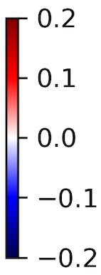
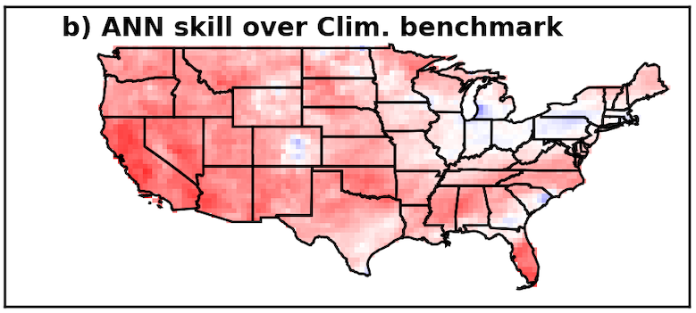
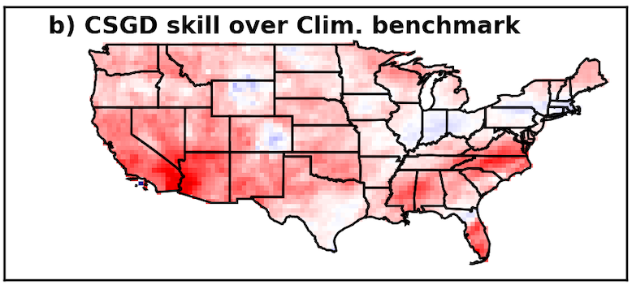
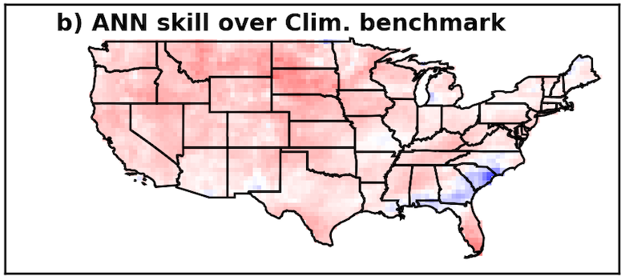
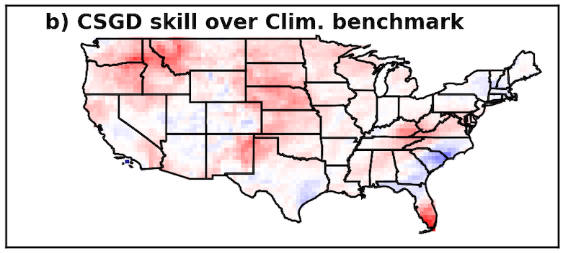
Both methods yield positive skill in January,
ANN retains more overall skill across CONUS at Week 4, including SW U.S.
ANN skill score
CSGD skill score
Continuous ranked probability skill score
Week 3
Week 3
Benchmark = climatological forecast
Week 4
Week 4

Slide 15
Both methods yield positive skill in January,
ANN retains more overall skill across CONUS at Week 4, including SW U.S.
ANN skill score
CSGD skill score
Continuous ranked probability skill score
Week 3
Week 3
Benchmark = climatological forecast
Week 4
Week 4

Slide 16
Both methods yield positive skill in January,
ANN retains more overall skill across CONUS at Week 4, including SW U.S.
ANN skill score
CSGD skill score
Continuous ranked probability skill score
Week 3
Week 3
Benchmark = climatological forecast
Week 4
Week 4

Slide 17
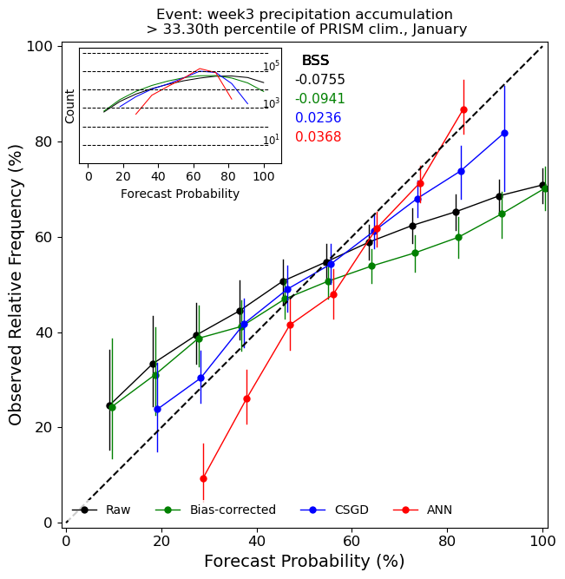
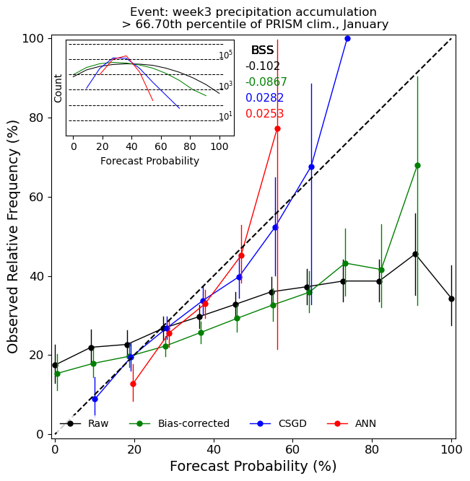
How reliable are the different post-processing methods?
Event: > 33th percentile of climatology
Event: > 67th percentile of climatology
Legend
Raw
CSGD
ANN
Unbiased
Observed Relative Frequency (%)
January
Week 3
January
Week 3
Forecast Probability (%)
Forecast Probability (%)

Slide 18
How reliable are the different post-processing methods?
Event: > 33th percentile of climatology
Event: > 67th percentile of climatology
Legend
Raw
CSGD
ANN
Unbiased
Observed Relative Frequency (%)
January
Week 3
January
Week 3
Forecast Probability (%)
Forecast Probability (%)

Slide 19
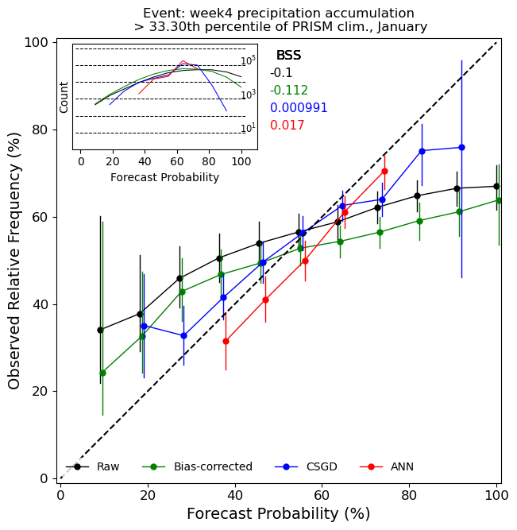
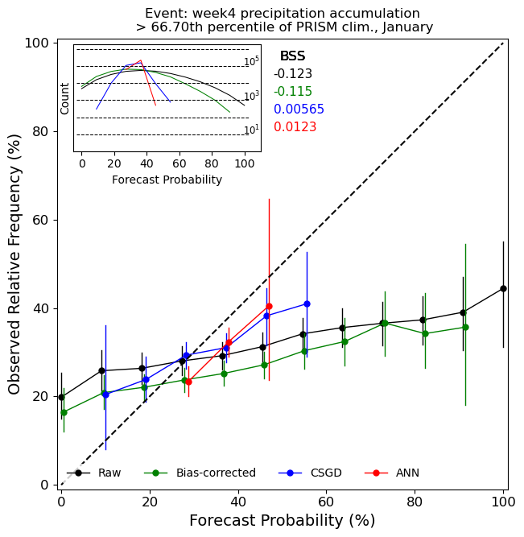
ANN overconfident at Week 4 & not “comfortable” making a forecast probability that deviates much from climatological forecast probability
Event: > 33th percentile of climatology
Event: > 67th percentile of climatology
Legend
Raw
CSGD
ANN
Unbiased
Observed Relative Frequency (%)
January
Week 4
January
Week 4
Forecast Probability (%)
Forecast Probability (%)

Slide 20
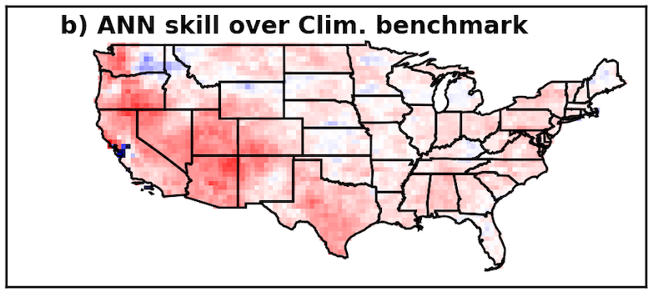
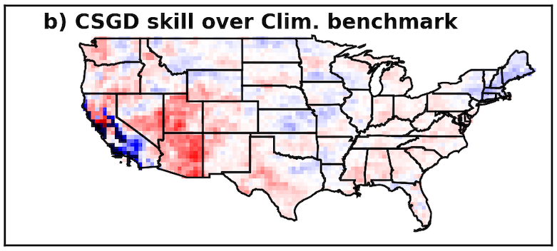
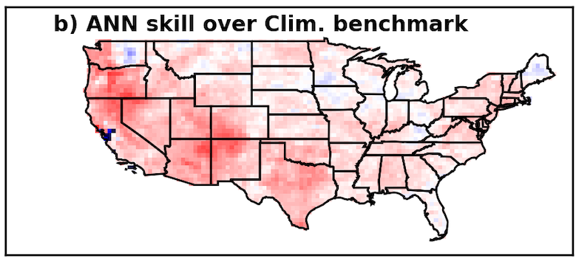
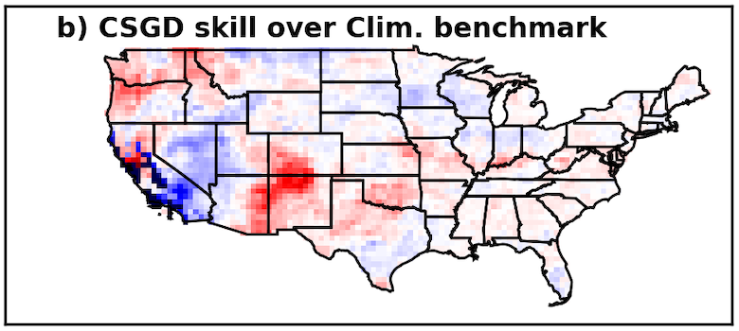
ANN & CSGD overall have less skill in July than January
CSGD particularly struggles in southern CA & Great Basin in Week 4
ANN skill score
CSGD skill score
Continuous ranked probability skill score
Week 3
Week 3
Benchmark = climatological forecast
Week 4
Week 4

Slide 21
ANN & CSGD overall have less skill in July than January
CSGD particularly struggles in southern CA & Great Basin in Week 4
ANN skill score
CSGD skill score
Continuous ranked probability skill score
Week 3
Week 3
Benchmark = climatological forecast
Week 4
Week 4

Slide 22
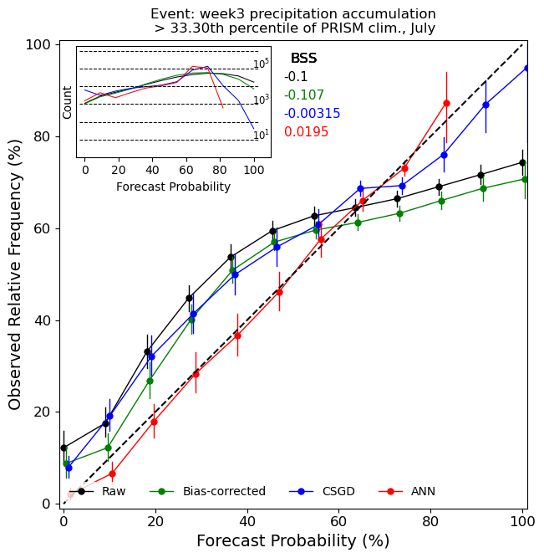
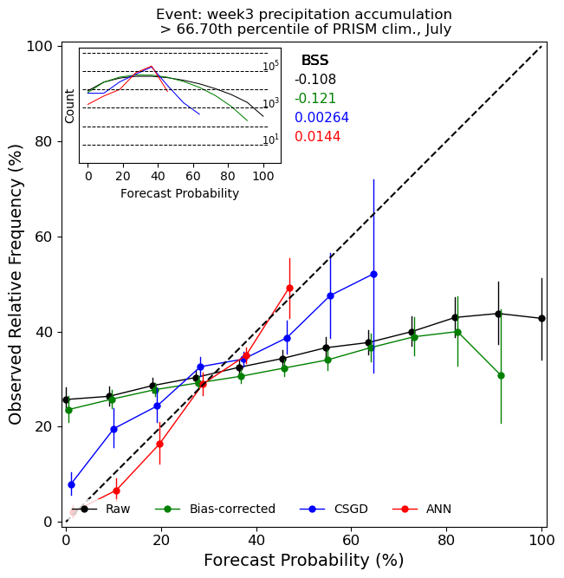
ANN is nearly perfectly reliable at Week 3 in July for > 37th percentile.
The same is true for > 67th percentile for lower forecast probabilities
Event: > 33th percentile of climatology
Event: > 67th percentile of climatology
Legend
Raw
CSGD
ANN
Unbiased
Observed Relative Frequency (%)
July
Week 3
July
Week 3
Forecast Probability (%)
Forecast Probability (%)

Slide 23
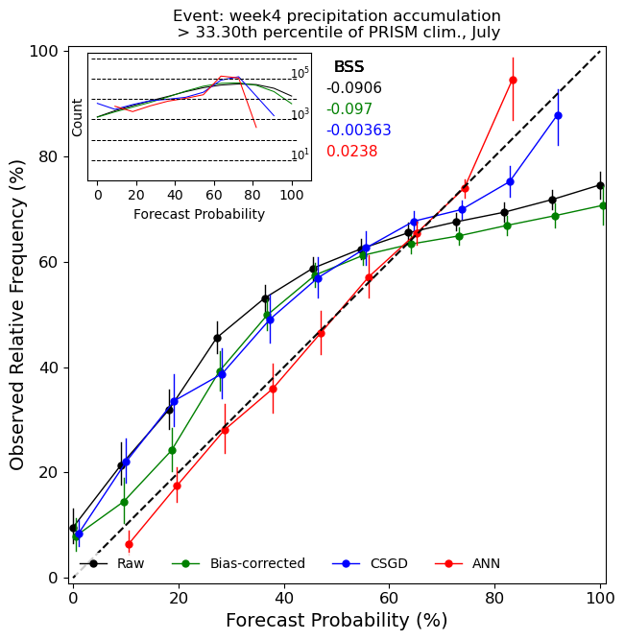
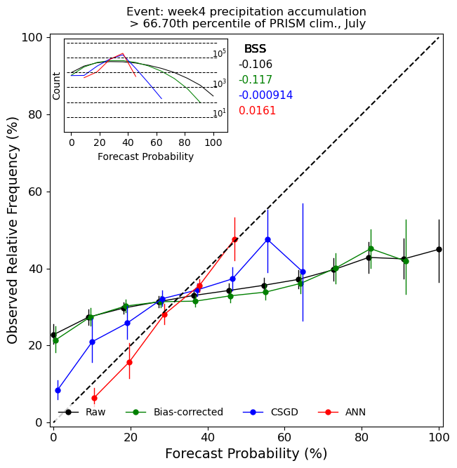
The postprocessing methods show similar reliability patterns
at Week 3 and Week 4 in July
Event: > 33th percentile of climatology
Event: > 67th percentile of climatology
Legend
Raw
CSGD
ANN
Unbiased
Observed Relative Frequency (%)
July
Week 4
July
Week 4
Forecast Probability (%)
Forecast Probability (%)

Slide 24
Summary of ANN
We used a single ANN post-processing model for the entire domain based on Scheuerer et al. 2020
ANN method had comparable skill scores to the CSGD method at Week 3 in January, but retained skill better than CSGD at Week 4
ANN method had generally higher skill scores than CSGD in July for Week 3 and Week 4 → ANN not as susceptible to overfitting at dry locations
Reliability of ANN needs improvement in January: makes overconfident forecasts
However, reliability of ANN in July is nearly perfect.
Scheuerer and Hamill 2015: Statistical Postprocessing of Ensemble Precipitation Forecasts by Fitting Censored, Shifted Gamma Distributions
Scheuerer et al. 2020: Using Artificial Neural Networks for Generating Probabilistic Subseasonal Precipitation Forecasts over California

Slide 25
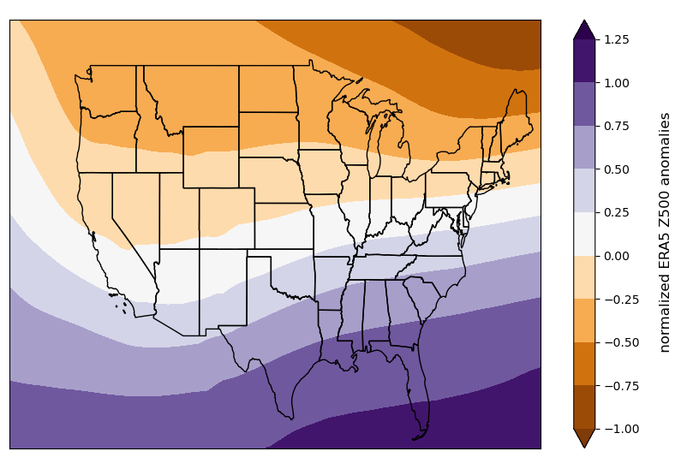
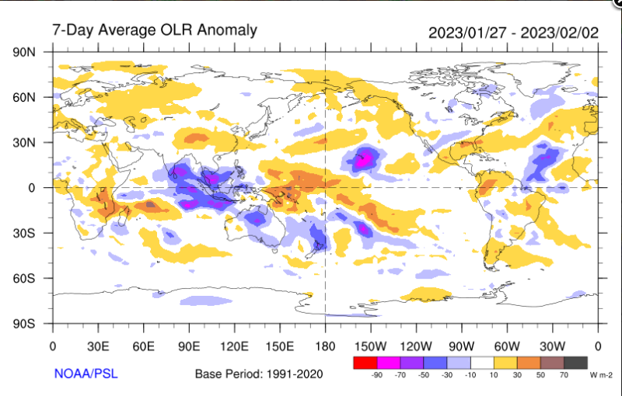
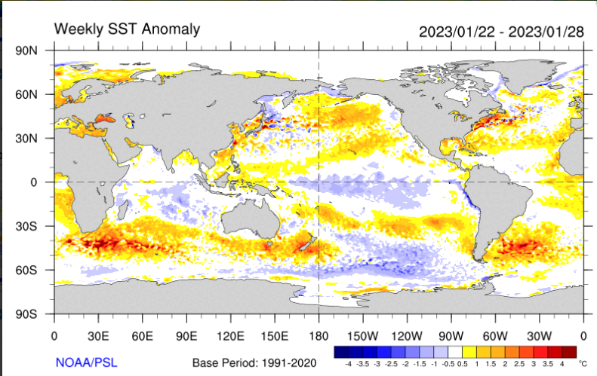
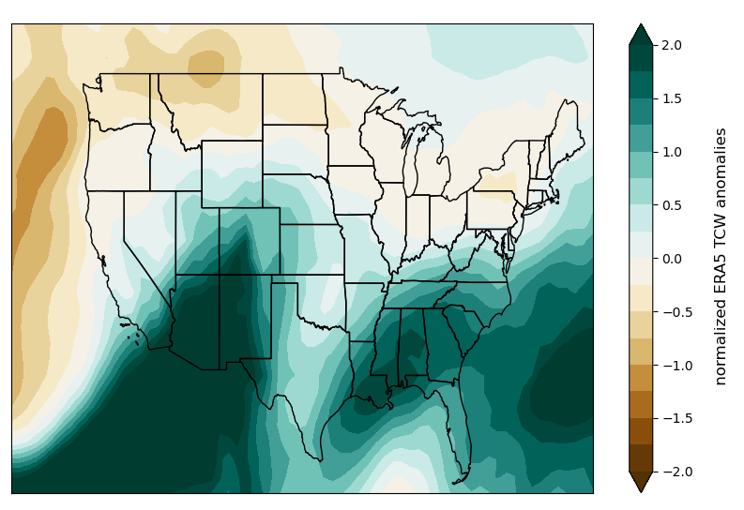
What’s next? Explore if a CNN can yield even greater skill at weeks 3-4.
Instead of forecast precipitation, we use normalized large-scale predictors as inputs (z500 & total column water anomalies, tropical teleconnectors)
Data/image provided by the NOAA/OAR/ESRL PSL, Boulder, Colorado, USA, from their Web site at http://psl.noaa.gov/

Slide 26
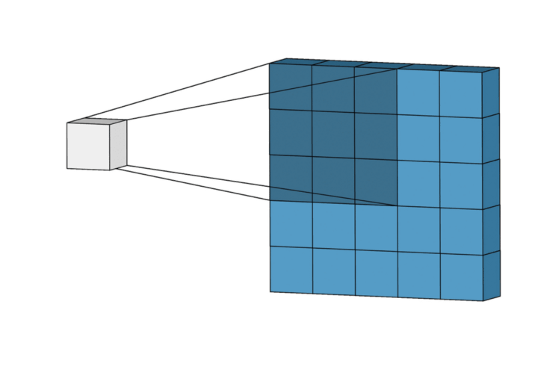
The CNN can learn non-linear relationships
among the different predictor images
The CNN uses multiple filters to search for & extract non-linear pattern information within the predictor images.
Probability of precipitation category
Small filters slide over and extract features from the weather maps

Slide 27
The goal is for the ANN & CNN outputs to provide calibrated & reliable
Weeks 3-4 precipitation outlooks
Our methods aim to improve guidance provided in figures like this through artificial intelligence

Slide 28
Thank you!
rochelle.worsnop@noaa.gov
Project funded by the Weather Program Office (WPO) via NOAA Cooperative agreement No. NA21OAR4590176
“Leveraging artificial intelligence to statistically postprocess GEFS ensemble forecasts for Week 3-4 Outlooks of precipitation probabilities for the CPC”

