Slide 1
METplus Tools for Evaluation of UFS MRW/S2S Application
Tara Jensen and METplus Team
National Center for Atmospheric Research and Developmental Testbed Center
Week 3/4 Webinar Series
2 Aug 2021
Contributions from UIUC, GMU, NOAA/PSL, NOAA/CPC

Slide 2
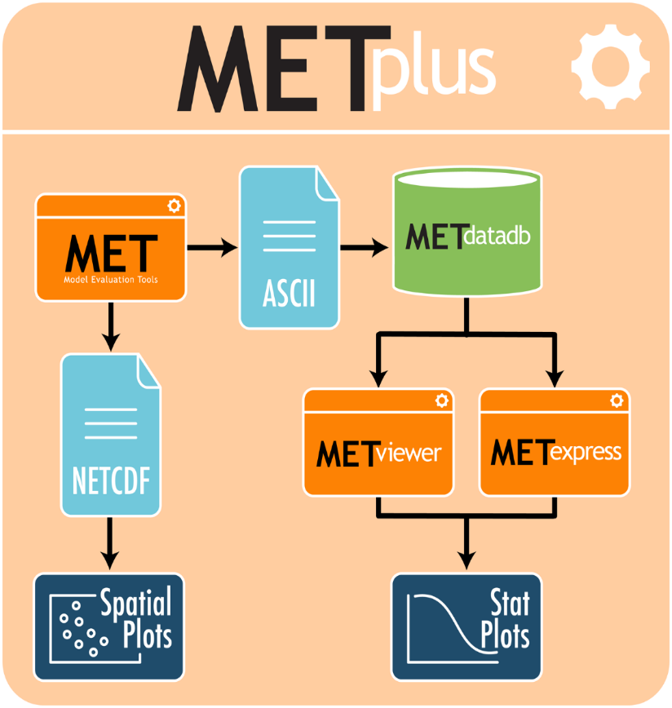
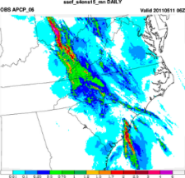
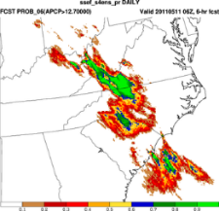
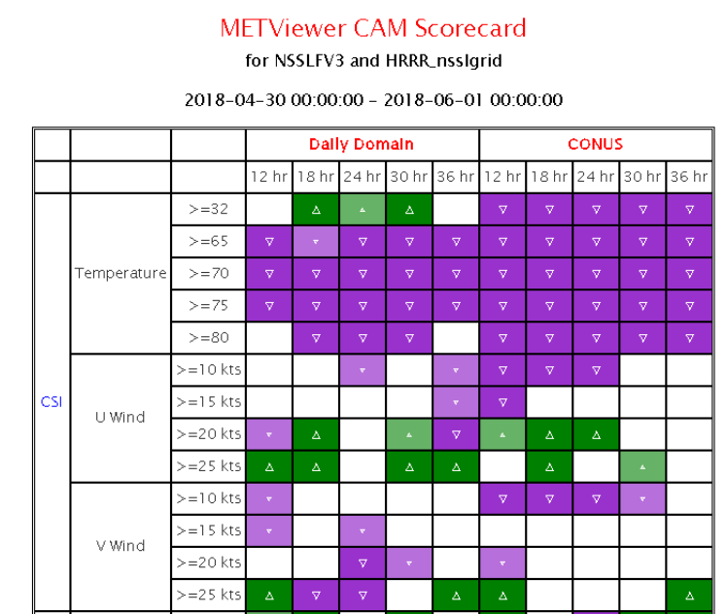
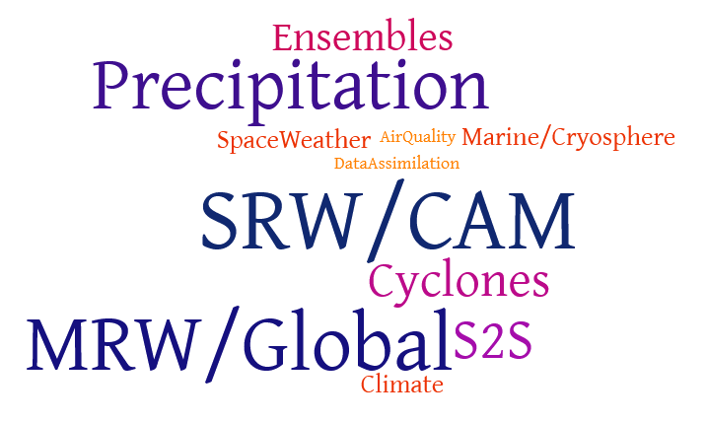
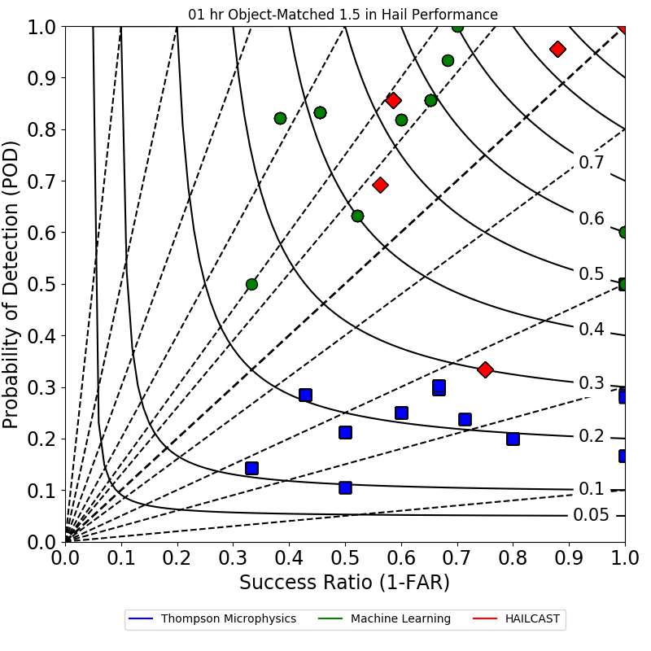
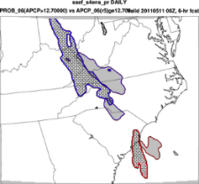
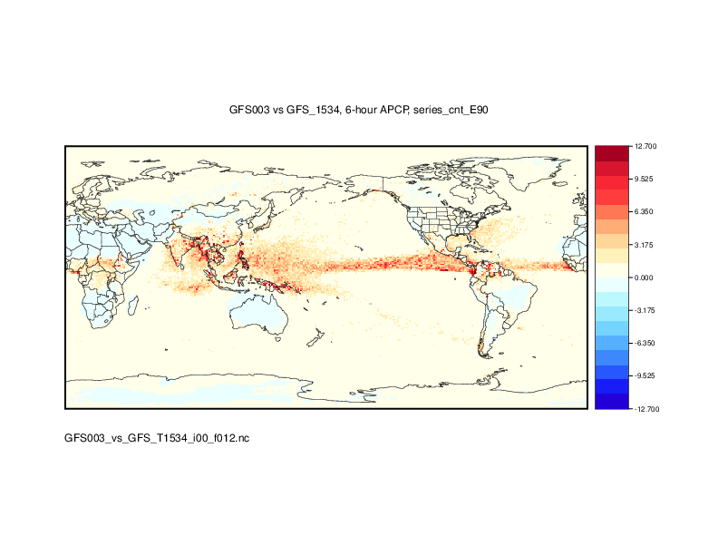
What is METplus?
Suite of Python wrappers around
MET (core)
Database and display systems(core)
Plotting
METviewer/METexpress User Interface
METviewer Batch Engine
Python plotting scripts
Communication between MET & python algorithms
Using manage_externals to connect repos
Over 100 traditional statistics and diagnostic methods for both point and gridded datasets
15 interpolation methods
Applied to many spatial and temporal scales
Developed to allow for easy sharing of config files for reproducible results
3500+ users; US and Int’l
METplus Examples/Use-Case In Development
Bad forecast or
Good forecast with displacement error?
Notes:
SRW – Short Range Weather
CAM – Convection Allowing Model
MRW – Medium Range Weather
S2S – Subseasonal to Seasonal

Slide 3
METplus Data Flow

Slide 4
METplus Data Flow
METplus Data Flow
for Most S2S Diagnostics

Slide 5
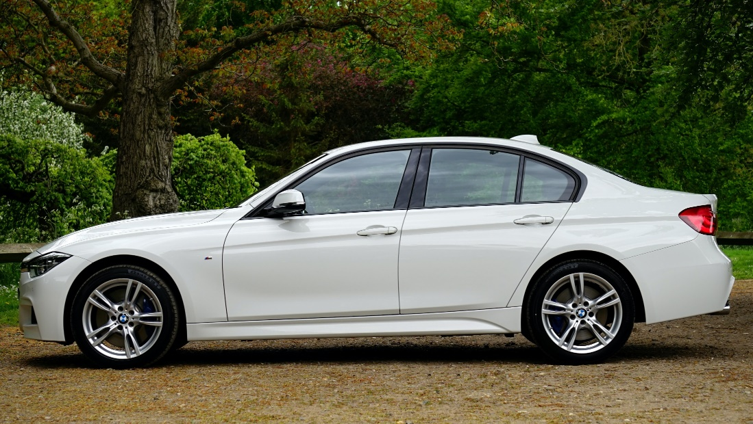
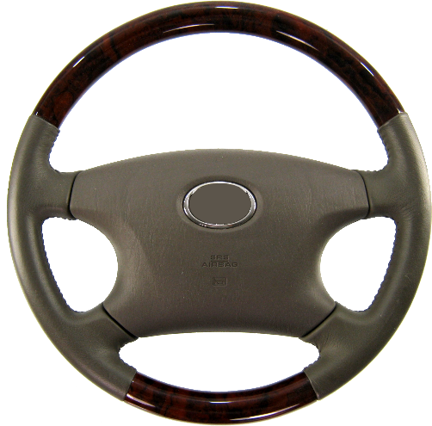
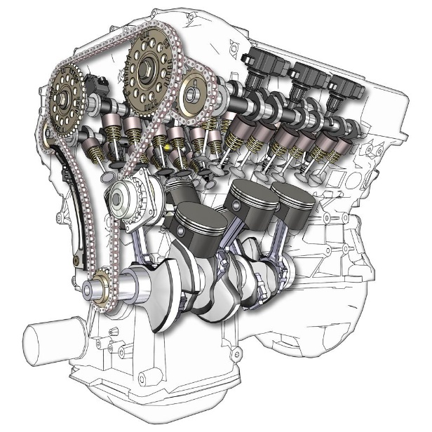
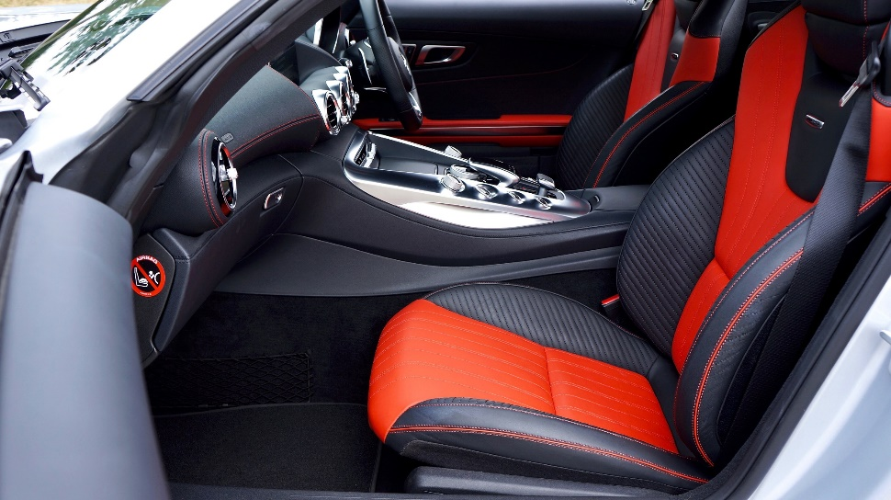
METplus Analogy
METplus
Drives the process and keeps everything together
MET
METplus Analysis Suite:
METviewer
METexpress
METcalcpy
METplotpy
Statistical engine
The accessories that makes the process better

Slide 6
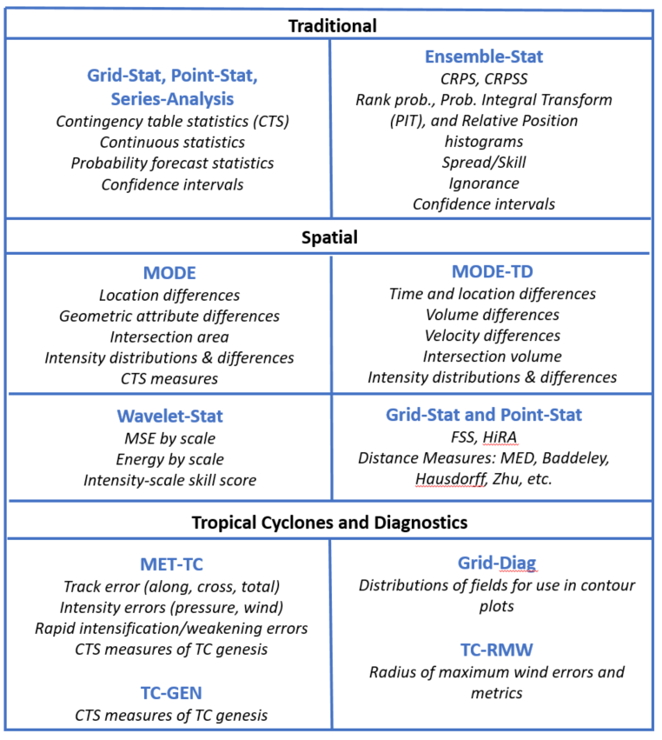
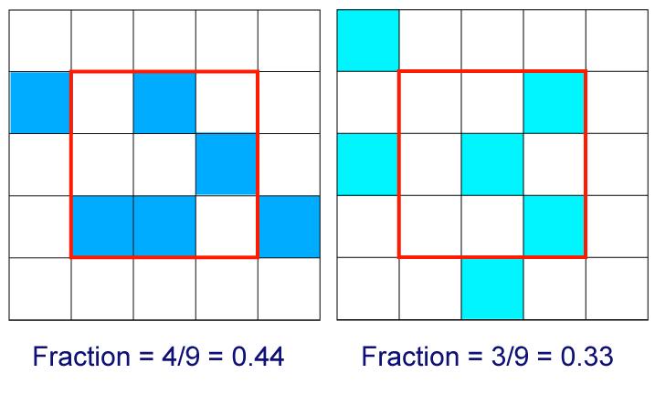
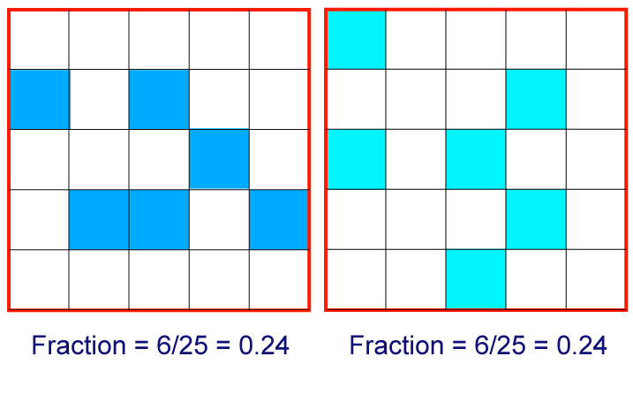
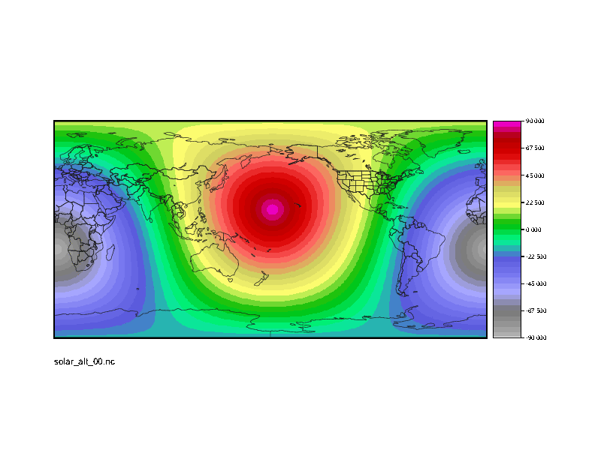
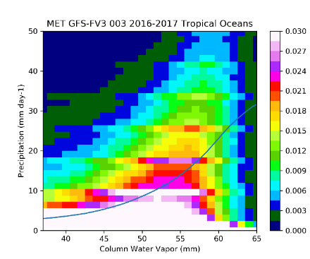
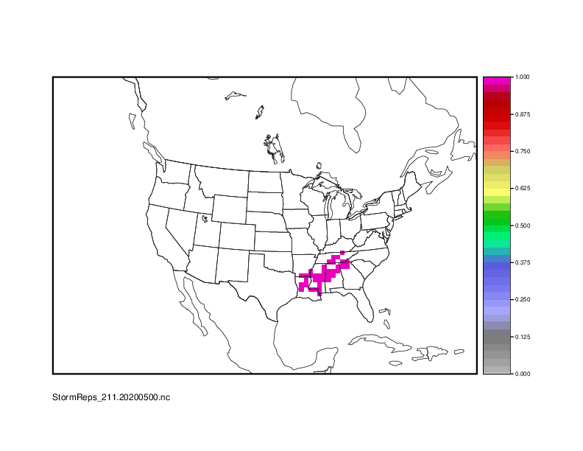
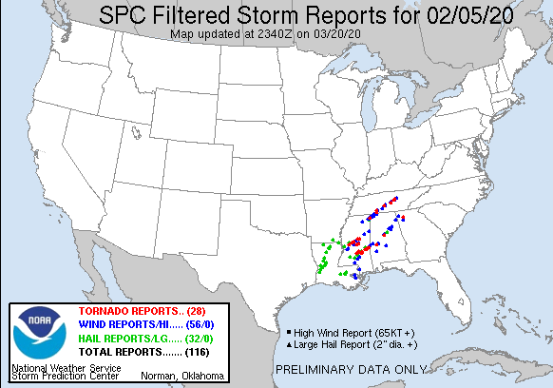
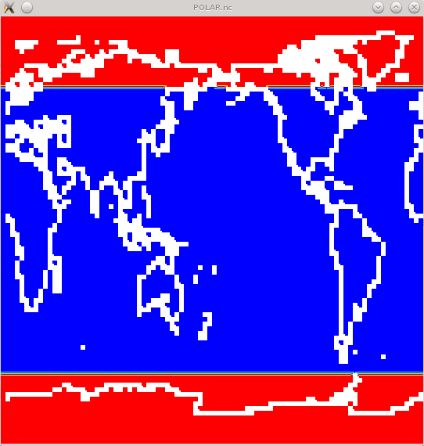
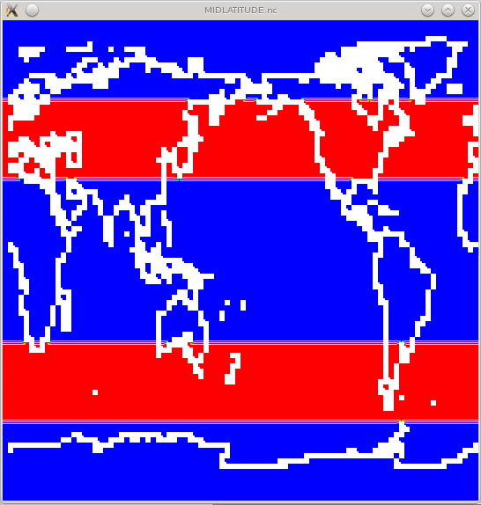
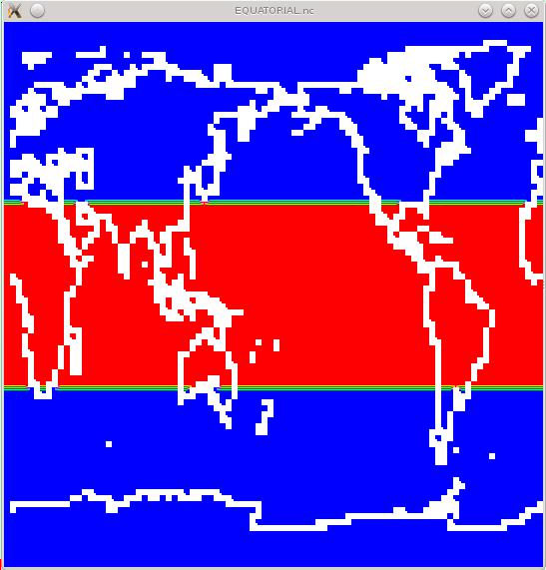
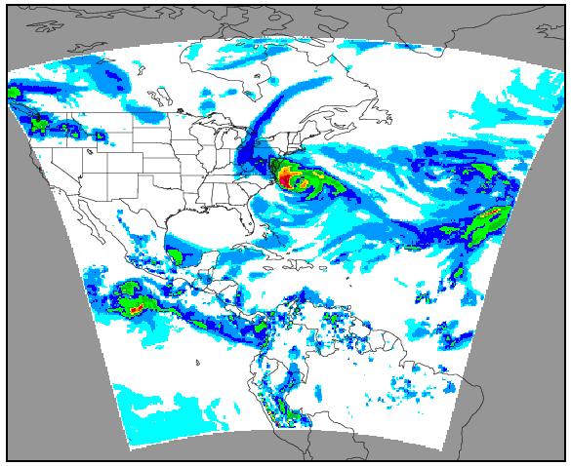
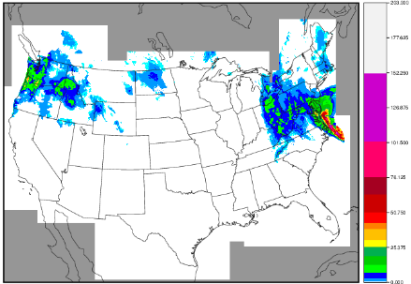
Some METplus Tools
Neighborhood Methods
Python
Embedding
Python Script
STAT
ASCII
NetCDF
Gridded
Forecast
(Grib)
Grid
Stat
Gridded
Analysis
(netCDF)
Python Script
Multivariate PDFs
For Climo and
Percentiles
Masking
Auto
Regridding
Point to Grid
Interpolation

Slide 7
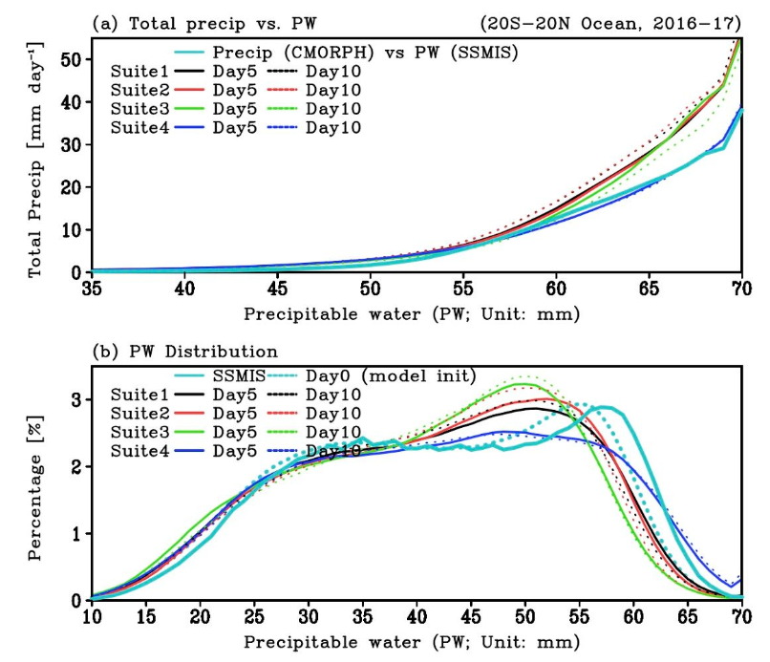
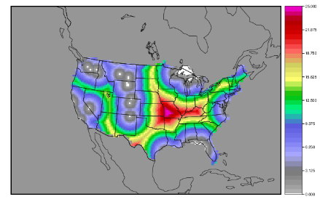
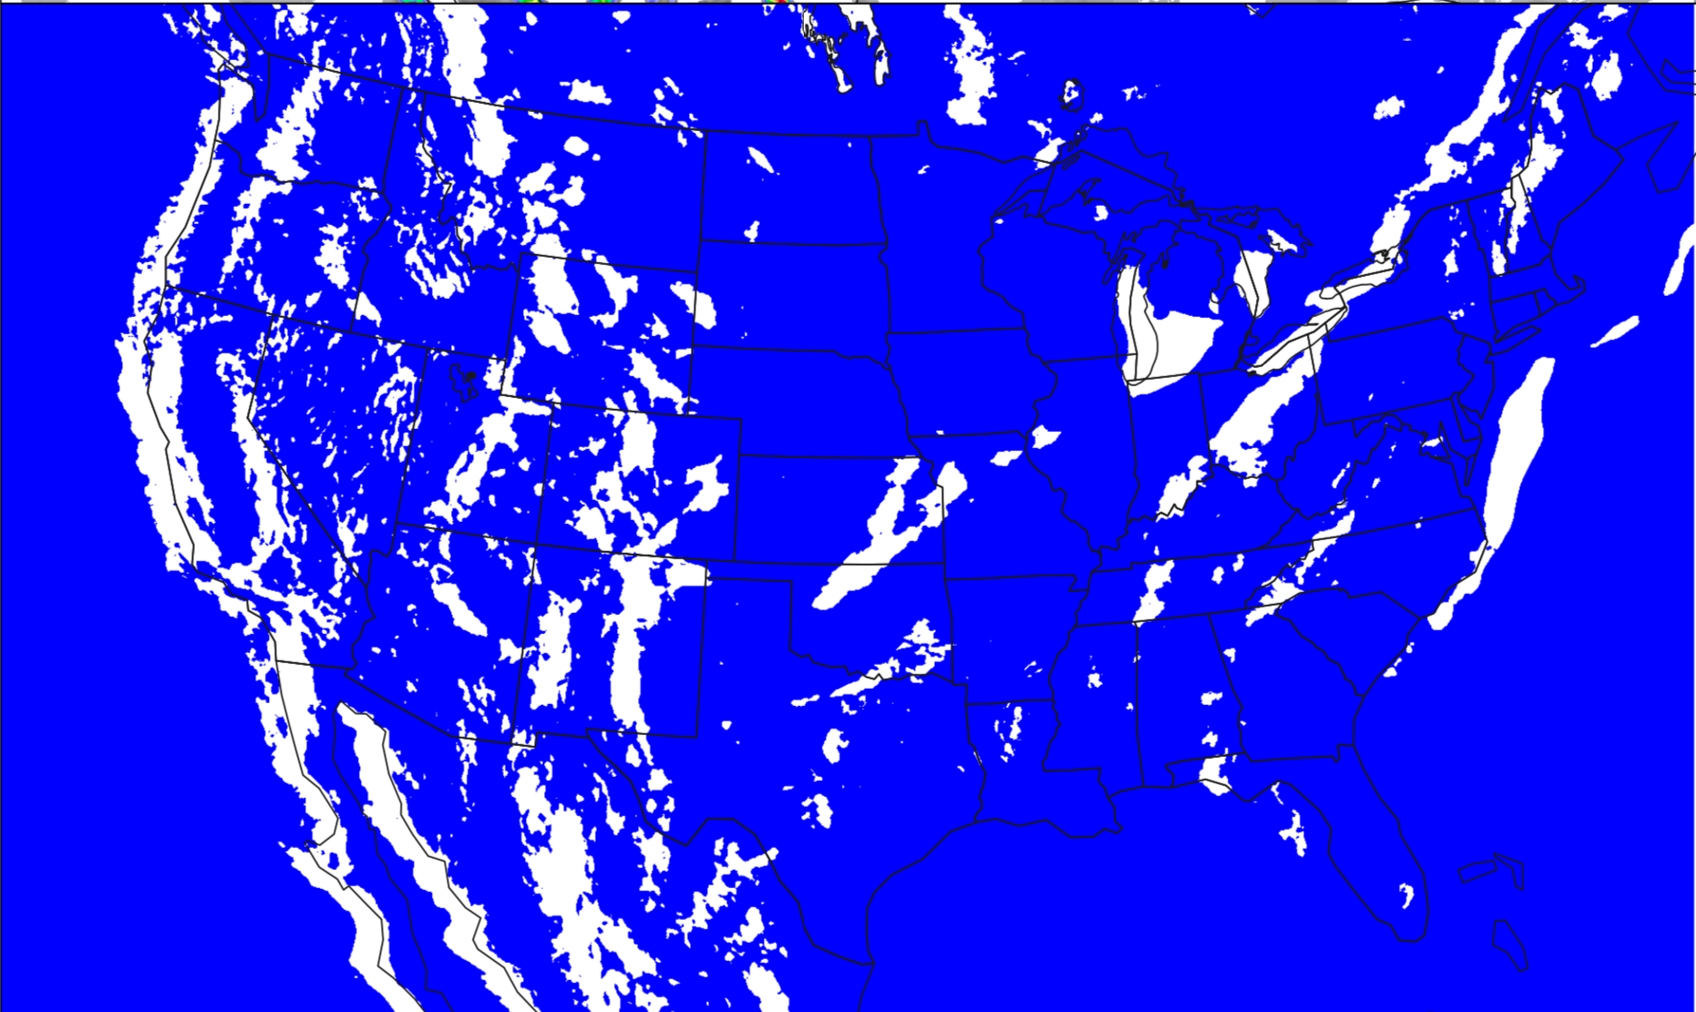
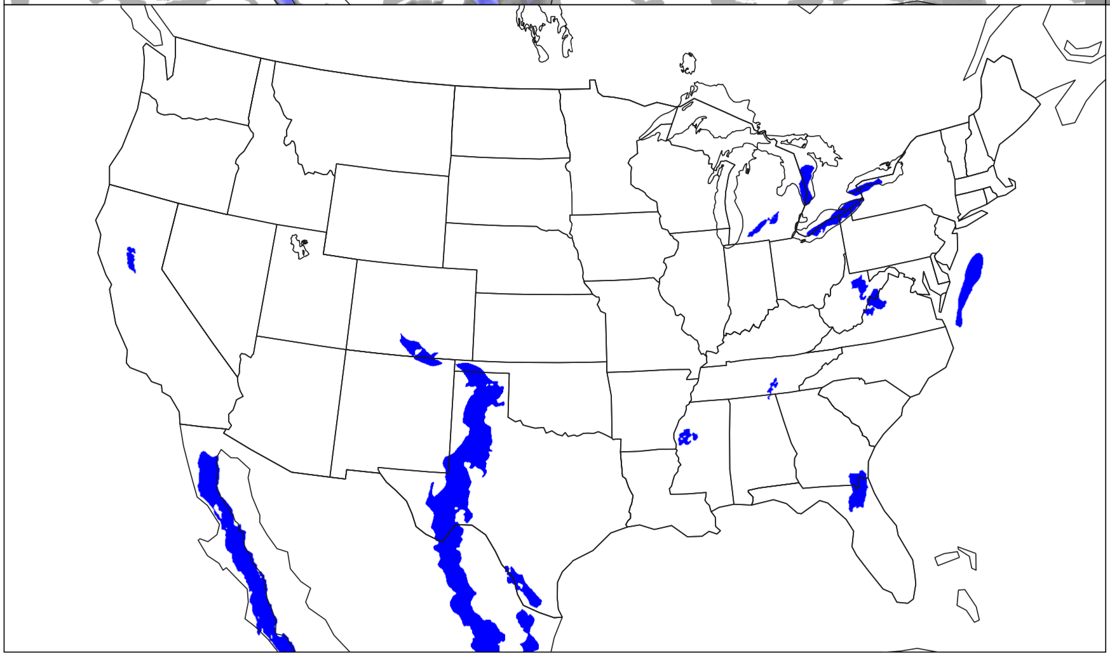
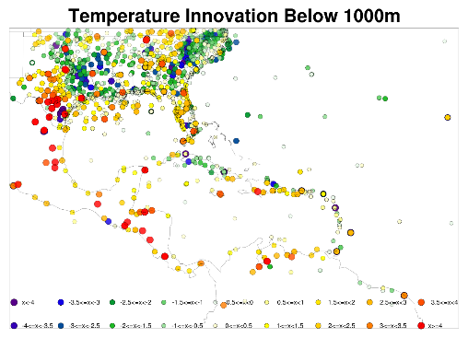
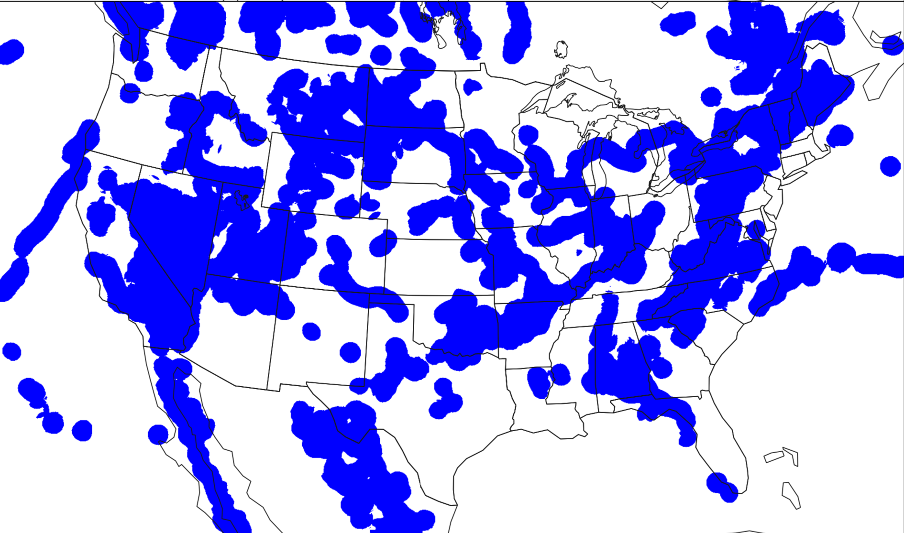
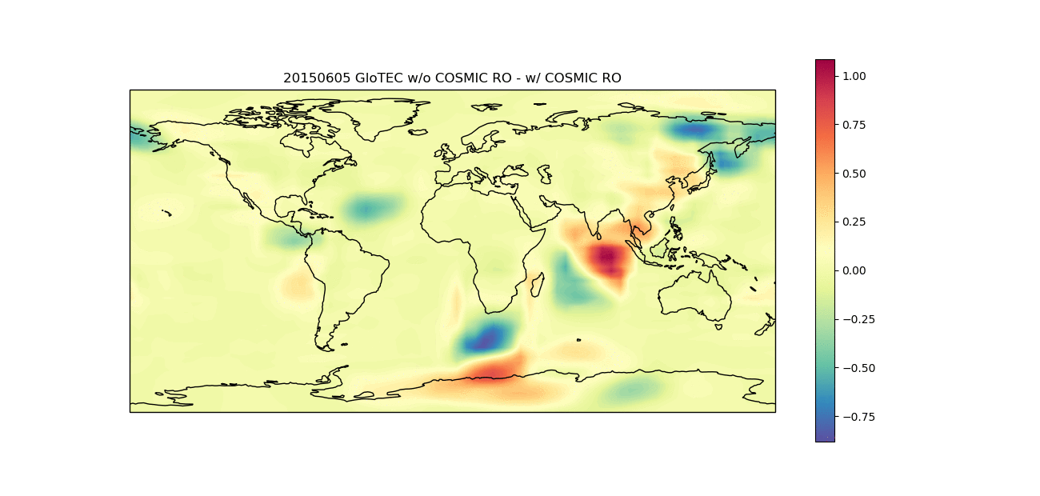
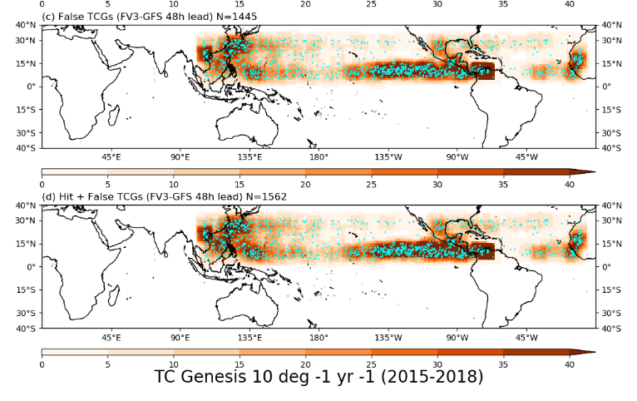
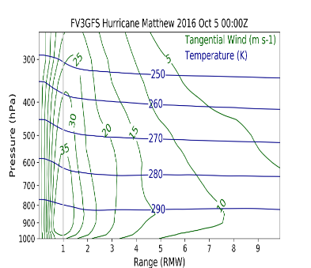
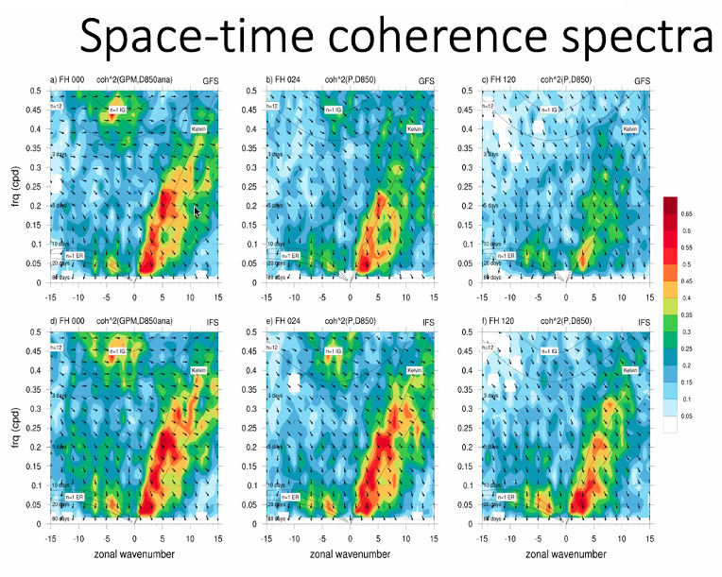
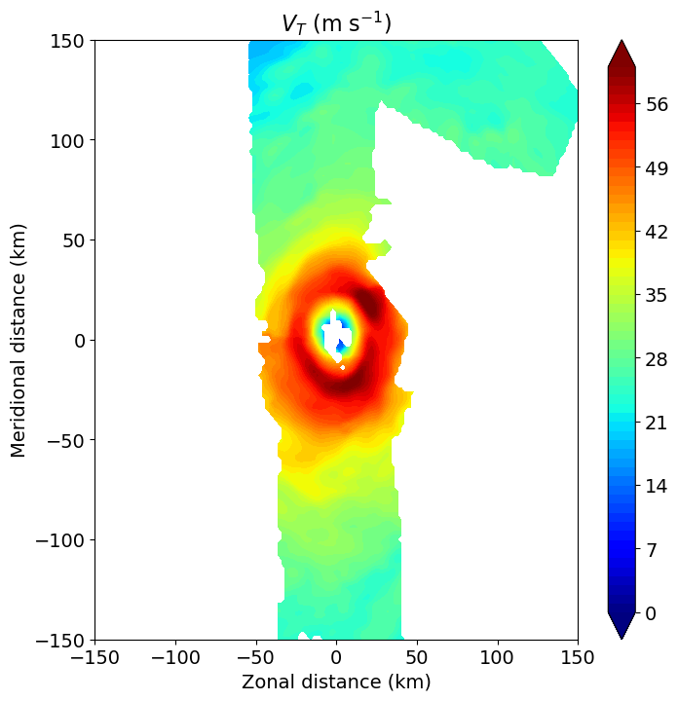
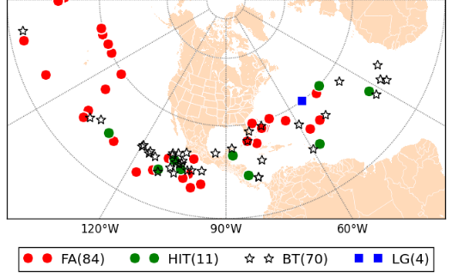
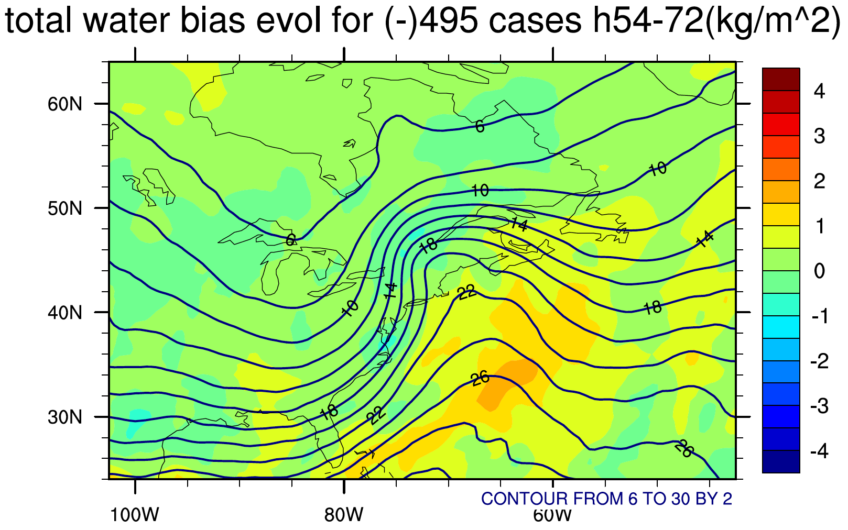
Some METplus Diagnostics
S2S Multivariate distributions
SRW/MRW Multivariate objects
All Spatial Methods
SRW/MRW Spatial Distribution of Errors
S2S Diagnostics
TCs New Projections and Obs
S2S TC-Genesis
SRW/MRW Systematic Errors

Slide 8
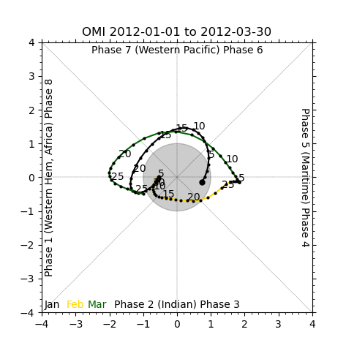
OLR-based MJO Index (OMI) Overview
Uses model or observation or both
Outgoing longwave radiation (OLR)
1 optional pre-processing step (Either/both model, observation)
[regrid_obs_olr] section
Regrid_data_plane: cut the domain to -20 – 20 latitude (turned off)
Calculation includes
Filter for 26 – 90 days
Regress OLR onto EOF patterns (retain frequencies of MJO)
Normalization of Principal Components
Plot phase diagram

Slide 9
OMI Setup
METplus v4.1.0 beta 1
Look for it in develop branch
METplus, METplotpy, METcalcpy, METdatadb in path or conda environment
Data:
OLR, 1979 – 2012 (ERA)
EOFs1 and 2
One file for each day of the year (1-366)
Text format from PSL website
UserScript_fcstGFS_obsERA_OMI.conf
OMI specific variables given in [user_env_vars] section
Whether to run forecast, obs, or both
Number of Observations per day
Plotting specific variables (start/end times, output file names and format)

Slide 10
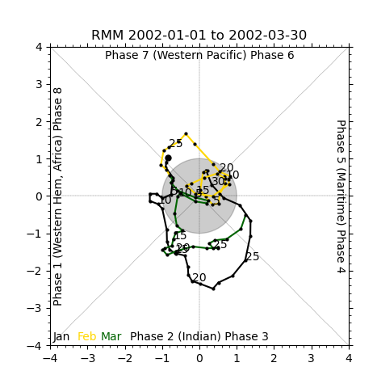
Real-Time Multivariate MJO Index (RMM) Overview
Uses Model, observation or both
Anomalies of Outgoing longwave radiation, 850 hPa wind, 200 hPa wind
1 optional pre-processing step (Either/both model, observation)
Regrid_data_plane: cut the domain to -15 – 15 latitude (turned off)
Calculation includes
Remove 120 day mean
Normalize by square root of variance
Regress data onto EOF patterns
Normalize principal components by standard deviation
Plots phase diagram, time series, EOFs

Slide 11
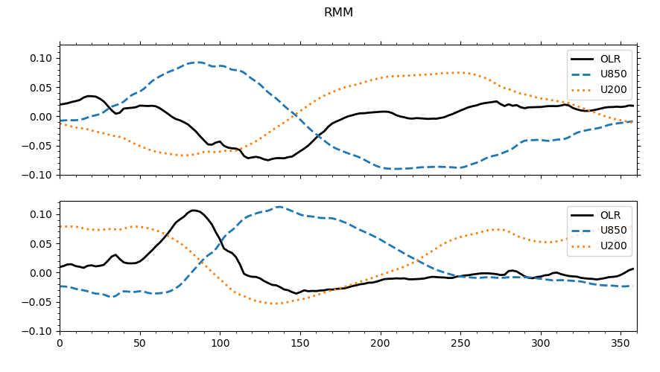
RMM Setup
METplus v4.1.0 beta 1
Look for it in develop branch
METplus, METplotpy, METcalcpy, METdatadb in path or conda environment
Data:
OLR U850, U200 anomalies, 2002 (ERA)
EOFs1 and 2 for OLR, U850, U200 from BoM Australia, text
UserScript_fcstGFS_obsERA_RMM.conf
RMM specific variables given in [user_env_vars] section
Whether to run forecast, obs, or both
Number of Observations per day and normalization factors
Plotting specific variables (start/end times, output file names and format)
PC1
PC2
RMM EOFs

Slide 12
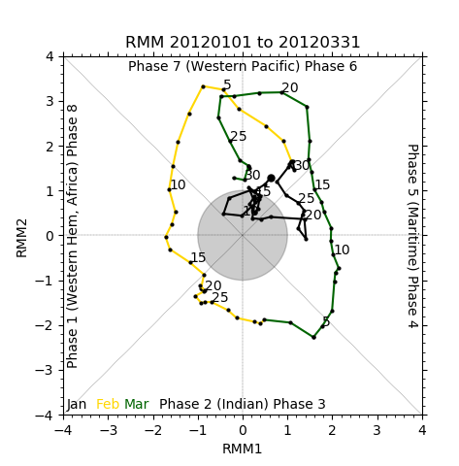
Phase Diagram/Extras
METplus v4.1.0 beta 1
Look for it in develop branch
Phase Diagram:
Creates a Phase diagram from previously computed RMM or OMI
Text data from PSL, BoM Australia
Extras:
For RMM, can currently compute anomalies using means with MET tool PCP-Combine
Support for harmonic Analysis to compute anomalies in progress
Would like to add support for other formats of EOFs, including computing them in python

Slide 13
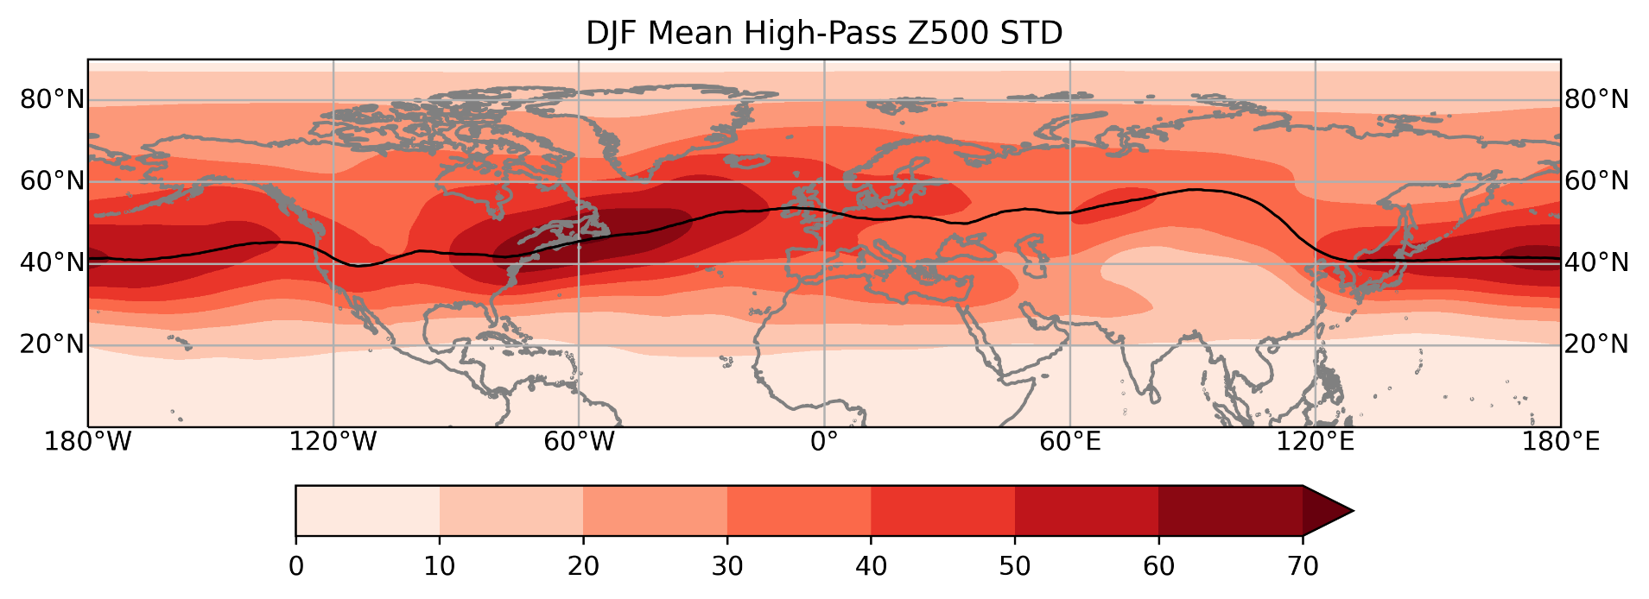
Blocking Overview/CBLs
METplus v4.0.0
Look for it in main_v4.0 branch
Requires model or observation or both, preferably 20-30 years
4 optional pre-processing steps (can be for both model and observation)
Regrid_data_plane: Regrid to 1 degree
Pcp_combine: daily mean/forecast lead mean, running mean (default is 5 day), computing anomalies
4 Calculation steps, must run in order
CBLs, IBLs, GIBLs, blocking frequency
3 plotting options
CBLs, IBLs, Blocks
CBL - Central Blocking Latitude
Latitude maximum of high pass filtered (9 points) geopotential height variance, weighted by cosine longitude

Slide 14
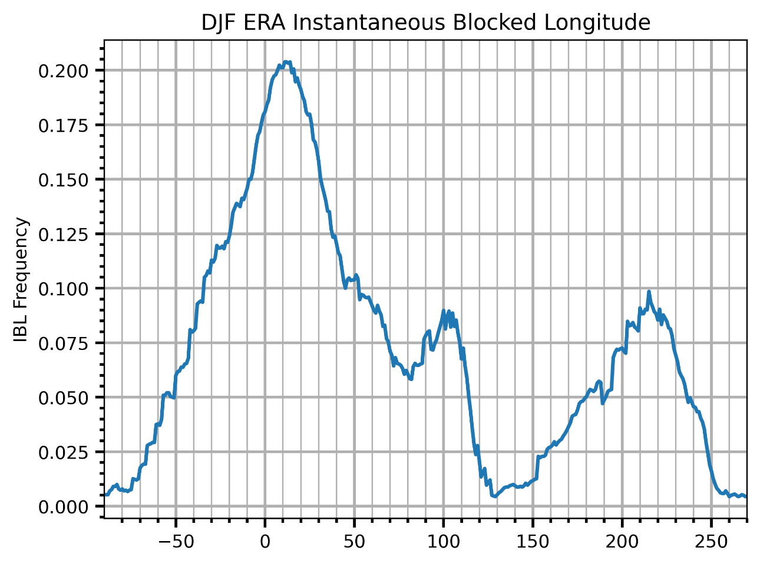
IBLs
IBL – Instantaneous Blocking Latitudes
Computes IBLs using Pelly-Hoskins method
Looks for reversals in Geopotential Height gradient
Allows for offset from CBL latitude
Easterly flow equatorward of block
500 hPa Geopotential Height
Methodology:
A. Barnes, J. Slingo, and T. Woollings. A methodology for the comparison of blocking climatologies across indices, models and climate scenarios. Clim. Dyn., 38: 2467–2481, 2012. doi: 10.1007/s00382-011-1243-6.

Slide 15
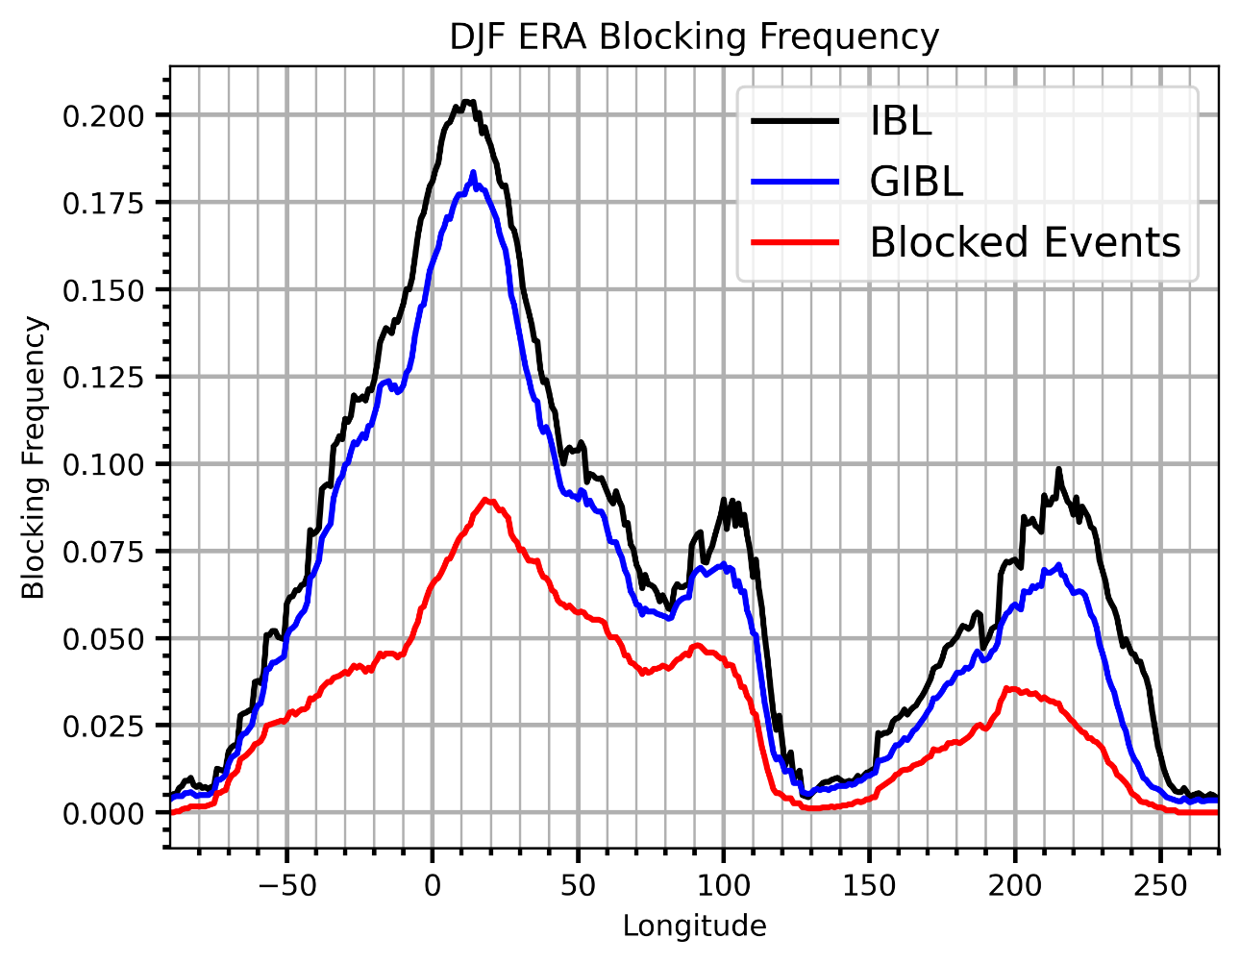
GIBLs/Calculating Blocks
GBL - Group Instantaneously Blocked Latitude
Groups IBLs together using criteria
Minimum number of grid points in IBL (15)
If IBLS separated by less than 7 grid points (default), all included as GIBL
GIBLs must overlap across days (10 grid points)
Calculate Blocks
Time requirement in days (5)
Cannot travel more than a certain number of grid points (45)
Writes MET MPR file for IBLs and Blocking frequency to compute additional skill scores

Slide 16
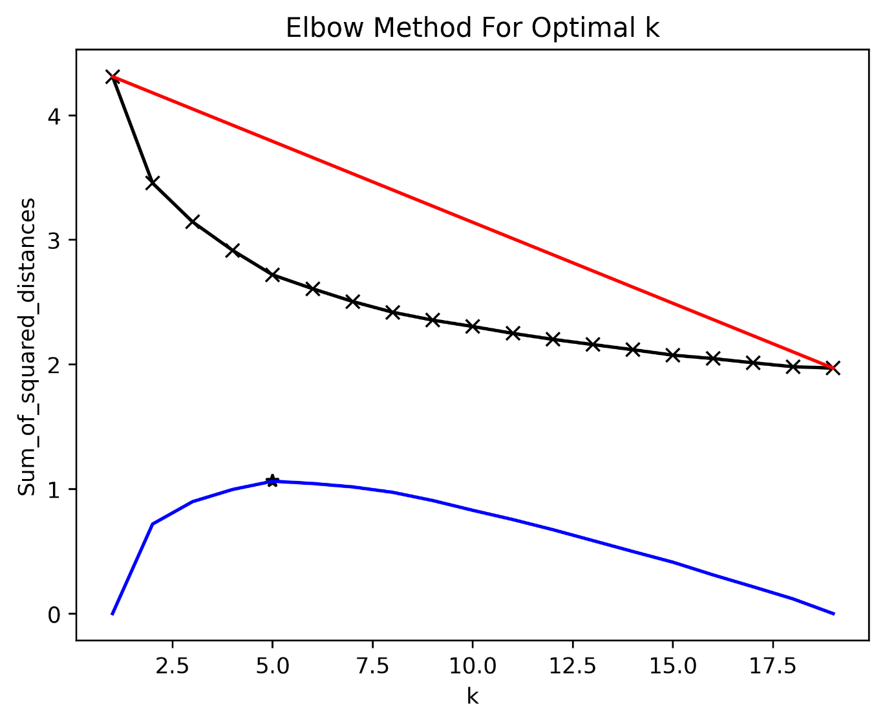
Weather Regime Overview/Elbow
METplus v4.0.0
Look for it in main_v4.0 branch
Requires model or observation or both, preferably 20-30 years
2 optional pre-processing steps (can be for both model and observation)
Regrid_data_plane: Regrid to 1 degree
Pcp_combine: daily mean/forecast lead mean
3 Calculation steps, run any
Elbow, EOFs, K-means
3 plotting options
Elbow, EOFs, K-means
Elbow:
Uses K-means clustering for 15 clusters
Computes optimal cluster number by finding the bend in the elbow using sum of squared distances

Slide 17
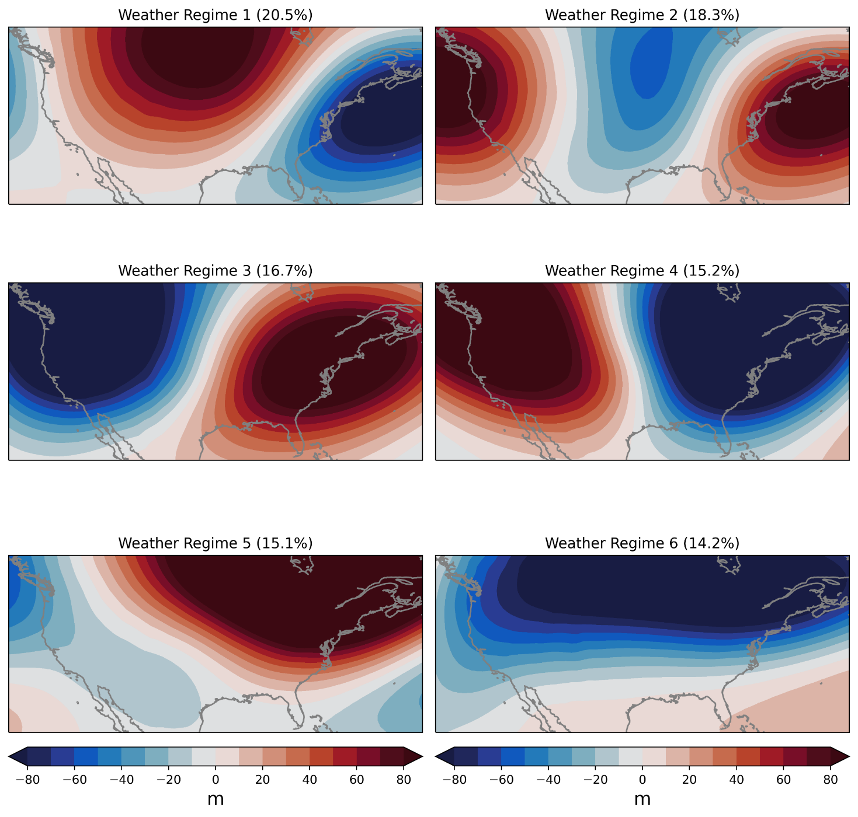
EOFs/K-Means
EOFs
Computes EOFs from 500 hPa heights
Reconstructs EOFs (eofs * pcs) to use as the heights input to K-means
K-means
Uses either 500 hPa heights or reconstructed EOFs (if EOFs run)
Computes K-means clustering on the input number of clusters (default: 6)
Computes frequency for each cluster
Outputs classification and time frequency
Writes MET MPR output file for weather regime classification and frequency to compute skill scores

Slide 18
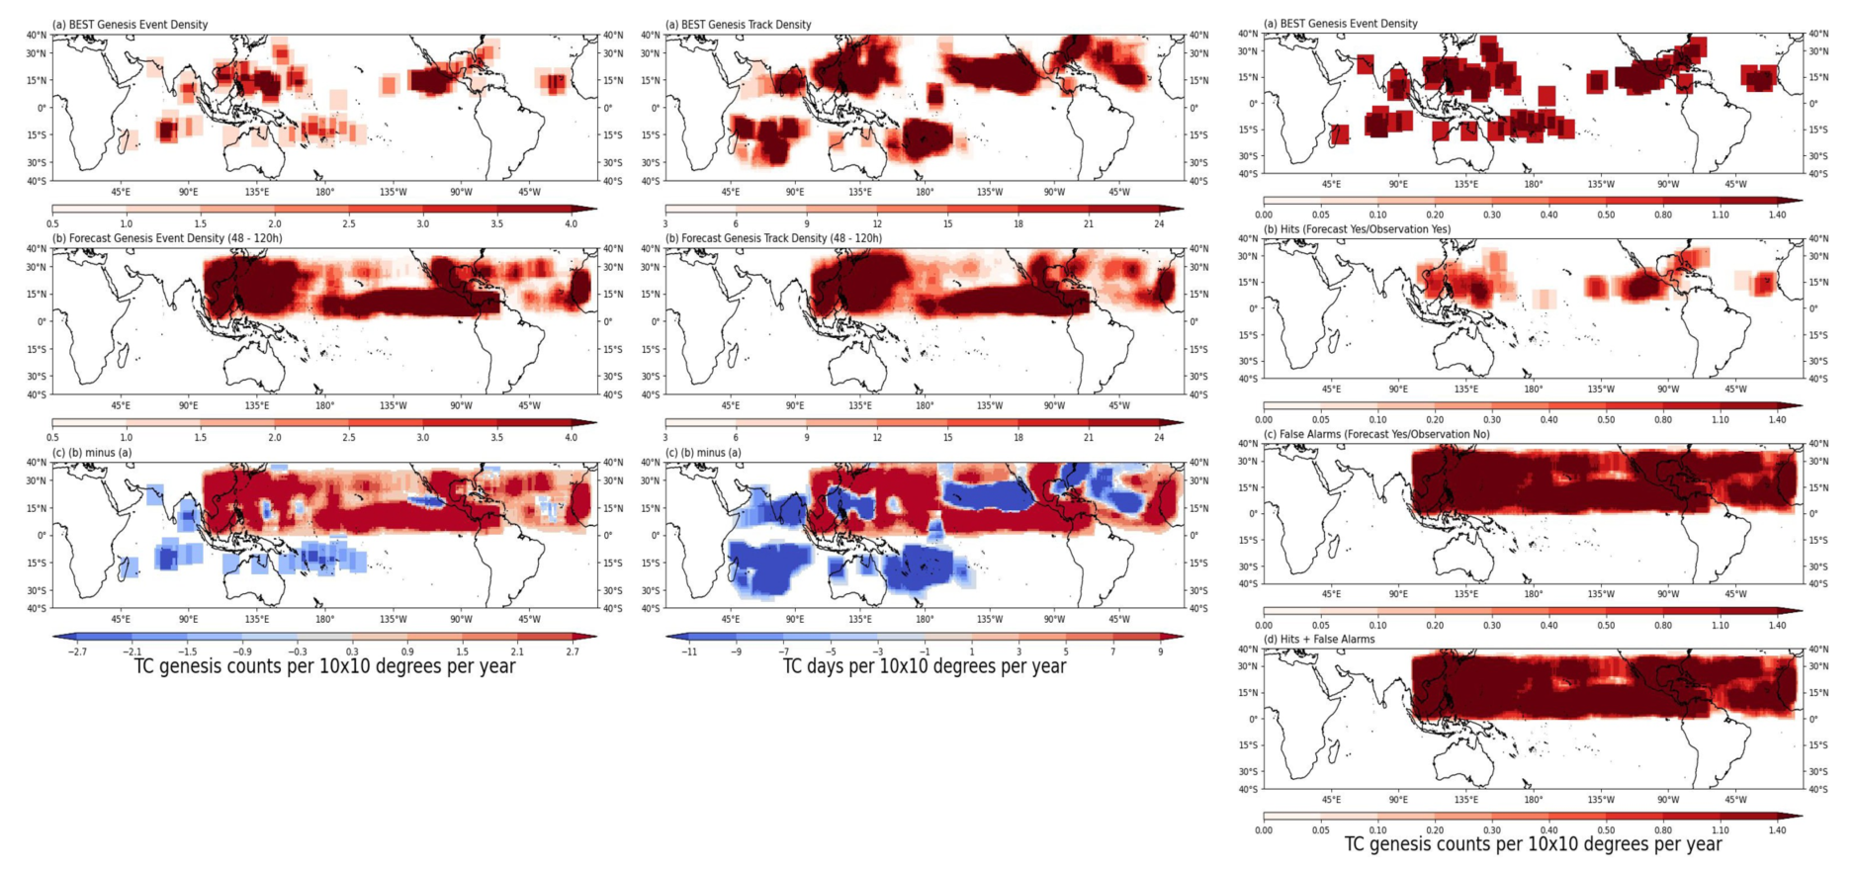
TC-Genesis Diagnostics
METplus v4.0.0
Look for it in main_v4.0 branch
Observed
Observed
Observed
Forecasted
Forecasted
Forecast Hits
Forecast False Alarms (FARs)
Difference
Difference
Forecast Hits+FARs

Slide 19
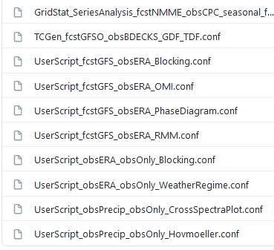
How to Run a METplus Use-Case
From:
https://github.com/dtcenter/METplus/tree/develop/parm/use_cases/model_applications/s2s
What you need for TC-Genesis Density Use-Case:
Python with cartopy, matplotlib, xarray, metplotpy
MET 10.0.0+METplus 4.0.0+
GFDL cyclone tracker output in “genesis mode” (FCST)
ATCF-formatted TC track data (OBS)
METplus Configuration File - Quick setup:
INIT_BEG = [set to first year of data, for 2016-2019, set to 2016]
TC_GEN_TRACK_INPUT_DIR = [obs ATCF directory]
TC_GEN_GENESIS_INPUT_DIR = [GFDL tracker directory]
INPUT_BASE = [top level INPUT_DIR]
OUTPUT_BASE = [top level OUTPUT_DIR]
MET_INSTALL_DIR = [path to MET install]
Run METplus:
> run_metplus.py \
-c /path/to/METplus/parm/use_cases/model_applications/s2s/TCGen_fcstGFSO_obsBDECKS_GDF_TDF.conf \
-c /path/to/user_system.conf

Slide 20
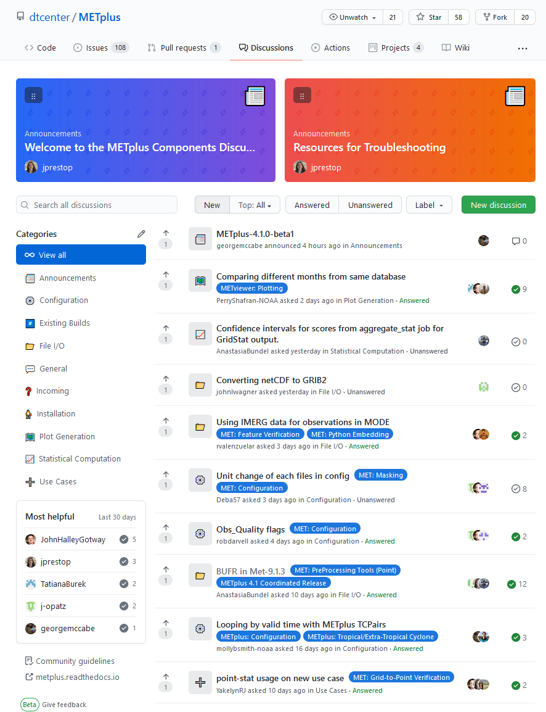
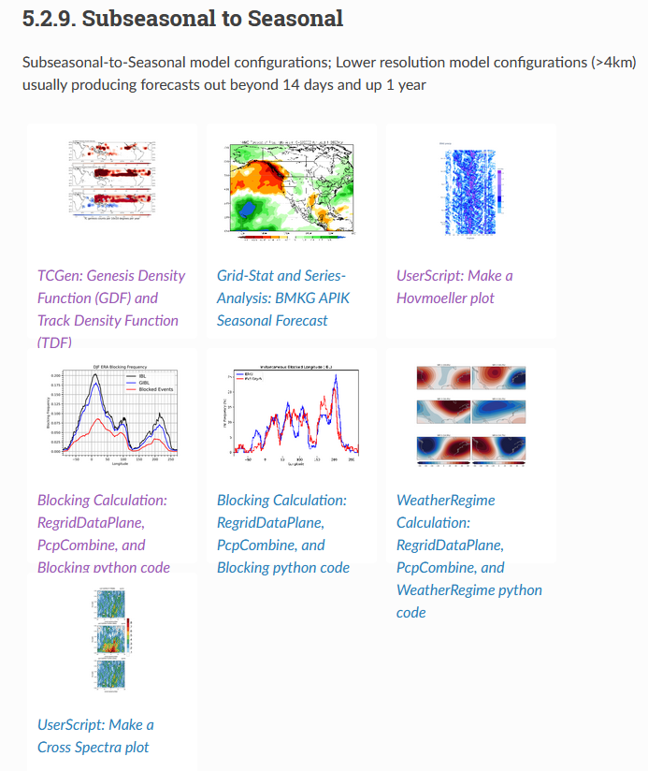
User’s Guide and Getting Help
https://github.com/dtcenter/METplus/discussions
https://metplus.readthedocs.io/en/ latest/Users_Guide/

Slide 21
Addtn’l Capability over next 2-3 years
Tropical mesoscale convection organization
Object-based diagnostics of organized tropical convection
Kelvin Wave Activity
Tendency statistics
Diagnostics of vertical distributions of tropical latent heating.
ENSO Diagnostics
Stratospheric Diagnostics
Precipitation and Temperature Tercile Evaluation
Extended support for Marine, Cryosphere, LSM, Atmospheric Composition, Space Weather, and hopefully Hydro
Stretch Goal: Connection/Integration with MDTF Diagnostics
Contributions from UIUC, GMU, NOAA/PSL, NOAA/CPC

Slide 22
Thank You for Your Attention
Tara Jensen, NCAR, jensen@ucar.edu
https://dtcenter.org/community-code/metplus
1st Annual METplus Users’ Workshop and Tutorial
Look for announcement in October
Targeting March-April 2022 timeframe
Sign up for more info on DTC Website at: https://dtcenter.org/community-code/metplus/sign-metplus-updates
DTC Visitor Program: https://dtcenter.org/visitor-program

