Slide 1
Understanding
Coupled vs Uncoupled GEFS Subseasonal Forecast Skill Differences
Xin-Zhong Liang¹ and Yuejian Zhu²
¹UMD ESSIC and ²NOAA EMC
2021 / 05 / 03
Weeks 3-4/S2S Webinar
Bing Fu², Sanghoon Shin¹, Bo Yang², Hong Guan², Eric Sinsky², Wei Li², Jiayi Peng², Xianwu Xue², Dingchen Hou², Chao Sun¹
Notes:
For a presentation at the Weeks 3-4/S2S Webinar organized by NOAA/OAR/Weather Program Office (WPO) on May 3, 2021.
Bing Fu, Bo Yang, Hong Guan, Eric Sinsky, Wei Li, Jiayi Peng, Xianwu Xue, Dingchen Hou

Slide 2
Experiments and Methods
Models & Resolutions
GEFS prototype-5 model (atmospheric model is the same as GFSv15 and GEFSv12)
CPL – Coupled forecasts at C192 (50km) horizontal resolution (MOM6 and CICE5 are as of September 2020)
RFC – Uncoupled atmosphere-only reforecasts at C384 (25km) horizontal resolution (GEFSv12)
Both outputs are mapped onto 1-degree (lat x lon) for comparisons
Forecast Periods
October 2017 – September 2019; 11 members
104 cases (every-Wednesday forecasts of 35 days)
Cumulative Differences
Difference = CPL – RFC ensemble average of 11 members
Four seasons: DJF, MAM, JJA, SON
A season is defined solely by the start date of the forecast
Each season has 13 weekly forecasts of 35 days – 13 weeks x 4 seasons x 2 years = 104 cases
Three forecast windows: Weeks 1-2 (days 1-14), Weeks 3-4 (days 15-28), Week 5 (days 29-35)
Each window has 26 samples per season = 13 weeks x 2 years
First get differences by averages in each window
Then do composite means or temporal correlations from 26 samples
Week 1
Week 2
Week 3
Week 4
Week 5
11 members having the same start date
26 samples per forecast window for composite mean/correlation

Slide 3
GEFS CPL vs RFC Key Skill Differences
CPL has significantly higher tropical skill (500hPa height anomaly correlation) than RFC throughout 1-4 weeks
CPL improves over RFC the MJO skill at all lead times, with the 50% anomaly correlation reaching 23-day for RMM1 and 31-day for RMM2
CPL largely reduces errors (from ERA5) in surface latent heat flux and outgoing longwave radiation over tropical Indian to western Pacific Oceans, and tends to enhance the predictive skill for convection activities over the MJO key region
CPL produces warmer SST than RFC; their differences increase slightly with lead times and reach ~0.35 °C averaged in 50°N-50°S, which are identified with ~2 W/m² smaller biases of downward shortwave radiation in CPL than RFC
These seem to indicate significant changes from RFC to CPL in cloud-radiation feedback on subseasonal forecasts when incorporating air-sea interaction

Slide 4
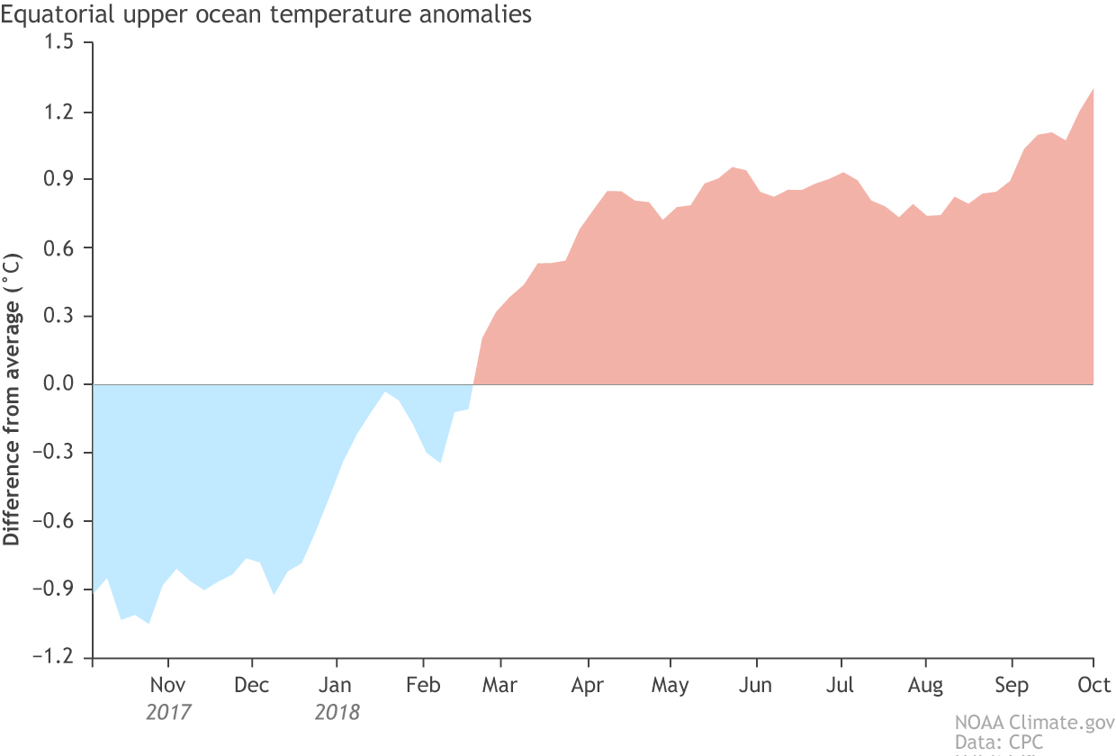
Tropical average of 500hPa height anomaly correlation
Day 01-07
Day 08-14
Equator upper ocean temperature anomaly
Day 01-07
Mar. 2918
Summary and discussion:
Tropical skill of CPL is significant better than RFC
May the skill drop during Jan-May 2018 be related to the rapid SST changes from negative to positive anomaly?
If so, then would CPL perform systematically poorer in cold SST anomalies than in warmer conditions? Why?

Slide 5
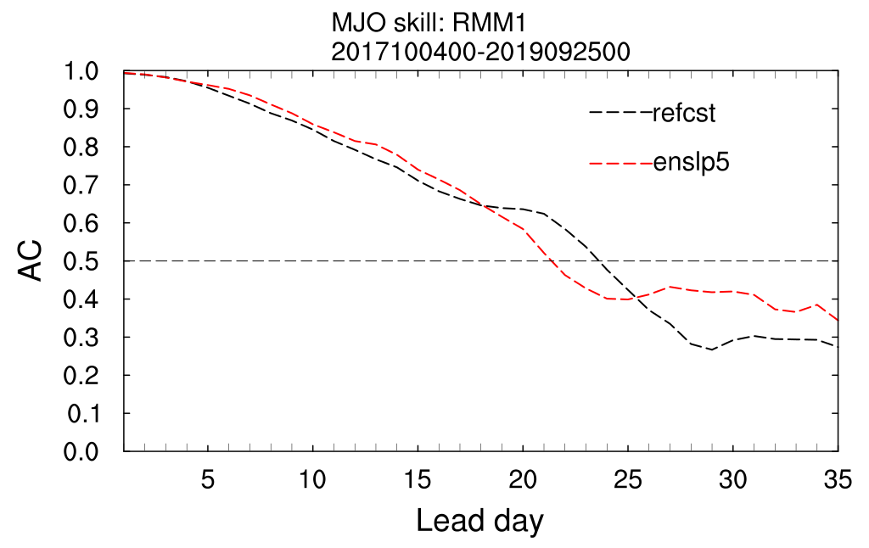
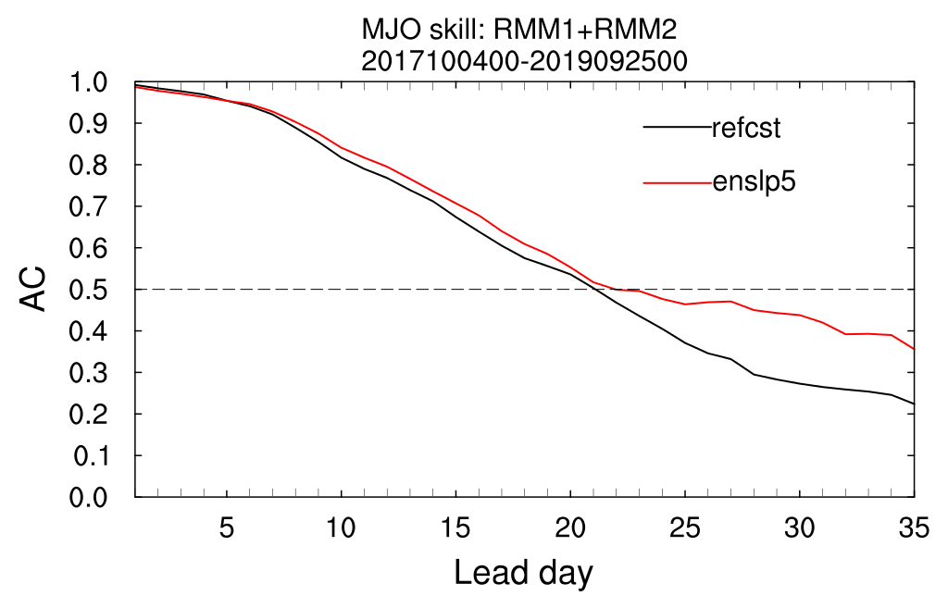
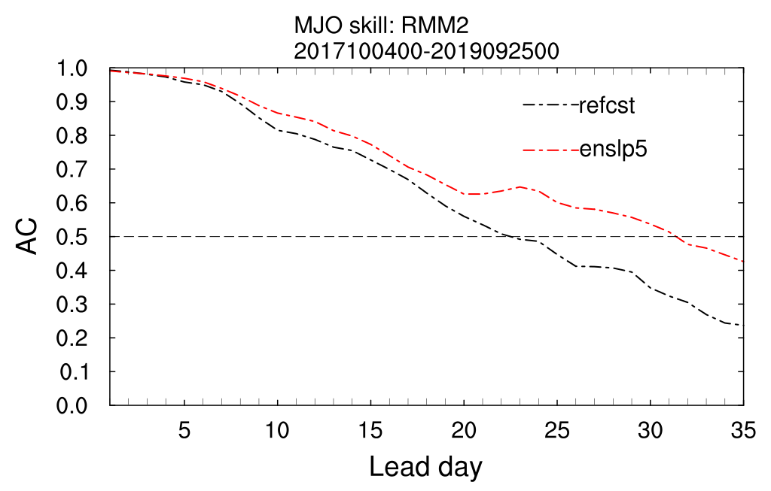
MJO Skill
Discussion and summary:
CPL improves RFC in MJO skill (RMM1+RMM2) for all lead time, with 50% AC reaching 23-day
RMM2 shows a bigger improvement, with 50% AC at ~31-day
An important question: how does including air-sea interaction improve the tropical circulation and enhance convection over Indian and western Pacific Oceans?
Notes:
Lim, Y., Son, S., & Kim, D., 2018: MJO prediction skill of the subseasonal‐to‐seasonal prediction models. Journal of Climate, 31(10), 4075–4094. https://doi.org/10.1175/JCLI‐D‐17‐0545.1
The MJO skill assessment is often conducted with Real-time Multivariate MJO (RMM) indices (Wheeler and Hendon 2004, hereafter WH04). The RMM indices, that is, RMM1 and RMM2, are the principle components associated with the two leading empirical orthogonal functions (EOFs) of the combined field of equatorially averaged OLR, and zonal wind at 850 hPa (U850) and 200 hPa (U200).

Slide 6
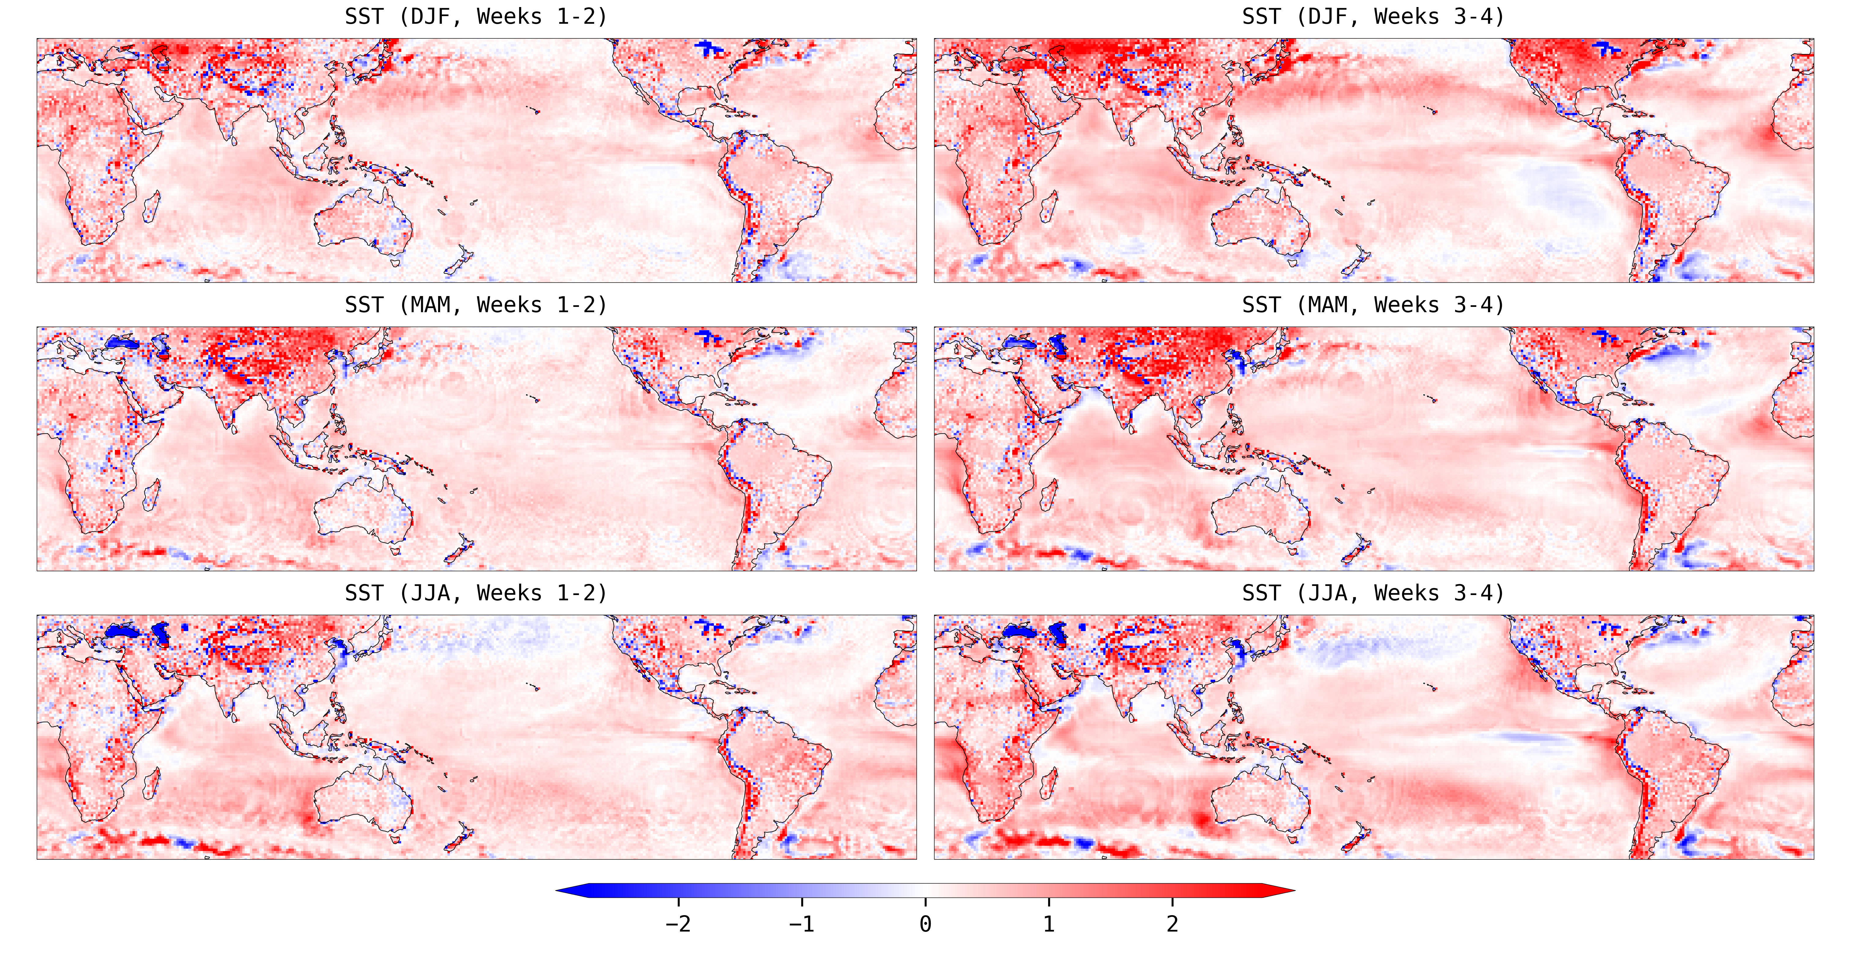
Tsfc CPL – RFC Difference
Notes:
Size: (115%,115%) (6.25”, 12.09”)
Position: (0.64”, 1.03”)

Slide 7
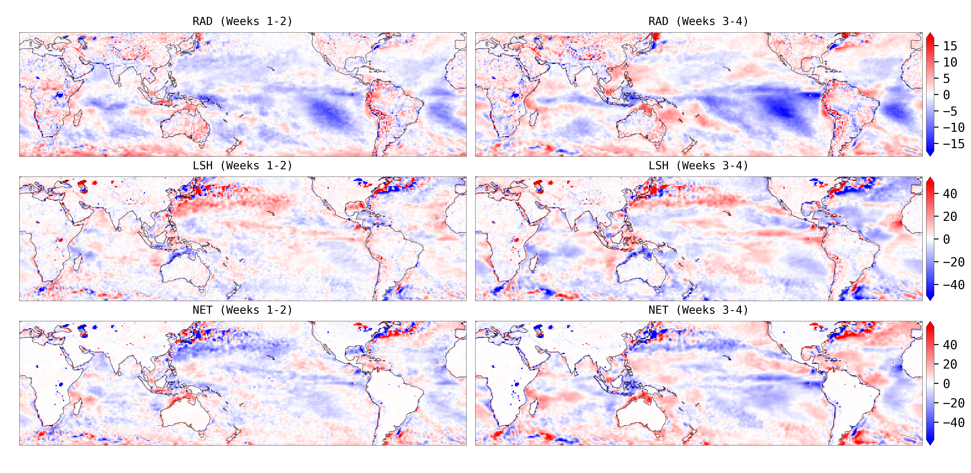
DJF CPL – RFC Difference
Notes:
Size: (117%,115%) (6.18”, 12.47”)
Position: (0.64”, 0.85”)
RAD Radiations at Surface (=NET_RAD) [W m⁻²]
LSH Latent and Sensible Heat Fluxes (=SEN_LAT) [W m⁻²]
NET Net Energy at Surface (=TOT_ENG) [W m⁻²]

Slide 8
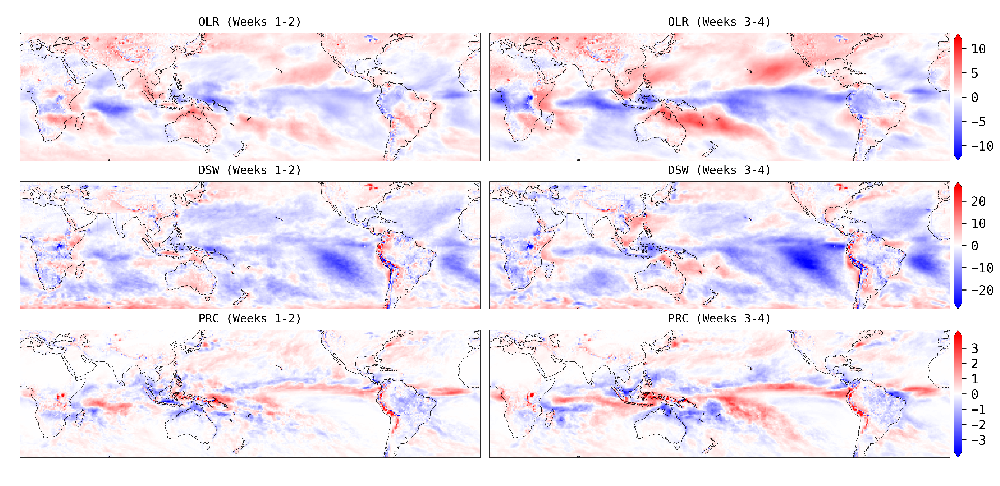
DJF CPL – RFC Difference
Notes:
Size: (117%,115%) (6.18”, 12.47”)
Position: (0.64”, 0.85”)
OLR Outward Longwave Radiation Flux (=ulwrf_tatm) [W m⁻²]
DSW Downward Shortwave Radiation Flux (=dswrf_sfc) [W m⁻²]
PRC Precipitation (=apcp_sfc) [mm day⁻¹]

Slide 9
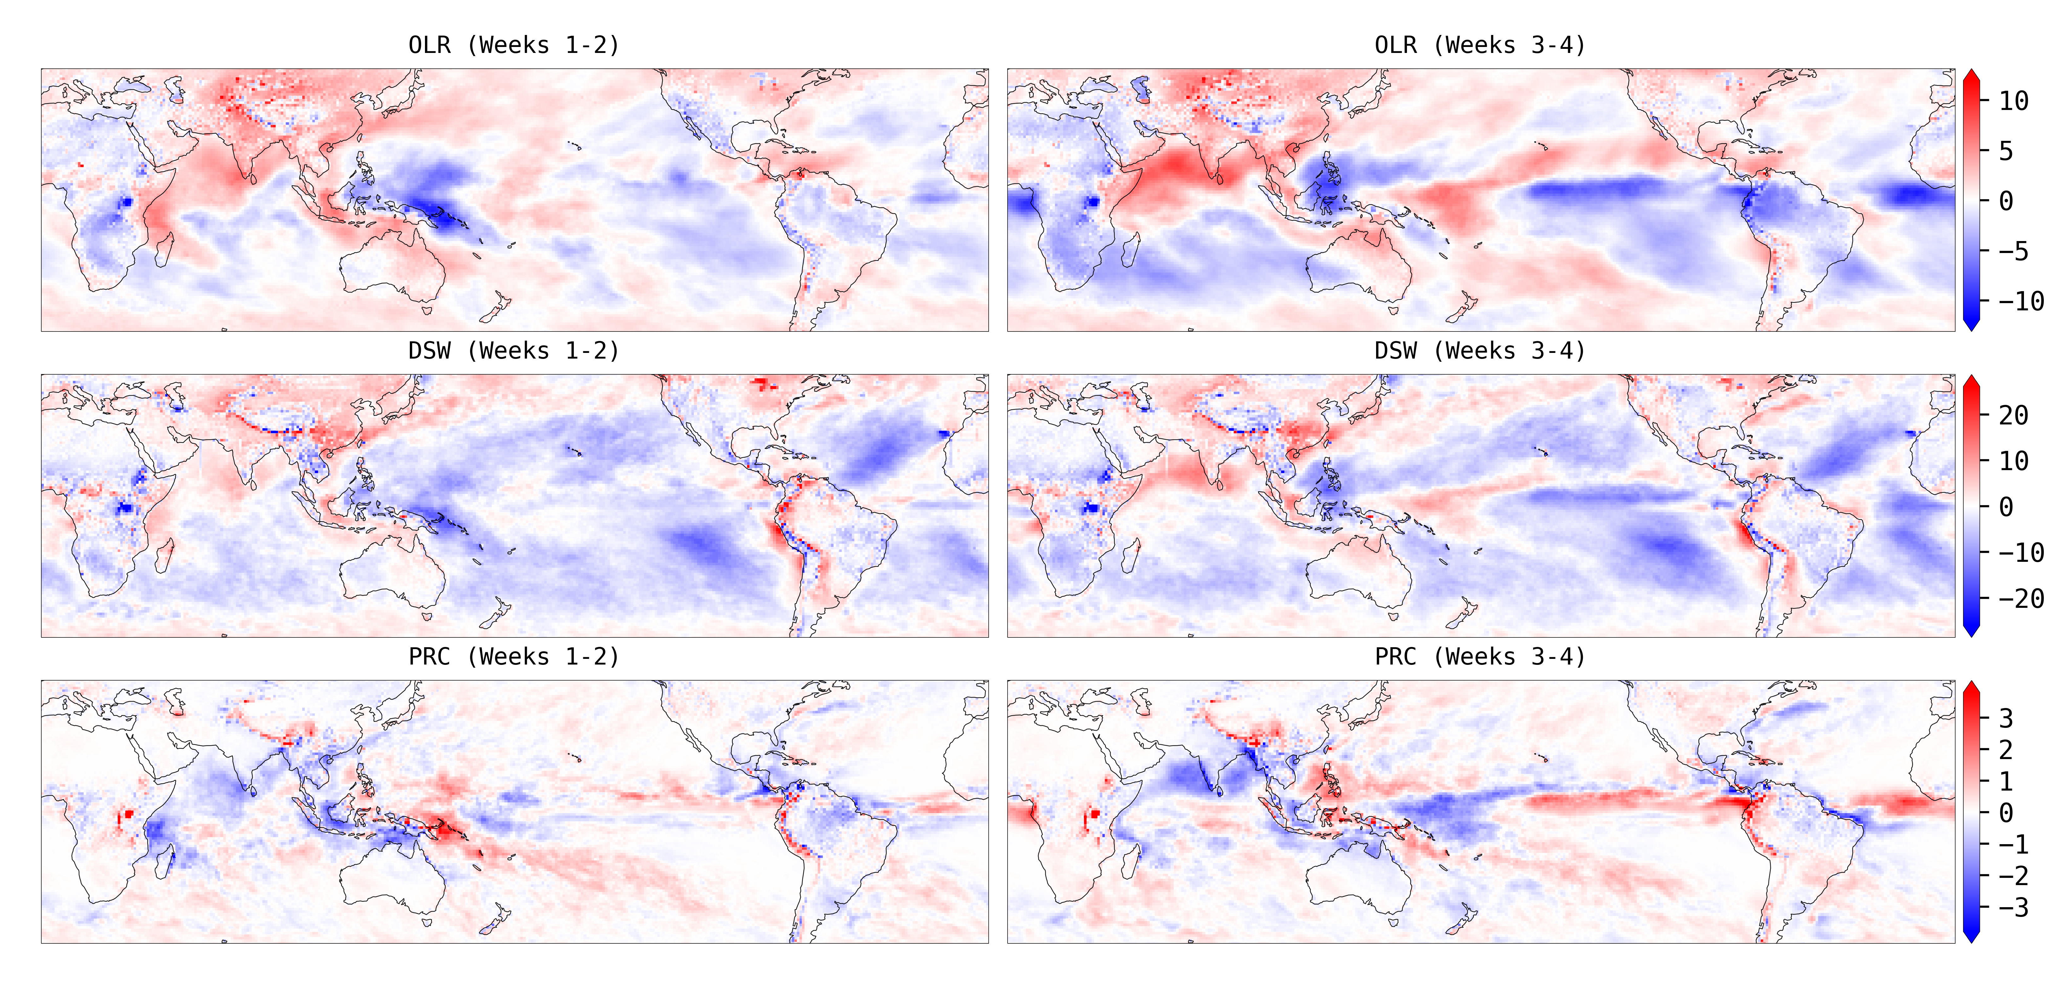
MAM CPL – RFC Difference
Notes:
Size: (117%,115%) (6.18”, 12.47”)
Position: (0.64”, 0.85”)
OLR Outward Longwave Radiation Flux (=ulwrf_tatm)
DSW Downward Shortwave Radiation Flux (=dswrf_sfc)
PRC Precipitation (=apcp_sfc)

Slide 10
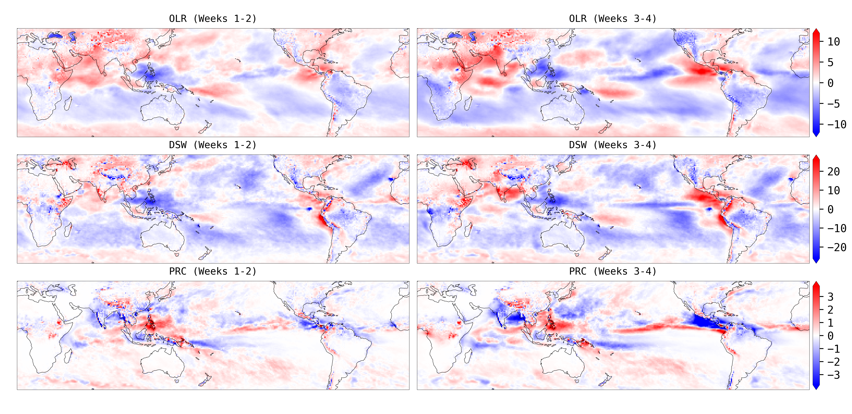
JJA CPL – RFC Difference
Notes:
Size: (117%,115%) (6.18”, 12.47”)
Position: (0.64”, 0.85”)
OLR Outward Longwave Radiation Flux (=ulwrf_tatm)
DSW Downward Shortwave Radiation Flux (=dswrf_sfc)
PRC Precipitation (=apcp_sfc)

Slide 11
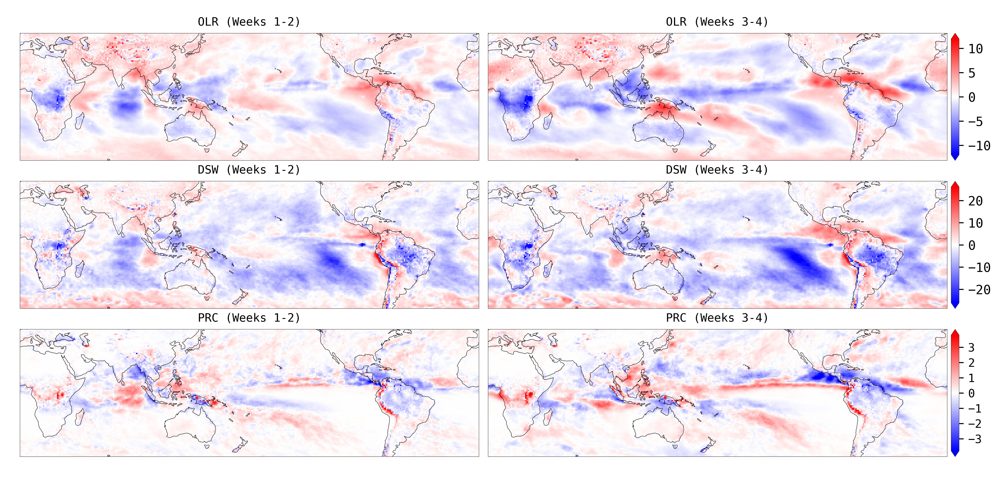
SON CPL – RFC Difference
Notes:
Size: (117%,115%) (6.18”, 12.47”)
Position: (0.64”, 0.85”)
OLR Outward Longwave Radiation Flux (=ulwrf_tatm)
DSW Downward Shortwave Radiation Flux (=dswrf_sfc)
PRC Precipitation (=apcp_sfc)

Slide 12
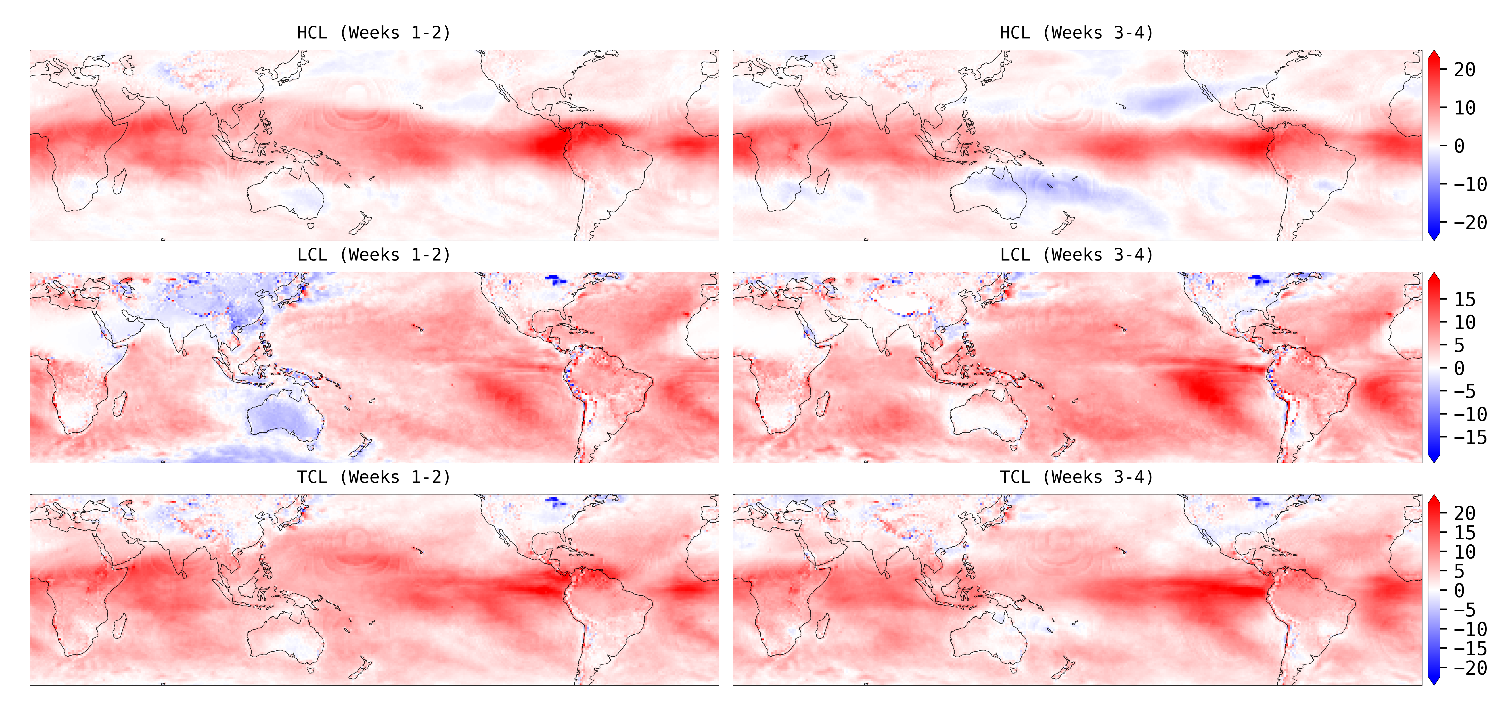
DJF CPL – RFC Difference
Notes:
Size: (117%,115%) (6.18”, 12.47”)
Position: (0.64”, 0.85”)
HCL High Cloud Layer (=cloud_high) [%]
LCL Low Cloud Layer (=cloud_low) [%]
TCL Total Cloud Layer (=tcdc_eatm) [%]

Slide 13
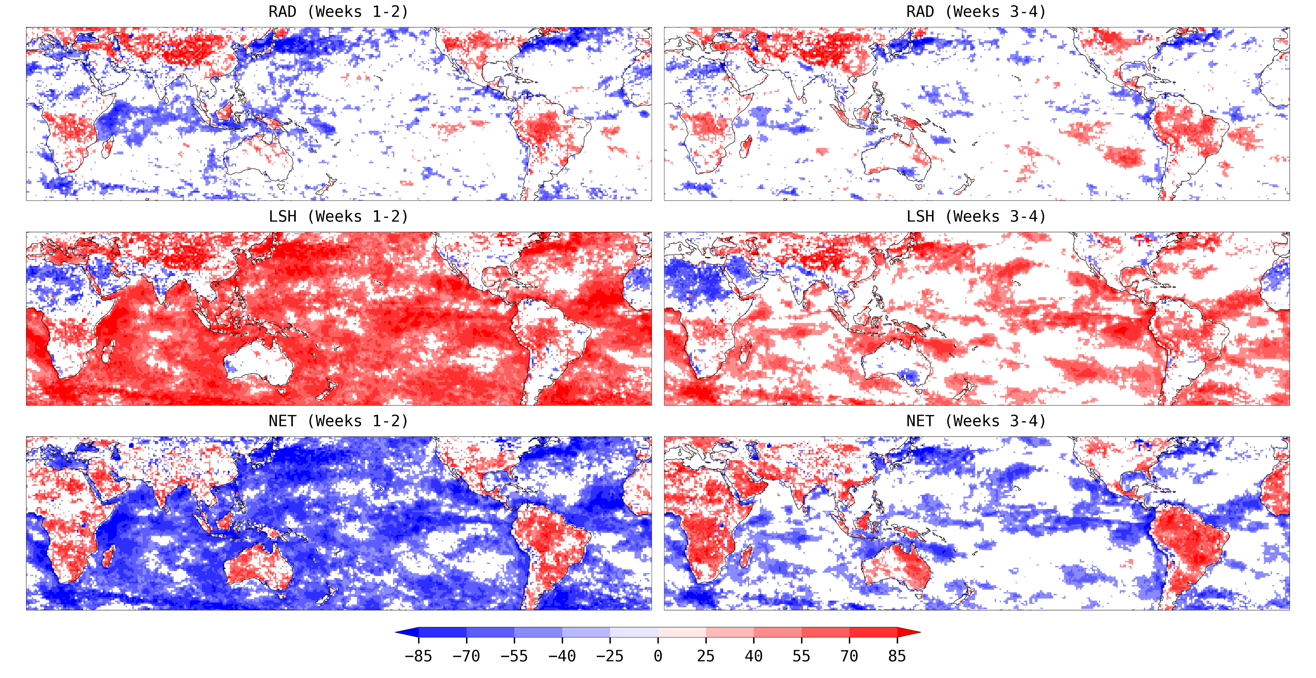
DJF CPL – RFC Difference Correlation with Tsfc
Notes:
Size: (115%,115%) (6.25”, 12.09”)
Position: (0.64”, 1.03”)
RAD Radiations at Surface (=NET_RAD)
LSH Latent and Sensible Heat Fluxes (=SEN_LAT)
NET Net Energy at Surface (=TOT_ENG)

Slide 14
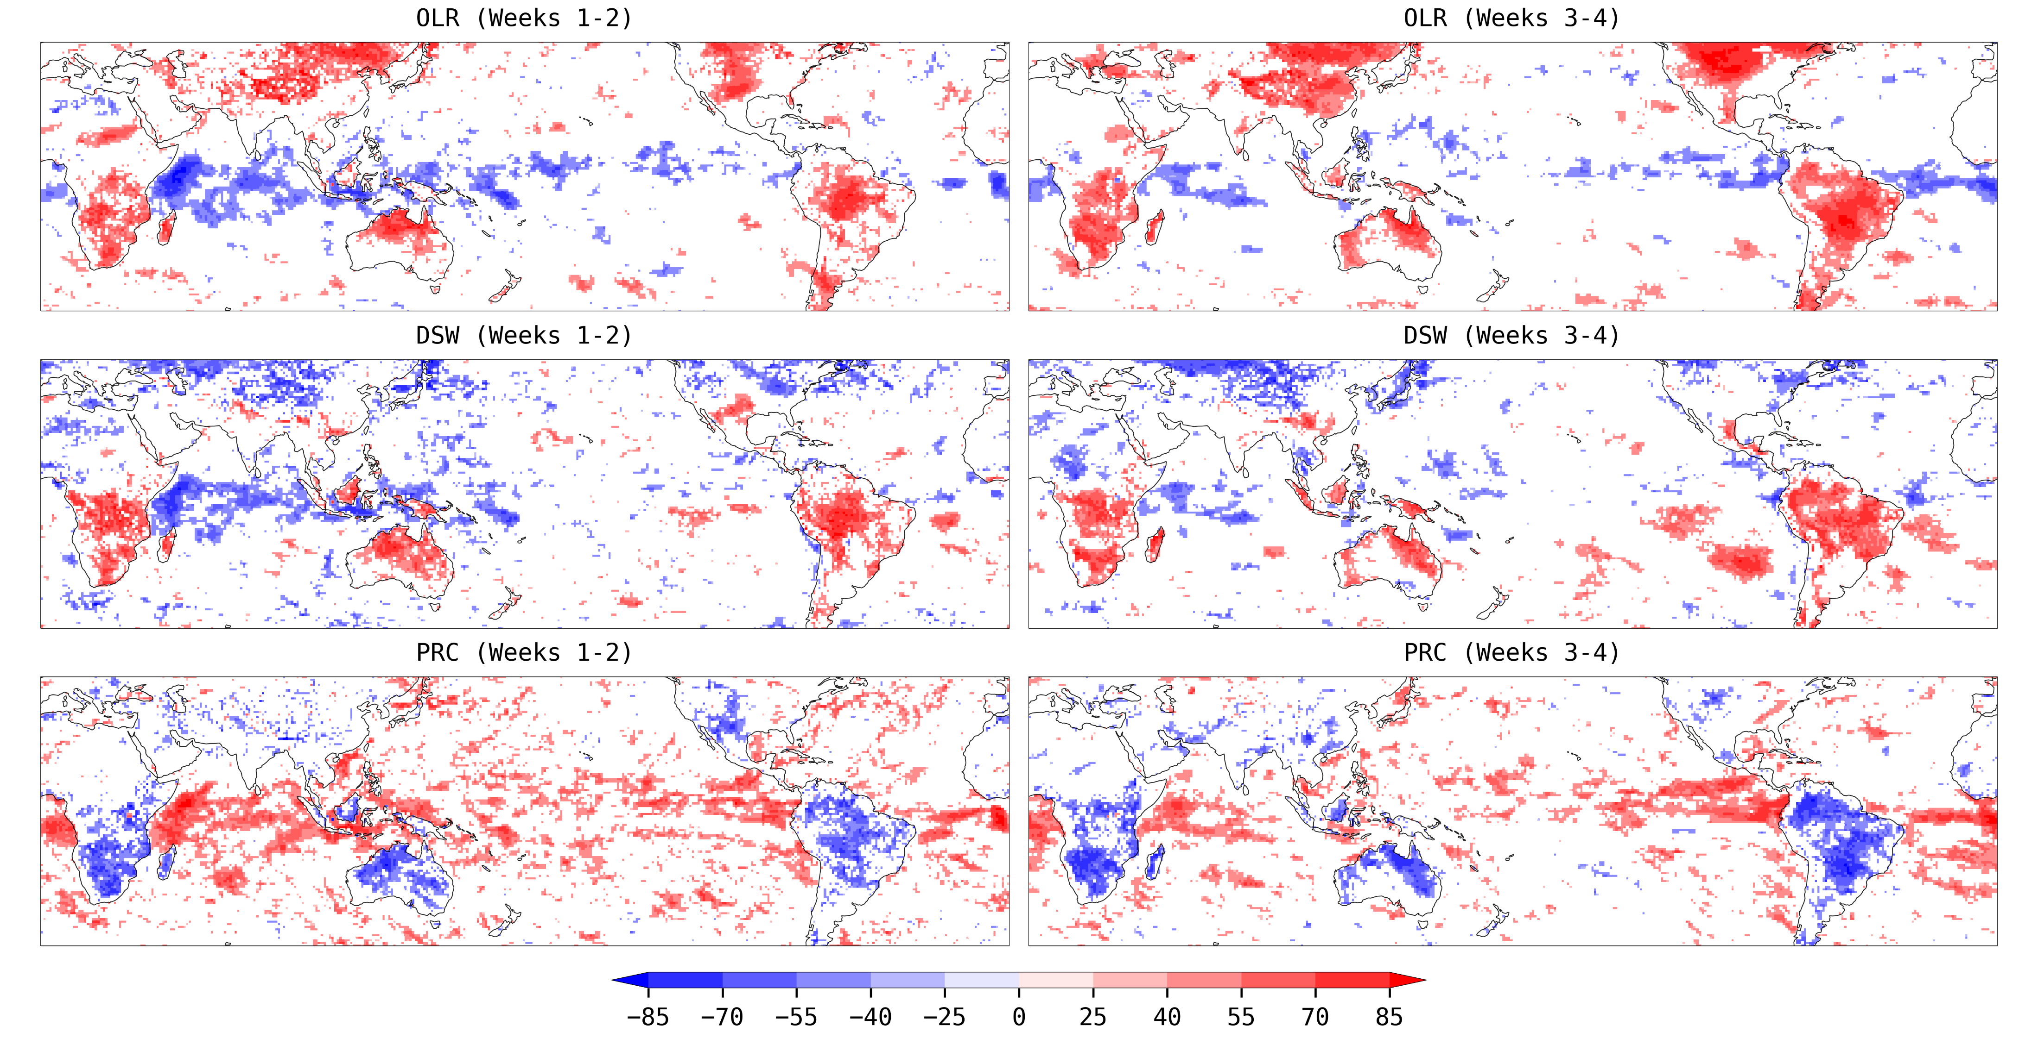
DJF CPL – RFC Difference Correlation with Tsfc
Notes:
Size: (115%,115%) (6.25”, 12.09”)
Position: (0.64”, 1.03”)
OLR Outward Longwave Radiation Flux (=ulwrf_tatm)
DSW Downward Shortwave Radiation Flux (=dswrf_sfc)
PRC Precipitation (=apcp_sfc)

Slide 15
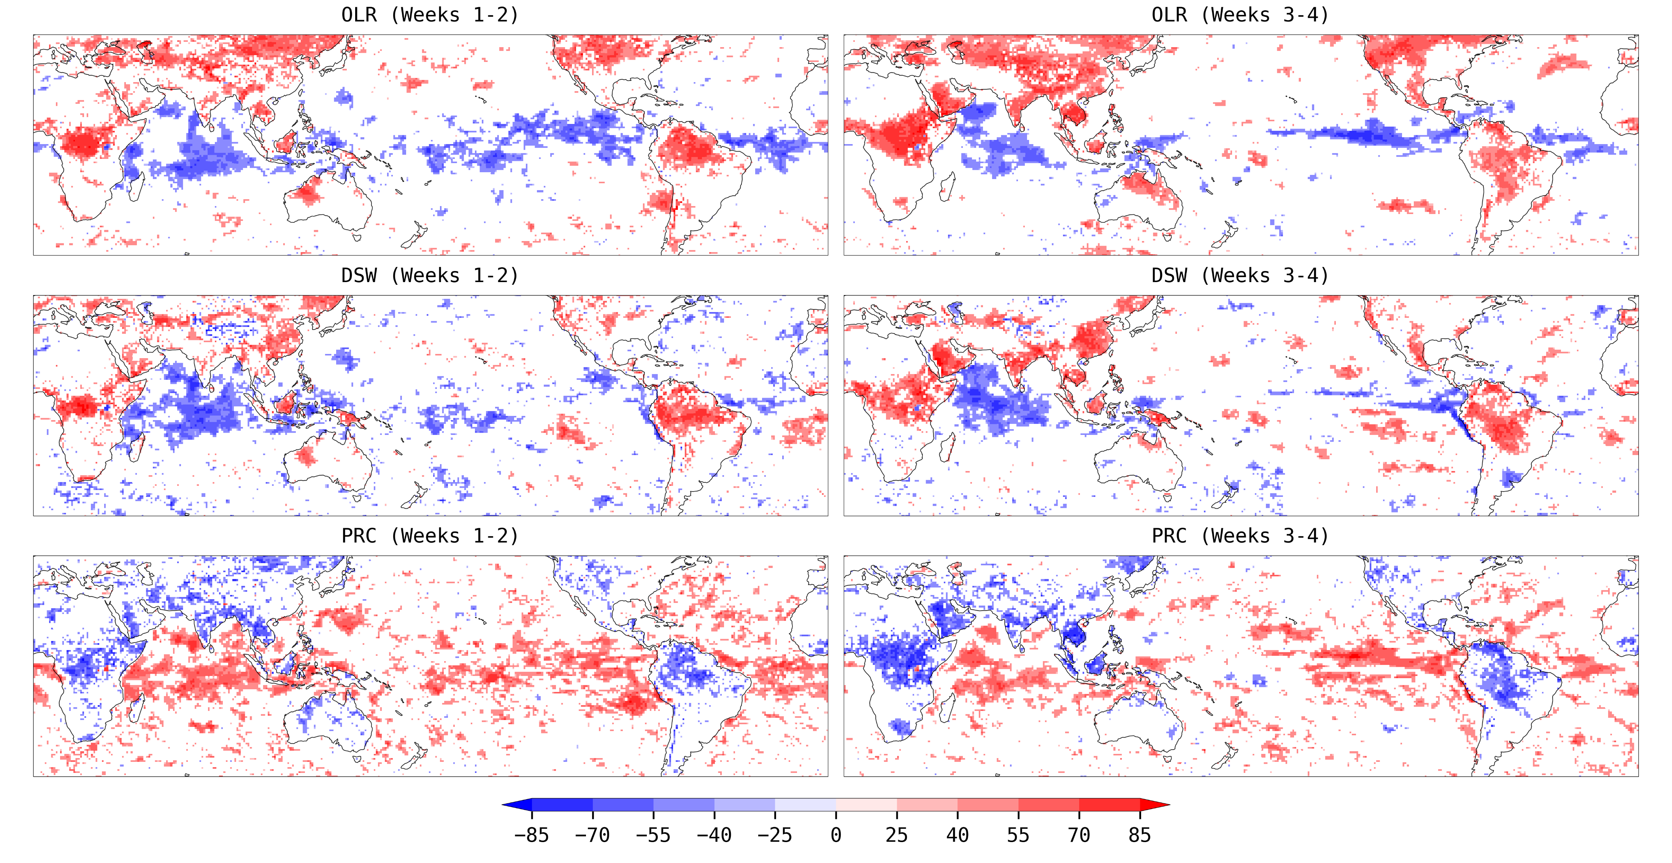
MAM CPL – RFC Difference Correlation with Tsfc
Notes:
Size: (115%,115%) (6.25”, 12.09”)
Position: (0.64”, 1.03”)
OLR Outward Longwave Radiation Flux (=ulwrf_tatm)
DSW Downward Shortwave Radiation Flux (=dswrf_sfc)
PRC Precipitation (=apcp_sfc)

Slide 16
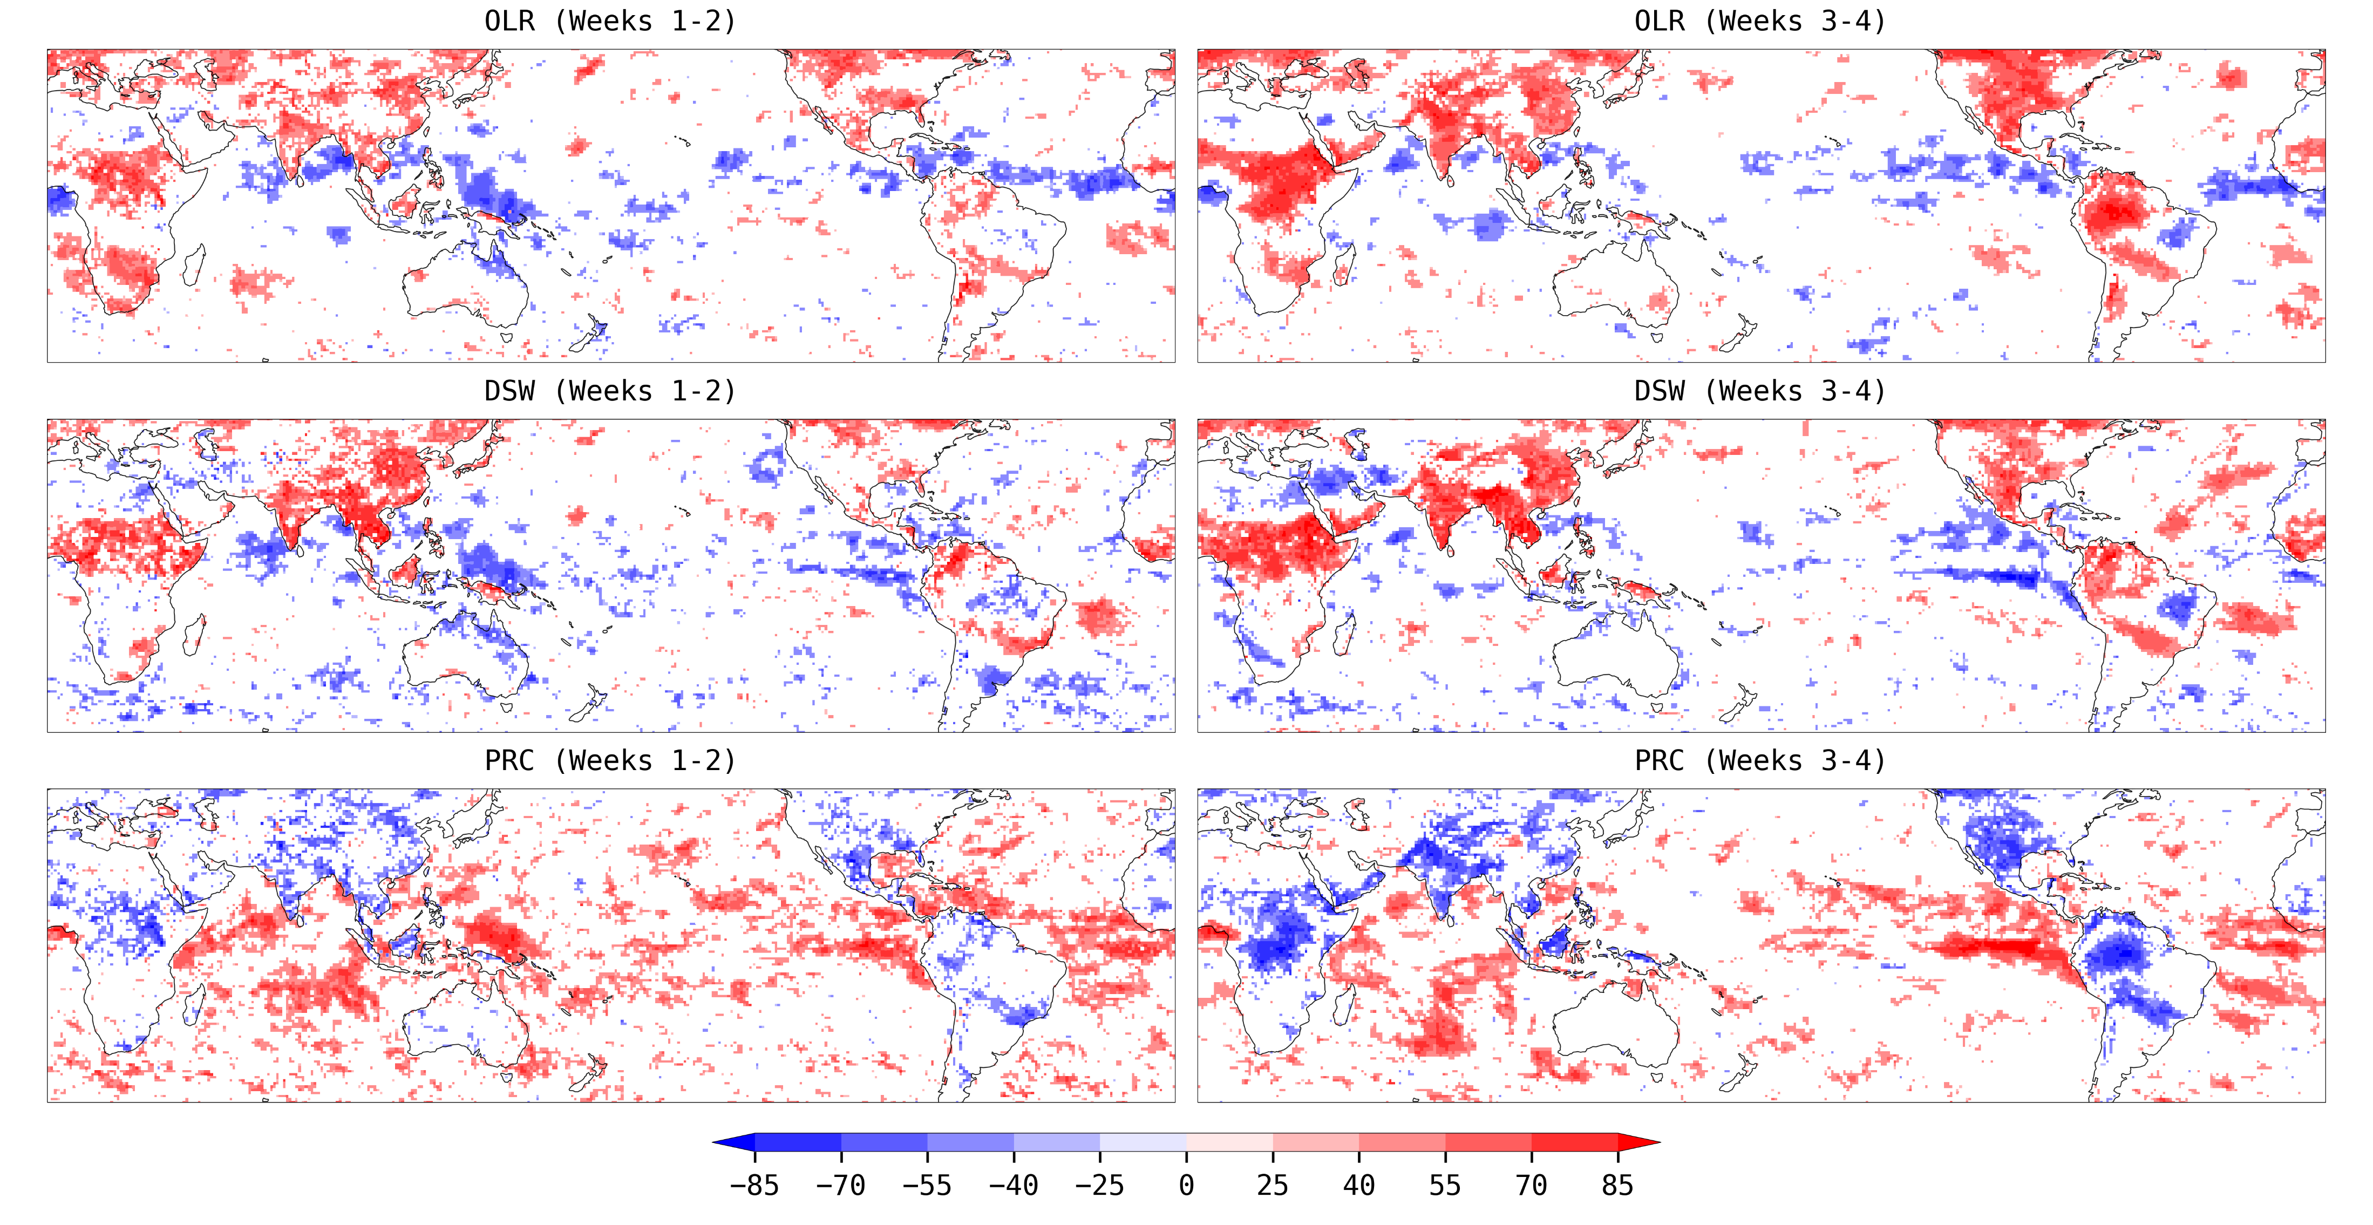
JJA CPL – RFC Difference Correlation with Tsfc
Notes:
Size: (115%,115%) (6.25”, 12.09”)
Position: (0.64”, 1.03”)
OLR Outward Longwave Radiation Flux (=ulwrf_tatm)
DSW Downward Shortwave Radiation Flux (=dswrf_sfc)
PRC Precipitation (=apcp_sfc)

Slide 17
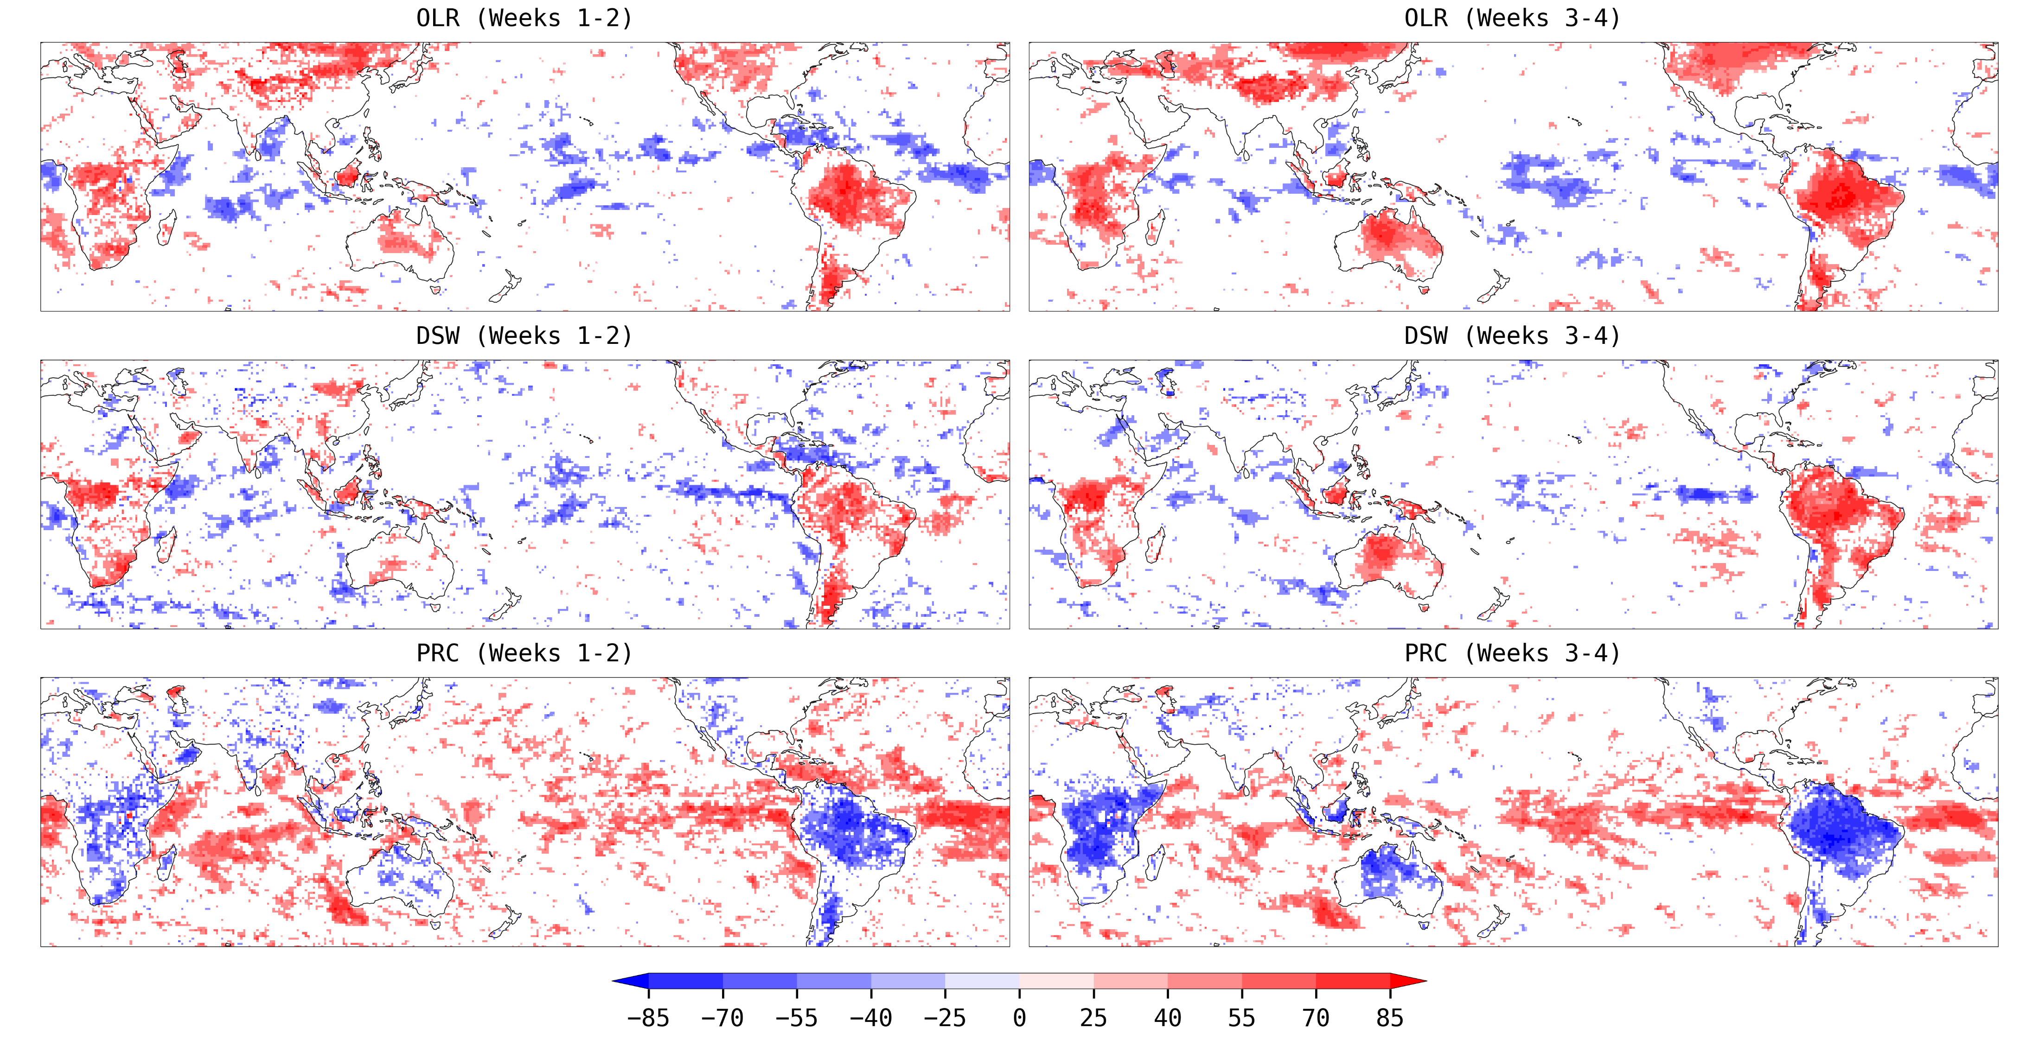
SON CPL – RFC Difference Correlation with Tsfc
Notes:
Size: (115%,115%) (6.25”, 12.09”)
Position: (0.64”, 1.03”)
OLR Outward Longwave Radiation Flux (=ulwrf_tatm)
DSW Downward Shortwave Radiation Flux (=dswrf_sfc)
PRC Precipitation (=apcp_sfc)

Slide 18
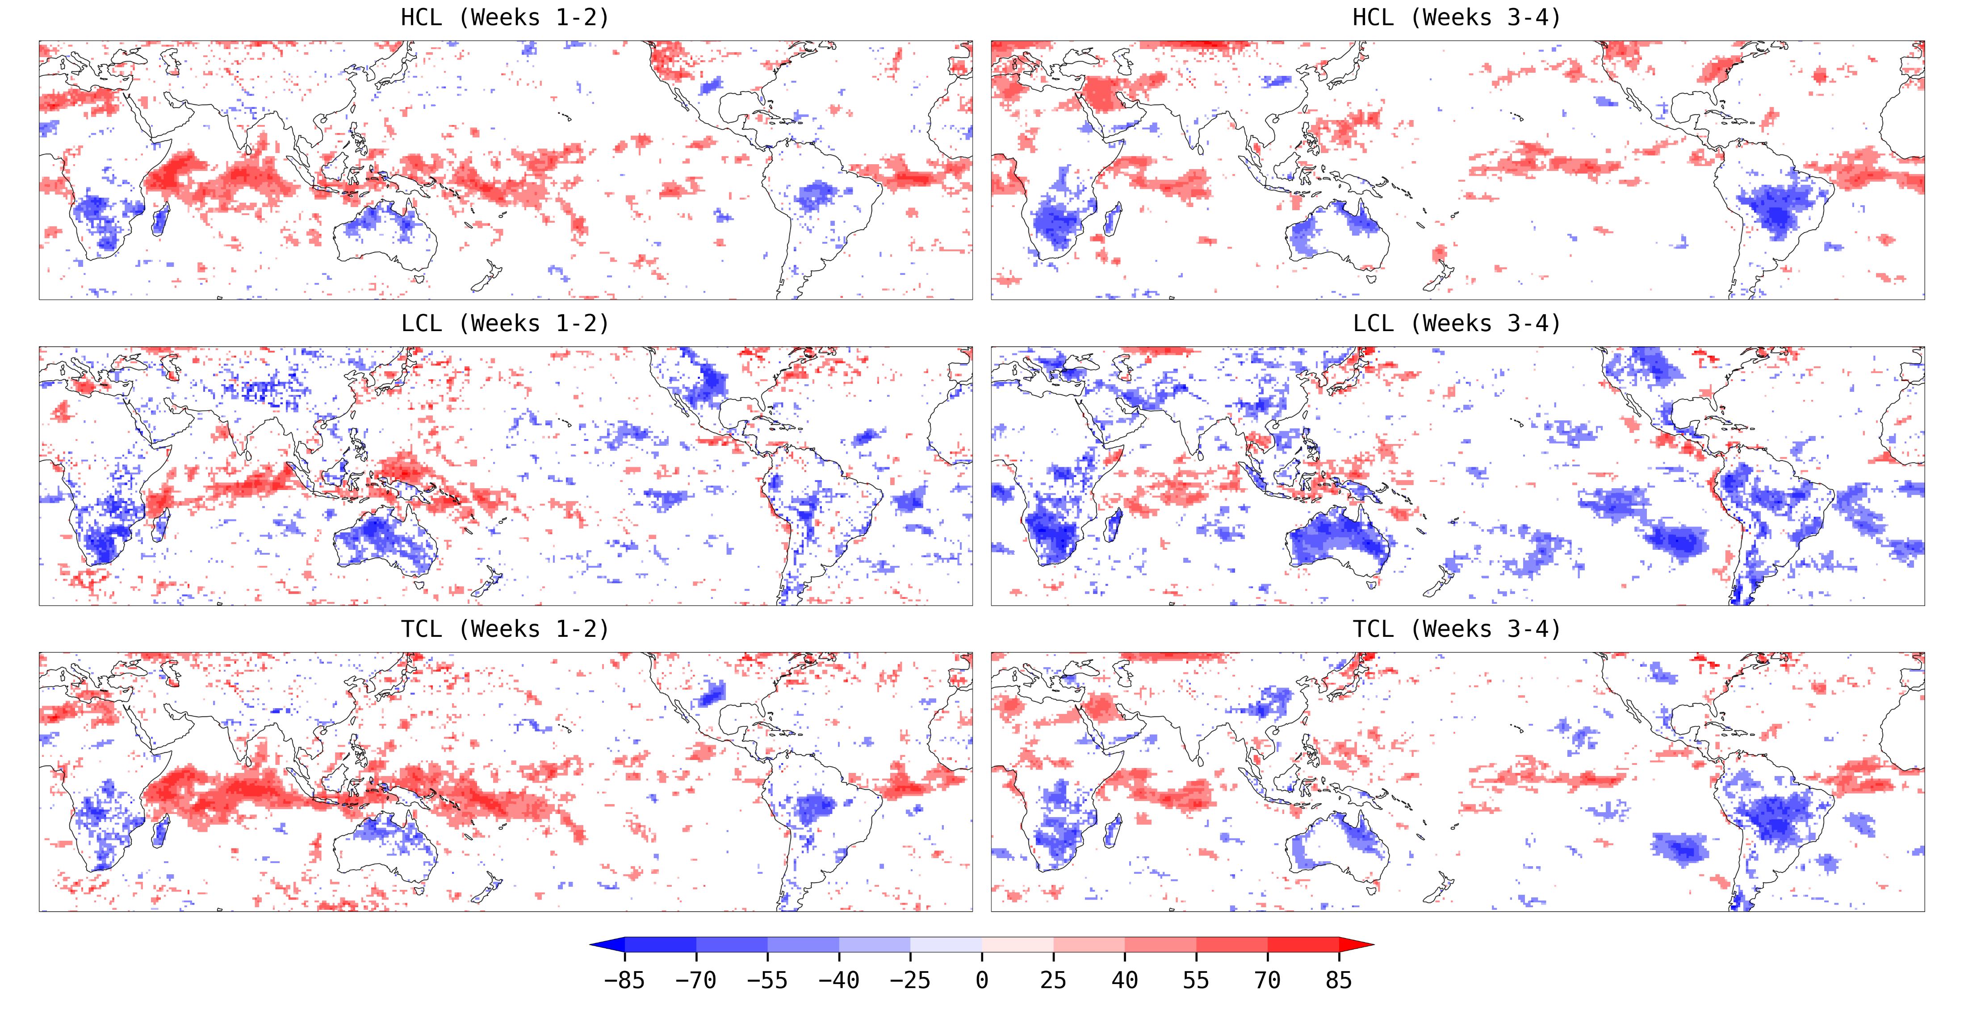
DJF CPL – RFC Difference Correlation with Tsfc
Notes:
Size: (115%,115%) (6.25”, 12.09”)
Position: (0.64”, 1.03”)
HCL High Cloud Layer (=cloud_high)
LCL Low Cloud Layer (=cloud_low)
TCL Total Cloud Layer (=tcdc_eatm)

Slide 19
GEFS CPL vs RFC Key Findings
Systematic warmer SSTs seem to be the primary source for the CPL skill gain, especially in the tropics; warmer SSTs are likely maintained by upwelling heat transport from deeper ocean layers, which decreases significantly in weeks 3-4.
Warmer SSTs increase LH+SH, cloud and rainfall, enhance deep convection, reduce OLR and DSW – a negative feedback to cool tropical I+WPO; this is opposite over the tropical land, where convections tend to drive the surface.
Significant differences also occur in EPO, where responses are stronger in the means (colder SST, ITCZ shifted south, more LCL, less DSW) than transients; ENSO related forecast skills are expected with notable changes.
Speculation: the convection-cloud-radiation feedback under air-sea interaction plays a central role on MJO forecast; initializing RFC with warmer SSTs to enhance deep convection in the tropics may improve the MJO skill as in CPL.

